Slide 1
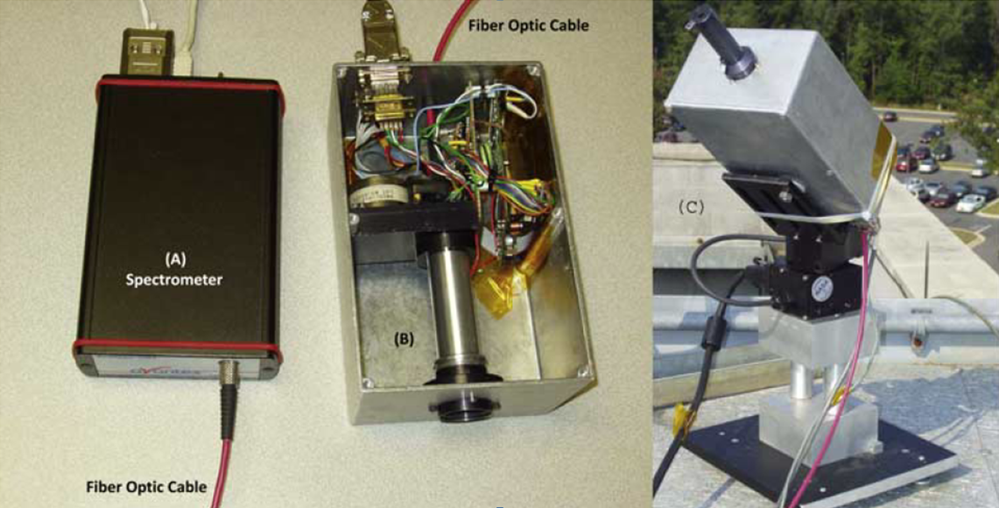
The First Pandora 2006
CMOS Spectometer Basic square Box
Single Filter Wheel Custom Electronics BUT IT WORKED!
Hand wiring Off the shelf parts

Slide 2
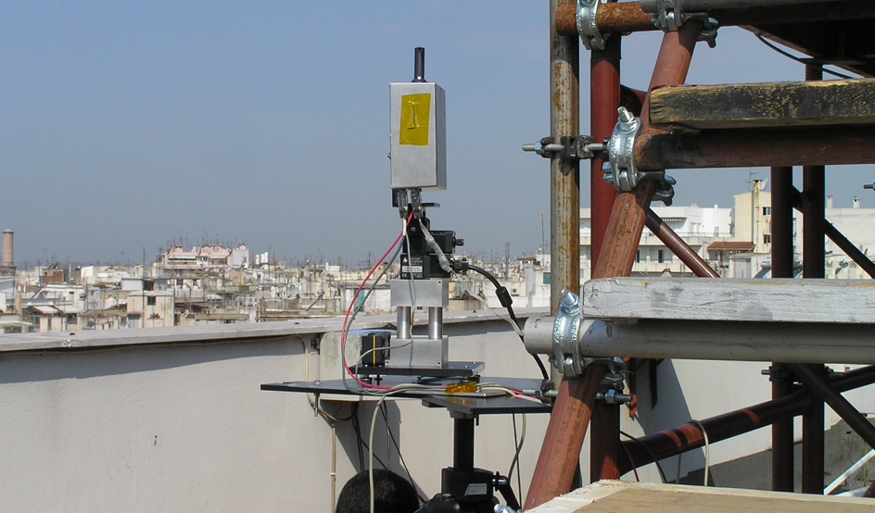
Pandora in Thessaloniki
The spectrometer was temperature copn

Slide 3
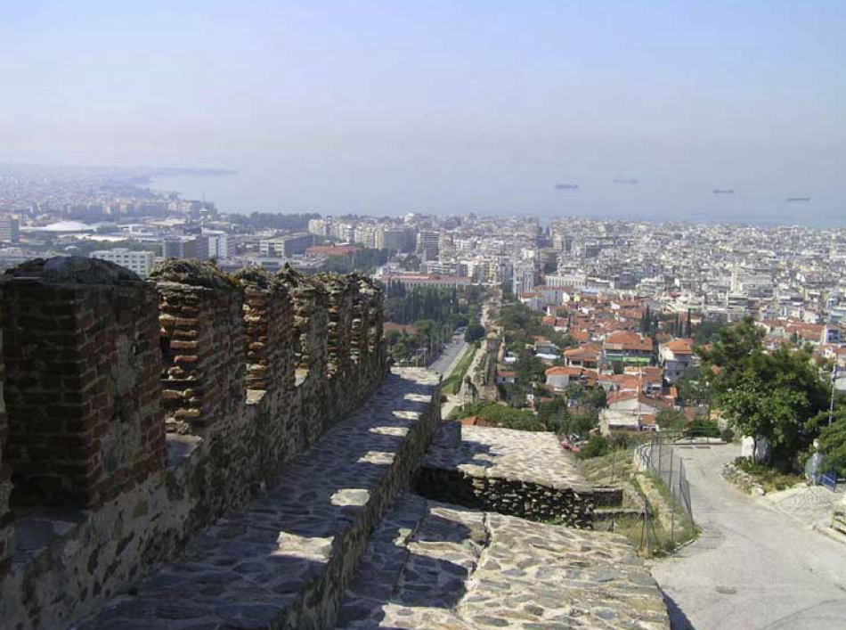
NO₂: Thessaloniki, Greece 2006
A view to the south from the hill above the Thessaloniki University Physics Department building on 15 July 2006 showing the pollution in the city and over the Mediterranean Sea with an almost cloud-free sky. The mild brown color is probably from the NO₂ in the air above Thessaloniki.

Slide 4
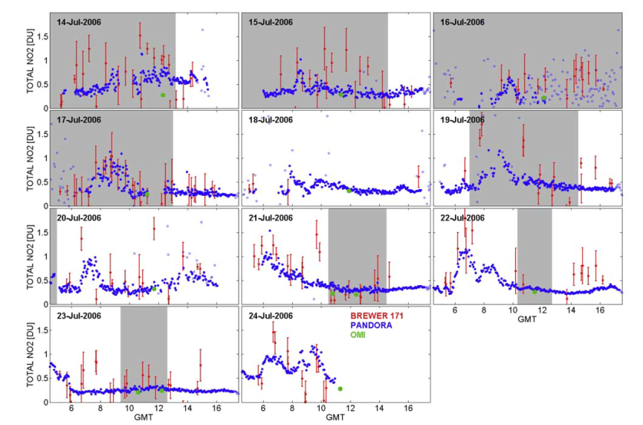
The daily variation of C(NO₂) in Thessaloniki, Greece, for 14 July to 24 July 2006
Pandora (blue circles), Brewer (red circles), and OMI (green circles)

Slide 5
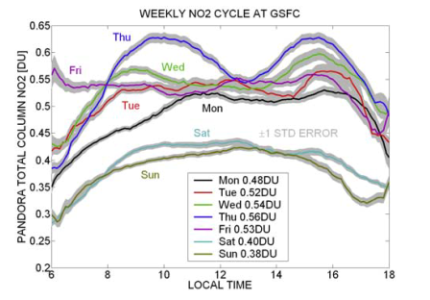
NASA Goddard Work Detector
Annual average for day of the week diurnal behavior of C(NO2) at GSFC. The gray area around each line shows the mean value ± the standard error of the mean.

Slide 6
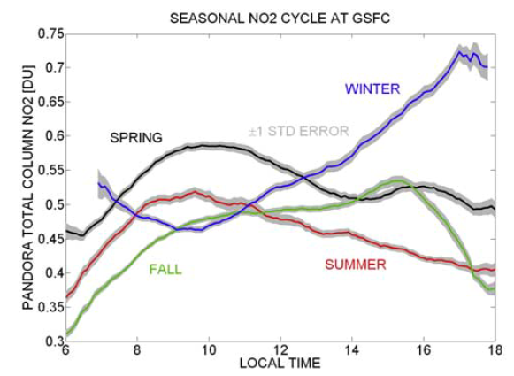
Seasonal NO₂ Cycle at GSFC
Winter(December, January, February), spring (March, April, May), summer (June, July, August), and Fall (September, October, November). The gray area around each line shows the mean value ± the standard error of the mean.

Slide 7
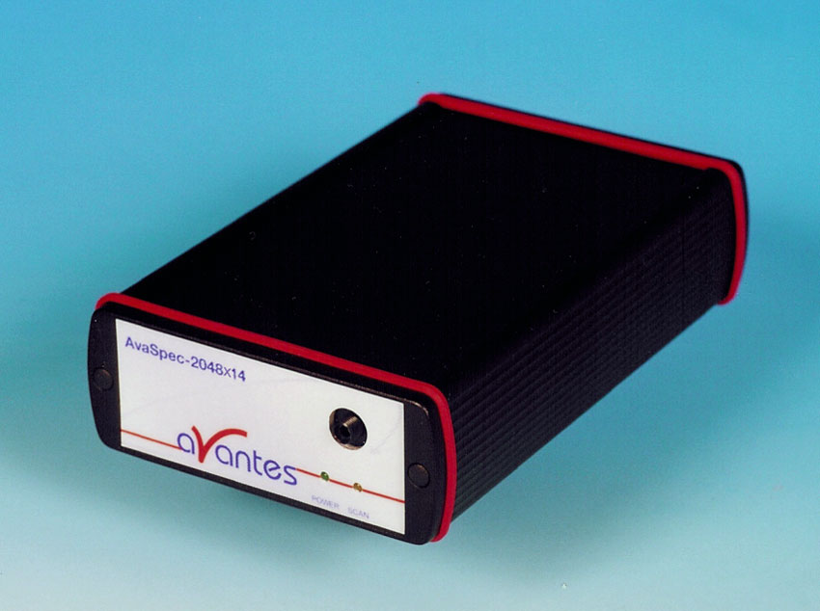
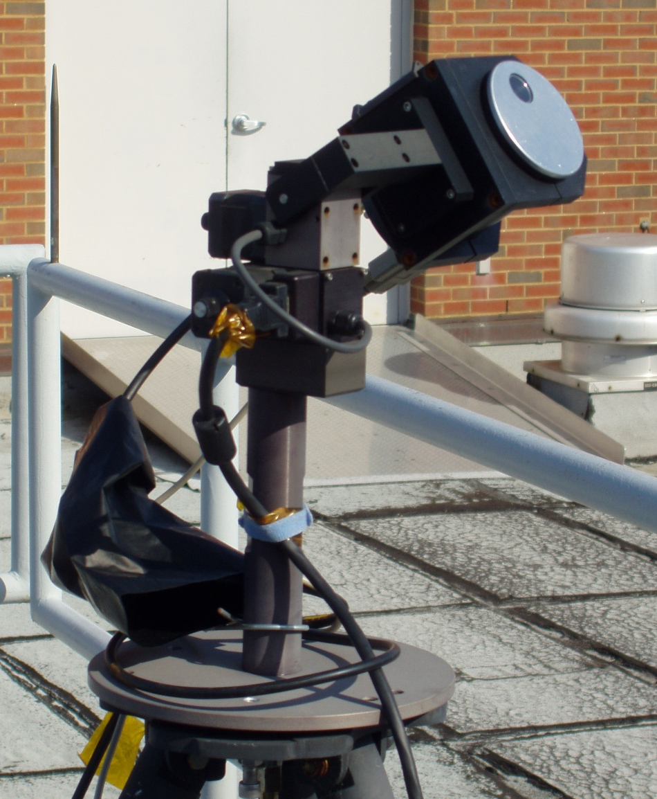
What is PANDORA?
Pandora is a small spectrometer system, which we have been developing since 2006. We now have 50 Pandoras. It consists of …
a “miniature”
spectrometer
and a head sensor on a sun tracker
Measures sun and sky radiance from 270 to 530 nm in 0.5 nm steps with a 1.6º field of view. Products: NO₂, H₂O, O₃, SO₂, HCHO, and aerosol properties.
O₃: 3 DU accuracy and 1 DU precision
NO₂: 0.1 DU accuracy and 0.01 DU precision

Slide 8
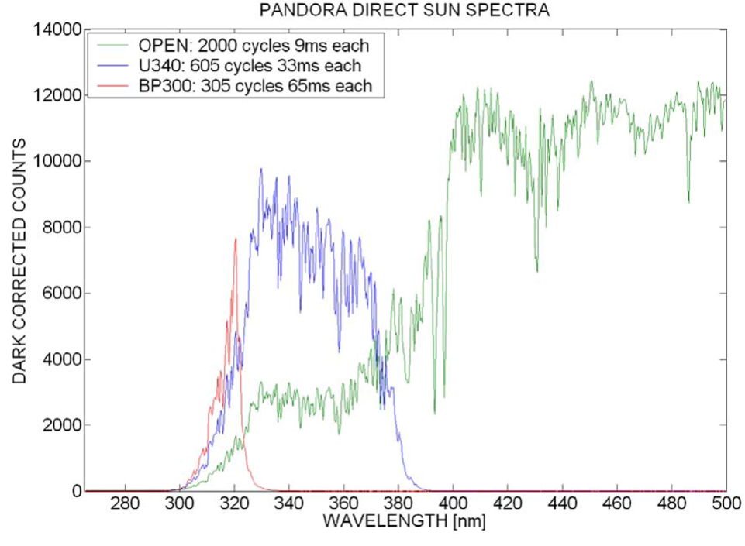
What does Pandora Measure ?
Green: No Filter
Blue: UV340 (Filter that blocks the visible light)

Slide 9
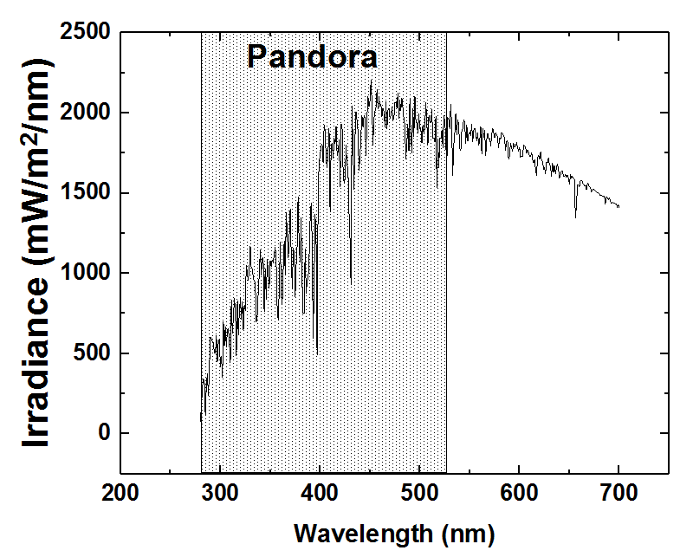
Solar Irradiance Above the Atmosphere
280 nm
530 nm

Slide 10
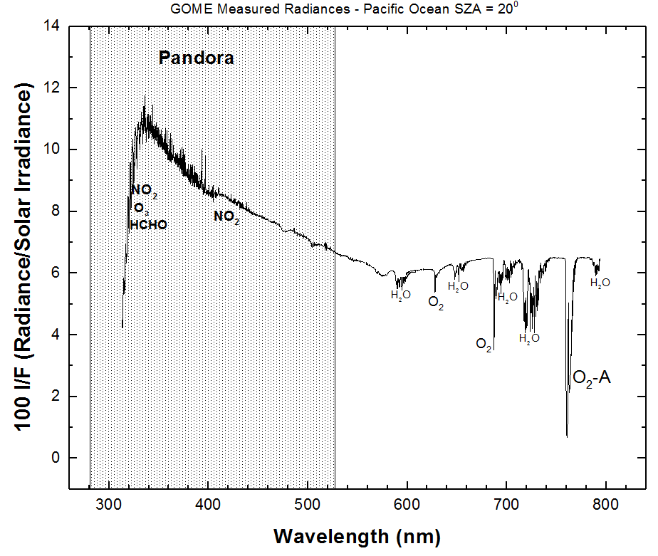
Knowing the Solar Spectrum, Remove Solar Spectral Features

Slide 11
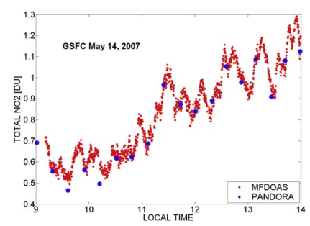
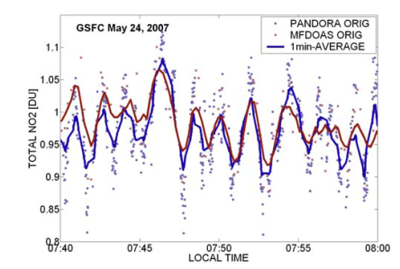
NO2: Traffic Light Problem
High time variability at GSFC observed on 14 and 24 May 2007 by Pandora and MFDOAS.

Slide 12
NO₂ as a GSFC Work Detector

Slide 13
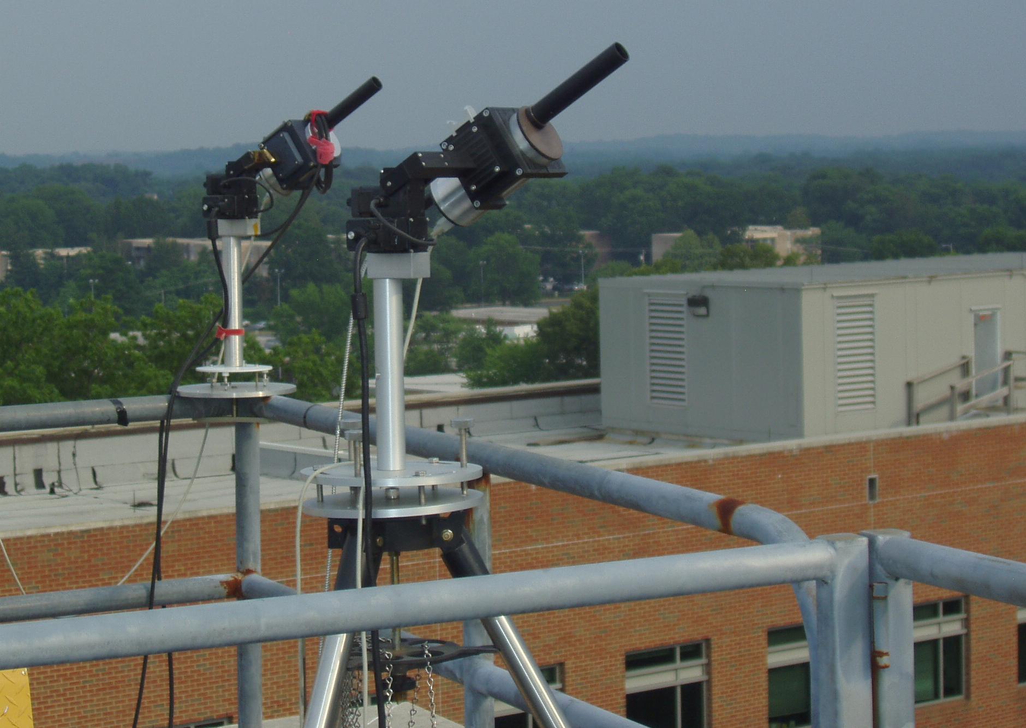
Air Quality and Ground Validation of Satellites:
Two Pandoras in Direct Sun & Sky-Scan Modes
Total Column every 80 seconds
Profiles every 20 minutes
O₃
SO₂
HCHO
BrO
NO₂
H₂O

Slide 14
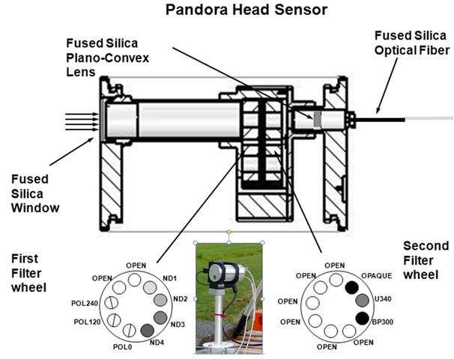
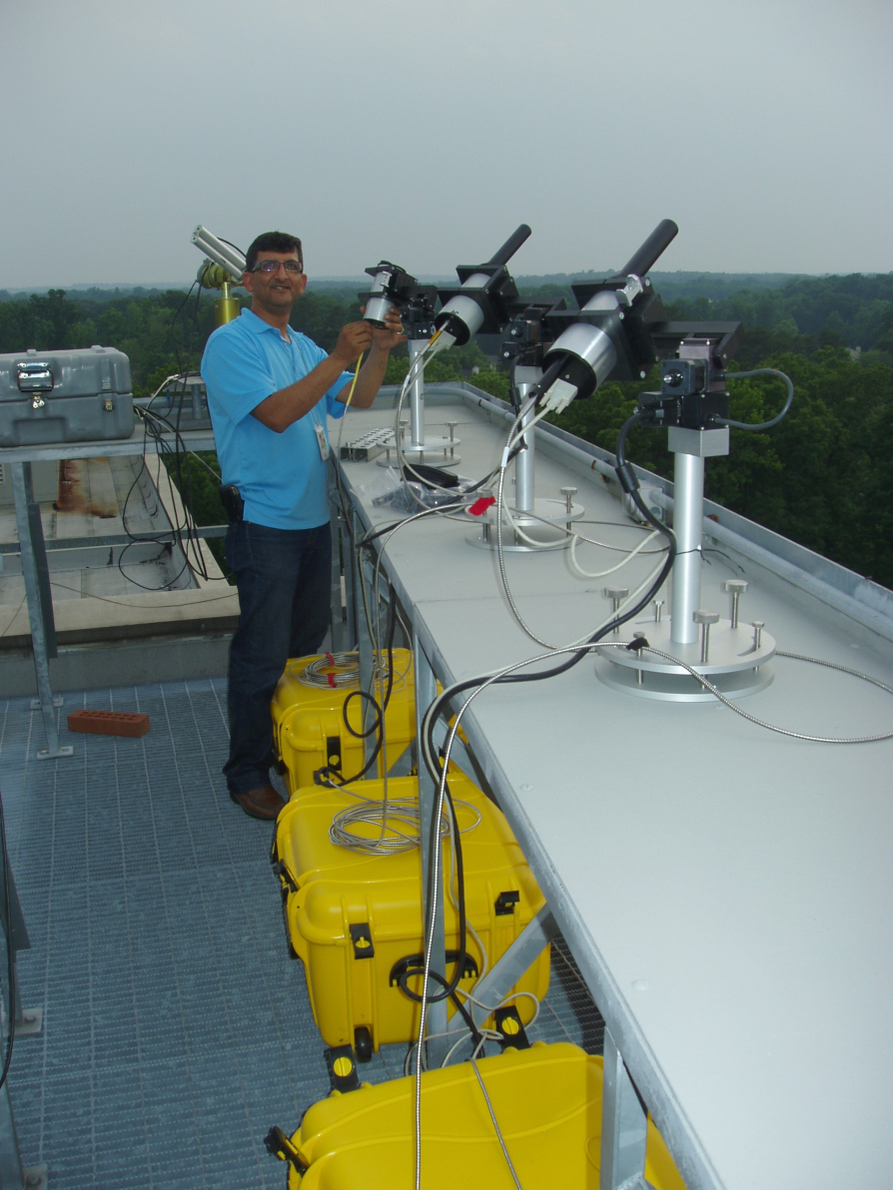
What is Pandora?
A small spectrometer system measuring between 290 and 530 nm with 0.5 nm resolution
The Pandora optical head assembly schematic and photograph (inset). Filter wheel 2 (FW2) contains neutral density filters ND1 to ND4, 3 polarization filters, and an open hole. Filter wheel 1 (FW1) contains an open hole, opaque (dark current), and two UV bandpass filters U340 and BP300 (stray light reduction). The fiber optic cable feeds a small spectrometer in a weather proof box
Pandora installation on a table
The installation is all weather and
requires little or no field operator intervention. Pandora needs 200 watts of A/C power and Internet access.

Slide 15
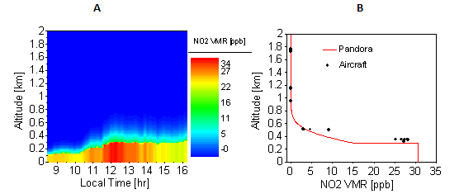
Profiles of NO₂ Compared with Aircraft Measurements Discover-AQ
Variation of Boundary Layer
NO₂ Profile
NO₂ profiles derived from Pandora direct-sun and MAXDOAS observations over Fresno, California on 18-Jan-2013
Comparison of Pandora retrieval to aircraft (P3B) measured NO₂ profile (Fresno California).

Slide 16
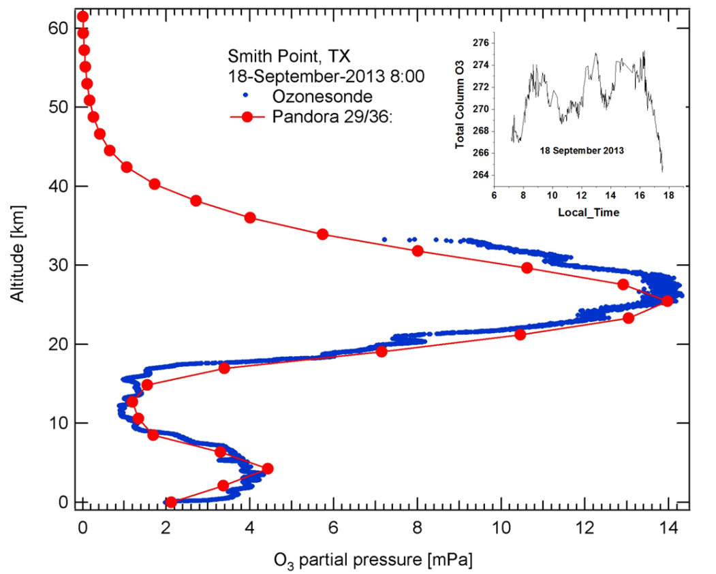
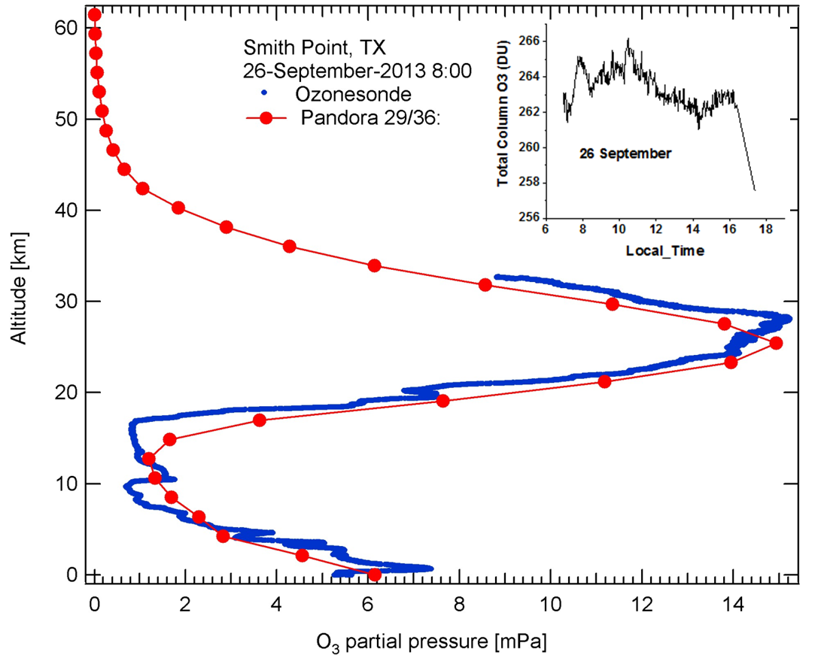
Pandora Measurements of Ozone Profiles Compared with O₃ Balloon Sondes
Smith Point, Texas on Sept 18 and 26, 2013
Pandora O₃ Profile
Notice the profile agreement in the Troposphere
Balloon Sonde O₃ Profile

Slide 17
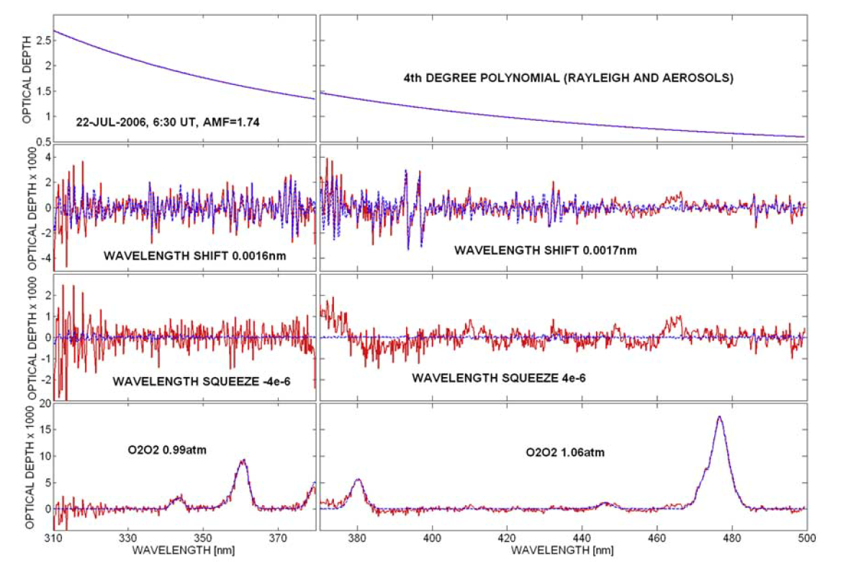
Fitted Pandora slant column optical depths (blue) for a measurement on 22 July 2006
during the campaign in Greece (red). The left side shows the measurement with the 380-nm low pass
filter; the right side shows the measurement without filter. Note that the wavelength range 370– 380 nm
appears on both sides.

Slide 18
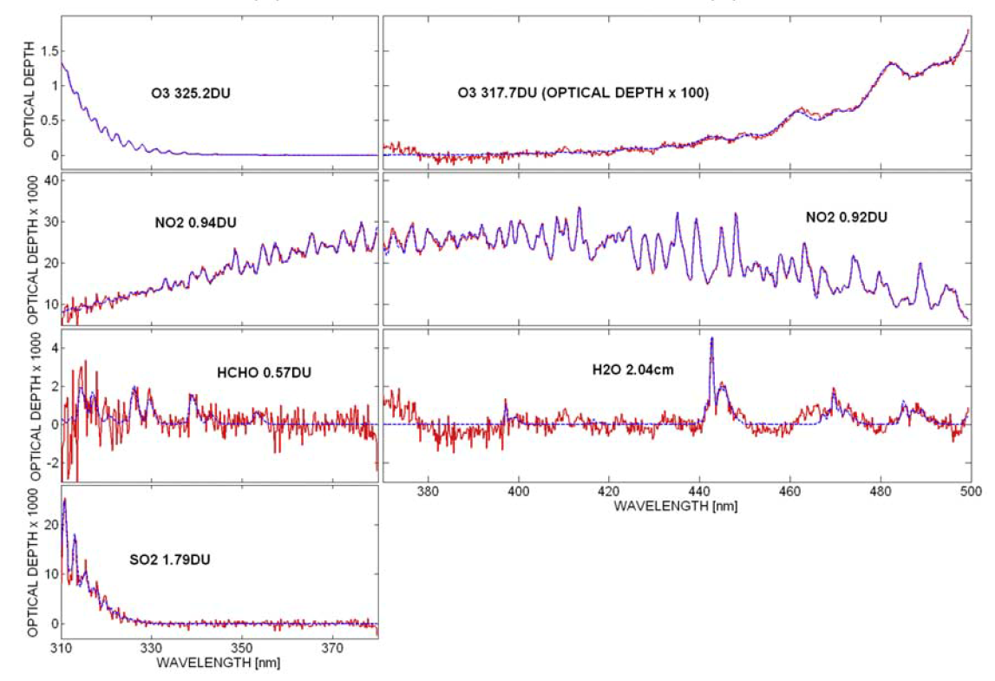
The black legends give the final retrieved vertical column amounts for each
atmospheric absorber.

Slide 19
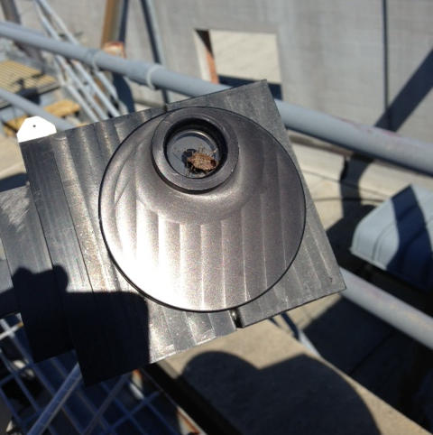
Known Pandora Bugs
EFFECTS
Reduced Transmission
Reduced SNR
Variable Signal
False Diurnal Change
Main Goal of Pandora
Project
ELIMINATE BUGS
BEFORE TEMPO FLIES

Slide 20
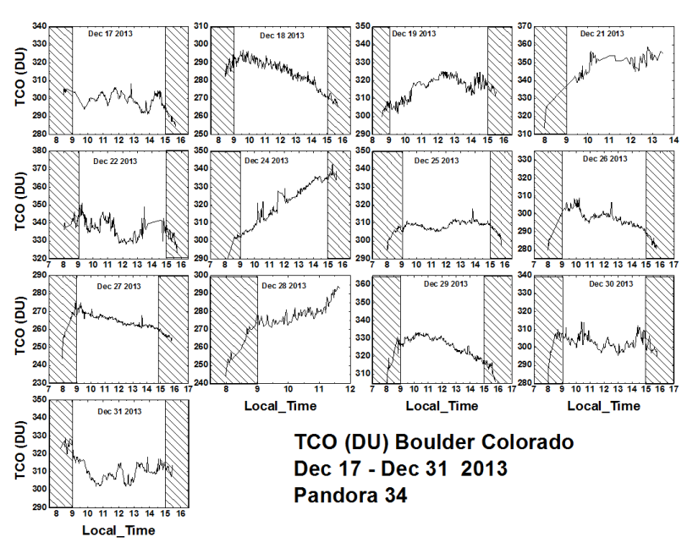
Day to Day Variability of Ozone in a Mountain Region

Slide 21
Earth as a Planet: A view from the Moon

Slide 22
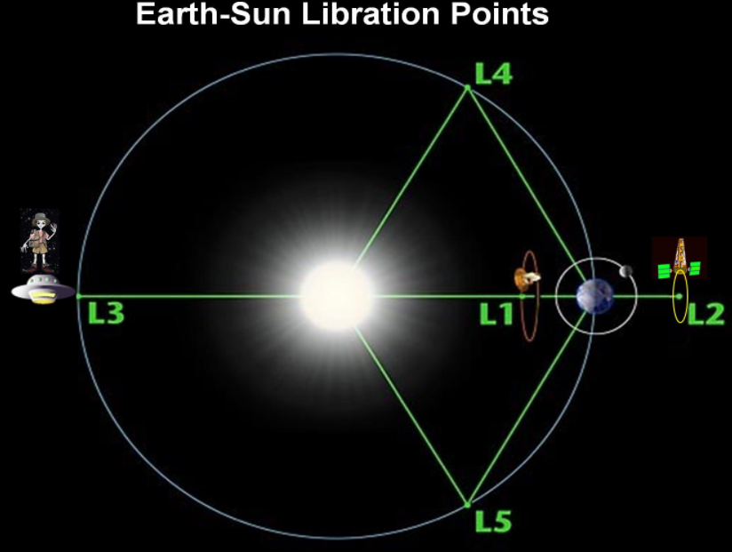
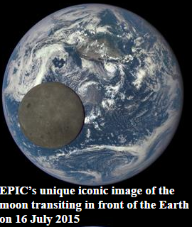
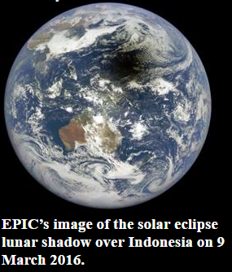
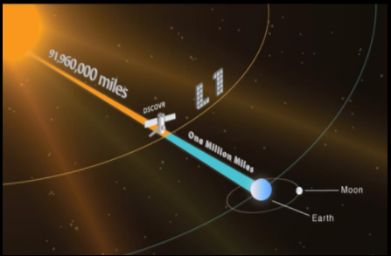

Slide 23
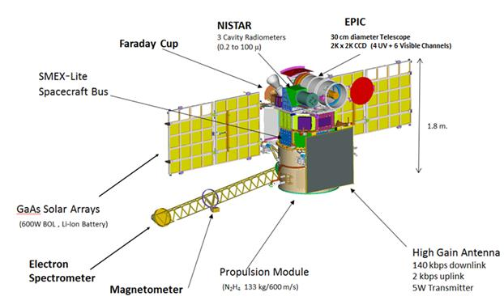
Drawing of the DSCOVR Spacecraft located at Lagrange-1

Slide 24
Lunar Transit with Music

Slide 25
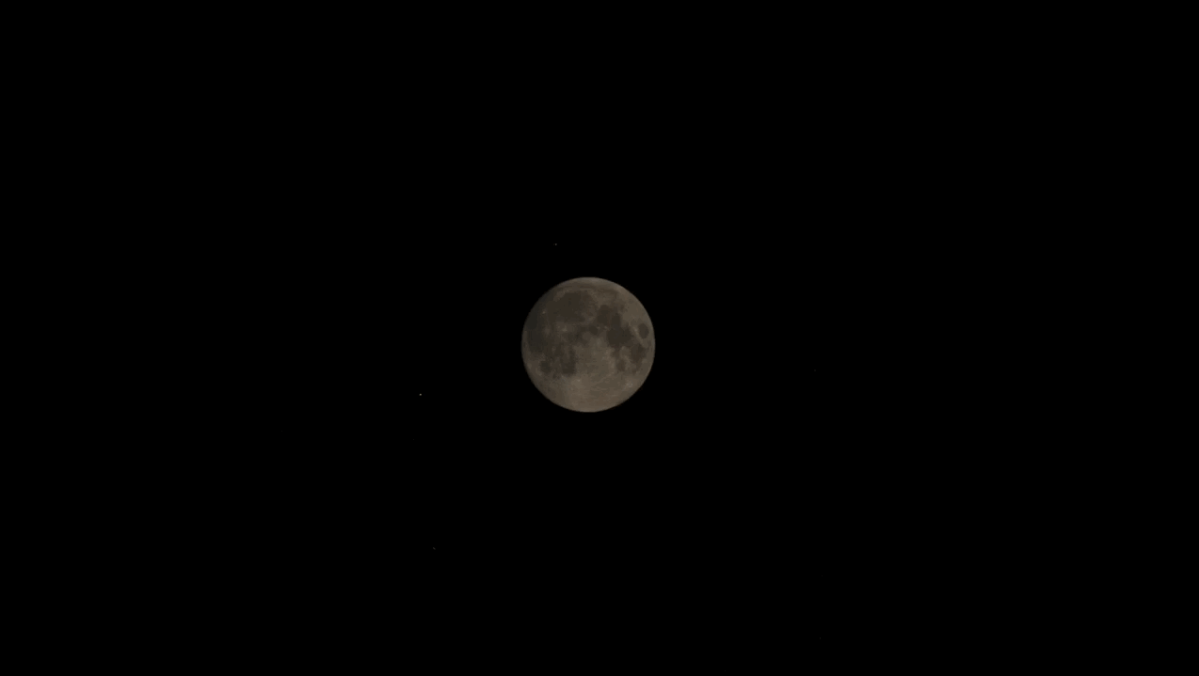

Slide 26
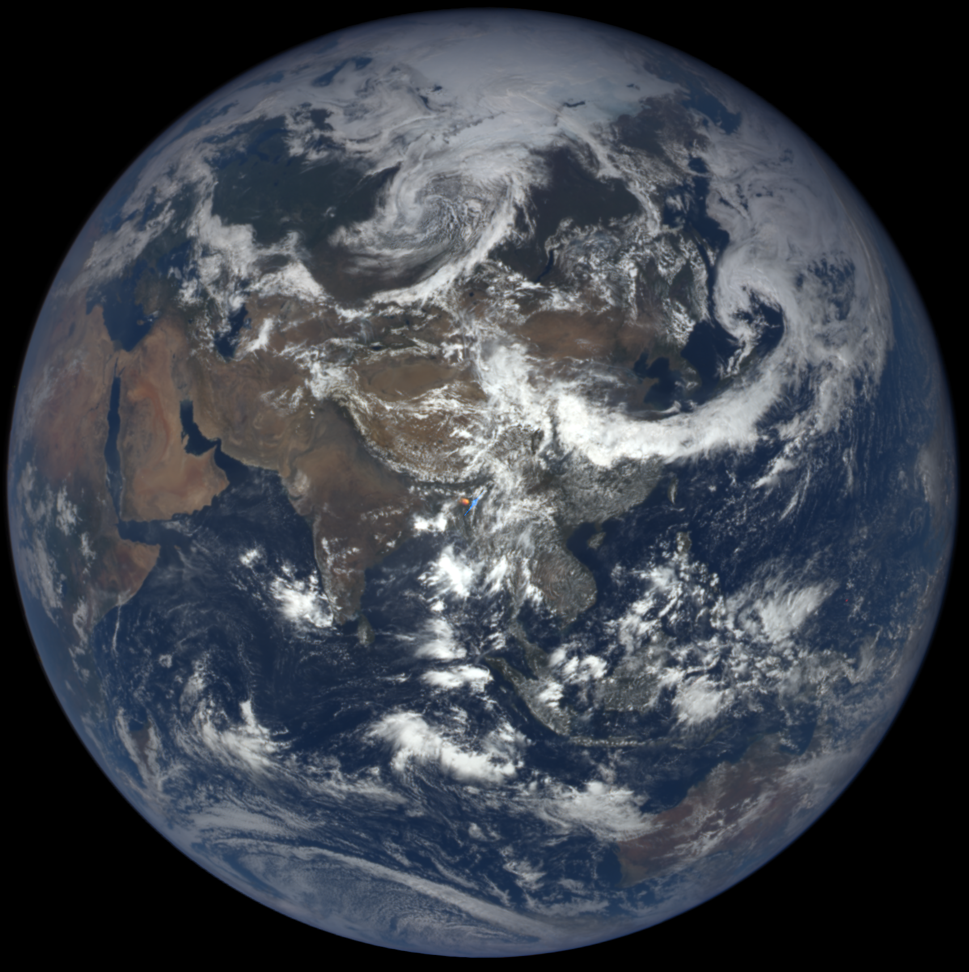
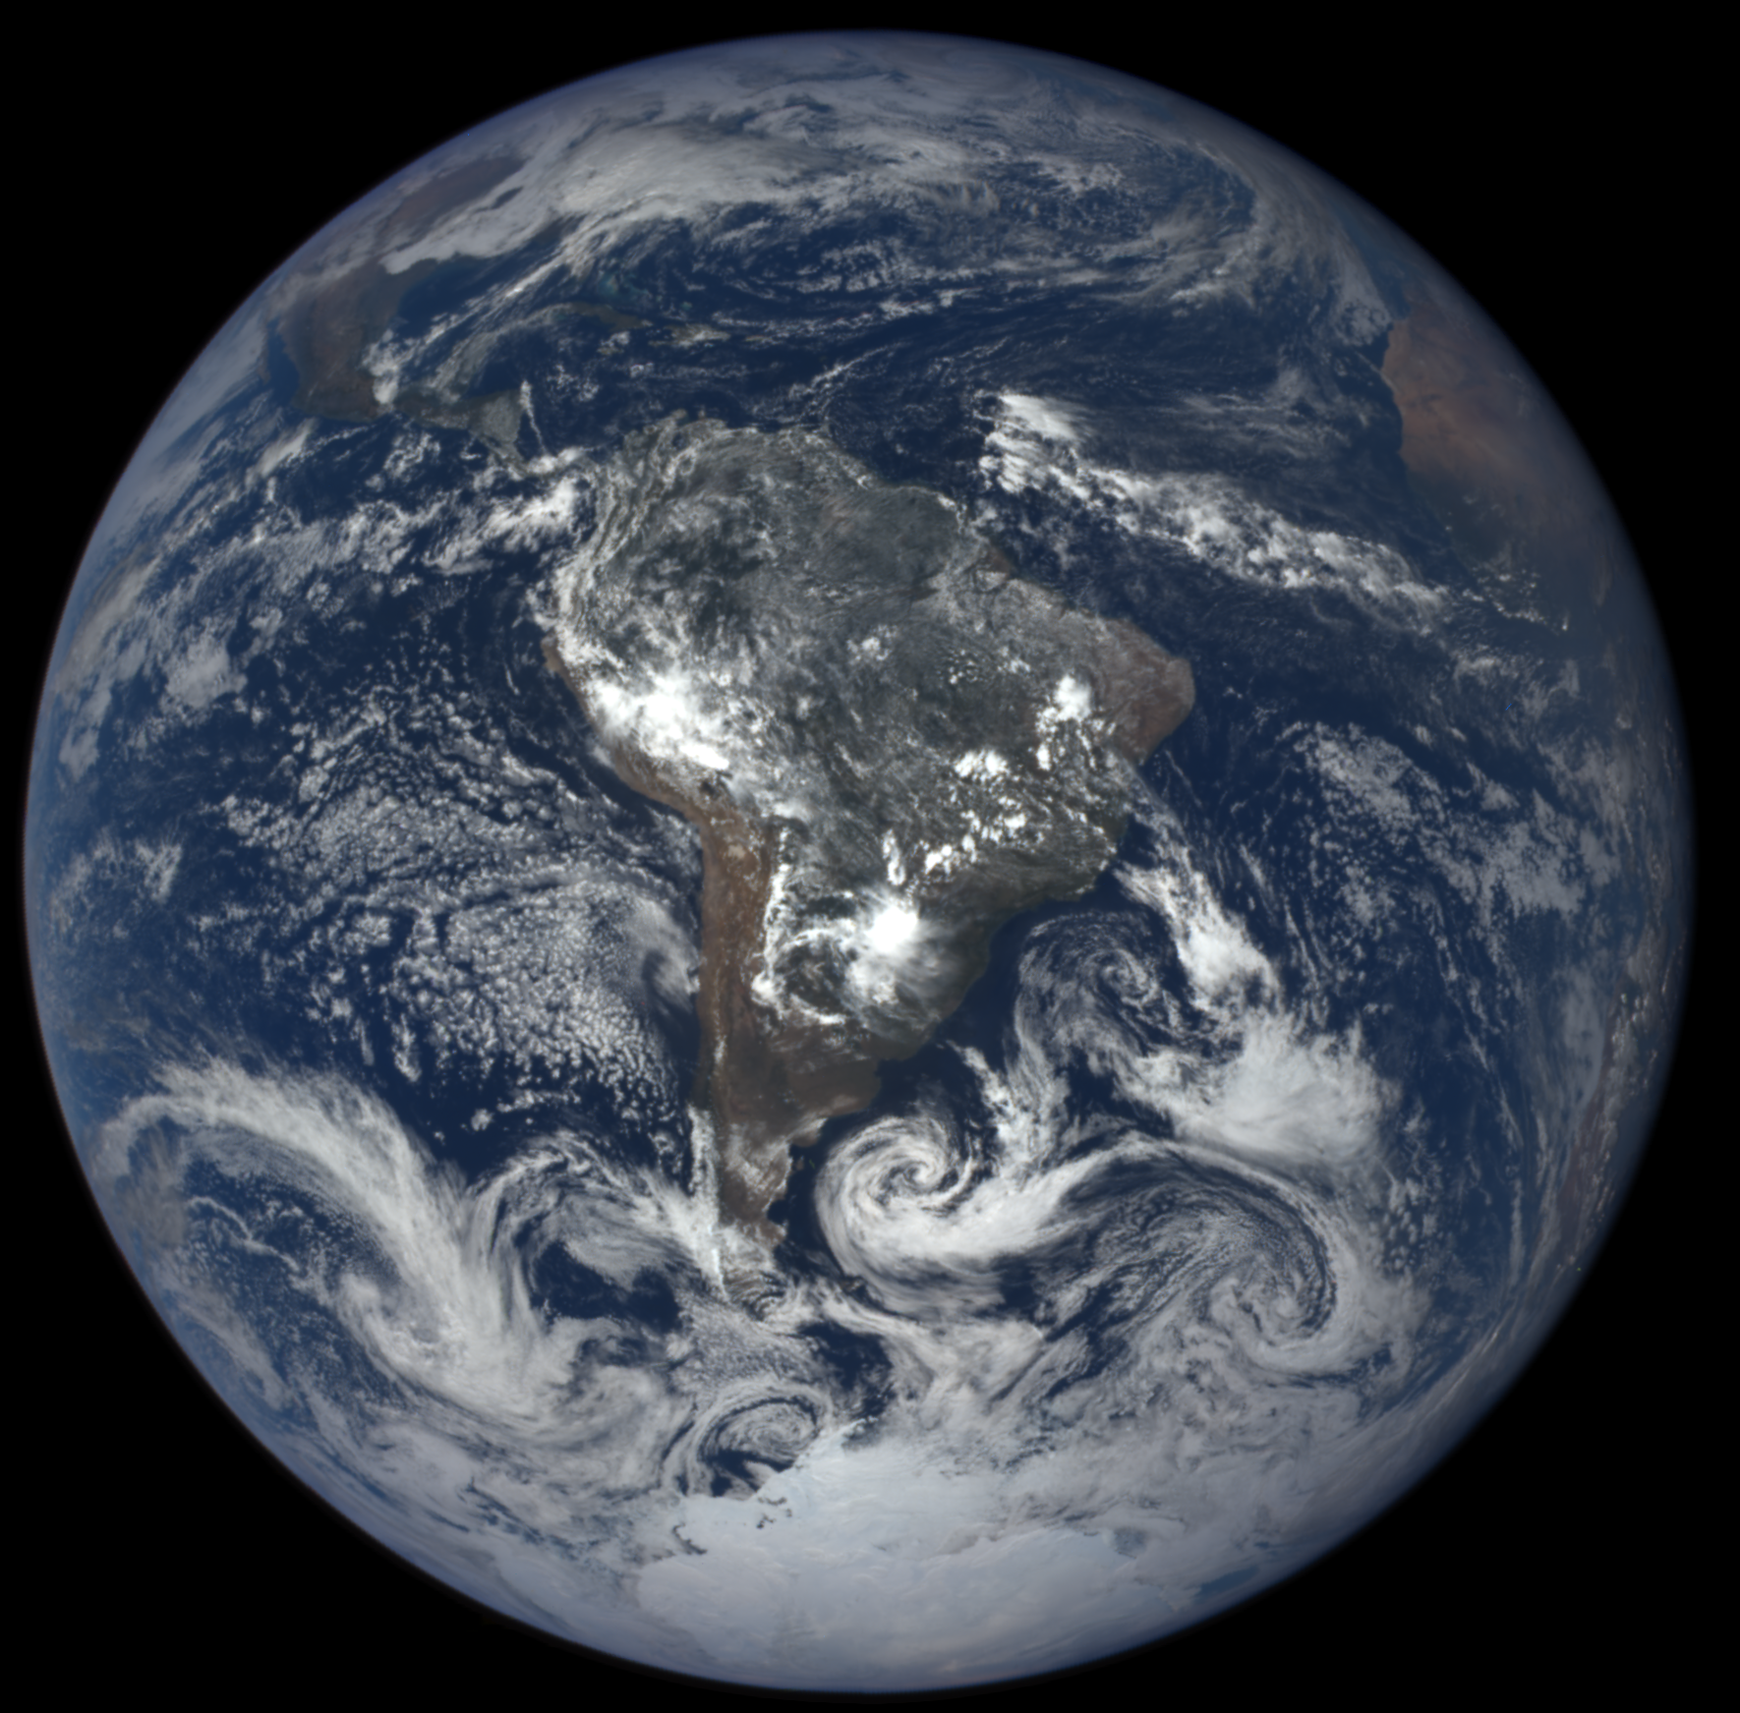
The View of Earth from Lagrange-1
June
December
Natural Color EPIC Earth images from June 6 and December 6, 2016 showing the field of view during the respective hemispheric summers.

Slide 27
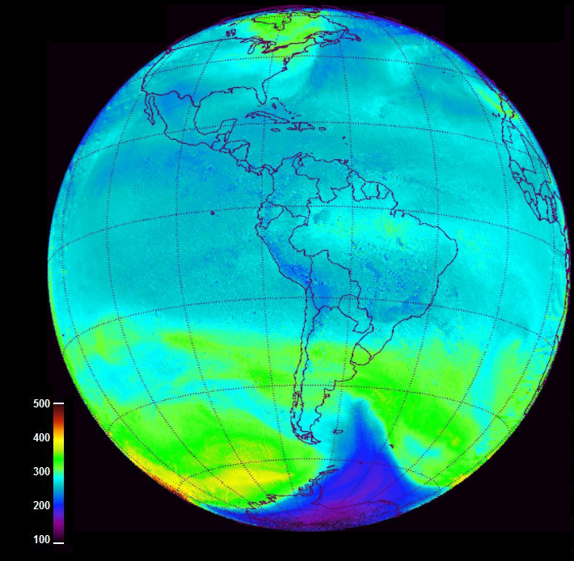
Antarctic Ozone Hole Observed from Lagrange-1
EPIC observed ozone from 23 November 2015 at 16:20 GMT showing the remnant of the Antarctic ozone hole.

Slide 28
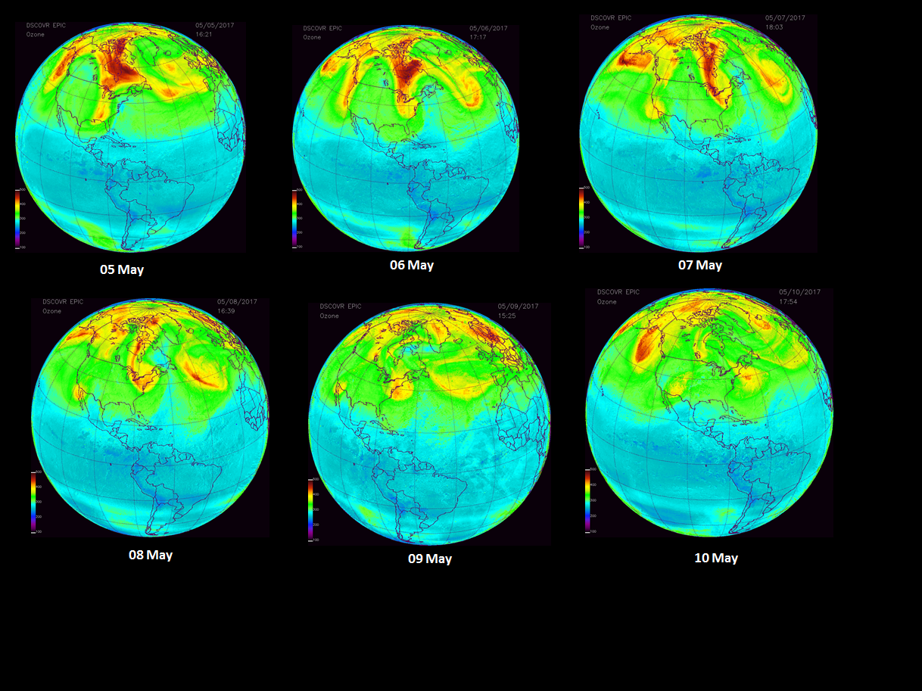
EPIC Ozone for US with high O₃ on the east coast including NASA HQ
High Values on May 6, 7, and 8

Slide 29
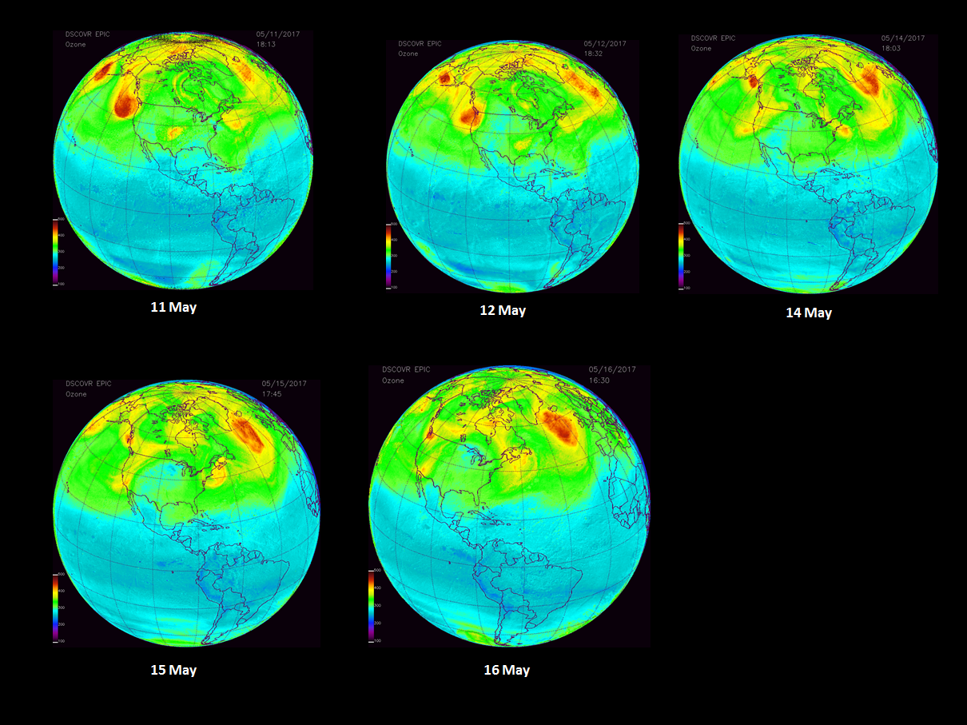
EPIC O₃ for US with high O₃ on the east coast including NASA HQ

Slide 30
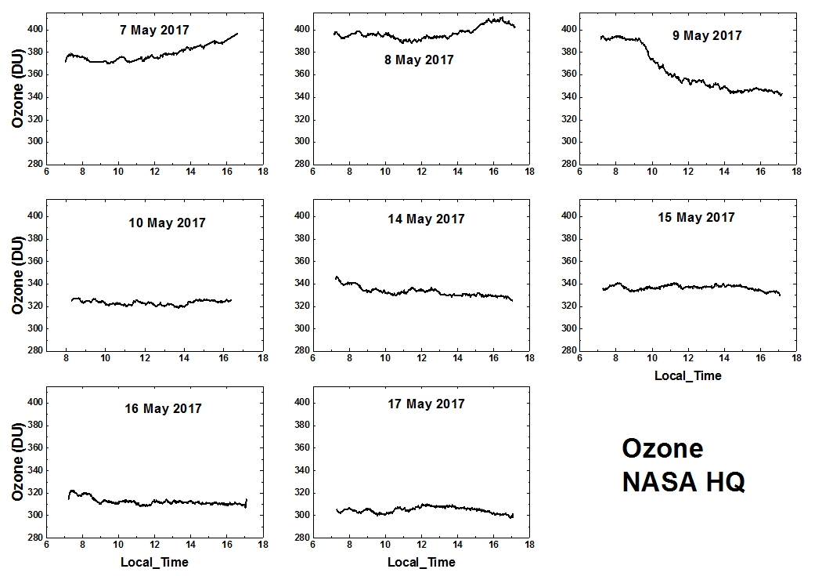
Pandora O₃ for NASA HQ

Slide 31
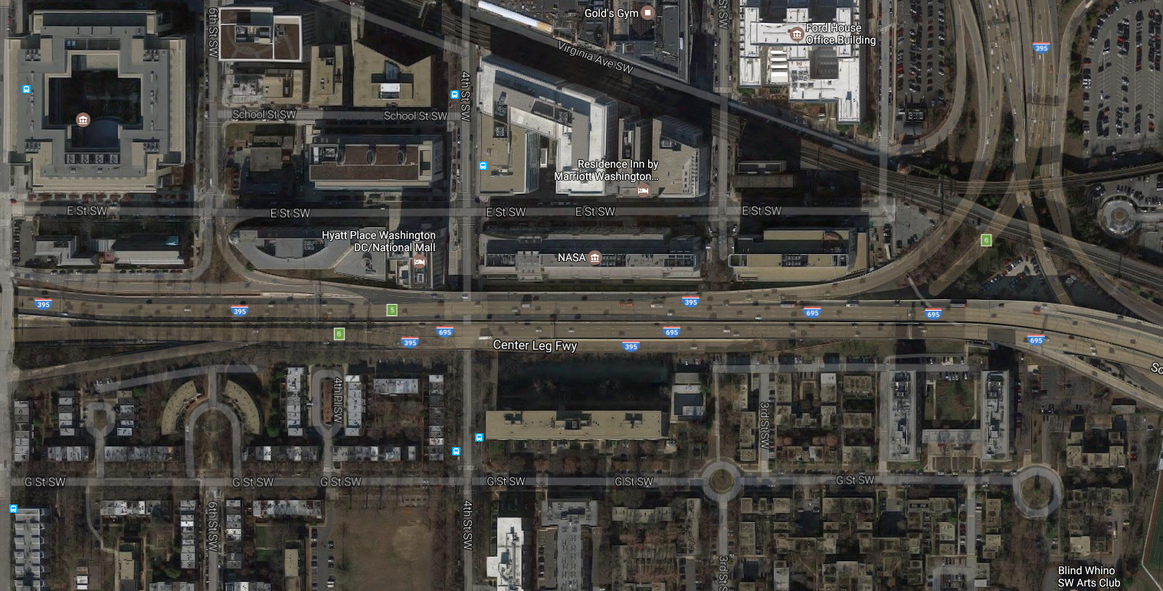

Slide 32
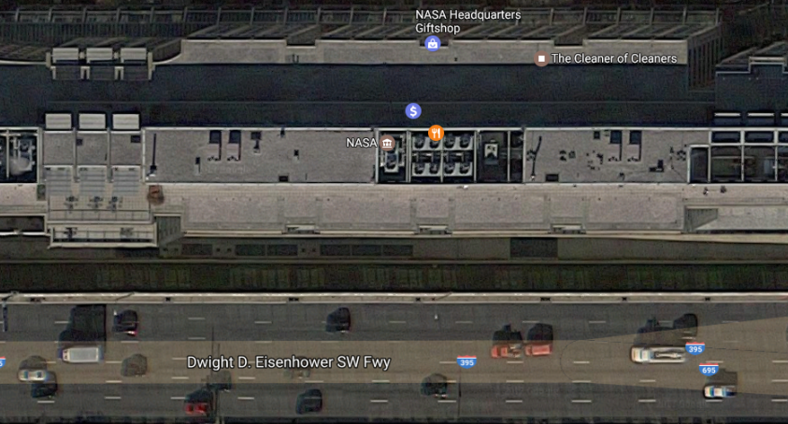

Slide 33
Pandora

Slide 34
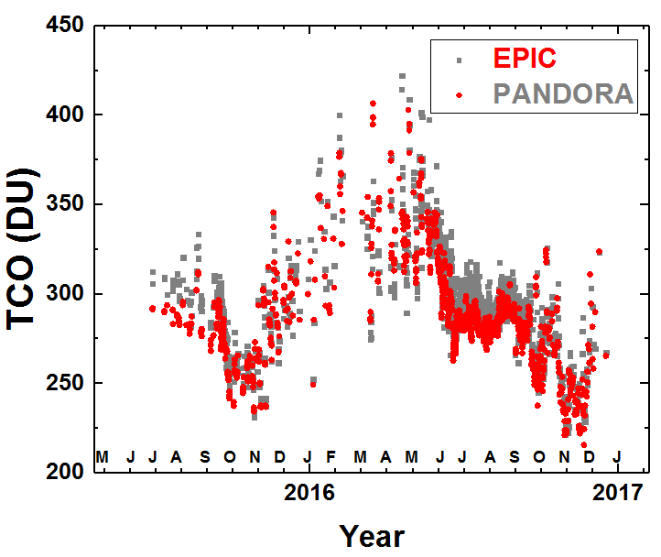
Pandora Ozone Compared to EPIC Ozone
Daily O₃ data for EPIC (red) and Pandora (Grey) 2015 - 2016.
EPIC ozone data compared to Pandora retrievals at Boulder Colorado

Slide 35
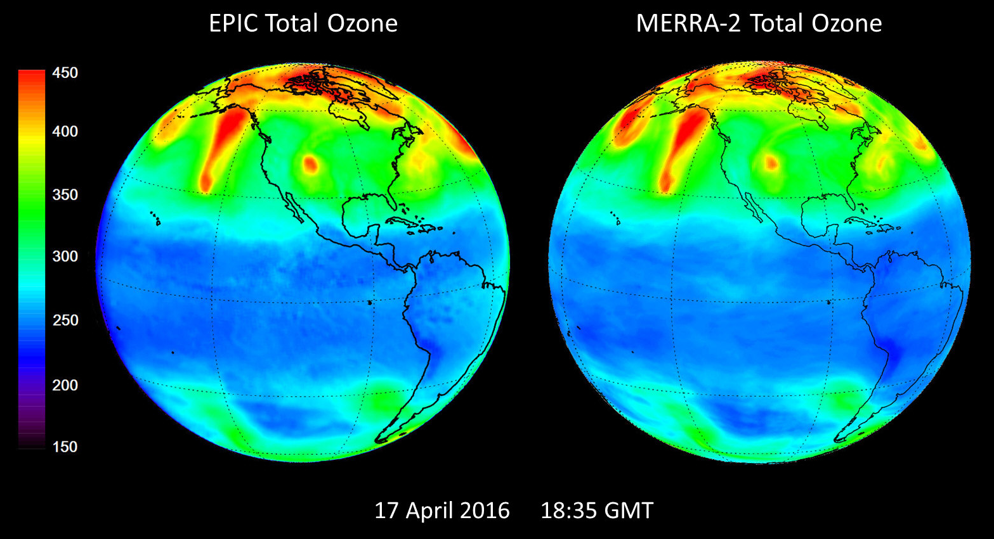
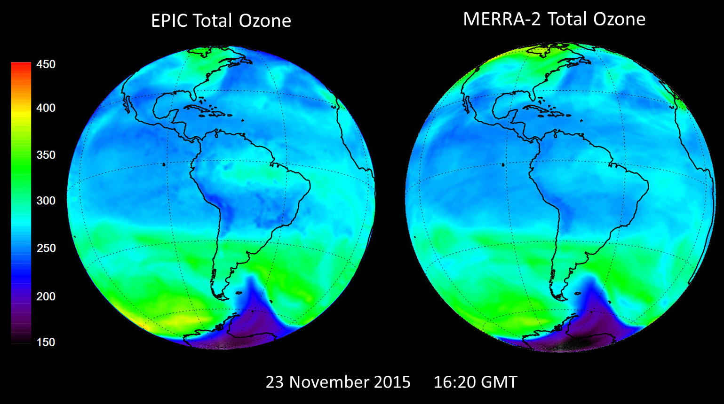
EPIC and MERRA-2
Computer Modelling such as the Merra-2 data assimilation model has become an essential tool for understanding the atmosphere.

Slide 36
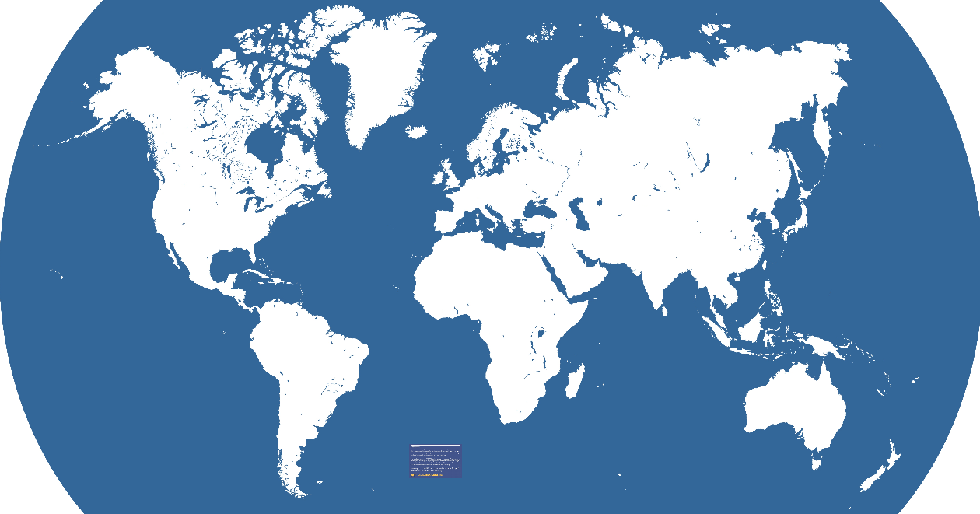
NASA PANDORAS AND ESA PANDONIA INSTRUMENTS
Helsinki (FMI)
Utrecht (KNMI)
2xBerlin Bucharest
Davos WRC
2x Innsbruck
2x Rome
Athens
2
GSFC
NASA-HQ
2 - LARC
Boulder
New Mexico
Houston
Mauna Loa
2
10
6
2- Korea
2
2-Tenerife
Namibia
Buenos Aires
Bariloche
Neuquen
Cordoba
Australia
+5x Australia 2017
More than 40
New NASA Pandoras for 2016: nd VA
CCNY (NYC). Chesapeake Bay
Saint Louis MO Richmond VA
Boulder CO. Huntsville AL
Wallops VA Table Mtn, CA
Locations of operating NASA Pandoras
1Colorado 4 Canada 2 Tenerife 1 New Mexico
10 GSFC 2 Boston 1 Houston 1 Taiwan
2 Langley 2 Finland 2 S. Korea 4 Argentina

Slide 37
What is the Pandora System?
Pandora uses a symmetric Czerny-Turner spectrometer optimized for detection of trace gases in the 280 – 525 nm spectral range (0.5 nm resolution connected by a 400 micron fiber optic cable to an optical head (1.6^{O} field of view) mounted on a high precision (0.01^{O}) sun-sky tracker.
Primary Products
O₃ and NO₂ total column
O₃ and NO₂ Altitude profiles every 15 minutes
O₃ from 0 to 50 km
NO₂ from 0 to 10 km

