Slide 1
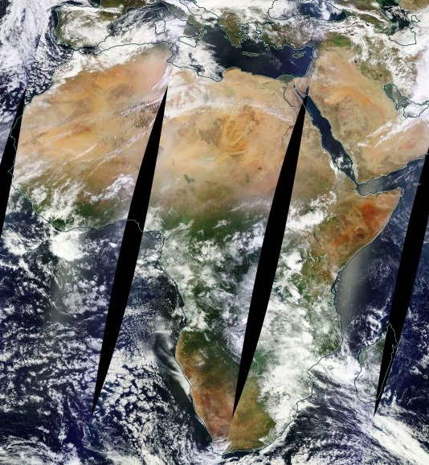
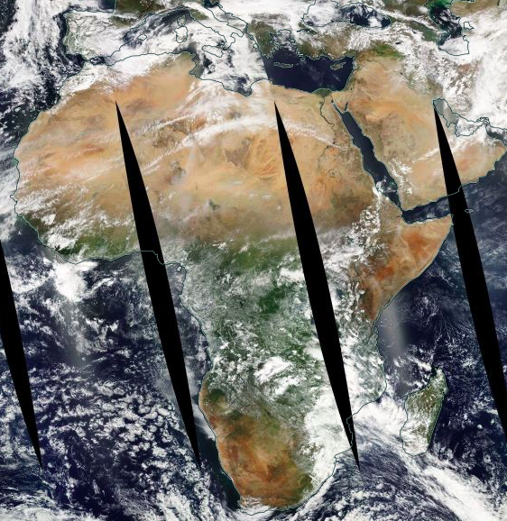
EPIC vs. MODIS
MODIS Terra
10:30 equatorial crossing time
EPIC
10:56 UTC
MODIS Aqua
13:30 equatorial crossing time
DSCOVR/EPIC image of Africa taken on March-22-2016 at 10:56 GMT. Composite MODIS Terra and MODIS Aqua images of the same area taken on the same day. Terra crosses equator at 10:30 am local time so that the western part of the left image (Terra) has a more similar cloud structure compared to the EPIC image than their eastern parts. Since Aqua crosses equator at 13:30 local time, the eastern part of the right (Aqua) and middle (EPIC) images are more alike than their western parts.

Slide 2
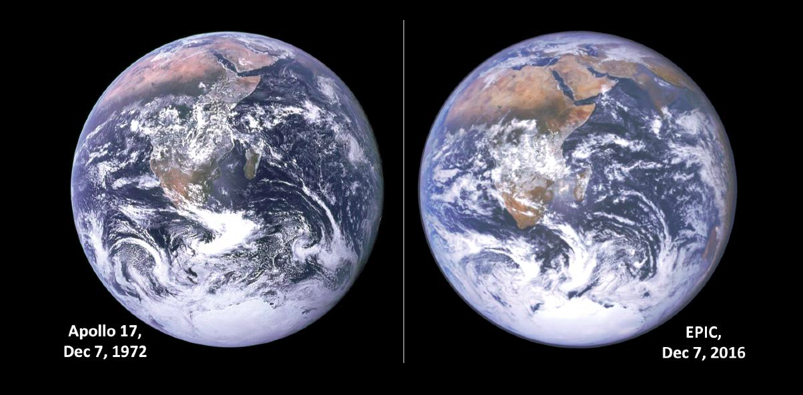
EPIC vs. Apollo 17
The major cloud structure is very similar 44 years after the Apollo 17 picture was obtained. This is consistent with the large set of EPIC images, which shows that the large cloud structures are persistant, but vary with the seasons. Because of the different viewpoints, the image perspective differs a little. The image angles are similar as can be seen from the positions of the specular reflection near the southeast coast of Africa. The Antarctic-ice coastline appears to have some significant differences.

Slide 3
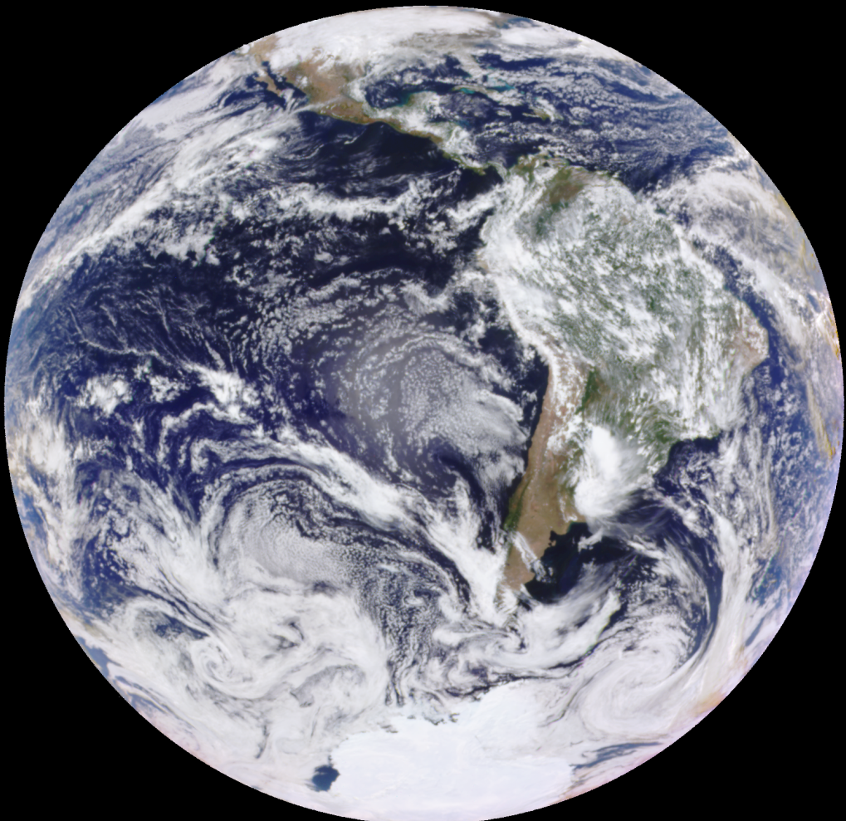
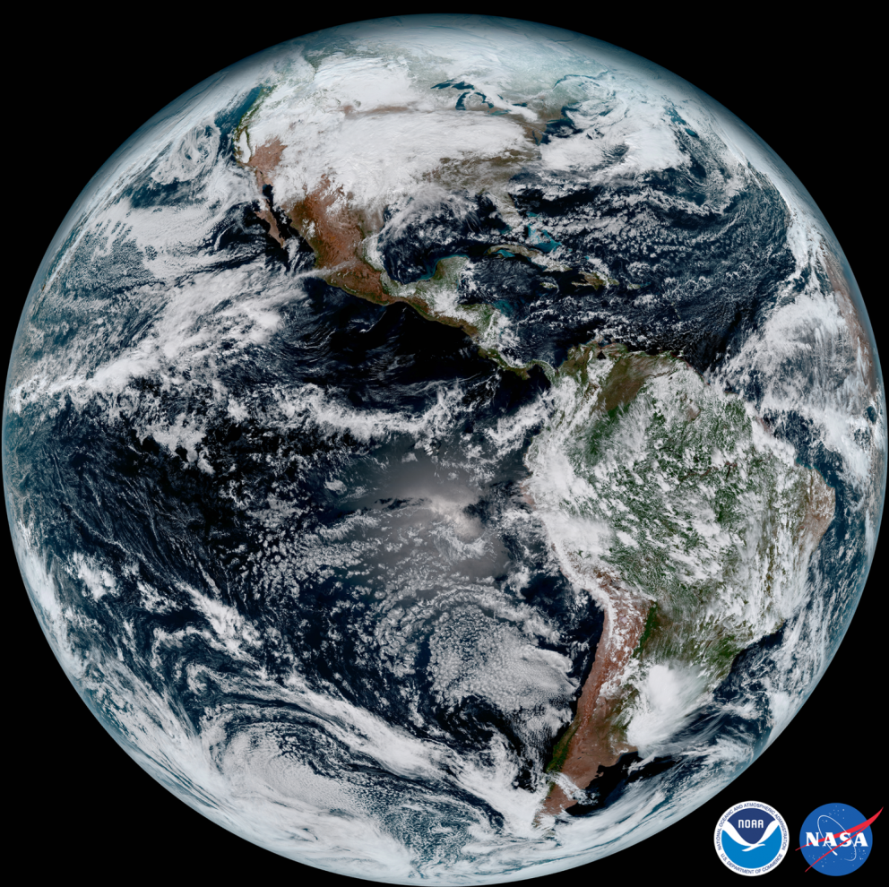
EPIC vs. GOES 16
EPIC (18:37 GMT) epic_1b_20170115183704_01
distance 1,528,077 km SEV angle 9.34º
GOES-16 (first image)
This image was captured 1:07 p.m. ET on Jan. 15 using several of the 16 spectral channels available on the GOES-16 Advanced Baseline Imager.
The images differ by 30 minutes apart (1:07 pm ET = 18:07 GMT). Note that the angles of view are quite different. GOES-16 is viewing from the equator, while EPIC is viewing from about 20^{O}S because of the tilt of the Earth's axis with the south pole pointing towards EPIC by about 20^{O}.

Slide 4
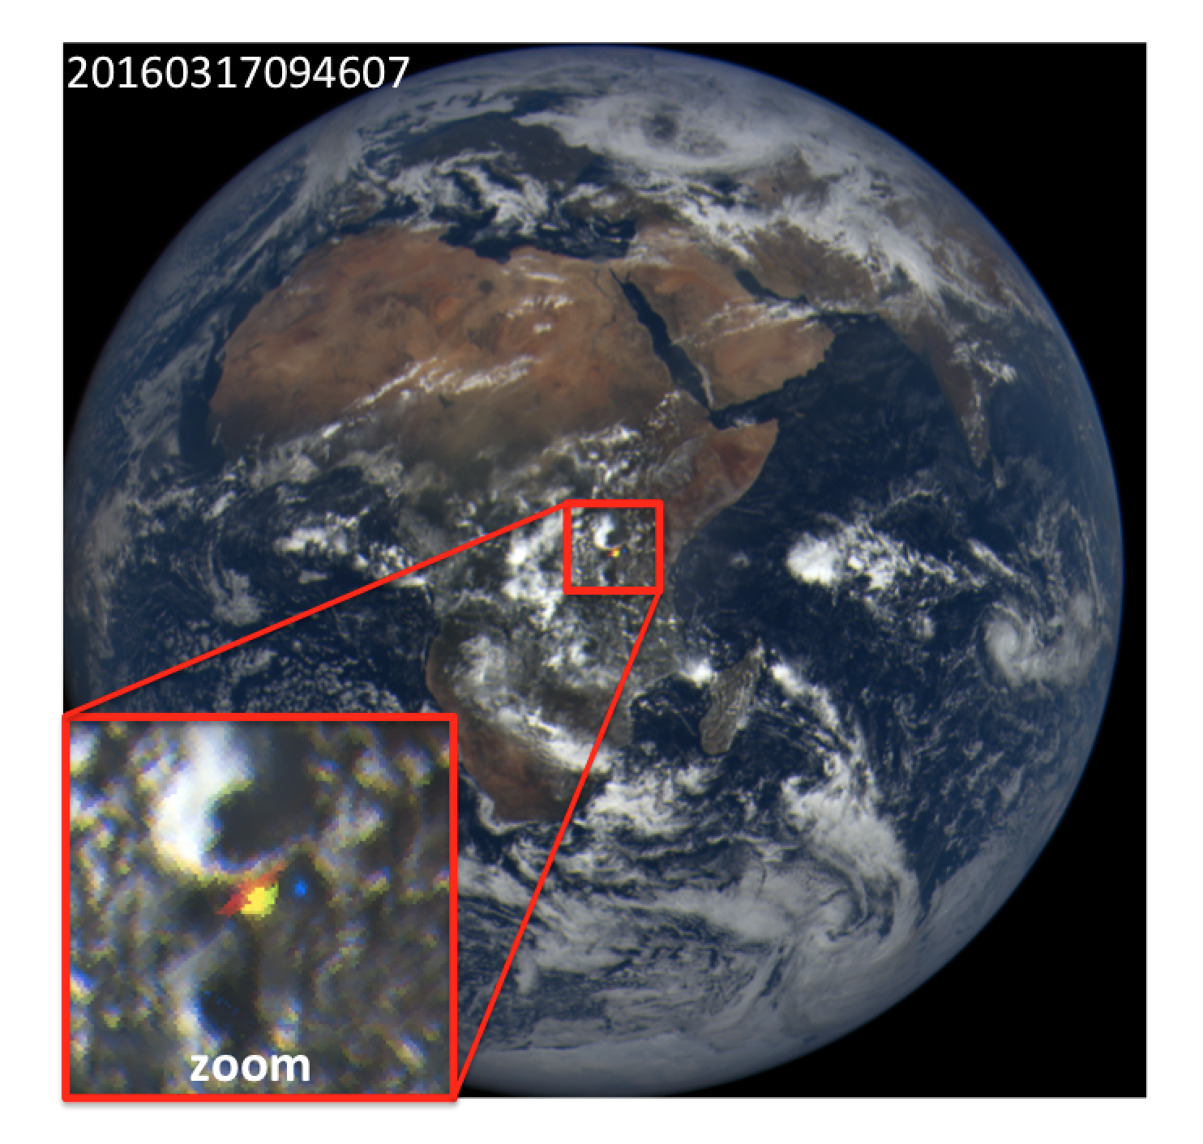
EPIC glints
Many EPIC images contain unexpected bright flashes of light over both ocean and land. We constructed a yearlong time series of flash latitudes, scattering angles and O2 absorption to demonstrate conclusively that the flashes over land are specular reflections off tiny ice platelets, floating in air nearly horizontally. Such deep space detection of tropospheric ice can be used to constrain the likelihood of oriented crystals and their contribution to Earth albedo (Marshak et al., GRL 2017).

Slide 5
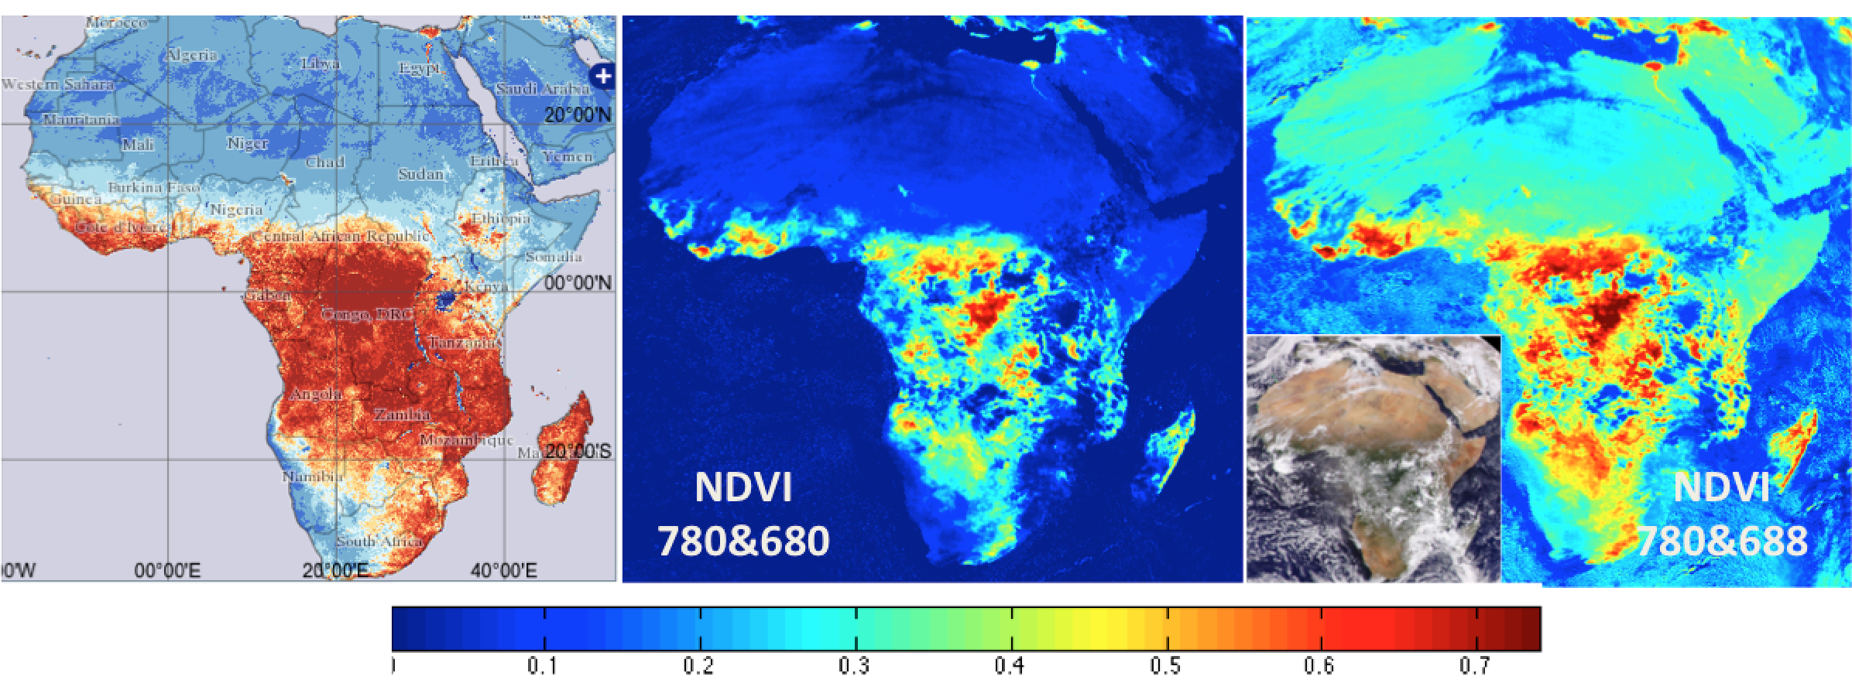
Use of the EPIC O2 B-band for
monitoring vegetation
The left panel shows MODIS/Terra surface NDVI composited over March, 2016. The middle and the right panels are EPIC NDVIs calculated with the red and O2 B-band channels, respectively, for only one EPIC snap shot on March 22, 2016 at 10:52 GMT. The insert in the right panel is the enhanced and Rayleigh corrected RGB image. The use of the O2 B-band enhances the sensitivity of the at-sensor NDVI to the presence of vegetation. (Marshak and Knyazikhin, JQSRT 2017).

Slide 6
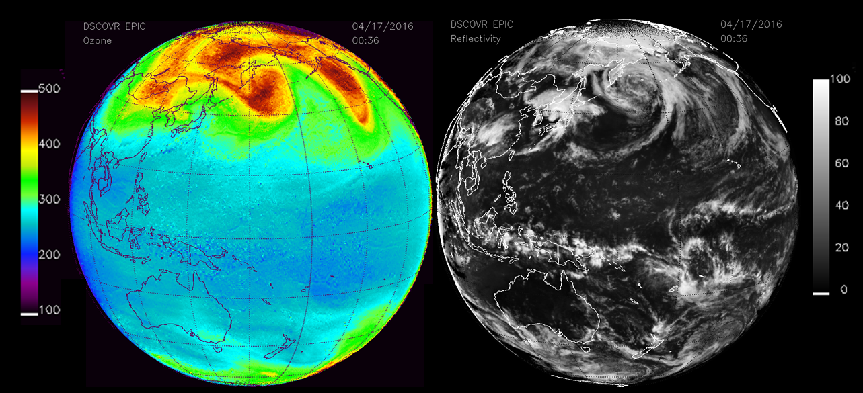
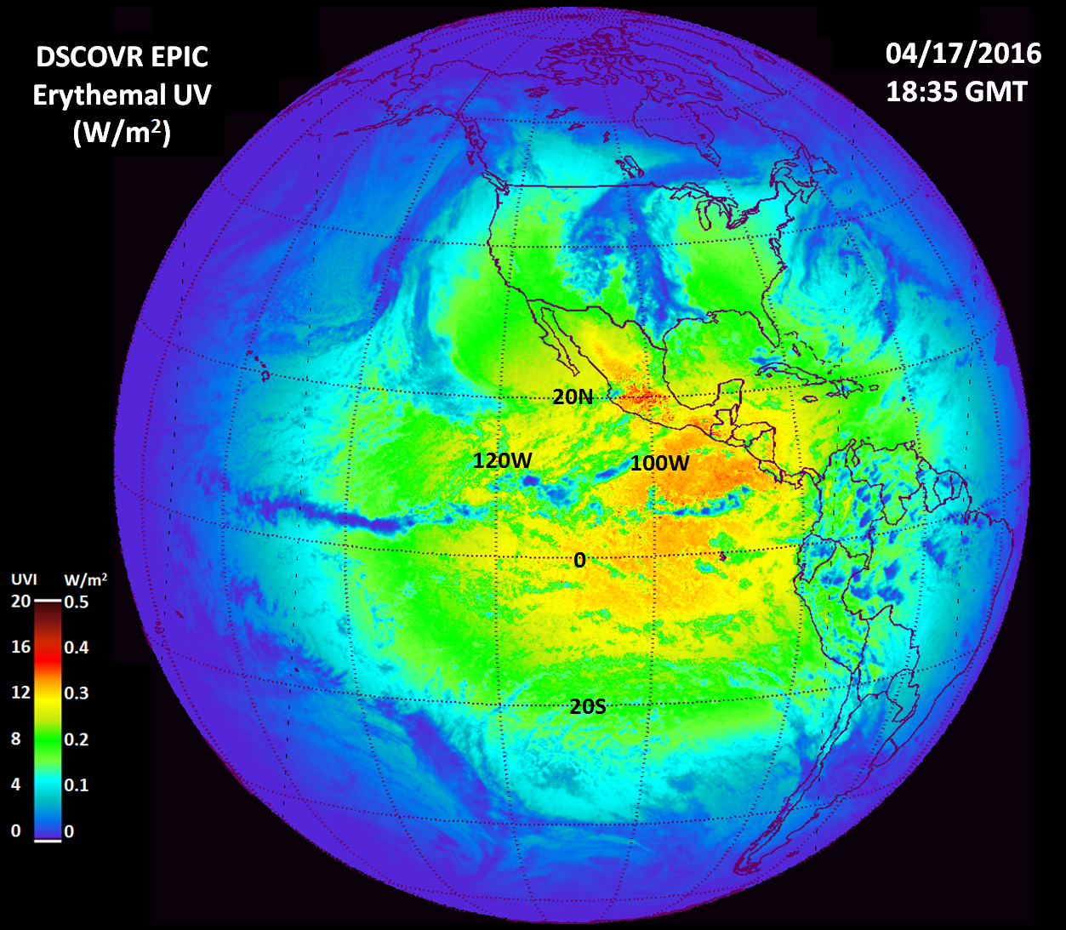
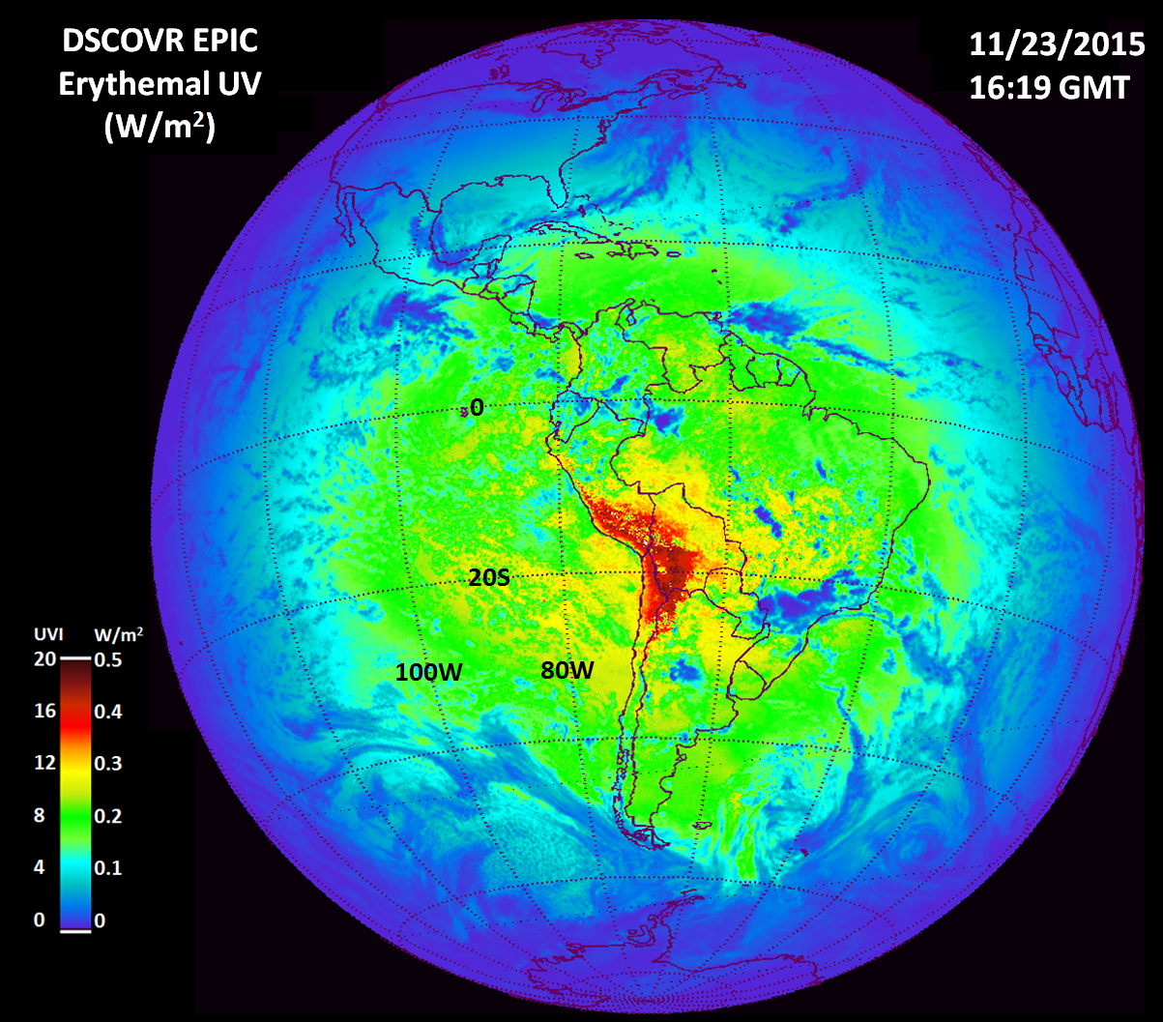
Ozone and Scene Reflectivity can be converted into Diurnal Variation of
UV Erythemal Radiation Reaching the Earth’s Surface
Ozone Reflectivity
Erythemal UV from Sunrise to Sunset including Altitude Effect
Sun just
North of
Equator
Noon
UVI=12
Sun
Overhead
at 20^{O}S
UV Index
20 for
Andes
Mtns

Slide 7
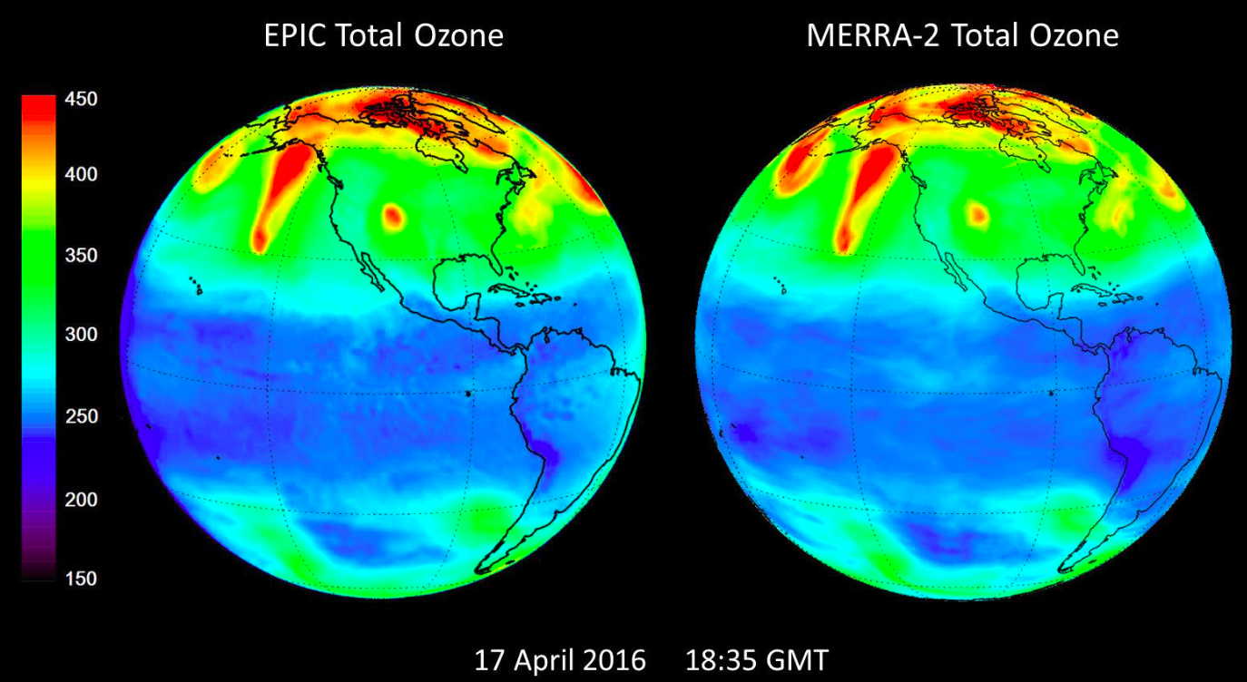
O₃
EPIC total ozone compared with ozone from the MERRA-2 Assimilation Model based on the Microwave Limb Sounder (MLS) and total column ozone from the Ozone Monitoring Instrument (OMI) on NASA’s EOS Aura satellite. Except for a small offset, the EPIC and MERRA-2 features are almost identical (Herman et al., 2017).

Slide 8
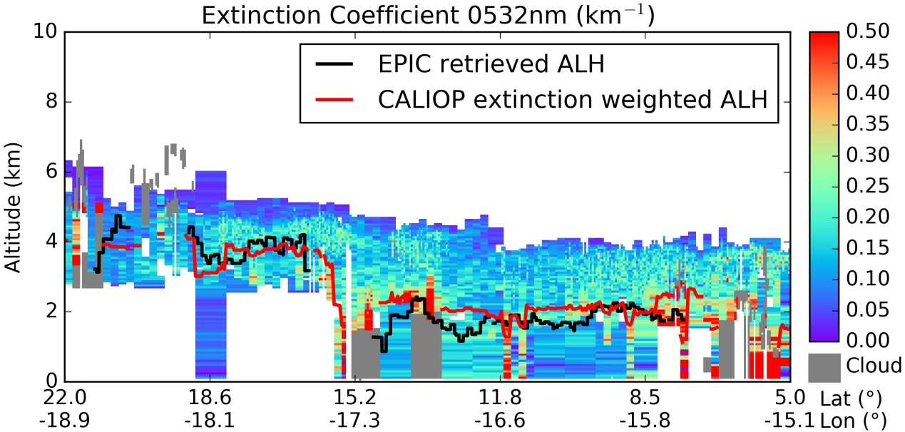
Aerosol Height
a
EPIC: 2016-04-18 14:59 UTC
CALIPSO: 2014-04-17 14:18 UTC
Comparison of EPIC retrieved aerosol layer height (ALH, black curve) with CALIOP profile of 532-nm extinction coefficient on April 17, 2014 over the North Atlantic. Cloud layers are indicated by gray color. The red curve depicts CALIOP extinction weighted ALH (Xu et al., GRL, 2017).

Slide 9
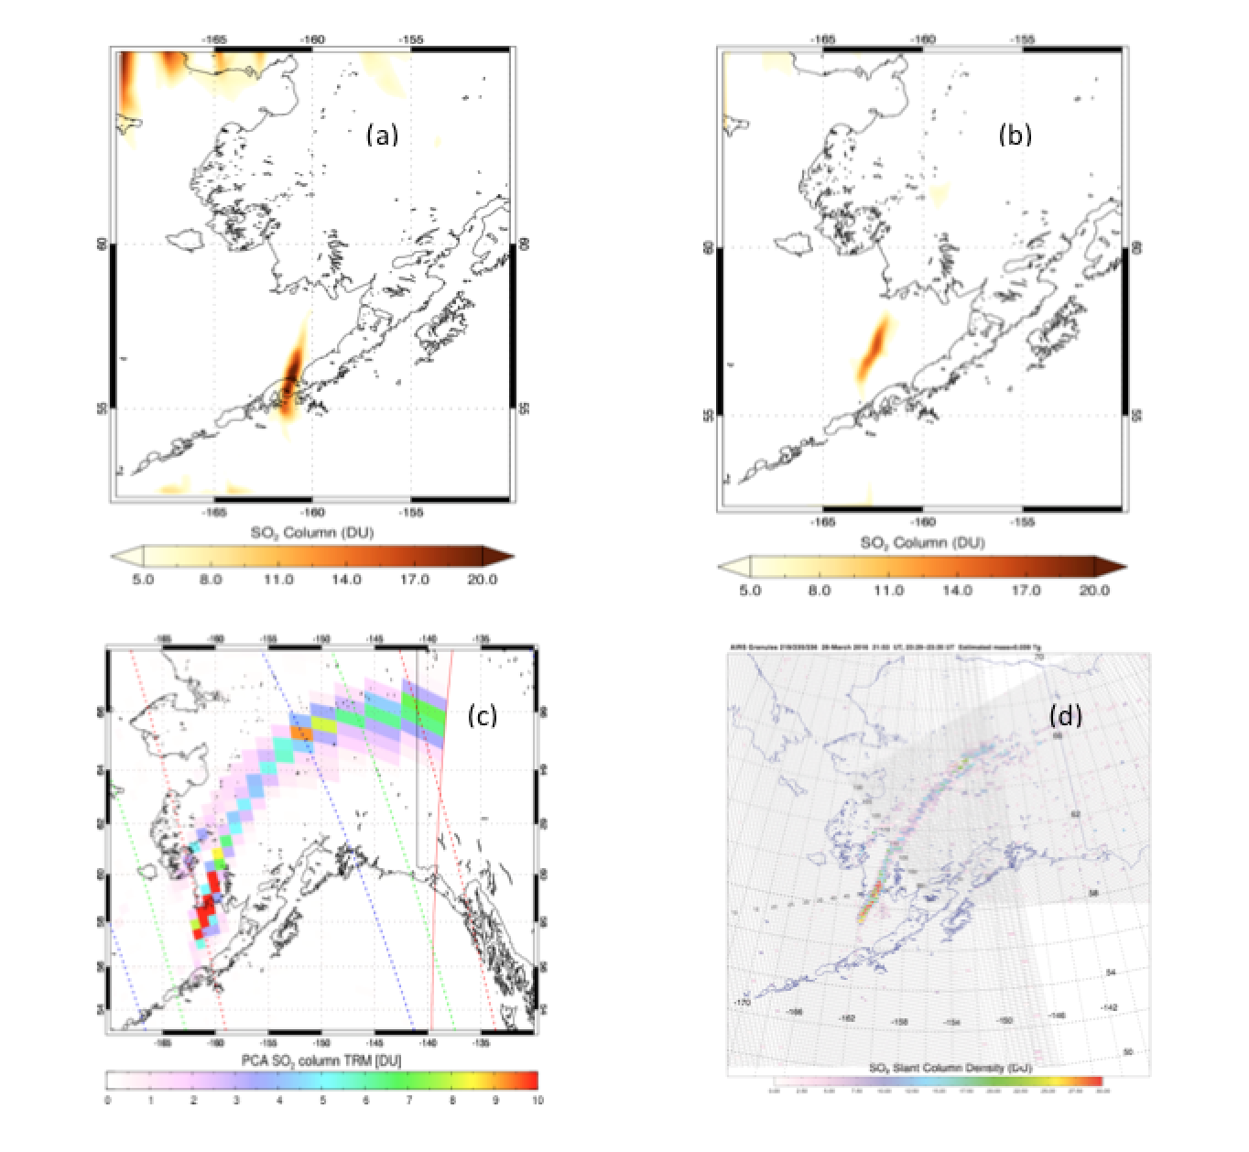
SO₂
EPIC
@ 21:54 UTC on 03/28
EPIC
@ 00:08 UTC on 03/29
Aqua/AIRS
@ ~23:29 - 23:35 UTC on 03/28
Suomi-NPP/OMPS
@ ~23:25 UTC on 03/28
SO₂ maps for the March 2016 eruption of Pavlof volcano (AK, USA). SO₂ in the Pavlof volcanic cloud was detected in two EPIC exposures at 21:54 UTC on March 28 and ­00:08 UTC on March 29 as well as Suomi-NPP/OMPS and AQUA/AIRS.

Slide 10
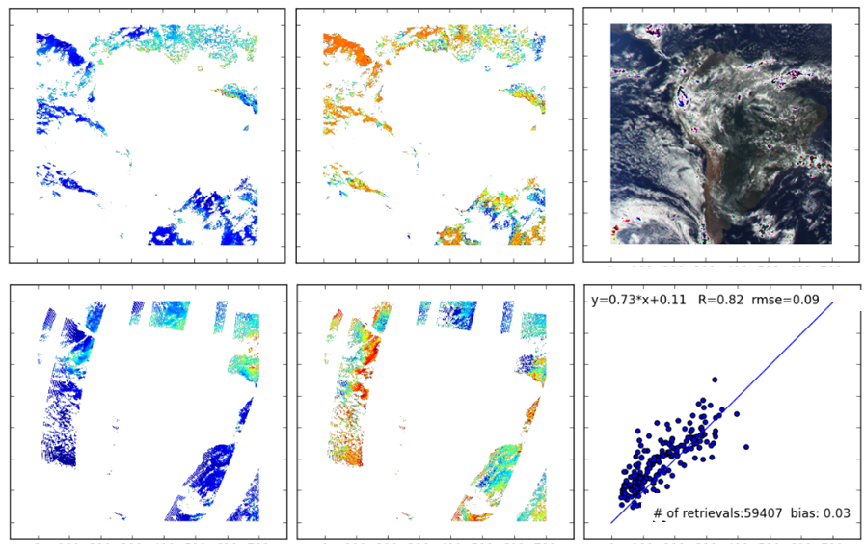
Aerosol Properties: 03/26/2016
Aerosol Optical Thickness (AOT)
Fine Mode Fraction (FMF)
RGB image
EPIC AOT
EPIC FMF
EPIC vs MODIS
MODIS AOT
MODIS FMF

Slide 11
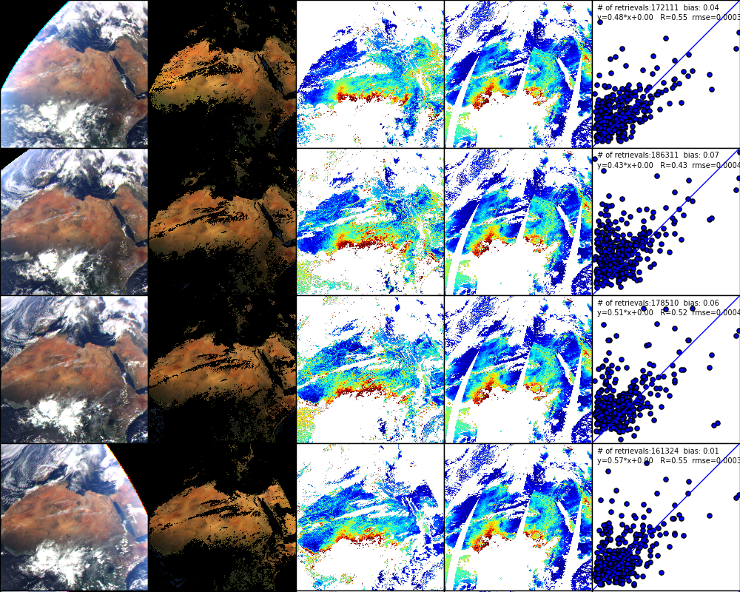
Aerosol Properties: 03/05/2016
TOA RGB
Corrected RGB
EPIC AOT
MODIS AOT
EPIC vs MODIS

Slide 12
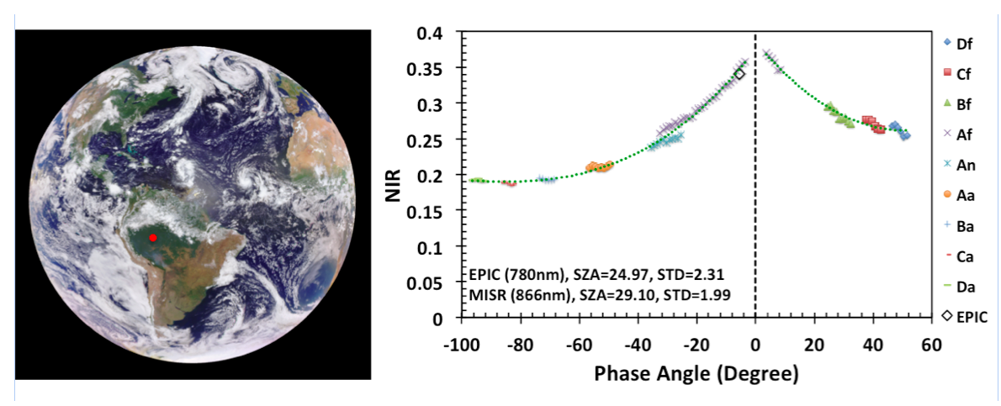
Surface BRF
Left panel: enhanced RGB image of the sunlit face of the Earth taken on Aug-23-2016 at 15:24:58 GMT. Right panel: NIR BRF of an area in Amazonian rain forest shown as red circle derived from MISR data (symbols) and EPIC (white square). Horizontal axis shows values of the phase angle, i.e., the angle between directions to the Sun and sensor.

