Slide 1
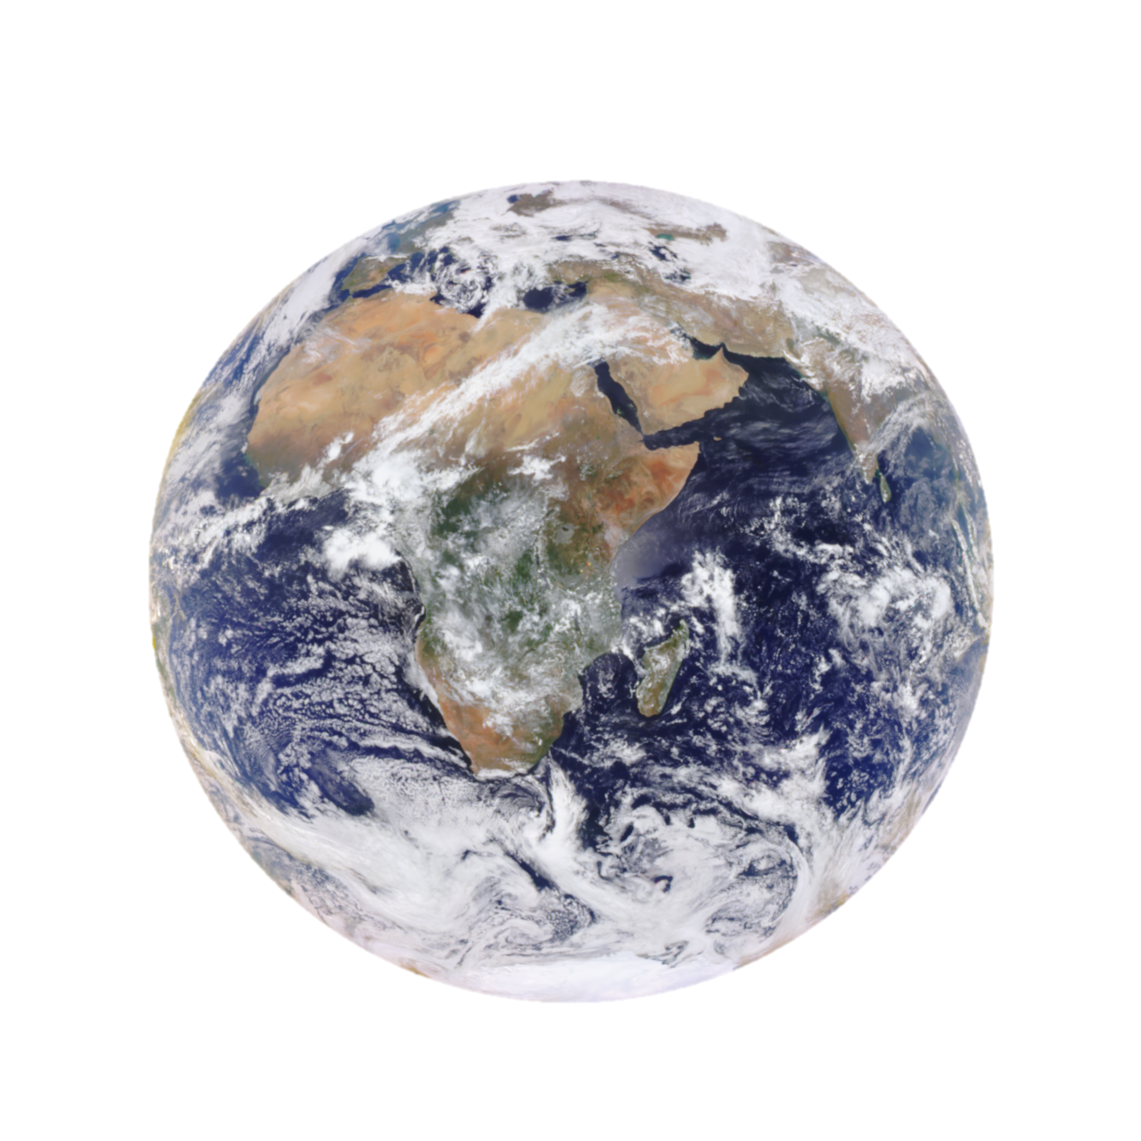
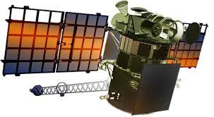
Spectral Reflectance Relations from EPIC Observations
Guoyong Wen^{1,2} and Alexander Marshak¹
¹NASA/GSFC Climate and Radiation Lab, ²Morgan State University

Slide 2
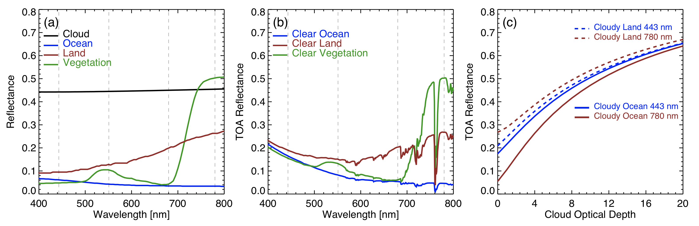
Reflectance Depends on Wavelength and Surface Type
(a) Surface spectral reflectance and cloud reflectance (𝜏=10); (b) Spectral reflectance with atmosphere; (c) Spectral reflectance at 443 nm and 780 nm for cloudy land and ocean.

Slide 3
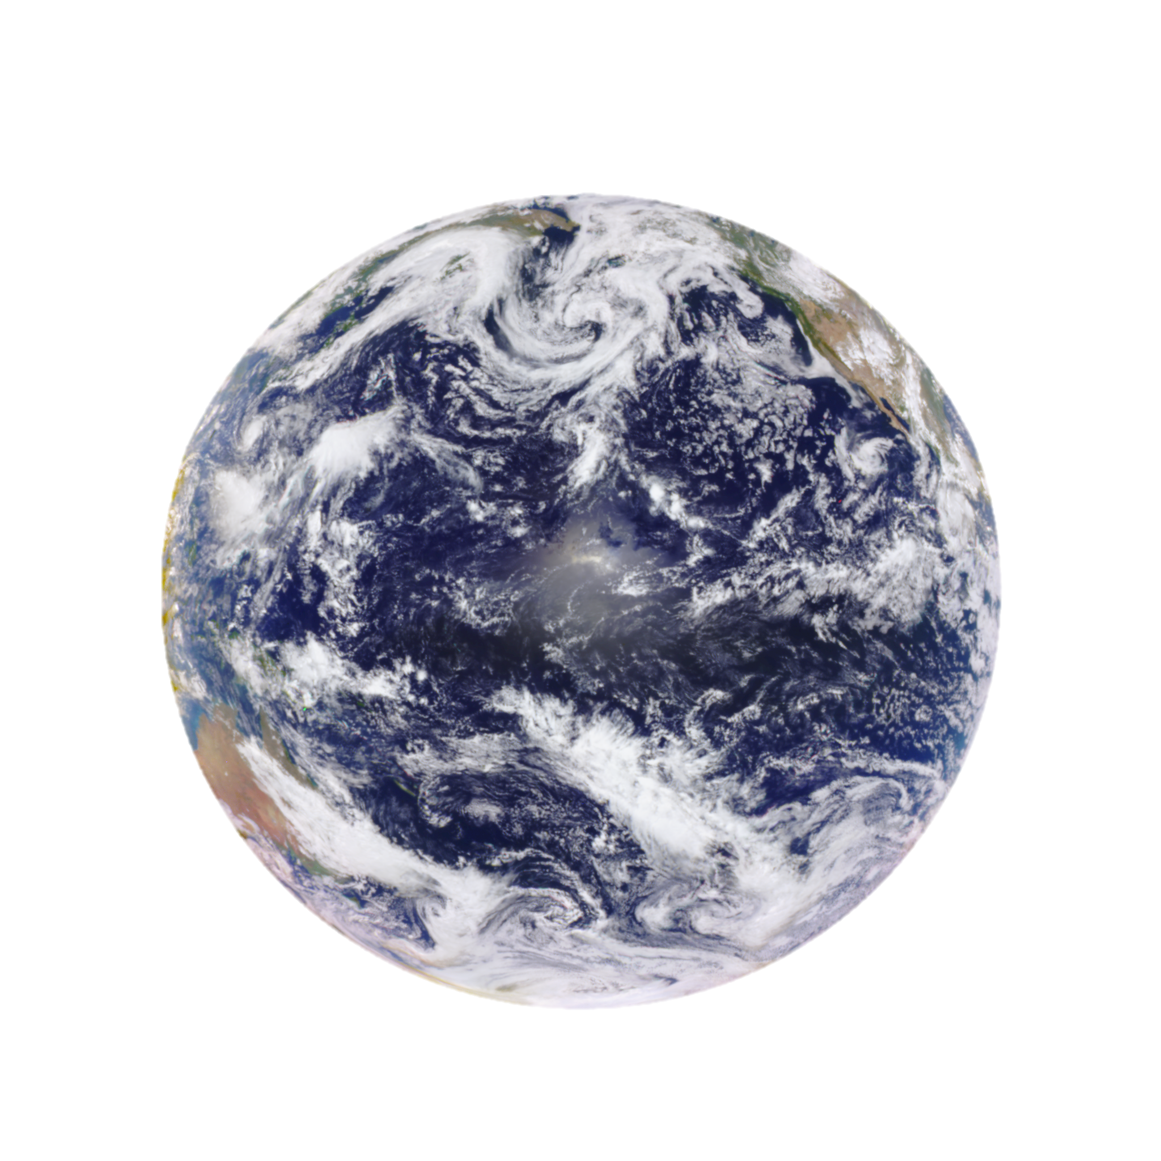
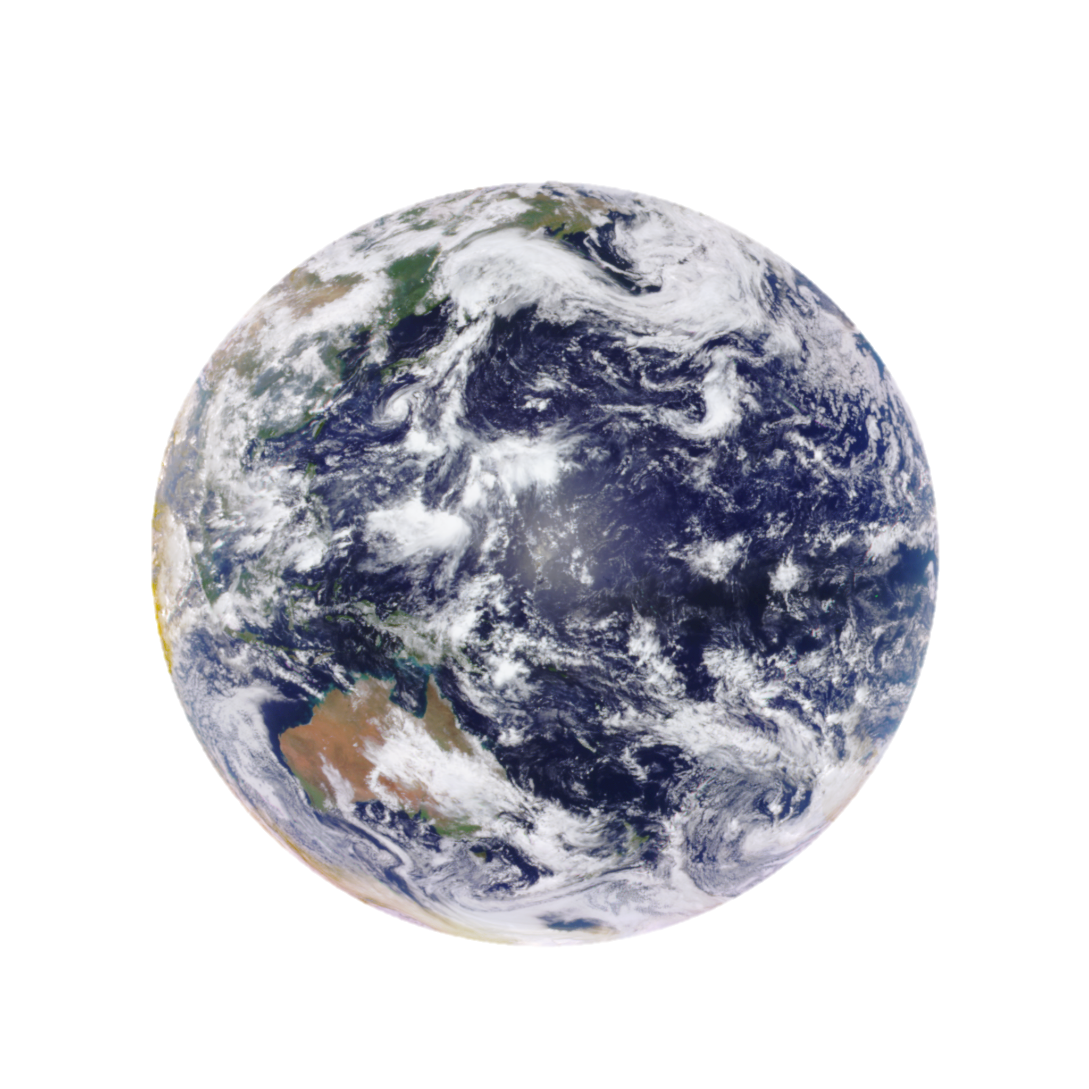
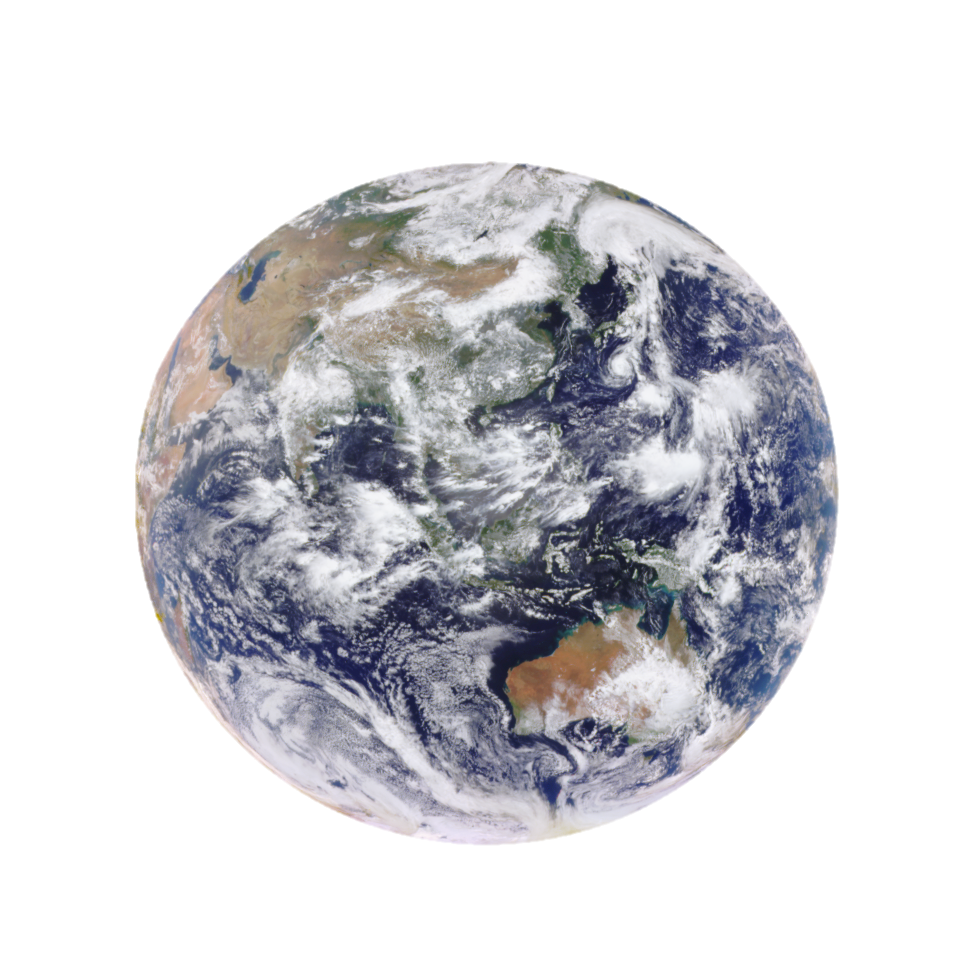
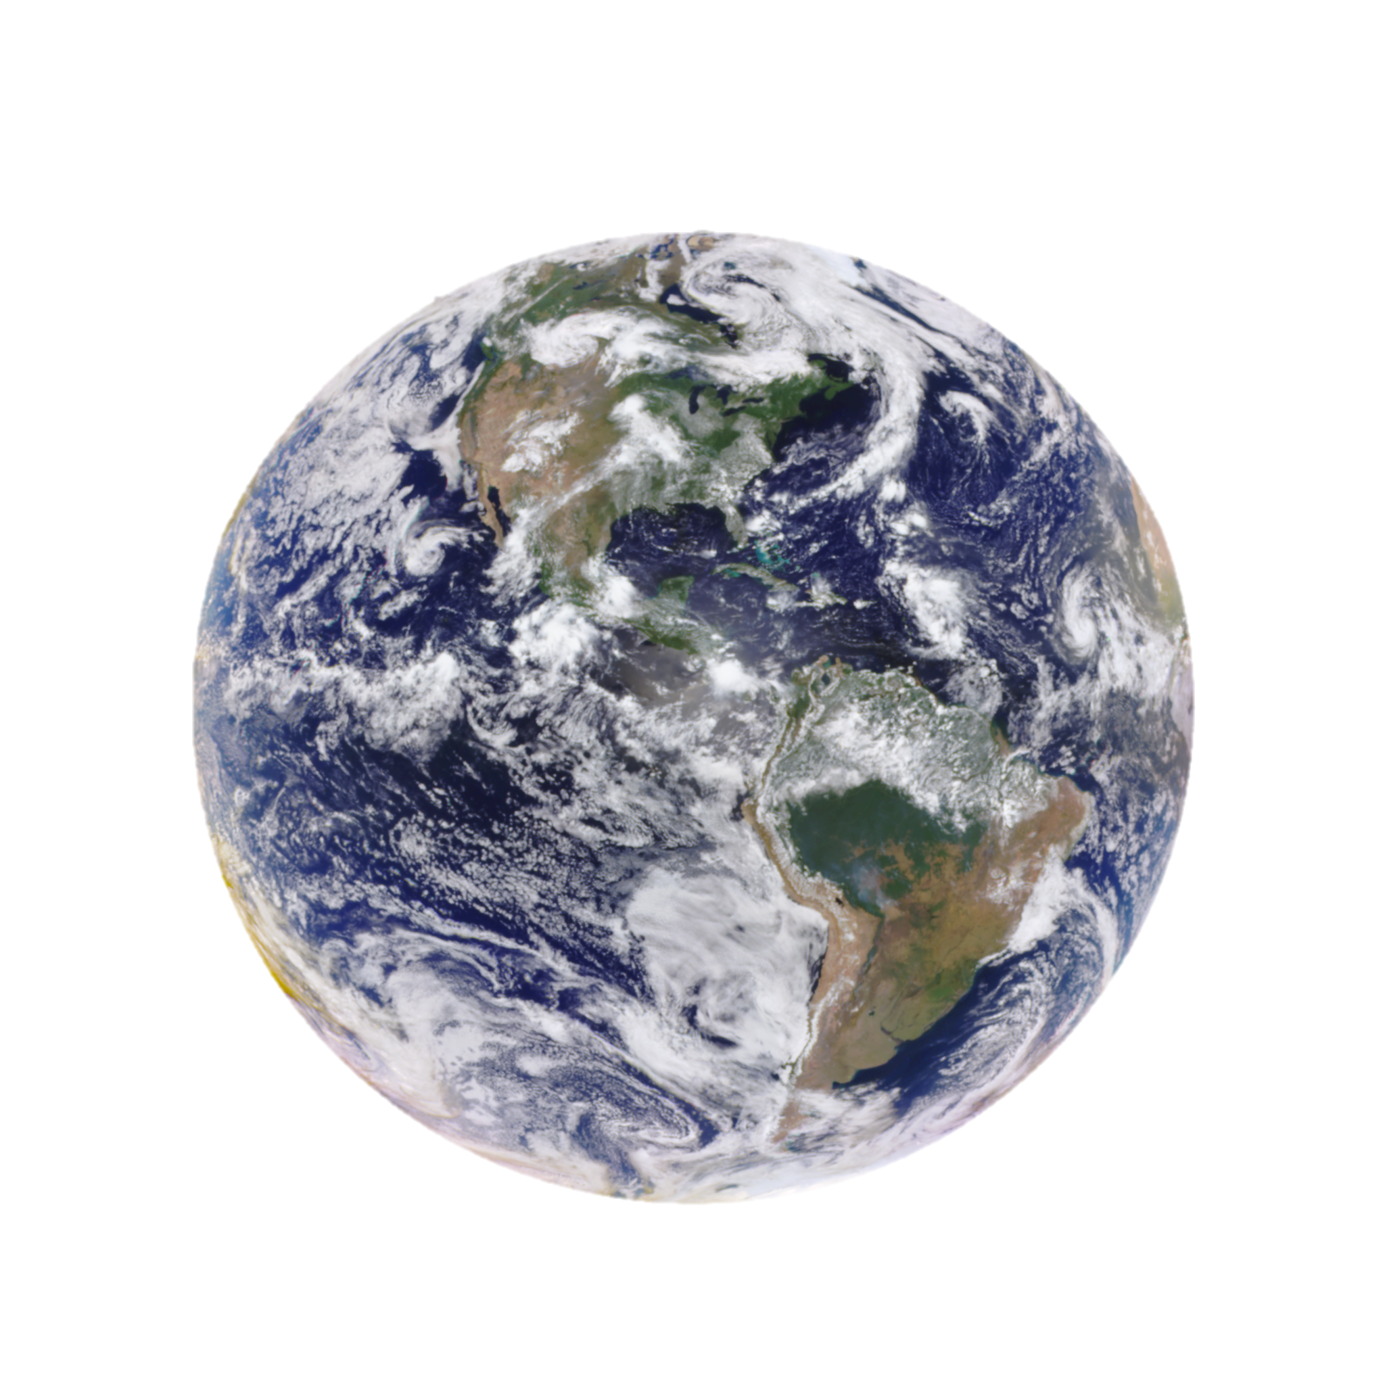
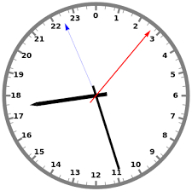
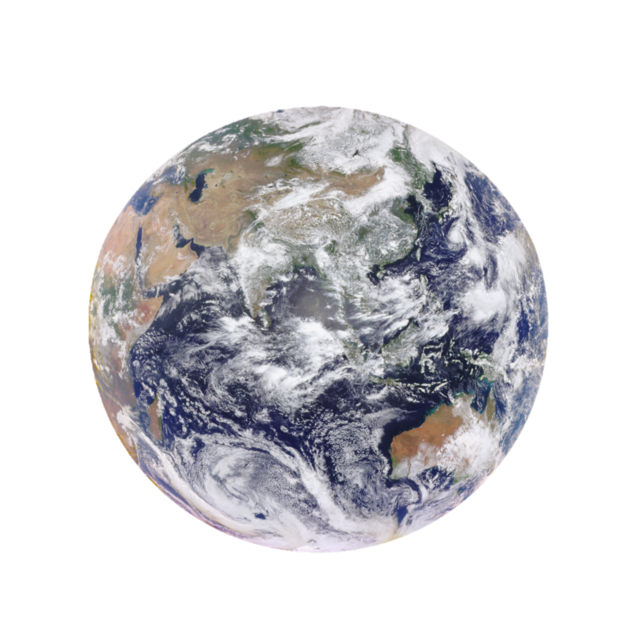
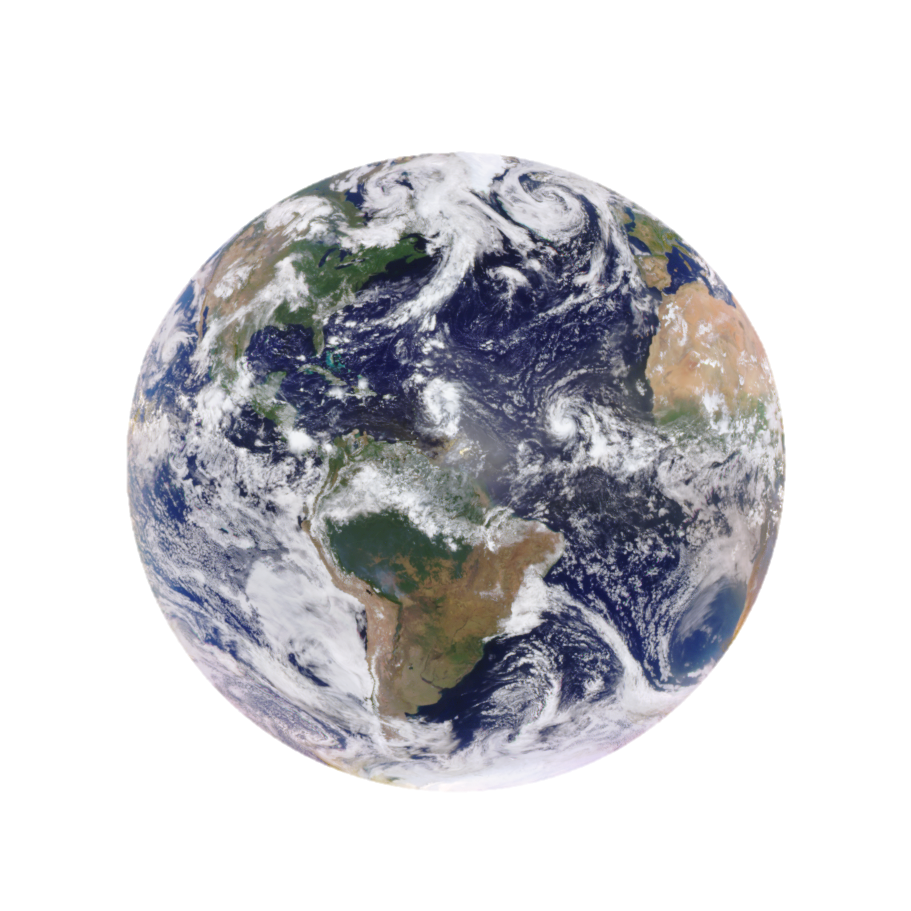
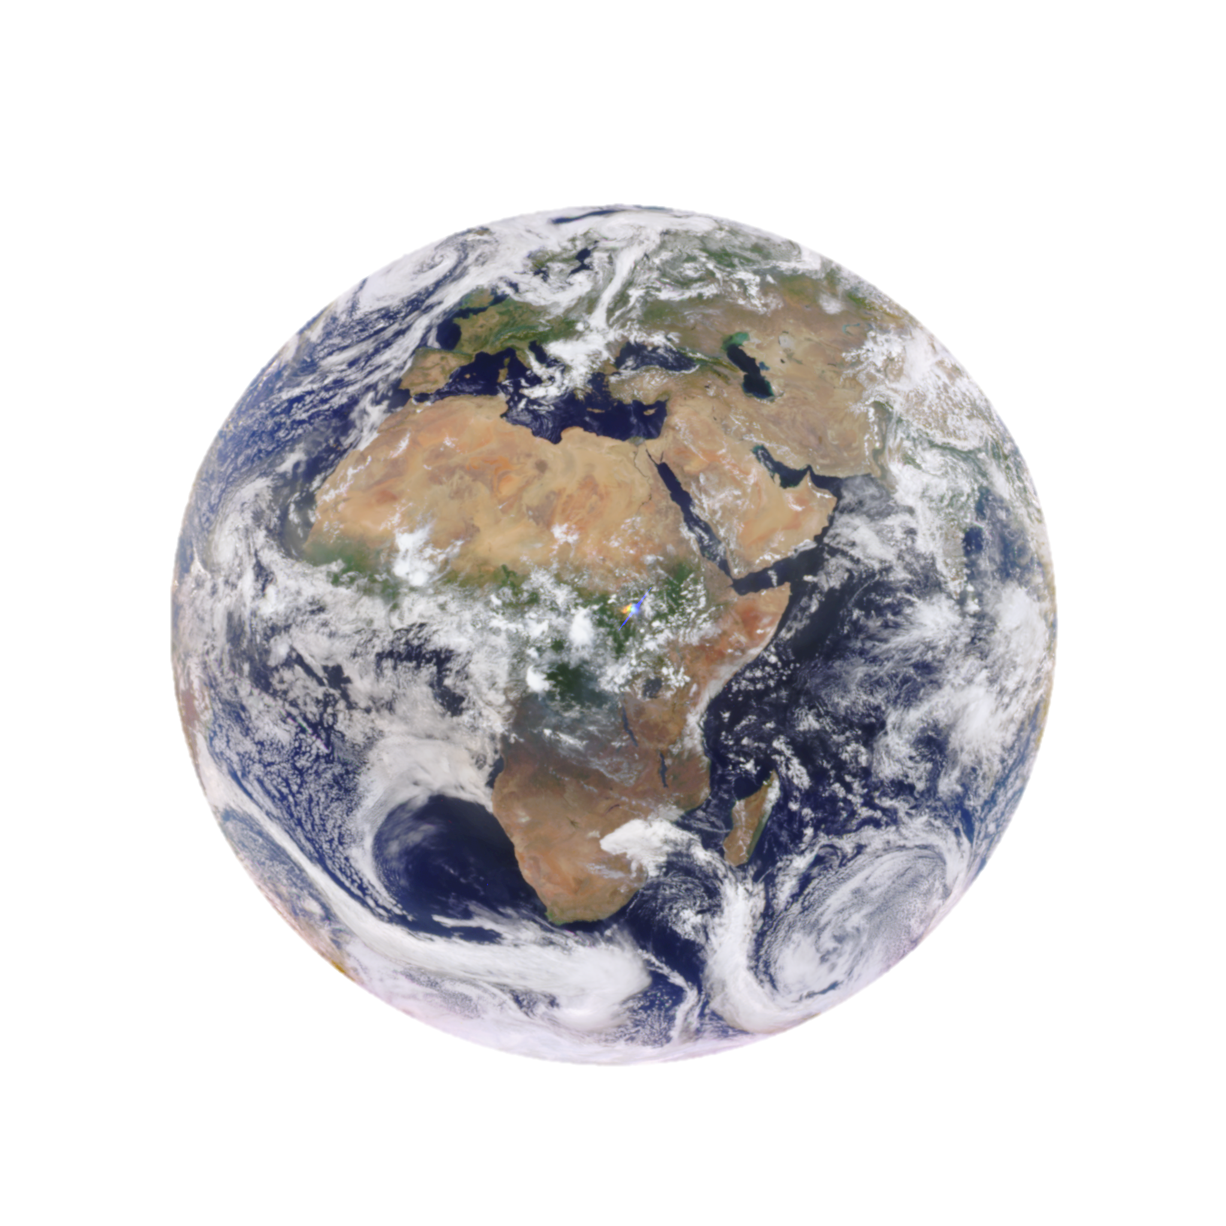
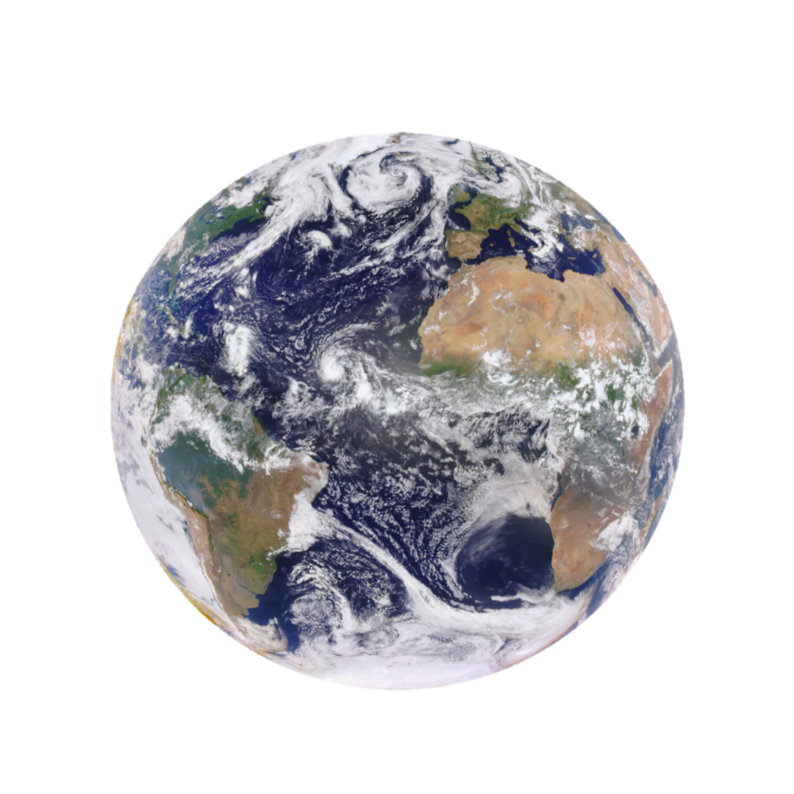
Rotation of the Earth leads to the changes of coverage of land, ocean, clouds, resulting temporal variation in global average spectral reflectance
The Pacific
(23 UTC)
The Pacific
(1 UTC)
Asia
(4-6 UTC)
America
(17 UTC)
South America (15 UTC)
Africa (10 UTC)
The Atlantic (13 UTC)

Slide 4
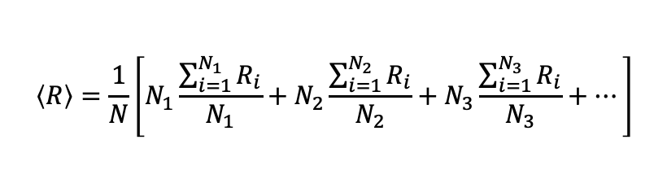
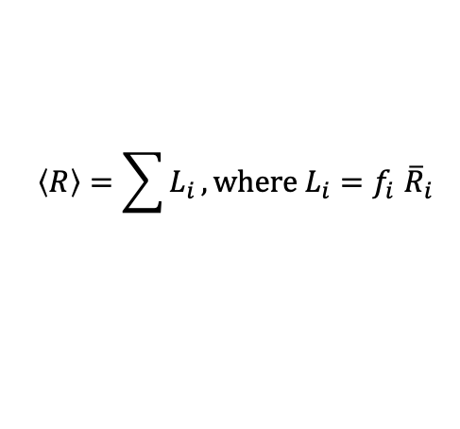

Decompose global average reflectance into contributions from different reflectors, including clear ocean, clear land, cloudy ocean, cloudy land, green vegetation.
$$〈R〉=\frac{1}{N}\left[N_{1}\frac{\sum_{i=1}^{N_{1}}{R_{i}}}{N_{1}}+N_{2}\frac{\sum_{i=1}^{N_{2}}{R_{i}}}{N_{2}}+N_{3}\frac{\sum_{i=1}^{N_{3}}{R_{i}}}{N_{3}}+…\right]$$
Fractional coverage
$〈R〉=f_{1}{\overline{R}}_{1}+f_{2}{\overline{R}}_{2}+f_{3}{\overline{R}}_{3}+…$
Average reflectance
$$〈R〉=\sum{L_{i}}, where{ L}_{i}{=f}_{i}{\overline{R}}_{i}$$
Reflectance contribution from i^{th} reflector

Slide 5
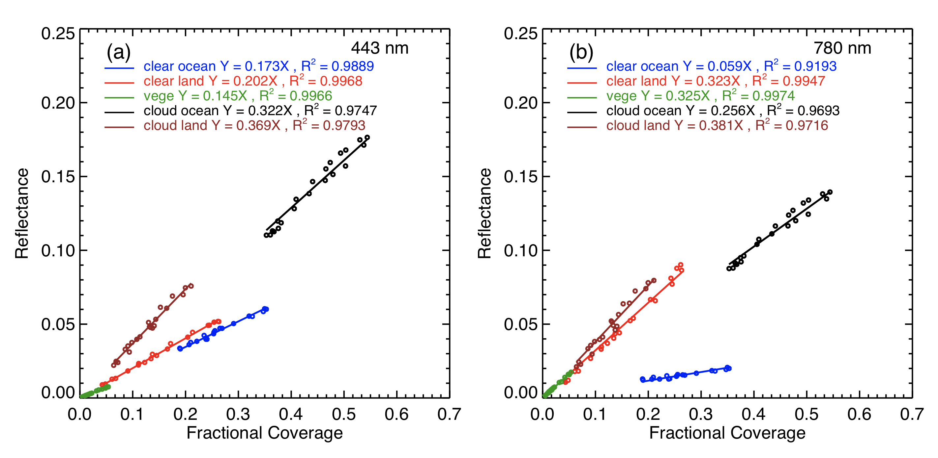
Reflectance Contribution is linearly related to fractional coverage
Reflectance Contribution
Reflectance Contribution

Slide 6
1:13UTC
9:57 UTC
5:35 UTC
15:24 UTC
Variation of spectral reflectance is the result of competition of reflectance contribution which is proportional to the change in fractional coverage of reflectors

Slide 7
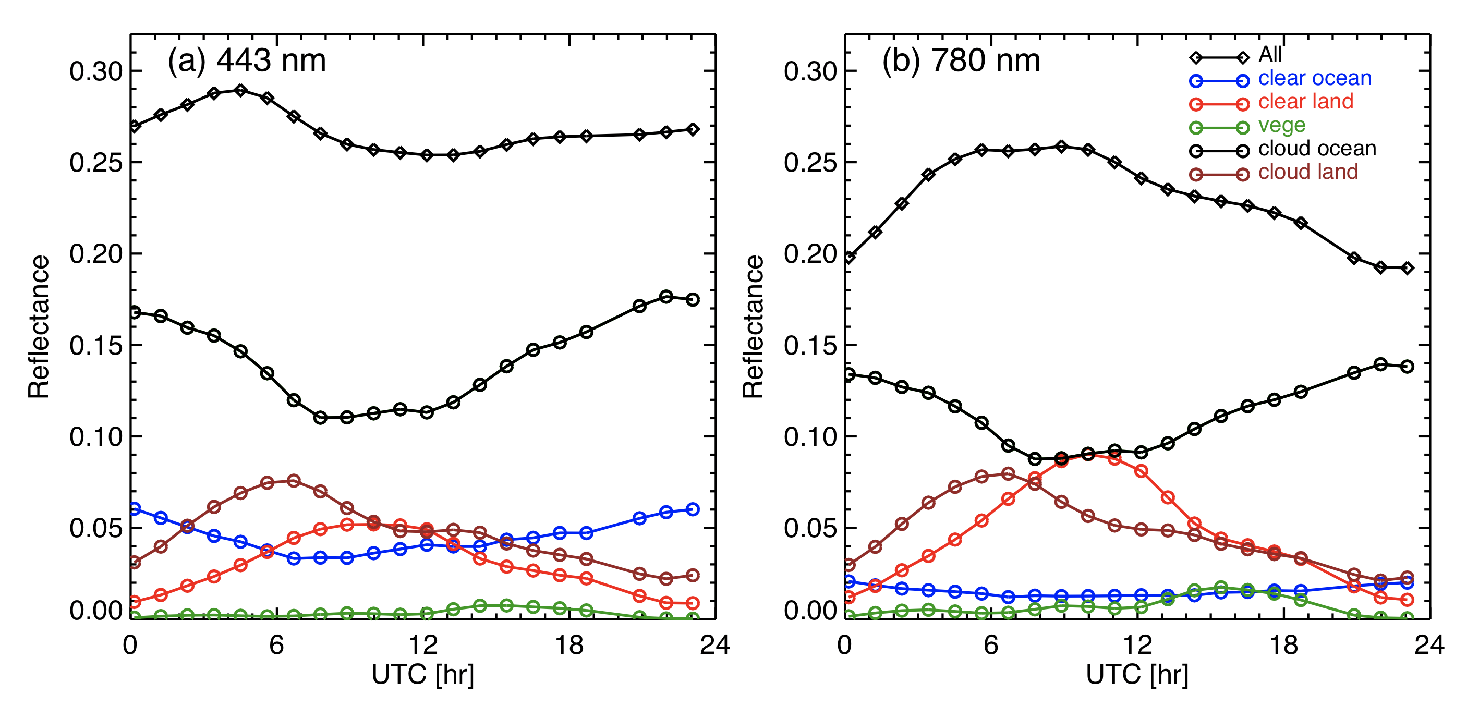
R = R(clr ocean) + R(cld ocean) + R(clr land) + R(cld land) + R(vege)
Spectral reflectance from each reflector follows closely to the associated fractional coverage of the reflector

Slide 8
2
3
1
4
From the Pacific to Asia: in cloudy and clear ocean; in cloudy and clear land-> larger increase in both 388 nm and 780 nm.
From Asia to Africa: in cloud cover -> in 388 nm and almost neutral in 780 nm
From Africa to the Atlantic (13UTC) and S. America: in 780 nm, in 388 nm
From S. America to the Pacific: in 780 nm, in 388 nm

Slide 9
From the Pacific to Asia: in 388 nm and in 780 nm.
From Asia to Africa: in 780 nm and almost neutral in 388 nm
….

Slide 10
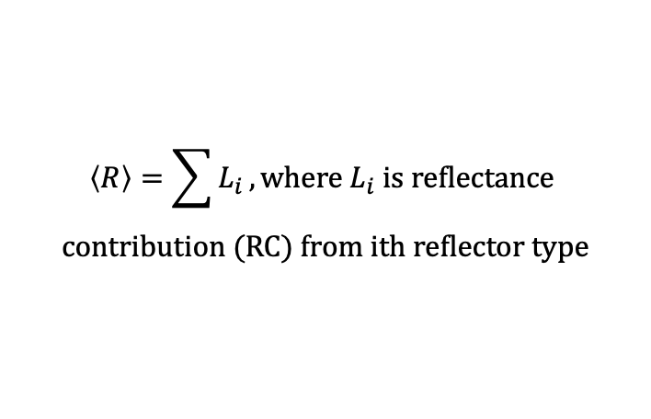
$$〈R〉=\sum{L_{i}}, where{ L}_{i} is reflectance$$
$$contribution (RC) from ith reflector type$$
RCs are linearly related to fractional coverage.
For 388 nm, RC is most sensitive to CF and less sensitive to clear surface faction (~0.35 vs ~0.2)
For 780nm, RC is most sensitive to CF over land followed by clear land faction including green vegetation, and CF of cloudy ocean; least sensitive to clear ocean fraction (~0.38, ~0.27, vs ~0.06)

Slide 11
Variations of Fractional Coverage with Time

Slide 12
Ref(780) is much more variable than Ref(388) because large surface contract between ocean and land for the NIR compared to the near-UV.
From the Pacific to Asia (0-8 UTC): larger increase in land (cloudy and clear) contributions leads to an increase in Ref(780nm); a larger decrease in cloudy ocean contribution compared to land (clear and cloudy) leads to a slightly decrease in Ref(388nm).
From Asia to Africa (8-10 UTC): an increase in Ref(780nm), almost neutral in Ref(388nm).
…

Slide 13
Correlation of Reflectance Contributions
443 vs 388
780 vs 388
Ref. contr. at 388 nm is highly correlates with 443nm for all reflectors
Ref. contr. at 388 nm is highly correlates with 443nm for clouds
Notes:
plot_corr2.pro in /gpfsm/dnb32/gwen/Blue_NIR_global/IDL_Code_1Aug22

Slide 14
Statistics of Quasi-Hourly Global Average Reflectance
443 vs 388
551 vs 388
680 vs 388
780 vs 388
Ref(388nm) is highly correlates with (443nm)
The correlation coefficient between Ref(388nm) and Ref(λ) decreases with wavelength
Notes:
plot_Ref_FR_Tau_Jun29a.pro in /gpfsm/dnb32/gwen/Blue_NIR_global/IDL_Code_1Aug22

Slide 15
Statistics of Daily Averages
Ref(388nm) is highly correlates with (443nm) with the slope close to 1
The correlation coefficient between Ref(388nm) and Ref(λ) decreases with wavelength
The slope of linear fit between Ref(388nm) and Ref(λ) decreases with wavelength
Notes:
plot_Ref_FR_Tau_Jun29a.pro in /gpfsm/dnb32/gwen/Blue_NIR_global/IDL_Code_1Aug22

Slide 16
Daily Average of Spectral Reflectance and Variability
Seasonal variations of spectral reflectance are clear
Larger daytime variation of reflectance in NIR is evident
Inter-annual variation is visible
Notes:
plot_Ref_FR_Tau_Jun29.pro in /gpfsm/dnb32/gwen/Blue_NIR_global/IDL_Code_1Aug22

Slide 17
Variation of Spectral Reflectance and Cloud Optical Depth and CF
There are four events of increase of spectral reflectance that are related to changes in clouds
The increase of spectral reflectance is associated with decreases in average cloud optical depth, but increase in CF
Larger changes for longer wavelengths (∆R = a*∆CF - b*∆CF)
Notes:
plot_Ref_FR_Tau_Jun29.pro in /gpfsm/dnb32/gwen/Blue_NIR_global/IDL_Code_1Aug22

Slide 18
Summary
Global average reflectance is a sum of contributions from each reflector type.
The contributions from each reflector type is linearly related to fractional coverage.
Reflectance between near-UV (or blue band) and NIR (near-hourly) follows certain relationship that can be explained by the change of fractional coverage of each reflector type in a course of Earth’s rotation.
Ref(388nm) is highly correlated with Ref(433nm). The correlation coefficients decrease with wavelength.
There are four events of increase of spectral reflectance in all five wavelength (388 – 780nm) in 2021.
Those events are associated with changes in cloud fraction and average cloud optical depth.
Further investigation is underway.
Notes:
plot_Ref_FR_Tau_Jun29.pro in /gpfsm/dnb32/gwen/Blue_NIR_global/IDL_Code_1Aug22

