Slide 1
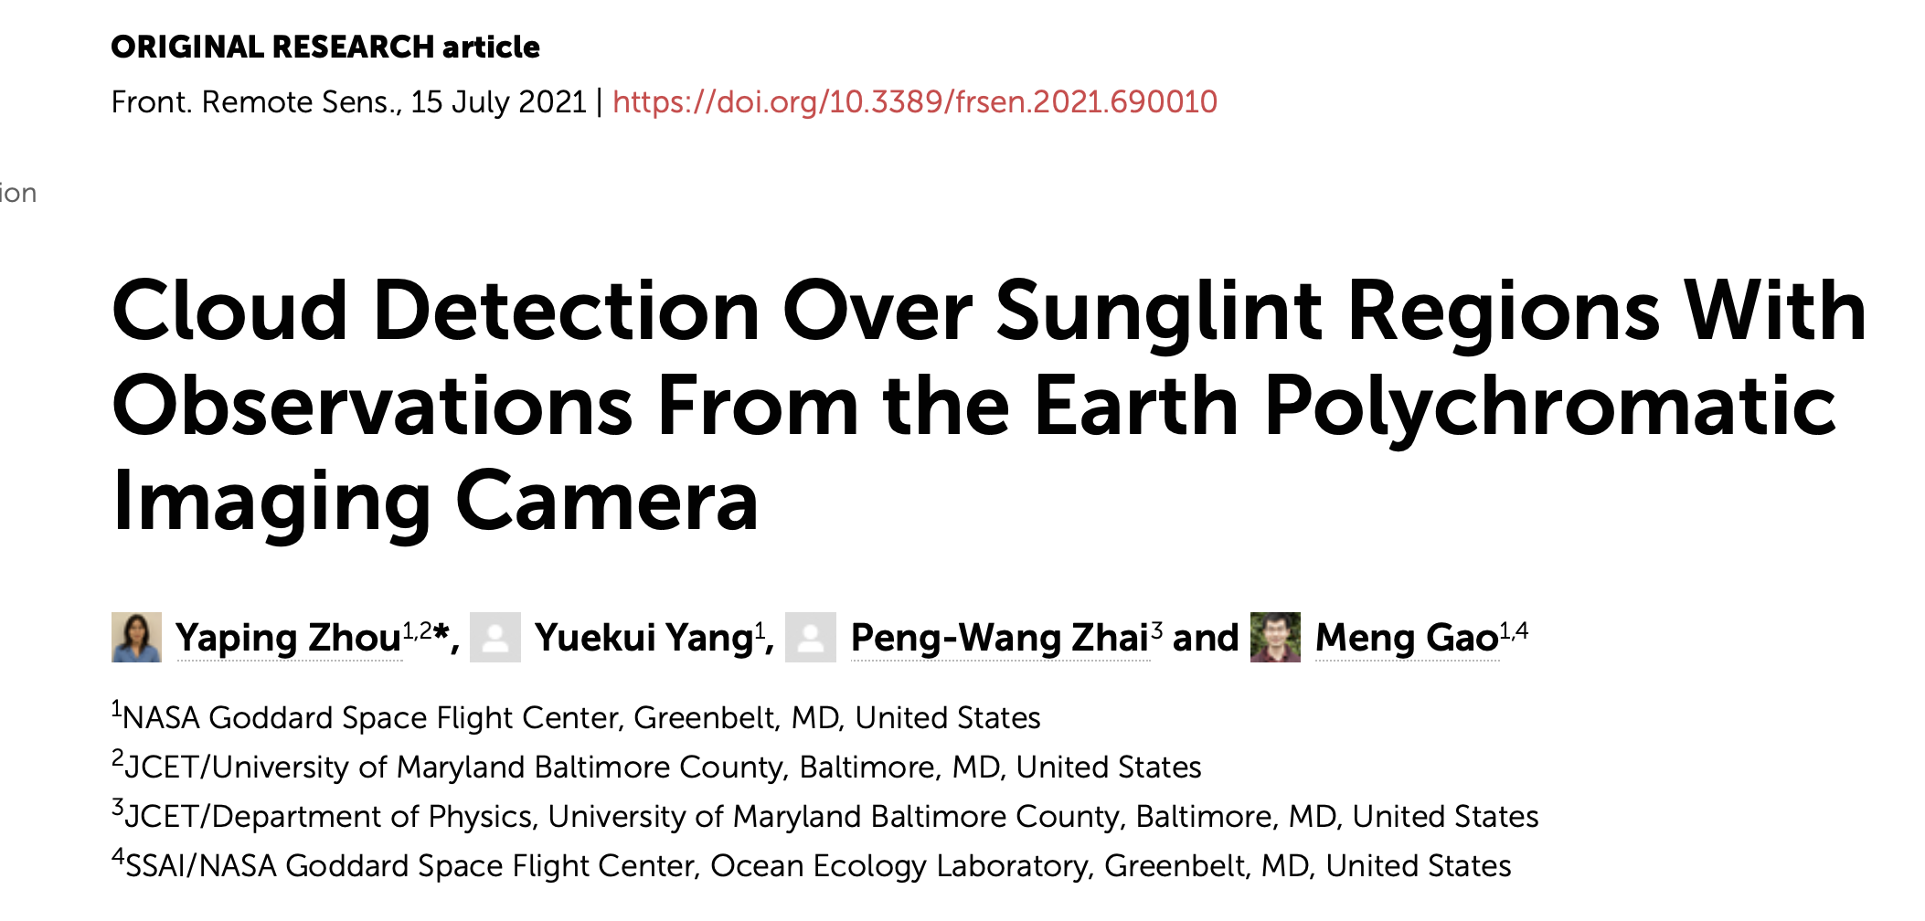
DSCOVR EPIC&NISTAR Science Team Meeting (Virtual)
Sep. 28-30, 2021

Slide 2
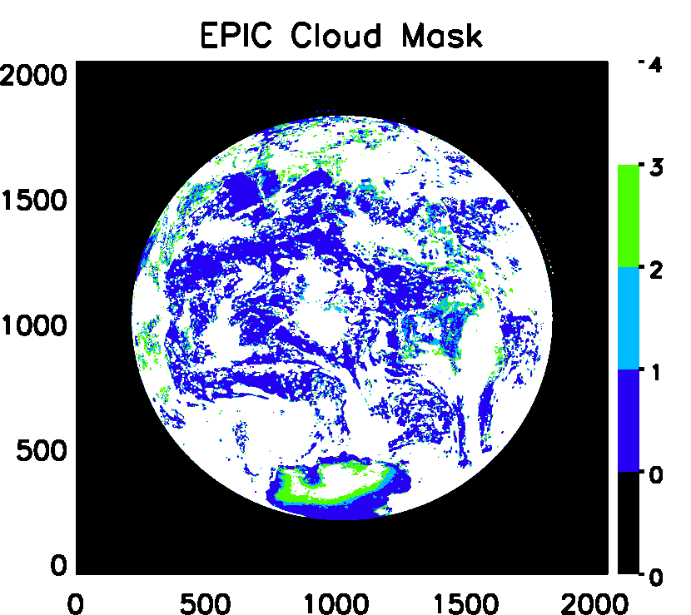
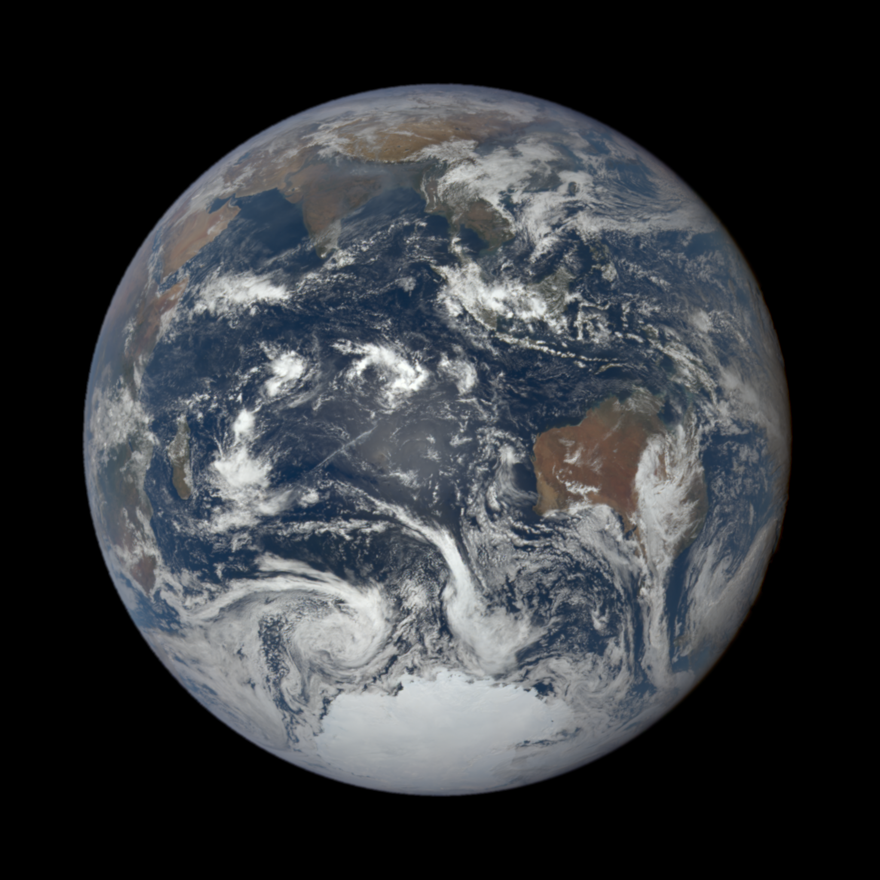
Overestimation of clouds in glint region
in version 1&2 EPIC cloud product

Slide 3
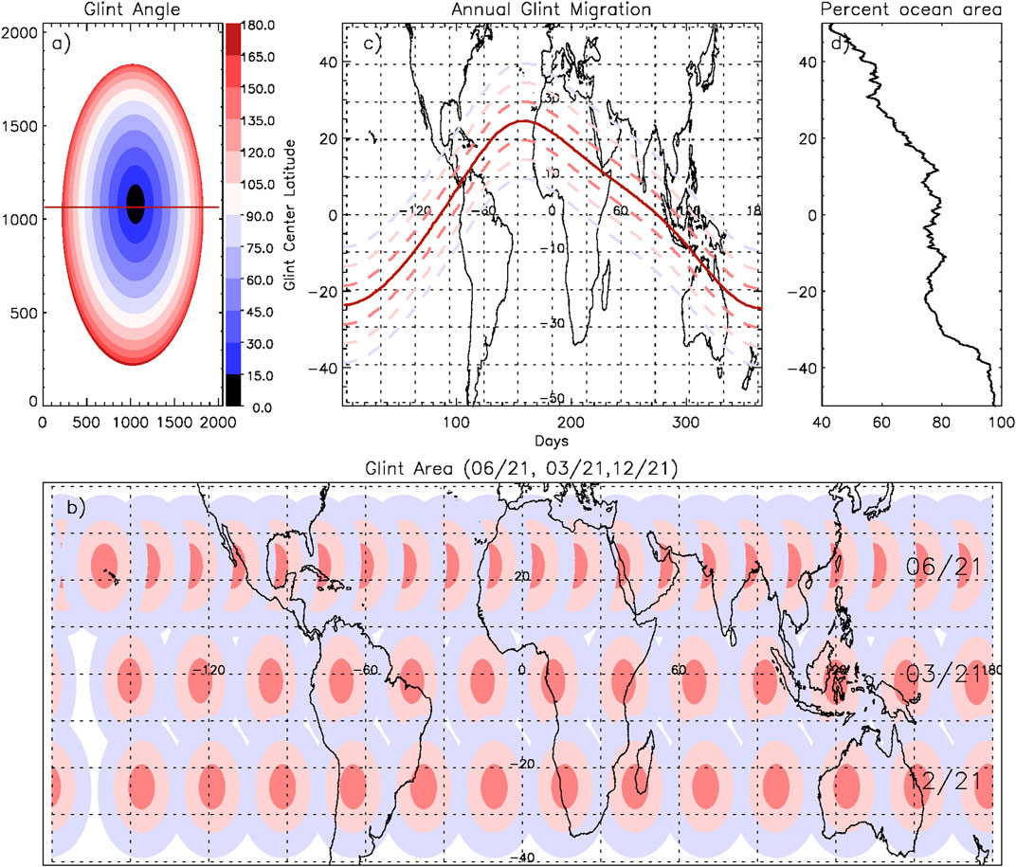
Daily and Annual Sunglint Migration from EPIC Measurements

Slide 4
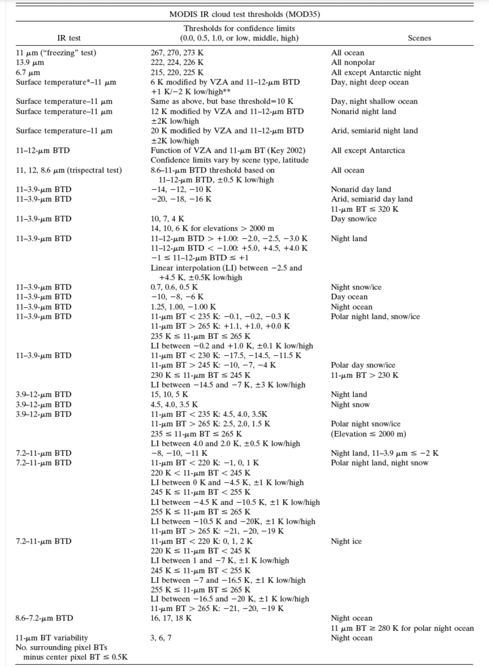
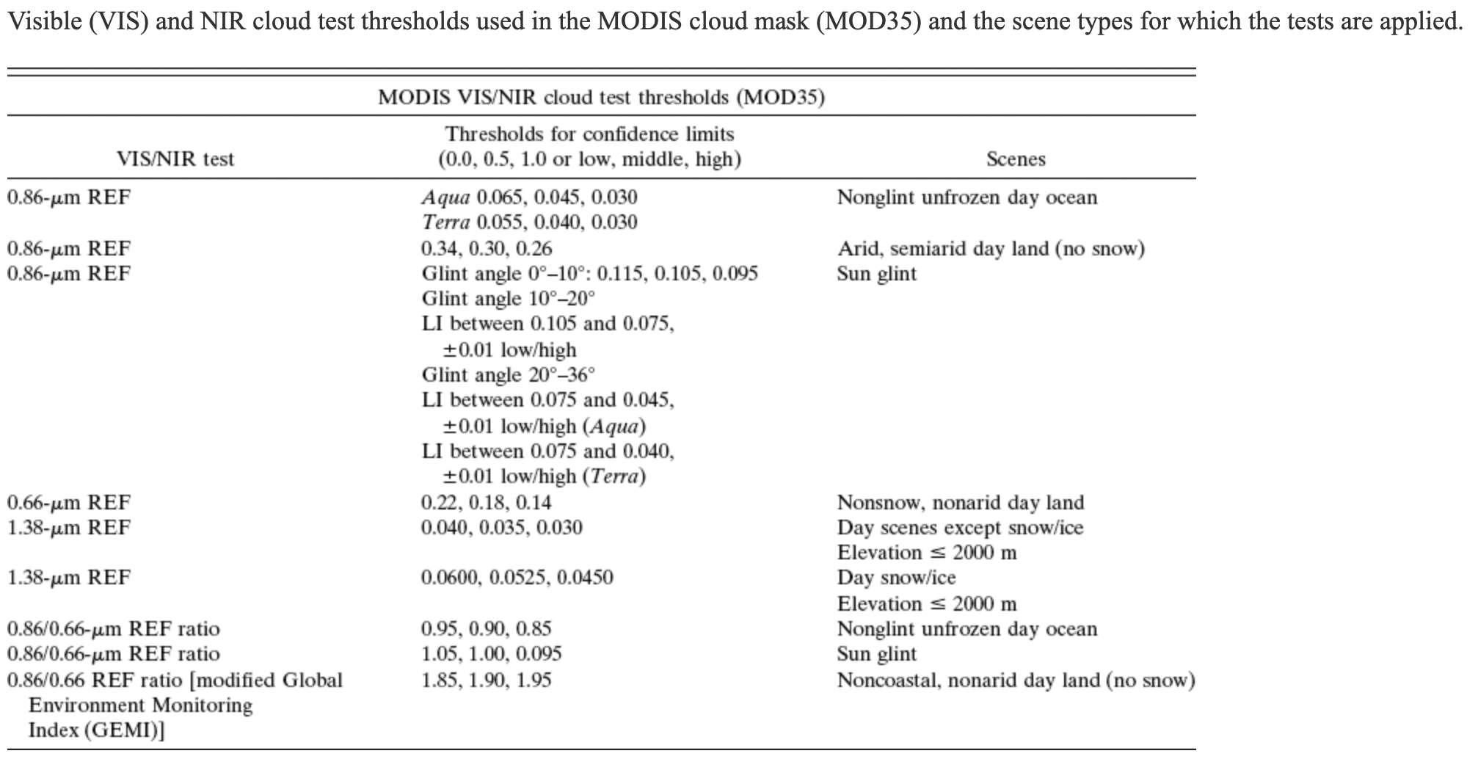
Cloud Detection Over Sunglint
MODIS IR-based Cloud Test
EPIC Channels
MODIS VIS/NIR Cloud Test
Frey et al. 2008

Slide 5
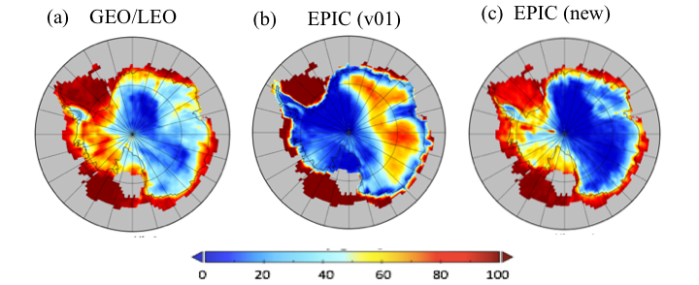
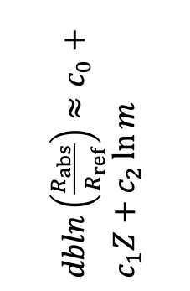
Application of O2-band ratios in Cloud Detection over Snow/Ice
$dbln\left(\frac{R_{abs}}{R_{ref}}\right)≈c_{0}+c_{1}Z+c_{2}\ln{m}$
Zhou, Y., Yang, Y., Gao, M., and Zhai, P.-W.: Cloud detection over snow and ice with oxygen A- and B-band observations from the Earth Polychromatic Imaging Camera (EPIC), Atmos. Meas. Tech., 13, 1575–1591, https://doi.org/10.5194/amt-13-1575-2020, 2020.

Slide 6
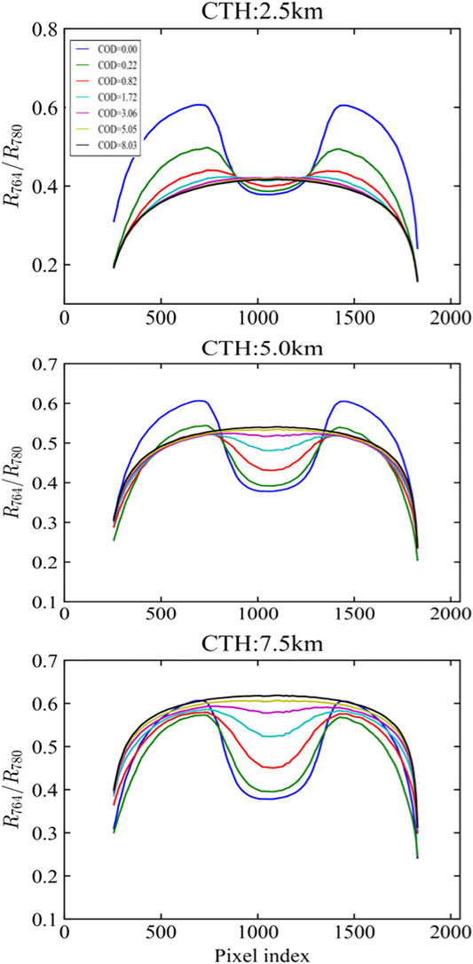
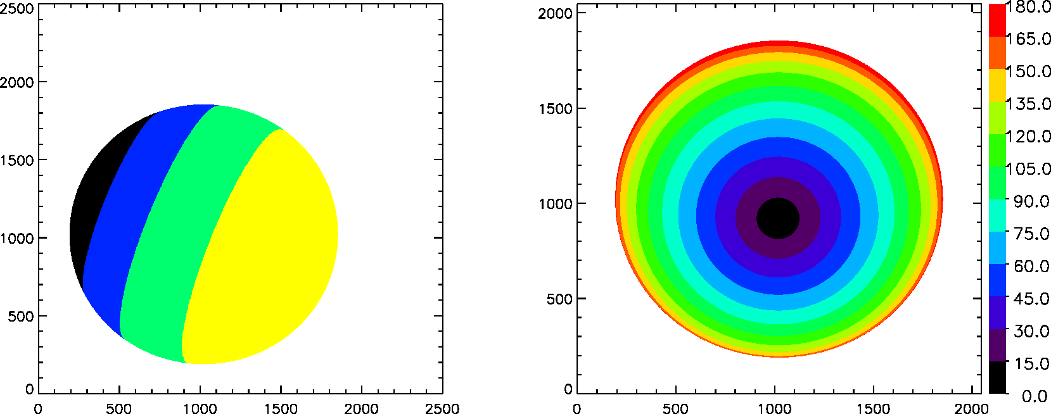
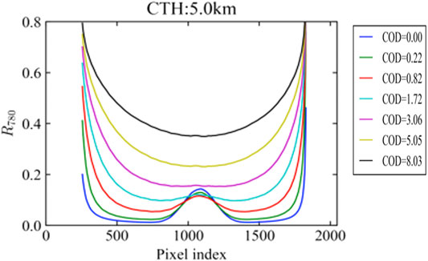
How can we avoid over detection of clouds in the glint region?
A-band Ratio
R780 Reflectance
EPIC geometry
Simulated radiances
Zero surface albedo
Cox-Munk Ocean roughness with 6 m/s surface wind

Slide 7
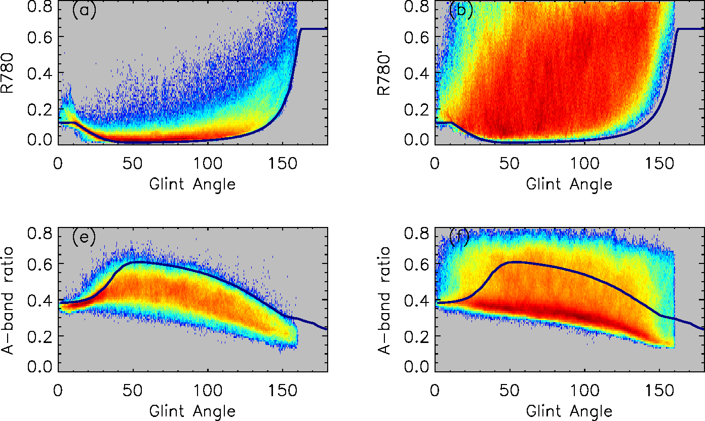
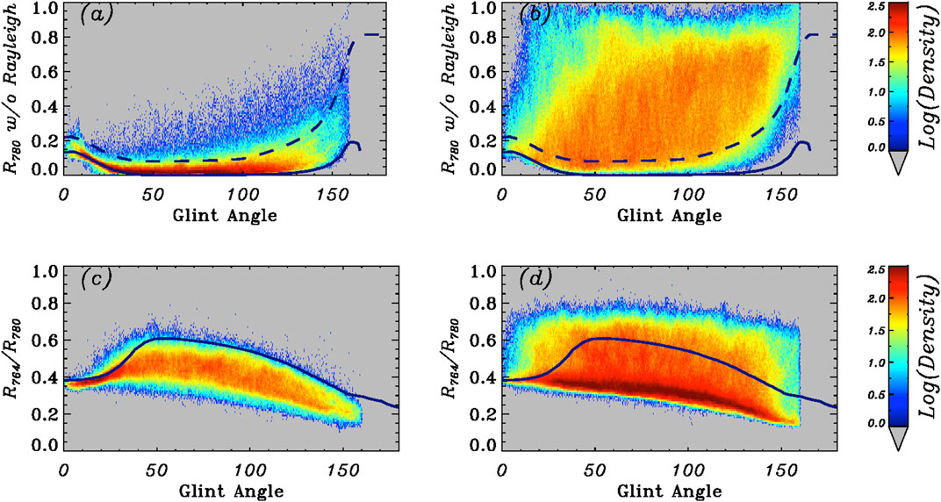
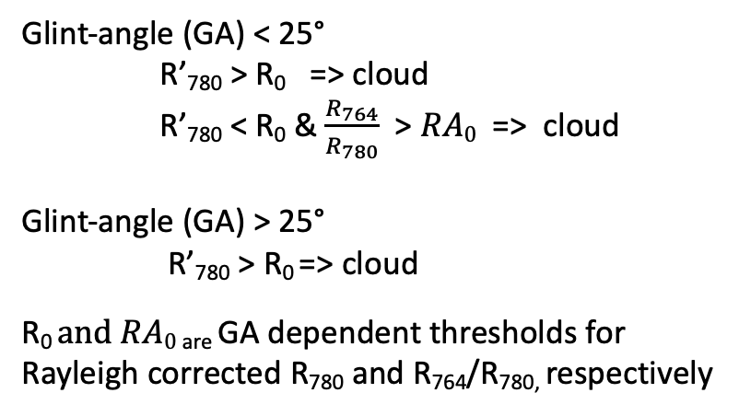
New Ocean Cloud Mask
Clear sky
Cloudy sky
Glint-angle (GA) < 25°
R’₇₈₀ > R₀ => cloud
R’₇₈₀ < R₀ & $\frac{R_{764}}{R_{780}}$ > $RA0$ => cloud
Glint-angle (GA) > 25°
R’₇₈₀ > R₀ => cloud
R₀ $and RA0$ _{are} GA dependent thresholds for
Rayleigh corrected R₇₈₀ and R₇₆₄/R_{780,} respectively
Note: Model derived clear sky reflectance and A-band ratio (solid lines) represent lower and up bounds of observed clear sky reflectance and A-band ratios. Some adjustments are necessary to use model derived thresholds.

Slide 8
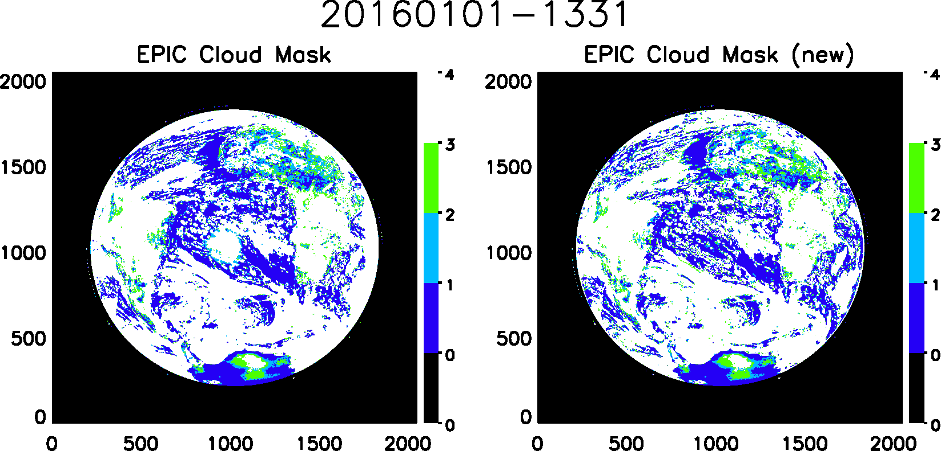
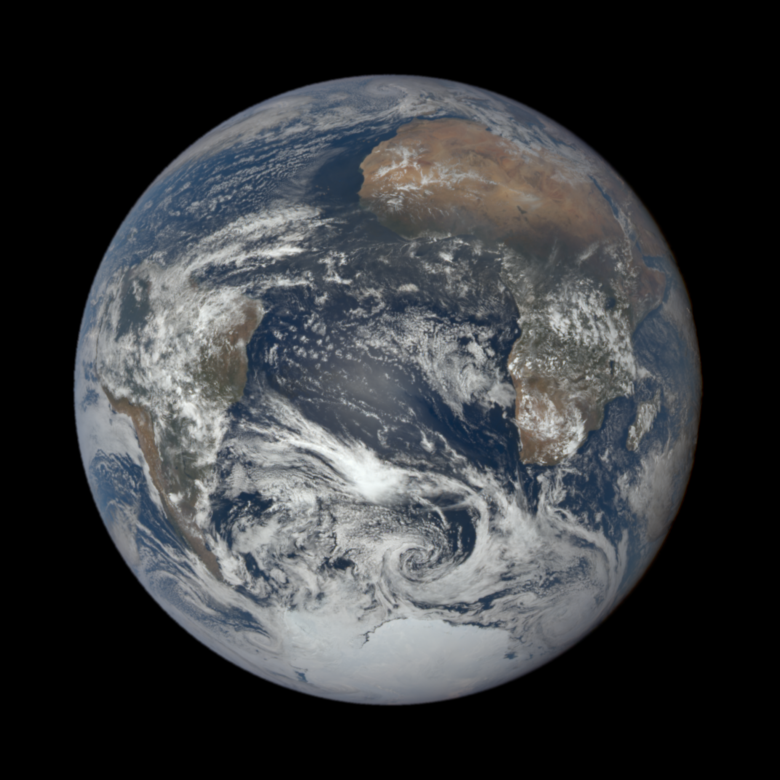
New Cloud Mask Samples

Slide 9
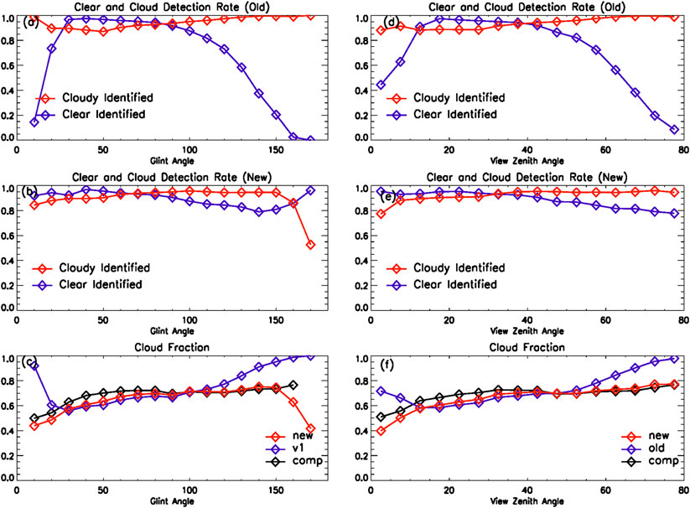
Geometry-Dependent Bias Corrected
Original algorithm does not detect enough clear sky pixels at both ends.
Both glint center and granule edges are much improved.
Residual bias and large uncertainties in granule edge (GA > 150°)
Original
New

Slide 10
EPIC Cloud Mask Comparison with Langley GEO/LEO Composites
Month | Region | Glint Center (Θ_{glint} <25°) |  | Large glint angles (Θ_{glint} >120°) |  | All Angles
 |  | v1 | New | v1 | New | v1 | New
2016.01 | Accuracy | 77.0 | 86.7 | 83.5 | 88.2 | 87.2 | 89.4
 | POCD | 93.6 | 85.0 | 98.8 | 92.0 | 91.5 | 90.9
 | POFD | 24.8 | 7.2 | 17.0 | 7.4 | 8.6 | 5.4
2017.03 | Accuracy | 76.4 | 88.3 | 84.4 | 91.7 | 88.5 | 90.9
 | POCD | 92.9 | 93.0 | 99.1 | 94.3 | 91.3 | 91.4
 | POFD | 25.9 | 12.0 | 16.5 | 5.3 | 8.2 | 5.0
2017.09 | Accuracy | 85.5 | 91.8 | 84.9 | 91.1 | 88.6 | 90.8
 | PCD | 95.2 | 93.6 | 99.0 | 93.3 | 91.5 | 91.3
 | POFD | 13.9 | 5.0 | 15.8 | 5.0 | 7.4 | 4.3
2017.12 | Accuracy | 82.5 | 86.3 | 83.7 | 89.6 | 89.9 | 90.5
 | POCD | 93.9 | 86.0 | 99.2 | 93.9 | 92.9 | 92.3
 | POFD | 15.6 | 4.8 | 17.1 | 7.3 | 7.4 | 4.8
Major improvements in
Glint Center (GA < 25°) 4~10%
Large angles (GA > 120°) 4∼6%
Overall improvement over ocean > 2~3%.

Slide 11
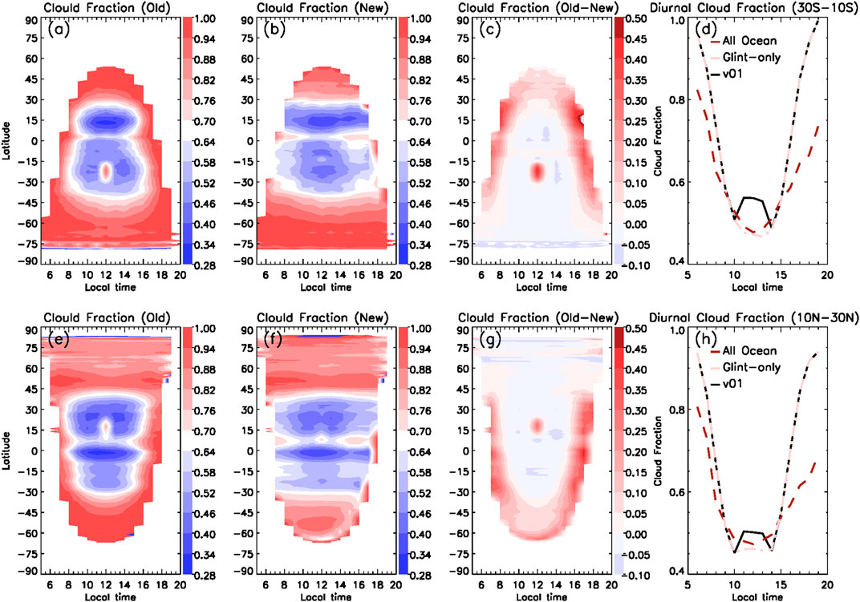
Improvement in Cloud Diurnal Cycles
January
July

Slide 12
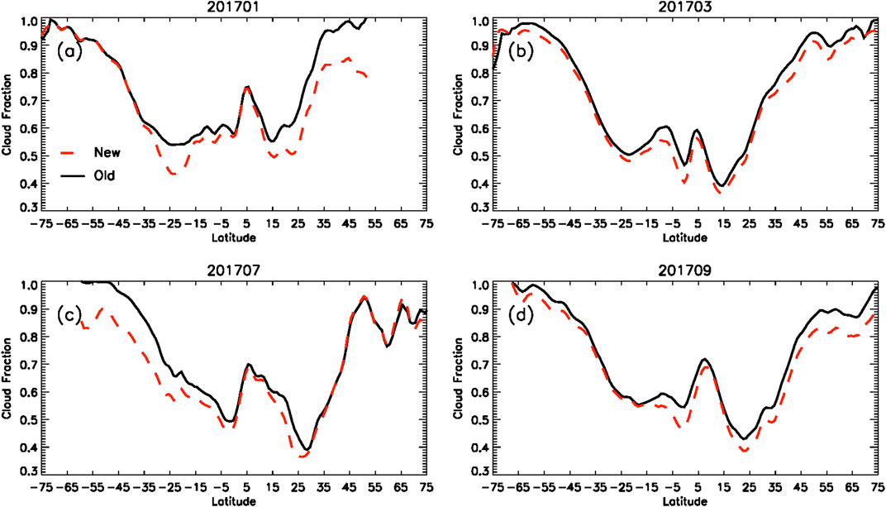
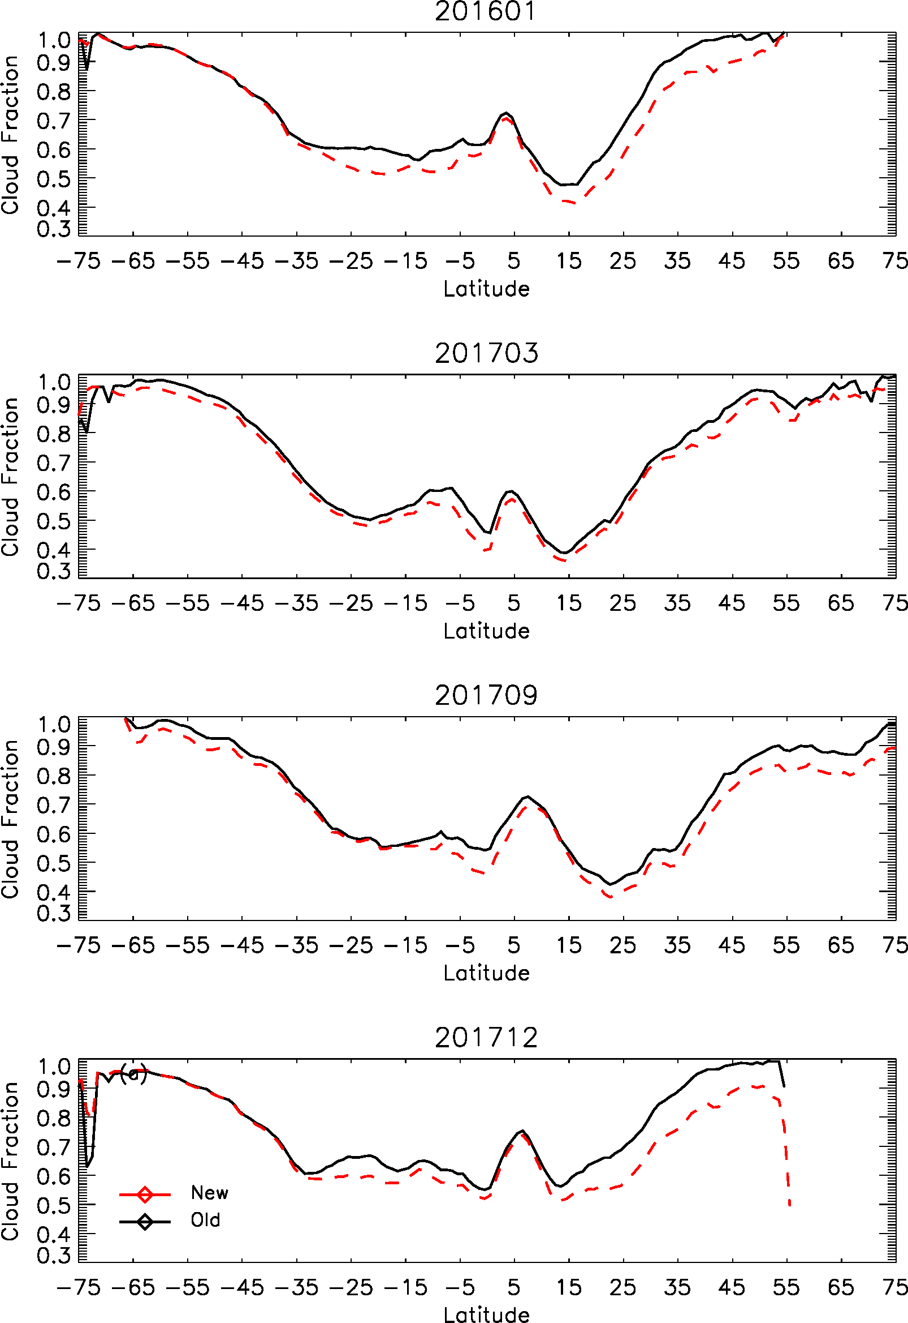
Impact on Zonal Mean Cloud Fraction
Slight reduction in glint center latitude (~5%).
Up to 10% reduction in high latitude winter hemisphere
Latitudinal cloud reduction is seasonal dependent

Slide 13
Summary
Cloud mask over ocean has been improved with new glint-angle dependent R780 threshold; In the glint center, additional A-band ratio tests are implemented to supplement reflectance only test.
The new ocean cloud mask algorithm reduces significant glint-induced overestimation of cloud fraction in the granule center and overestimation of clouds in high zenith/solar angles.
The new ocean cloud mask improves the diurnal cycles of ocean cloud fraction by reducing the artificial peak at local noon time in the glint center latitudes and reducing early morning and afternoon cloud fraction in most oceanic regions.

Slide 14
Summary (cont.)
A-band ratio helps cloud detection in very difficult situations such as over snow/ice and sun glint surfaces. It has low sensitivity for thin clouds with optical thickness less than 3 or low clouds below 2.5 km due to closeness between clear sky and cloud sky values (applies to both snow/ice and glint cases)
Large uncertainties may still exist in granule edge. Current study has not considered the impact of ocean surface wind speed and aerosol to the clear sky thresholds. Ocean surface wind could be potentially used to further improve the algorithm.

Slide 15
The current algorithm is still very simple, mainly limited by the available spectral channels. The O2 band ratios reach limitation for low and thin clouds. The threshold is currently only a function of glint angle. Further improvement is possible through fine-tuning the threshold and explore additional tests.
Future Work

Slide 16
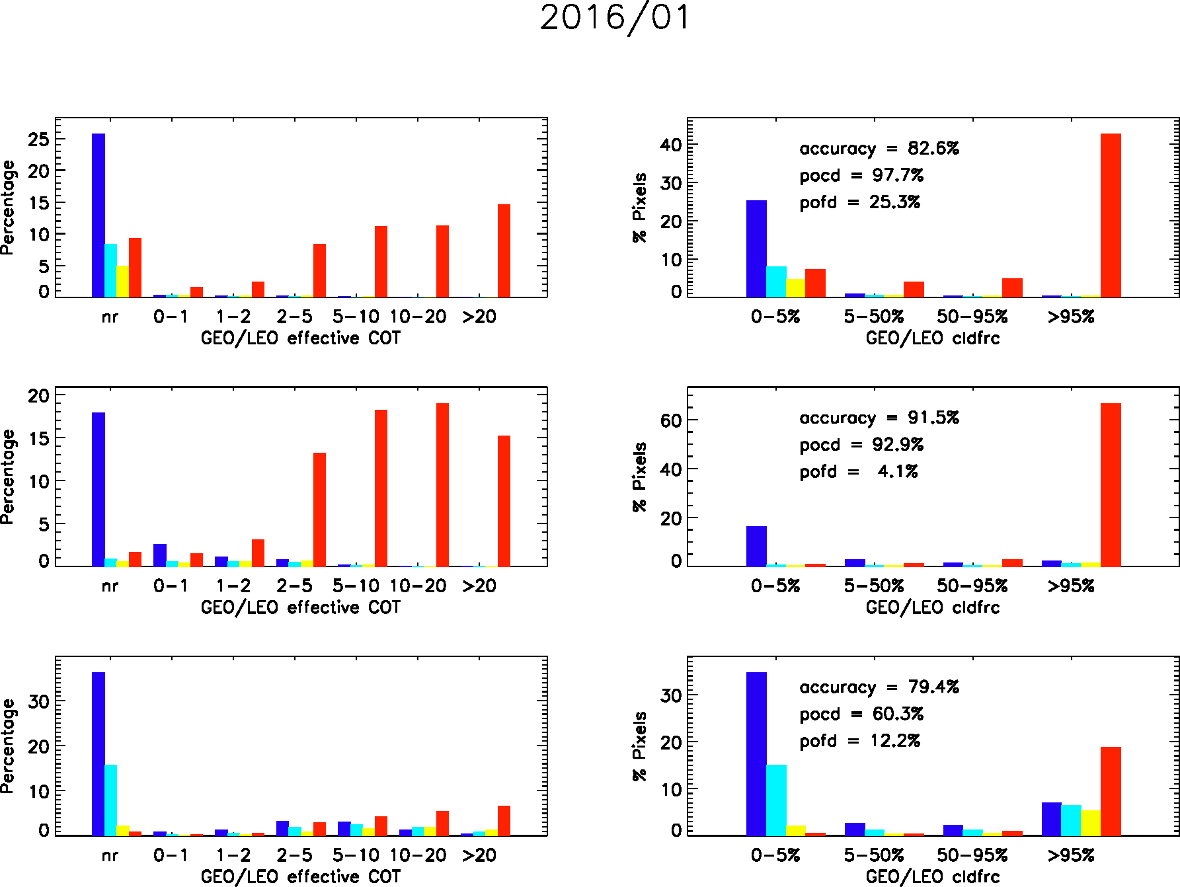
First, What should be considered cloudy or clear?
Land
Land
Ocean
Ocean
Ice/Snow
Ice/Snow

Slide 17
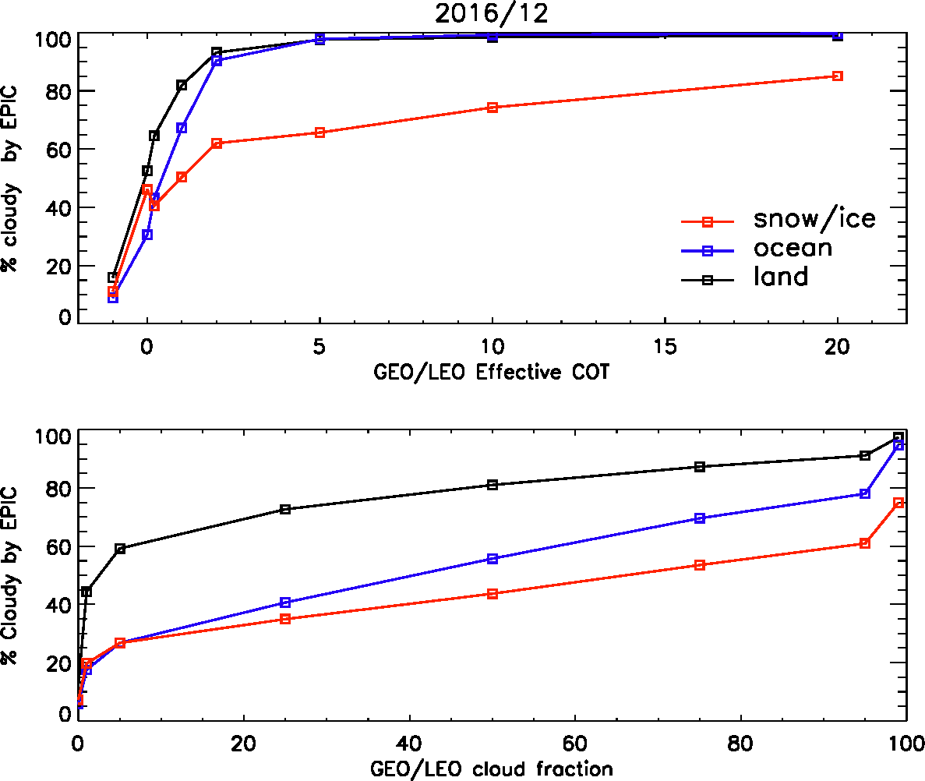
Consistency in All Surface Types
How much cloud fraction or effective COT should be identified as cloud in EPIC? Are we taking clear conservative or cloud conservative approach?
Currently land algorithm is more likely to claim cloudy for small COT and CF than ocean and ice/snow.

Slide 18
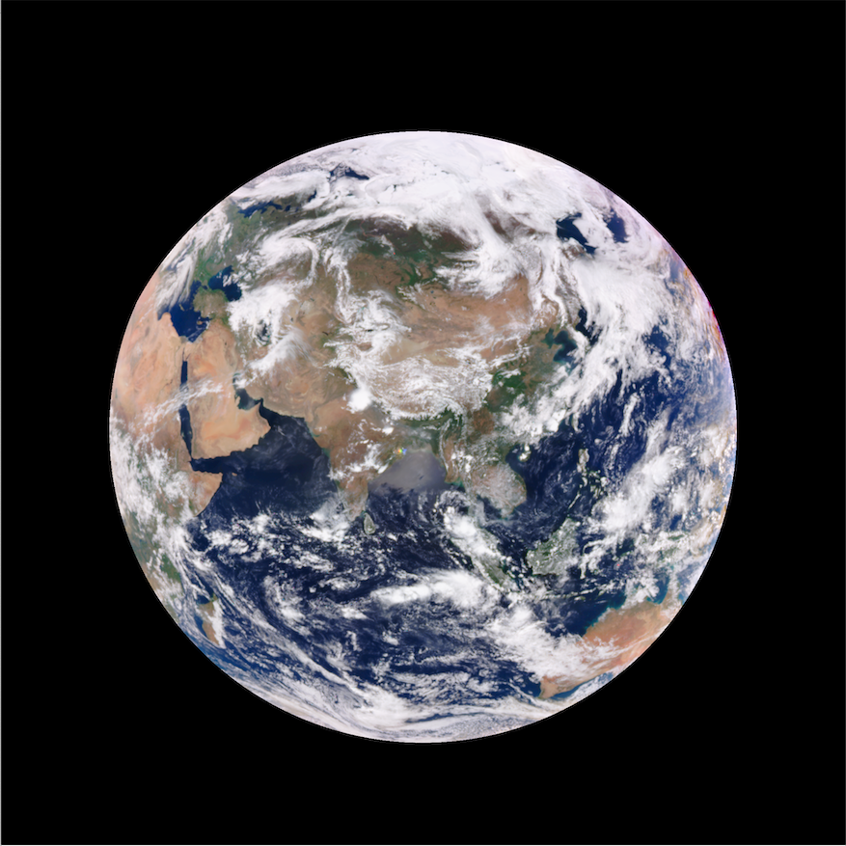
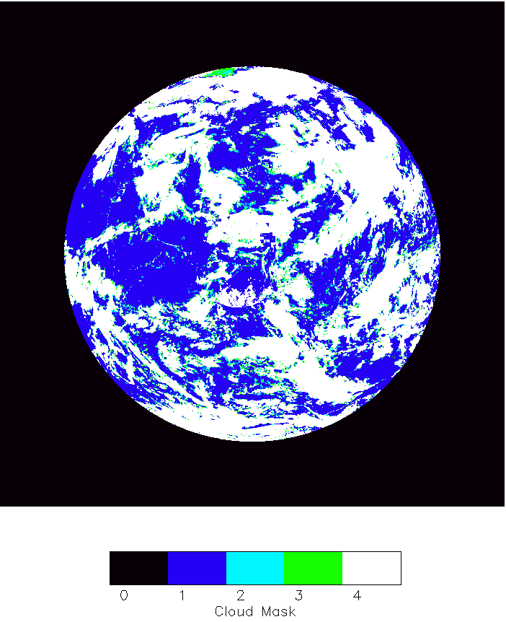
DSCOVR_EPIC_L2_CLOUD_03_20200510063154_03
Simple remedy with more glint coverage

Slide 19
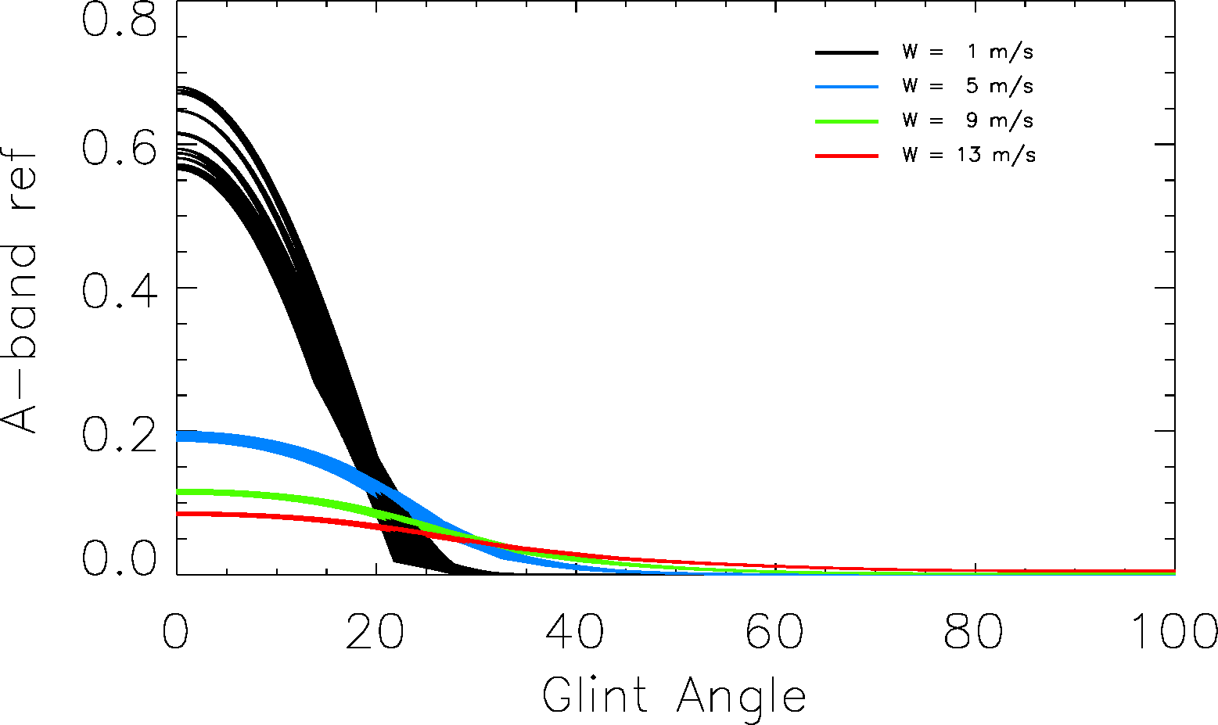
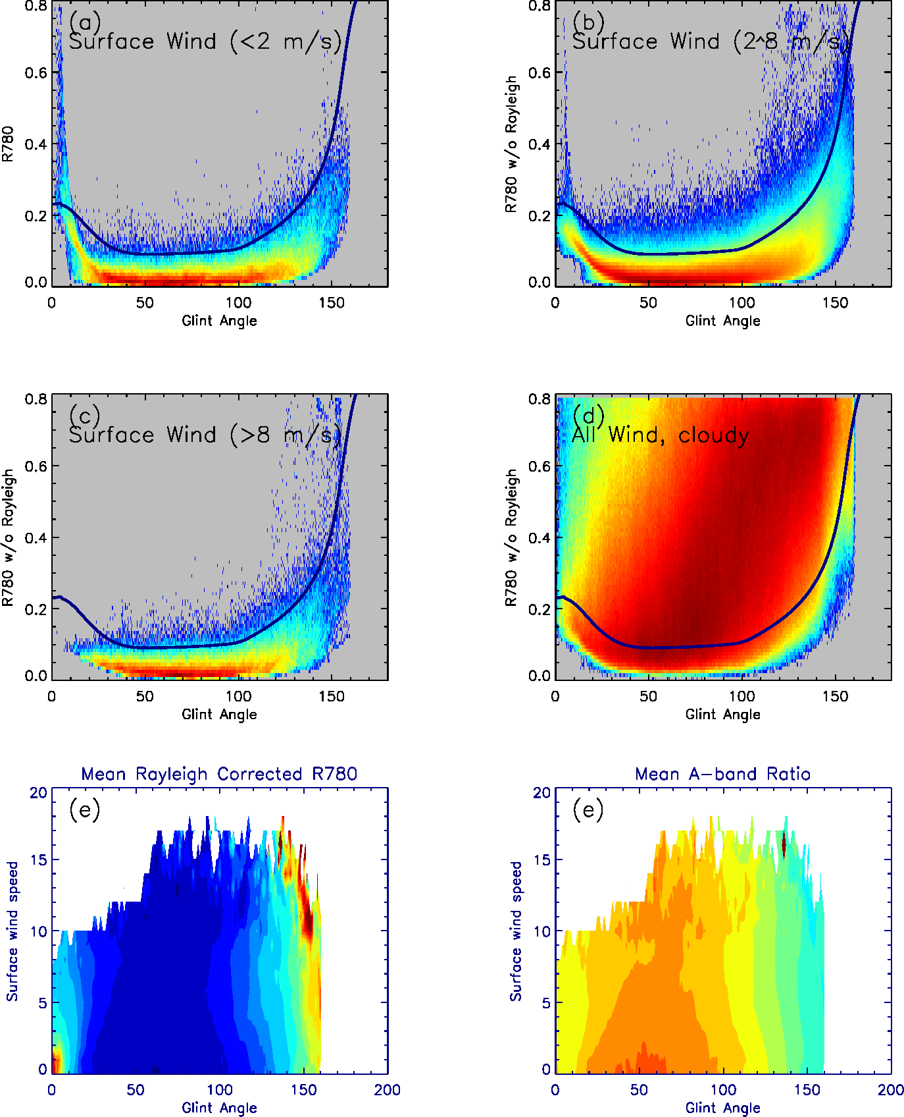
780 nm Reflectance from Cox - Munk model
Potential inclusion of surface wind to surface reflectance threshold
780 nm Reflectance from EPIC

