Slide 1
Version 3 EPIC Cloud Products: Improvements and Assessments
Yuekui Yang, Yaping Zhou, Galina Wind,
Alfonso Delgado-Bonal, Pengwang Zhai, Kerry Meyer
DSCOVR EPIC&NISTAR Science Team Meeting
Sep. 28-30, 2021, Online

Slide 2
List of major updates (work since last STM in Oct. 2020)
cloud mask over ocean sunglint regions paper published
Zhou, Y., Y. Yang, P. Zhai, M. Gao, 2021: Cloud Detection over Sunglint Regions with Observations from the Earth Polychromatic Imaging Camera (EPIC), Front. Remote Sens. 2:690010. doi: 10.3389/frsen.2021.690010.
Code updates and release of version 3 products
L2 cloud products naming convention:
DSCOVR_EPIC_L2_CLOUD_03_20190627131403_03.nc4
28,399 granules
05/12/2016 – present
Cloud Product Version
L1b Version
version 3 products assessment: comparison with the Langley GEO/LEO composites and with the GOES 16 and 17 cloud products; Identification of issues that need further improvements

Slide 3
EPIC Standard L2 Cloud Product System
EPIC L1B Products
Ancillary Data
Cloud Mask
Effective Height/Pressure
Cloud Optical Thickness
EPIC L2 Cloud Products

Slide 4
EPIC L2 Major Cloud Product List
EPIC Cloud Mask
Oxygen A-band Cloud Effective Pressure
Oxygen A-band Cloud Effective Height
Oxygen B-band Cloud Effective Pressure
Oxygen B-band Cloud Effective Height
Cloud Optical Thickness – assuming liquid phase
Cloud Optical Thickness – assuming ice phase
Cloud Effective Temperature
Most likely cloud thermodynamic phase

Slide 5
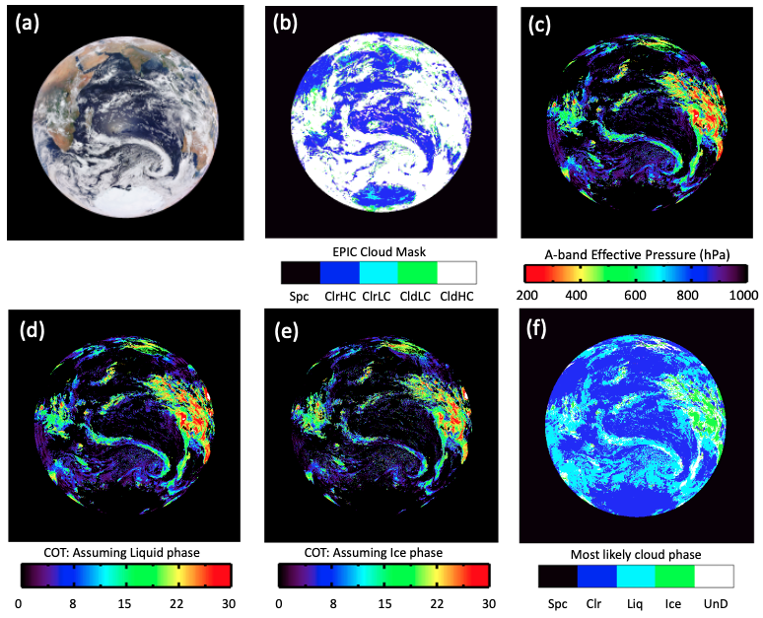
Improvements in version 3 cloud products
Example: DSCOVR_EPIC_L2_CLOUD_03_20161222075806_03.nc4
ClrHC 30.3
ClrLC 5.8
CldLC 2.2
CldHC 61.7

Slide 6
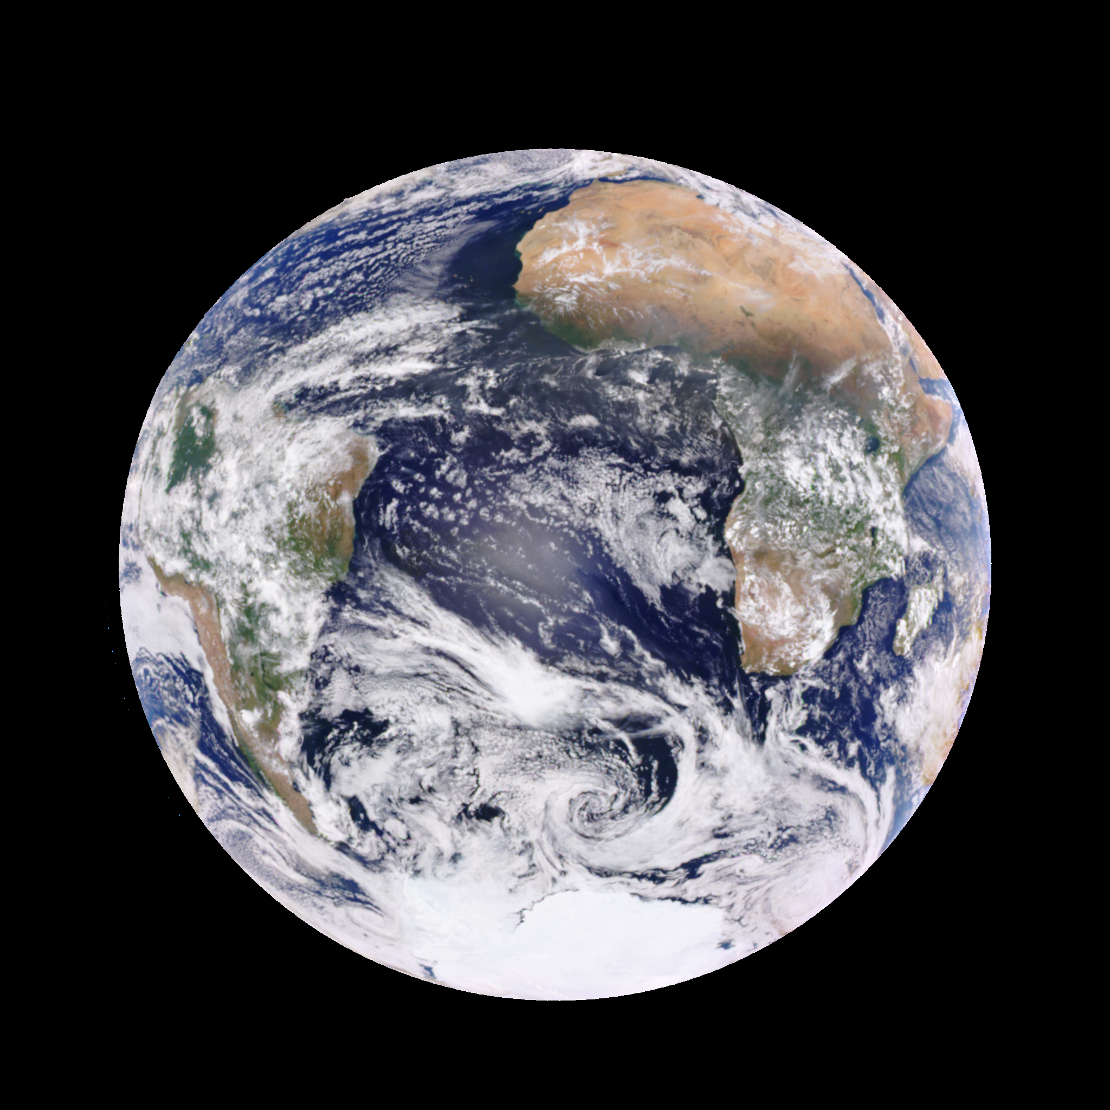
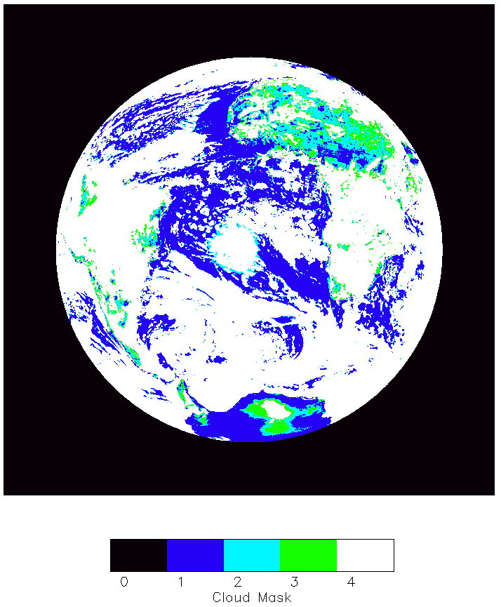
Cloud Version 2
Example: DSCOVR_EPIC_L2_CLOUD_02_20160101133135_03.nc4

Slide 7
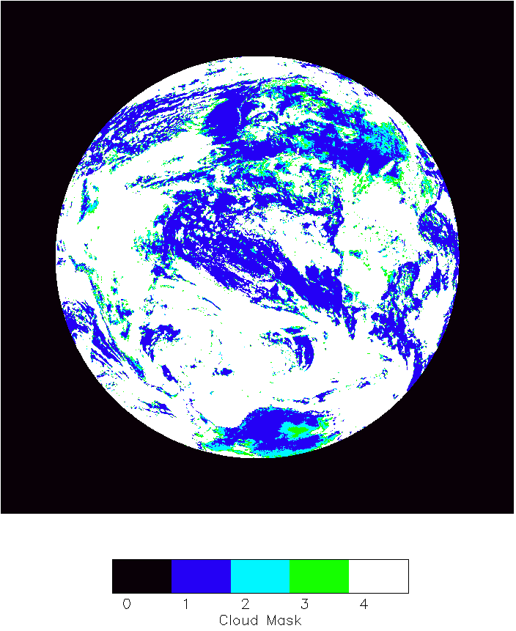
Cloud Version 3
Example: DSCOVR_EPIC_L2_CLOUD_02_20160101133135_03.nc4

Slide 8
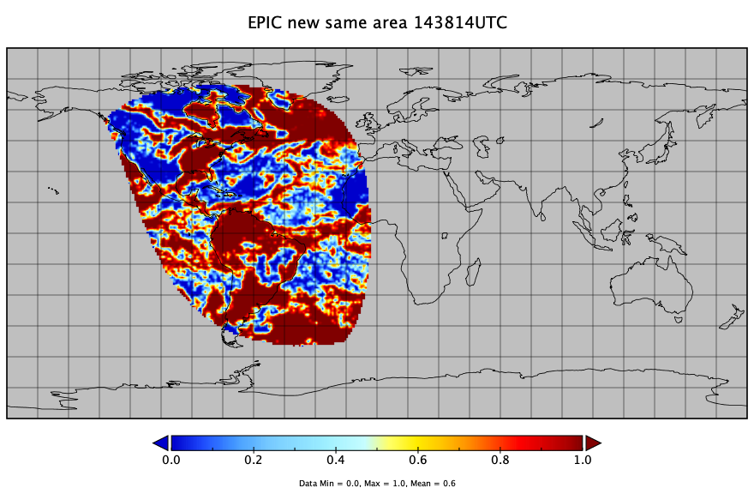
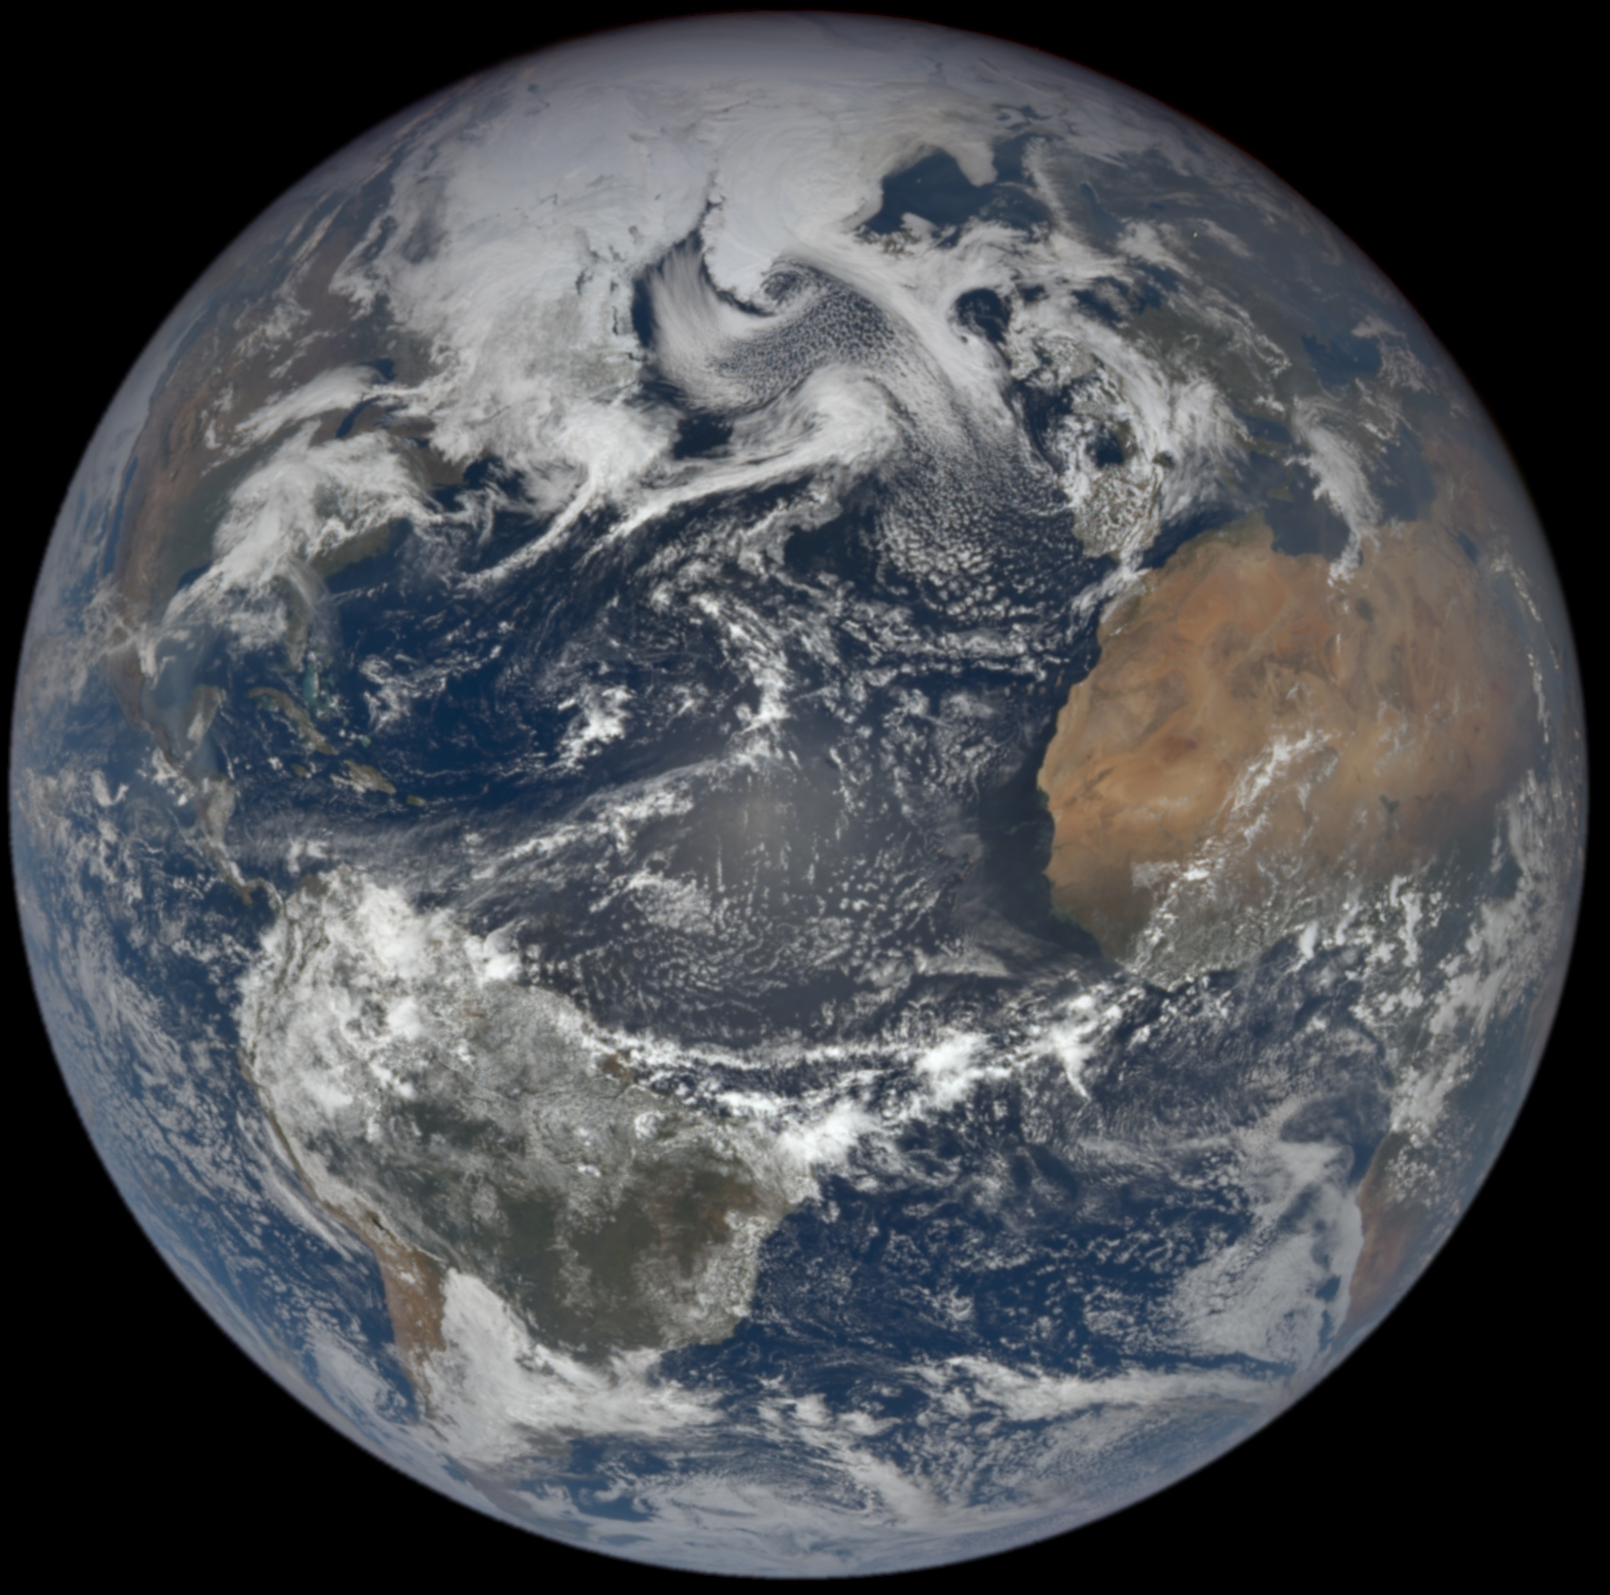
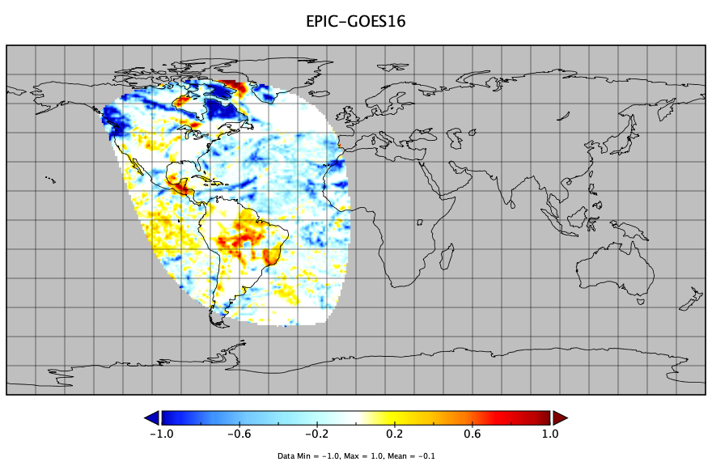
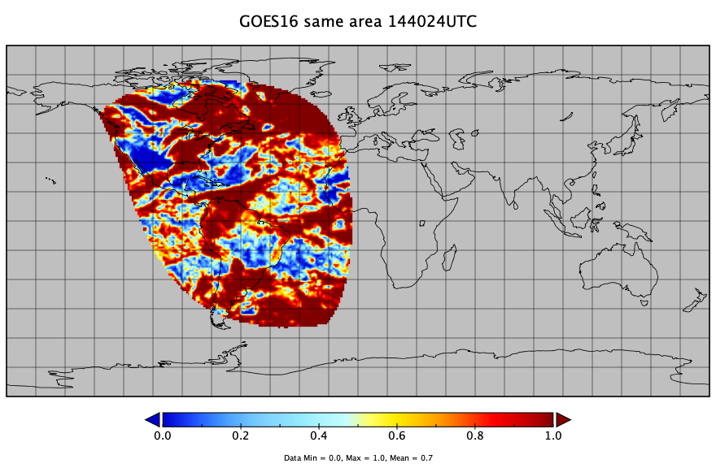
Cloud Fraction Comparison with GOES-16
V3 2019-04-25 14:38:14

Slide 9
Cloud Fraction Comparison with GOES-16
Cloud fraction of the co-located areas; data from 2020.

Slide 10
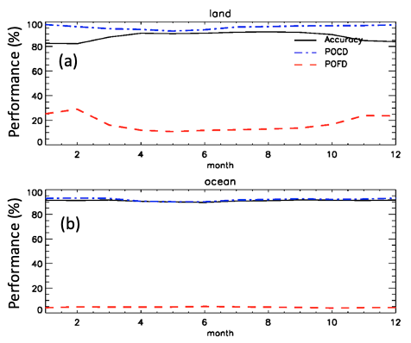
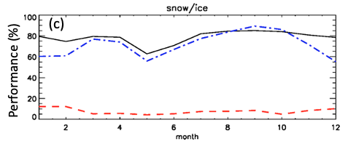
Cloud Mask comparison with the Langley GEO/LEO composite
The accuracy, the percentage of correct detection (POCD) and the percentage of false detection (POFD) of EPIC cloud mask for each month of the year 2016 when using Langley GEO/LEO composite results as a reference. (a) Over land, (b) over ocean, and (c) over snow/ice.

Slide 11
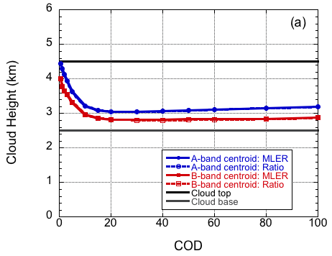
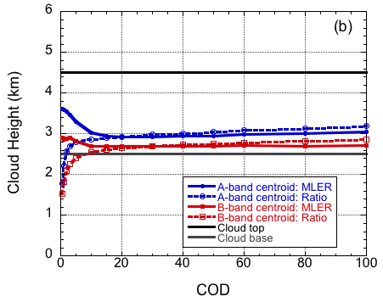
EPIC cloud effective pressure from Oxygen A- and B-band
α_{s} = 0
Due to photon penetration, retrievals are lower than the cloud top. (e.g., Yang et al., 2013, Vanbauce et al. 2003; Sneep et al. 2008, Vasilkov et al. 2008, and Ferlay et al. 2010).
SZA=VZA=0⁰
Due to different absorption and different effective depth of light penetration into a cloud, h_{B} is generally lower than h_{A}
α_{s} = 0.1
SZA=VZA=0⁰
Yang et al., 2013

Slide 12
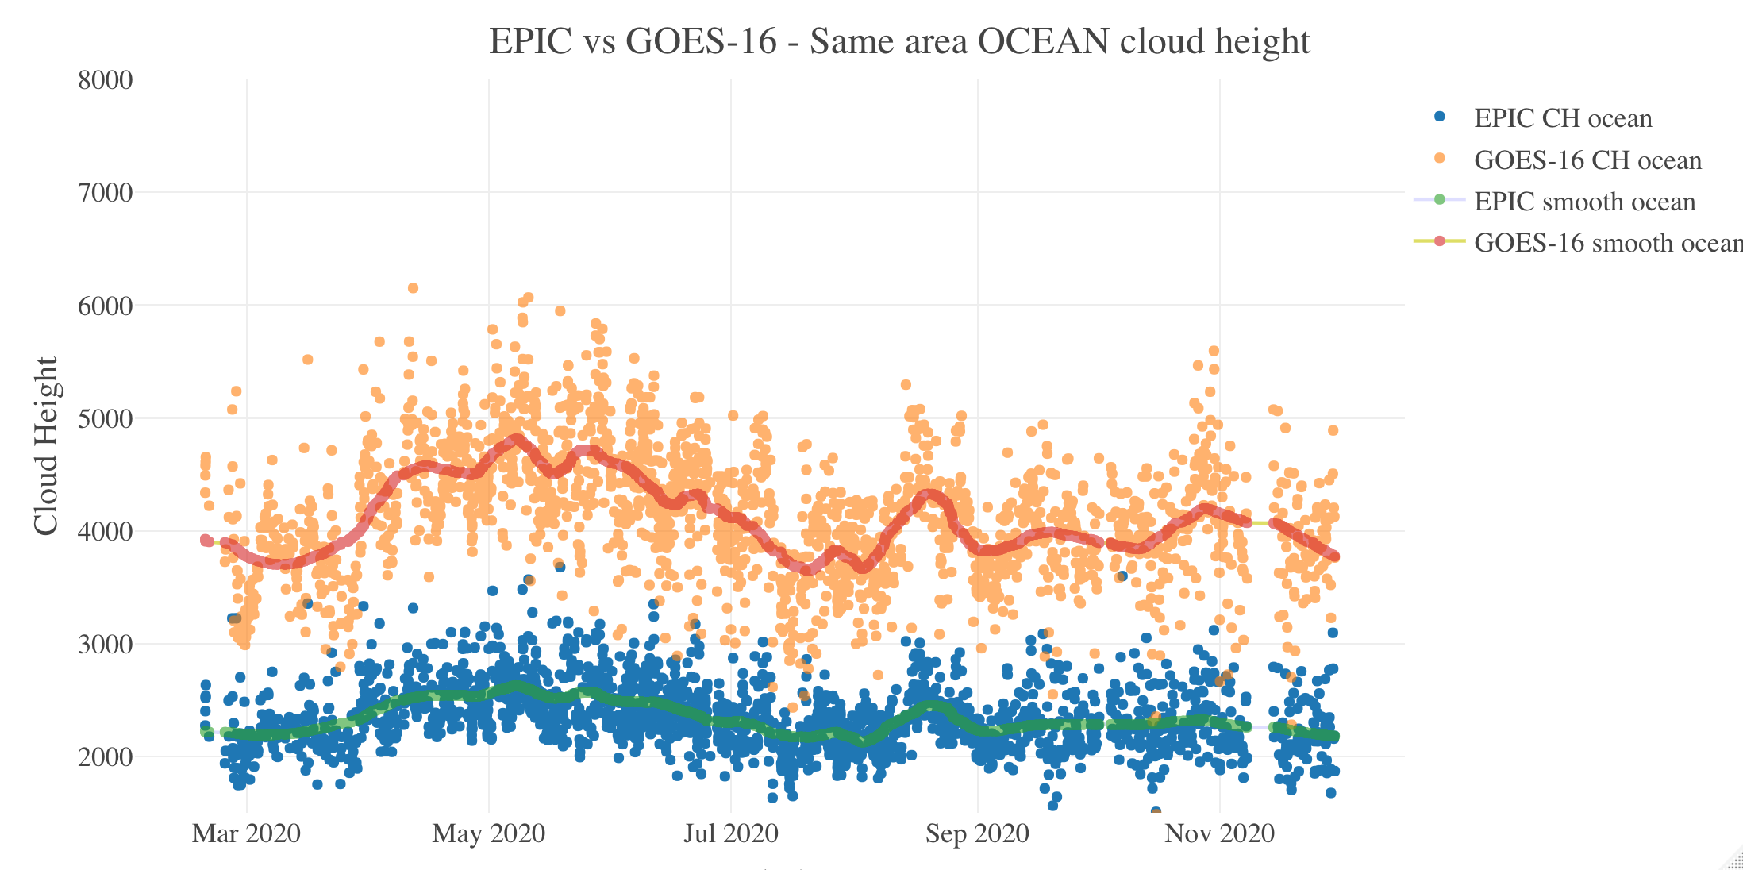
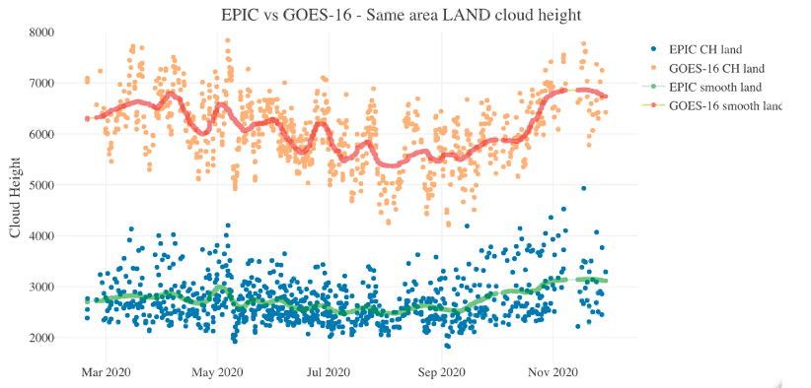
Cloud Height Comparison with GOES-16
EPIC cloud height are lower than that of the GOES-16, which is retrieved based on the IR brightness temperature.
The difference is larger over land than over ocean, because over land more photon contribution from the surface for the EPIC retrievals, which makes the retrieved A-band cloud height lower.

Slide 13
Cloud Height Comparison with GOES-16
Data from 2020

Slide 14
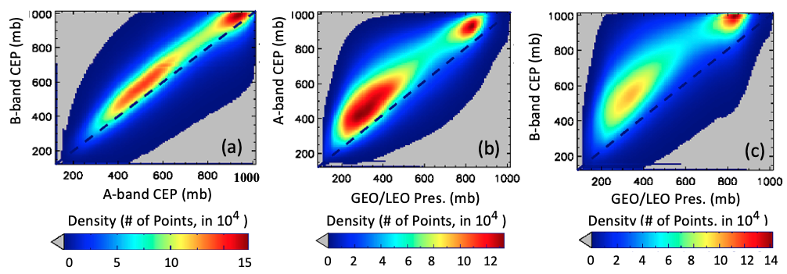
v3 A- and B-band Cloud Effective Pressure
Scatterplots for (a) EPIC A- vs. B-band CEP; (b) the Langley GEO/LEO composite cloud pressure vs EPIC A-band CEP; and (c) the Langley GEO/LEO composite cloud pressure vs EPIC B-band CEP. Data are from the year 2016.

Slide 15
Future Work: Impact of Scattering Angle
Variation of EPIC 3-day mean scattering angle in 2020, from February to December.

Slide 16
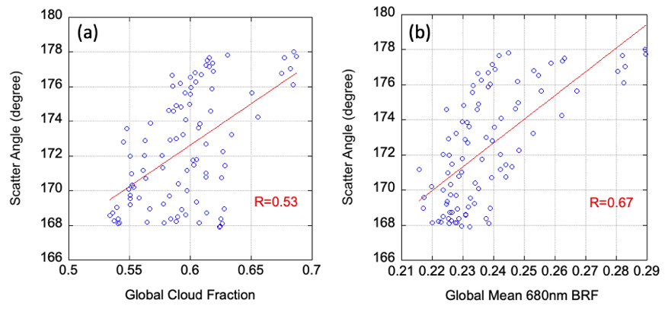
Future Work: Impact of Scattering Angle
Scattering angle change affects the EPIC measured spectral BRF; when BRF is used as a cloud mask test, for the same thresholds, an increase of scene BRF will lead to an increase of cloud fraction

Slide 17
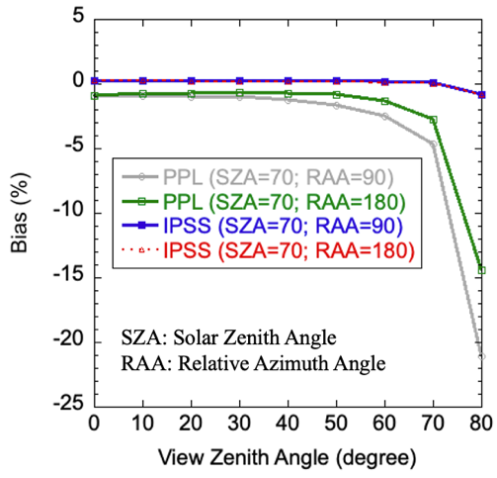
Future Work: Earth Curvature Inclusion in Radiative Transfer for Better Look-up Tables
Bias in the simulations with the plane parallel (PPL) and the improved pseudospherical shell (IPSS) approximation as compared to a benchmark full spherical model. The atmosphere is assumed to be filled with a homogenous conservative Rayleigh scattering medium extending from the sea level to 100 km altitude. The total optical depth is 0.25. For the IPSS method, the solar incident and viewing angles are treated as a function of altitude in a spherical atmosphere. Note the results for the two IPSS lines are overlapping each other.

Slide 18
Extending the maximum VZA for cloud retrievals from the current 76⁰ to 80⁰ will decrease the no-retrieval edge pixels from 3% to 1%.

Slide 19
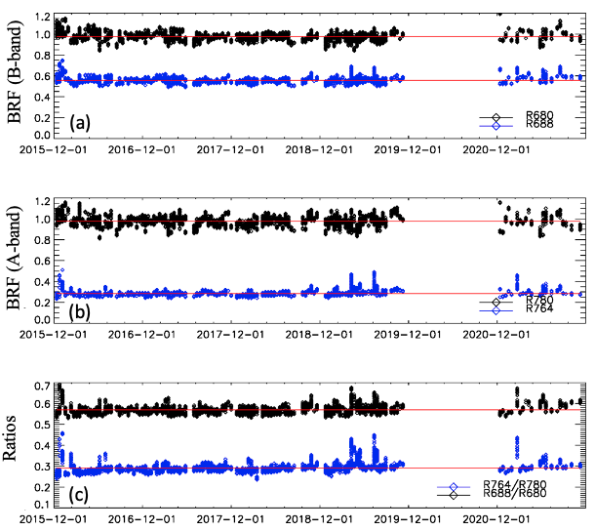
Future Work: Oxygen A- and B-band Performance and Stability Monitoring
EPIC O₂ A- and B-band observations over the Amundsen–Scott South Pole Station. Data are for the month of December from 2015 to 2020, except December 2019 when DSCOVR was offline on the safe hold mode. Only clear sky observations are selected based on surface reports. (a) BRF for the B-band absorption (R688, blue) and reference channels (R680, black); (b) BRF for the O₂ A-band absorption (R764, blue) and reference channels (R780, black); and (c) channel ratios.

Slide 20
Summary
Since last STM, version 3 cloud products have been released. Cloud mask over ice/snow, and over sunglint has seen improvements.
Assessment has been conducted by comparing with GOES-16 cloud products and with the Langley GEO/LEO composites.
EPIC L2 cloud products have been used in many studies and applications, including cloud diurnal cycle analysis, trace gas retrieval correction, surface solar radiation studies, cloud system analysis etc.
Future work include:
-- Refinement of EPIC Cloud Mask by taking the EPIC scattering angle effect into account.
-- Earth Curvature Inclusion in Radiative Transfer for Better Look-up Tables by adopting the improved pseudospherical shell (IPSS) approximation .
-- Oxygen A- and B-band performance and stability monitoring using observations co-located with the South Pole Station.

Slide 21
Publications
15) Zhou, Y., Y. Yang, P. Zhai, M. Gao, 2021: Cloud Detection over Sunglint Regions with Observations from the Earth Polychromatic Imaging Camera (EPIC), Front. Remote Sens. 2:690010. doi: 10.3389/frsen.2021.690010
14) Delgado-Bonal, A., A. Marshak, Y. Yang, L. Oreopoulos, 2021: Global daytime variability of clouds from DSCOVR/EPIC observations. Geophys. Res. Lett., 48, e2020GL091511. https://doi.org/10.1029/2020GL091511
13) Yin, B., Min, Q., Morgan, E., Yang, Y., Marshak, A., and Davis, A. B., 2020: Cloud-top pressure retrieval with DSCOVR EPIC oxygen A- and B-band observations, Atmos. Meas. Tech., 13, 5259–5275, https://doi.org/10.5194/amt-13-5259-2020.
12) Zhou, Y., Y. Yang, M. Gao, P. Zhai, 2020: Cloud Detection over Snow and Ice with Oxygen A- and B-band Observations from the Earth Polychromatic Imaging Camera (EPIC), Atmos. Meas. Tech., 13, 1575–1591, https://doi.org/10.5194/amt-13-1575-2020.
11) Delgado-Bonal, A., A. Marshak, Y. Yang, L. Oreopoulos, 2020: Daily variability of cloud amount from EPIC observations, J. Geophys. Res., 125(10), https://doi.org/10.1029/2019JD031488
10) Gao, M. P.-W. Zhai, Y. Yang, Y. Hu, 2019: Cloud remote sensing with EPIC/DSCOVR observations: a sensitivity study with radiative transfer simulations, J. Quant. Spectrosc. Radiat. Trans., 230, 56-60, doi: https://doi.org/10.1016/j.jqsrt.2019.03.022
9) Gao, B.-C., R.-R. Li, and Y., Yang, 2019: Remote Sensing of Water Surfaces over Sunlit Portions of Oceans and Large Inland Lakes from EPIC onboard the DSCOVR Spacecraft at Lagrange-1 Point, Sensors. 2019, 19(5), 1243; doi: 10.3390/s19051243.
8) Yang, Y., K. Meyer, G. Wind, Y. Zhou, A. Marshak, S. Platnick, Q. Min, A. B. Davis, J. Joiner, A. Vasilkov, D. Duda, and W. Su, 2019: Cloud Products from Earth Polychromatic Imaging Camera (EPIC) observations: Algorithm and Initial Evaluation, Atmos. Meas. Tech., 12, 2019-2031, https://doi.org/10.5194/amt-12-2019-2019.

Slide 22
Publications
7) Davis A., N. Ferlay, Q. Libois, A. Marshak, Y. Yang and Q. Min, 2018: Cloud information content in EPIC/DSCOVR's oxygen A- and B-band channels: A physics-based approach, J. Quant. Spectrosc. Radiat. Trans., 220, 84-96, https://doi.org/10.1016/j.jqsrt.2018.09.006
6) Davis, A. B., G. Merlin, C. Cornet, L. C. Labonnote, J. Riedi, N. Ferlay, P. Dubuisson, Q. Min, Y. Yang, and A. Marhsak, 2018: Cloud information content analysis of EPIC/DSCOVR’s oxygen A- and B-band channels: an optimal estimation approach, J. Quant. Spectrosc. Radiat. Trans. 216, 6-16, https://doi.org/10.1016/j.jqsrt.2018.05.007.
5) Marshak, A., J. Herman, A. Szabo, K. Blank, A. Cede, S. Carn, I. Geogdzhayev, D. Huang, L-K, Huang, Y. Knyazikhin, M. Kowalewski, N. Krotkov, A. Lyapustin, R. McPeters, O. Torres, and Y. Yang, 2018: Earth Observations from DSCOVR/EPIC Instrument, Bull. Amer. Meteor. Soc.99(9), 1829-1850, https://doi.org/10.1175/BAMS-D-17-0223.1
4) Xu, X., J., Wang, Y., Wang, J., Zeng, O., Torres, Y., Yang, A., Marshak, J., Reid, and S., Miller, 2017: Passive remote sensing of altitude and optical depth of dust plumes using the oxygen A and B bands: first results from EPIC/DSCOVR at Lagrange-1 point, Geophys. Res. Lett., 44, doi:10.1002/2017GL073939.
3) Meyer, K., Y. Yang, and S. Platnick, 2016: Uncertainties in cloud phase and optical thickness retrievals from the Earth Polychromatic Imaging Camera (EPIC), Atmos. Meas. Tech., 9, 1785-1797, doi:10.5194/amt-9-1785-2016.
2) Holdaway, D. and Y. Yang, 2016: Study of the Effect of Temporal Sampling Frequency on DSCOVR Observations Using the GEOS-5 Nature Run Results (Part II): Cloud Coverage. Remote Sens. 8(5), 431, doi:10.3390/rs8050431.
1) Holdaway, D. and Y. Yang, 2016: Study of the Effect of Temporal Sampling Frequency on DSCOVR Observations Using the GEOS-5 Nature Run Results (Part I): Earth’s Radiation Budget. Remote Sens. 8(2), 98, doi:10.3390/rs8020098.

Slide 23
Backup

Slide 24
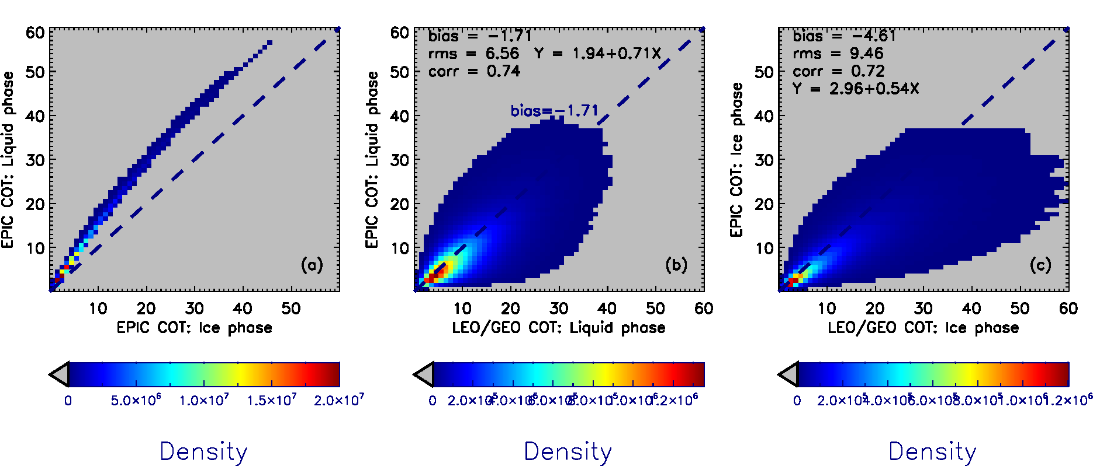
EPIC COT: 2016 data

Slide 25
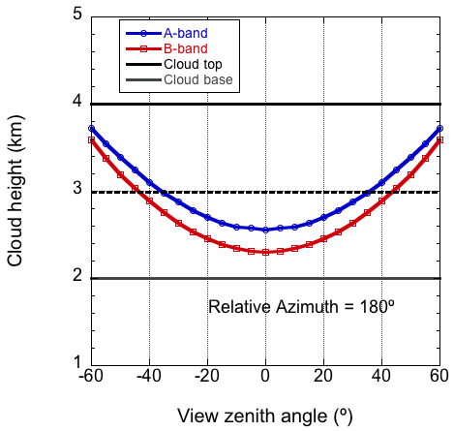
EPIC cloud effective pressure from Oxygen A- and B-band
SZA=VZA; COT=30
Black Surface
Due to photon penetration, retrievals from a single band (h_{A,} h_{B}) are lower than the cloud top. (e.g., Yang et al., 2013, Vanbauce et al. 2003; Sneep et al. 2008, Vasilkov et al. 2008, and Ferlay et al. 2010).
h_{A}
Due to different absorption and different effective depth of light penetration into a cloud, h_{B} is generally lower than h_{A}
h_{B}
Yang et al., 2013

Slide 26
EPIC Cloud Product Version Naming Convention
Versions 01
DSCOVR_EPIC_L2_CLOUD_01_20190627131403_02.nc4
Cloud Product Version
L1b Version
Versions 02
DSCOVR_EPIC_L2_CLOUD_02_20190627131403_03.nc4
Versions 03
DSCOVR_EPIC_L2_CLOUD_03_20190627131403_03.nc4
28,399 granules
05/12/2016 – present

Slide 27
EPIC Channels Used for Cloud Retrievals
Product | Resolution | Description | EPIC Data Used
Cloud Mask | Original pixel size | Each EPIC pixel is classified as clear/cloudy with high/low confidence. | 388 nm, 680 nm, and the 780 nm reflectances, the 764/780 nm and the 688/680 nm ratios.
CEP/CEH | Original pixel size | Cloud effective pressure (CEP) is retrieved for both O2 A- and B-bands | O₂ A-band (780 nm and 764 nm), and B-band (680 nm and 688 nm), EPIC cloud mask
COT | Original pixel size | Cloud optical thickness is retrieved using a single-channel approach (680 nm over land and 780 nm over ocean) | 680 nm, 780nm, EPIC cloud mask, EPIC CEP
Observation time for each EPIC channel starting from the 443 nm channel. Red dots are the channels used for cloud retrievals.
EPIC cloud products and required EPIC observations

