Slide 1

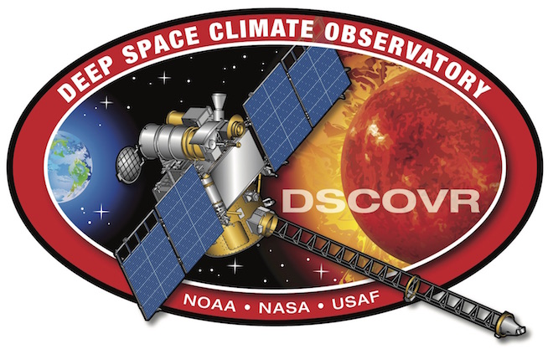
The effect of SEV on EPIC and NISTAR observations
Alexander Marshak (GSFC)
Alfonso Delgado-Bonal (GESTAR, GSFC)
Yuri Knyazikhin (Boston University)
DSCOVR STM, Sep 28-30, 2021

Slide 2
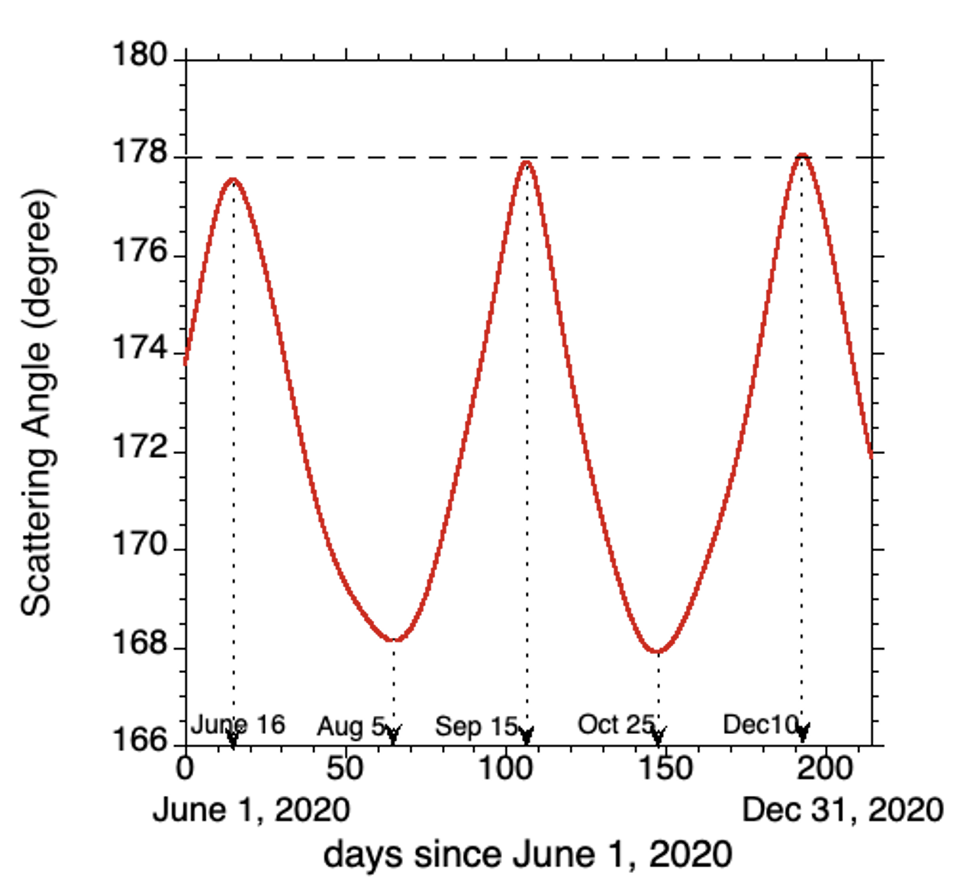
EPIC Scattering Angle
(180º-SEV)
After March 2020 the range of scattering angle has substantially increased towards backscattering reaching 178^{о}. This provided a unique opportunity to study angular variations of the Earth reflectivity in the vicinity of the backscattering direction.

Slide 3
TOA reflectance at 780 nm
(Sep 17 – Dec 10, 2020)
(A) Global TOA reflectance and its components accumulated over ocean and land.
(B) TOA reflectance accumulated over cloudy and clear sky pixels.
(C) TOA reflectance accumulated over cloudy and clear pixels.

Slide 4
TOA reflectance at 780 nm
(Feb 26 – Dec 20, 2020)
Global
Ocean
Land

Slide 5
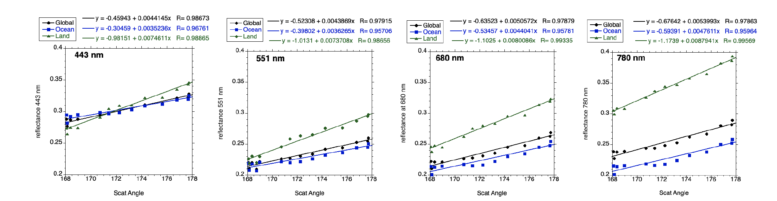
Spectral behavior
(Oct 25 – Dec 14, 2021)
The correlation over land is much stronger than that over ocean for all spectral bands. The highest value is for land at 780 nm.

Slide 6
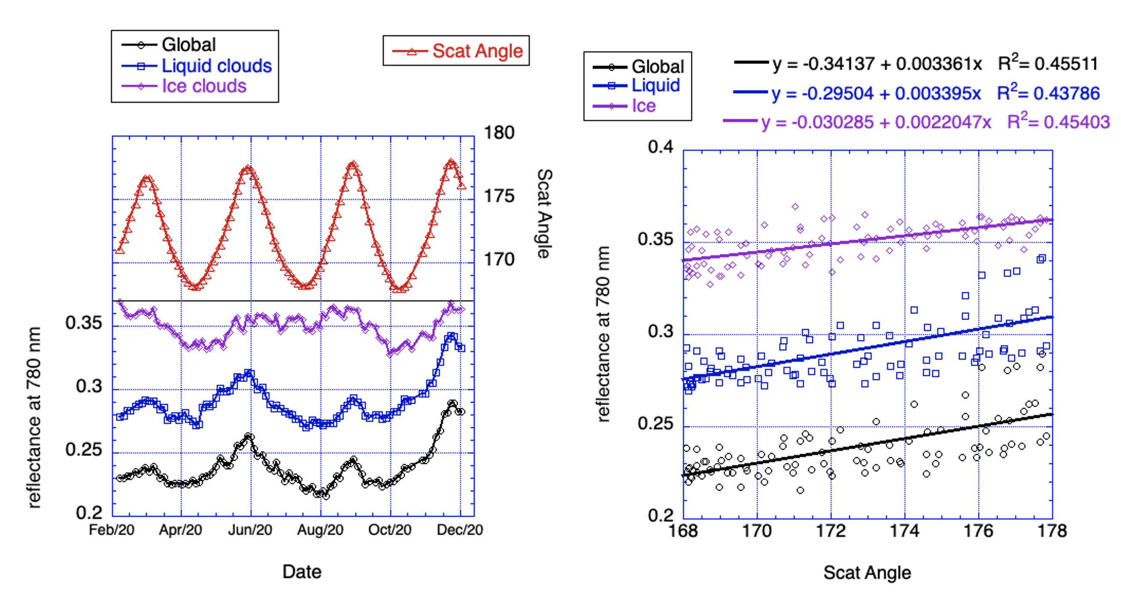
Clouds

Slide 7
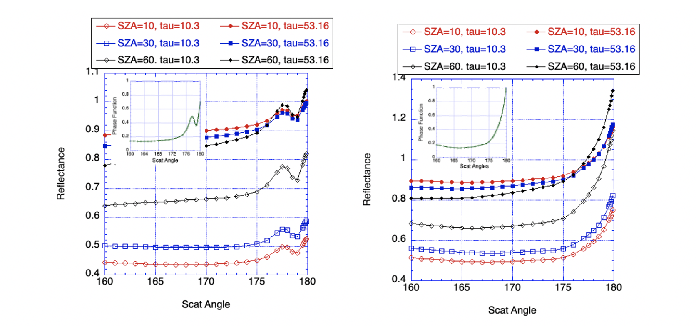
Clouds (model)
Water
Ice

Slide 8
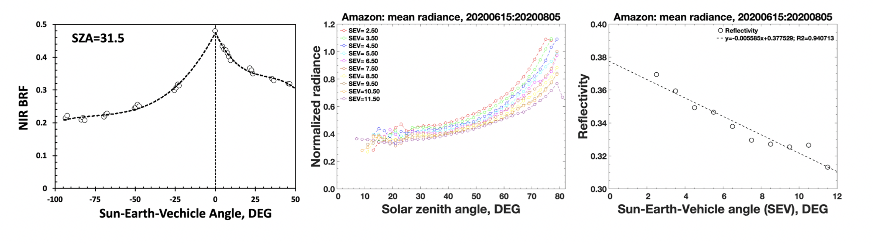
Vegetation
SEV = 180º – Scat. Angle
MISR
EPIC
EPIC
Reflective properties of Amazonian forests.
(left) NIR BRF of an area in Amazonian rainforests obtained from MISR data.
(middle) Two-months average normalized radiance over Amazonian forests derived from MAIAC BRF vs. SZA for 10 values of SEV.
(right) Two-months average scattering function vs. SEV.

Slide 9
Vegetation (model)
BRF of forest at the NIR spectral band in the principal plane as a function of
(A) VZA and (B) phase angle.

Slide 10
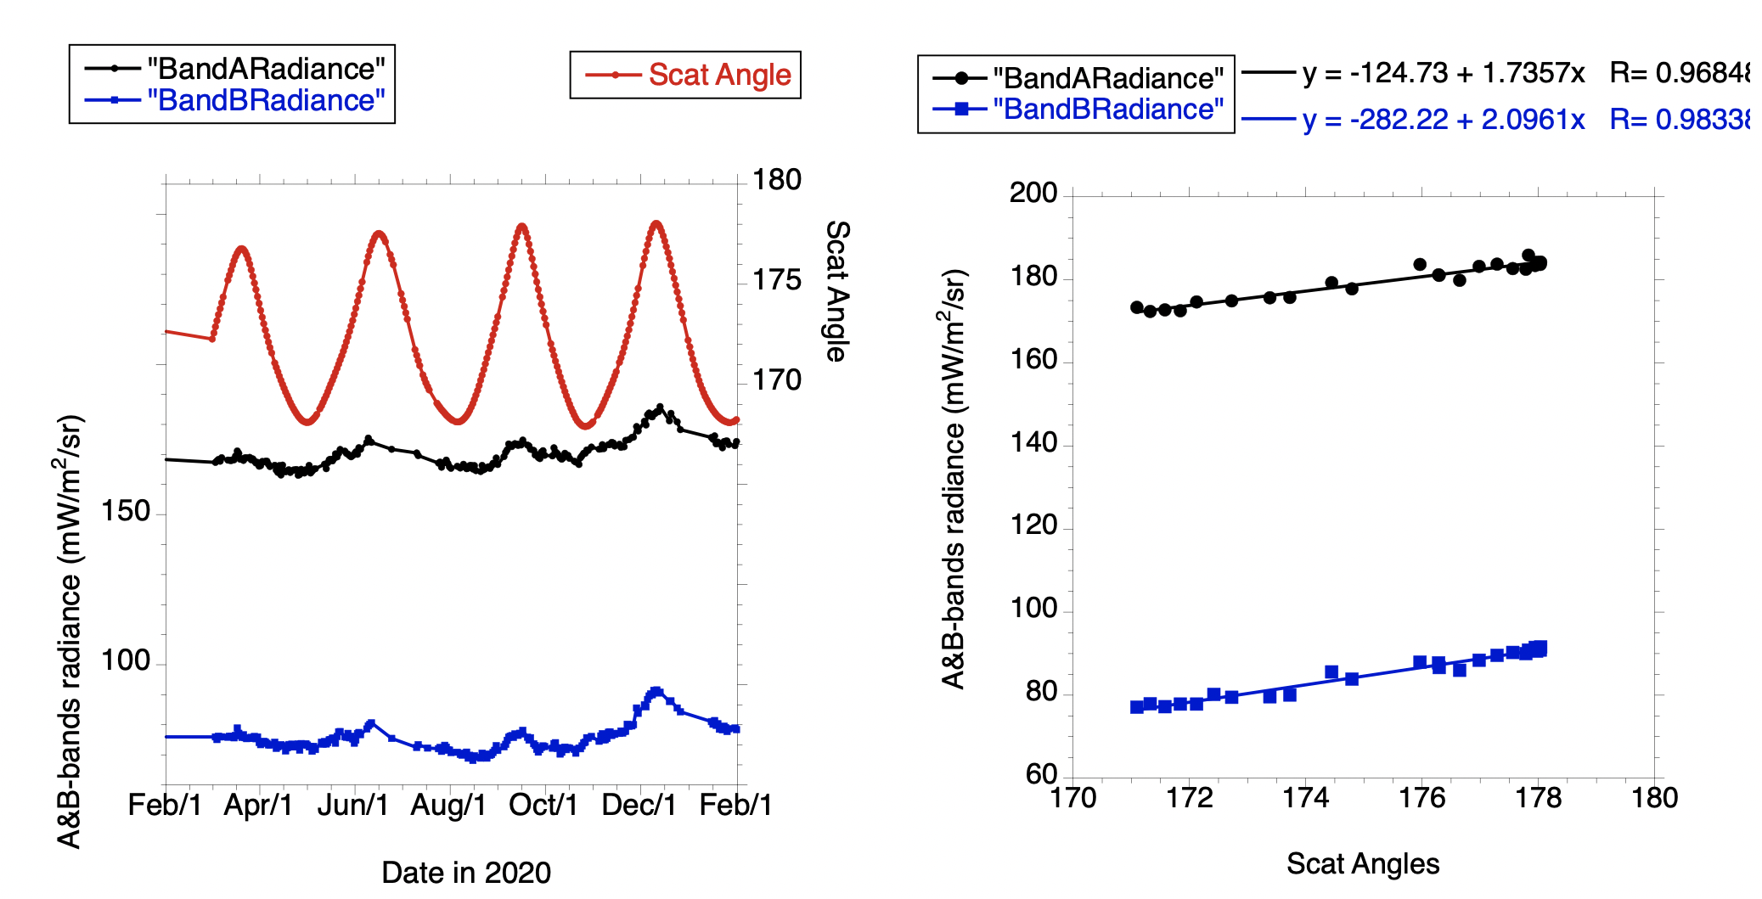
NISTAR
Band A
Band A
Band B
Band B
A strong positive correlation between the Scat. Angle and NISTAR data. This is especially true for time interval between Nov. 15 and Dec. 20, 2020 with maximum around Dec. 10 when Scat Angle reaches its maximum of 178.1º.
Radiances plotted vs. Scat Angle confirm it with high correlation which is slightly higher for the B-band radiance. It is also true for C-band radiance though with a bit lower correlation coefficient (0.90 for band C vs. 0.98 for band B).

Slide 11
Summary
- All EPIC observations, except over ocean under clear sky, show a strong increase of reflectance towards backscattering direction.
- The increase is well confirmed with cloud and vegetation models.
- The strongest increase is observed over land at the NIR band (780 nm).
- NISTAR observations also demonstrate an increase with scattering angle for all bands but the strongest one is for B-band radiance (0.2–4 μm).
- Any angular distribution model with a bin size bigger than 1º–3º near backscattering may lead to substantial errors.

