Slide 1
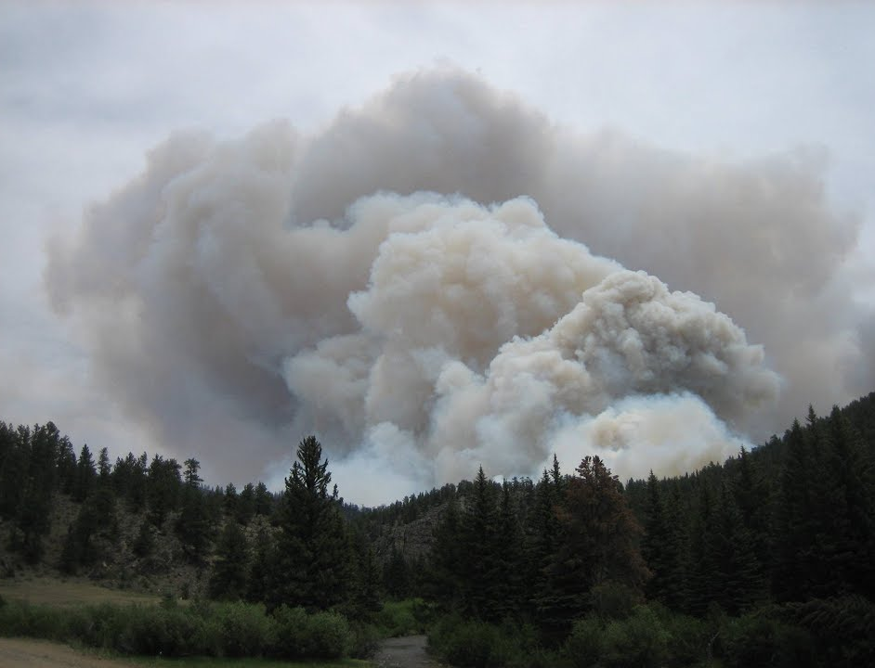
Stratospheric Injection of Massive Smoke Plume from Canadian Boreal Fires in 2017:
EPIC verification of self-lifting of carbonaceous aerosol layers
Omar Torres
Hiren Jethva, Nickolay Krotkov, Changwoo Ahn and Pawan Bhartia
5th DSCOVR EPIC and NISTAR Science Team Meeting
NASA-GSFC, Sept. 17 –19, 2019
Torres et al., Stratospheric Injection of Massive Smoke Plume from Canadian Boreal Fires in 2017 as seen by DSCOVR-EPIC, CALIOP and OMPS-LP Observations, 2019, JGR (under review)

Slide 2
PyroCb event of August, 2017
EPIC Version 3 L1b data

Slide 3
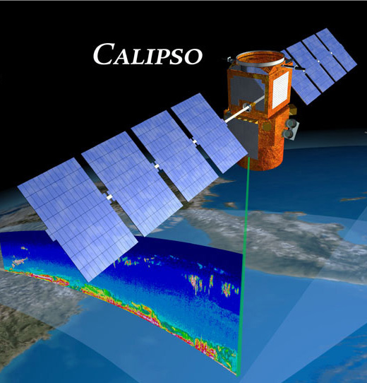
CALIOP
Cloud Aerosol LIdar with Orthogonal Polarization
Flies on CALIPSO satellite, launched in 2006
Measurements
-1064 nm intensity
-532 nm orthogonally polarized components
Products:
Day/nighttime profiles of attenuated backscatter (532/1064 nm)
Vertical Feature Mask

Slide 4
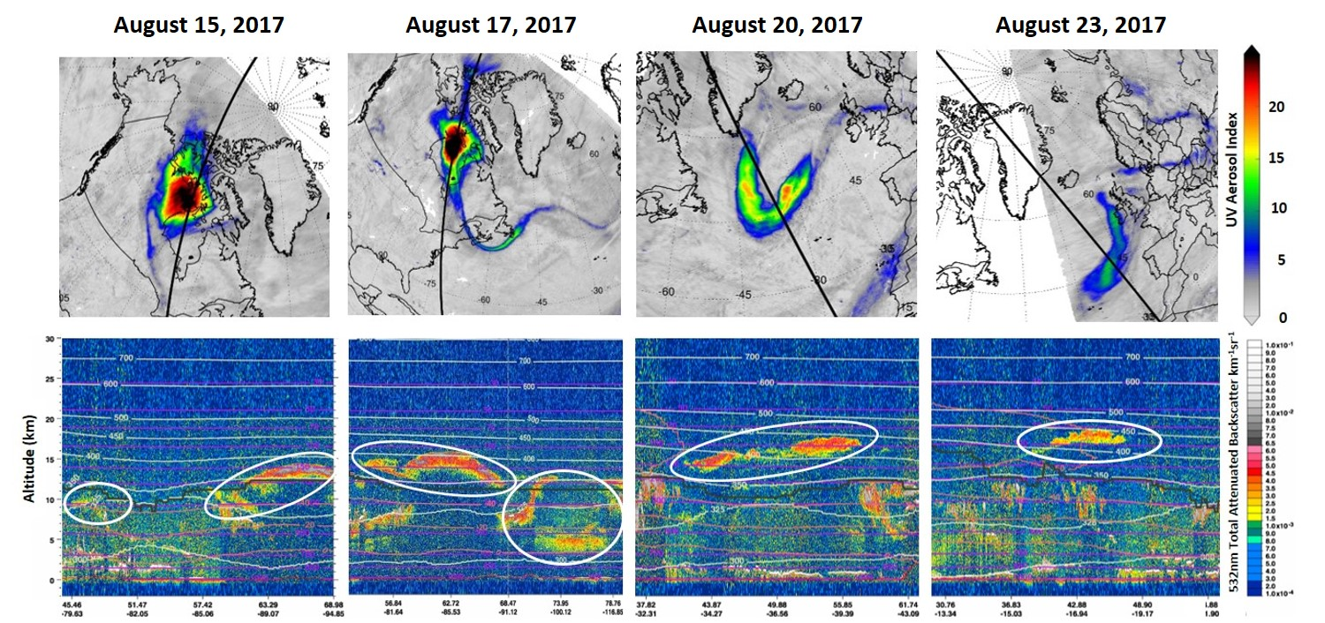
EPIC and CALIOP view

Slide 5
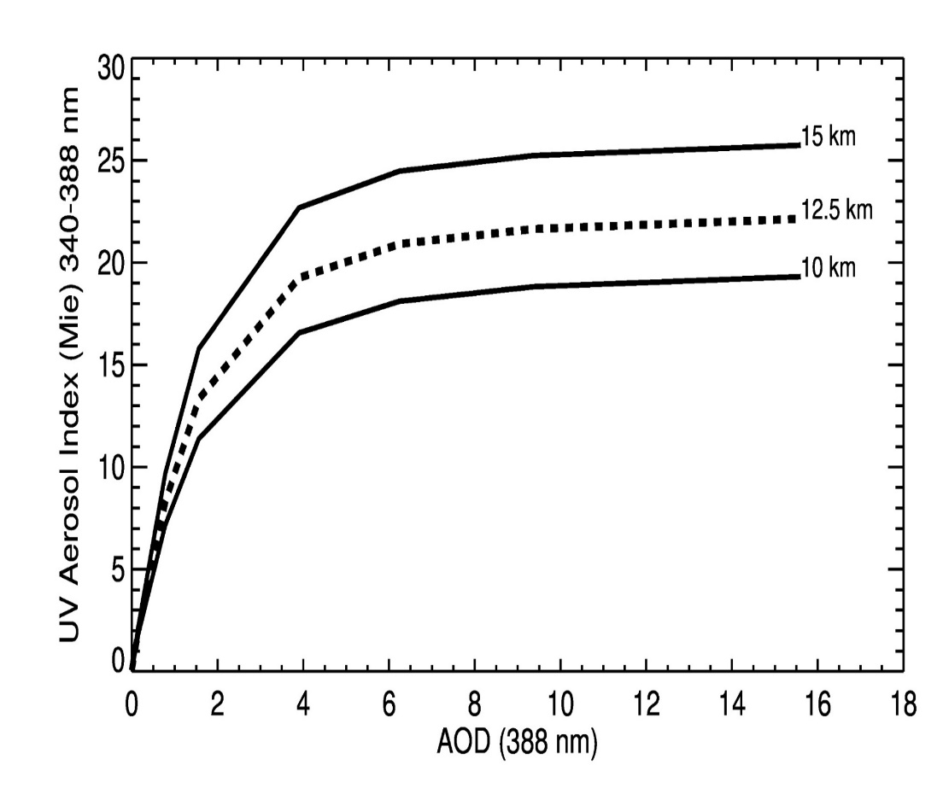
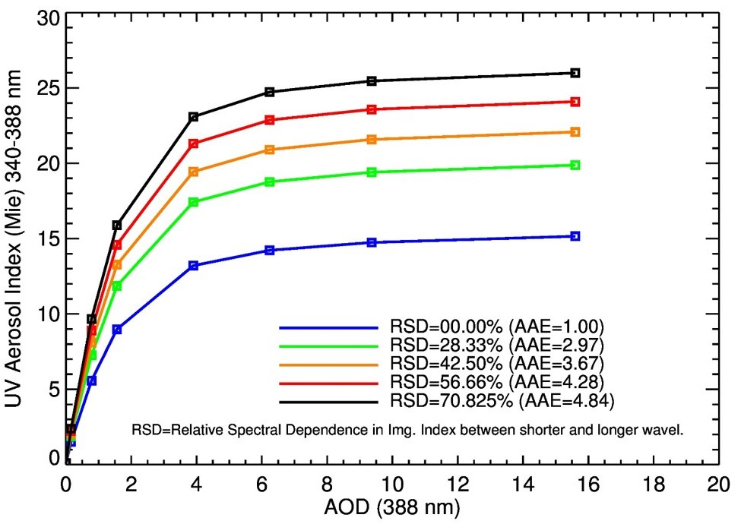
Interpreting the UVAI Signal
AAE = 4.8
ALH = 15 km
The large observed UVAI signal cannot be explained by
black carbon alone (blue line). The presence of Organic
Carbon is likely responsible for the enhanced UVAI’s
- For a given ALH and AAE, UVAI are AOD are closely correlated for AOD as large as about 4
At larger AOD values, UVAI saturates and its magnitude is correlated with ALH and AAE

Slide 6
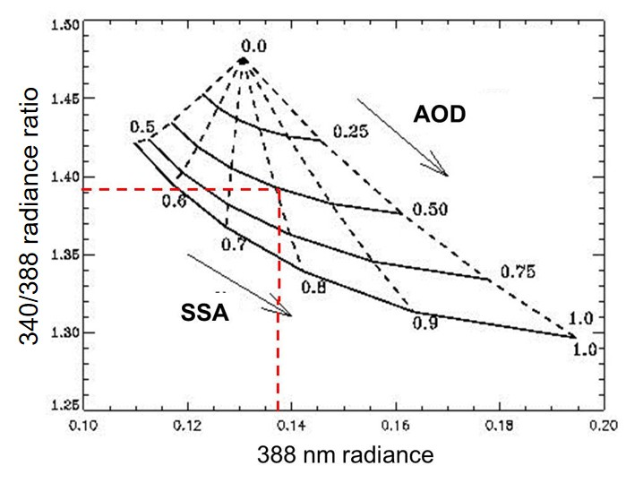
… From Qualitative
UVAI
…to Physically Meaningful Quantitative Products
If Aerosol Layer Height is known, accurate values of AOD and SSA can be retrieved
CALIOP ALH’s are used in conjunction with assumed AAE 4.8

Slide 7
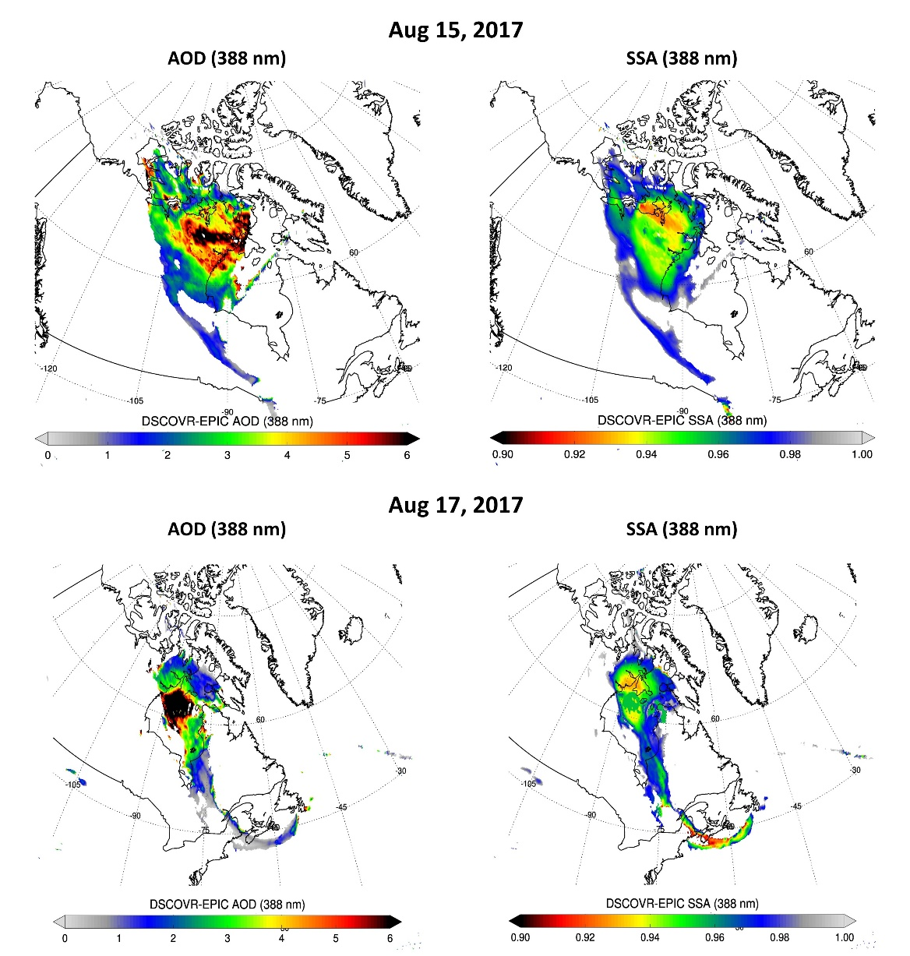
ALH constrained EPIC AOD/SSA Retrievals

Slide 8
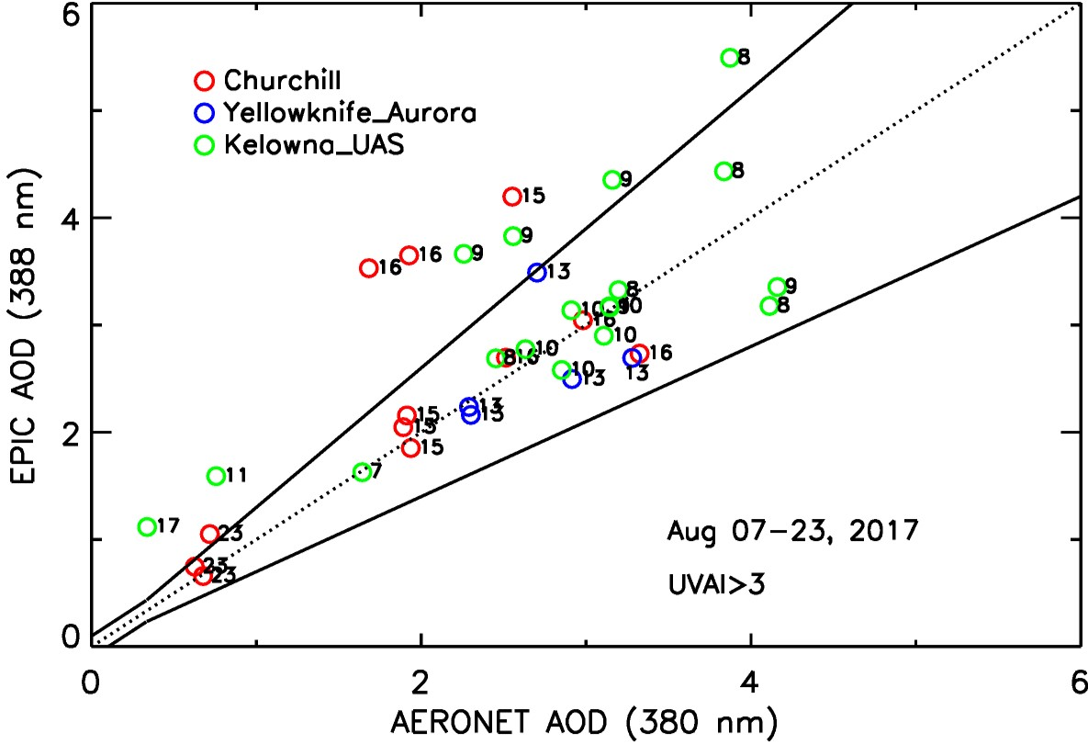
EPIC-AERONET AOD comparison
(59N,94W)
(62N,114W)
(50N,119W)
Comparisons at the Kelowna_UAS site use standard EPICAERUV retrievals
Other sites use ALH (> 10 km) constrained research algorithm

Slide 9

Separating Stratospheric from Tropospheric Aerosols
RSD = 71%, AAE = 4.8
Calculated AOD-UVAI relationship at the tropopause height can be use to identify
stratospheric aerosols.

Slide 10
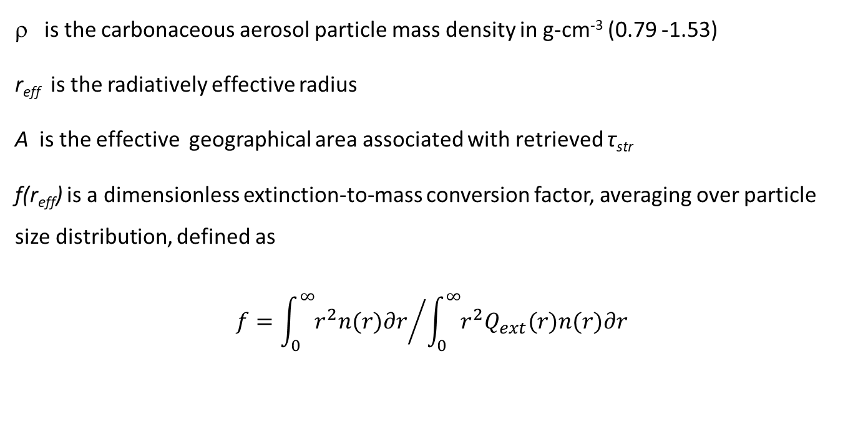

Stratospheric Aerosol Mass Calculation
$M=Σ \frac{4}{3}ρr_{eff}Aτ_{str}f\left(r_{eff}\right)$
is the carbonaceous aerosol particle mass density in g-cm⁻³ (0.79 -1.53)
r_{eff} is the radiatively effective radius
A is the effective geographical area associated with retrieved τ_{str}
f(r_{eff}) is a dimensionless extinction-to-mass conversion factor, averaging over particle size distribution, defined as
$$f={\int_{0}^{∞}{r^{2}n(r)∂r}}/{\int_{0}^{∞}{r^{2}Q_{ext}(r)n(r)∂r}}$$
n(r)dr is the assumed number particle size distribution,
Q_{ext} (r) is the extinction efficiency factor calculated using Mie scattering theory
Standard EPICAERUV particle size distribution for carbonaceous aerosols (AERONET-based)

Slide 11
Results
August 13, 2017 |  |  | August 14, 2017 |  |  | August 15, 2017 |  |  | August 16, 2017 |  |  | August 17, 2017
UTC h:m | A(km²) 10³ | M (Kt) | UTC h:m | A(km²) 10³ | M (Kt) | UTC h:m | A(km²) 10³ | M (Kt) | UTC h:m | A(km²) 10³ | M (Kt) | UTC h:m | A(km²) 10³ | M (Kt)
15:53 | 32 | 1±0.4 | 14:29 | 305 | 82±26 | 15:24 | 487 | 196±62 | 15:43 | 728 | 268±86 | 16:02 | 614 | 254±82
16:58 | 39 | 6±2 | - | - | - | 16:30 | 565 | 225±72 | 16:49 | 705 | 260±82 | 17:07 | 606 | 224±72
18:03 | 40 | 10±3 | - | - | - | 17:35 | 549 | 234±74 | 17:54 | 745 | 260±82 | 18:13 | 692 | 181±52
19:09 | 54 | 16±5 | - | - | - | 18:41 | 589 | 243±74 | 19:00 | 821 | 251±80 | - | - | -
20:14 | 109 | 34±11 | - | - | - | 19:46 | 645 | 261±78 | 20:05 | 806 | 244±78 | - | - | -
Avg. | 54 | 13±4 |  | 305 | 82±26 |  | 567 | 232±72 |  | 761 | 255±80 |  | 637 | 219±69
Near-hourly (daytime) Injected Aerosol Mass from August 13 to August 17

Slide 12
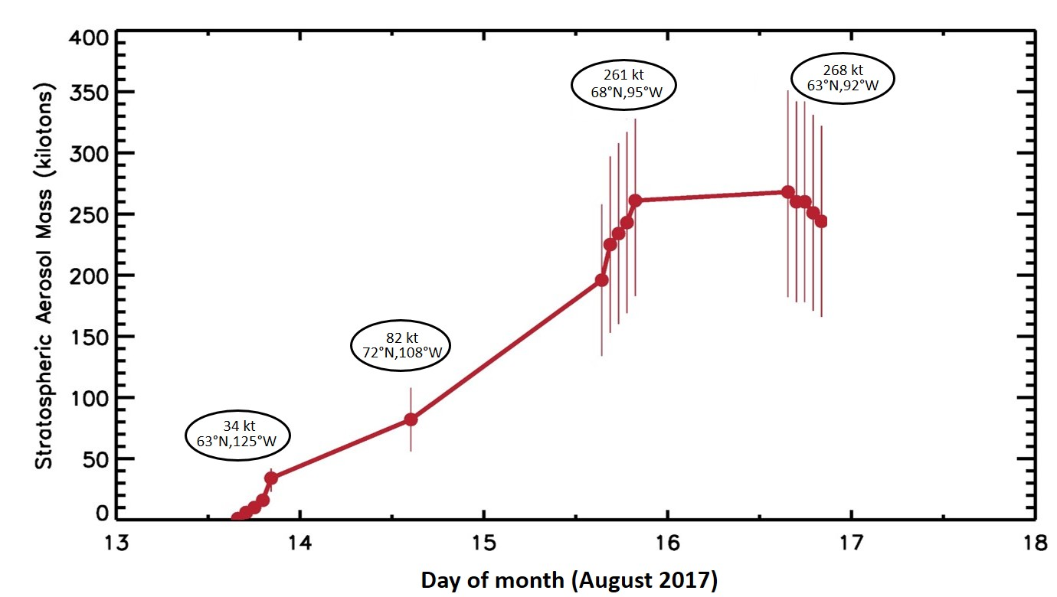
Time line of EPIC-derived Carbonaceous Aerosol Injection in the Stratosphere
-Large day-night differences in aerosol mass injection rates are apparent.
-Observed day-night differences are consistent with diabatic heating as the physical mechanism
responsible for the lifting of the aerosol layer from the upper troposphere to the stratosphere.

Slide 13
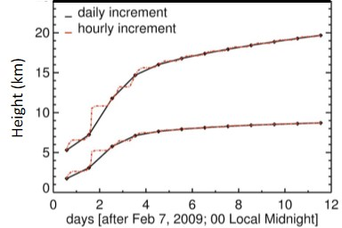
Self-lifting Modelling results
de Laat et al., (2012), A solar escalator: Observational evidence of the self-lifting of smoke and aerosols by absorption of solar radiation in the February 2009 Australian Black Saturday plume, J. Geophys. Res., 117, D04204, doi:10.1029/2011JD017016.

Slide 14
Conclusions
Unprecedented amounts of carbonaceous aerosols were lifted to the upper troposphere in August 2017, resulting from intensive convective activity pyro-cumulonimbus events triggered by fires in Canada’s British Columbia province.
CALIOP profiles of attenuated backscatter provided information of the height of the injected aerosol plume.
Total column aerosol amount (AOD) and absorption properties over about 10 days after the injection were retrieved by the EPIC sensor on the DSCOVR satellite. AOD values as high as 16 and SSA’s as low as 0.92 were retrieved.
Estimated stratospheric carbonaceous aerosol mass in the stratosphere from EPIC observations indicates that about 268 kt were injected over three days (August 13-15).
Marked day-night differences in injection rates suggest diabatic heating (self-lifting) is the driving mechanism
responsible for the mobilization of the aerosol mass from the upper-troposphere to the stratosphere. Results
are consistent with de Laat et al (2012) modelling analysis.

