Slide 1
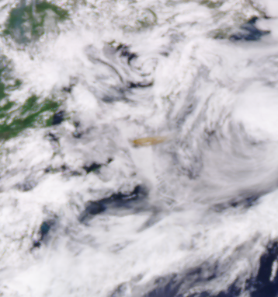
EPIC Level 2 Processing
DSCOVR Science Team Meeting
Goddard Space Flight Center
Marshall Sutton/586
Marshall.H.Sutton@nasa.gov
September 2019
EPIC Enhanced image Epic_RGB_2019062215123

Slide 2
DSCOVR EPIC Science
Functional Block Diagram and Major Data Flow
DSOC
ASDC
Earthdata Search
SPOCC
Level 2
Products (FTP)
EPIC L1 Files (FTP)
EPIC L1 Files
Rsync
NCCS
Level 2 Processing
Level 2 Products
ROSES Science Teams
EPIC L1 Files (secure Rsync) (backup)
EPIC website
Atmospherically Corrected Enhanced RGB images (FTP)

Slide 3
Level 2 Processing of EPIC_1b_v03
 | Start Date | End Date | Granules Available on ASDC | Processed Granules | % Complete | Size (TB)
UV AEROSOL | 6/27/15 | 6/27/19 | 19,921 | 20,522 | 97% | 3.2
TO3 | 6/17/15 | 6/27/19 | 20,244 | 20,277 | 100% | 2.9
SO2 | 12/3/15 | 6/27/19 | 998 | 998 | 100% | 0.19
O3SO2AI | 6/12/15 | 6/27/19 | 20,454 | 20,454 | 100% | 1.2
CLOUD | 8/18/15 | 6/27/19 | 16,743 | 16,675 | 100% | 4.6
Atm. Correction | 6/13/15 | 6/27/19 | 18,904 | 18,904 | 100% | 1.10
Vegetation | 6/13/15 | 6/27/19 | 18,904 | 18,904 | 100% | 0.40

Slide 4
Level 2 Processing of EPIC_1b_v03
 | Start Date | End Date | Granules available on NCCS
UV AEROSOL | 1/1/17 | 8/31/18 | 2034
TO3 | 1/1/17 | 12/31/17 | 9803
SO2 | 1/1/17 | 12/31/17 | 307
O3SO2AI | 1/1/17 | 12/31/17 | 672
CLOUD | 1/1/17 | 1/31/18 | 4460
Atm. Correction | 1/1/17 | 12/31/18 | -
Vegetation | 1/1/17 | 12/31/18 | -

Slide 5
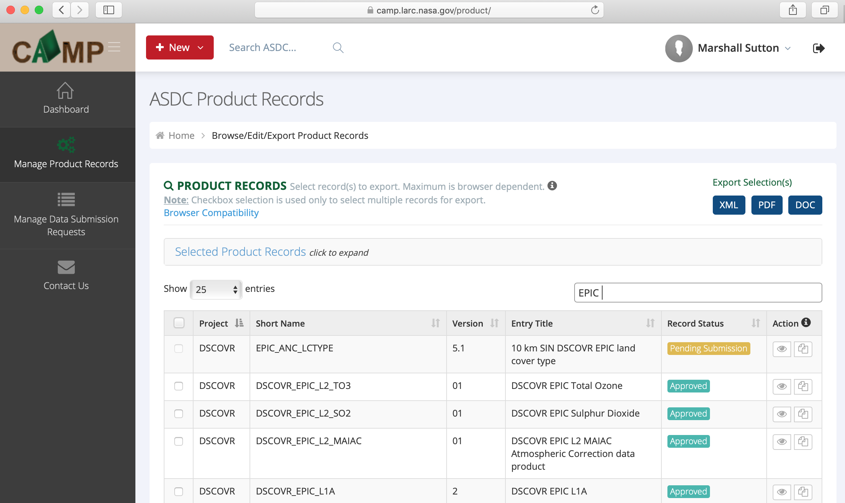
Level 2 Processing of EPIC_1b_v03
Must create new product record in CAMP for each record camp.larc.nasa.gov
Notes:
Need Keywords, personnel, Spatial and Temporal resolution

Slide 6
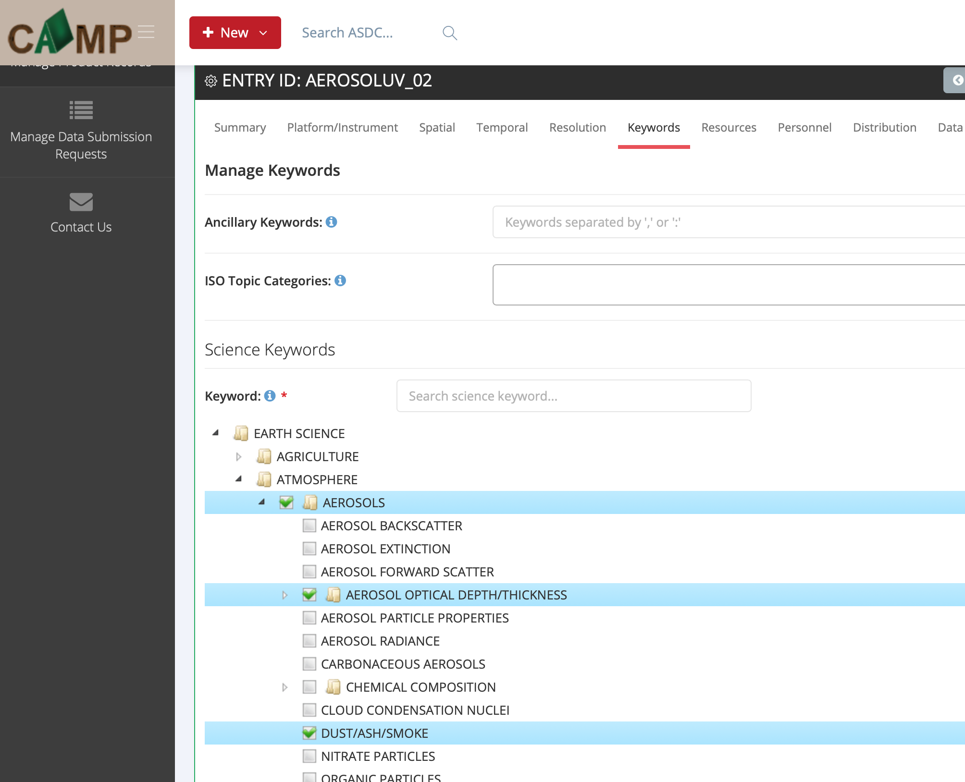
EPIC 1b Version 03 Processing
Must create new product record in CAMP for each record camp.larc.nasa.gov

Slide 7
EPIC 1b Version 03 Processing
For new NCCS accounts: https://www.nccs.nasa.gov/usradmin/usaduarf.html
Please validate level 2 products with epic_1b version 03 inputs. Can be found on NCCS: /discover/nobackup/projects/DSCOVR/
Let me know when product is ready to publish!
Processing pipelines for version 03 will be up and running by the time EPIC is fixed.

Slide 8
NCCS – NASA Center for Climate Simulations nccs.nasa.gov
Scalable Unit 12
17,136 Intel Xeon 2.6 GHz Haswell processor cores
2 14-core processors per node
128 GB of memory per node
Given a set limit
Processing optimized for allocation
Optimizing Code
NCCS Help Desk –support@nccs.nasa.gov
MPI and OpenMP
Intel Parallel Studio
Intel Python

