Slide 1
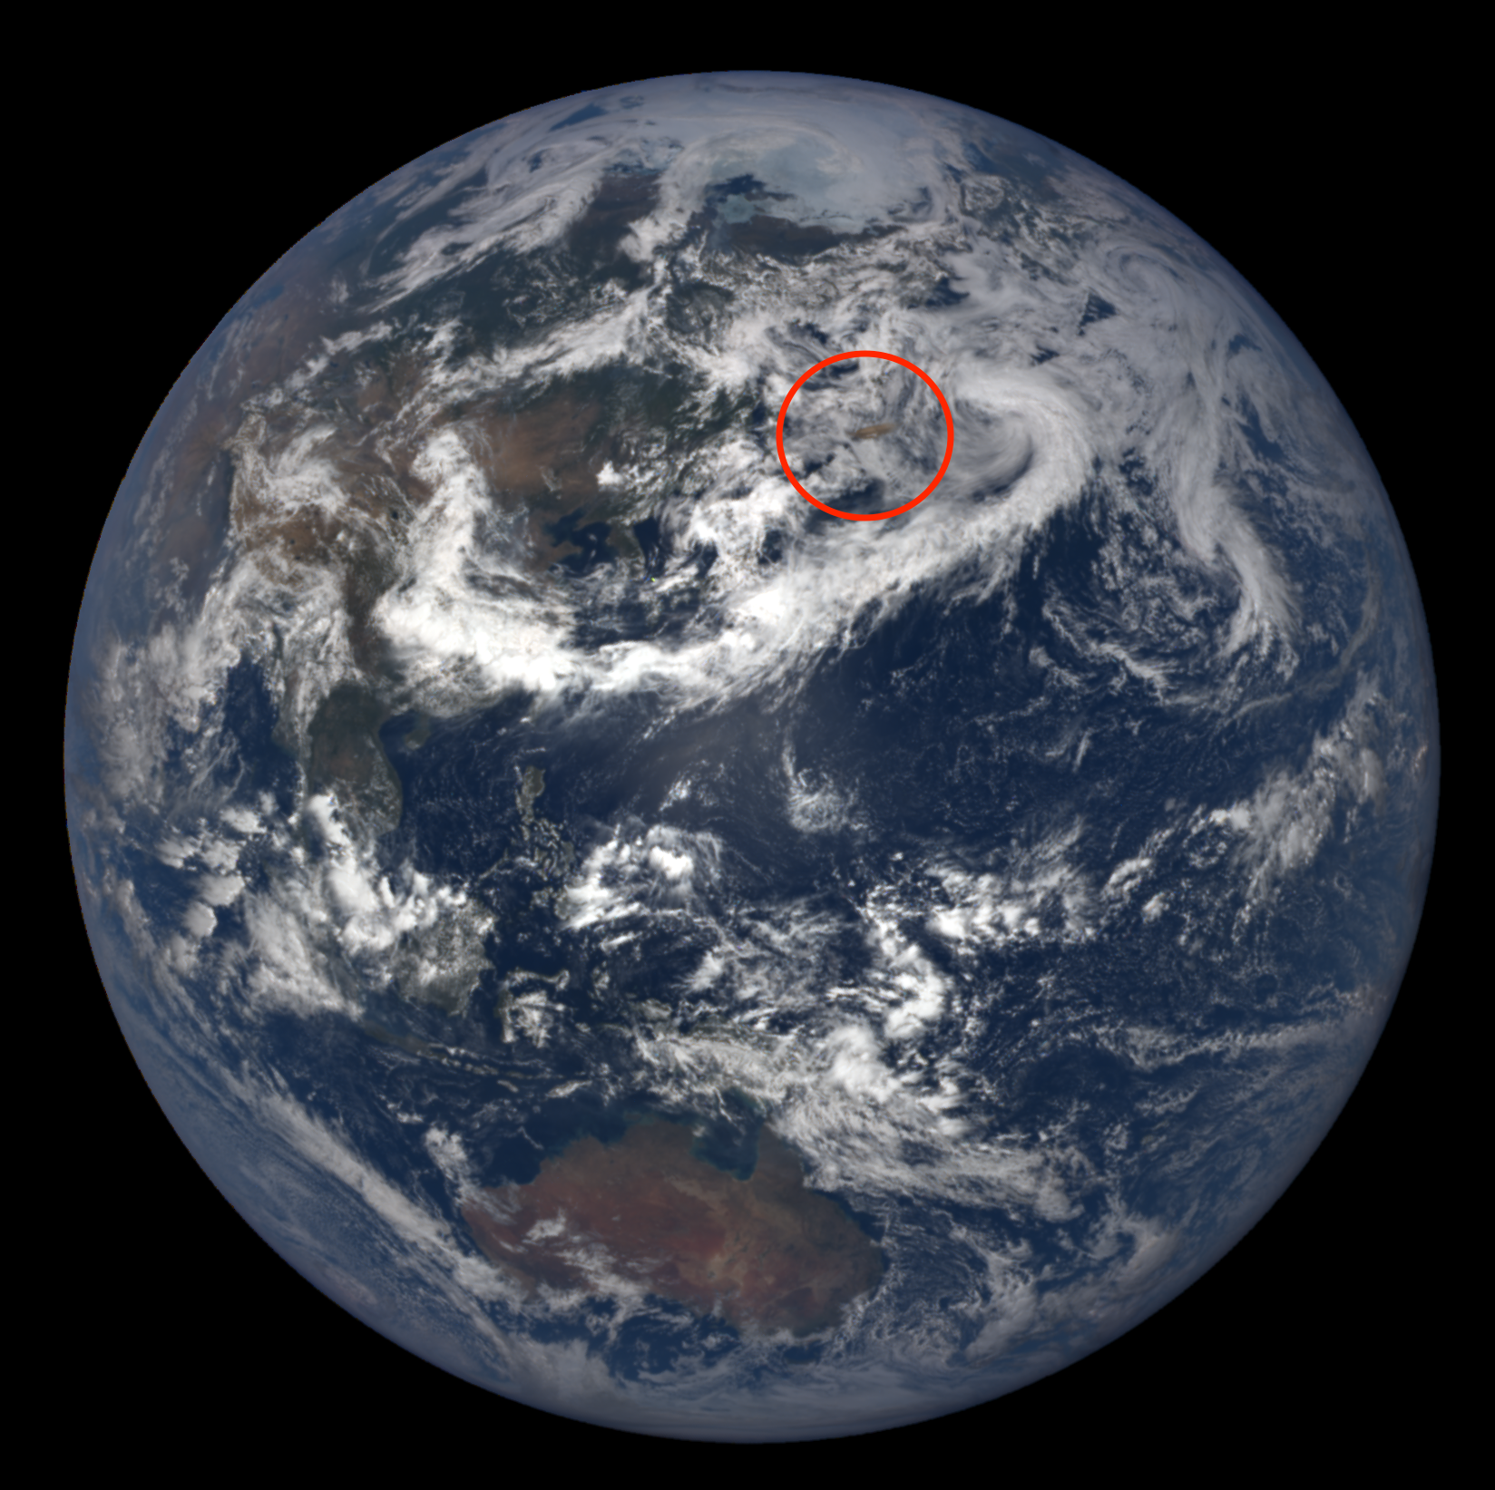
DSCOVR/EPIC volcanic SO₂ product: update and latest results
Simon Carn¹, Nick Krotkov², Brad Fisher^{2,3}, Can Li^{2,4}, Fred Prata⁵
Michigan Technological University, Houghton, MI, USA; scarn@mtu.edu
NASA Goddard Space Flight Center, Greenbelt, MD, USA
SSAI, Lanham, MD, USA
ESSIC, University of Maryland, College Park , MD, USA
AIRES Pty Ltd, Melbourne, Australia
Acknowledgments: NASA DSCOVR STM for support; Marshall Sutton for data processing

Slide 2
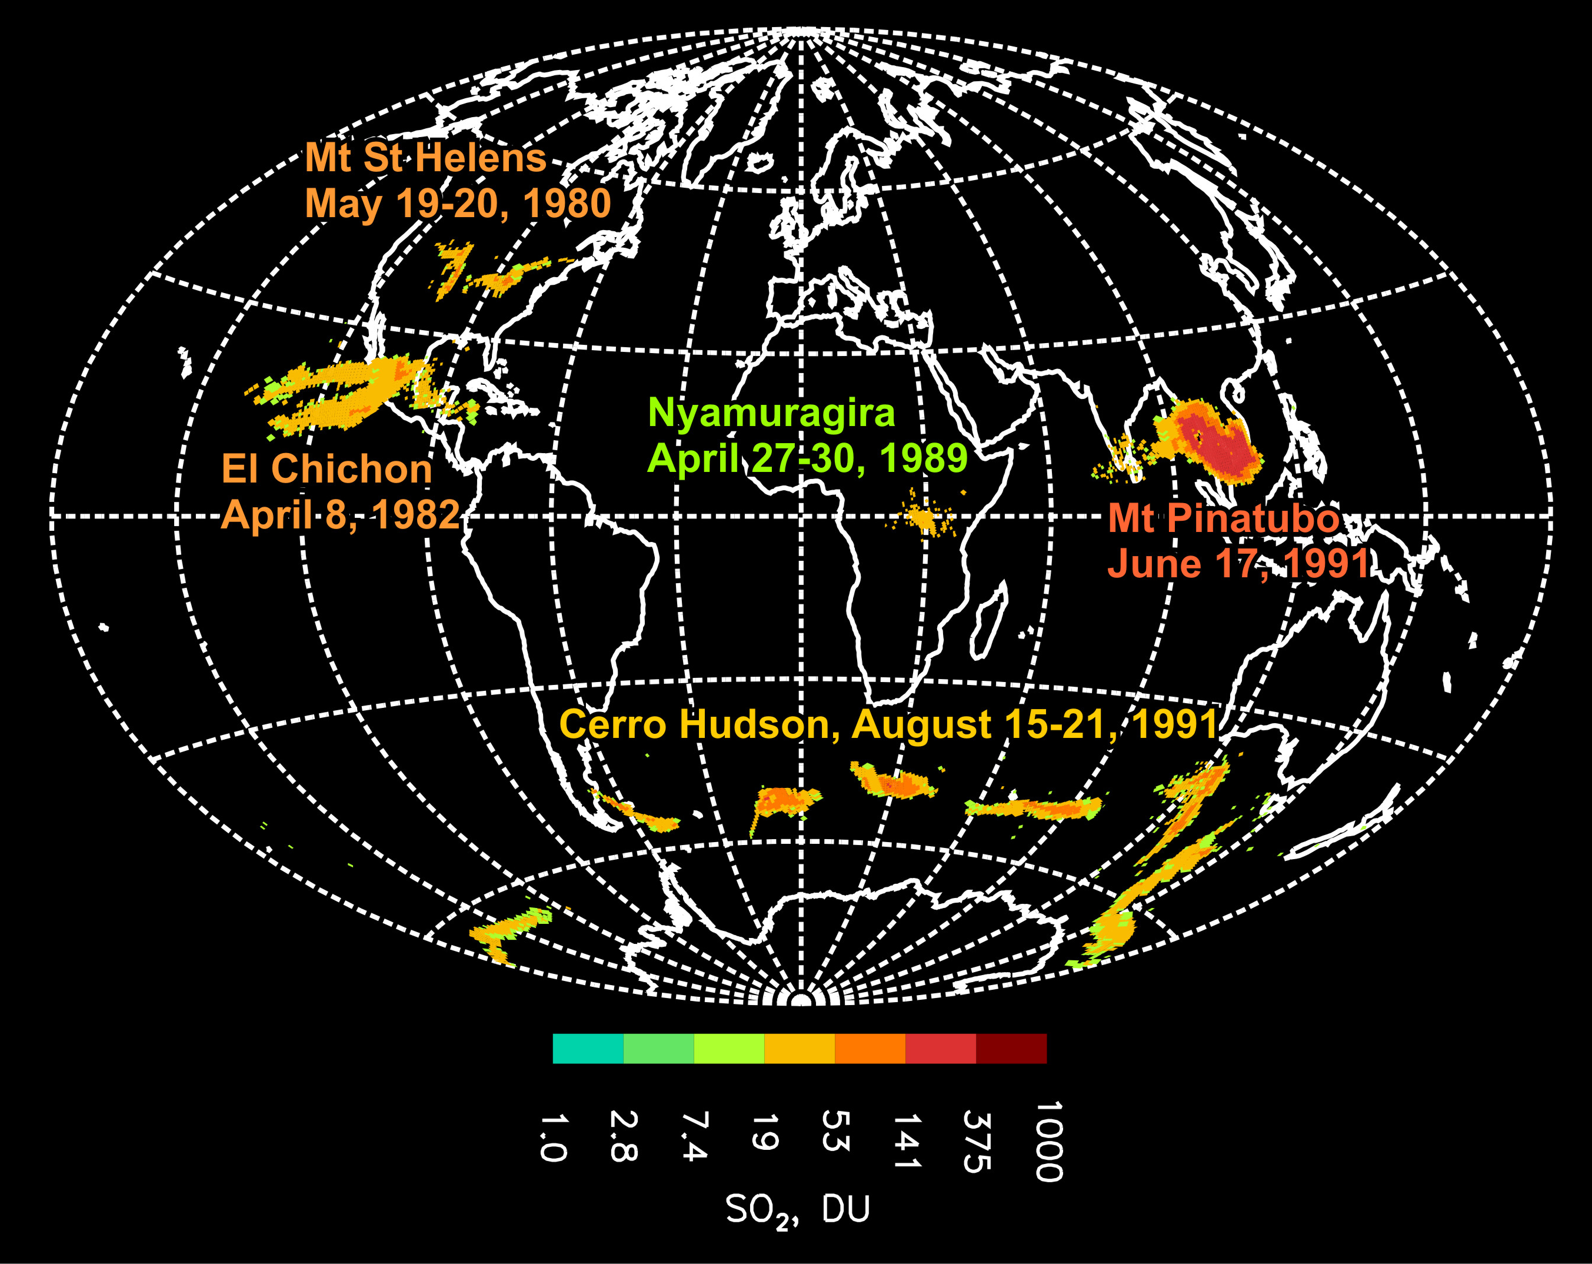
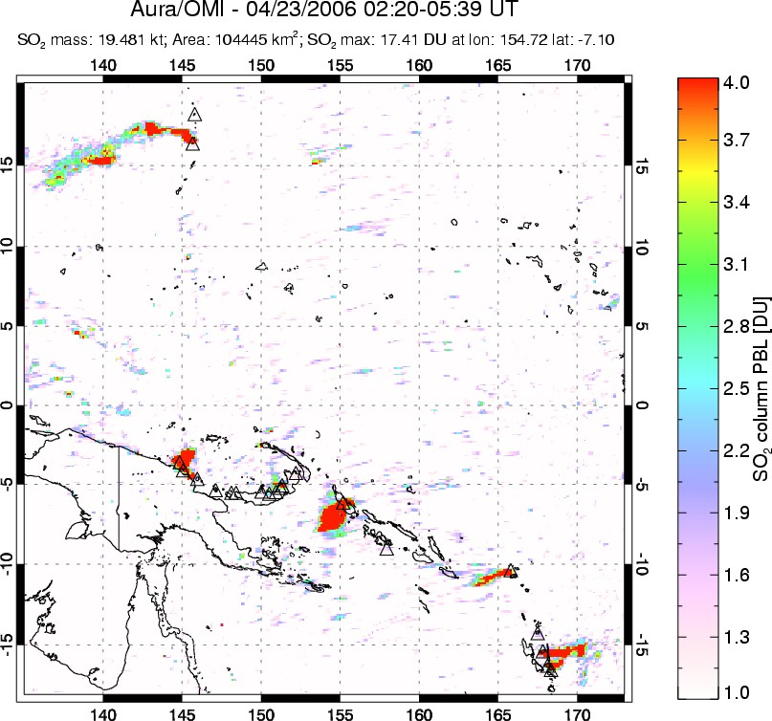


UV satellite remote sensing of volcanic SO₂
[Carn et al., 2008, 2013, 2016]
SW Pacific
April 23, 2006
1978-2005
Total Ozone Mapping Spectrometer (TOMS)
1995-2003
Global Ozone Monitoring Experiment (GOME)
2004-
Ozone Monitoring Instrument (OMI)
2006-
Global Ozone Monitoring Experiment 2 (GOME-2)
2012-
Ozone Mapping and Profiler Suite (OMPS)
2015-
DSCOVR/EPIC
2017-
S5P/
TROPOMI

Slide 3
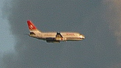
More Reflected
Solar Flux
Stratospheric aerosols
(Lifetime ≈ 1-3 years)
STRATOSPHERE
backscatter
H₂S
SO₂
absorption
(near IR)
Solar Heating
IR
Heating
emission
→ H₂SO₄
NET HEATING
IR Cooling
HCl,
BrO, ClO
Heterogeneous → Less
O₃ depletion Solar Heating
absorption (IR)
emission
CO₂
H₂O
forward scatter
Tropopause
(8-17 km)
Ice
Enhanced
Diffuse
Flux
Effects
on cirrus
clouds
Gas scavenging?
TROPOSPHERE
Reduced
Direct
Flux
NET COOLING
~1-3 hrs
Ashfall
0.1-0.4ºC global average cooling after 20th century volcanic eruptions (1963 Agung,1982 El Chichon, 1991 Pinatubo)
Volcanic eruptions and climate
Dissolved gases
Original slide courtesy of A. Robock

Slide 4
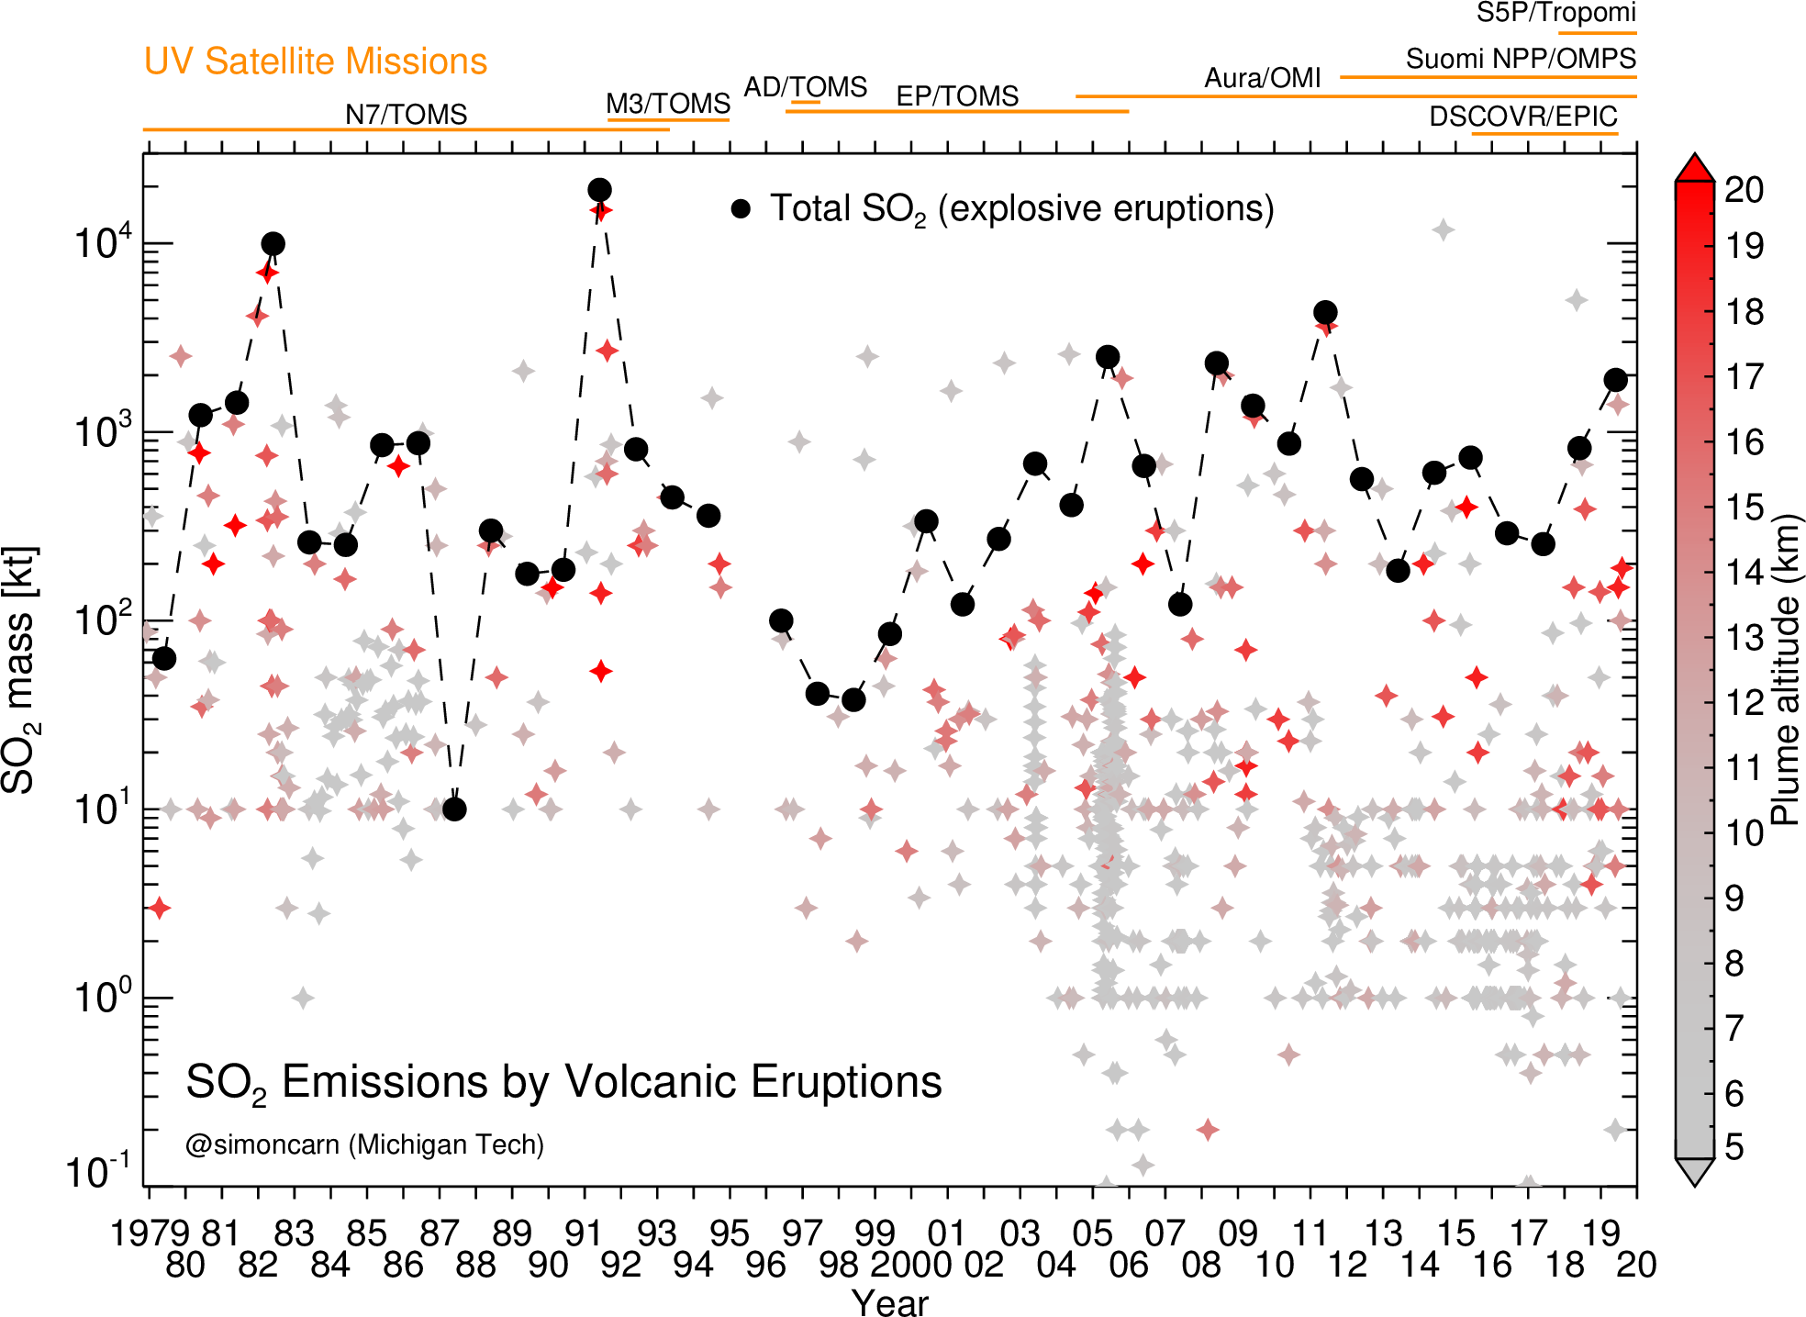
Multi-decadal volcanic SO₂ emissions record
Carn et al. (2016) and updates

Slide 5
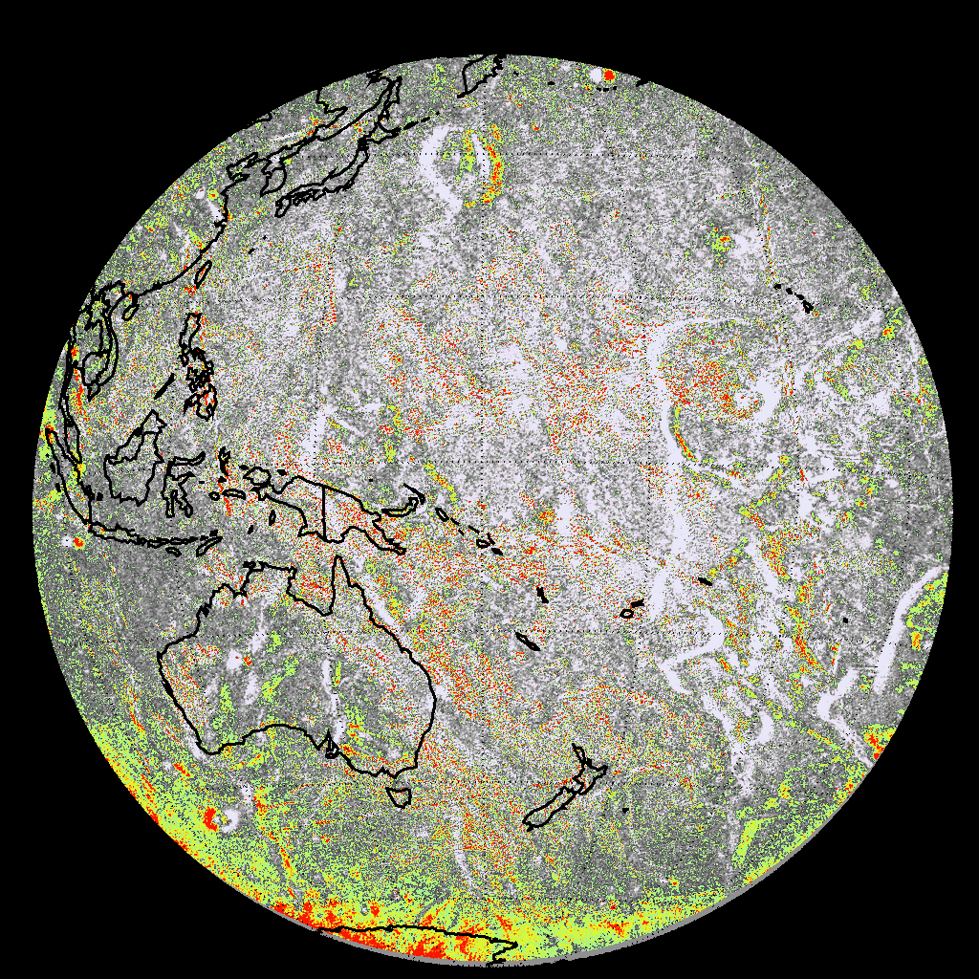
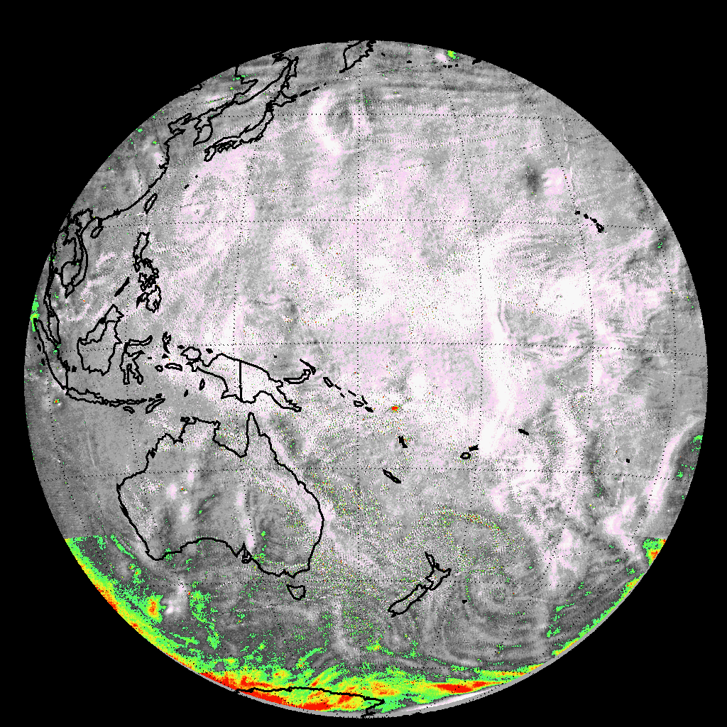
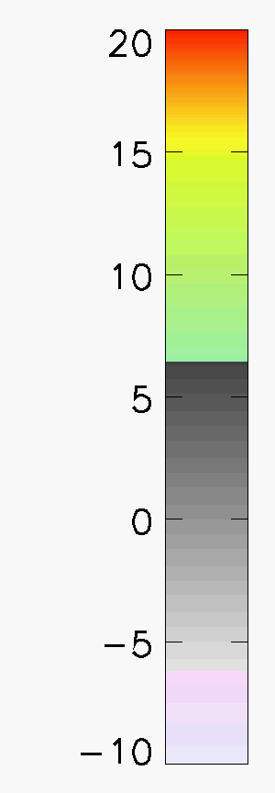
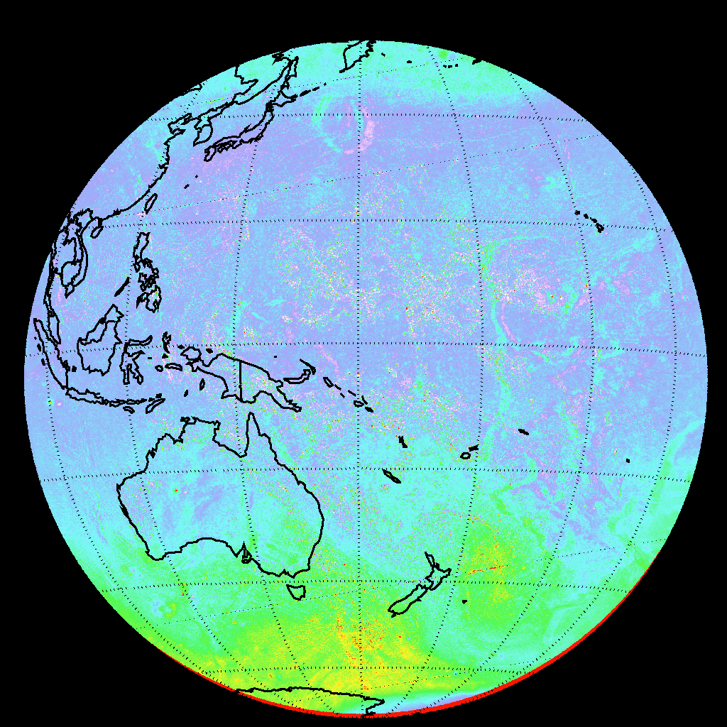
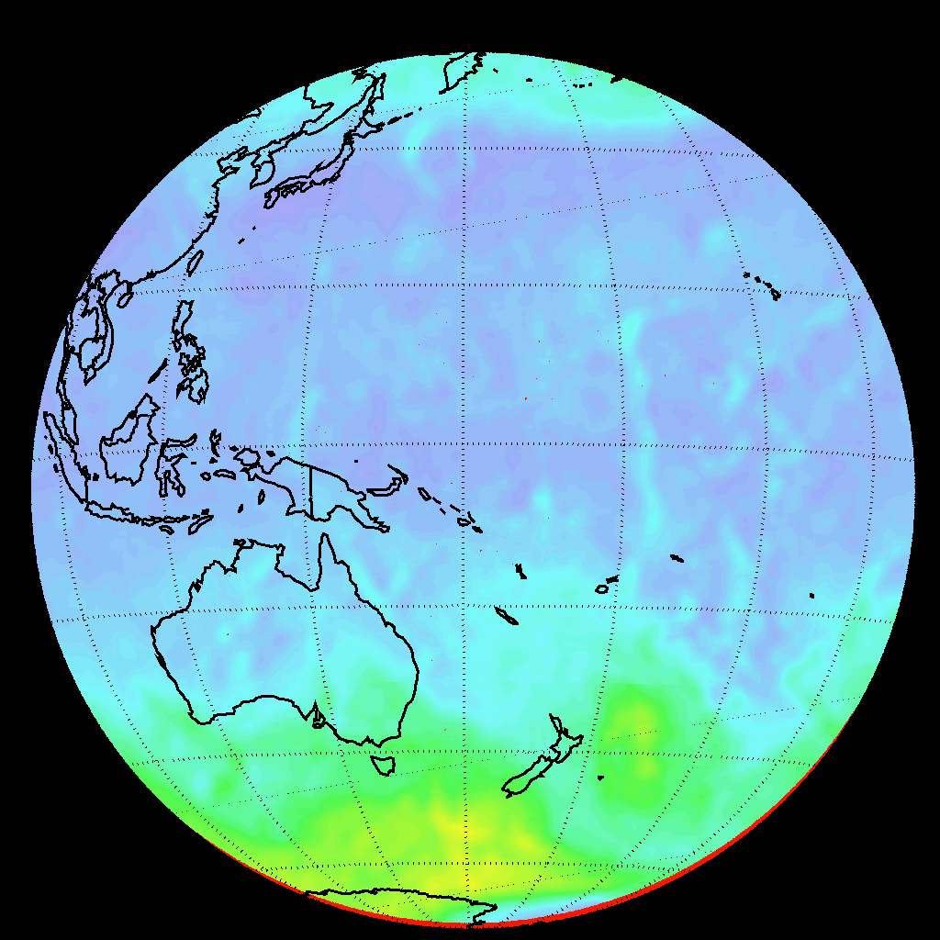
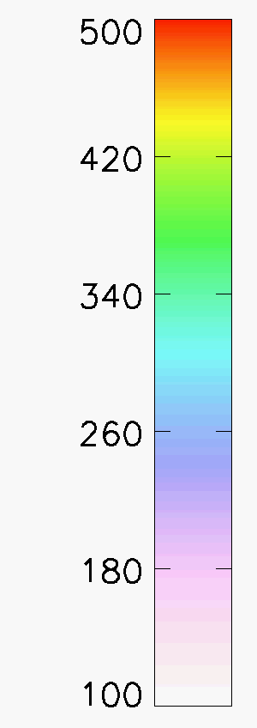

EPIC volcanic SO₂ retrieval algorithm
State vector
Step 1
Step 2
$$x=\left(\begin{matrix}SO2 \\ O3 \\ \begin{matrix}dR/dλ \\ R\end{matrix}\end{matrix}\right)$$
SO₂
Tinakula eruption
Dobson Units (DU)
Uses 4 EPIC UV channels
Step 1 -> initial estimates
Step 2 -> reduce artifacts
  Earth rotation
  Geolocation errors
  Cloud noise
  Ozone variability
Should improve with v03 L1b data
Noise at high SZA
Smoothed Ozone field
O₃
Dobson Units (DU)
Notes:
Description of the DSCOVR/EPIC SO2 Algorithm PI: Nick Kroktov
The DSCOVR/EPIC volcanic SO₂ algorithm is a modified version of the heritage NASA Total Ozone Mapping Spectrometer (TOMS) 4-band algorithm, adapted to the EPIC wavelengths. The algorithm uses all four EPIC UV channels (centered at 317nm, 325nm, 340 nm, 388nm) to retrieve 4 parameters of the state vector (x): vertical column amounts of SO₂ (assuming 13km height) and total O₃, the Lambertian equivalent reflectivity at 388 nm (R), and its spectral dependence, dR/dλ. The algorithm relies on spectral differences in SO₂ and O₃ absorption cross sections to separate the two trace gases. SO₂ is more absorbing than O₃ at the shortest UV channel (317 nm), whereas O₃ is more absorbing at the longer channel (325nm).
The retrieval is performed iteratively for each EPIC pixel with SZA < 75º. It starts with the climatological profile of O₃ and zero SO₂ and first computes Lambertian equivalent scene Reflectivity (LER) at 388 nm (R). This parameter remains fixed during the iterations. The algorithm then retrieves adjustments to the state vector: Δx =[ΔSO_{2,} ΔO₃, Δ(dR/dλ)] by matching measured and calculated sun-normalized backscatterd UV (BUV) radiances at shorter spectral channels (317,325 and 340nm). The sensitivities (Jacobians) associated with linear perturbations in SO₂, O₃ and R are pre-computed for each UV spectral band and stored in look-up tables, which are numerically interpolated for EPIC viewing geometry and state vector values at each iteration. This algorithm appears to have adequate sensitivity to detect moderate to large volcanic eruptions from L1 Lagrange point.
Max iterations = 3
Quit itrations when Min res325 = 0.001 ( N value)

Slide 6
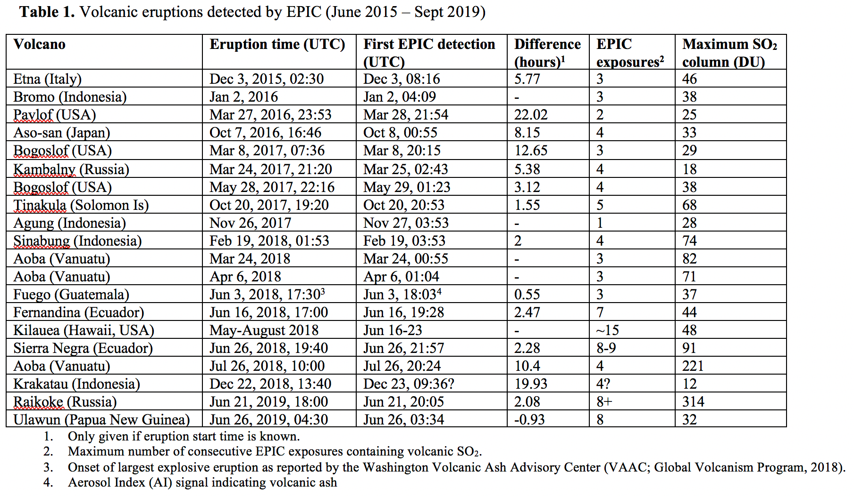
Volcanic eruptions detected by EPIC (2015 - )
Carn et al., GRL (2018) and updates
All significant eruptions since June 2015 detected by EPIC
At least 6 eruptions detected within ~0-3 hours of onset; major Raikoke eruption in June 2019

Slide 7
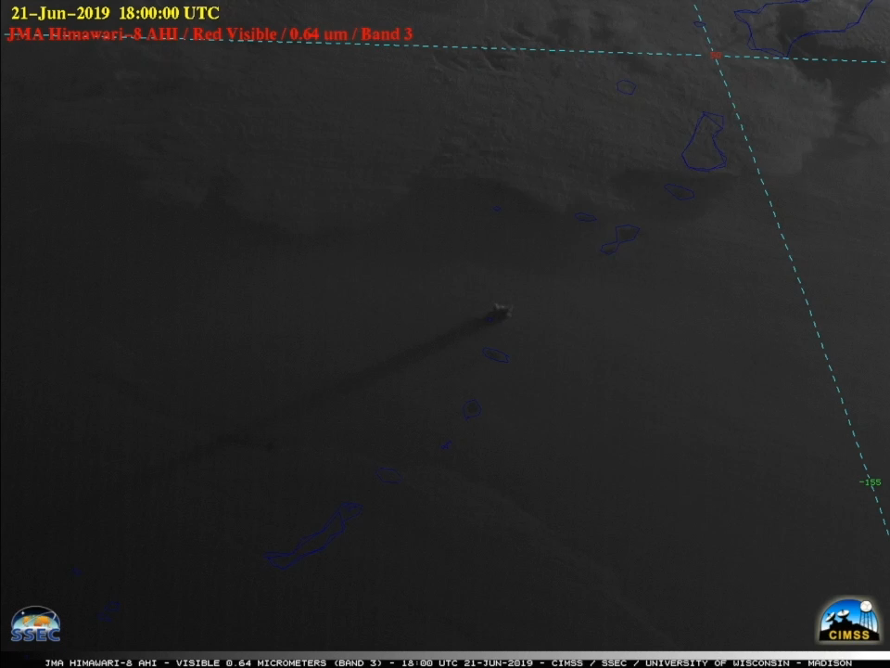
Raikoke eruption (Kuril Islands, Russia) – June 2019
Strong eruption w/ stratospheric injection
Mid-latitude
NH summer solstice
Summer cadence
Sunrise to sunset eruption
Himawari-8 AHI
(CIMSS/SSEC)
Remote infrasound from Petropavlovsk-Kamchatskiy
(R. Matoza/UCSB)

Slide 8
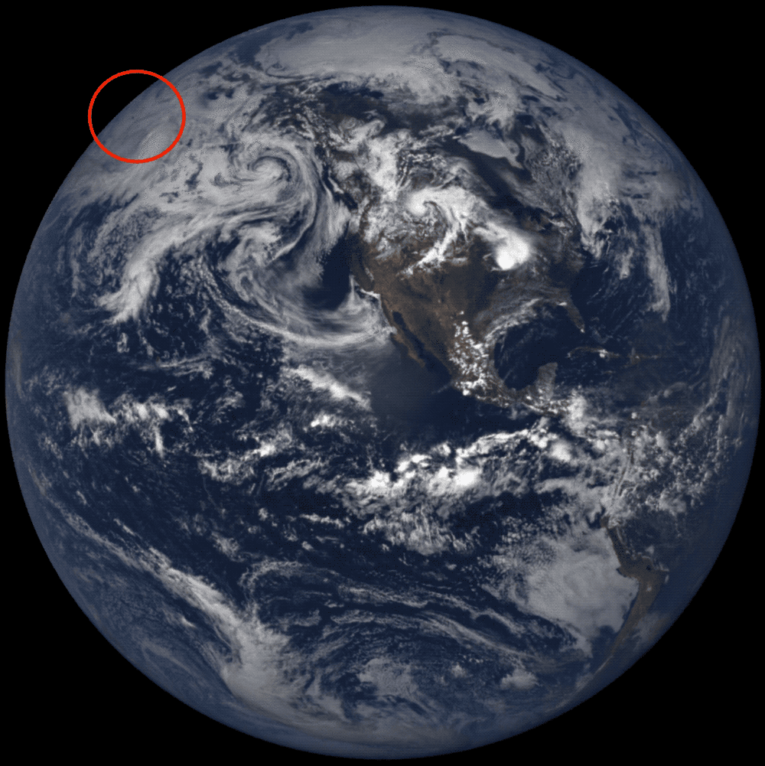
Raikoke eruption (Kuril Islands, Russia) – June 21, 2019
EPIC RGB images

Slide 9
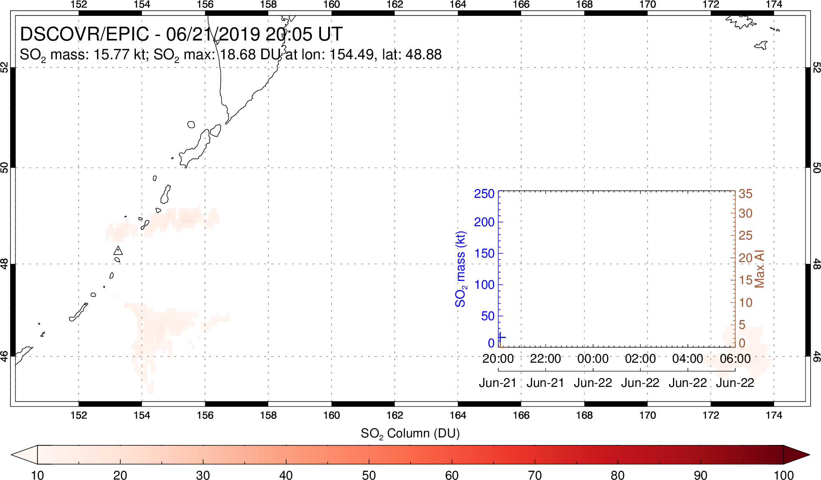
Raikoke eruption (Kuril Islands, Russia) – June 2019
First possible SO₂ detection (high SZA)

Slide 10
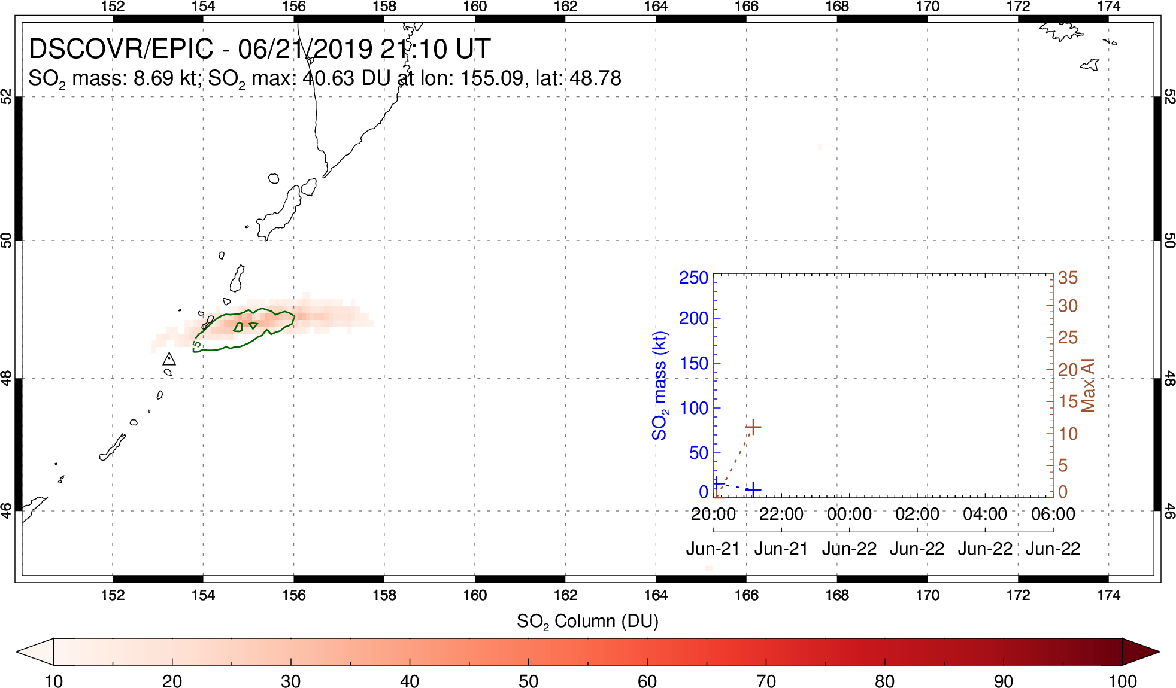
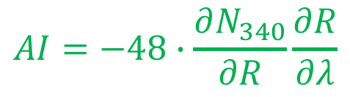
Raikoke eruption (Kuril Islands, Russia) – June 2019
$$AI=−48∙\frac{∂N_{340}}{∂R}\frac{∂R}{∂λ}$$
UVAI
First confident ash detection (UVAI>5)

Slide 11
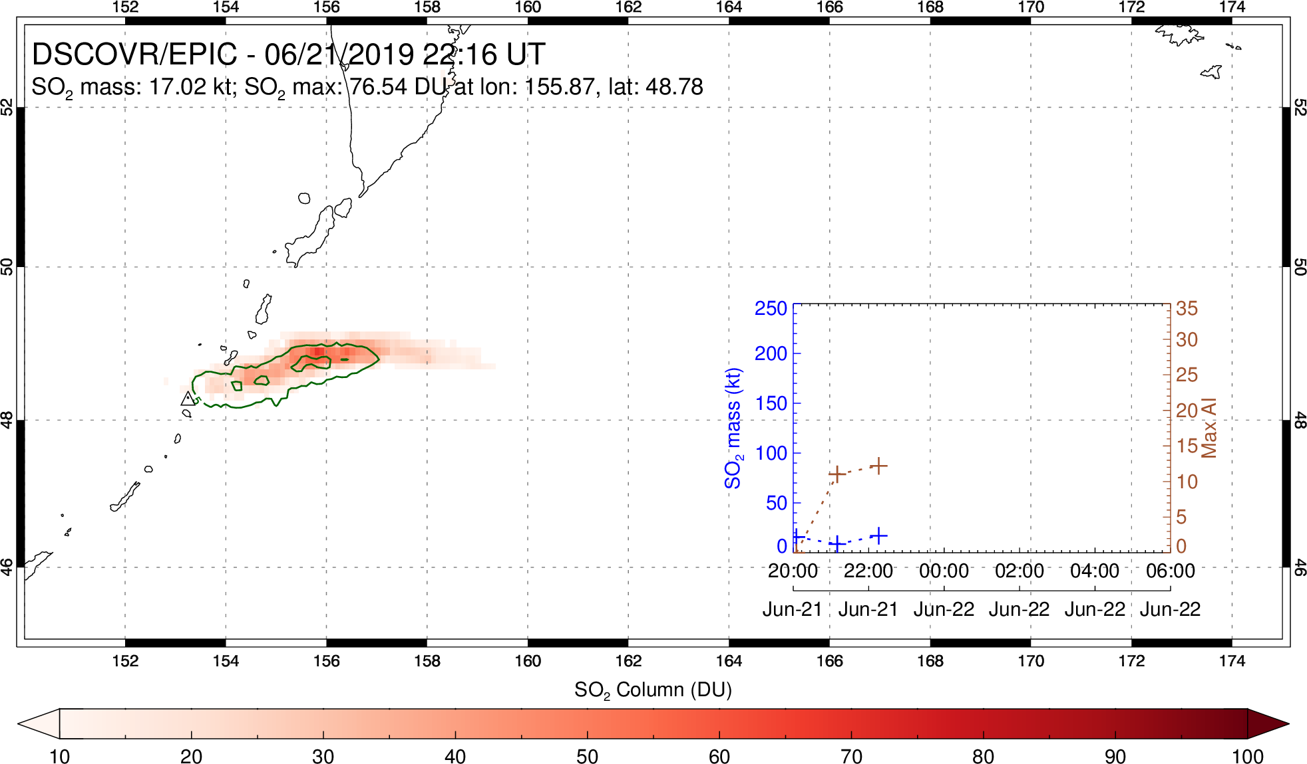
Raikoke eruption (Kuril Islands, Russia) – June 2019
Ash/SO₂ ‘puffs’ apparent

Slide 12
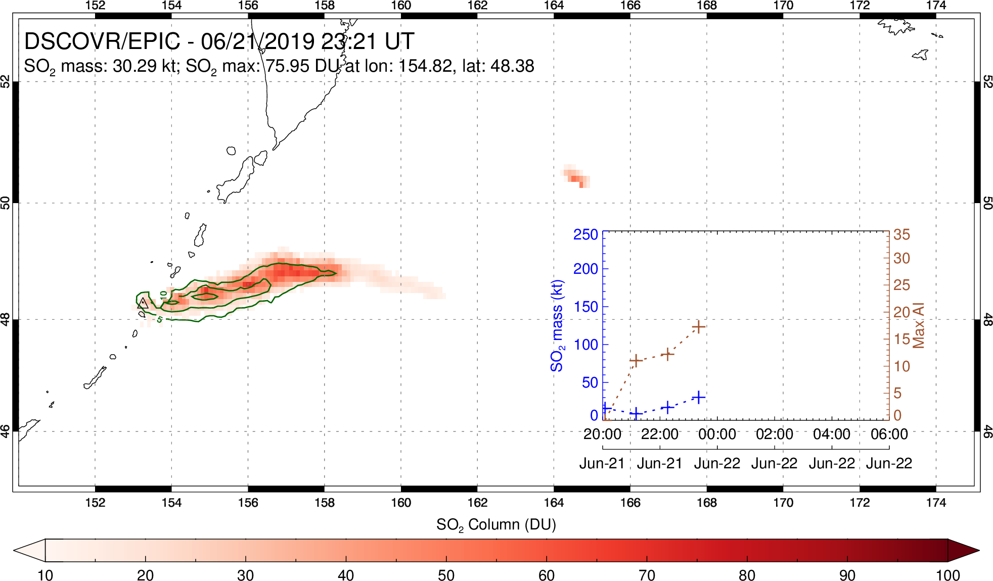
Raikoke eruption (Kuril Islands, Russia) – June 2019
SO₂ cloud ahead of ash cloud (higher altitude?)

Slide 13
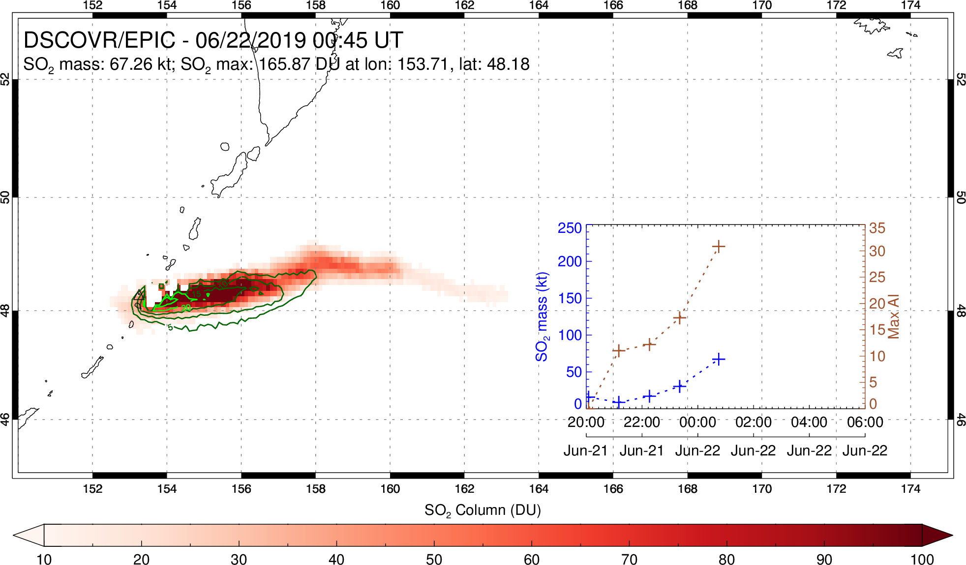
Raikoke eruption (Kuril Islands, Russia) – June 2019
Strong ash emission phase (AI>30)

Slide 14
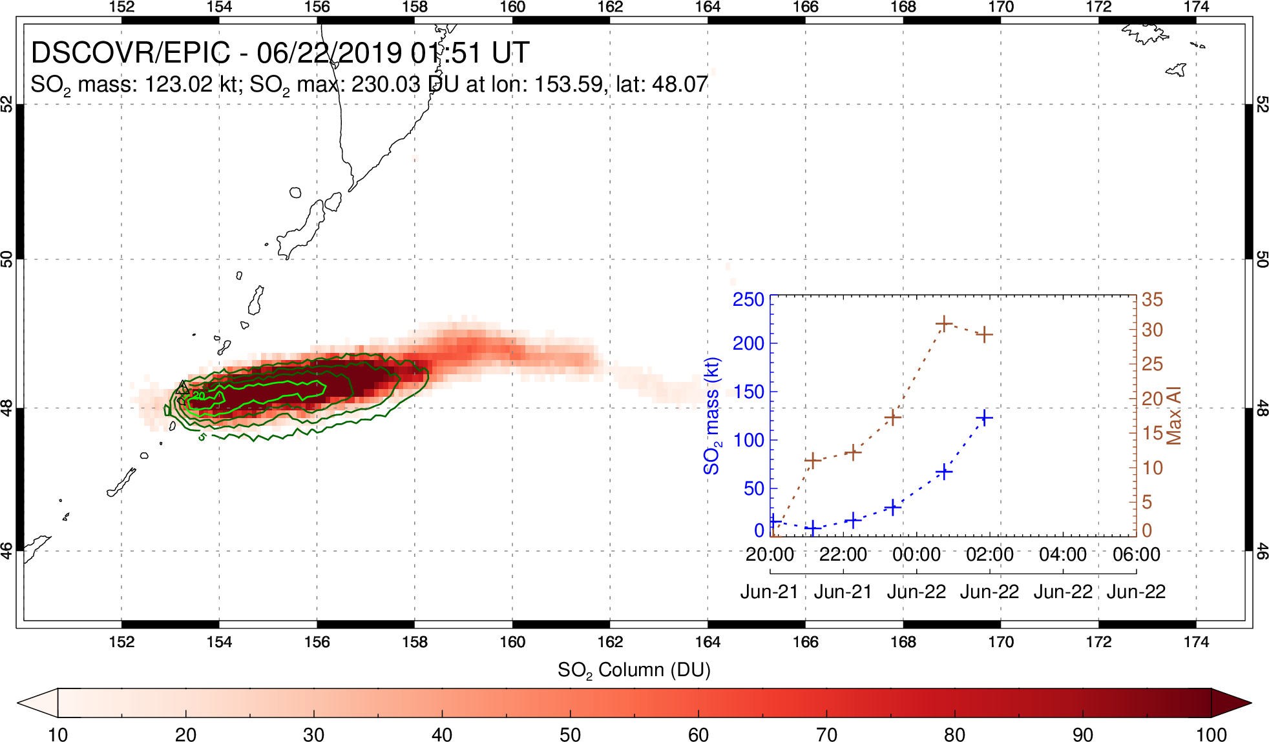
Raikoke eruption (Kuril Islands, Russia) – June 2019
Max SO₂ emission rate; ash interference

Slide 15
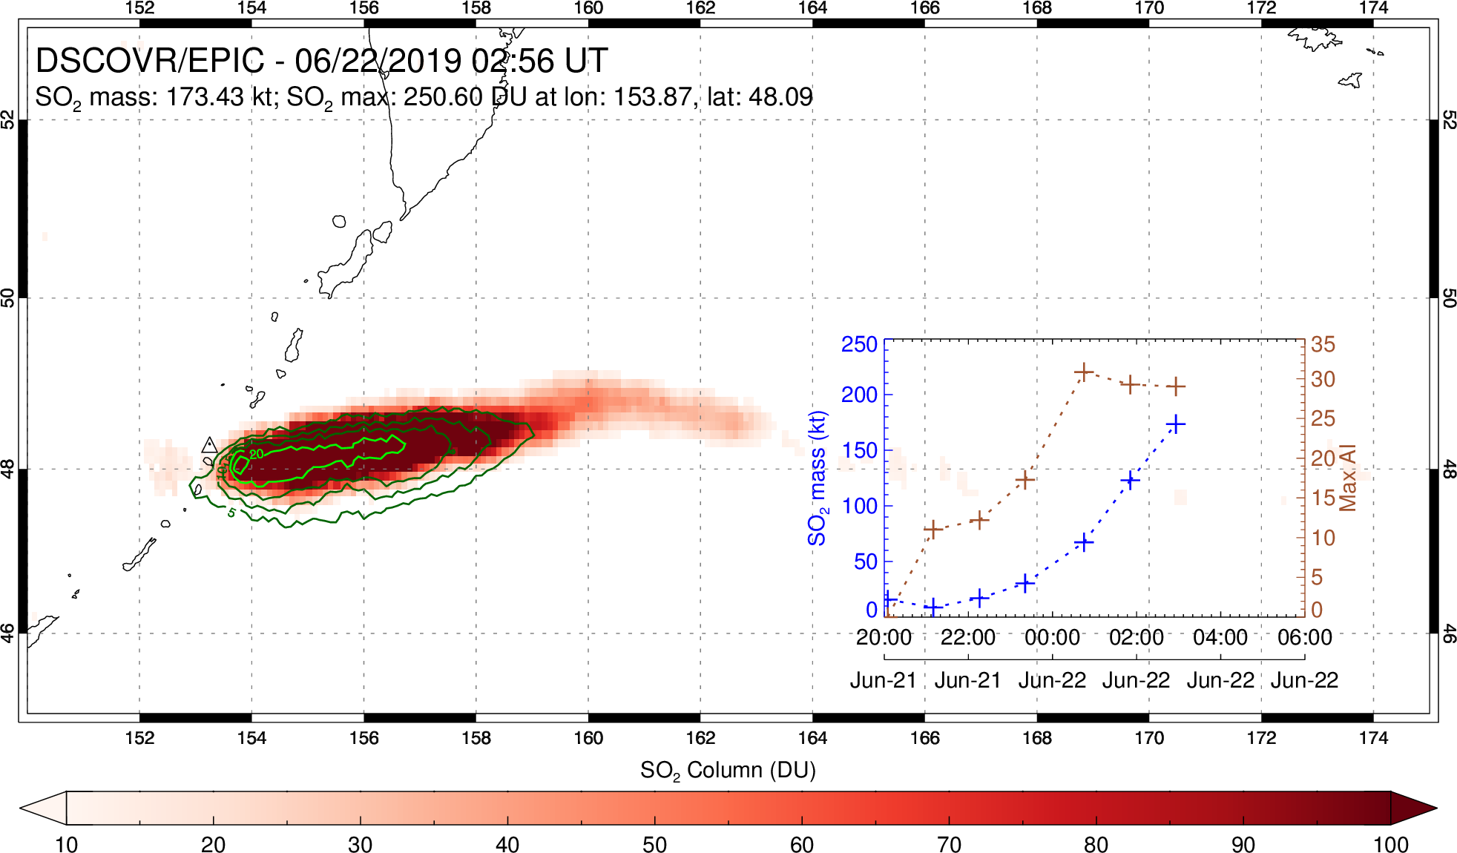
Raikoke eruption (Kuril Islands, Russia) – June 2019
Continued high AI; plume spreads ‘upwind’

Slide 16
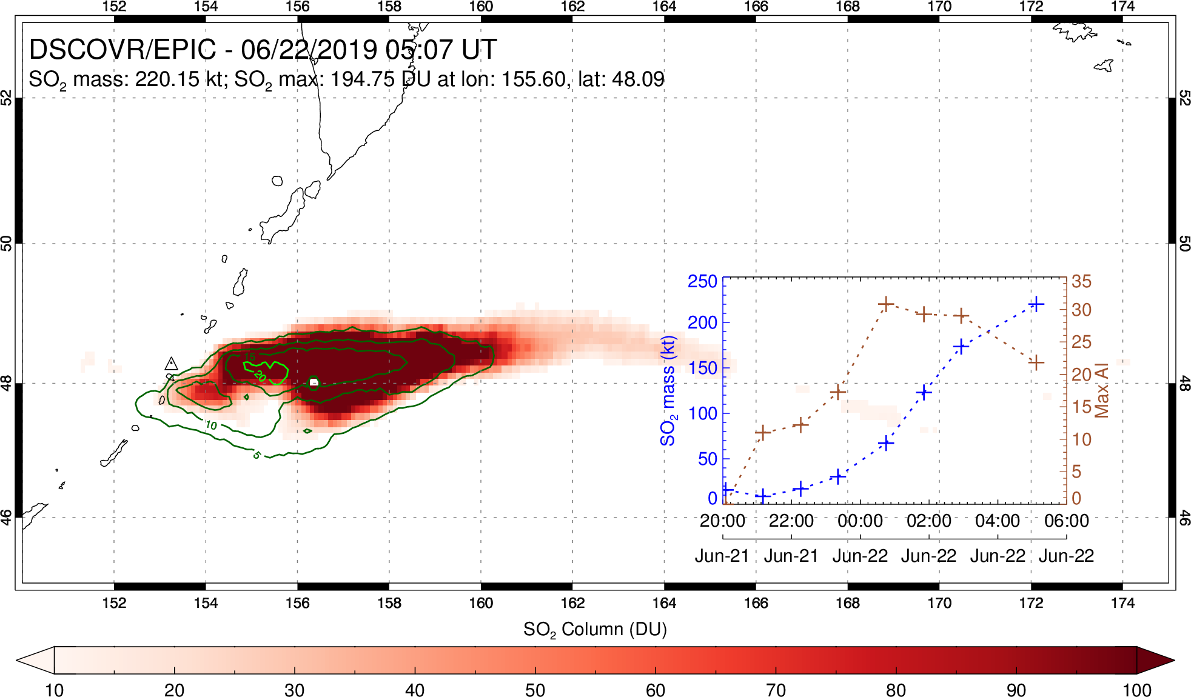
Raikoke eruption (Kuril Islands, Russia) – June 2019
AI decrease; SO₂ mass increasing; ash/SO₂ separating (~2 hour EPIC gap)

Slide 17
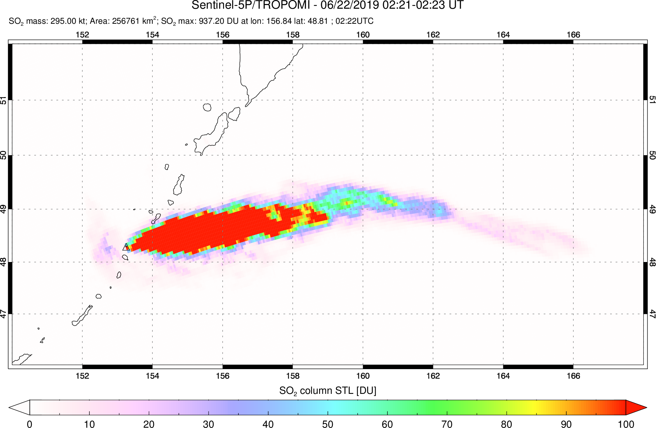
Raikoke eruption: comparison of EPIC and S5P/TROPOMI
Both TROPOMI and EPIC underestimate SO₂ on June 22 due to high ash loading
Notes:
Advantage of EPIC – single image with no orbit overlap

Slide 18
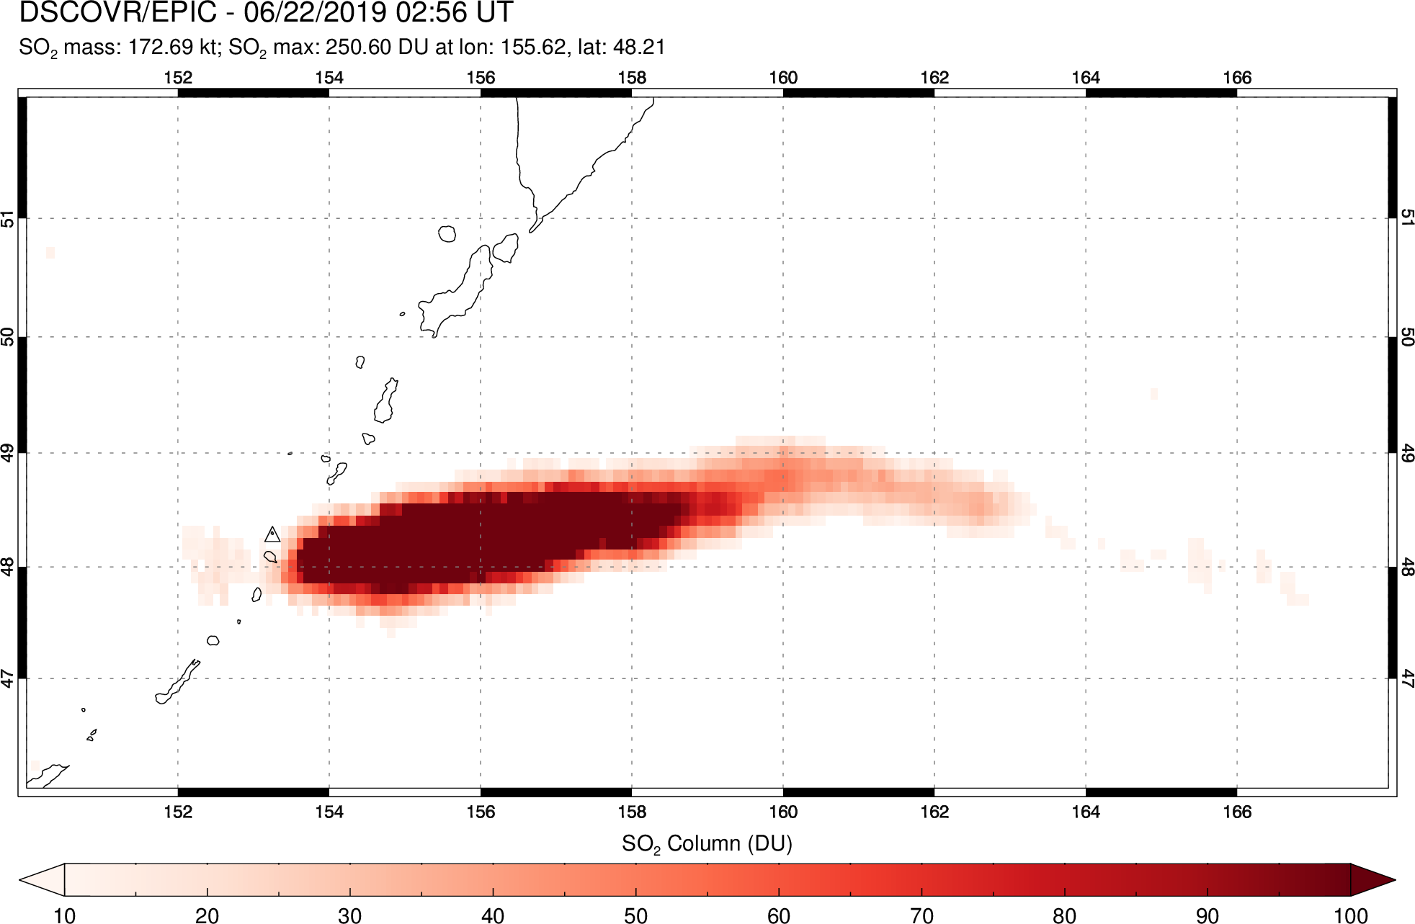
Raikoke eruption: comparison of EPIC and S5P/TROPOMI
Both TROPOMI and EPIC underestimate SO₂ on June 22 due to high ash loading
Notes:
Advantage of EPIC – single image with no orbit overlap

Slide 19
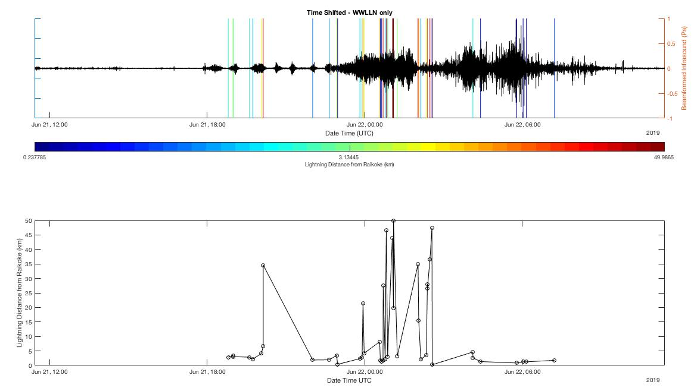
Raikoke eruption: infrasound and lightning
Petropavlovsk infrasound
(R. Matoza/UCSB; C. Smith/USGS)
World Wide Lightning Location Network (WWLLN)
Both TROPOMI and EPIC underestimate SO₂ on June 22 due to high ash loading

Slide 20
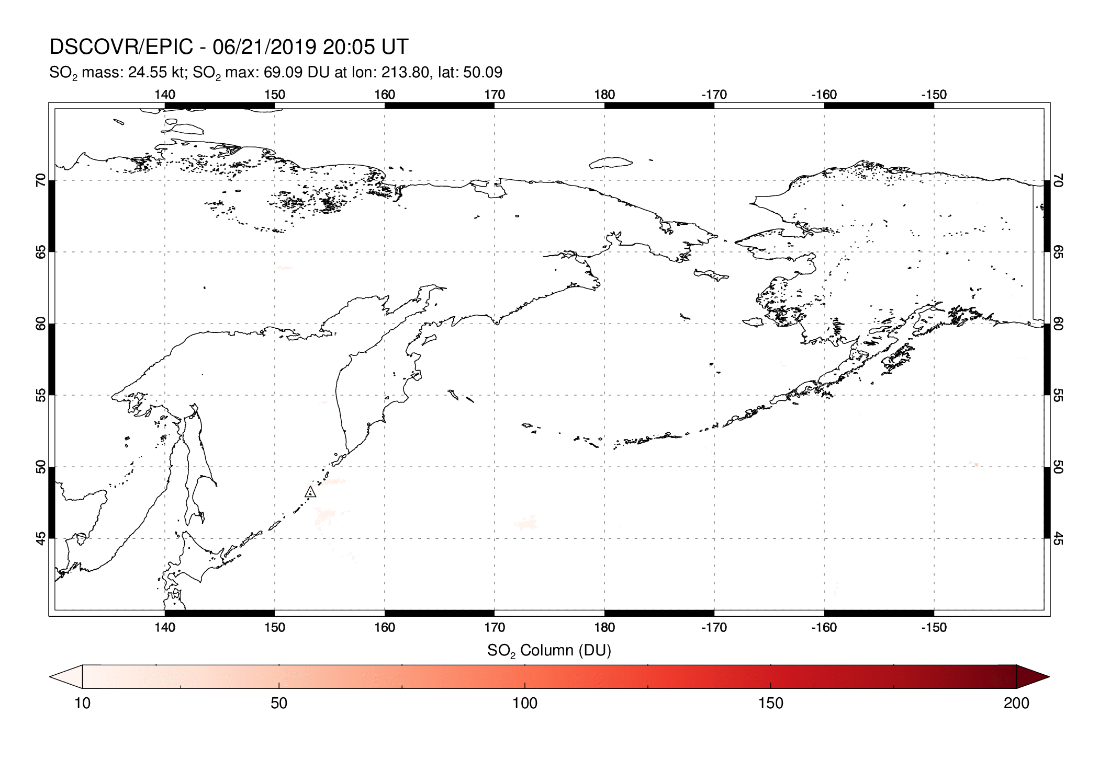
Raikoke eruption (Kuril Islands, Russia) – June 2019
Max SO₂ column:
314 DU (June 22)
Max SO₂ mass:
1.28 Tg (June 24)

Slide 21
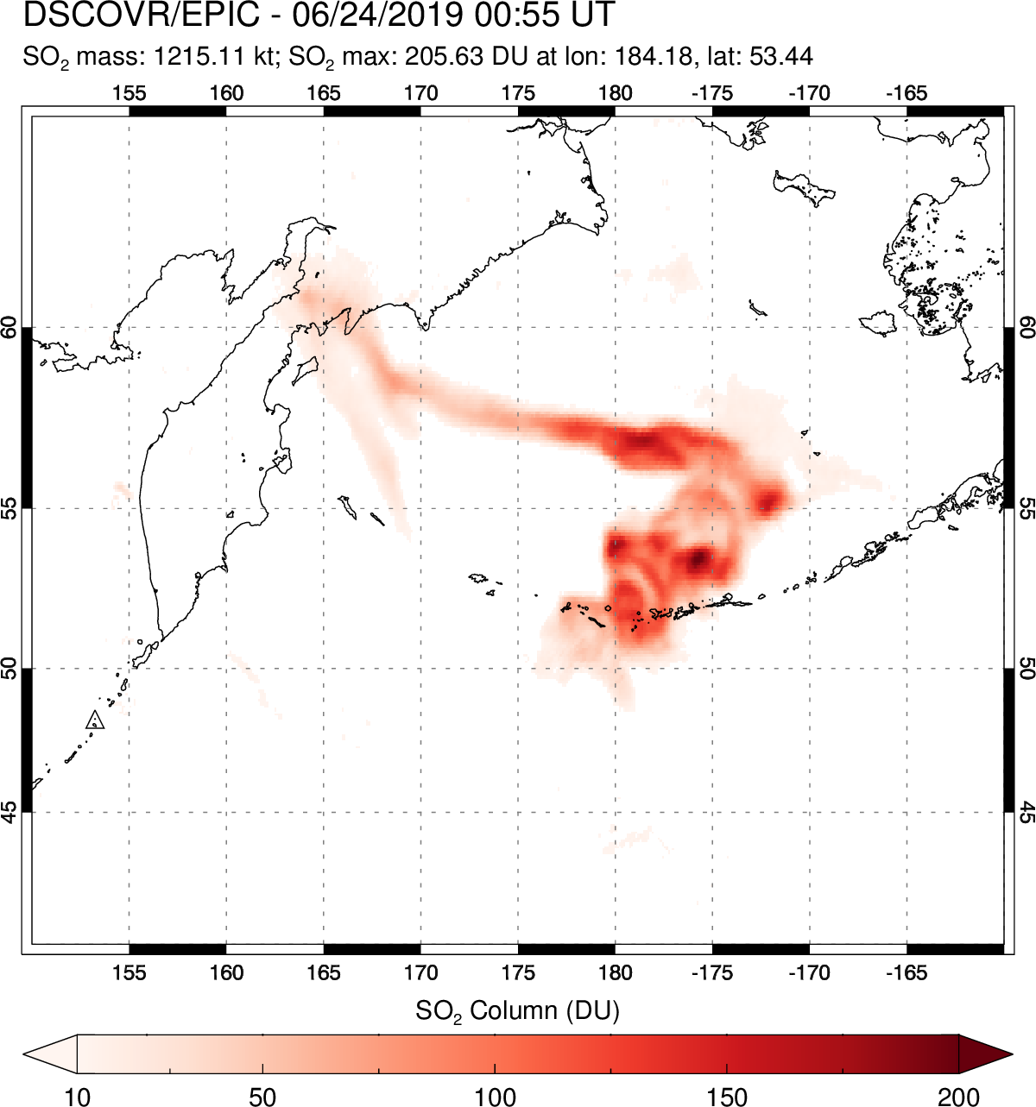
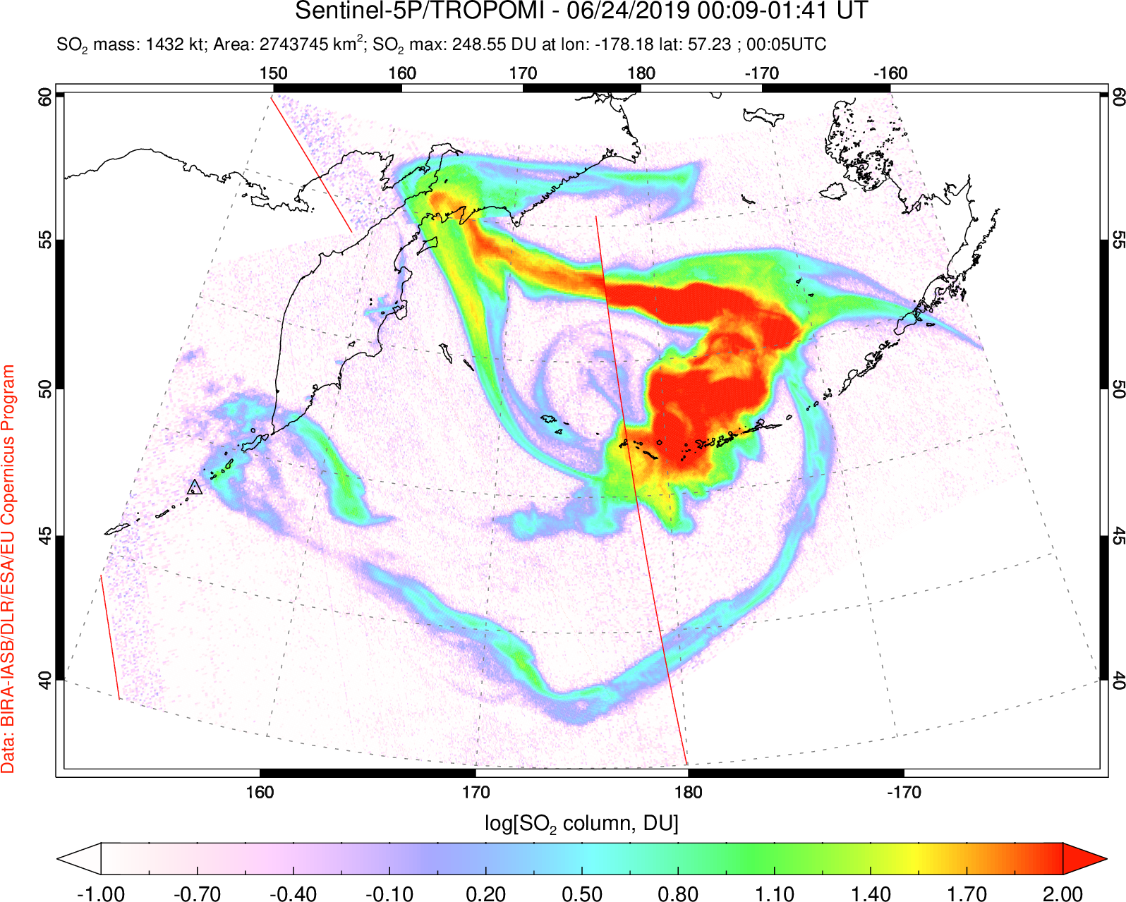
Raikoke eruption: comparison of EPIC and S5P/TROPOMI
TROPOMI: 1.4 Tg SO₂
EPIC: 1.2 Tg SO₂
Maximum measured at ~same time as TROPOMI
Advantage of EPIC for volcanic clouds: single image with no inter-orbit temporal gaps
Notes:
Advantage of EPIC – single image with no orbit overlap

Slide 22
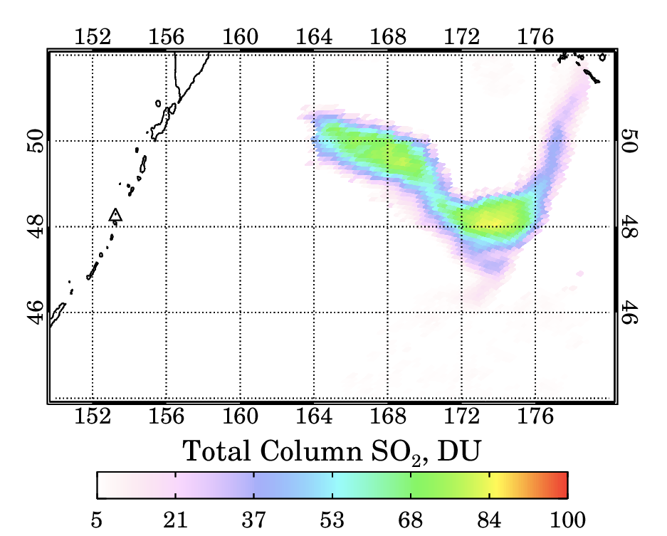
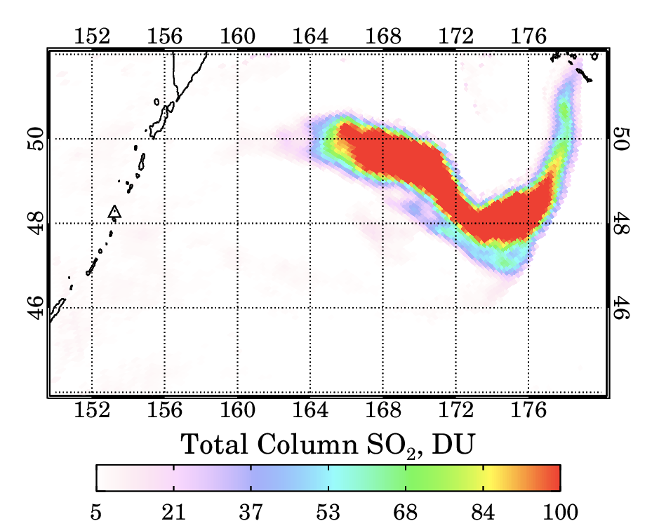
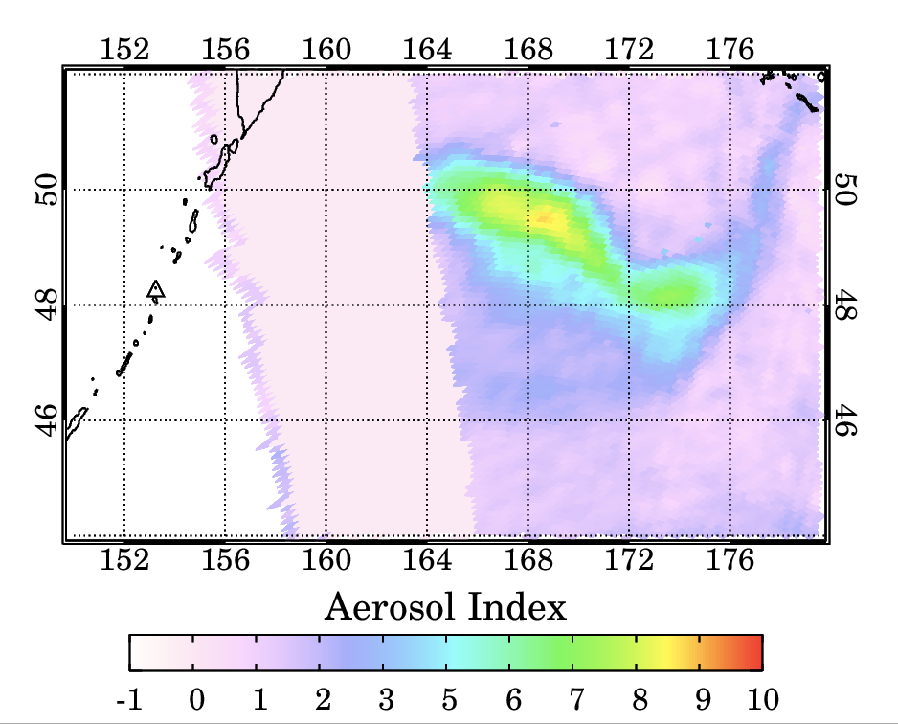
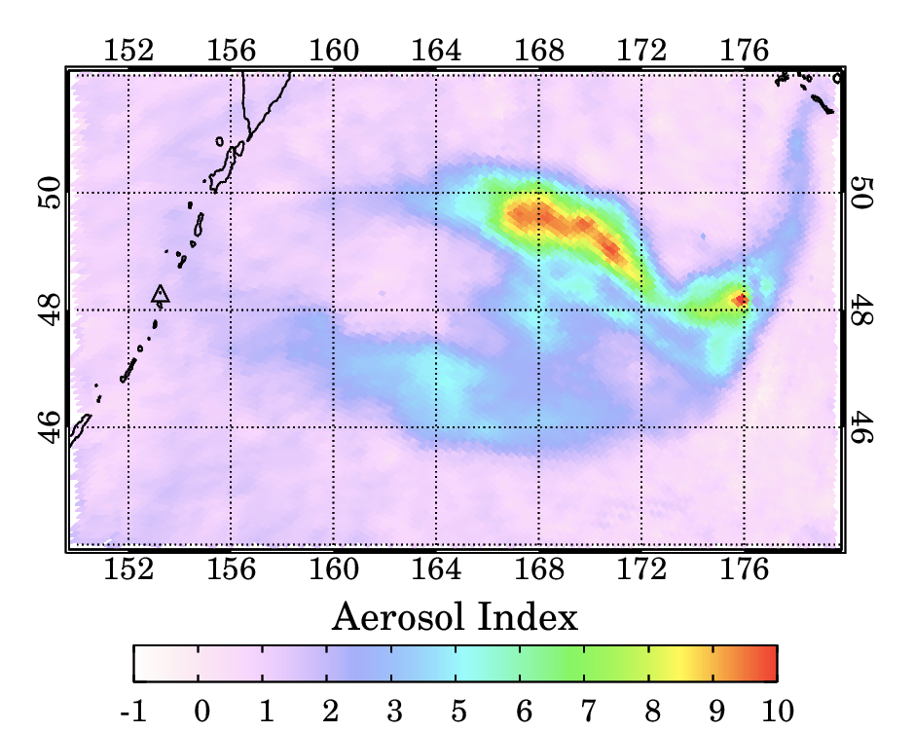
06/22/2019 19:18
06/22/2019 20:24
High
SZA

Slide 23
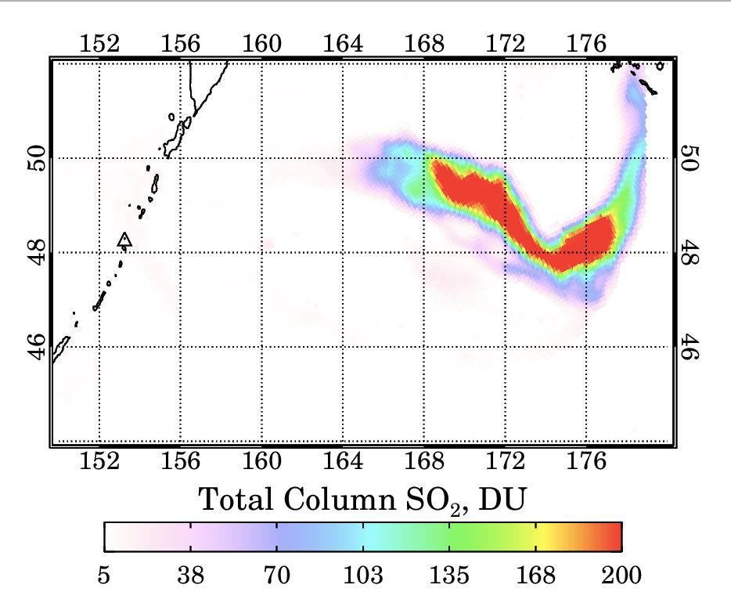
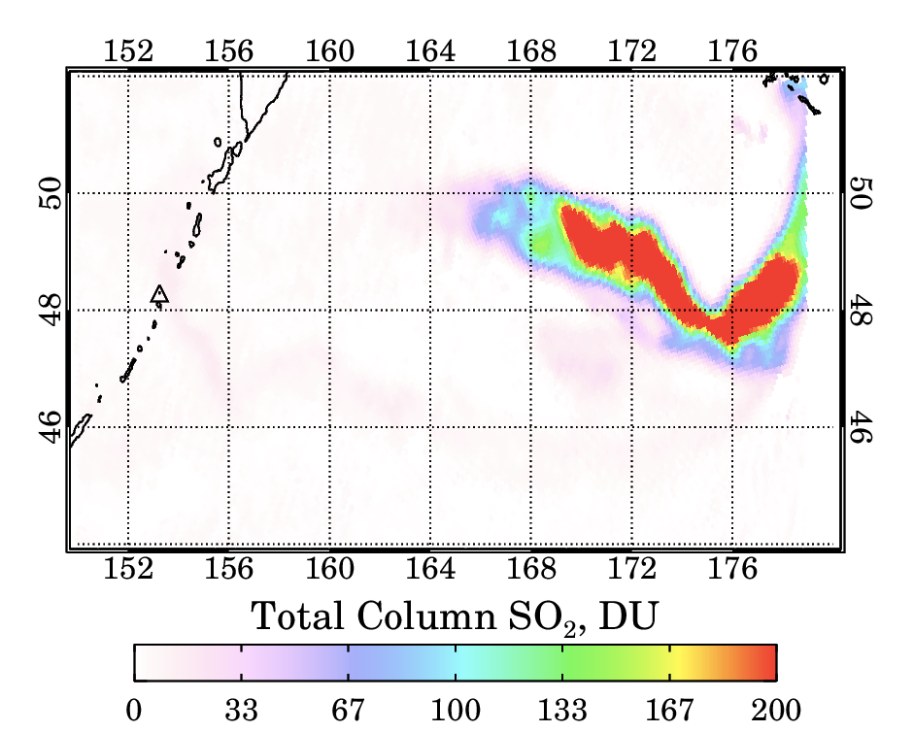
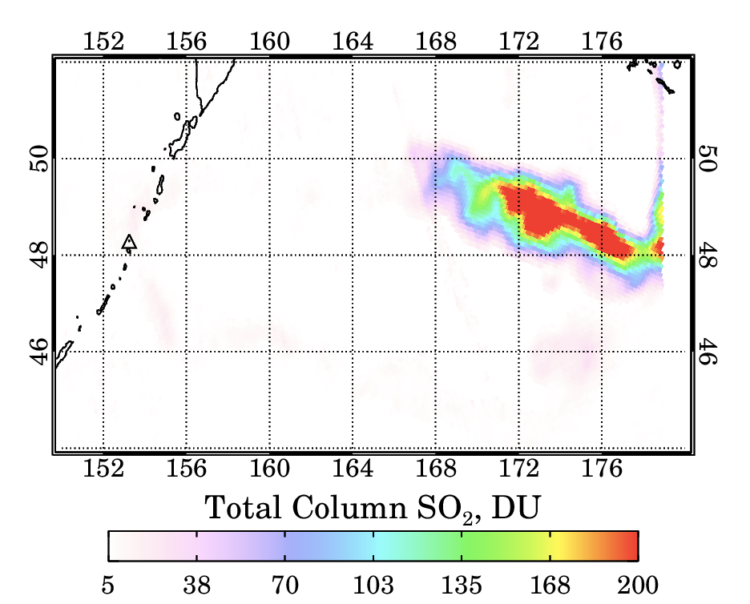
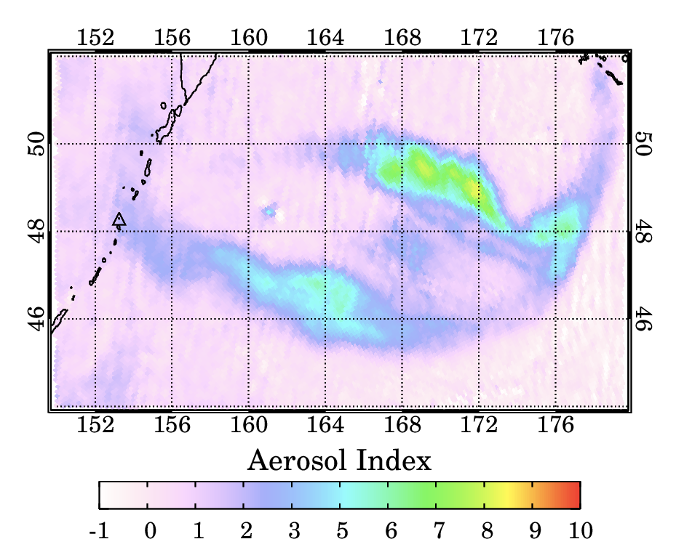
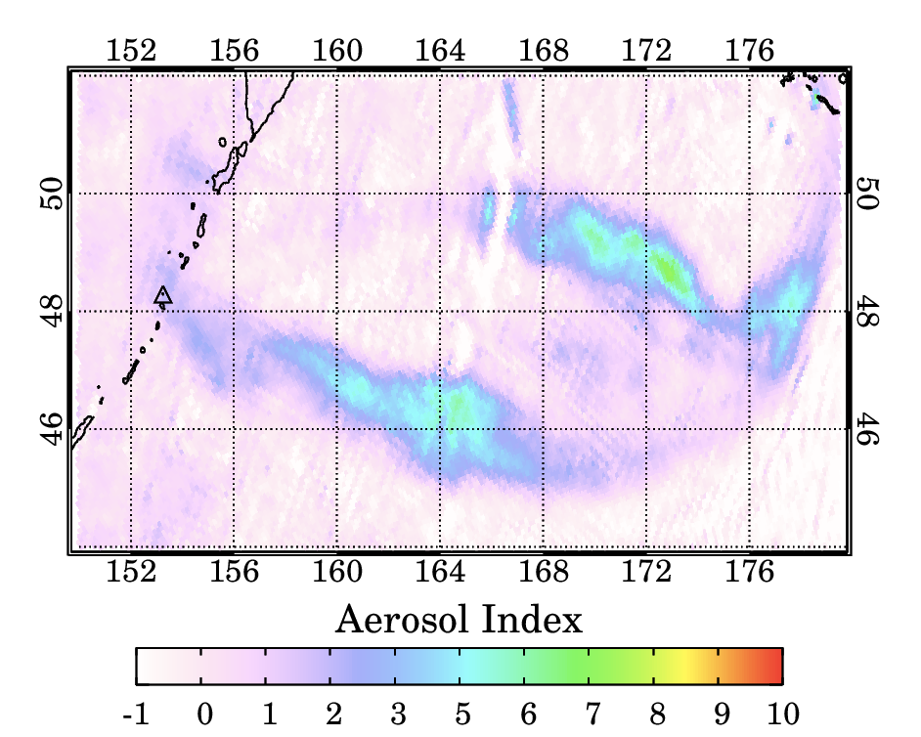
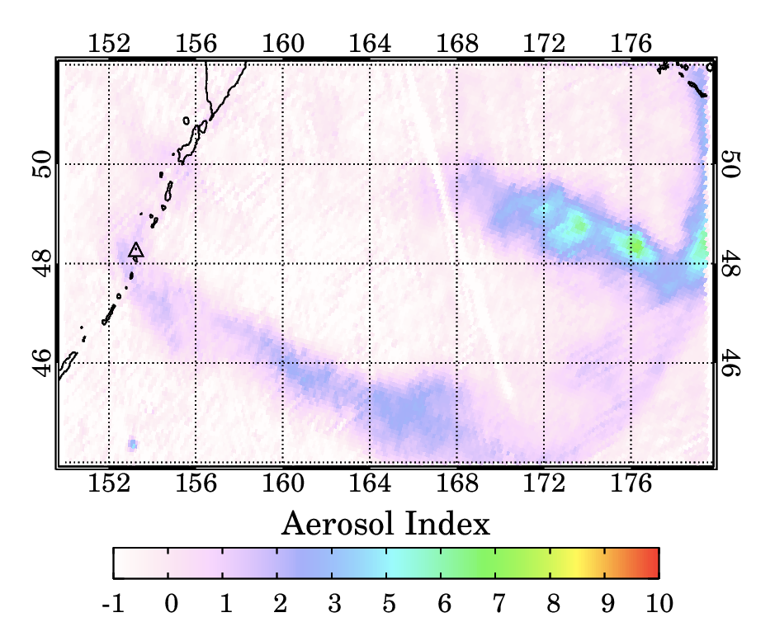
06/22/2019 21:29
06/22/2019 22:35
06/23/2019 03:15

Slide 24
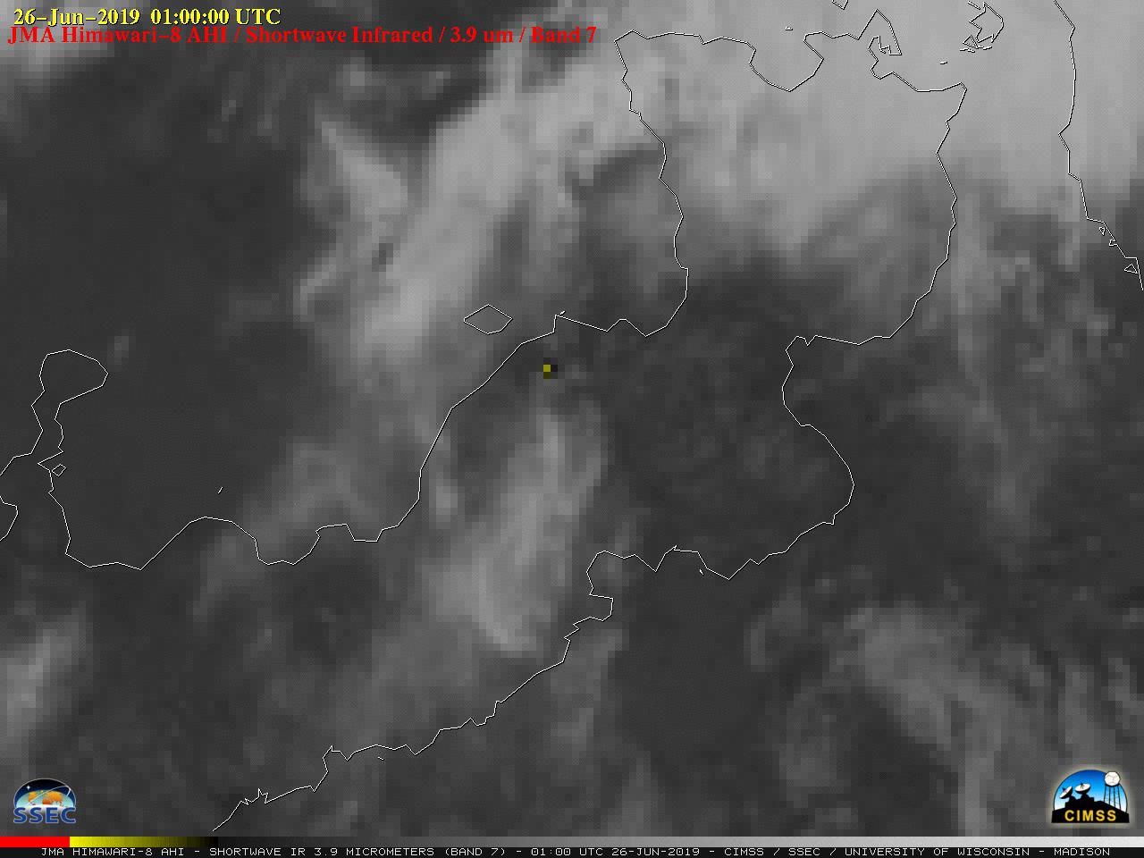
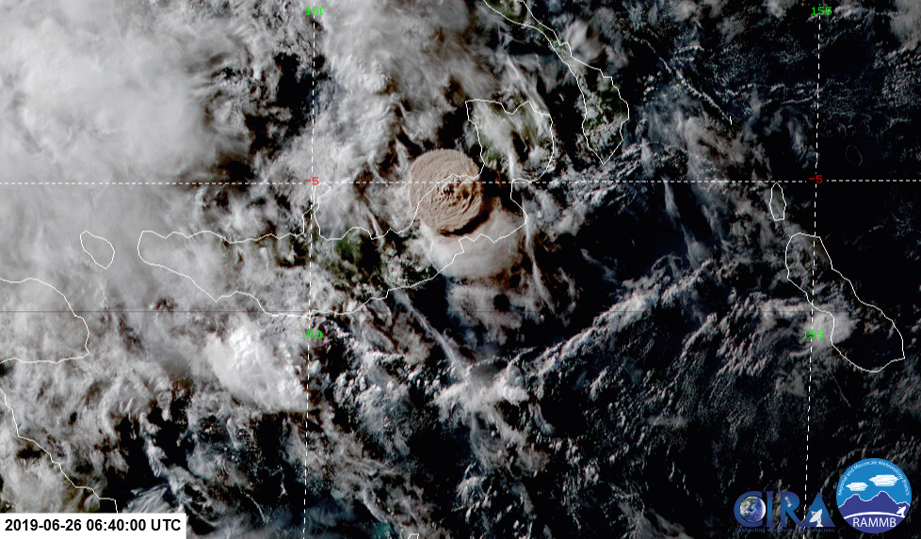
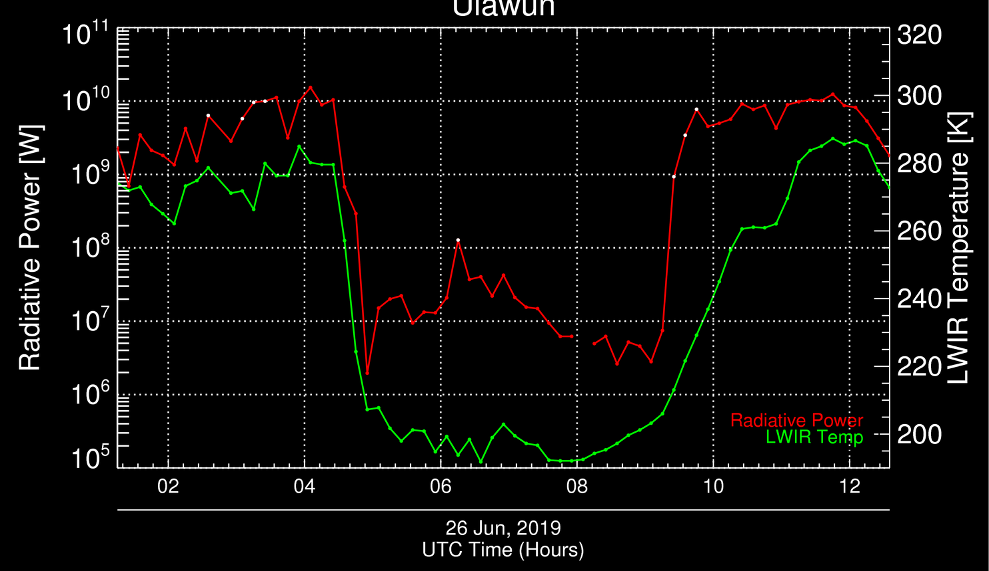
Ulawun eruption (Papua New Guinea) – June 2019
Himawari-8
EPIC SO₂
Strong eruption w/ tropical stratospheric injection
Eruption started in late afternoon (local time)
CIMSS/SSEC

Slide 25
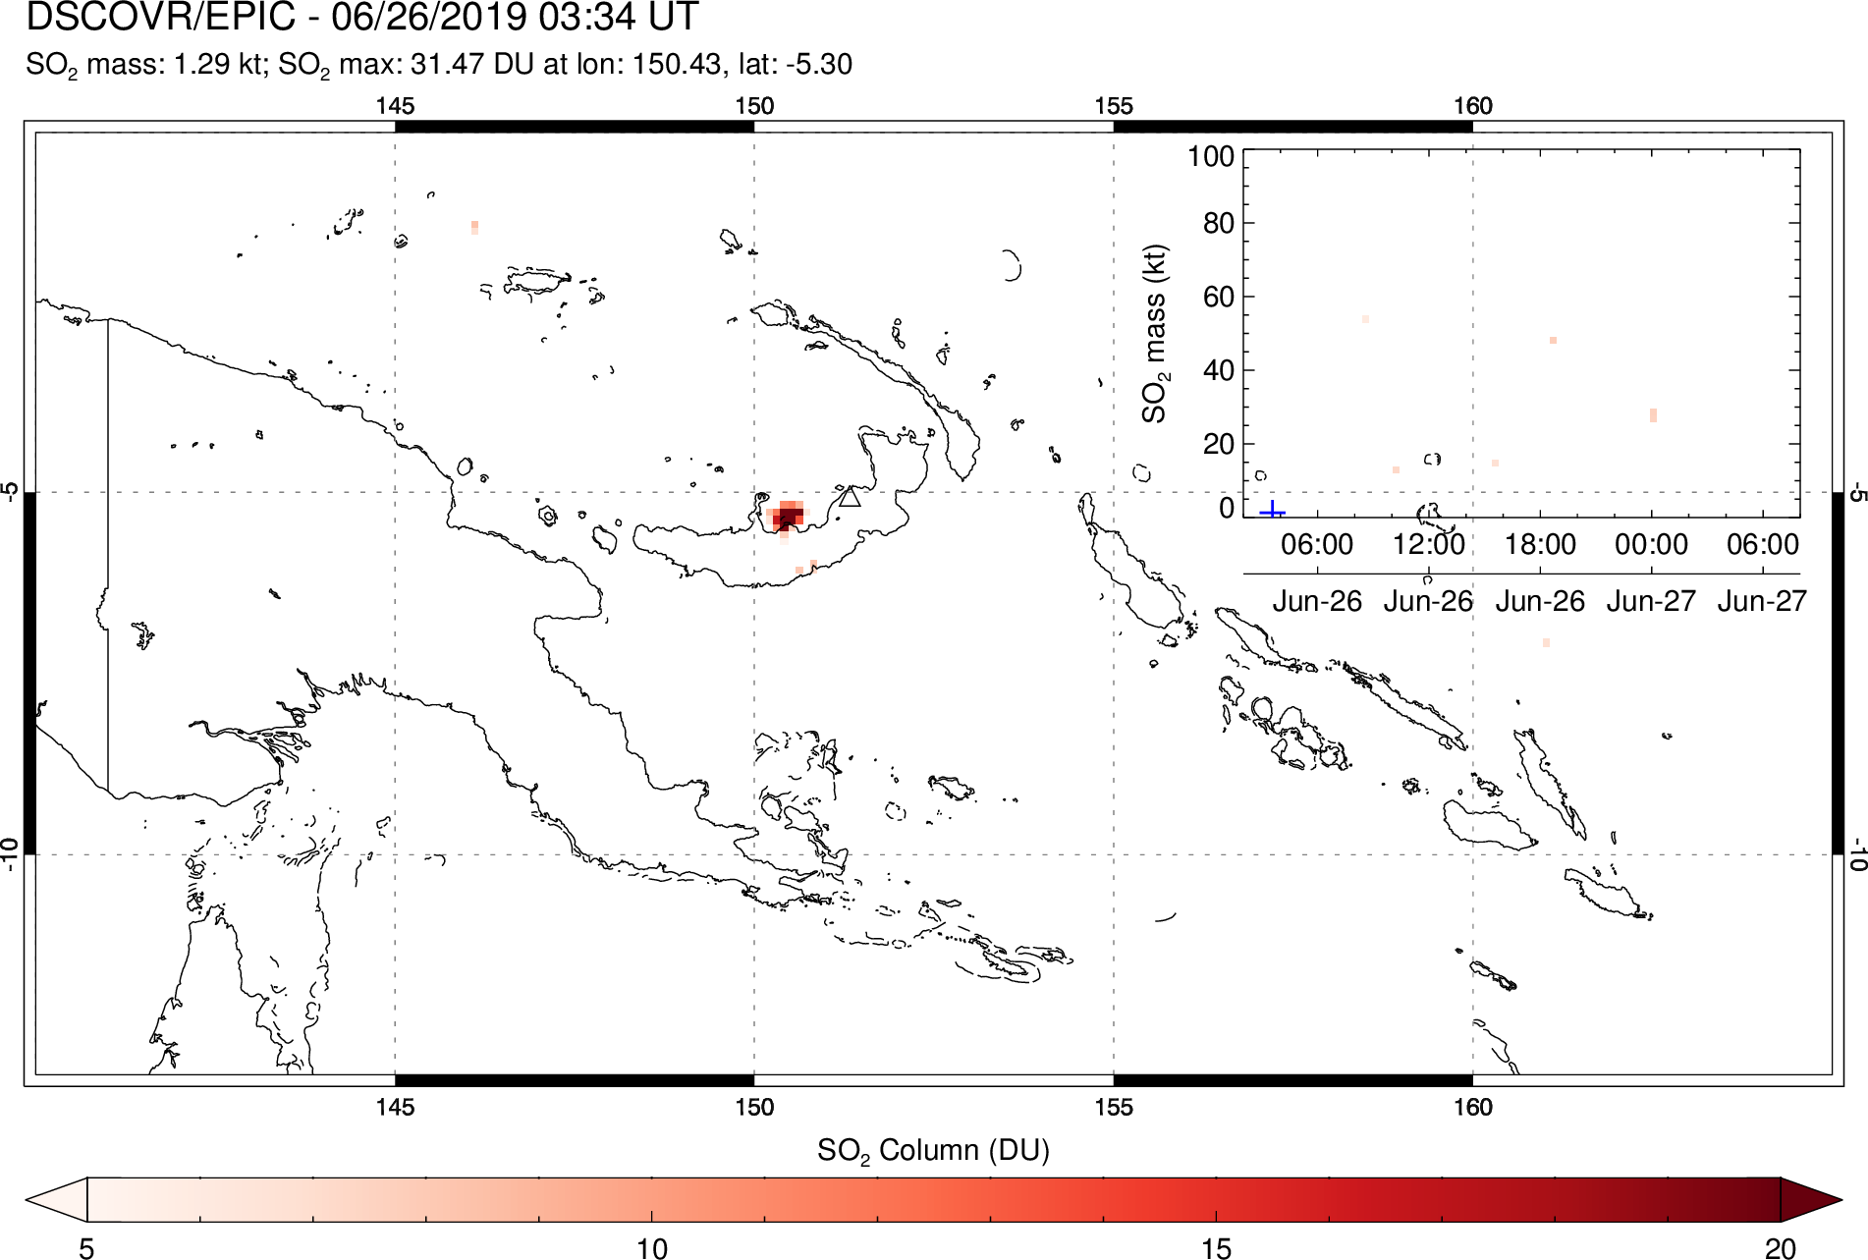
Ulawun eruption (Papua New Guinea) – June 2019

Slide 26
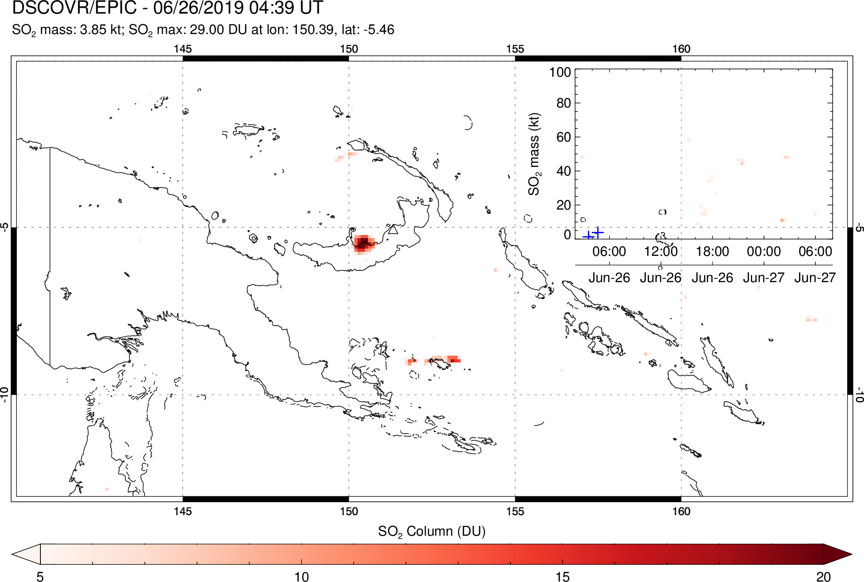
Ulawun eruption (Papua New Guinea) – June 2019

Slide 27
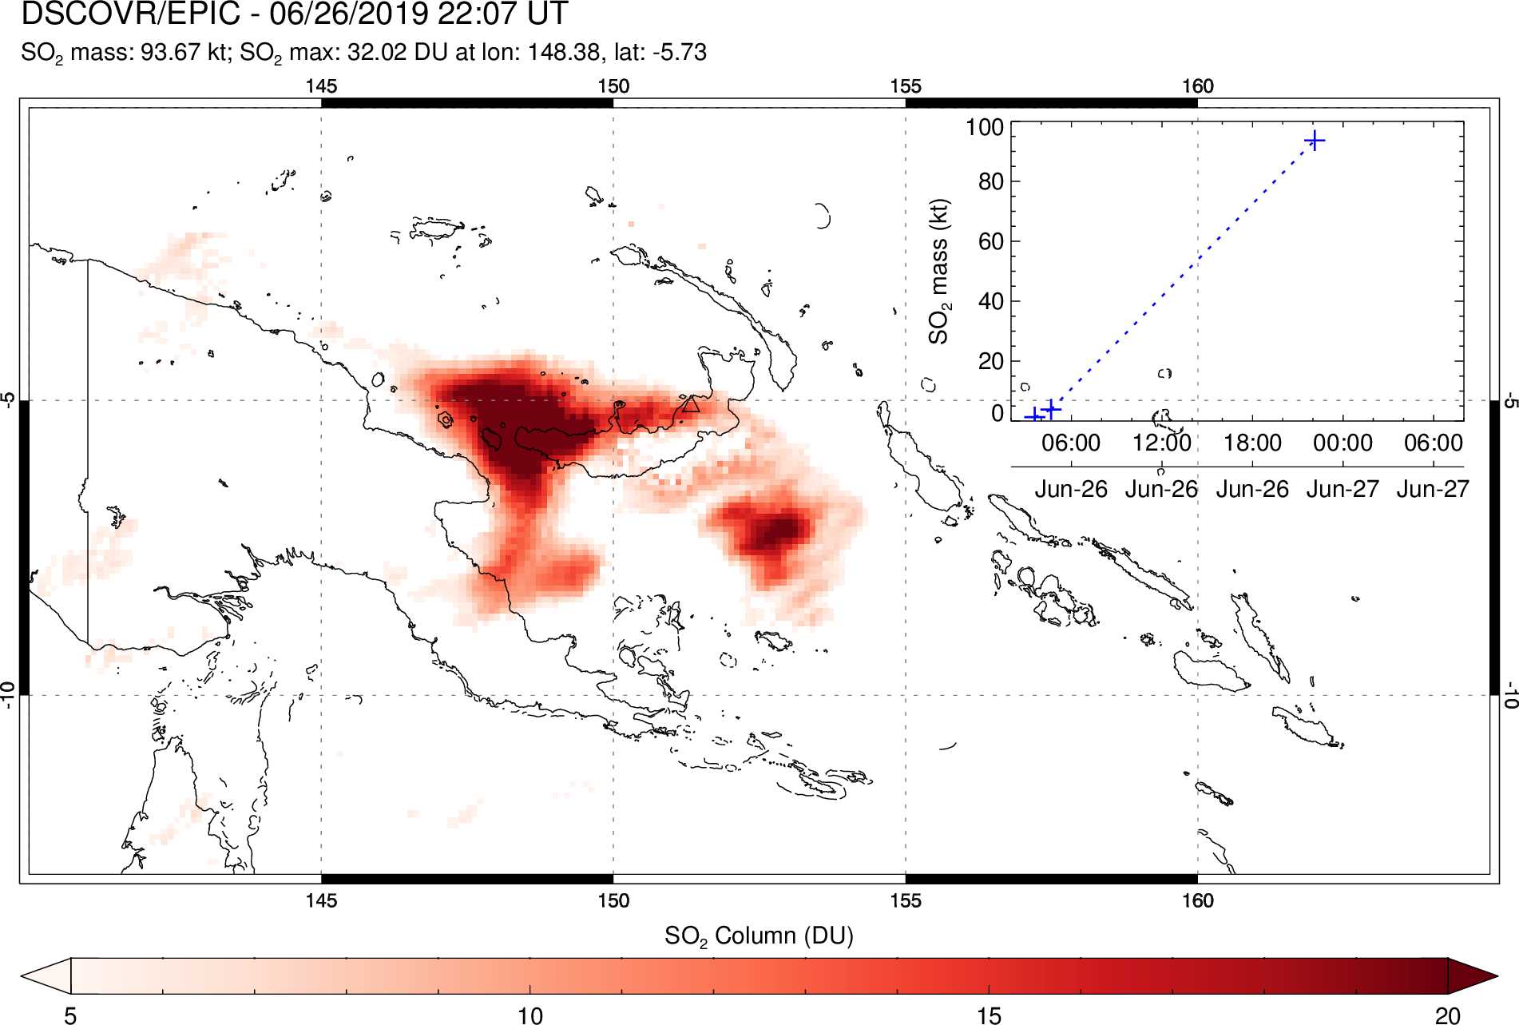
Ulawun eruption (Papua New Guinea) – June 2019

Slide 28
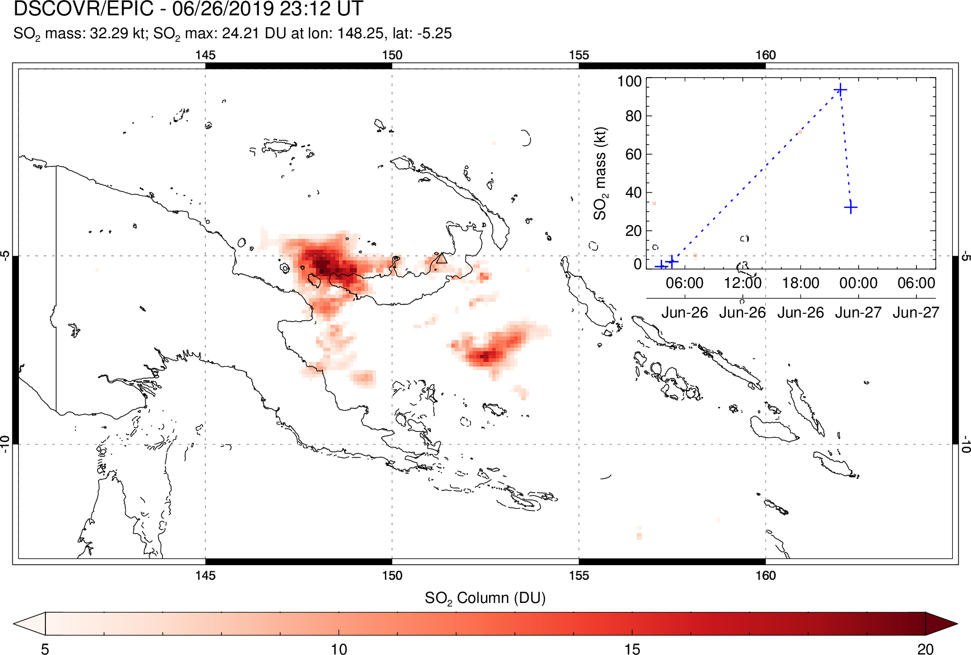
Ulawun eruption (Papua New Guinea) – June 2019

Slide 29
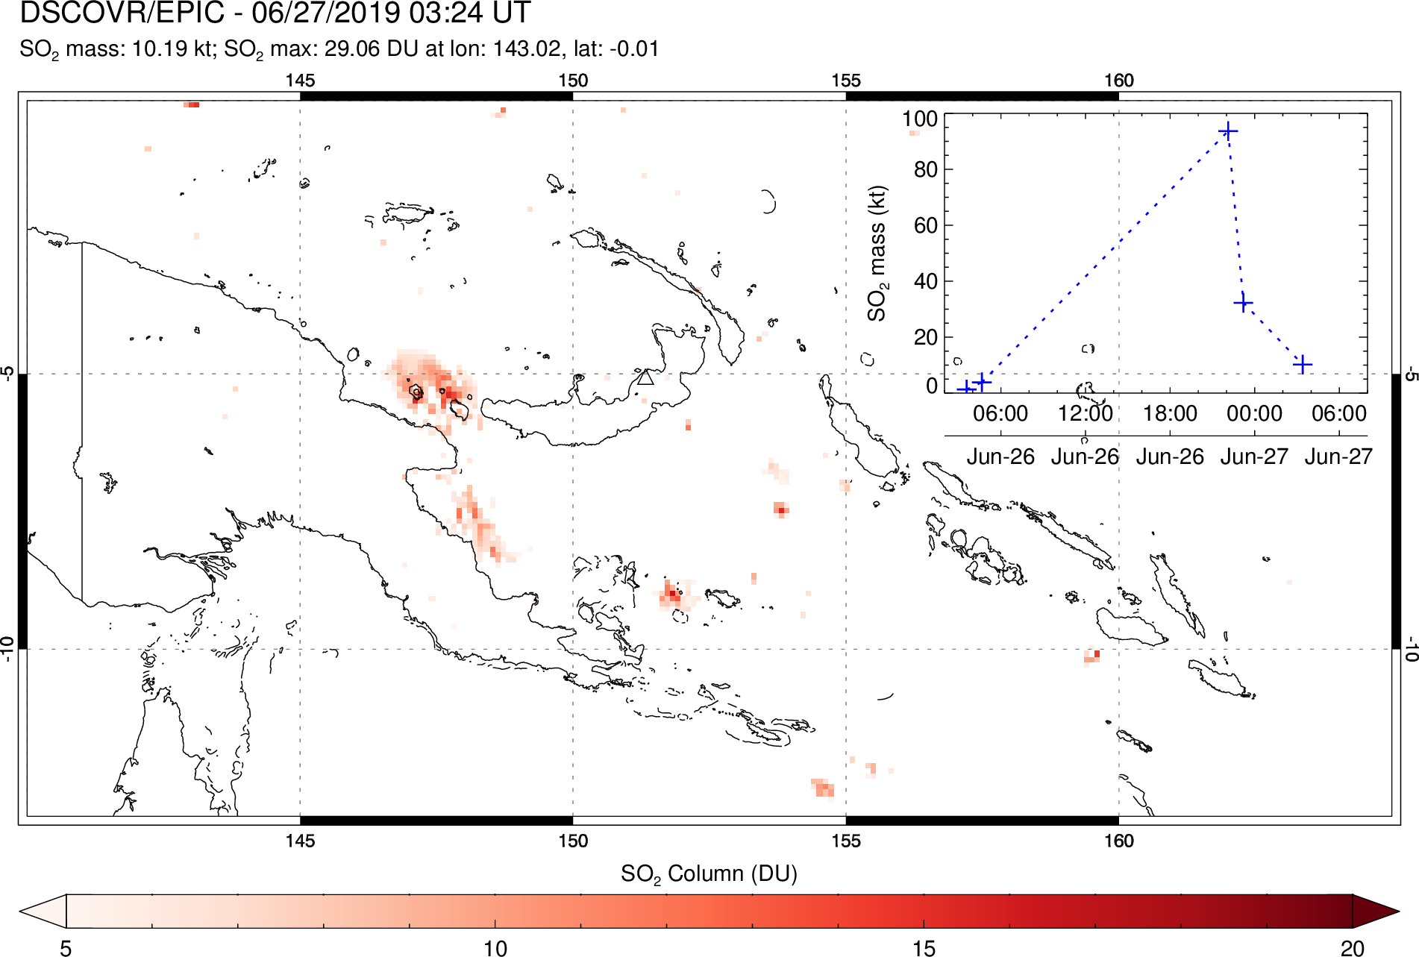
Ulawun eruption (Papua New Guinea) – June 2019

Slide 30
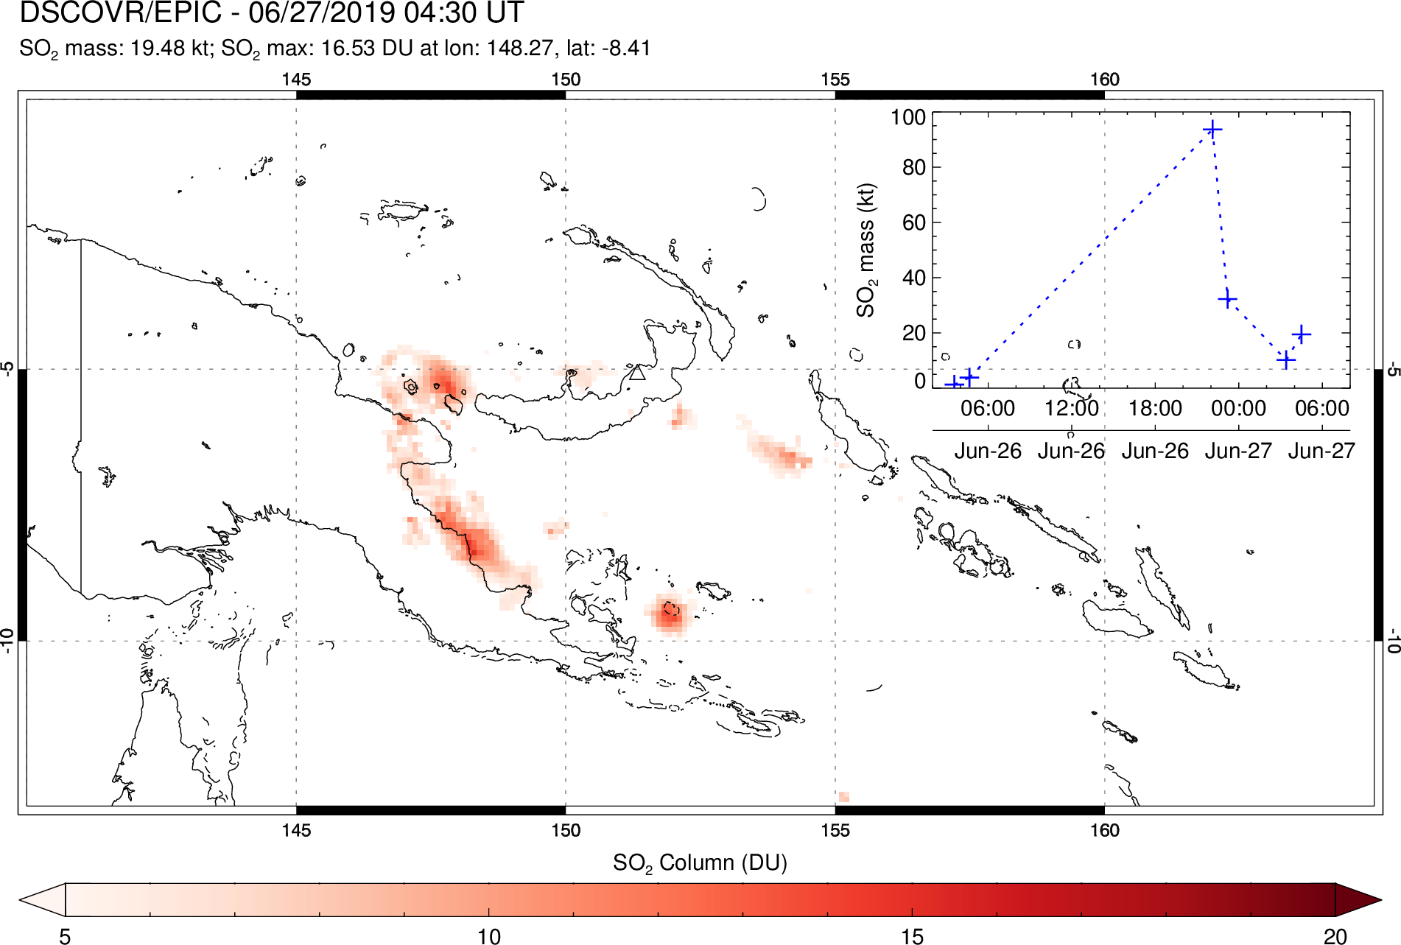
Ulawun eruption (Papua New Guinea) – June 2019

Slide 31
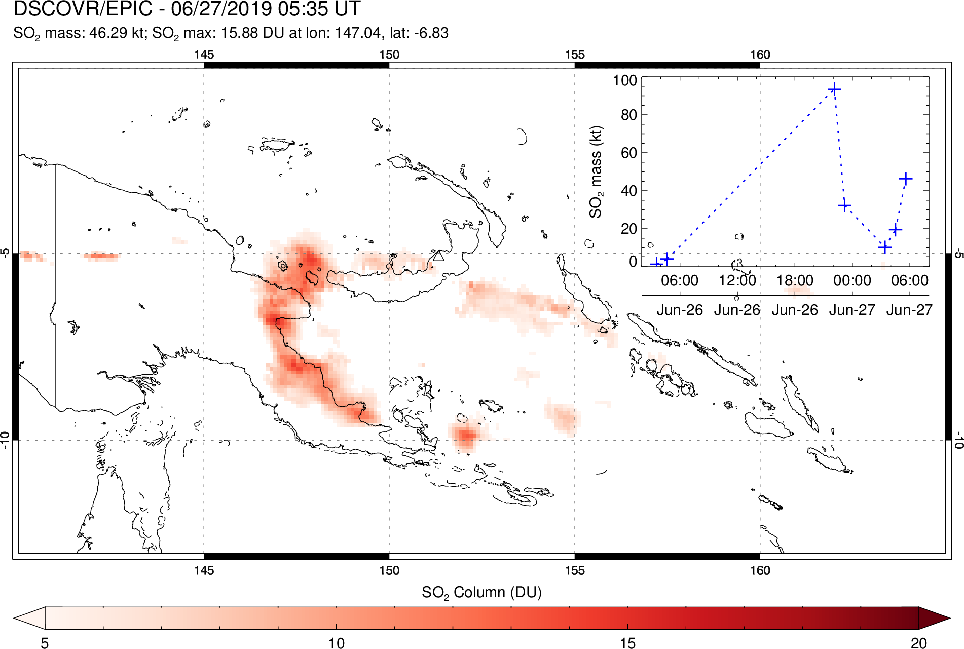
Ulawun eruption (Papua New Guinea) – June 2019

Slide 32
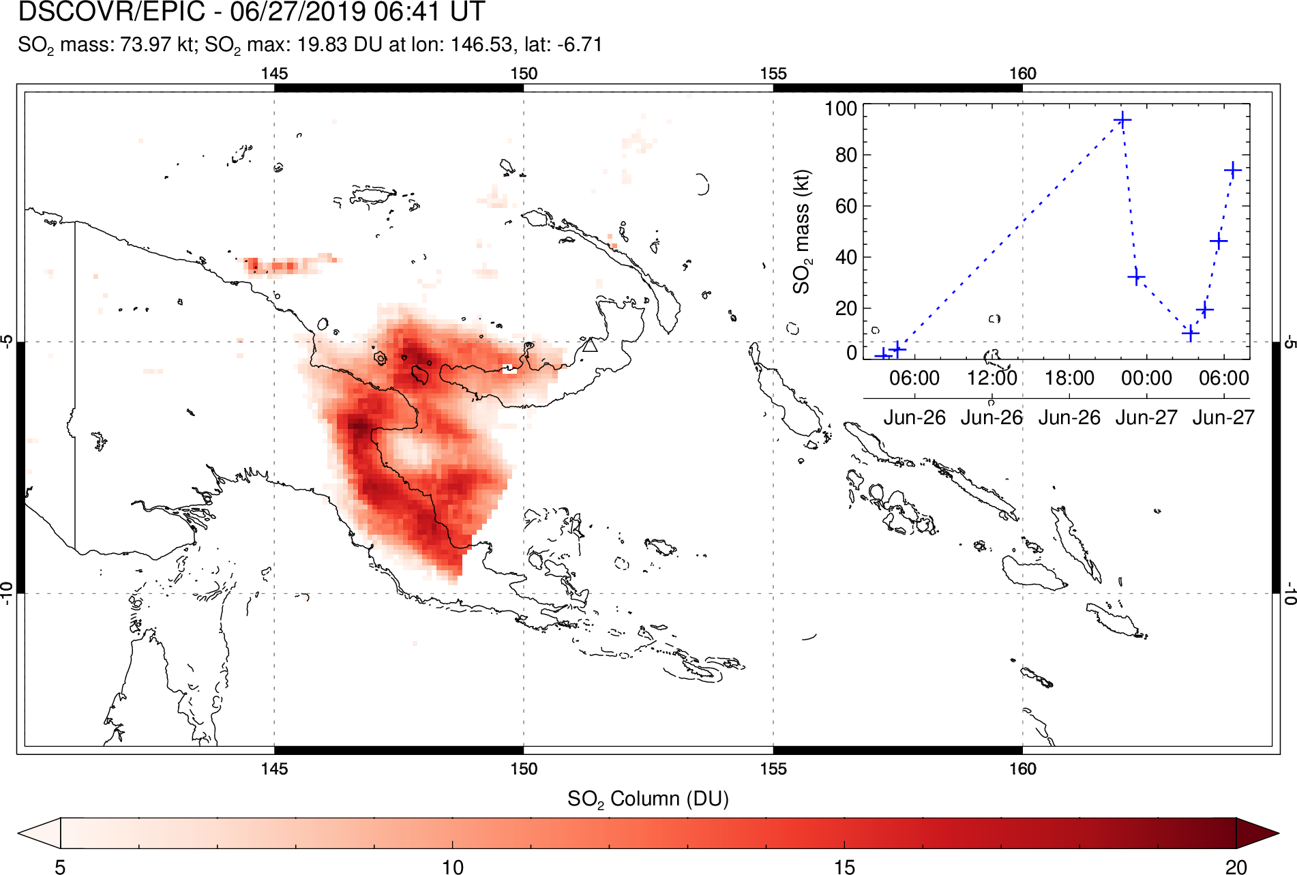
Ulawun eruption (Papua New Guinea) – June 2019

Slide 33

Ulawun eruption (Papua New Guinea) – June 2019
Similar peak SO₂ mass loading measured by EPIC (~0.1 Tg; 22:00 UTC June 26) and TROPOMI (~0.14 Tg; 04:00 UTC June 27) but at different times
Larger EPIC SO₂ mass/columns at high SZA – scattering angle effect?

Slide 34

Ulawun eruption (Papua New Guinea) – June 2019
Oblique GOES-17 visible imagery of Ulawun eruption
Note umbrella clouds at two altitude levels
CIMSS/SSEC

Slide 35
Product status/updates
EPIC L2 volcanic SO₂ product released: Nov 20, 2017 (only known volcanic events currently processed)
Results shown here are from v02 data – v03 reprocessing of SO₂ product underway (2017 complete) and should provide better geolocation
EPIC L2 SO2 data products (DSCOVR_EPIC_L2_SO2_01) archived at NASA Langley ASDC (https://eosweb.larc.nasa.gov/project/dscovr/dscovr_epic_l2_so2_01)
Article on EPIC volcanic SO₂ measurements published in Geophys. Res. Lett. (Carn, S.A., et al. (2018), First observations of volcanic eruption clouds from the L1 Earth-Sun Lagrange point by DSCOVR/EPIC, Geophys. Res. Lett.)
Article on recent Raikoke observations in prep.
Two abstracts submitted to 2019 Fall AGU meeting (DSCOVR session)
EPIC SO₂ results disseminated via social media (Twitter)

Slide 36

Summary and next steps
Recent volcanic eruptions further demonstrate EPIC’s ability to provide timely observations of volcanic SO₂ clouds
Hourly tracking of Raikoke eruption – largest eruption of EPIC mission to date
Analysis of EPIC observations of Raikoke eruption and other geophysical data in progress
EPIC SO₂ retrievals generally consistent with OMI, OMPS and TROPOMI
Future plans: improve retrievals near limb, and over bright clouds; assess changes in sensitivity with varying SZA; estimate volcanic ash mass loading from UV Aerosol Index to study temporal evolution of ash and SO₂ loading
Krotkov et al. (1999)

Slide 37


Krakatau eruption (Indonesia) – Dec 2018

Slide 38










SNPP/OMPS and DSCOVR/EPIC track volcanic SO₂ and ash plumes from June 3 2018 explosive eruption of Fuego volcano
19:02-06 UTC
19:09 UTC
20:14 UTC
21:20 UTC
EPIC SO₂ plume
OMPS SO₂ plume
Sulfur dioxide (SO₂) maps for the June 3 2018 eruption of Fuego volcano (triangle) in 3 consecutive EPIC exposures. Total column SO₂ amount is measured in Dobson Units (1DU = 2.69x10¹⁶ molecules SO₂/cm²).
19:02-06 UTC
19:09 UTC
20:14 UTC
21:20 UTC
EPIC Ash plume
OMPS Ash plume
Positive values of UV Aerosol Index (AI > 3) allow discrimination of volcanic ash clouds from the regular water and ice clouds (AI < 1). Volcanic Ash clouds present danger to aviation and are monitored by Volcanic Ash Advisory Centers.
EPIC higher spatial resolution (20km) than OMPS (50km) reveals higher ash concentrations and hourly evolution.

Slide 39

EPIC SO₂ Algorithm
The EPIC SO₂ algorithm retrieves a state vector x, using the 4 UV channels on EPIC (317, 325, 340 and 388 nm). The algorithm simultaneously retrieves volcanic SO₂ (317 nm), O₃ (325 nm), the spectral dependence dR/d𝛌 (340 nm), and the Lambertian Equivalent Reflectivity R (388 nm) :
$x=\left(\begin{matrix}SO2 \\ O3 \\ \begin{matrix}dR/dλ \\ R\end{matrix}\end{matrix}\right)$
The retrieval is performed in two steps, Step 1 and Step 2, as shown in the flow chart
Measurement
Step 1
Step 2
State Vector
x

Slide 40
Forward Radiative Transfer Model (RTM)
TOMRAD RTM [Dave 1965] calculations are used to create hyperspectral radiance master Look-Up Tables (LUTs) for all geometries across the full EPIC spectrum of wavelengths between 310 and 400 nm.
The TOMRAD forward model accounts for Rayleigh scattering and absorption by O₃ [Daumont et al., 1992] and SO₂ [Bogumil et al., 2003], using temperature dependent, laboratory measured cross sections
We assume a Gaussian SO₂ plume vertical profile with a peak altitude of 13 km and a standard deviation ±2.0 km
Instrument LUTs are generated from the master LUTs by convolving the forward model radiances with the EPIC bandpass

Slide 41
Instrument LUTs
Instrument LUTs are computed at specific viewing geometries and total column trace gas amounts for O₃ and SO₂ as described in the Table. Calculated N-values are then linearly interpolated between nodal points based on the estimated gas amounts (O₃, SO₂).
Structure of Instrument LUTs
Atmospheric Parameter | Number of Nodes | Values
Surface Pressure | 2 | 1013.25 and 500 hPa
Wavelength | 6 | 313, 317, 331, 340, 360 and 380
Total Column Ozone | 21 | 3 low, 8 middle and 11 high latitude bands (atm-cm)
Total Column SO₂ | 12 | 0, 5, 10, 50, 100, 150, 200, 250, 350, 450, 550, 650 DU
SZA | 10 | 0, 30, 45, 60, 70, 77, 81, 84, 86, 88
VZA | 6 | 0, 15, 30, 45, 60, 70

Slide 42


EPIC SO₂ Algorithm: Step 1
The state vector is retrieved in Step 1 by iteratively solving the following equation by inversion:
d$y=Kdx$
where dy is the difference between the measured (N_{m}) and forward model calculated N-value (N_{c}) and dx the difference between the current estimate and the previous iteration: x_{i} = x_{i-1} + dx
K in the above expression represents a 4 x 4 matrix, consisting of Jacobians defined with respect to the measured radiances N_{i} and the retrieved state vector x_{j} as shown:
$$K= \left(\begin{matrix}\frac{∂N_{317}}{∂Ω} & \frac{∂N_{317}}{∂Σ} & \begin{matrix}\frac{∂N_{317}}{∂R}\left(λ_{1}−λ_{R}\right) & \frac{∂N_{317}}{∂R}\end{matrix} \\ \frac{∂N_{331}}{∂Ω} & \frac{∂N_{331}}{∂Σ} & \begin{matrix}\frac{∂N_{331}}{∂R}\left(λ_{2}−λ_{R}\right) & \frac{∂N_{331}}{∂R}\end{matrix} \\ \begin{matrix}\frac{∂N_{340}}{∂Ω} \\ 0\end{matrix} & \begin{matrix}\frac{∂N_{340}}{∂Σ} \\ 0\end{matrix} & \begin{matrix}\begin{matrix}\frac{∂N_{340}}{∂R}\left(λ_{3}−λ_{R}\right) \\ 0\end{matrix} & \begin{matrix}\frac{∂N_{340}}{∂R} \\ \frac{∂N_{380}}{∂R}\end{matrix}\end{matrix}\end{matrix}\right)$$

Slide 43
EPIC SO₂ Algorithm: Step 2
Our Step 2 procedure was added to reduce false positive and negative SO₂ artifacts due to spatiotemporal mismatch between 4 UV channels that are not completely accounted for in Level 1B processing
Step 1 retrieved quantities (SO₂, dR/dλ and R) are used as first guesses
A 31 x 31 box smoothing procedure is applied to the every Step 1 O₃ FoV to obtain a smoothed ozone field across the full disc image.
The smoothed O₃ FoVs are fixed in Step 2 and a second retrieval of SO₂ and dR/dλ is performed using a 2x2 K-matrix (Jacobians for SO₂ and dR/dλ)
In the SO₂ product, we report both Step 1 and the smoothed Step 2 ozone.
Notes:
Description of the DSCOVR/EPIC SO2 Algorithm PI: Nick Kroktov
The DSCOVR/EPIC volcanic SO₂ algorithm is a modified version of the heritage NASA Total Ozone Mapping Spectrometer (TOMS) 4-band algorithm, adapted to the EPIC wavelengths. The algorithm uses all four EPIC UV channels (centered at 317nm, 325nm, 340 nm, 388nm) to retrieve 4 parameters of the state vector (x): vertical column amounts of SO₂ (assuming 13km height) and total O₃, the Lambertian equivalent reflectivity at 388 nm (R), and its spectral dependence, dR/dλ. The algorithm relies on spectral differences in SO₂ and O₃ absorption cross sections to separate the two trace gases. SO₂ is more absorbing than O₃ at the shortest UV channel (317 nm), whereas O₃ is more absorbing at the longer channel (325nm).
The retrieval is performed iteratively for each EPIC pixel with SZA < 75º. It starts with the climatological profile of O₃ and zero SO₂ and first computes Lambertian equivalent scene Reflectivity (LER) at 388 nm (R). This parameter remains fixed during the iterations. The algorithm then retrieves adjustments to the state vector: Δx =[ΔSO_{2,} ΔO₃, Δ(dR/dλ)] by matching measured and calculated sun-normalized backscatterd UV (BUV) radiances at shorter spectral channels (317,325 and 340nm). The sensitivities (Jacobians) associated with linear perturbations in SO₂, O₃ and R are pre-computed for each UV spectral band and stored in look-up tables, which are numerically interpolated for EPIC viewing geometry and state vector values at each iteration. This algorithm appears to have adequate sensitivity to detect moderate to large volcanic eruptions from L1 Lagrange point.
Max iterations = 3
Quit itrations when Min res325 = 0.001 ( N value)

