Slide 1
EPIC L2 Cloud Products: Current Status and Future Plans
Yuekui Yang, Yaping Zhou,
Kerry Meyer, Gala Wind, Steven Platnick, Qilong Min, Anthony Davis, David Duda, and Wenying Su
DSCOVR EPIC&NISTAR Science Team Meeting
Sept. 17-18, 2018, Goddard Space Flight Center, Greenbelt, MD

Slide 2
EPIC Standard L2 Cloud Product System
EPIC L1B Products
Ancillary Data
Cloud Mask
Effective Height/Pressure
Cloud Optical Thickness
EPIC L2 Cloud Products

Slide 3
Current Status
Running at DSOC and Archived at Langley ASDC.
Initial assessment conducted by comparing with results from GEO/LEO; results are consistent with other products and with theoretical expectations.
Known issues identified and future plans proposed.
EPIC standard L2 cloud product algorithm paper submitted to AMT
Yang, Y., K. Meyer, G. Wind, Y. Zhou, A. Marshak, S. Platnick, Q. Min, A. B. Davis, J. Joiner, A. Vasilkov, D. Duda, and W. Su 2018: Cloud Products from Earth Polychromatic Imaging Camera (EPIC) observations: Algorithm Description and Initial Evaluation, AMT, (submitted).

Slide 4
EPIC L2 Cloud Product List
EPIC Cloud Mask
Oxygen A-band Cloud Effective Pressure
Oxygen A-band Cloud Effective Height
Oxygen B-band Cloud Effective Pressure
Oxygen B-band Cloud Effective Height
Cloud Optical Thickness – assuming liquid phase
Cloud Optical Thickness – assuming ice phase
Cloud Effective Temperature
Most likely cloud thermodynamic phase

Slide 5
EPIC Channels Used for Cloud Retrievals
Product | Resolution | Description | EPIC Data Used
Cloud Mask | Original pixel size | Each EPIC pixel is classified as clear/cloudy with high/low confidence. | 388 nm, 680 nm, and the 780 nm relectances, the 764/780 nm and the 688/680 nm ratios.
CEP/CEH | Original pixel size | Cloud effective pressure (CEP) is retrieved for both O2 A- and B-bands | O₂ A-band (780 nm and 764 nm), and B-band (680 nm and 688 nm), EPIC cloud mask
COT | Original pixel size | Cloud optical thickness is retrieved using a single-channel approach (680 nm over land and 780 nm over ocean) | 680 nm, EPIC cloud mask, EPIC CCP
Observation time for each EPIC channel starting from the 443 nm channel. Red dots are the channels used for cloud retrievals.
EPIC cloud products and required EPIC observations

Slide 6
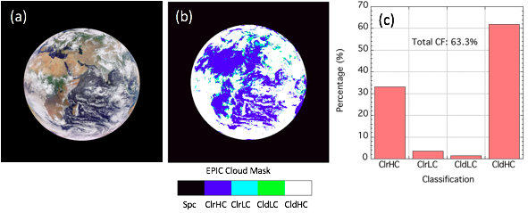
EPIC Cloud Product Example (08GMT 08/18/2016): Cloud Mask
EPIC RGB (enhanced color) image
Cloud coverage
With the EPIC cloud mask, it is straightforward to calculate global day time cloud coverage and its variability

Slide 7
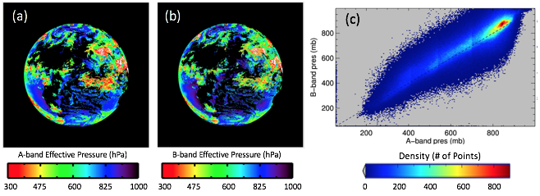
EPIC Cloud Product Example (08GMT 08/18/2016):
Cloud Effective Pressure/Height
Effective cloud pressure are generally higher (lower altitude) than the physical cloud top; A-band pressure can be slightly lower than the B-band pressure due to that photons in B-band penetrate deeper into clouds.

Slide 8
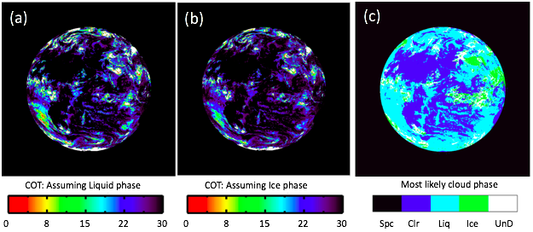
EPIC Cloud Product Example (08GMT 08/18/2016):
Cloud Optical Thickness (COT)
EPIC COT retrieval adopts a single channel approach. Since EPIC does not provide enough information to confidently determine cloud thermodynamic phase, two COT values are retrieved for each cloudy pixel by assuming liquid and ice phases, respectively. A most likely cloud phase is provided based on the effective cloud height.

Slide 9
Comparison of EPIC cloud masks with collocated GEO/LEO observation
The multi-sensor composites are produced by reprojecting collocated GEO/LEO results (such as AVHRR, MODIS and GOES) onto the EPIC grids (David Duda, Wenying Su et al.).
This dataset provides an independent source for EPIC cloud product verification.

Slide 10
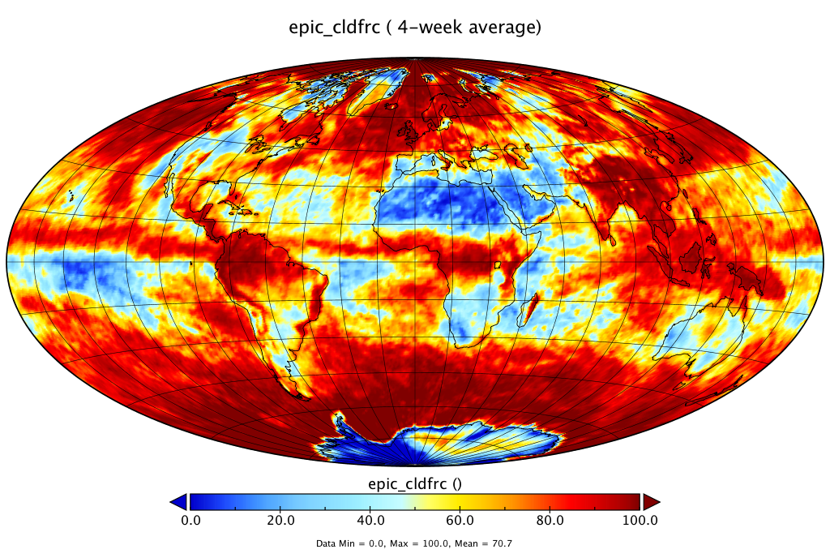
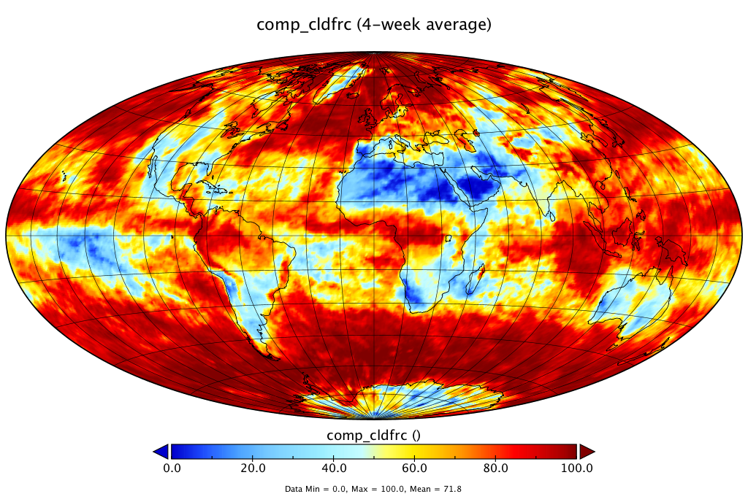
EPIC vs GEO/LEO composites: Global cloud coverage
EPIC
GEO/LEO
GEO/LEO
Comparison used four weeks of data from 2016 with one week for each season.
General patterns agree well, but problems exist for EPIC cloud masks over snow/ice covered areas.

Slide 11
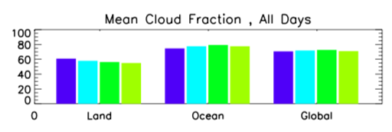
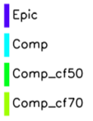
Overall performance: EPIC reports higher cloud fraction over land, but lower cloud fraction over ocean
GEO/LEO
Surface | EPIC | Collocated GEO/LEO
Land | 60.9% | 57.9%
Ocean | 74.7% | 77.5%
Global | 70.7% | 71.8%

Slide 12
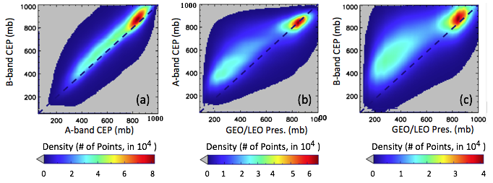
EPIC vs GEO/LEO composites: Effective Cloud Pressure
Effective cloud pressure are generally higher (lower altitude) than the physical cloud top; factors contribute to the A- and B-band differences include penetration depths differences, surface albedo differences, geolocation uncertainties, cloud evolution etc.

Slide 13
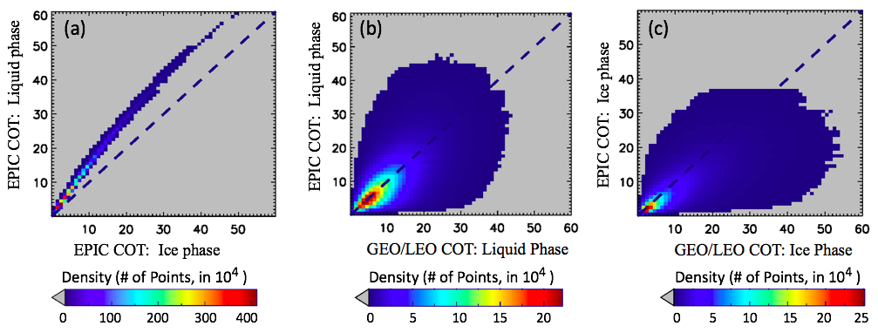
EPIC vs GEO/LEO composites: Cloud Optical Thickness
Two COT values are retrieved for each cloudy pixel by assuming liquid and ice phases, respectively. For the same reflectance, liquid clouds have higher COTs, as expected. EPIC COTs and GEO/LEO composites compare well given the fact that the CERES-cloud algorithm uses a different set of assumptions and cloud models than MODIS.

Slide 14
Future Plans
Improve cloud mask over ice and snow
Monitor O2 A- and B-band performance through establishing a long term record
Continue cloud product assessment; a MODIS retrieval dataset will be generated for this purpose.
Generate Level 3 gridded cloud products

Slide 15
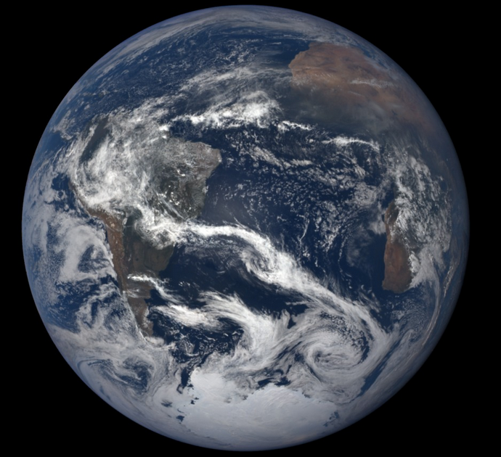
Tracking A- and B-band Performance
EPIC O₂ A- and B-band observations over the Amundsen–Scott South Pole Station area.
Data are from December 2015, January and December 2016 and January 2017 when the South Pole is on the daytime side of the earth and the solar elevation angle is relatively high.
Choose a bright surface will make sure most of the photons are coming from the surface, which have a well defined photon path.
A-band Ratio: R₇₆₄ / R₇₈₀
B-band Ratio: R₆₈₈ / R₆₈₀

Slide 16
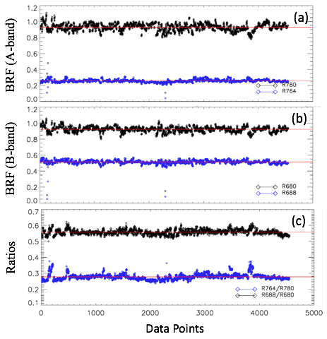
Tracking A- and B-band Performance
EPIC O₂ A- and B-band observations over the Amundsen–Scott South Pole Station area.
Data are from December 2015, January and December 2016 and January 2017 when the South Pole is on the daytime side of the earth and the solar elevation angle is relatively high.
Choose a bright surface will make sure most of the photons are coming from the surface, which have a well defined photon path.
A-band Ratio: R₇₆₄ / R₇₈₀
B-band Ratio: R₆₈₈ / R₆₈₀
Observation values will be used as the basis for cloud detection thresholds.
Will perform radiative transfer calculations as an independent test for the radiometric calibration.

Slide 17
Potential Level 3 Gridded Cloud Products
One major strength of EPIC observations is its ability to observe one location multiple times during the sunlit hours, which has potential for studying the daily cycle of the local climate systems.
The potential Level 3 product will include gridded cloud fraction, cloud effective height and cloud optical thickness as a function of time of day.
EPIC temporal resolution: 1.08 hours in boreal summer and every 1.85 hours in winter; hence for a place with 12 hours of sunlight per day, it will have ~11 EPIC observations in a boreal summer day and ~8 observations in a winter day.

Slide 18
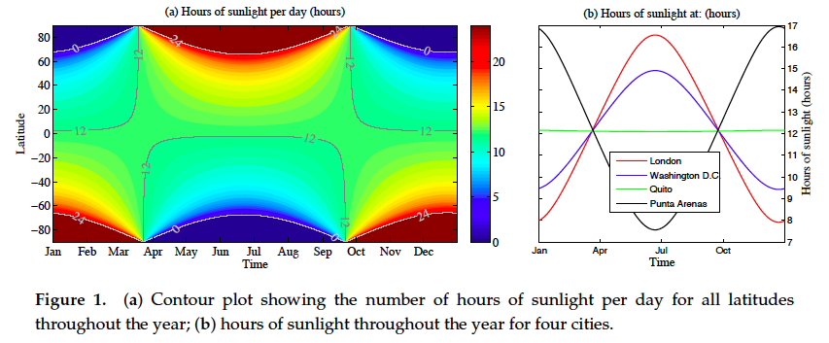
Daily Sunlit Hours Around the Globe
Holdaway and Yang, 2016

Slide 19
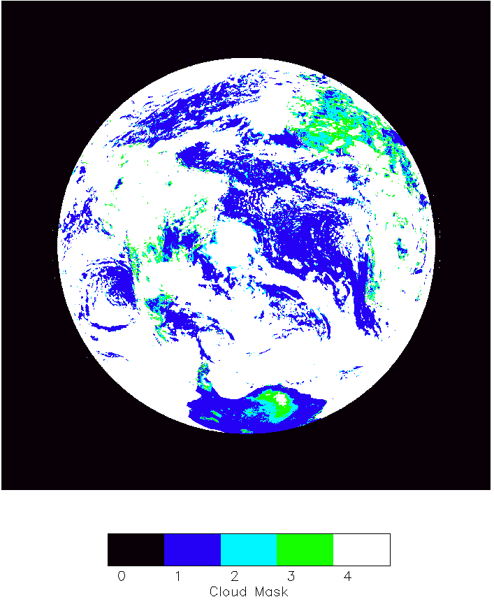
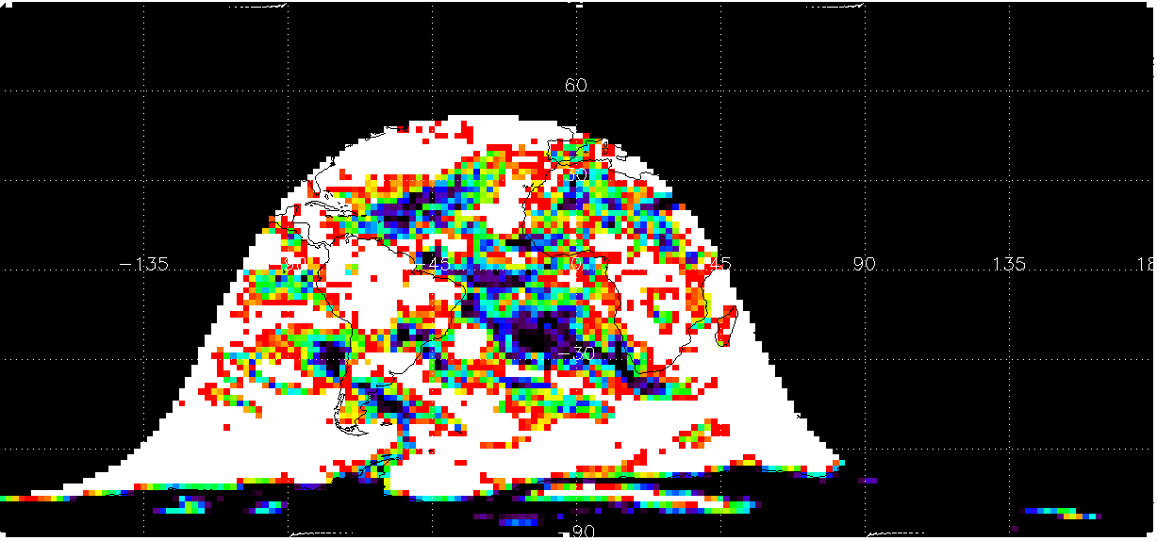
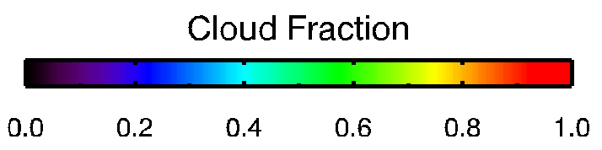
Using EPIC cloud mask for studying cloud daytime variability
1, project EPIC cloud mask on a 3-D grid: [lat, lon, GMT]; data is binned into 2 hour bins, so we have a time series (12 points) for each day and the standard deviation of this time series contains information of daytime variability (V_{hh}).
2, Calculate the average cloud coverage for each day, then we have a time series (30 points) for each month; the standard deviation of this time series is the day to day variability (Vdd).

Slide 20
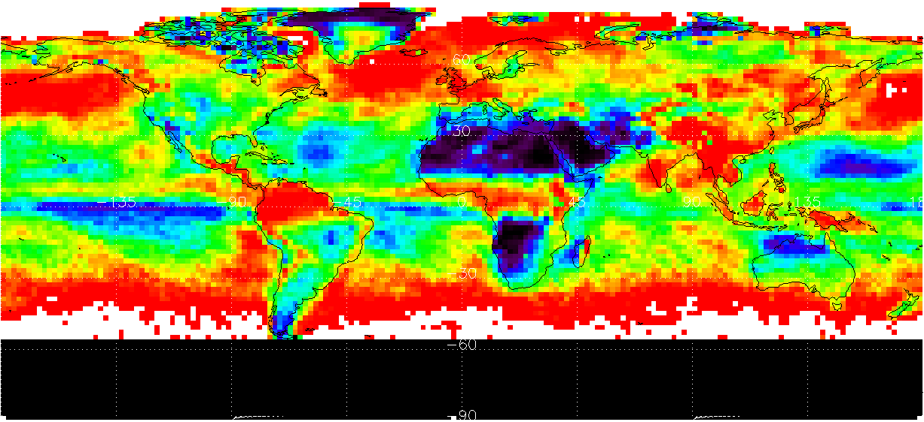
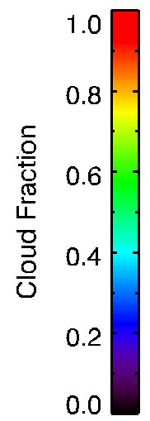
Monthly mean cloud coverage (June 2016)
90N
60N
30N
0
30S
60S
90S
135W
90W
45W
0
45E
90E
135E

Slide 21
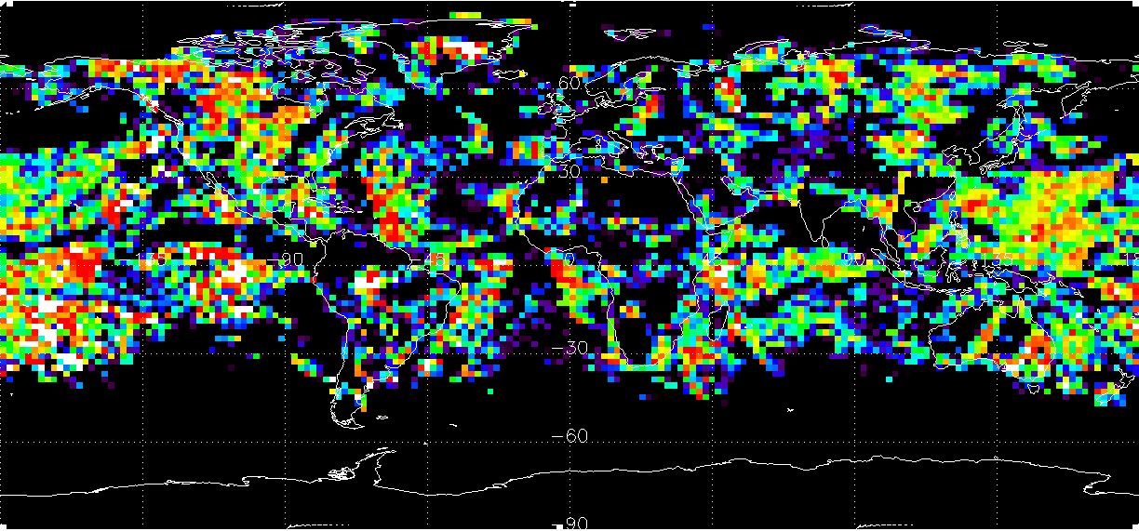
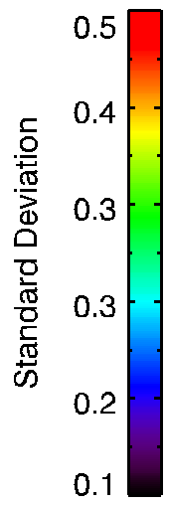
Daytime Variability (Standard Deviation 00-23 GMT)
90N
60N
30N
0
30S
60S
90S
135W
90W
45W
0
45E
90E
135E

Slide 22
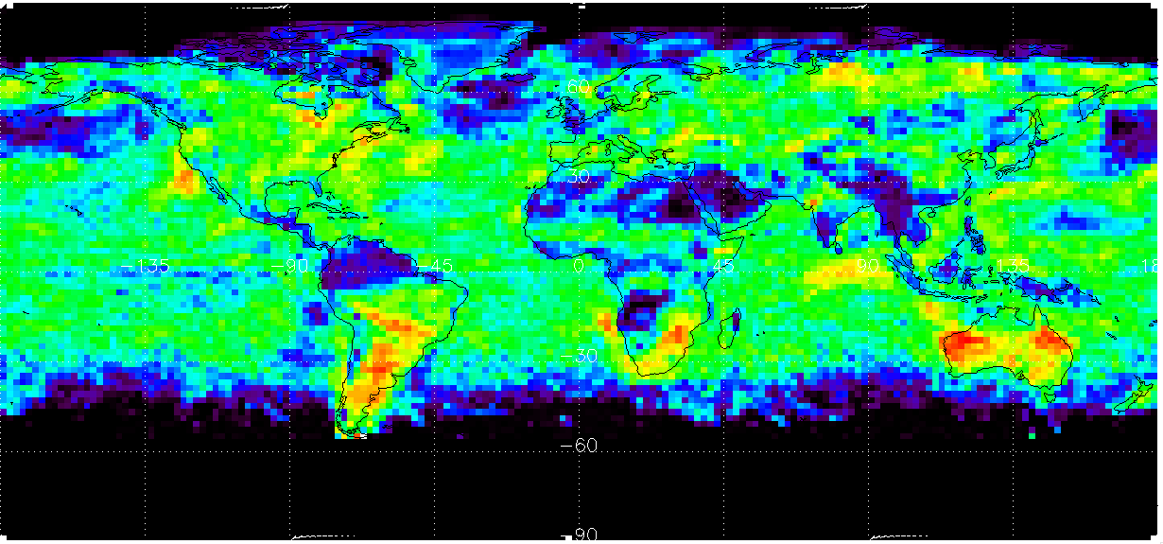
Standard Deviation of daily average cloud fraction across the month is much smoother
90N
60N
30N
0
30S
60S
90S
135W
90W
45W
0
45E
90E
135E

Slide 23
Daytime Variability (Standard Deviation 00-23 GMT)
90N
60N
30N
0
30S
60S
90S
135W
90W
45W
0
45E
90E
135E

Slide 24
Summary
The standard Level2 products, including cloud mask, cloud effective pressure/height, and cloud optical thickness, compare well in general with the GEO/LEO results derived by the CERES-cloud team.
Issues of cloud mask over ice- and snow covered areas are observed and efforts are ongoing to improve the product.
A longterm record over the South Pole station is being established to track the performance of A- and B-band performance.
EPIC shows the potential for studying regional cloud daytime variability. A Level 3 gridded cloud product will be very helpful in the investigation.

