Slide 1
NIST Advanced Radiometer
NISTAR Update
Allan Smith, Yinan Yu, Steven Lorentz
L-1 Standards and Technology

Slide 2
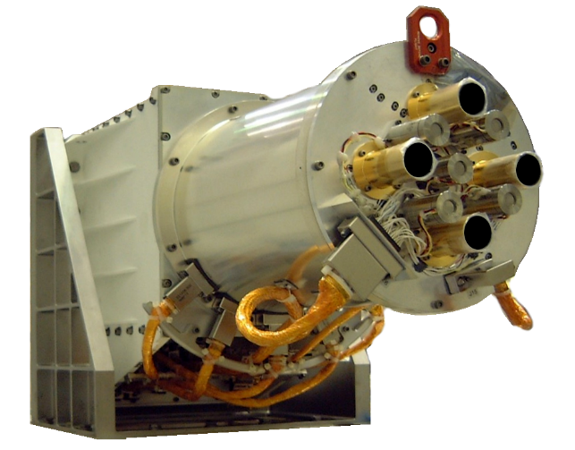
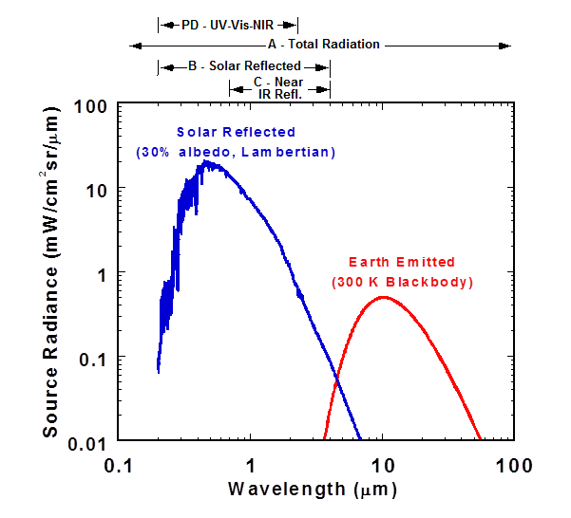
NISTAR
NIST advanced radiometer measures the Earth solar-reflected and emitted irradiance from the Earth-Sun Lagrange 1 point in 4 bands
Band | Wavelength Range | Description
Photodiode | 0.2 to 1.1 μm | UV-Vis-NIR
Band A | 0.2 to 100 μm | Total Outgoing Radiation
Band B | 0.2 to 4 μm | Solar-Reflected
Band C | 0.7 to 4 μm | Near-IR Solar-Reflected
NISTAR Science Requirement: to provide measurements that could be used to determine the Earth outgoing irradiance in the wavelength range of 0.2 -100 microns with an accuracy of 1.5 percent or better.

Slide 3
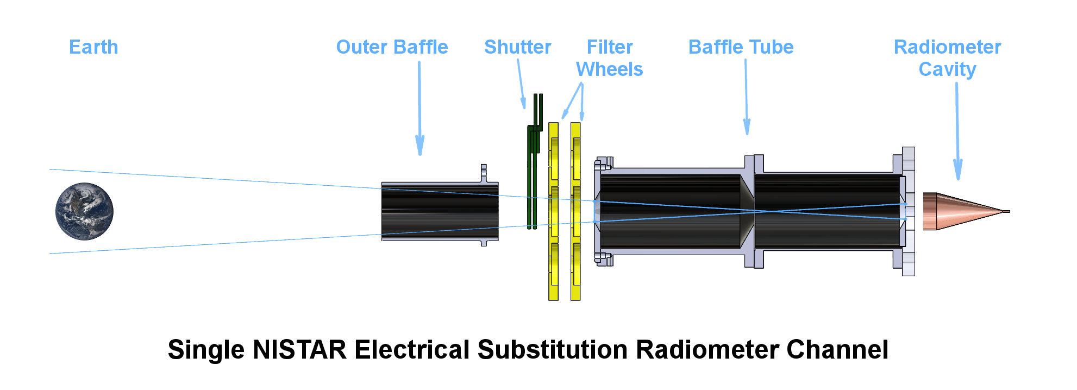
NISTAR
Continuously measurement of absolute irradiance in all filter bands
Three broad-band (0.2 to 100 μm) electrical substitution radiometers (ESRs)
Two filter types select either band B or band C
Cavity ESRs for stability, ground calibration for accuracy
Photodiode monitors filter transmittance stability on-orbit

Slide 4
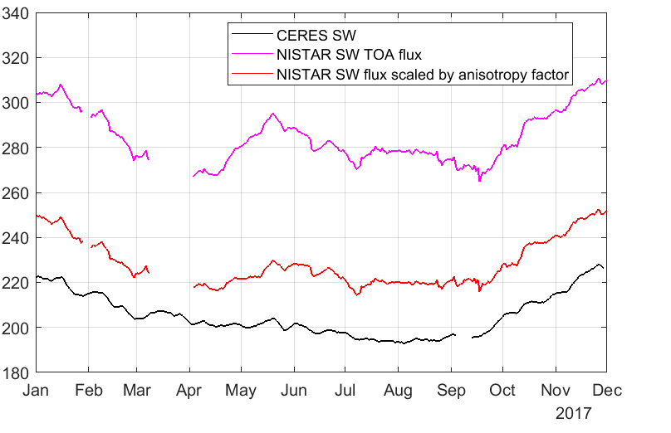
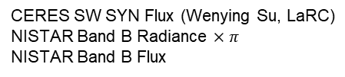
Comparison: CERES SW and NISTAR Band B
Large, 8% to 13%, difference between CERES SW SYN Flux and NISTAR Band B
NISTAR uncertainty of ≈2% is, by itself, too low to explain the discrepancy
→ looking for sources of unquantified NISTAR measurement error
CERES SW SYN Flux (Wenying Su, LaRC)
NISTAR Band B Radiance $×π$
NISTAR Band B Flux
(W/m²)
Anistropy Factor (Wenying Su, LaRC)
≈10%

Slide 5
Possible Sources of Measurement Error
Instability of the instrument on-orbit—evidence supports stability
  Variability of offsets not capture by monthly measurements
  Contamination of optical components
    Filters (and PD) are very susceptible
    (Cavities NOT sensitive to small contamination)
  Changes in the ESR electronics
    Radiation induced
    Aging
Launch induced post calibration changes—would detect if not same for all channels
  e.g., paint loss in cavities
Unanticipated transient with internal shutter
  Shown to be removable background effect
  Earth signal shown to settled
Calibration errors—none expected at the 10% level; being reviewed

Slide 6
Comparison: CERES SW and NISTAR Band B
Large, 8% to 13%, difference between CERES SW SYN Flux and NISTAR Band B
NISTAR uncertainty of ≈2% is, by itself, too low to explain the discrepancy
→ looking for sources of unquantified NISTAR measurement error
CERES SW SYN Flux (Wenying Su, LaRC)
NISTAR Band B Radiance $×π$
NISTAR Band B Flux
(W/m²)
Anistropy Factor (Wenying Su, LaRC)
≈10%

Slide 7
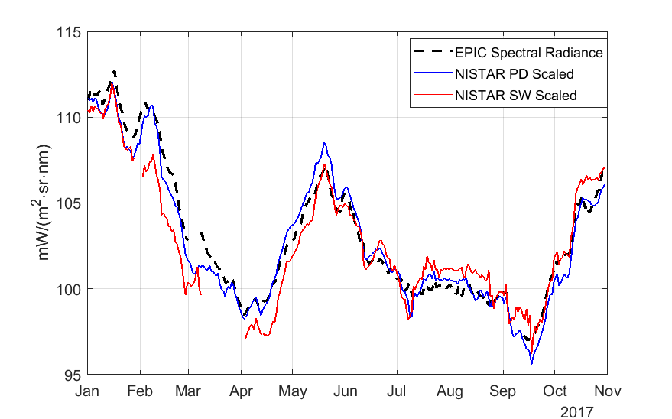
Comparison of EPIC, NISTAR PD & SW
Three independent measurements track each other in a relative—not absolute—sense
EPIC Earth-averaged radiance, bands (O₂ excluded) from Jay Herman weighted to the NISTAR PD response function, interpolated and wavelength integrated
NISTAR data scaled by a constant times the square of the Earth-DISCOVR distance
→No major instrument effects that vary in time, e.g. ESR offsets
Spectral Radiance (mW/m²·sr·nm)

Slide 8
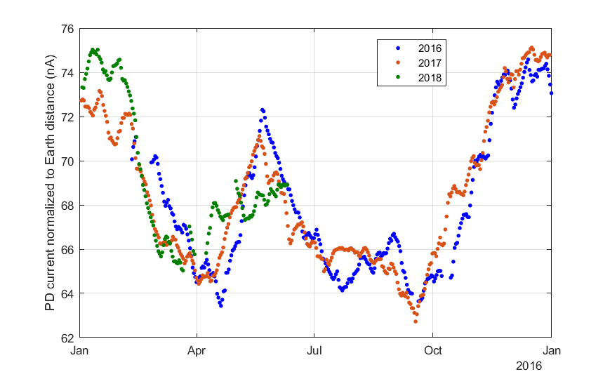
NISTAR Photodiode (PD) vs Time
Long-term stability of PD is apparent even with seasonal and view angle effects
Earth distance effects removed—but not viewing angle
→ Stability implies clean space instrument (Cavity ESRs less sensitive to contamination than PD)

Slide 9
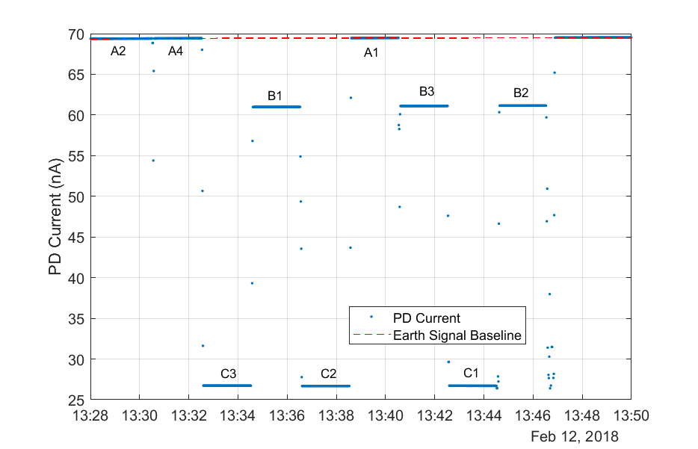
Filter Inter-comparisons (Band-B and Band-C)
Filter broad-band transmittance is measured using the photo-diode as a detector and the Earth as a source, which is stable of the 15 minute measurement time
There are 3 nominally identical filters for each band—two are spares
The ratio of transmittance between like filters is a measure of differential degradation

Slide 10
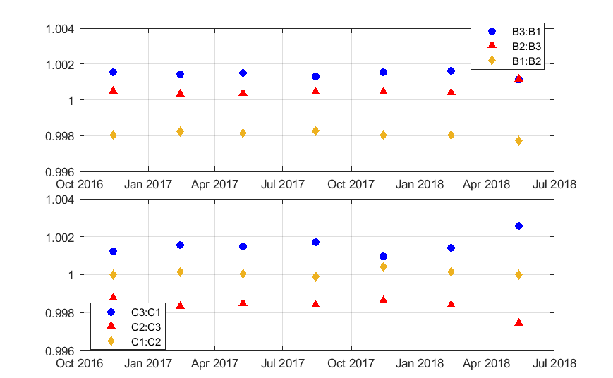
Filter Inter-comparisons (Band-B and Band-C)
Pairwise filter transmission ratios stable to less than 0.1% in 1.5 years
→ Adds to evidence of stable, clean instrument

Slide 11
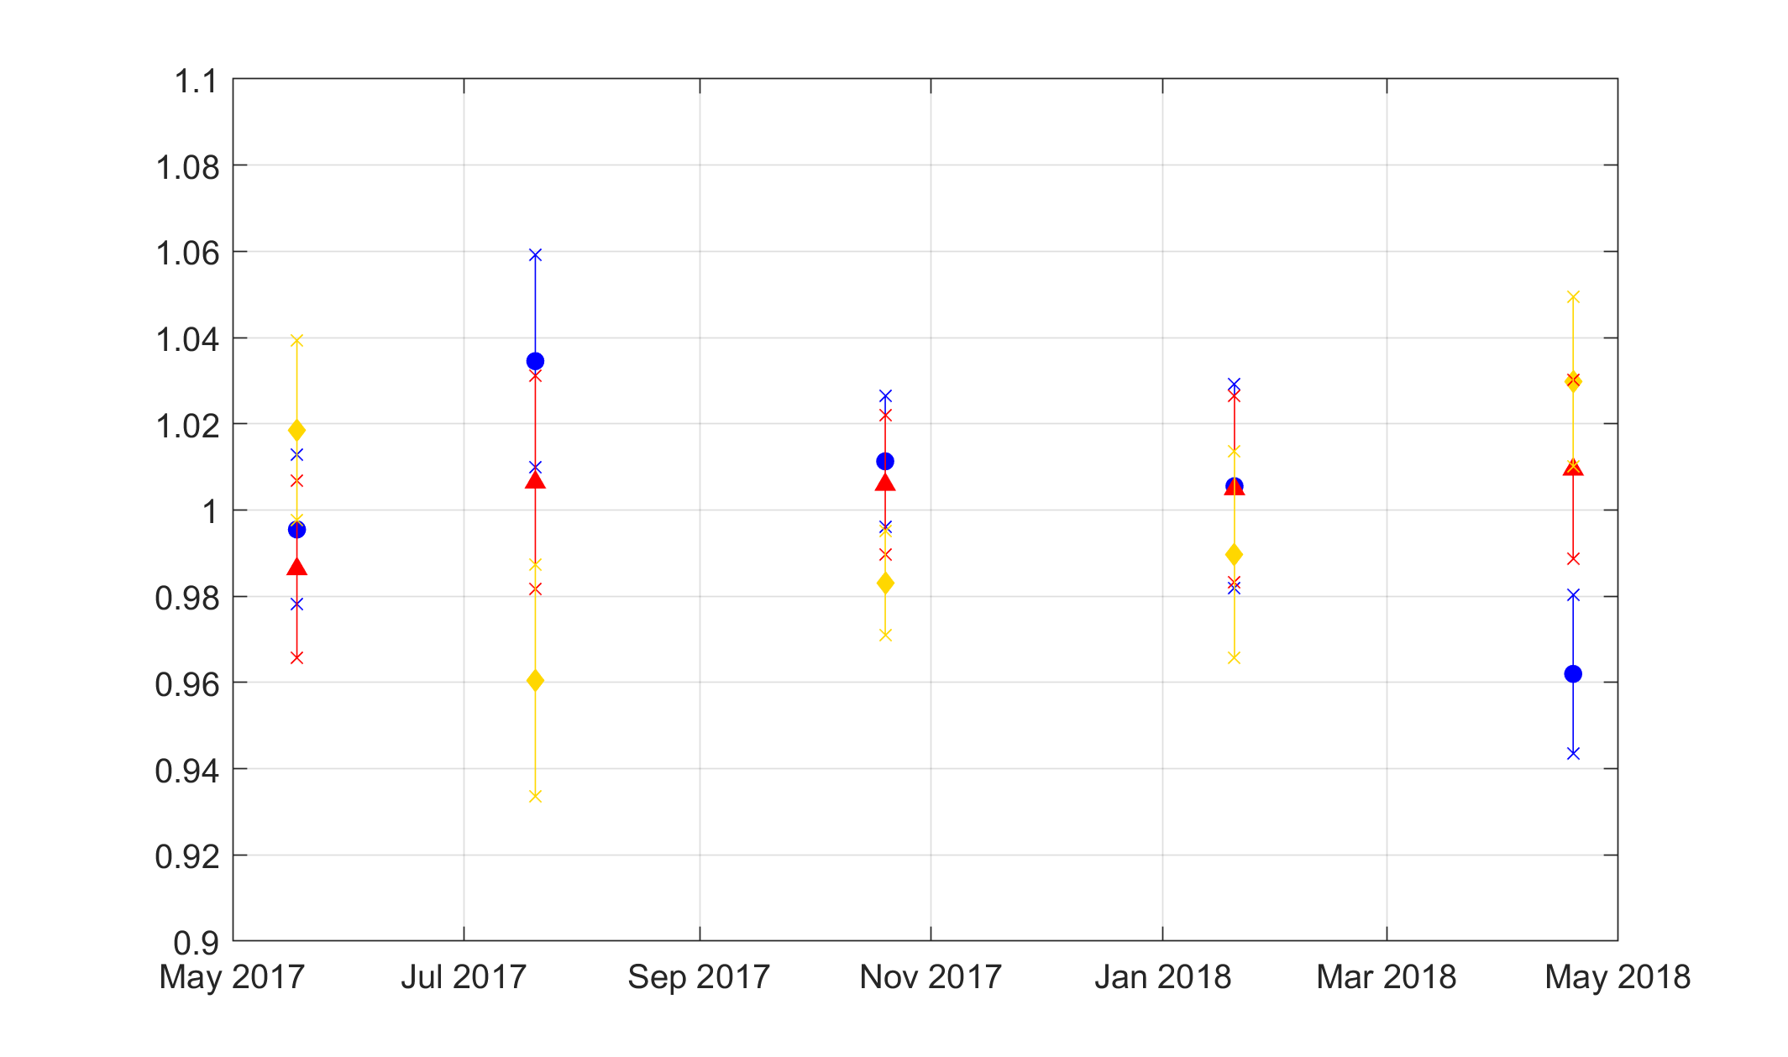
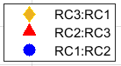
Receiver (Band A) Inter-comparisons
Three ESRs view the Earth for 8 hours in the Band A configuration (no filters) followed by a background measurement
The pairwise ratio averages are <0.4% (indicated by lines), which is within the type A uncertainty
→ Further evidence of stable, clean instrument

Slide 12
ESR Background: Offset Determination
All ESRs have a large background as they measure the change in incident optical power
NISTAR removes the background in two steps
  A shutter modulates the source—removes most background but some remains
  Views of dark space remove the residual shutter-modulated background
The shutter modulated background is largest for the total channel (Band A) but is much smaller for the SW and NIR filtered channels (bands B and C)
Filters block shutter modulated long wave IR—leaving only indirect heating effects

Slide 13
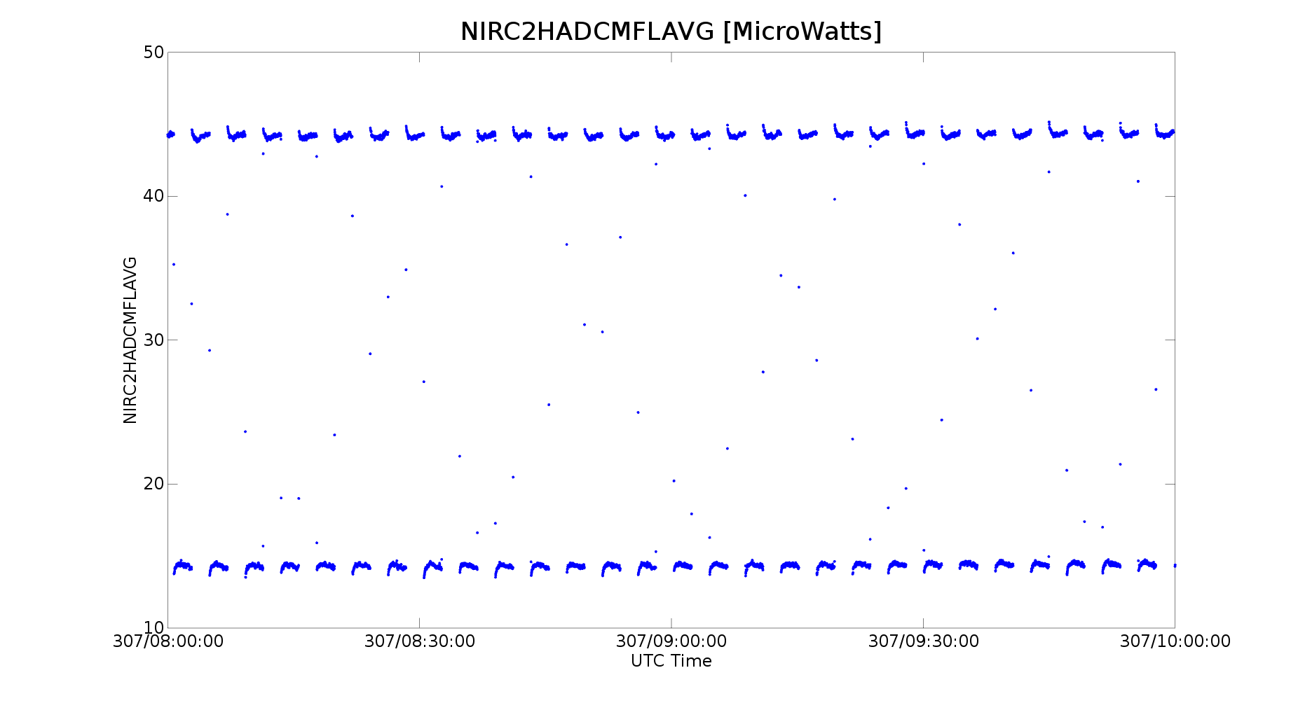
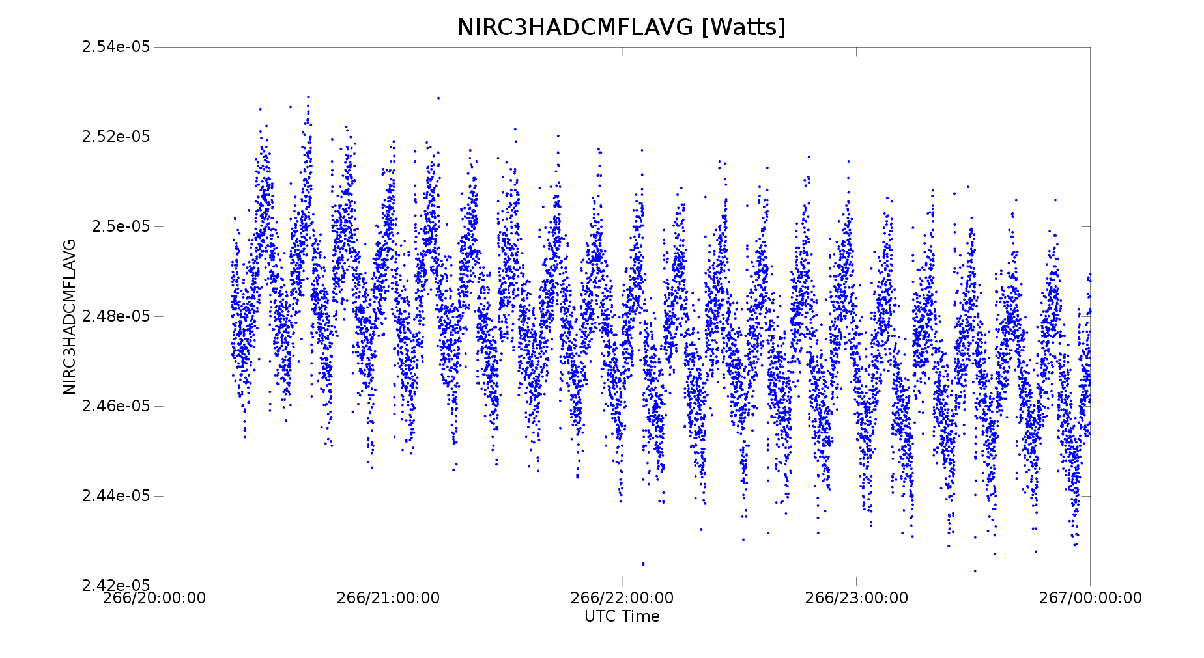
Unexpected Transient Observed On-Orbit
Laboratory: calibration source modulated with external shutter—all background is un-modulated
On-orbit: Earth light and some background-IR are modulated with internal shutter
Square wave not observed but required in Earth signal for accurate demodulation
Band A (Total)
Expected flat top square wave
30 μW
Band B (SW)
0.4 μW

Slide 14
ESR Background: Offset Determination
All ESRs have a large background as they measure the change in incident optical power
NISTAR removes the background in two steps
  A shutter modulates the source—removes most background but some remains
  Views of dark space remove the residual shutter-modulated background
The shutter modulated background is largest for the total channel (Band A) but is much smaller for the SW and NIR filtered channels (bands B and C)
Filters block shutter modulated long wave IR—leaving only indirect heating effects

Slide 15
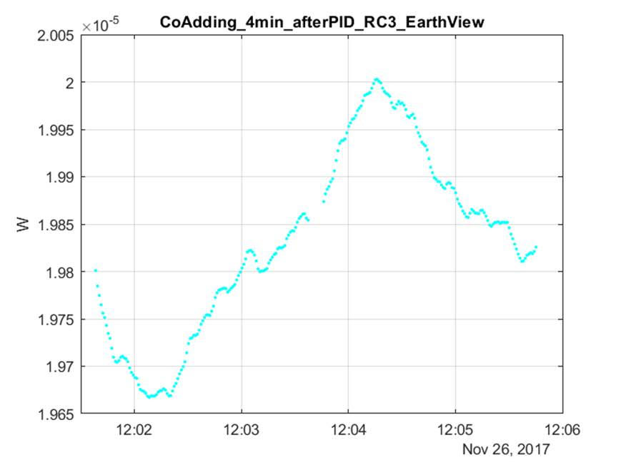
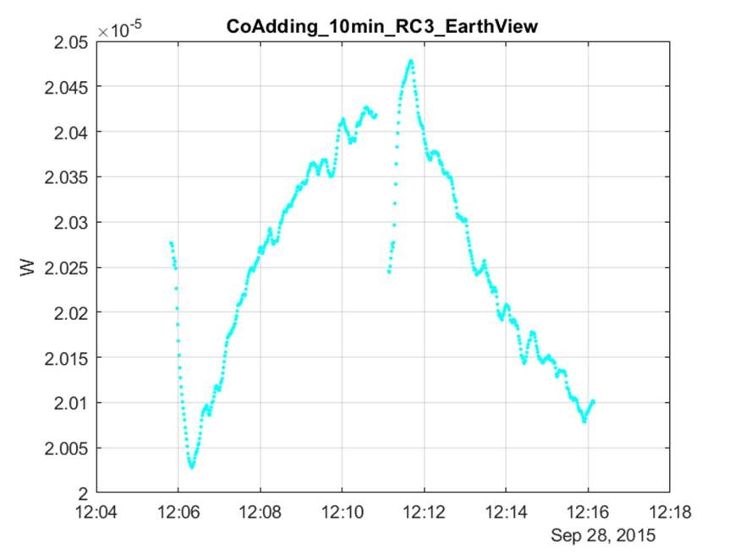
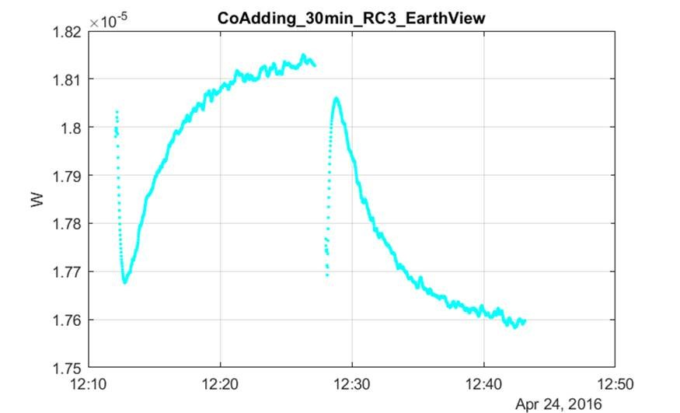
Unexpected Transient Observed On-Orbit
Band B (SW)
Open
Closed
Observations (to the left):
Shutter-modulated background transient evolves over time
Magnitude grows with time following shutter transition
Filters block LW IR → transient is indirect from heating and cooling of heatsink & possibly filters
4 Min. Cycle
Open
Closed
Receiver Power (Coadded Cycles)
Changes to operation:
Shorter 4 minute cycle was chosen to minimize magnitude
Servo PIDs adjusted for faster settling time to a step change in temperature setpoint during live sessions
10 Min. Cycle
Open
Closed
30 Min. Cycle
Time (One Cycle)

Slide 16
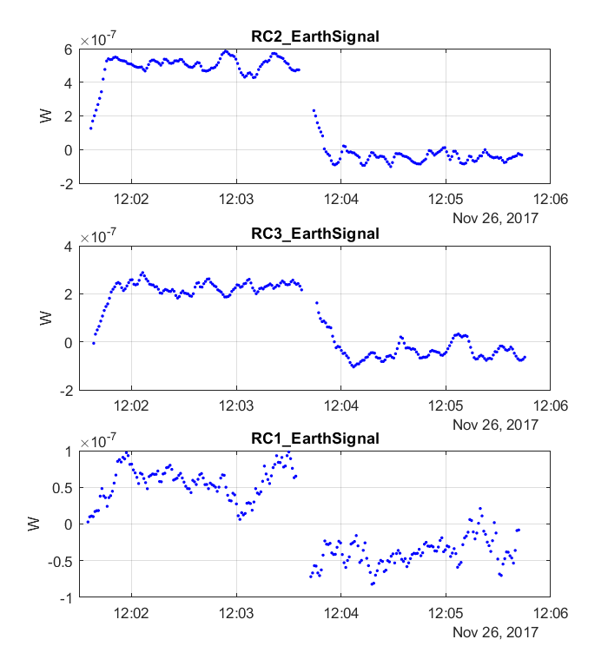
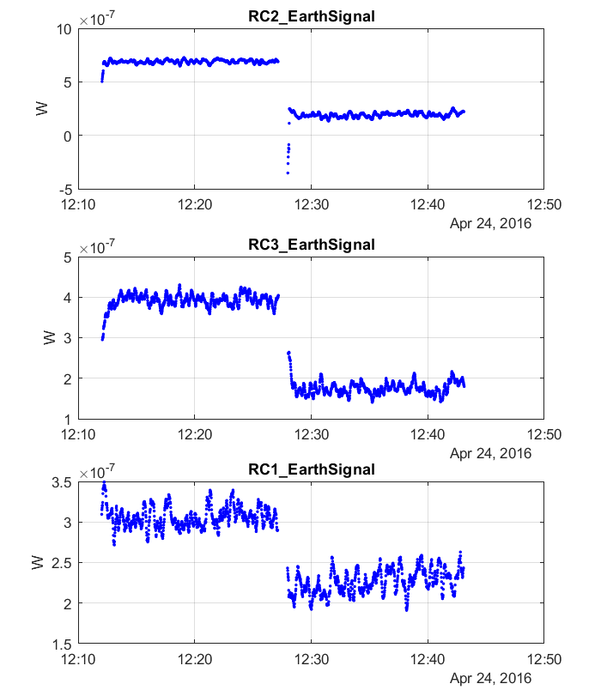
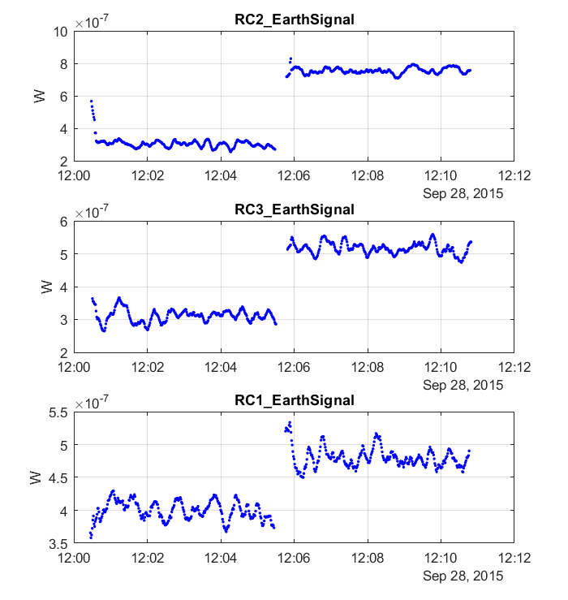
Background Subtracted Waveforms
Band B (SW)
Open
Closed
Background subtracting removes transient:
Background waveforms co-added from dark space view—dominate noise
Additional filtering from running average
Background subtracted waveforms are ‘square’ to within noise
→ No significant error from demodulation which requires square wave for accuracy
4 Min. Cycle
Open
Closed
Negative Receiver Power (Coadded Cycles)
10 Min. Cycle
Closed
Open
30 Min. Cycle
Time (One Cycle)

Slide 17
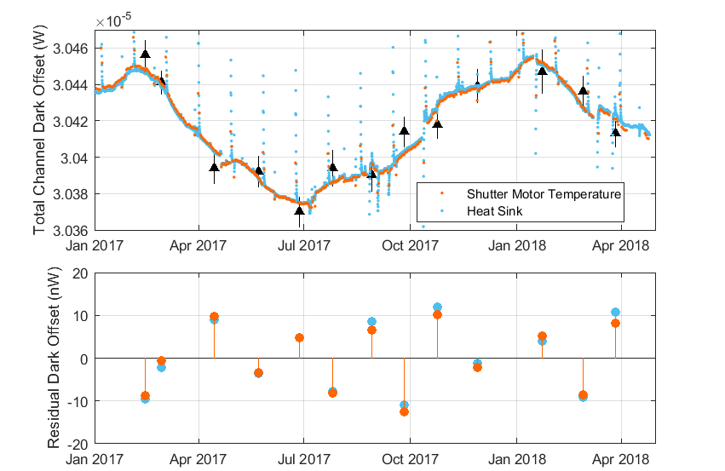
Total Channel Dark Offset Determination
Total channel background changes in between monthly measurements driven by orbitally induced changes in spacecraft temperature
Background tracks instrument temperature as sensed by the heatsink servo effort (heater power) and shutter motor temperature sensor

Slide 18
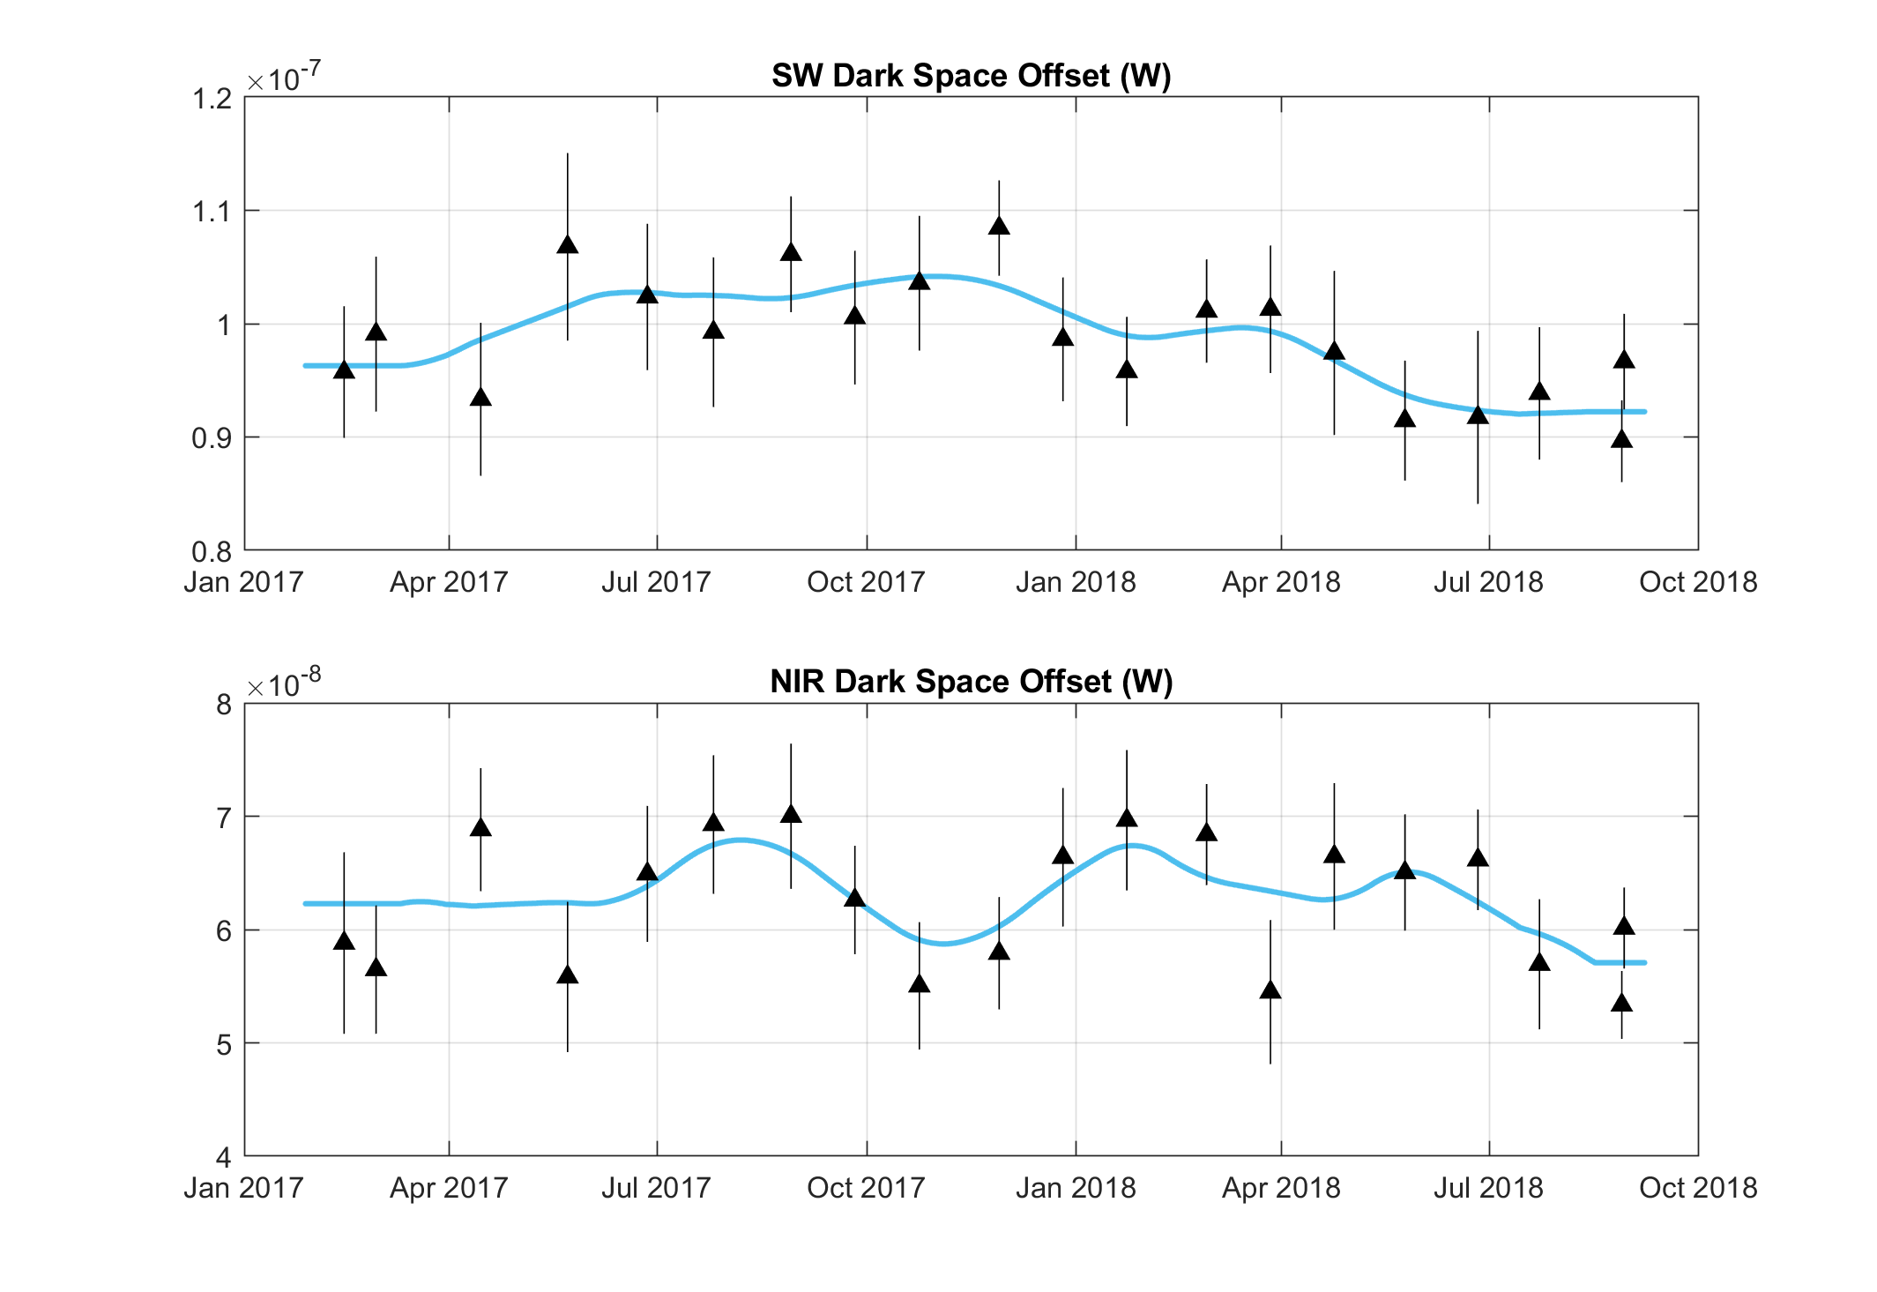
Filtered Channel Dark Offset Determination
Filtered channel backgrounds are much more stable as drifts in the filter IR emissions from temperature are removed by the shutter
To reduce noise three background measurements are smoothly averaged (blue curve below)

Slide 19
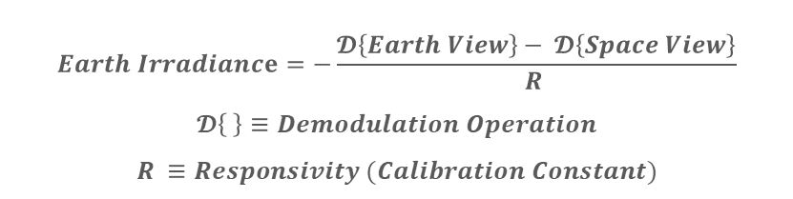
NISTAR Uncertainty Estimates
$$Earth Irradiance=−\frac{𝓓\left\{Earth View\right\}− 𝓓\left\{Space View\right\}}{R }$$
$$𝓓\left\{ \right\}≡Demodulation Operation$$
$$R ≡Responsivity (Calibration Constant)$$
Filter Channel | Instrument Noise |  | Responsivity (Calibration factor) |  | NISTAR Total Uncertainty⁵
 | Space View¹ | Earth View² | Laboratory Calibration³ | Stability on Orbit⁴
Total | 1.0 % | 0.3 % | <0.2 % | 0.5 % | 1.2 %
SW | 1.3 % | 0.4 % | ≈1 % | 0.5 % | 1.7 %
NIR | 3.5 % | 1.7 % | ≈1 % | 0.5 % | 4.0 %
All uncertainties are calculated at k = 1
Normalized to the Earth signal. 2-hour dark space view performed monthly. 3 consecutive dark space views are averaged for the SW and NIR channels; no averaging for the Total channel.
Instrument noise—ignoring source variability—averaged over 24-hour time periods.
Uncertainty components are from both the ESR receiver and the filter transmission. For the two filtered channels, SW and NIR, the uncertainty of the filter transmission dominates.
Estimate based on-orbit inter-comparison between receivers and filters during Earth view.
Total uncertainties of daily averages is the quadrature sum of all listed components.

Slide 20
Conclusions
No measurable instrument on-orbit degradation
  Cavity responsivities agree and stable to < 0.5%
  Filter transmittances stable to <0.1%
No time varying measurement errors
  EPIC, NISTAR PD and Band B (SW) track one another
  Bands B (SW) and C (NIR) offsets very stable
Proper settling of instrument response to shutter modulated Earth radiation—observed transient is truly a background effect
Comparison with CERES Synoptic Model using LaRC anisotropy predictions results in a ≈10% disagreement for Band B (SW)
Investigation into potential measurement errors continues
  Ground calibration is being reviewed in detail

