Slide 1


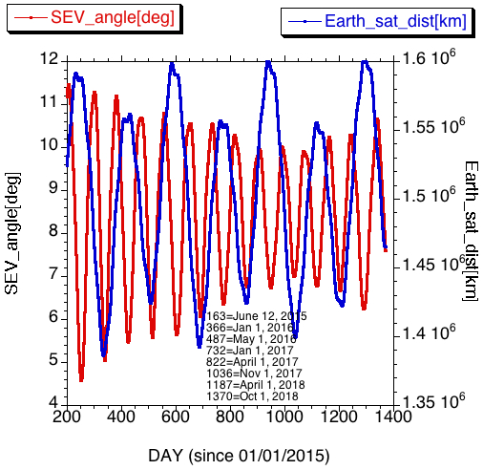
DSCOVR EPIC and NISTAR STM
Sep 17, 2018
First image: June12, 2015
1193 days
DSCOVR Sun
SEV
Earth
Distance: 1.4884 10⁶ km
SEV=9.19º => Scat. angle=170.81º
Velocity=0.342 km/sec

Slide 2
Successfully passed the ‘End of Prime Mission’ review (July 24, 2018);
Directed to prepare and submit a proposal to the 2020 Senior Review and to provide funding for continued operations and data analysis for EPIC and NISTAR through FY2020, and possibly beyond, pending outcome of the 2020 Senior Review;
EPIC Level 2 product has been released;
O3; Nov 20, 2017
Volcanic SO2; Nov 20, 2017
UV aerosol; Nov 20, 2017
Cloud; Jan 19, 2018
Atm. Correction; Feb. 26. 2018
Vegetation; June 4, 2018
EPIC Level 1 V2 (July 2017); EPIC Level 1 V3 (Sep/Oct 2018);
NISTAR data version 2.1 (Nov 2016 – Jun 2018) has been reprocessed and will be released this week.
EPIC webpage (https://epic.gsfc.nasa.gov) has been substantially improved (447,247 pageviews for the last year)
AGU 2017 Deep Space Observations session (Dec 2017); will be also at AGU 2018

Slide 3
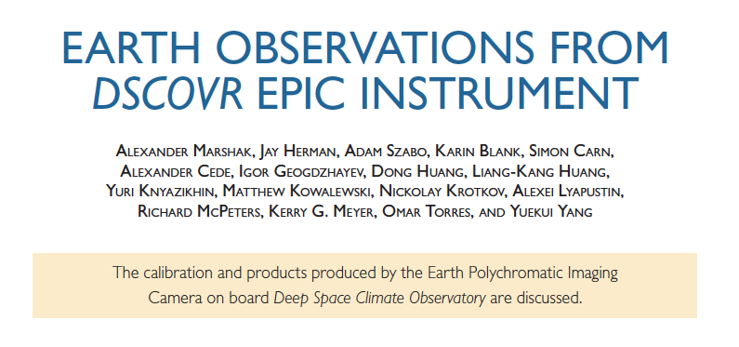
- ROSES A.46 DSCOVR SCIENCE TEAM (Sep 2018);
8 peer review papers have been published (+ 3-4 submitted) in 2018 including BAMS paper Earth Observations from DSCOVR/EPIC Instrument (Sep 2018)

Slide 4
Mon Sep 17
Intro/Project/Web/Archive
9:00 Szabo/Marshak/Herman (Welcome and update)
9:10 GSFC (Irons/Platnick) & HQ (Eckman/Kaye)
9:25 DSOC and EPIC website (Hostetter/Pearce)
9:40 EPIC L2 data processing (Sutton)
9:50 ASDC data archiving (Baskin)
EPIC Level 1 data and reprocessing
10:00 Blank
10:15 Cede/Kowalewski
Break
10:45-11:15
EPIC Calibration
11:15 UV channels (Huang/Herman)
11:30 Visible and NIR channels (Geogdzhaev/Marshak)
11:45 O2 channels (Kowalewski/Marshak)
Lunch and posters
12:00-2:00
NISTAR
2:00 Smith/Yu
2:30 Su/Feldman
EPIC Products
3:10 Herman/McPeters (O3)
Break
3:40-4:00
EPIC Products (cont.)
4:00 K. Yang (O3, SO2, AI)
4:30 Krotkov/Carn (SO2)
5:00 Torres (UV aerosols)
DSCOVR EPIC and NISTAR STM
Tue Sep 18
EPIC Products (cont.)
9:00 Lyapustin (Atm. correction)
9:30 Y. Yang (Clouds)
10:00 Knyazikhin (Vegetation)
Break
10:30-11:00
Science with the DSCOVR EPIC and NISTAR observations
11:00 Jun Wang (Aerosol Height)
11:15 Jay Herman (Eclipse)
11:30 Guoyong Wen (Eclipse)
11:45 Jan Pisek (Vegetation)
Lunch and posters
12:00-2:00
Science with the DSCOVR EPIC and NISTAR observations (cont.)
2:00 Tamas Varnai (Sun glint)
2:15 Anthony Davis (O2 A- and B-bands)
2:30 Qilong Min (Cloud Height)
2:45 Dong Huang (Atmospheric Correction)
3:00 Alfonso Delgado (Cloud properties)
Break
3:15-3:45
Science with the DSCOVR EPIC and NISTAR observations (cont.)
3:45 Pengwang Zhai (Clouds and Ocean color)
4:00 Charles Gatebe (Ocean Color Retrieval)
4:15 Andy Lacis and Barbara Carlson (Model/Data Analysis of the
Seasonal Rad. Forcing of the Global Rad. Energy Balance)
4:30 Jonathan Jiang and Renyu Hu (Earth as Exoplanet)
Discussion
4:45-5:15

