Slide 1
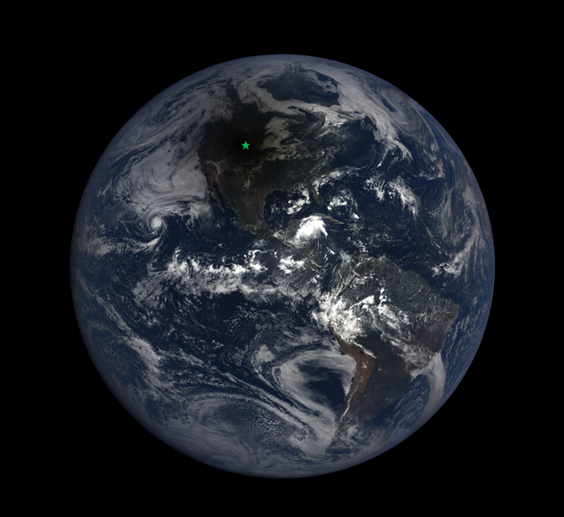
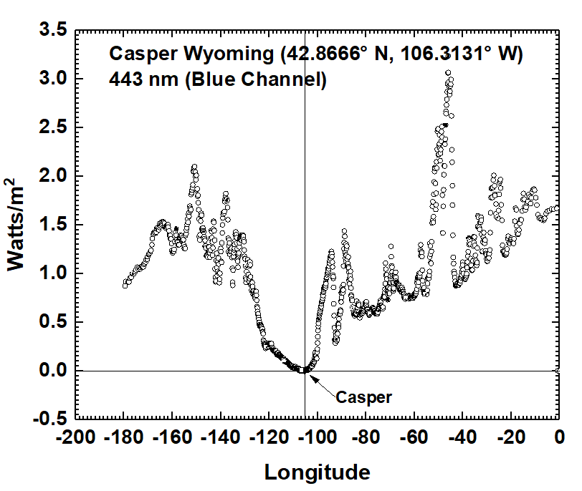
Total Eclipse August 21, 2016 at 11:45
Casper Wyoming
DSCOVR / EPIC
1.5 Million km from Earth

Slide 2
Total Eclipse August 21, 2016 at 11:45
Why Should we care ?
Climate change increases the amount of shadow casting high clouds
The shadows affect the Earth’s energy balance
Testing 3-D calculations on the eclipse data is the first step to understand the more complicated cloud effects on energy balance

Slide 3
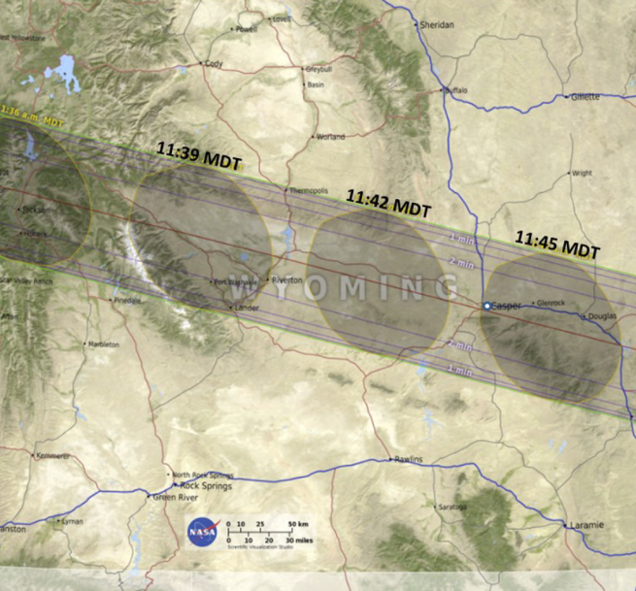
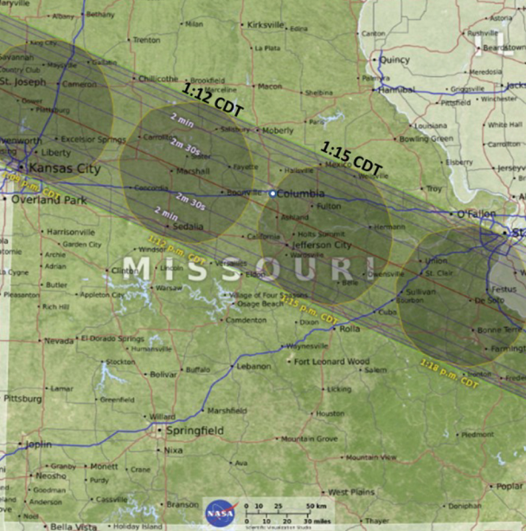
Columbia MO
13:15 CDT
Casper WY
11:45 MDT

Slide 4
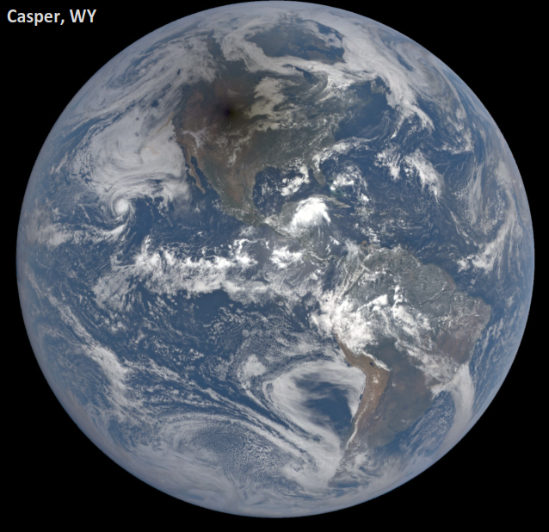
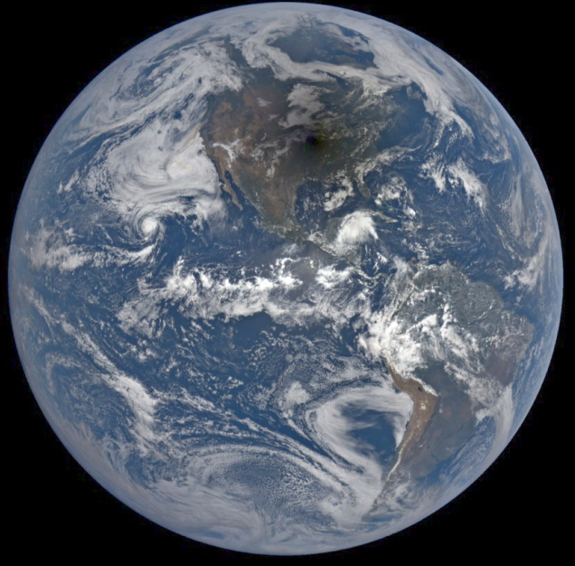
Columbia, MO

Slide 5
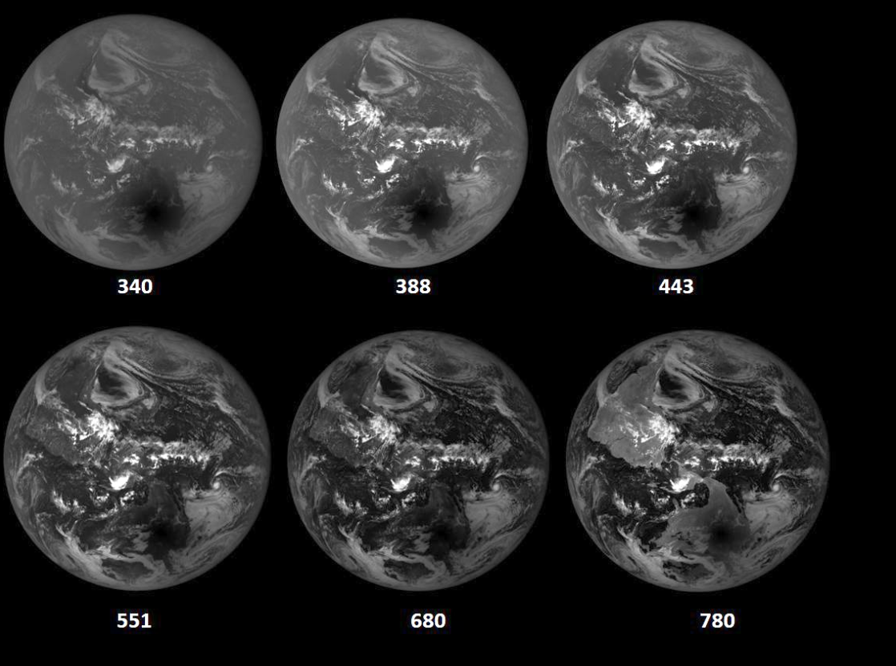

Slide 6
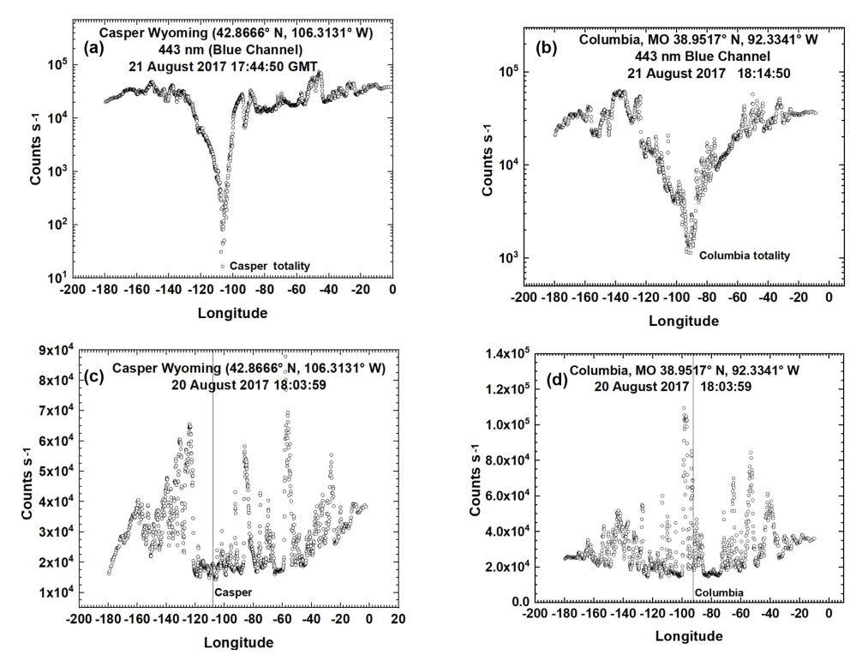
Reflected Light Before and During the Eclipse Along a Line of Longitude
21 August
20 August

Slide 7
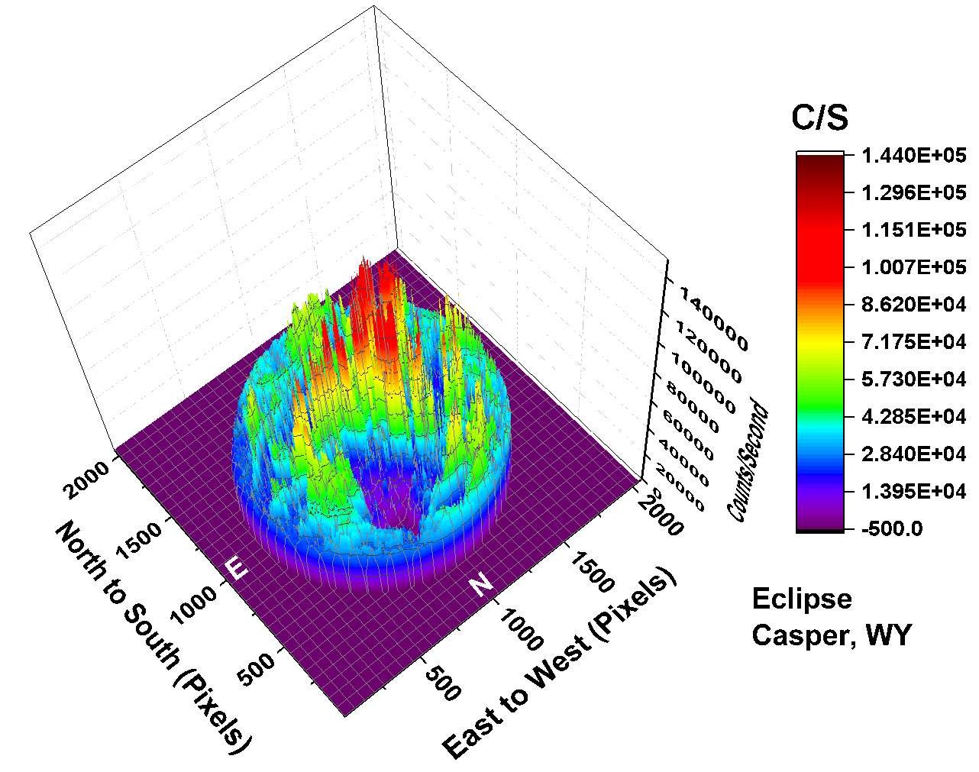
Total Eclipse August 21, 2016 at 11:45
11% Reduced Light Energy Reflected from Earth

Slide 8
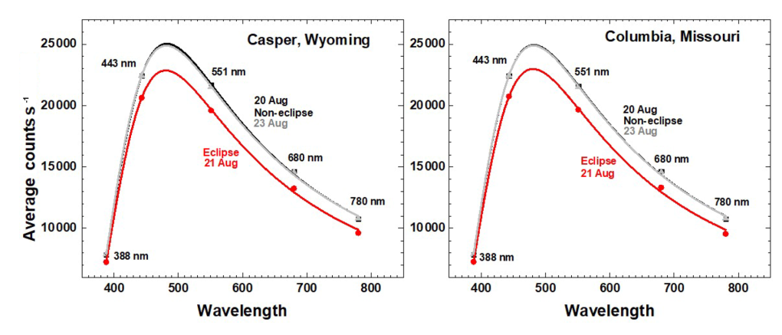
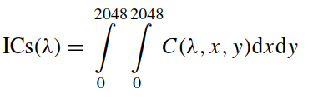
Global Integrated Reflected Light (C/s) vs Wavelength
For 21 August Compared with 20 and 23 August

Slide 9
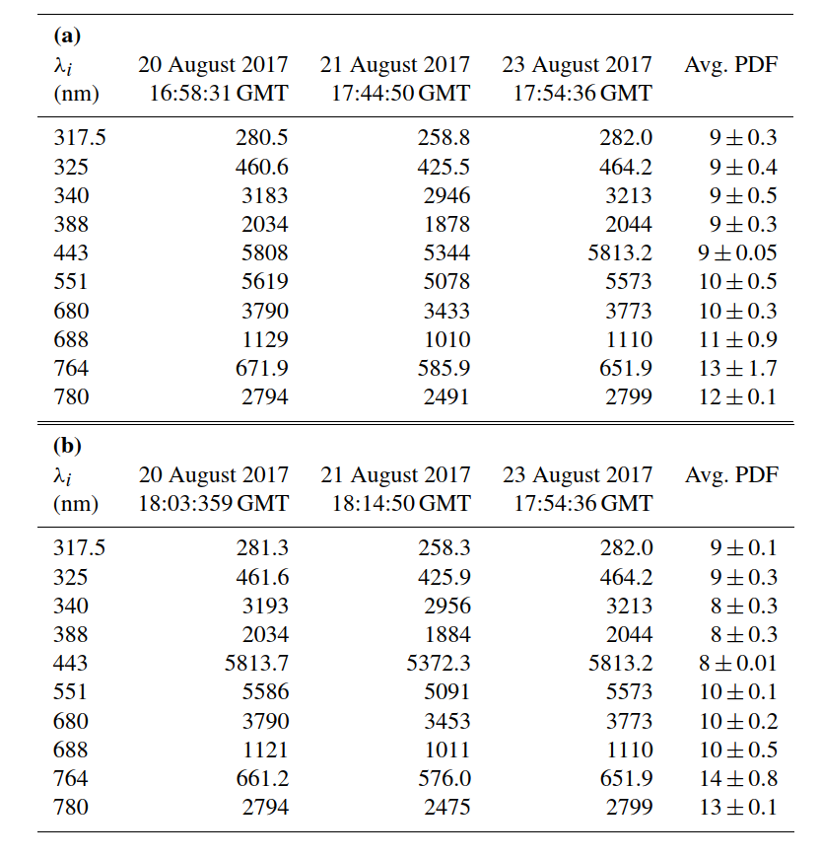

Casper WY
Columbia, MO
Eclipse change in reﬂected light at Casper, WY, and Columbia MO from 20, 21, and 23 August 2017. Units are ICs ×10−7.

Slide 10
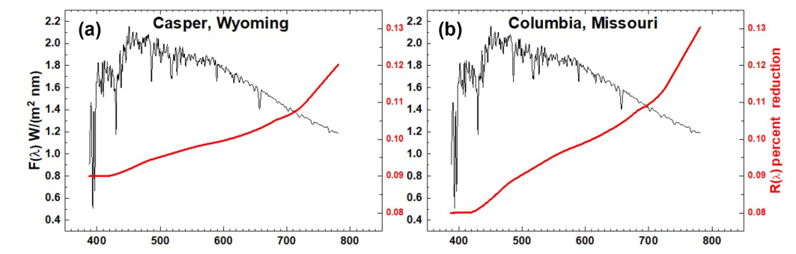


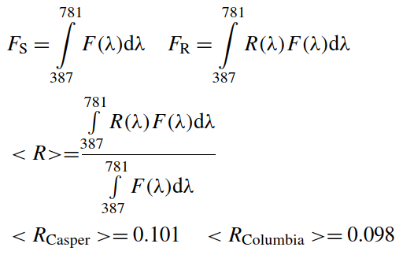
Global Integrated Eclipse Reduction in Reflected Light

