Slide 1
Ocean Color Products from DSCOVR/EPIC Measurements
C. K. Gatebe
USRA & NASA GSFC/Code 613
Team:
SIT: Y. Fan, N. Chen, W. Li & K. Stamnes
GSFC: A. Mannino

Slide 2
Can we retrieve ocean color from DSCOVR/EPIC? why not …

Slide 3
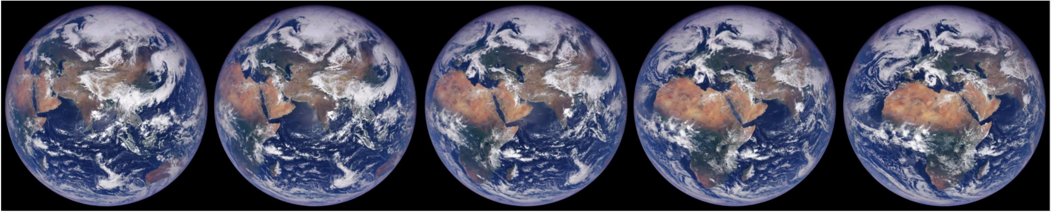
EPIC enhanced RGB images on 05/03/2018
0613 UTC
0718 UTC
0824 UTC
0929 UTC
1035 UTC
These 5 images were taken ~1-hr. apart. EPIC can see short-term variations in marine ecosystems (globally) unlike the polar orbiting satellites .
SNR: 400 in UV bands
150 in VIS bands
100 in NIR bands

Slide 4
Relevance to the 2017 Decadal Survey:
Ocean color products derived from EPIC will enable global and regional studies of the marine ecosystems and large coastal/inland water bodies such as the Mediterranean, the Baltic Sea, the Great Lakes, Lake Victoria, etc. and address the following high priority ESAS-2017 questions:
(E-2) What are the fluxes (of carbon, water, nutrients, and energy) between ecosystems and the atmosphere, the ocean and the solid Earth, and how and why are they changing?
(E-3) What are the fluxes (of carbon, water, nutrients, and energy) within ecosystems, and how and why are they changing?

Slide 5
Lets now talk about strategy:

Slide 6
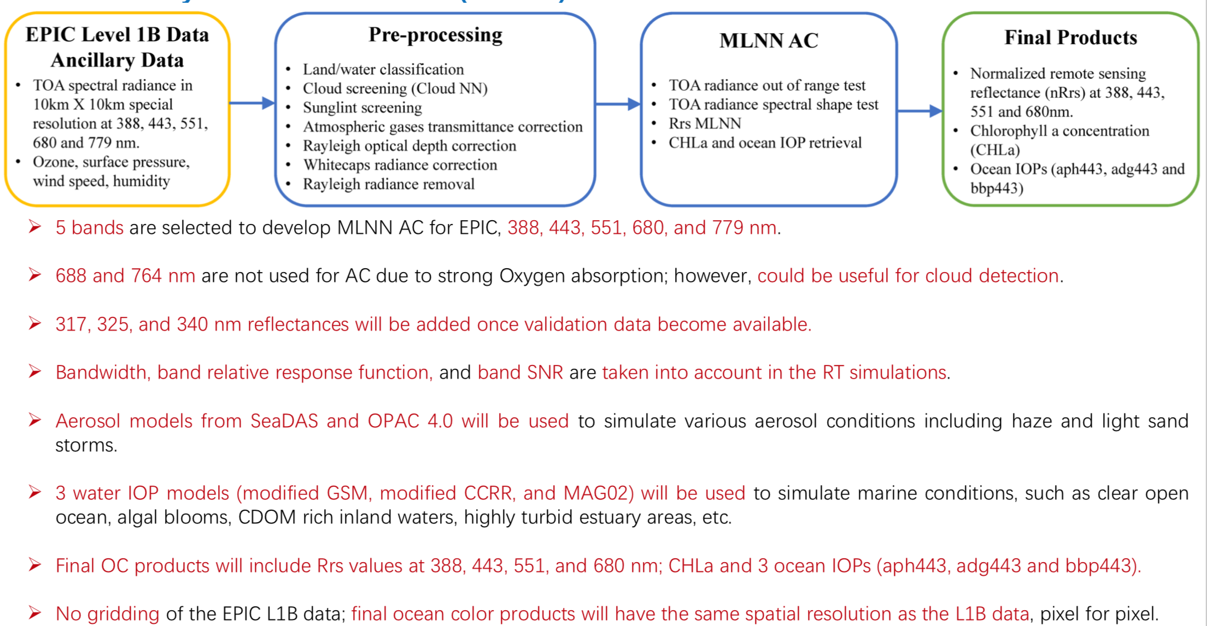
The Multilayer Neural Network (MLNN) AC:
Notes:
the CoastColour Round Robin (CCRR) project

Slide 7
For more info:
1) Fan, Y., W. Li, C. K. Gatebe, C. Jamet, G. Zibordi, T. Schroeder, and K. Stamnes, Atmospheric correction and aerosol retrieval over coastal waters using multilayer neural networks, Remote Sensing of the Environment, 199, 218-240, 2017
2) Fan, Y., W. Li, K. J. Voss, C. Gatebe, and K. Stamnes, A neural network method to correct bidirectional effects in water-leaving radiance, Applied Optics, 55, 10-21, 2016
3) Lin, Z., W. Li, C. Gatebe, R. Poudyal, and K. Stamnes, Radiative transfer simulations of the two-dimensional ocean glint reflectance and determination of the sea surface roughness, Applied Optics, 55, 1206-1215, 2016

Slide 8
Other papers:
1) Chen, N., W. Li, C. Gatebe, T. Tanikawa, M. Hori, R. Shimada, T. Aoki, and K. Stamnes (2018). New cloud mask algorithm based on machine learning methods and radiative transfer simulations, submitted to Remote Sensing of Environment (under review)

Slide 9
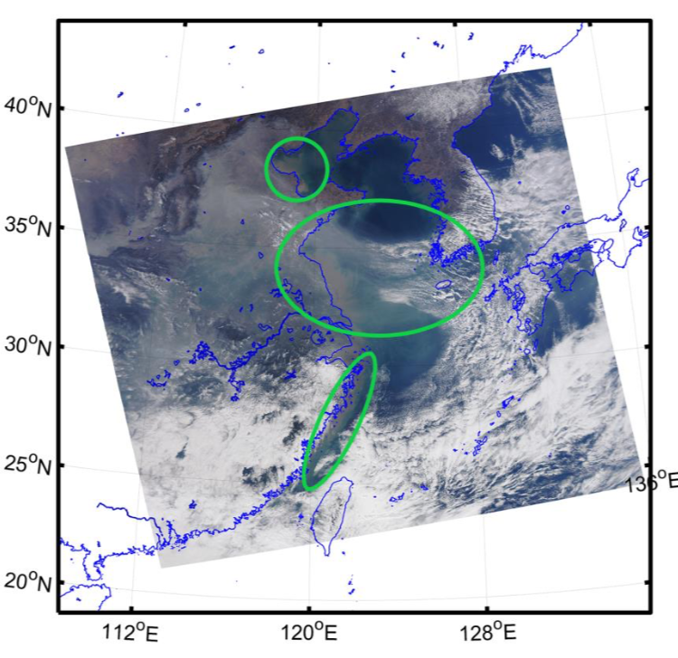
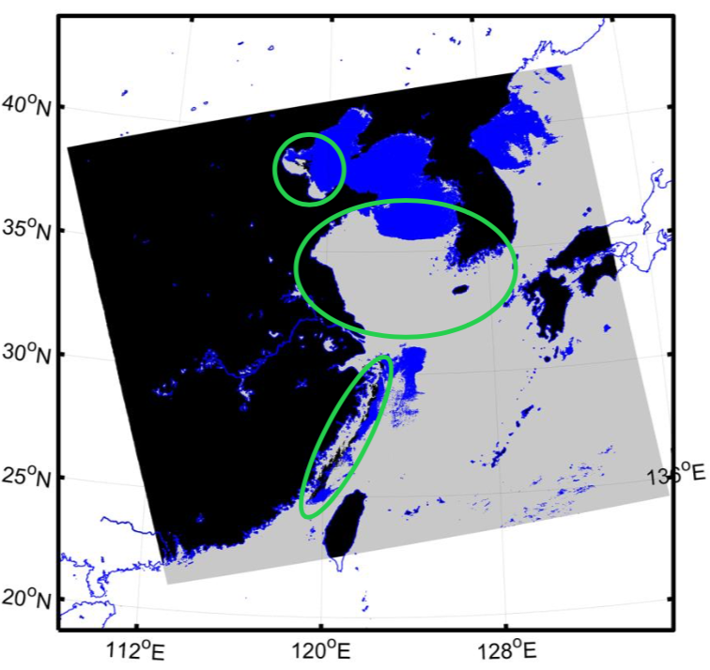
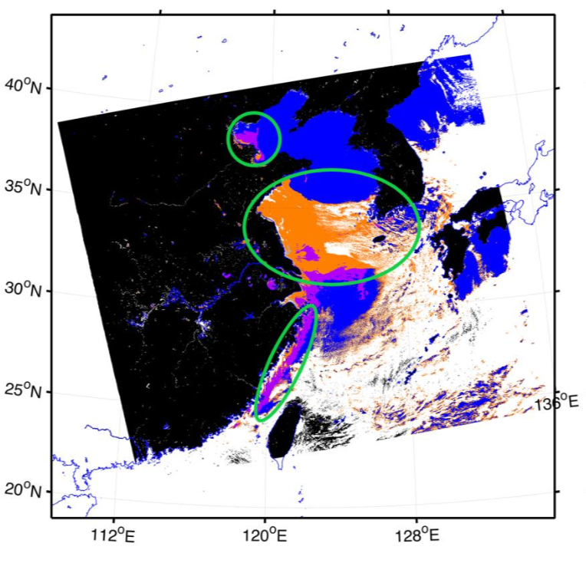
1. Cloud Screening:
MODIS RGB/East China Sea (03/09/2014)
SeaDAS/threshold-based
Neural network classifier using only 4 MODIS bands (469, 555, 645, and 859 nm)
Our cloud mask is threshold-free and based on a neural network classifier driven by extensive radiative transfer model simulations.

Slide 10
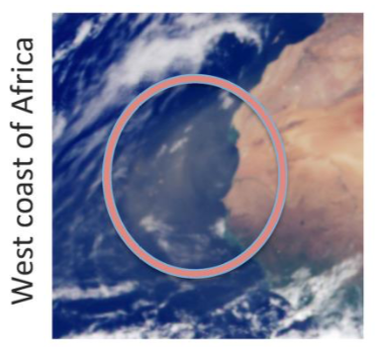
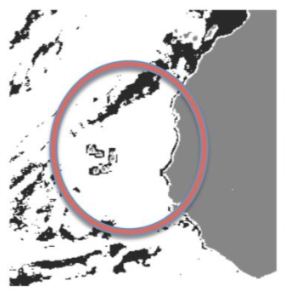
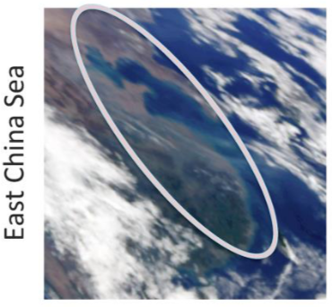
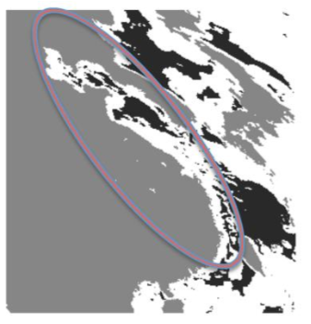
MAIAC Cloud Screening:
MODIS RGB/West Coast of Africa
MAIAC Cloud Mask
MODIS RGB/East China Sea
MAIAC Cloud Mask
Note that heavy aerosols (04/02/2017) over the west coast of Africa (12:24 UTC) and turbid coastal waters in East China Sea (14:12 UTC) are all cloud-screened.

Slide 11
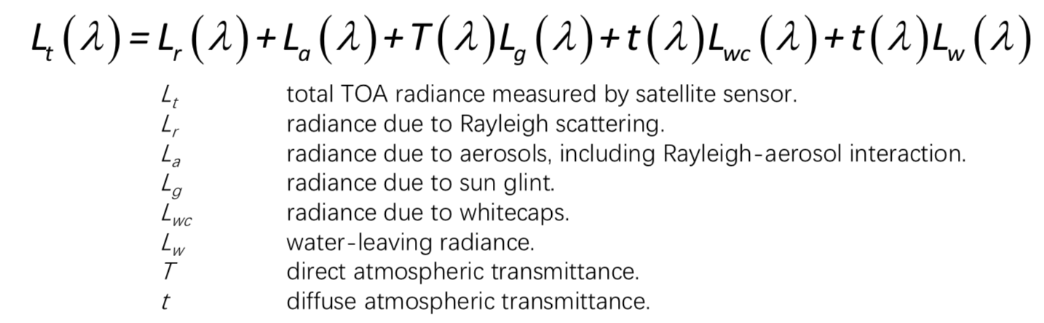
2. Atmospheric Correction:
The assumption that values of water leaving radiance in the near-infrared (NIR) are negligible enables aerosol radiative properties to be easily determined in the correction of satellite ocean color imagery.
EPIC NIR bands: 764 nm & 779 nm are spectrally close. Oxygen-A band absorption @764nm.

Slide 12
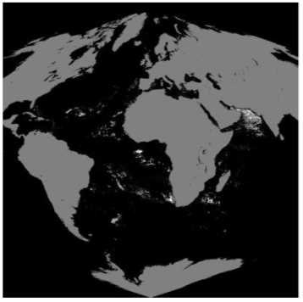
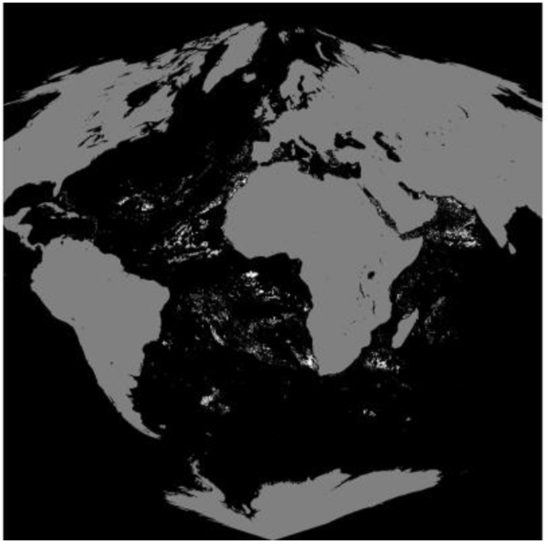
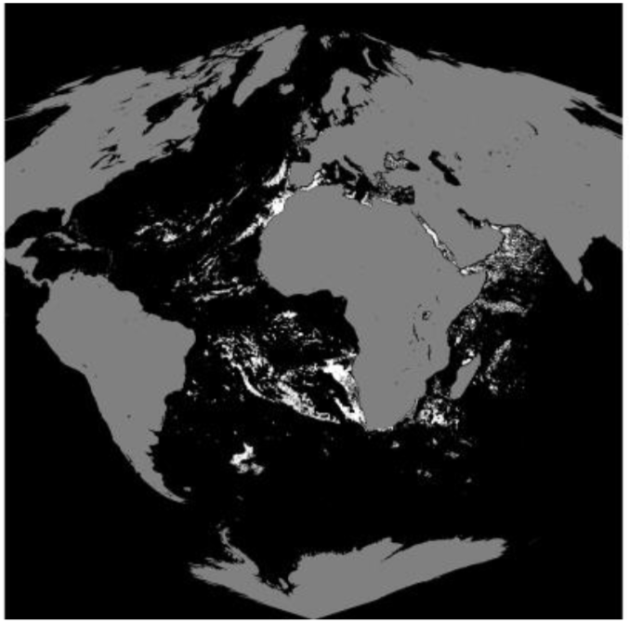
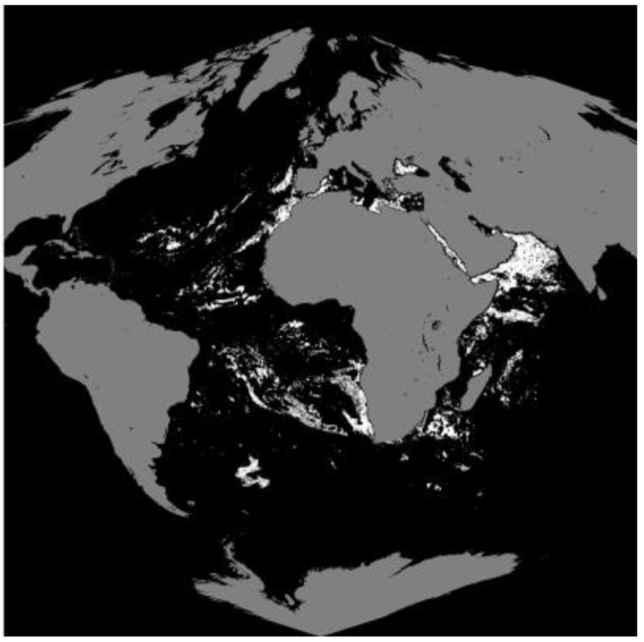
MAIAC Retrieved Ocean Surface Reflectance from EPIC:
443 nm
551 nm
680 nm
779 nm
Note that white color marks the pixels with negative values which exist in every MAIAC L2 product we investigated. On average, there are 22% negative values at 443 nm, 29% at 551nm, 76% at 680 nm and 84% at 779 nm.

Slide 13
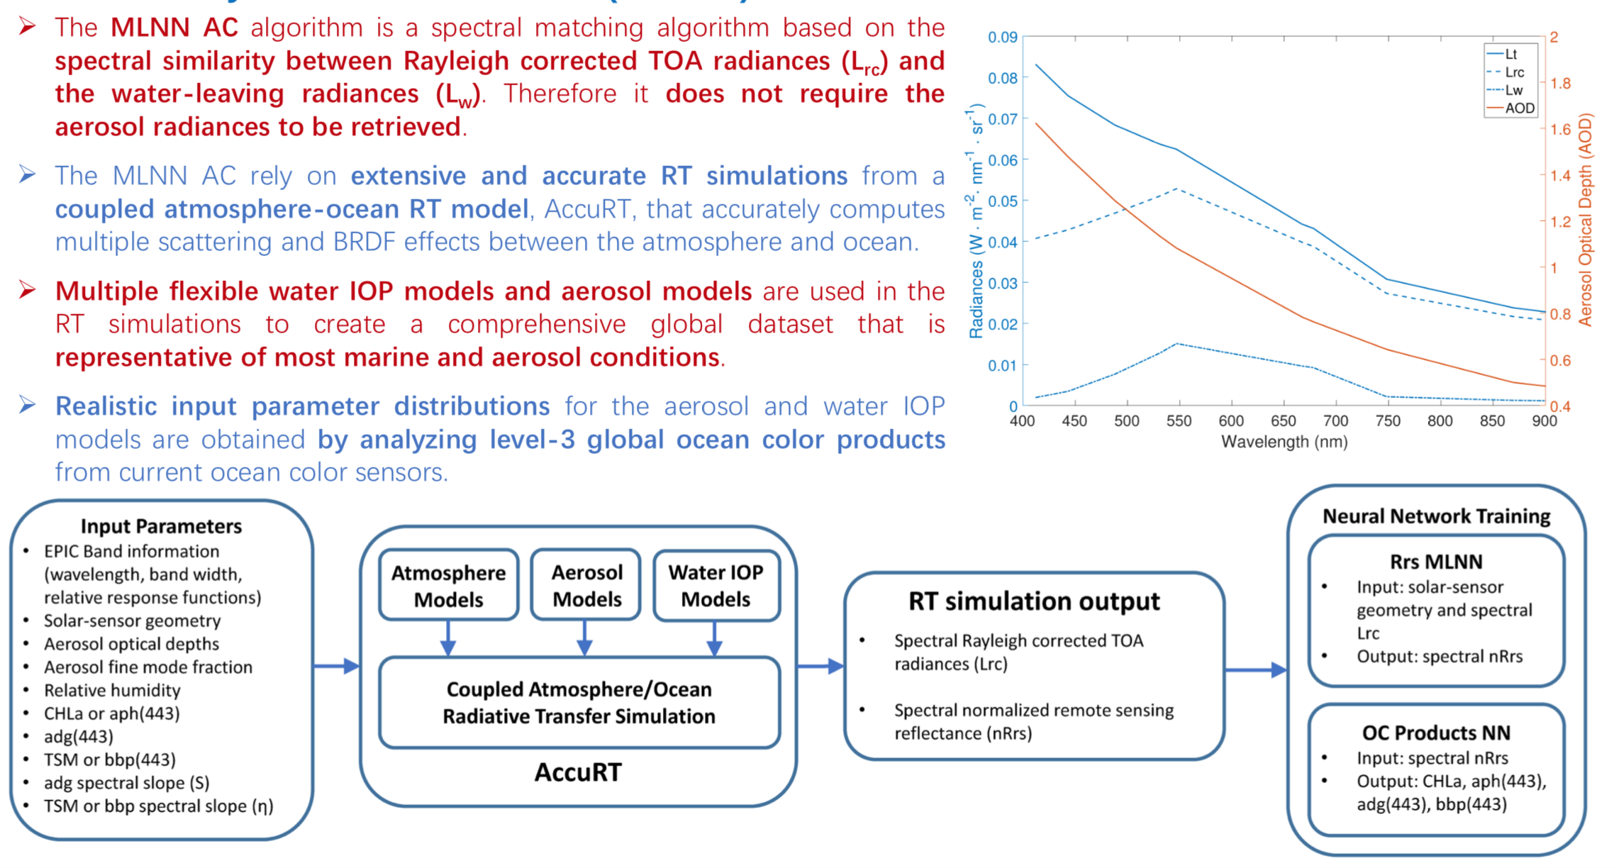
The MLNN Spectral Matching:

Slide 14
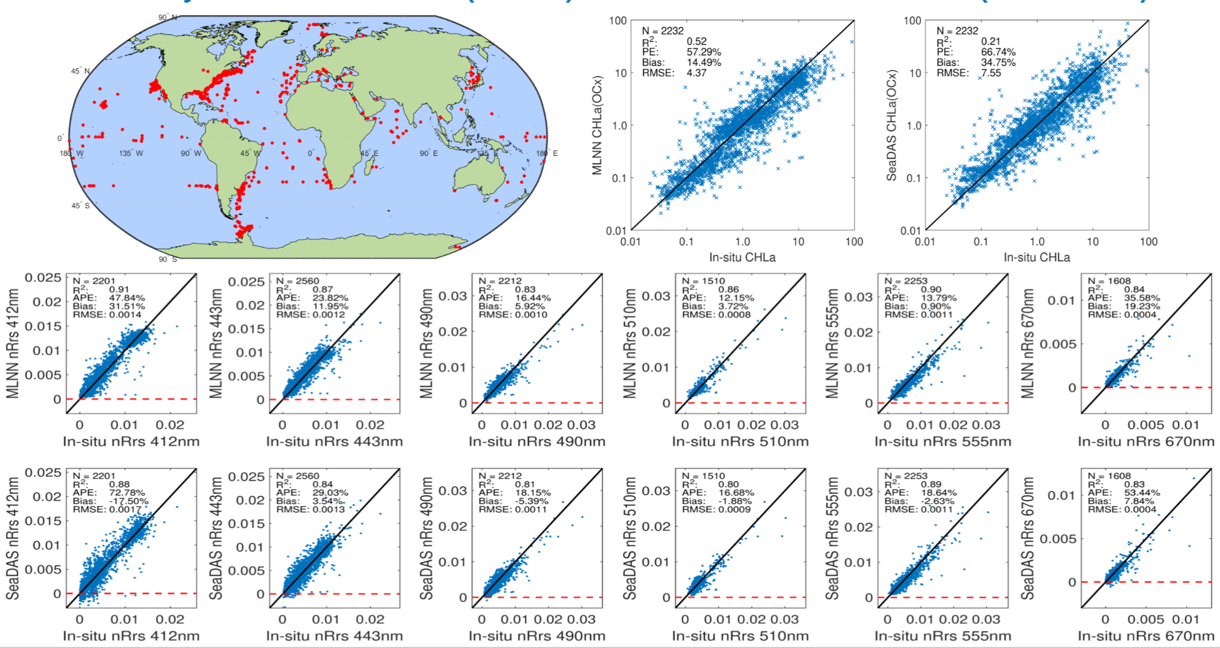
Validation of MLNN AC/SeaWiFS (1997-2010):

Slide 15
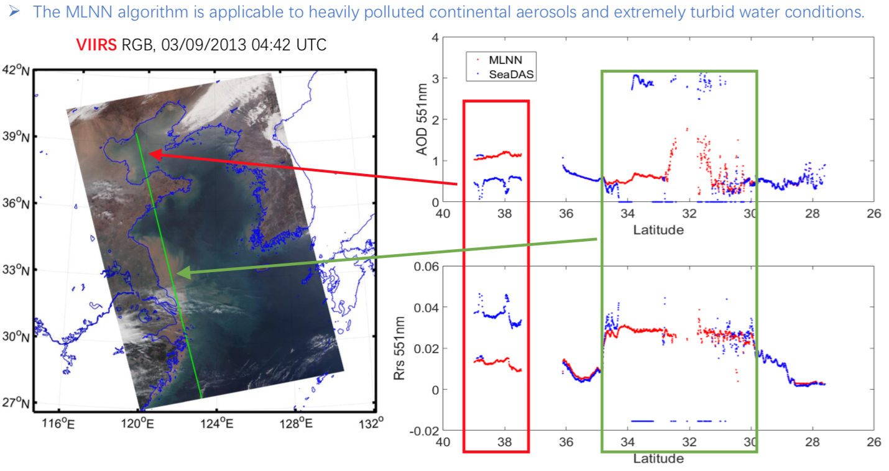
Validation of MLNN AC/VIIRS:

Slide 16
Summary:
1) The MLNN AC algorithm has been proven to perform better than standard AC algorithms due to its superior cloud screening, improved OC product quality, flexible sensor configuration, and capability of providing accurate OC products from low SNR satellite data.
2) The final OC products will include normalized remote sensing reflectances (nRrs values), chlorophyll concentration (CHLa), and 3 water IOP products (aph443, adg443 and bbp443). The OC products will have the same spatial resolution as the EPIC level 1B data.
3) Implementation of the MLNN AC algorithm for EPIC is underway and examples of OC products derived from EPIC data will be presented at the 2018 AGU Fall Meeting.

