Slide 1
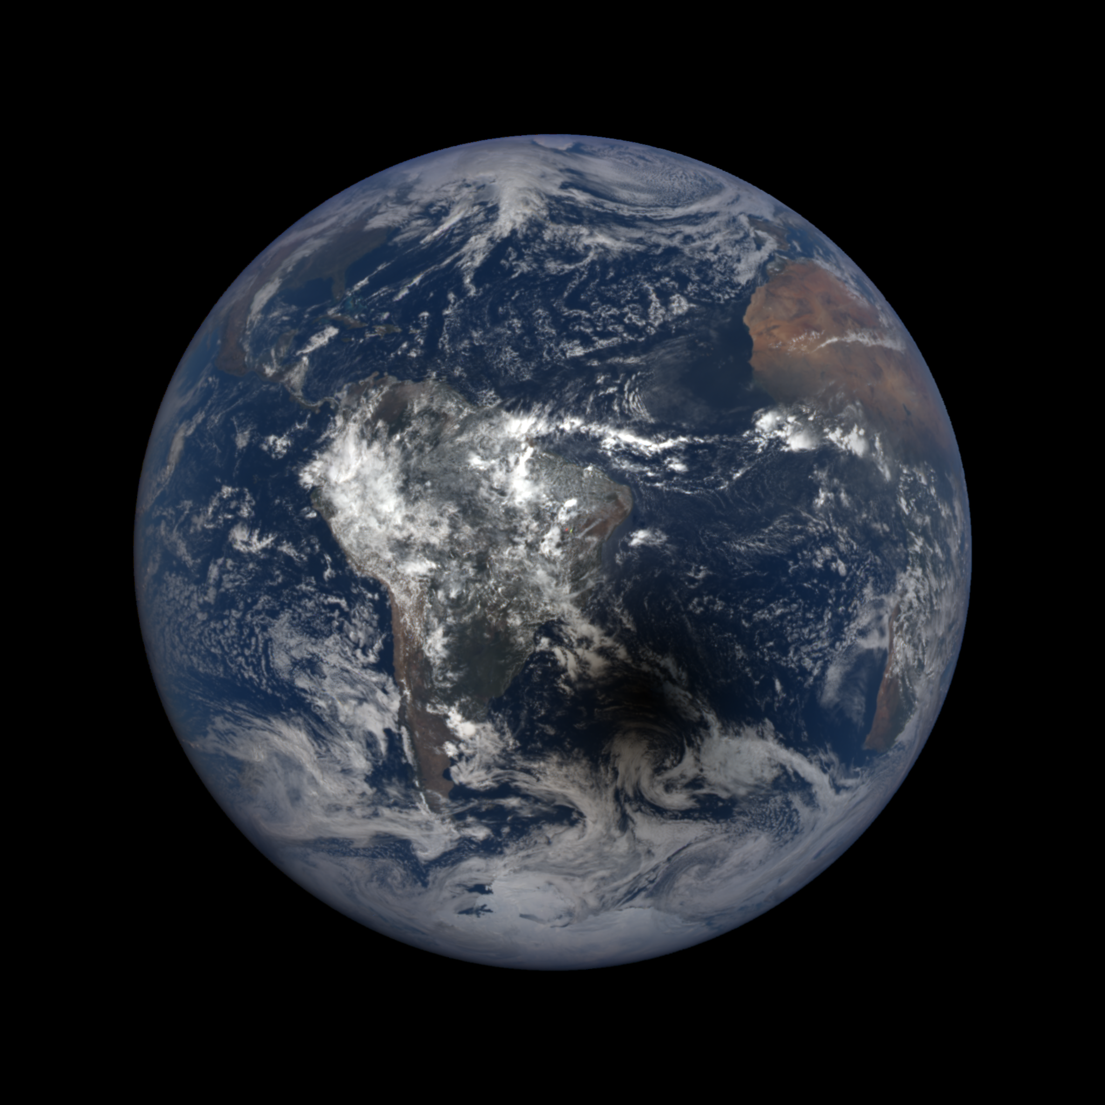
DSCOVR/EPIC volcanic SO₂ product: update and latest results
Simon Carn¹, Nick Krotkov², Brad Fisher^{2,3}, Can Li^{2,4}, Fred Prata⁵
Michigan Technological University, Houghton, MI, USA; scarn@mtu.edu
NASA Goddard Space Flight Center, Greenbelt, MD, USA
SSAI, Lanham, MD, USA
ESSIC, University of Maryland, College Park , MD, USA
AIRES Pty Ltd, Melbourne, Australia

Slide 2
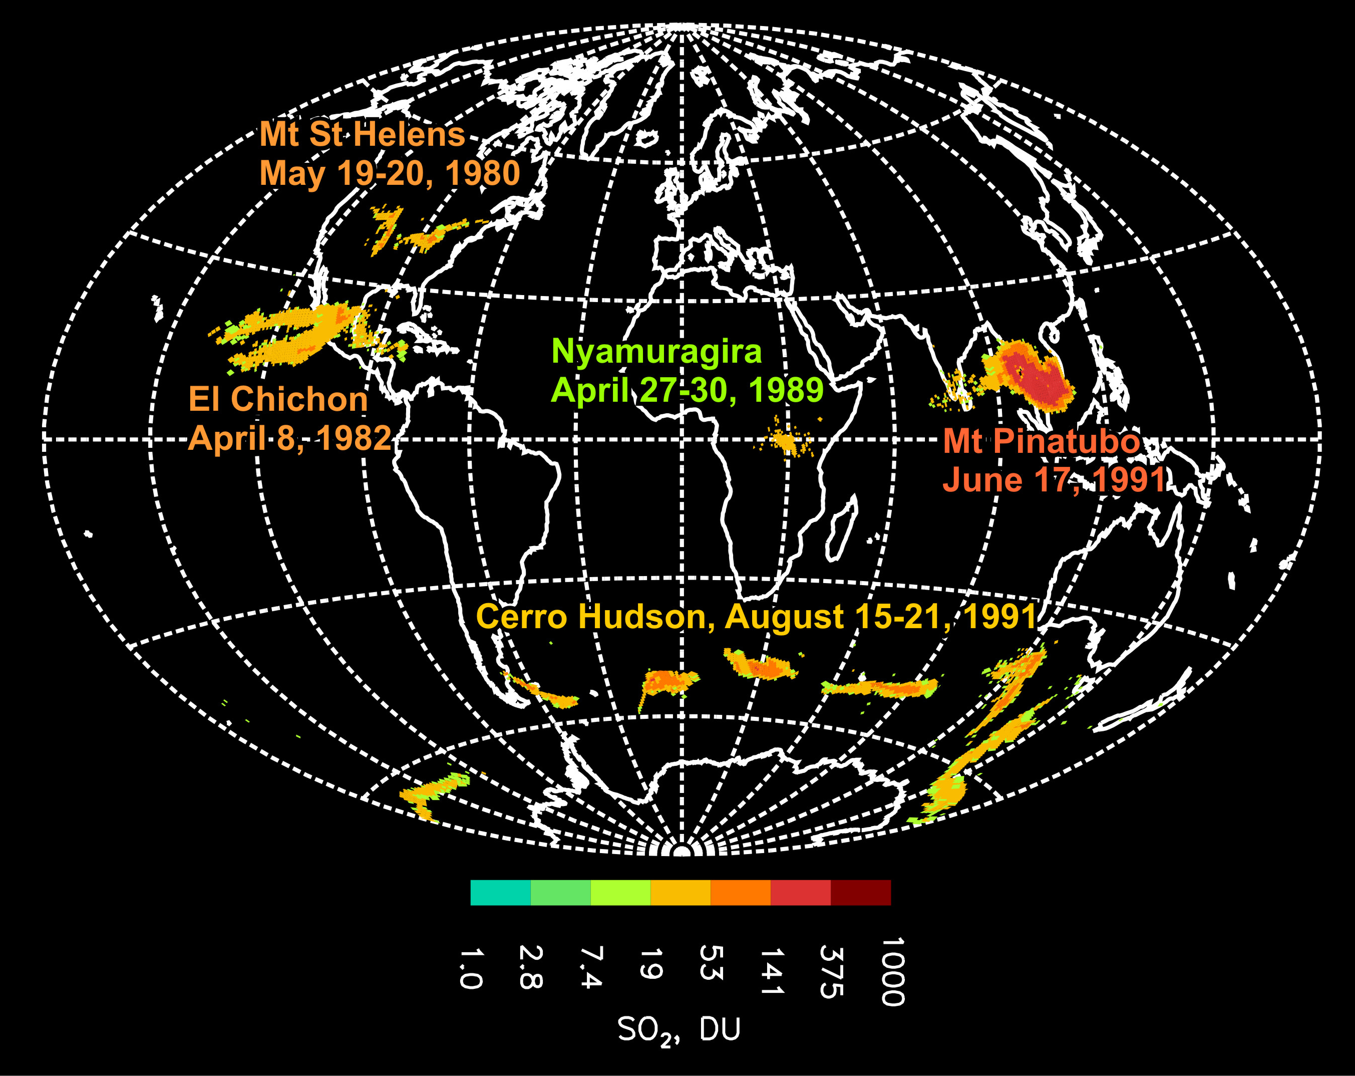
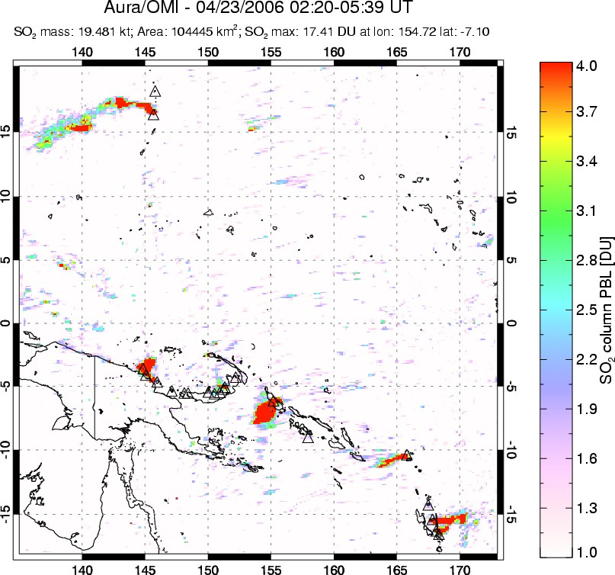


UV satellite remote sensing of volcanic SO₂
[Carn et al., 2008, 2013, 2016]
SW Pacific
April 23, 2006
1978-2005
Total Ozone Mapping Spectrometer (TOMS)
1995-2003
Global Ozone Monitoring Experiment (GOME)
2004-
Ozone Monitoring Instrument (OMI)
2006-
Global Ozone Monitoring Experiment 2 (GOME-2)
2012-
Ozone Mapping and Profiler Suite (OMPS)
2015-
DSCOVR/EPIC

Slide 3
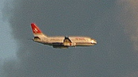
More Reflected
Solar Flux
Stratospheric aerosols
(Lifetime ≈ 1-3 years)
STRATOSPHERE
backscatter
H₂S
SO₂
absorption
(near IR)
Solar Heating
IR
Heating
emission
→ H₂SO₄
NET HEATING
IR Cooling
HCl,
BrO, ClO
Heterogeneous → Less
O₃ depletion Solar Heating
absorption (IR)
emission
CO₂
H₂O
forward scatter
Tropopause
(8-17 km)
Ice
Enhanced
Diffuse
Flux
Effects
on cirrus
clouds
Gas scavenging?
TROPOSPHERE
Reduced
Direct
Flux
NET COOLING
~1-3 hrs
Ashfall
0.1-0.4ºC global average cooling after 20th century volcanic eruptions (1963 Agung,1982 El Chichon, 1991 Pinatubo)
Volcanic eruptions and climate
Dissolved gases
Original slide courtesy of A. Robock

Slide 4
Deep Space Climate Observatory (DSCOVR) at L₁
http://epic.gsfc.nasa.gov
Simulation of EPIC views of May 2006 Soufriere Hills volcanic cloud
Earth Polychromatic Imaging Camera (EPIC)
  ~68-100 min temporal resolution
  Spatial resolution similar to OMI at sub-satellite point (~20 km)
  Unique vantage point for volcanic SO₂ and ash observations

Slide 5
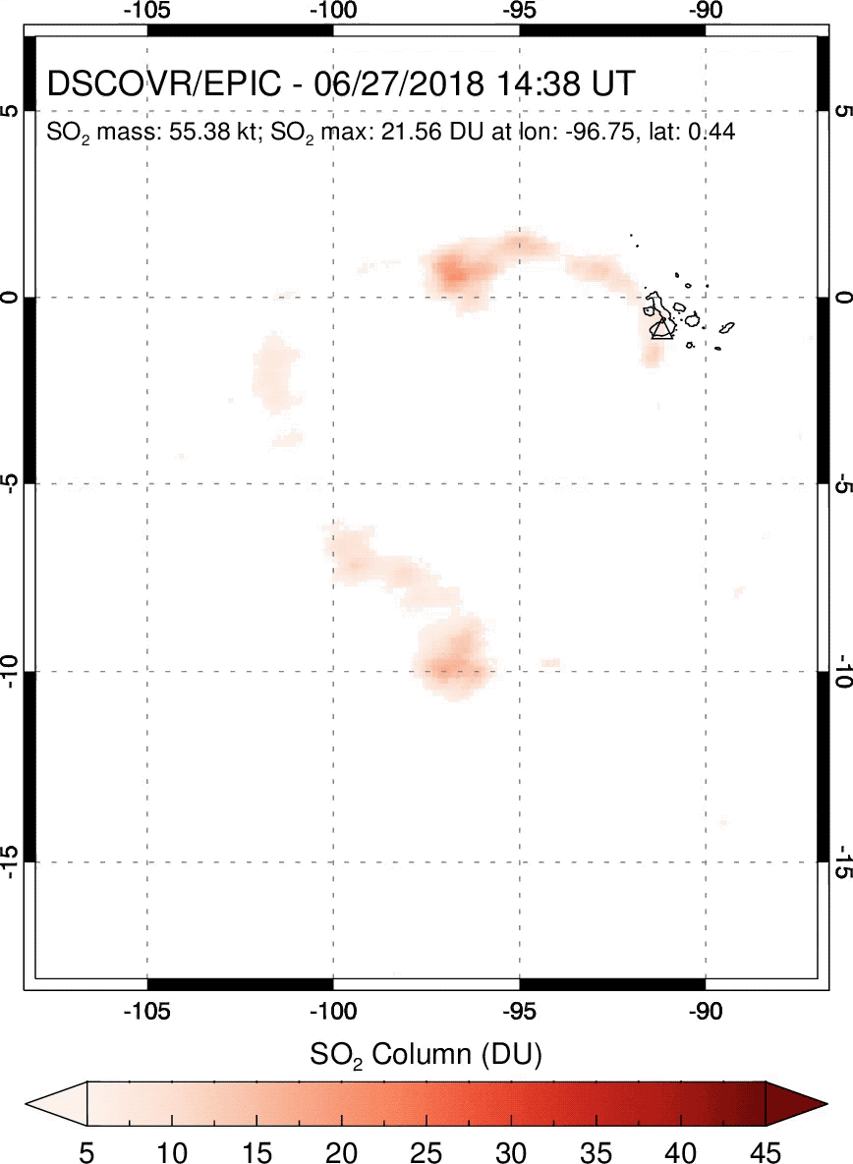
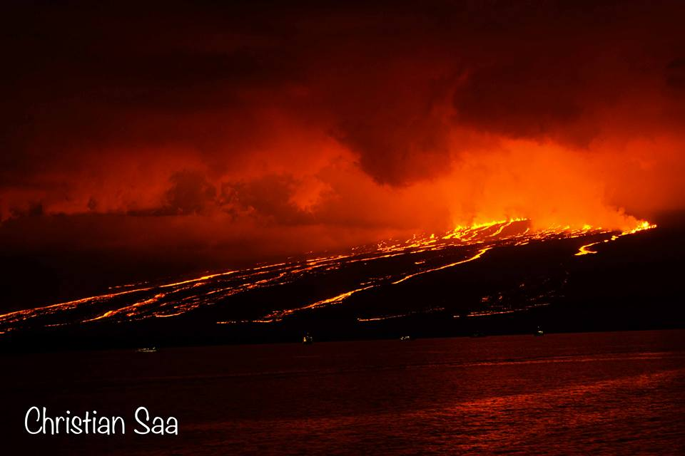
Sierra Negra (Galapagos Islands) eruption – June 2018
Effusive eruption captured in 8-9 consecutive, hourly EPIC exposures

Slide 6

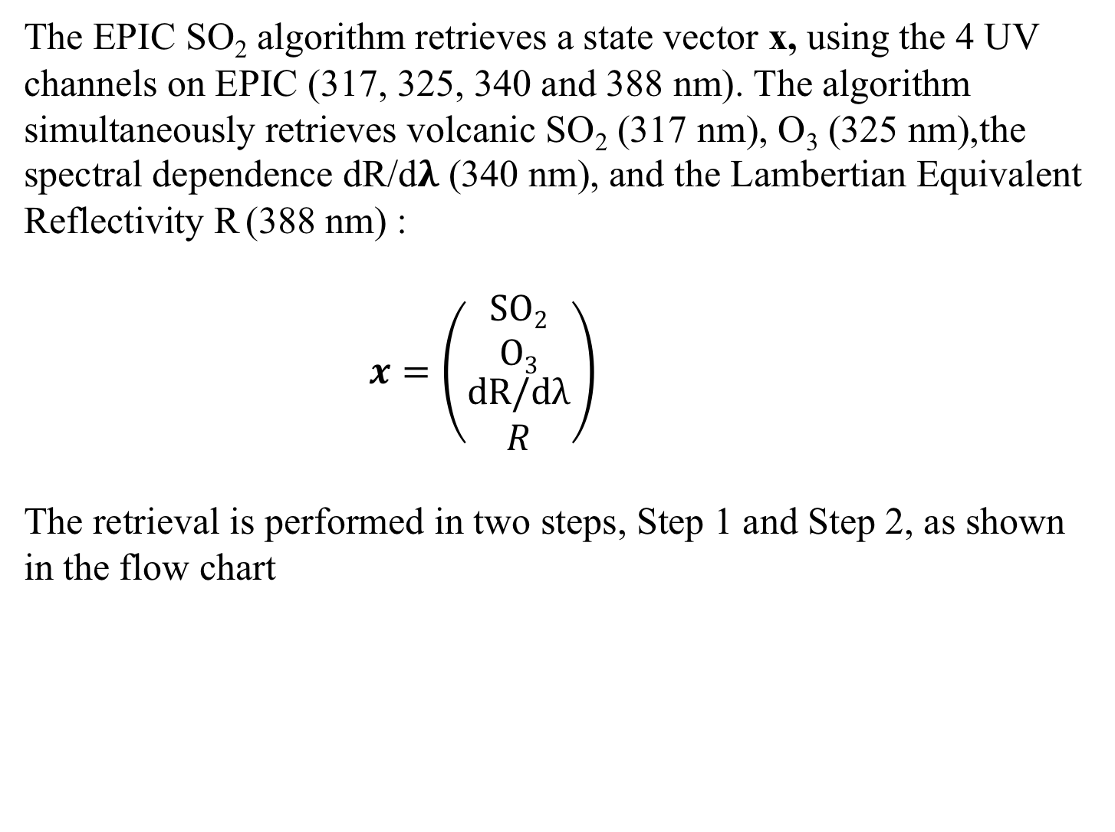
EPIC SO₂ Algorithm
The EPIC SO₂ algorithm retrieves a state vector x, using the 4 UV channels on EPIC (317, 325, 340 and 388 nm). The algorithm simultaneously retrieves volcanic SO₂ (317 nm), O₃ (325 nm),the spectral dependence dR/d𝛌 (340 nm), and the Lambertian Equivalent Reflectivity R (388 nm) :
$x=\left(\begin{matrix}SO2 \\ O3 \\ \begin{matrix}dR/dλ \\ R\end{matrix}\end{matrix}\right)$
The retrieval is performed in two steps, Step 1 and Step 2, as shown in the flow chart
Measurement
Step 1
Step 2
State Vector
x

Slide 7
Forward Radiative Transfer Model (RTM)
TOMRAD RTM [Dave 1965] calculations are used to create hyperspectral radiance master Look-Up Tables (LUTs) for all geometries across the full EPIC spectrum of wavelengths between 310 and 400 nm.
The TOMRAD forward model accounts for Rayleigh scattering and absorption by O₃ [Daumont et al., 1992] and SO₂ [Bogumil et al., 2003], using temperature dependent, laboratory measured cross sections
We assume a Gaussian SO₂ plume vertical profile with a peak altitude of 13 km and a standard deviation ±2.0 km
Instrument LUTs are generated from the master LUTs by convolving the forward model radiances with the EPIC bandpass

Slide 8
Instrument LUTs
Instrument LUTs are computed at specific viewing geometries and total column trace gas amounts for O₃ and SO₂ as described in the Table. Calculated N-values are then linearly interpolated between nodal points based on the estimated gas amounts (O₃, SO₂).
Structure of Instrument LUTs
Atmospheric Parameter | Number of Nodes | Values
Surface Pressure | 2 | 1013.25 and 500 hPa
Wavelength | 6 | 313, 317, 331, 340, 360 and 380
Total Column Ozone | 21 | 3 low, 8 middle and 11 high latitude bands (atm-cm)
Total Column SO₂ | 12 | 0, 5, 10, 50, 100, 150, 200, 250, 350, 450, 550, 650 DU
SZA | 10 | 0, 30, 45, 60, 70, 77, 81, 84, 86, 88
VZA | 6 | 0, 15, 30, 45, 60, 70

Slide 9
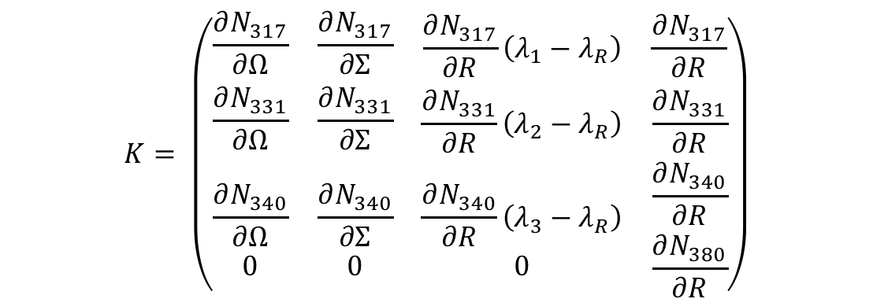
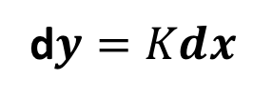
EPIC SO₂ Algorithm: Step 1
The state vector is retrieved in Step 1 by iteratively solving the following equation by inversion:
d$y=Kdx$
where dy is the difference between the measured (N_{m}) and forward model calculated N-value (N_{c}) and dx the difference between the current estimate and the previous iteration: x_{i} = x_{i-1} + dx
K in the above expression represents a 4 x 4 matrix, consisting of Jacobians defined with respect to the measured radiances N_{i} and the retrieved state vector x_{j} as shown:
$$K= \left(\begin{matrix}\frac{∂N_{317}}{∂Ω} & \frac{∂N_{317}}{∂Σ} & \begin{matrix}\frac{∂N_{317}}{∂R}\left(λ_{1}−λ_{R}\right) & \frac{∂N_{317}}{∂R}\end{matrix} \\ \frac{∂N_{331}}{∂Ω} & \frac{∂N_{331}}{∂Σ} & \begin{matrix}\frac{∂N_{331}}{∂R}\left(λ_{2}−λ_{R}\right) & \frac{∂N_{331}}{∂R}\end{matrix} \\ \begin{matrix}\frac{∂N_{340}}{∂Ω} \\ 0\end{matrix} & \begin{matrix}\frac{∂N_{340}}{∂Σ} \\ 0\end{matrix} & \begin{matrix}\begin{matrix}\frac{∂N_{340}}{∂R}\left(λ_{3}−λ_{R}\right) \\ 0\end{matrix} & \begin{matrix}\frac{∂N_{340}}{∂R} \\ \frac{∂N_{380}}{∂R}\end{matrix}\end{matrix}\end{matrix}\right)$$

Slide 10
EPIC SO₂ Algorithm: Step 2
Our Step 2 procedure was added to reduce false positive and negative SO₂ artifacts due to spatiotemporal mismatch between 4 UV channels that are not completely accounted for in Level 1B processing
Step 1 retrieved quantities (SO₂, dR/dλ and R) are used as first guesses
A 31 x 31 box smoothing procedure is applied to the every Step 1 O₃ FoV to obtain a smoothed ozone field across the full disc image.
The smoothed O₃ FoVs are fixed in Step 2 and a second retrieval of SO₂ and dR/dλ is performed using a 2x2 K-matrix (Jacobians for SO₂ and dR/dλ)
In the SO₂ product, we report both Step 1 and the smoothed Step 2 ozone.
Notes:
Description of the DSCOVR/EPIC SO2 Algorithm PI: Nick Kroktov
The DSCOVR/EPIC volcanic SO₂ algorithm is a modified version of the heritage NASA Total Ozone Mapping Spectrometer (TOMS) 4-band algorithm, adapted to the EPIC wavelengths. The algorithm uses all four EPIC UV channels (centered at 317nm, 325nm, 340 nm, 388nm) to retrieve 4 parameters of the state vector (x): vertical column amounts of SO₂ (assuming 13km height) and total O₃, the Lambertian equivalent reflectivity at 388 nm (R), and its spectral dependence, dR/dλ. The algorithm relies on spectral differences in SO₂ and O₃ absorption cross sections to separate the two trace gases. SO₂ is more absorbing than O₃ at the shortest UV channel (317 nm), whereas O₃ is more absorbing at the longer channel (325nm).
The retrieval is performed iteratively for each EPIC pixel with SZA < 75º. It starts with the climatological profile of O₃ and zero SO₂ and first computes Lambertian equivalent scene Reflectivity (LER) at 388 nm (R). This parameter remains fixed during the iterations. The algorithm then retrieves adjustments to the state vector: Δx =[ΔSO_{2,} ΔO₃, Δ(dR/dλ)] by matching measured and calculated sun-normalized backscatterd UV (BUV) radiances at shorter spectral channels (317,325 and 340nm). The sensitivities (Jacobians) associated with linear perturbations in SO₂, O₃ and R are pre-computed for each UV spectral band and stored in look-up tables, which are numerically interpolated for EPIC viewing geometry and state vector values at each iteration. This algorithm appears to have adequate sensitivity to detect moderate to large volcanic eruptions from L1 Lagrange point.
Max iterations = 3
Quit itrations when Min res325 = 0.001 ( N value)

Slide 11
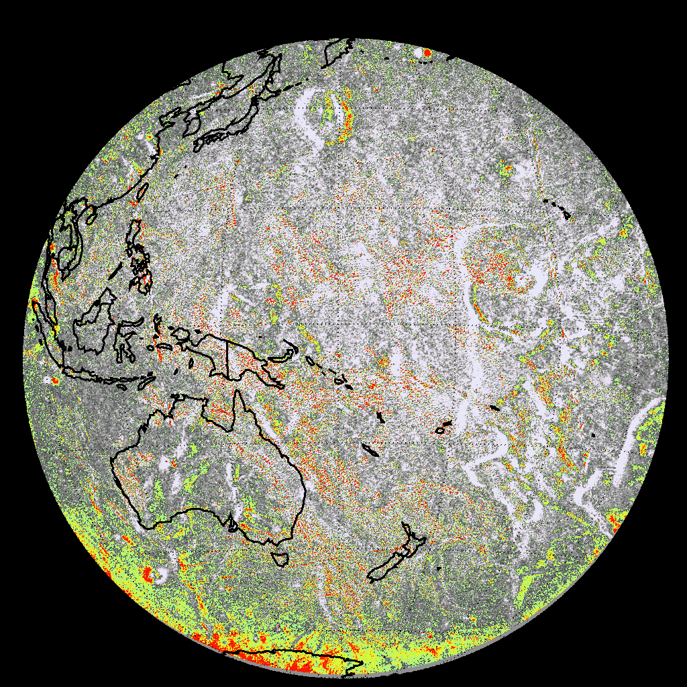
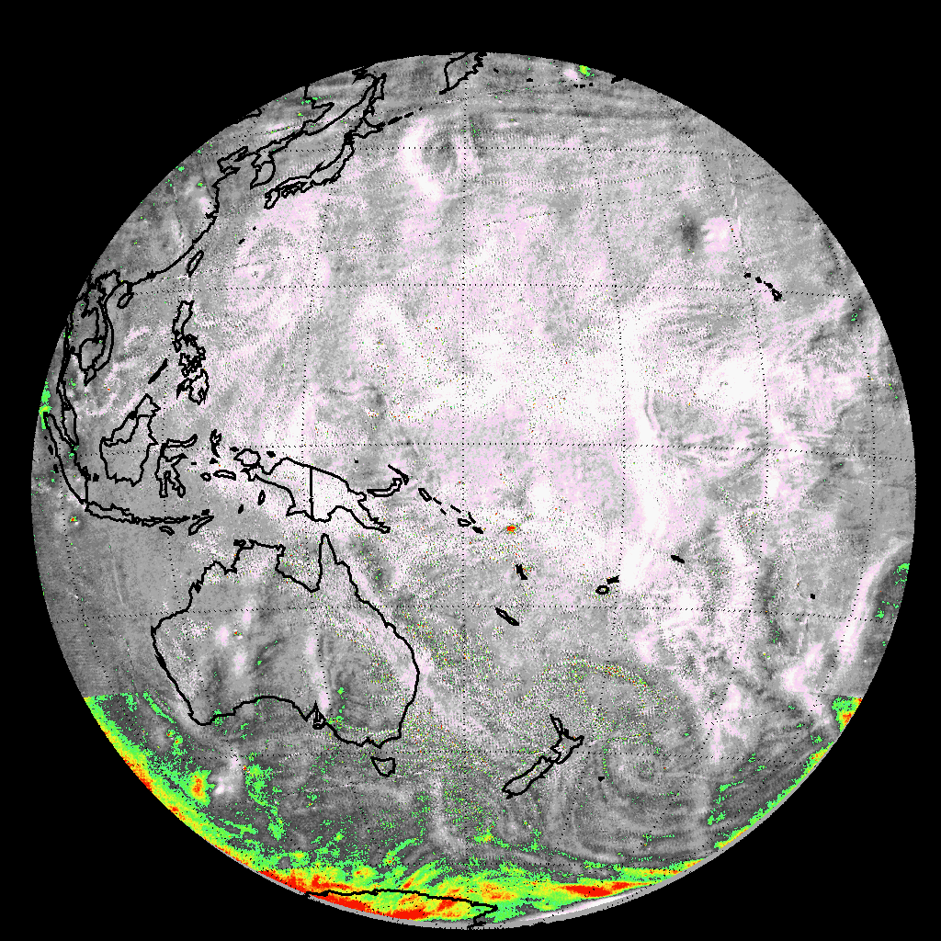
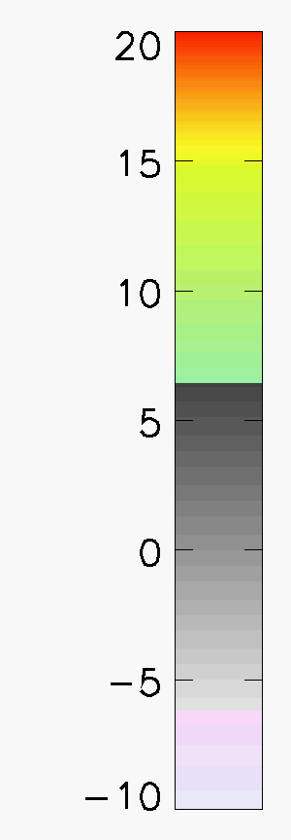
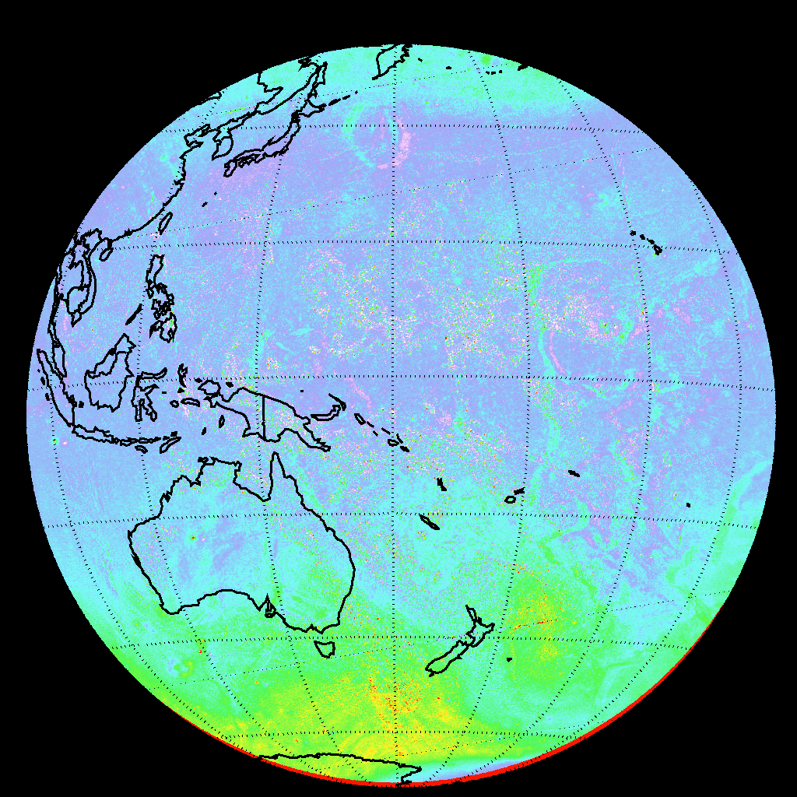
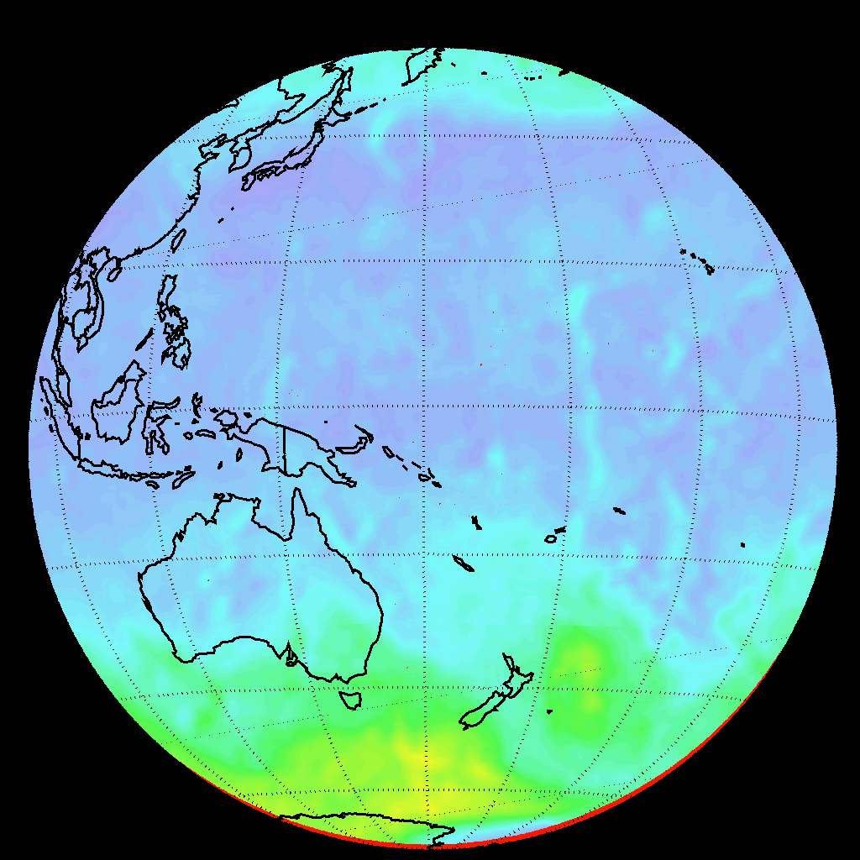
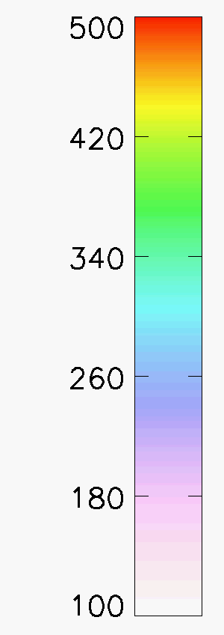
EPIC SO₂ retrieval algorithm
Step 1
Step 2
SO₂
Tinakula eruption
Dobson Units (DU)
Earth rotation
Geolocation errors
Cloud noise
Ozone variability
Noise at high SZA
Smoothed Ozone field
O₃
Dobson Units (DU)
Notes:
Description of the DSCOVR/EPIC SO2 Algorithm PI: Nick Kroktov
The DSCOVR/EPIC volcanic SO₂ algorithm is a modified version of the heritage NASA Total Ozone Mapping Spectrometer (TOMS) 4-band algorithm, adapted to the EPIC wavelengths. The algorithm uses all four EPIC UV channels (centered at 317nm, 325nm, 340 nm, 388nm) to retrieve 4 parameters of the state vector (x): vertical column amounts of SO₂ (assuming 13km height) and total O₃, the Lambertian equivalent reflectivity at 388 nm (R), and its spectral dependence, dR/dλ. The algorithm relies on spectral differences in SO₂ and O₃ absorption cross sections to separate the two trace gases. SO₂ is more absorbing than O₃ at the shortest UV channel (317 nm), whereas O₃ is more absorbing at the longer channel (325nm).
The retrieval is performed iteratively for each EPIC pixel with SZA < 75º. It starts with the climatological profile of O₃ and zero SO₂ and first computes Lambertian equivalent scene Reflectivity (LER) at 388 nm (R). This parameter remains fixed during the iterations. The algorithm then retrieves adjustments to the state vector: Δx =[ΔSO_{2,} ΔO₃, Δ(dR/dλ)] by matching measured and calculated sun-normalized backscatterd UV (BUV) radiances at shorter spectral channels (317,325 and 340nm). The sensitivities (Jacobians) associated with linear perturbations in SO₂, O₃ and R are pre-computed for each UV spectral band and stored in look-up tables, which are numerically interpolated for EPIC viewing geometry and state vector values at each iteration. This algorithm appears to have adequate sensitivity to detect moderate to large volcanic eruptions from L1 Lagrange point.
Max iterations = 3
Quit itrations when Min res325 = 0.001 ( N value)

Slide 12
Volcanic eruptions detected by EPIC (2015 - )
Carn et al., GRL (in revision)
All significant eruptions since June 2015 detected by EPIC
At least 6 eruptions detected within ~0-3 hours of onset
Sierra Negra eruption (June 2018) captured in 8-9 EPIC exposures

Slide 13
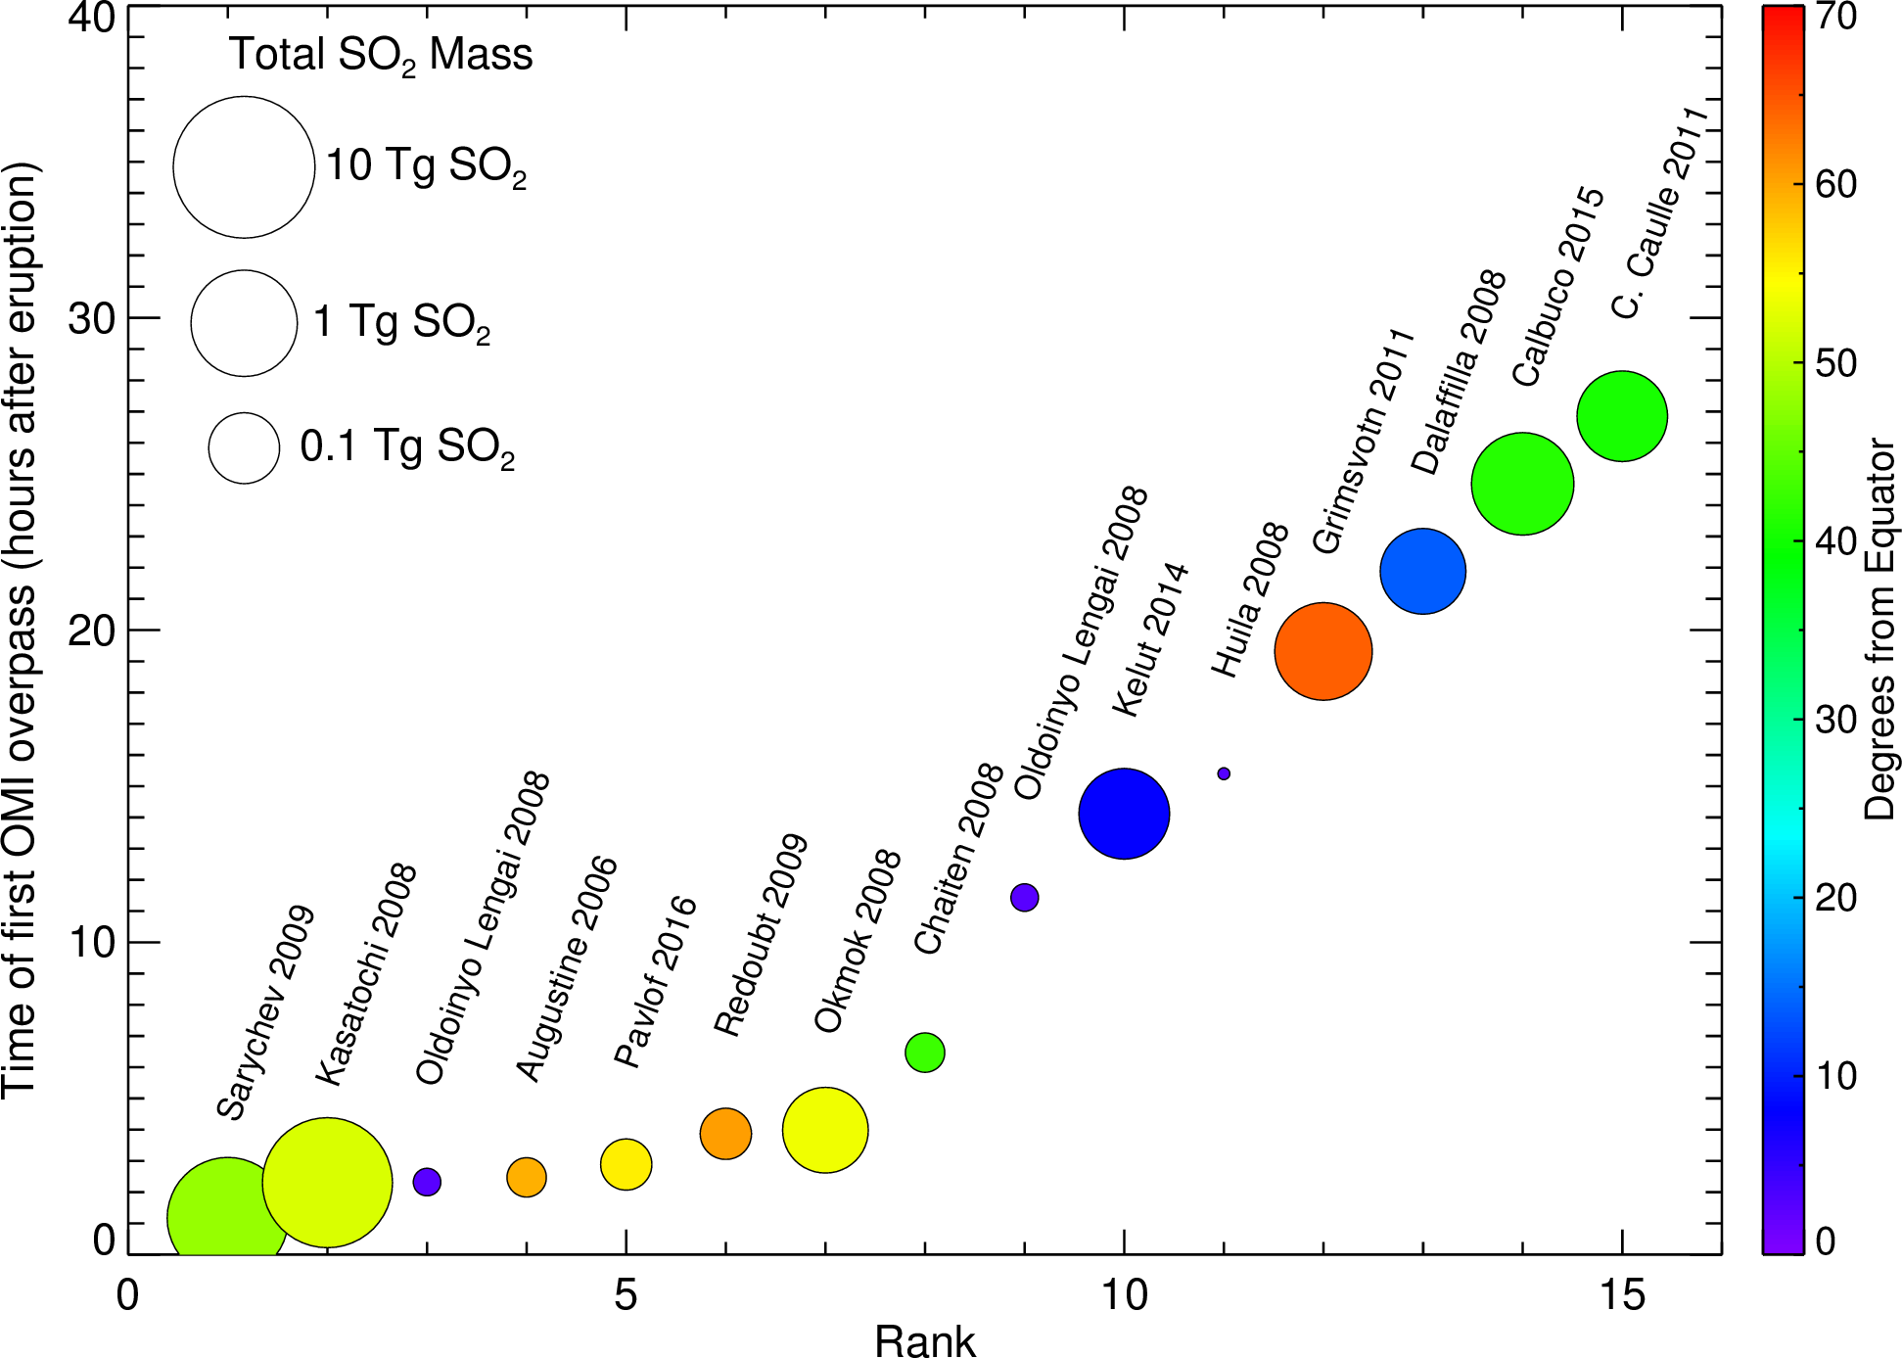
Volcanic eruptions detected by OMI (2004 - )
Significant improvement in timeliness of eruption detection (vs. LEO sensors) with EPIC
6 eruptions detected by EPIC within 3 hours

Slide 14
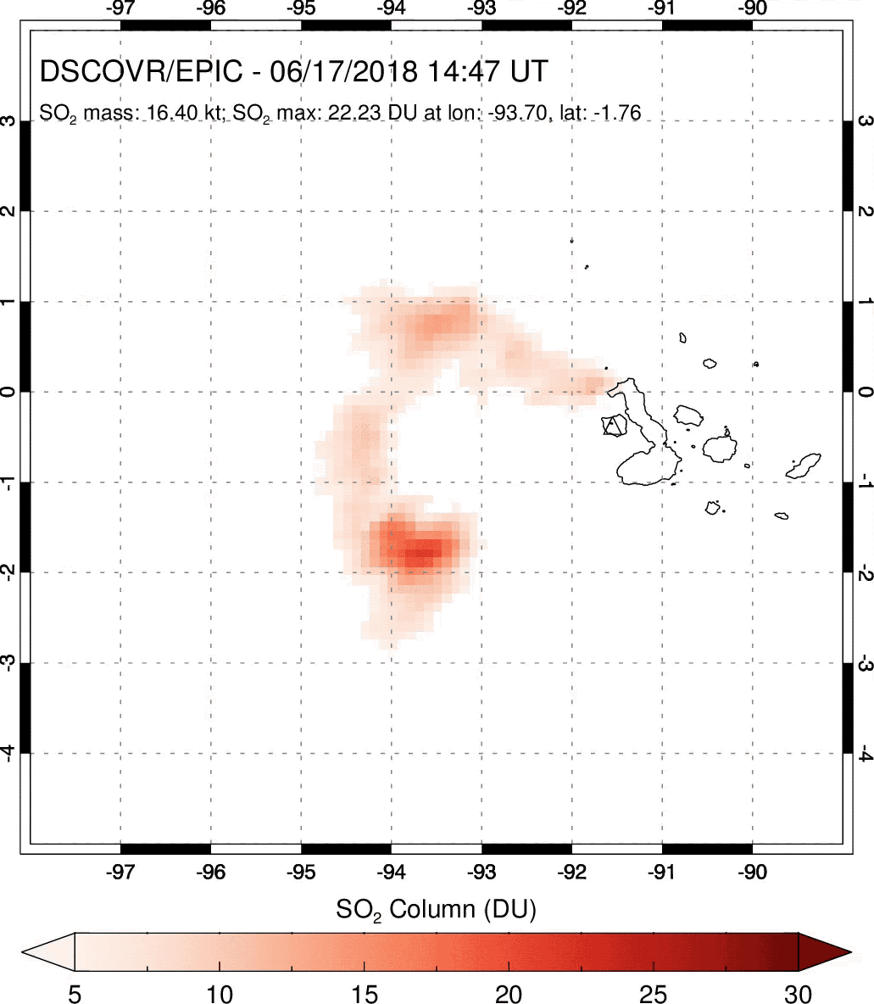
Fernandina (Galapagos Islands) eruption – June 2018
Effusive eruption captured in 7 consecutive, hourly EPIC exposures
Lower tropospheric emissions, hence EPIC SO₂ columns underestimated (13 km altitude assumed)
Carn et al., GRL (in revision)

Slide 15
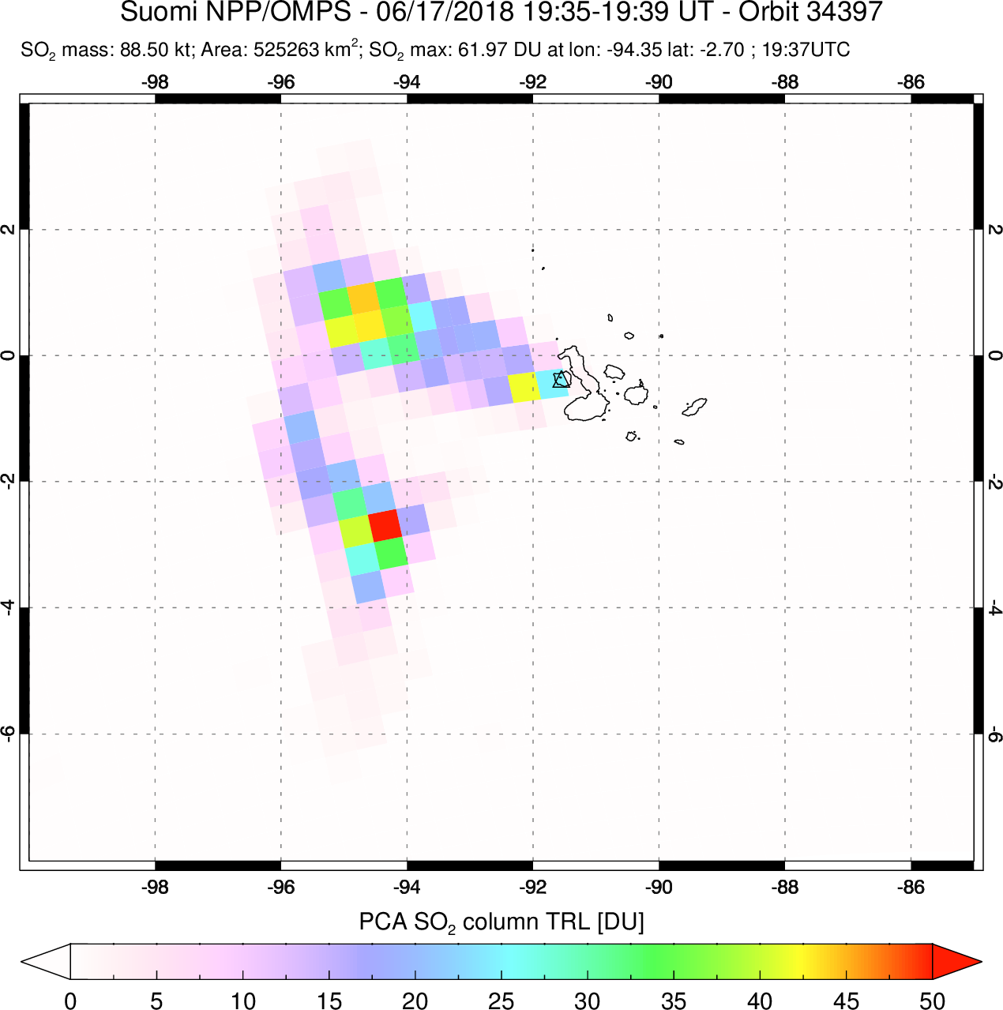
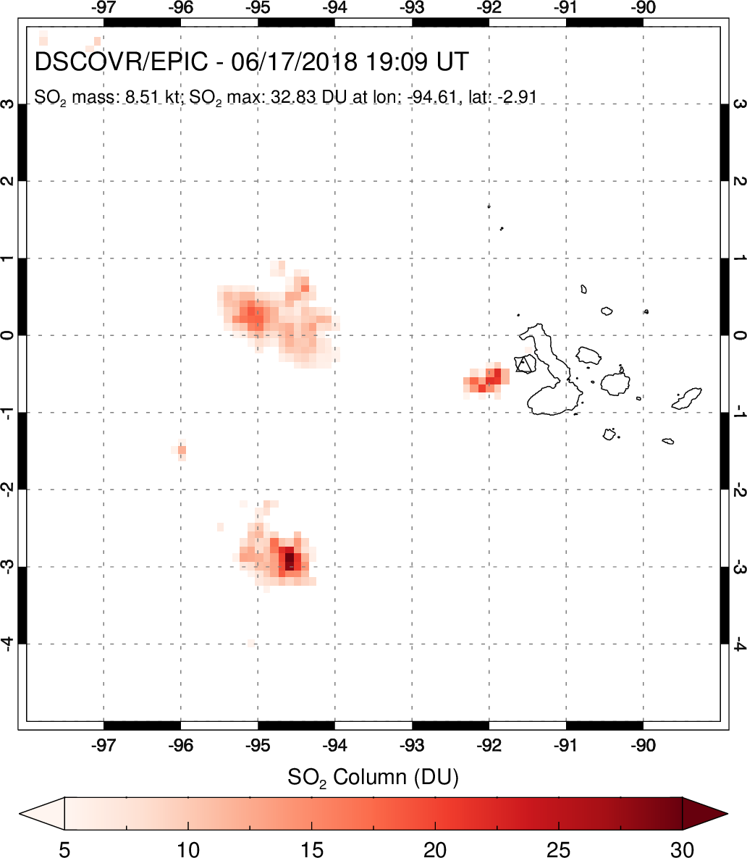
Fernandina eruption – EPIC and OMPS SO₂ data

Slide 16
Sierra Negra (Galapagos Islands) eruption – June 2018
Effusive eruption captured in 8-9 consecutive, hourly EPIC exposures
Mixed lower and upper tropospheric emissions, hence EPIC SO₂ columns partly underestimated (13 km altitude assumed)

Slide 17
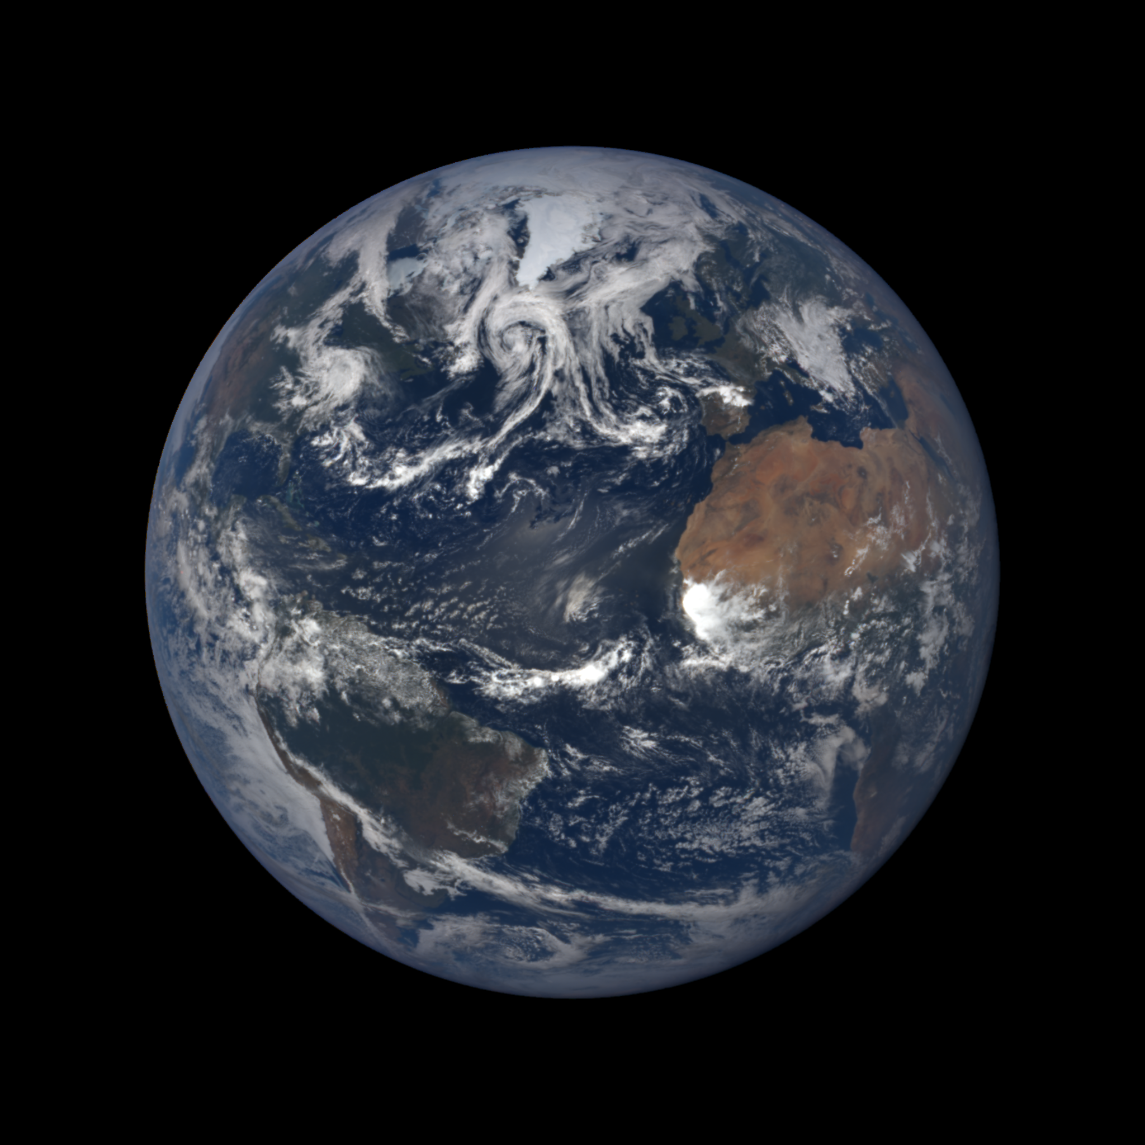
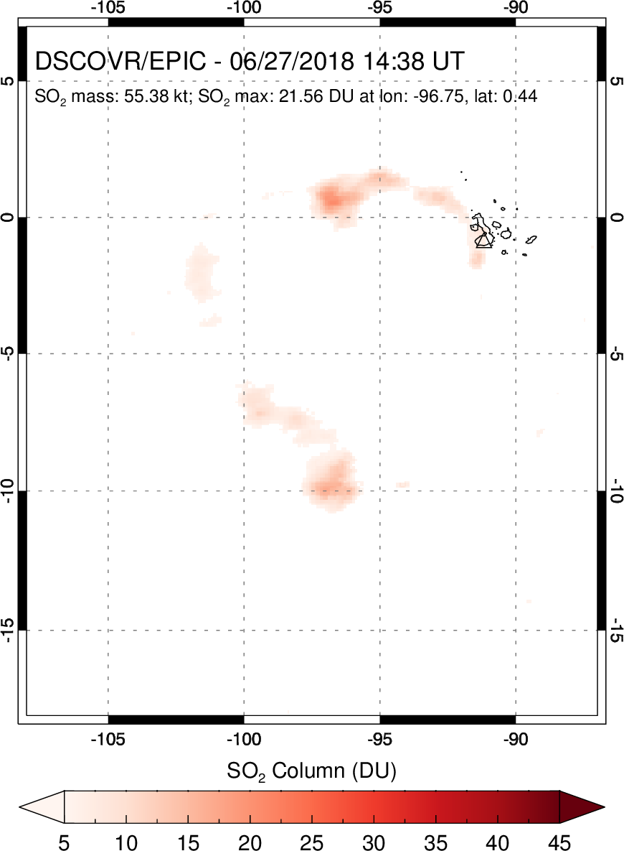
Sierra Negra
Jun 26, 2018
14:38 UT

Slide 18
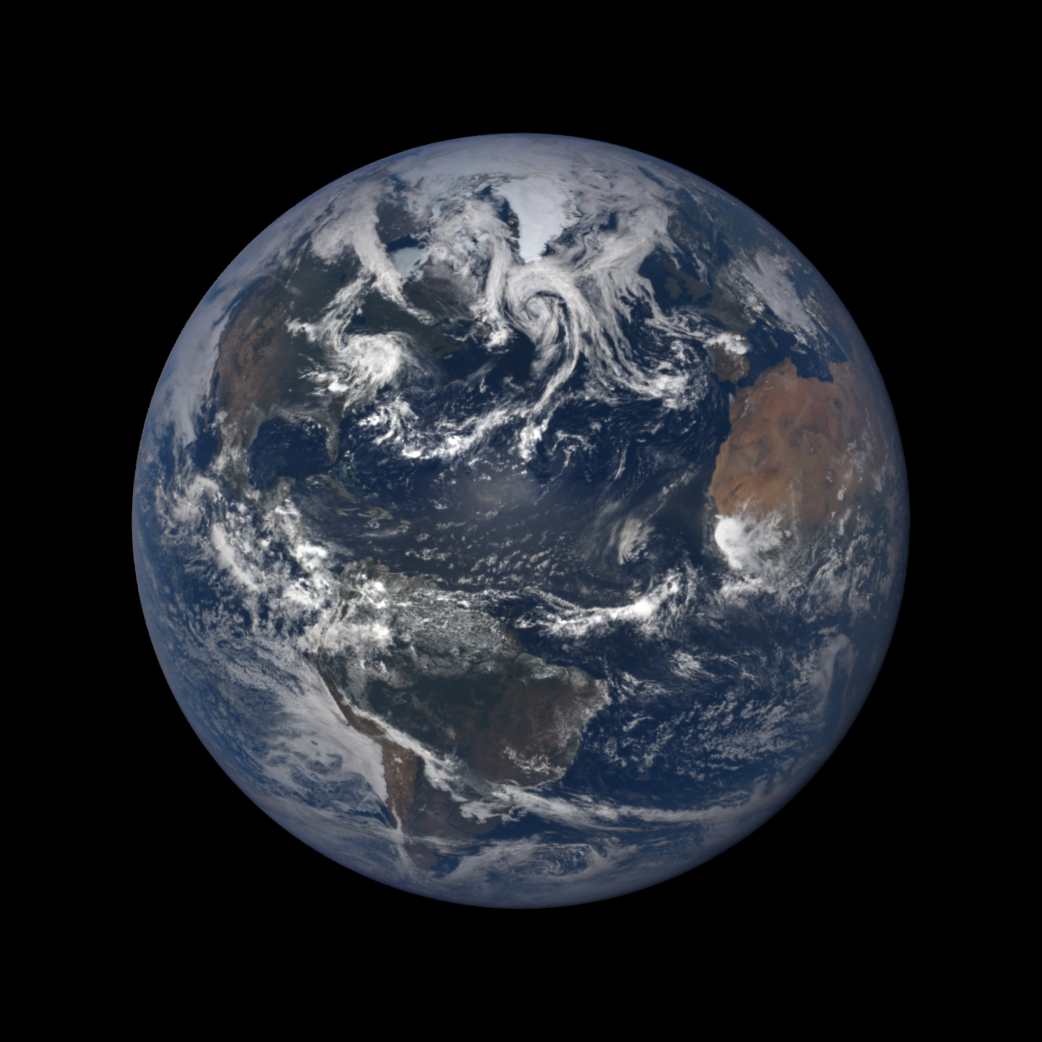

Jun 26, 2018
15:43 UT

Slide 19
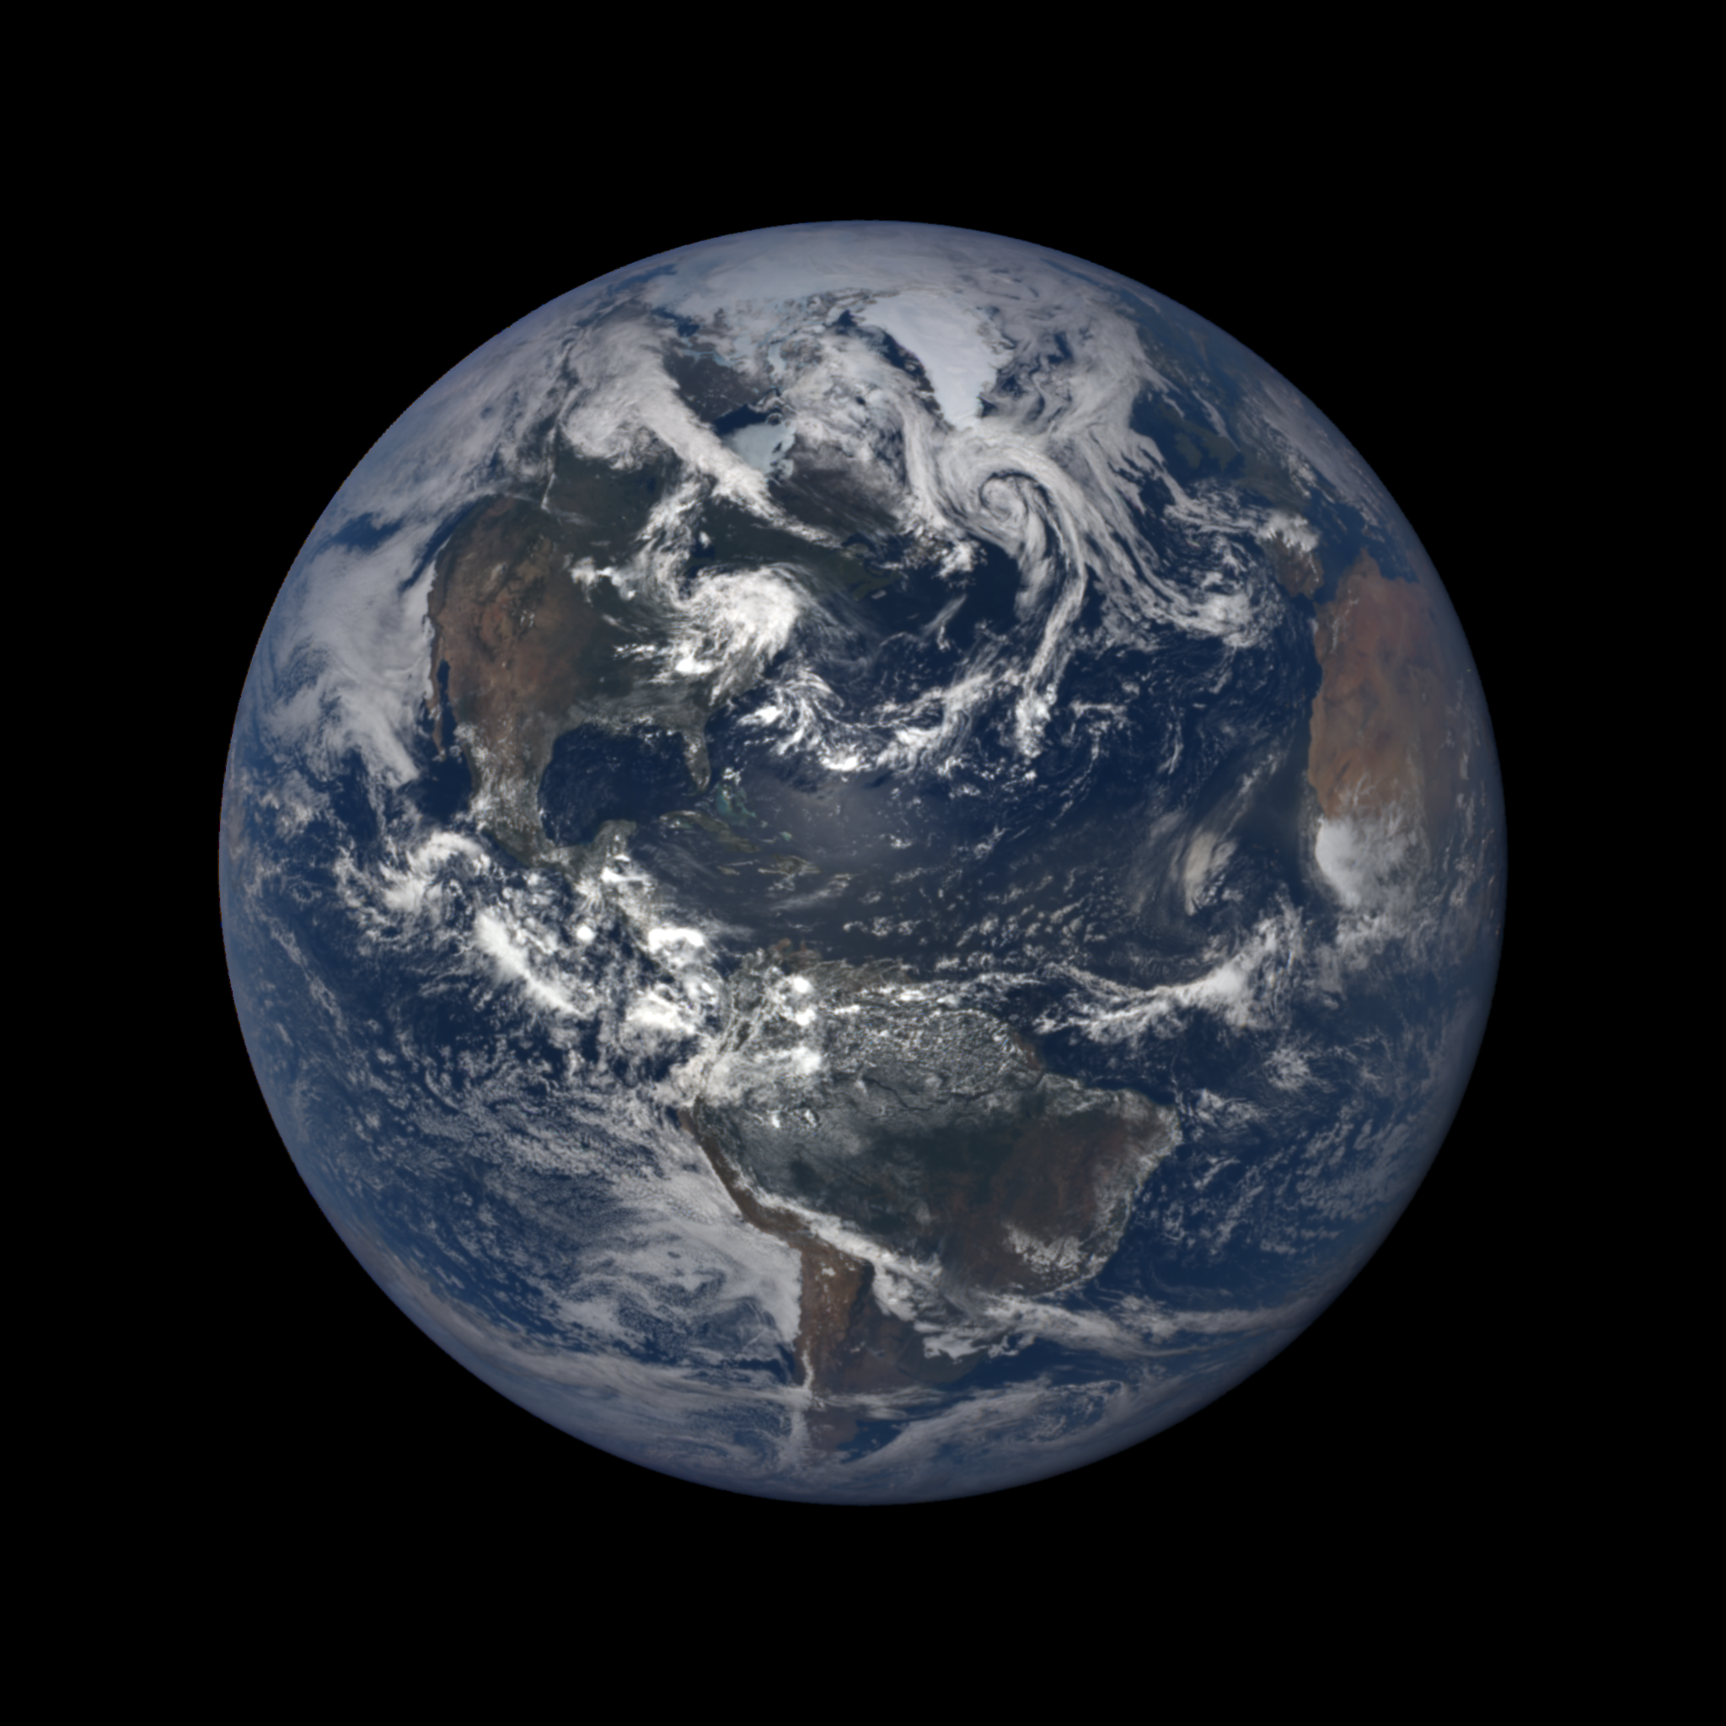
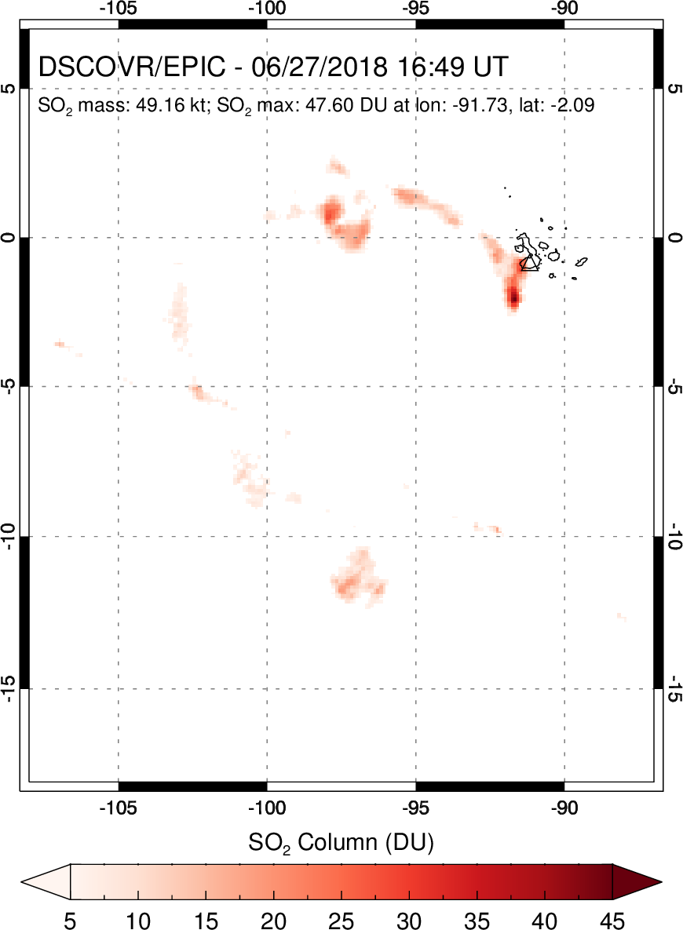
Jun 26, 2018
16:49 UT

Slide 20
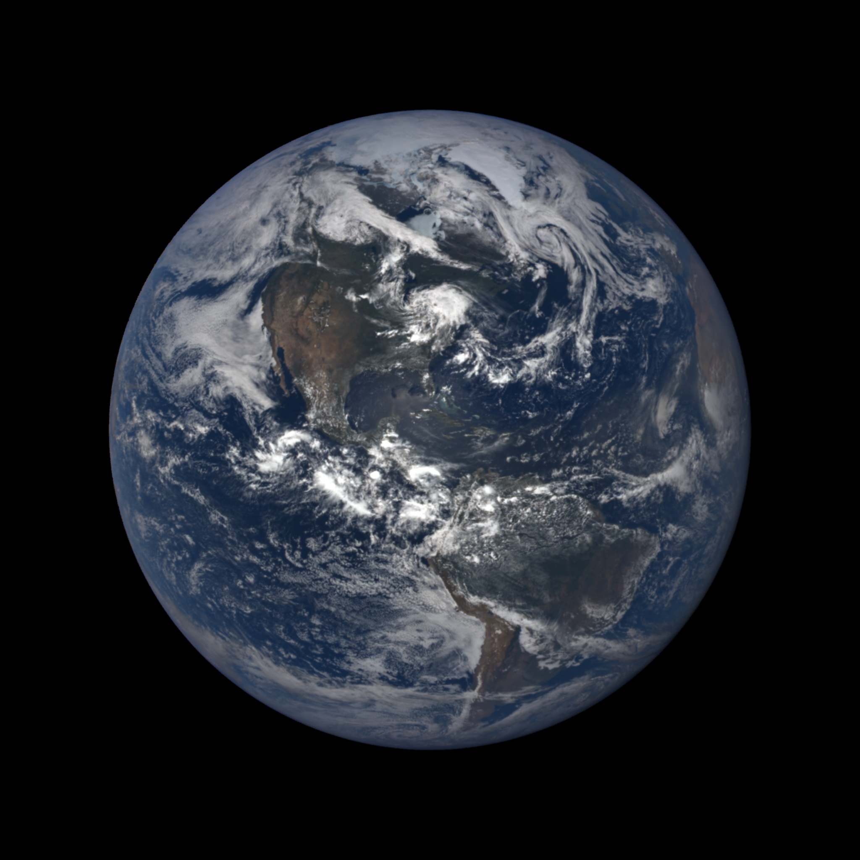
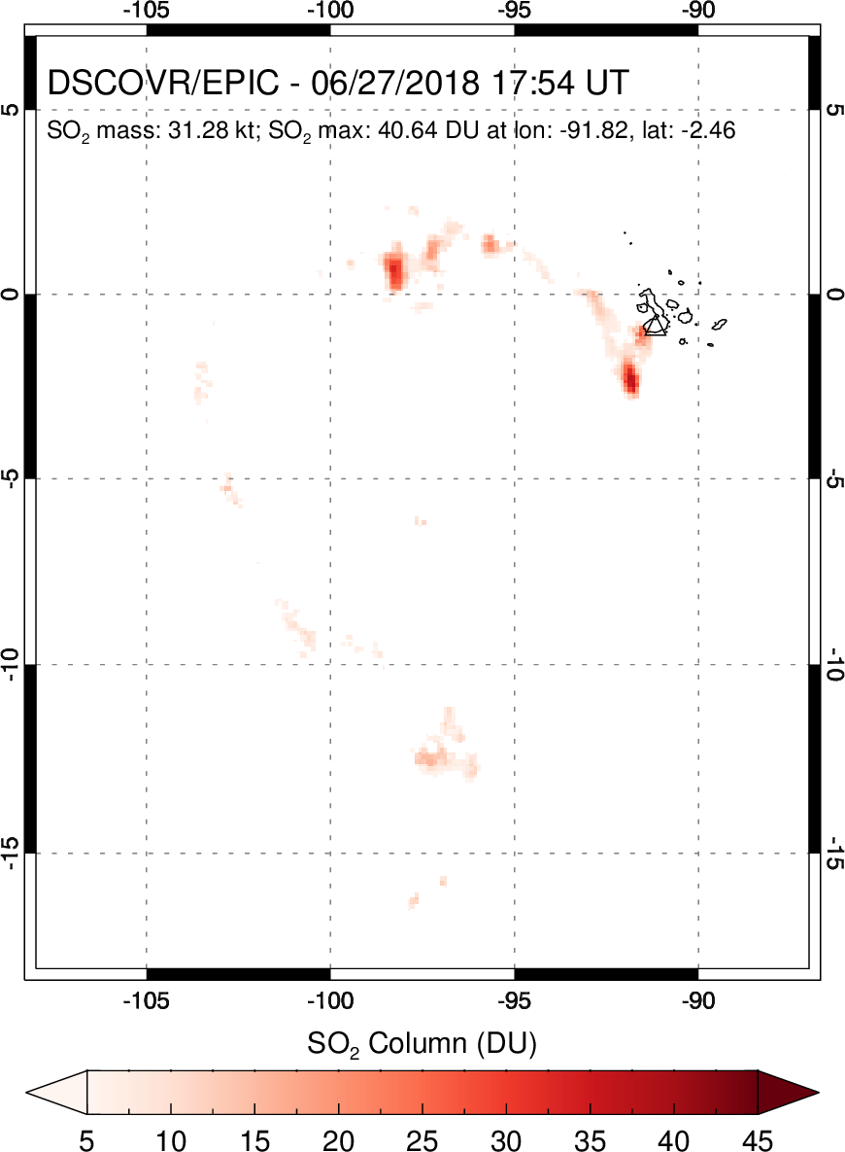
Jun 26, 2018
17:54 UT

Slide 21
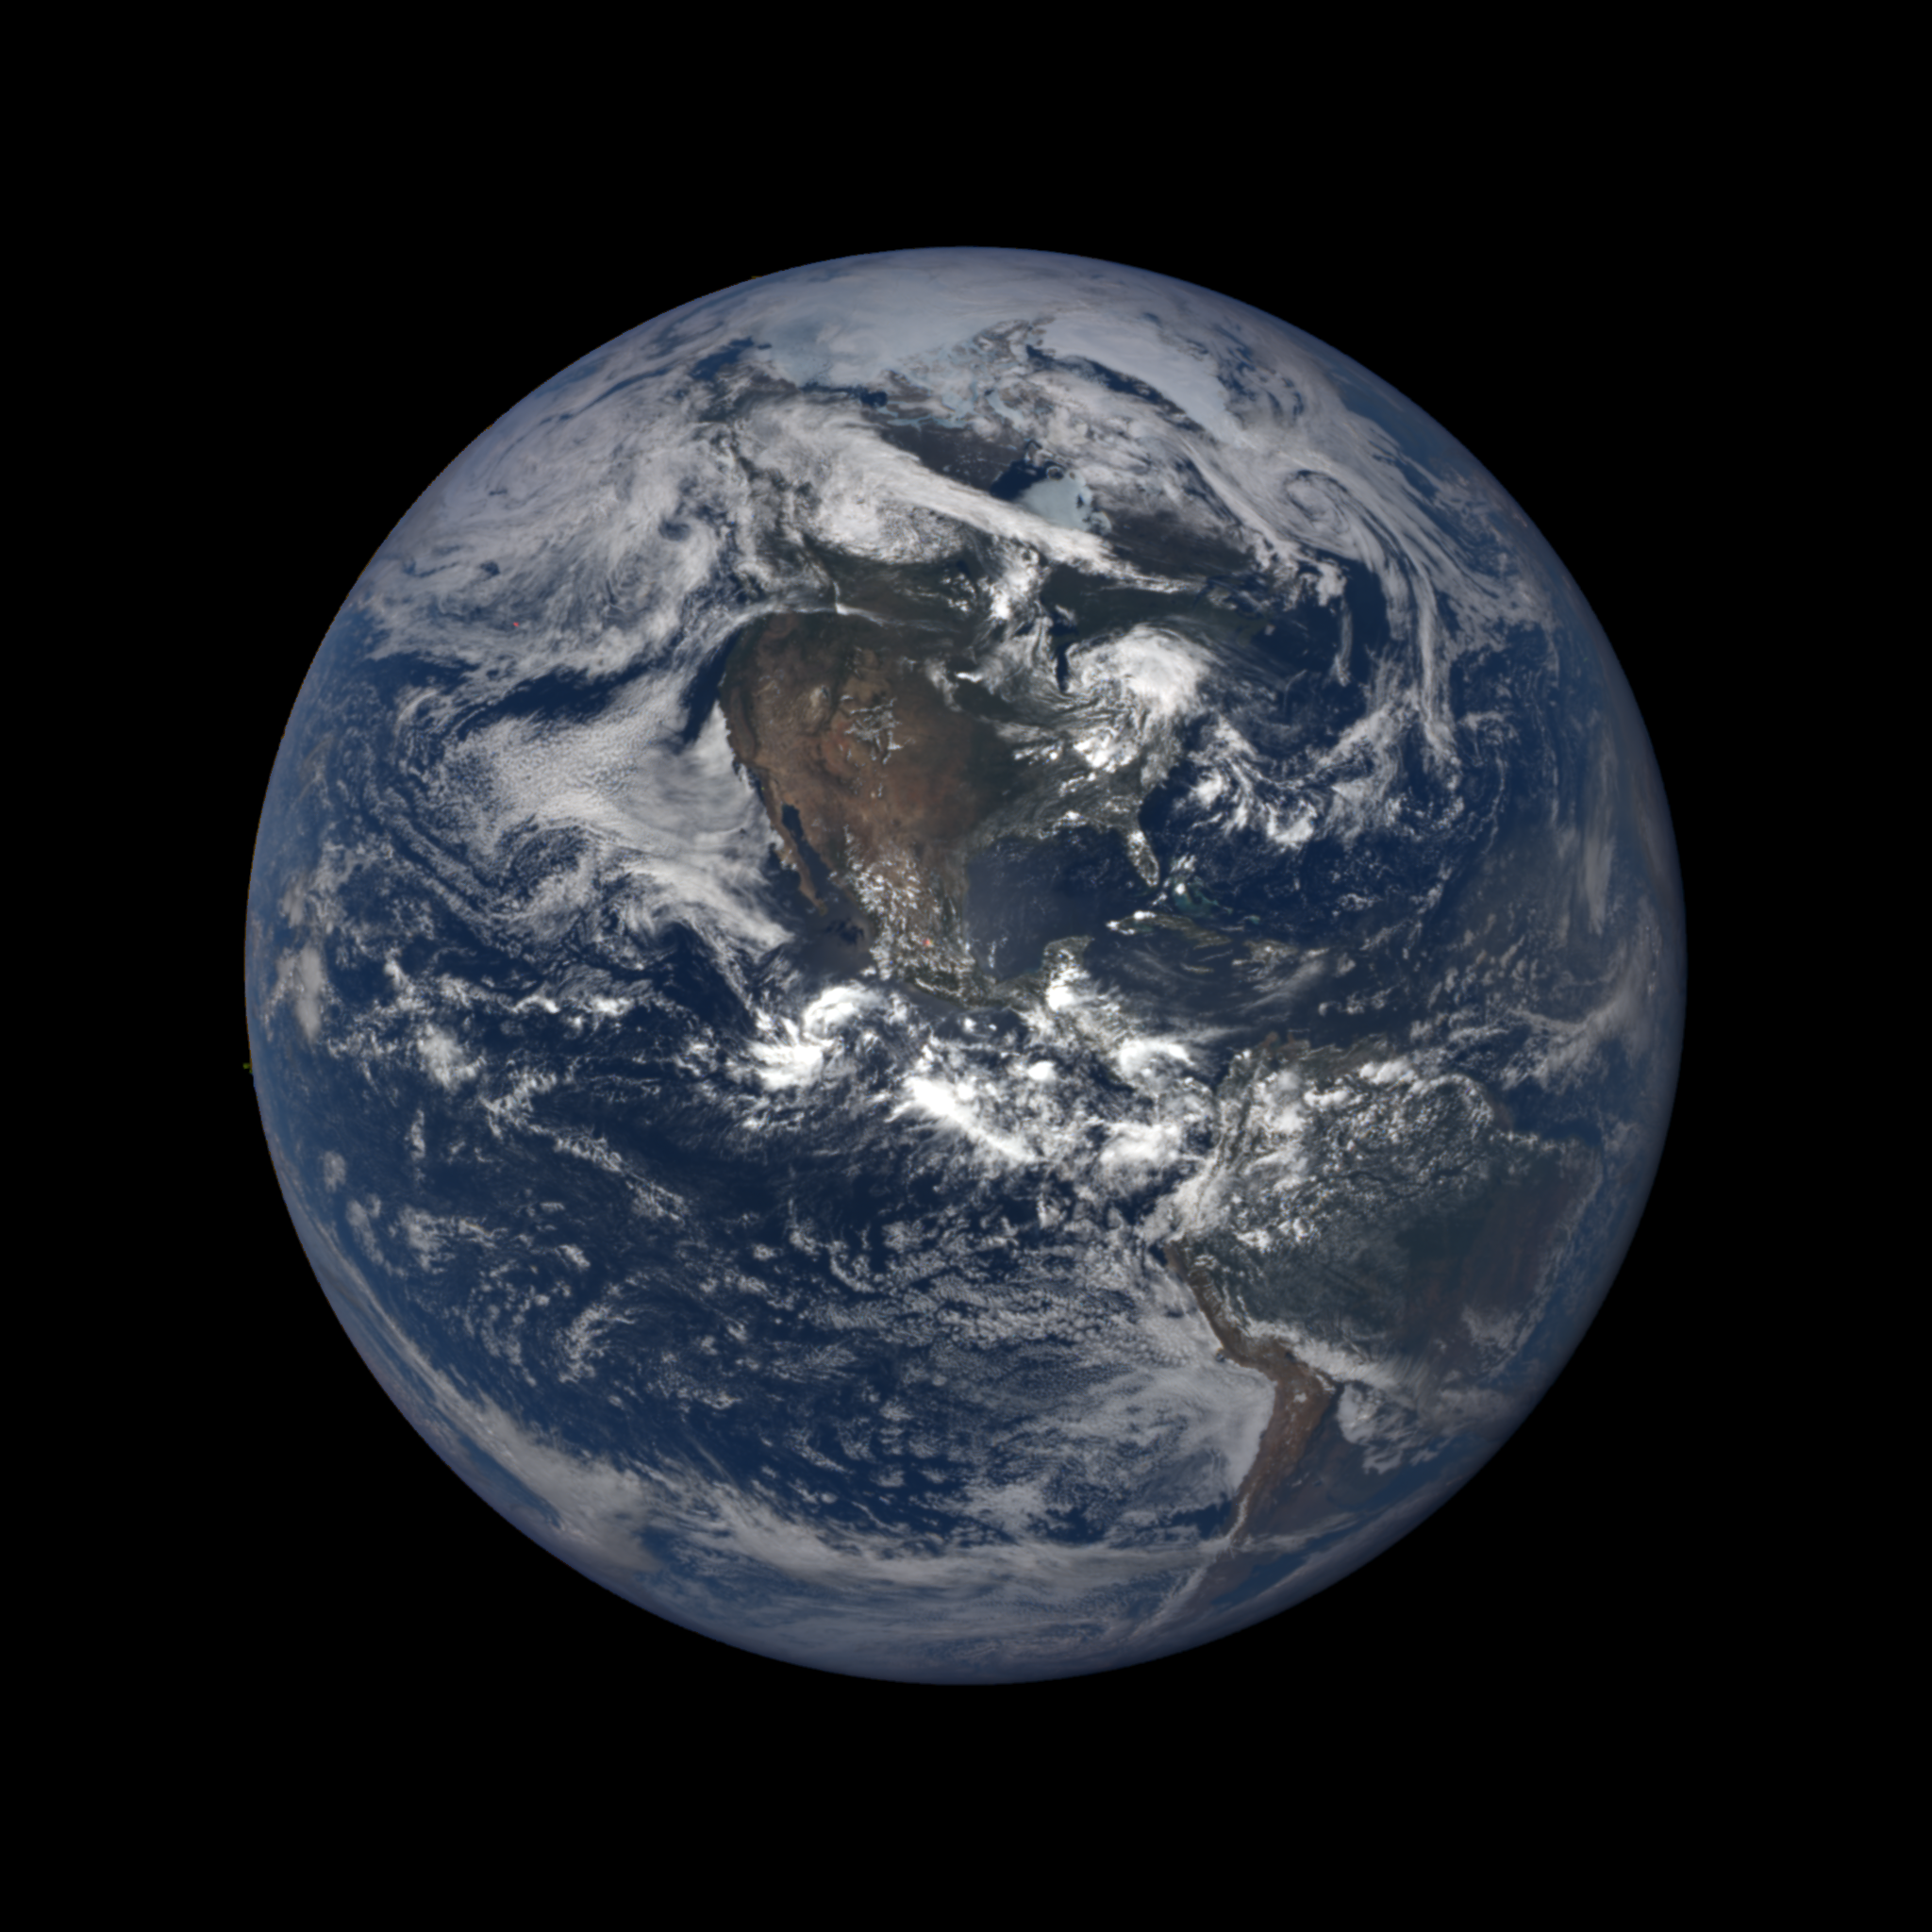

Jun 26, 2018
19:00 UT

Slide 22
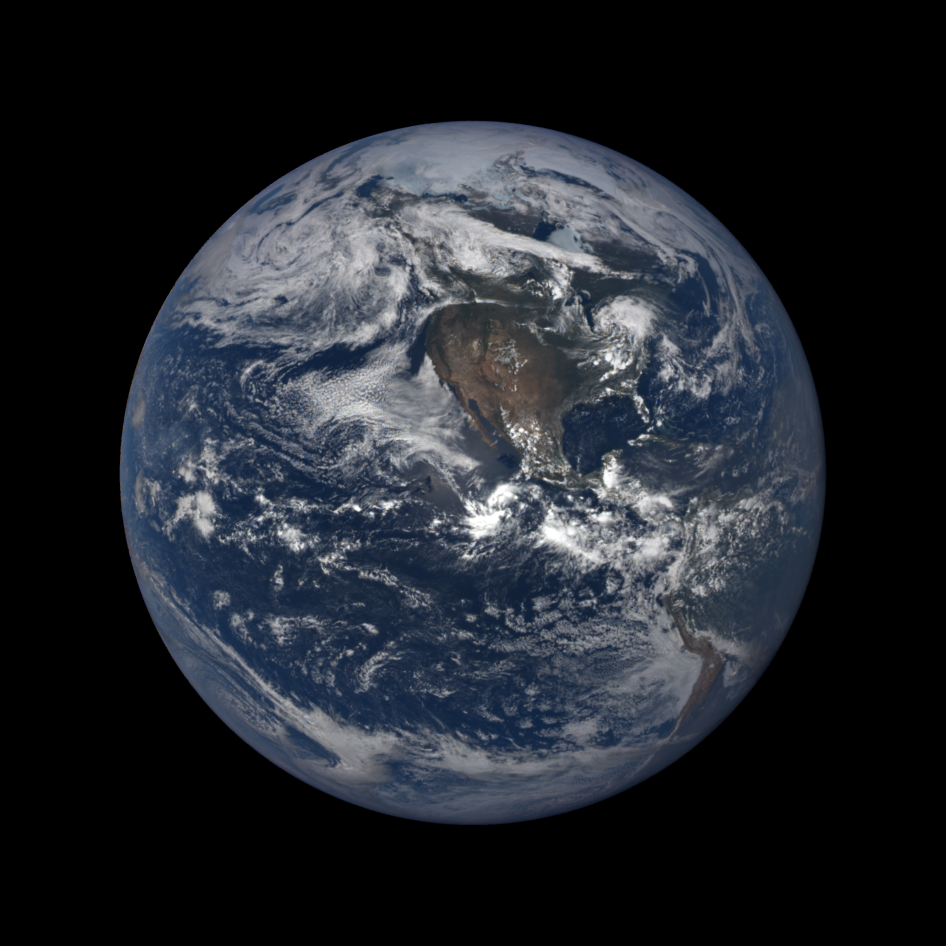

Jun 26, 2018
20:05 UT

Slide 23
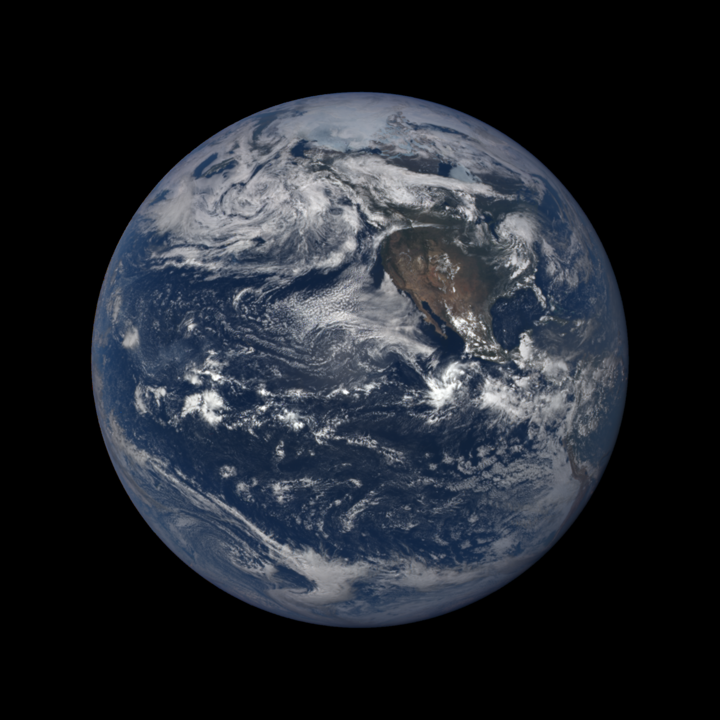
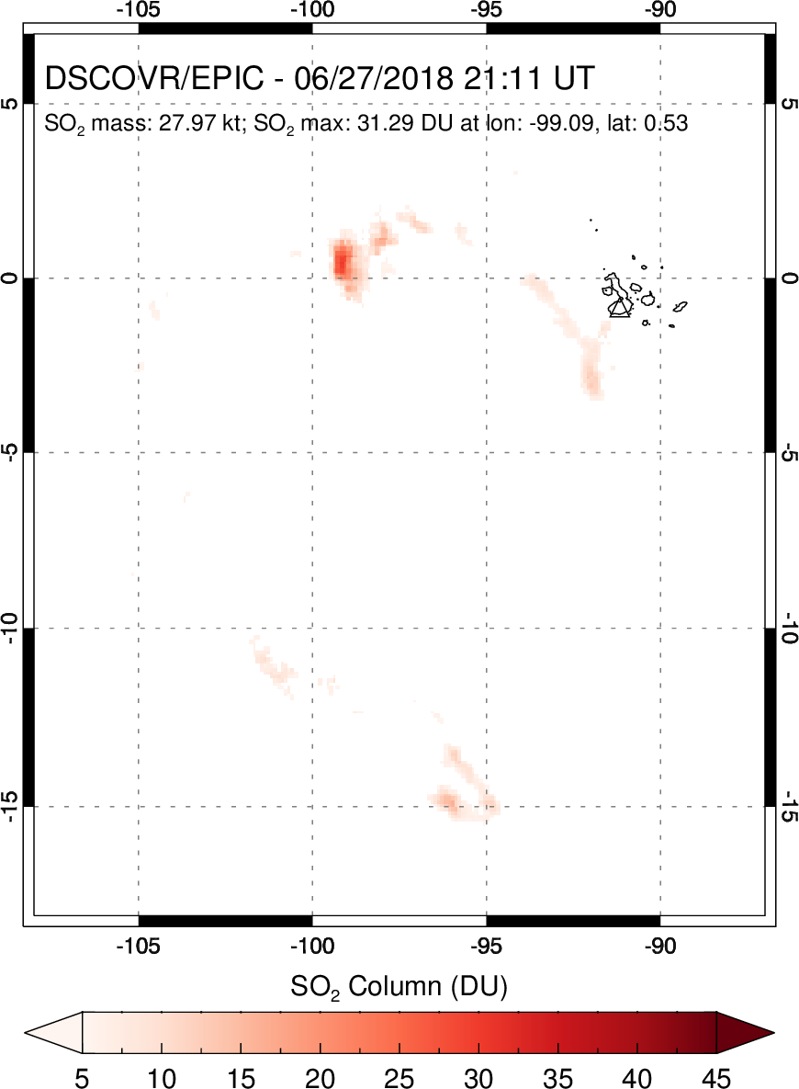
Jun 26, 2018
21:11 UT

Slide 24
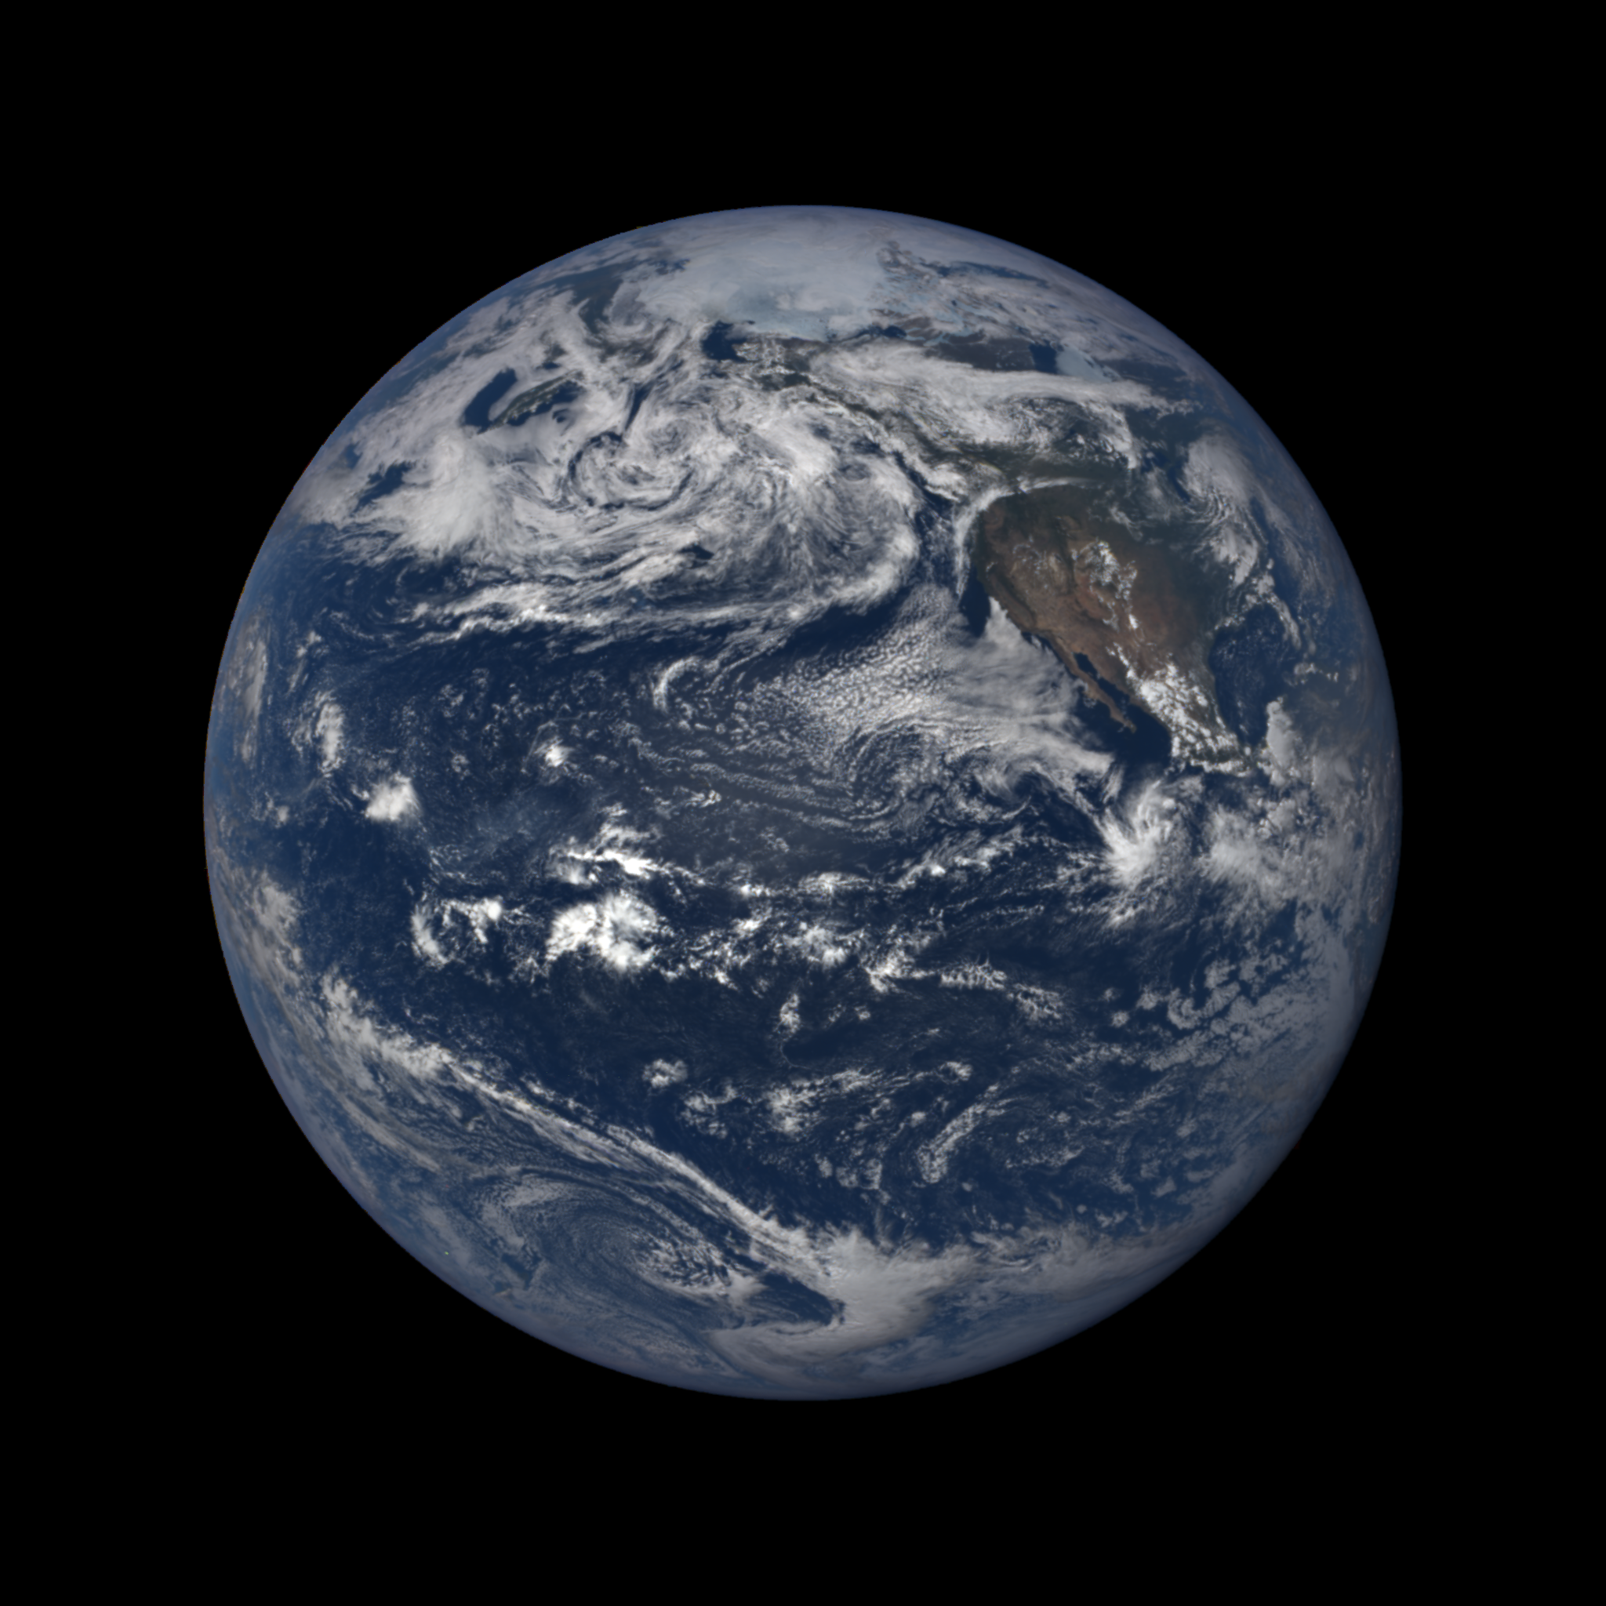
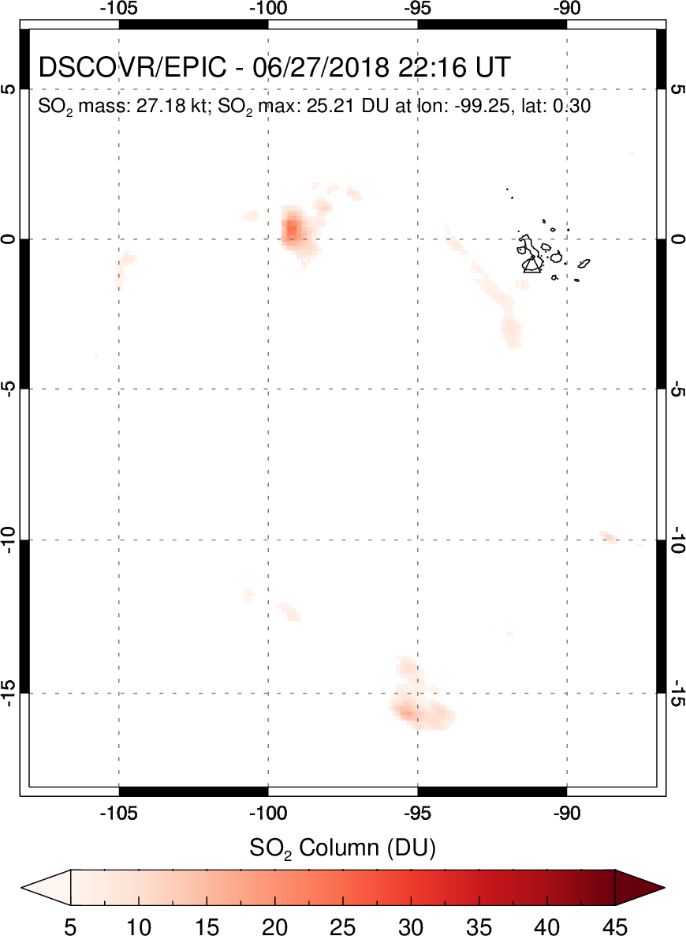
Jun 26, 2018
22:16 UT

Slide 25
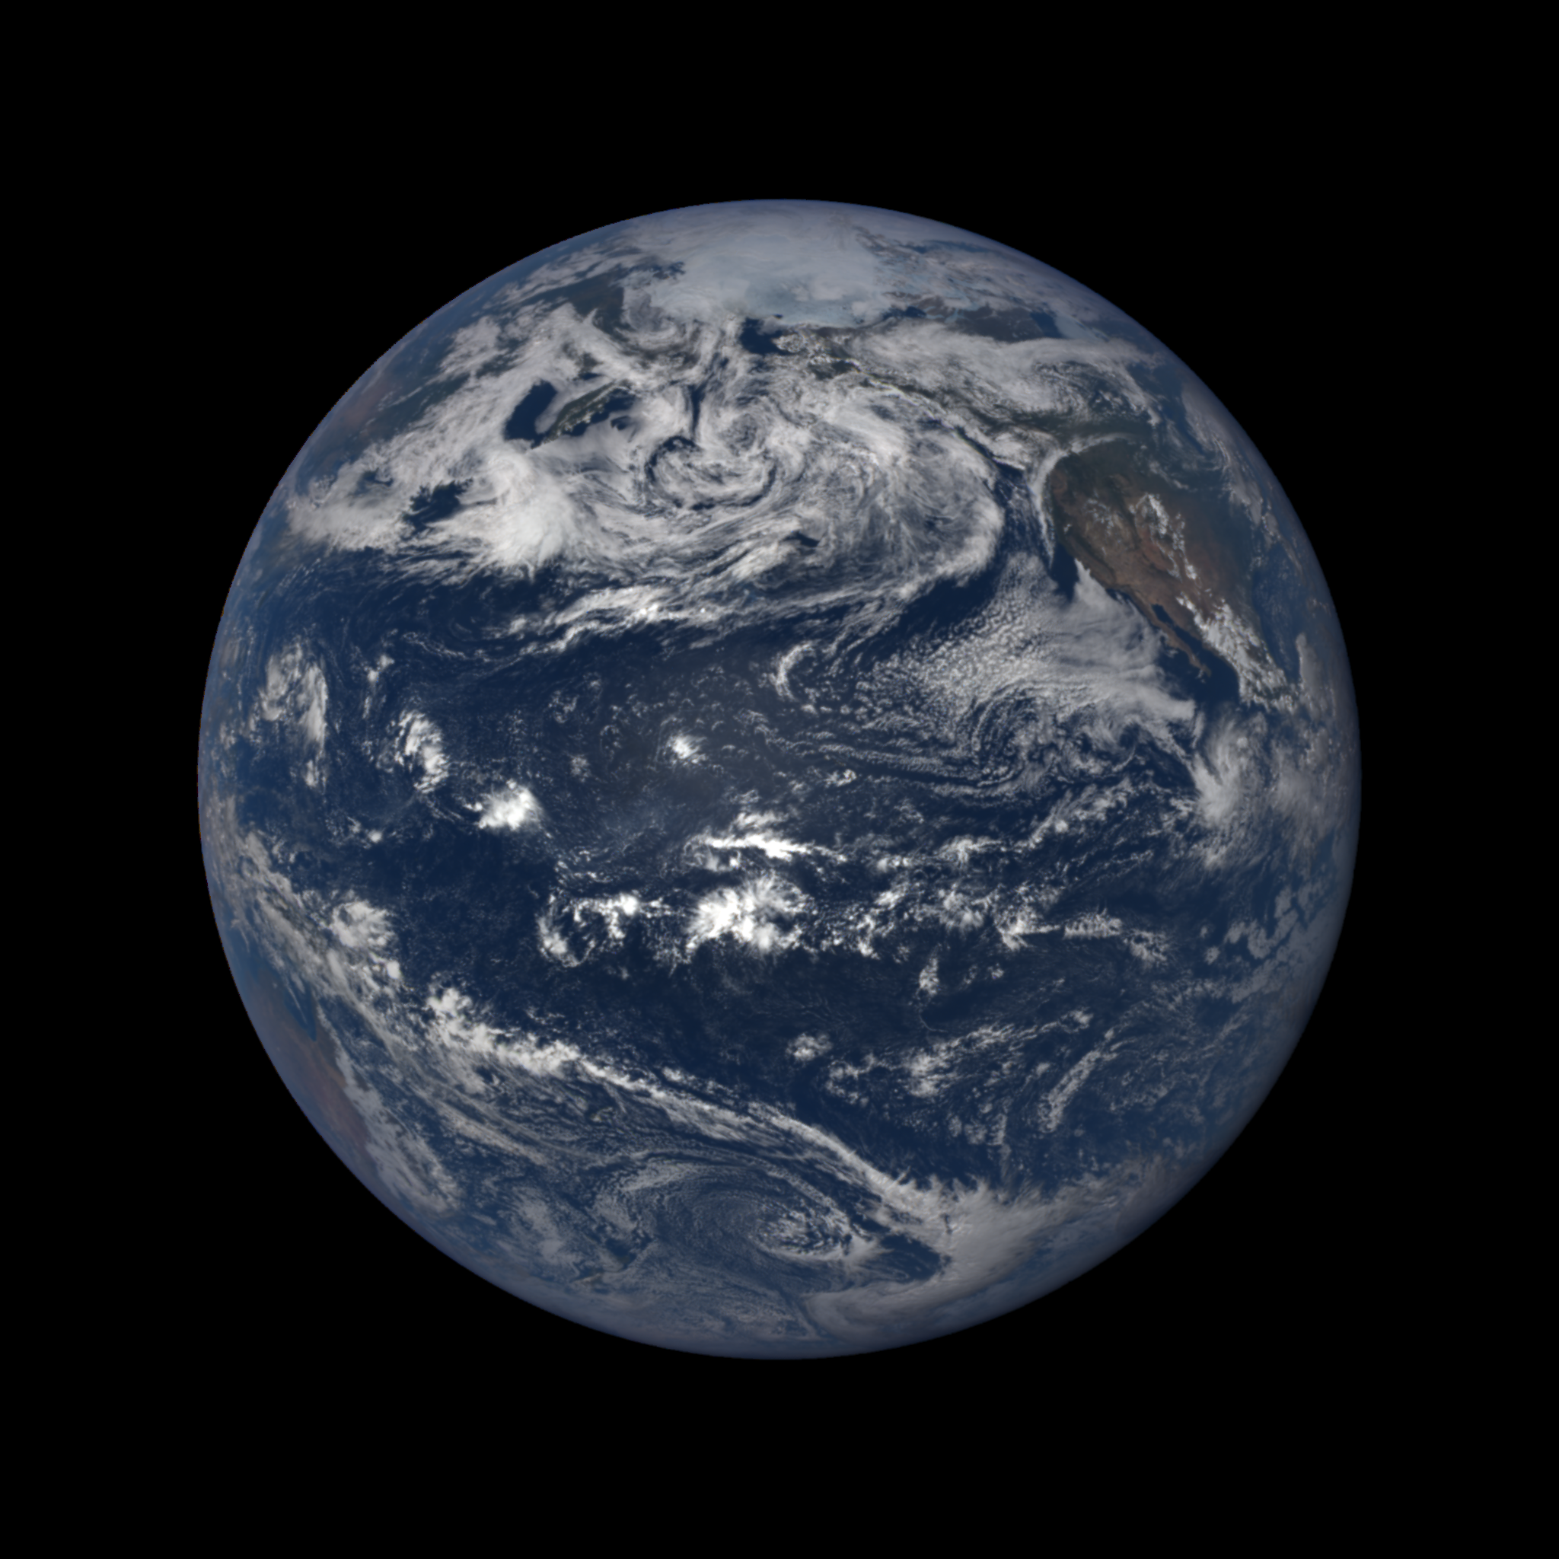
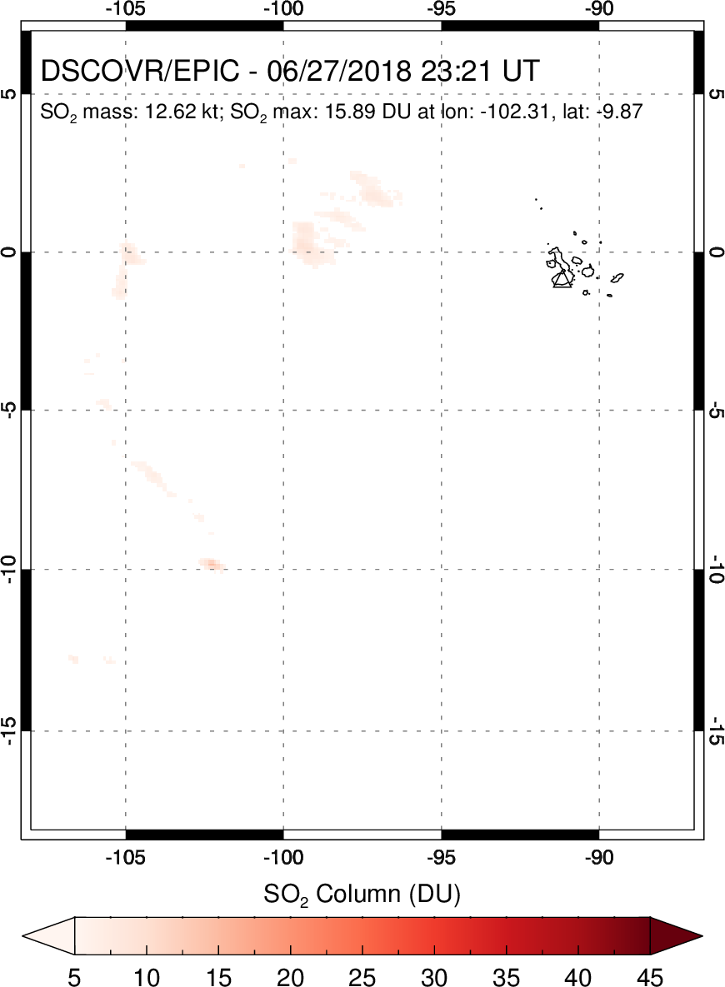
Jun 26, 2018
23:21 UT

Slide 26
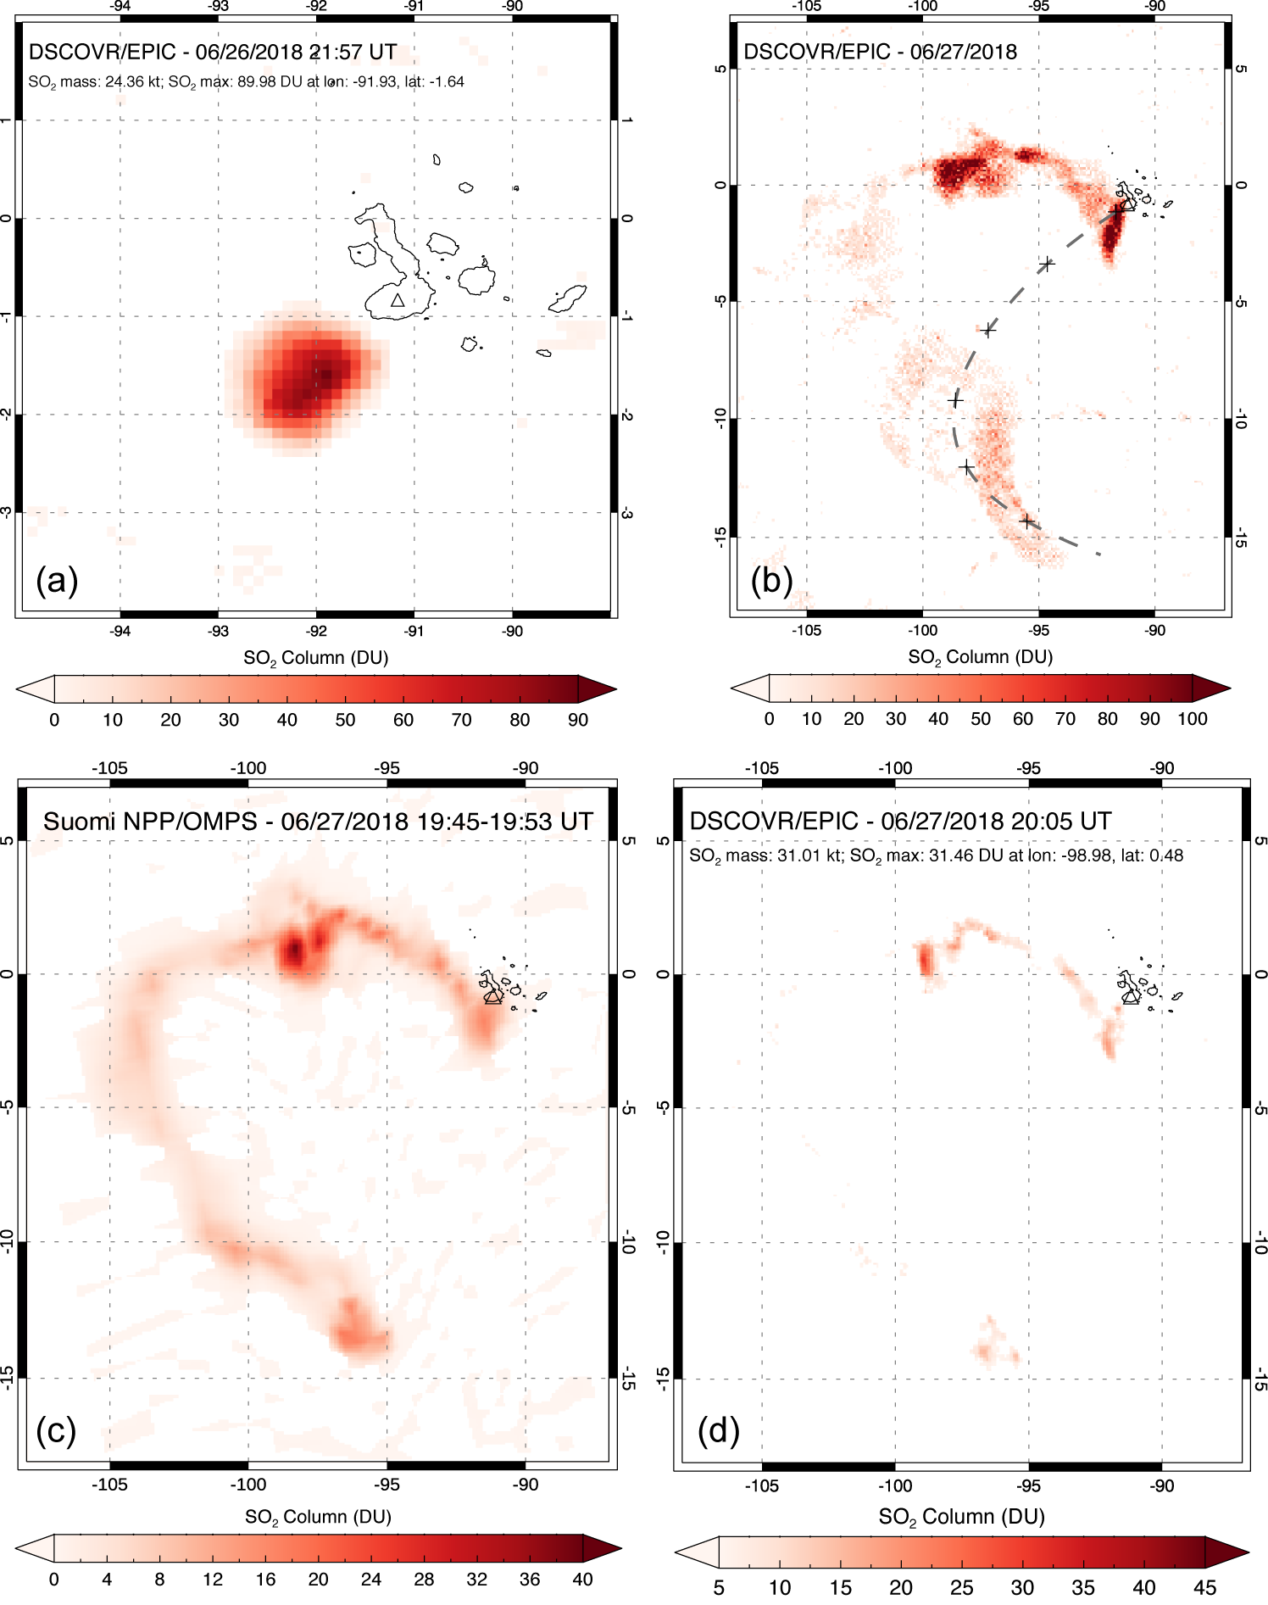
Sierra Negra (Galapagos Islands) eruption – June 2018
HYSPLIT forward trajectory @11 km
First EPIC detection of Sierra Negra eruption (June 26)
Cumulative EPIC SO₂ map (June 27)

Slide 27
Sierra Negra (Galapagos Islands) eruption – June 2018
OMPS
EPIC

Slide 28
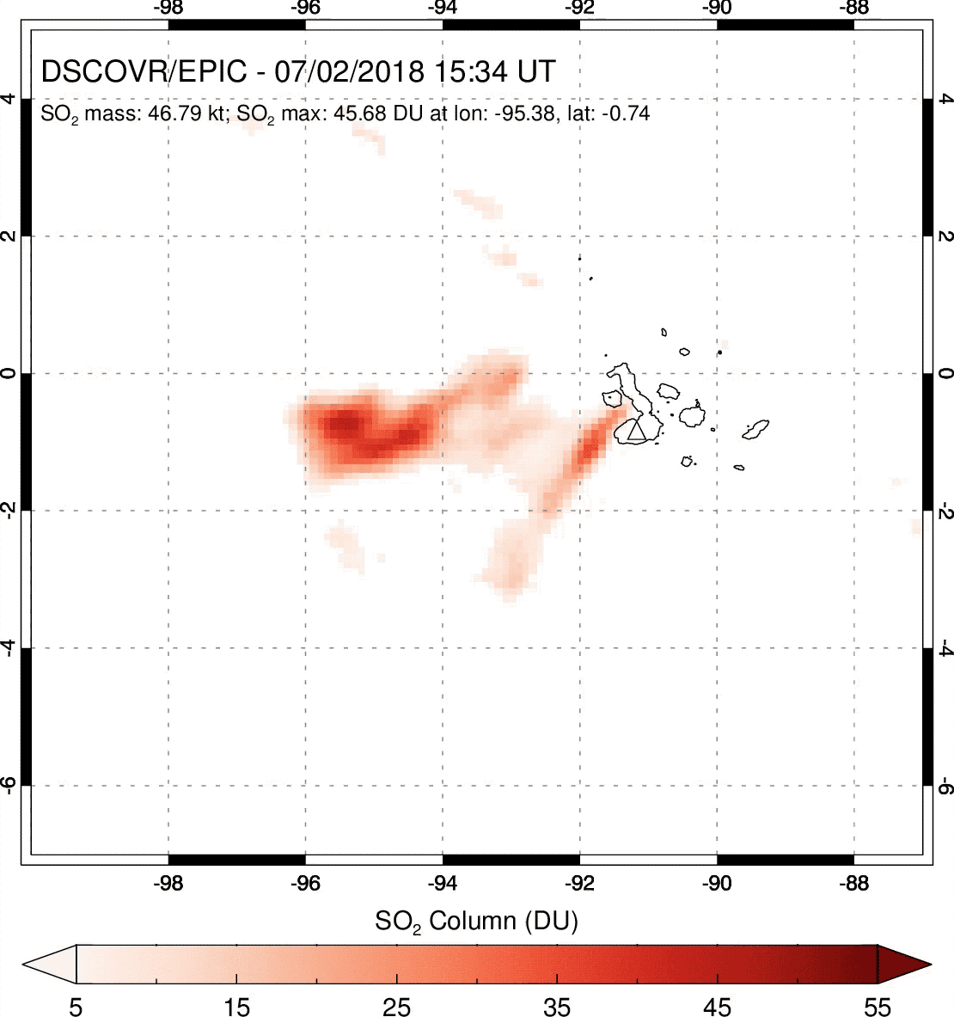
Sierra Negra (Galapagos Islands) eruption – July 2, 2018

Slide 29
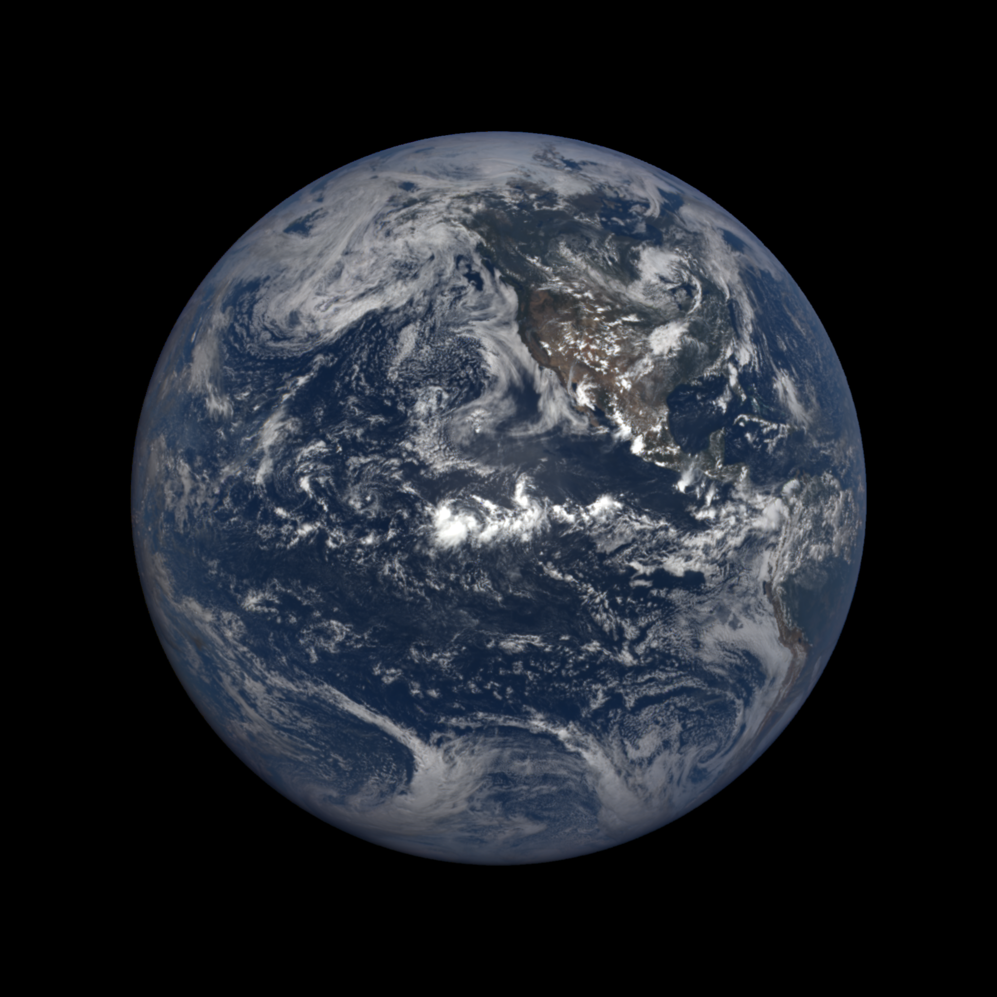
Ambae (Vanuatu)
July 26, 2018
20:24 UT

Slide 30
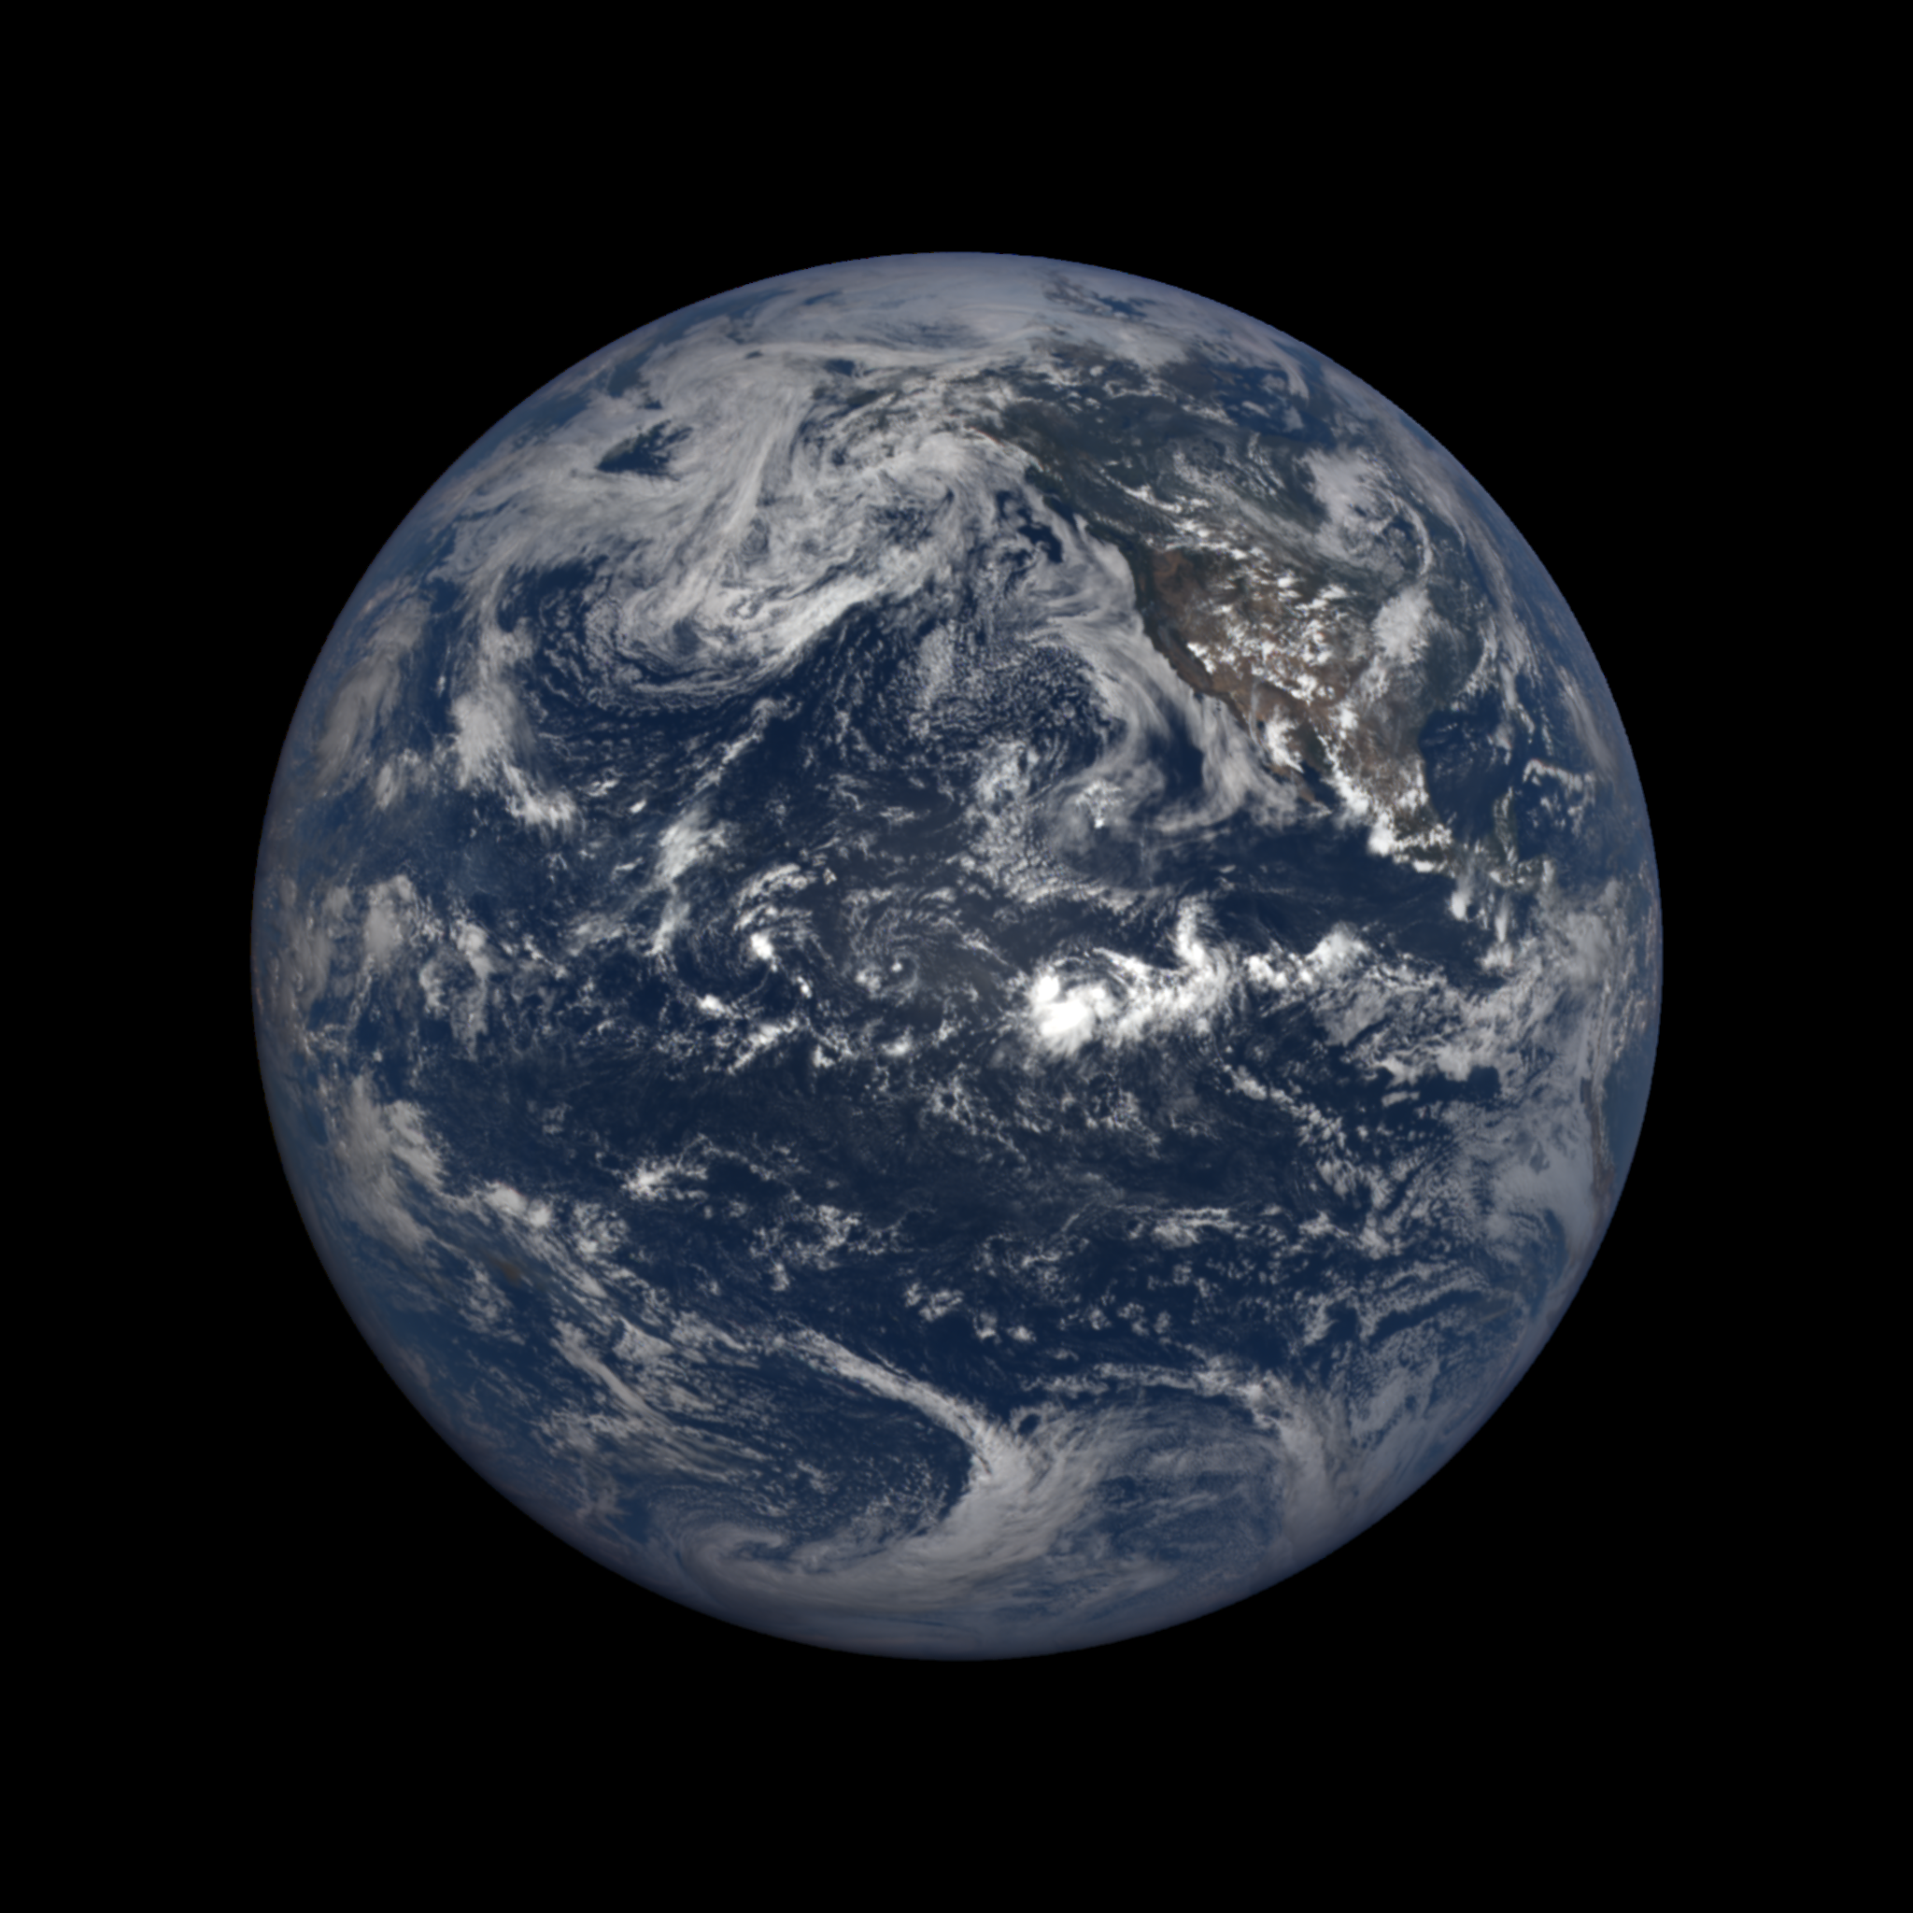
Ambae (Vanuatu)
July 26, 2018
21:29 UT

Slide 31
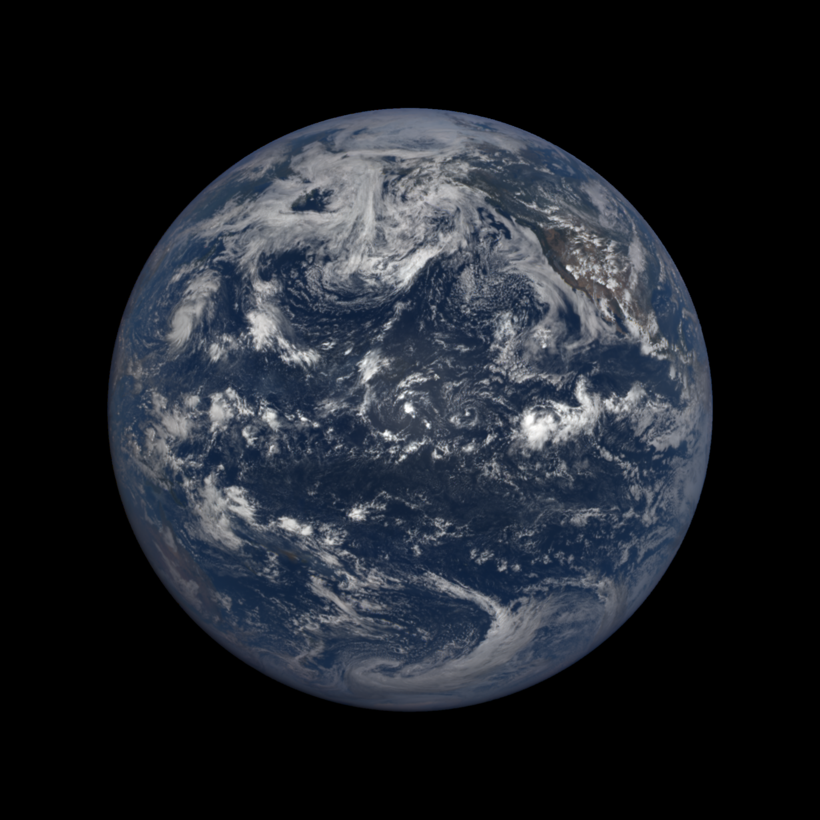
Ambae (Vanuatu)
July 26, 2018
22:35 UT

Slide 32
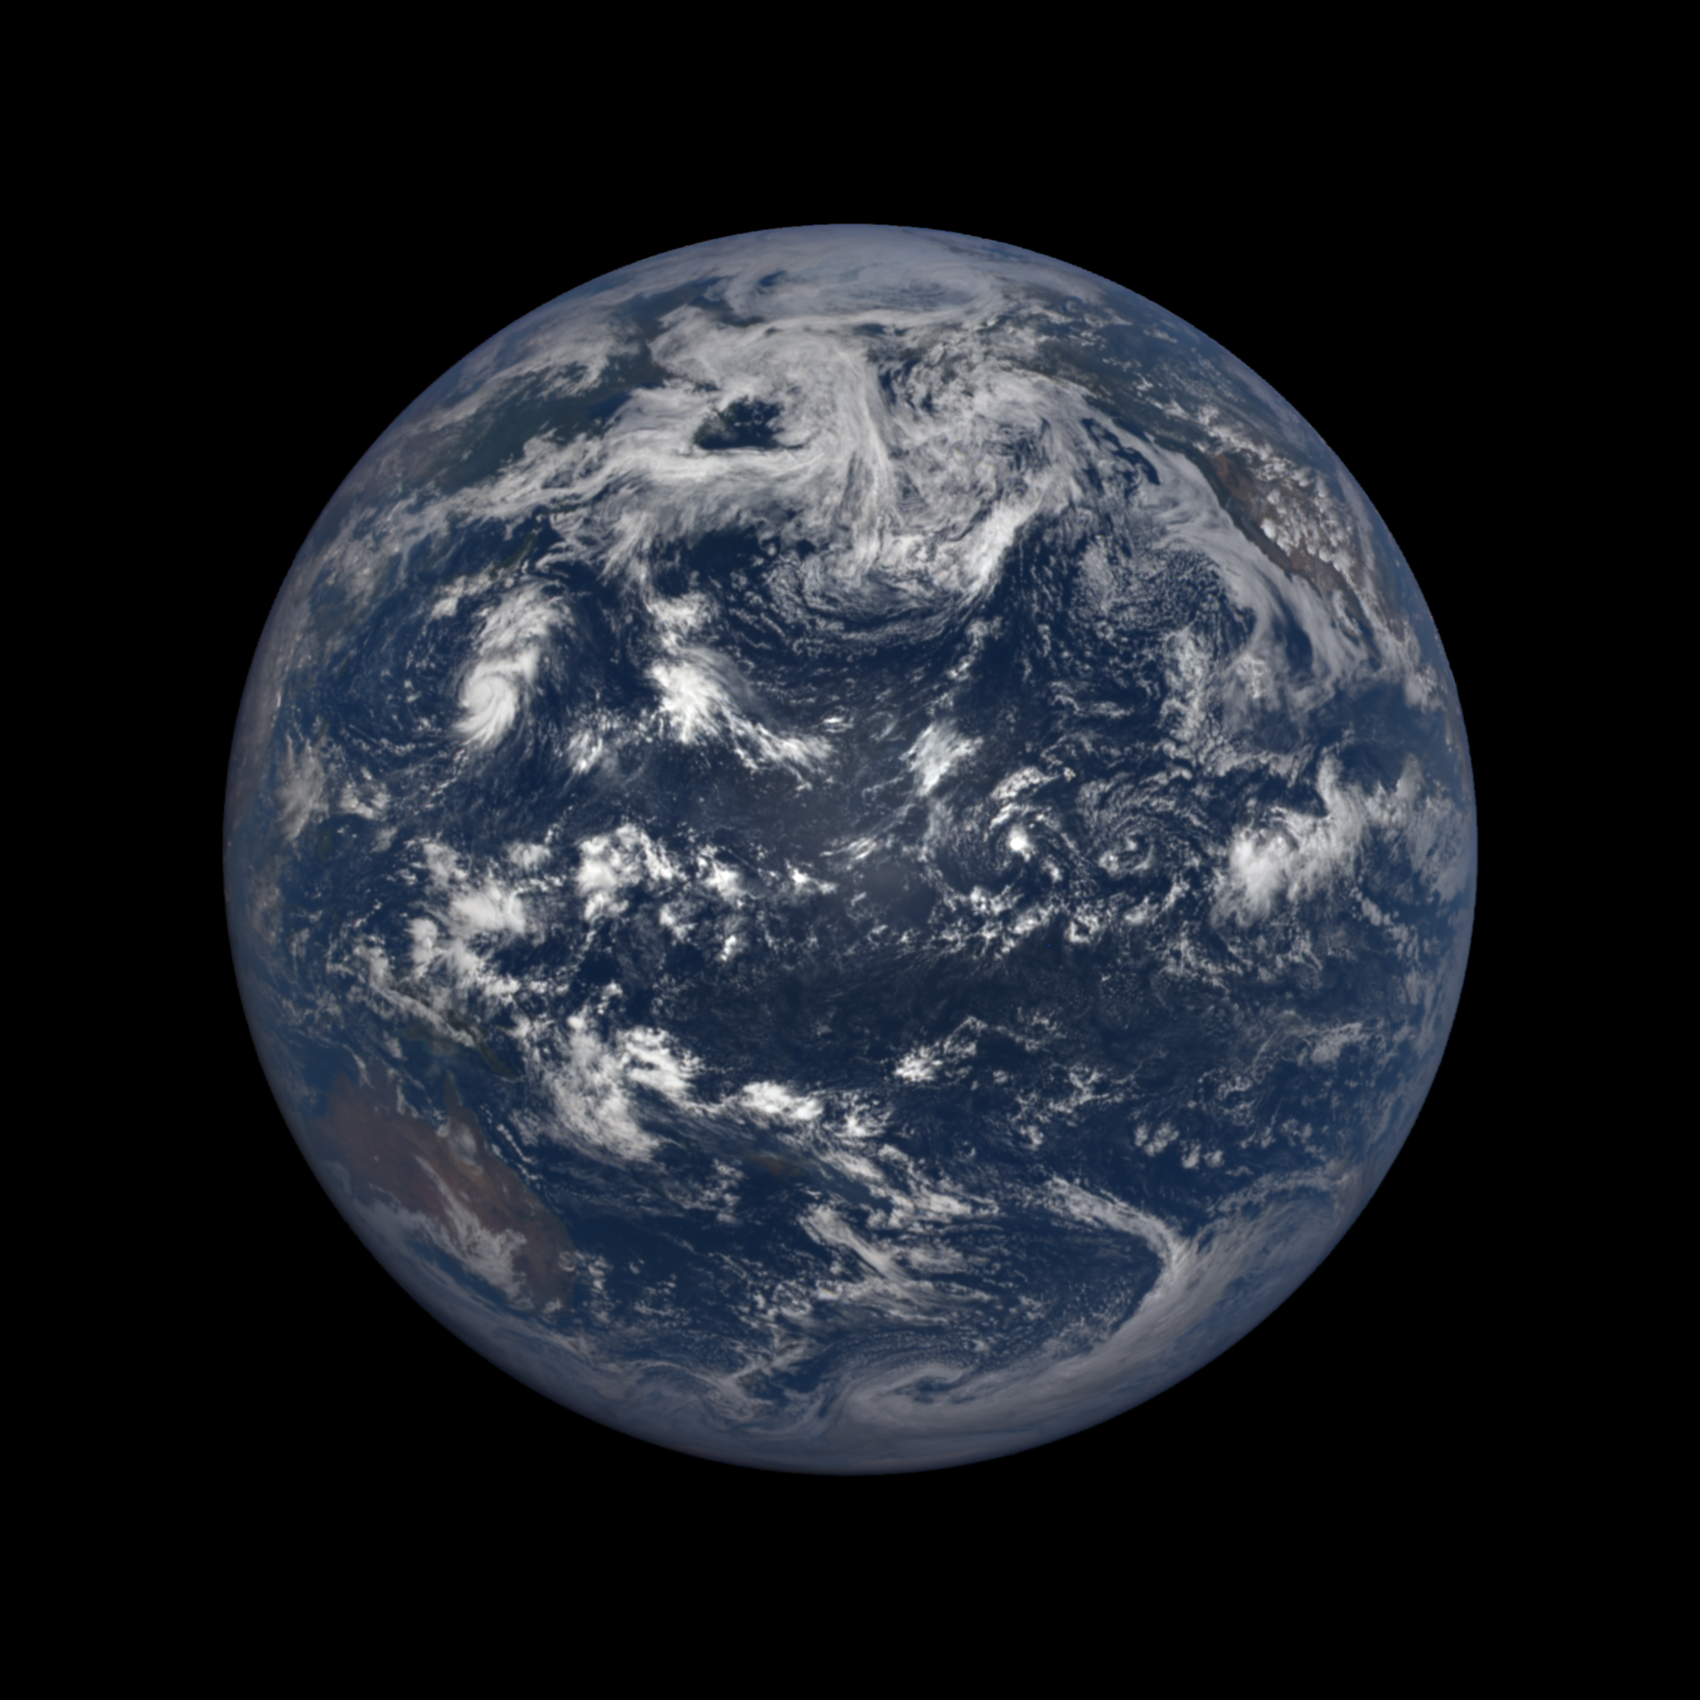
Ambae (Vanuatu)
July 26, 2018
23:40 UT
Lunar obs on July 27

Slide 33
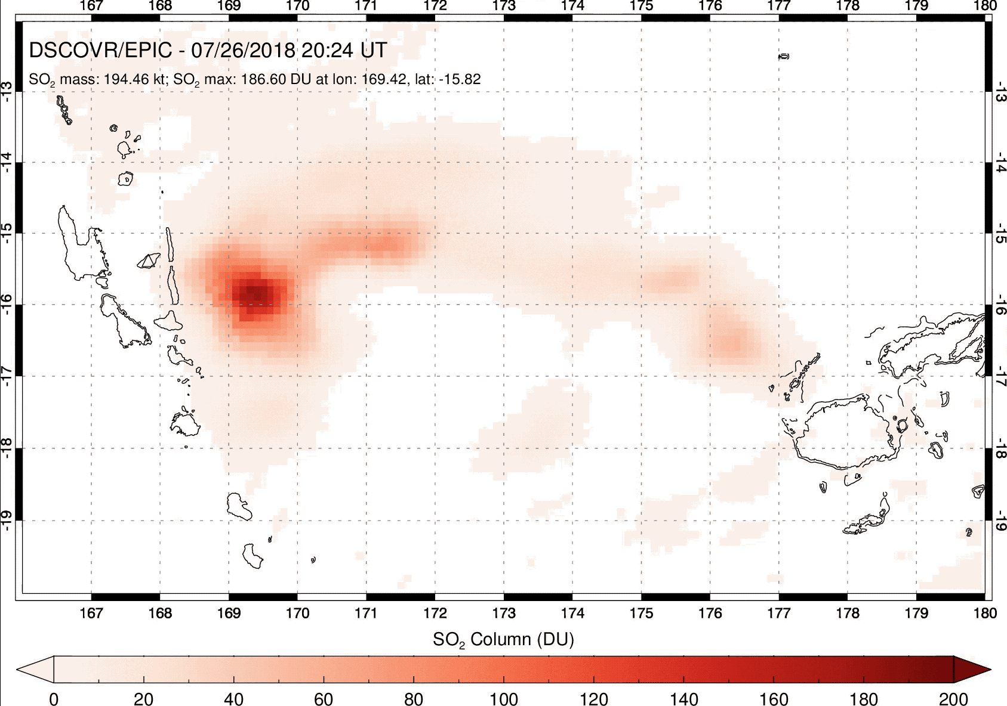
Ambae/Aoba (Vanuatu) eruption – July 2018
Notes:
No EPIC data for July 27 – lunar observations

Slide 34
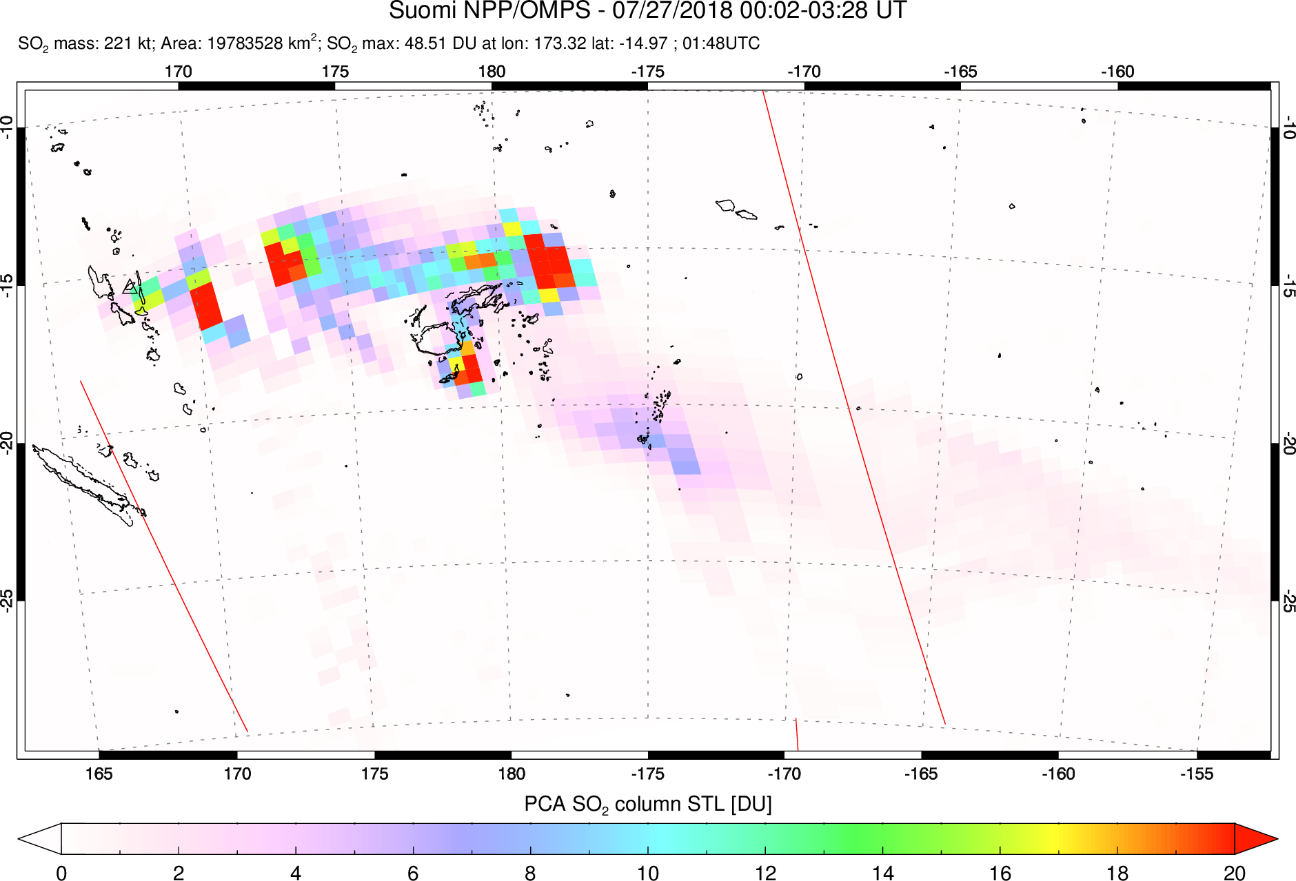
OMPS data for Ambae (Vanuatu) eruption
First OMPS overpass at 01:50 UTC July 27 – max. SO₂ columns significantly lower than EPIC (effect of FOV size?)

Slide 35
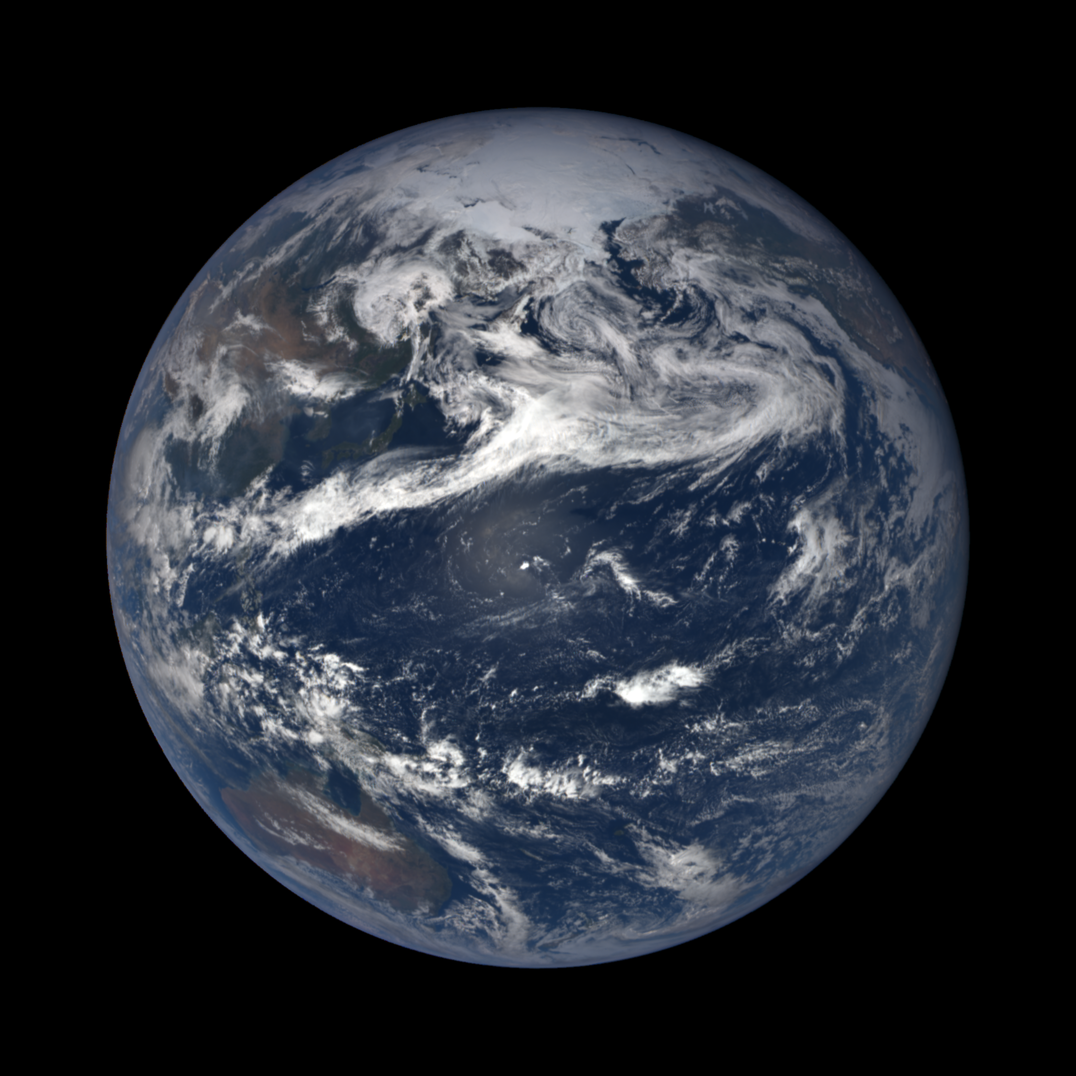
Bogoslof (AK, USA)
May 28, 2017

Slide 36
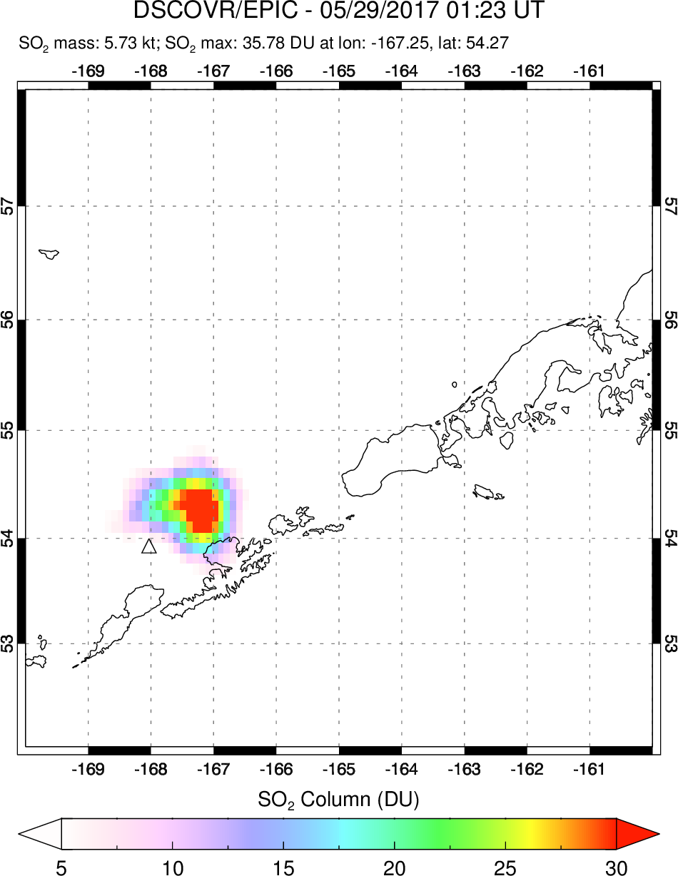
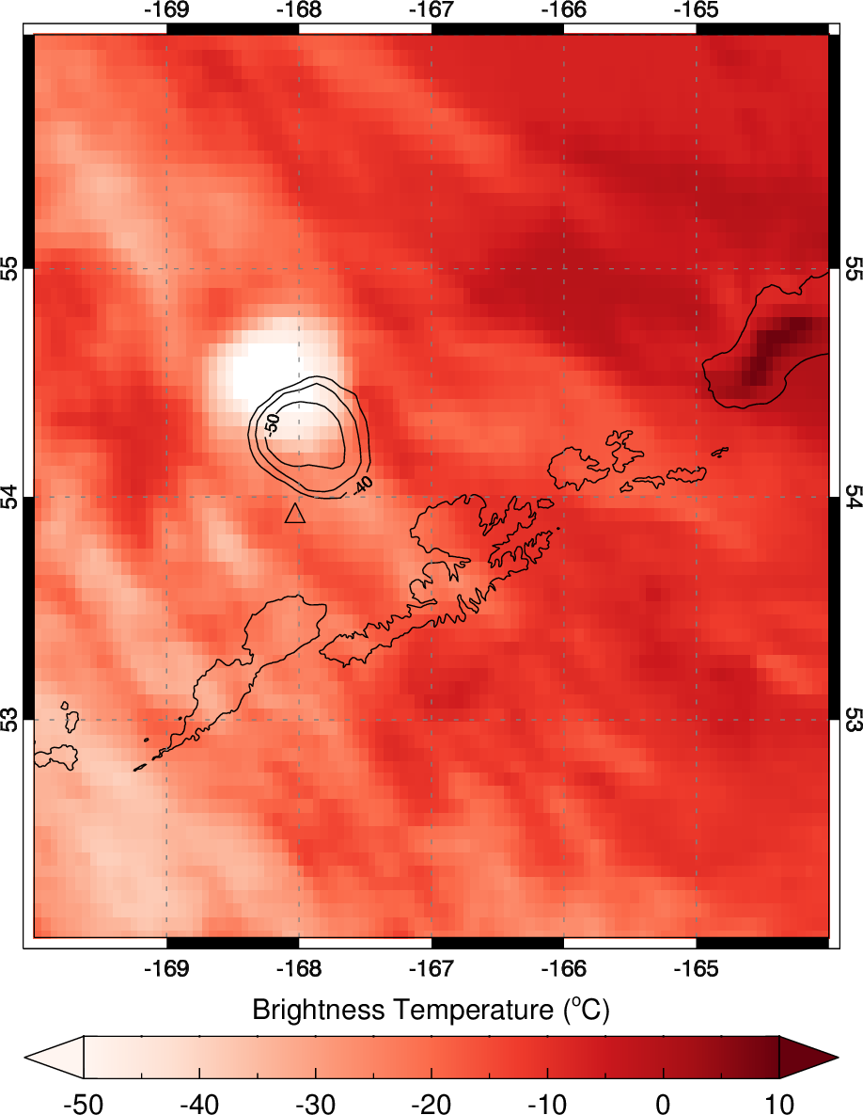
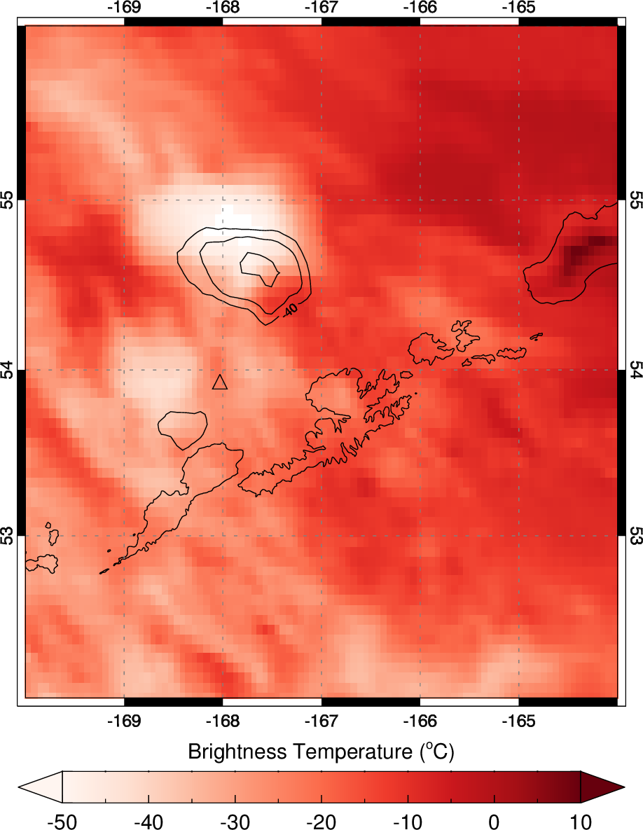
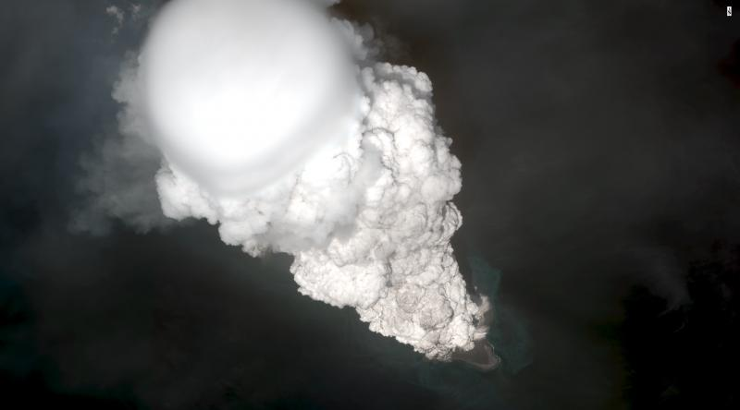
Bogoslof (Alaska, USA) eruption – May 28-29, 2017
Aqua/AIRS (IR)
May 29, 00:06 UTC
1.6 kt SO₂
DSCOVR/EPIC
May 29, 01:23 UTC
5.7 kt SO₂
Digital Globe/AVO
WorldView
May 28, 22:34 UTC

Slide 37
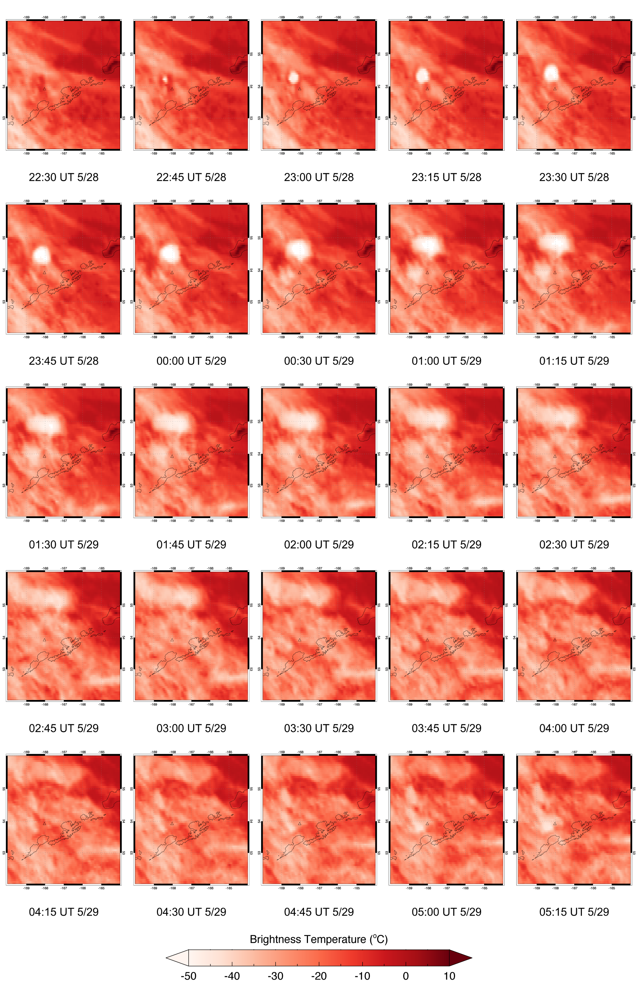
Bogoslof eruption – EPIC exposures
01:23 UT
02:28 UT
03:34 UT
04:39 UT
GOES-15 (W)
Separation of ice-rich (opaque) and SO₂ clouds -> gas ‘cap’?
Transient SO₂ feature at 02:28 UTC – H₂S oxidation?

Slide 38
Product status/updates
EPIC L2 volcanic SO₂ product released: Nov 20, 2017 (only known volcanic events currently processed)
Working on ATBD. Deliver by the end of 2018.
EPIC L2 SO2 data products (DSCOVR_EPIC_L2_SO2_01) archived at NASA Langley ASDC (https://eosweb.larc.nasa.gov/project/dscovr/dscovr_epic_l2_so2_01)
Article on EPIC volcanic SO₂ measurements in minor revision for Geophys. Res. Lett. (Carn, S.A., et al. (2018), First observations of volcanic eruption clouds from the L1 Earth-Sun Lagrange point by DSCOVR/EPIC, Geophys. Res. Lett., in revision)
Two abstracts submitted to 2018 Fall AGU meeting (DSCOVR session)
NASA ROSES 2018 DSCOVR Science Team volcanic SO₂ proposal submitted
EPIC SO₂ results disseminated via social media (Twitter)

Slide 39
Summary and next steps
Recent volcanic eruptions demonstrate EPIC’s ability to provide timely observations of volcanic SO₂ clouds
EPIC SO₂ retrieval sensitivity is similar to TOMS (~5-10 DU), but should improve with reprocessed L1b data
Highest temporal resolution UV SO₂ observations achieved from space to date; hourly tracking of Galapagos eruptions
Bogoslof eruption: 4 EPIC exposures track early evolution of SO₂ cloud and separation from opaque ice cloud
Potential for much more scientific analysis of EPIC observations of young volcanic clouds
EPIC SO₂ retrievals generally consistent with OMI and OMPS
Future plans: improve retrievals near limb, and over bright clouds; assess changes in sensitivity with varying SZA; UV Aerosol Index (volcanic ash) also in development
Acknowledgements: Funding from NASA Earth Science program - DSCOVR Earth Science Algorithms

Slide 40
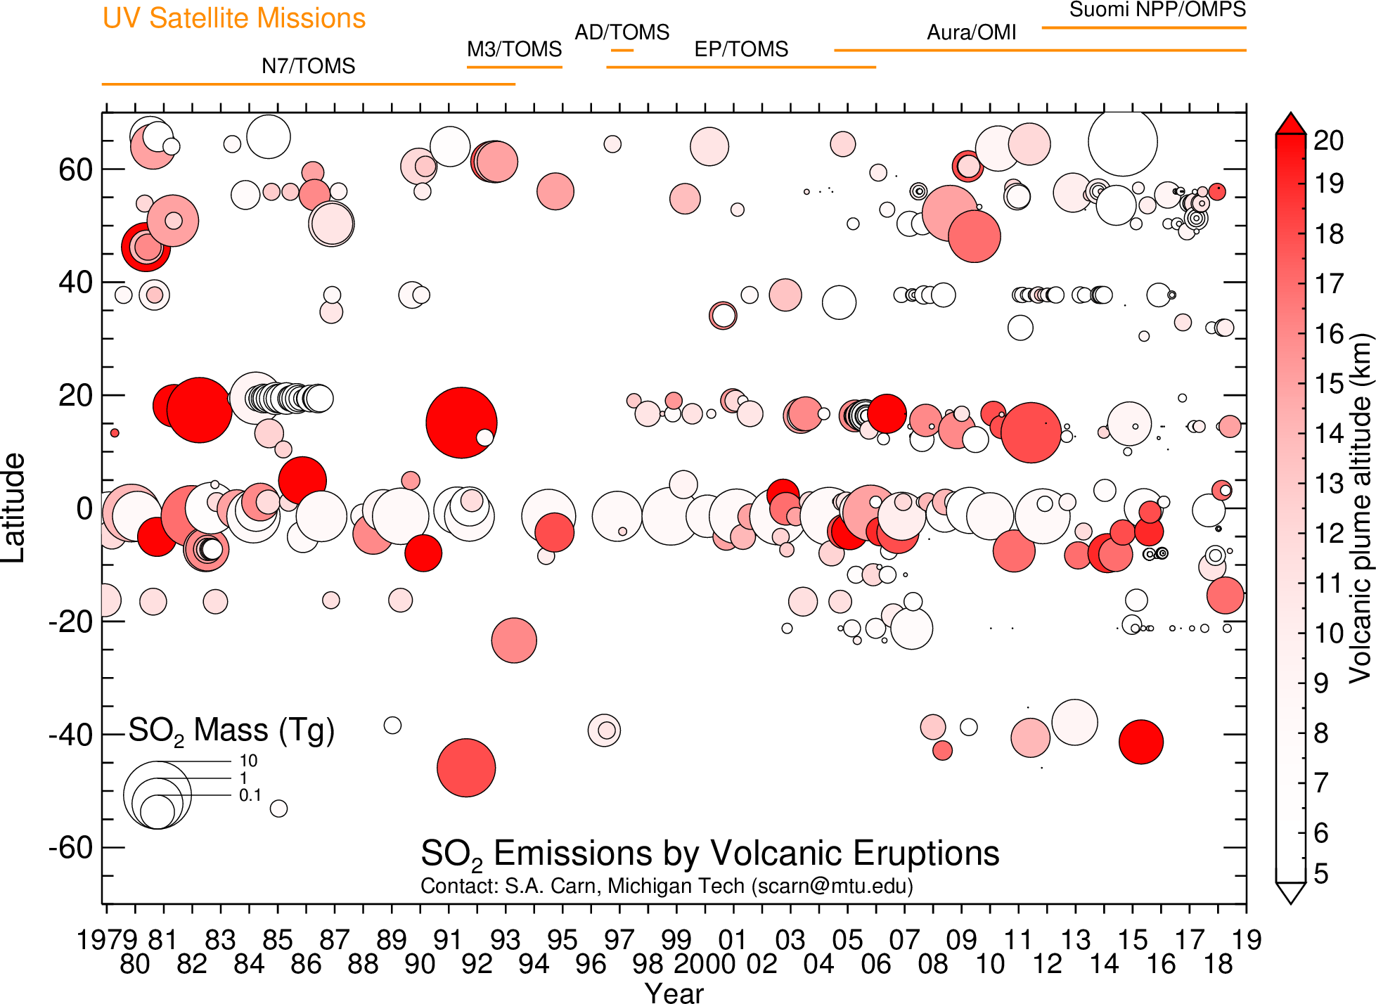
Multi-decadal volcanic SO₂ emissions record

Slide 41
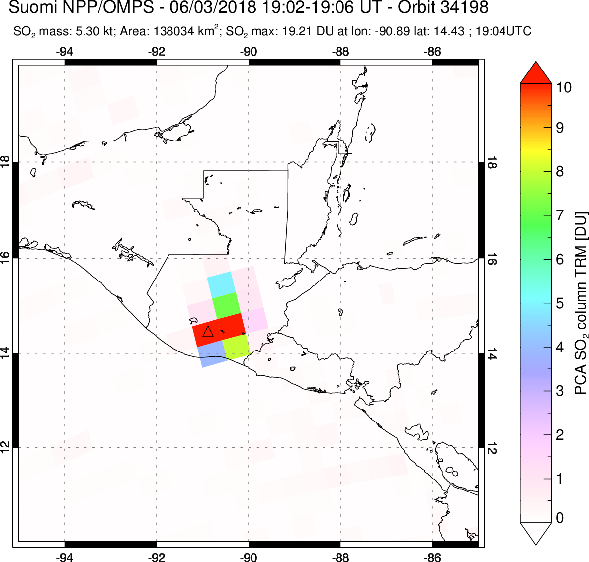








SNPP/OMPS and DSCOVR/EPIC track volcanic SO₂ and ash plumes from June 3 2018 explosive eruption of Fuego volcano
19:02-06 UTC
19:09 UTC
20:14 UTC
21:20 UTC
EPIC SO₂ plume
OMPS SO₂ plume
Sulfur dioxide (SO₂) maps for the June 3 2018 eruption of Fuego volcano (triangle) in 3 consecutive EPIC exposures. Total column SO₂ amount is measured in Dobson Units (1DU = 2.69x10¹⁶ molecules SO₂/cm²).
19:02-06 UTC
19:09 UTC
20:14 UTC
21:20 UTC
EPIC Ash plume
OMPS Ash plume
Positive values of UV Aerosol Index (AI > 3) allow discrimination of volcanic ash clouds from the regular water and ice clouds (AI < 1). Volcanic Ash clouds present danger to aviation and are monitored by Volcanic Ash Advisory Centers.
EPIC higher spatial resolution (20km) than OMPS (50km) reveals higher ash concentrations and hourly evolution.

Slide 42


Tinakula (Solomon Islands)
Oct 20, 2017
Ash cloud

Slide 43


Tinakula (Solomon Is) eruption – Oct 20, 2017
Himawari IR SO₂ index: 20:50 UT
Geolocation error?
~90 mins after 1st eruption at 19:20 UT
F. Prata
UV EPIC retrievals more sensitive to SO₂ in fresh volcanic eruption cloud than IR (Himawari) – even at the ‘limb’

Slide 44




Tinakula eruption – EPIC exposures
Oct 20
22:41 UT
~3h 20m after 1st eruption
13 kt SO₂
Oct 21
00:55 UT
~1h 20m after 2nd eruption
10 kt SO₂
Conclusion: 1st eruption produced most SO₂
Oct 21
02:43 UT
~3h after 2nd eruption
10 kt SO₂
Oct 21
04:31 UT
~4h 50m after 2nd eruption
11 kt SO₂
May 21
02:43 UT
~3h after 2nd eruption

Slide 45


Tinakula eruption – EPIC vs. OMI
EPIC SO₂ retrieval sensitivity should improve with new L1b data in 2018
May 21
02:43 UT
~3h after 2nd eruption

