Slide 1


DSCOVR Science Operations
Marshall Sutton, DSOC Manager, Level 2 Processing
October 17, 2024
Goddard Space Flight Center, Code 586

Slide 3
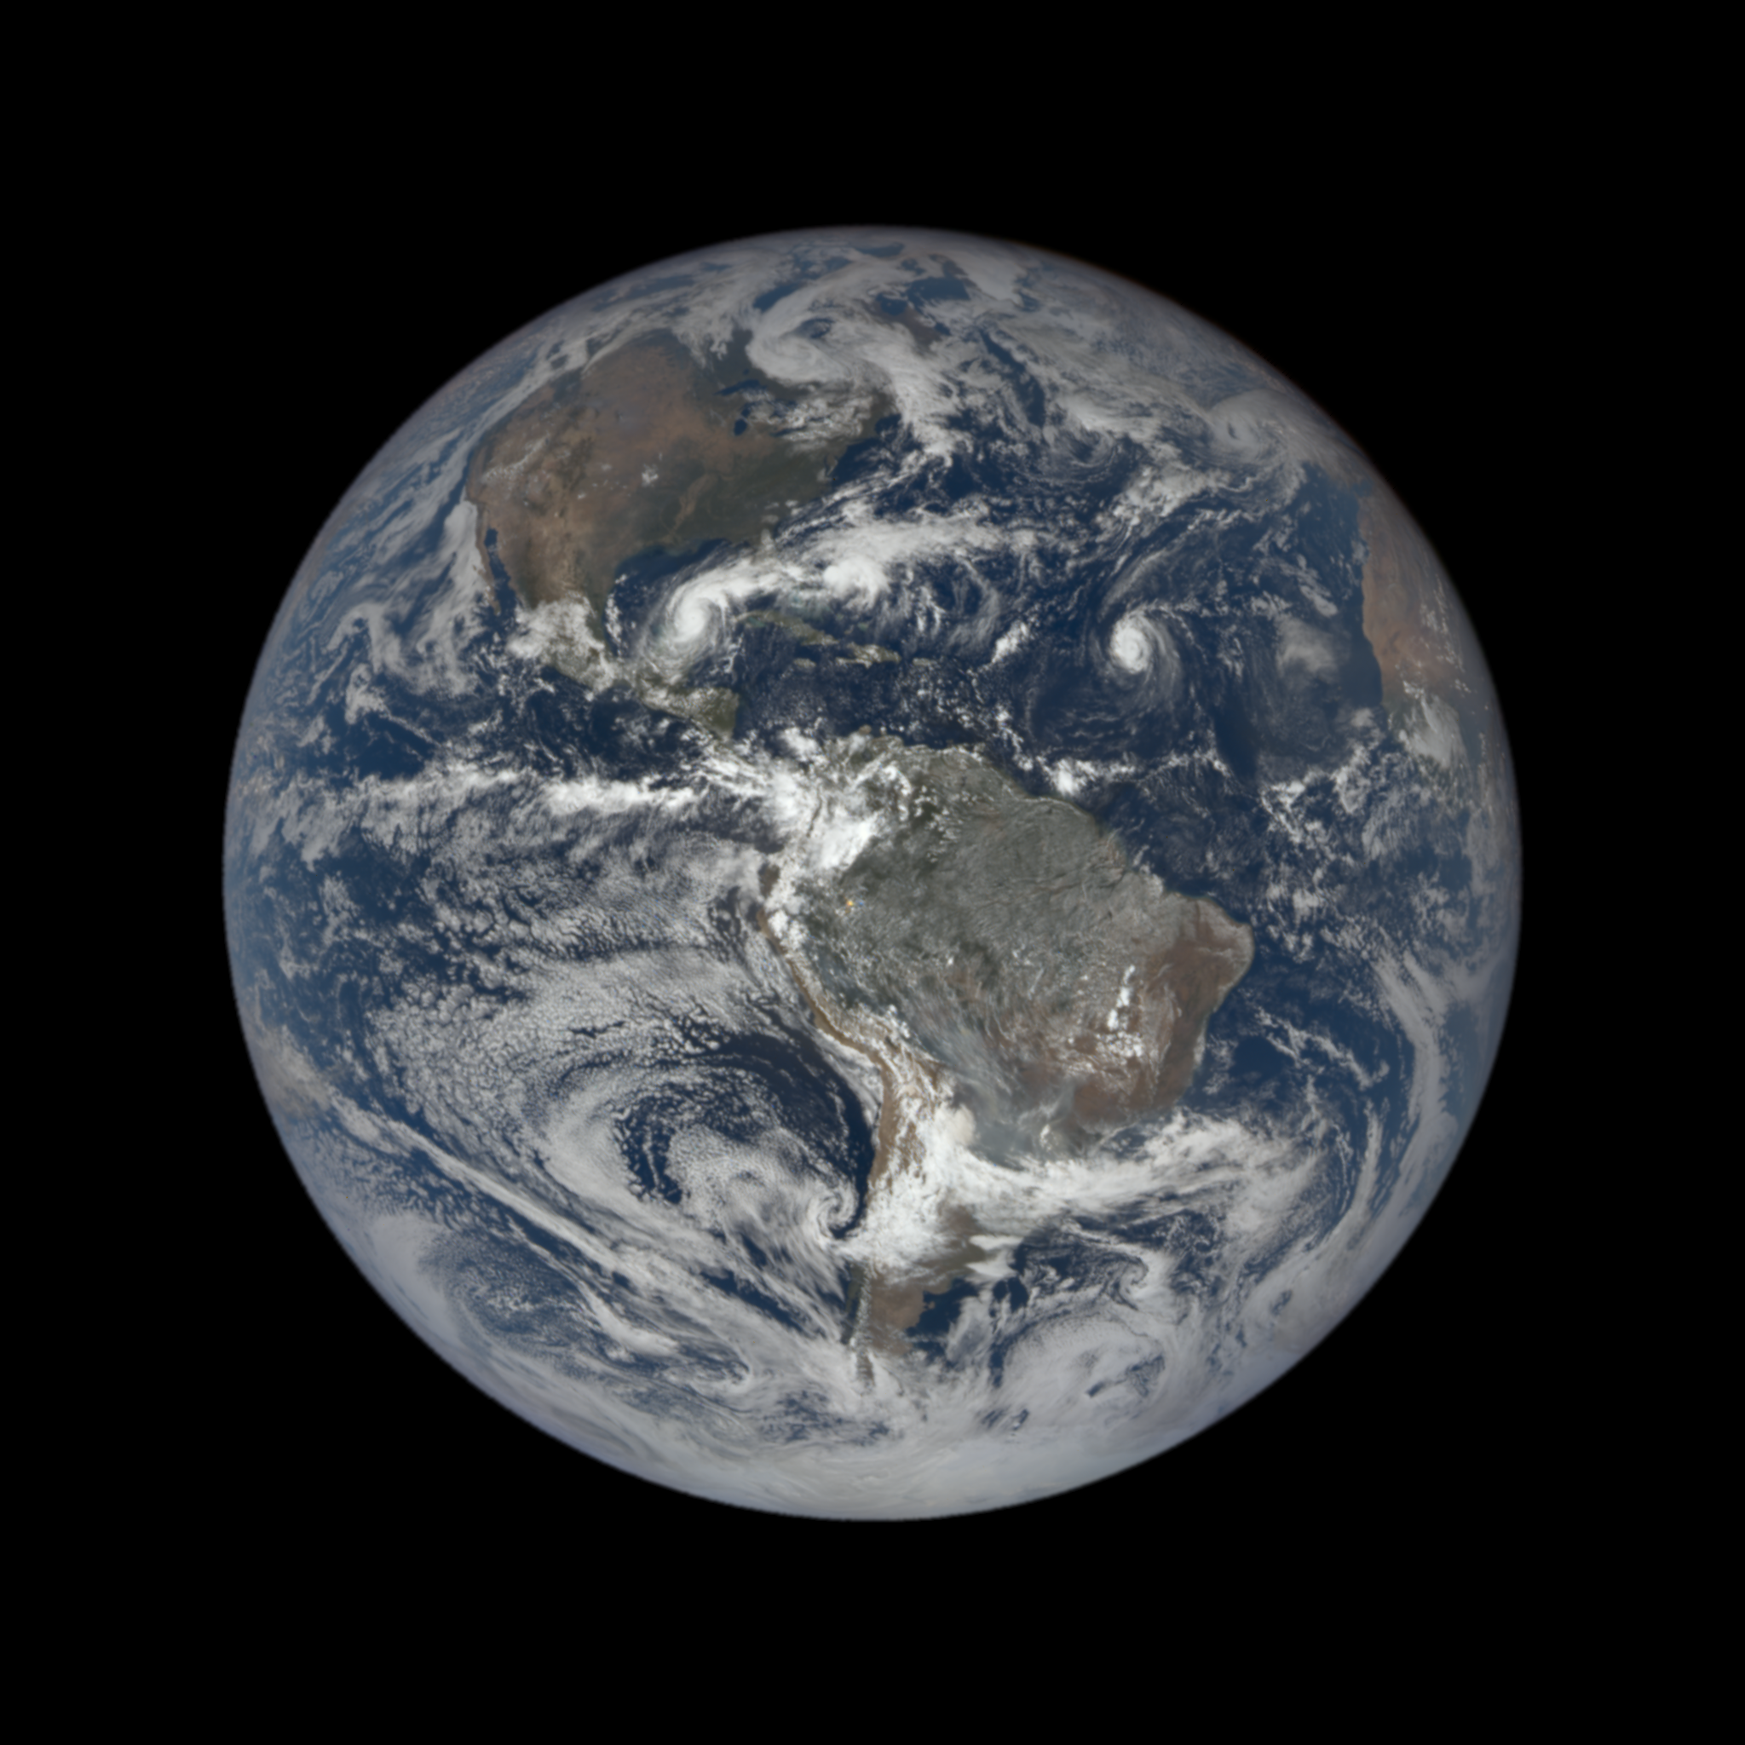
Level 1 Processing
EPIC Level 1 data images of the earth in 10 spectral bands.
Each pixel is geolocated.
Each Image is bundled into HDF5 format.

Slide 4
Level 2 Total Granules Processed

Slide 5
EPIC Level 2 Pipeline
Ancillary Data
(GEOSFPIT, AIRS CO, Merra 2)
NCCS
ASDC Archive
Search.earthdata.nasa.gov
EPIC 1B
Level 2 Products
EPIC Level 2 Science Products (Cloud, Ozone, MAIAC)

Slide 6
EPIC 1B
MAIAC
Aerosol UV
Aerosol UV-Fast
SO2
Cloud
GLINT
VESDR
Tropospheric OZONE
OZONE
O3SO2AI
Ocean Product
EPIC Level 2 dependencies
Future work: Incorporate dependencies into pipeline.

Slide 7
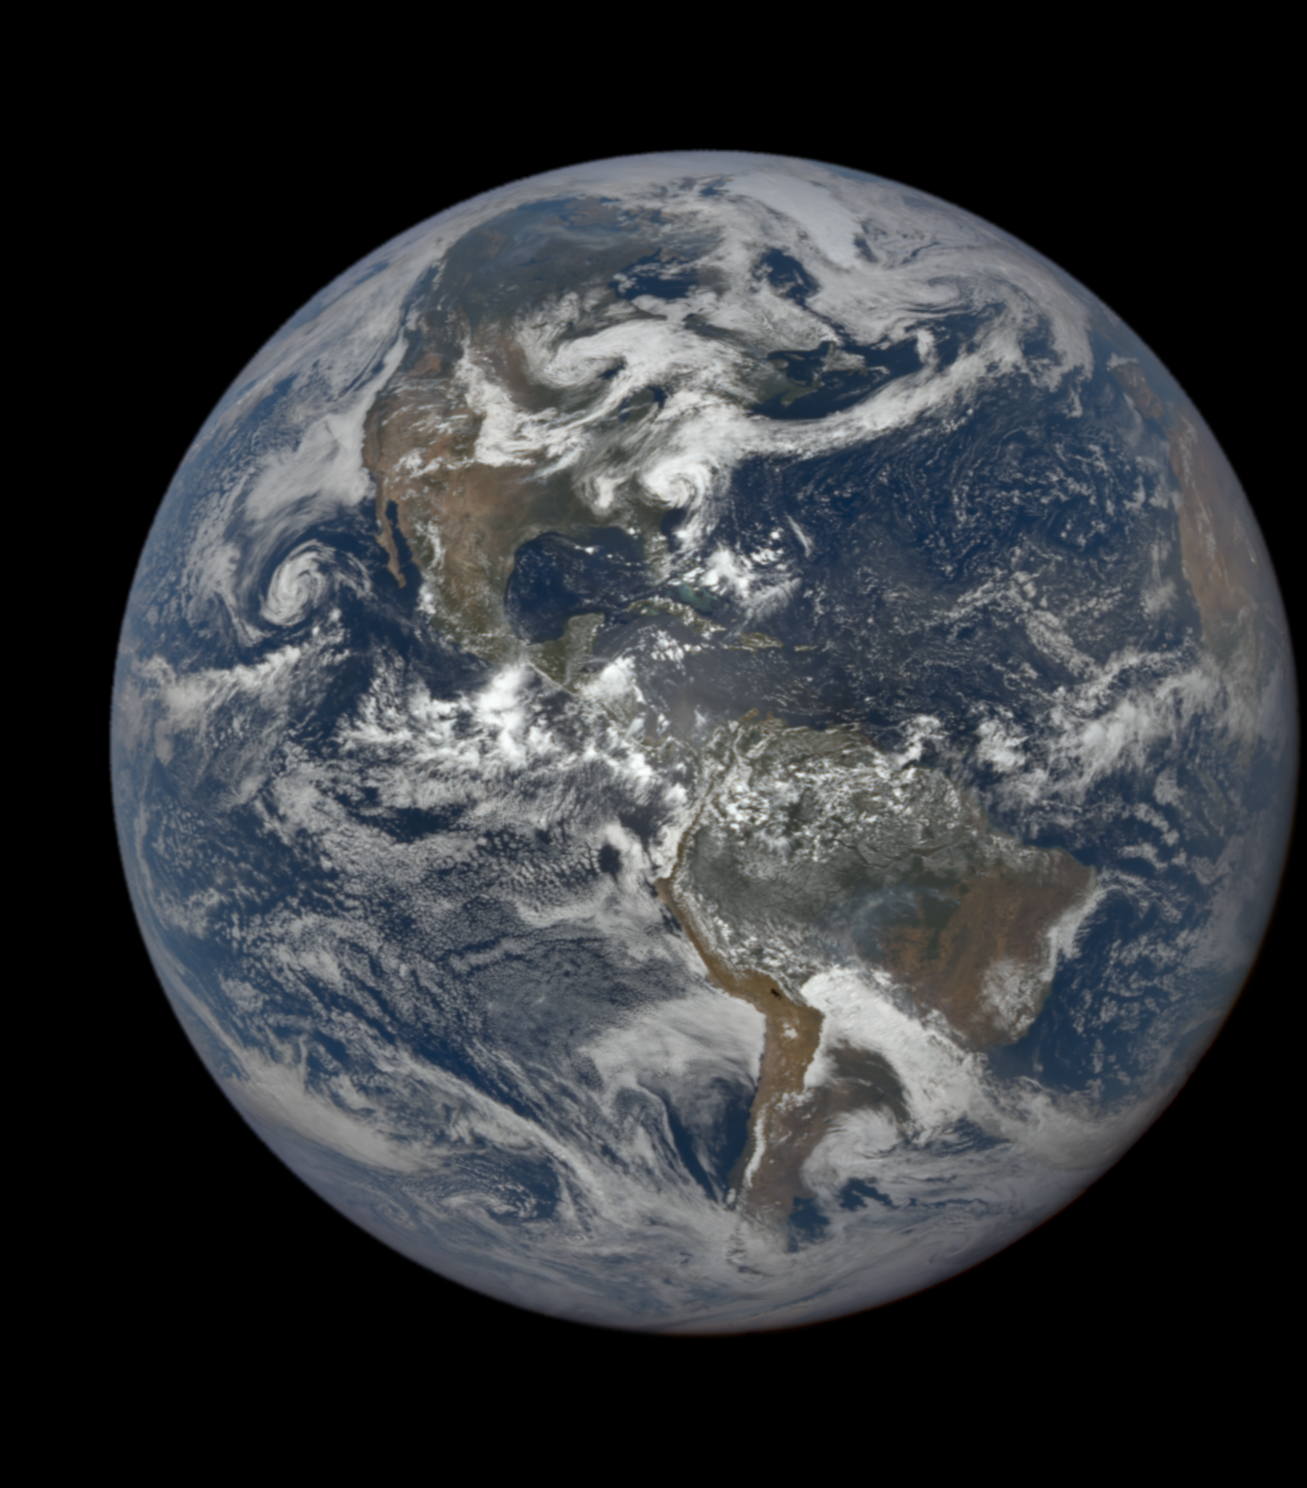

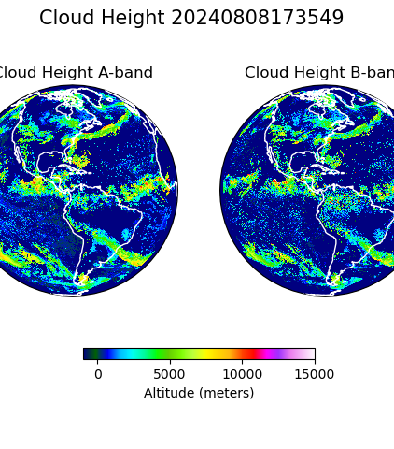
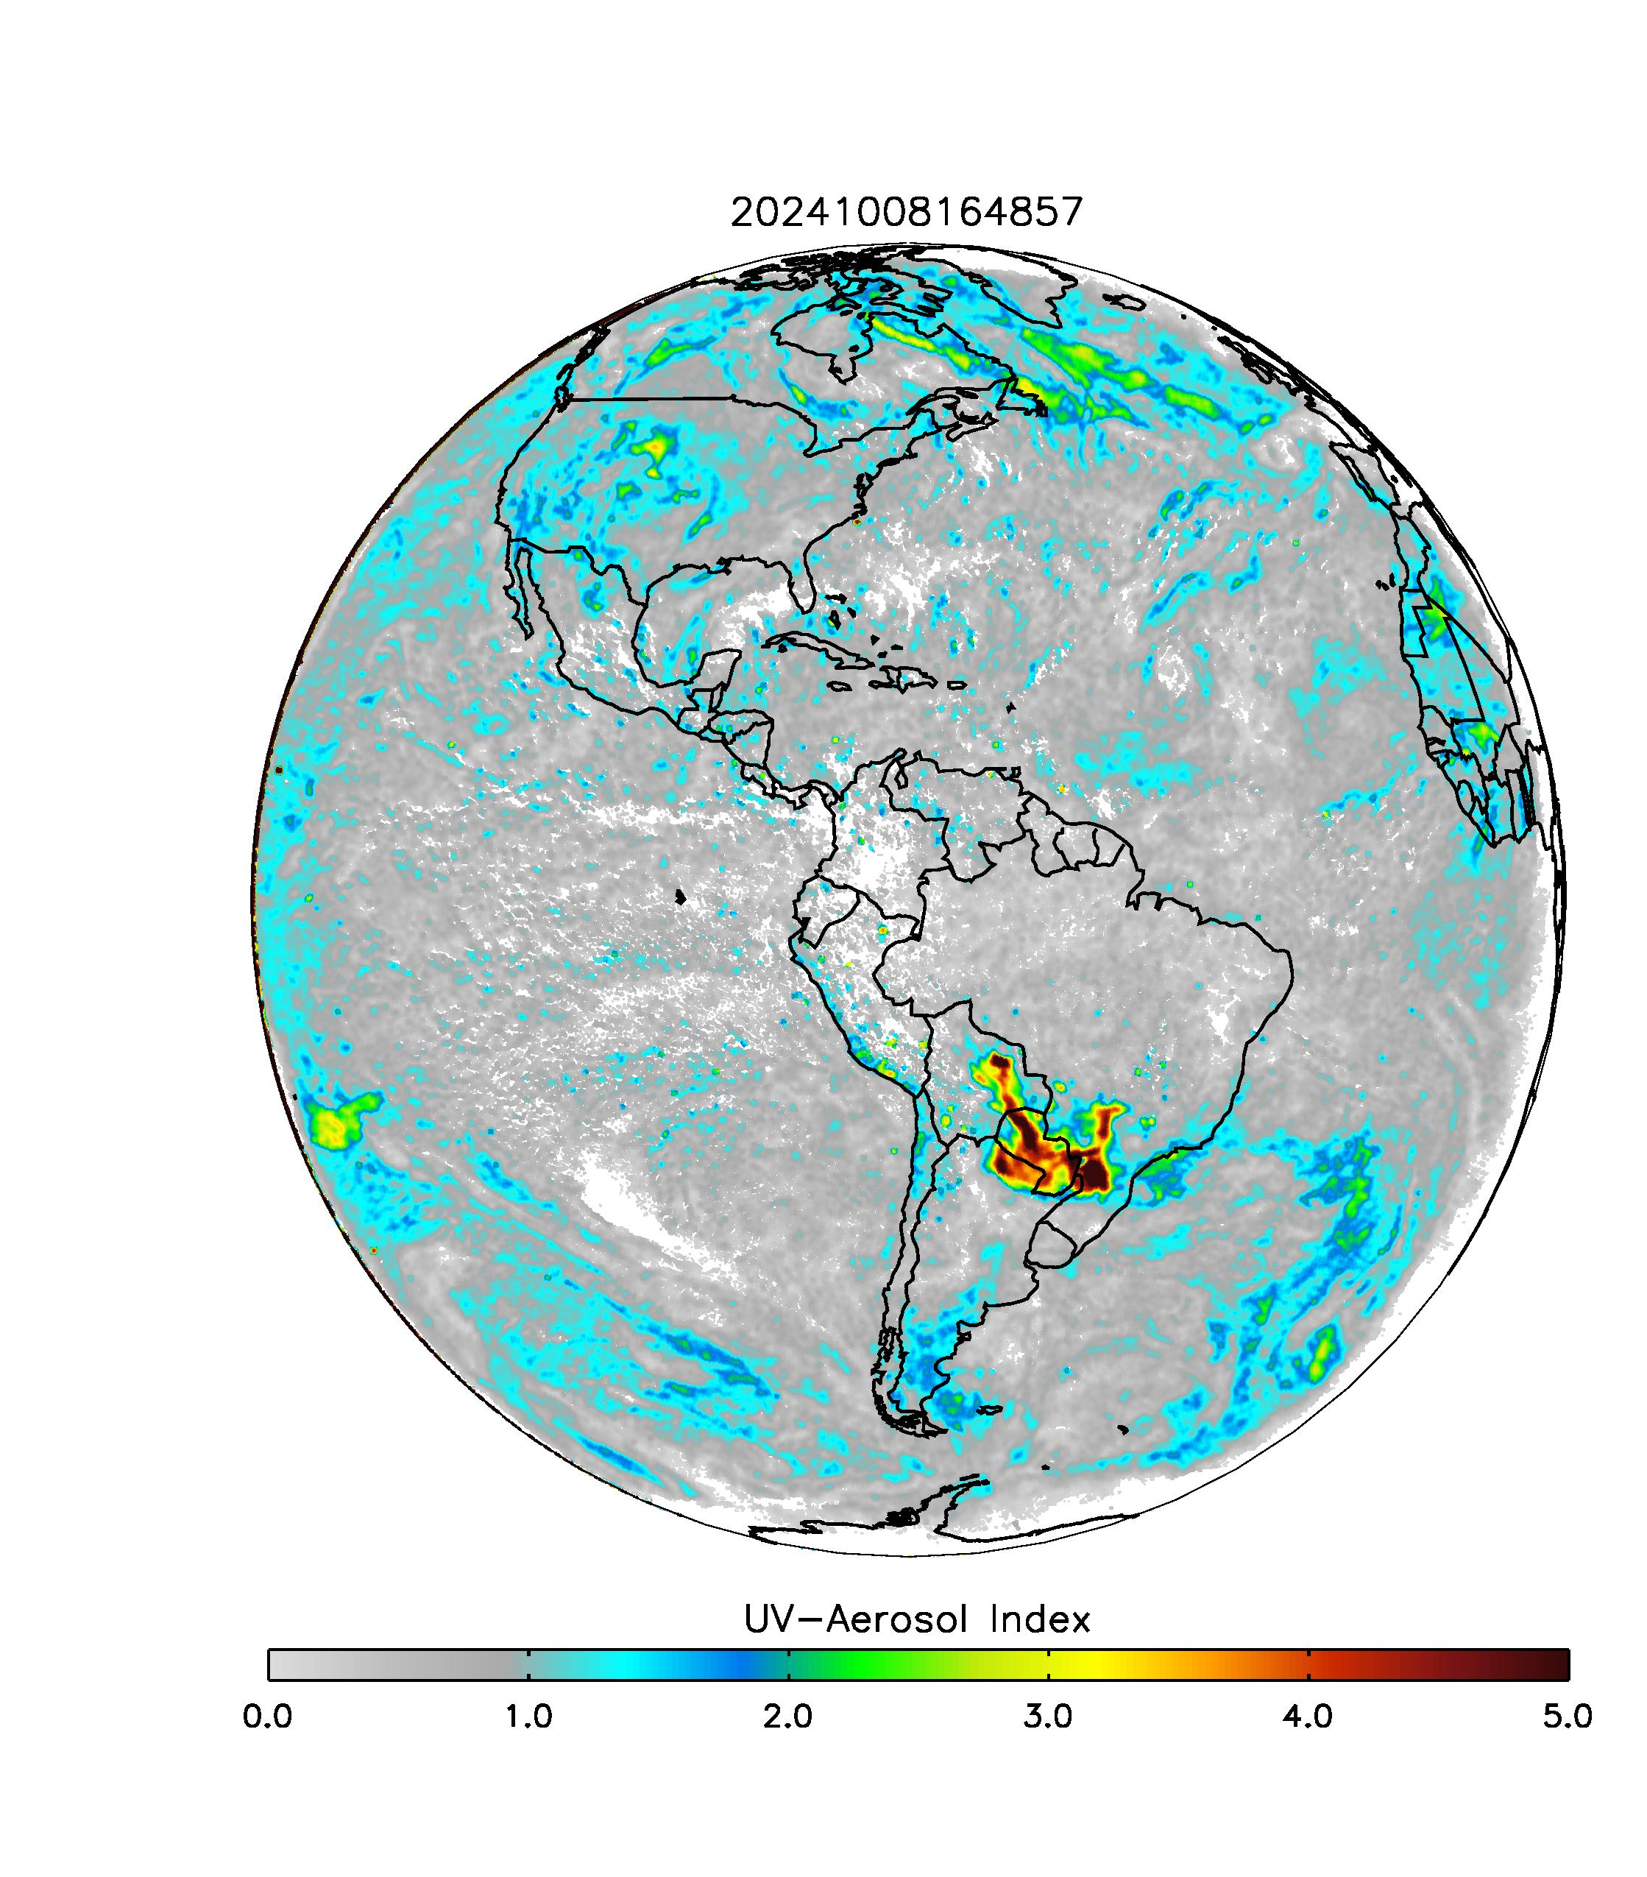
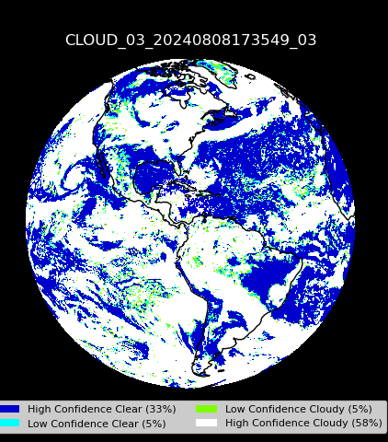
Daily images
Upcoming products:
MAIAC Daily
Aerosol Centroid Height
Ozone, LER
Epic.gsfc.nasa.gov

Slide 8
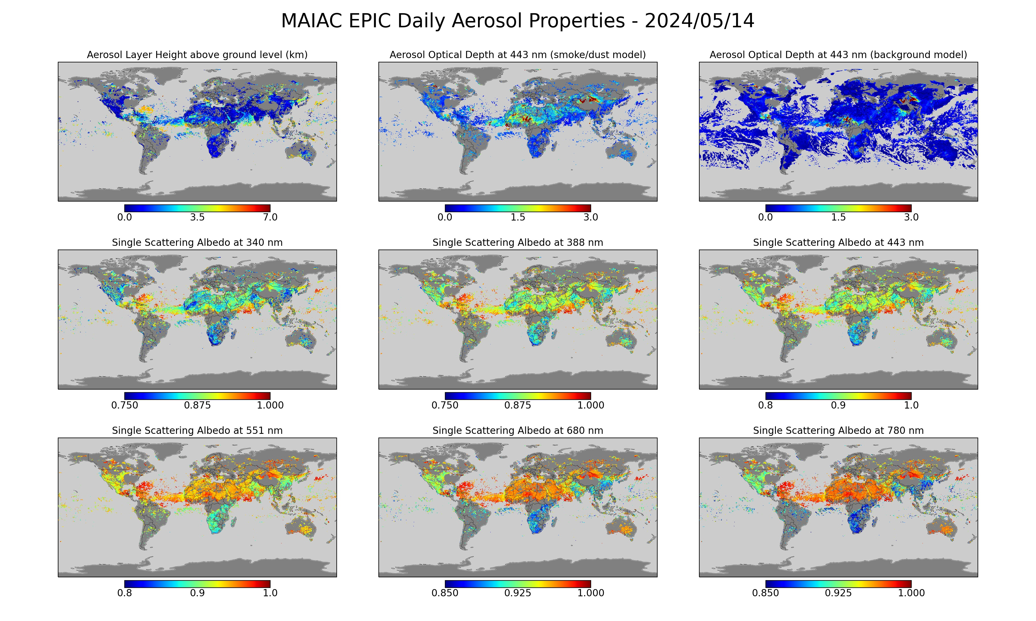

Slide 9
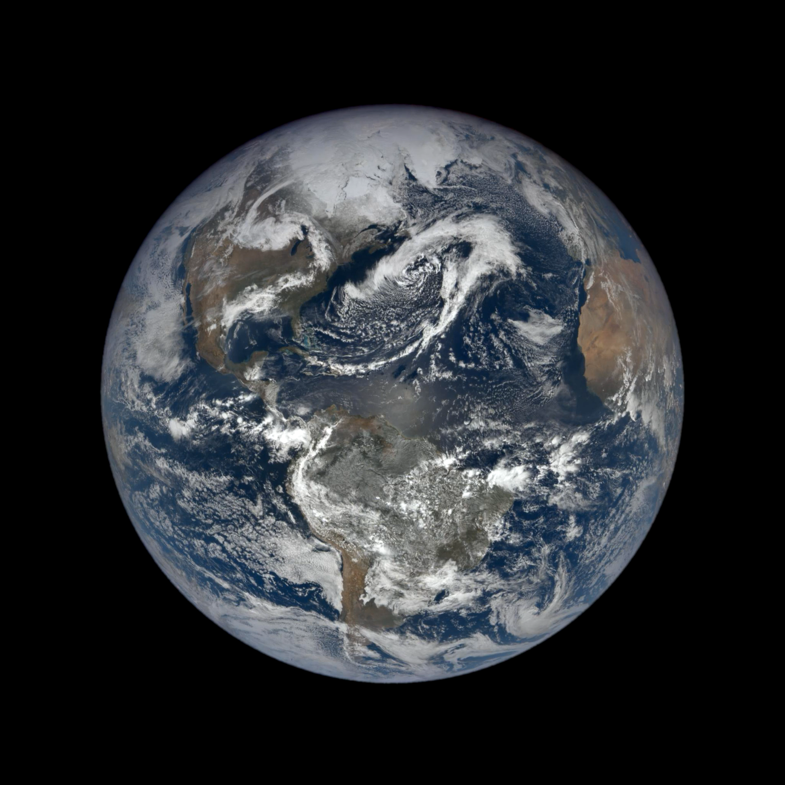
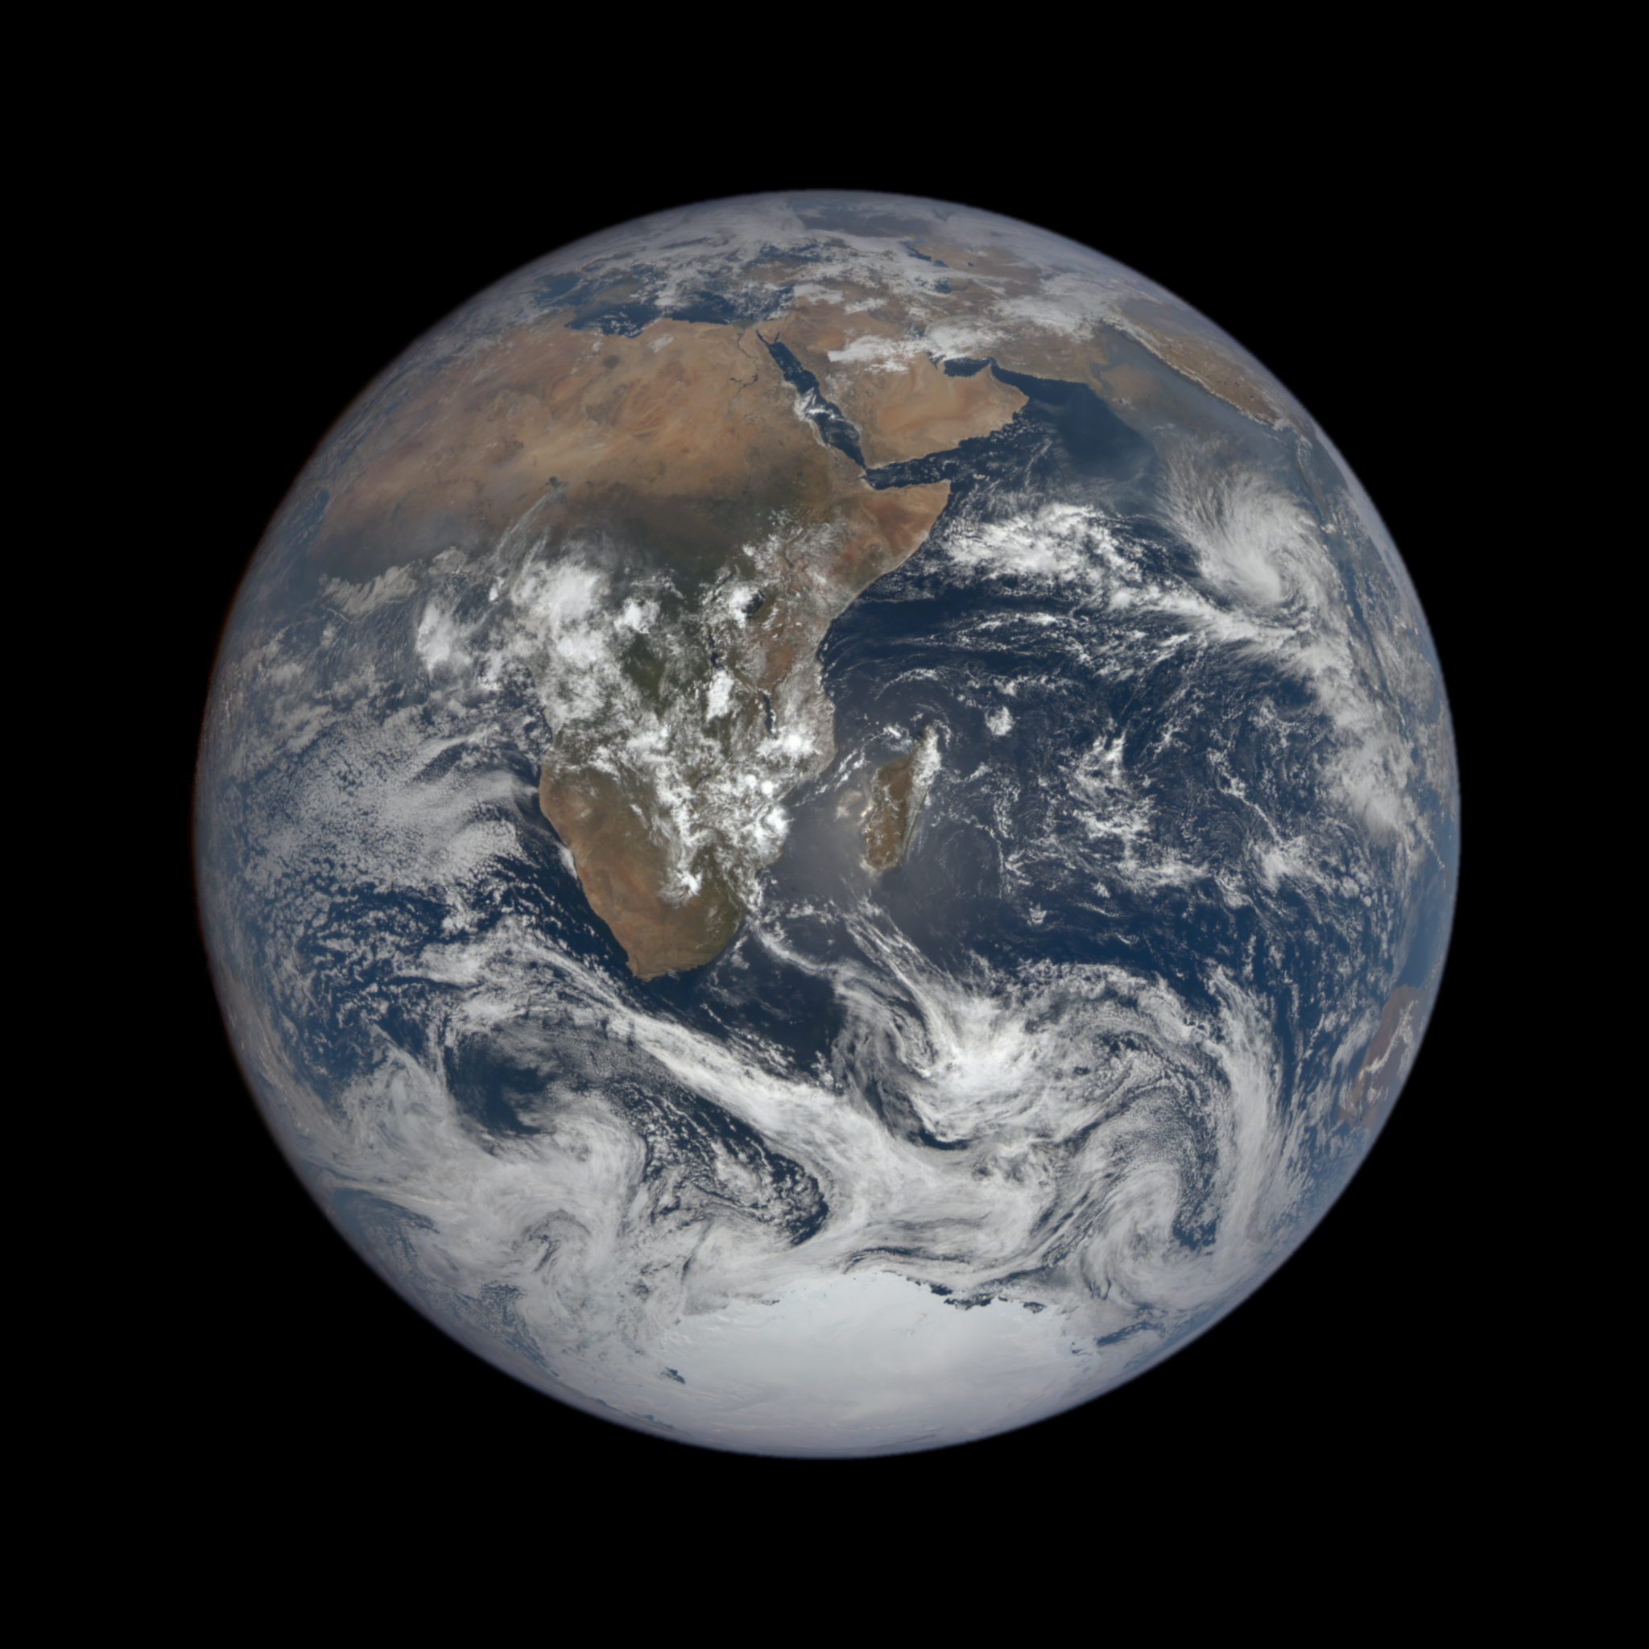
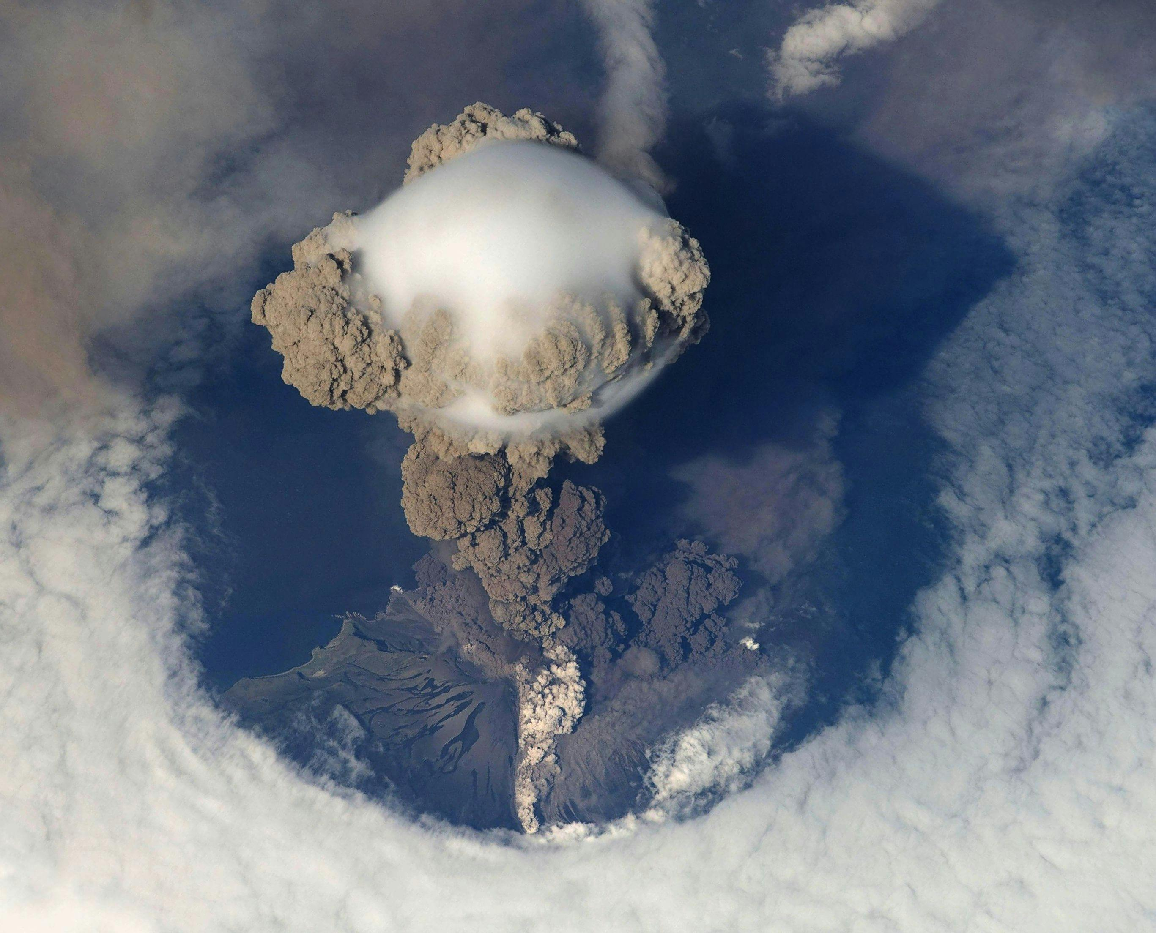
Special imaging
Dark space calibrations
Lunar Calibrations
Blue Marble
Eclipse imaging
High cadence imaging for volcanic eruptions
Gallery on EPIC webpage: https://epic.gsfc.nasa.gov/galleries

Slide 10

NCCS updates and future
DISCOVER Nodes
Scalable Unit 17 – CPU-only Nodes
90,112 AMD Milan EPYC processor cores
2 64-core processors per node
512 GB of memory per node
2.0 GHz AMD Milan EPYC
Interconnect: HDR100 Infiniband 100 Gbps
Production: 4Q 2023
CSS Storage (contains EPIC 1b, Cloud, Merra2)
Login Nodes
Cron Nodes
Sftp, curl
Conversion to Cloud systems?
AWS, Azure
Increase in availability
Better access to ancillary data
ASDC, Other DAACs

Slide 11
Accomplishments and Challenges
Converted pipelines to MILAN nodes.
Added MAIAC Daily product, Cloud Height.
~47k granules produced and uploaded to ASDC.
AER Fast Pipeline is broken.
Enhanced images are reliant on Python 2.7.
NISTAR processing and ingest.

Slide 12
Questions?

