Slide 1
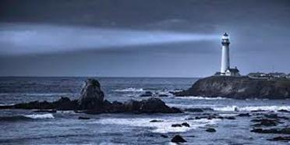
Aerosol Layer Height and Spectral Absorption: v3 MAIAC EPIC
Alexei Lyapustin (NASA GSFC)
Myungje Choi (UMBC), Yujie Wang (UMBC), Sujung Go (UMBC), Sergey Korkin (UMBC)
Notes:
- Project full name

Slide 2
v3 MAIAC EPIC Overview
MAIAC v3 includes:
  i) standard processing (aerosol retrieval with climatological regional aerosol models and atmospheric correction),
  ii) advanced aerosol retrieval and speciation algorithm (smoke and dust; land and ocean)
Products (standard algorithm):
  CM, AOD_{0.44}, QA, spectral BRF, NDVI, and BRDF model parameters over land;
  AOD-FMF-AE, water leaving reflectance over ocean;
Products (4D algorithm based on UV-Vis-NIR):
  AOD, refIM(λ), and ALH for smoke and dust (+ SSA 340, 388, 550, 680, 780nm)
  Speciation information on main absorbers for smoke (Black carbon/Brown carbon) and dust (Hematite/Goethite) – volume fraction and mass concentration
1. Lyapustin A, Wang Y, Go S, Choi M, Korkin S, Huang D, Knyazikhin Y, Blank K and Marshak A (2021) Atmospheric Correction of DSCOVR EPIC: Version 2 MAIAC Algorithm. Front. Remote Sens. 2:748362. doi: 10.3389/frsen.2021.748362.
2. Lyapustin A., Go S., Korkin S., Wang Y., Torres O., Jethva H. and Marshak A. (2021) Retrievals of Aerosol Optical Depth and Spectral Absorption From DSCOVR EPIC. Front. Remote Sens. 2:645794. doi: 10.3389/frsen.2021.645794.
3. Go, S., Lyapustin, A., Schuster, G. L., Choi, M., Ginoux, P., Chin, M., Kalashnikova, O., Dubovik, O., Kim, J., Silva, A. D., Holben, B., and Reid, J. S.: Inferring iron-oxide species content in atmospheric mineral dust from DSCOVR EPIC observations, Atmos. Chem. Phys. doi: 10.5194/acp-22-1395-2022.
4. Choi, M., A. Lyapustin, Schuster, G. L., ... & Moosmüller, H. (2024). Light-absorbing black carbon and brown carbon components of smoke aerosol from DSCOVR EPIC measurements over North America and central Africa. Atmos. Chem. Phys., 24(18), 10543-10565.
5. Lyapustin, Choi et al., Aerosol Height and Spectral Absorption form DSCOVR EPIC: MAIAC v3 Algorithm (in preparation)

Slide 3
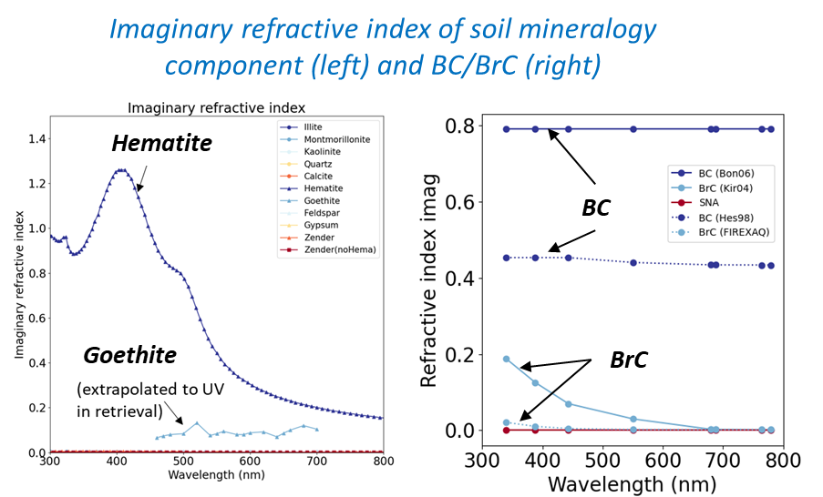
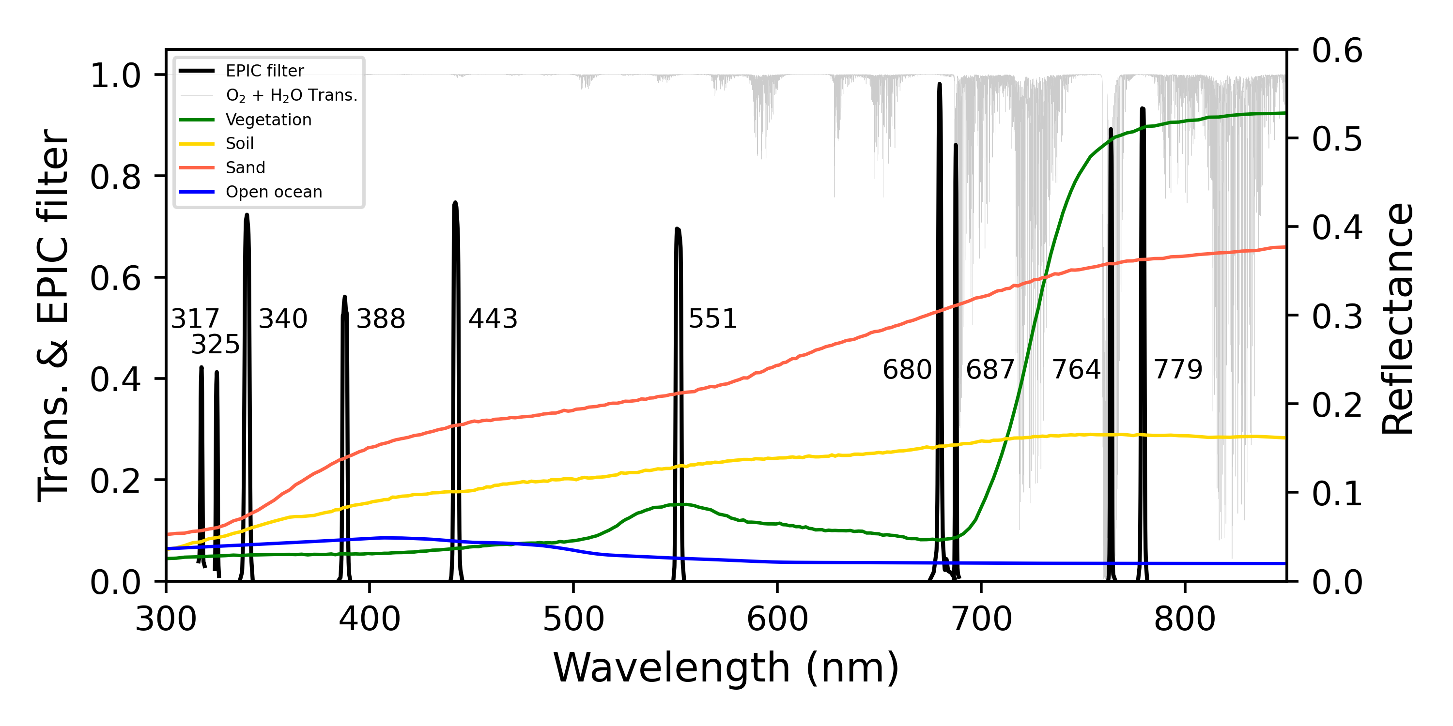
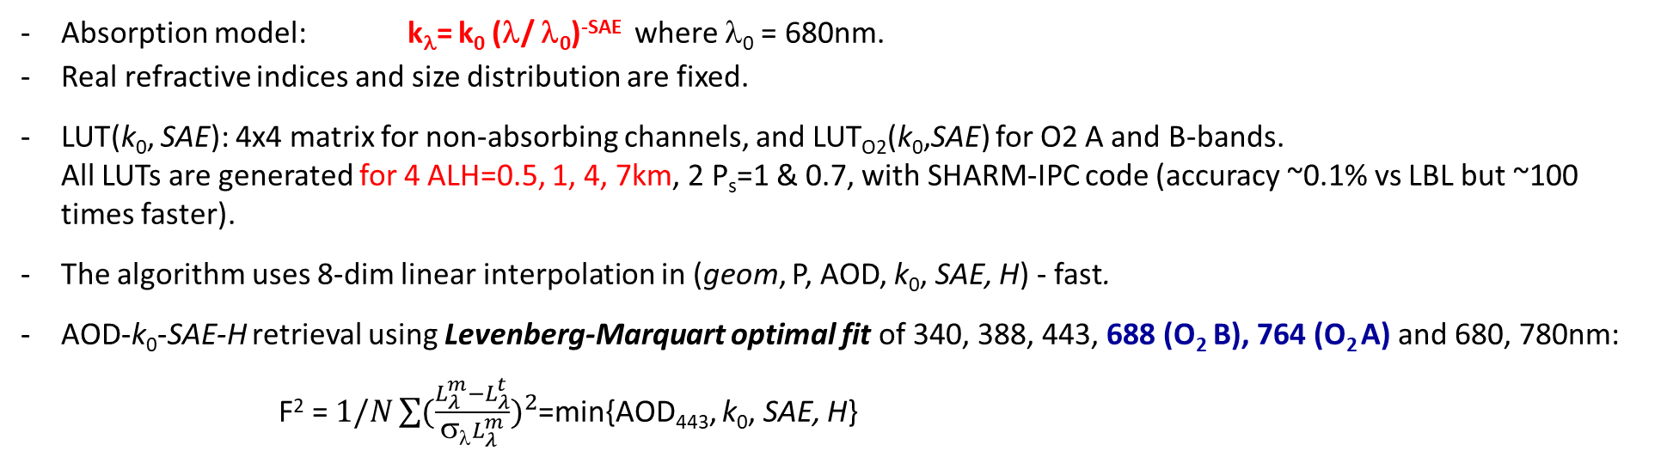
v3 Algorithm (AOD-k₀-SAE-ALH)
Absorption model: k_{λ}= k₀ (λ/ λ₀)^{-SAE} where λ₀ = 680nm.
Real refractive indices and size distribution are fixed.
LUT(k₀, SAE): 4x4 matrix for non-absorbing channels, and LUT_{O2}(k₀,SAE) for O2 A and B-bands.
All LUTs are generated for 4 ALH=0.5, 1, 4, 7km, 2 P_{s}=1 & 0.7, with SHARM-IPC code (accuracy ~0.1% vs LBL but ~100 times faster).
The algorithm uses 8-dim linear interpolation in (geom, P, AOD, k₀, SAE, H) - fast.
AOD-k₀-SAE-H retrieval using Levenberg-Marquart optimal fit of 340, 388, 443, 688 (O₂ B), 764 (O₂ A) and 680, 780nm:
F² = $1/N\sum{({\frac{L_{λ}^{m}−L_{λ}^{t}}{σλL_{λ}^{m}})}^{2}}$=min{AOD₄₄₃, k₀, SAE, H}
Notes:
(UV+Oxygen channels physical explanation would be interesting)
(Simultaneous retrieval of AOD-k0-SAE-H,)
EPIC is a satellite instrument, located at Lagrangian 1 (L1) point between the Earth and the Sun. It observes the sunlit side of the Earth every 1-2 hours across the near-UV (340, 388nm) to near-infrared (IR) spectrum with a spatial resolution of about 16km since 2015. AND(Also, Furthermore!!!!!!!!(more educated, polished)) we adopted the MAIAC aerosol retrieval algorithm for the EPIC instruments.
As an algorithm theoretical background, the recently developed advanced 4D aerosol retrieval algorithm use
Exponential absorption model with fixed real refractive index and size distribution.
The LUTs are consists of dimension of geometry, surface pressure, AOD, imaginary refractive index at 680nm, Spectral Absorption Exponent, and Aerosol Layer Height (above Sea-level).
Finally, for the inversion, optimal estimation and Maxwell-Garnett effective medium approximation’s are used for 4D-retrieval and speciation retrieval, respectively.
;;----------------------------------------------------------------------------------------------------------------------(EXTRA)
Why sigma?????-spectral weight
(different combination test – land/ocean, step1,2/region)

Slide 4
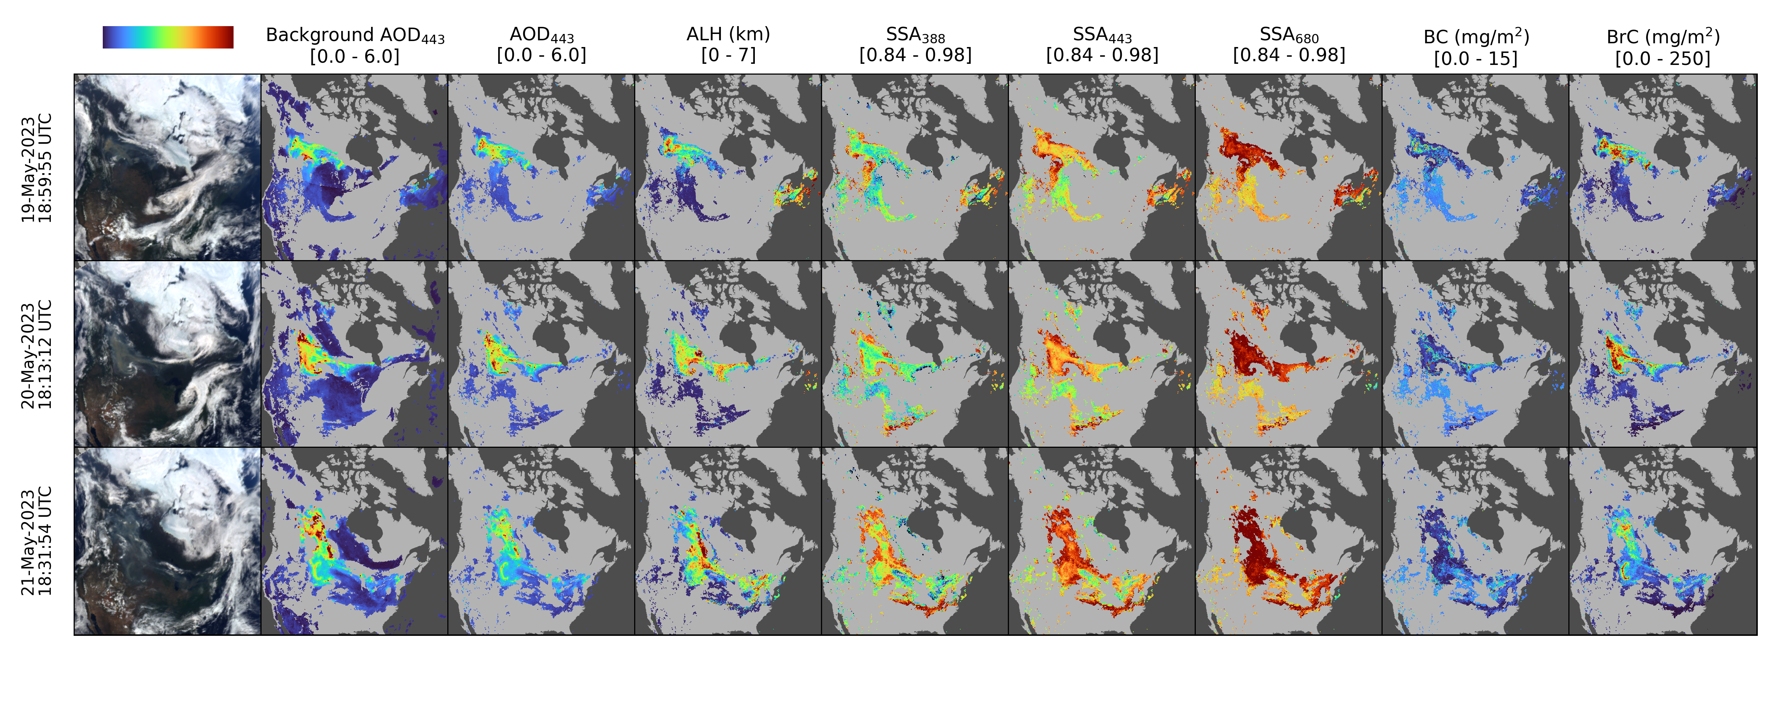
Example of Products
Continental-scale transport of heavy smoke from northwestern Canada wildfires for May 19-21, 2023.
Smoke reached altitudes of up to 7 km and exhibited strong spectral absorption in the UV-Vis range, revealing a significant presence of brown carbon (BrC).

Slide 5
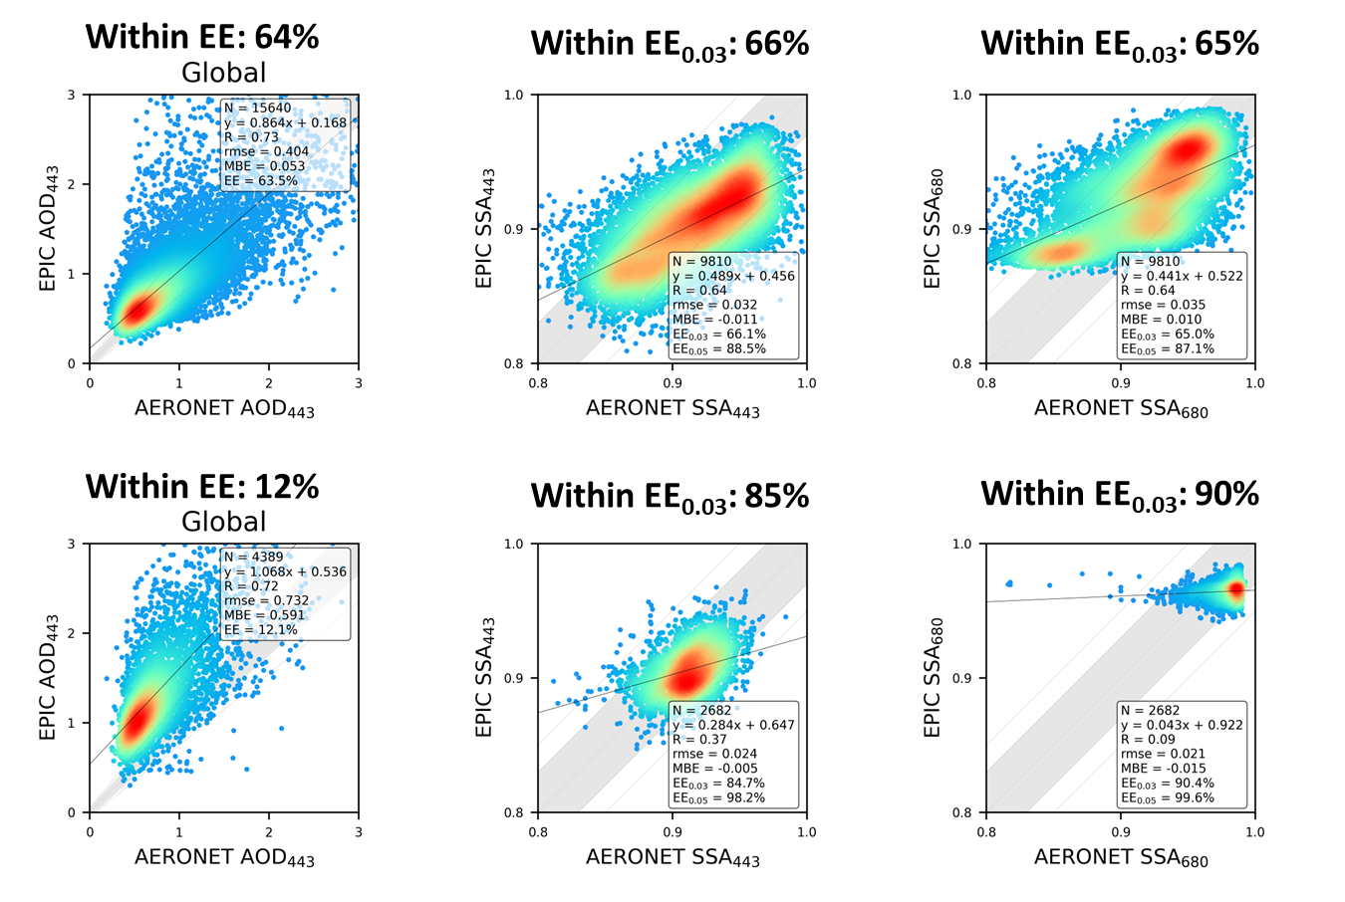
Algorithm Tuning and Validation (2015-2023)
Previous:
August 2024
Smoke
Dust
EE range of AOD: ±(0.2 × AERONET AOD + 0.05)
EE range of SSA: ±(AERONET SSA + 0.03 (or ±0.05)); only when AERONET AOD > 0.6
Notes:
(Great Spectral Aerosol Absorption) – don’t even mention the AOD.

Slide 6
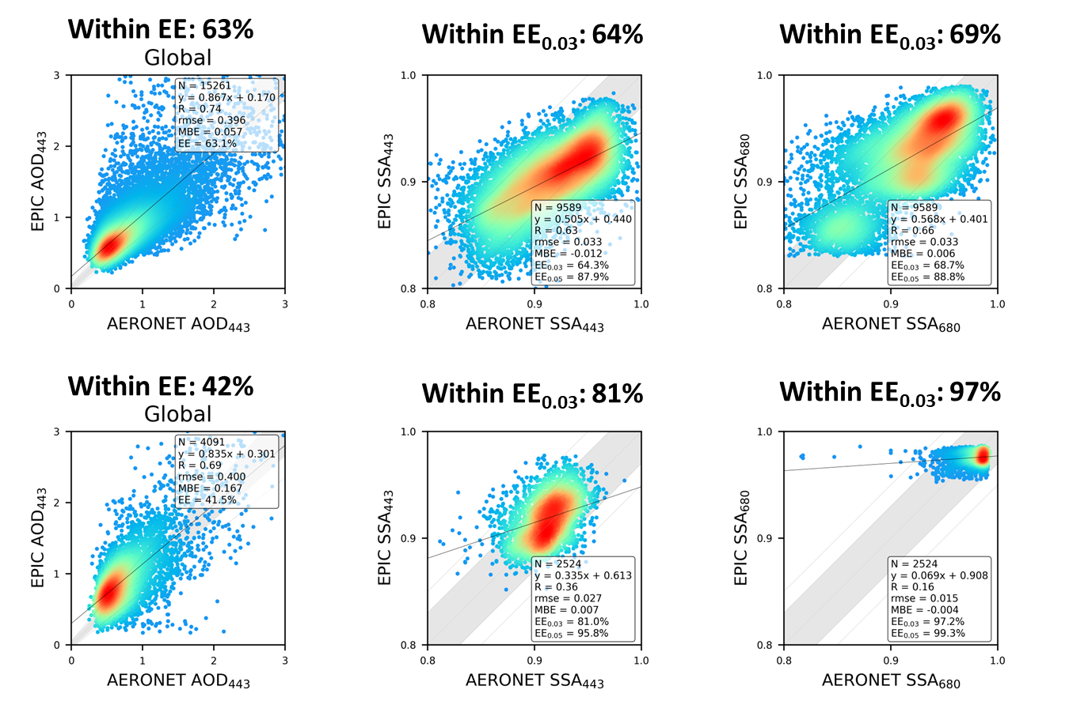
Algorithm Tuning and Validation (2015-2023)
Latest:
9/29/2024
Smoke
Dust
EE range of AOD: ±(0.2 × AERONET AOD + 0.05)
EE range of SSA: ±(AERONET SSA + 0.03 (or ±0.05)); only when AERONET AOD > 0.6
Notes:
(Great Spectral Aerosol Absorption) – don’t even mention the AOD.

Slide 7
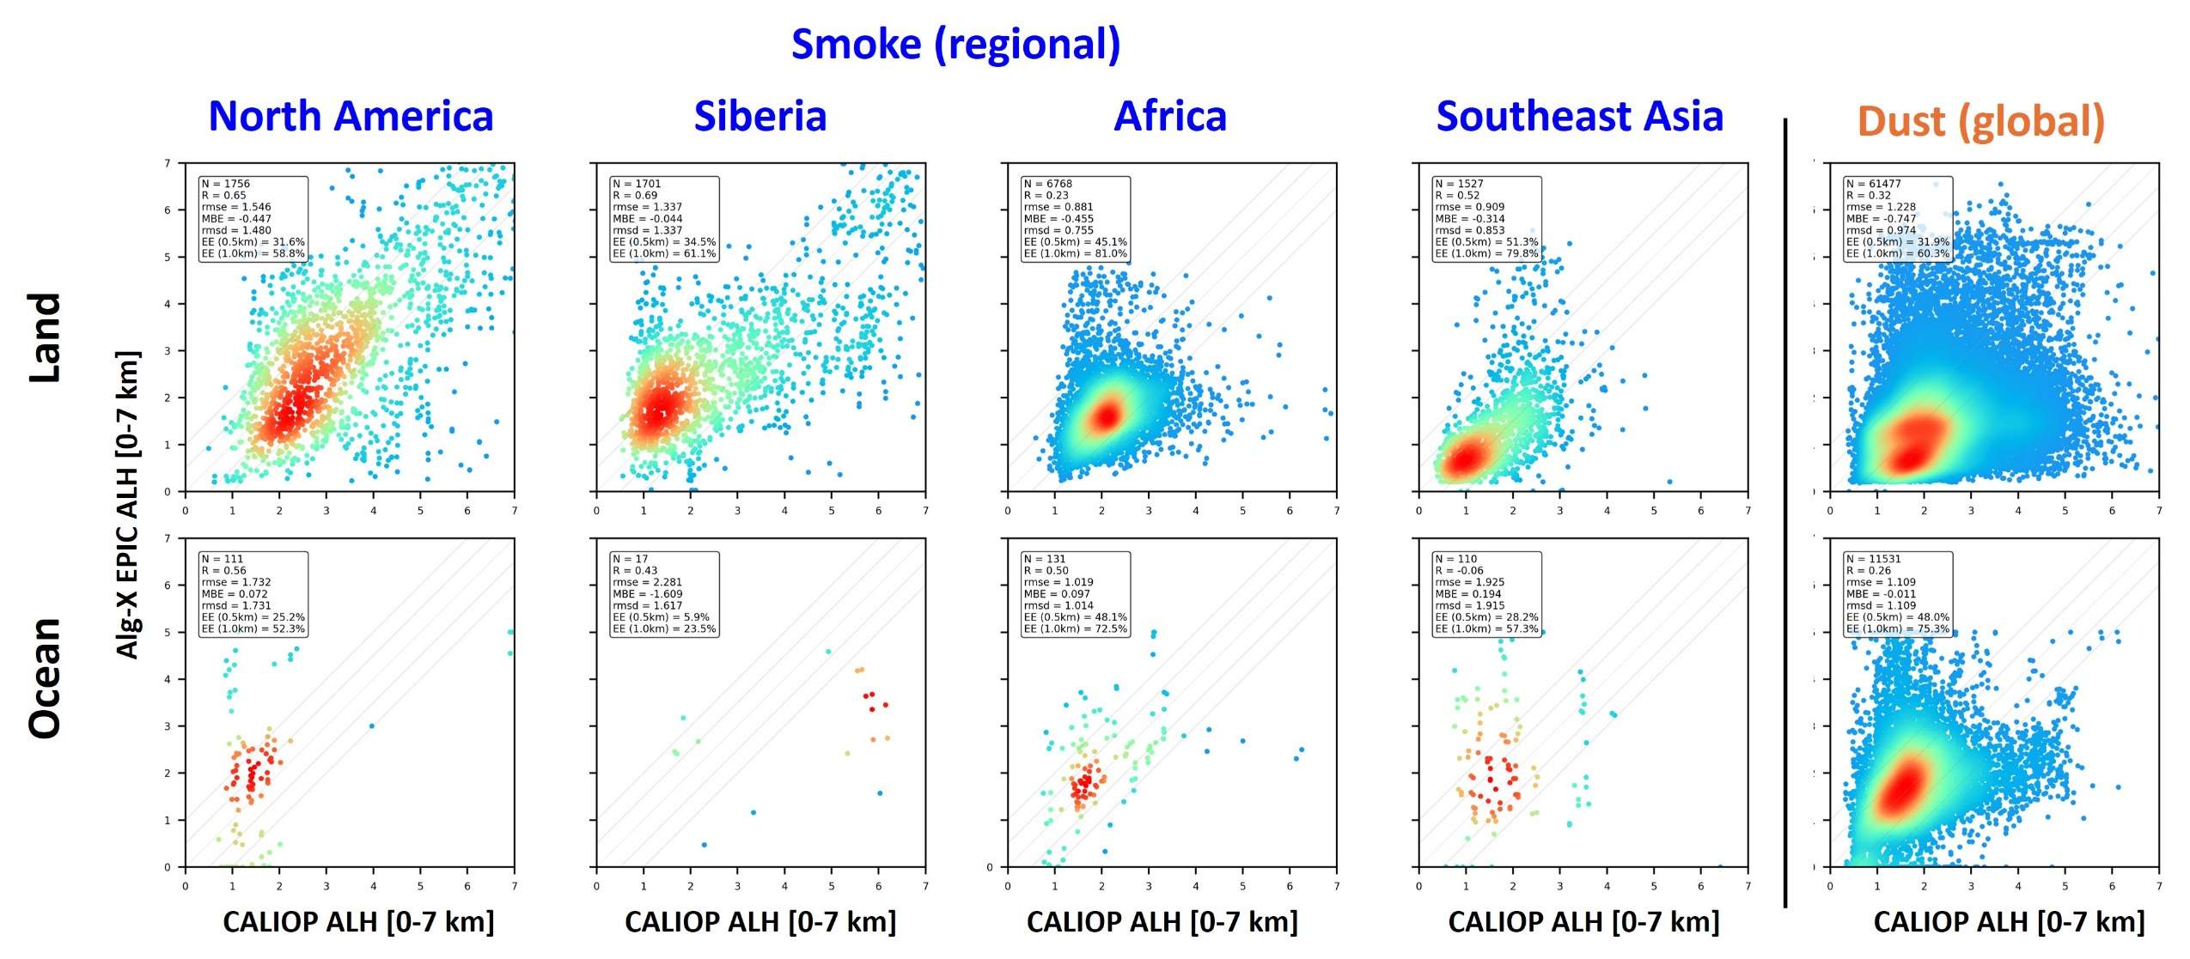
ALH Validation Against CALIOP (2015-2023)
MAIAC ALH [0-7km]
CALIOP: Backscatter-weighted height.
Collocation when CALIOP AOD > 0.6; ±30min from EPIC
Bias land: -450m (smoke); -750m (dust)
Bias ocean: No
RMSE: ~1.1km
Notes:
Presently, Now this slide shows (demonstrates) the “Validation results of MAIAC EPIC Aerosol Layer Height using CALIOP” datasets.
The upper panel represents Land, the lower panel represents Ocean, and each panel displays the accuracy for each continental region for smoke, on the left side, and for dust, on the right side.
Across all continents, ALH (Aerosol Layer Height) values of at least 56% of the collocated data points were within 1km difference against CALIOP.
In the case of the Ocean, although there are fewer data points compared to Land, over 59% of ALH values showed errors within 1km of CALIOP.
This is a highly encouraging result. Also, I bet this is the best Aerosol Layer Height accuracy among the existing operational algorithm products.

Slide 8
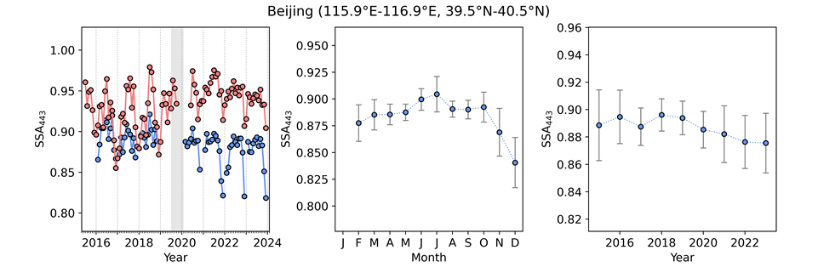
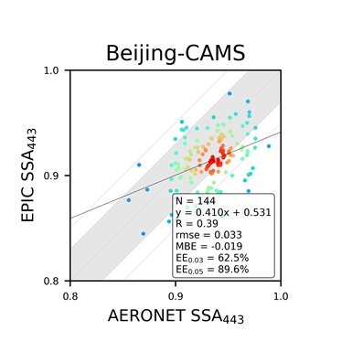
Limitations: MAIAC EPIC
Large footprint (16km nadir)
Lack of NIR – SWIR and thermal channels
Backscatter view geometry minimizing aerosol vs surface signal
Assumption of size distribution and real refractive index
Assumption of pure aerosol types (smoke or dust)
Limited cloud detection

Slide 9
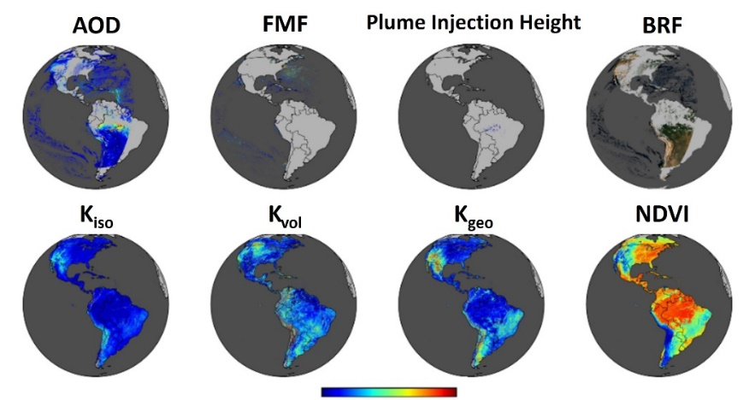
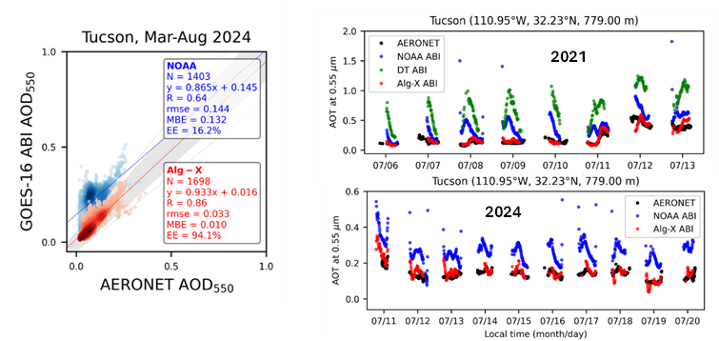
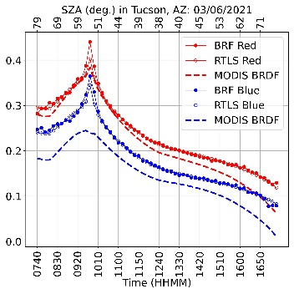
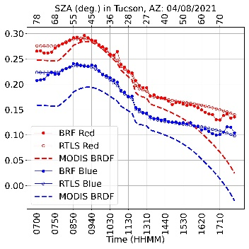
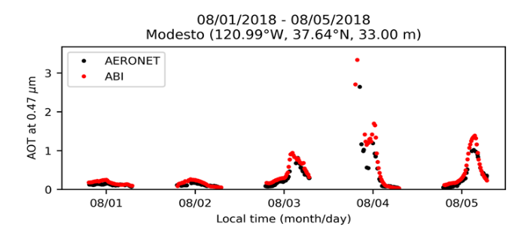
Limitations: MAIAC GOES-ABI
Footprint (~1-2 km)
Very good cloud/shadow/snow detection & surface knowledge
Only Blue, Red and SWIR bands for AOD retrieval over land
Assumption of size distribution and complex refractive index
Assumption of pure aerosol types (smoke or dust)
GeoNEX
MAIAC
MAIAC
MAIAC

Slide 10
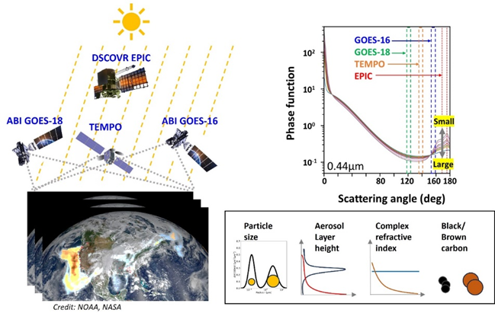
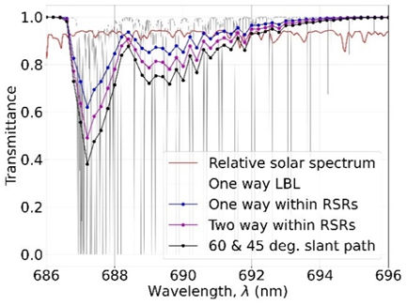
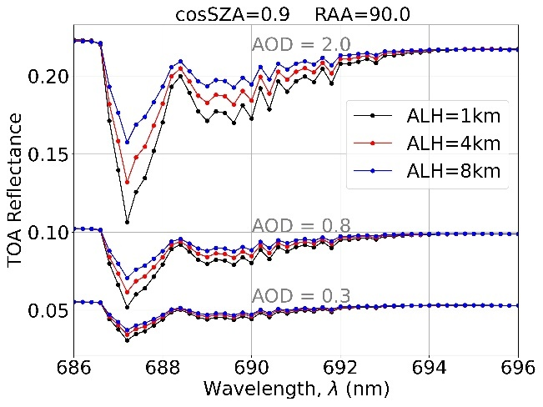
Next Frontier: Virtual Aerosol Observatory
VAO is data fusion of L1-GEO sensors collocated in space and time. It will provide good sensitivity to aerosol properties including scattering function (size distribution), spectral refractive index and particle shape. It will sample aerosol properties at hourly rate from 3-4 near-simultaneous view angles in UV-SWIR spectrum including O₂ A,B-bands.
TEMPO O2 B-band

