Slide 1

2024 DSCOVR Science Team Meeting
Daily Dayurnal Variability in EPIC Data Modeling Results is Fully Verified by NISTAR Photodiode Measurements
Andrew Lacis
NASA Goddard Institute for Space Studies New York, NY
Wenying Su
NASA Langley Research Center Hampton, VA
Yinan Yu
L-1 Standards and Technology New Windsor, MD
NASA Goddard Space Flight Center Greenbelt, MD
October 16 – 18, 2024

Slide 2
Common Format Model/Data Comparisons

Slide 3


EPIC / NISTAR Perspective on SW Flux Determination
EPIC and NISTAR viewing geometry from the Lissajous orbit around the Lagrangian L-1 point in the direction of the Sun

Slide 4
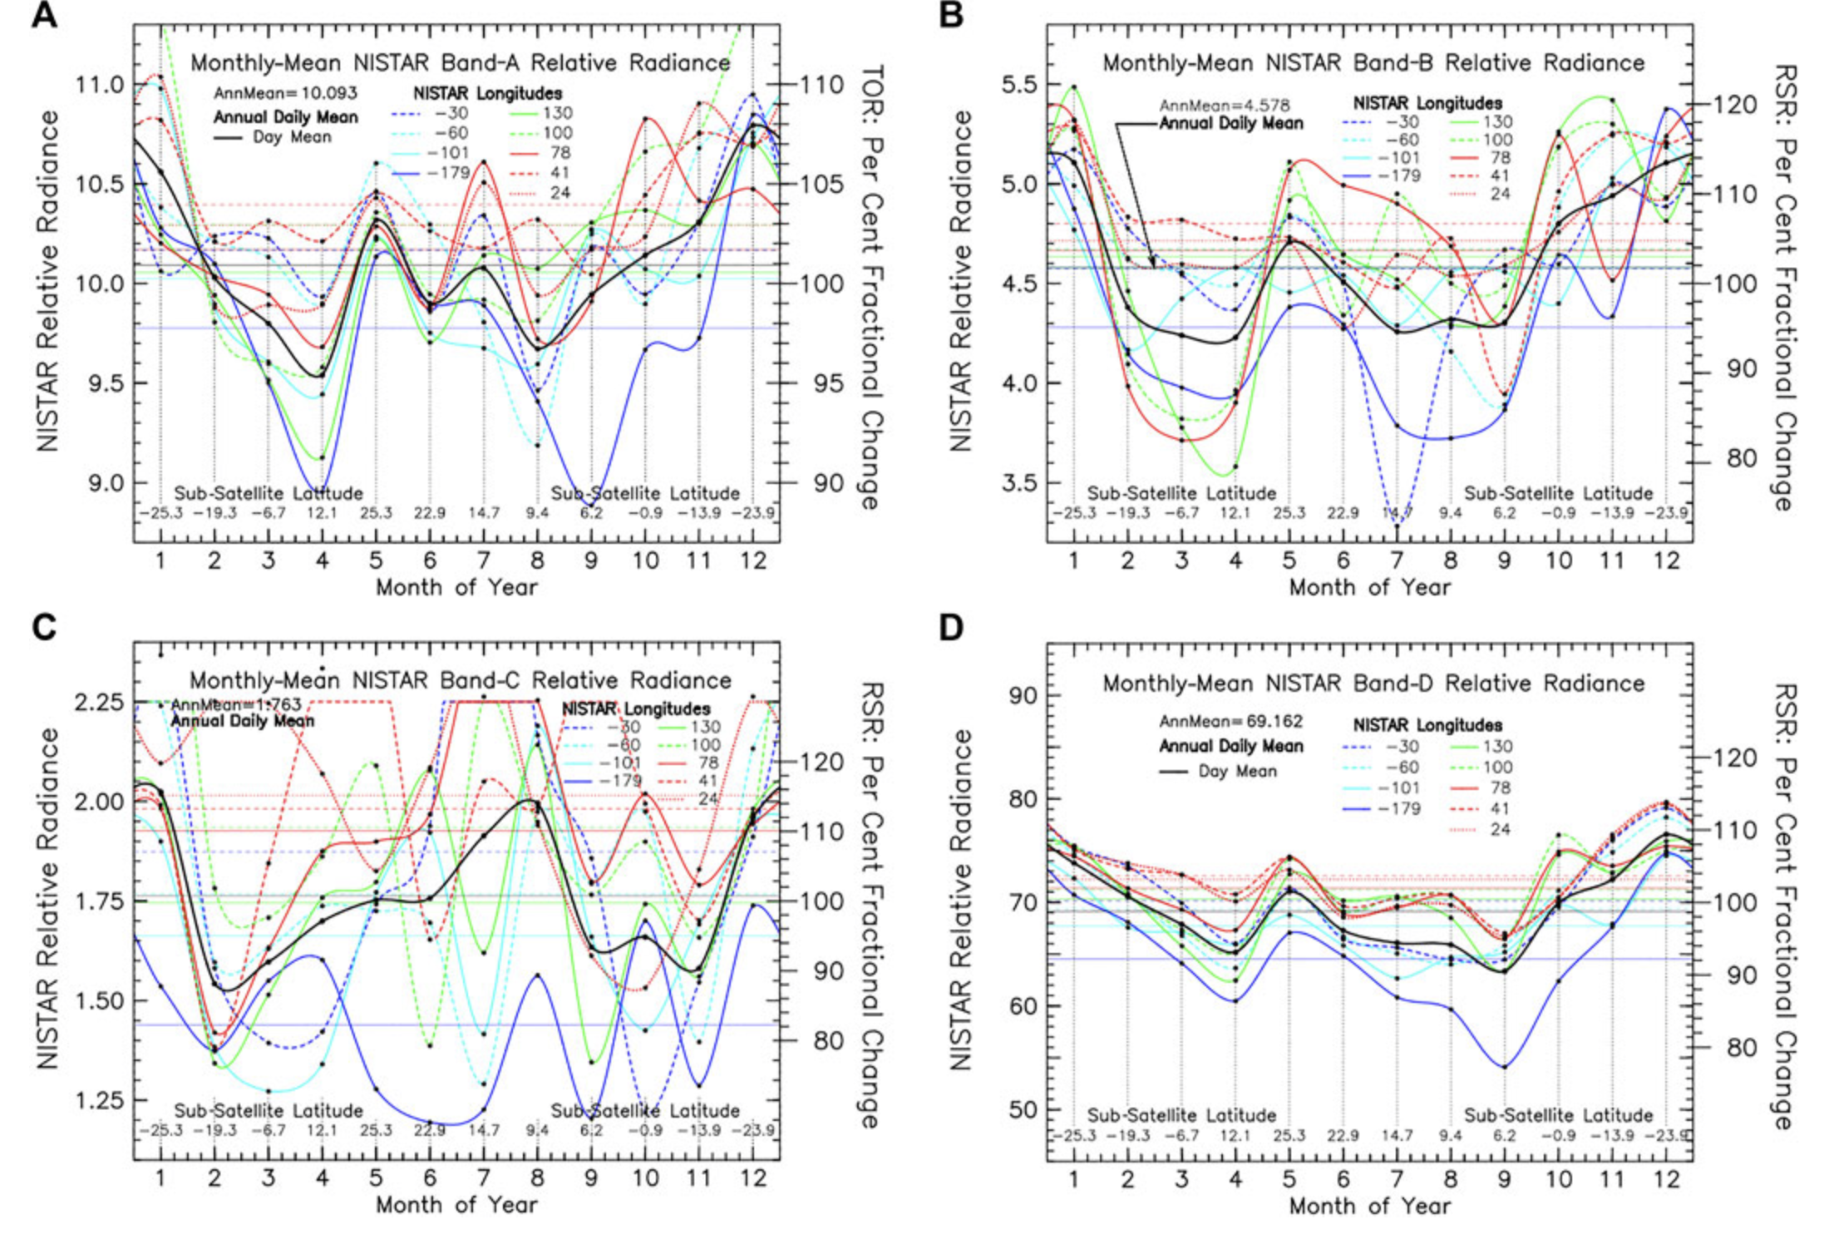
NISTAR Bands A,B,C,D Single-pixel Backscattered Radiance Sampling
of Earth’s Sunlit-Hemisphere for Selected Longitudes

Slide 5
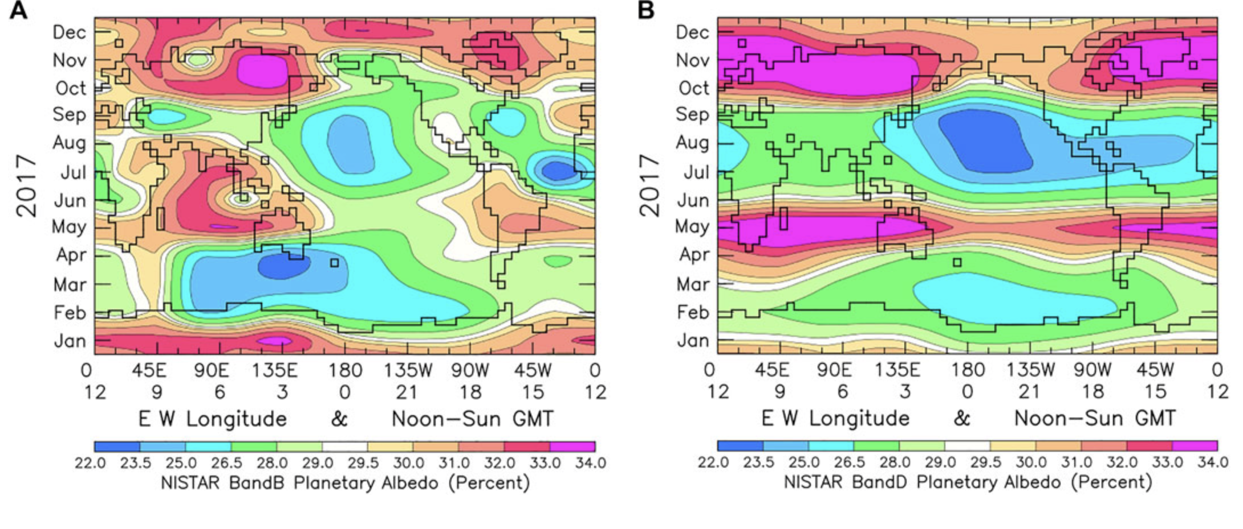
Hovmoller Maps of NISTAR Band B (total SW) and Band D (Vis) for Year 2017

Slide 6
Longitudinally Sampled Planetary Albedo: EPIC vs ModelE2

Slide 7
Hovmoller Maps of Earth’s Planetary Albedo Ratio: EPIC vs ModelE2

Slide 8
EPIC Planetary Albedo – Dayurnal Amplitude

Slide 9
EPIC Planetary Albedo – Dayurnal Amplitude
for (5) 8day-Blurred Meridians relative to Global Mean

