Slide 1



Status of EPIC total ozone algorithm
Natalya Kramarova¹, Jerald Ziemke^{2,1}, Liang-Kang Huang^{3,1}, Jay Herman^{4,1}
1- NASA Goddard Space Flight Center, Greenbelt; 2- Morgan State University;
3- Science Systems and Applications; 4- University of Maryland Baltimore County;
DSCOVR Science Team Meeting, October 16-17, 2023, NASA GSFC, Maryland
natalya.a.kramarova@nasa.gov

Slide 2
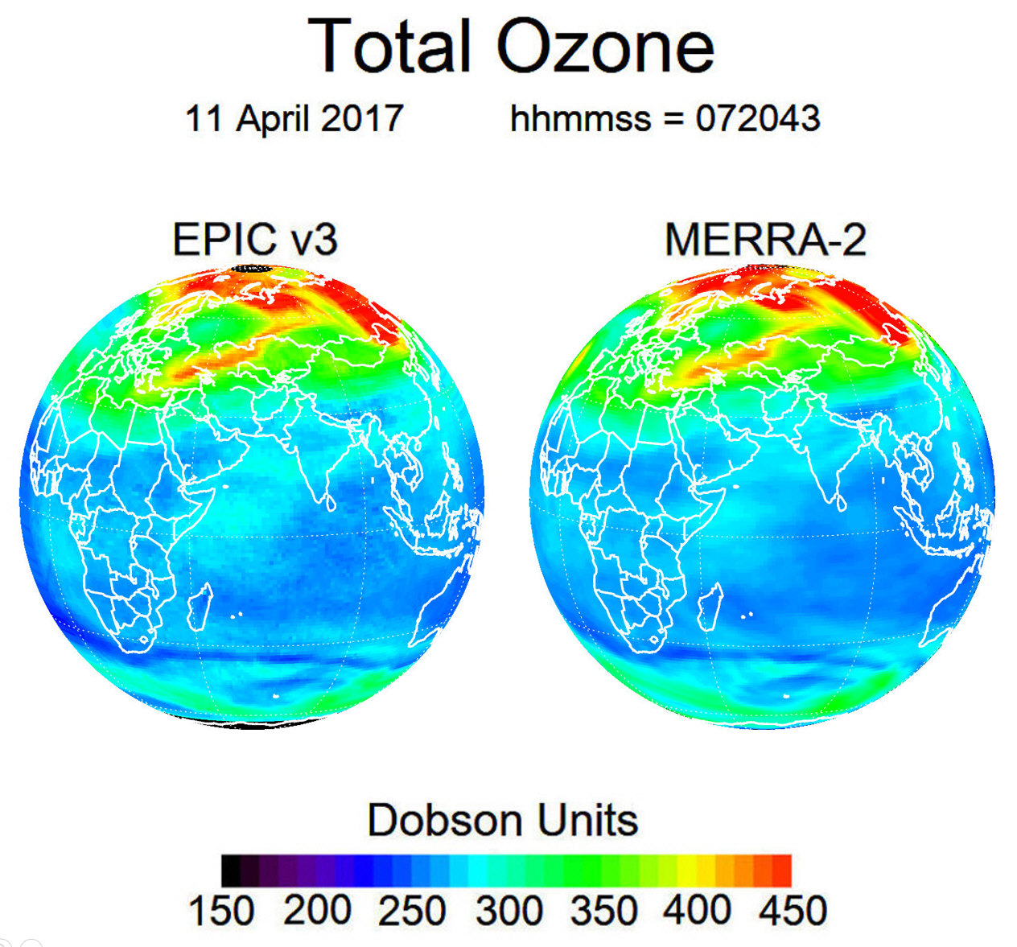
EPIC Version 3 Total Ozone Column
Key features of Version 3:
a) Uses Version 3 Level 1 with improved geolocation registration, flat field and dark counts corrections;
b) Uses the simultaneous EPIC A-Band cloud height;
c) Updates absolute calibrations using SNPP OMPS;
d) Adds corrections for ozone profile shape and temperature;
e) Reports algorithm and error flags to filter data;
f) Adds column weighting functions for each observation to facilitate error analysis.
https://eosweb.larc.nasa.gov/project/DSCOVR/DSCOVR_EPIC_L2_TO3_03

Slide 3

EPIC Version 3 Ozone Products

Slide 4
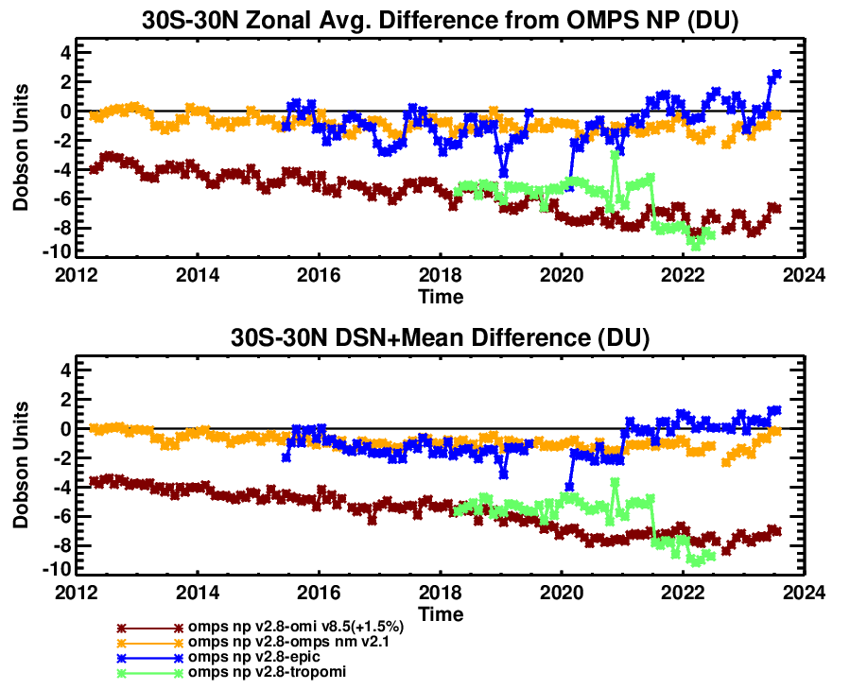
EPIC Total Ozone Columns
DSCOVR Science Team Meeting, October 16-17, 2023, NASA GSFC, Maryland
natalya.a.kramarova@nasa.gov

Slide 5
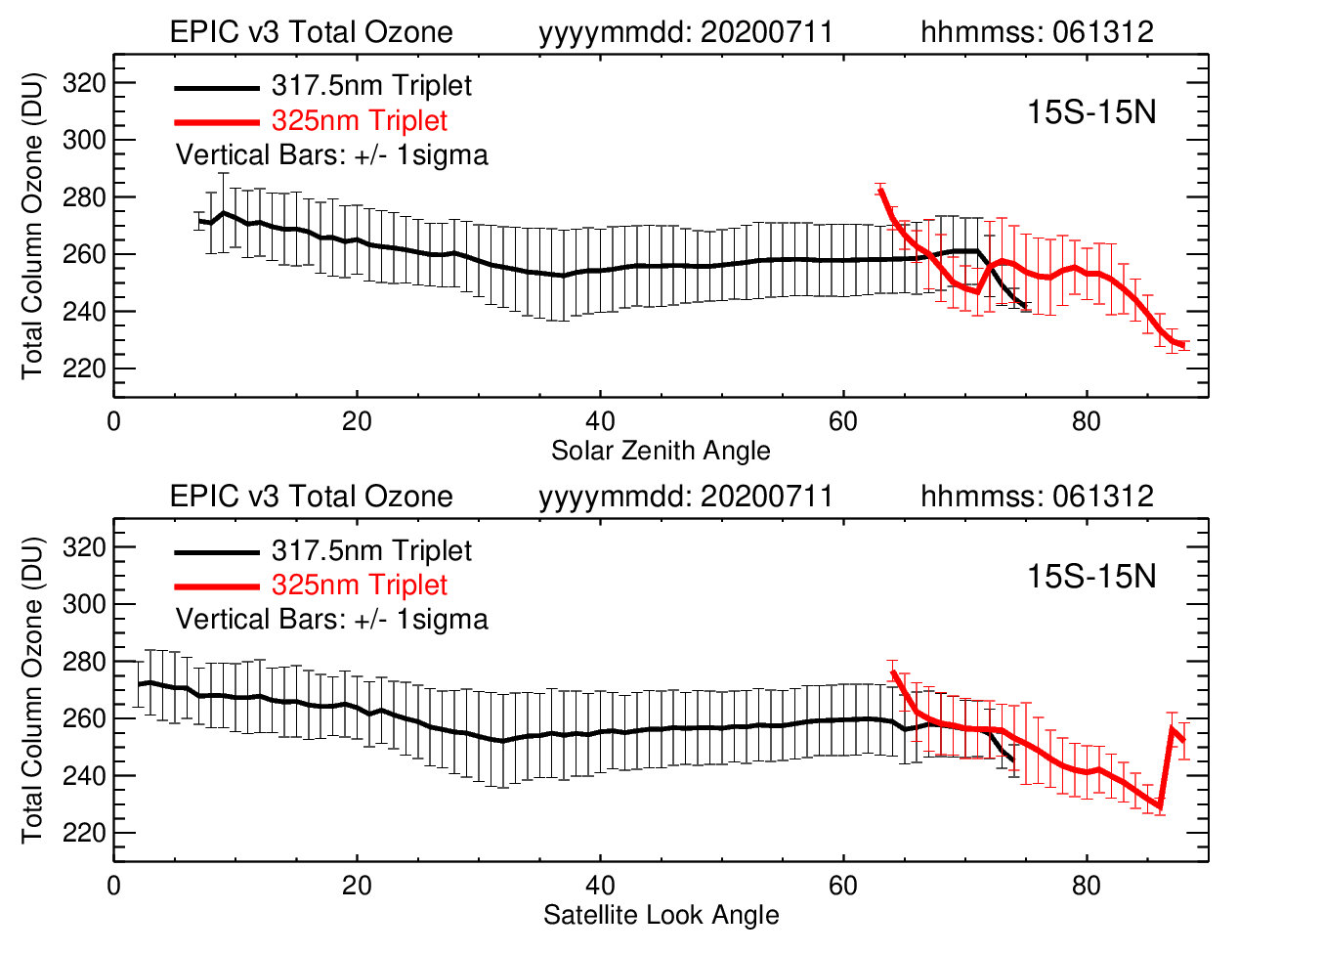
Biases between 317.5 and 325 nm triplets
The retrieval algorithm uses two triplets:
318 nm, 340 nm & 388 nm at low optical path (<1.5)
325 nm, 340 nm & 388 nm at high optical path (>1.5)
The current exclusion of EPIC 325 nm retrievals limits applications of EPIC data for studying ozone variability in early morning and late afternoon hours or at polar latitudes in months with high SZAs.
errors in radiance simulations at high SZAs and SVAs with a pseudo-spherical correction;
uncertainties in absolute calibrations of EPIC UV channels.

Slide 6
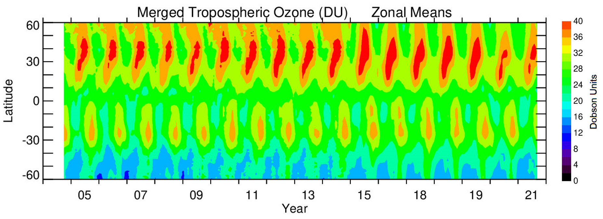
NASA merged TCO Record
Ziemke et al., 2022, 10.1029/2022GL098712
Decadal seasonal trend
3DU (7-8%) drop
Hemispheric differences
Aura OMI
Aura OMI+SNPP OMPS +EPIC
Stratospheric ozone column derived from MERRA-2 assimilated MLS profiles
DSCOVR Science Team Meeting, October 16-17, 2023, NASA GSFC, Maryland
natalya.a.kramarova@nasa.gov
Notes:
The merged TCO is determined by averaging the three individual measurements by their overall daily global coverage (e.g., weightings of 1.0 for OMPS and EPIC, and ~0.7 for OMI). All three top panels for OMPS, OMI, and EPIC (and bottom panel for the merged dataset) indicate anomalous drops in TCO of ~3 DU in years 2020 and 2021 in the NH compared to previous years 2015-2019.

Slide 7
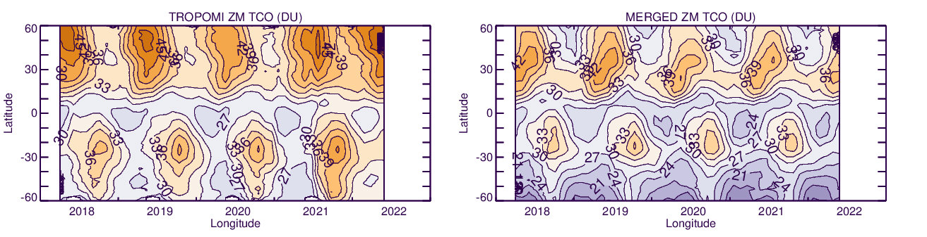
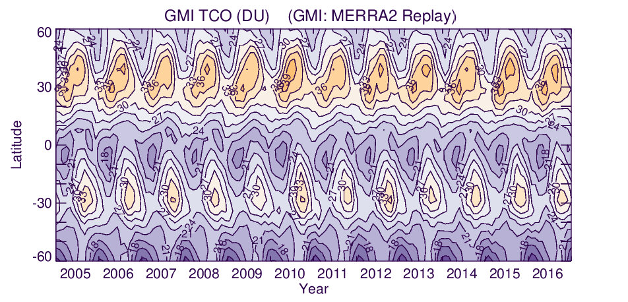
TROPOMI and NASA merged TCO
TCO declined in 2020 but then increased in 2021
TROPOMI/BASCOE
Aura OMI+SNPP OMPS +EPIC/MERRA-2
Lag in seasonal cycle peak
TCO also increased in SH in 2021
Limited latitude zone
Model data also show lag in TCO seasonal cycle in NH
DSCOVR Science Team Meeting, October 16-17, 2023, NASA GSFC, Maryland
natalya.a.kramarova@nasa.gov

Slide 8
TCO comparisons with sonde
OMPS EPIC TROPOMI SONDE
DSCOVR Science Team Meeting, October 16-17, 2023, NASA GSFC, Maryland
natalya.a.kramarova@nasa.gov

Slide 9
TCO comparisons with sondes
This plot is based on measurements at 40 stations world-wide over 2018-2021 time period
South → North
DSCOVR Science Team Meeting, October 16-17, 2023, NASA GSFC, Maryland
natalya.a.kramarova@nasa.gov

Slide 10
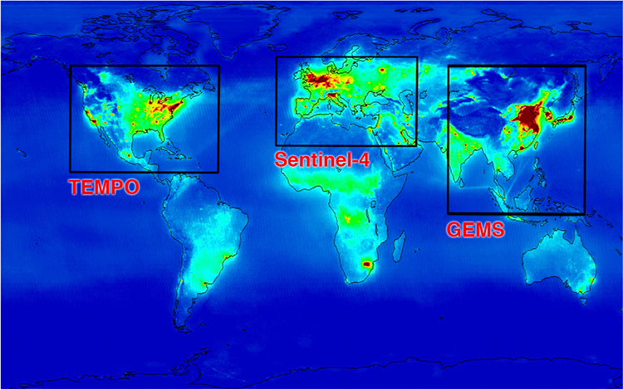
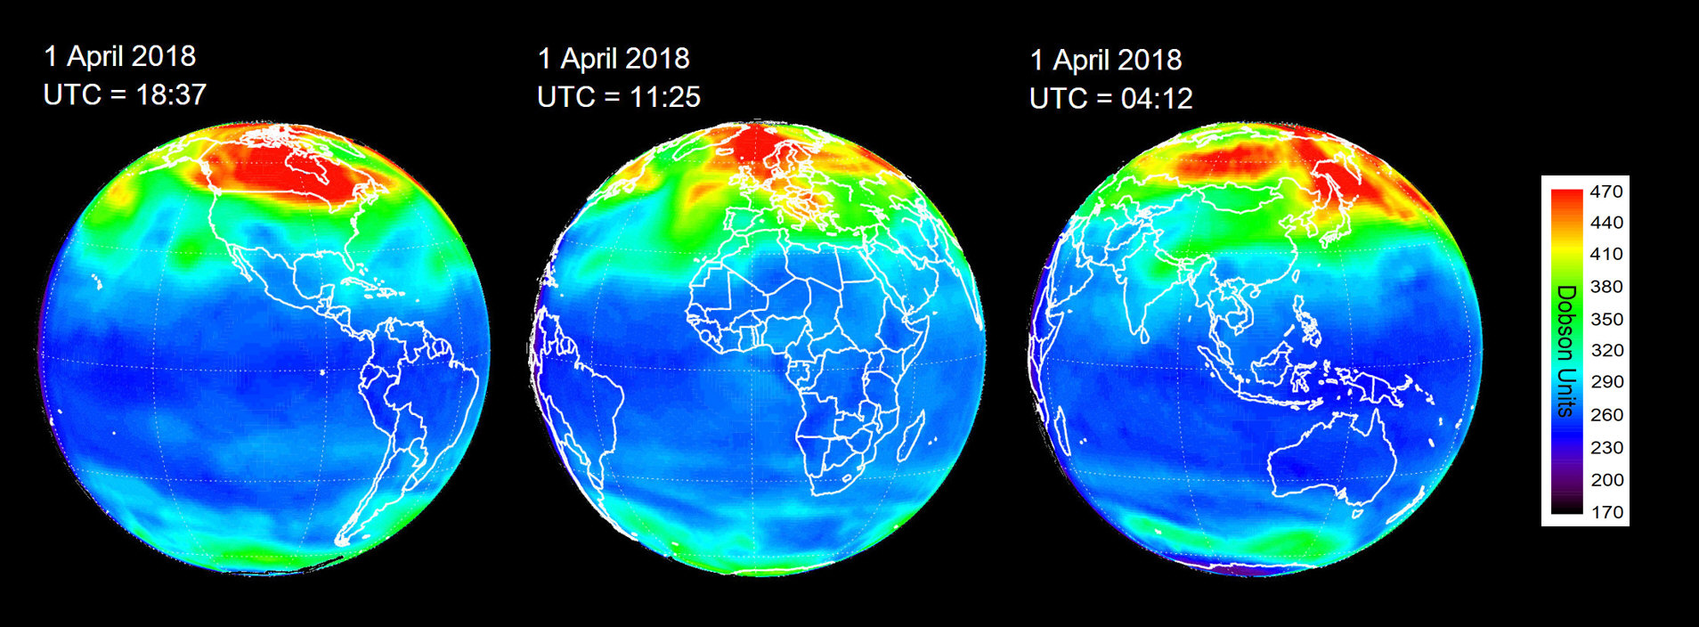
EPIC as a Pathfinder for Geostationary Missions
TEMPO was launched on April 7, 2023
GEMS was launched on February 18, 2020
Notes:
The upper panel shows spatial domains covered by the three GEO constellation missions with a map of OMI nitrogen dioxide in the background. The three images in the lower panel represent EPIC synoptic maps of total ozone column from April 1, 2018 with focuses on North America, Europe and Asia. EPIC ozone measurements, sampled from sunrise to sunset, will serve as a pathfinder for the geostationary missions. EPIC ozone will connect all three domains observed with the geostationary missions and provide measurements over the Southern Hemisphere not covered by the GEO constellation.

Slide 11
Summary:
Comparisons of EPIC total ozone columns with satellite instruments (SNPP OMPS and Aura OMI) demonstrated good agreement with mean biases within ±5–7 DU (or 1.5–2.5%). Outside of the tropics, biases with other satellite instruments show seasonal variability.
Comparisons of EPIC tropospheric ozone with sondes show that satellite observations closely follow ground-based observations with mean biases of ±2-4 DU. Comparisons with TROPOMI tropospheric ozone revealed a positive bias in TROPOMI tropospheric ozone. We plan to repeat this analysis with the new version of TROPOMI data.
We investigated biases between EPIC retrievals derived from the two triplets (317 and the 325 nm). Errors in radiance simulations with a pseudo-correction for atmospheric sphericity at high SZAs and SLAs are smaller than the biases we observe. The current exclusion of EPIC 325 nm retrievals limits applications of EPIC data for studying ozone variability in early morning and late afternoon hours or at polar latitudes in months with high SZAs.
In the future, we plan to compare EPIC measurements with observations from two operational geostationary missions TEMPO and GEMS.
DSCOVR Science Team Meeting, October 16-17, 2023, NASA GSFC, Maryland
natalya.a.kramarova@nasa.gov

Slide 12
Back-up Slides
DSCOVR Science Team Meeting, October 16-17, 2023, NASA GSFC, Maryland
natalya.a.kramarova@nasa.gov

Slide 13
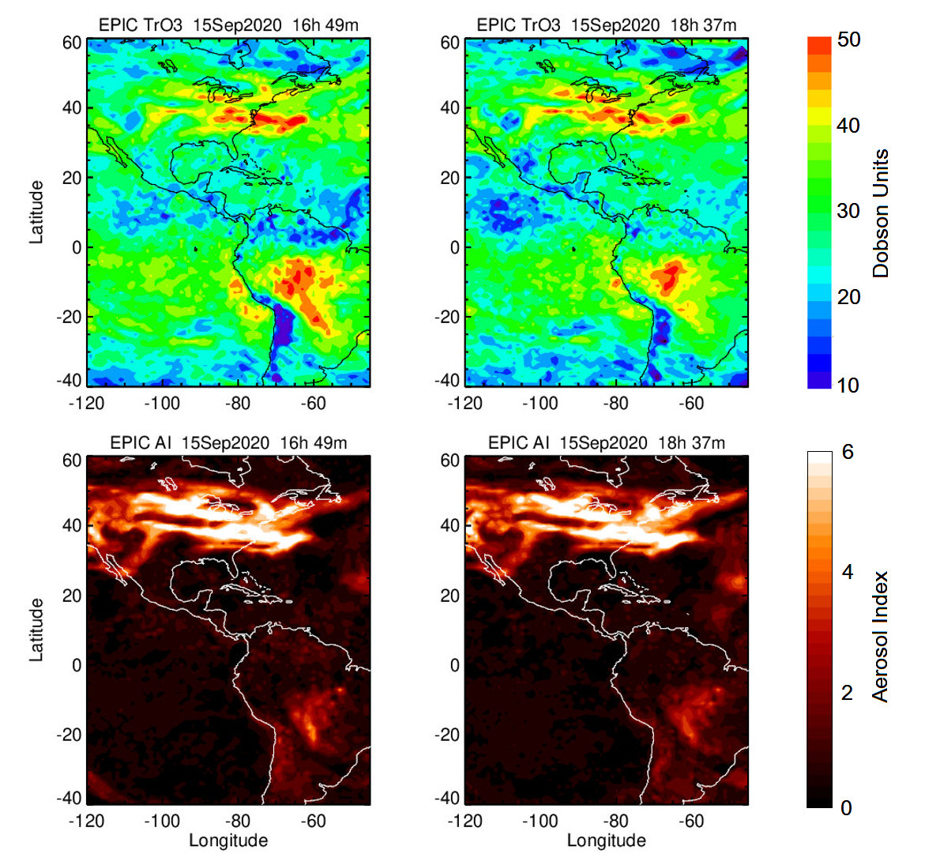
Synoptic TCO and AI Maps
DSCOVR Science Team Meeting, October 16-17, 2023, NASA GSFC, Maryland
natalya.a.kramarova@nasa.gov

Slide 14
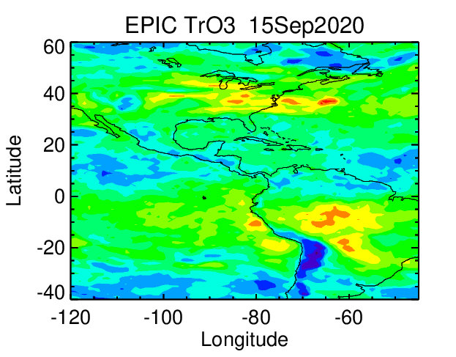
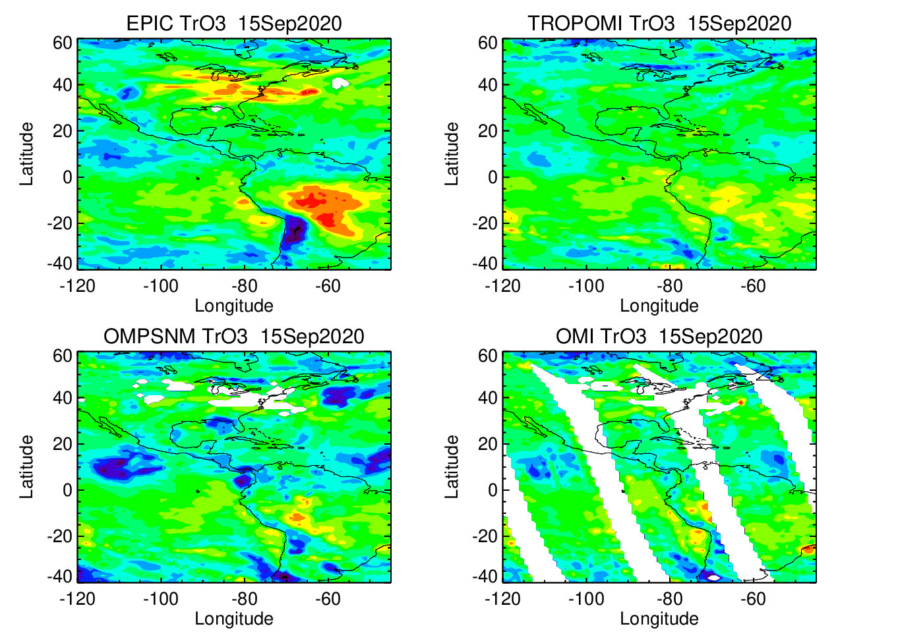
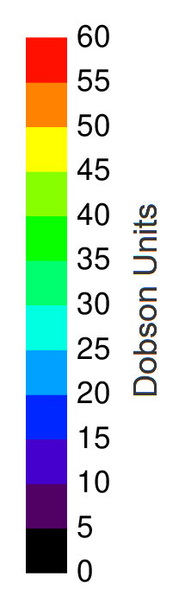
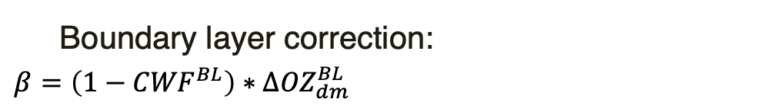
EPIC BL Correction
Without BL Correction
With BL Correction
BL correction needs revision
Boundary layer correction:
${β=\left(1−{CWF}^{BL}\right)∗∆OZ}_{dm}^{BL}$
DSCOVR Science Team Meeting, October 16-17, 2023, NASA GSFC, Maryland
natalya.a.kramarova@nasa.gov

Slide 15
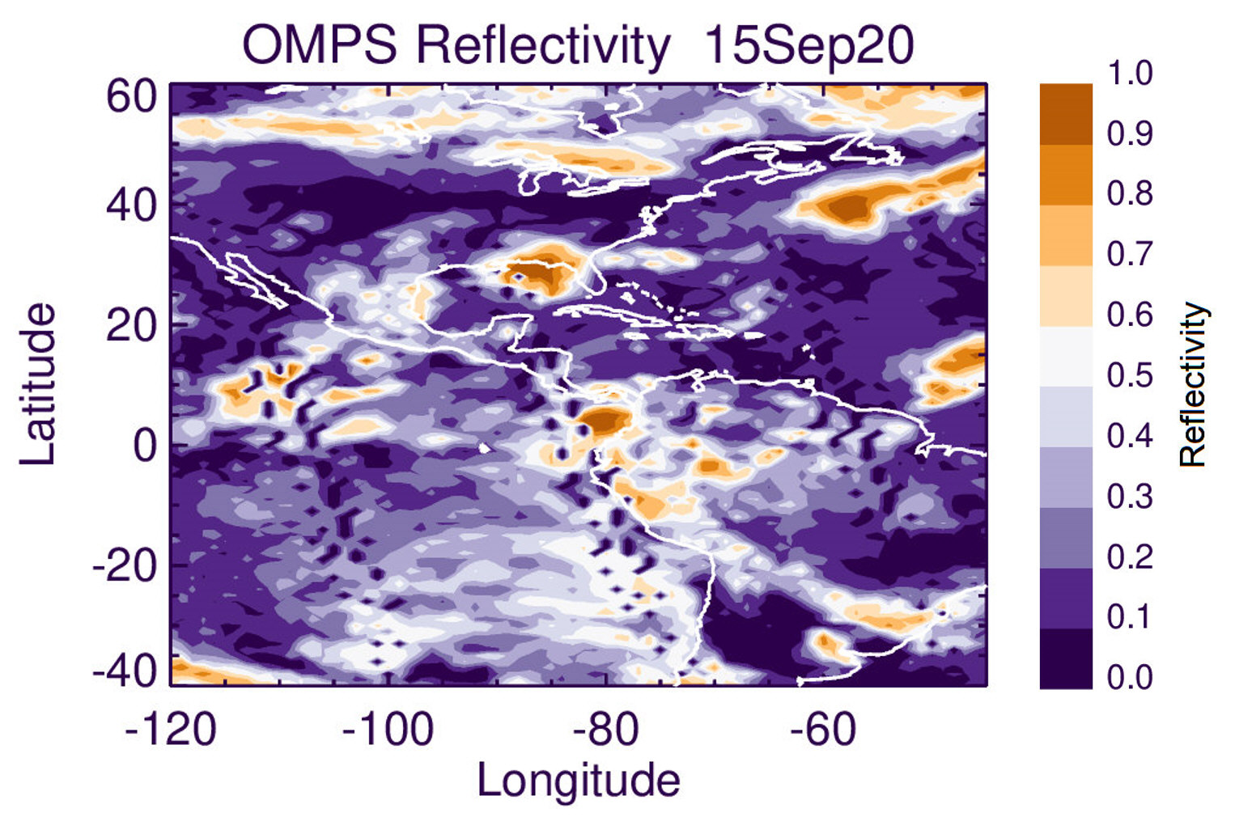
Daily TCO Maps, Sep. 15 2020
Positive TCO anomalies in EPIC related to high AI
EPIC TCO data should be screened for scenes with high AI (>5).
Accurate cloud information is required for creating daily TCO maps.
OMPS TCO negative anomalies corresponds to convective clouds. OMPS uses OCP climatology
v8.6
DSCOVR Science Team Meeting, October 16-17, 2023, NASA GSFC, Maryland
natalya.a.kramarova@nasa.gov

Slide 16
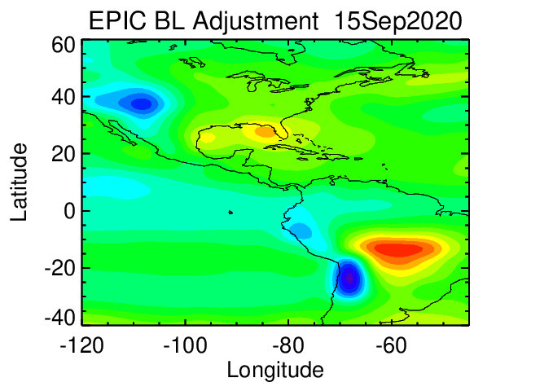
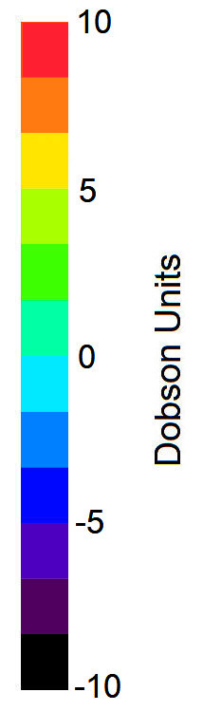
EPIC BL correction, September 15, 2020
DSCOVR Science Team Meeting, October 16-17, 2023, NASA GSFC, Maryland
natalya.a.kramarova@nasa.gov

Slide 17
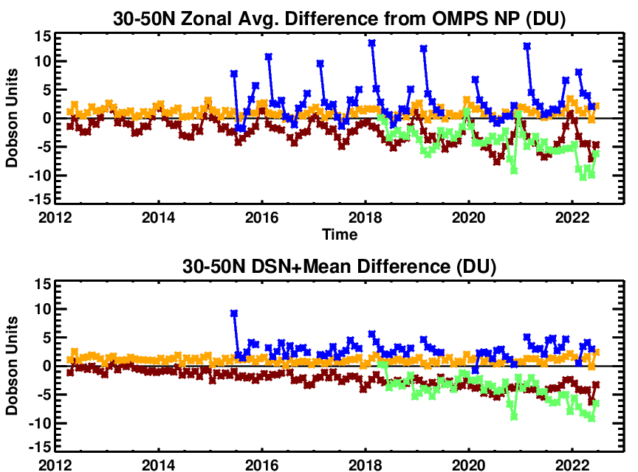
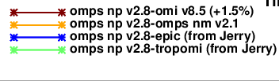
TROPOMI and NASA Total Ozone Columns
DSCOVR Science Team Meeting, October 16-17, 2023, NASA GSFC, Maryland
natalya.a.kramarova@nasa.gov

