Slide 1
EPIC Observations of Conditionally Averaged Global Reflectance Patterns
Alex Kostinski, Alexander Marshak, Tamas Varnai
Preliminary results of an ongoing exploration.
In an attempt to detect longer term changes and semi-permanent features such as the ever present ocean glitter, we introduce CCD pixel-pinned temporally and conditionally averaged reflectance images, uniquely suited to the DSCOVR/EPIC observational circumstances.

Slide 2
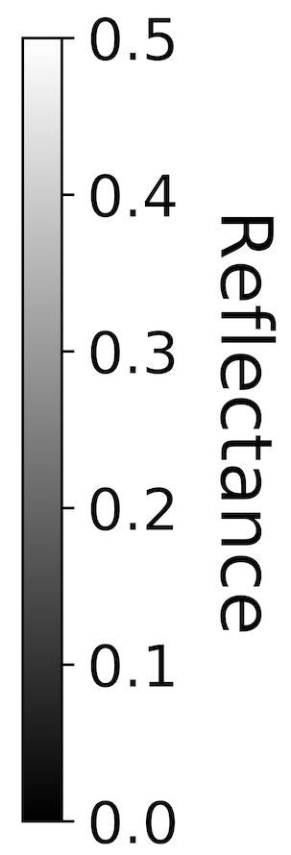
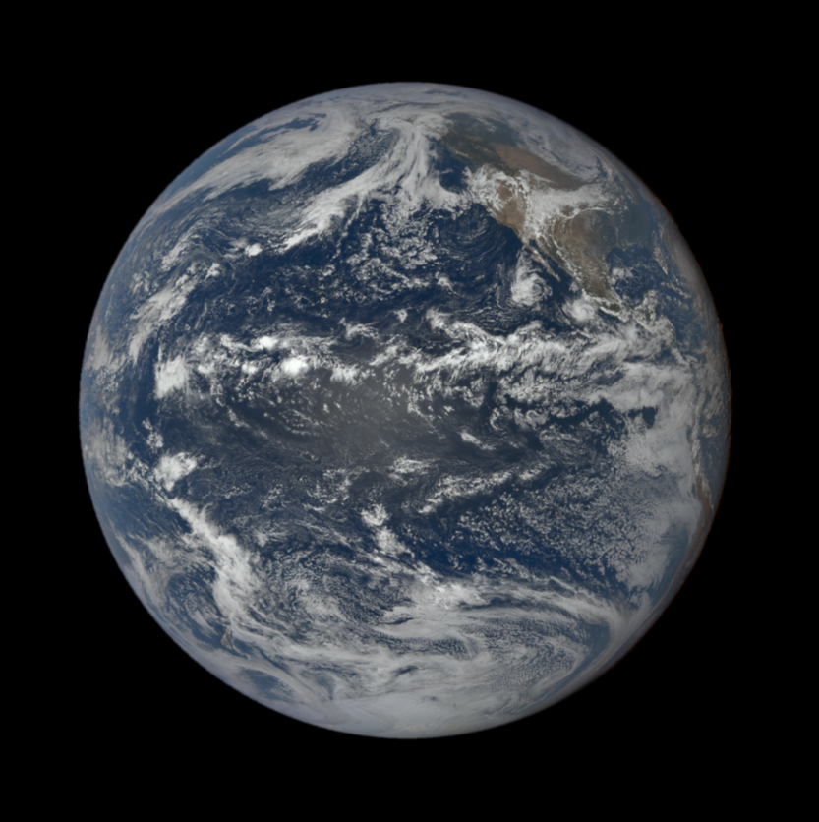
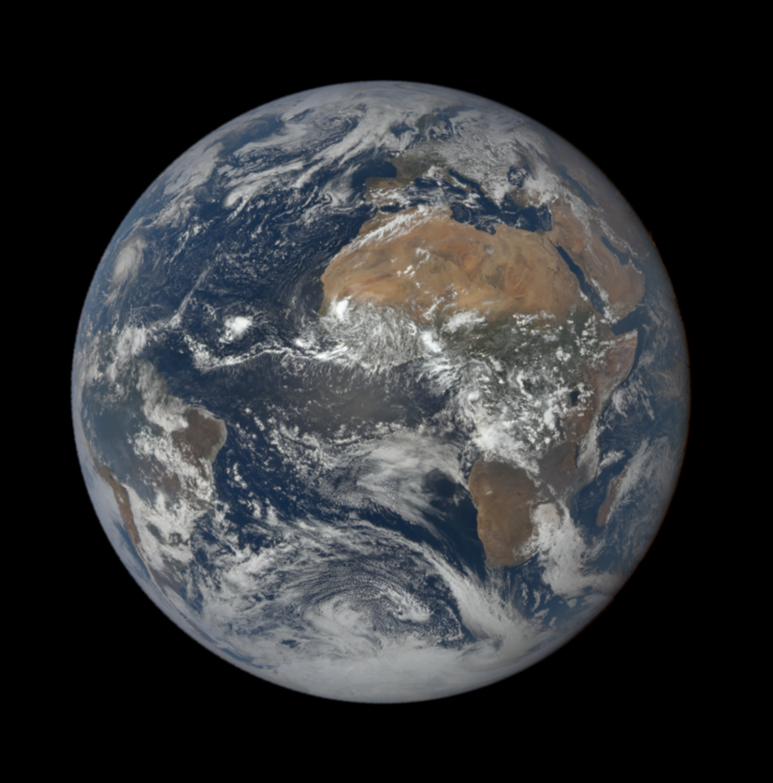
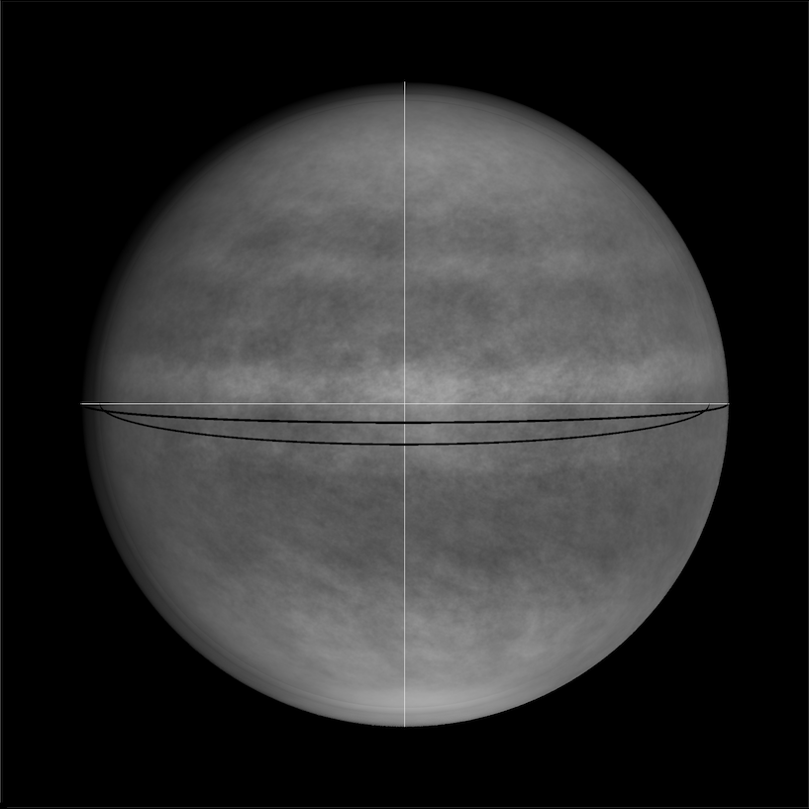
Construction of the CCD pixel-pinned, time averaged global reflectance maps
a
b
c
Panels a & b: September 21, 2022, 21:54 UTC and 12.54 UTC.
Panel c: average over the entire September 2017, 780 nm reflectance.
Red boxes are pinned in CCD space as the Earth spins underneath.
Brights bands from this “window” averaging shows ITCZ clouds.
No conditioning by surface type yet in panel c.

Slide 3
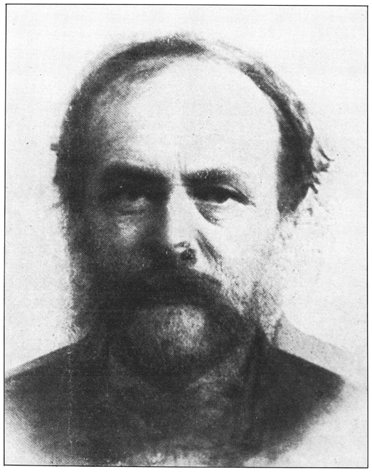
Why average an image? Seems odd as geographic information is lost, temporal resolution is lost. History of an average image is interesting: e.g., photo of an Average Man:
To the right: average of 12 mathematicians.
From: Can You Identify These Mathematicians? by
Stephen M. Stigler. See also his “Seven Pillars of
Statistical Wisdom” on the history of “Average”.
Averaging is used to reduce speckle in radar and laser, although at the expense of resolution. Ours is different and uniquely suited to DSCOVR/EPIC observation conditions.

Slide 4
Construction of the CCD pixel-pinned, time averaged global reflectance maps
a
b
c
Panels a & b: September 21, 2022, 21:54 UTC and 12.54 UTC.
Panel c: average over the entire September 2017, 780 nm reflectance.
Red boxes are pinned in CCD space as the Earth spins underneath. Tailored to EPIC observations. Brights bands in panel (c) are ITCZ clouds.
Next slide: condition by surface type -- only cloud-free ocean pixels.

Slide 5
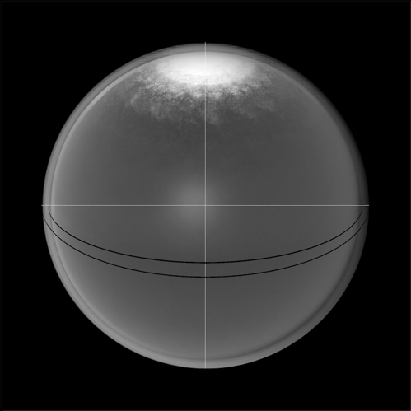
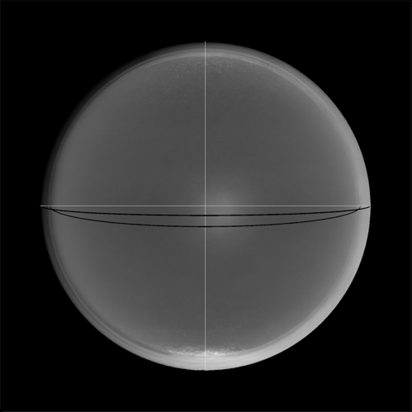
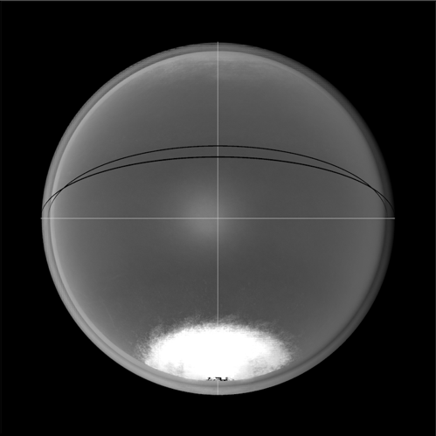

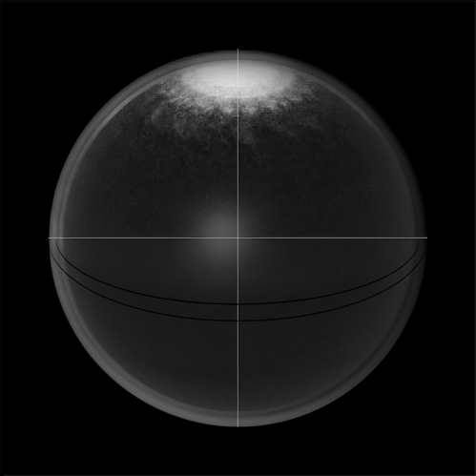
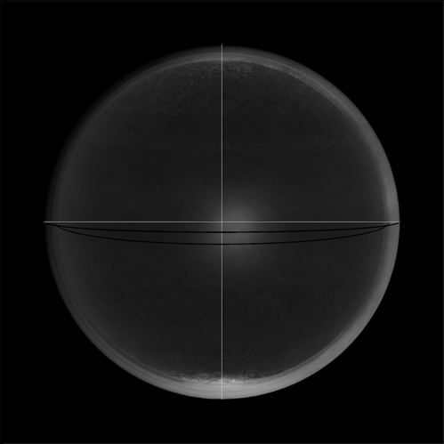
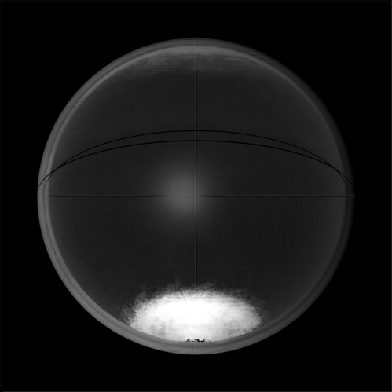

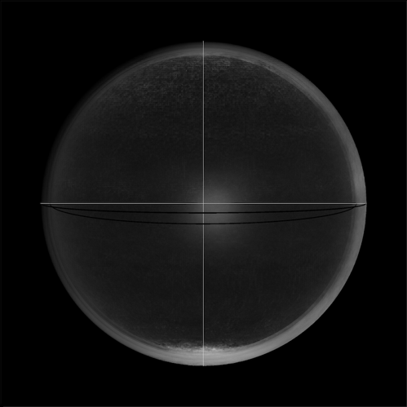
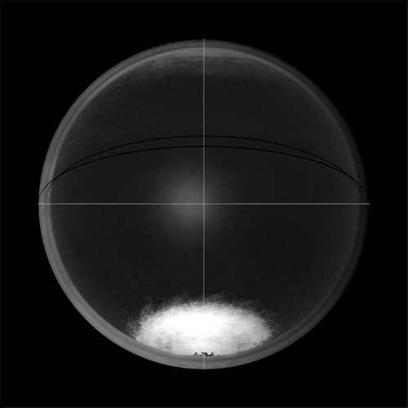
June
September
December
Rows: atmospheric scattering; Rayleigh effect evident;
In accordance with the ”blue sky” scattering, the atmosphere is brightest at 443 nm.
The central bright spot is ocean glitter.
Clear water
only
Columns:
Seasonal.
The Poles
are beacons.
Can this
display be
understood
by high school
students?
Educational
Outreach for
EPIC.
443 nm
680 nm
780 nm

Slide 6


Slide 7
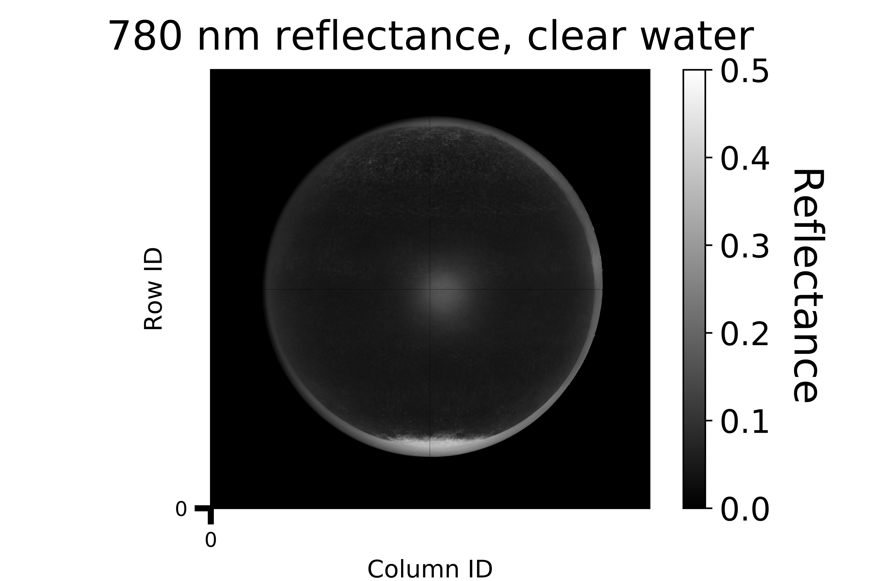
Central bright spot is caused by ocean glitter.
Specular reflection off short gravity (under 10 cm) and capillary waves.
Central spot size in the image is related to slope distribution and the latter is related to wind speed and pattern.

Slide 8
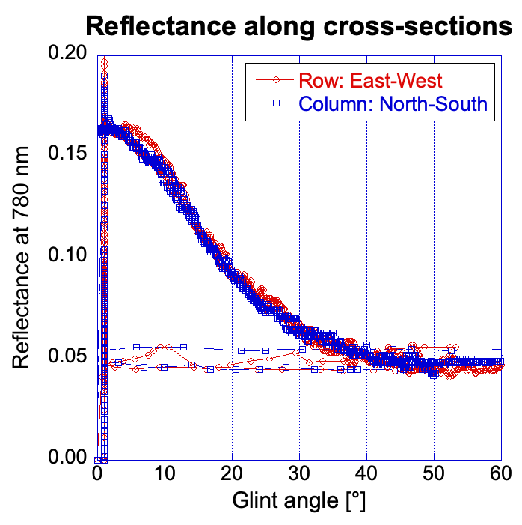
Reflectance profiles along cross-hairs (transects), centered on the ocean glitter (central) bright spot.
Wind ruffles the surface, slopes are approx. Gaussian pdf.
Slopes related to winds
(8 million images analyzed by Breon and Henriot, 2006). One (aggregate) EPIC image here.

Slide 9
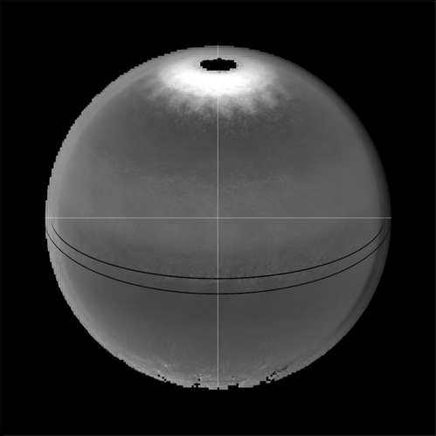
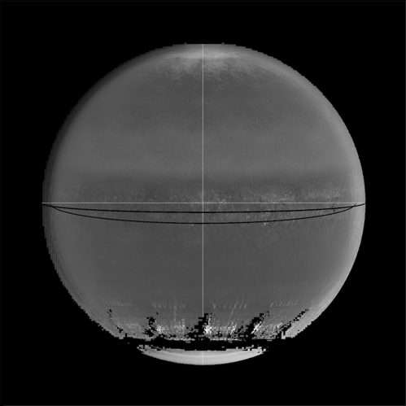
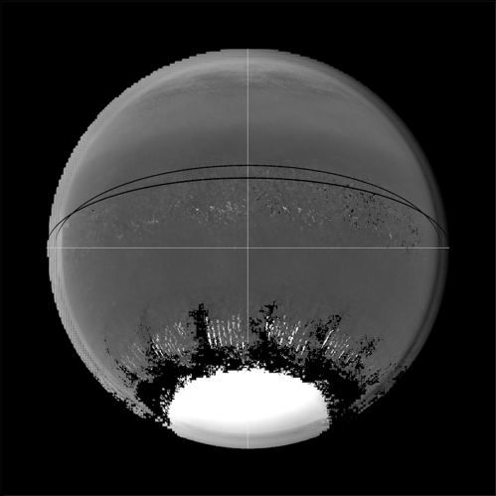
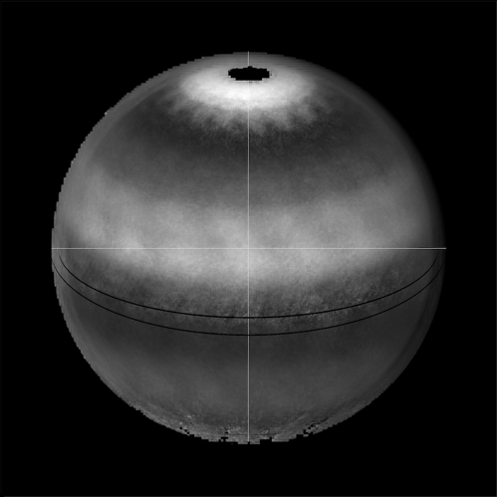
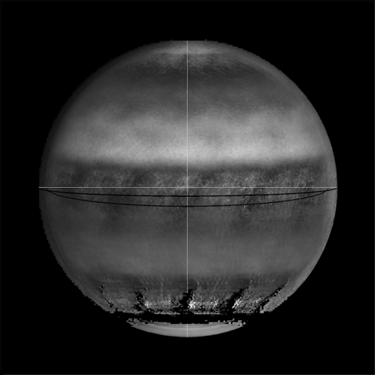
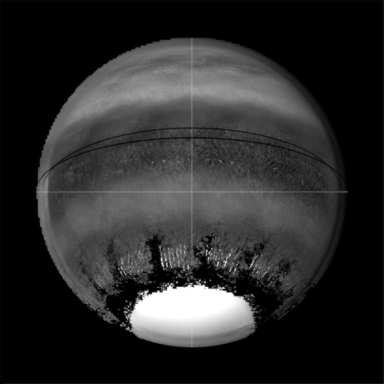
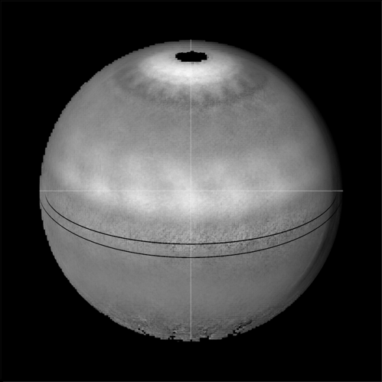
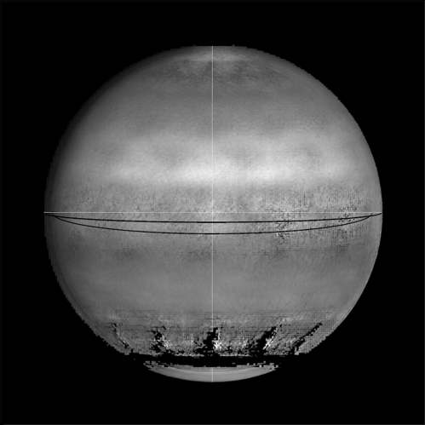
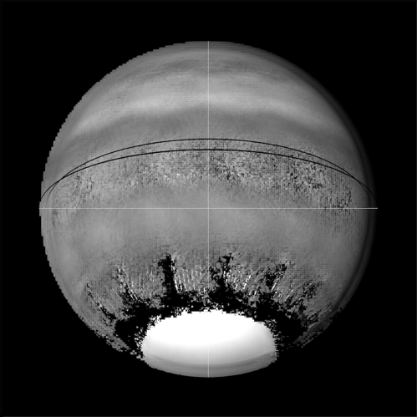
Earth masquerading as Jupiter
June
September
December
443 nm
Bright bands in mid-
upper latitudes
are due to deserts,
e.g., Sahara
680 nm
Cloud-free
Land pixels
only
780 nm

Slide 10
Thanks!

