Slide 1
EPIC Cloud Observations with Oxygen Bands Over Snow, Ice and Sunglint Regions
Yaping Zhou (UMBC/NASA), Yuekui Yang (GSFC),
Peng-Wang Zhai (UMBC), Meng Gao (SSAI/NASA)
DSCOVR EPIC&NISTAR Science Team Meeting
Oct. 6-8, 2020, Online

Slide 2
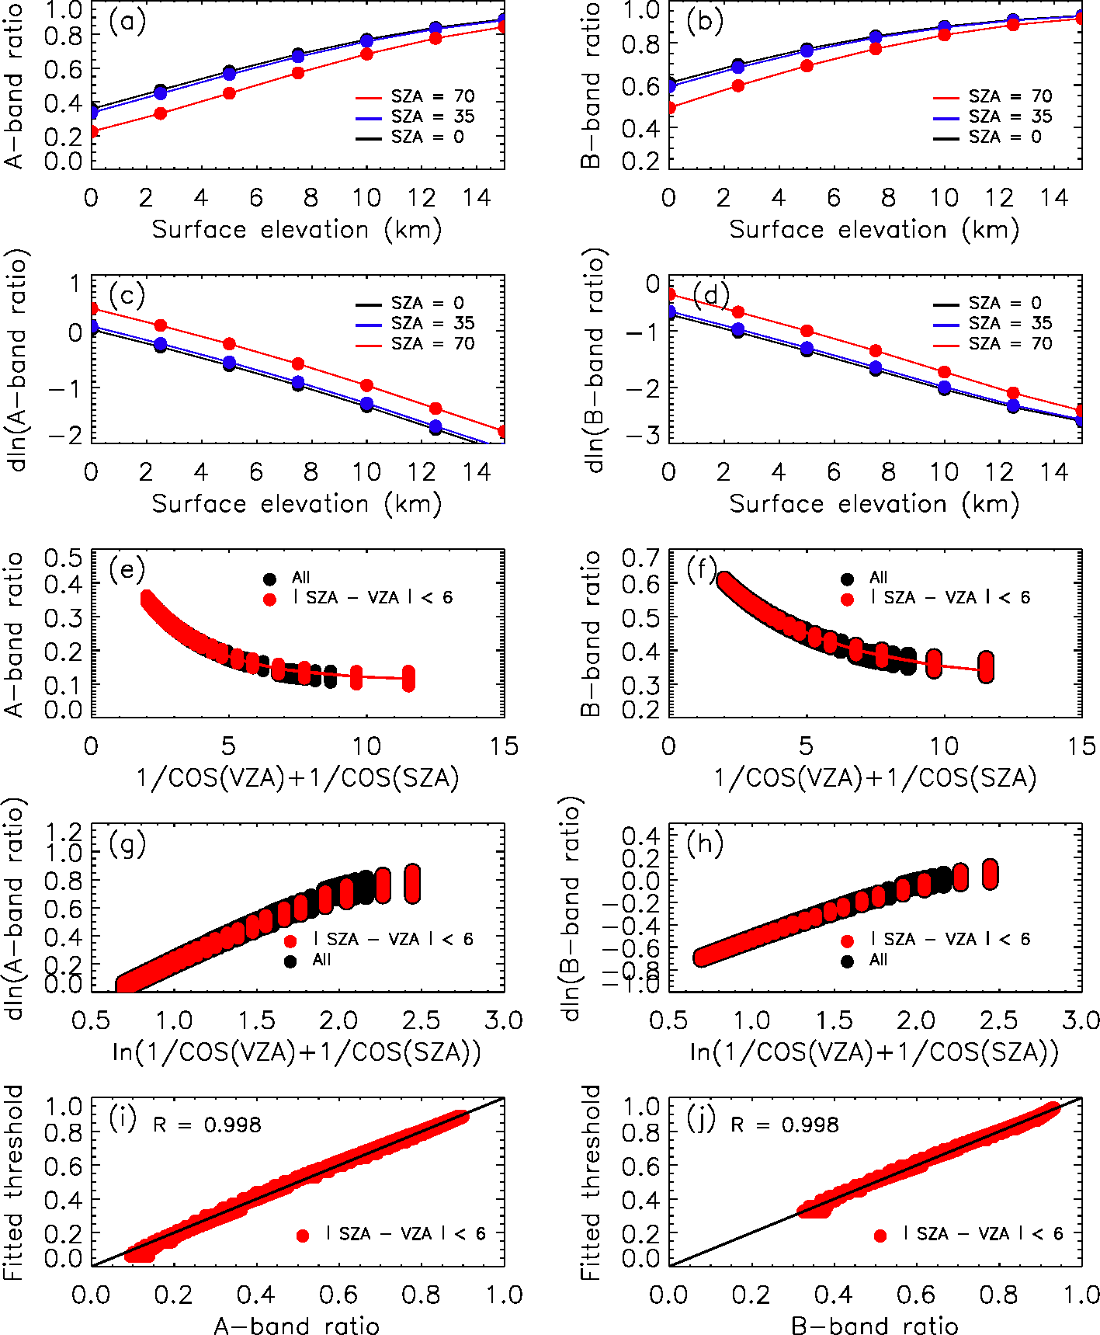

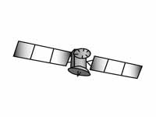

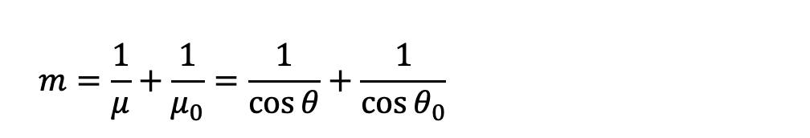
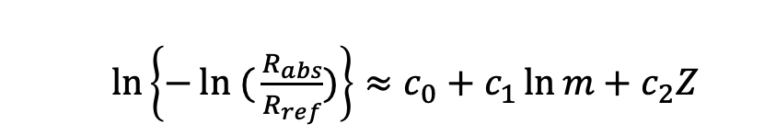
$\ln\left\{−ln ({\frac{R_{abs}}{R_{ref}})}\right\}≈c_{0}+c_{1}\ln{m}+c_{2}Z$
Principles of O2-band Cloud Detection:
Beer’s Law
$$m=\frac{1}{μ}+\frac{1}{μ_{0}}=\frac{1}{\cos{θ}}+\frac{1}{\cos{θ_{0}}}$$

Slide 3
Radiative Transfer Model Sensitivities Studies
Clear Sky Simulations
Solar/view zenith angles (17): every 5º, 0 - 80º
Relative azimuth angle(37): every 5º, 0 -180º
Surface elevation (7): 0.0, 2.5, 5, 7.5 km
Atmosphere profiles: Standard US, Mid-latitude winter, Subarctic winter, Subarctic summer
Surface Albedo: 0.8, 0.6, 1.0, 0.0
Cloudy Sky Simulations
Cloud optical thickness(COT) (9 values): 0.2, 0.8, 1.7, 3.0, 5.0, 8.0, 12.5, 19.0, 29.0
Cloud Top Height (CTH) in km (6 values): 1, 3, 5, 7.5, 10.0, 12.5, 15.
Cloud Geometric Thickness (CGT) in km (1 values): 0.5, 1.0, 2.0, 4.0
Atmosphere profiles: Standard US
Surface elevation: 0 km, 2.5km
Surface albedo: 0.8, 0.6, 0.0
Define clear-sky thresholds
Understand cloud detection uncertainties
Blue configurations are used for ocean simulations.
Convoluted with EPIC spectral response functions!

Slide 4


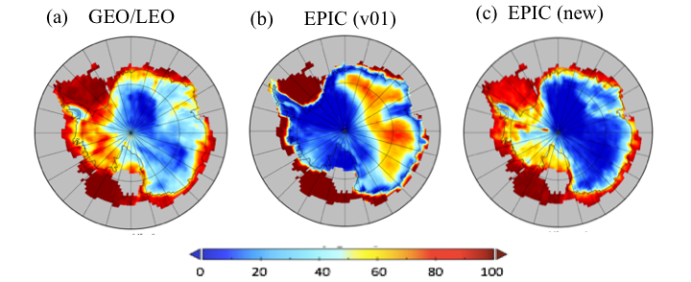
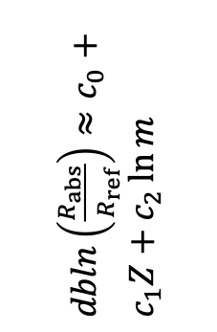
Cloud Detection over Snow and Ice
using DSCOVR-EPIC’s Oxygen Bands
Yaping Zhou^{1,2}, Yuekui Yang¹, Meng Gao³, Peng-Wang Zhai⁴
¹NASA/GSFC, Code 613, ²UMBC-JCET, ³SSAI, ⁴UMBC
POD: 36 % to 65 %
FOD: 50 % to 10 %
Jan. 2017
$dbln\left(\frac{R_{abs}}{R_{ref}}\right)≈c_{0}+c_{1}Z+c_{2}\ln{m}$
Satellite cloud detection over snow and ice with passive remote sensing instruments is challenging due to the lack of contrast between clouds and cold/bright surfaces. Detections usually rely on shortwave infrared (IR) channels. With no such channels available, the Earth Polychromatic Imaging Camera (EPIC) instrument onboard the Deep Space Climate Observatory (DSCOVR) relies on two oxygen band ratios to detect clouds over snow and ice. We developed a novel dynamic threshold scheme for the oxygen band ratios and achieved significant improvements over the existing algorithm.
Earth Sciences Division - Atmospheres

Slide 5
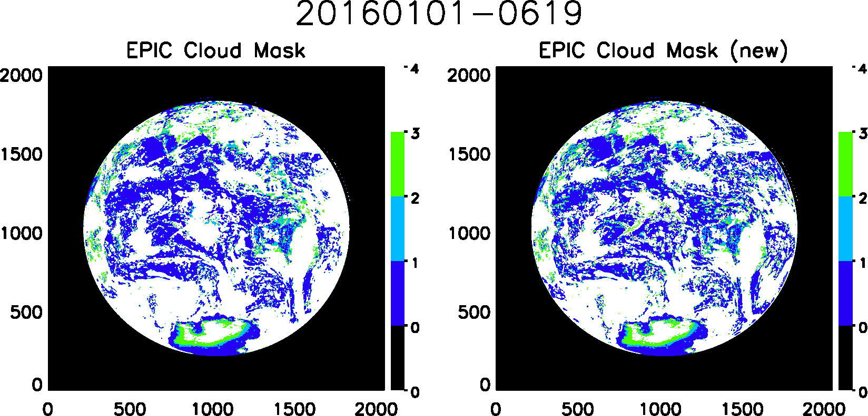
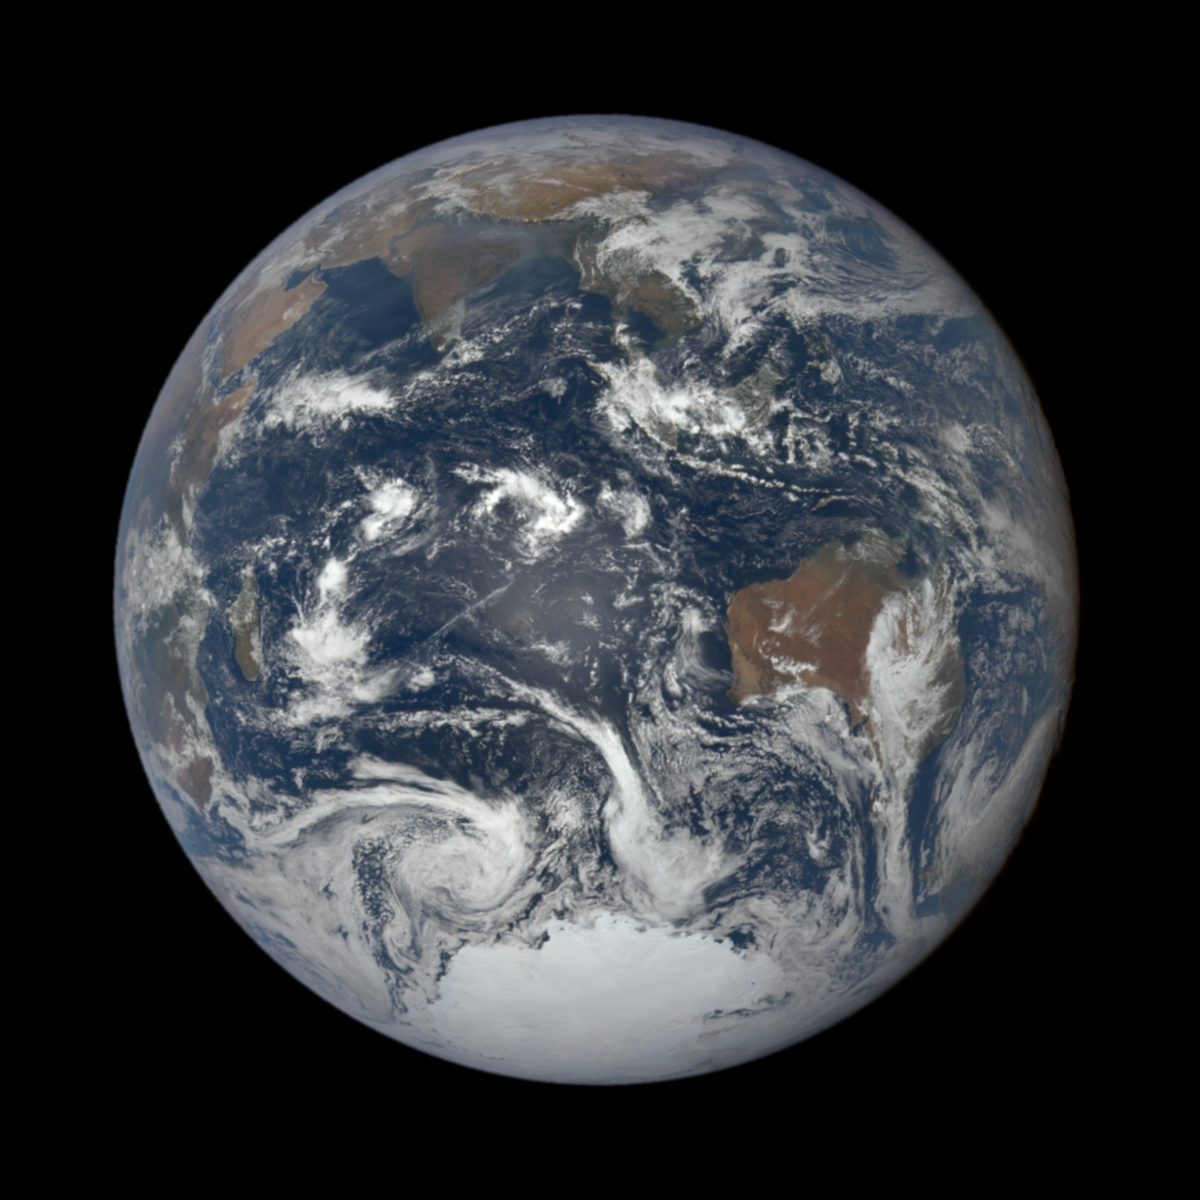
Overestimation of clouds in glint region
is very common in EPIC cloud product

Slide 6
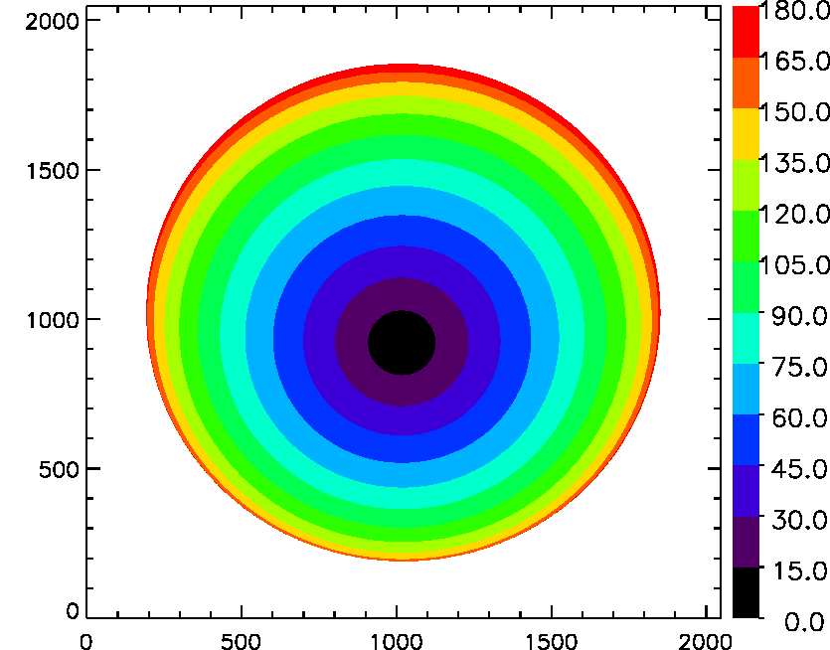
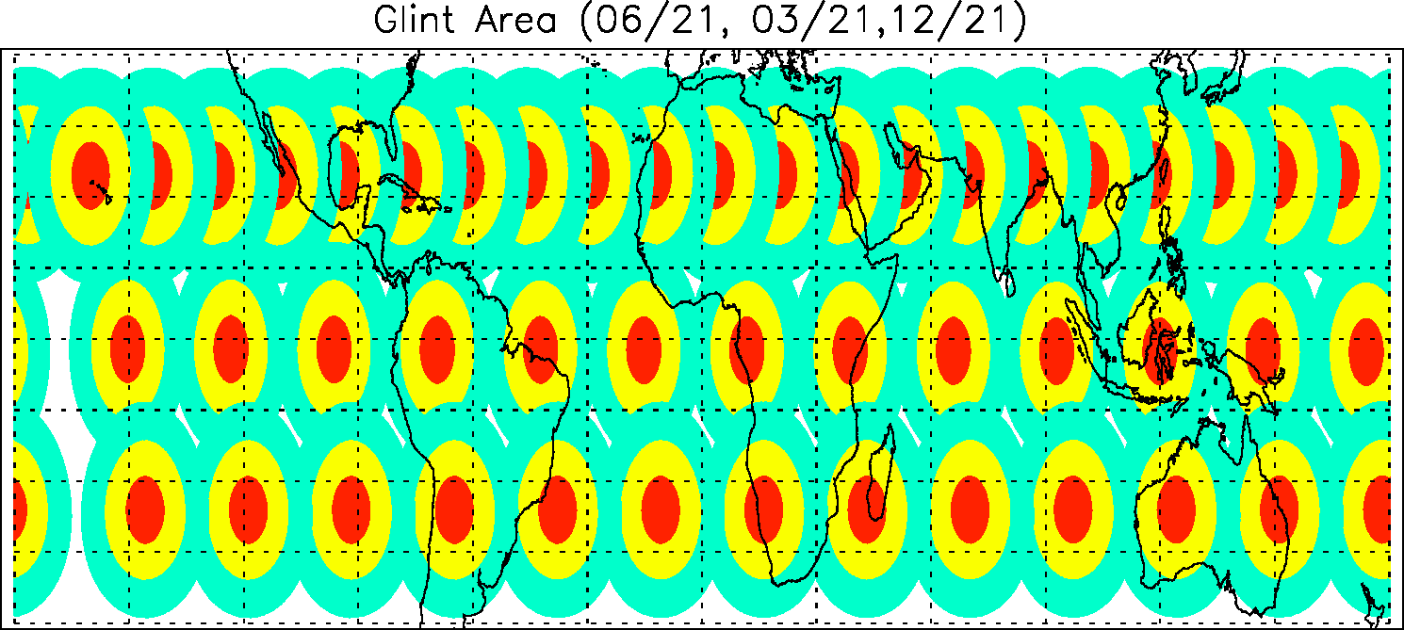
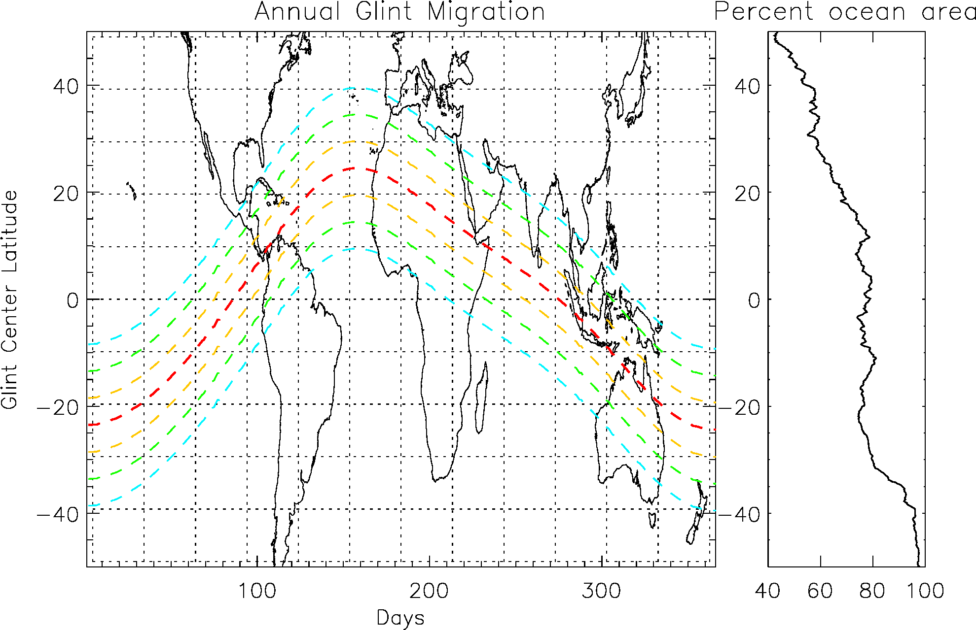
EPIC Observed Glint Regions
06/21
03/21
12/21

Slide 8
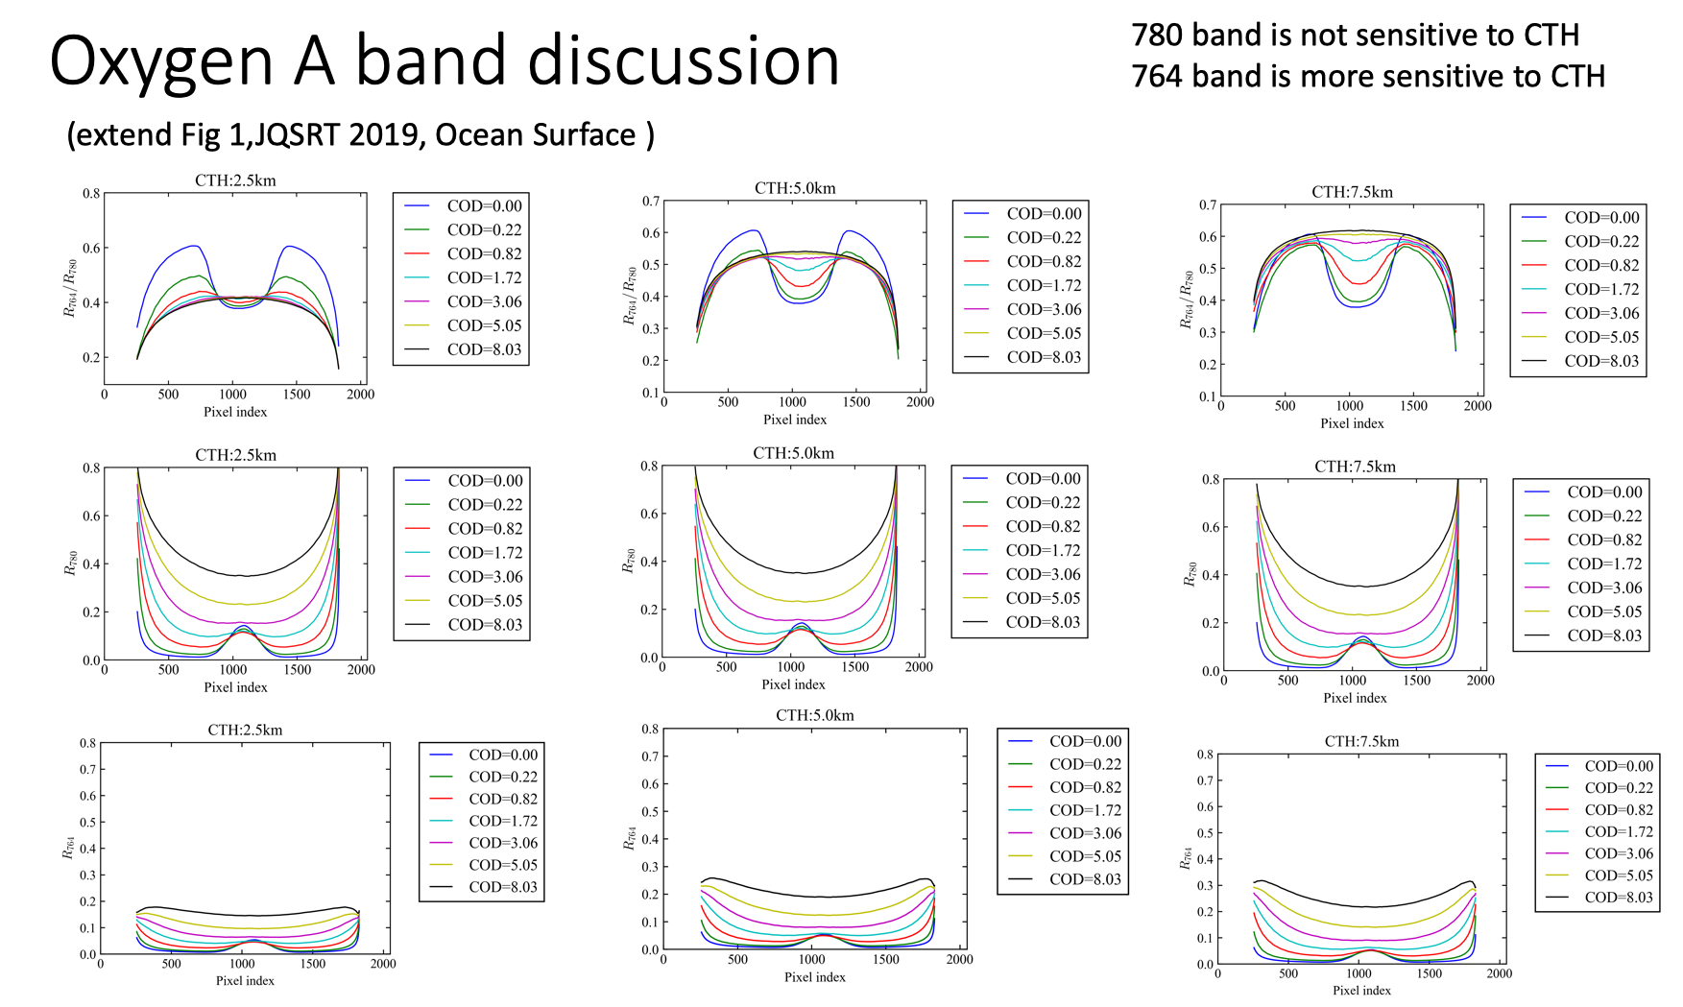
How can we avoid over detection of clouds in the glint region?
EPIC geometry
Simulated radiances
Zero surface albedo
Cox-Munk Ocean roughness with 6 m/s surface wind
Meng et al. 2019

Slide 9
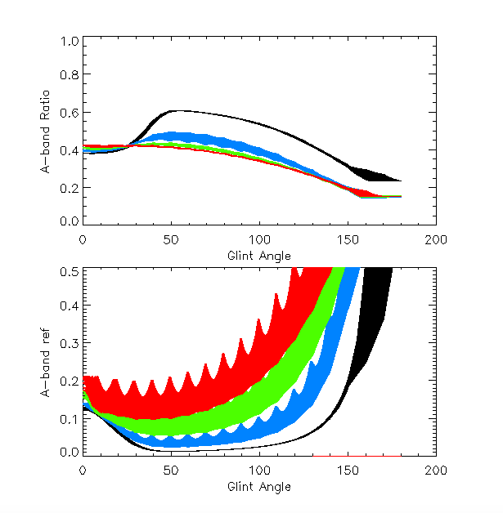
COD = 0
COD = 0.22
COD = 0.82
COD = 1.72
Ensemble of simulated A-band ratio and reflectance with geometries from EPIC granules from each month in 2016
Well defined clear sky A-band reflectance and ratio
COD = 0
COD = 0.22
COD = 0.82
COD = 1.72

Slide 10
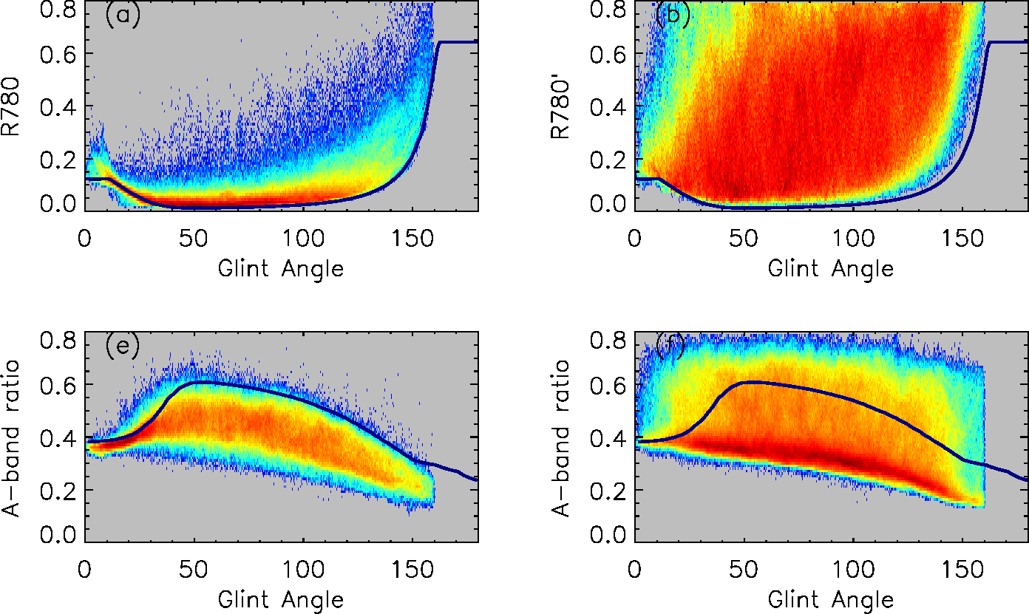
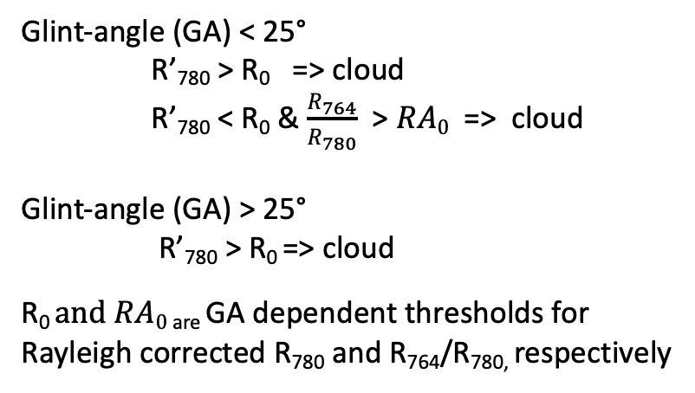
Improving cloud mask over ocean
Clear sky
Cloudy sky
Glint-angle (GA) < 25°
R’₇₈₀ > R₀ => cloud
R’₇₈₀ < R₀ & $\frac{R_{764}}{R_{780}}$ > $RA0$ => cloud
Glint-angle (GA) > 25°
R’₇₈₀ > R₀ => cloud
R₀ $and RA0$ _{are} GA dependent thresholds for
Rayleigh corrected R₇₈₀ and R₇₆₄/R_{780,} respectively
Note: Model derived clear sky reflectance and A-band ratio (solid lines) represent lower and up bounds of observed clear sky reflectance and A-band ratios. Some adjustments are necessary to use model derived thresholds.

Slide 11
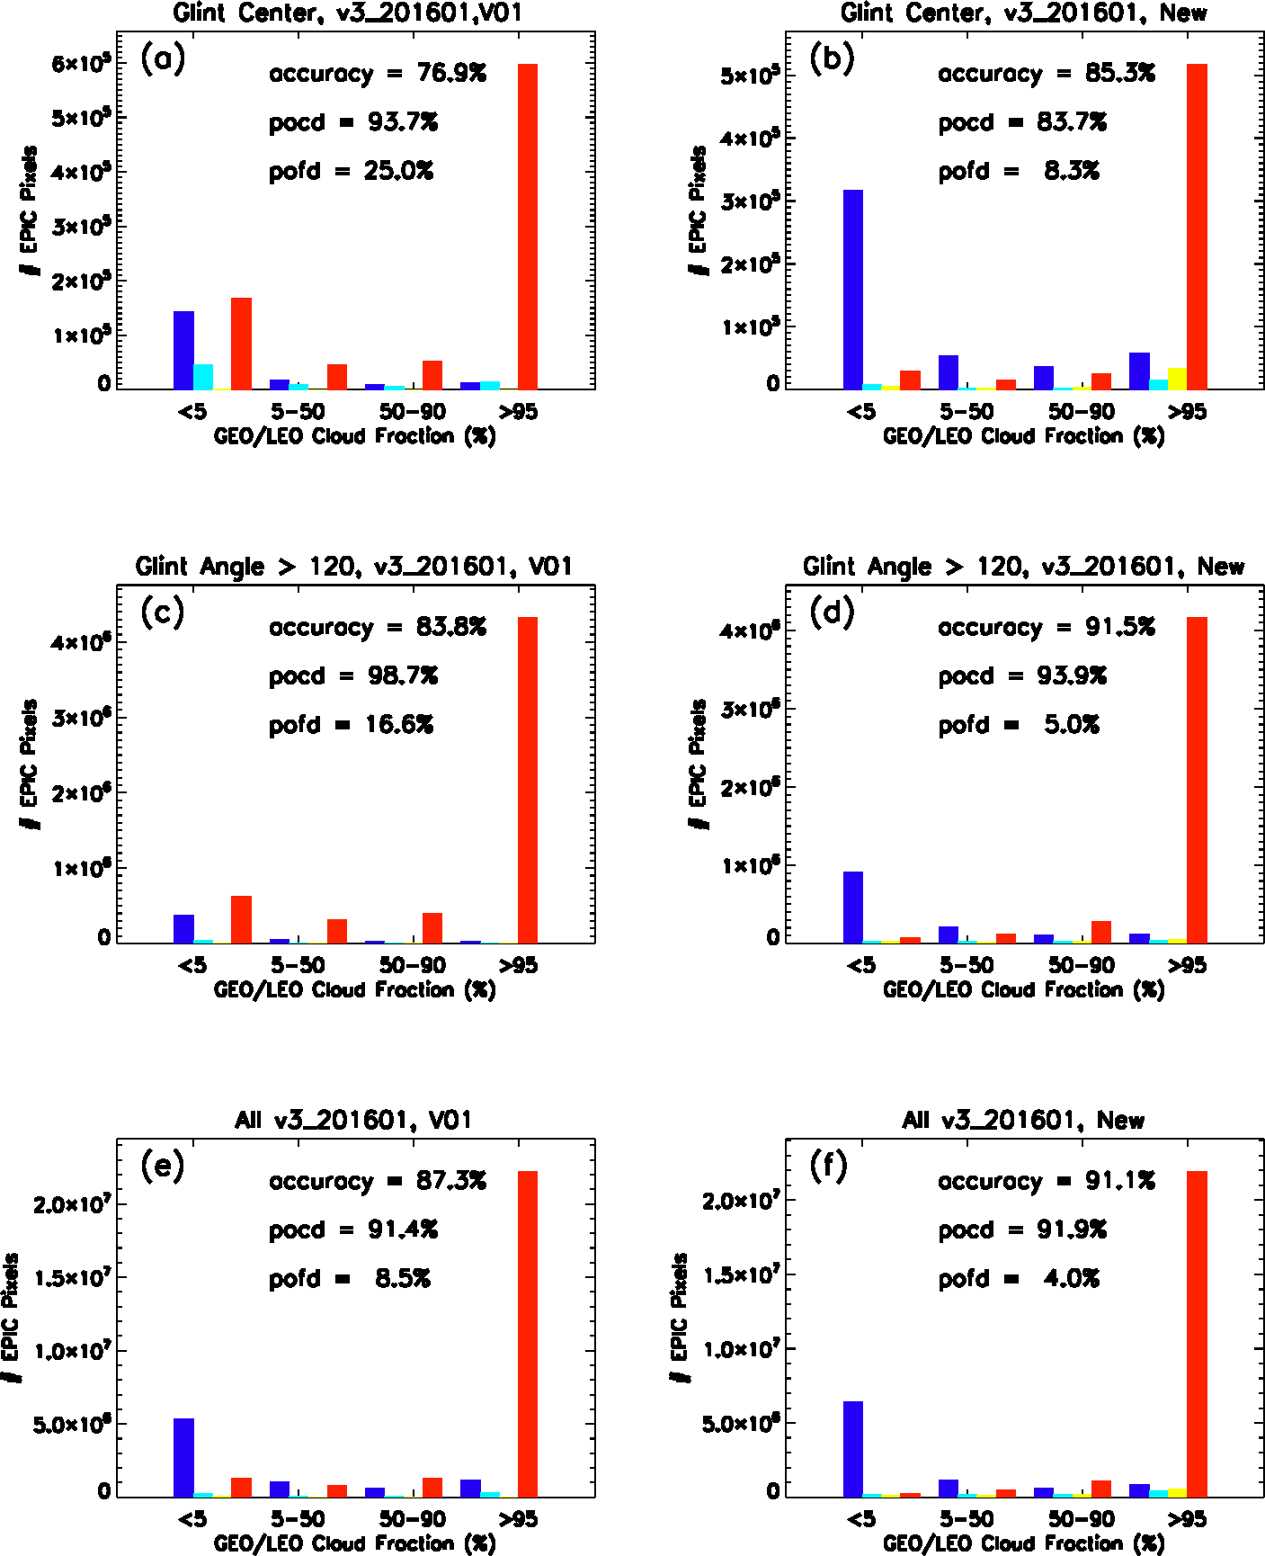
Cloud Mask Compared with Cloud Fraction from GEO/LEO Composite Products
EPIC and GEO/LEO composite collocation data (5-min) :
Major improvements in Glint Center (GA < 25°) and large angles (GA > 120°)
Overall improvement over ocean > 2~3%.
Similar improvements in all 7 months tested.

Slide 12
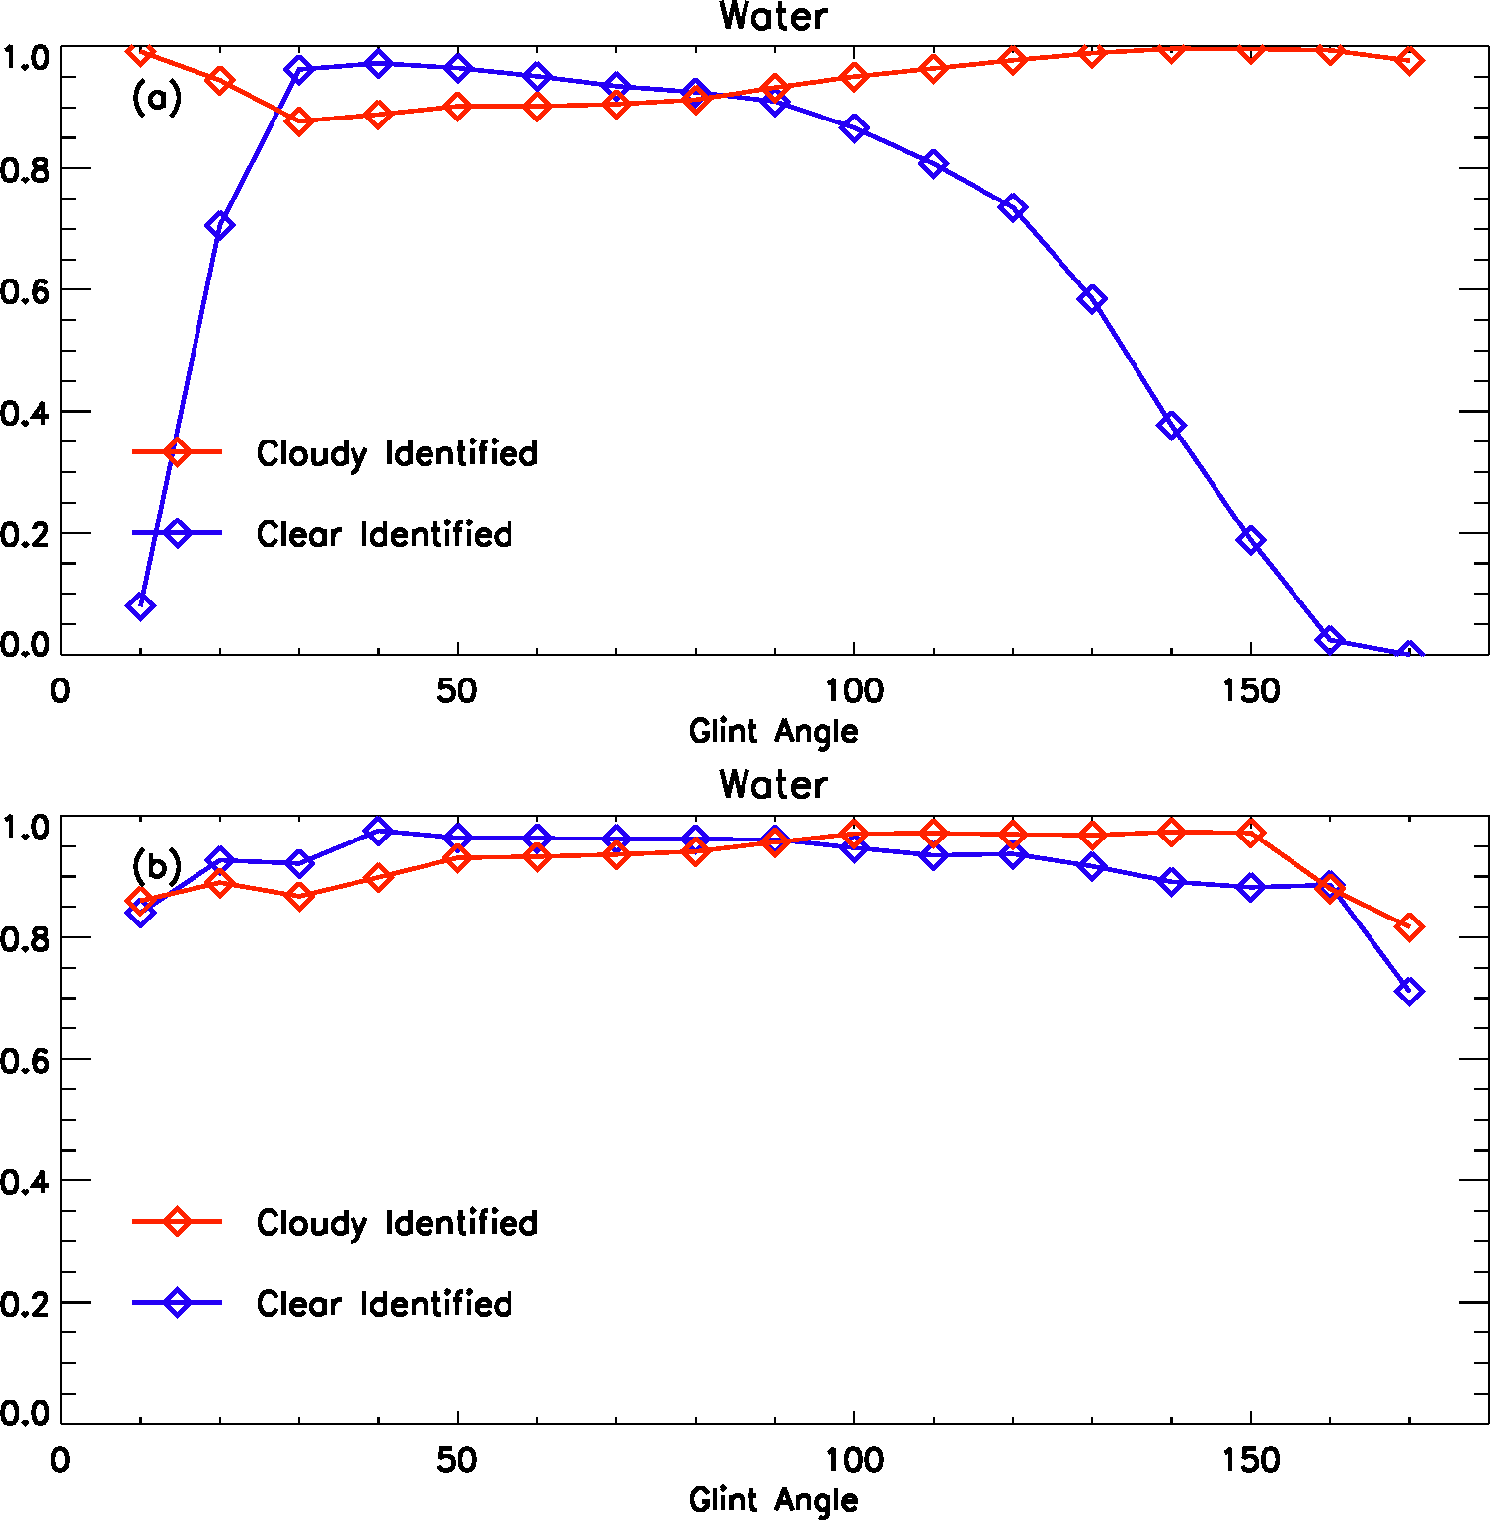
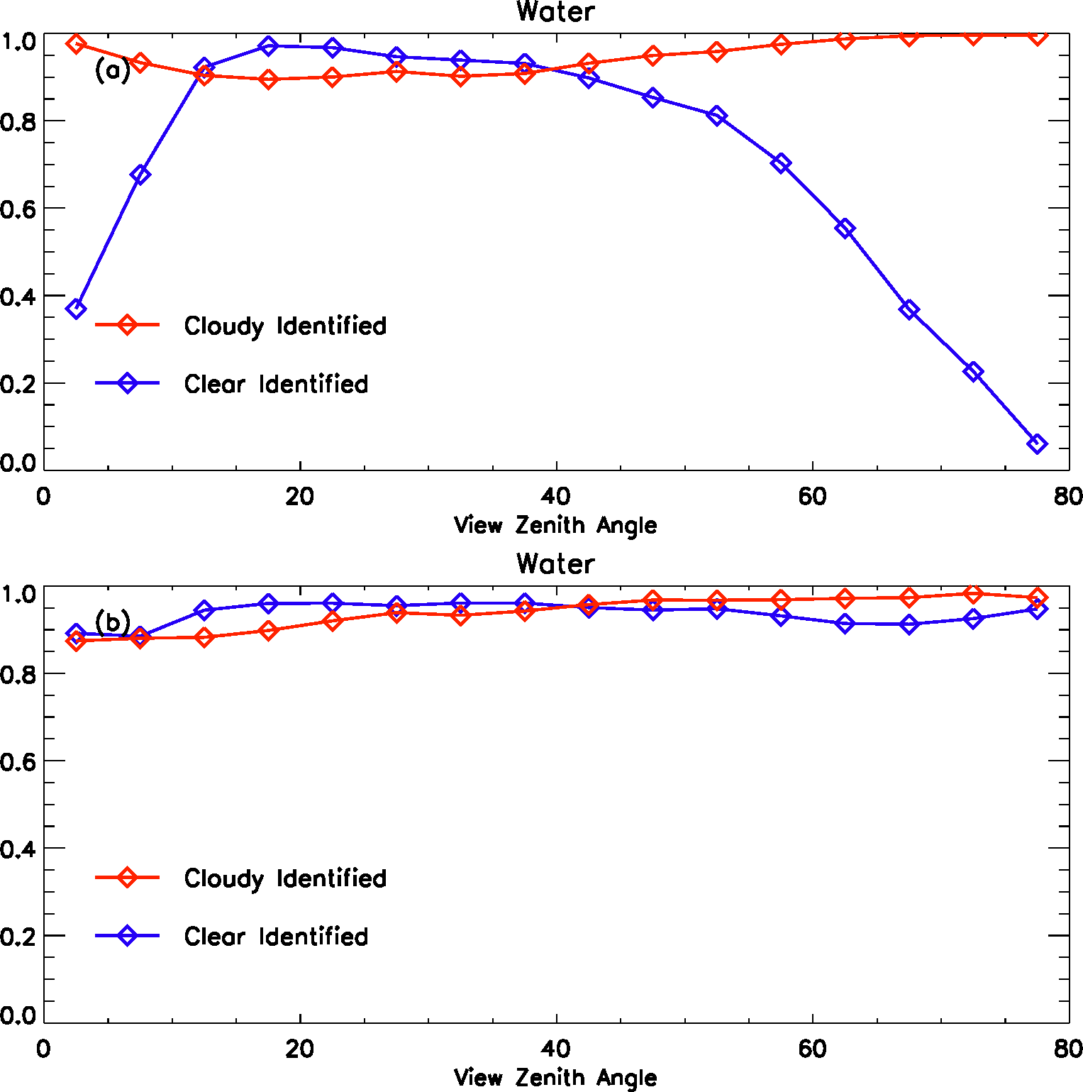
Fraction of cloud and clear sky pixels detected (based on GEO/LEO data) as a function of glint angle and view zenith angle (201601)
Original
New
Original algorithm does not detect enough clear sky pixels at both ends.
Both glint center and granule edges are much improved.
Residual bias and large uncertainties in granule edge (GA > 150°)

Slide 13
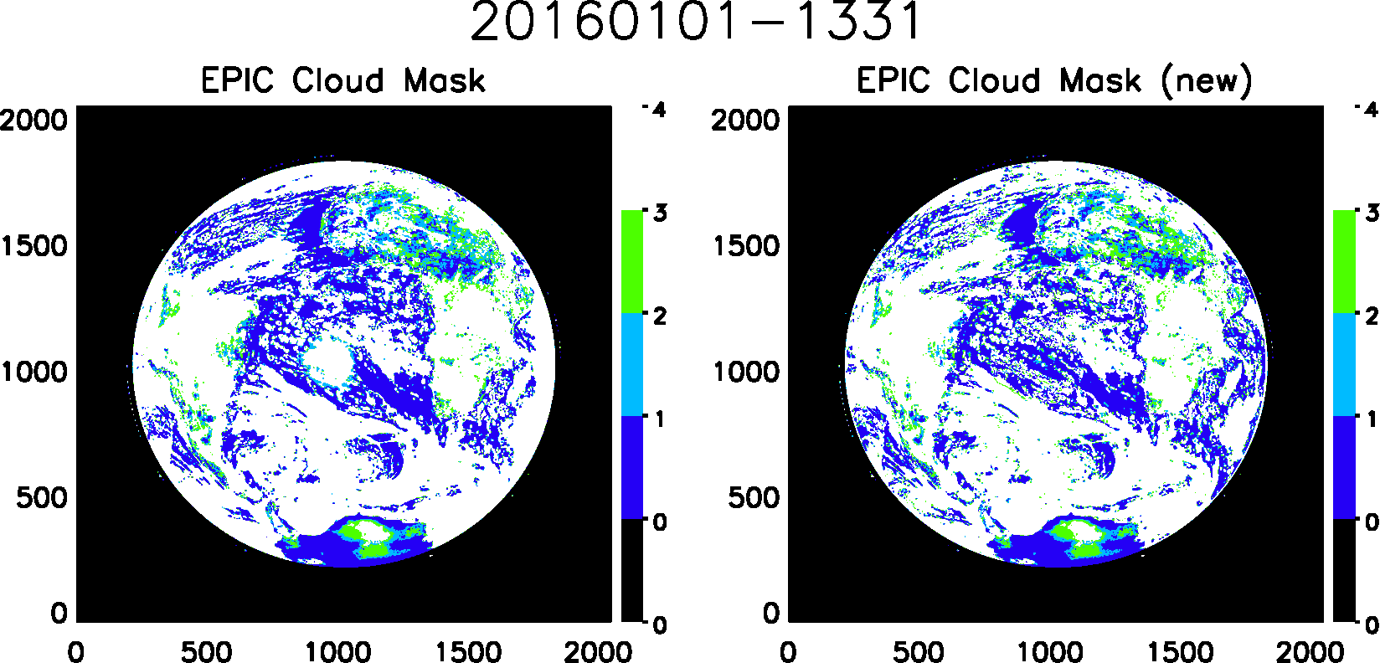
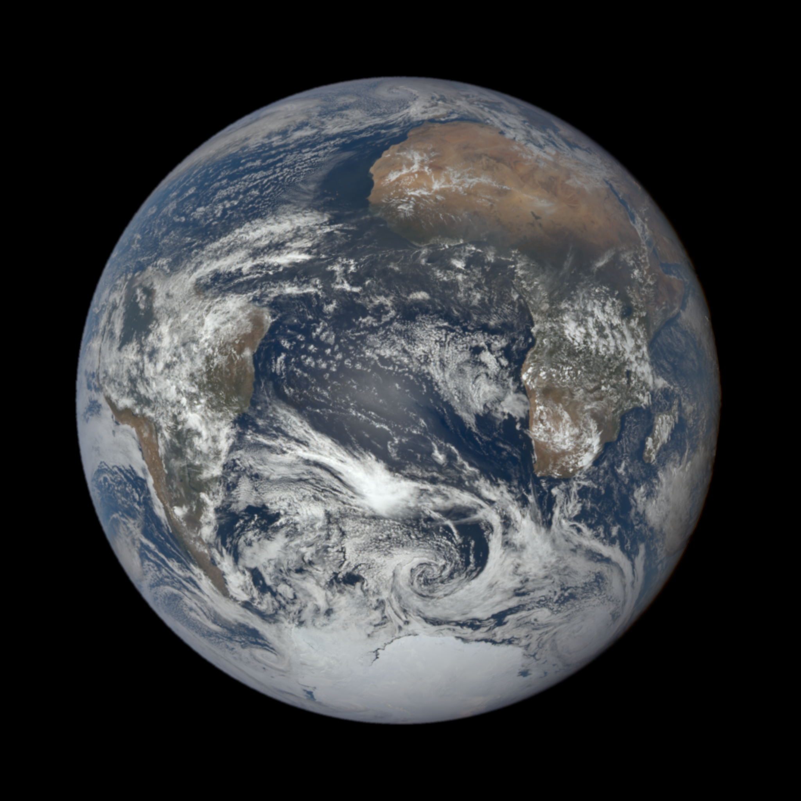
Sample Granules

Slide 14
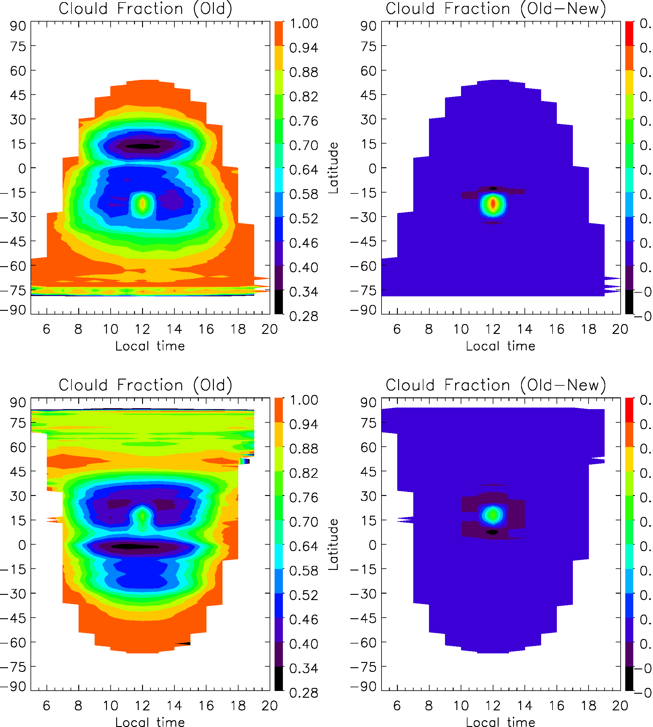
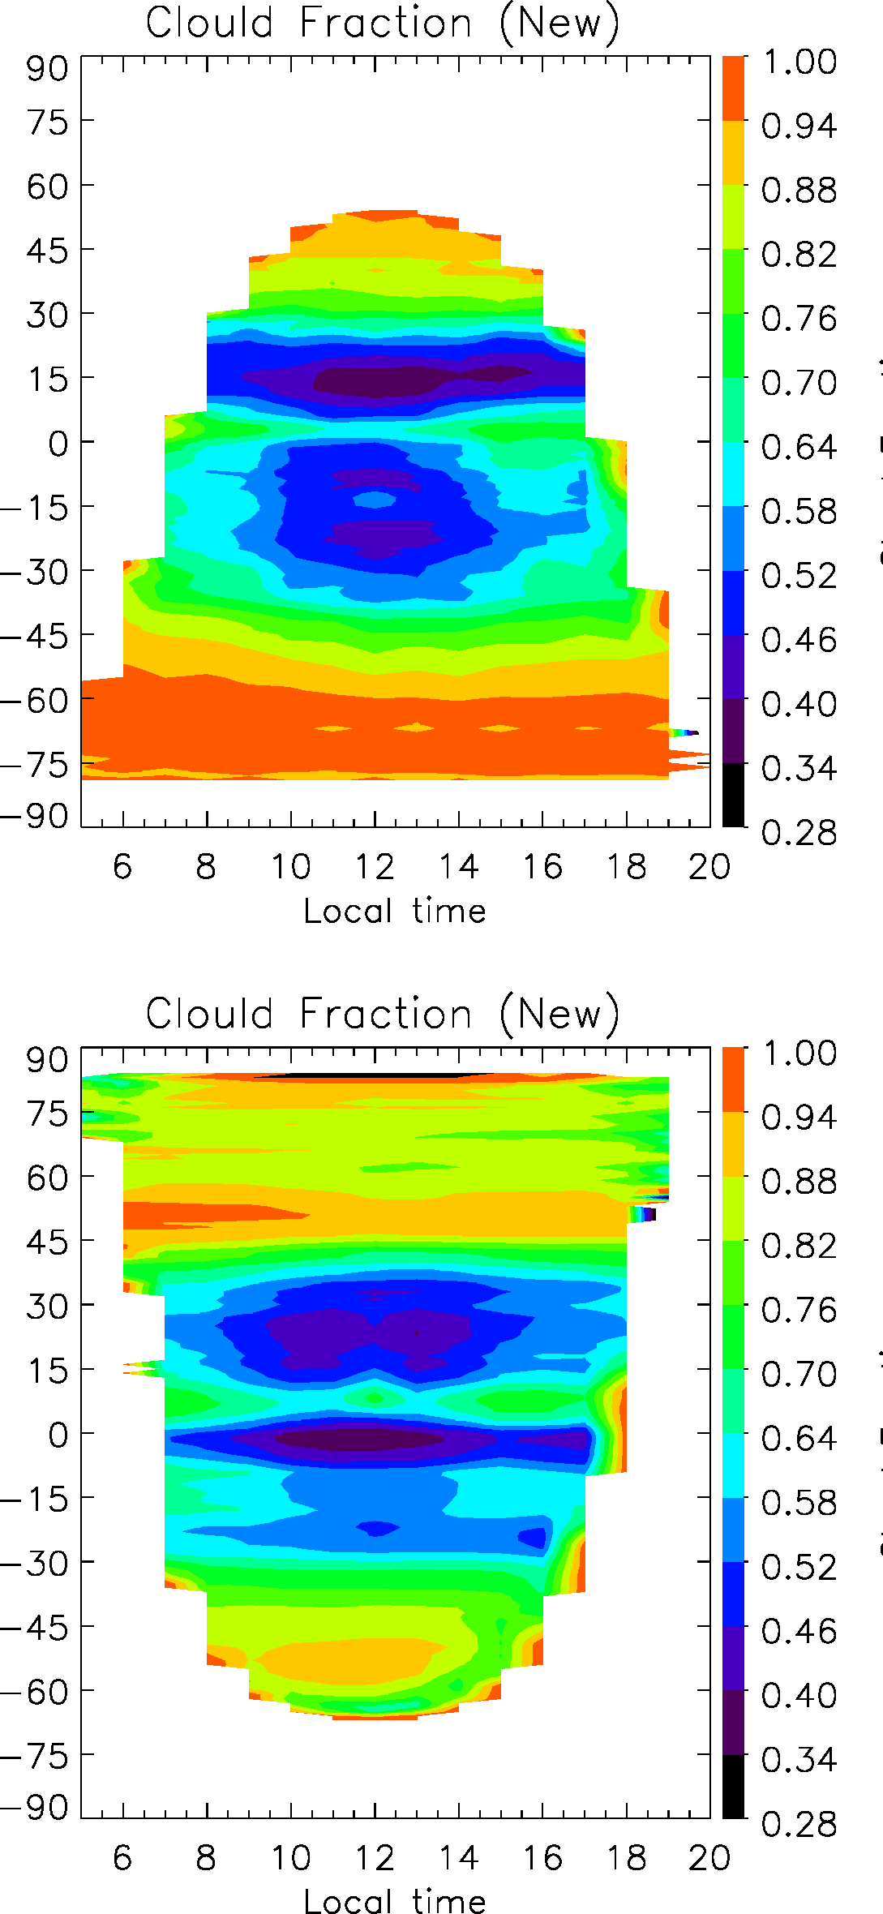
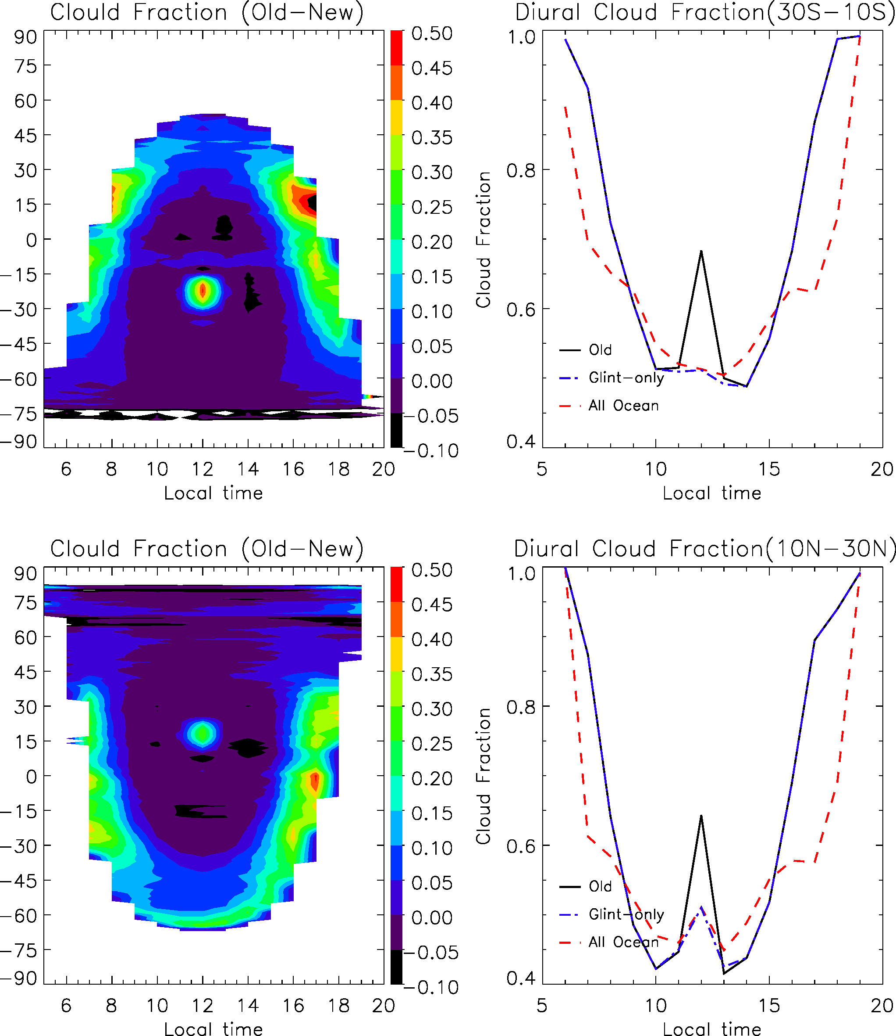
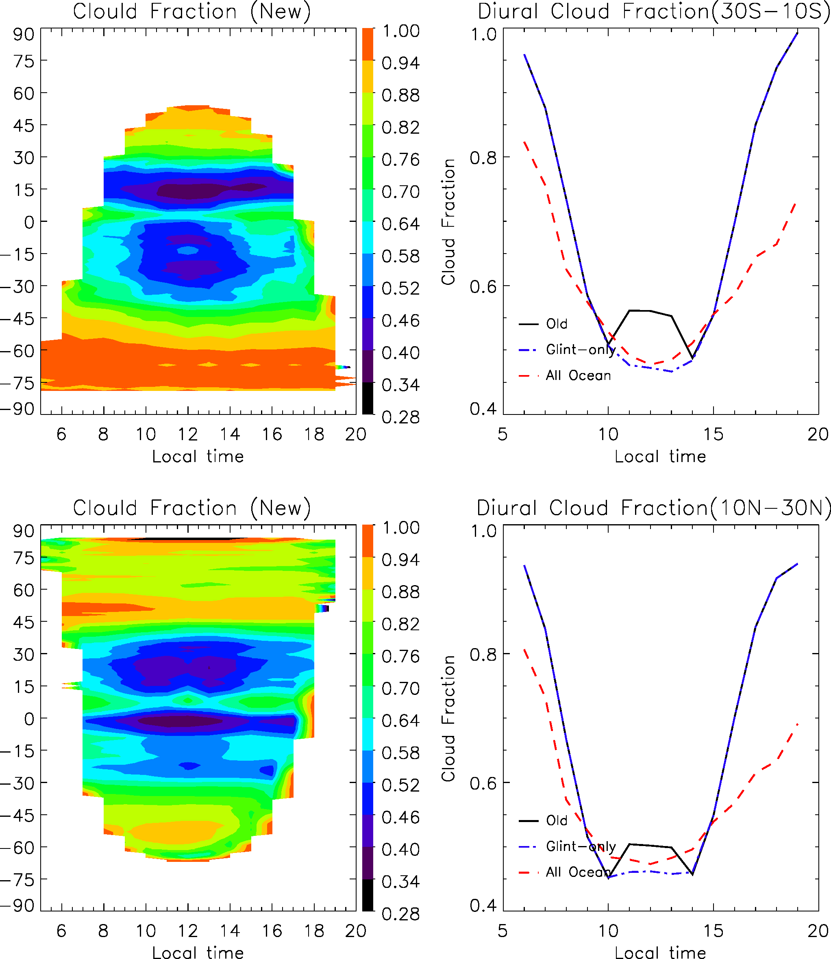
Impact on Oceanic Cloud Diurnal Cycles
January
July

Slide 15
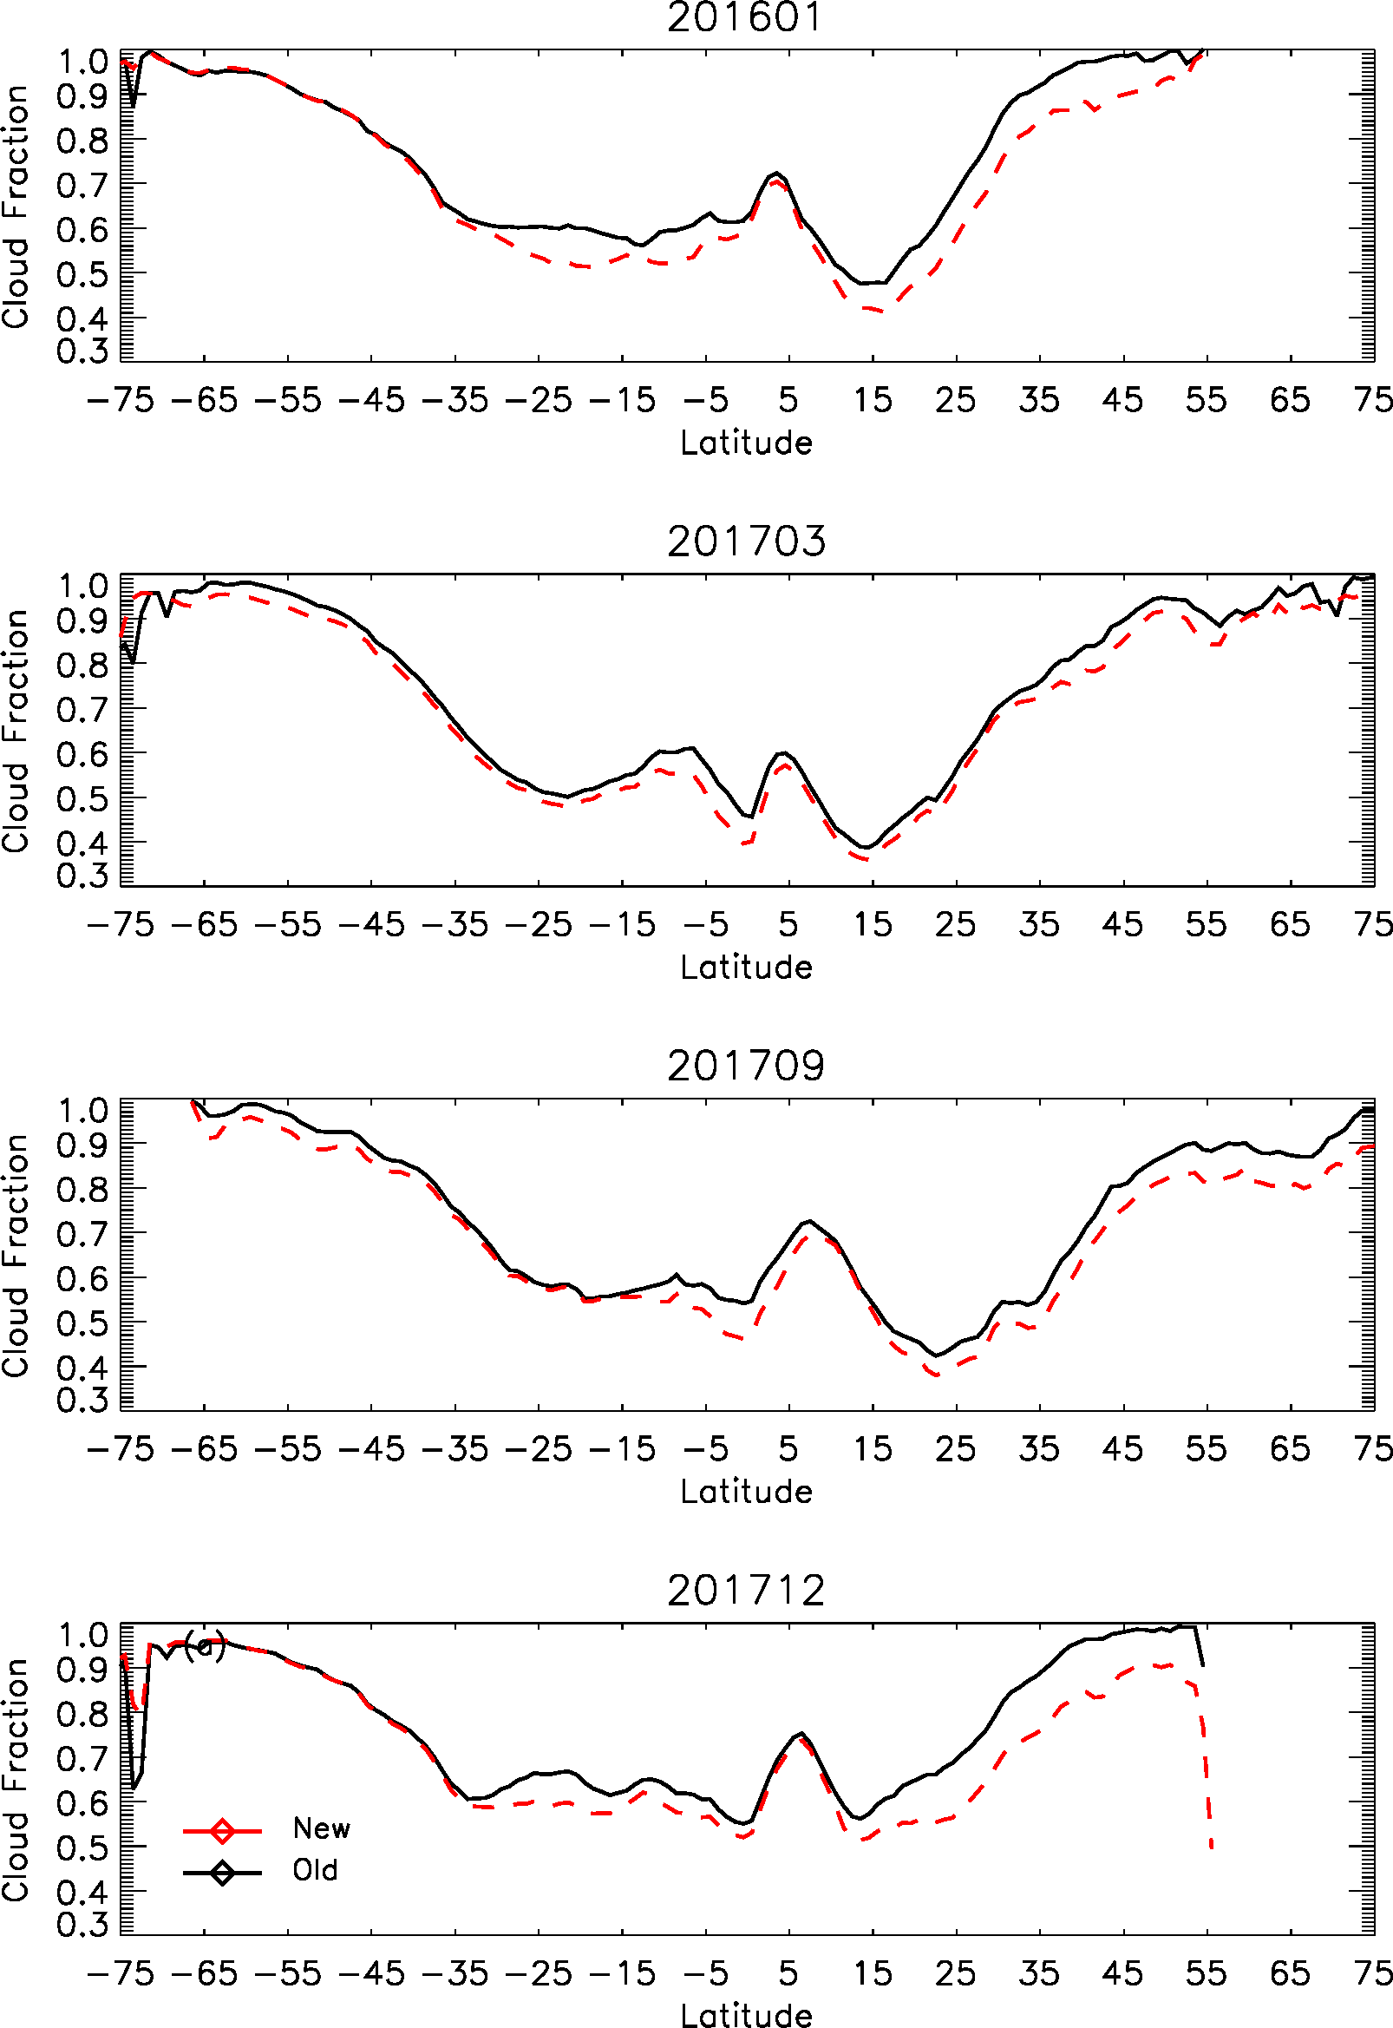
Impact on Zonal Mean Cloud Fractions
Slight reduction in glint center latitude (~5%).
Up to 10% reduction in high latitude winter hemisphere
Latitudinal cloud reduction is seasonal dependent

Slide 16
Conclusions
Dynamically varying A- and B-band ratio thresholds as a function of surface elevation and zenith angles significantly improves the accuracy of cloud mask over snow and ice, e.g., Antarctic, Greenland.
Cloud mask over ocean has been improved with new glint-angle dependent R780 threshold; In the glint center, additional A-band ratio tests are implemented to supplement reflectance only test.
The new ocean cloud mask algorithm reduces significant glint-induced overestimation of cloud fraction in the granule center and overestimation of clouds in high zenith/solar angles.
The new ocean cloud mask improves the diurnal cycles of ocean cloud fraction by reducing the artificial peak at local noon time in the glint center latitudes and reducing early morning and afternoon cloud fraction in most oceanic regions.

Slide 17
Conclusions (cont.)
A-band ratio helps cloud detection in very difficult situations such as over snow/ice and sun glint surfaces. It has low sensitivity for thin clouds with optical thickness less than 3 or low clouds below 2.5 km due to closeness between clear sky and cloud sky values (applies to both snow/ice and glint cases)
Current study has not considered the impact of ocean surface wind speed and aerosol to the clear sky thresholds. Ocean surface wind could be potentially used to further improve the algorithm.

