Slide 1
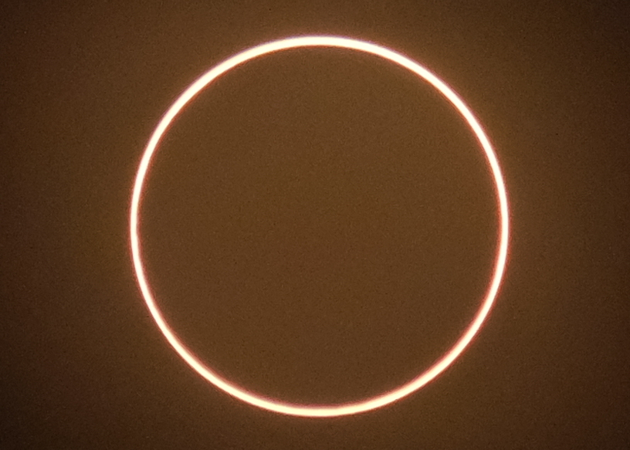
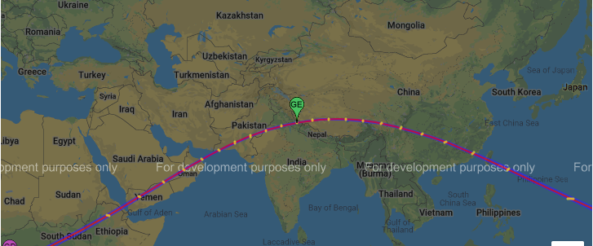
Reduction of Spectral Radiance Reflectance during the Annular Solar Eclipse of 21 June 2020 from DSCOVR/EPIC
Guoyong Wen, Alexander Marshak, and Jay Herman

Slide 2
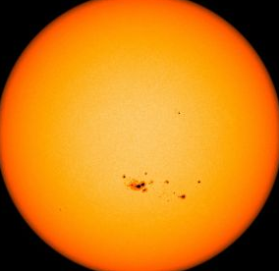
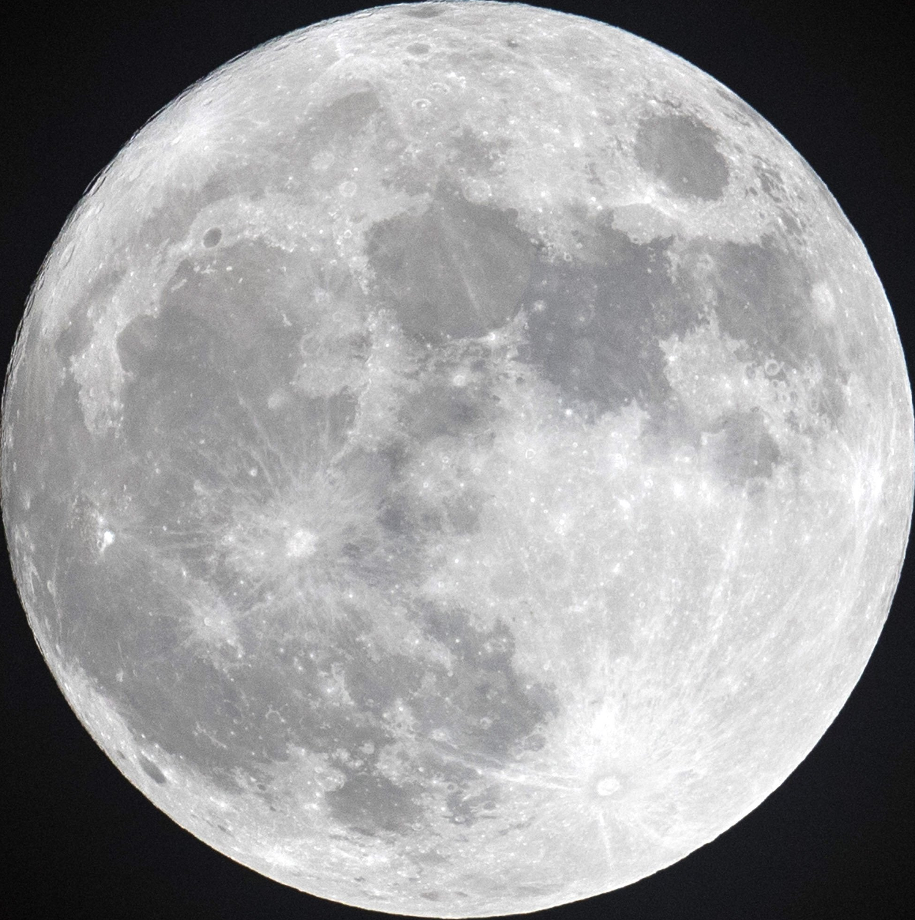
Total Solar Eclipse R_{moon} > R_{sun} Magnitude (2017) = 1.0306
Total Solar Eclipse vs Annular Solar Eclipse
Partial Eclipse
Total Eclipse
Magnitude = R_{moon} / R_{sun}
Annular Solar Eclipse
R_{moon} < R_{sun}
Magnitude (2020) = 0.994
Covered area≈98.8%
Partial Eclipse
Annular Eclipse

Slide 3
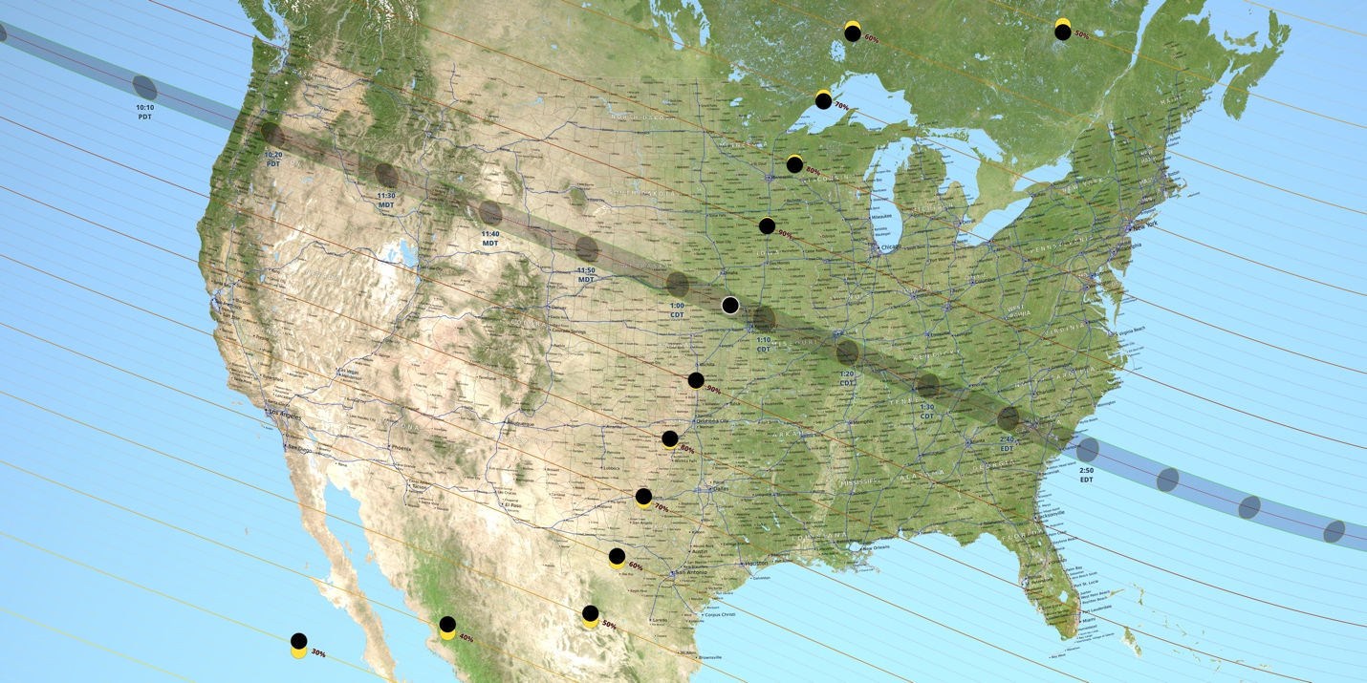
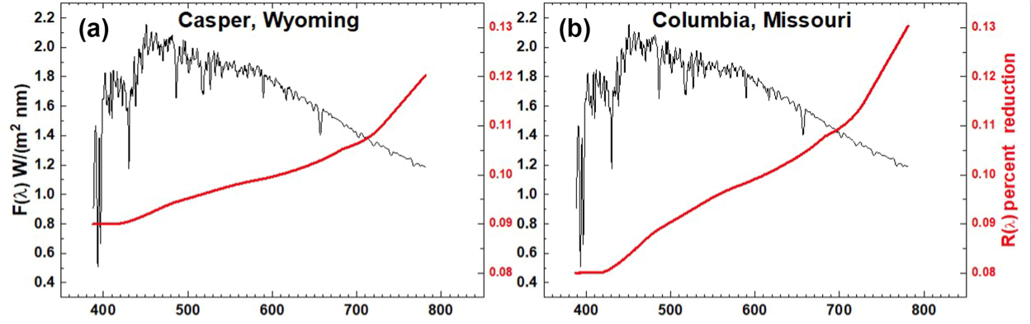
2020 Annular Solar Eclipse vs 2017 Total Solar Eclipse
June 21, 2020
August 21, 2017
Casper
Columbia
In 2017 eclipse, about 10% reduction in spectrally integrated reflectance over Casper, WY and Columbia, MO from EPIC (Herman et al., 2018)
What can we learn from June 21, 2020 solar eclipse?
Wavelength [nm]
Wavelength [nm]

Slide 4
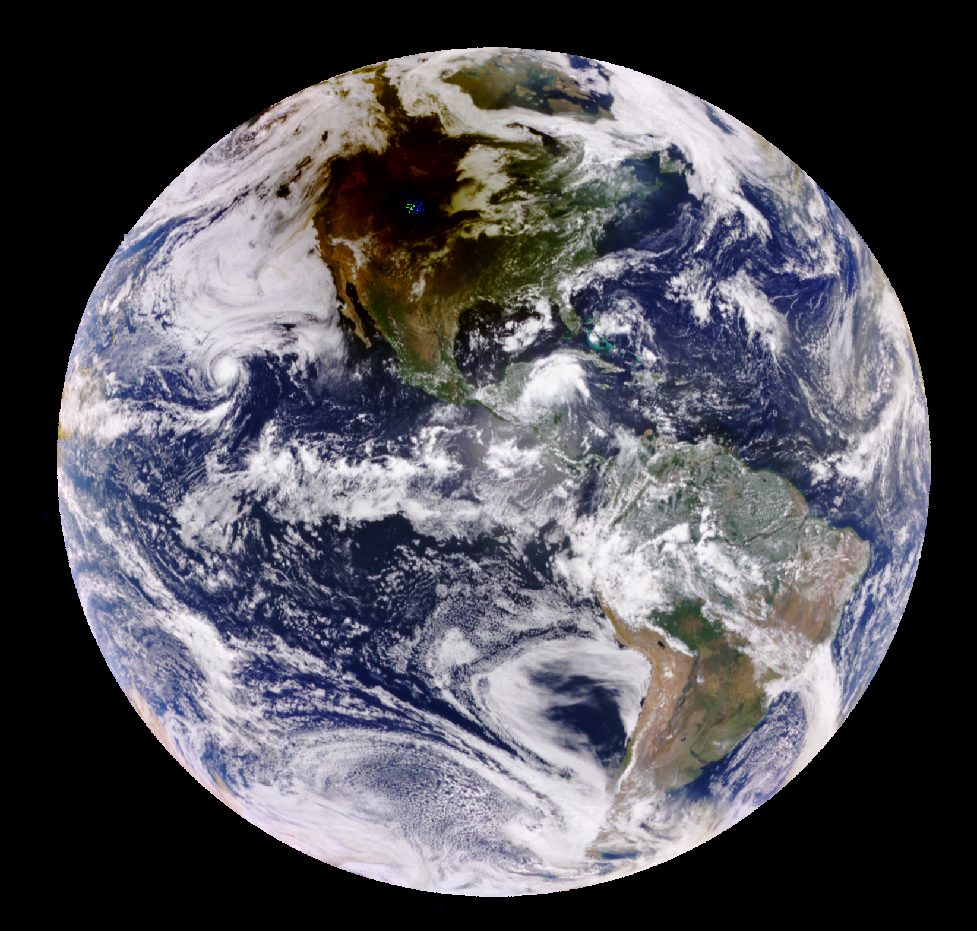
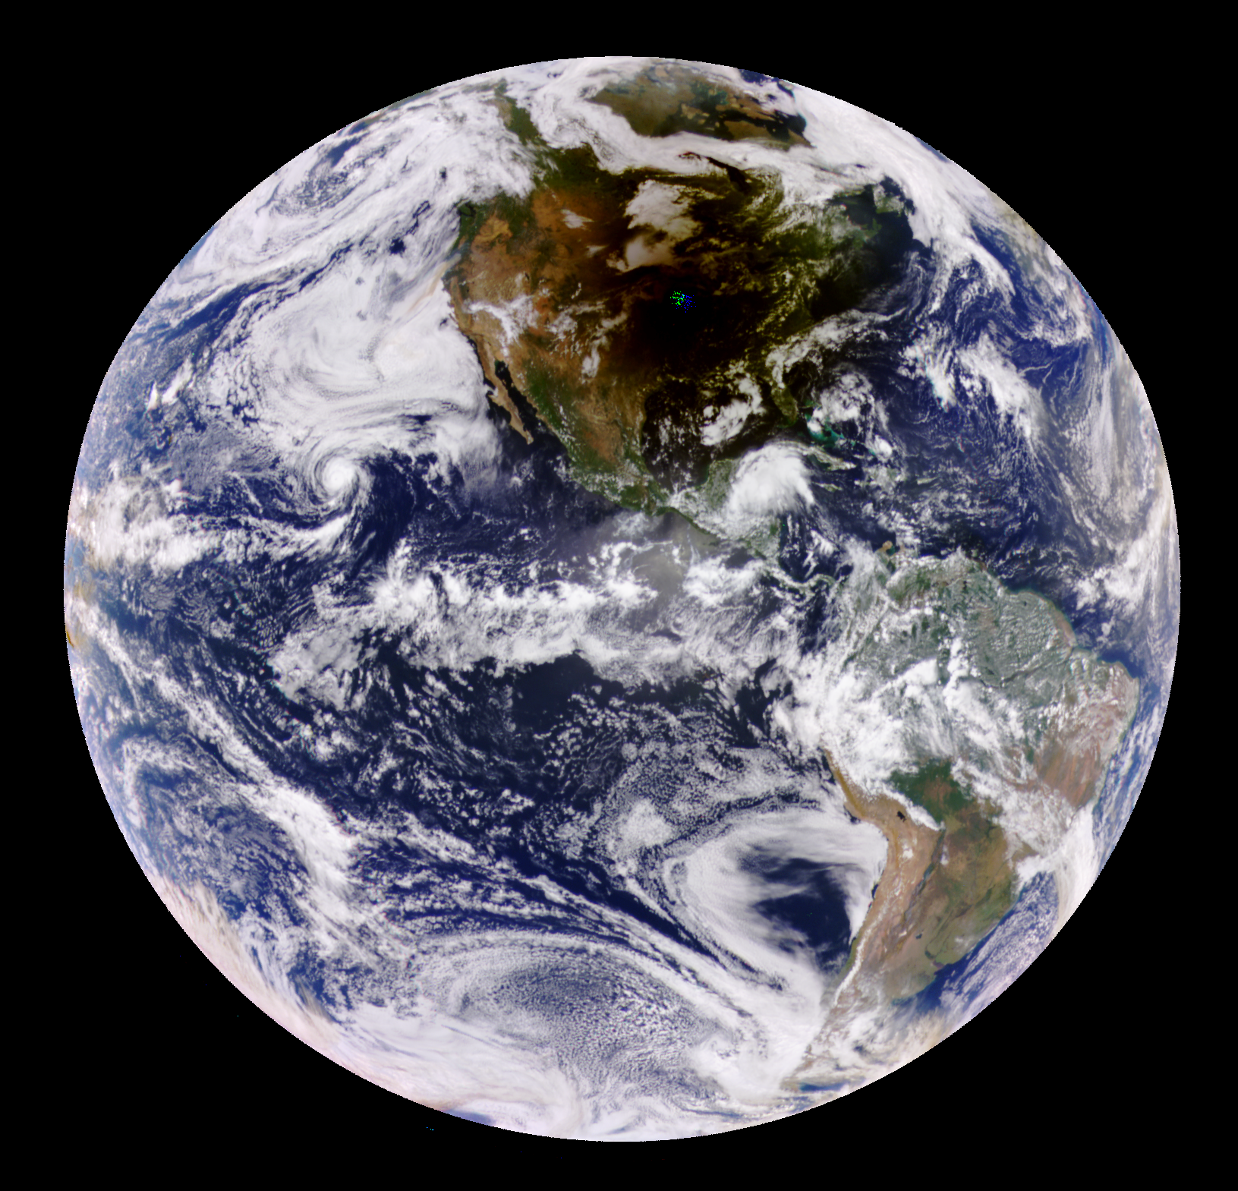
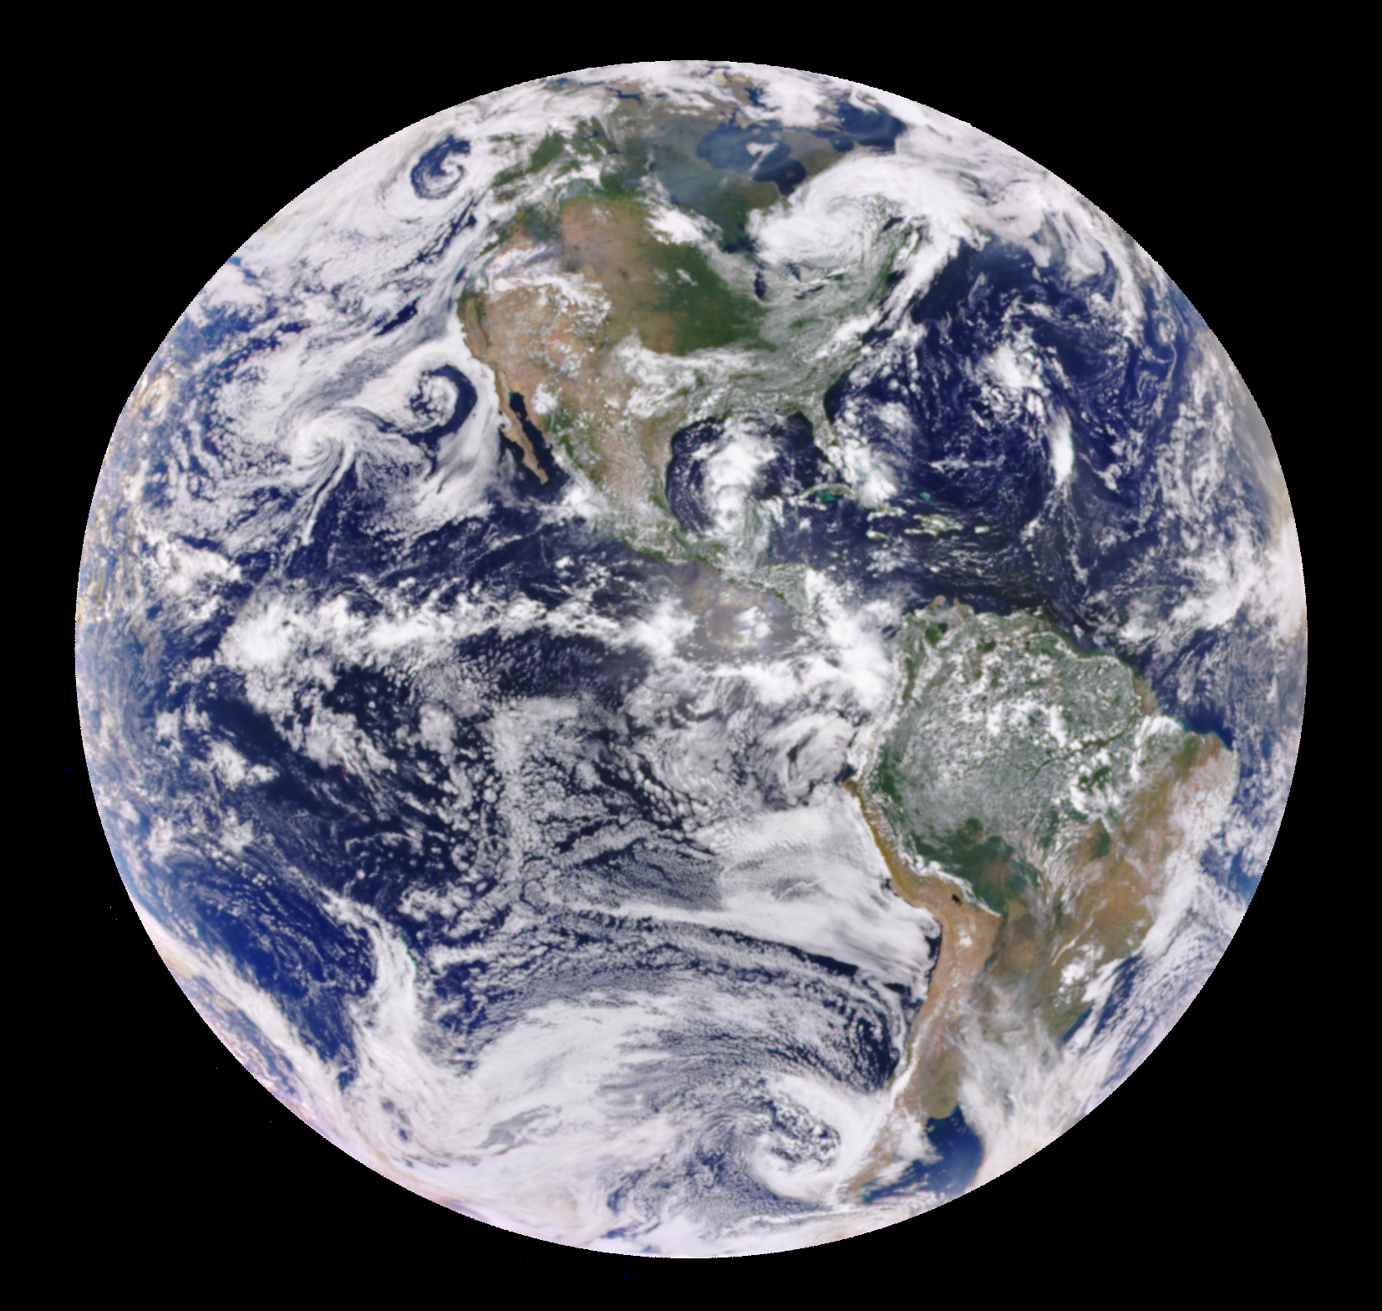
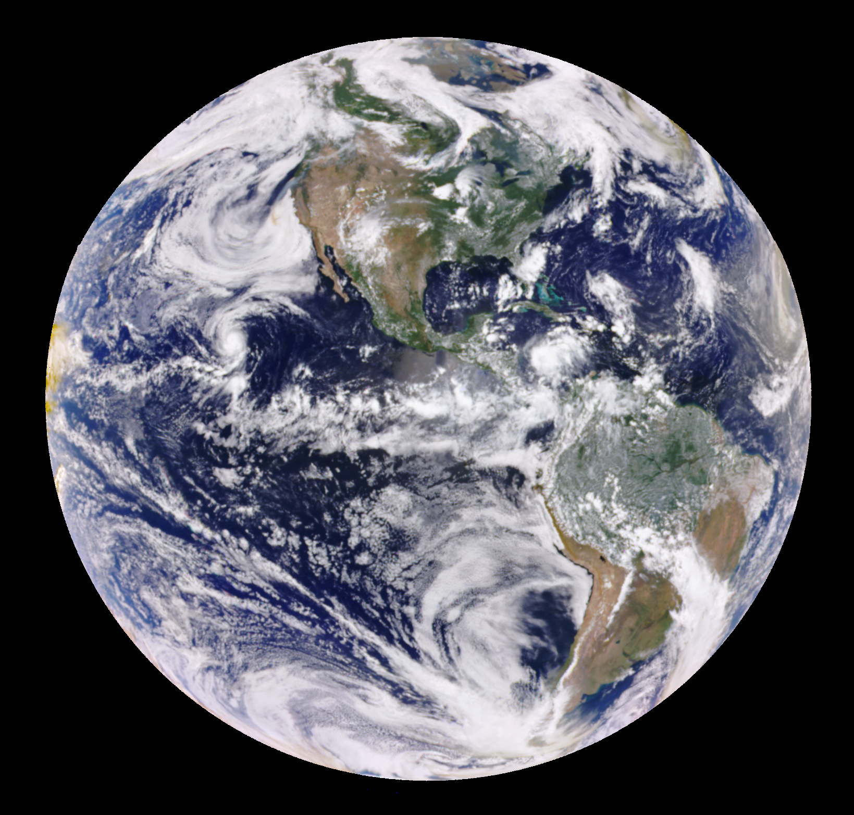
2017 Eclipse vs Non-Eclipse EPIC Images
Casper, WY
Columbia, MO
08/21
08/21
Day-to-day variabilities of EPIC image are small except in Moon’s shadow, allowing us to examine the impact of solar eclipse on global average reflected solar radiation.
17:44:50 UTC
18:14:50 UTC
08/23
08/20
17:54:36 UTC
18:03:59 UTC

Slide 5
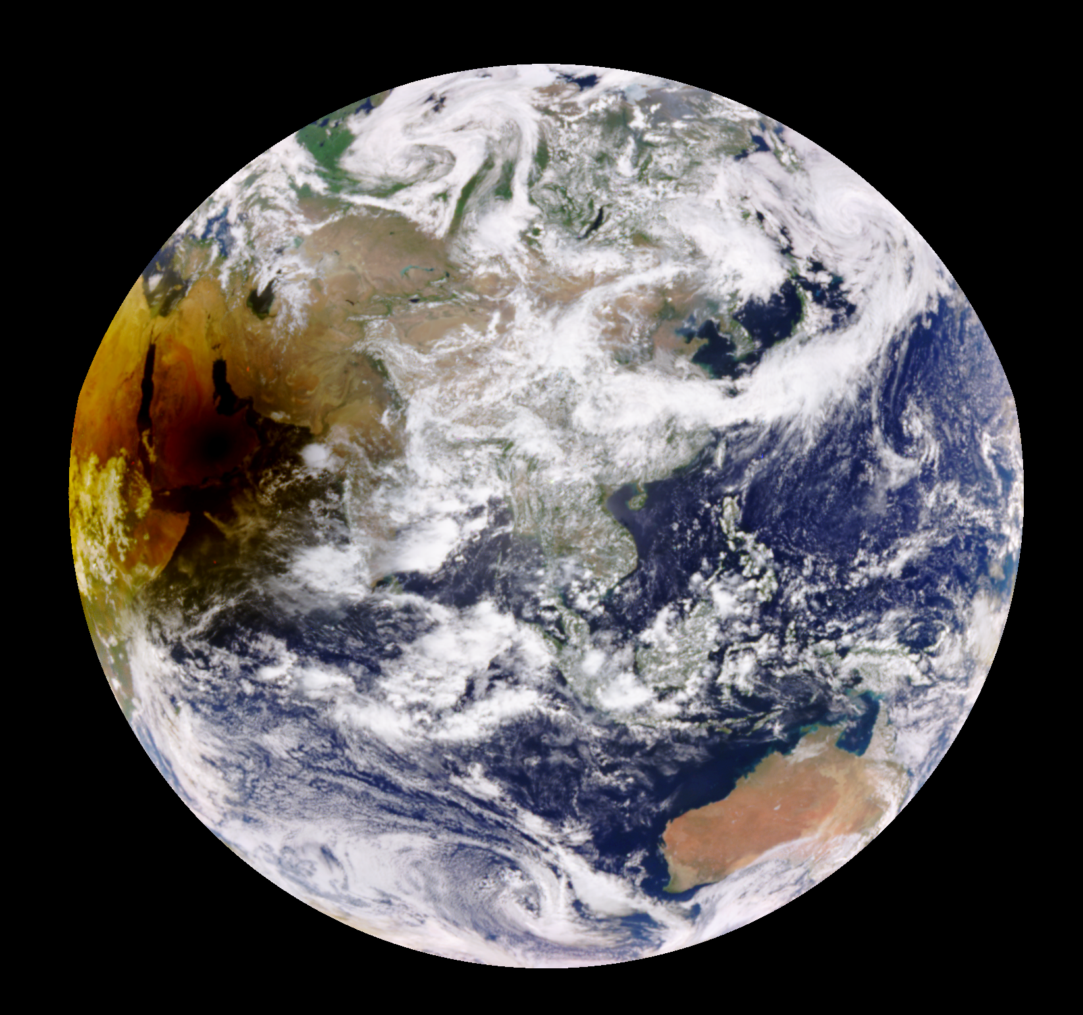
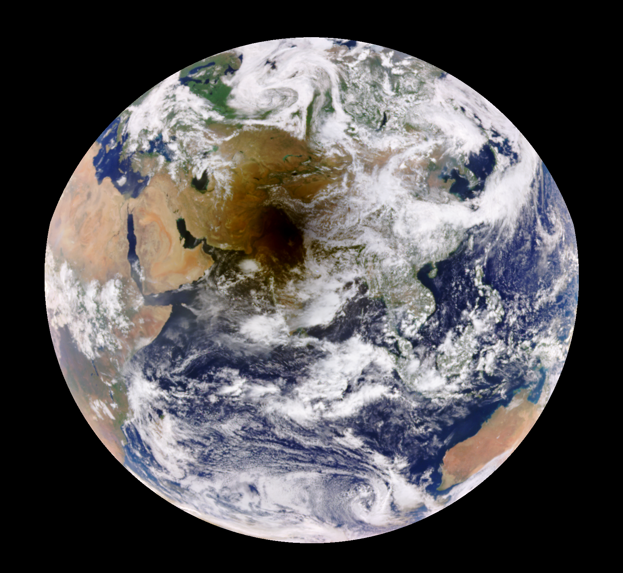
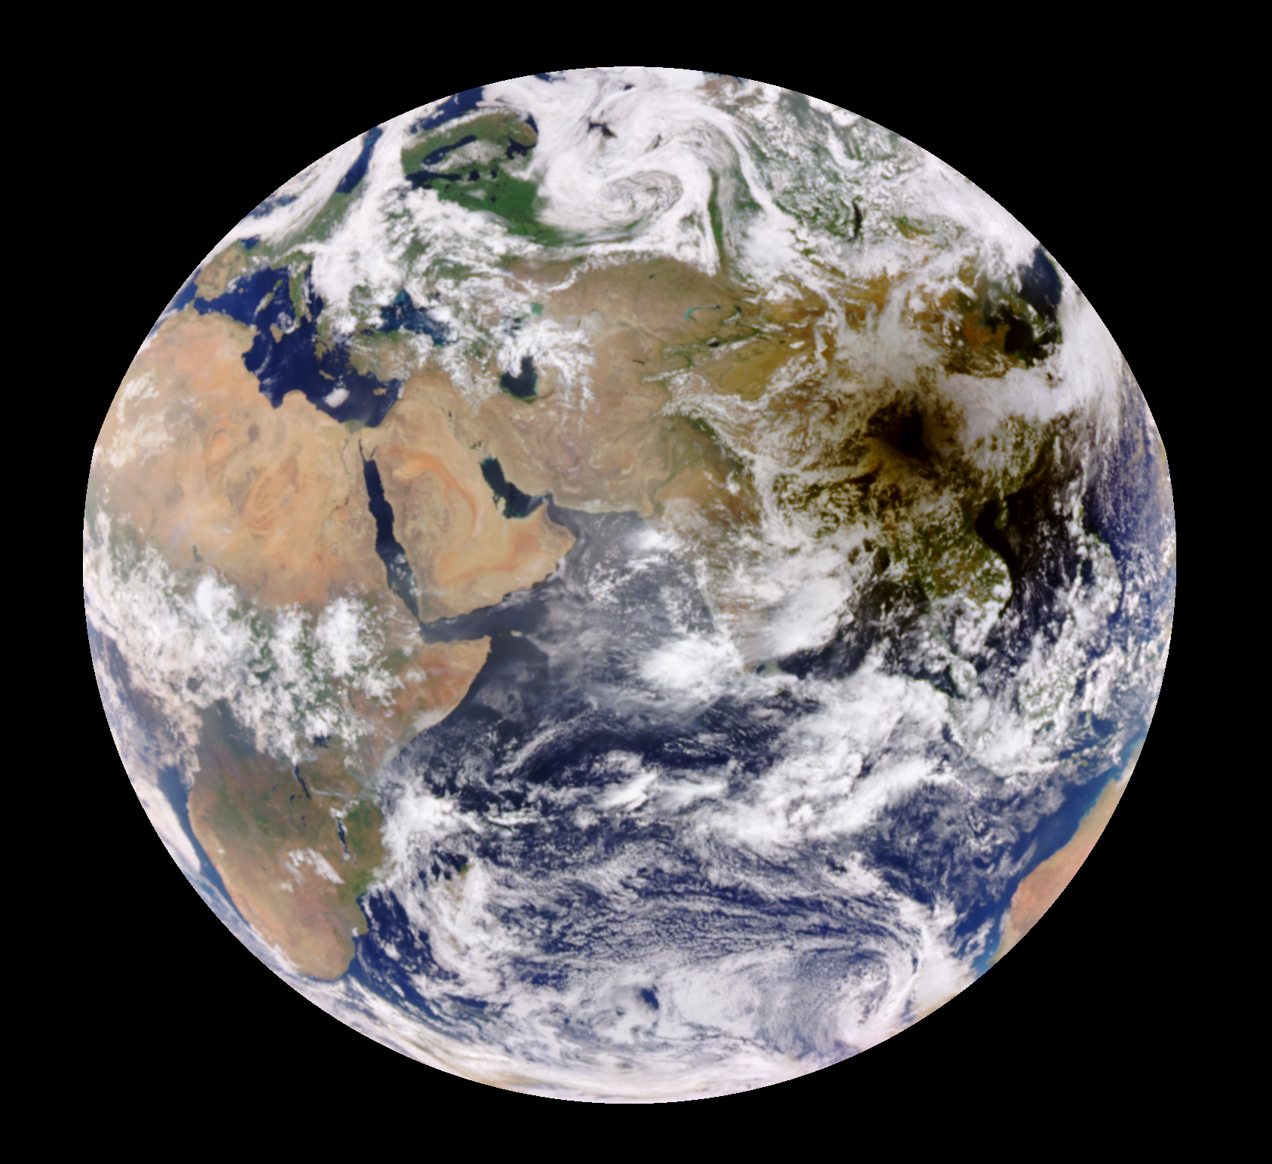
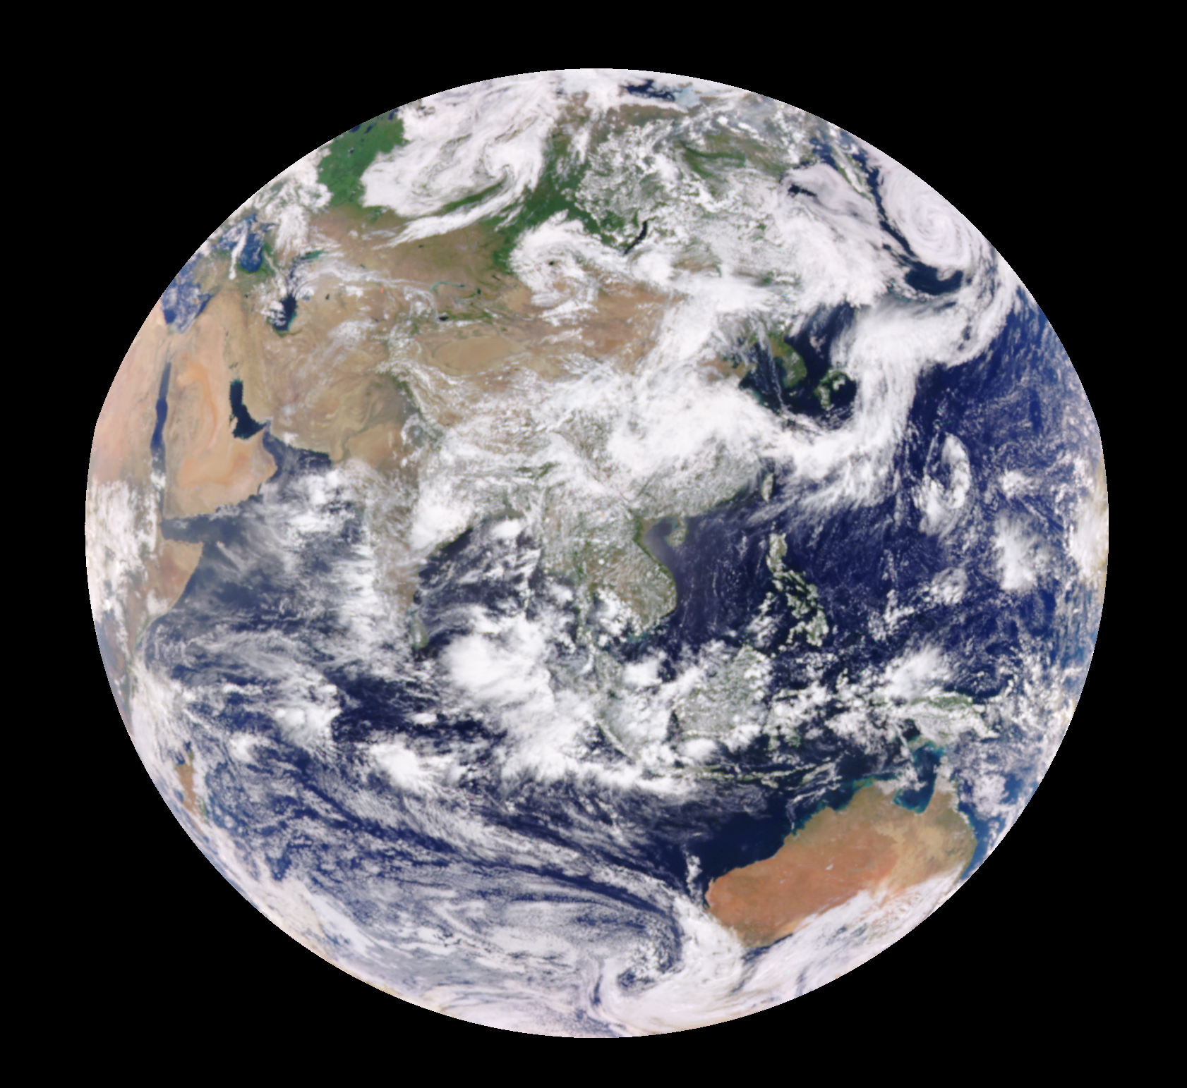
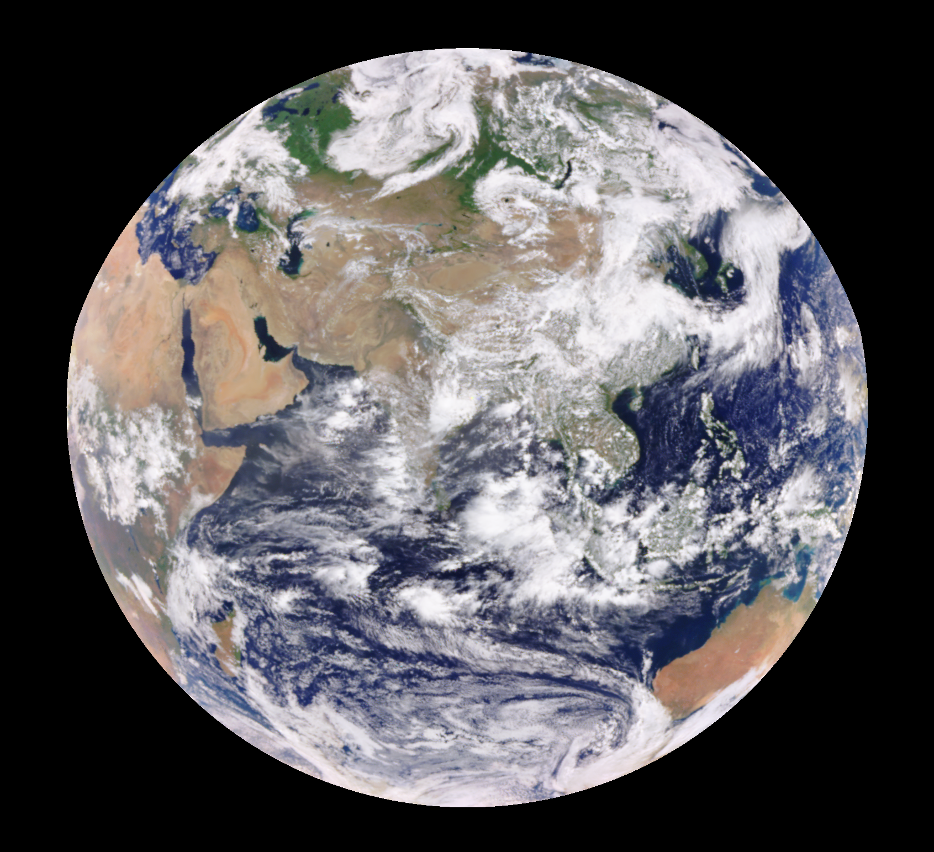
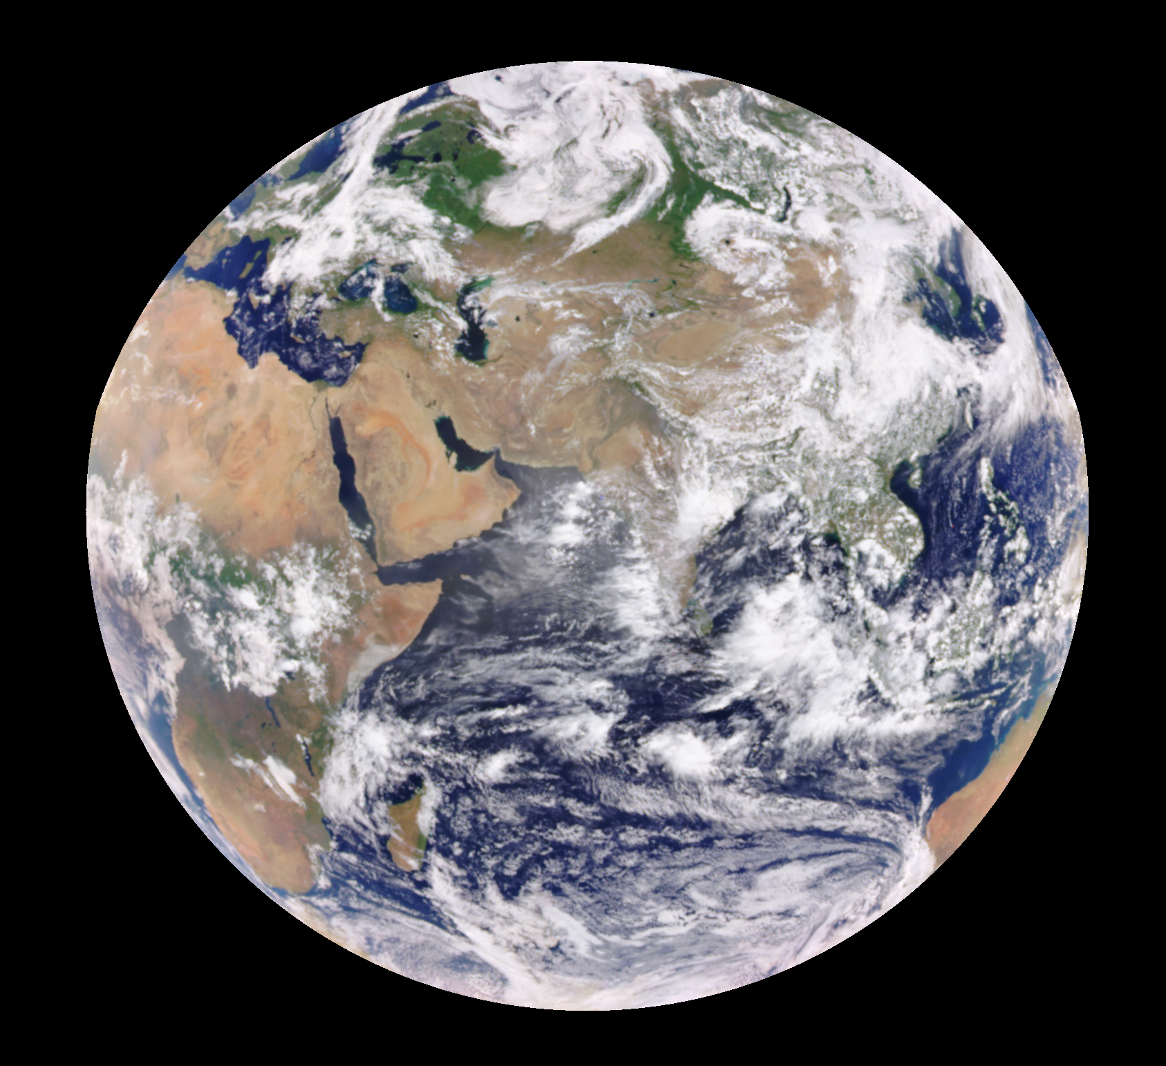
2020 Eclipse (June 21) vs Non-Eclipse (June 22) EPIC Images
05:26 UTC
06:31 UTC
07:37 UTC
05:17 UTC
06:22 UTC
07:28 UTC

Slide 6
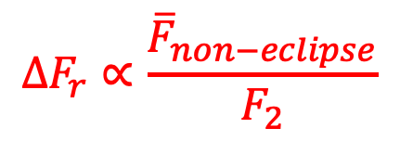
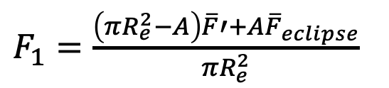

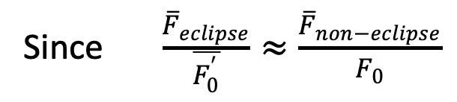
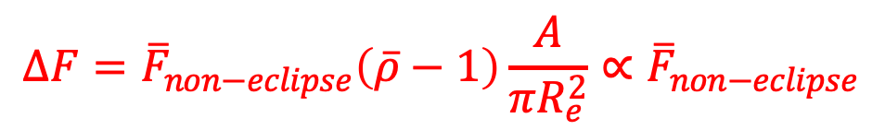
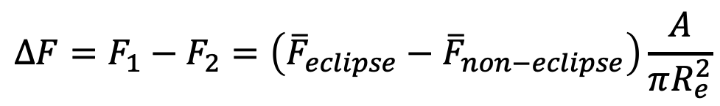
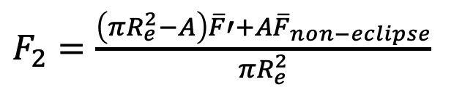
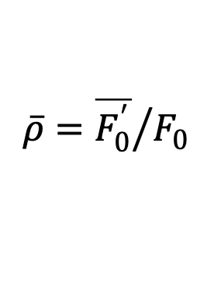
The $∆F$ ∝ Average Radiation in the “Shadow Area” for Non-Eclipse
$F_{1}=\frac{\left(πR_{e}^{2}−A\right)\overline{F}′+A{\overline{F}}_{eclipse}}{πR_{e}^{2}}$
$F_{2}=\frac{\left(πR_{e}^{2}−A\right)\overline{F}′+A{\overline{F}}_{non−eclipse}}{πR_{e}^{2}}$
$$∆F=F_{1}−F_{2}=\left({\overline{F}}_{eclipse}−{\overline{F}}_{non−eclipse}\right)\frac{A}{πR_{e}^{2}}$$
Since $\frac{{\overline{F}}_{eclipse}}{\overline{F_{0}^{′}}}≈\frac{{\overline{F}}_{non−eclipse}}{F_{0}}$
$$∆F={\overline{F}}_{non−eclipse}\left(\overline{ρ}−1\right)\frac{A}{πR_{e}^{2}}∝{\overline{F}}_{non−eclipse}$$
Reduced brightness
TOA Irradiance
Absolute
${\overline{F}}_{eclipse}≈\overline{ρ}{\overline{F}}_{non−eclipse}$
$$∆F_{r}∝\frac{{\overline{F}}_{non−eclipse}}{F_{2}}$$
Relative
$$\overline{ρ}={\overline{F_{0}^{′}}}/{F_{0}}$$

Slide 7
Surface Spectral Albedo and TOA Spectral Reflectance
No atmosphere
COD=10
TOA spectral reflectance depends strongly on surface spectral albedo through the wavelength dependence of Rayleigh and aerosol scattering

Slide 8
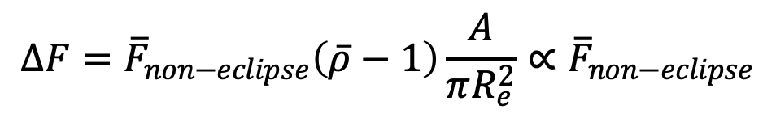
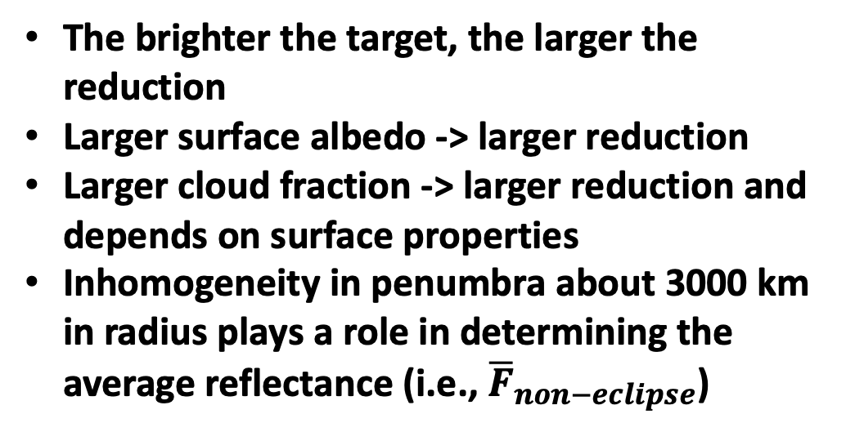
Factors Determining the Reflectance Reduction
$$∆F={\overline{F}}_{non−eclipse}\left(\overline{ρ}−1\right)\frac{A}{πR_{e}^{2}}∝{\overline{F}}_{non−eclipse}$$
2017 EPIC image with obscuration levels
The brighter the target, the larger the reduction
Larger surface albedo -> larger reduction
Larger cloud fraction -> larger reduction and depends on surface properties
Inhomogeneity in penumbra about 3000 km in radius plays a role in determining the average reflectance (i.e., ${\overline{F}}_{non−eclipse}$)
80%
60%
40%
20%
0%

Slide 9
Reduction of the Global Average Spectral Reflectance
The wavelength dependence of the reduction over Casper is similar to Columbia.
Reduction at Casper is slightly larger
Desert: decrease from 388 to 551nm followed by an increase
China: larger than Himalayas, difference decrease with wavelength

Slide 10
Relative Reduction of the Global Average Spectral Reflectance
The total eclipse in 2017 leads to larger reduction compared to the 2020 annular eclipse
Much smaller reduction over Arabian Peninsula

Slide 11
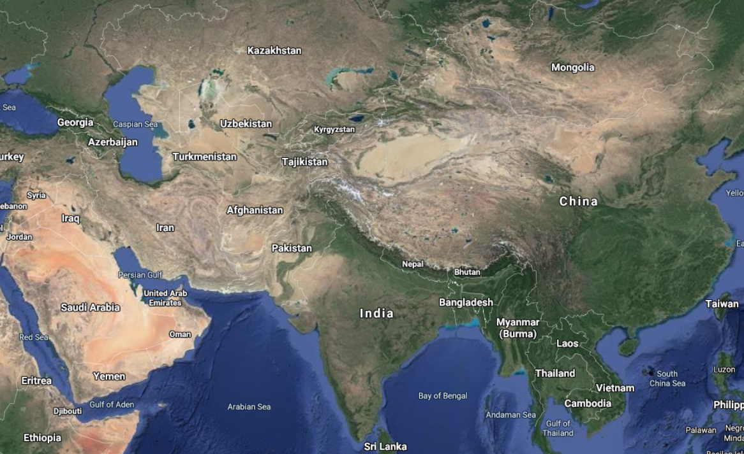
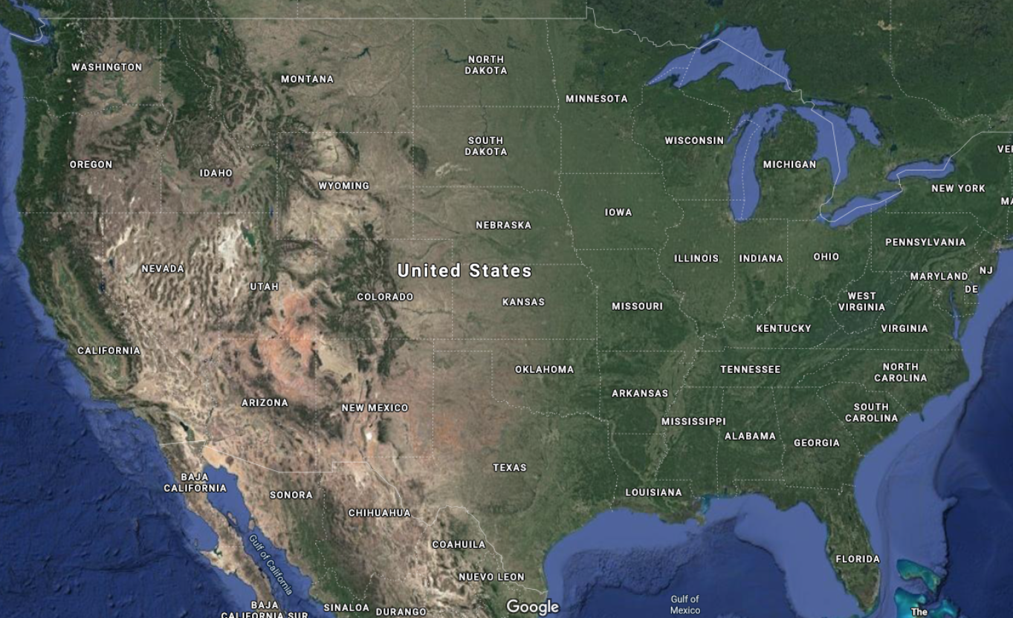
MODIS Surface Albedo and the Center of the Moon’s Shadow
Himalayas
30.03ᵒN, 76.94ᵒE
EPIC
Desert
20.43ᵒ N, 53.55ᵒE
China
29.73ᵒN, 101.16ᵒE
Casper, WY
42.87ᵒN,106.31ᵒW
Columbia, MO
38.95ᵒN,92.33ᵒW

Slide 12
Reduction of the Global Average Spectral Reflectance 2017 Eclipse
EPIC
Vege signature
The shape of surface spectral albedo for Casper is similar to Columbia, resulting similar TOA reflectance and reduction.
Surface albedo is larger for Casper than for Columbia -> larger reduction
Clouds?

Slide 13
Reduction of the Global Average Spectral Reflectance 2020 Eclipse
EPIC
cloud signature
desert signature
The reduction over the desert can be explained by 80% of desert, 10% ocean, and 10% vegetation
More cloud cover leads to a larger reduction over China than Himalayas

Slide 14
Summary
The reduction of global average TOA spectral reflectance is proportional to reflectance in the hypothetical penumbra area in a closest non-eclipse day.
The TOA average spectral reflectance (thus the reduction) depends strongly on surface spectral albedo as well as cloud fraction.
Similar vegetation spectral albedo leads to similar reduction of TOA spectral reflectance for Casper, WY and Columbia, MO during 2017.
The reduction of the average TOA spectral reflectance over Arabian Peninsula can be explained by 80% of desert, 10% ocean, and 10% vegetation during 2020 solar eclipse.
More cloud explains larger reduction in China at shorter wavelengths compared to Himalayas even the surface albedo is larger.
Inhomogeneity in penumbra about 3000 km in radius plays a role in determining the average reflectance

