Slide 1
NIST Advanced Radiometer
NISTAR
Dr. Steven Lorentz
James Briscoe
L-1 Standards and Technology

Slide 2
Overview
Introduction
  NISTAR Description
  Objectives and Requirements
Data Products
Level 1 Data Issues
  Thermal Instability
  Operating Modes
Results
Future Work

Slide 3
Introduction

Slide 4
NISTAR Objective
The objective of NISTAR is to measure the solar reflected and Earth emitted irradiance along the Earth-Sun line.
An accurate measurement of the irradiance can help increase our understanding of the energy balance of the planet and human impact on climate change.

Slide 5
NISTAR Channels
The irradiance is measured over four broadband channels:
Channel | Wavelengths | Description
Photodiode | 0.2 to 1.1 μm | UV-Vis-NIR
Band A | 0.2 to 100 μm | Total Irradiance
Band B | 0.2 to 4 μm | Total Solar Reflected
Band C | 0.7 to 4 μm | Near IR Solar Reflected
Notes:
State the “why” for each channel – photodiode for calibration, band A for absolute radiation, band B to separate solar reflected portion, and band C to better understand the near IR region to help answer an open question in literature regarding this spectral band

Slide 6
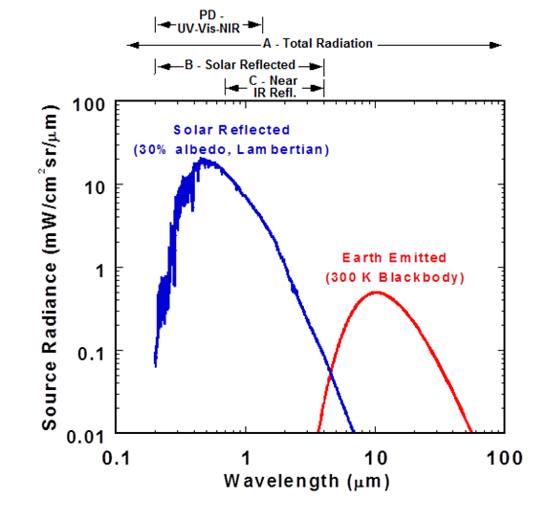
Irradiance Source Spectral Content
Blue: Estimate for solar reflected assuming Lambertian
Red: Earth thermal emissions
Two curves have almost equal integral
Notes:
Integrals of two curve match, ~14 mW/cm2 sr

Slide 7
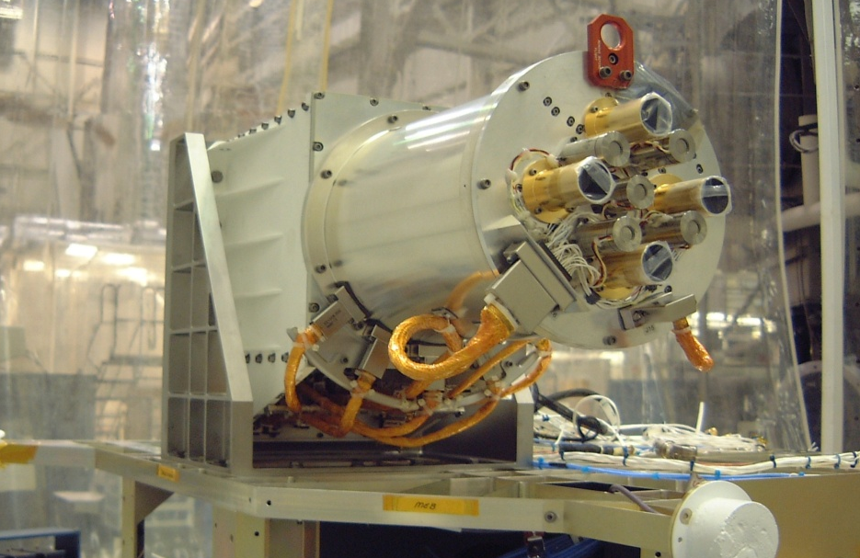
NISTAR at Test Facility

Slide 8
Radiometer Description
Active cavity radiometer with precision aperture.
Shutter is cycled open and closed and the power to maintain a nearly constant temperature in the cavity is measured.
More power = Less irradiance.
The irradiance is then computed by demodulating this square wave power signal to extract the optical power.
Apply a zero offset measurement using dark space calibration.

Slide 9
Science Requirements
Absolute-calibrated daily mean irradiance or current measurements from all four channels
Must be able to provide measurements to determine total outgoing radiation of Earth in wavelength range of 0.2-100 μm with an accuracy of 1.5% or better.

Slide 10
NISTAR Timeline
Feb 11th, 2015: Launch and NISTAR Power On
Feb 16th, 2015: First brief shutter opening
Mar 18th, 2015: First extended shutter opening
Apr 1st, 2015: Began editing ground processing software
Jun 7th, 2015: Lissajous injection burn
Aug 12th, 2015: First ground processing software release to NASA
Nov 9th, 2015: Transition to 30 minute autocycle
Jan 4th, 2016: Second ground processing software release to NASA

Slide 11
NISTAR Timeline
May 10th, 2016: Transition to autocycle off
June 8th, 2016: Discovered temperature control anomaly which affected about a month of data total and four dark space calibrations
Sept 23rd, 2016: Transition to 4 minute autocycle
Oct 7th, 2016: NISTAR Ground Processing Software Version 1
Oct 24th, 2016: NISTAR Level 1 data public release
12 spacecraft safehold states, NISTAR requires at least two to four days to recover from each

Slide 12
NISTAR Data Products

Slide 13
NISTAR Level 0 Data
Level 0 data takes AppID sequential print data files, ephemeris, and attitude data and outputs data which has been:
Sorted into one file per Julian Day in chronological order.
Filtered to only contain data values which are within the defined limits.
Ensured not to contain two data points which are too close in time.

Slide 14
NISTAR Level 1A Data
Science data is converted to engineering units.
Ephemeris and attitude data are used to determine what bodies are in the field of view.
Compute photodiode current and radiometer power from raw data.
Process calibration tables.
Outputs hdf files and text file inputs to Level 1B processing.

Slide 15
NISTAR Level 1B Data Products
Level 1B data products are the daily, four hour, and four shutter cycle period averages of:
  Radiometer Irradiance: Demodulation of the radiometer power signal,
  Photodiode Current,
Along with the corresponding Geolocation data
Averages are only computed over data at nominal operating configuration, and only when enough data is present within the time bin

Slide 16
Level 1 Data Issues

Slide 17
Publicly Released Data
Last week the first NISTAR data was publicly released. This is not science-ready data:
Dark Space offsets not applied
Must be careful when comparing data from different operating modes
Other calibration parameters not applied.
Photodiode data good to go. Offset is well known, and not affected by mode changes.

Slide 18
Next Data Release
The next data release will incorporate:
A finalized instrument state
Carefully applied offsets for past data to allow comparison across modes
Offset algorithm for data going forward
Calibration parameters
Data product of Earth irradiance daily, four hour, and four shutter period means
Calendar and metadata indicating good/bad data, and pertinent spacecraft events

Slide 19
Uncertainty Sources
Level 1B Irradiance Averages
Radiometer Demodulated Power
Primary Aperture Area
Geolocation Data
Radiometer Power
Ephemerides:
DSCOVR
Solar
Lunar
Attitude Control
Thermal Stabilization
Dark Signal Noise
Power Lost to Space
Calibration Data
Jitter
Ground Calibration:
Filter Transmission
Receiver Responsivity
Dark Current
PTC Res. vs. T
Thermistor Res. vs. T
PD Spectral Resp.
Electronics Gain/Offset
On-Orbit Calibration:
Dark Measurement
Filter Degradation
Receiver Responsivity
Filter Transmission
FOV/FOR
Quaternion Data
Relative Pointing between NISTAR and EPIC
Aperture Areas and
Separation

Slide 20
Uncertainty Budget Overview
Geolocation
Low uncertainties
Can tolerate 0.1° error
Calibration Data
Some are well defined
Some do not directly affect uncertainty
Responsivity needs more analysis
Thermal Stabilization
Increased shutter period
But still drifting
Now at short autocycle
Dark Signal Noise
Well understood
< 1% on Band A
< 2% on Band B
About 3-4% on Band C

Slide 21
Thermal Stability

Slide 22
Operations with Autocycle On
Shutters cycled open and closed
Measured irradiance from demodulating the noisy “square” wave power signal
Drifting of the signal due to external thermal effects are canceled out in demodulation
Relies on internal thermal equilibrium achieved before next shutter motion

Slide 23
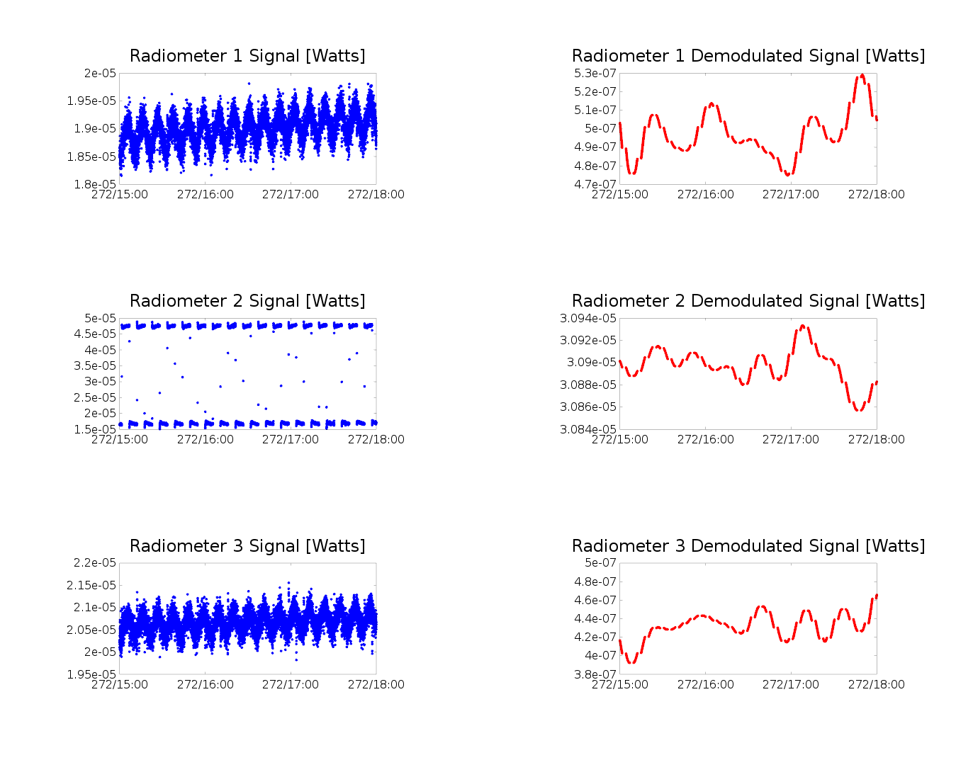
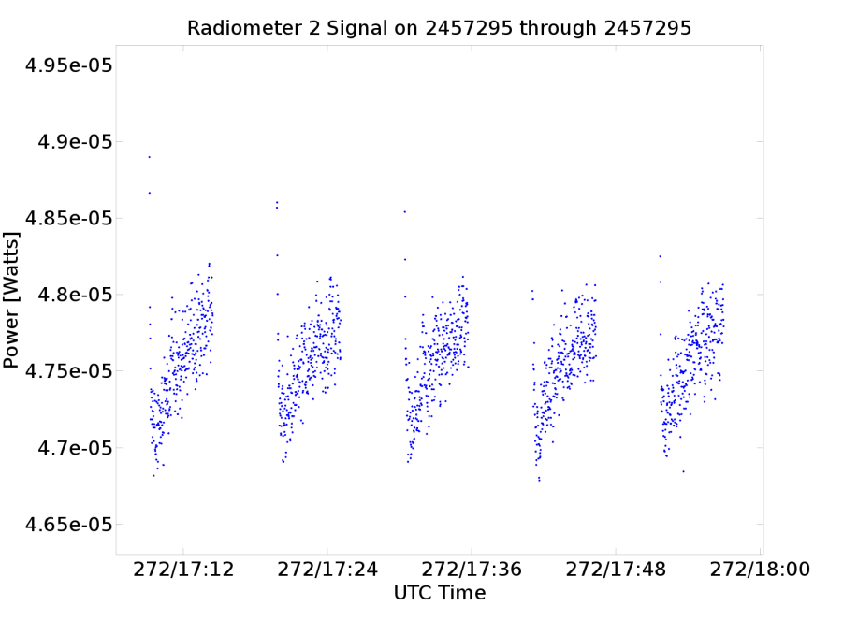
Original Configuration:
10 Minute Shutter Period
No Equilibrium

Slide 24
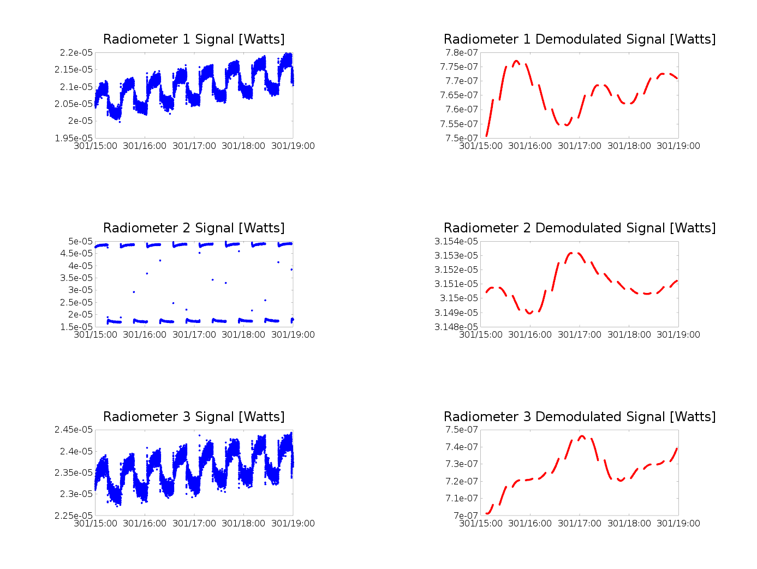
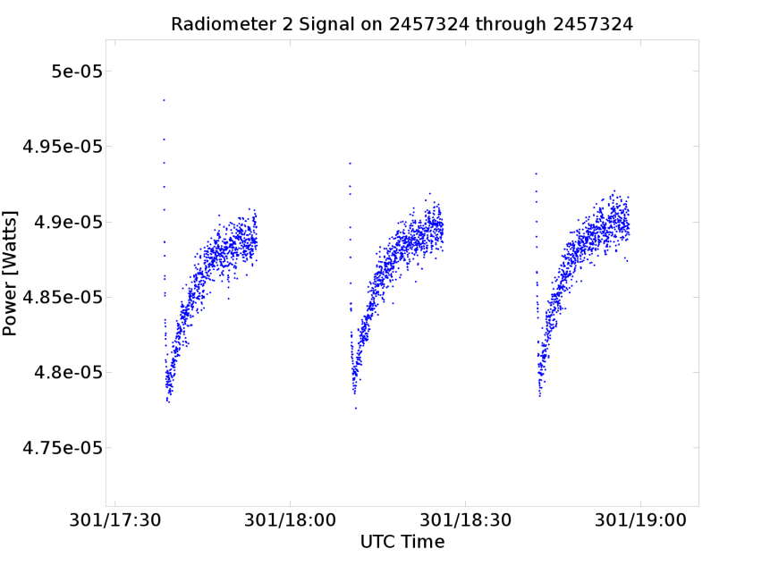
Second Configuration:
30 Minute Shutter Period
Did it Reach Equilibrium?

Slide 25
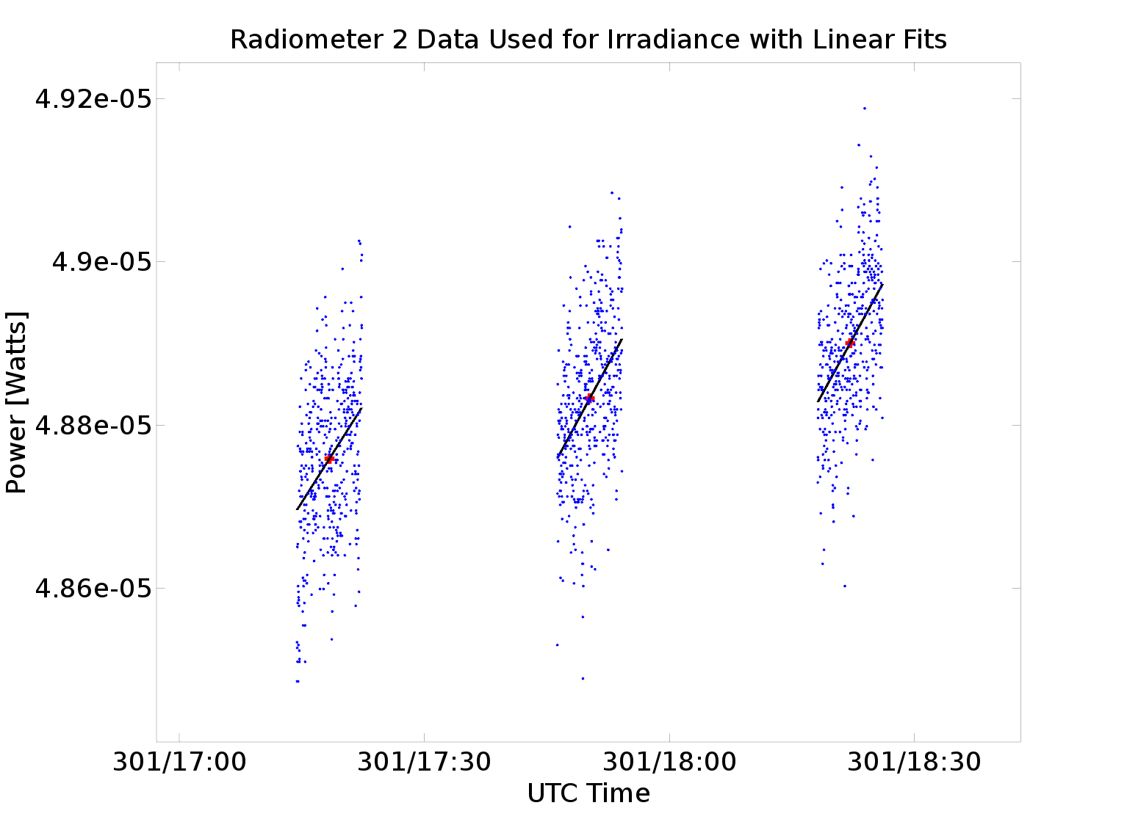
Second Configuration:
30 Minute Shutter Period
Only use second half of data from each shutter motion
Small slope remaining showing it was not fully at equilibrium
This effect does not cancel out after subtracting dark measurement
Estimated 1-5% error due to this remaining drift

Slide 26
Work Arounds
Increasing shutter period further not practical:
  Earth signal would change significantly within a shutter period
  Thermal time constant would increase
Can the decay curve towards equilibrium be modeled to predict final stabilized value?
  Decay waveform not constant
  Extrapolation introduces additional error
  How can accuracy be quantified?

Slide 27
Autocycle On Conclusions
Thermal instability prevents meeting accuracy requirement
Longer shutter period not possible
Thermal effects highly dependent on shutter period

Slide 28
Second Configuration:
Autocycle Off
Shutter remains open all the time
Always at thermal equilibrium internally
Vulnerable to external thermal effects
Needs more frequent dark space calibrations to maintain accuracy
Need some way to interpolate dark power measurements in between calibrations
Heat sink power should be a measure of external thermal variability

Slide 29
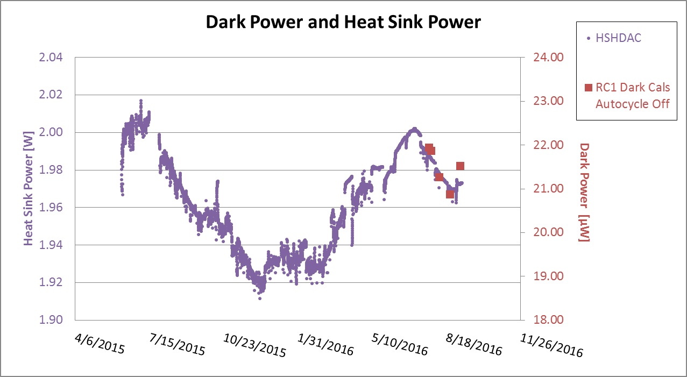
RC1 Autocycle Off (Last 5)

Slide 30
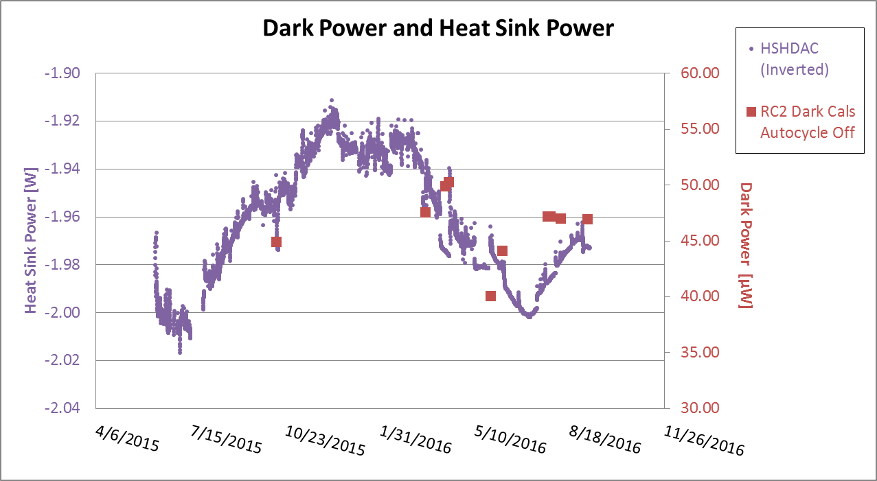
RC2 Autocycle Off

Slide 31

RC3 Autocycle Off (Last 5)

Slide 32
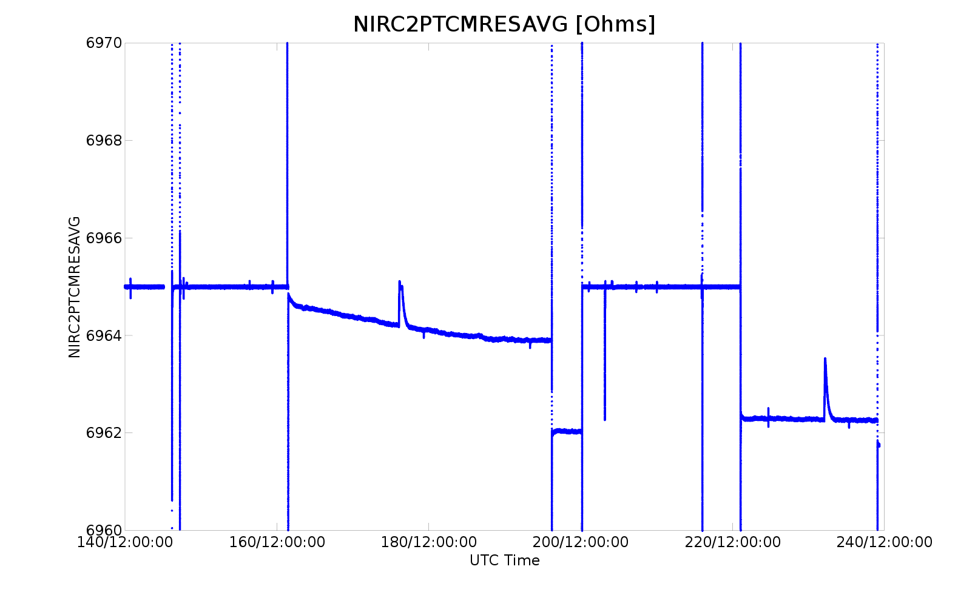
Receiver Servo Anomaly

Slide 33
Autocycle Off Conclusions
Would need weekly or at most biweekly dark space calibrations
Operations concerns
Even still, Heat sink power may not be good enough interpolating function to meet accuracy requirement
Unresolved receiver servo anomaly

Slide 34
Current Configuration:
Autocycle On 4 Min Period
Thermal effects showed to be significantly dependent on autocycle period
Shorter autocycle period would decrease temperature swing during shutter motions
Preempt the problem
Limit on how short: must return to temperature setpoint between shutter motions

Slide 35
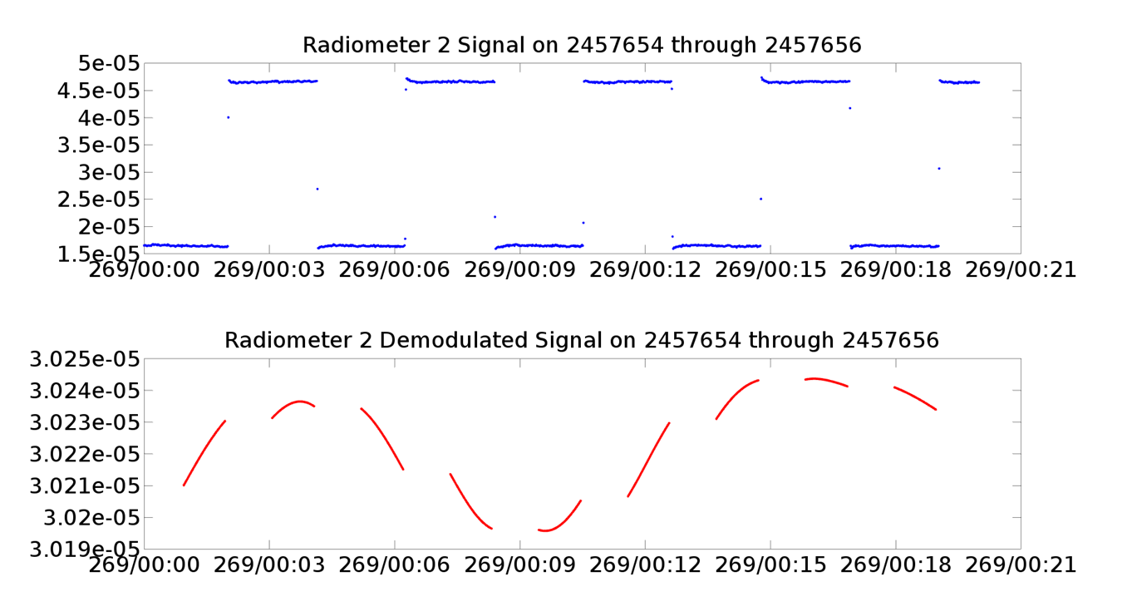
4 Min Autocycle

Slide 36
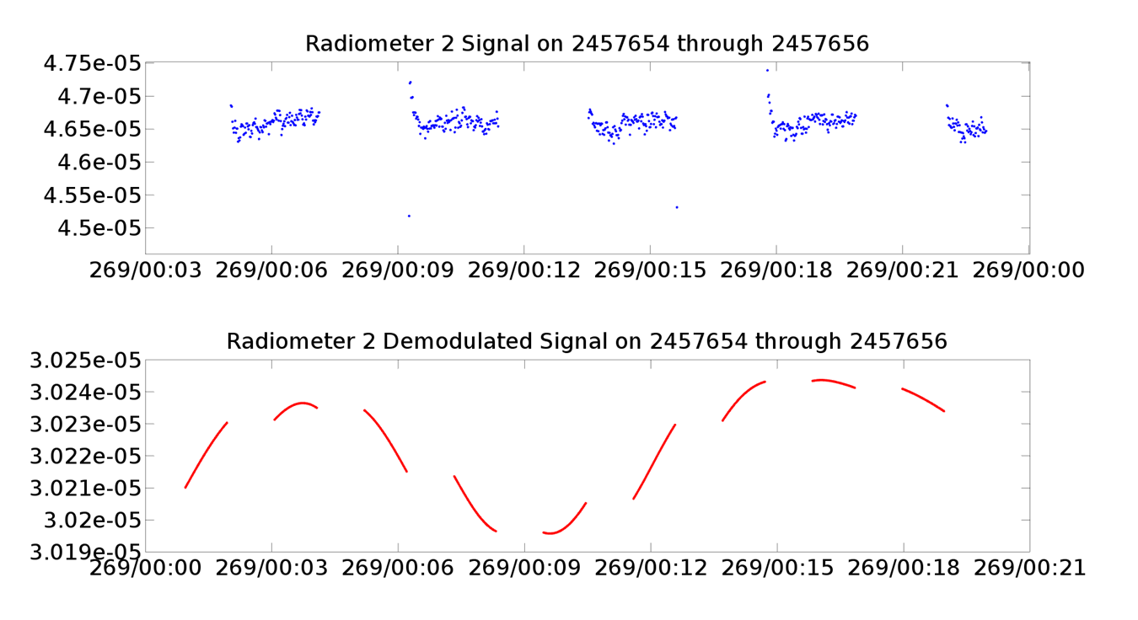
4 Min Autocycle

Slide 37
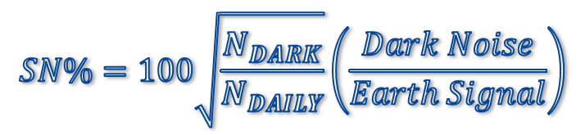
Autocycle Comparison
4 Min Autocycle Dark Space Calibration Noise %
 | Band A: Total Channel | Band B: Solar Reflected | Band C: Near IR Solar Reflected
Dark Cal 37 | 0.12 | 1.23 | 6.45
Dark Cal 38 | 0.50 | 1.39 | 1.28
Dark Cal 39 | 0.53 | 0.51 | 1.64
30 Min Autocycle Dark Space Calibration Noise %
 | Band A: Total Channel | Band B: Solar Reflected | Band C: Near IR Solar Reflected
Dark Cal 15 | 0.89 | 2.03 | 3.29
Dark Cal 18 | 0.64 | 3.29 | 4.43
Dark Cal 21 | 0.67 | 2.08 | 6.02
Dark Cal 22 | 0.91 | 1.34 | 5.47
Dark Cal 27 | 0.56 | 2.15 | 5.66

Slide 38
What Have We Gained?
Allows quicker dark calibrations
Earth scene does not change significantly within shutter period
Absolute noise increases, but
Noise on daily mean decreases due to statistics
Visibly improved waveform shape

Slide 39
Results

Slide 40
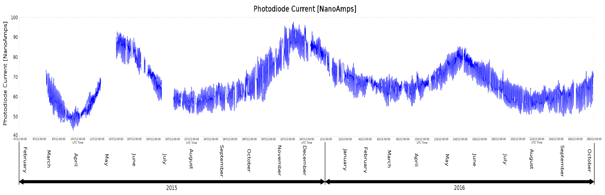
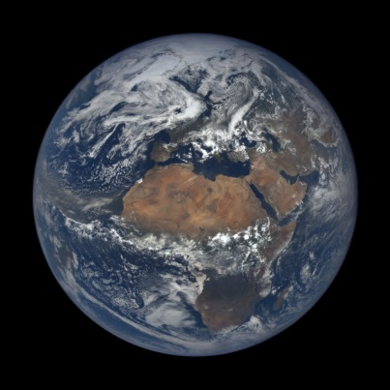
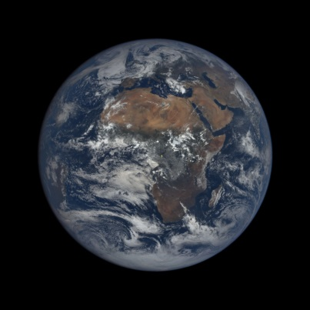
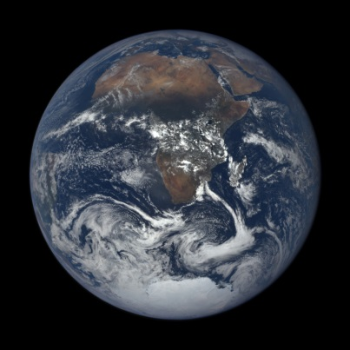
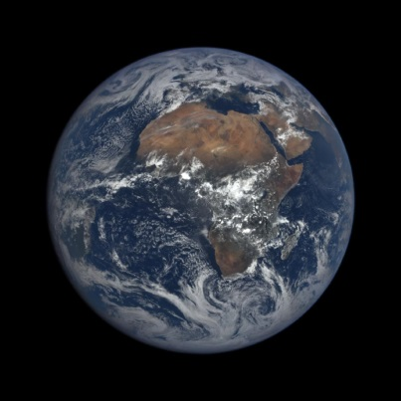
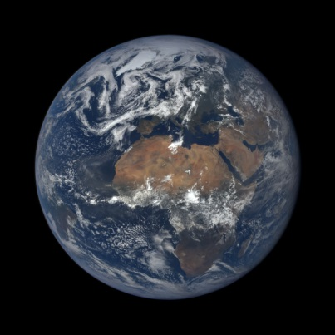
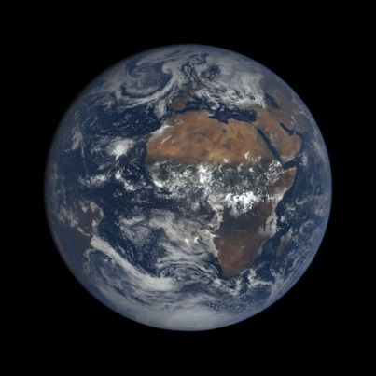
Long Term PD Current
June 17th 2015
11:13
Sep. 22nd 2015
10:35
Dec. 22nd 2015
11:15
Mar. 21st 2016
11:06
June 21st 2016
12:08
Sep. 21st 2016
11:15

Slide 41
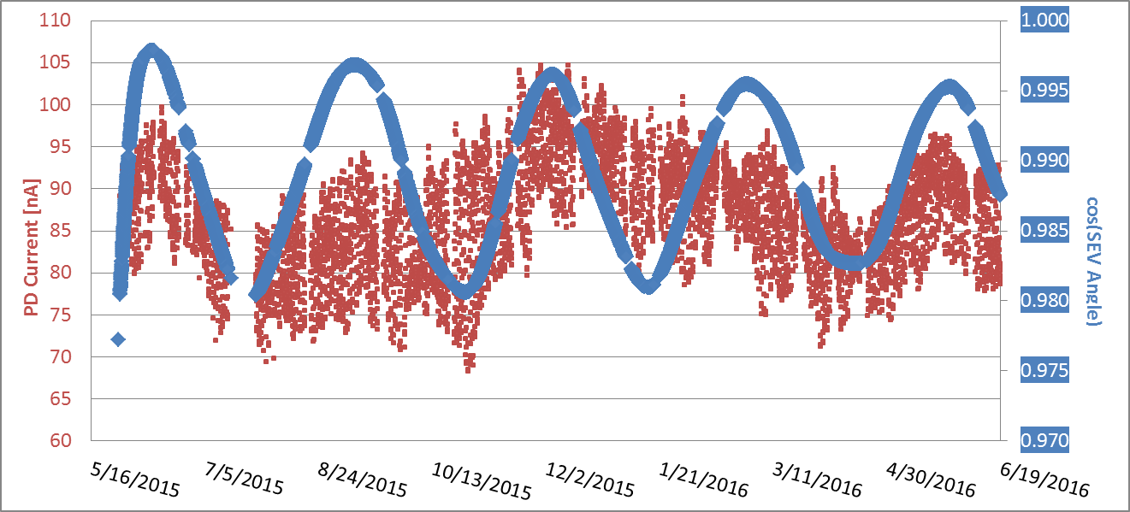
Seasonal Variability of Photodiode
Scaled to remove distance effects
Signal increases as SEV angle approaches 0 (opposition)
30% Peak to peak variability relative to mean

Slide 42
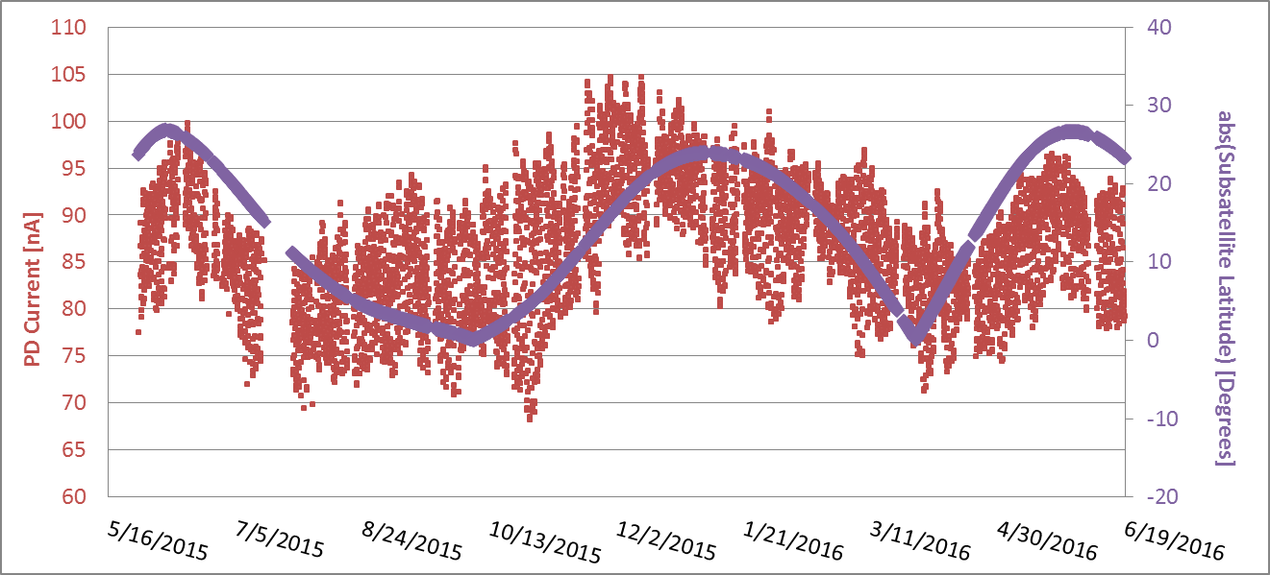
Seasonal Variability of Photodiode
Scaled to remove distance effects
Subsatellite latitude can quantify the seasonal effect
30% Peak to peak variability relative to mean

Slide 43
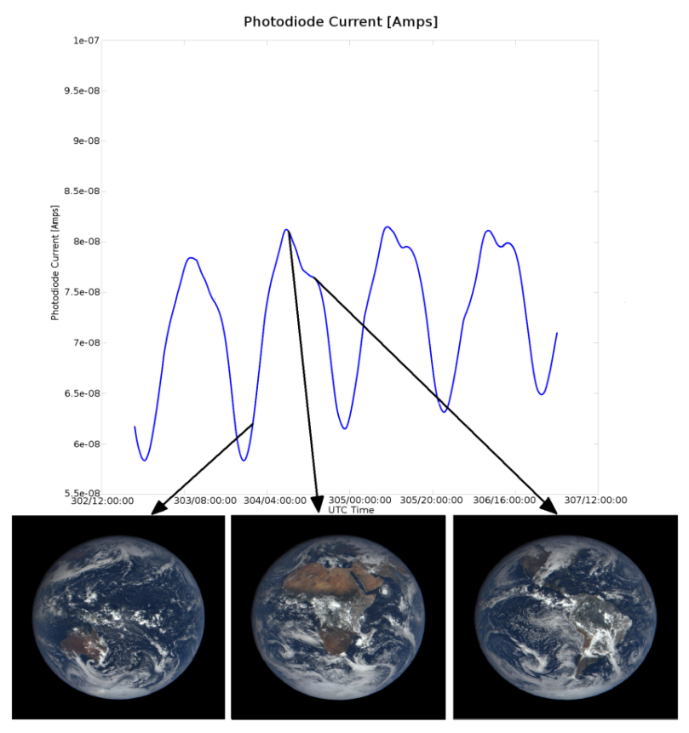
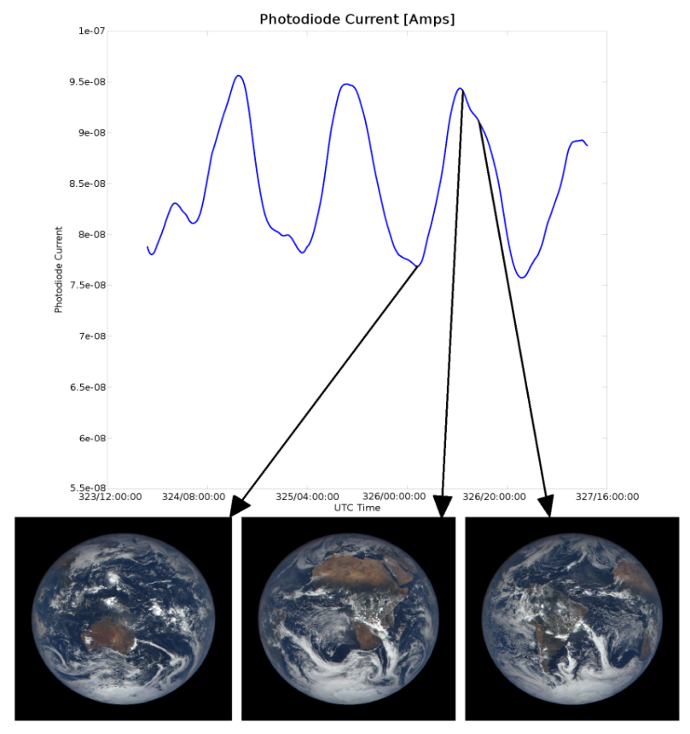
Daily Variability of Photodiode
Oct 29th – Nov 3rd, 2015
Nov 19th – Nov 23rd, 2015
Africa land mass corresponds to peak photodiode current each day
Average current: 70.77 nA
Peak to peak: 23.15 nA (32.7% of avg)
More visibility of ice caps and more cloud cover leads to increased irradiance
Average current: 84.73 nA
Peak to peak: 19.89 nA (23.5% of avg)

Slide 44
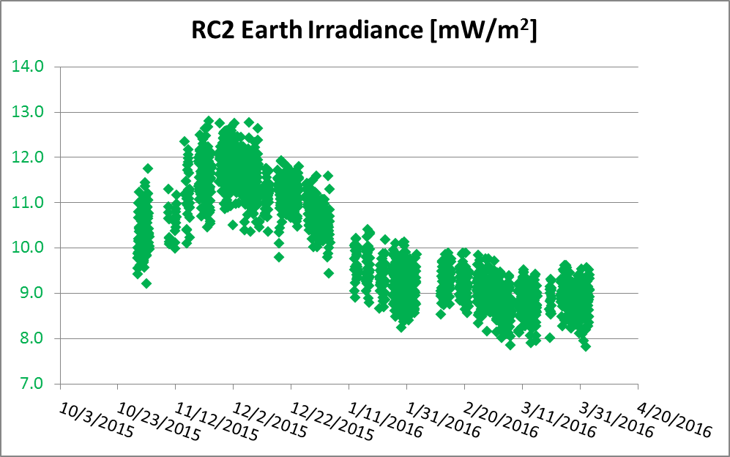
Seasonal Variability of
Total Channel Irradiance

Slide 45
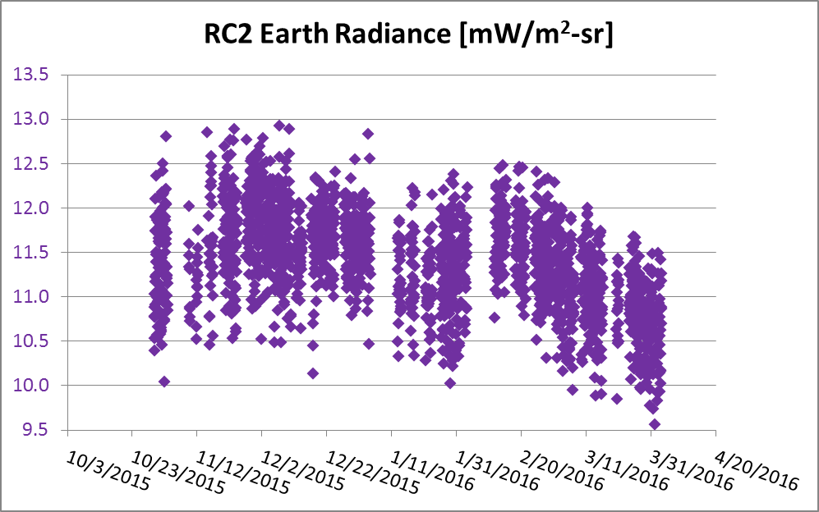
Seasonal Variability of
Total Channel Irradiance

Slide 46
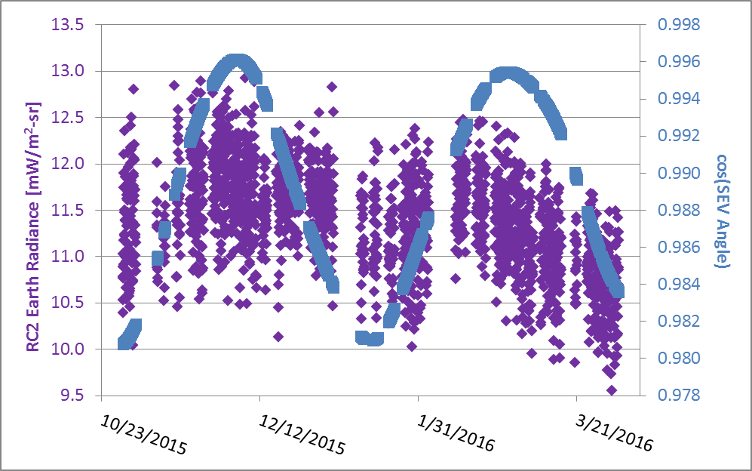
Seasonal Variability of
Total Channel Irradiance

Slide 47
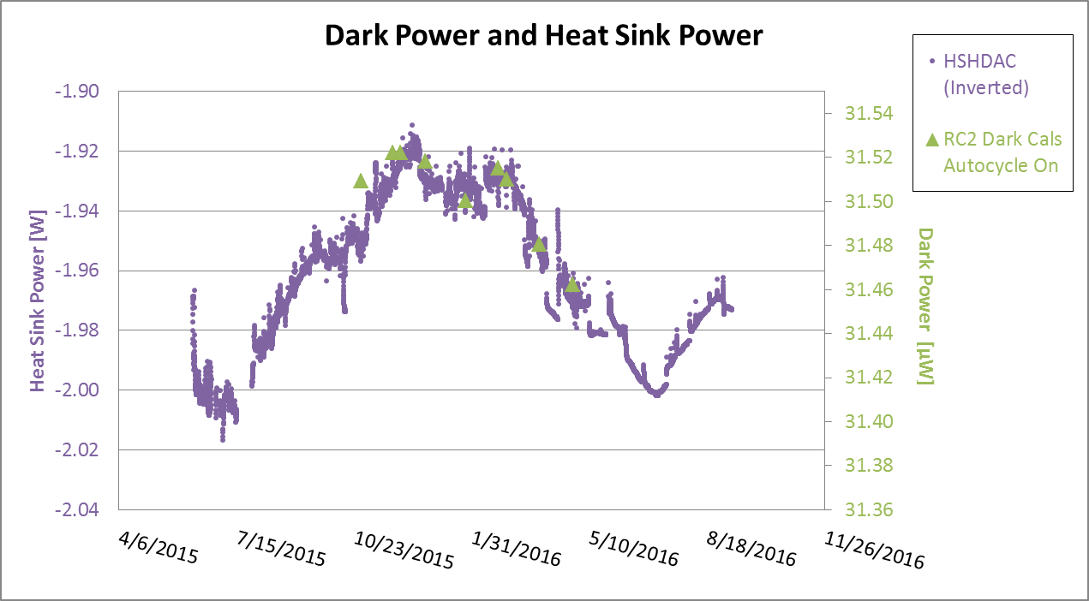
Band A 30 Min Autocycle
Dark Measurements

Slide 48
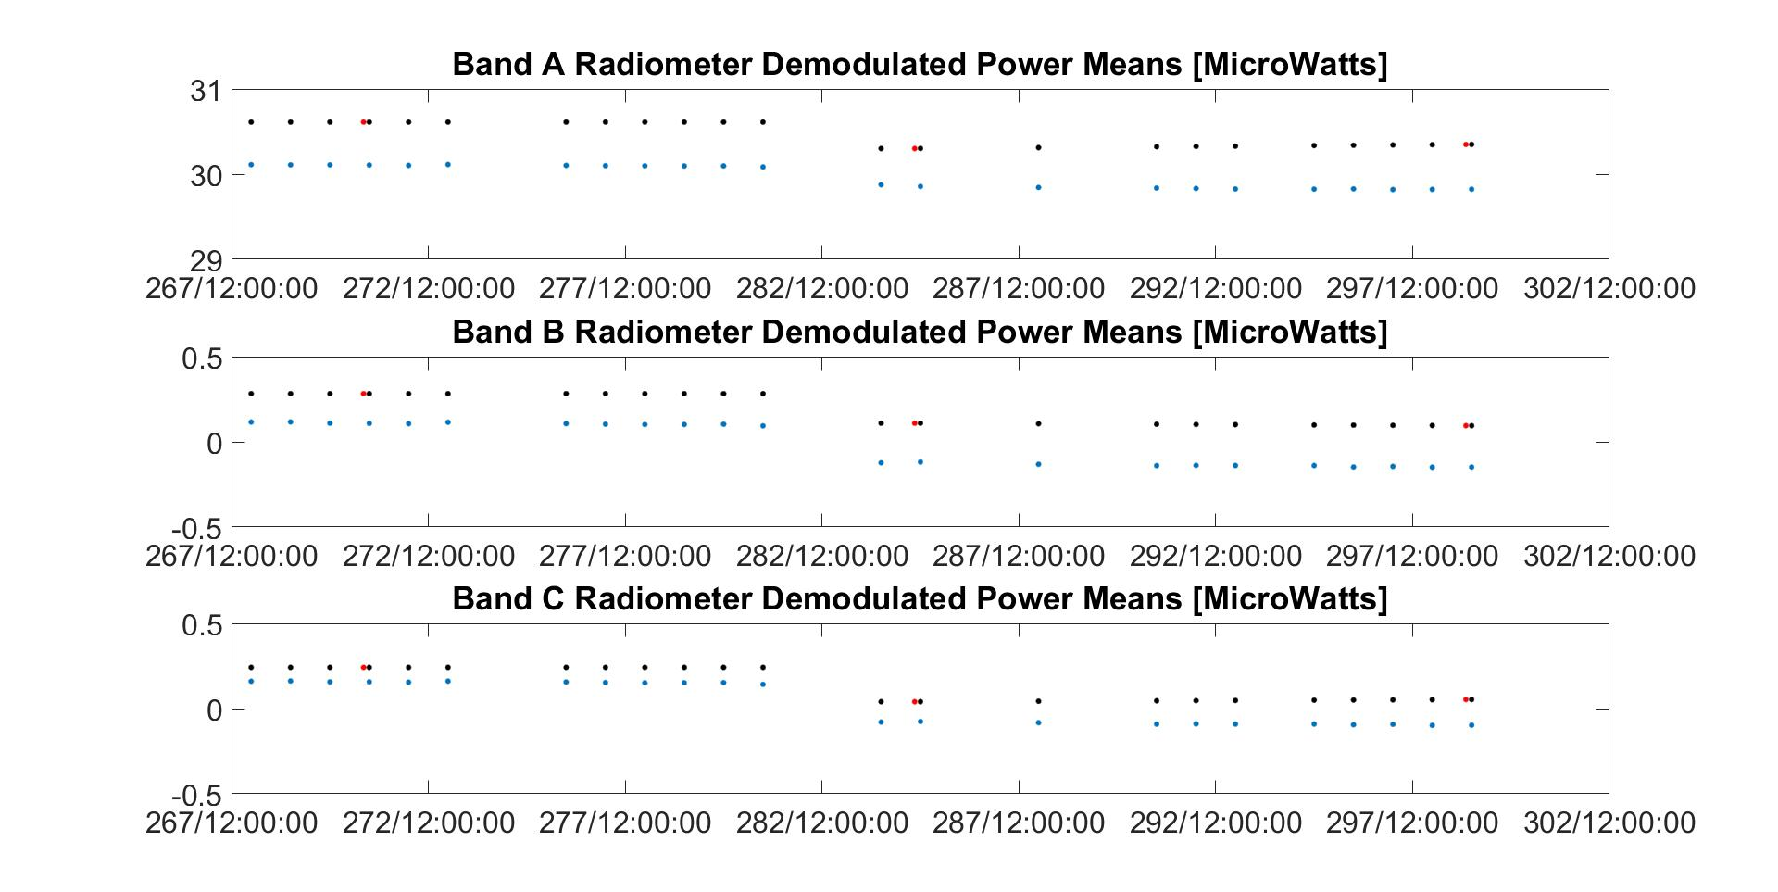
4 Min Autocycle Daily Means
Blue: Demodulated Power
Red: Dark Calibration Power
Black: Interpolated Dark Power

Slide 49
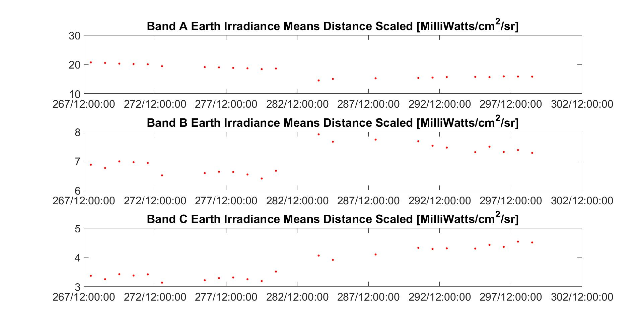
4 Min Autocycle Irradiance

Slide 50
Future Work

Slide 51
Future Work
Live Session for finalizing parameters
Validate accuracy for 4 minute autocycle data
Get back to filling calibration tables
  Relative responsivities
  Filter degradation
Rev 2 software and data release
Collaborate with Level 2 science teams
Prepare for AGU Fall Meeting
Publish results

Slide 52
Epilogue
Live Session Results

Slide 53
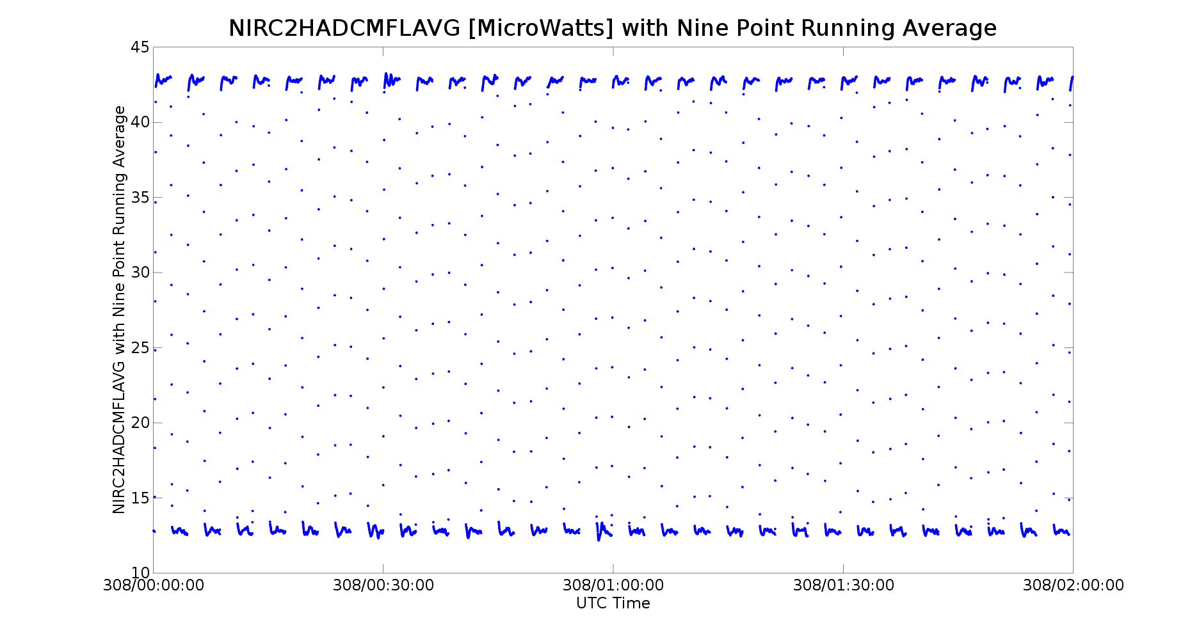
Live Session Results
Very much improved waveform, signal squared up nicely in exchange for increased fast
noise, which is filtered out by demodulation. Accuracy requirement will be met.

Slide 54
Backup Slides

Slide 55
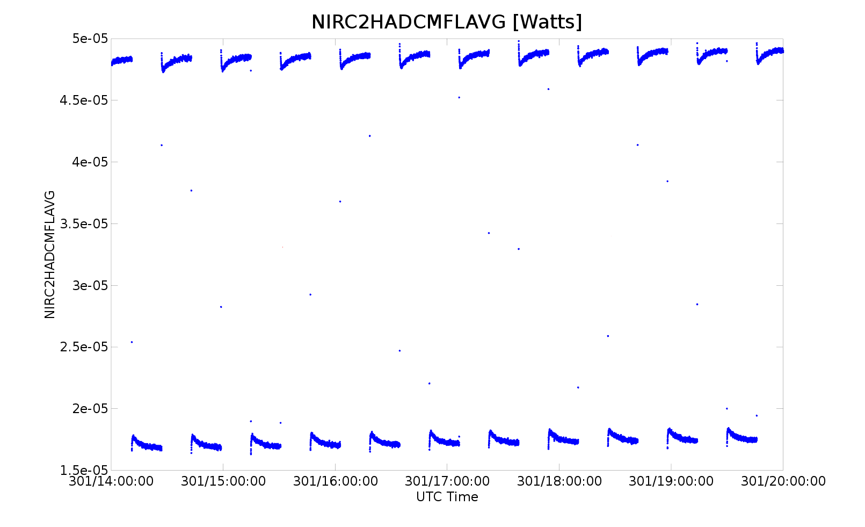
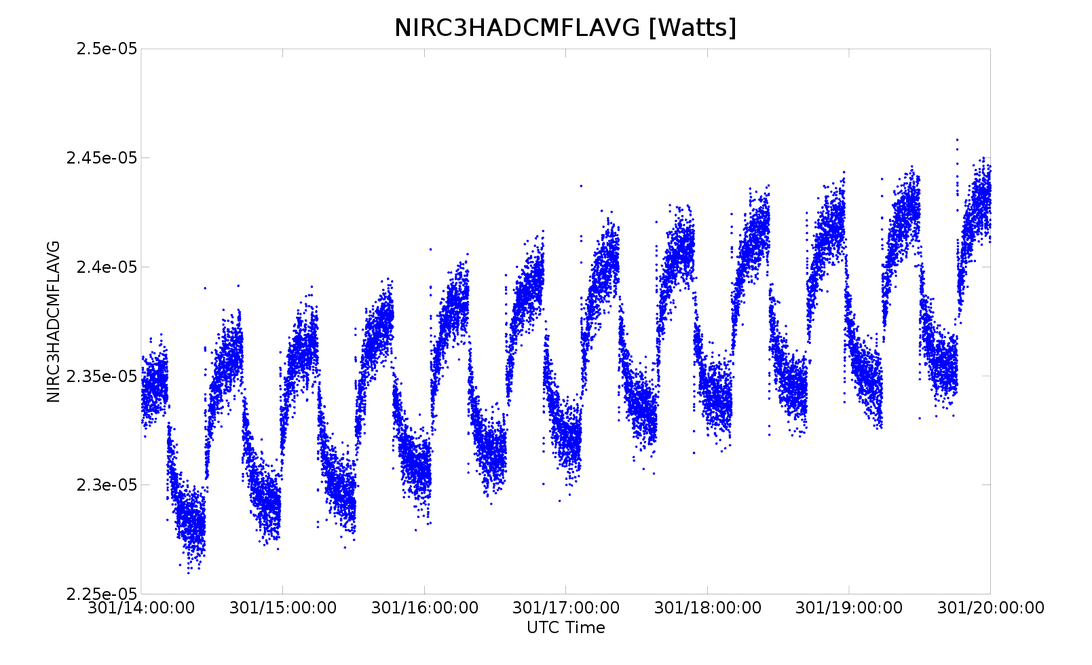
Modeling Decay Waveform
For this data set,
RC 2: Slopes of remaining drift varies from 9.5e-7 to 1.6e-6 (W/hr)
RC 3: Slopes of remaining drift varies from 1.3e-8 to 2.4e-7

Slide 56

Exponential Fitting
Assume functional of form:
Constant term captures the final settling point of the curve
B, C define horizontal offset and rate of decay
B, C expected to be negative on open side and only C expected to be negative on closed side
Least squares fit over each half period

Slide 57
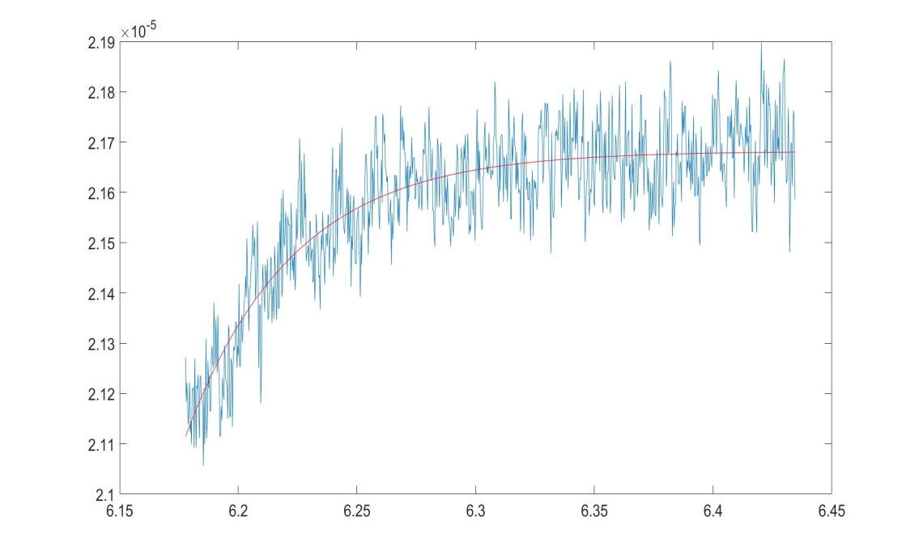
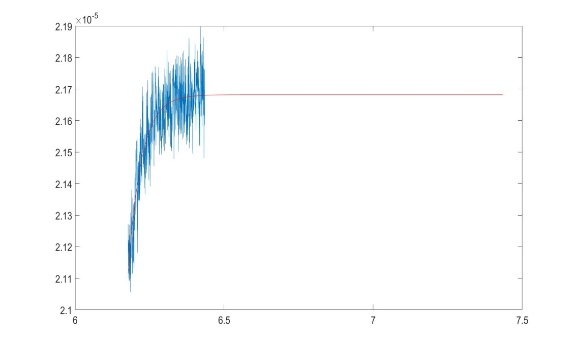
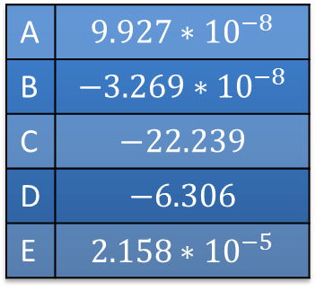
Exponential Fitting (2)
Radiometer 1 during dark cal
Where T is time in hours, Rad is power in Watts, and D and E are applied offsets (fixed parameters)
A | $$9.927∗{10}^{−8}$$
B | $$−3.269∗{10}^{−8}$$
C | $$−22.239$$
D | $$−6.306$$
E | $$2.158∗{10}^{−5}$$

Slide 58

Exponential Fit Algorithm
Very sensitive to initial guesses
Subtract mean Time and max/min Rad power (parameters D and E)
Solve least squares of with A fixed to maximum (or minimum) power (Linear Least Squares)
Then use B, C from this as initial guesses to second solution with A as a free parameter (Nonlinear Least Squares)
If diverges adjust B, C and retry

Slide 59
Exponential Fit Results
 | Dark Cal 15 RC1 (C) | Dark Cal 15 RC2 (A) | Dark Cal 15 RC3 (B)
Dark Demod | 7.65778E-007 | 3.15092E-005 | 7.26365E-007
Earth Demod | 6.85616E-007 | 3.10008E-005 | 5.09570E-007
Demod Earth Signal | 8.01625E-008 | 5.08355E-007 | 2.16795E-007
Dark Demod Std | 6.46084E-009 | 1.11245E-008 | 1.08052E-008
Demod Noise Percent | 8.05967543 | 2.188337229 | 4.984070799
Demod Daily Mean Noise Percent | 3.29034872 | 0.89338493 | 2.03473838
Dark Exp Fit | 7.83557E-007 | 3.16513E-005 | 7.69493E-007
Earth Exp Fit | 7.03863E-007 | 3.11506E-005 | 5.52424E-007
Exp Fit Earth Signal | 7.96938E-008 | 5.00672E-007 | 2.17069E-007
Exp Fit Demod Std | 1.63874E-008 | 2.43461E-008 | 2.69870E-008
Exp Fit Noise Percent | 20.56301434 | 4.862693161 | 12.43246319
Exp Fit Daily Mean Noise Percent | 8.39481545 | 1.98518617 | 5.07553184

Slide 60
Exponential Fit Results (2)
 | Dark Cal 27 RC1 (C) | Dark Cal 27 RC2 (A) | Dark Cal 27 RC3 (B)
Dark Demod | 7.57177E-007 | 3.14624E-005 | 7.15100E-007
Earth Demod | 6.75633E-007 | 3.09639E-005 | 5.03363E-007
Demod Earth Signal | 8.1544E-08 | 4.98441E-07 | 2.11738E-07
Dark Demod Std | 1.13021E-008 | 6.88325E-009 | 1.11473E-008
Demod Noise Percent | 13.86011855 | 1.380956121 | 5.26465335
Demod Daily Mean Noise Percent | 5.658369705 | 0.563772975 | 2.14928573
Dark Exp Fit | 7.69885E-007 | 3.16211E-005 | 7.58347E-007
Earth Exp Fit | 6.94690E-007 | 3.11288E-005 | 5.52231E-007
Exp Fit Earth Signal | 7.51953E-08 | 4.92239E-07 | 2.06116E-07
Exp Fit Demod Std | 1.98873E-008 | 2.55559E-008 | 1.73129E-008
Exp Fit Noise Percent | 26.44757248 | 5.191754983 | 8.399594902
Exp Fit Daily Mean Noise Percent | 10.79717625 | 2.119525096 | 3.429120259

Slide 61
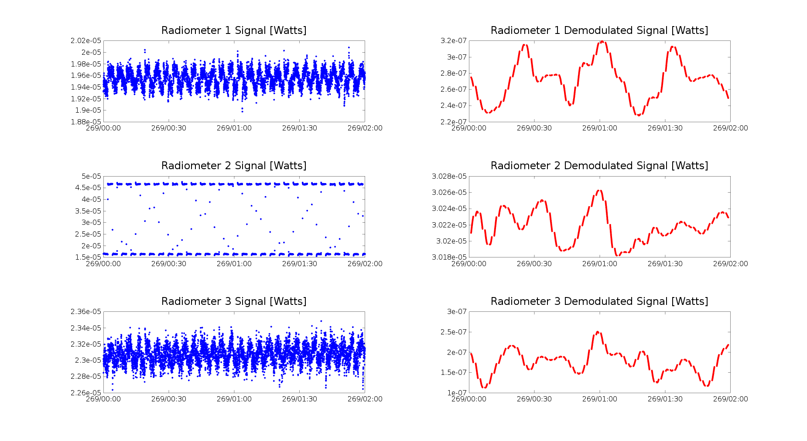
4 Min Autocycle Demod

Slide 62
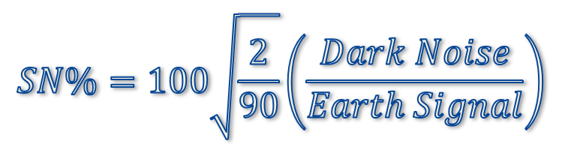
4 Min Autocycle Conclusions
Dark Space Calibration #37 Results
Dark Space Calibration # 37: 2016/270/20:15 – 20:45
Channel | Band A: Total Channel | Band B: Solar Reflected | Band C: Near IR Solar Reflected
Earth Signal [nW] | 502 | 195 | 65
Dark Noise [nW] | 3.9 | 16.1 | 27.9
Est. Signal Noise % for Daily Mean | 0.12 | 1.23 | 6.45

Slide 63
4 Min Autocycle Conclusions
Dark Space Calibration #38 Results
Dark Space Calibration # 37: 2016/284/20:15 – 20:45
Channel | Band A: Total Channel | Band B: Solar Reflected | Band C: Near IR Solar Reflected
Earth Signal [nW] | 450 | 274 | 63
Dark Noise [nW] | 15 | 26 | 5
Est. Signal Noise % for Daily Mean | 0.50 | 1.39 | 1.28

Slide 64
4 Min Autocycle Conclusions
Dark Space Calibration #39 Results
Dark Space Calibration # 39: 2016/298/20:15 – 20:45
Channel | Band A: Total Channel | Band B: Solar Reflected | Band C: Near IR Solar Reflected
Earth Signal [nW] | 528 | 246 | 100
Dark Noise [nW] | 19 | 7 | 11
Est. Signal Noise % for Daily Mean | 0.53 | 0.51 | 1.64

Slide 65
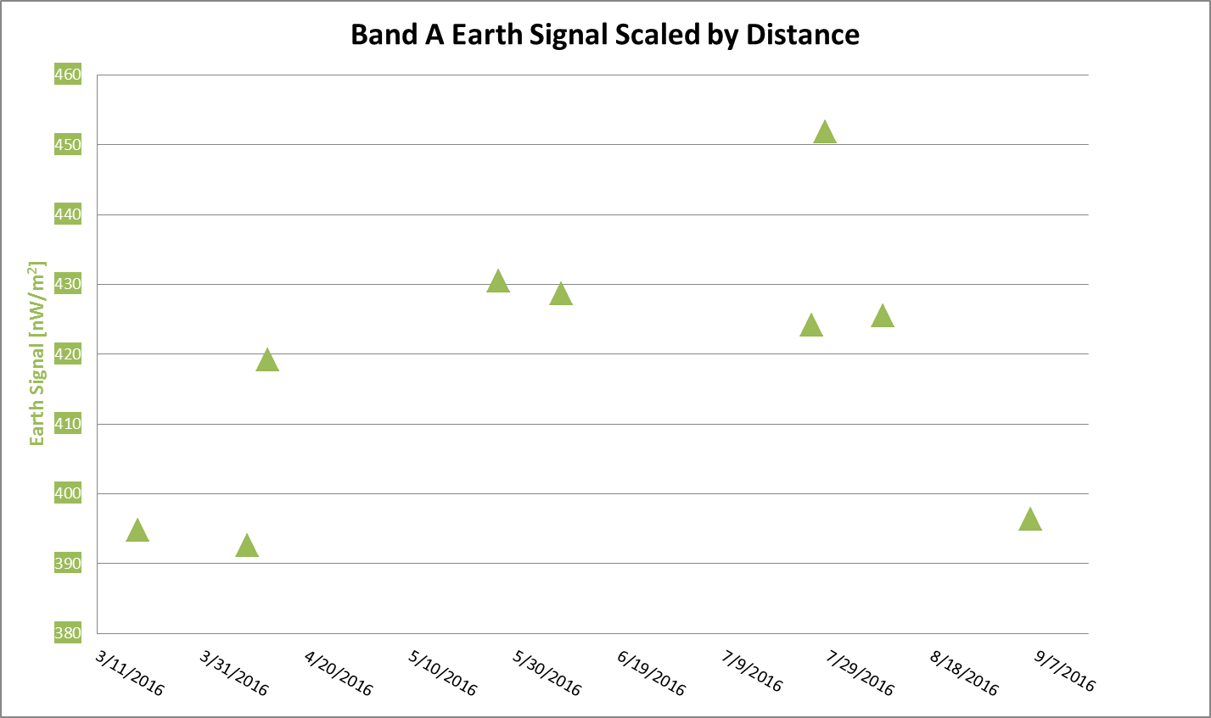
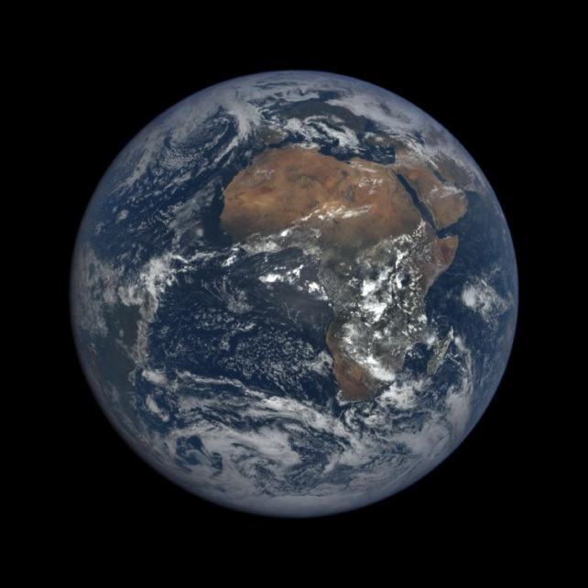
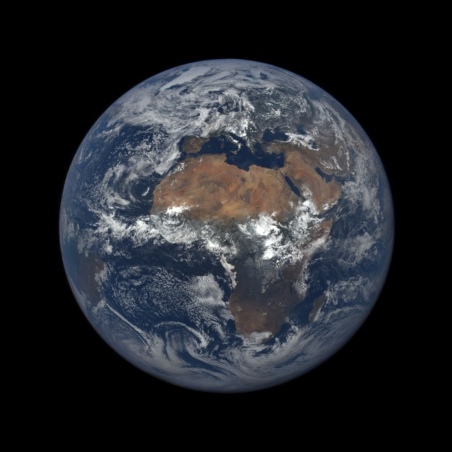
Earth Signal Power
Total Channel (Scaled by Distance)
15% increase from March to July
Notes:
Measurements taken during dark space calibrations, earth signal most accurate at these times as no interpolation is needed

Slide 66
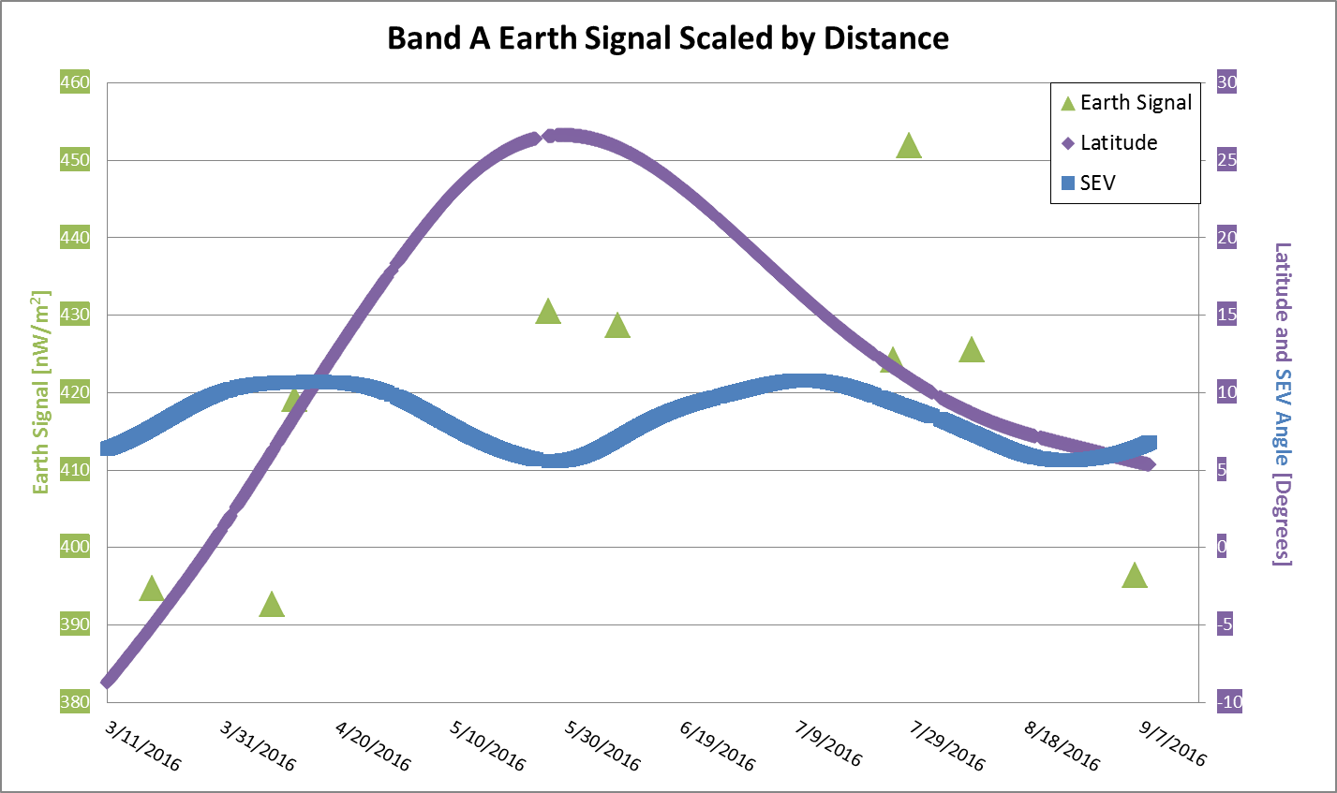
Earth Signal Power
Total Channel (Scaled by Distance)
Variation is a result of complex interaction between Latitude (Seasons) and
Sun-Earth-Vehicle Angle (Geometry)
Notes:
Measurements taken during dark space calibrations, earth signal most accurate at these times as no interpolation is needed

