Slide 1
EPIC and the 2017 Lunar Eclipse
The lunar eclipse experiment was designed to test 3-D radiative transfer calculations against measurements made on the ground (Pandora Sp[ectrometer Instrument) in Casper Wyoming and from space using EPIC
This presentation will only discuss the EPIC portion of the experiment
The bottom line is that EPIC detected an 11% reduction in global sunlight reflected back to space or reaching the ground

Slide 2
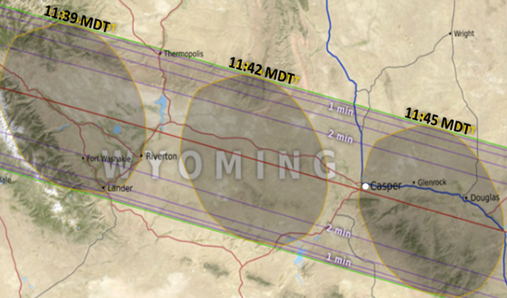
EPIC and the 2017 Lunar Eclipse
The timing and shape of the Moon’s shadow over Casper, Wyoming showing the
relative location of Casper (white circle) at 11:45 MDT
(https://eclipse2017.nasa.gov/eclipse-maps).

Slide 3
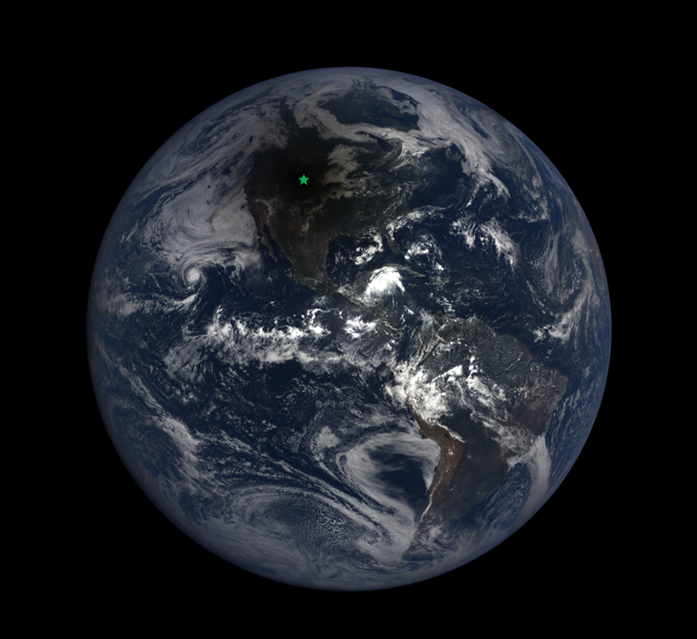
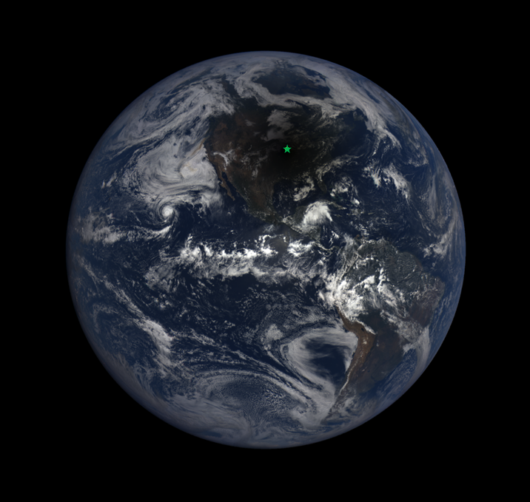
EPIC and the 2017 Lunar Eclipse
Casper WY Columbia MO
We observed at two sites, Casper Wyoming and Columbia Missouri

Slide 4
EPIC and the 2017 Lunar Eclipse
All of the wavelengths considered were obtained in a period of 2.7 minutes
Within 100 km of Casper or 1^{O} of Longitude
Table 1 Eclipse Maximum and EPIC Image Times |  | Measurement Duration 2.7 minutes | Longitude
Eclipse West Edge of WY | 2017-08-21 17:35:40 |  | -111^{O}02’
Wavelength (nm) | Date and Time | Location
551 | 2017-08-21 17:42:36 | West of Casper | -106^{O}22’
680 | 2017-08-21 17:43:30 | West of Casper
Casper Wyoming | 2017-08-21 17:43:51 | Casper WY | -106^{O}19’
780 | 2017-08-21 17:44:24 | Near Glenrock WY | -105^{O}52’
443 | 2017-08-21 17:44:50 | West of Douglas WY
388 | 2017-08-21 17:45:18 | West of Douglas WY | -105^{O}17’
Eclipse East Edge of WY | 2017-08-21 17:48:04 |  | -104^{O}03’

Slide 5
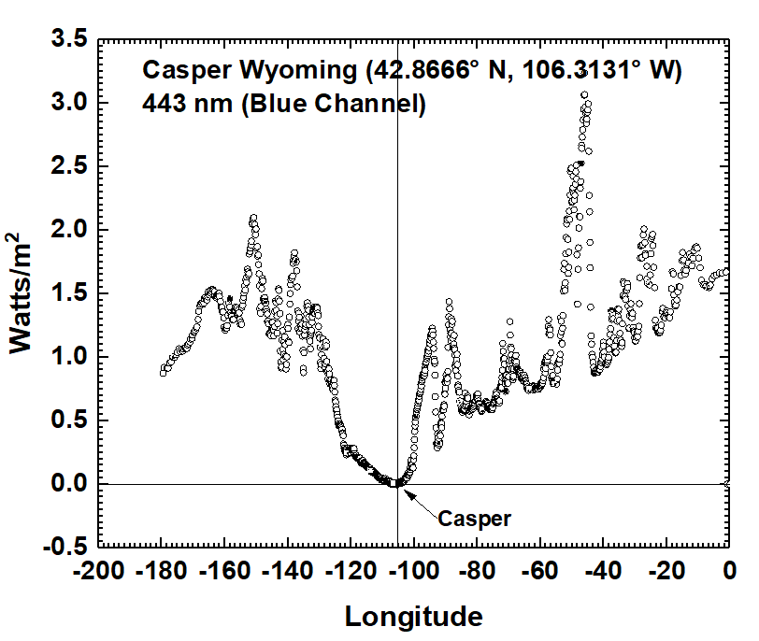
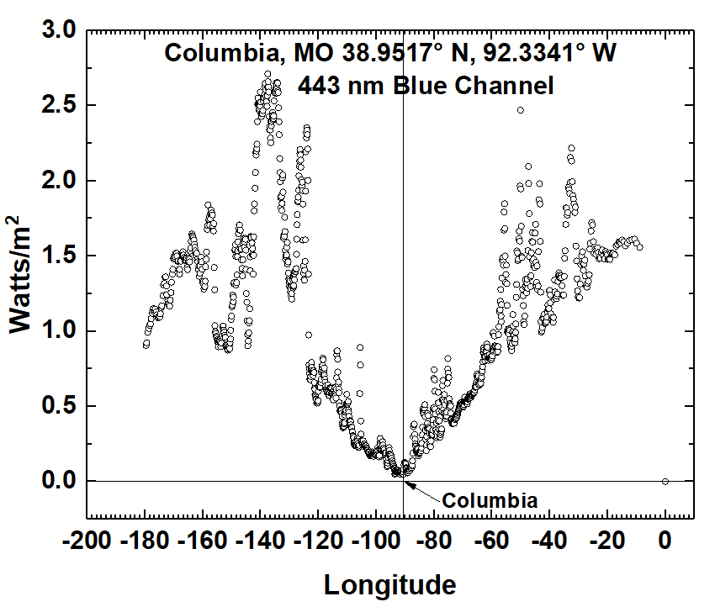
EPIC and the 2017 Lunar Eclipse
The effect of an eclipse on the solar energy reflected back to space as a function of longitude (degrees). In Casper WY, the eclipse reached almost zero energy reflected back to space, while light clouds in Columbia MO diminished the effect. For 443±1.3 nm, irradiance(W/m²) = 5.291x10⁻⁶ π 2.6 C/S.

Slide 6
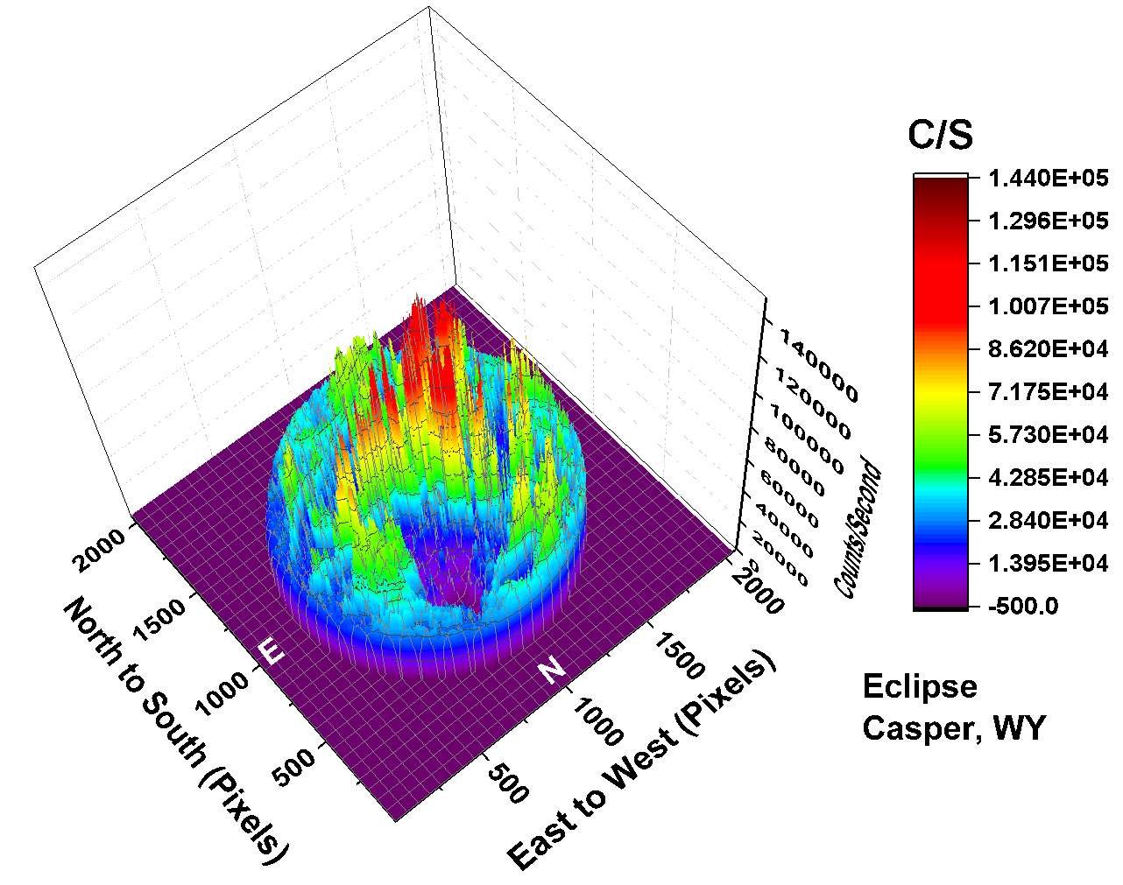
EPIC and the 2017 Lunar Eclipse
443 nm
The counts/second C/S observed by EPIC for the 443 nm channel corresponding to the color image. In this image there are approximately 2.59x10⁶ illuminated pixels out of 2048² = 4.194304x10⁶ pixels (61.8%). Illuminated pixels form a circle of 1816 pixels in diameter

Slide 7
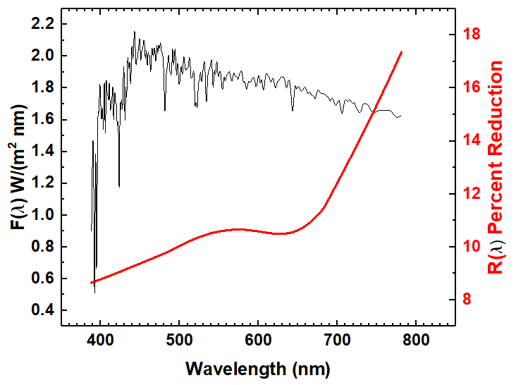
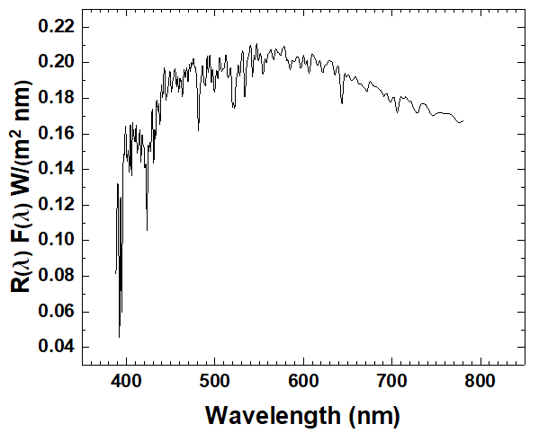
EPIC and the 2017 Lunar Eclipse
Table 2 Eclipse Percent Change
Wavelength nm l | Percent Decrease PD
388 | 9
443 | 9
551 | 11
680 | 10
780 | 18
TOA No Eclipse
TOA Eclipse
F(λ)
F_{R}(λ)
R(λ)
72.3 Watts/m² represents and 11% reduction caused by the eclipse

