Slide 1
EPIC Calibration UV channels
Jay Herman and Liang Huang
Goals:
Produce O₃ with 1 – 2% accuracy
Produce Cloud reflectivity (LER)
Calculate Erythemal Irradiance
Progress:
Current O₃ processing is within 2% over most of the earth
LER is available for the entire data record
Erythemal Irradiance is available for the entire data record

Slide 2
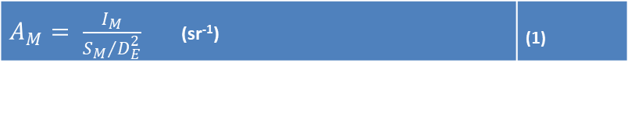
Outline of Calibration Method
The radiometric calibration for each wavelength channel in terms of EPIC counts/second can be converted to earth normalized radiances or reflectances (backscattered at approximately 172^{O}).
The earth upwelling normalized radiance I_{M} (W/(m² nm sr)) at the top of the atmosphere (TOA) is defined in terms of the earth albedo A_{M}
for wavelength bands M=1 to 4, S_{M} is the incident solar irradiance (W/(m² nm)) weighted with the filter function for band M at 1 AU and D_{E} is the sun-earth distance in AU (astronomical units).
$A_{M}= \frac{I_{M}}{{S_{M}}/{D_{E}^{2}}}$ (sr⁻¹) | (1)

Slide 3
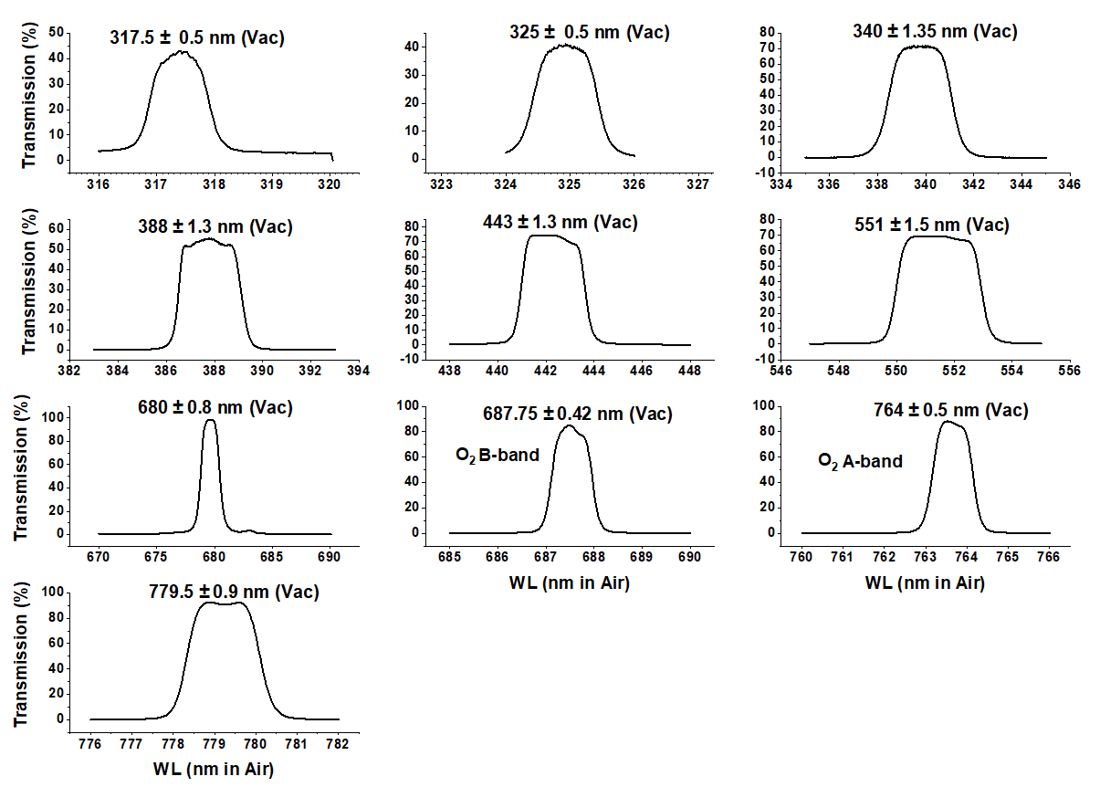
Outline of Calibration Method
T_{M} = :

Slide 4
Outline of Calibration Method
Select OMPS LEO footprints with viewing angles nearly identical to EPIC’s (within 1º in backscatter angle and 2^{O} degrees in solar zenith angle).
Use OMPS calibrated measured backscattered radiances as a reference
EPIC’s backscatter angle varies with latitude and longitude by less than 0.25º, since the angular size of the earth varies from 0.45^{O} to 0.53^{O} to 0.45^{O} every 6 months depending on the location of DSCOVR in its orbit.
The orbit varies from 4^{O} to 15^{O} away from the Earth-Sun line.
Lunar perturbation of the orbit
Small differences in observing geometry are corrected in the atmospheric radiative transfer model calculations resulting in corrections less than 2 %

Slide 5
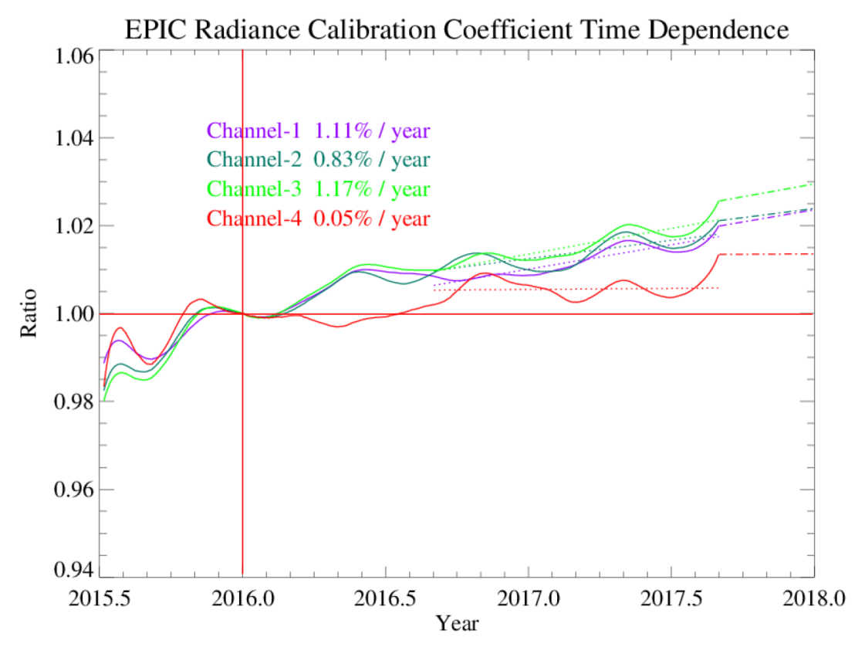
Outline of Calibration Method
Wavelength Radiance Reflectance
Channel | Wavelength | A0 (V1) | K1=pi*A0/SF | A0 (V2) | Ratio (V2/V1) | SF | K2=pi*A0/SF
1 | 317.478 | 0.03172 | 1.22E-04 | 0.03125 | 0.9852 | 819.00 | 1.20E-04
2 | 325.035 | 0.02857 | 1.11E-04 | 0.02819 | 0.9868 | 807.70 | 1.10E-04
3 | 339.858 | 0.00626 | 1.98E-05 | 0.0062 | 0.9909 | 995.80 | 1.96E-05
4 | 387.923 | 0.00857 | 2.69E-05 | 0.00854 | 0.9957 | 1003.30 | 2.67E-05
5 | 442.397 | 0.00524 | 8.42E-06 | 0.00527 | 1.0057 | 1956.00 | 8.46E-06

Slide 6
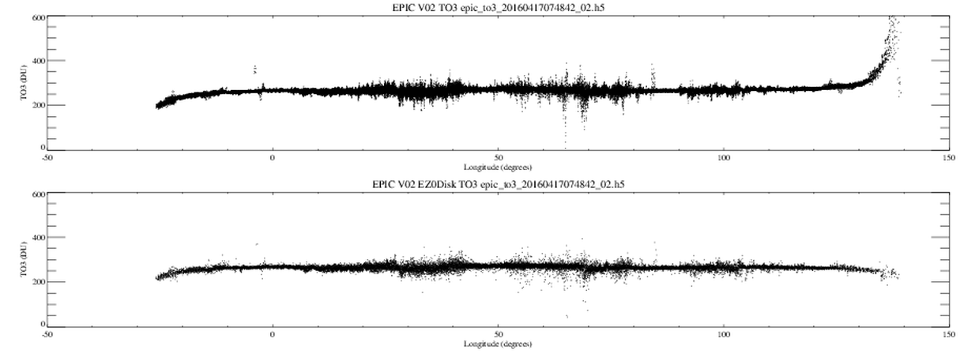
Possible Geolocation Validation for Version 3
The method devised by Huang is based on finding the edge of the earth by distinguishing the atmosphere from the solid earth based on the results from the OMPS limb sounder
This method is needed for the UV and 443 nm channels where Rayleigh scattering is important. The method should also be used for the green and red channels.
V2
V2
Longitude

Slide 7
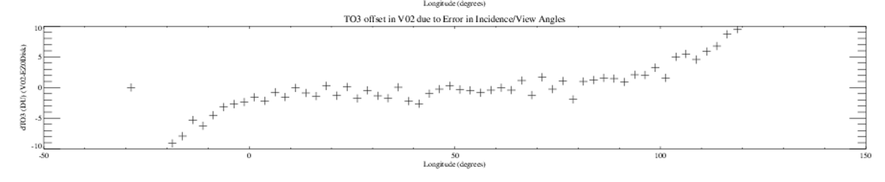
Ozone Correction from Improved Limb Location
-50 0 50 100 150
Longitude

Slide 8
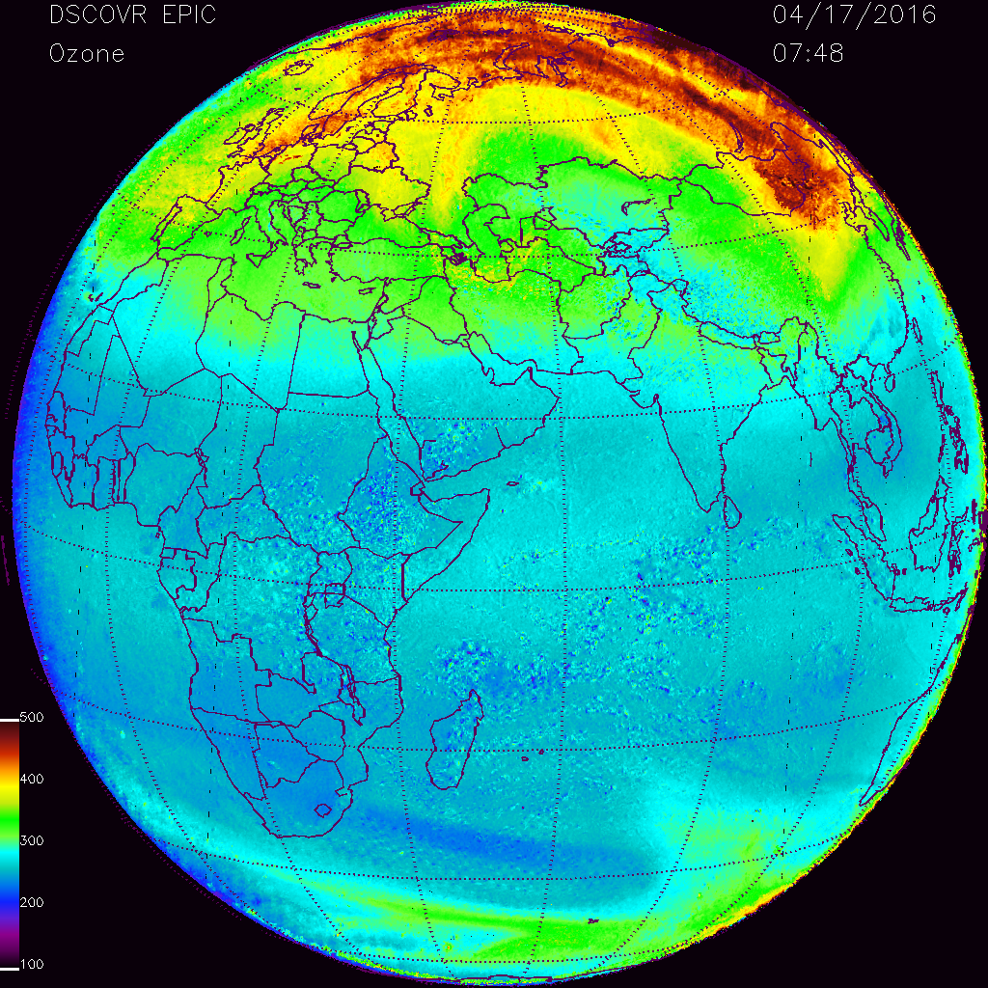
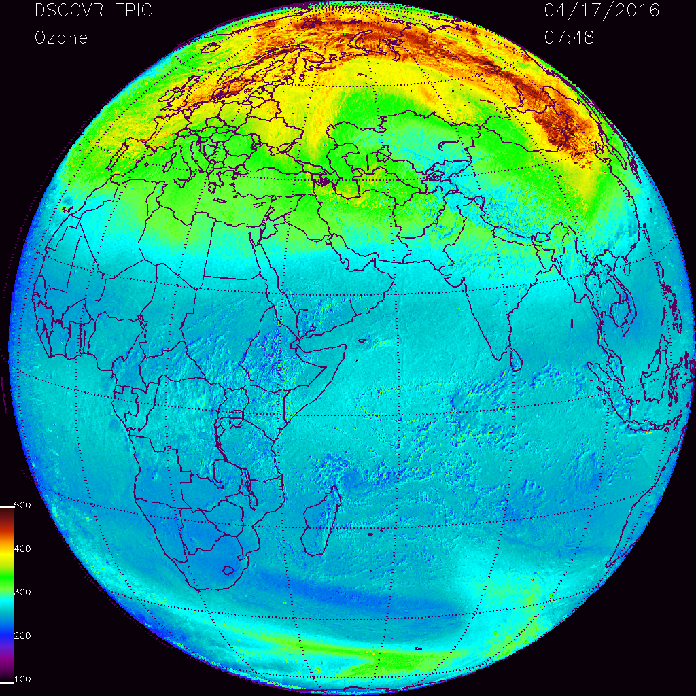
Change in Retrieved Ozone

