Slide 1
EPIC L2 Cloud Product Updates
Yuekui Yang (GSFC)
Kerry Meyer, Gala Wind, Qilong Min, Anthony Davis, Steven Platnick, Daniel Holdaway
Alexei Lyapustin, Lazaros Oreopoulos, Zhibo Zhang
Thanks to:
David Duda, Patrick Minnis, Wenying Su
EPIC Science Team Meeting
03-04 October 2017 , Greenbelt, MD

Slide 2
Cloud Product System
EPIC L1B Products
Ancillary Data
Cloud Mask
Effective Height/Pressure
Cloud Optical Thickness
EPIC L2 Cloud Products

Slide 3
EPIC Channels Currently Used for Cloud Products
l (nm) | Dl (nm) FWHM | Purpose
317.5±0.1 | 1±0.2 | Ozone
325±0.1 | 2±0.2 | Ozone
340±0.3 | 3±0.6 | Ozone, Aerosols
388±0.3 | 3±0.6 | Aerosols, Clouds
443±1 | 3±0.6 | Aerosols
551±1 | 3±0.6 | Aerosols, Vegetation
680±0.2 | 2±0.4 | Aerosols, Vegetation, Clouds, O₂ B-Band Reference
687.75±0.2 | 0.8±0.2 | O₂ B-Band Cloud Height
764.0±0.2 | 1±0.2 | O₂ A-Band Cloud Height
779.5±0.3 | 2±0.4 | O₂ A-Band Reference, Vegetation

Slide 4
EPIC L2 Cloud Product List
EPIC Cloud Mask
Oxygen A-band Cloud Effective Pressure
Oxygen A-band Cloud Effective Height
Oxygen B-band Cloud Effective Pressure
Oxygen B-band Cloud Effective Height
Cloud Optical Thickness – assuming liquid phase
Cloud Optical Thickness – assuming ice phase
Cloud Effective Temperature
Most likely cloud thermodynamic phase

Slide 5
Current Status
Operational:
EPIC cloud product system has been integrated into the production line
Products will be released as soon as processing and checking is finished (within a month)
Publications:
Holdaway, D. and Y. Yang, 2016: Study of the Effect of Temporal Sampling Frequency on DSCOVR Observations Using the GEOS-5 Nature Run Results (Part II): Cloud Coverage. Remote Sens. 8(5), 431, doi:10.3390/rs8050431.
Meyer, K., Y. Yang, and S. Platnick, 2016: Uncertainties in cloud phase and optical thickness retrievals from the Earth Polychromatic Imaging Camera (EPIC), Atmos. Meas. Tech., 9, 1785-1797, doi:10.5194/amt-9-1785-2016.
Holdaway, D. and Y. Yang, 2016: Study of the Effect of Temporal Sampling Frequency on DSCOVR Observations Using the GEOS-5 Nature Run Results (Part I): Earth’s Radiation Budget. Remote Sens. 2016, 8(2), 98; doi:10.3390/rs8020098.

Slide 6
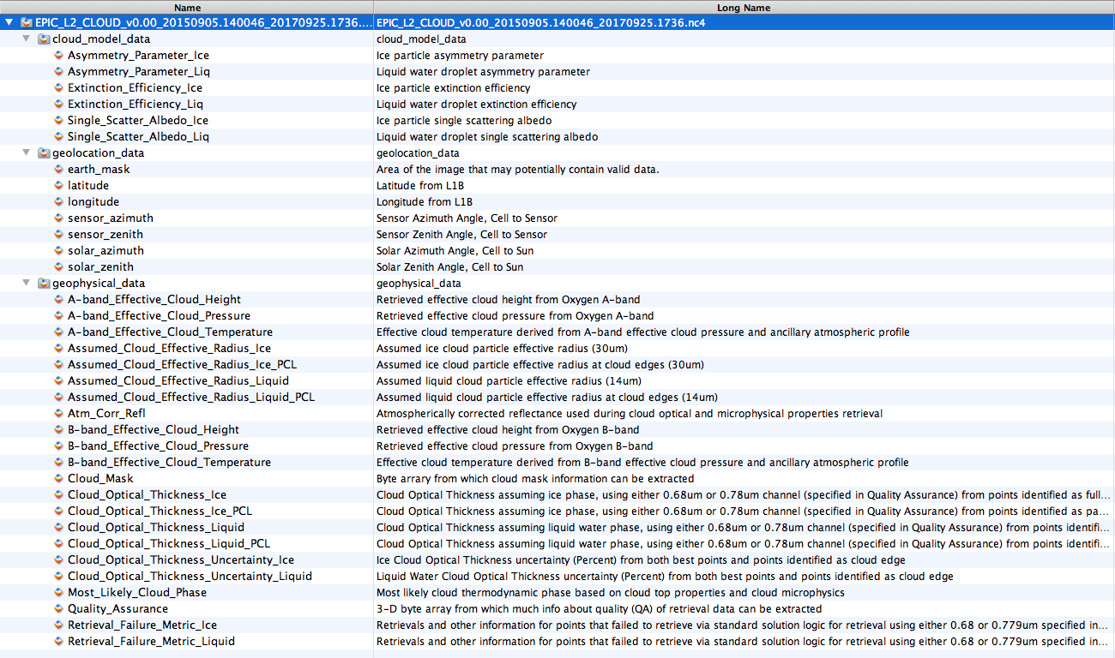
EPIC L2 Cloud Product File Structure

Slide 7

1. Cloud Mask
Clr LC
Clr HC
Cld LC
Cld HC
T1
T2
T3
Test

Slide 8
2. Cloud Effective Height/Pressure
Cloud height retrieval with O2 absorption has been successfully applied to several missions, such as GOME, MERIS, POLDER, OMI, SCIAMACHY etc., as well as many other studies.
B-band
reference
A-band
reference
B-band
e.g., Daniel et al., 2003, Ferlay et al. 2010, Fischer and Grassl, 1991, Koelemeijer et al. 2001, , Kokhanovsky et al., 2005, Lindstrot et al. 2006, Stephens and Heidinger, 2000, Vanbauce et al. 2003, Vasilkov et al. 2008, Wang et al. 2008.
A-band

Slide 9
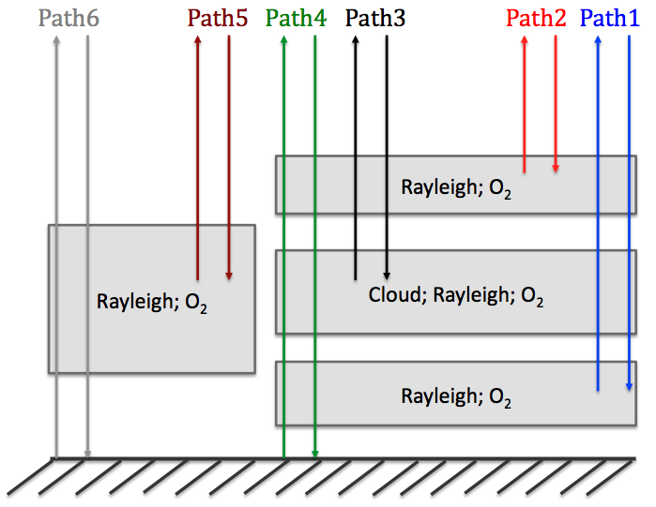
Complexity of photon pathways
A- and B-band radiances are functions of:
Cloud top height
Cloud geometrical thickness
Cloud fraction
Cloud optical depth
Atmosphere profile
Surface albedo
Sun-view geometry
Aerosol loading
Cloud particle size and shape
Cloud phase
Cloud vertical distribution
Clear part
Cloudy part

Slide 10
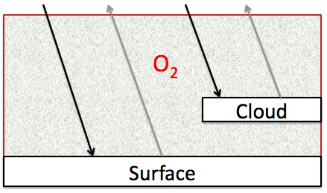
Mixed Lambertian-Equivalent Reflectivity (MLER) method
A pixel contains two Lambertian reflectors, the surface and the cloud;
Clouds are opaque; no photon penetration and transmission considered.
Mixed Lambertian Equivalent Reflectivity (MLER) Model, e.g. Koelemeijer et al. 2001
Variables:
R_{abs}: absorption channel radiance
R_{ref}: reference channel radiance
A_{c}: cloud fraction
α_{s}: surface albedo
α_{c}: cloud albedo
T_{abs} : absorption channel transmittance
T_{ref} : absorption channel transmittance
Two cloud effective pressure sets, one for A-band and the other for B-band, are retrieved by solving the equations through iteration.

Slide 11
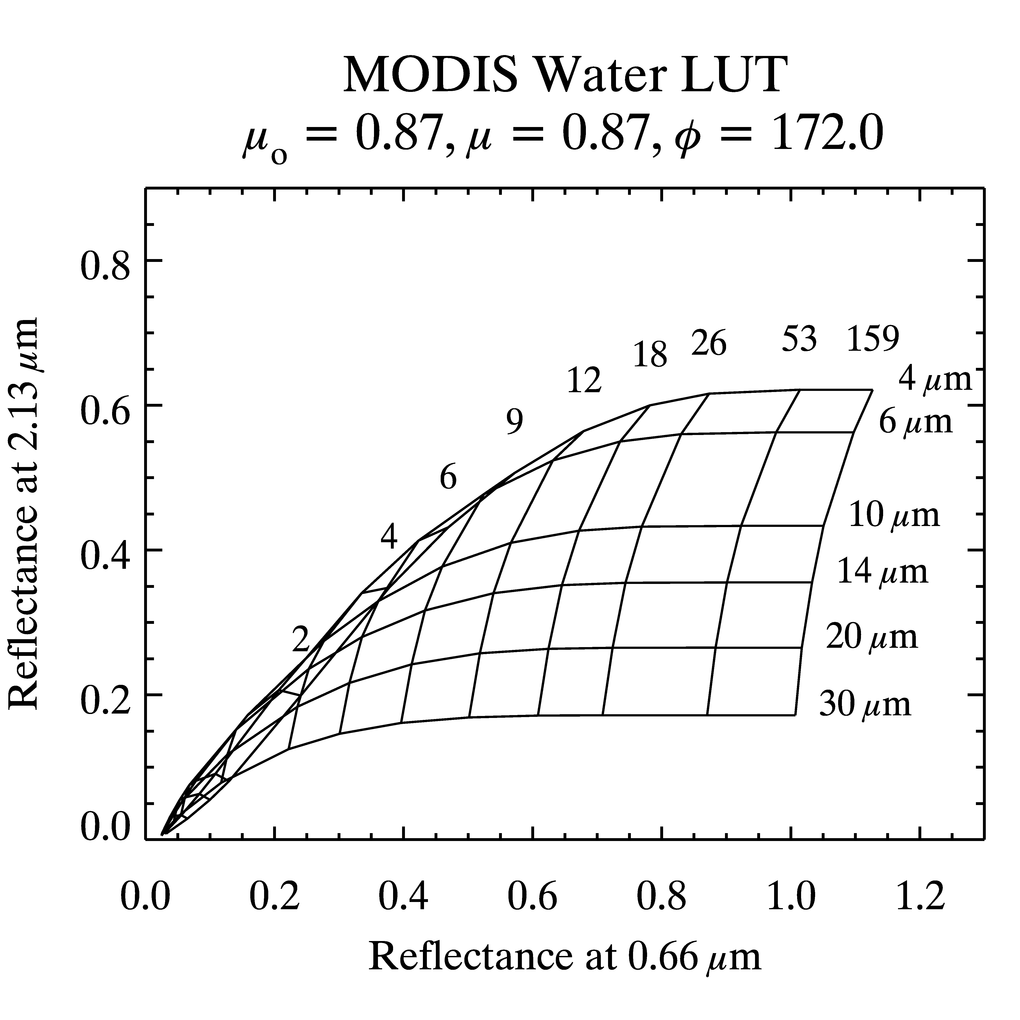
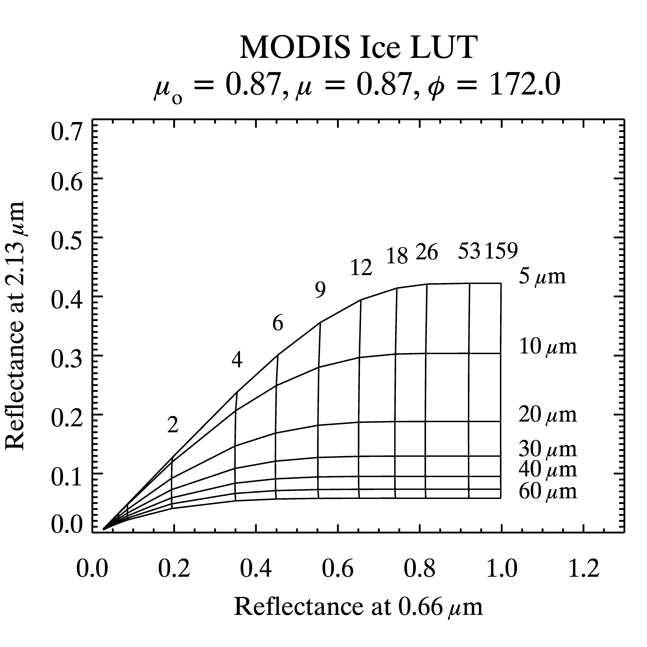
3. Cloud Optical Thickness Retrieval
EPIC cloud optical thickness retrieval adopts a single channel method assuming a fixed effective radius.

Slide 12
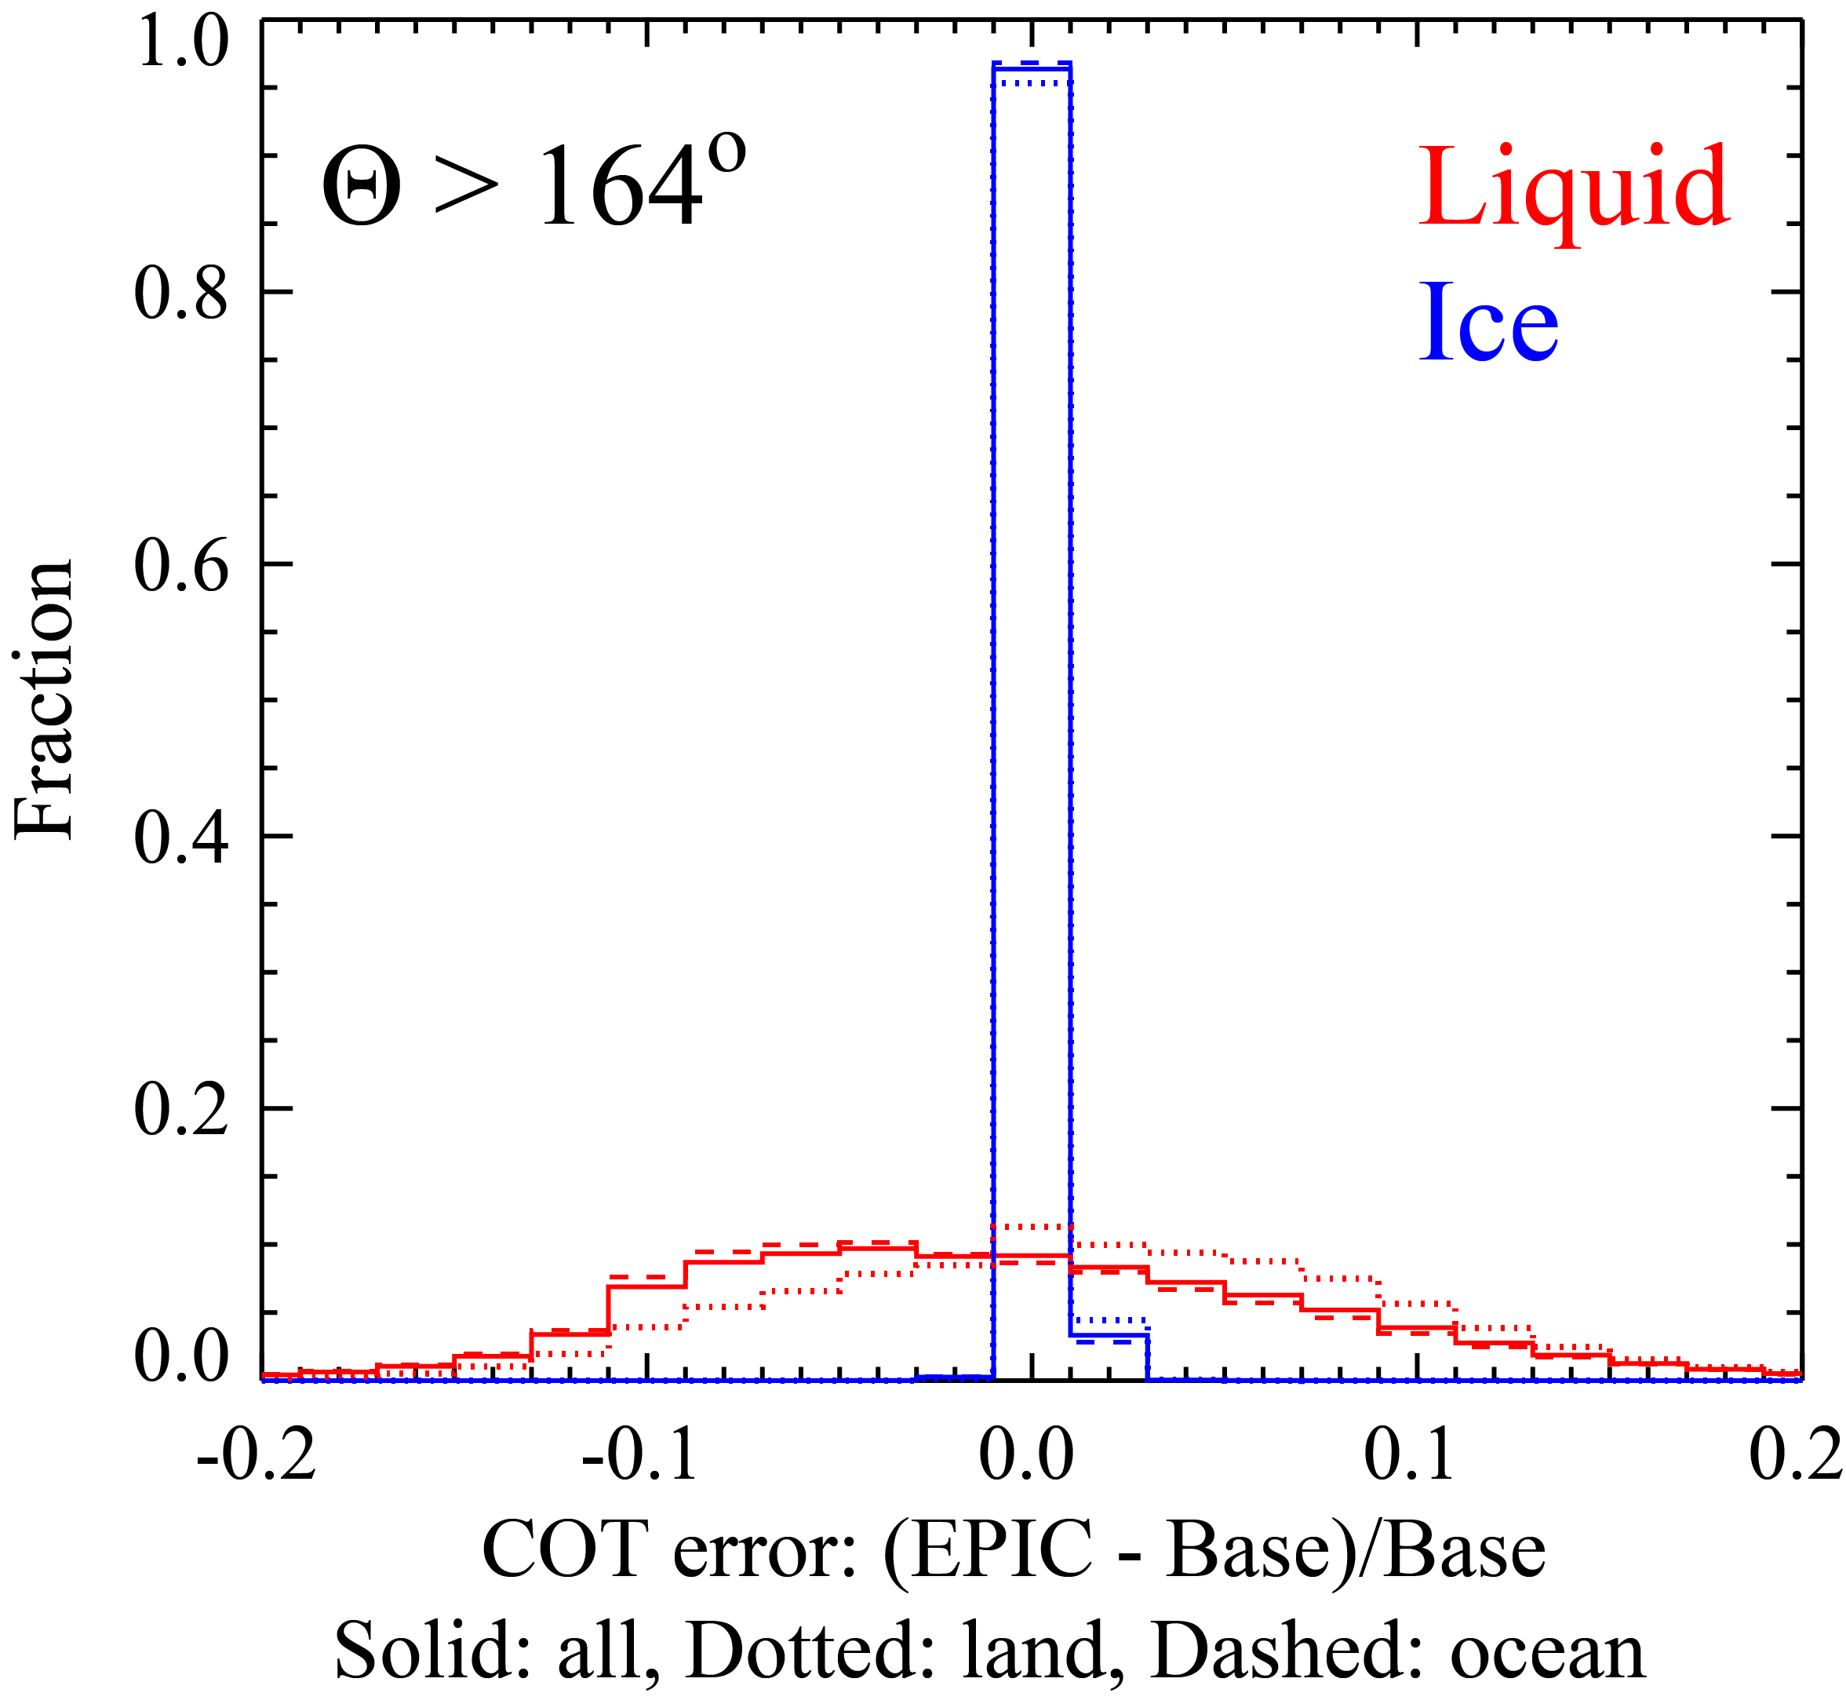
Uncertainties due to Single-Channel Retrieval
Distribution of single-channel COT retrieval errors w.r.t. two-channel COT-CER retrievals.
Meyer, Yang and Platnick, 2016, AMT

Slide 13
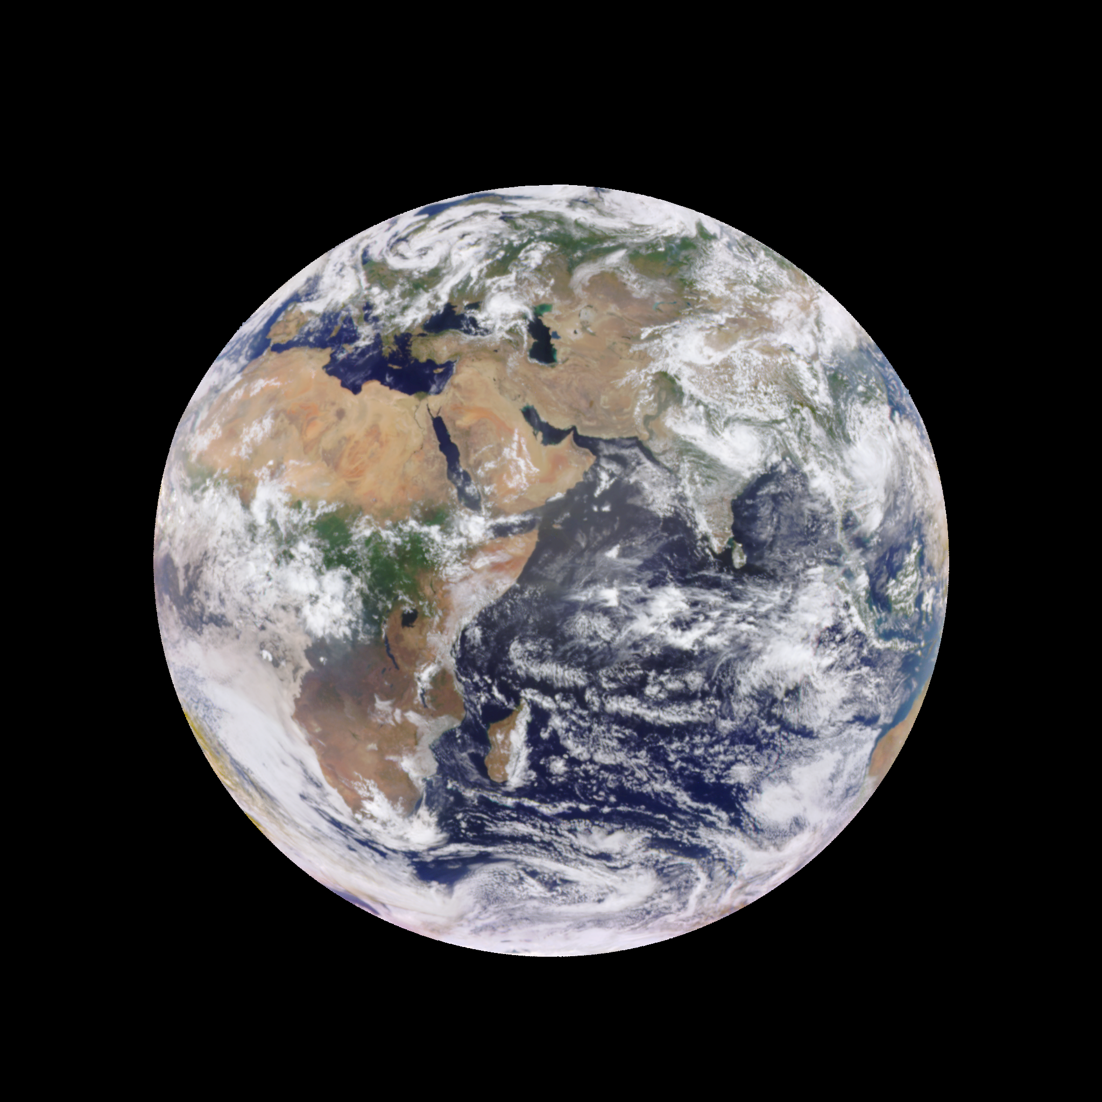
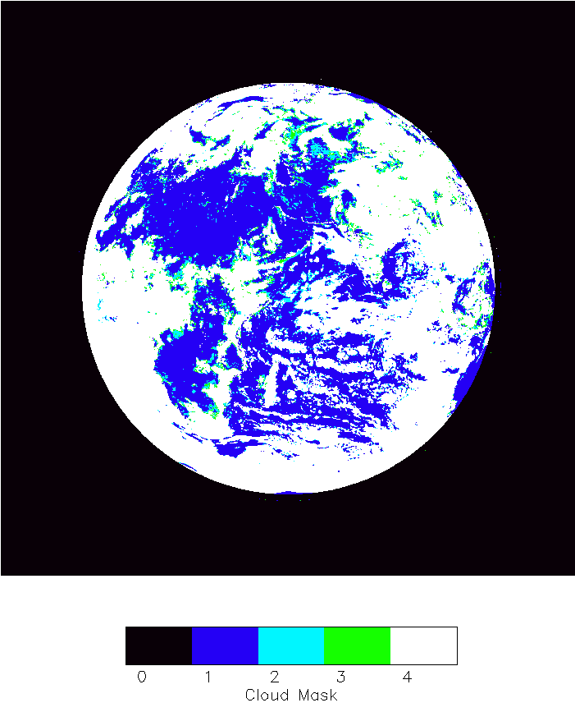
Example: first granule from the production line (from 08GMT 08/18/2016)

Slide 14
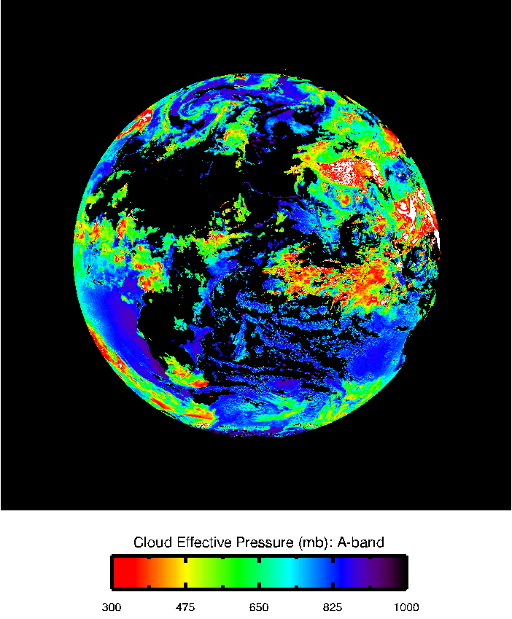
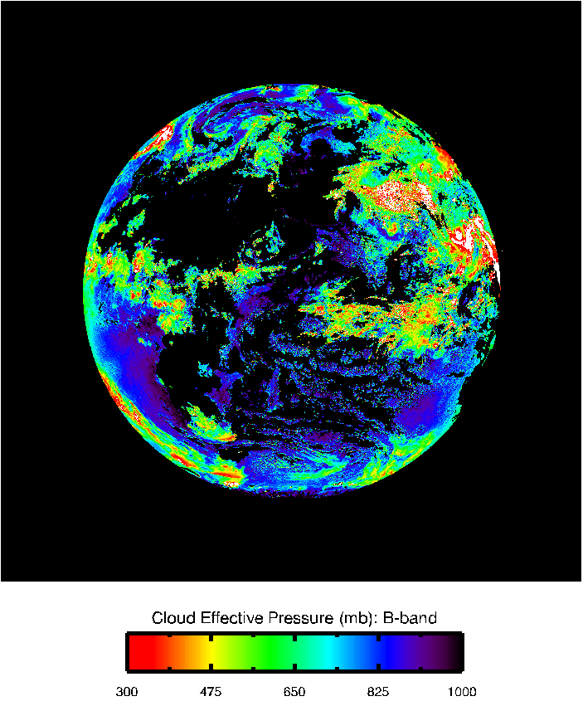
Cloud effective pressure

Slide 15
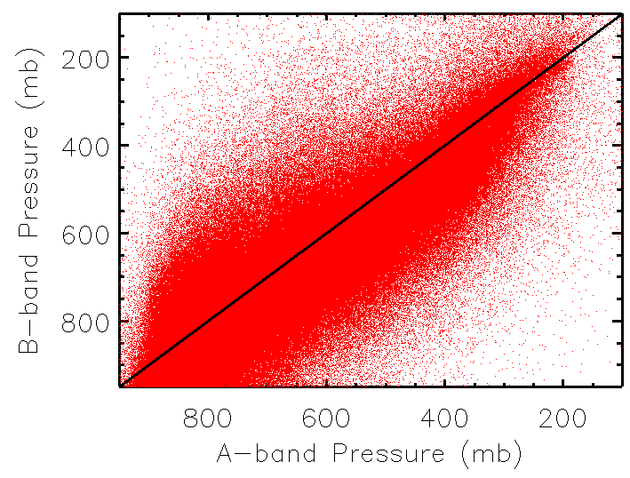
A-band vs B-band pressure

Slide 16
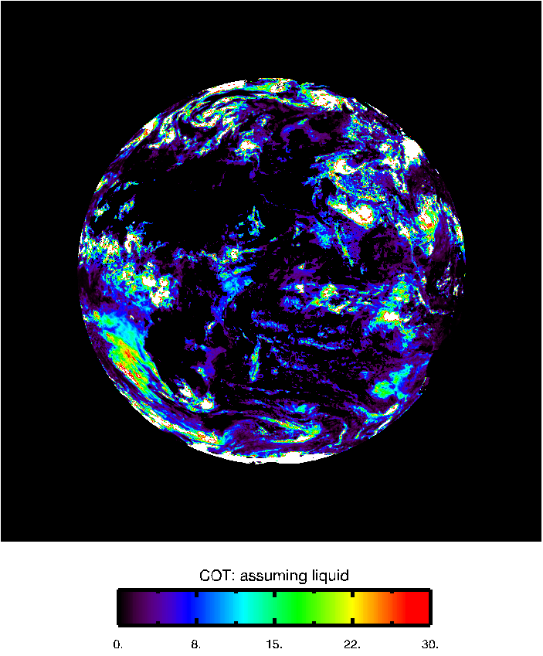
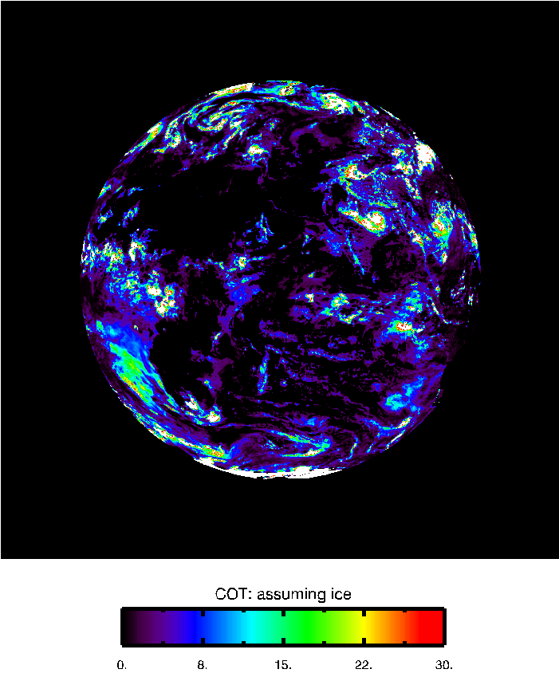
Cloud optical thickness

Slide 17
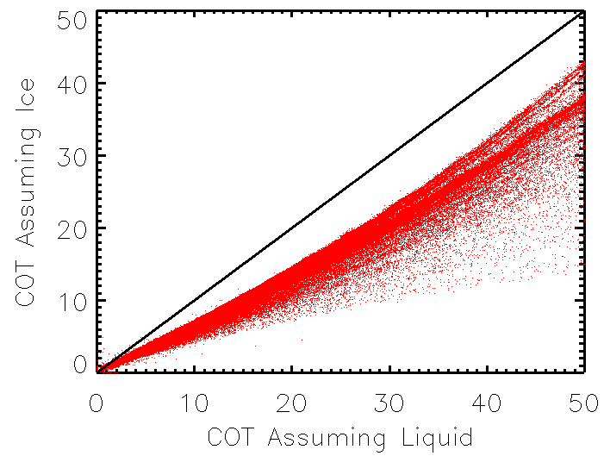
COT retrieval ice vs liquid phase

Slide 18
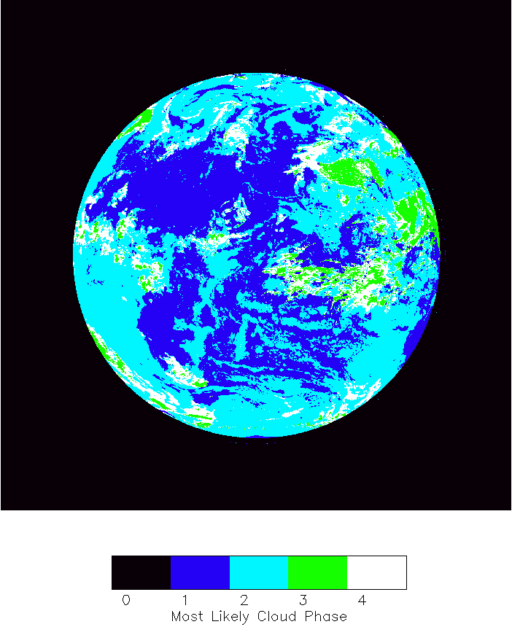
Most likely cloud phase
Clr Liq Ice UnD

Slide 19
Comparison with Langley Composites
The Langley multi-sensor composites are produced by reprojecting GEO/LEO results (such as AVHRR, MODIS and GOES) onto the EPIC grids.
This dataset provides an independent source for EPIC cloud product verification.

Slide 20
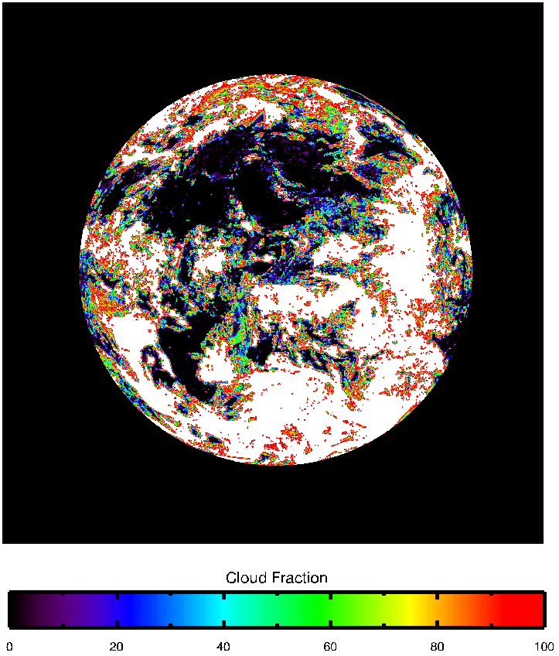
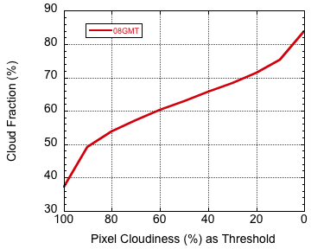
A large portion of the EPIC pixels are partially cloudy
How cloudy is cloudy?

Slide 21
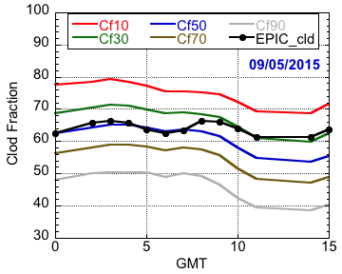
Comparison on global statistics
EPIC cloud mask can generally pick up pixels that are 30% to 50% cloudy.

Slide 22
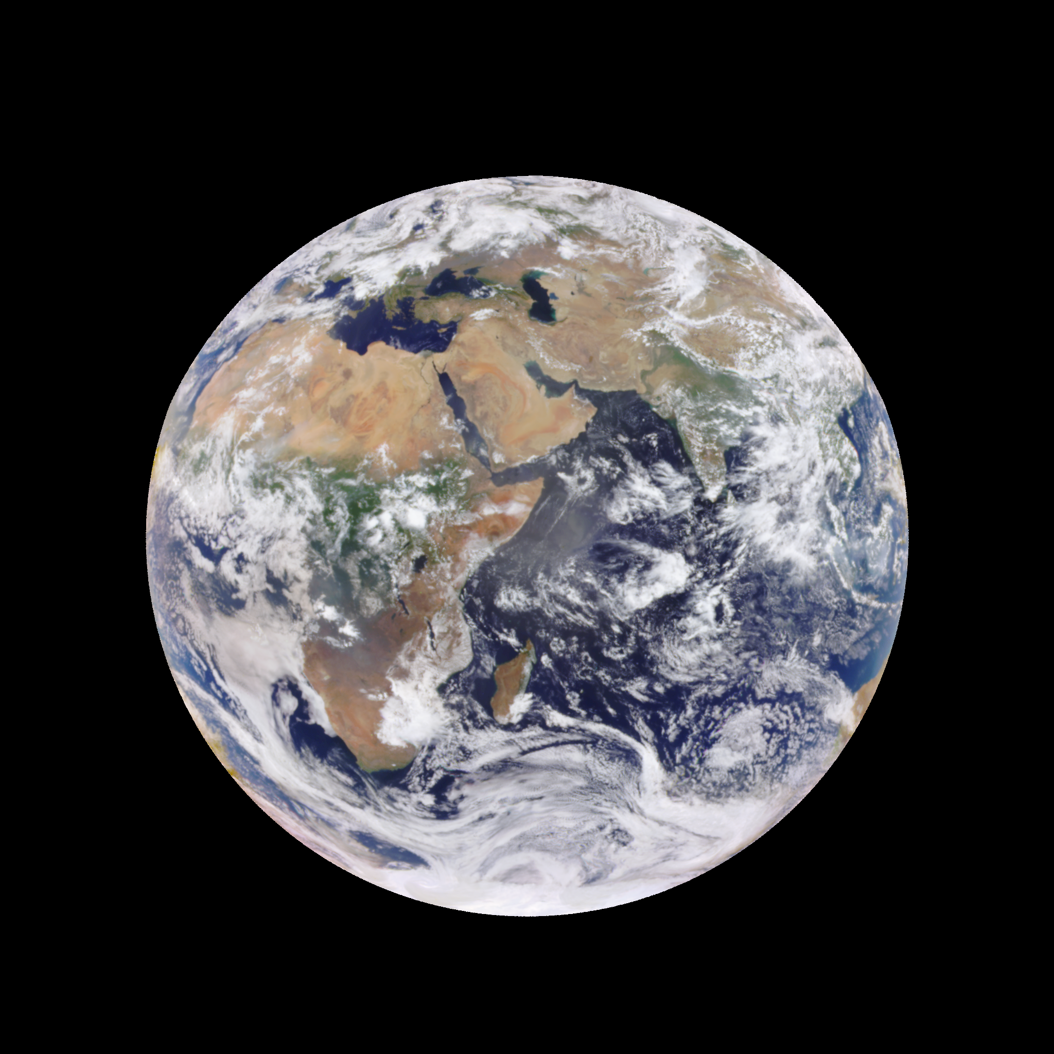
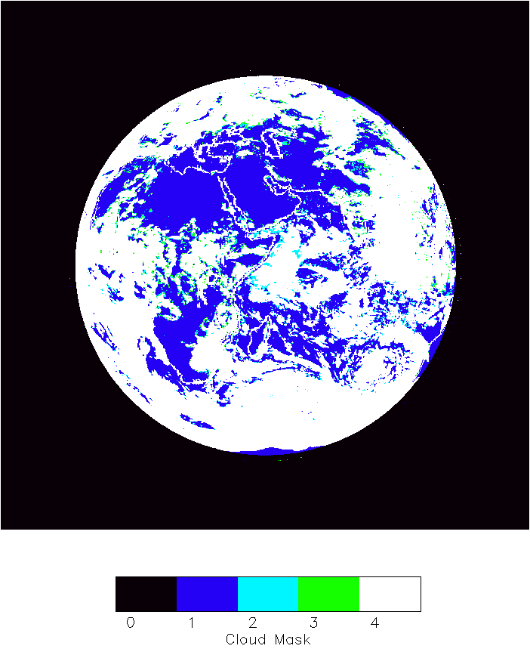
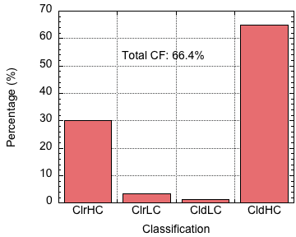
One complicated case in the day: 08 GMT
EPIC Cloud Mask
Composite

Slide 23
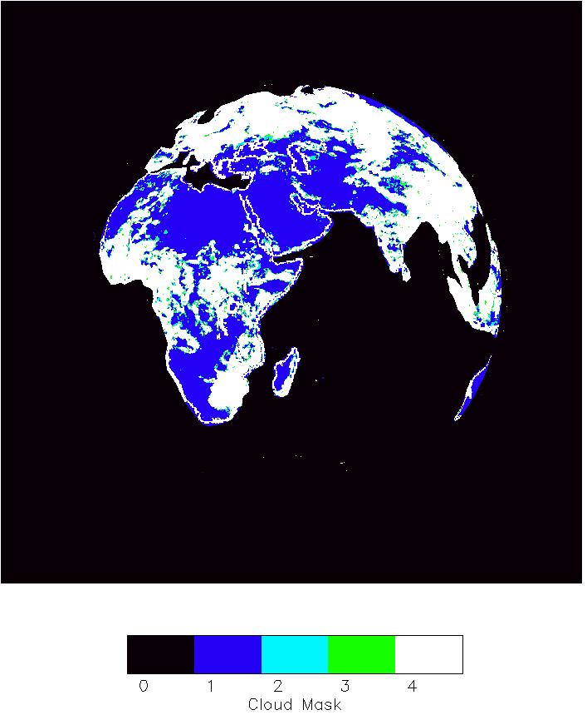
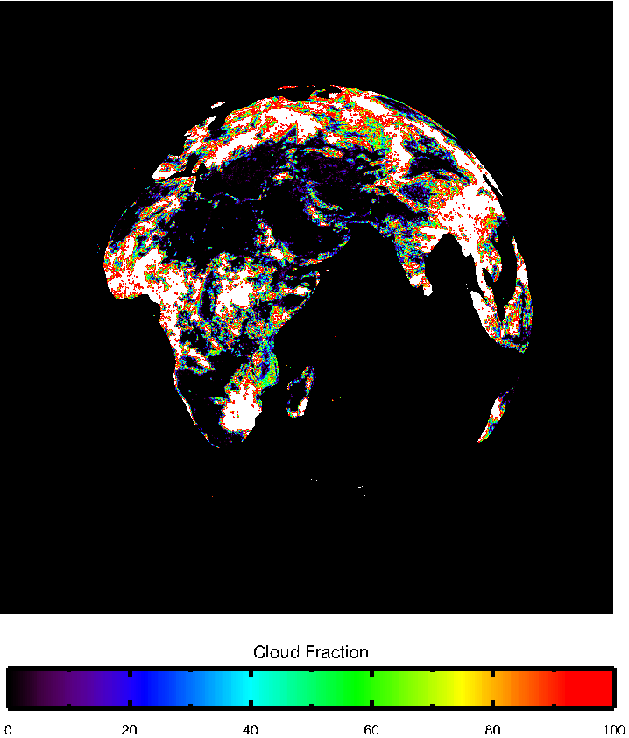
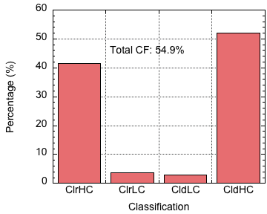
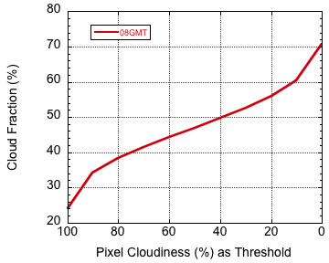
Overland
EPIC Cloud Mask
Composite

Slide 24
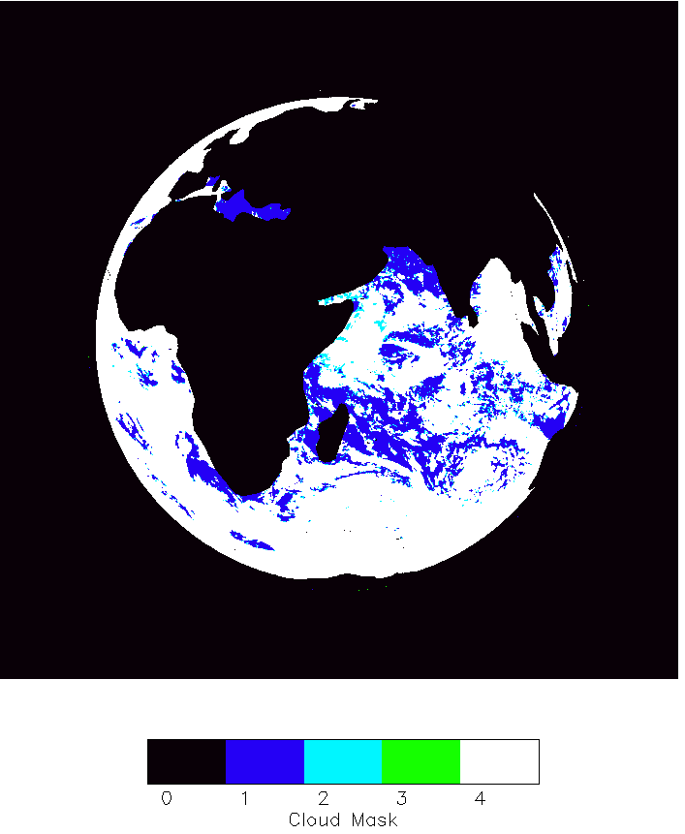
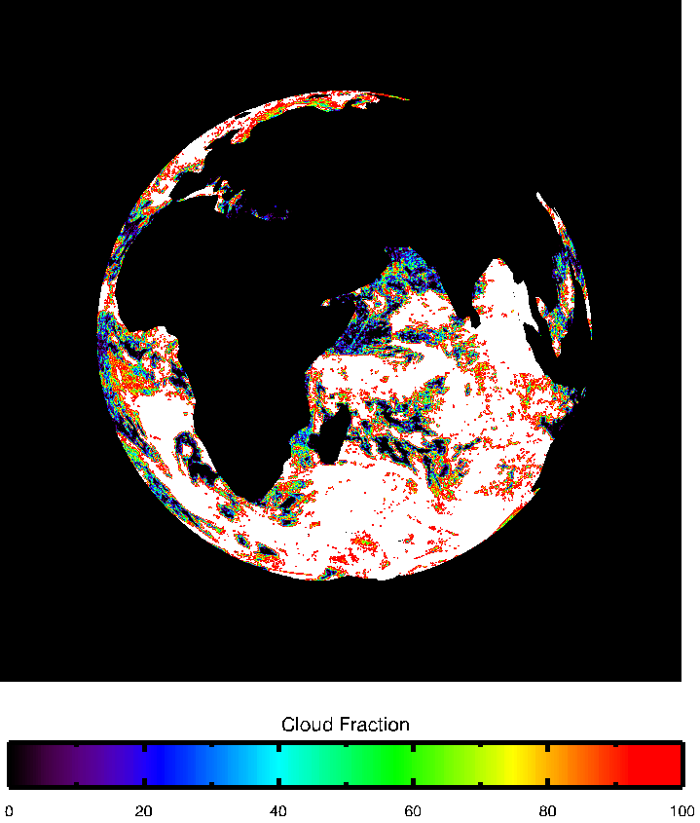
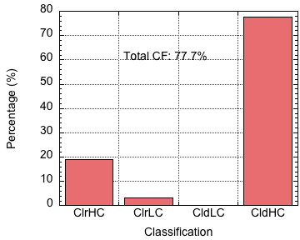
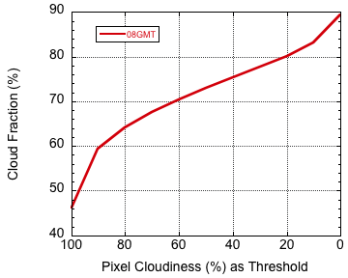
Over Ocean
EPIC Cloud Mask
Composite

Slide 25
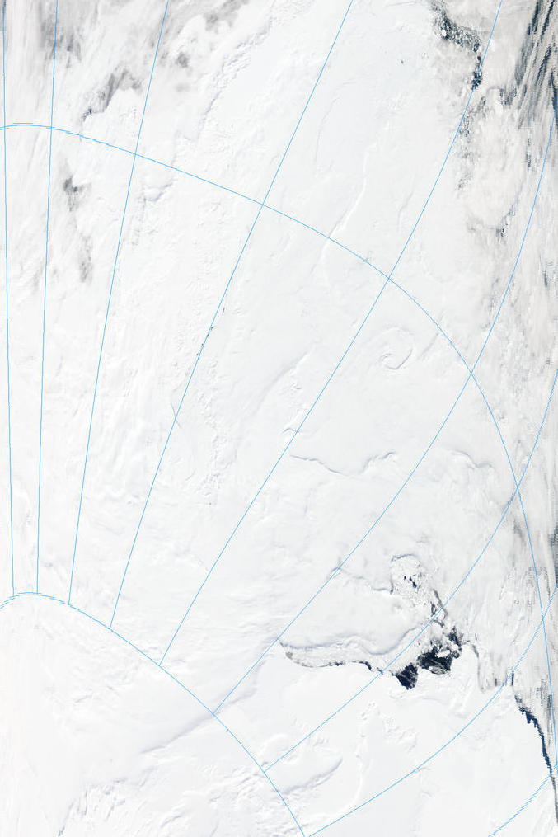
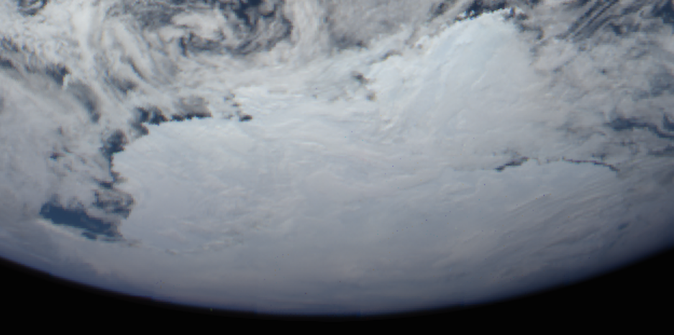

Difficulties in cloud detection over ice/snow
EPIC image time: 12/29/2015 18:27 GMT
Aqua MODIS time: 19:00 to 19:05 GMT

Slide 26
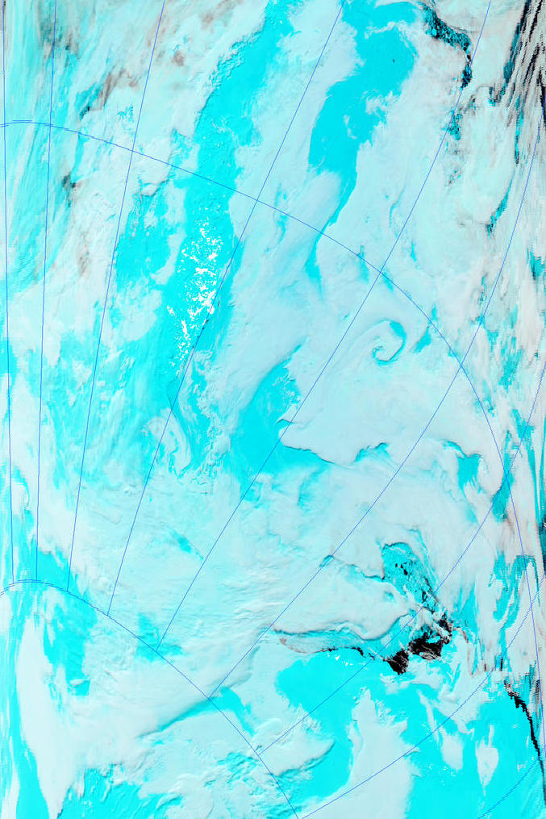
Difficulties in cloud detection over ice/snow
EPIC image time: 18:27 GMT
But
MODIS has SWIR channels
0.47, 1.6, 2.1 µm as RGB
Aqua MODIS time: 19:00 to 19:05 GMT

Slide 27
Cloud signal in EPIC A-band over different surface types

Slide 28
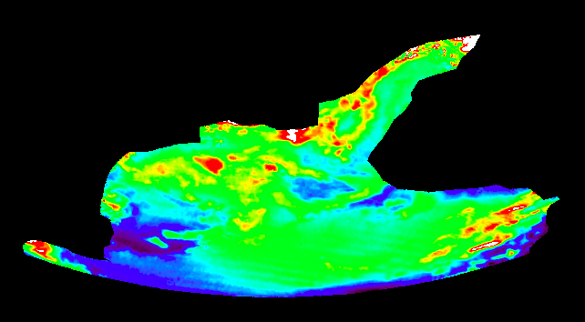
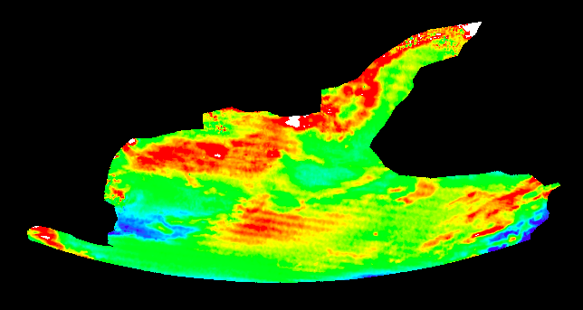
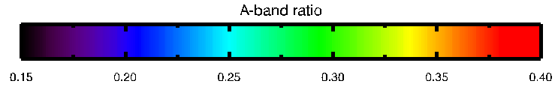
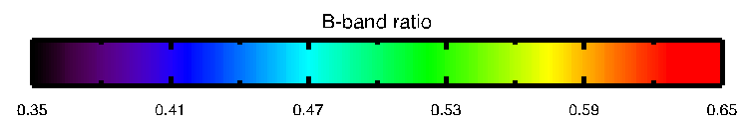
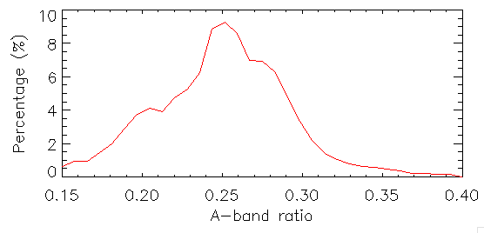
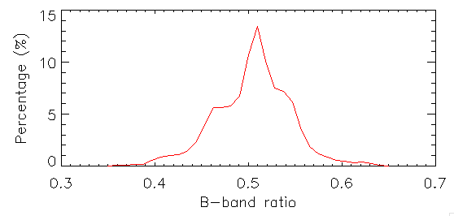
Cloud signal in EPIC A- and B-bands over ice/snow
A-band Ratio
B-band Ratio

Slide 29
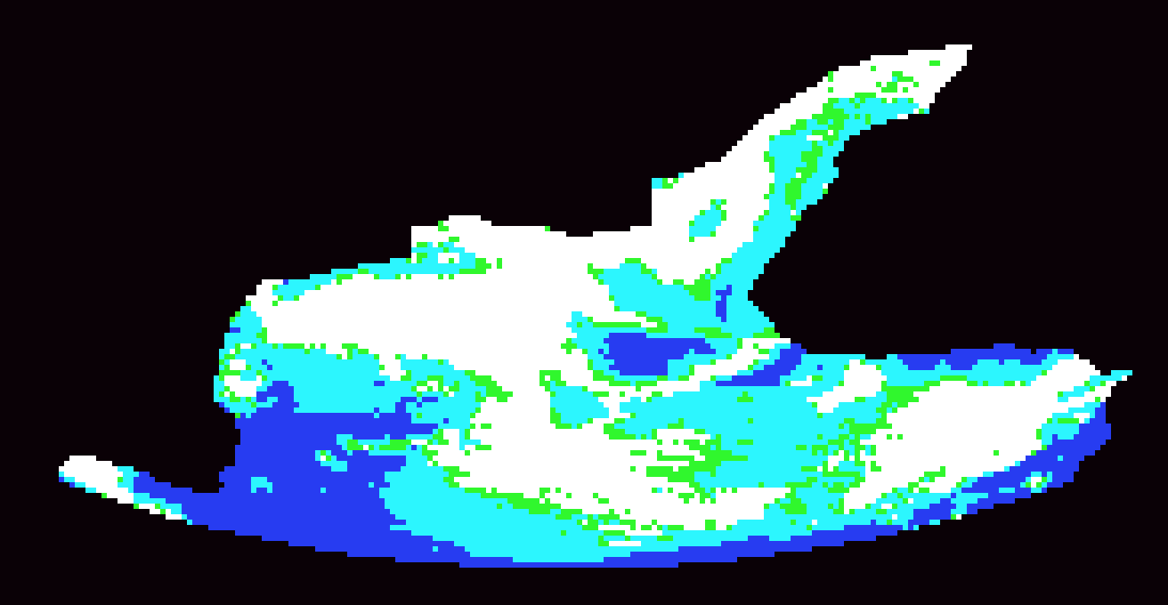


Cloud Mask Using EPIC Oxygen A- and B-bands
MODIS time: 19:00 to 19:05 GMT
EPIC time: 18:27 GMT

Slide 30
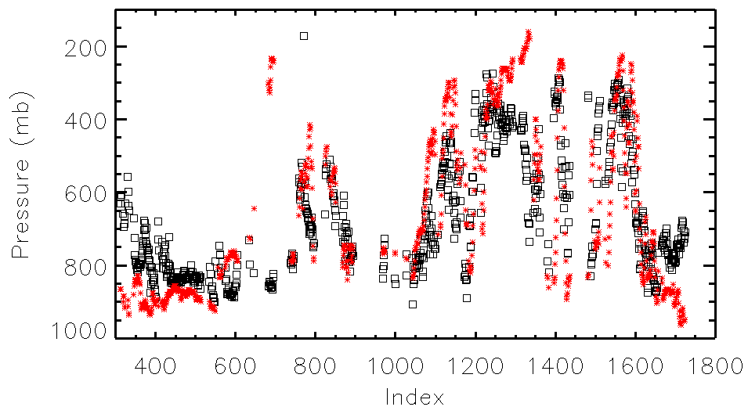
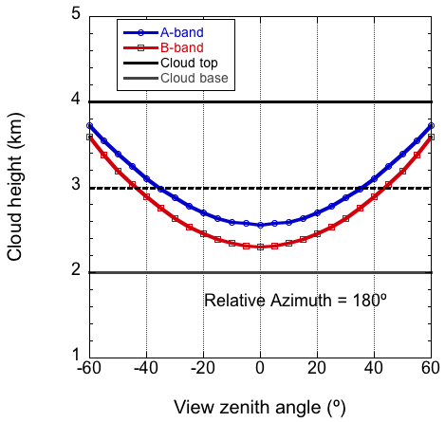
Cloud height comparison
☐ A-band Pressure (mean: 658 mb)
* Langley Composite (mean: 645 mb)
SZA=VZA
Modeling results of cloud height retrievals from EPIC A- and B-bands
Cloud height comparison between EPIC A-band retrieval and the composite along Line 1100 (middle of image)
Yang et al. 2014, JQSRT

Slide 31
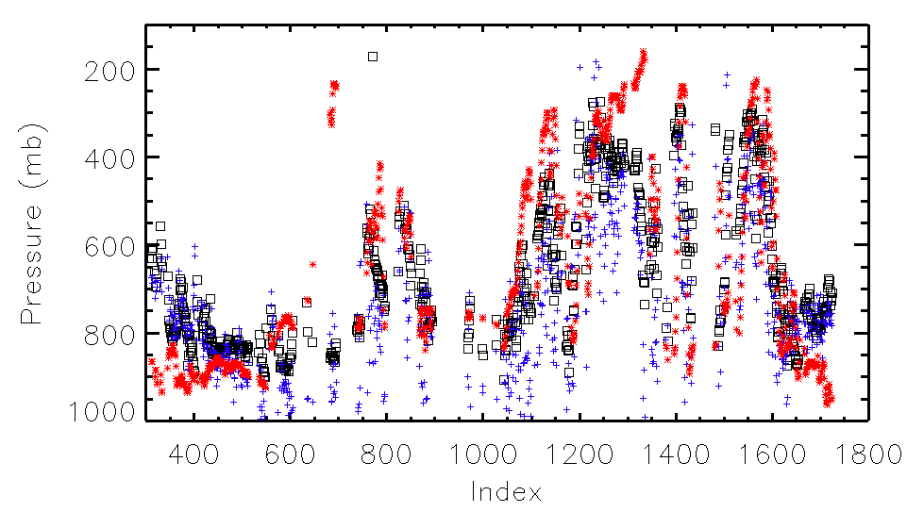
Cloud height comparison: A-band, B-band and composite
☐ A-band Pressure
+ B-band Pressure
* Langley Composite
EPIC effective cloud height are generally lower that the cloud height from the composites except in very high angles, which is consistent with the literature

Slide 32
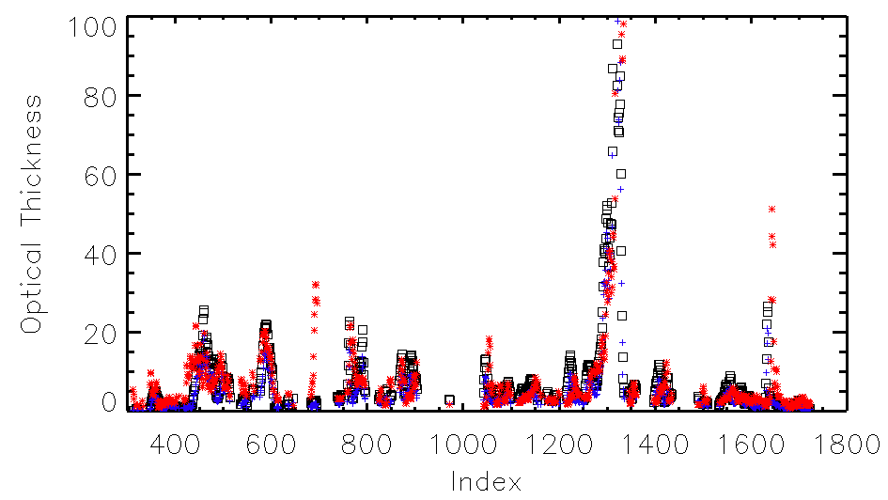
Cloud optical thickness comparison
☐ COT assuming liquid (mean: 8.9)
+ COT assuming ice (mean: 7.4)
* Langley Composite (mean: 9.5)

Slide 33
Summary
EPIC cloud product system has been integrated to the production line; products will be releases as soon as processing is done.
Comparison with the GEO/LEO composites generated by the Langley group shows that 1) EPIC cloud mask can generally pick up pixels that are 30% to 50% cloudy; 2) EPIC effective cloud height are generally lower than the cloud height from the composites except in very high angles, which is consistent with the literature; 3) single channel cloud optical thickness retrieval provides valuable information.

