Slide 1
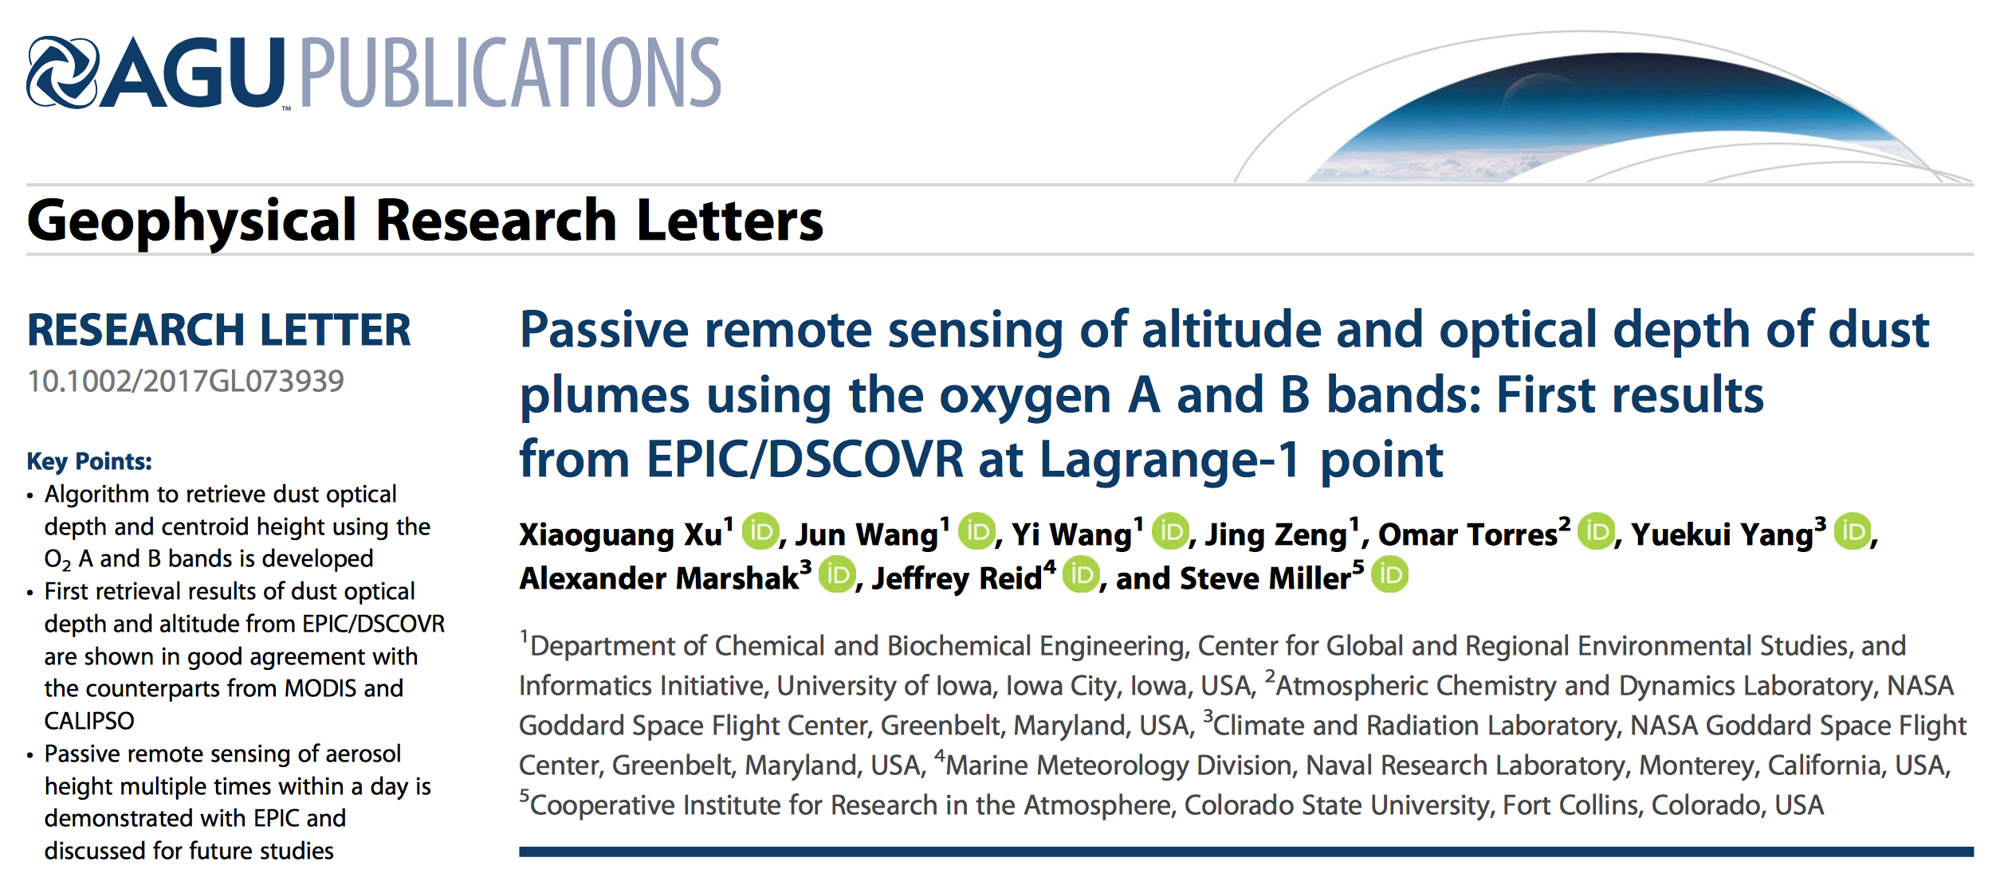
44, 7544–7554
DSCOVR Science Team Meeting
3 October 2017

Slide 2
Why aerosol layer height (ALH)?
Aerosol direct effect
  - Elevated scattering aerosols restrain gaseous absorption of solar radiation
  - Heating the air by smoke and dust -> air temperature profile
Aerosol semi-direct and indirect effect
  - The altitude of aerosol relative to cloud determines the sign of aerosol-cloud radiative forcing
Aviation safety (Volcanic ash, dust storms)
Remote sensing of trace gases and aerosol properties
  - Neglecting aerosol vertical distribution can lead to substantial errors in retrieving trace gases (e.g., NO₂, SO₂, O₃, CO₂) and aerosol properties

Slide 3
Active remote sensing of aerosol height
Liu et al. 2008 JGR
Space-borne Lidar gives detail and accurate backscatter profile, but its spatial coverage suffers from narrow sub-orbital footprint.
Notes:
A dust event that originated in the Sahara desert on 17 August 2007 and was transported to
the Gulf of Mexico. Red lines represent back trajectories indicating t he transport track of the dust event.
Vertical images are 532 nm attenuated backscatter coefficients measured by CALIOP when passing over
the dust transport track. The letter ‘‘D’’ designates the dust layer, and ‘‘S’’ represents smoke layers from
biomass burning in Africa (17–19 August) and South America (22 August). The track of the HSRL
measurement is indicated by the white line superimposed on the 28 August CALIPSO image. The HSRL
track is coincident with the track of the 28 August CALIPSO measurement off the coast of Texas between
28.75°N and 29.08°N. Plot courtesy of Kurt Severance at NASA Langley Research Center.

Slide 4
Introduction of Gas Absorption
Wang et al., 2014

Slide 5
Introduction to O₂ A and B bands
O2 Absorption Optical Depth (0.01 nm interval)
Penetration Altitude (direct light attenuated by a factor of e)
Radiation at some wavelengths in O₂ A & B band would never reach the surface and they are sensitive to the aerosol vertical profile.
Ding et al., 2016

Slide 6

At atmospheric window channels:
I₀
I₁
I₀
I₂
Aerosol plume
Aerosol plume
I₁= I₂

Slide 7

At O2 absorption band:
I₀
I₁
I₀
I₂
O₂
O₂
Aerosol plume
O₂
Aerosol plume
O₂
I₁> I₂

Slide 8
O2 A and B bands of EPIC
EPIC
MERIS O2 A
FWHM: 3.75nm
FWHM: 0.8 ± 0.2 nm
POLDER O2 A
FWHM: 1.0 ± 0.2 nm
FWHM: 10nm
Dubuisson et al 2009

Slide 9
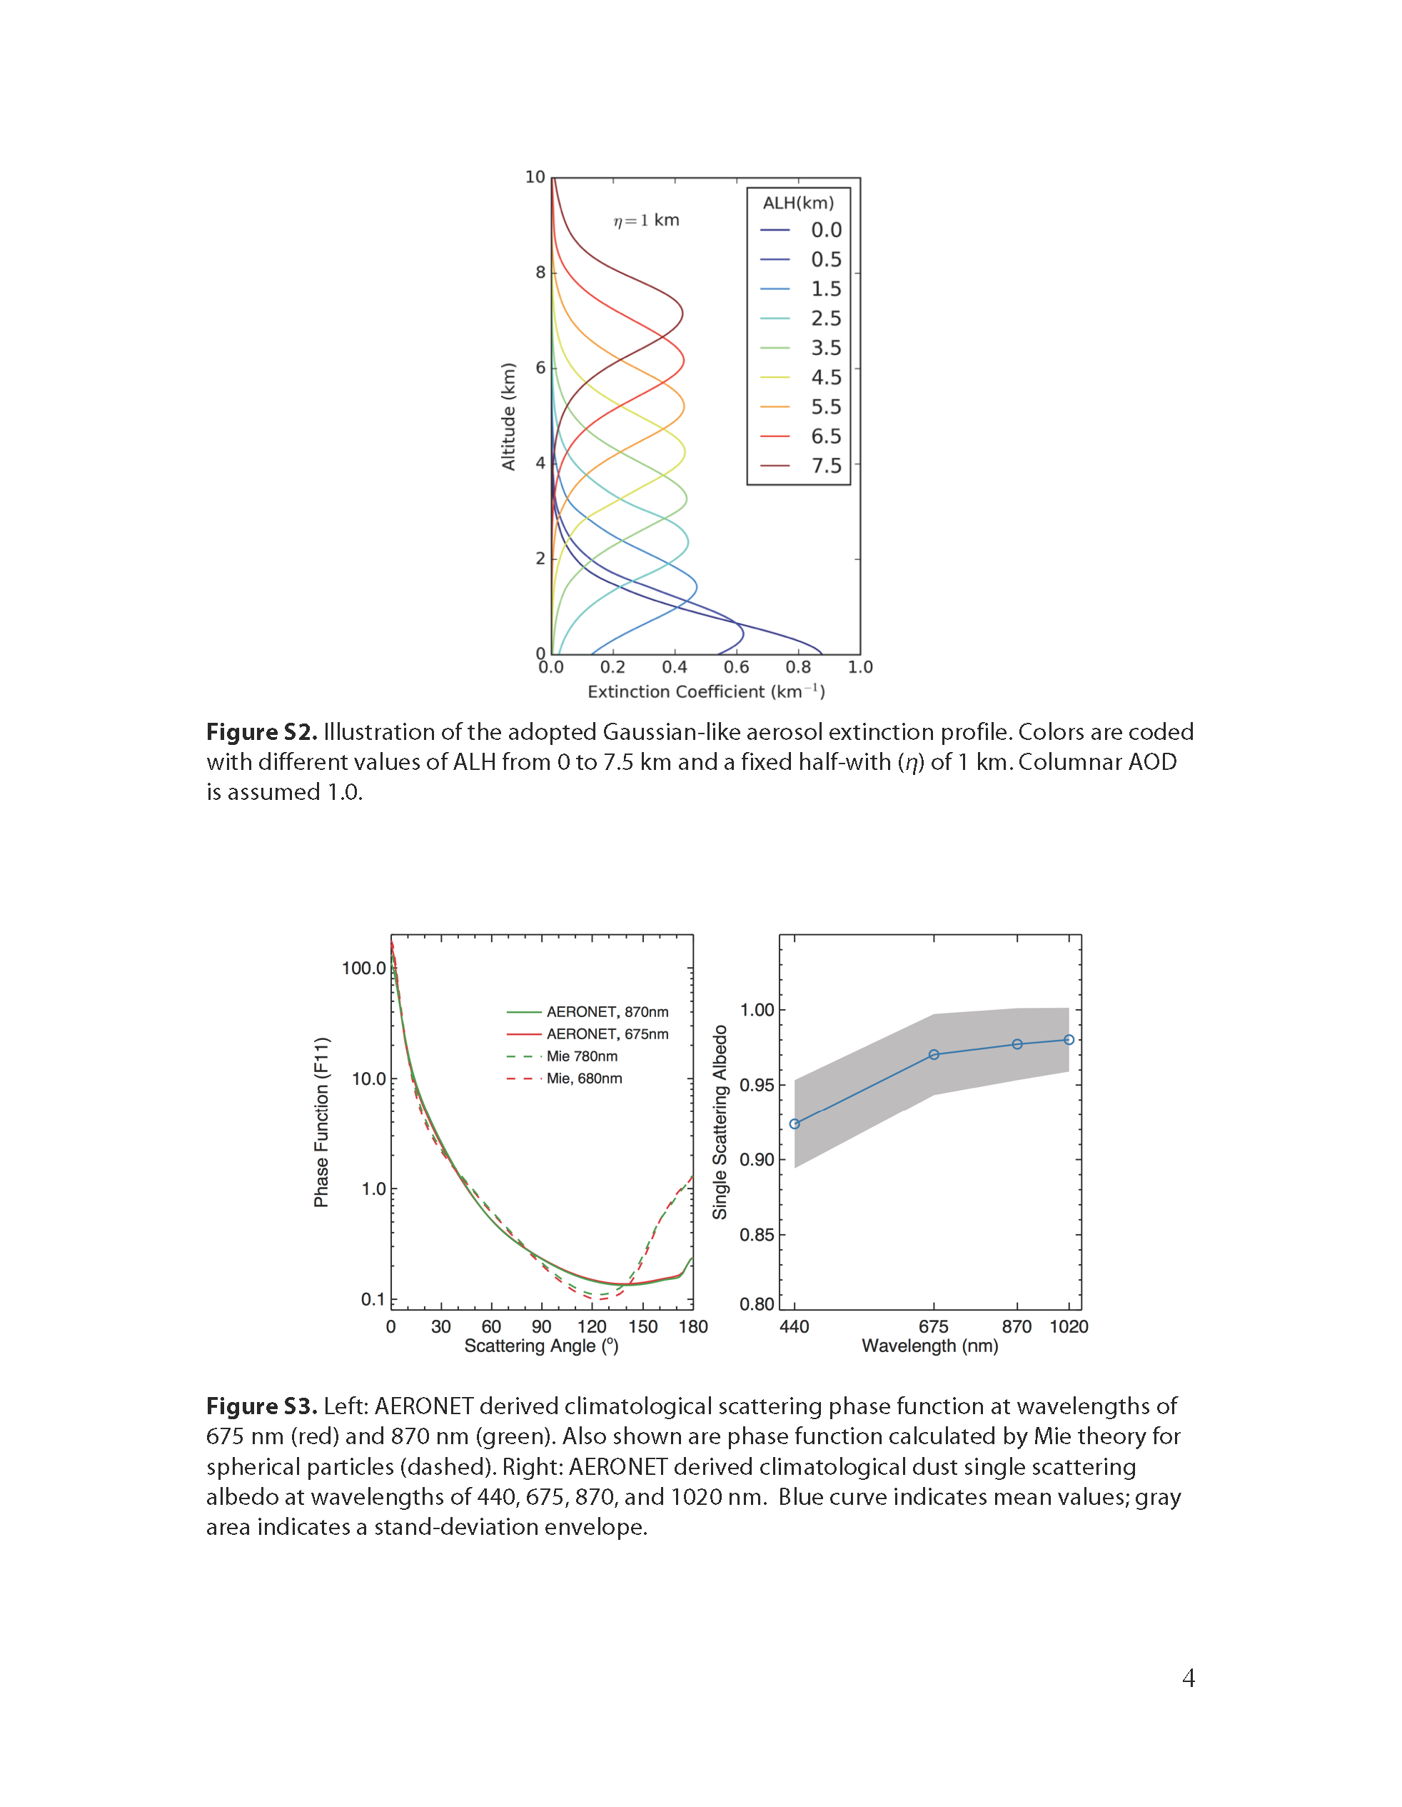
Aerosol Properties
η

Slide 10
Simultaneous retrieval of AOD ad ALH

Slide 11
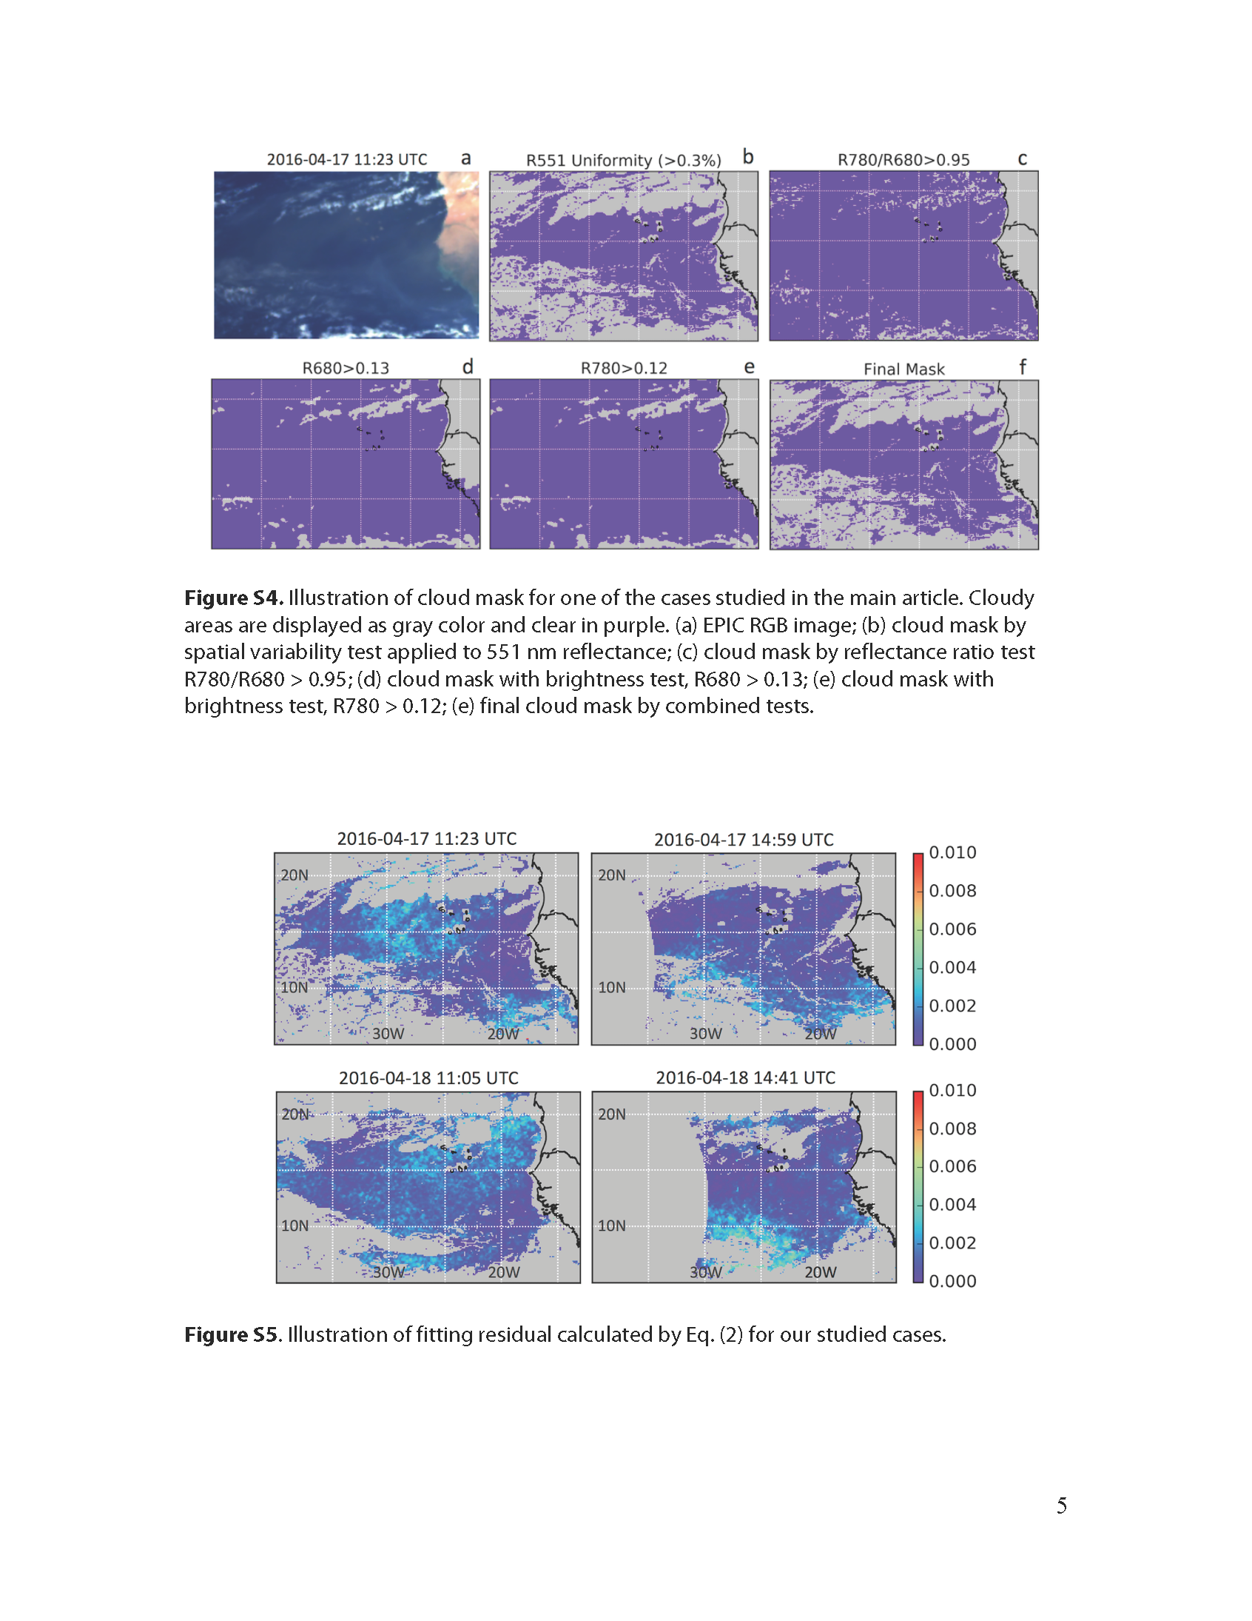
Cloud Mask

Slide 12
Retrieval of plume height and AOD

Slide 13
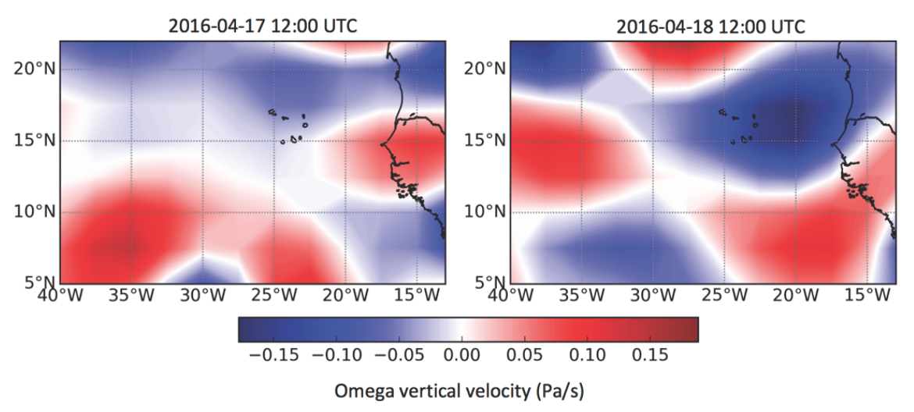
Evaluation of plume height
Vertical velocity
U
U
D
D
D

Slide 14
Validation with MODIS and CALIOP data

Slide 15
AOD evaluations

Slide 16
Summary & Future Plan
Algorithm to retrieve dust optical depth and centroid height using the O₂ A and B bands is developed.
First retrieval results of dust optical depth and altitude from EPIC/DSCOVR are shown in good agreement with the counterparts from MODIS and CALIPSO.
Passive remote sensing of aerosol height multiple times within a day is demonstrated with EPIC and discussed for future studies
Retrieval of plume heights of smoke and other aerosols are ongoing, bot over the ocean and over the vegetated lands. Hope to represent results in AGU.

Slide 17


Thank you !

Slide 18
Fitting residuals

