Slide 1
Deep space observations of oriented ice crystals
Tamás Várnai^{1,2}, Alexander Marshak¹, Alexander Kostinski³
1: NASA GSFC, 2: UMBC JCET, 3: Michigan Technological University

Slide 2
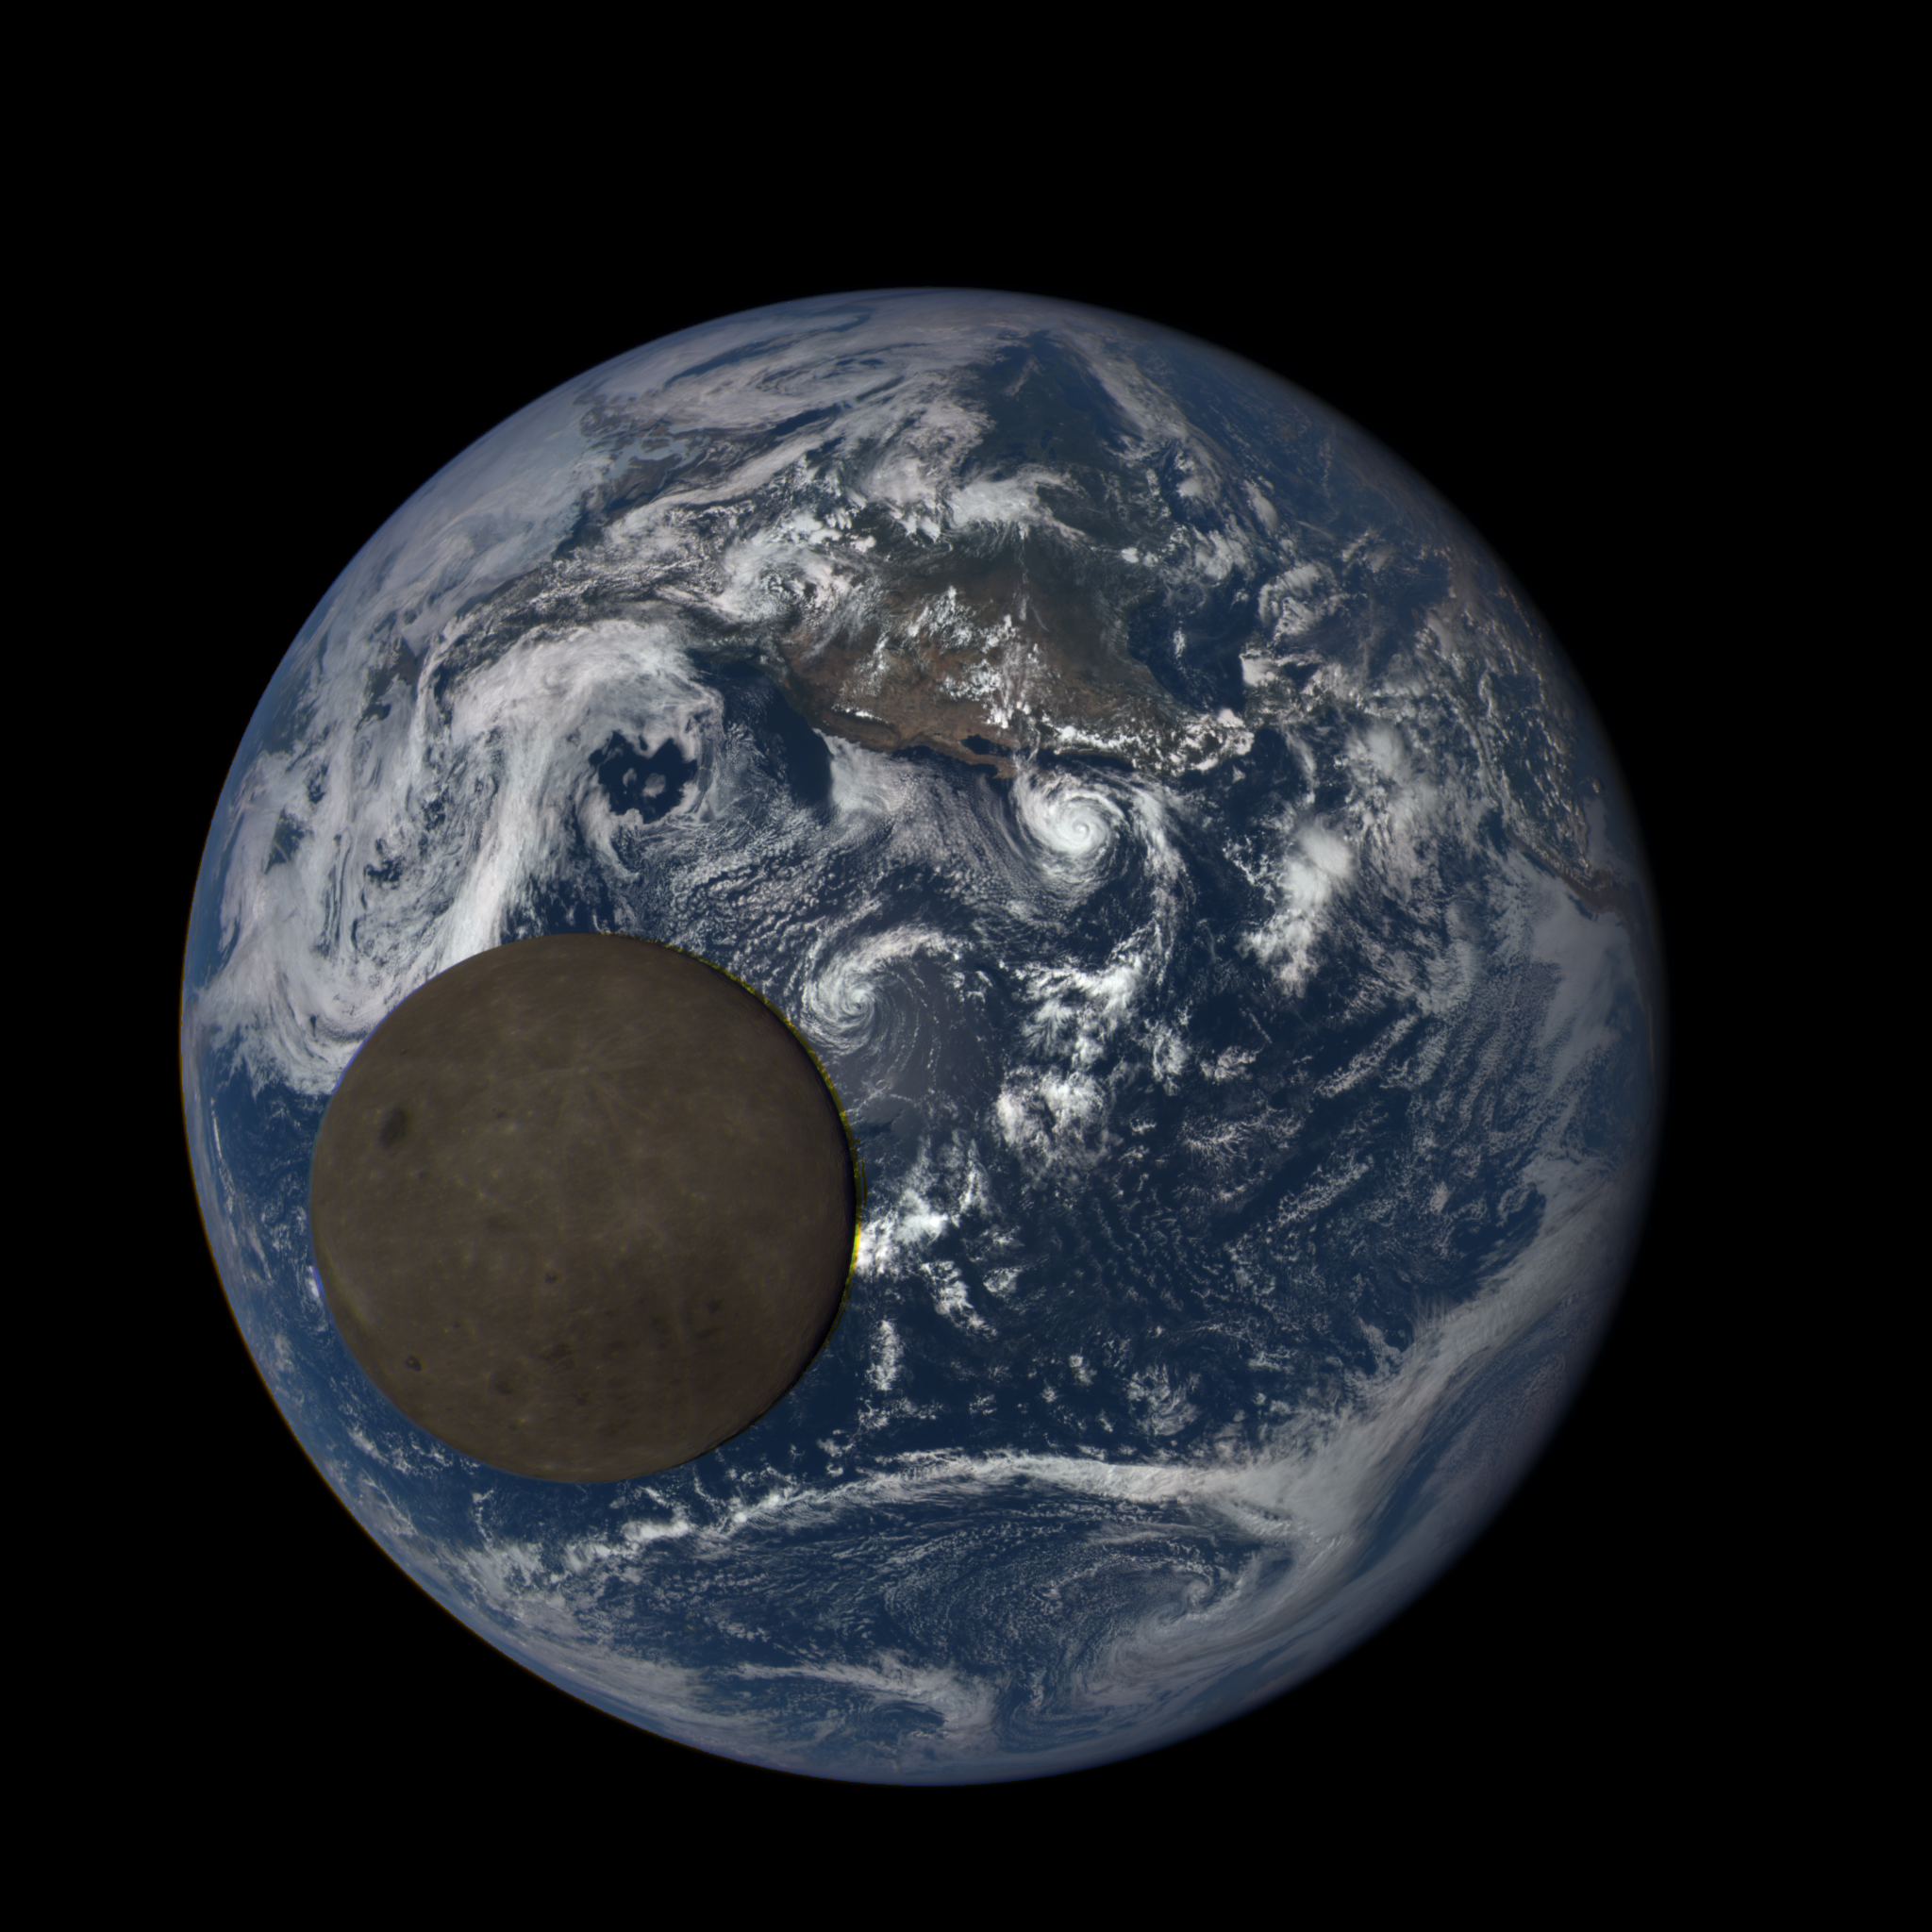
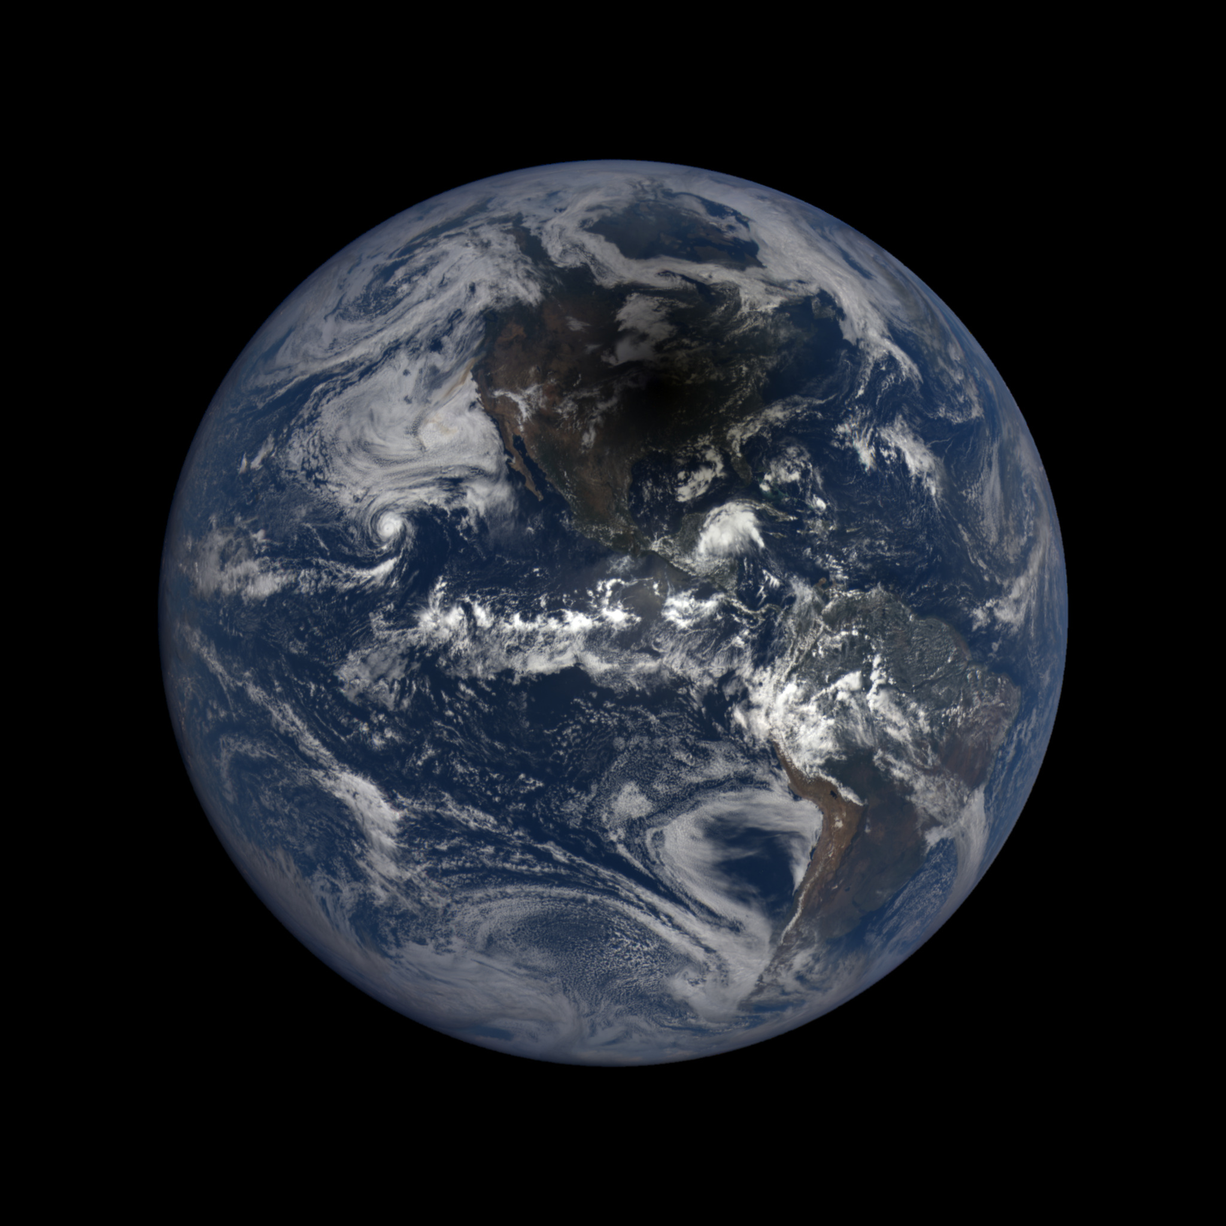
Some EPIC images are especially interesting
July 16, 2015
August 21, 2017

Slide 3
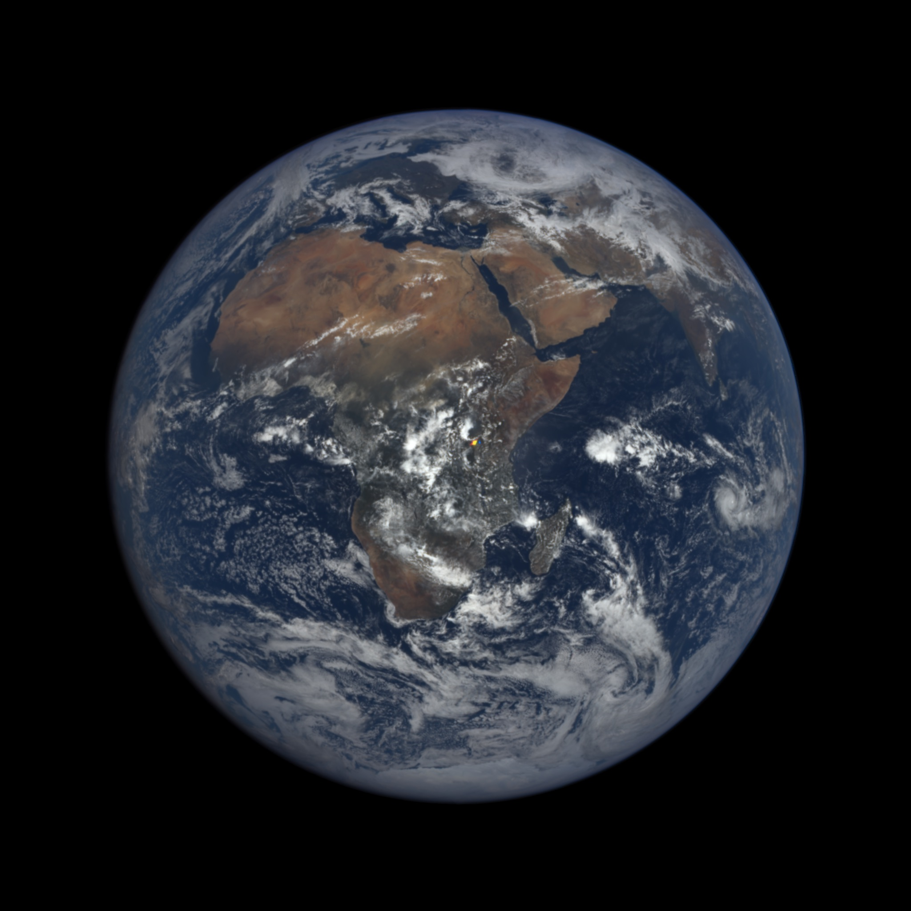
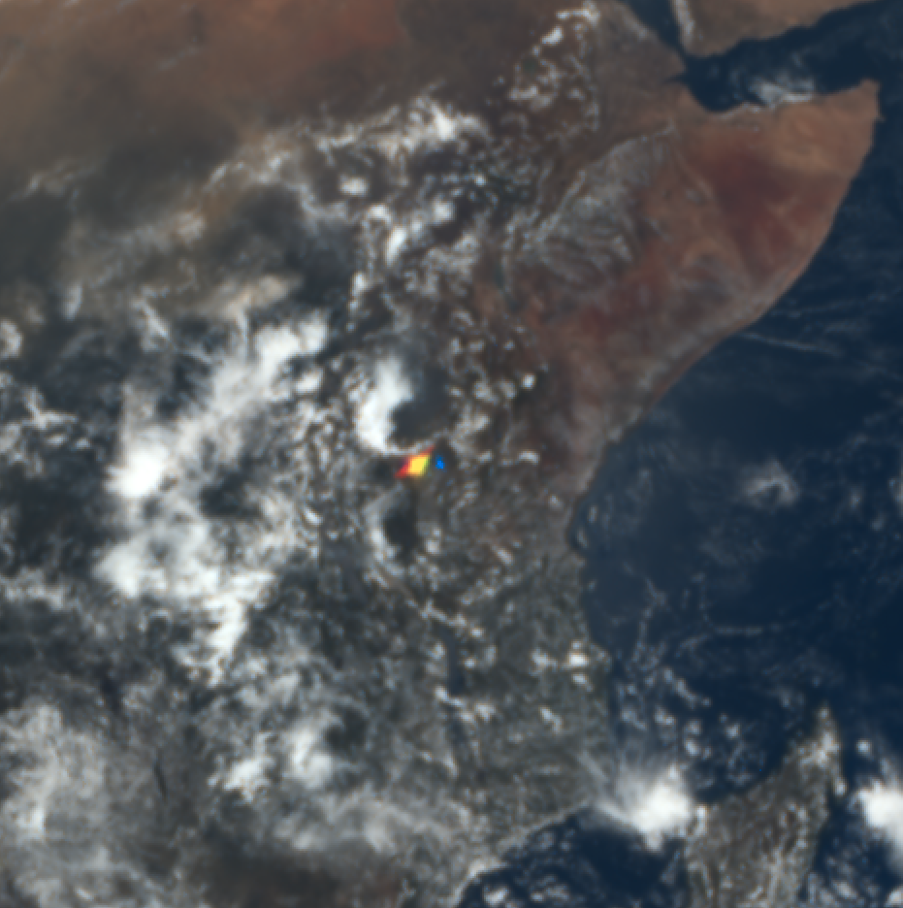
Colorful bright flash over Africa
2016 03 17, 09:46 UTC

Slide 4
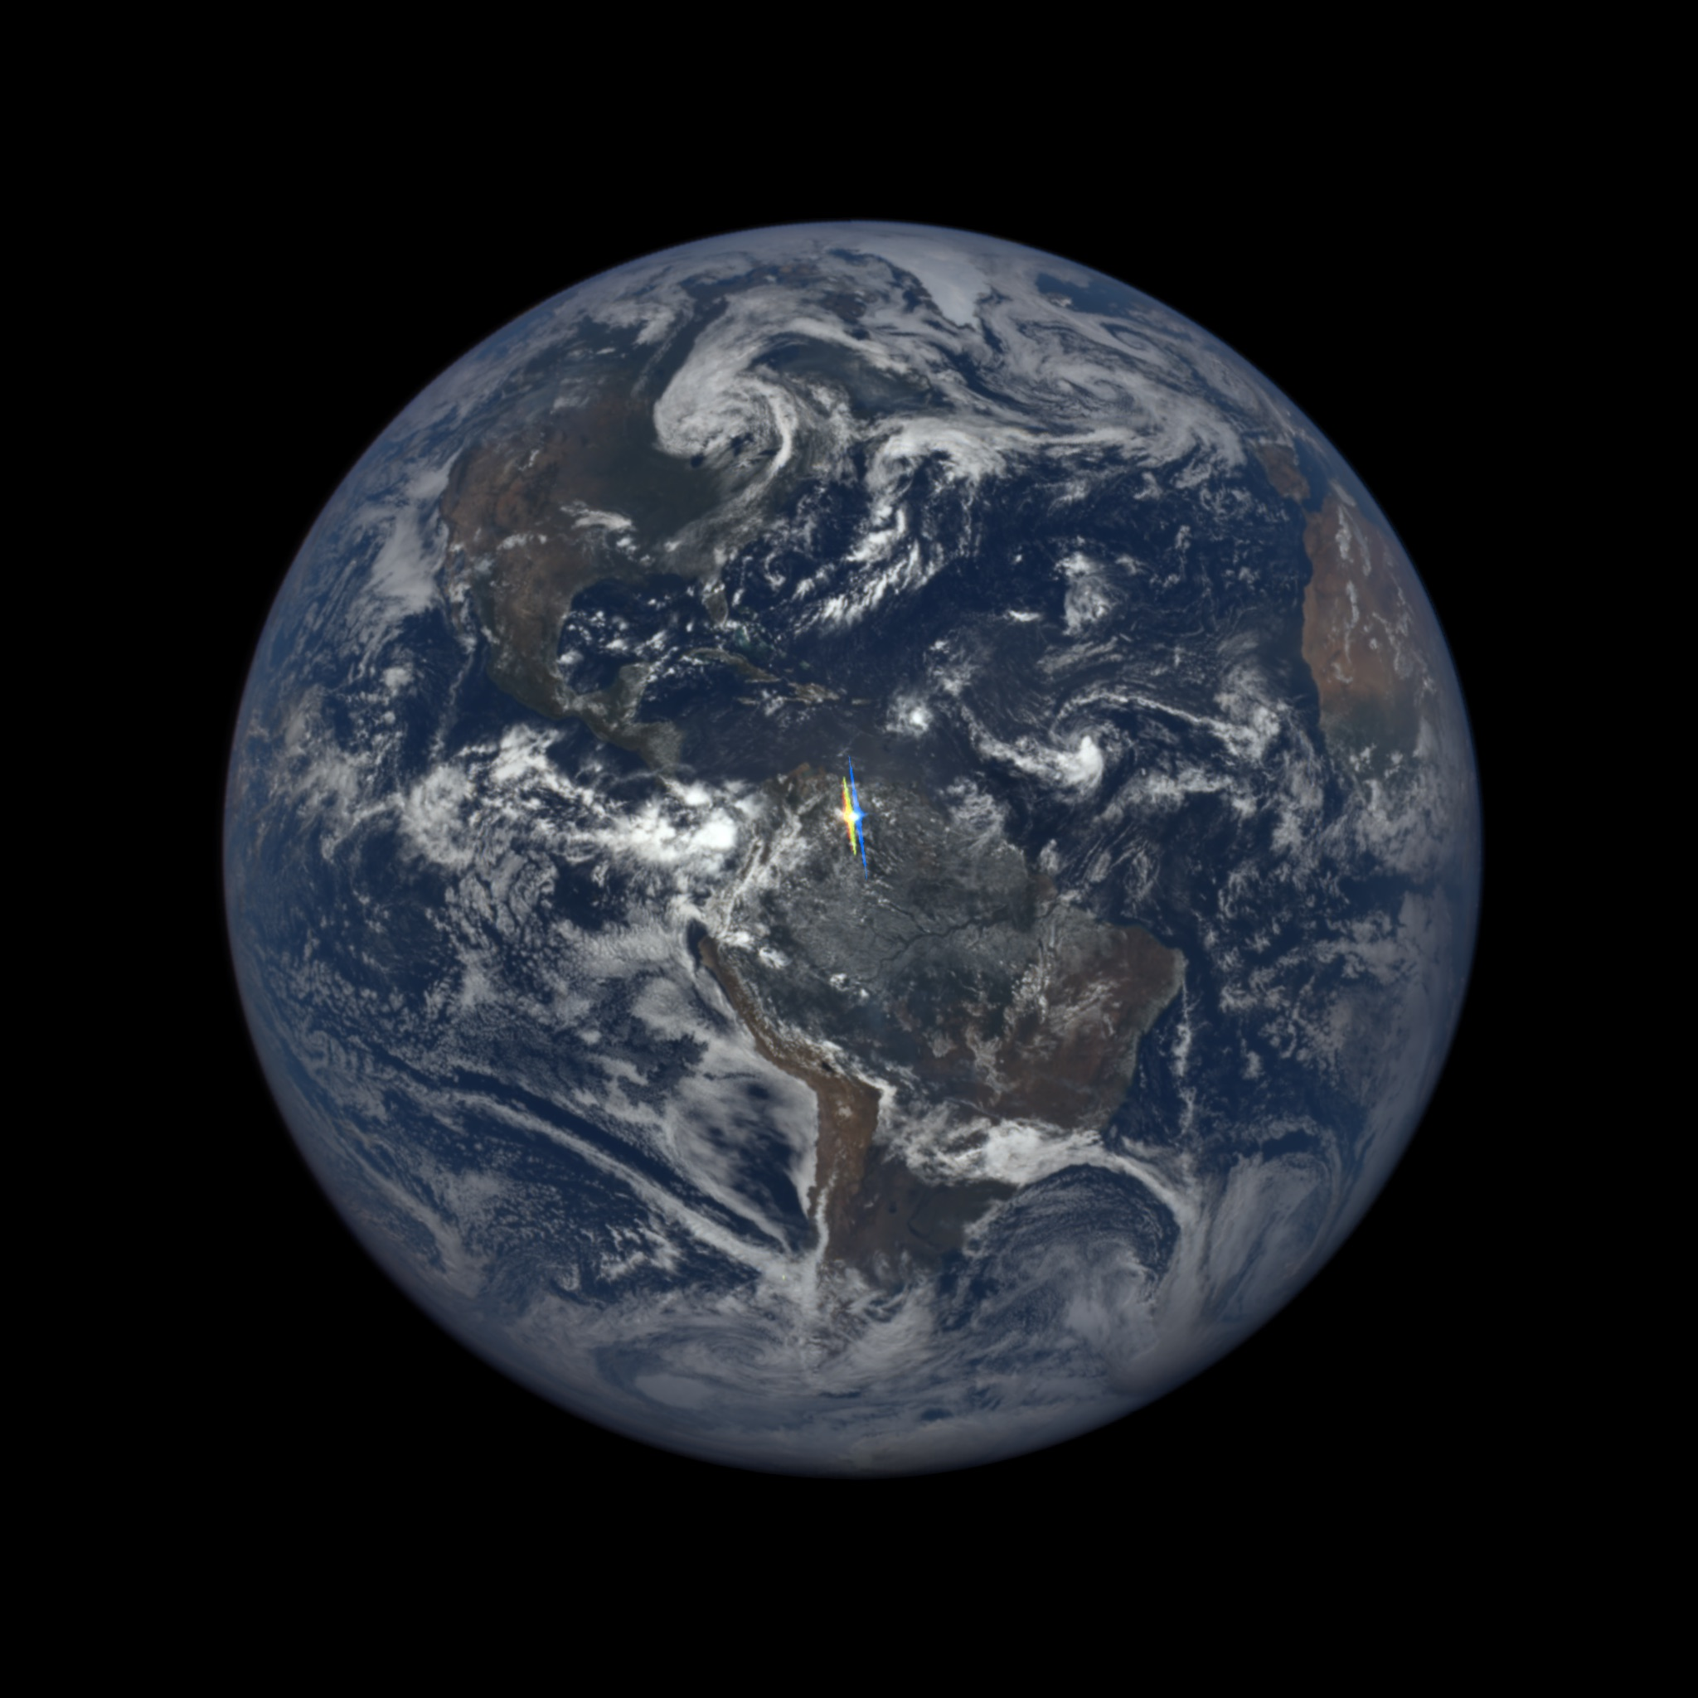
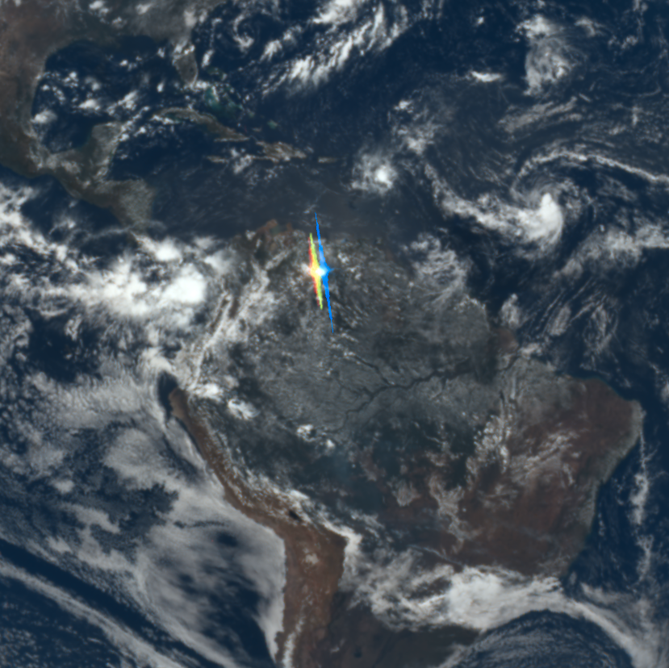
Colorful bright flash over South America
2015 08 24, 16:35 UTC

Slide 5
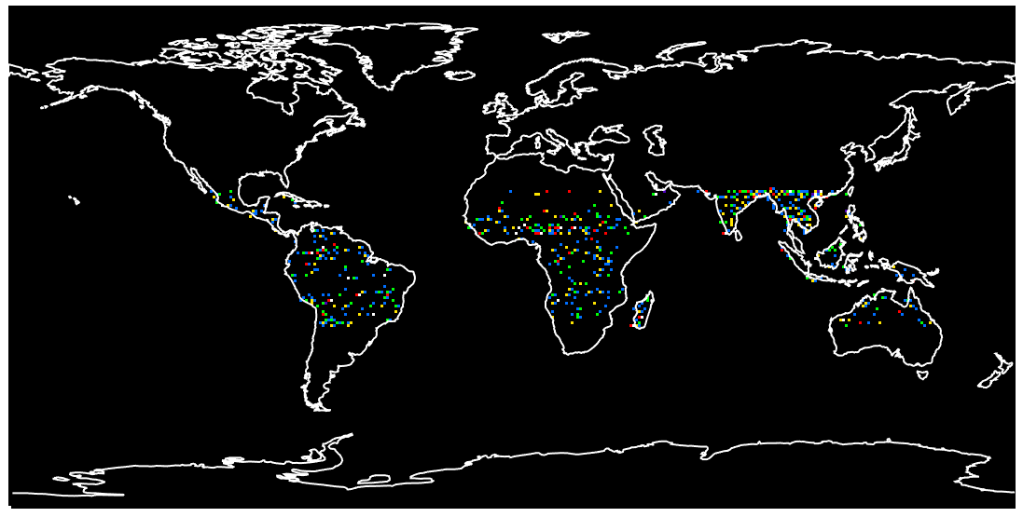
Location of flashes over a year

Slide 6
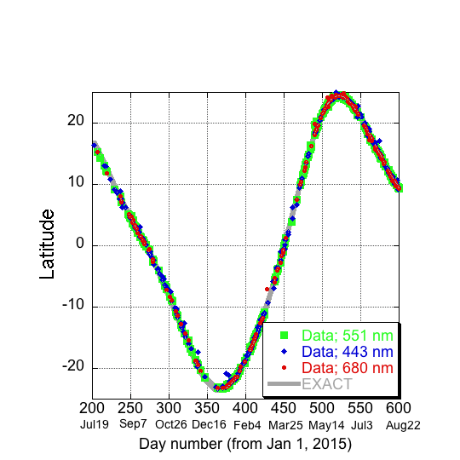
Latitude of flashes: specular reflection?
DSCOVR
Θ₀ = Θ
Θ₀ = Solar zenith angle
Θ = Viewing zenith angle

Slide 7
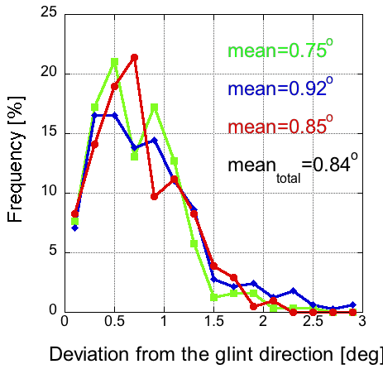
View direction is close to specular reflection

Slide 8
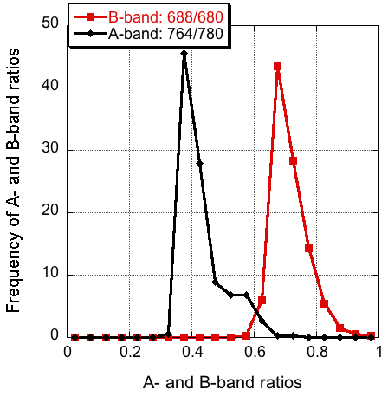
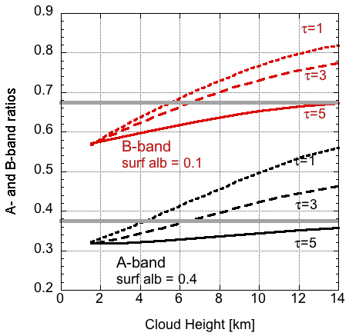
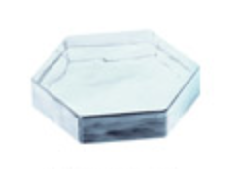
Most flashes come from clouds
Observations
Simulations
Assuming τ ≈ 1- 3,
histogram peak ≈ 5-8 km
← Low altitude High altitude →
POLDER: oriented crystals most common in 500-700 hPa range (Bréon & Dubrulle, 2004, JAS)
CALIOP: oriented crystals most common in -10°C - -30°C range (Noel & Chepfer, 2010, JGR)

Slide 9
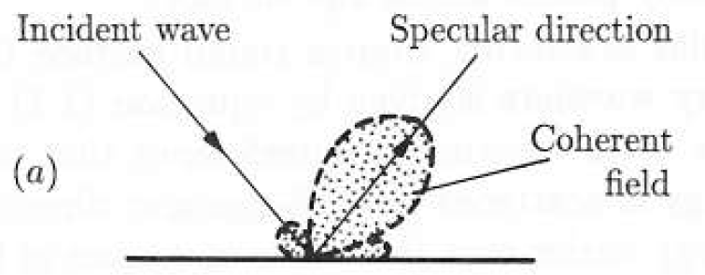
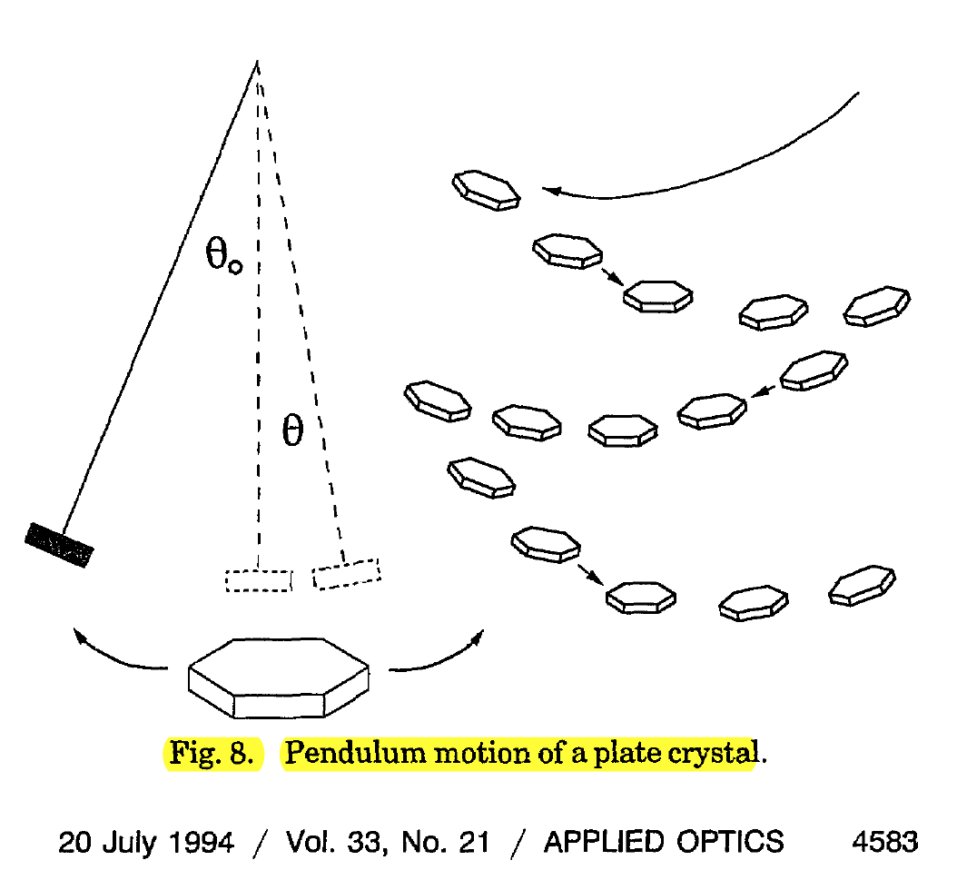
Deviation from exact glint angle
Tilt
Diffraction
Solar disc
from Lynch (1994, Appl. Optics)
Θ = λ / D
Θ is half-width of the diffraction lobe
For λ = 0.5 μm and D = 50 μm, Θ = 10⁻² (≈ 0.6º)
Katz (1996, JAS): tilt depends on Reynolds number
Bréon & Dubrulle (2004, JAS): tilt angle varies “between 0.5º and a few degrees from weak to strong turbulence.” for plate diameters between 100 μm and a few mm
Diameter is 0.5°

Slide 10
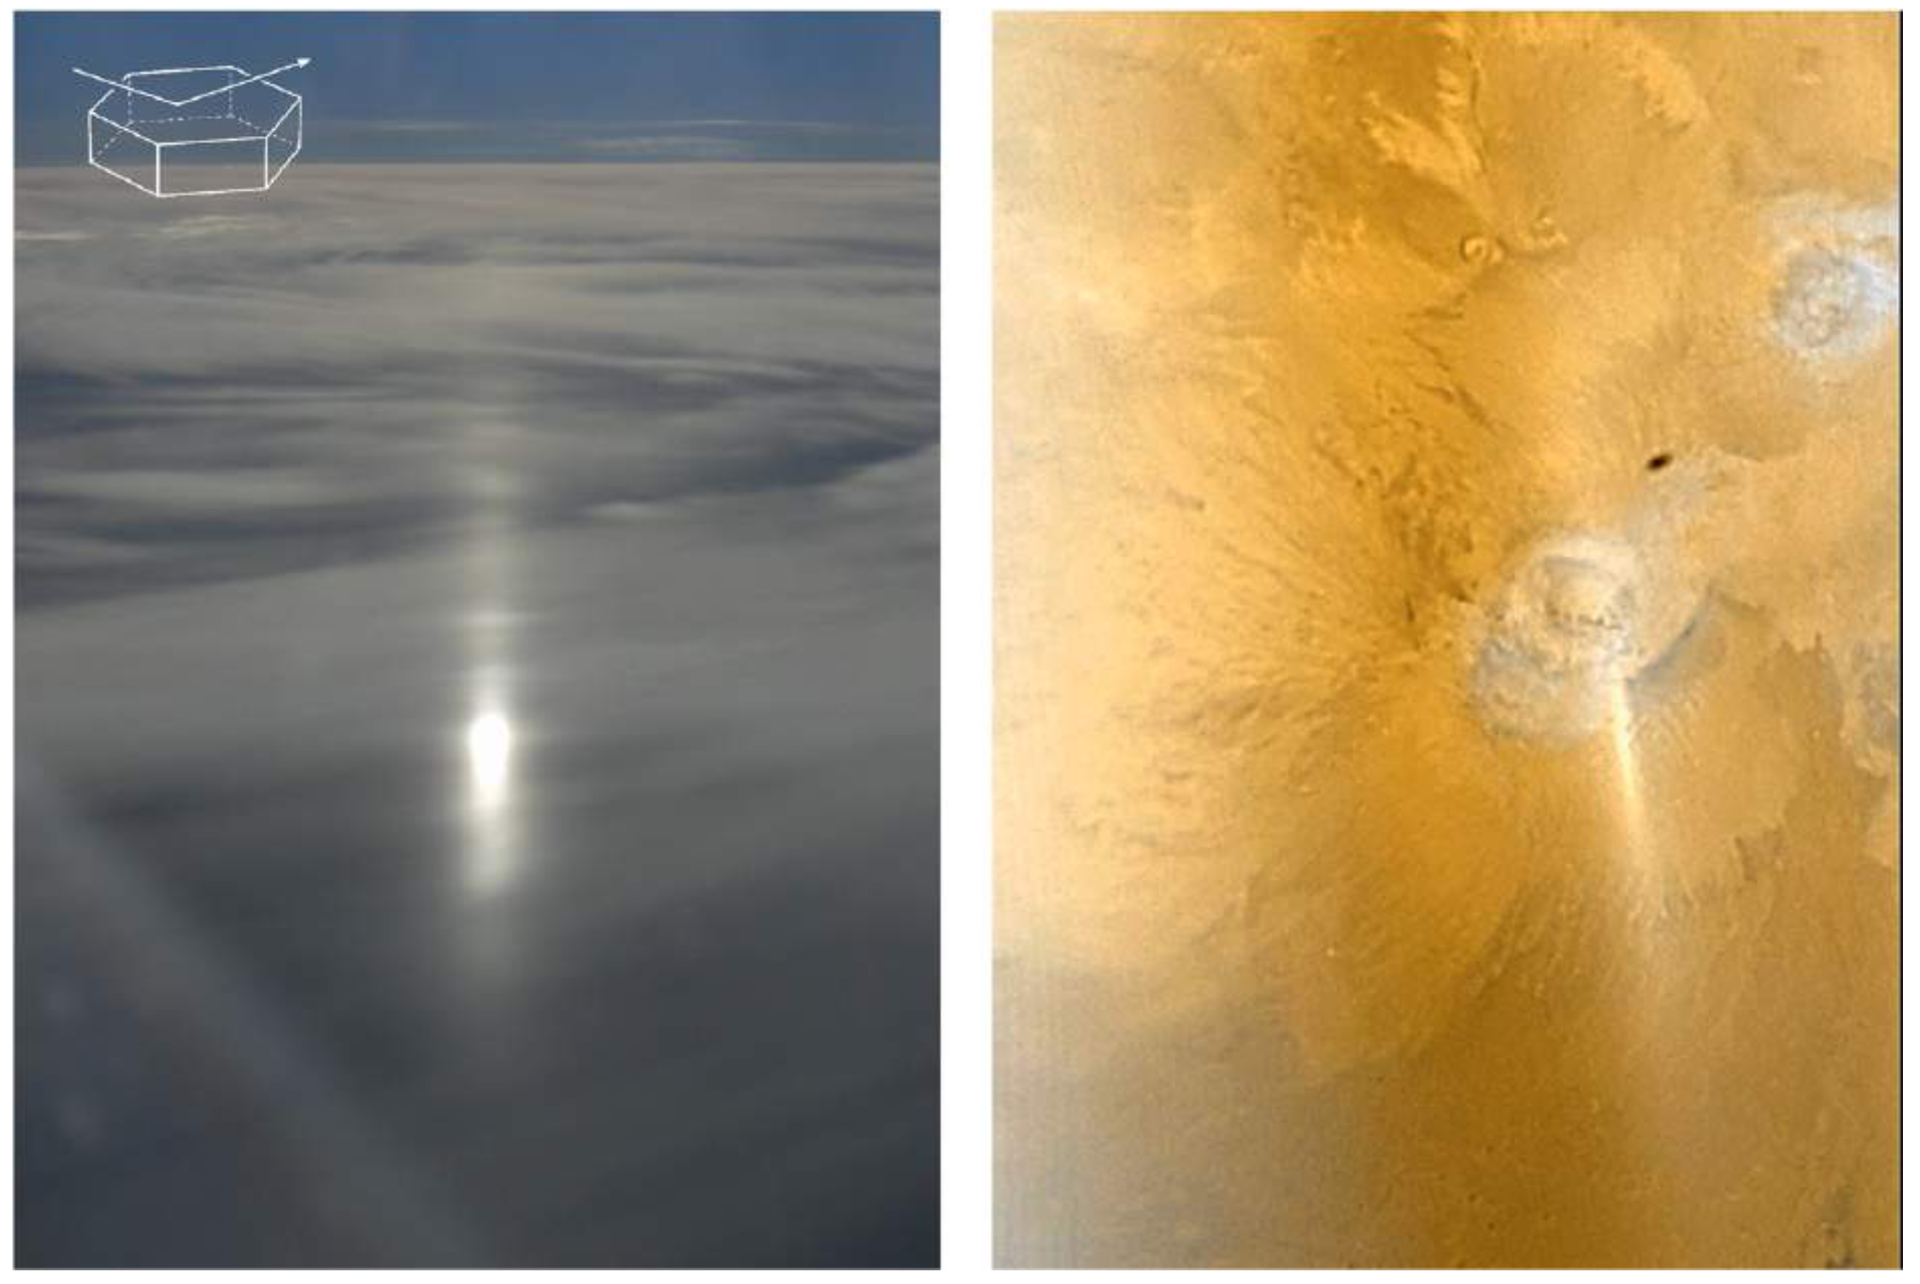
Specular reflection by oriented ice crystals (subsun)
Photo from aircraft
Mars Orbiter Camera
300 km
Shadow of Phobos
Können (2017, BAMS)
Water ice clouds, Feb. 6, 2006

Slide 11
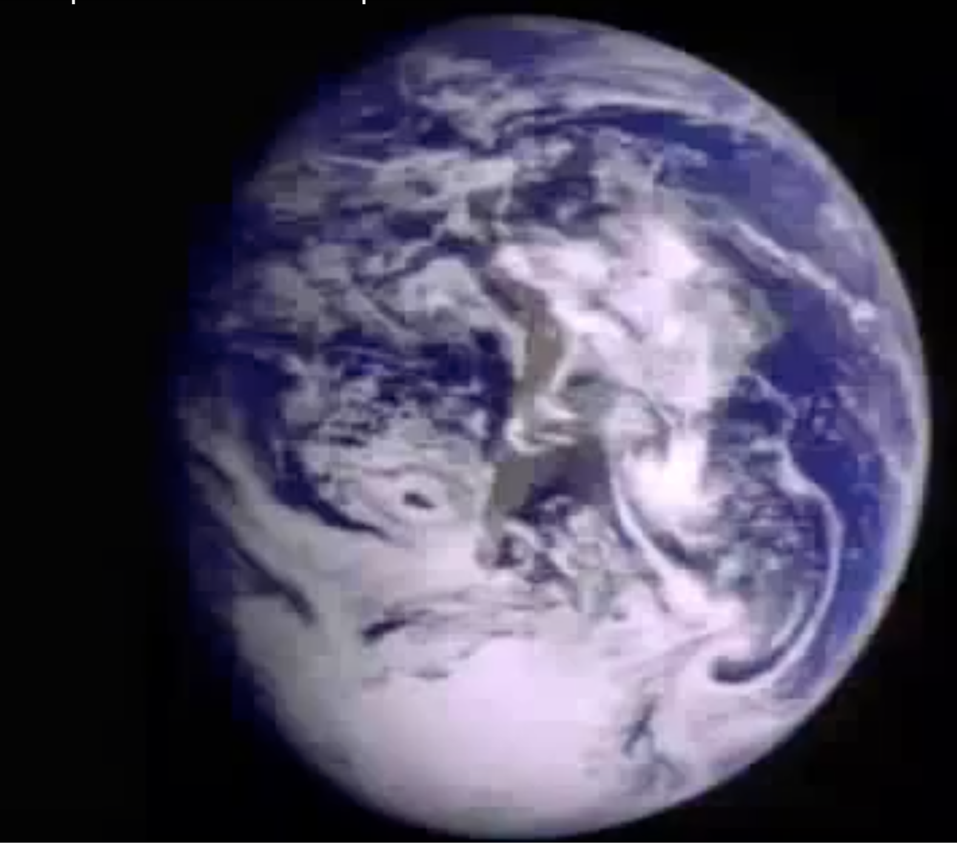
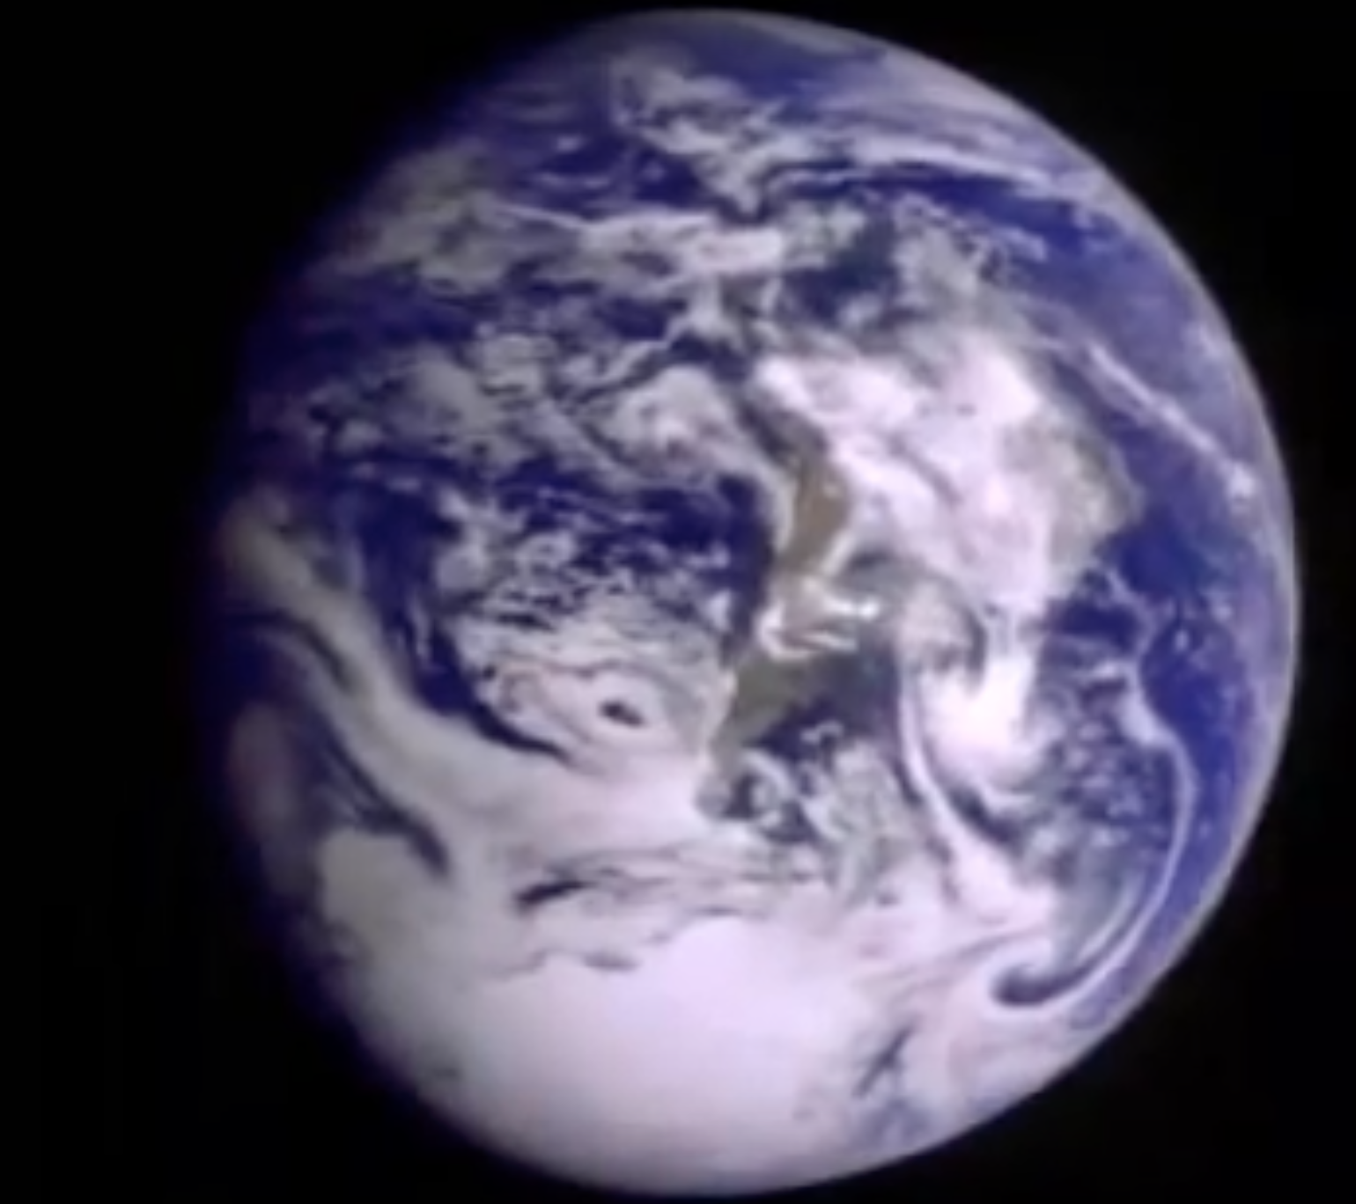
Glint observations may help exoplanet research
glint
Suggestion by Sagan et al. (1993, Nature)
Galileo (1990, ≈2 million km), glint at first seconds in video at https://www.youtube.com/watch?v=ceJOBFj3hKs

Slide 12
Blue flash is to the East from the red & yellow
Wings due to sensor saturation

Slide 13
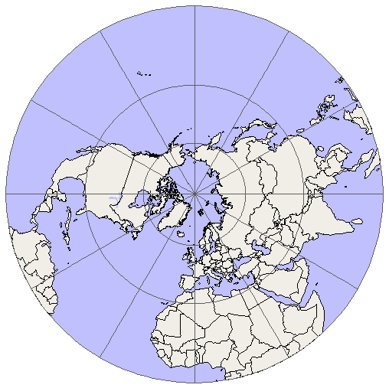
Flashes are colorful because of Earth rotation
Time of blue image
DSCOVR
Time of red image
(≈4 minutes later)
Glint shifts by ≈ 100 km
DSCOVR

Slide 14
Summary
Many DSCOVR/EPIC images contain colorful bright flashes of light over land
Analysis of sun-view geometry and O₂ absorption demonstrates that most flashes are specular reflections from horizontally oriented ice platelets floating in clouds
Such observations can help to constrain the likelihood of oriented ice crystals and their contribution to Earth albedo
Glint observations may even help in characterizing exoplanets
Marshak, A., T. Várnai, and A. Kostinski (2017), Terrestrial glint seen from deep space: Oriented ice crystals detected from the Lagrangian point, Geophys. Res. Lett., 44, doi:10.1002/ 2017GL073248.

