Slide 1
DSCOVR Level 2 Status Update EPIC and NISTAR Science Team Meeting
Marshall Sutton (code 586)
6/30/2017

Slide 2
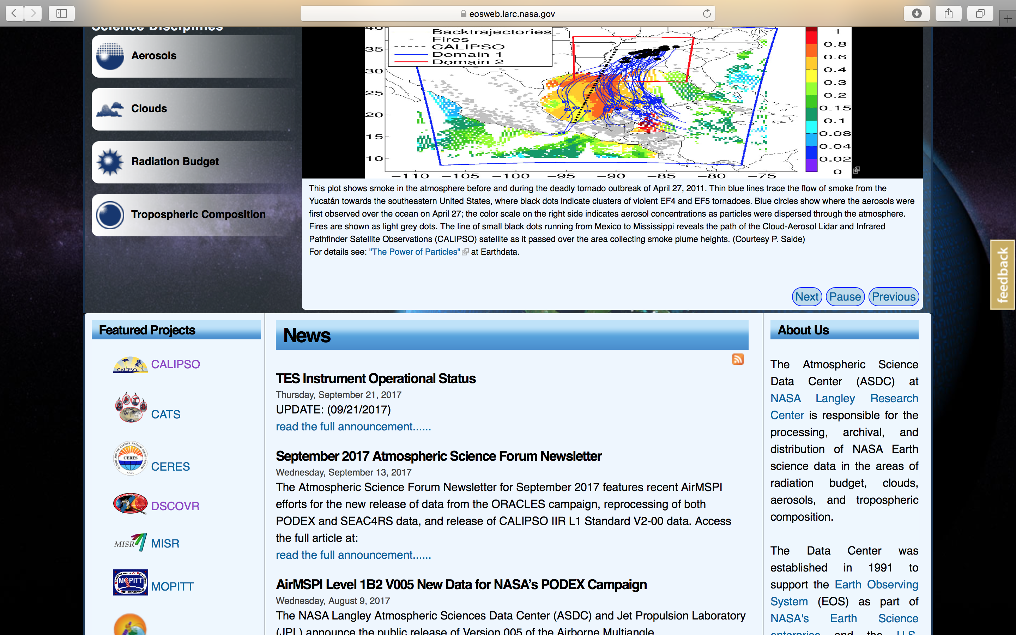
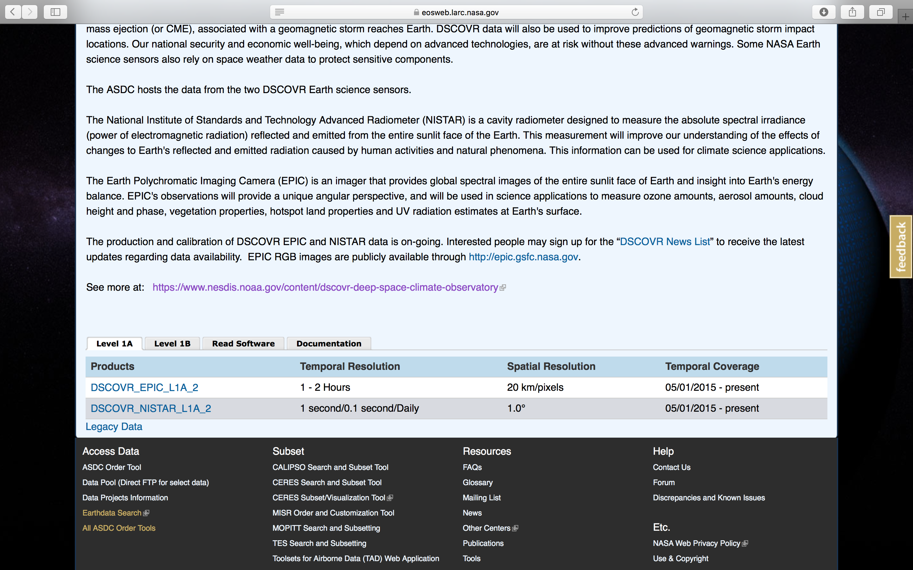
Retrieving Data Products
https://eosweb.larc.nasa.gov
https://earthdata.nasa.gov

Slide 3
NCCS Support
Support@nccs.nasa.gov
https://www.nccs.nasa.gov/user_info/primer
Help with
Makefiles
Software support
Memory management
Algorithmic efficiency
Parallel Processing (MPI and OPEN MP)

Slide 4
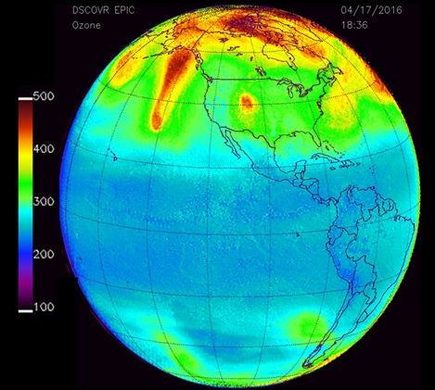
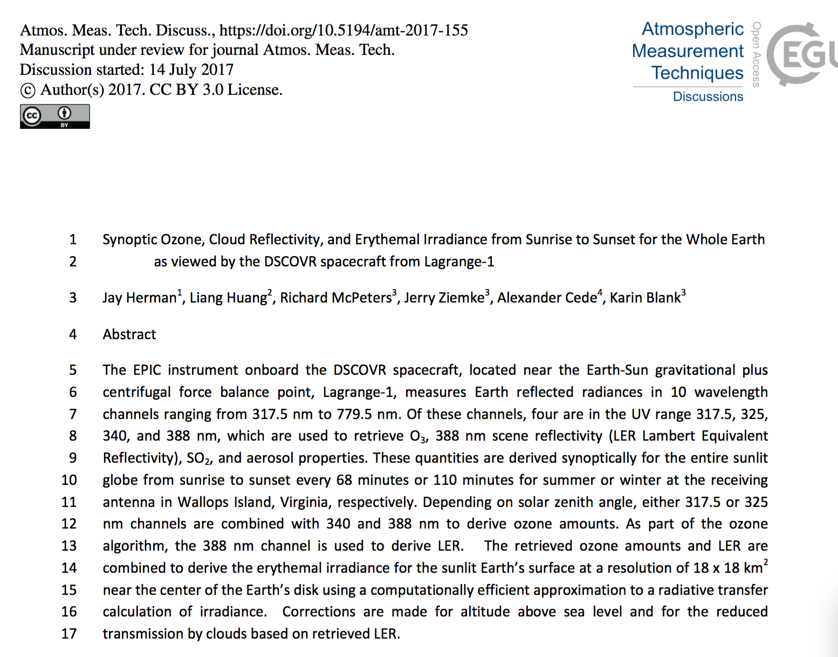
Documenation
Total Ozone
We have created an accurate data set of total column ozone, tropospheric ozone, and reflectivity from the DSCOVR EPIC instrument by implementing the latest algorithms modified from those used on Aura OMI and Suomi NPP OMPS. The results accurately capture short term synoptic changes in total column ozone driven by geochemical and geophysical processes. This can be done uniquely with EPIC from DSCOVR's vantage point …
Short description
Image
ATBD

Slide 5
EPICAERUV– Omar Torres
Ready to Download!
Item | Issues |  |  | Status
Received Production Software |  |  |  | G
Integrated into pipeline |  |  |  | G
Approval from science team to upload |  |  |  | G
Approval from ASDC to upload | Waiting for approval of Product Record |  |  | Y
Documentation | ATDB | Description | Image
 |  | X | X

Slide 6
Total Ozone – Richard McPeters
Ready to Download!
Item | Issues | Status
Received Production Software |  | G
Integrated into pipeline |  | G
Approval from science team to upload |  | G
Approval from ASDC to upload | Waiting for approval of Product Record | Y
Documentation | ATDB | Description | Image
 | X | X | X

Slide 7
SO2 - Nikolay Krotkov
Item | Issues | Status
Received Production Software | Yes | G
Integrated into pipeline | Resource intensive, Optimizing number of processors per node. Only processing needed images | Y
Approval from science team to upload | Waiting for a good eruption | G
Approval from ASDC to upload | Waiting for approval of Product Record | Y
Documentation | ATDB | Description | Image
 |  | X | X

Slide 8
SO2O3AI – Kai Yang
Item | Issues | Status
Received Production Software | Received preliminary software | Y
Integrated into pipeline | Resource intensive But we have plenty of resources available. | G
Okay to upload to ASDC | Waiting for production software to test and Integrate | Y
Approval from ASDC to upload | Waiting for approval of Product Record | Y
Documentation
ATDB
Description
Image
X
X
Documentation | ATDB | Description | Image

Slide 9
Clouds – Yuekui Yang
Item | Issues | Status
Received Production Software | Software finished, awaiting delivery. | G
Integrated into pipeline | Integration nearly complete. | G
Okay to upload to ASDC | Waiting for production software to test and Integrate | Y
Approval from ASDC to upload | Not yet submitted product record | Y
Documentation | ATDB | Description | Image

Slide 10
MAIAC – Alexei Lyapustin
Item | Issues | Status
Received Production Software |  | G
Integrated into pipeline | Difficulty getting Python 3 wrapper functions to work. Missing lookup tables | R
Okay to upload to ASDC | Need to finish pipeline and test | Y
Approval from ASDC to upload | Need to finish pipeline | Y
Documentation | ATDB | Description | Image

Slide 11
VESDR – Yuri K.
Item | Issues | Status
Received Production Software |  | G
Integrated into pipeline | Need to get MAIAC pipeline working first | R
Okay to upload to ASDC | Need to finish pipeline and test | Y
Approval from ASDC to upload | Need to finish pipeline | Y
Documentation | ATDB | Description | Image

Slide 12
NCCS Allocation
Allocation | SBUs Used | SBUs Left | Percent used
1,564,565 | 59,802 | 1,504,762 | 3.8%
Processed so far
SO2O3AI (Entire set)
AER UV
T03
All Enhanced images
Allocation runs through September 30th, 2017
Creating shared drive. Available to all teams. Will host Level 1 files and GEOS-5 dataset.

