Slide 1
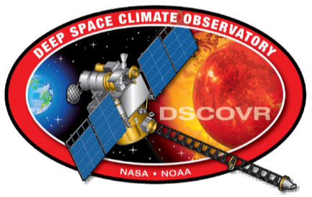
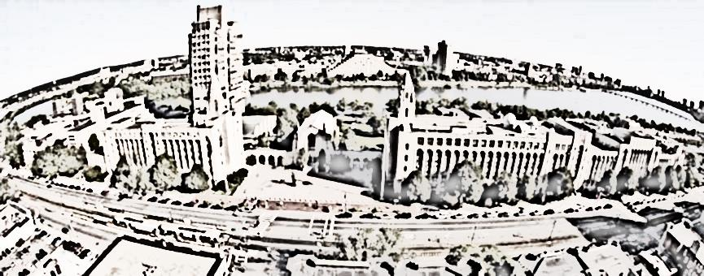
Earth Reflectivity from Deep Space Climate Observatory (DSCOVR) Earth Polychromatic Camera (EPIC)
W. Song^{a,b}, Y. Knyazikhinª, G. Wen^{c}, A. Marshak^{c}, Matti Mõttus^{d}
wjsong@bu.edu
ªEarth & Environment, Boston University, Boston, MA, USA
^{b}Faculty of Geographical Science, Beijing Normal University, Beijing, China
^{c}NASA Goddard Space Flight Center, Greenbelt, MD, USA
^{d}Aalto University (Finland)
DSCOVR Science Team Meeting
Greenbelt, MD, October 03-04, 2017

Slide 2
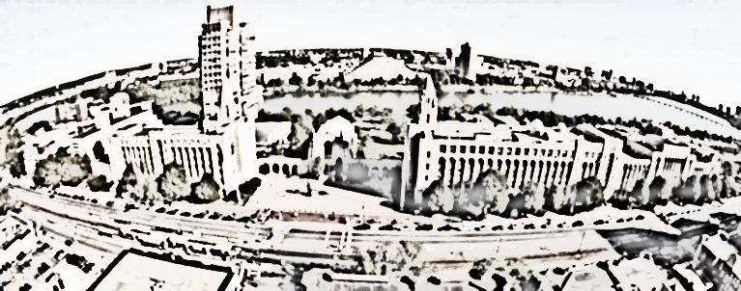
Content
Motivation
Data and Data Managements
Results
Conclusions

Slide 3
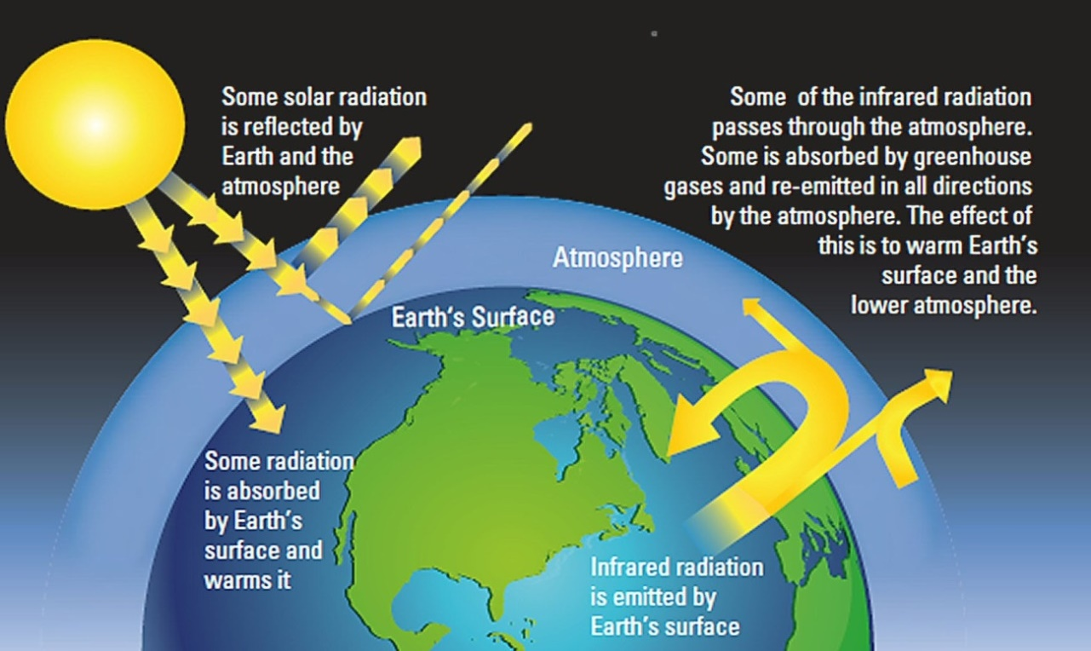
Earth Reflectivity
Earth reflectivity defined as the fraction of incident solar radiation reflected to the space.
Needed to estimate Earth radiation budget, atmosphere condition, clouds and so on.
https://www.koshland-science-museum.org/explore-the-science/earth-lab/processes
Notes:
ER=pi*I/(miu0*E0)
Here, I is the radiance reflected by the Earth (in Wm2nm1sr1), E0 is the incident solar irradiance at the top of atmosphere perpendicular to the solar beam (in Wm2nm1), and miu0 is the cosine of the solar zenith angle.

Slide 4
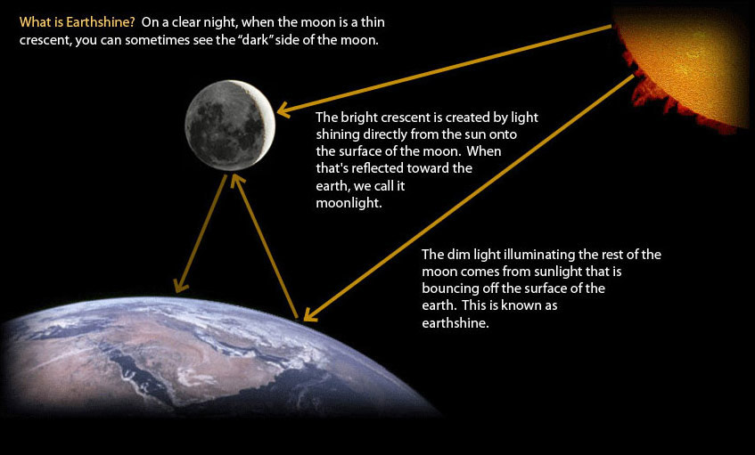
Measurement of Earth’s Albedo
The Presatellite Era
-- model calculations based on solar radiative transfer in the atmosphere and surface (Abbot and Fowle, 1908; Aldrich 1922; Simpson 1928a,1928b,1929)
-- earthshine observations (observations of the earth-lit Moon) (Very, 1912; Danjon 1928,1936; Palle et al., 2004)
http://earthshinefoundation.org/what_is_earthshine.html
The results depend on model assumptions and vary between 0.29 to 0.89.
Notes:
The TOA albedo is one of the main components of the Earth’s energy budget and thus our understanding of it
follows the evolution of our understanding of the energy balance of Earth.
Components: cloud free, cloud below 1800m, cloud above 1800m, water

Slide 5
Measurement of Earth Reflectivity
2. The Postsatellite Era
Satellite | Orbit (Apogee) | Sensor | Swath width /FOV | Wavelength | Equatorial Crossing LST | Time
Nimbus-7 | 956km | TOMS | 1º1º | 6 bands 0.31-0.38μm | 10:45 | 1964-1978
NOAA -9/10 | 850 /810km | ERBE | Full Earth disk Limb to limb | 0.2-5μm 5-50μm 0.2-50μm | 7:30 /15:30 | 1984/1986-1998/2001
ENVISAT | 790km | SCIAMACHY | 960km | 8 bands 0.2-2.4μm | 10:00 | 2002-2012
Terra /Aqua | 710 /703km | CERES (MODIS /VIRS) | ±78º (±55º(2330km)) | 0.3-5μm 8-12μm total | 10:30 /13:30 | 1999/2002-now
Aura | 710km | OMI | 114º(2600km) | 3 bands 0.27-0.5μm | 13:45 | 2004-now
Metop | 817km | GOME-2 | 1920km | 4 main bands 0.24-0.79μm | 9:30 | 2006-now
All these Earth reflectivity estimates came from low orbit observations.
Satellites observe part of the Earth at a specific time.
* This table only list some of the satellites and sensors being used for Earth Reflectivity
The results become stable at around 0.3±0.02
Notes:
Nimbus 7 : Ardanuy, P. E., L. L. Stowe, and A. Gruber, 1991: Shortwave, longwave, and net cloud-radiative forcing as determined from Nimbus-7 observations. J. Geophys. Res.
* The equatorial crossing time of the Nimbus-7 satellite drifted to 10:45 during the mission of the TOMS instrument. Original 12:00
Earth Radiation Budget Experiment (ERBE) :Kandel, Robert, Viollier, Michel,2005: Planetary radiation budgets. Space science reviews
Kandel, Robert, Viollier, Michel,2010: Observation of the Earth's radiation budget from space. Comptes Rendus Geoscience
Scanning Imaging Absorption Spectrometer for Atmospheric Chartography (SCIAMACHY) : Tilstra, L. G.et al. 2017 : Surface reflectivity climatologies from UV to NIR determined from Earth observations
by GOME-2 and SCIAMACHY. Journal of Geophysical Research: Atmospheres
Clouds and the Earth's Radiant Energy System (CERES): Wielicki et al., 2005: Changes in Earth's albedo measured by satellite. Science, 308, 825
Ozone Monitoring Instrument (OMI): Gupta, P.,2016: Top-of-the-atmosphere shortwave flux estimation from satellite observations: an empirical neural network approach applied with data from the A-
train constellation. Atmos. Meas. Tech.
Global Ozone Monitoring Experiment (GOME): Koelemeijer, R. B. A., de Haan, J. F. and Stammes, P., 2003: A database of spectral surface reflectivity in the range 335–772 nm derived from 5.5 years of
GOME observations. Journal of Geophysical Research: Atmospheres
Visible and Infrared Sounder（VIRS）
Total Ozone Mapping Spectrometer (TOMS)
The accuracy is estimated to be 2% for the ERBE shortwave scanner instruments and 1% for the CERES SW instruments [Wieliki et al., 2006; Loeb et al.,2009].

Slide 6
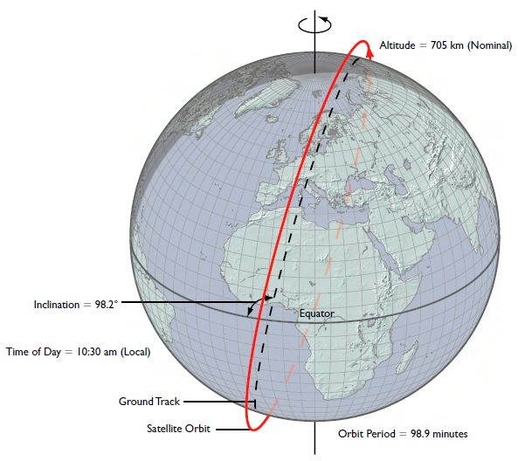
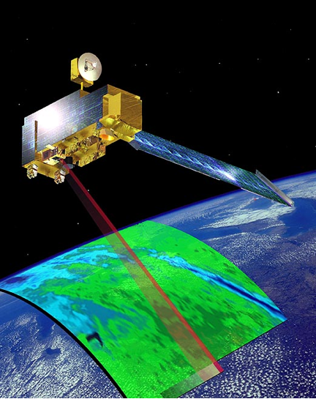
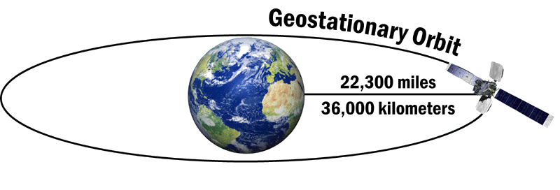
Terra/Aqua and GOES
Terra/Aqua satellite – MODIS
Terra
2330km
(King, 2007)
GOES satellite – ABI
GOES-E: 75ºW
Full disk: Hemispheric coverage of 83º local zenith angle
Notes:
Advanced Baseline Imager (ABI)

Slide 7
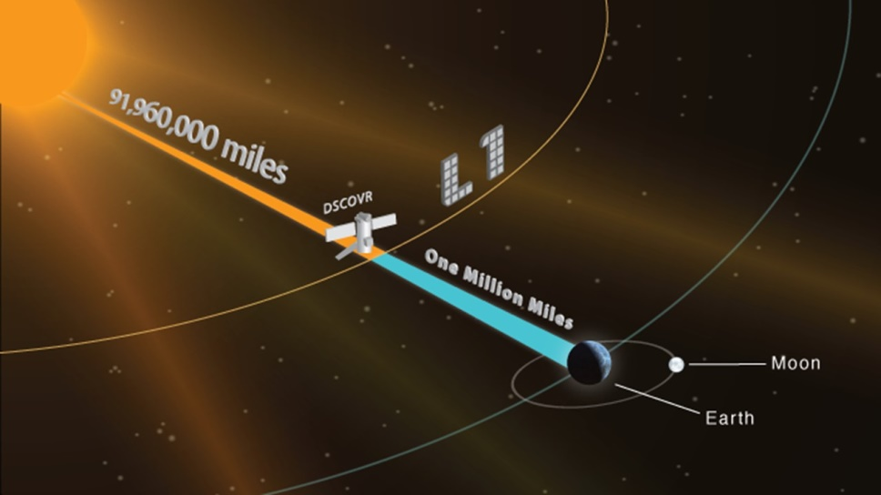
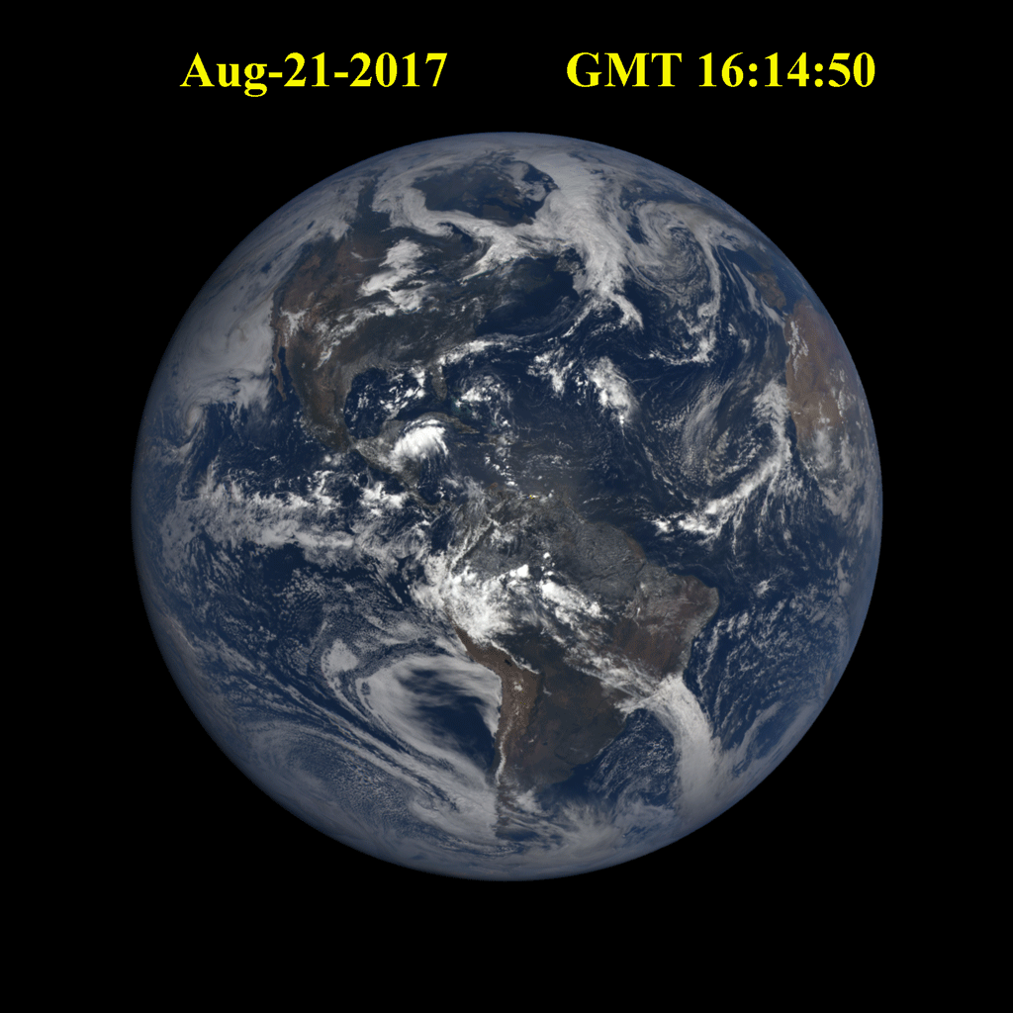
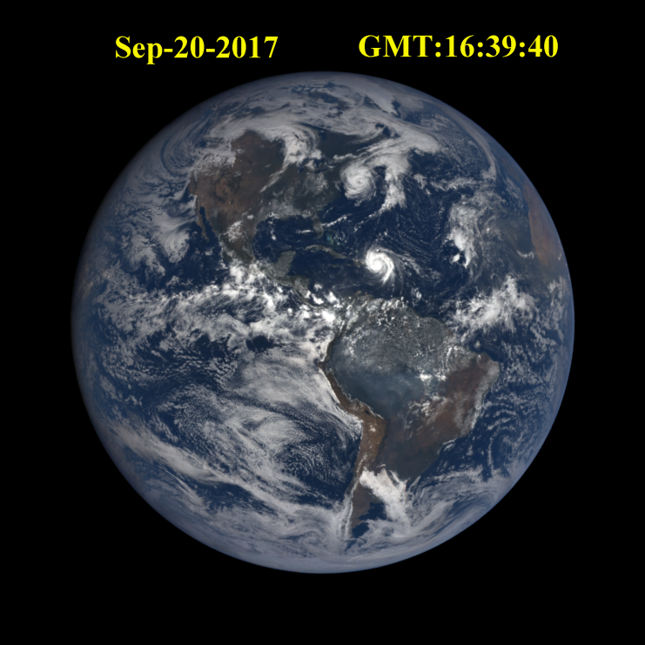
DSCOVR EPIC
The DSCOVR satellite is 1 million miles from Earth.
For the first time, EPIC collects simultaneously radiance data of the entire sunlit earth every 65 to 110 min.
It provides reflectivity images in backscattering direction with the scattering angle between 168º and 176º at 10 narrow spectral bands (317nm~779nm).
Jose
Maria
Eclipse
Hurricane

Slide 8
Content
Motivation
Data and Data Managements
Results
Conclusions

Slide 9
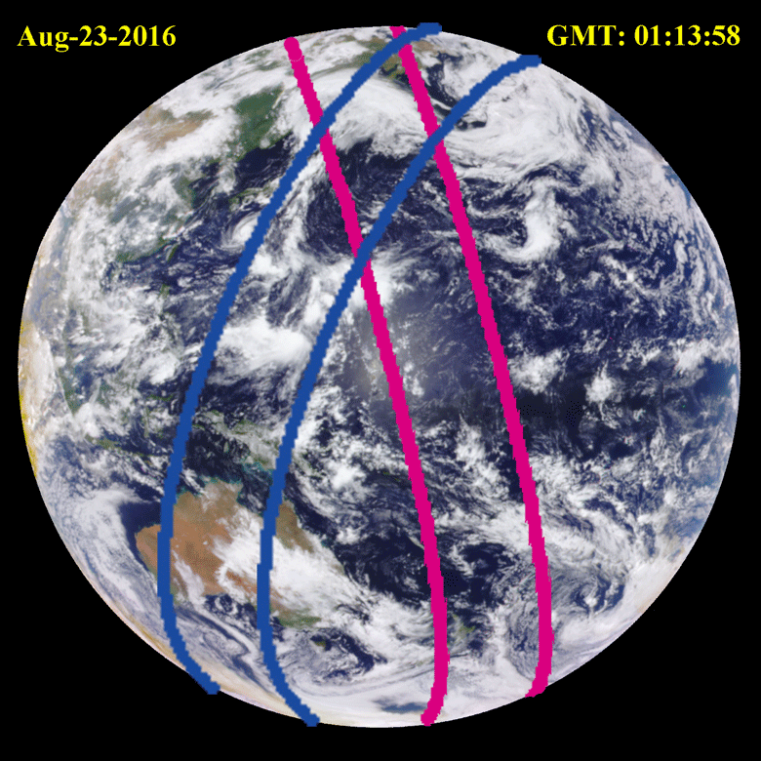
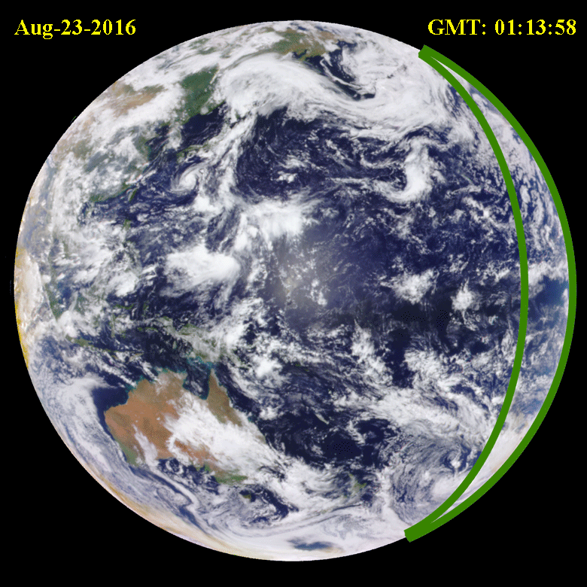
Sampling Approaches
Terra and Aqua MODIS Samplings
GOES Sampling
Notes:
We use EPIC data to estimate an impact of sampling strategy on estimation of the Earth reflectivity. To do it, we need to fix sun-sensor geometry. The sampling area vary.

Slide 10
Sampling Approaches
Both Terra and Aqua MODIS Sampling areas are constant and each observes more than 20% of DSCOVR EPIC disk.
GOES Sampling area changes with time.

Slide 11
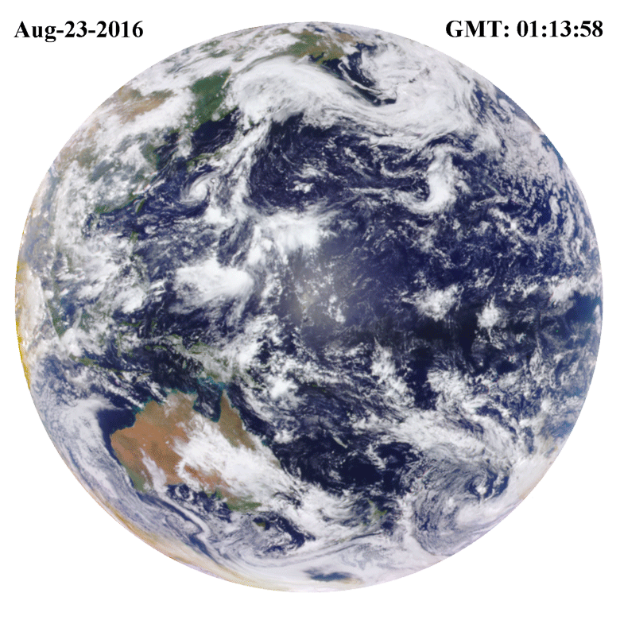
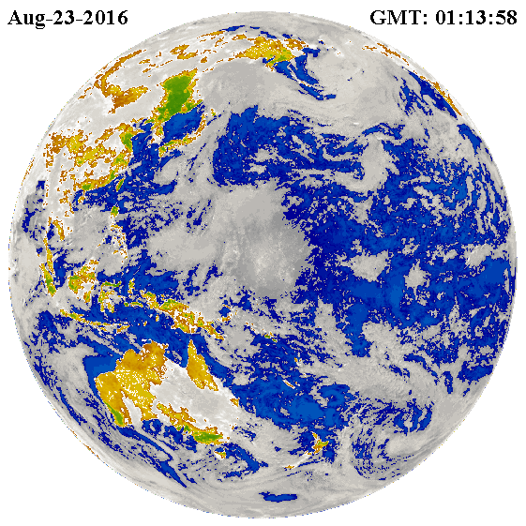
Earth Type Classification
Land
Cloud
Ocean
Vegetation
LAI ≈ 0.5
Earth disk is classified into Cloud, Land, Vegetation, and Ocean using a Green-NIR index based on recollision probability.

Slide 12
Reflectance in NIR vs RED plane
Cloud reflectances are always higher than others in Red;
Ocean reflectances are always lower than others in both Red and NIR;
Vegetation reflectances behave as theory predicts;
Land have LAI <0.5 as defined.

Slide 13
Content
Motivation
Data and Data Managements
Results
Conclusions

Slide 14
Diurnal Course of Earth Reflectance,
Aug 23, 2016
DSCOVR
Terra
Aqua
GOES
Earth Reflectance varies with the fraction of Earth type.

Slide 15
Daily Earth Reflectance in Aug., 2016
Terra and Aqua exhibit similar tendencies as DSCOVR
GOES shows different tendency as it only observes part of the Earth

Slide 16
Monthly Earth Reflectance in 2016
In Green, Red and NIR bands, Terra and Aqua reflectances are higher than DSCOVR reflectance
GOES is lower in most months

Slide 17
Radiation Reflected by Cloud
Aug.
Terra and Aqua see a fraction of clouds in the DSCOVR image. Estimates of their contributions to Earth reflectivity are different.

Slide 18
Radiation Reflected by Vegetation
The radiation reflected by vegetation from Terra and Aqua samplings are similar to DSCOVR.
GOES matches DSCOVR only when their sampling areas overlap by more than 80%.

Slide 19
Earth Type Impact
Ocean
Sampling | DSCOVR | Terra | Aqua | GOES
Yearly average Cloud cover | 58.0% | 59.1% | 58.6% | 58.4%
Land
*The average global cloud cover is 56% with clouds optical depth lager than 2 (Stubenrauch et. al., 2013)
Global
Vegetation
Cloud
Clouds significantly impact the Earth reflectivity.
Notes:
Stubenrauch, C. J.; Rossow, W. B.; Kinne, S.; Ackerman, S.; Cesana, G.; Chepfer, H; Di Girolamo, L.; Getzewich, B.; Guignard, A.; Heidinger, A.; Maddux, B. C.; Menzel, W.P; Minnis, P.; Pearl, C.; Platnick, S.; Poulsen, C.; Reidi, J.; Sun-Mack, S; Walther, A.; Winker, D.; Zeng, S.; Zhao, G. (2013). "Assessment of global cloud datasets from satellites: Project and Database initiated by GEWEX Radiation Panel" (pdf). Bulletin of the American Meteorological Society. 94: 1031–1049.Bibcode:2013BAMS...94.1031S.doi:10.1175/BAMS-D-12-00117.1.

Slide 20
Content
Motivation
Data and Data Managements
Results
Conclusions

Slide 21
Conclusions
1. Sampling approach may impact estimates of Earth reflectivity. The average difference between DSCOVR and Terra reflectance is 7.4%, DSCOVR and Aqua is 6.1%, GOES and DSCOVR is 3.5%.
 | DSCOVR | Terra | Aqua | GOES
Blue | 0.302 | 0.315 | 0.313 | 0.309
Green | 0.232 | 0.249 | 0.246 | 0.226
Red | 0.233 | 0.254 | 0.250 | 0.225
NIR | 0.249 | 0.272 | 0.267 | 0.235
2. A new Earth type classification method is involved to estimate contributions from cloud, land, ocean, and vegetation to the Earth reflectance. Different Earth types have different impacts on Earth reflectivity.
DSCOVR | Cloud | Ocean | Land | Vegetation
Blue | 0.374 | 0.188 | 0.213 | 0.158
Green | 0.303 | 0.100 | 0.181 | 0.123
Red | 0.311 | 0.074 | 0.205 | 0.105
NIR | 0.316 | 0.063 | 0.311 | 0.329

Slide 22
Thanks for your attentions!
W. Songª, Y. Knyazikhinª, G. Wen^{b}, A. Marshak^{b}
wjsong@bu.edu
ªEarth & Environment, Boston University, Boston, MA, USA
^{b}NASA Goddard Space Flight Center, Greenbelt, MD, USA
DSCOVR Science Team Meeting
Greenbelt, MD, October 03-04, 2017

Slide 23
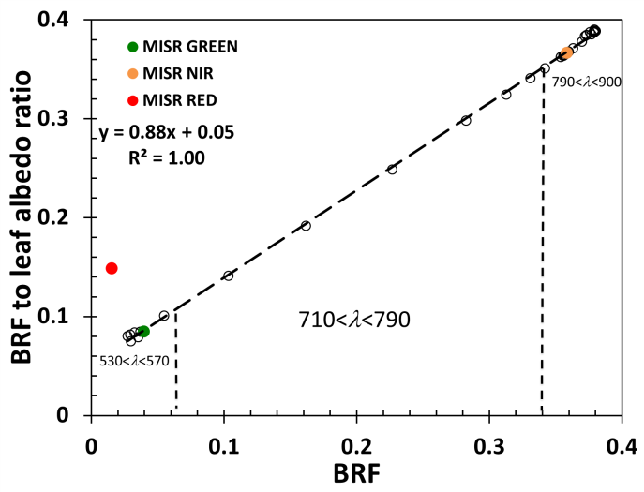
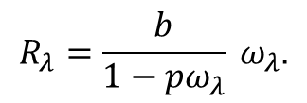
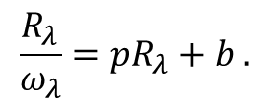
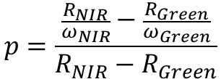
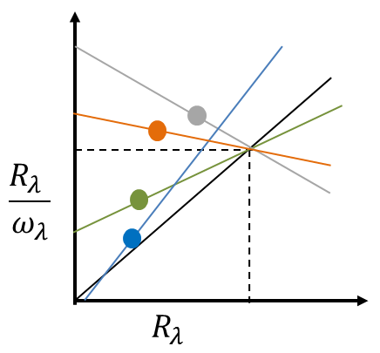
Green-NIR Index
For a spectral BRF, ,it can be expressed as:
Here b and $p$ are spectrally invariant parameters.
bright leaf SSA as baseline

Slide 24
Radiation Reflected by Ocean
Notes:
Y-axis for daily is less than 0.1.

Slide 25
Radiation Reflected by Land

Slide 26
Earth Reflectivity from Aqua Sampling

