Slide 1
ASDC DSCOVR Update
October 3, 2017
Notes:
General instructions:
Don’t be redundant.
Be ready to answer questions.
Leadership prefers a briefer slide, rather than a text rich slide

Slide 2
Issues Resolved
Corrupt/missing or invalid spatial data for DSCOVR_EPIC_L1A
Due to dark space images (used for calibration), lunar images (also used for calibration), or have the moon in view
Ingest issues resolved
Unique name for the PDR file for every upload

Slide 3
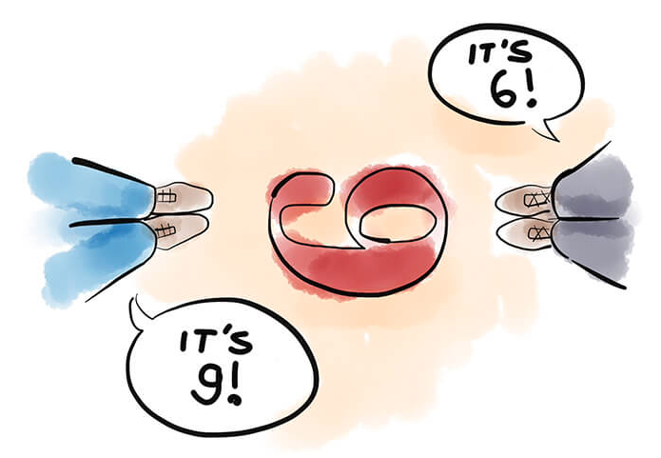
Metadata!
Why?
Discovery
Searchability
Usability
The DAACs currently hold more than 9 Petabytes (PB) of Earth science data. 1 PB is equivalent to ~20 million four-drawer file cabinets filled with text. Metadata enables users to find specific EOSDIS data products and understand their quality to know if that data is what they need.

Slide 4
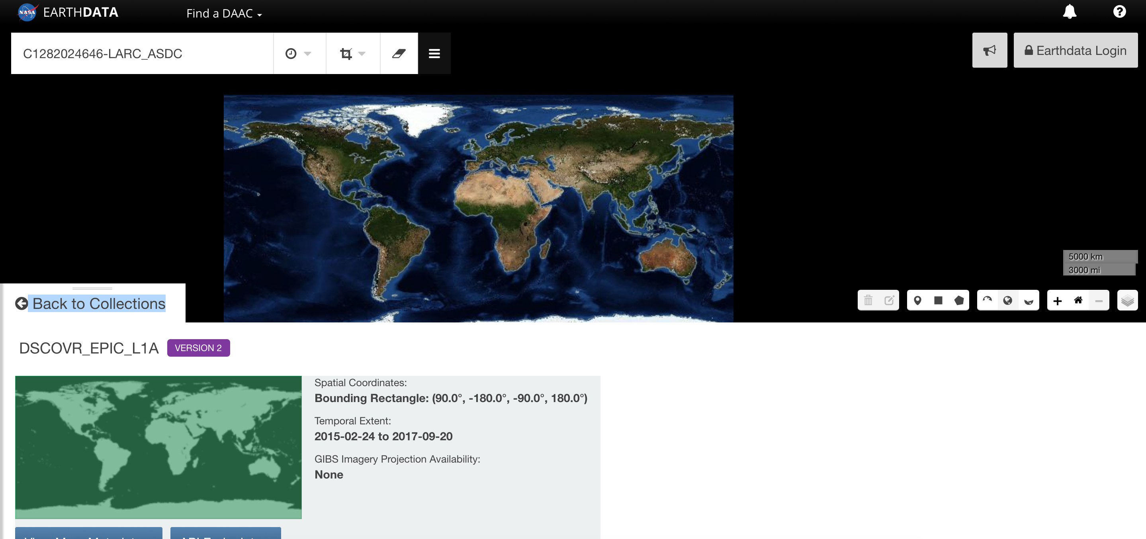
Earthdata/GCMD
Metadata is sent to the CMR (Common Metadata Repository)
CMR feeds Earthdata and the GCMD (Global Change Master Directory)

Slide 5
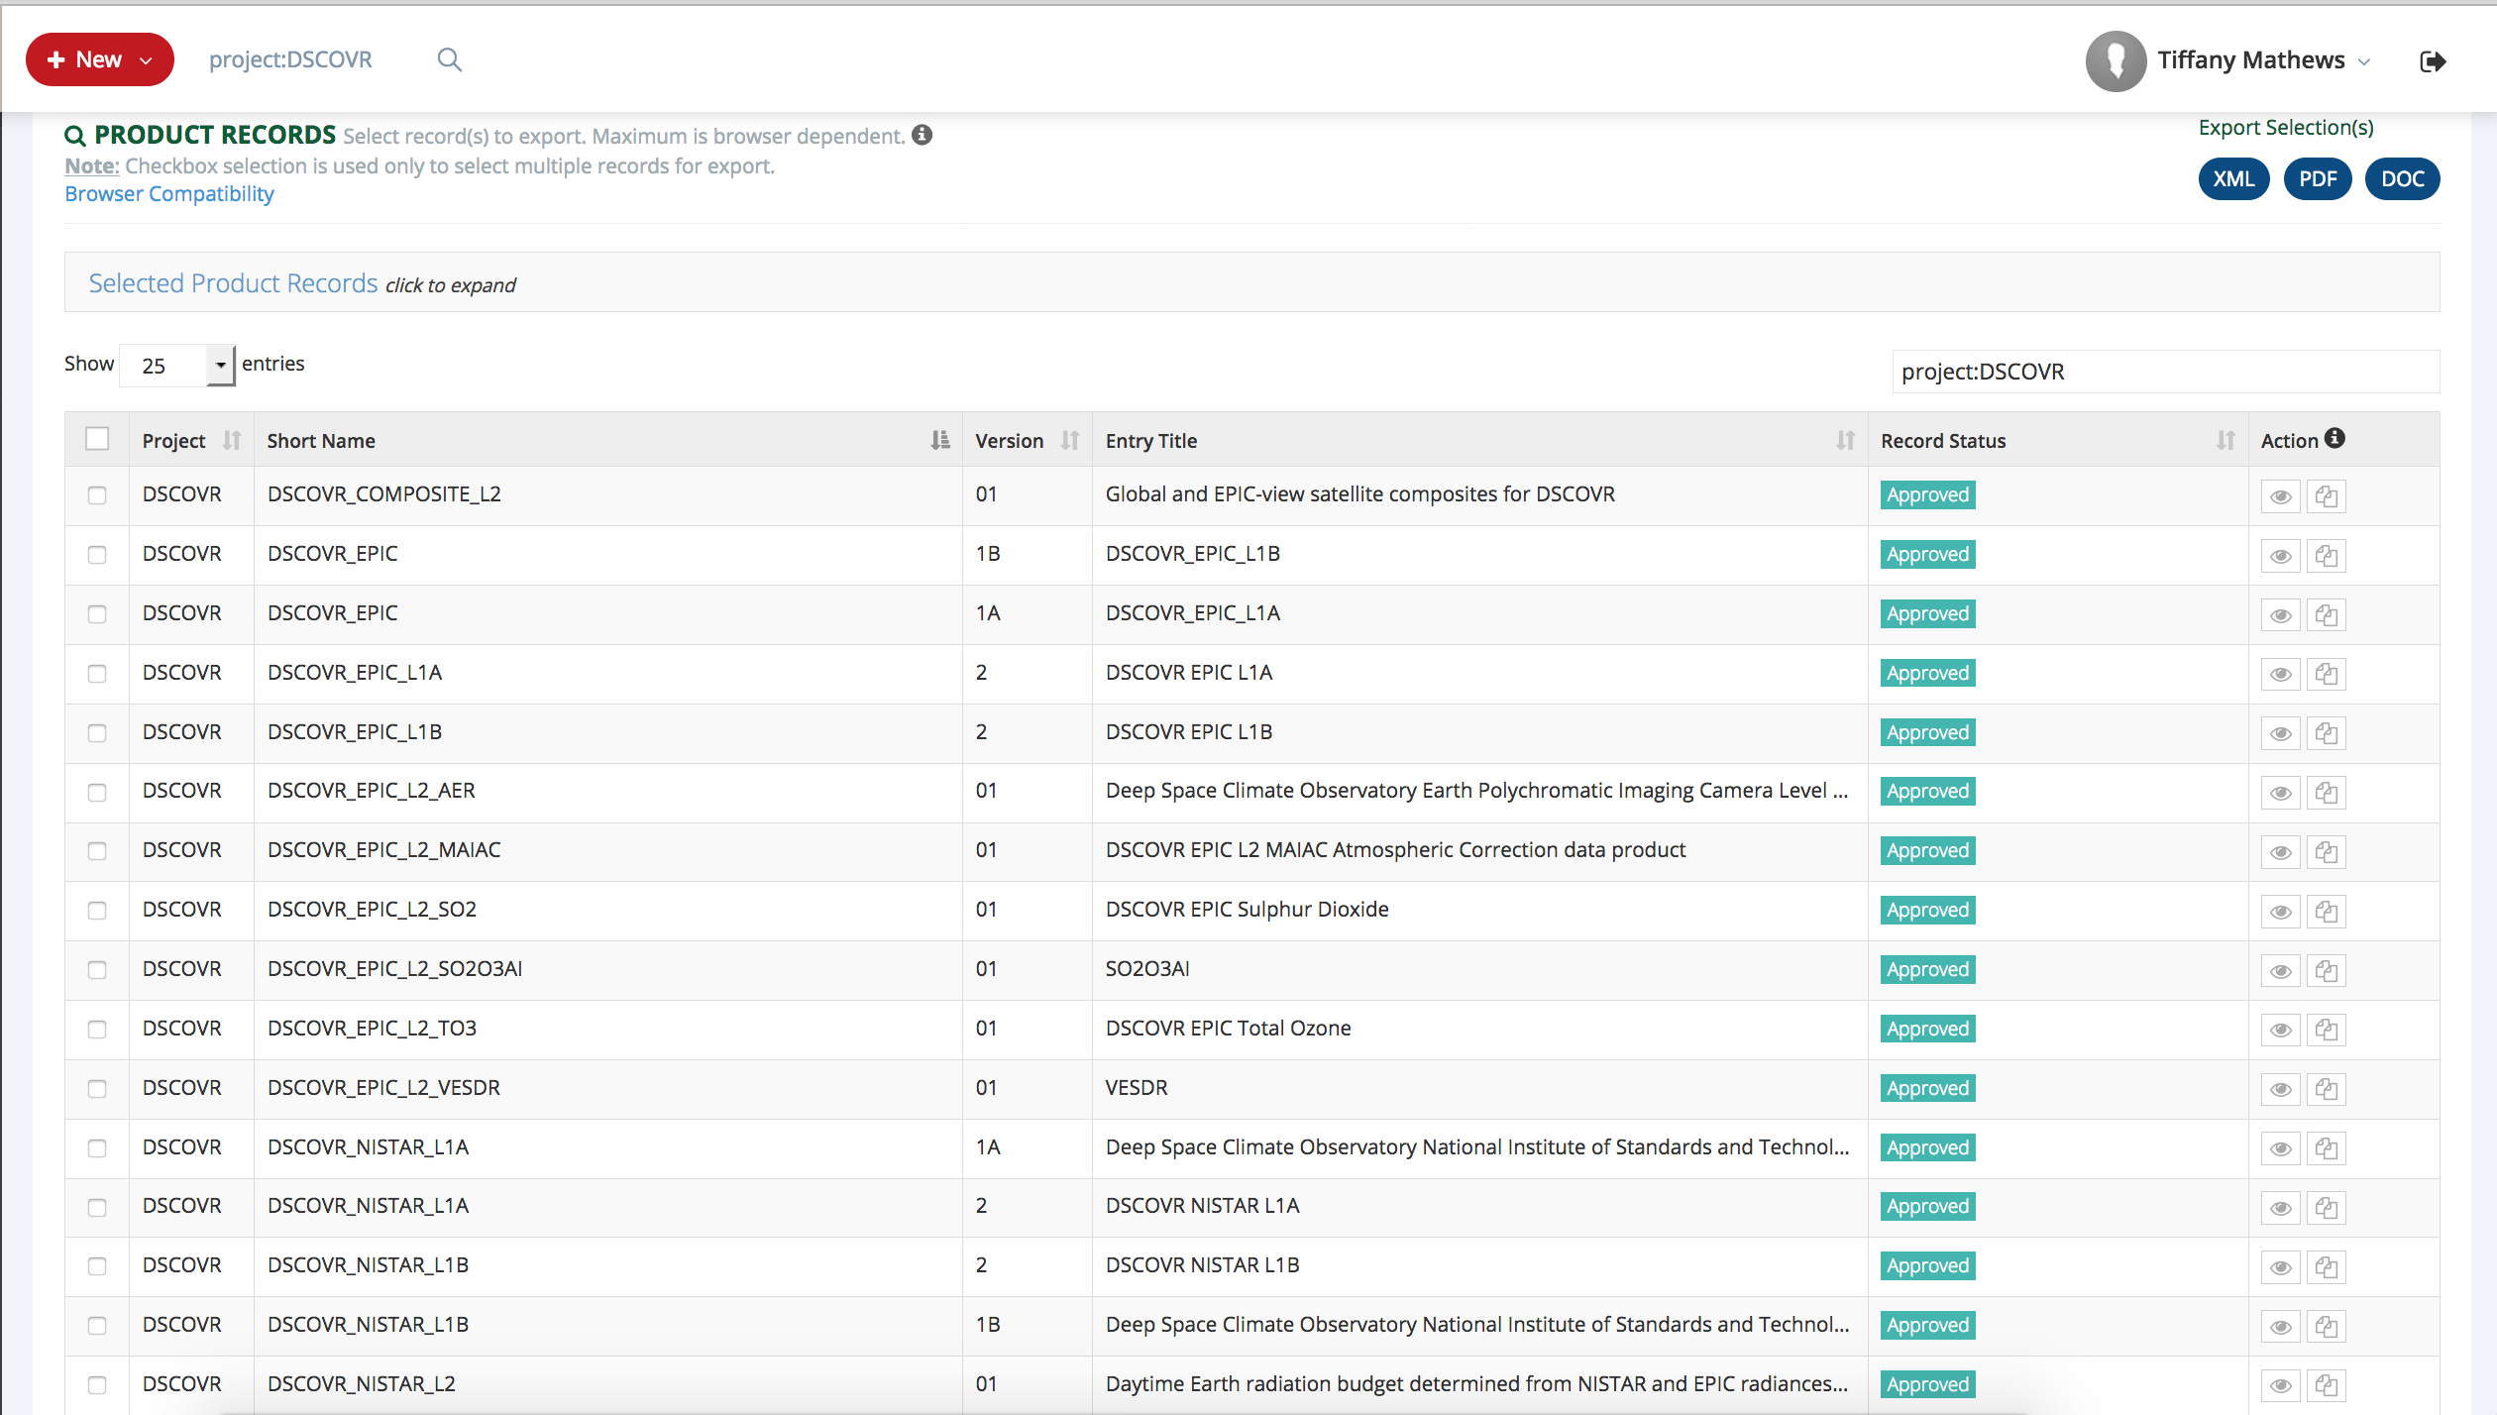
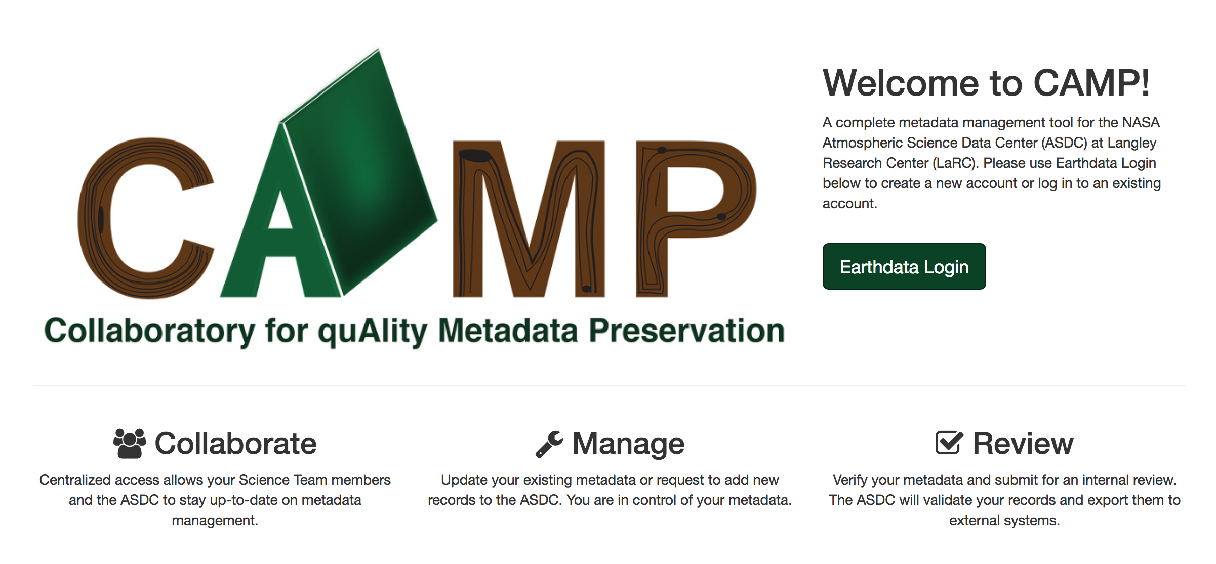
Collaboratory for quAlity Metadata Preservation (CAMP)
An interface to science teams to submit quality collection level metadata and informs the ASDC that collections are coming and will need serviceshttp://CAMP.LaRc.NASA.gov)
Notes:
This shows where you can create new product records or submit new Data Submission requests (DSRs = more for brand new products or reprocessing, when a lot of products are expected in a short period of time).

Slide 6
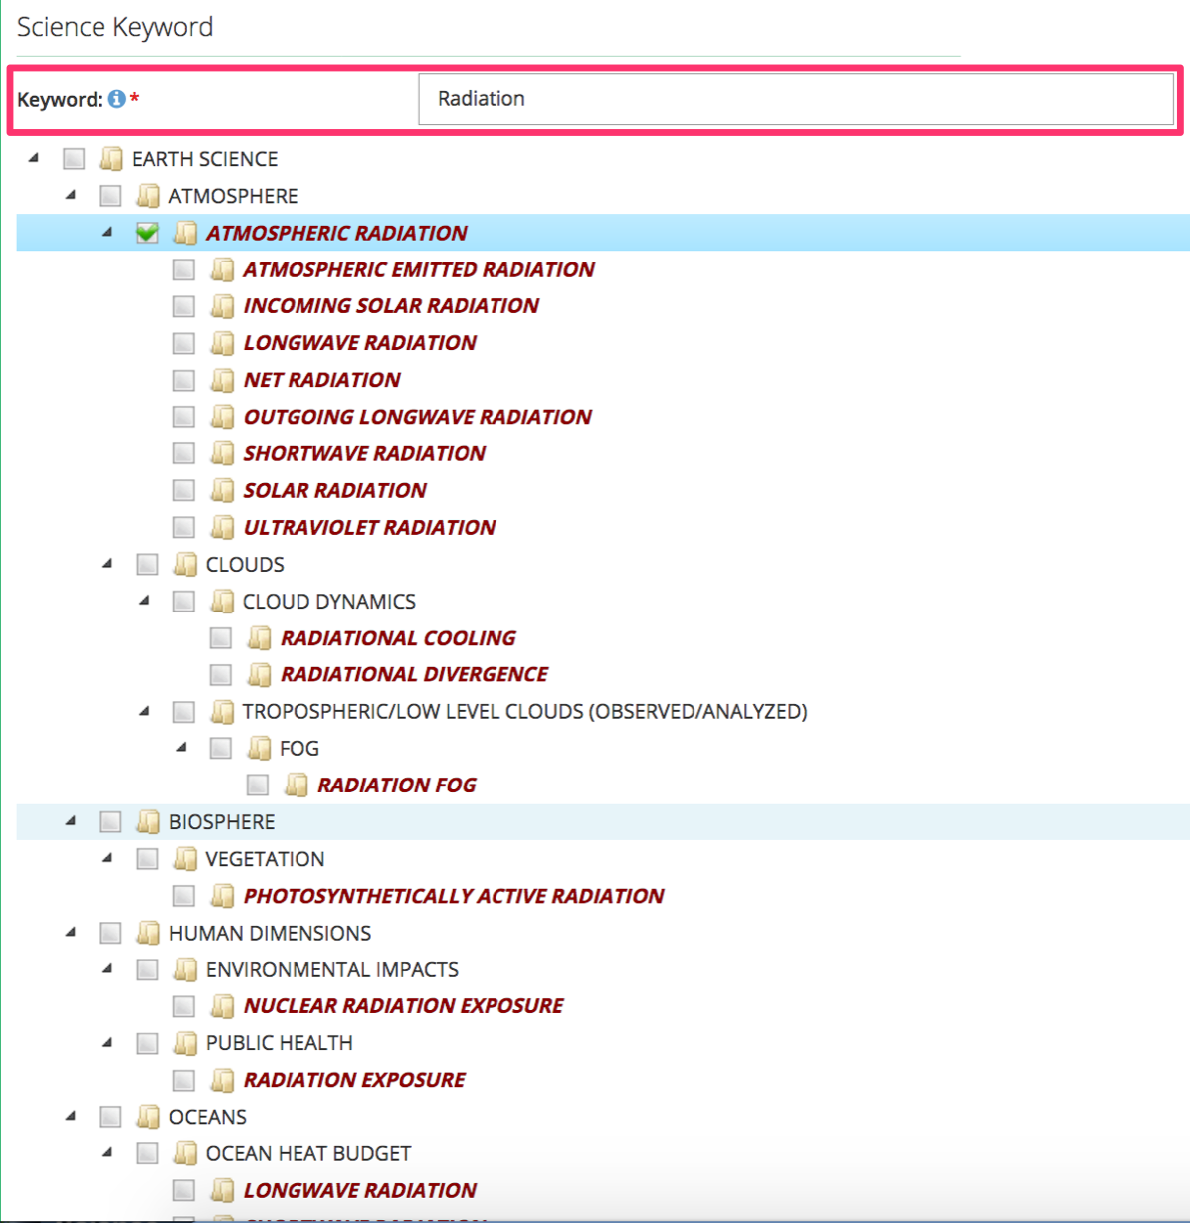
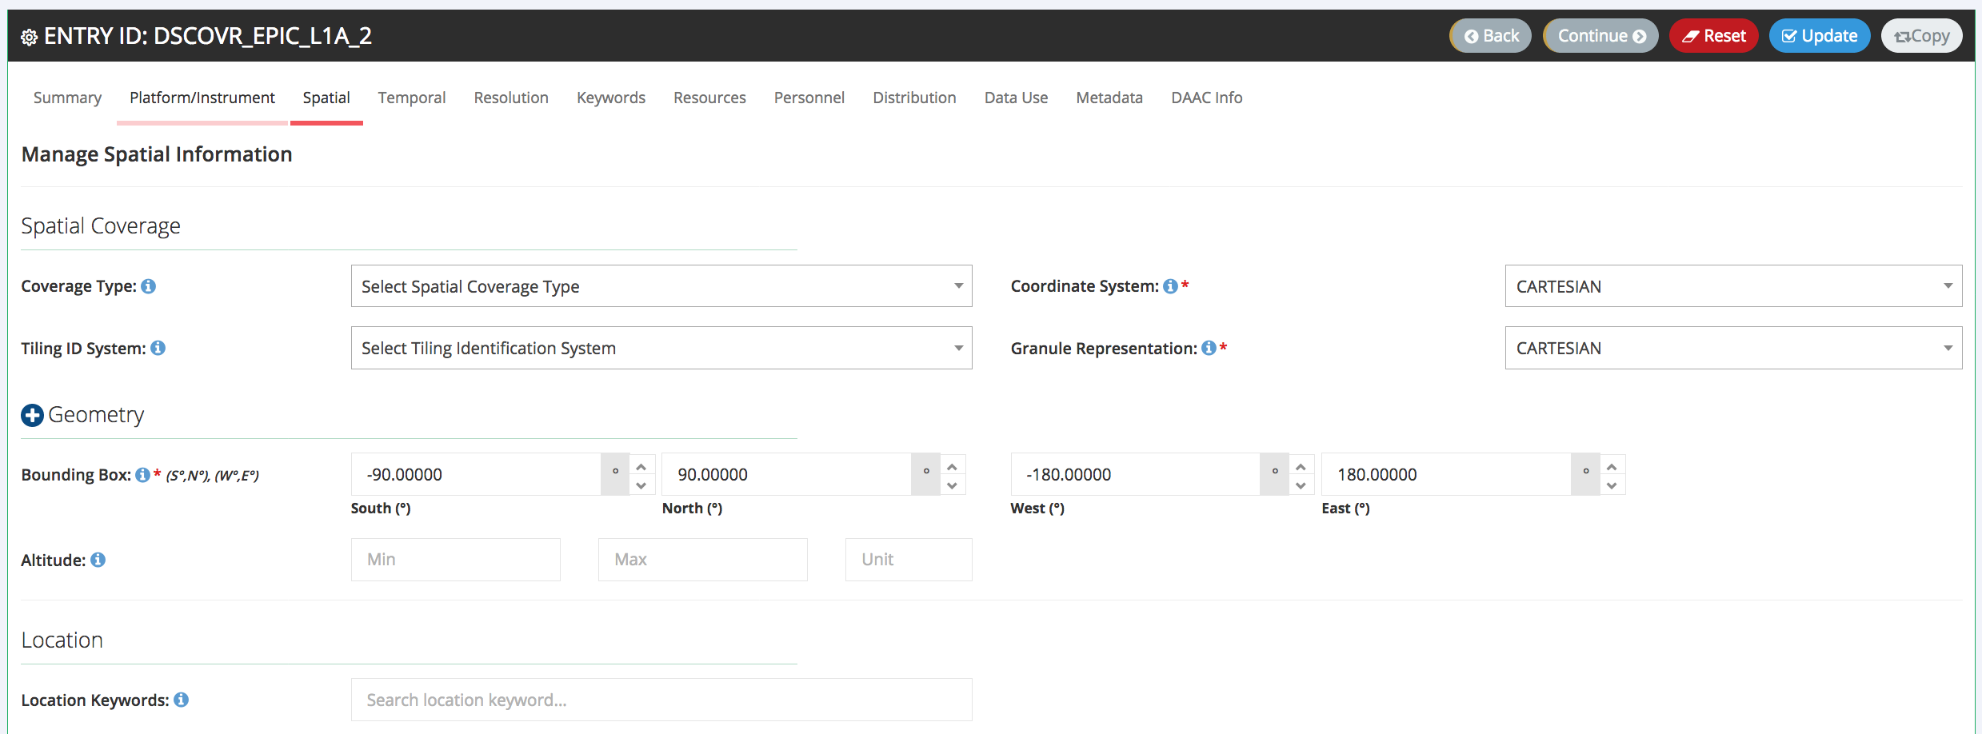
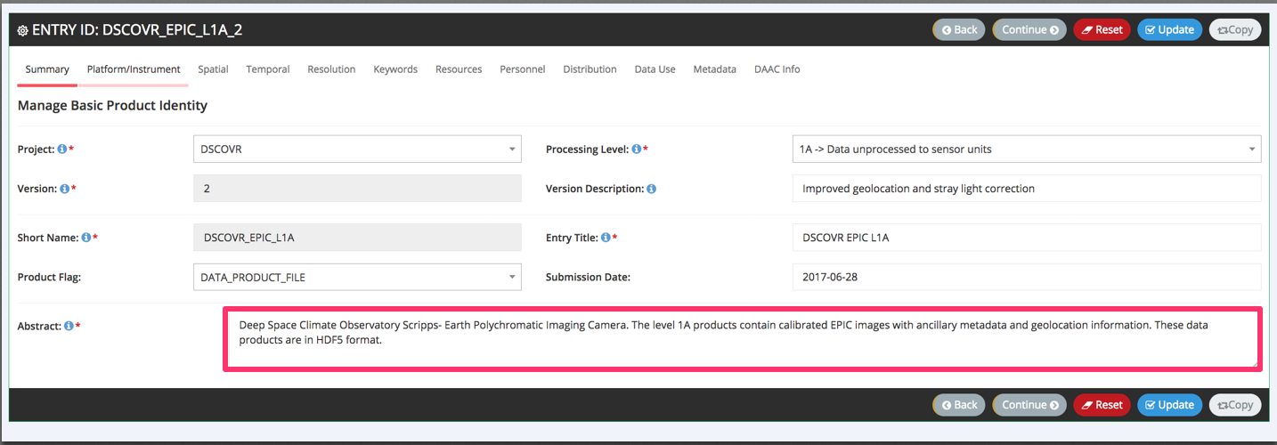
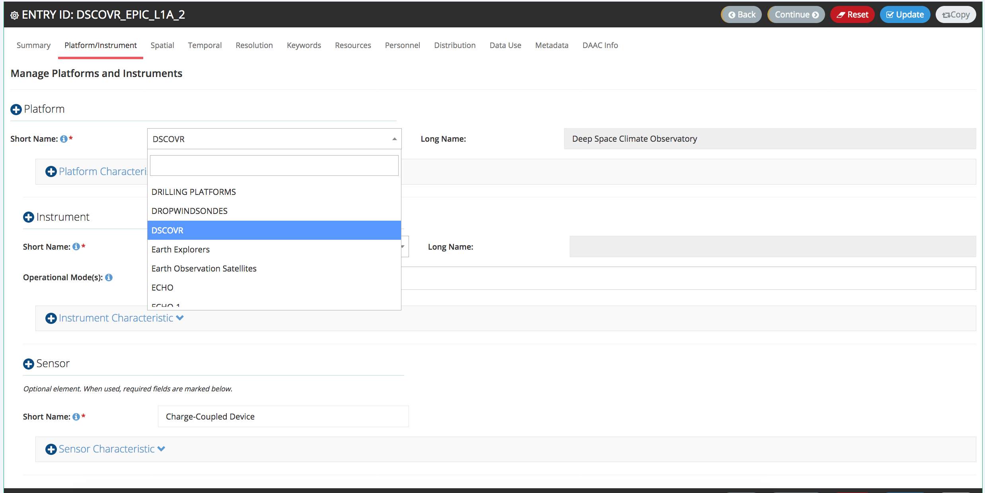
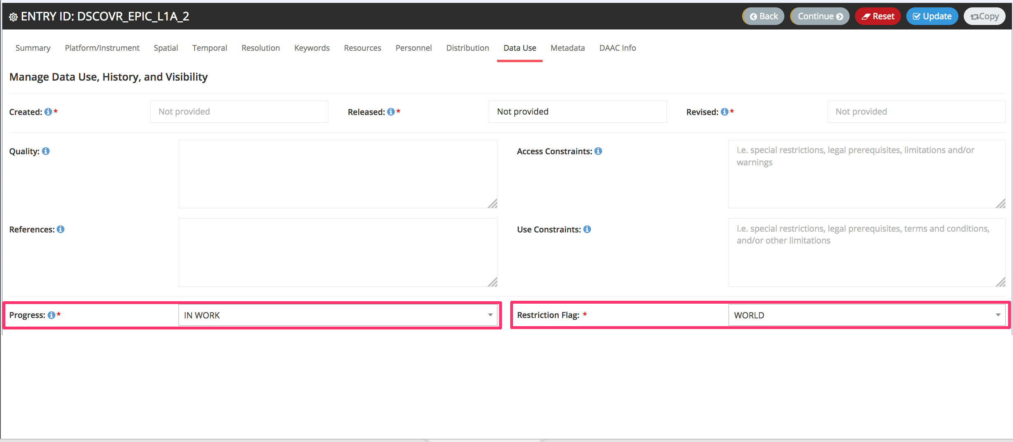
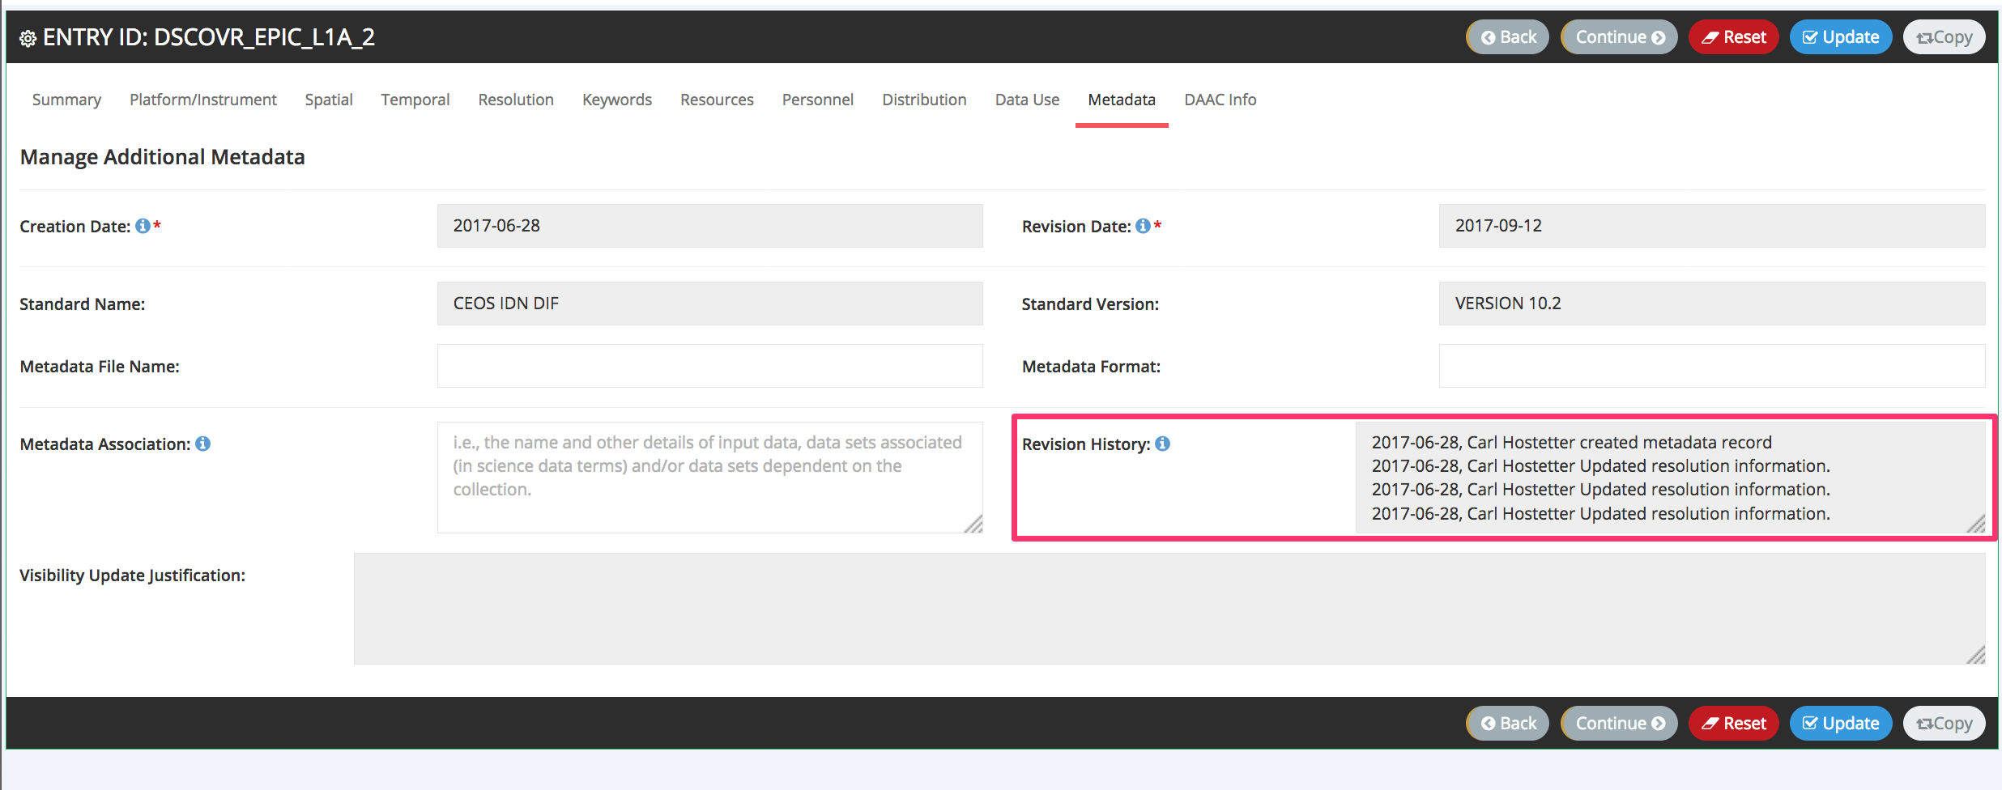
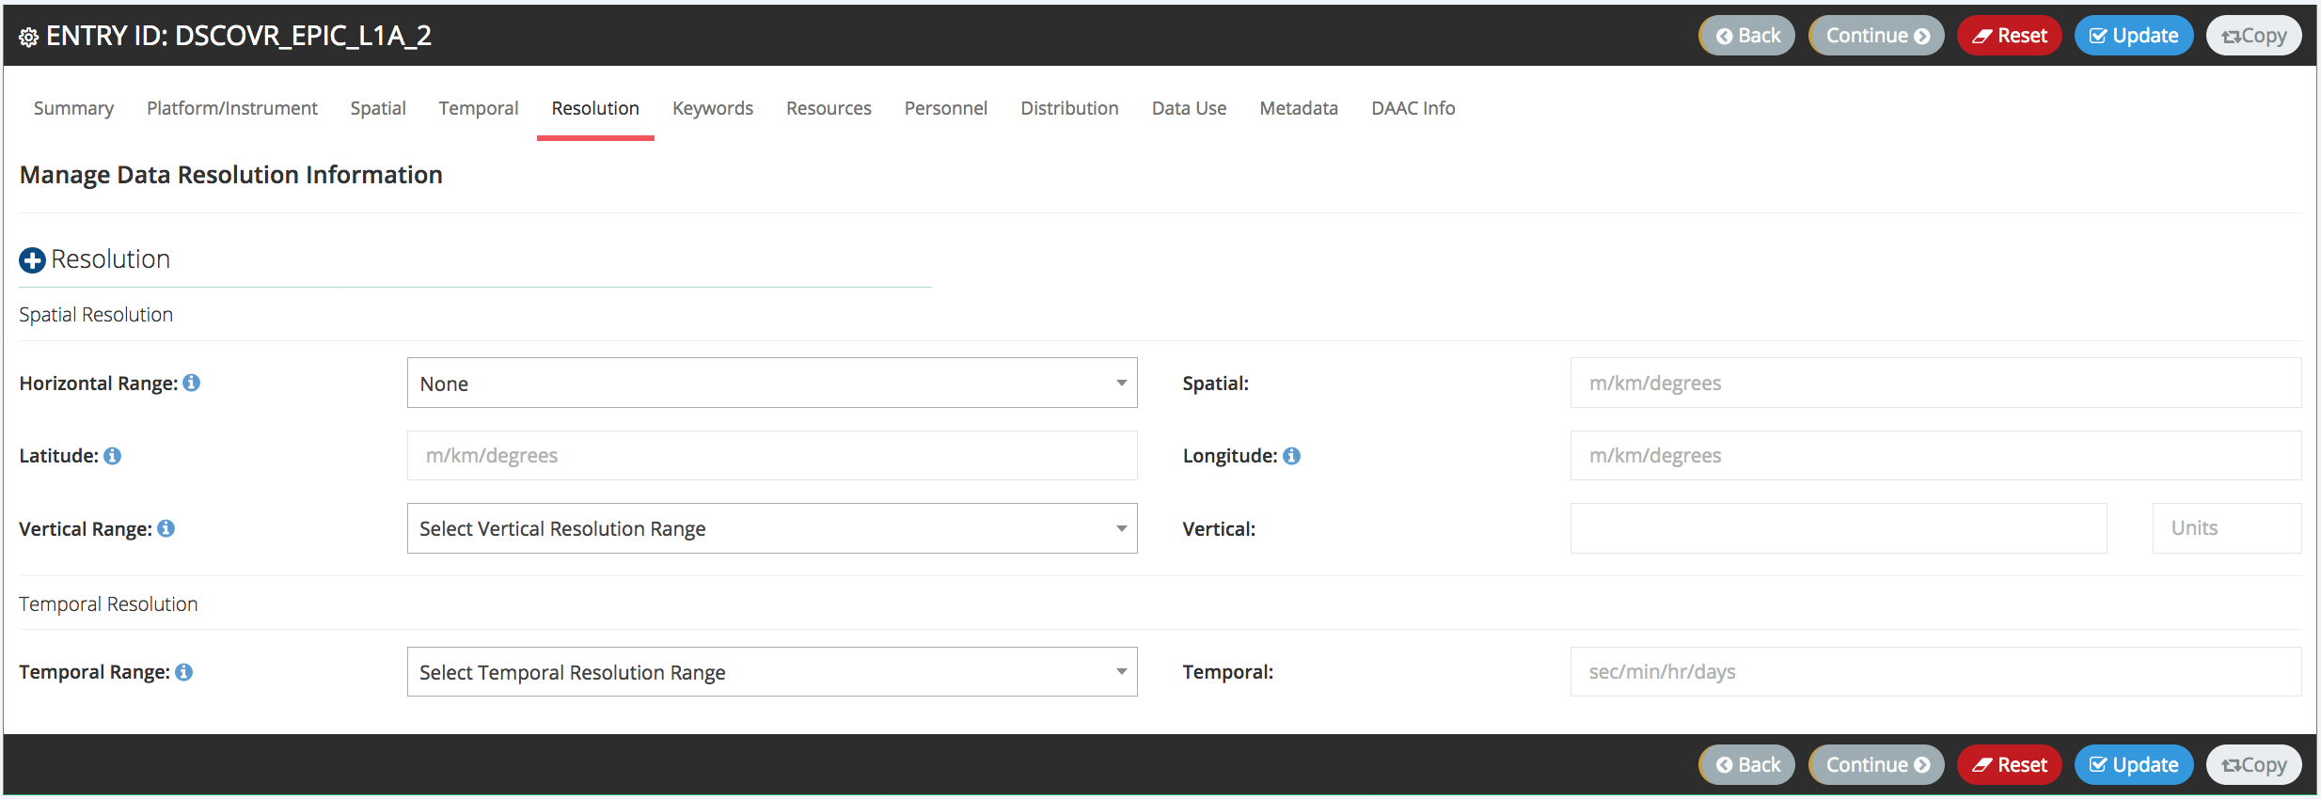
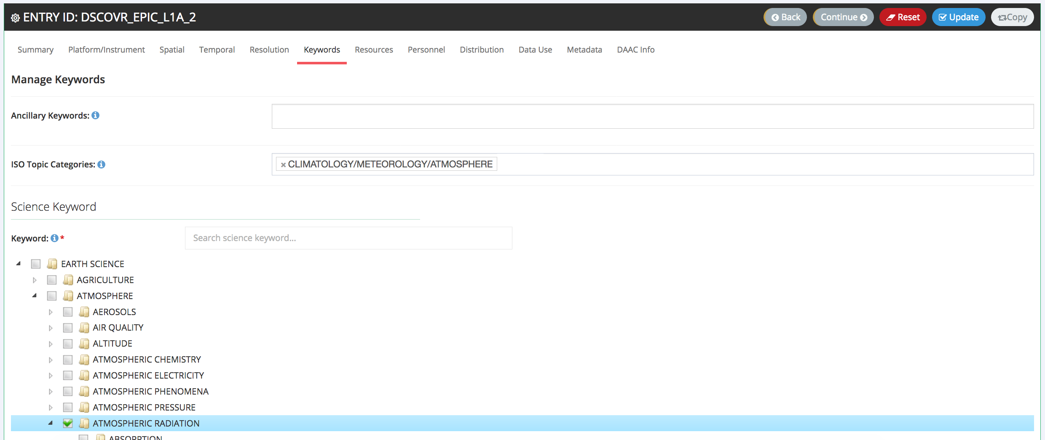
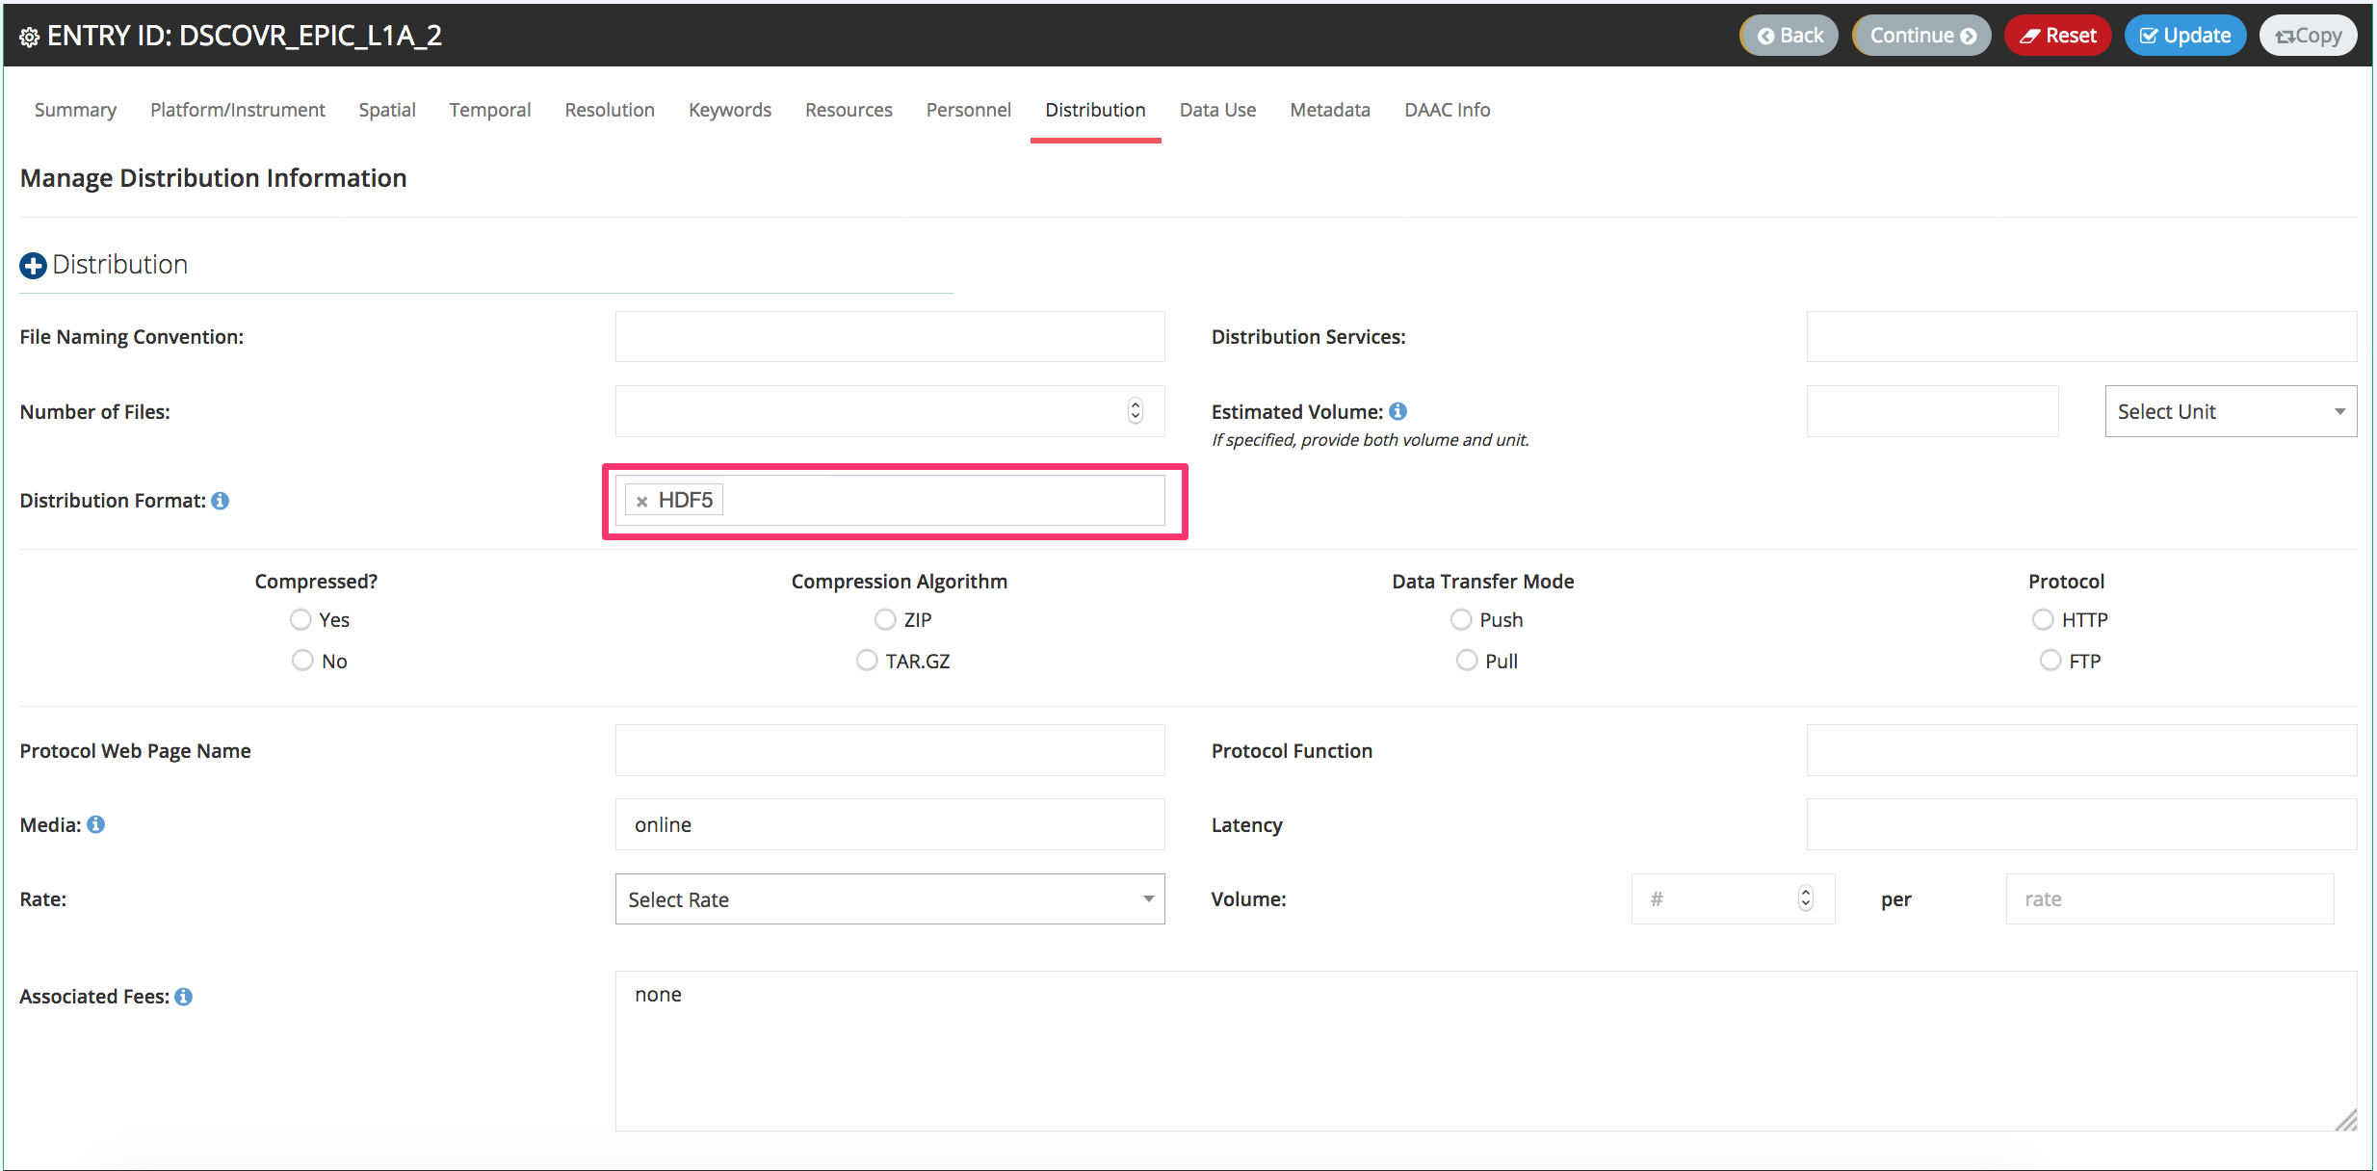
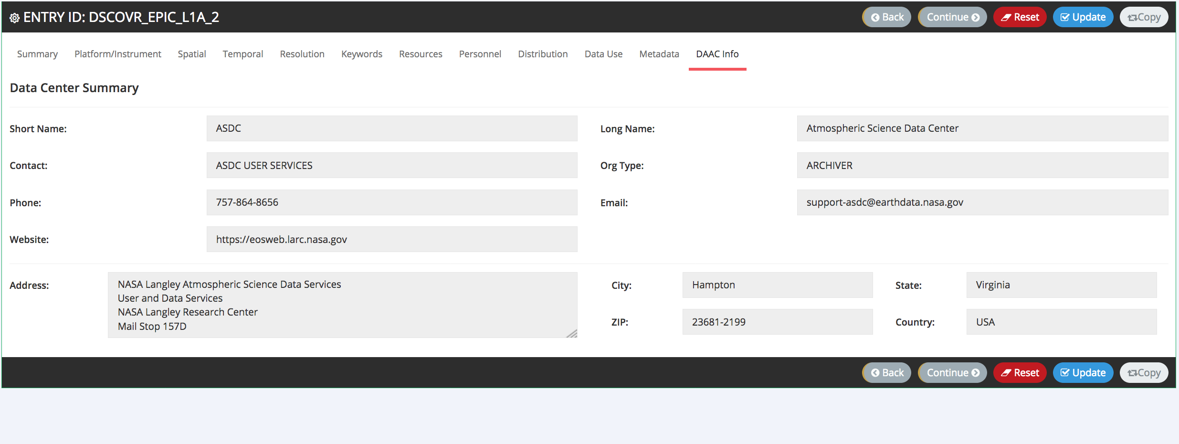
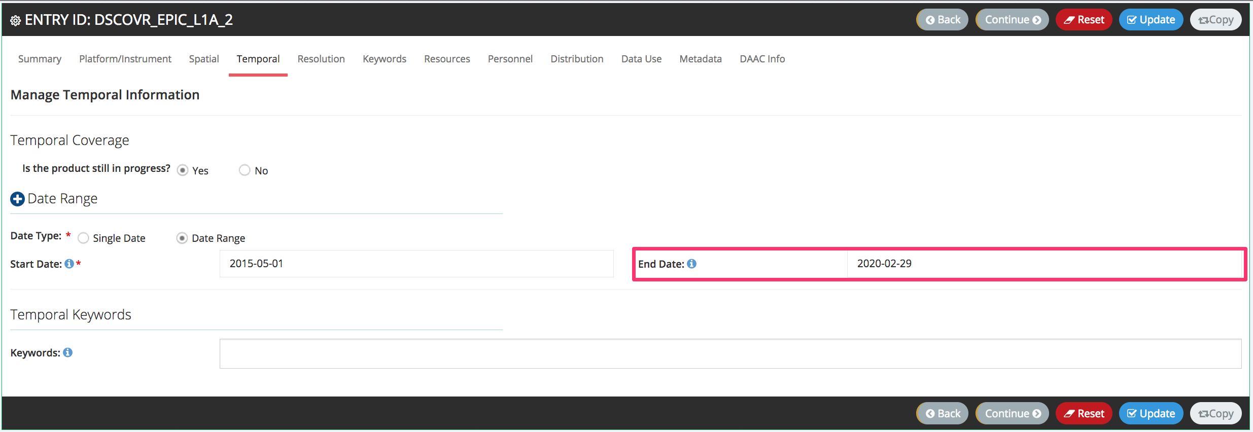
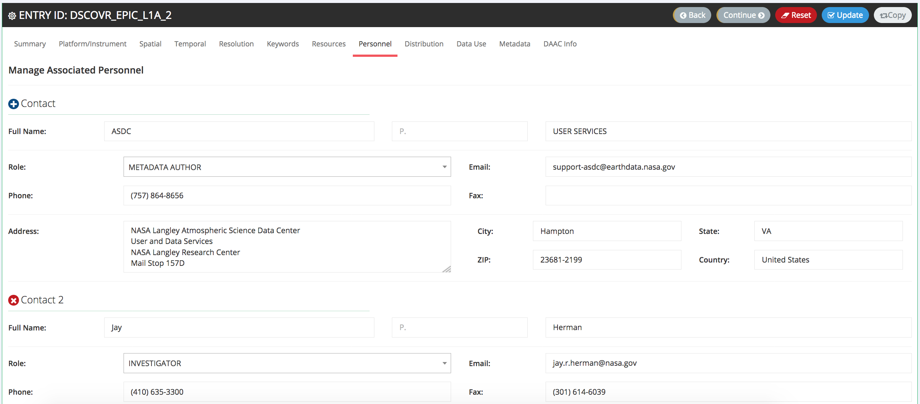
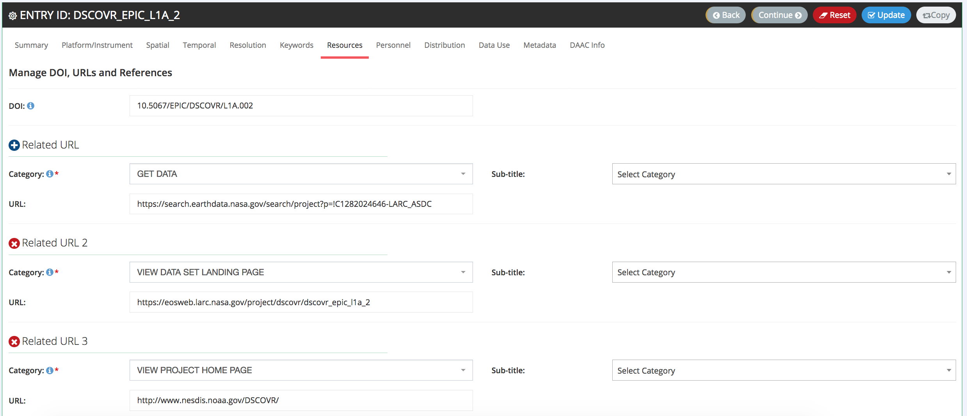
Metadata in CAMP

Slide 7
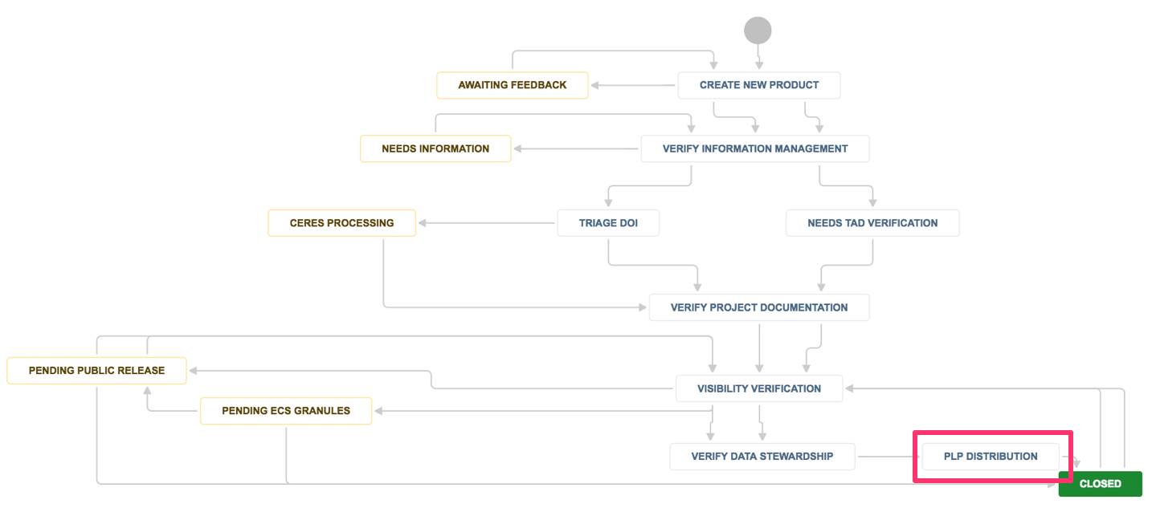
Product Lifecycle Process
Manages data products (collections) throughout the lifecycle
Initiated with approvals in CAMP through new product records and visibility changes.
Ensures traceability with ASDC services
CMR Availability (Earthdata, GCMD)
OPeNDAP
Product pages (EOSWEB)
DOI’s
GIBS
Any new Services to come…
Notes:
We are working on building out distribution services now. However, we do have dashboards that people are working with now to show what roducts are available through which services.

Slide 8
Questions?
Tiffany Mathews: Tiffany.J.Mathews@nasa.gov

