Slide 1
Lunar calibration of the O2 absorbing channels: 688 and 764 nm
A. Marshak, M. Kowalewski, M. Sutton

Slide 2
Lunar calibration of the O2 absorbing channels: 688 and 764 nm
Assumptions:
Lunar reflection is constant relative to the adjacent pairs: 680 and 688; 764 and 780;
The ratio between two neighboring channels doesn’t depend on Solar and Viewing angles

Slide 3
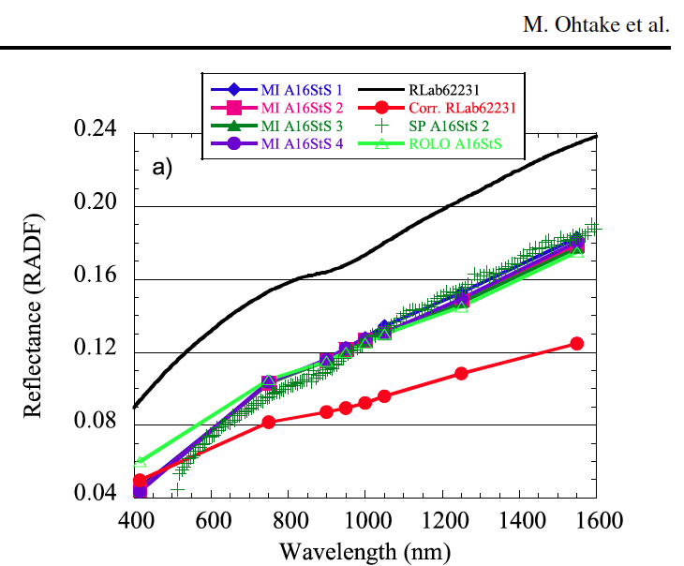
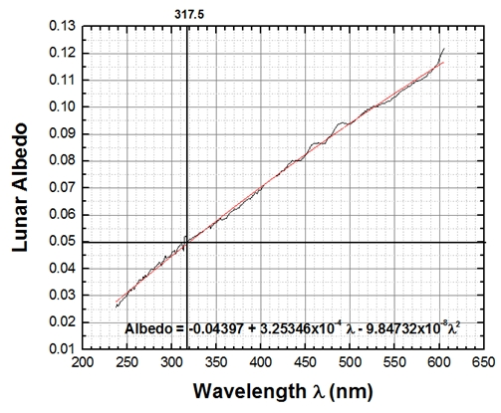
Lunar calibration of the O2 absorbing channels: 688 and 764 nm
Assumptions:
Lunar reflection is constant relative to the adjacent pairs: 680 and 688; 764 and 780
Using GOME Lunar Albedo:
10 nm difference ~ 0.5% increase
10 nm difference ~ 1.0-1.5% increase

Slide 4
Lunar calibration of the O2 absorbing channels: 688 and 764 nm
Assumptions:
Lunar reflection is constant relative to the adjacent pairs: 680 and 688; 764 and 780
- Moon reflectance R_{λ} increases slowly with λ; in most cases, a 10 nm difference in wavelength leads to a difference in reflectance in the range of 0.0006-0.0013 or 0.8-1.2%.
- The difference in R_{λ} between 688 nm and 680 nm as well as between 764 nm and 780 nm will be within 1.6%.
- We use the moon refl. ratios R₆₈₈/R₆₈₀ = 1.008 and R₇₆₄/R₇₈₀ = 0.984.

Slide 5
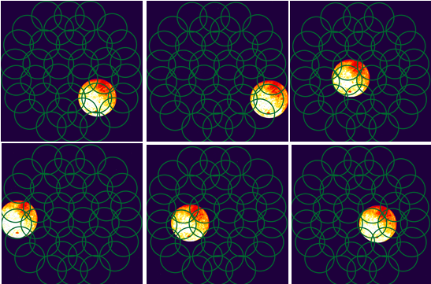
Lunar calibration of the O2 abs. channels;
different solar and viewing angles
DOY 189-191
from Matt Kowalewski & Alexander Cede

Slide 6
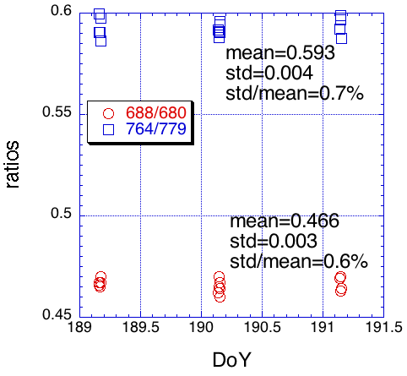
Lunar calibration of the O2 abs. channels
< 1%
Also, the difference between the ROLO ratios and the Lunar derived ratios are ~1.5%

Slide 7
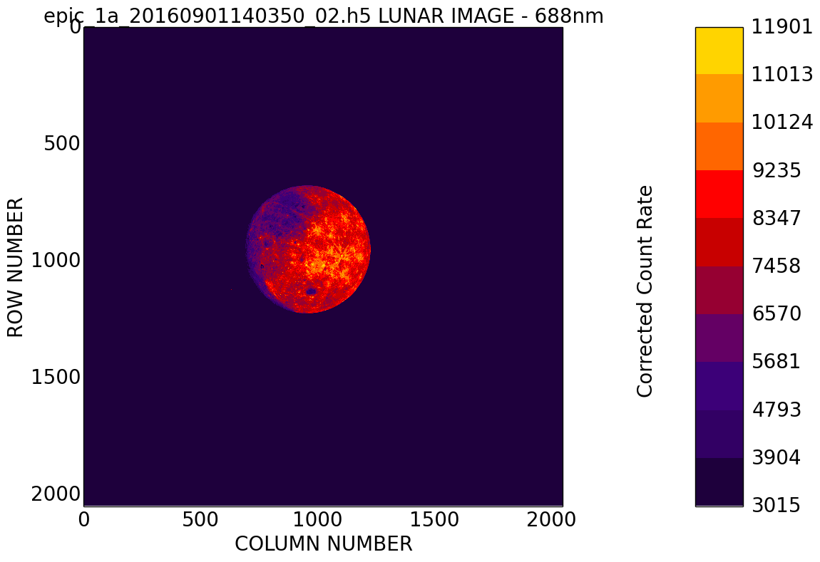

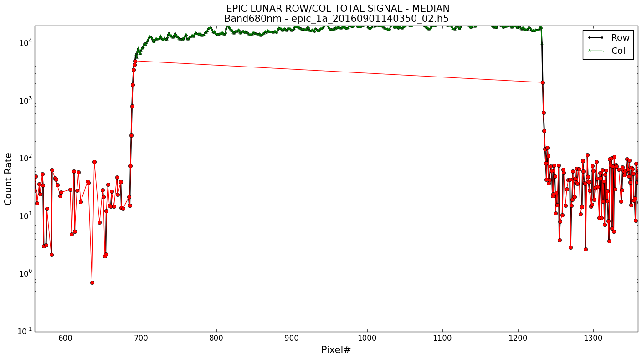
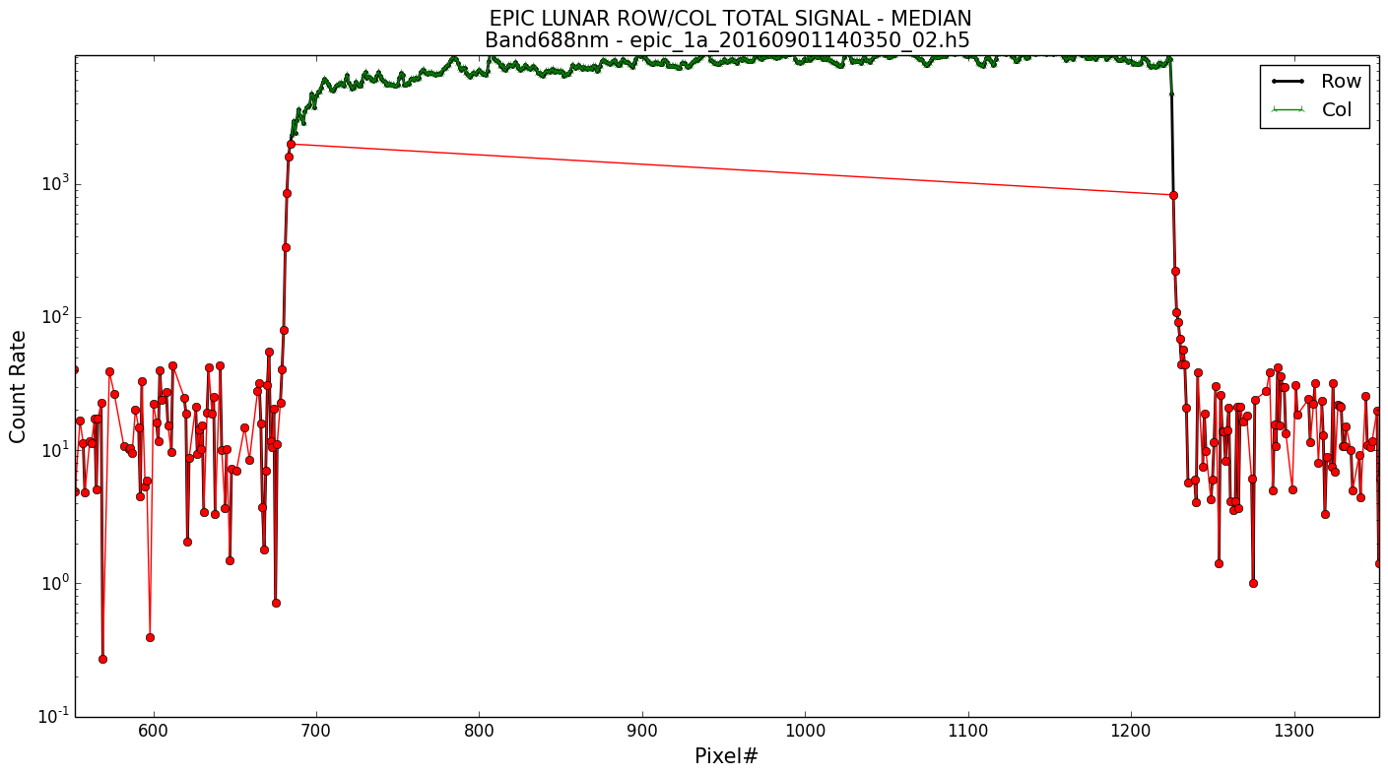
Lunar calibration of the O2 abs. channels
Examples of moon observations in 680 (left) and 688 (right) on 09/01/2016 (courtesy of Matt Kowalewski).

Slide 8
Lunar calibration of the O2 abs. channels
F(680,688)
and
F(780,764)
Ratios of Moon reflectance F in counts/sec at 688 over 680 nm and at 764 over 780 nm channels.

Slide 9
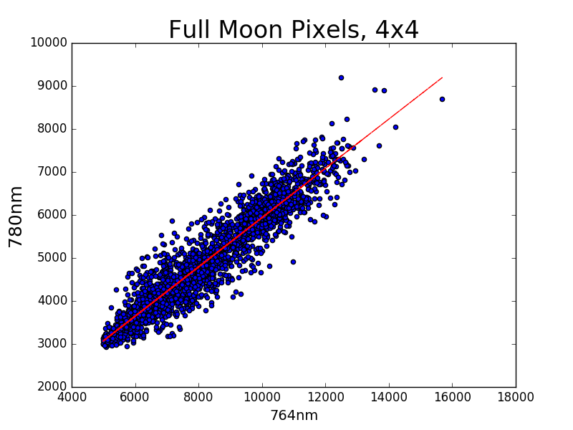
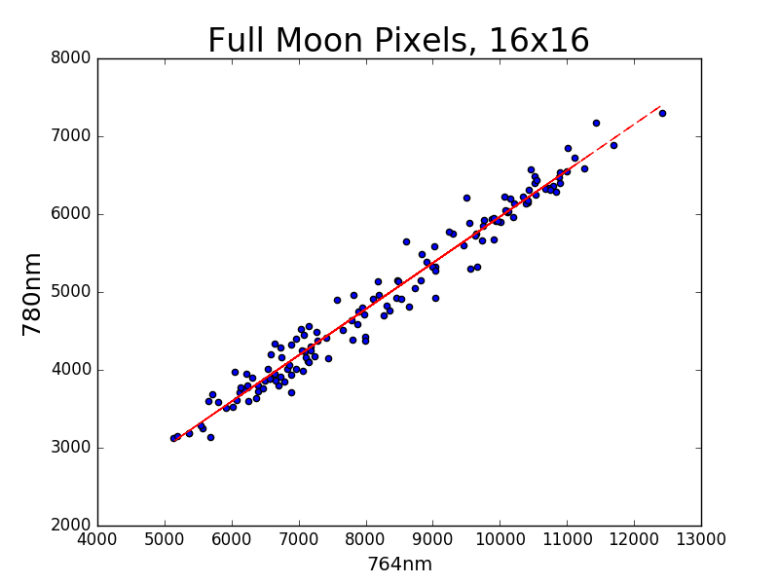
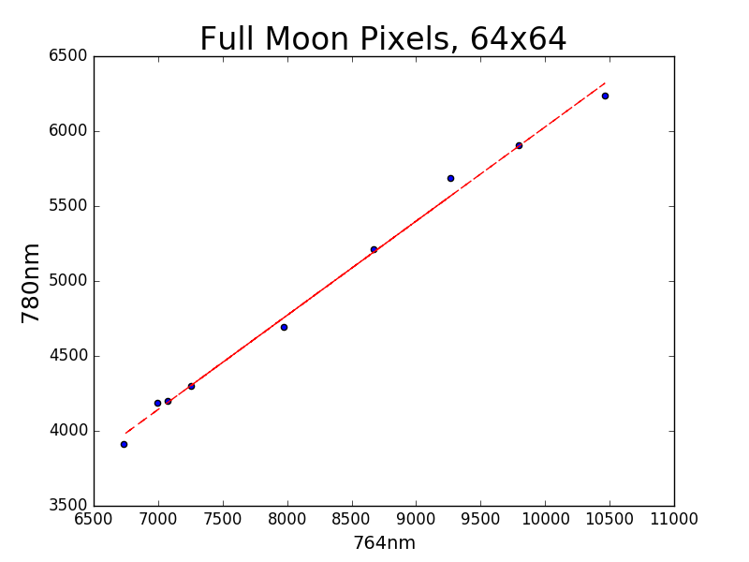
780 vs. 764
Courtesy of Marshall Sutton

Slide 10
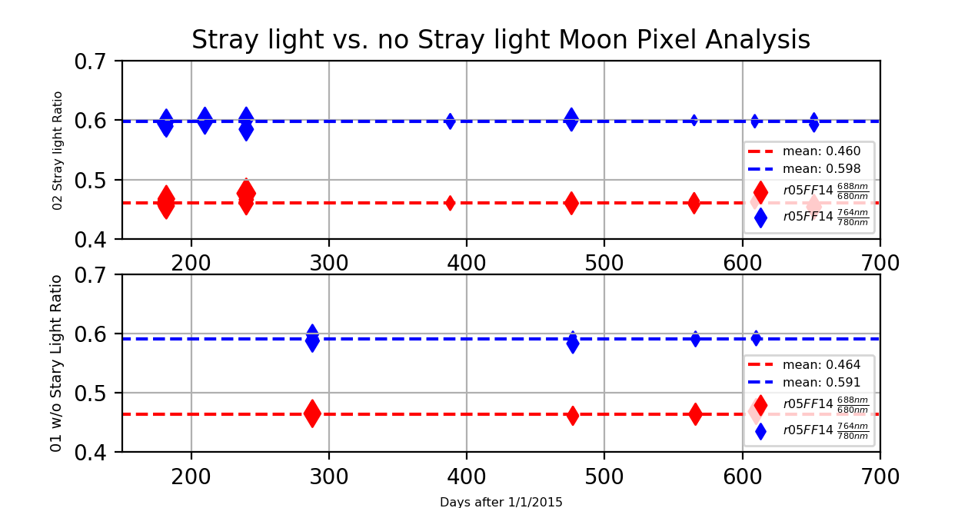
Lunar calibration of the O2 abs. channels
F(680,688)
and
F(780,764)
new moon
Courtesy of Marshall Sutton
17 images without the stray light cor. and 36 images with the stray light cor.
The difference in 764/780 ratio < 2%, and the difference in the 688/680 ratio < 1%.

Slide 11
Lunar calibration of the O2 abs. channels
K₆₈₈ = R₆₈₈/R₆₈₈^{counts}
= R₆₈₈/[R₆₈₀^{counts} F(680,688)]
= [R₆₈₈ K₆₈₀]/[R₆₈₀ F(680,688)]
= [R₆₈₈/R₆₈₀] [K₆₈₀/F(680,688)]
≈ 1.008 [K₆₈₀/F(680,688)] = 2.02 10⁻⁵
K₇₆₄ ≈ 0.984 [K₇₈₀/F(780,764)] = 2.36 10⁻⁵

Slide 12
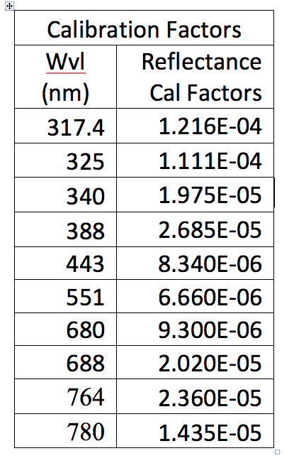
To covert Level 1 data into reflectance for each λ we have to multiply data given in engineering units (counts/second) by calibration factors K_{λ}. The accuracy of the calibration factors is about 1-3%.

Slide 13
Thank you

Slide 14
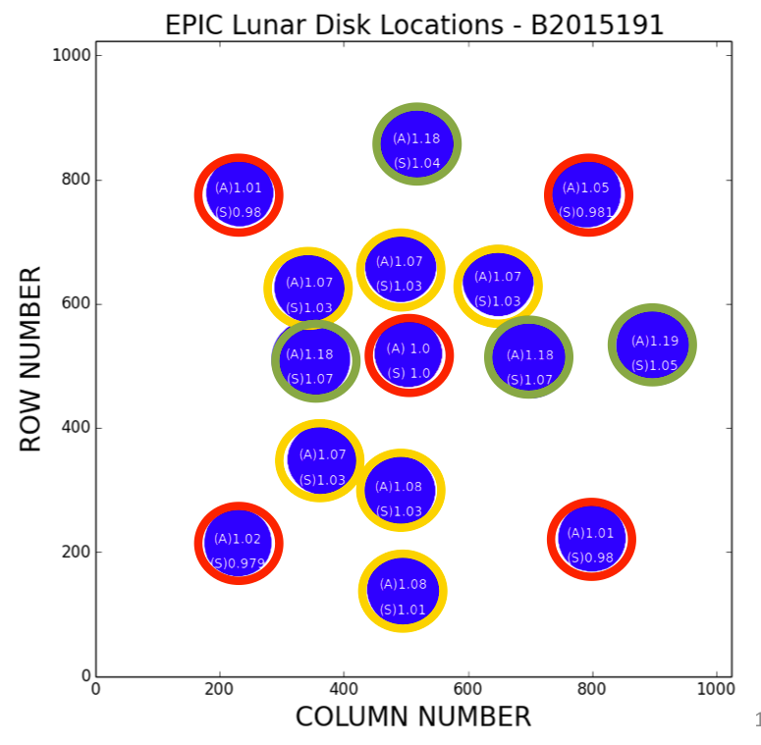

Slide 15
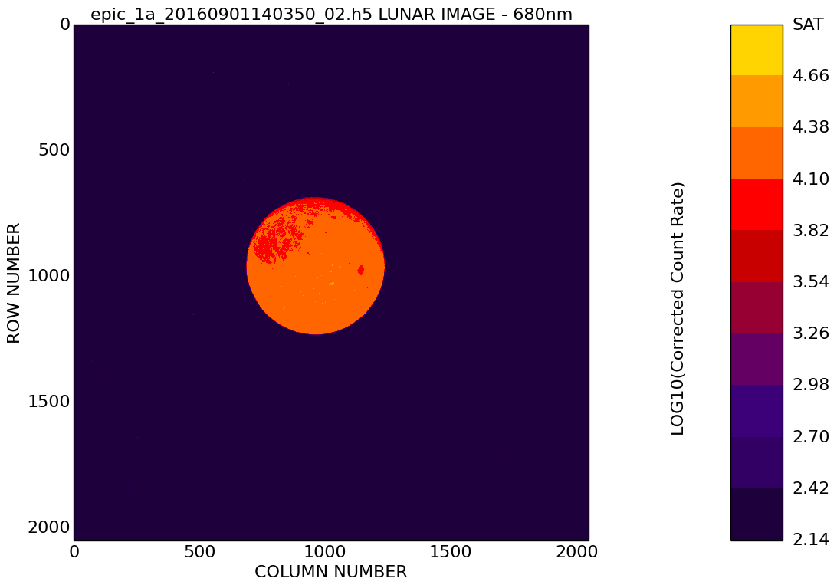
R05-V02: 09/01/2016 - 680nm
Examples of moon observations in 680 (left) and 688 (right) on 09/01/2016 (courtesy of Matthew Kowalewski).

Slide 16
EPIC_1a_20160719143037_01.h5
780nm / 764nm
Square Size | OLS Forced Through Origin |  | OLS |  |  | Average
 | Slope | Variance | Slope | Intercept | Variance | Average
2 | 0.5962 | 0.0005 | 0.5613 | 304.29 | 0.002 | 0.6005
4 | 0.5969 | 0.0008 | 0.5731 | 207.48 | 0.003 | 0.5998
16 | 0.5972 | 0.0018 | 0.5932 | 34.35 | 0.009 | 0.5976
32 | 0.5976 | 0.0024 | 0.6040 | -54.911 | 0.013 | 0.5972
64 | 0.5981 | 0.0031 | 0.6286. | -257.43 | 0.017 | 0.5966

