Slide 1
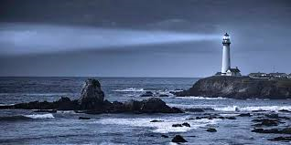
UV-Signal of the Ocean and Global Aerosol from EPIC DSCOVR
Alexei Lyapustin, GSFC
D. Huang (SSAI), Y. Wang (UMBC),
S. Korkin (USRA)
DSCOVR Science Team Meeting
NASA GSFC, October 3-4, 2017

Slide 2
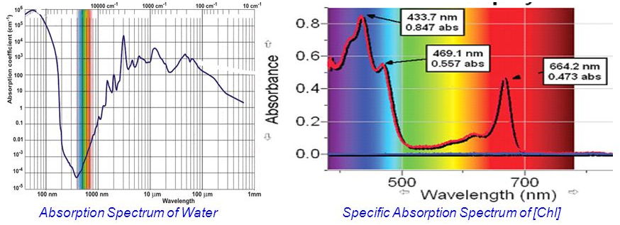
Intro into Ocean Optics in near-UV
Min absorption of pure water at 418nm;
Rapid increase of absorptance into UV;
Strong Chl absorption at 388nm and 340nm;
Even stronger absorption by yellow substance and other …
More phytoplankton (eutrophic) – less ρ^{w} → upwelling regions
Need to know for atm. gas & aerosol retrievals; fisheries …
Measured (2m depth) and modelled reflectance of underlight at 380nm, from Vasilkov et al., Appl. Optics, 44, 2005

Slide 3
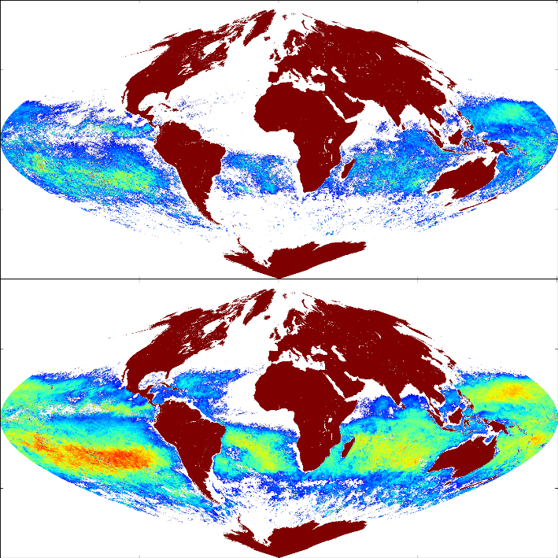
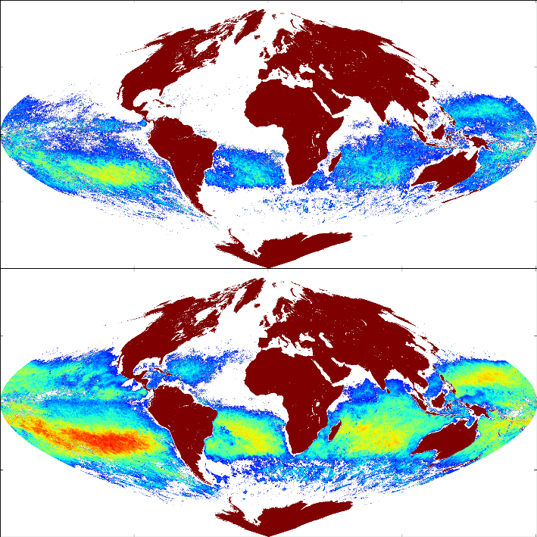
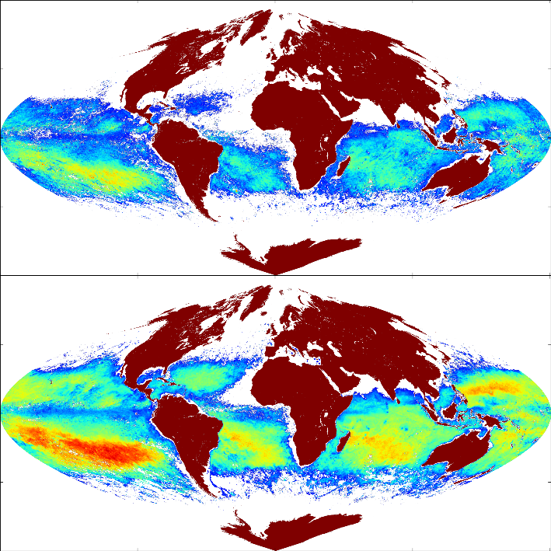

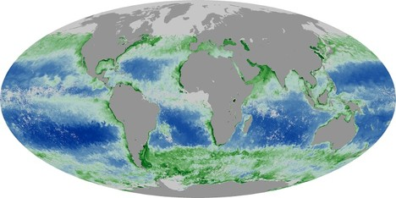
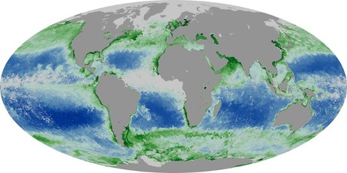
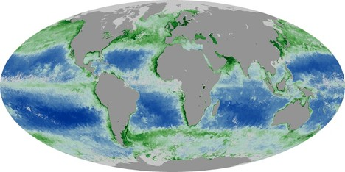

EPIC Monthly ρ^{w} vs MYD Chl
Jan. 2016
Feb. 2016
Mar. 2016
340
388
Source: NASA Earth Observatory, Global Maps, Chlorophyll MODIS Aqua

Slide 4
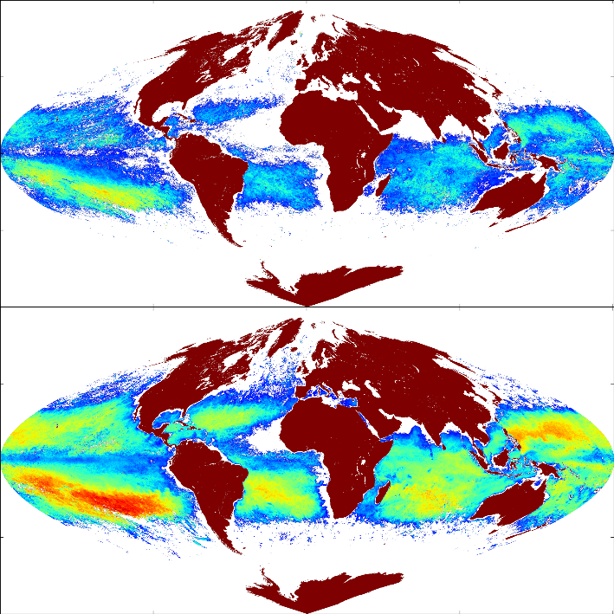
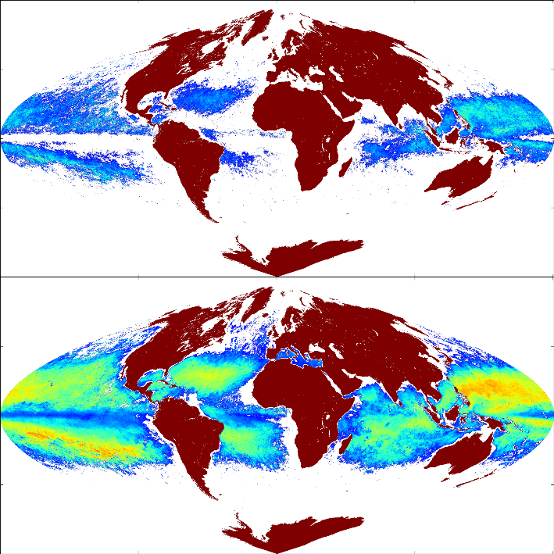
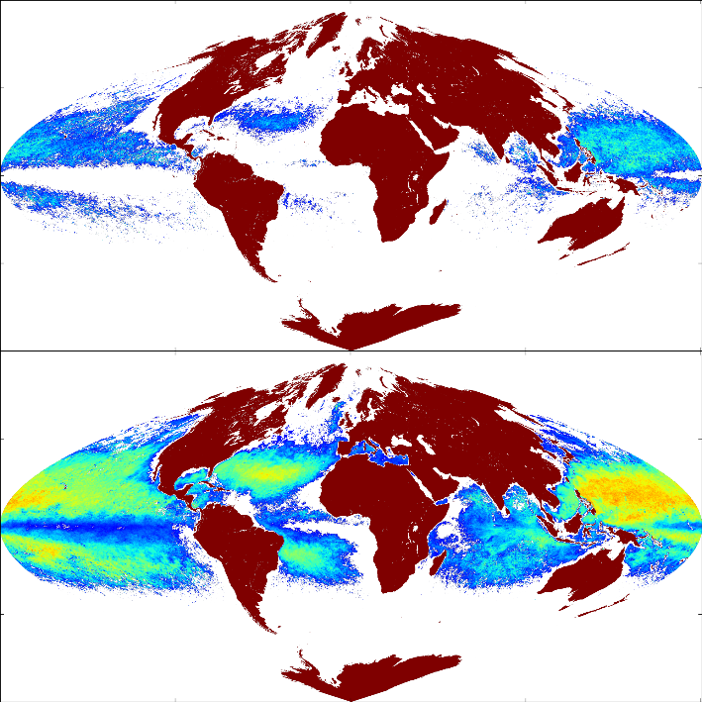
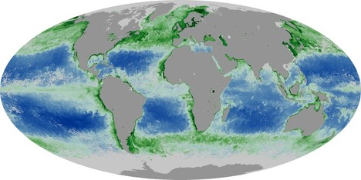
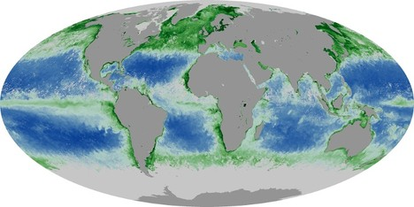
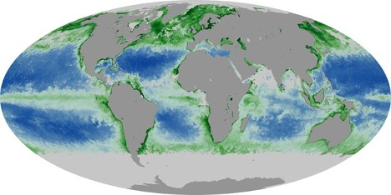
EPIC Monthly ρ^{w} vs MYD Chl
Apr. 2016
May 2016
June 2016
340
388

Slide 5
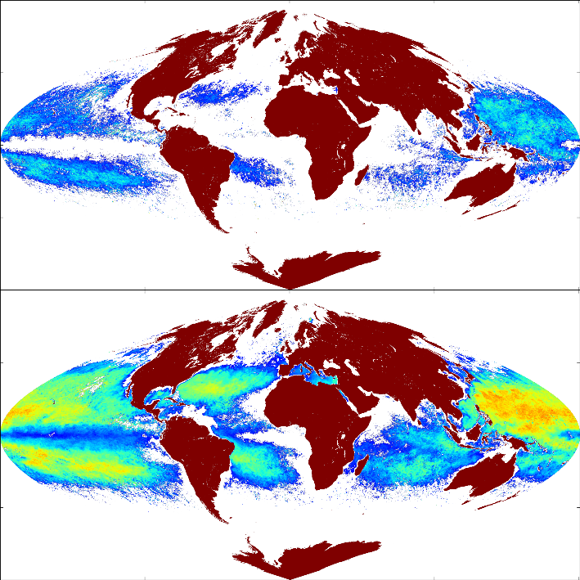
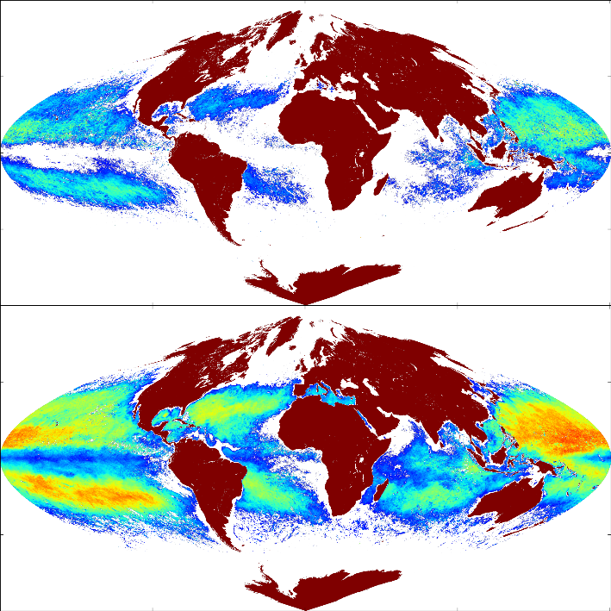
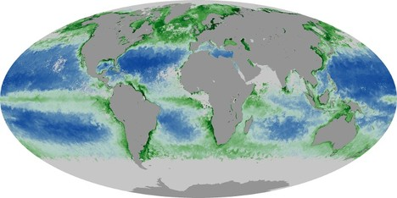
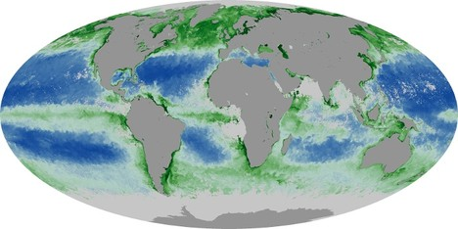
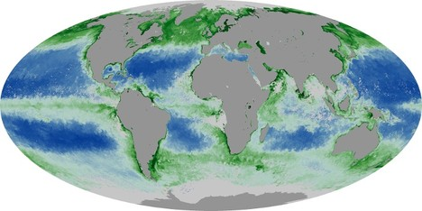
EPIC Monthly ρ^{w} vs MYD Chl
July 2016
Aug. 2016
Sep. 2016
340
388

Slide 6
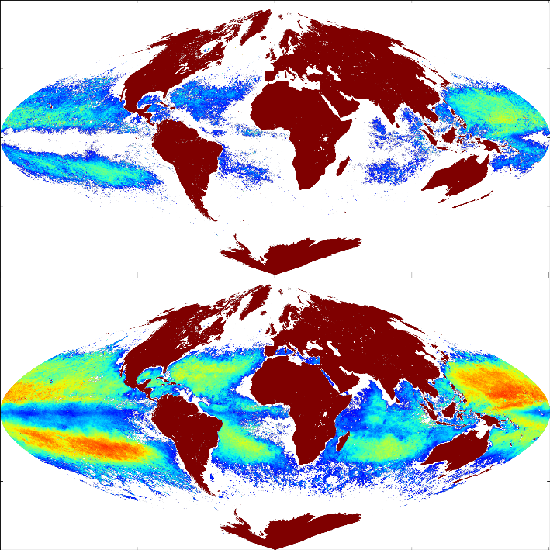
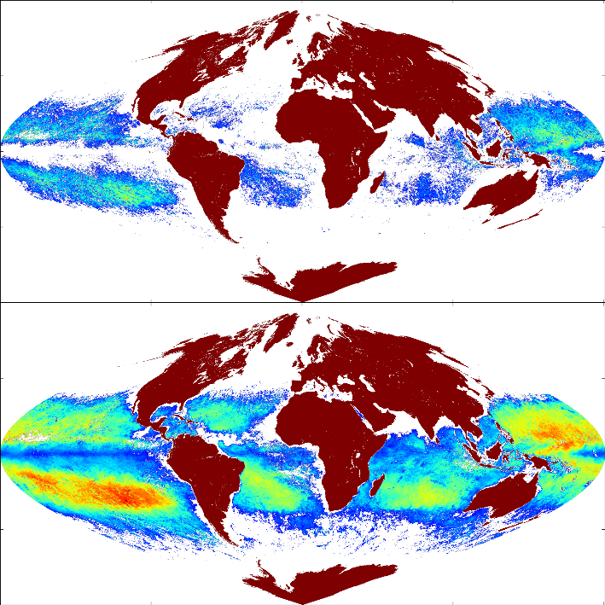
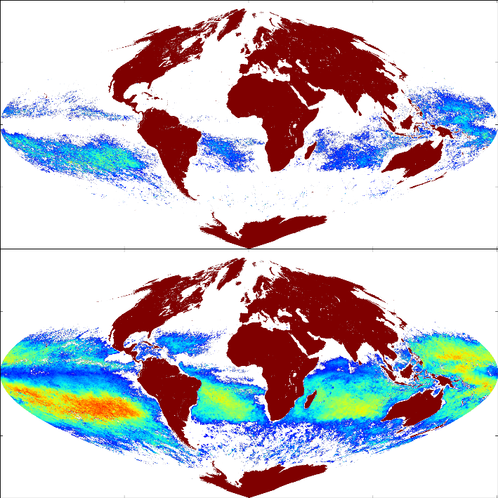
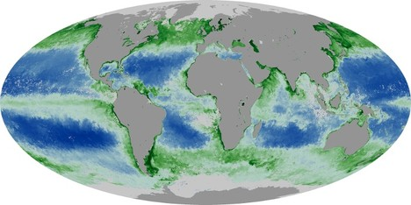
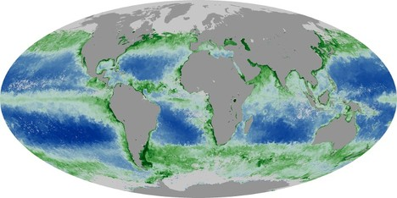
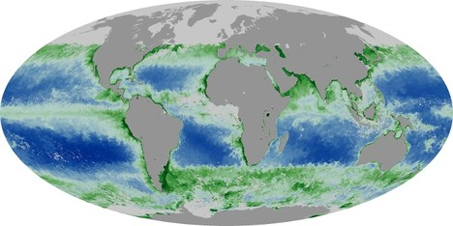
EPIC Monthly ρ^{w} vs MYD Chl
Oct. 2016
Nov. 2016
Dec. 2016
340
388

Slide 7

… in Detail
Jan. 2016
388

Slide 8
Comparison with OMI Climatology
(Kleipool et al., JGR, 2008)
Oct. 2016
2005-2009 av.
340
388

