Slide 1
DSCOVR EPIC & NISTAR Science Team Meeting,
GSFC, Oct 3 & 4, 2017
L1a update
Alexander Cede, Matt Kowalewski

Slide 2
L1a processing steps
→ This talk focuses on the dark correction, flat field and stray light
Processing step | Average impact | Affected pixels impact
Dark correction | Moderate | Extreme
Enhanced pixel detection | Small | Large
Read wave correction | Small | Small
Latency correction | Moderate | Significant
Non-linearity correction | Small | Small
Temperature correction | Small | Small
Conversion to count rates | Small | Small
Flat fielding | Significant | Large
Stray light correction | Significant | Large
Conversion to radiances* | Significant | Significant
* Not done by SciGlob

Slide 3
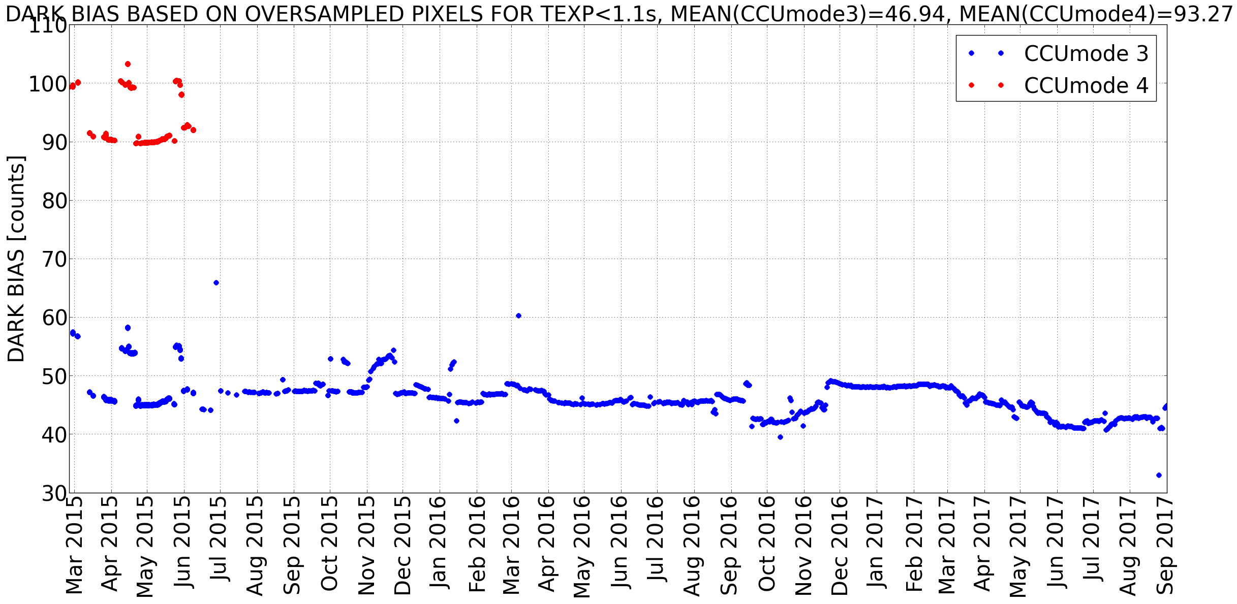
Dark bias
The dark bias is changing in an "unpredictable way". However this has no consequences in the dark correction, since the information of the oversampled pixels is included in the dark map.

Slide 4
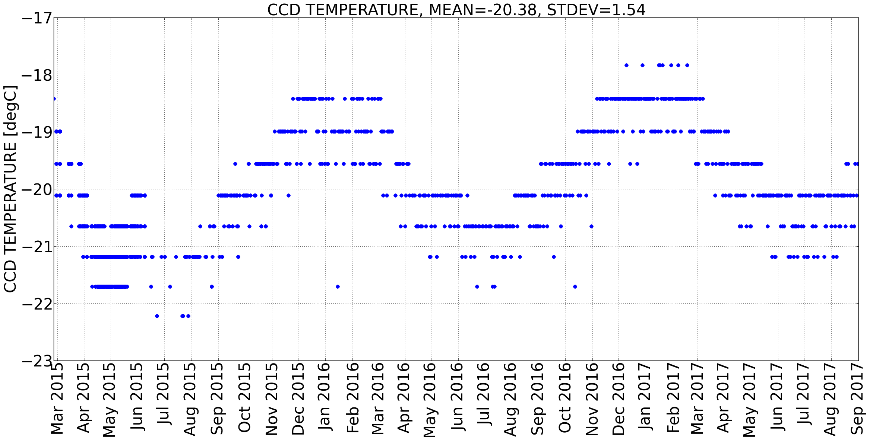
CCD-temperature
Based on the pre-launch dark analysis, the dark increases for ~1 count for an increase in the temperature of 1°C.
EPIC CCD-temperature shows a seasonal cycle with amplitude of ±2°C, which would correspond to a dark variation of ±2 counts
The CCD-temperature is drifting to warmer temperatures at a rate of +0.5°C per year, which would correspond to a dark count increase of 0.5 counts per year
The dark map should in principle be able to adjust for the varying temperature.
+0.5°C/y
±2°C

Slide 5
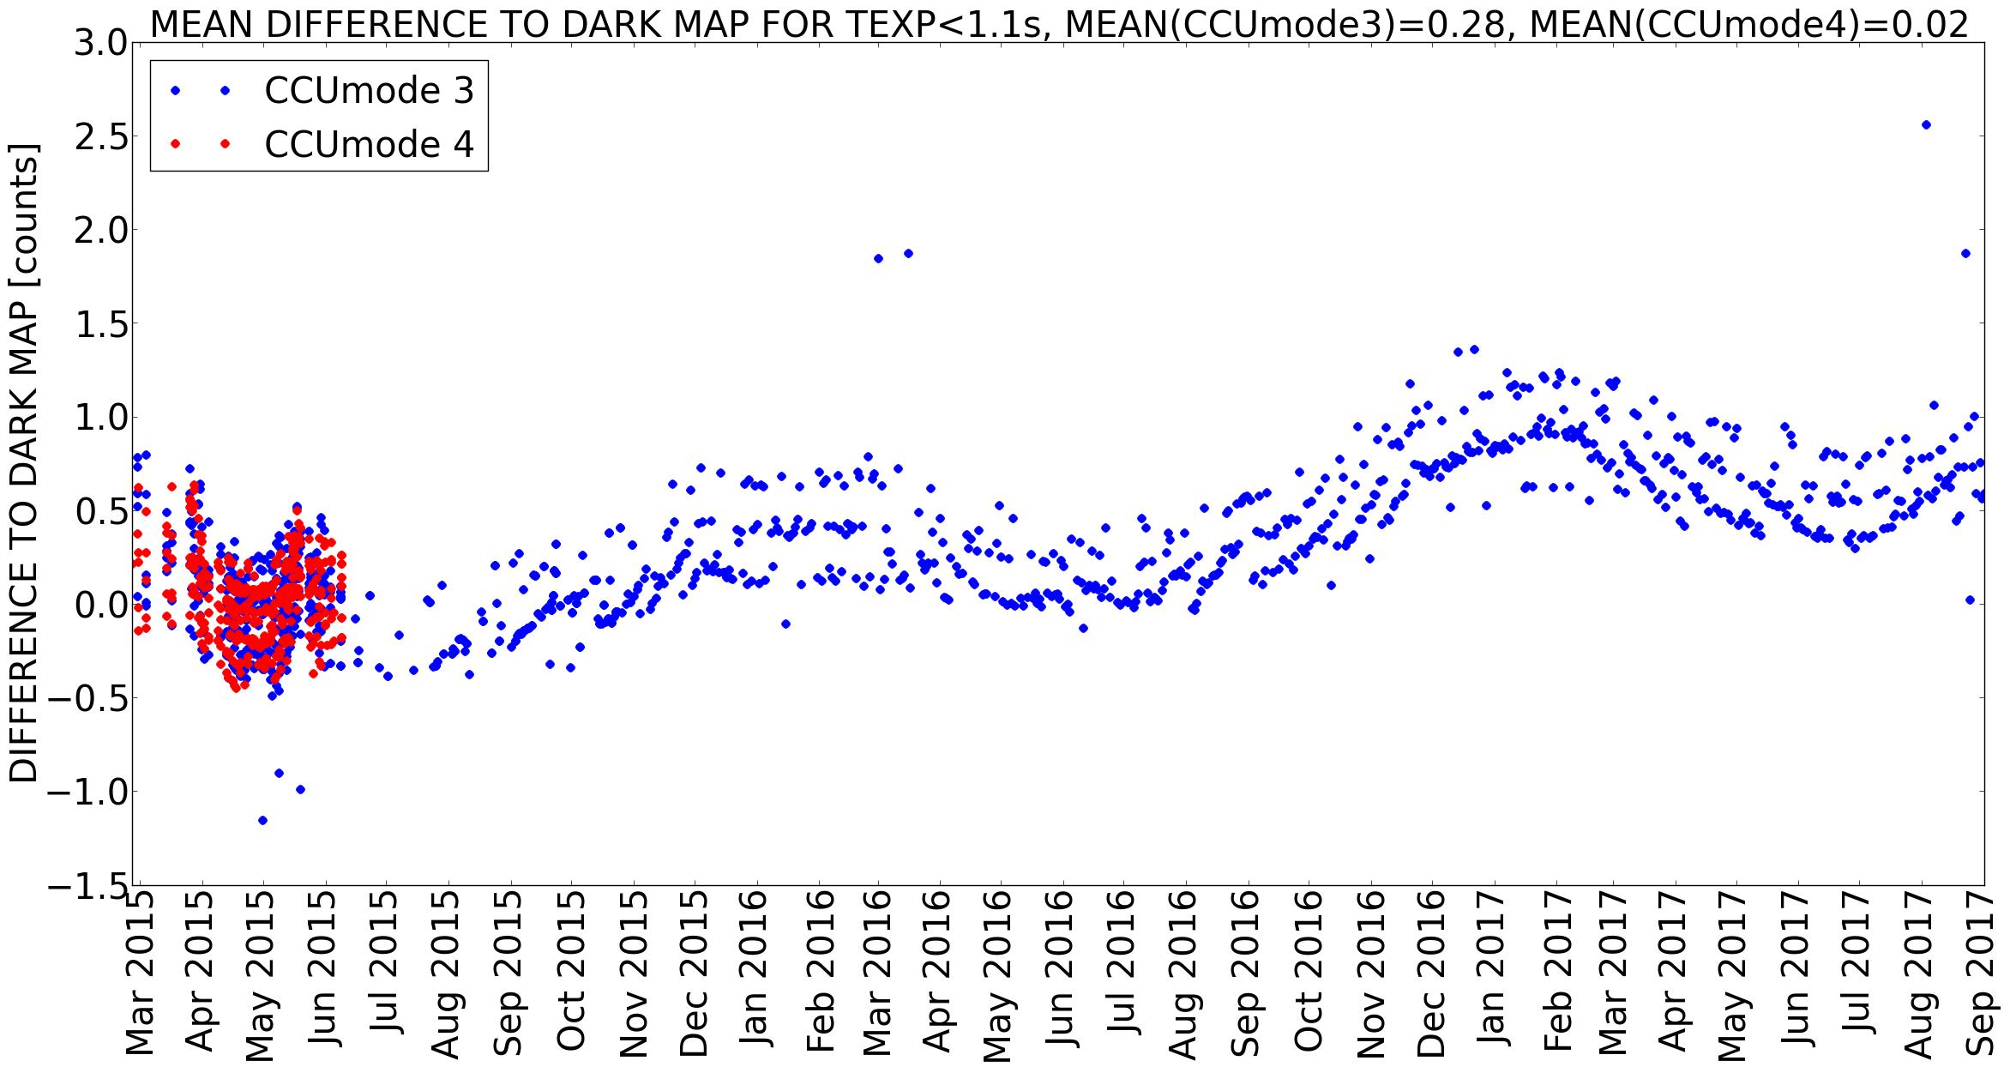
Dark count
The difference between the dark count predicted by the dark map and the weekly measured dark count shows a seasonal cycle with amplitude of ±0.25 counts and a drift of +0.25 counts per year.
This means the dark map is able to correct for 85% of the seasonal dark cycle (amplitude ±2 counts is reduced to ±0.25 counts), but does not reduce significantly the drift.
Hence the dark current increase is more than what would only be expected by temperature.
At the moment the true dark count is about 1 count higher than the dark map estimation, i.e. all images are about 1 count to high, i.e. too little dark is subtracted.
+0.5DN/y
±0.25 DN

Slide 6
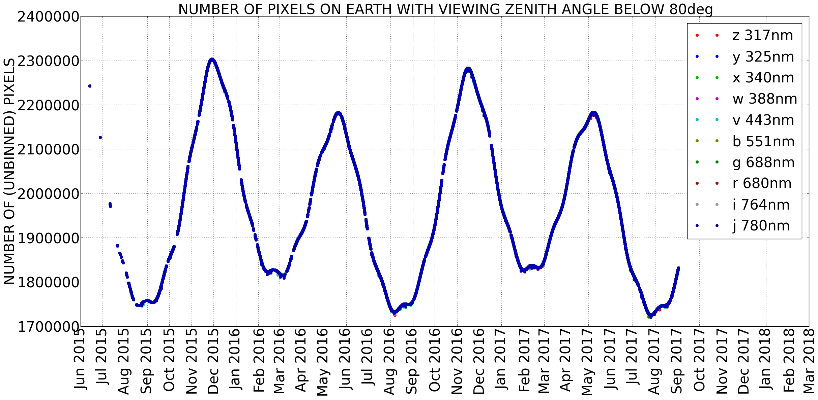
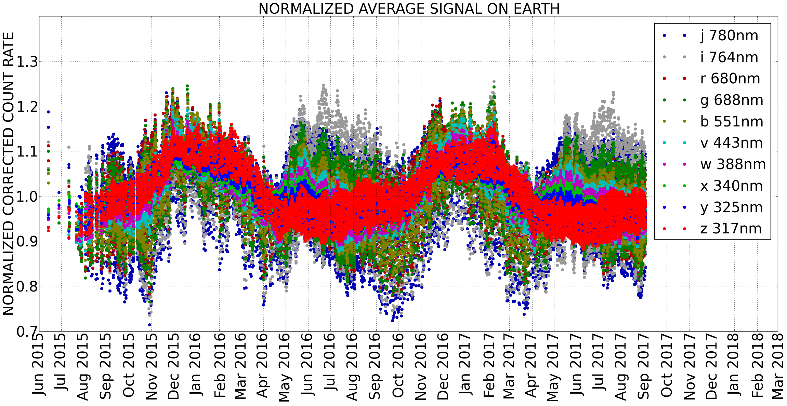
Normalized average signal
Averaged signal depends on which “face” of the Earth is seen by EPIC (it is NOT related to the EPIC-Earth distance!)

Slide 7
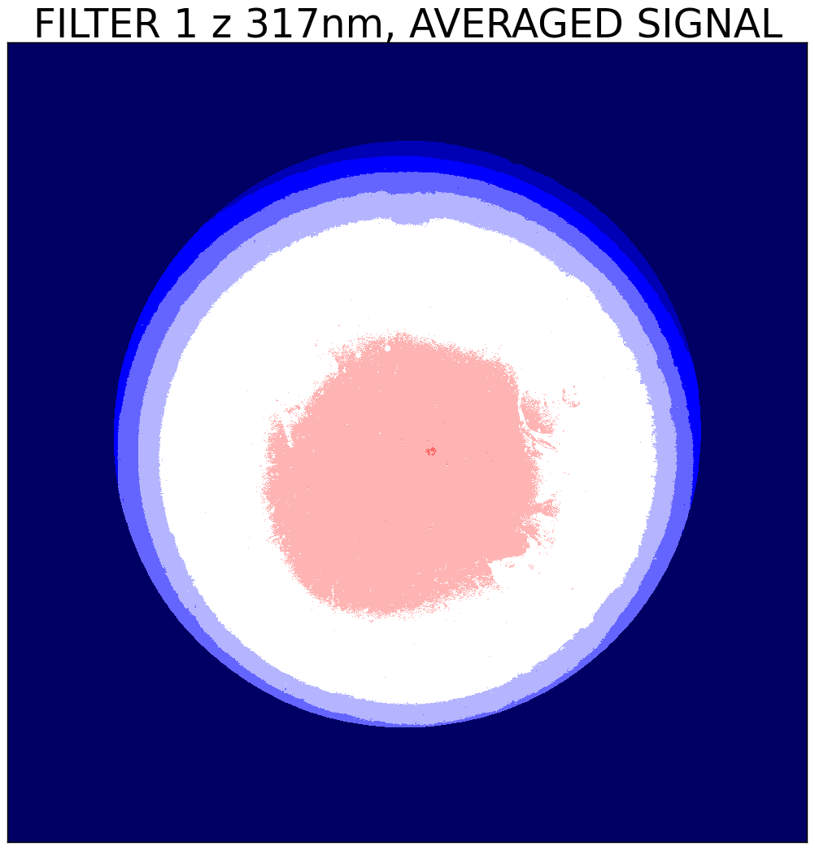
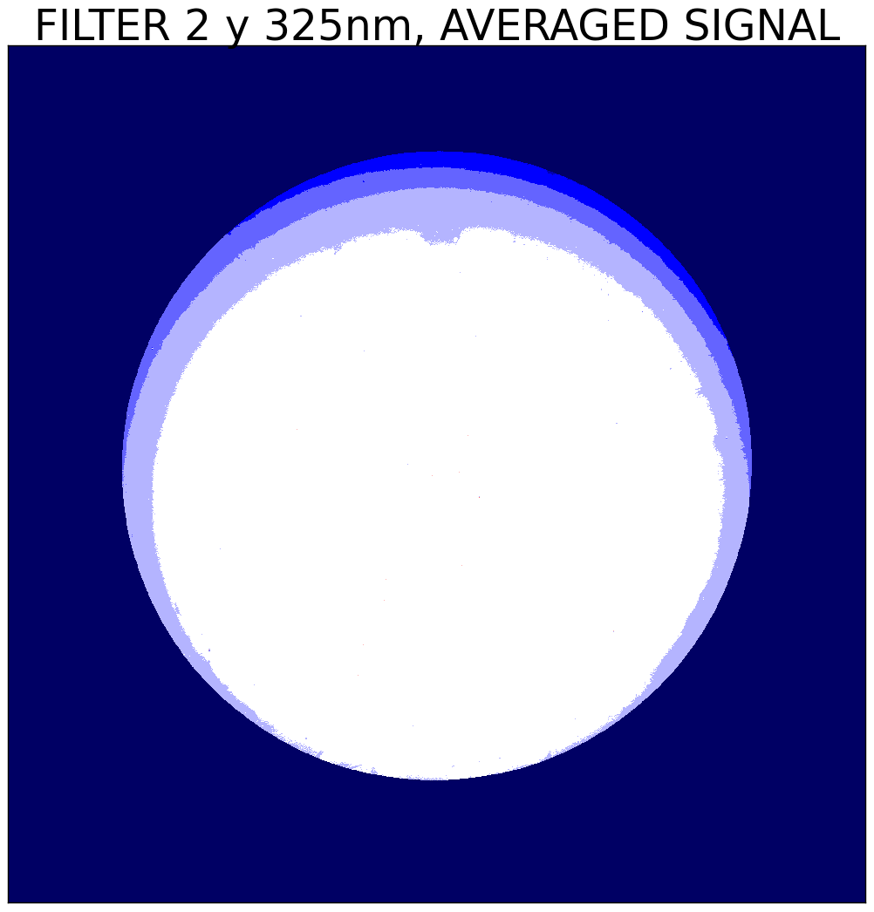
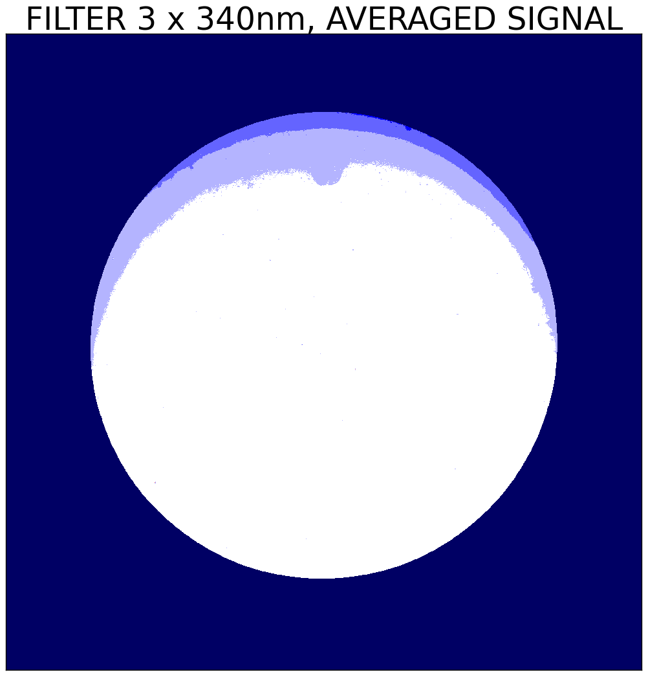
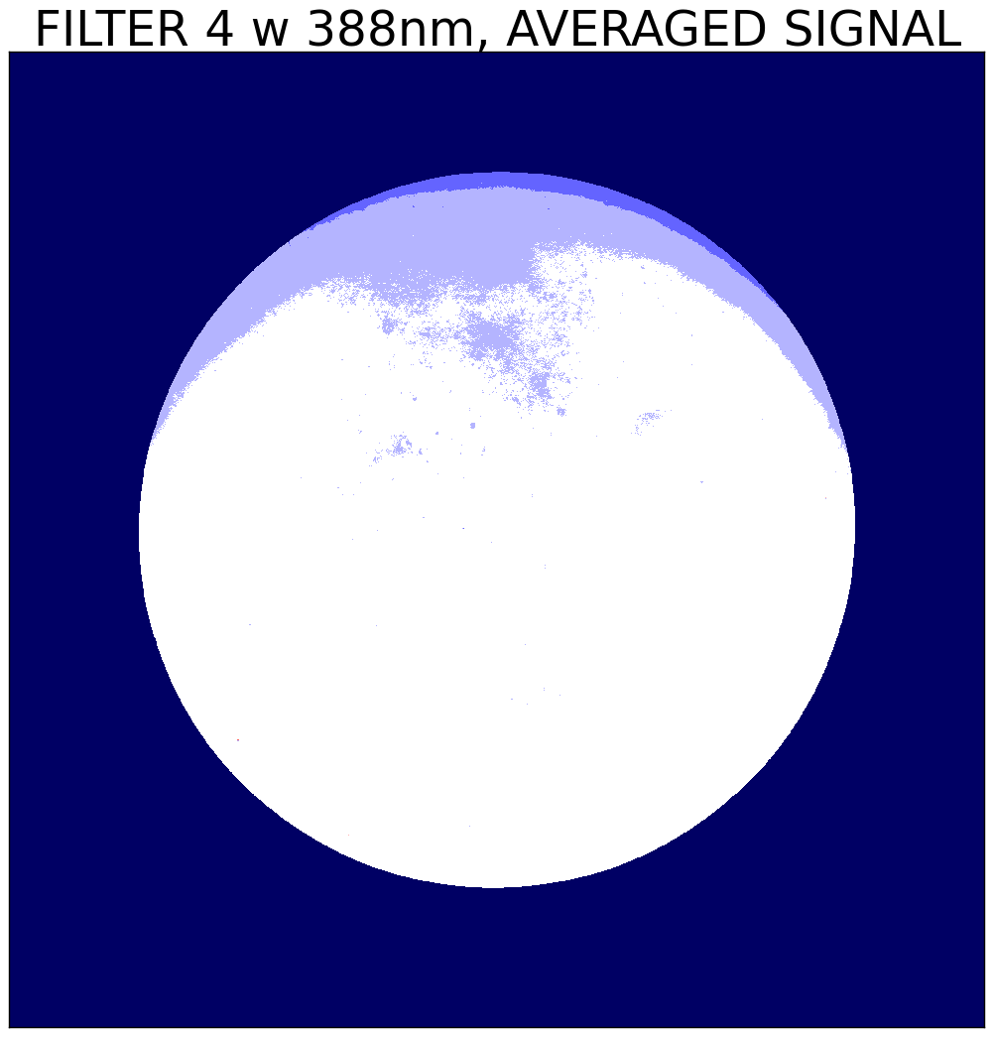
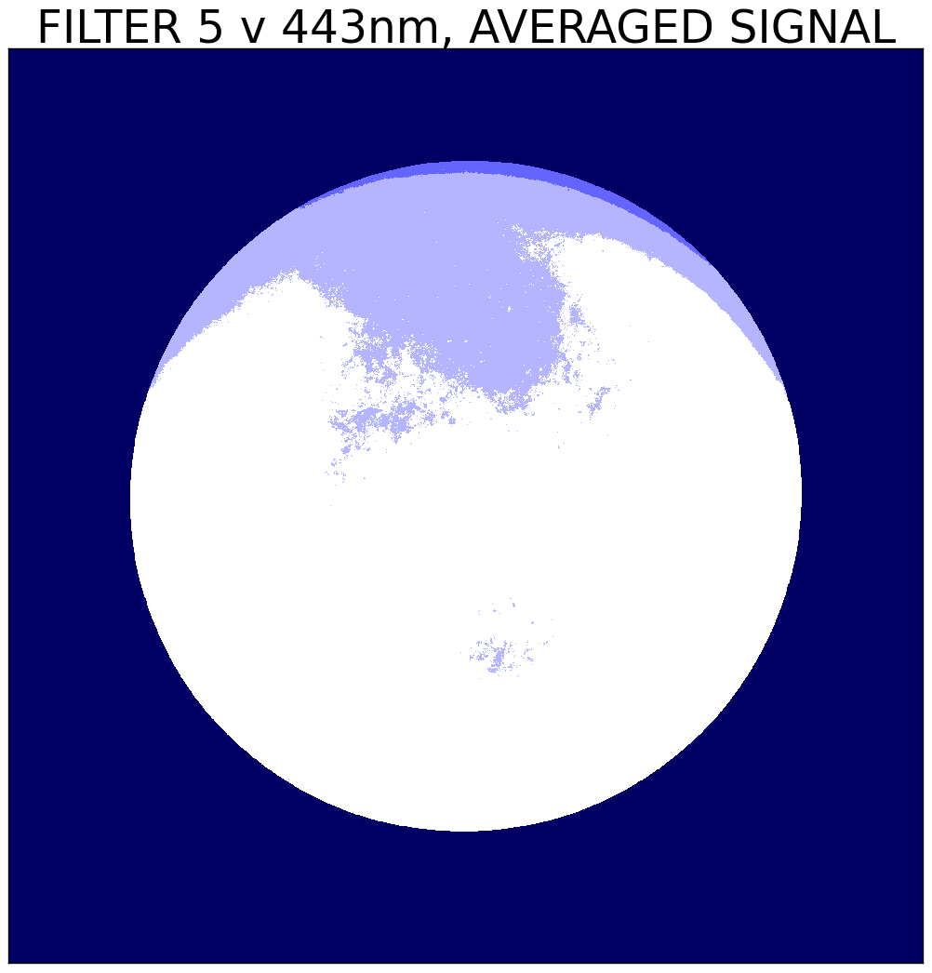
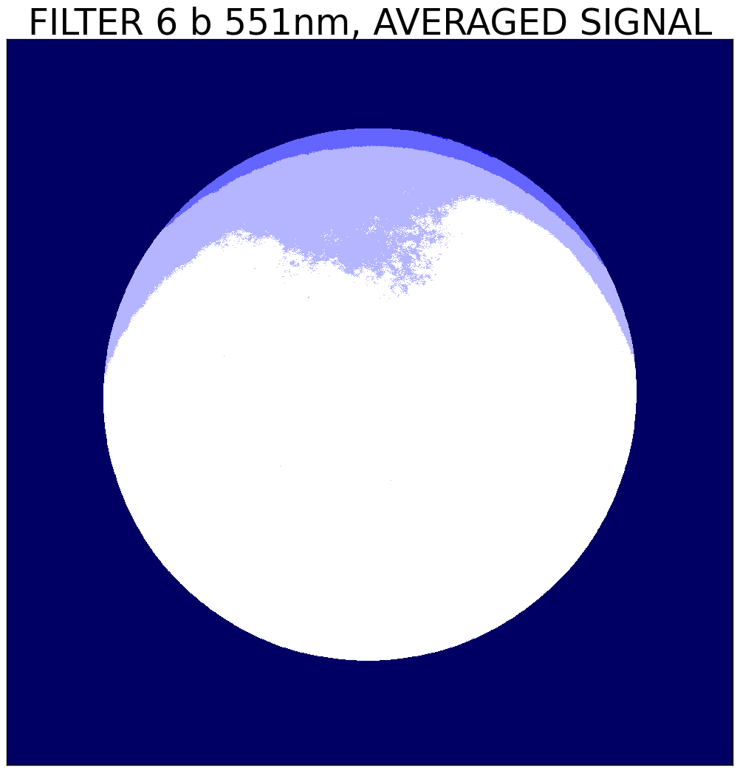
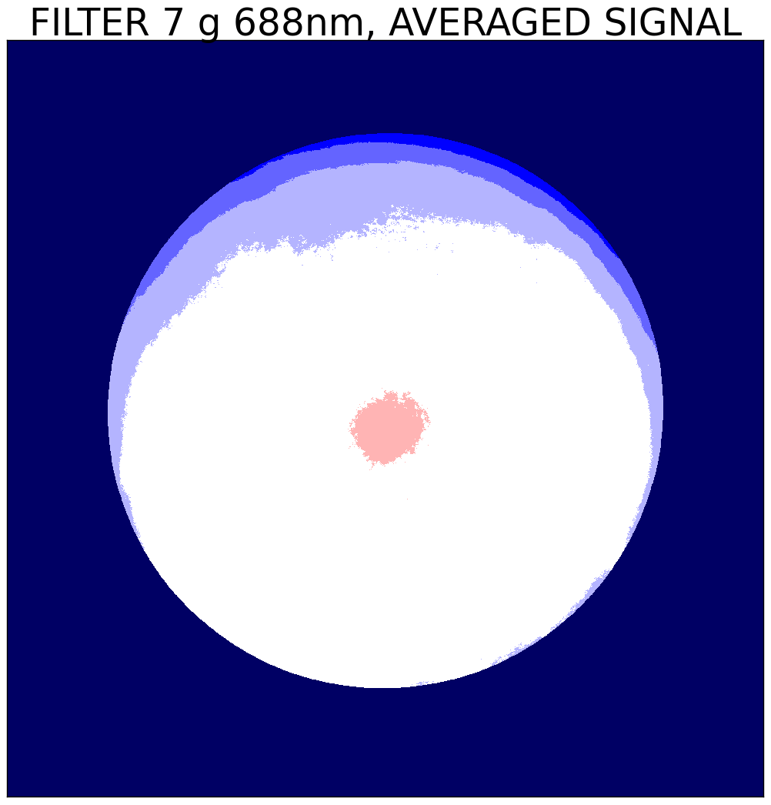
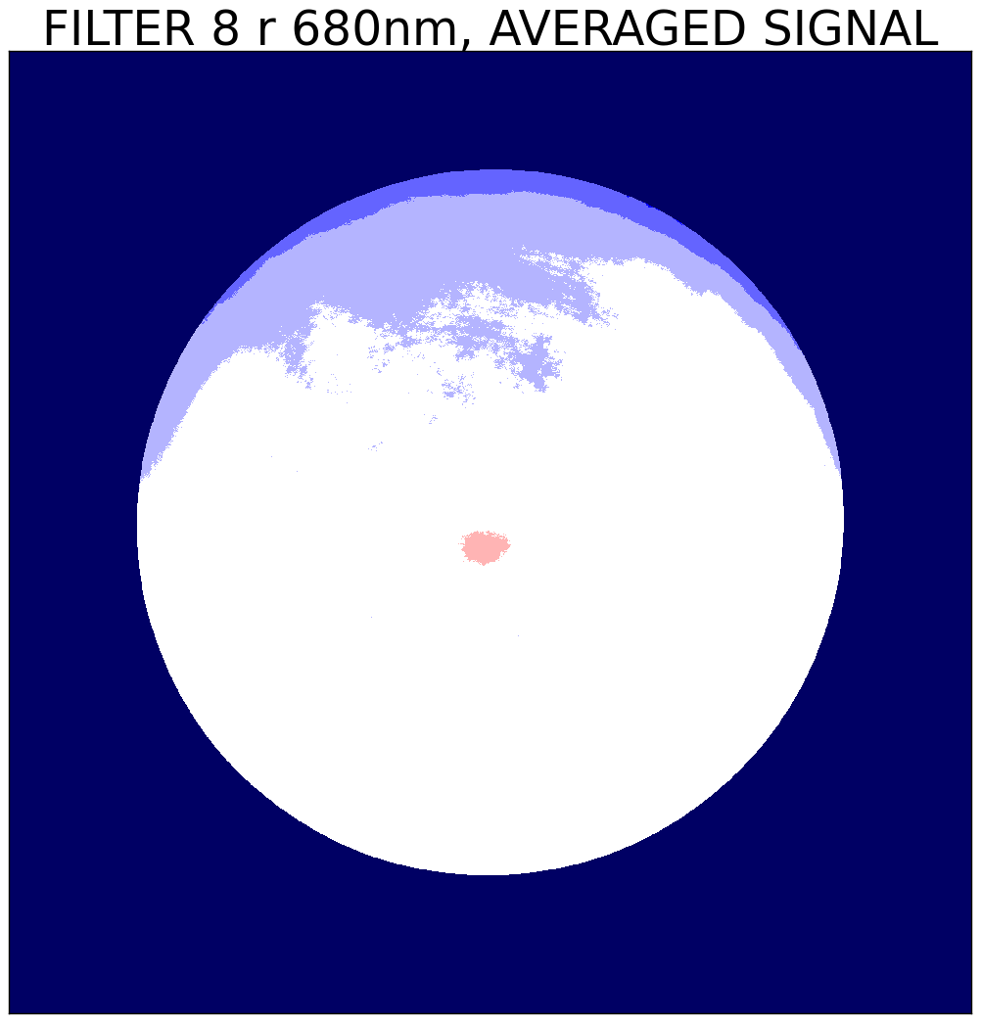
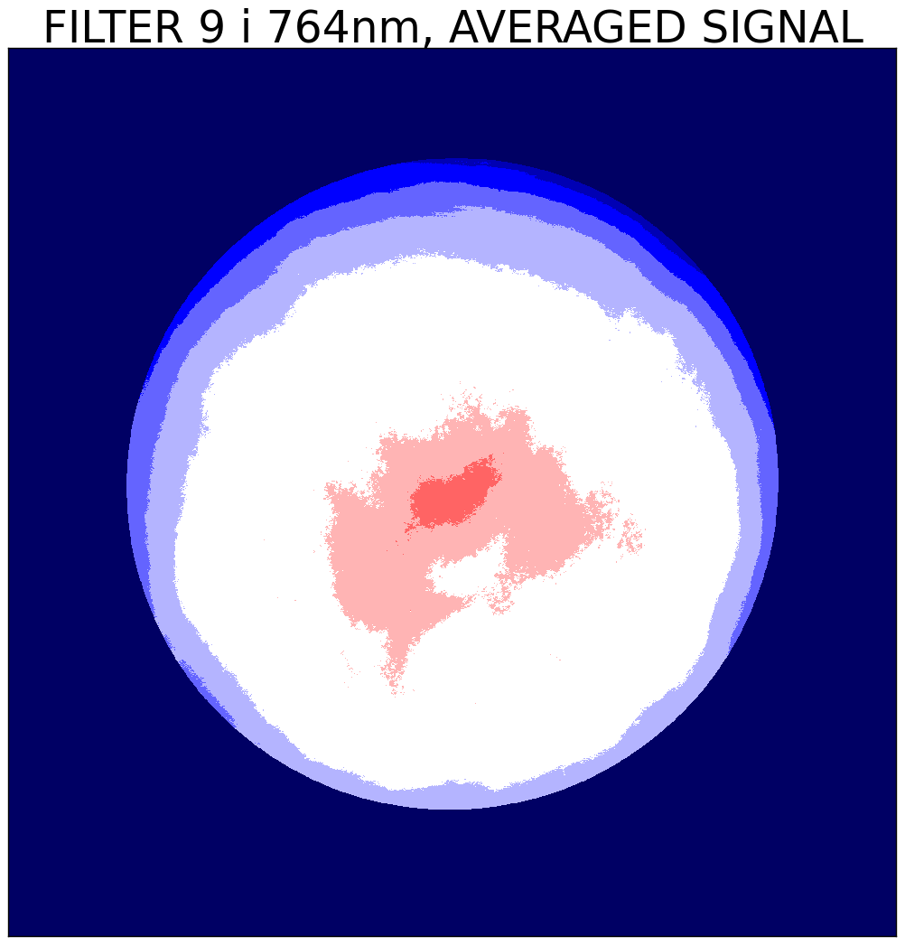
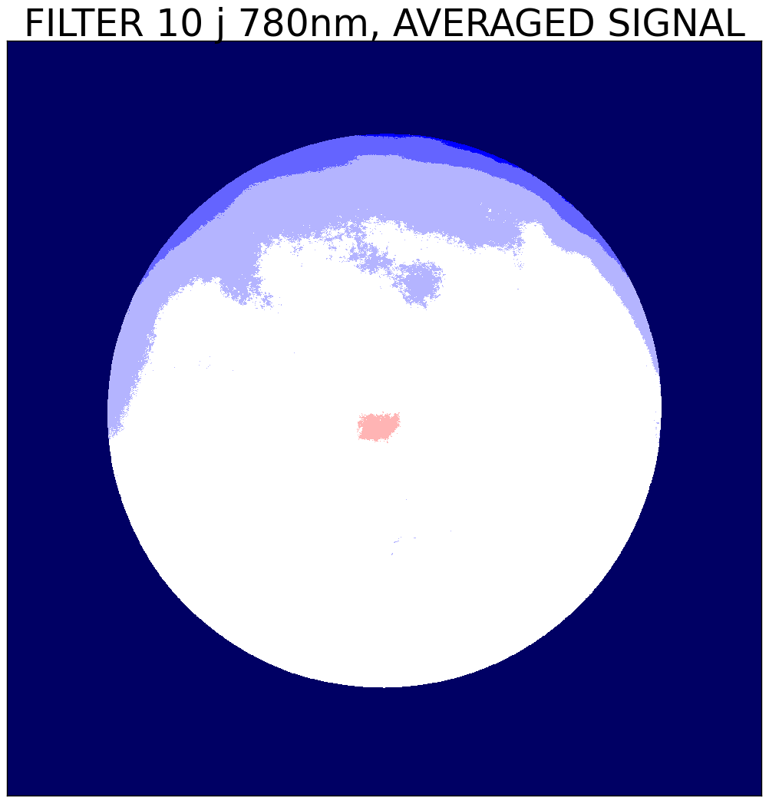
Averaged images coarse scale
Atmospheric absorption
Hot spot

Slide 8
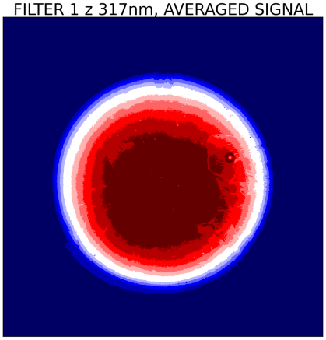
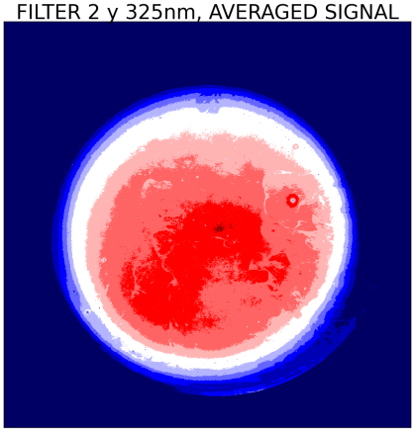
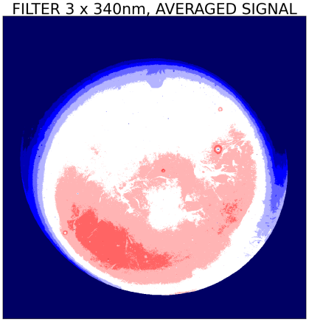
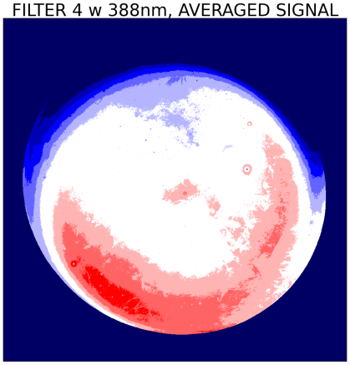
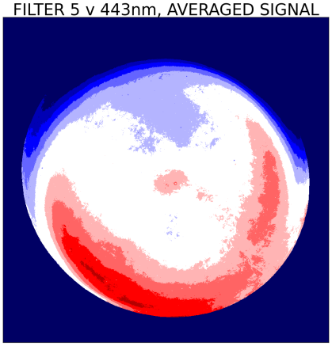
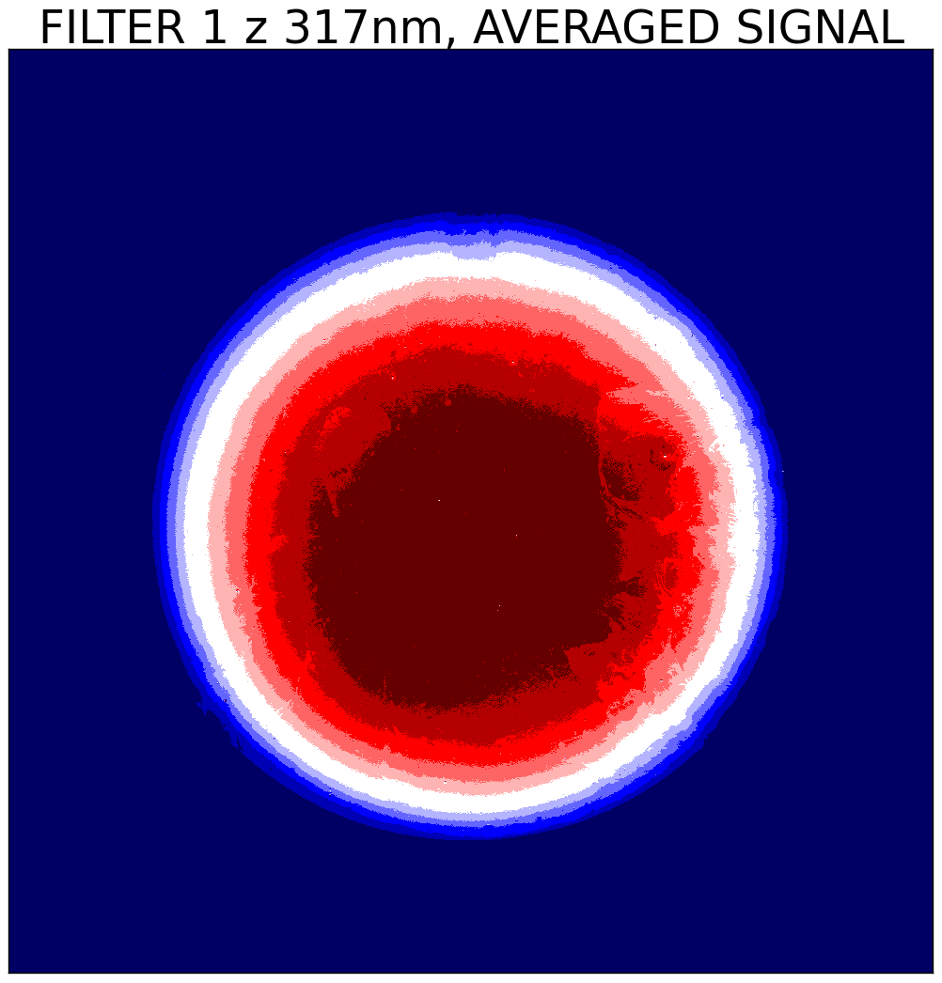
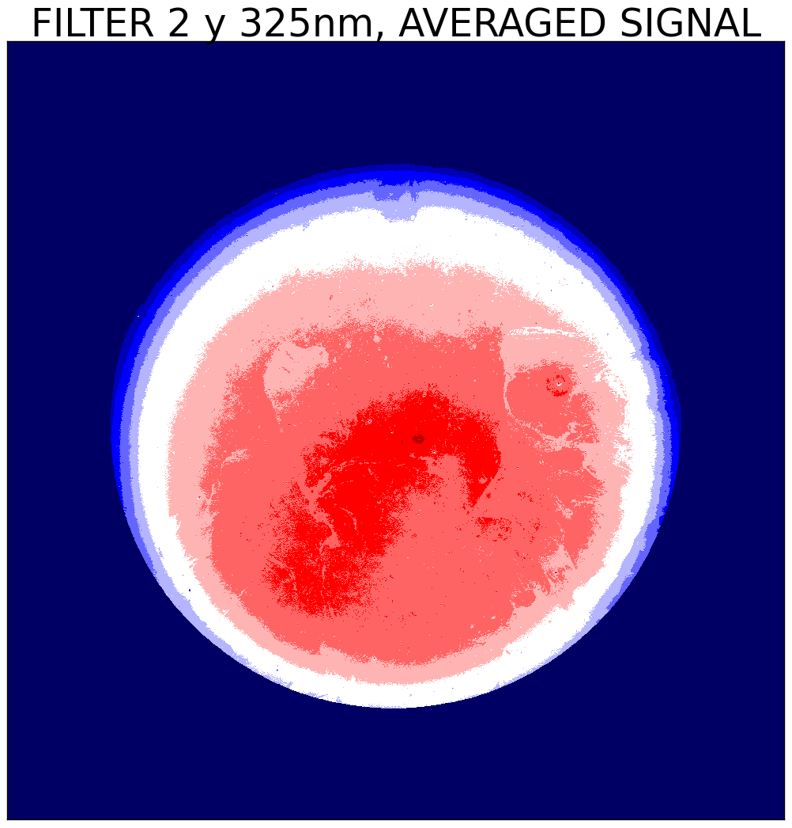
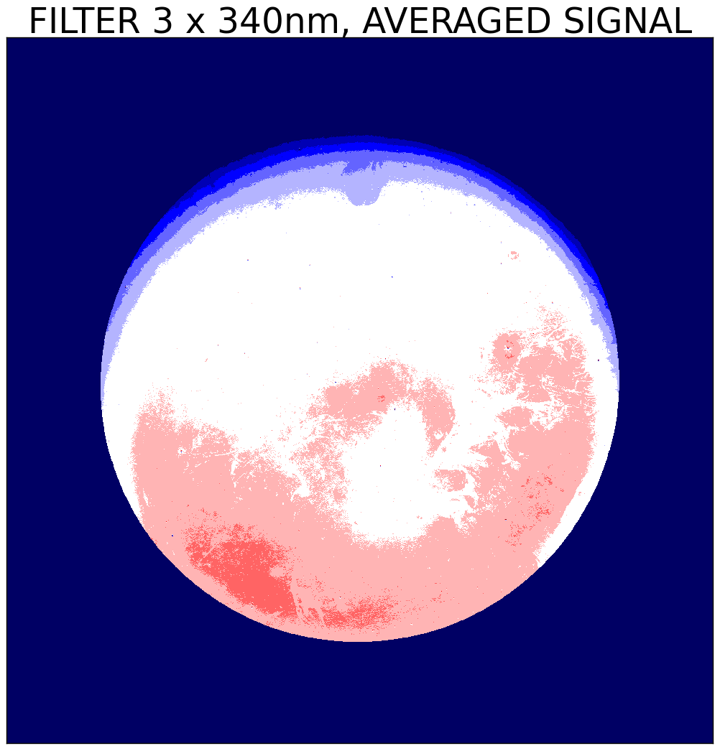
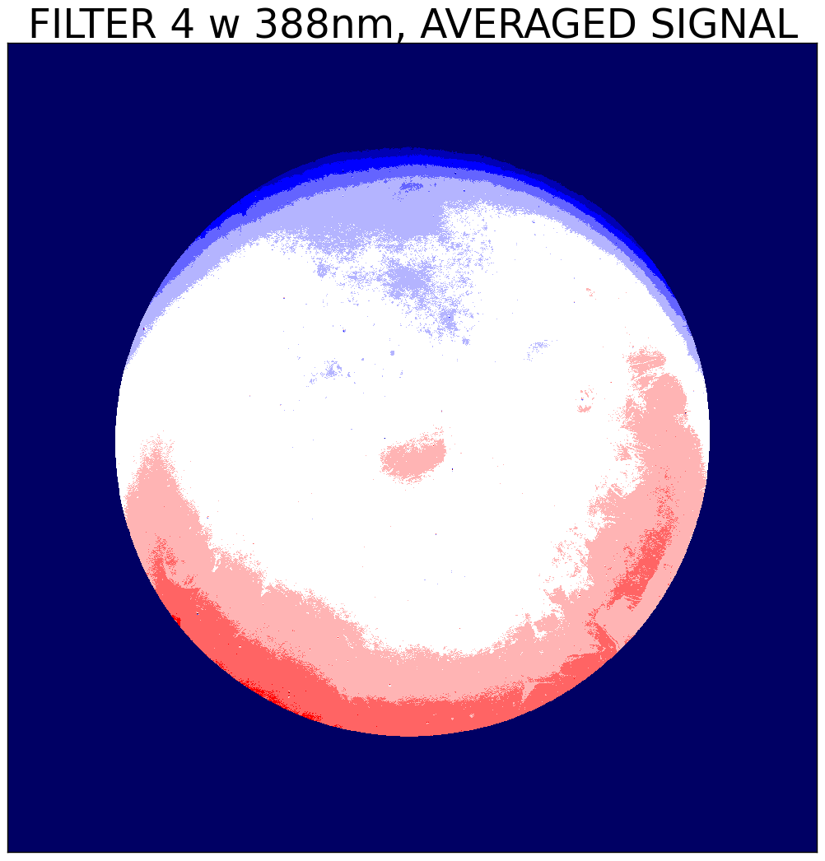
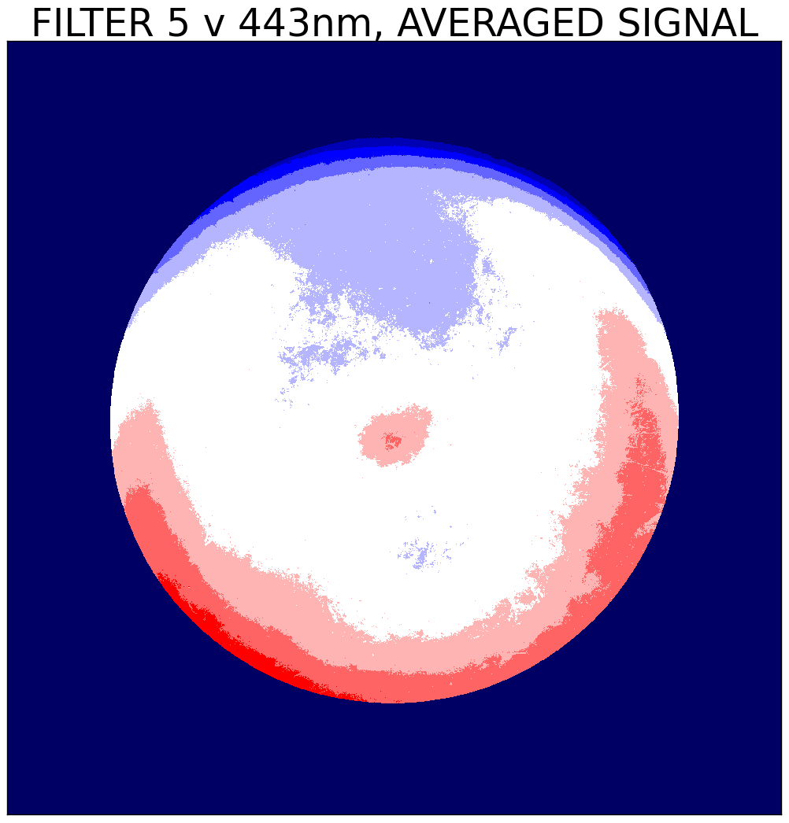
Averaged images V01 versus V02
“Smiley” (Antarctica positions) reduced due to longer time period
Extreme surface inhomogeneity points have improved, but are not totally gone
Top row: V01, Bottom row: V02, filters 1 to 5

Slide 9
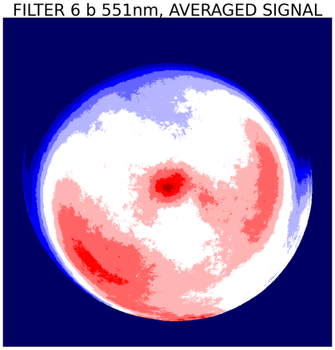
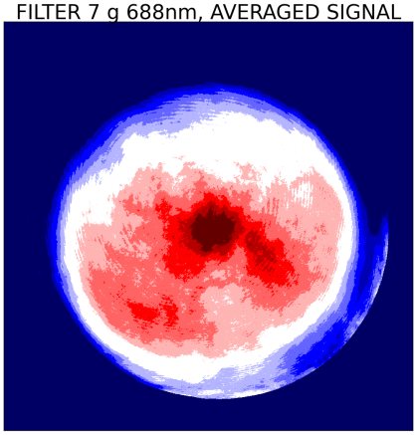
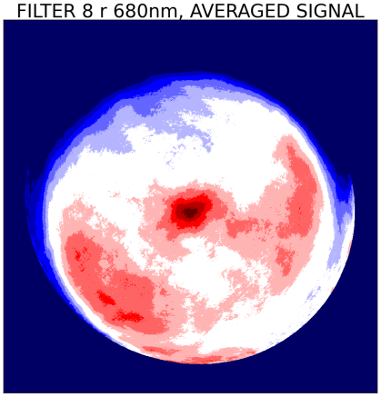
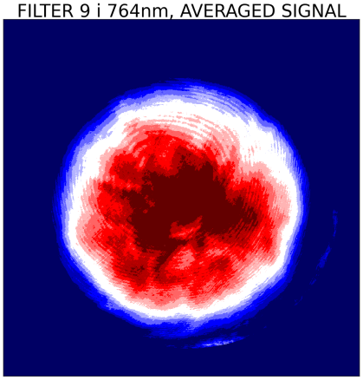
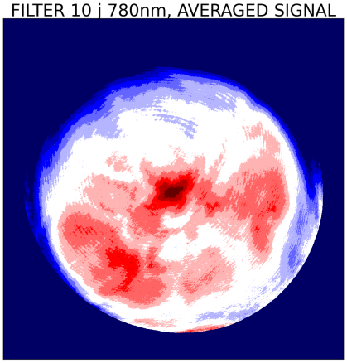
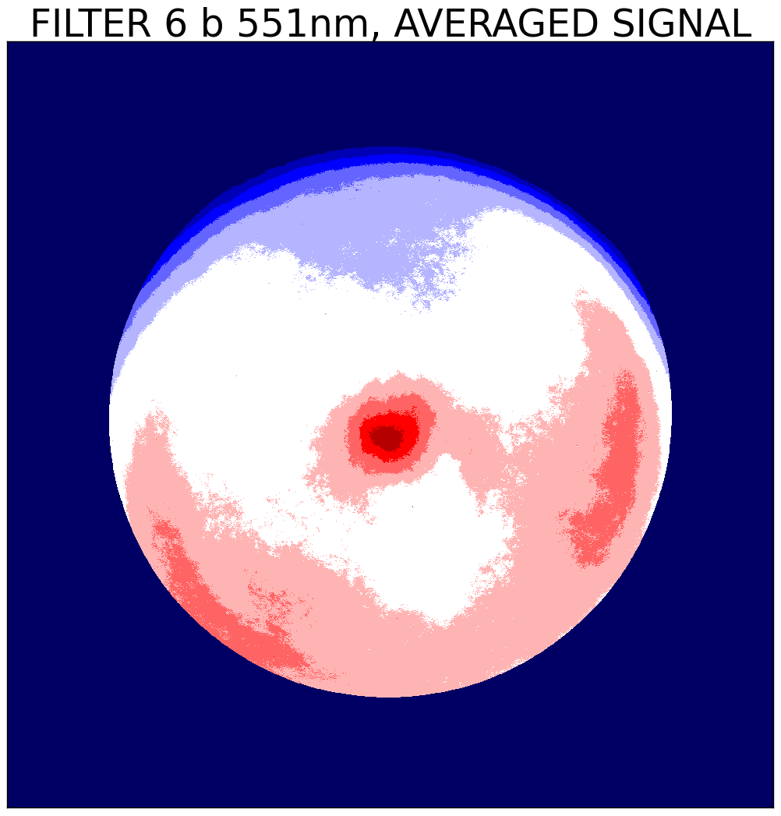
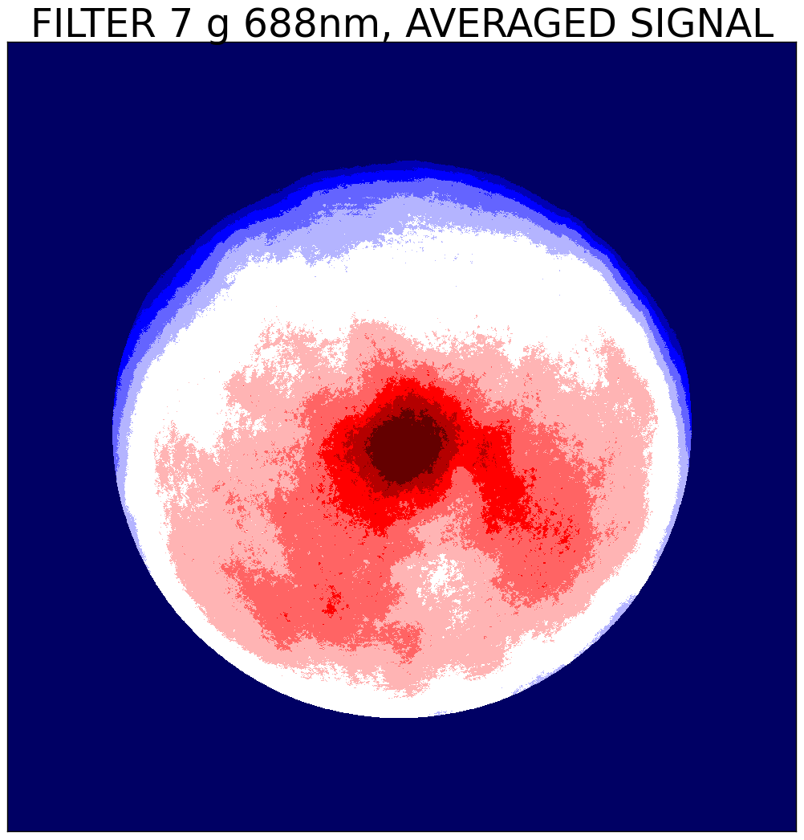
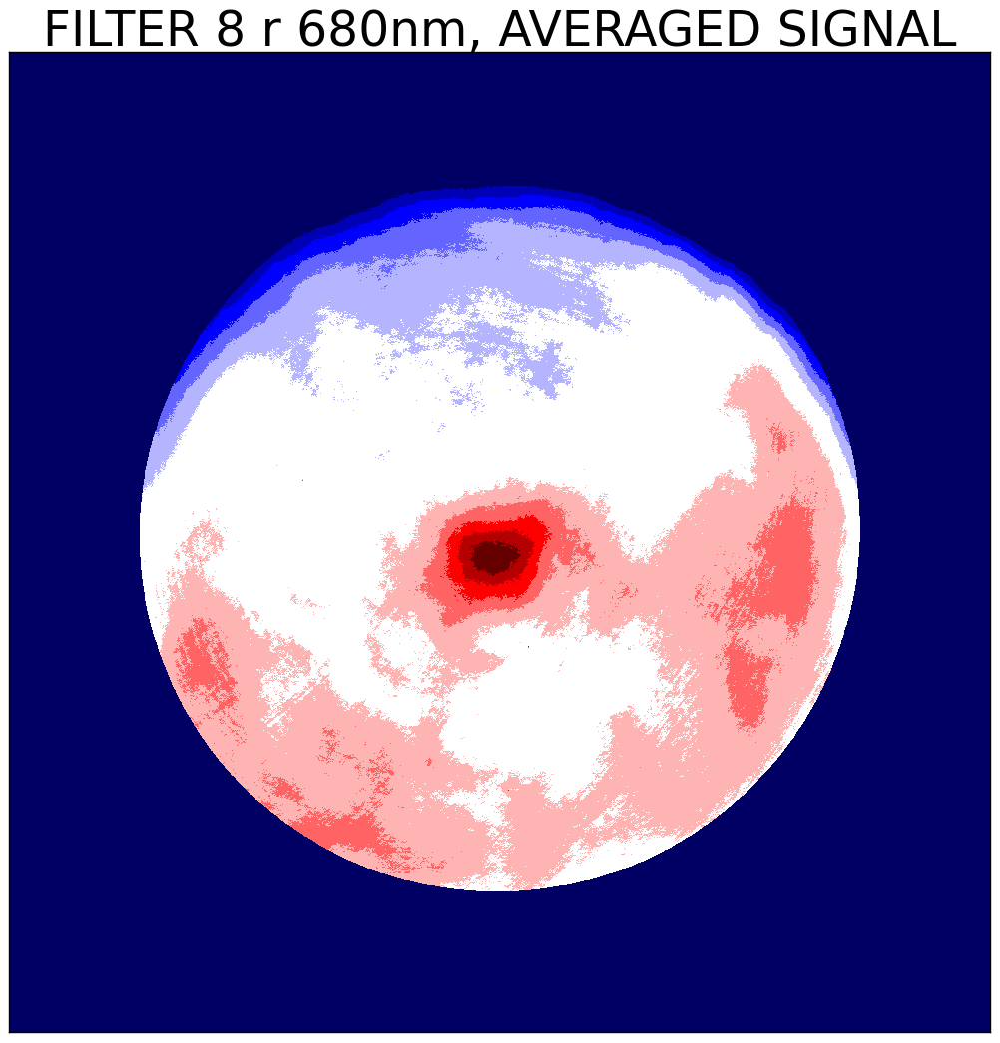
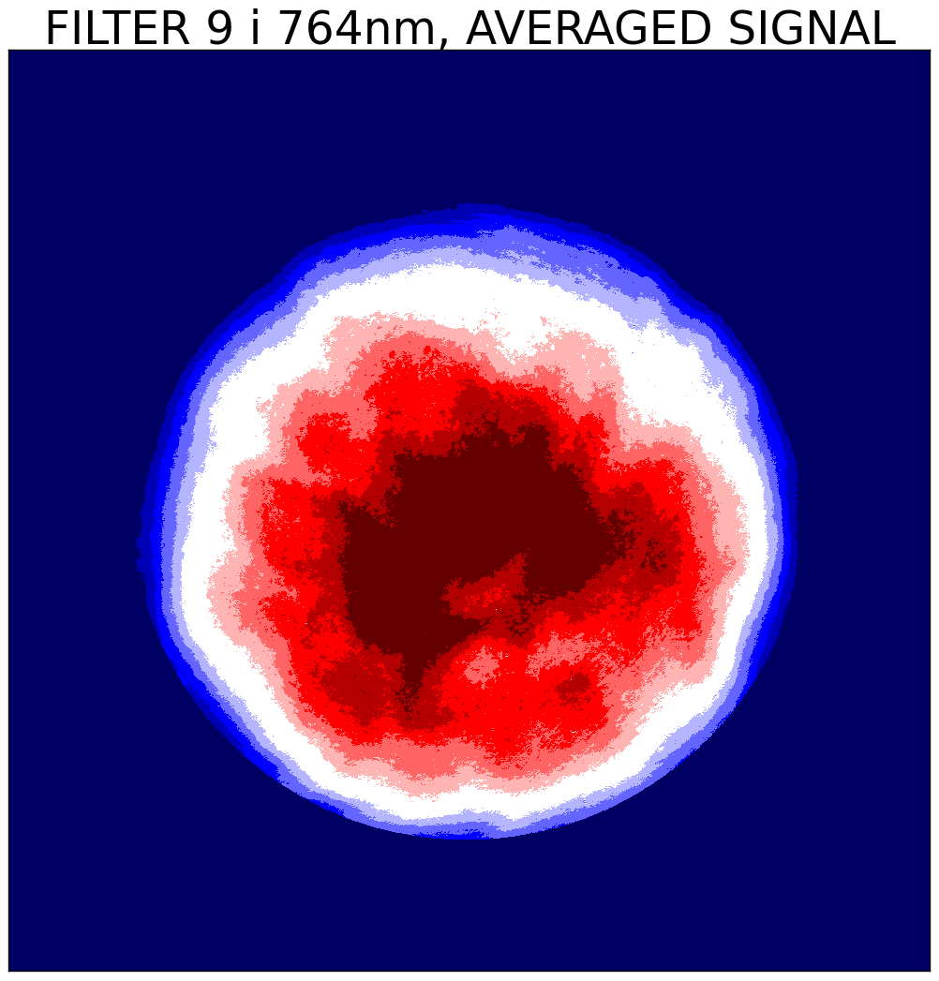
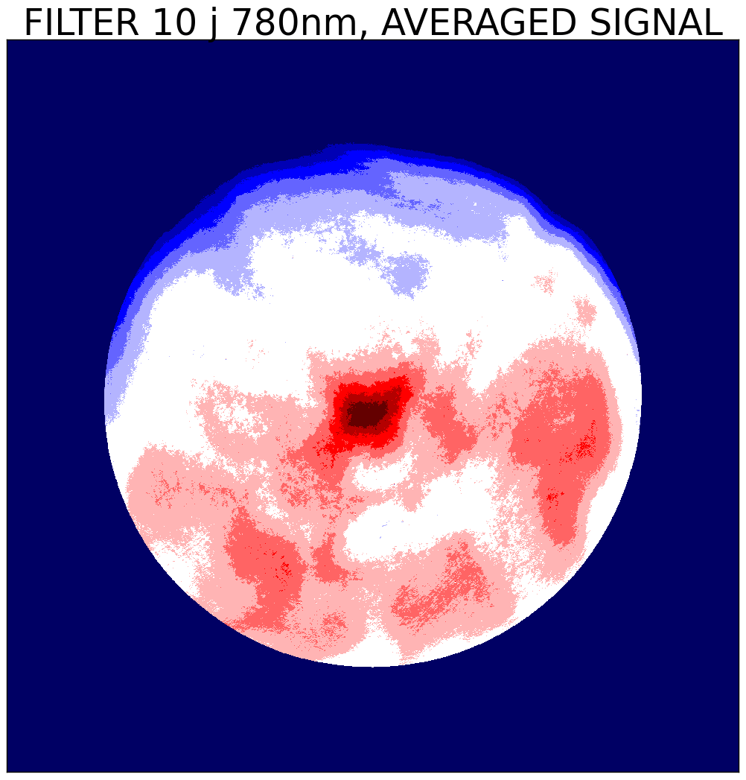
Averaged images V01 versus V02
“Smiley” (Antarctica positions) reduced due to longer time period
Etaloning features are reduced!
Top row: V01, Bottom row: V02, filters 6 to 10

Slide 10
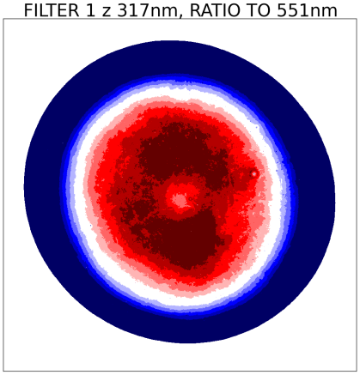
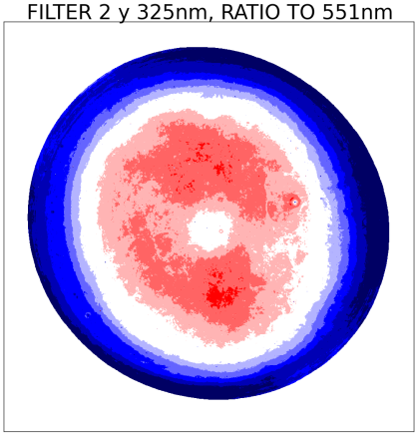
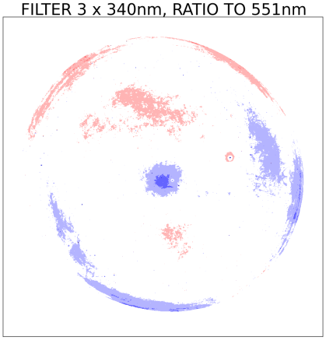
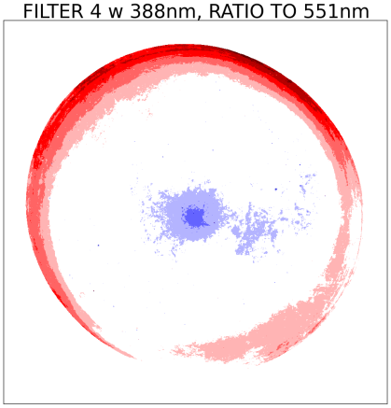
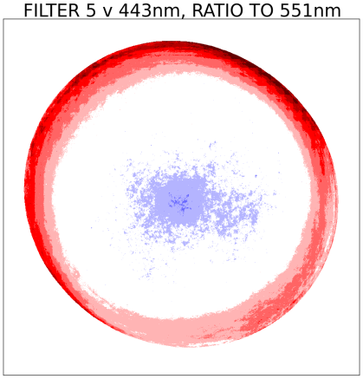
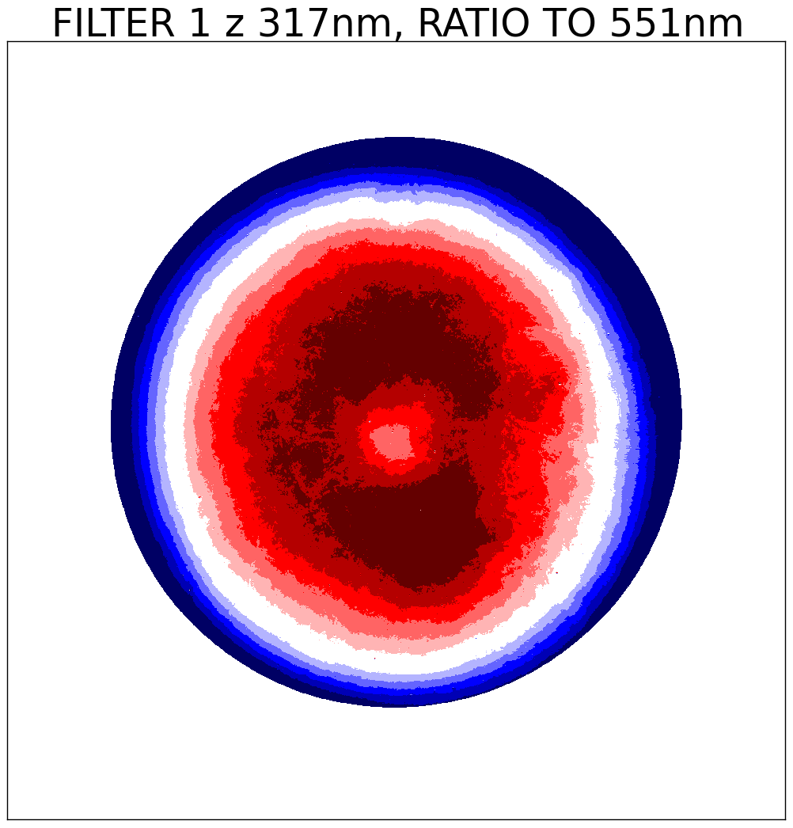
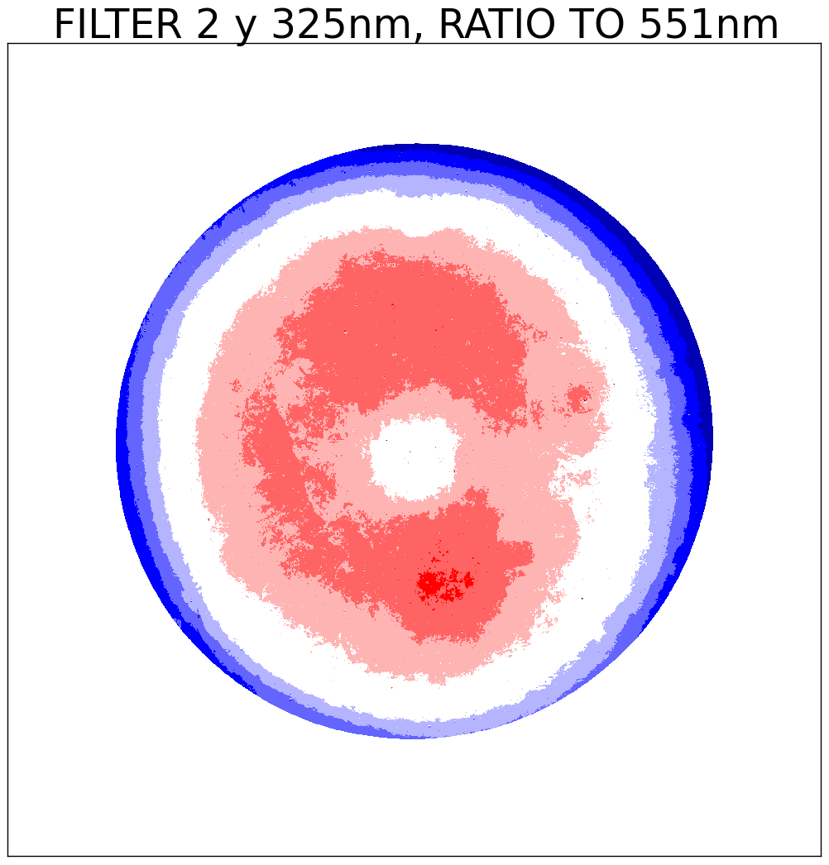
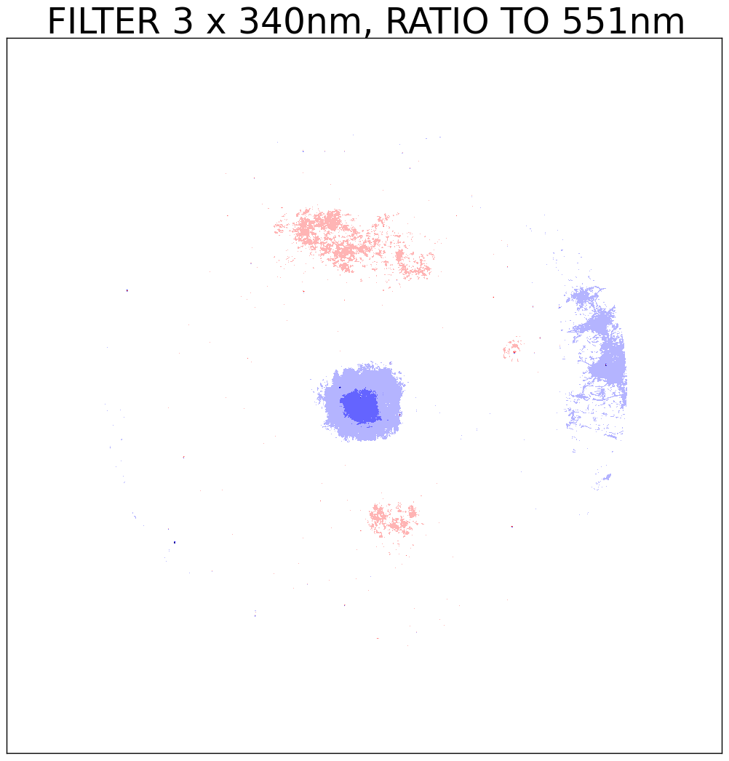
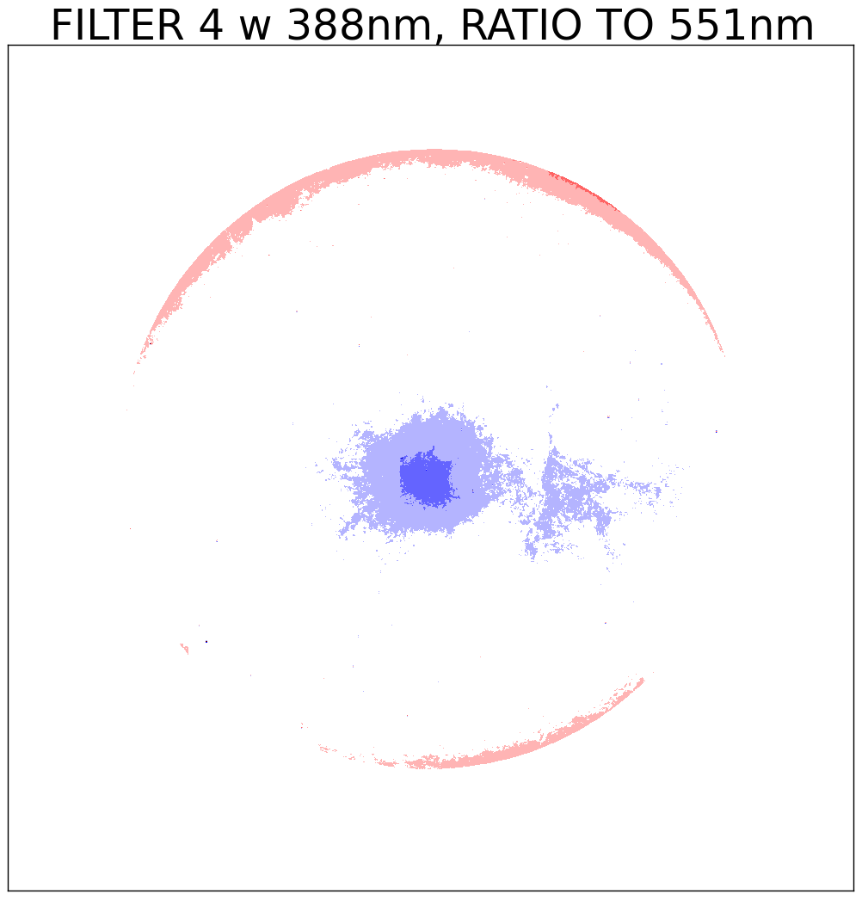
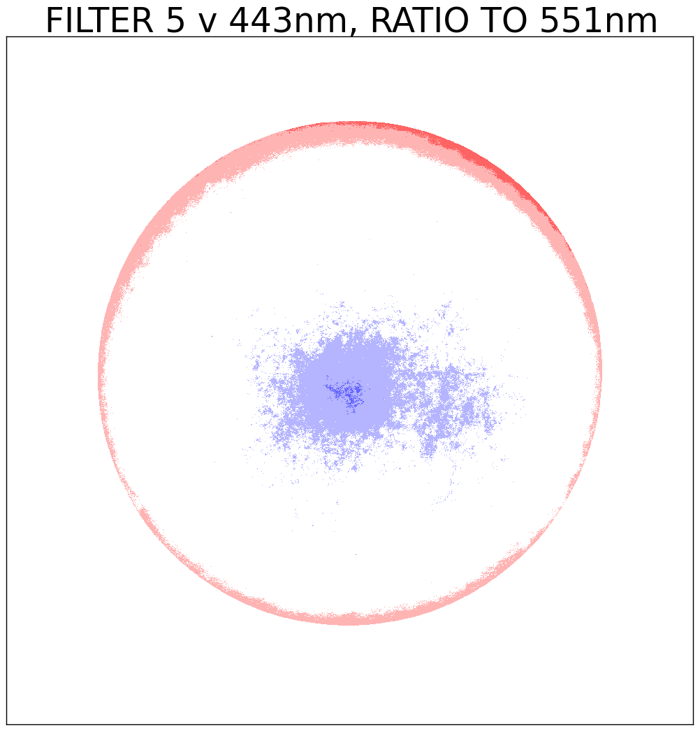
Ratio to 551nm
V02 versus V01
Ratio to filter 6 (551nm) removes “input effects” to a large extent
V02 has improved the correction of the surface inhomogeneity!
Top row: V01, Bottom row: V02, filters 1 to 5

Slide 11
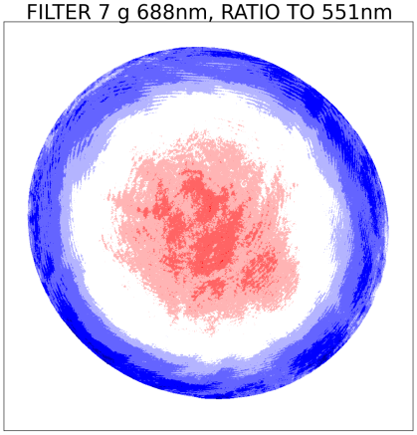
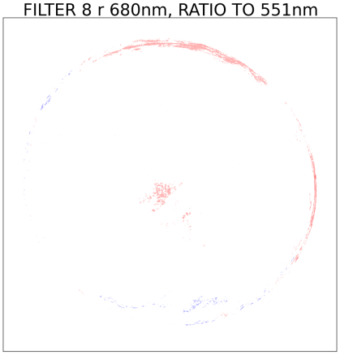
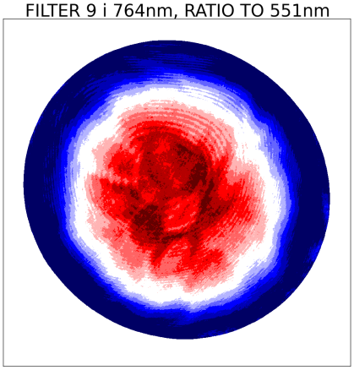
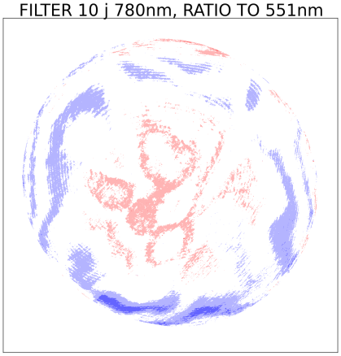
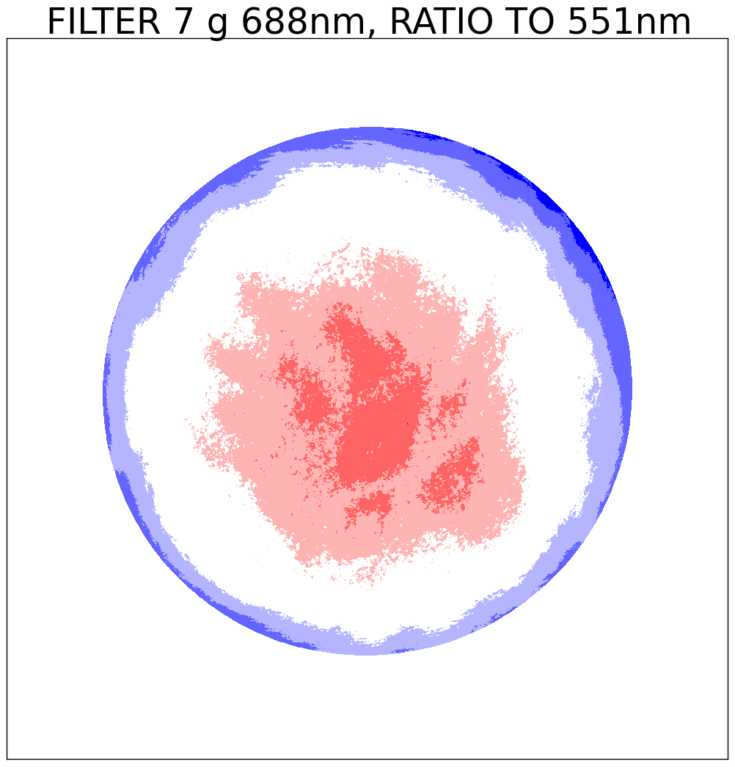
Ratio to 551nm
V02 versus V01
V02 has improved the correction of the etaloning!
Top row: V01, Bottom row: V02, filters 7 to 10

Slide 12
An ozone example
Value is 319DU (outside scale)
→ Flat field issue?

Slide 13
Stray light correction - VIS
It is hard to check the quality of stray light correction for the data “on Earth”.
One option is to check, whether EPIC data, multiplied with a single calibration value, agree with data from other satellites for both clear sky and cloudy data.
Based on Sasha’s analysis for filters 5, 6, 8 and 10 the stray light correction was an improvement.

Slide 14
Stray light correction - UV
Calibration constants used to convert disk averaged corrected count rates to reflectance.
Monotonicity improved by applying stray light correction.

Slide 15
Stray light correction
The signal outside the Earth is another quality indicator for the stray light correction. Ideally this signal would be zero.
Panels show the averaged signal for pixels outside the Earth, normalized to the total energy falling on the CCD.
Ideally all values should be within ±1e-9 (white color).
There are several places, where the signal is still too high (reddish) or too low (bluish).

Slide 16
Octant 1 feature
The feature in octant 1 (top of CCD) is only seen in filters 4, 6, 9 and 10 and is strongest in filter 9.
It has been there since the beginning of the measurements.
We don’t know where it comes from, but it is not caused by the stray light as we define it.

Slide 17
Residual etaloning
In this representation, residual systematic effects in the etaloning show up in data outside the Earth after stray light correction.

Slide 18
Stray light asymmetry
Most filters show higher values outside Earth in left-right direction than in up-down direction.
If this is caused by stray light, it would indicate that the stray light has an asymmetry, i.e. light is spread more in left-right direction than in up-down correction. We could not detect such asymmetry in the pre-launch calibration.

Slide 19
Filter 8 asymmetry
An exception is filter 8, where the stray light correction causes the data outside Earth to be below zero in the top-left part of the CCD, and above zero in the bottom right part.
That would indicate a “different kind” of asymmetry for this filter only.

Slide 20
Conclusions
DARK COUNT
The CCD temperature is increasing and leaving the range of temperatures, where it was calibrated pre-launch (-45 to -20°C).
The variation of the dark count caused by the seasonal temperature variation is captured by the dark map to within ¼ count.
The dark count increases at a rate of 0.5 counts per year, which cannot be explained solely by the increasing CCD-temperature. Therefore, at this moment (Sept 2017), this results in an under-correction of the data after dark correction by 1 count.
One could add a time-dependent parameter into the dark map to correct for this drift.

Slide 21
Conclusions
FLAT FIELD
The flat field analysis based on Earth images has been repeated for V02 data covering all images until 1 Sept 2017. With the longer time series the “mixing” of images has improved, e.g. the “Smiley” (Antarctica effect) is much smaller now.
It can be seen in the data that the 2 strongest flat field effects, the surface inhomogeneity and the etaloning, have both improved in V02 versus V01.
The flat field is definitely still not perfect. The only way we can think of a further improvement is:
Feedback from L2 products
Analyze whether this could be flat field
Remove the feature manually from flat field maps
This would be extremely work-intensive and is only possible, if the “pixeltype” map or an pixel index map is also included in L1b and L2 products.

Slide 22
Conclusions
STRAY LIGHT
It is hard to check the quality of stray light correction for the data “on Earth”. Based on Sasha’s analysis for filters 5, 6, 8 and 10 and the lunar reflectivity for the UV channels the stray light correction was an improvement. For further evaluation we probably need feedback from L2 scientists.
The analysis of the region outside the Earth shows, that the data are not in the ideal range around zero everywhere. In most cases we do not attribute this to the stray light.
Most filters show higher values outside Earth in left-right direction than in up-down direction, after the stray light correction has been applied. If this is caused by stray light, it would indicate that the stray light has an asymmetry, i.e. light is spread more in left-right direction than in up-down correction. We could not detect such asymmetry in the pre-launch calibration, but it is in theory possible to include such asymmetry in the stray light correction.

Slide 23
Conclusions
OVERALL L1a CONCLUSIONS
The most significant L1a corrections, dark, flat field and stray light correction, are not “perfect”. Our future focus will be to:
… continue the dark trending analysis (detector health, enhanced pixels)
… continue the stray light trending analysis for pixels outside the Earth
… improve the flat field correction through L2 product evaluation: This requires the propagation of an index matrix into L1b and L2!
Knowing, which pixel this is on the CCD would
permit investigating whether it is caused
by insufficient flat field correction!

