Slide 1

EARTH SYSTEM DATA RECORDS OF GLOBAL VEGETATION INDEX, FRACTION OF ABSORBED PAR, LEAF AREA AND ITS SUNLIT FRACTION FROM DSCOVR EPIC DATA
  Yuri Knyazikhin¹, Wanjuan Song^{1,2}, Matti Mõttus⁴, Miina Rautiainen⁵ and Pauline Stenberg⁴
¹Boston University, ²Beijing Normal University, ³University of Helsinki, ⁴Aalto University (Finland), ⁵NASA GSFC
jknjazi@bu.edu
  DSCOVR Earth Science Algorithms Meeting
  GSFC, 03-04 October,2017

Slide 2
product description
NAME: DSCOVR_EPIC_L2_VESDR_00_20160824002712_02.h5; SIZE ~313 MB
Parameter | Units | Resolution |  | Accuracy | Precision
 |  | temporal | Spatial
NDVI Diurnal Course | none | hourly | 10 km | 0.05 NDVI units | 0.02
FPAR Diurnal Course | percent | hourly | 10 km | min{0.1FPAR, 10%} | 0.2
LAI | m²_{plant}/m²_{ground} | daily | 10 km | min{0.5LAI, 10%} | 0.2
DLAI (precision) | none | hourly | 10 km | N/A | N/A
Sunlit LAI Diurnal Course | m²_{sunlit}/m²_{plant} | hourly | 10 km | 0.05 SLAI units | 0.02
QA | class flag | hourly | 10 km | N/A | N/A
EPIC NDVI: the difference between Bidirectional Reflectance Factor (BRF) at 779.5 nm and 680 nm normalized by their sum.
EPIC FPAR: fraction of photosynthetically active radiation (400 – 700nm) absorbed by vegetation.
EPIC LAI: total hemi-surface leaf area per unit ground area.
EPIC DLAI: precision of LAI
EPIC SLAI: leaf area illuminated by the direct solar beam per unit ground area
EPIC vegetation QA: Quality Assurance variables to characterize the quality of DSCOVR EPIC ESDR.

Slide 3
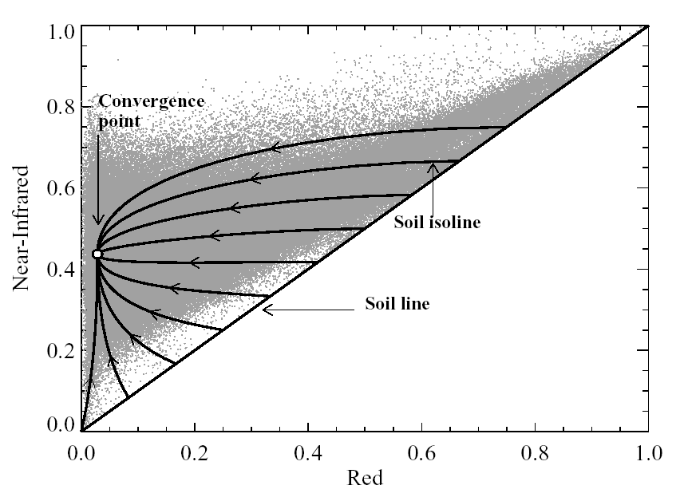
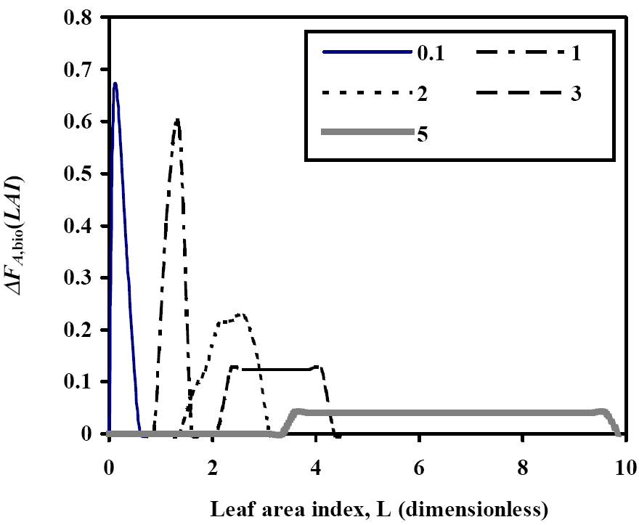
ALGORITM
MODIS LAI/FPAR operational algorithm is adopted
  Look-up-Table approach
  LUT has been significantly modified
Algorithm input:
  DSCOVR EPIC Biome Classification Map;
  Sun-sensor geometry
  Atmospherically corrected surface reflectance (EPIC L2 MAIAC product) at green (551 nm); red (680 nm) and NearInfrared (780 nm) spectral bands
  Precision in EPIC L2 MAIAC product
Algorithm output: VESDR
Solutions corresponding to various combinations of the coefficients in the RT equation are pre-calculated and stored in the Look-Up-Table
Set of acceptable LAI values based on χ2 distribution is calculated
Mean LAI and its dispersion, SLAI, NDVI are archived.
Near-Infrared
Soil line (LAI=0)
Red
Notes:
Hot spot phenomenon and recent advances in the theory of canopy spectral invariants incorporated;
Stochastic radiative transfer equations are used to generate the LUT for all biome types;
The LUT entries are measurable, i.e., they can be independently derived from both below canopy measurements of the transmitted and above canopy measurements of reflected radiation fields

Slide 4

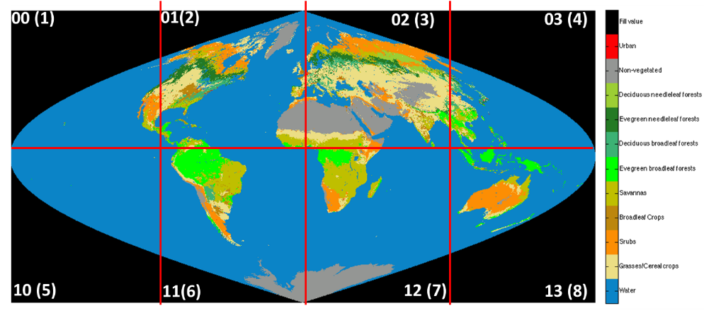
Generation of VESDR
8/23/2017
16:30:25GMT
MAIAC NIR BRF
red, NIR, green
INPUT: DSCOVR_EPIC_L2_MAIAC_00_20160823163025_02.h5
LAI
VESDR
NDVI
FPAR
SLAI

Slide 5
STATUS
VESDR algorithm has been developed and delivered to NCCS
  1.8 sec/image; ~4h to process 1Y data (DELL)
  10 km Biome Classification Map from MODIS MCD12Q1 product has been generated
  biome distribution within 10 km pixel
needs to be done
Algorithm calibration

Slide 6
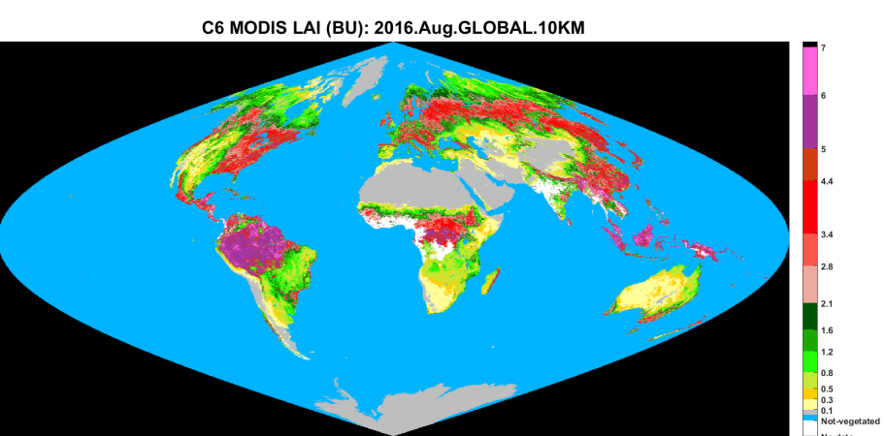
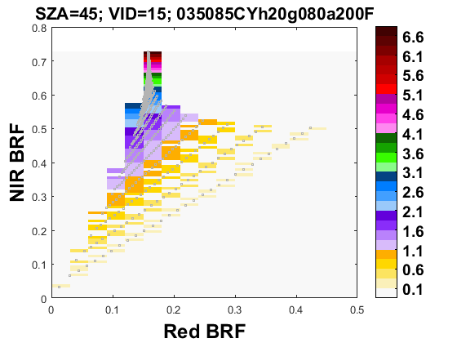
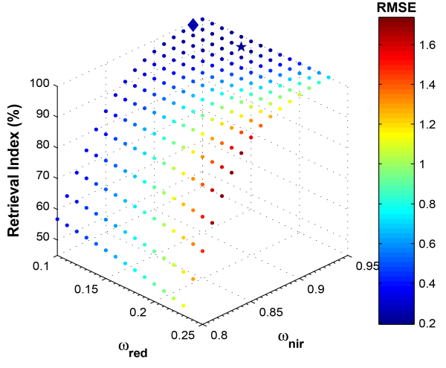
VESDR algorithm calibration
DSCOVR_EPIC_L2_MAIAC: 2016-06-01 to 2016-08-27 (based on v01 1B data)
Analyses of the EPIC BRF product to specify its uncertainties
Analyses of the VESDR product over selected regions and time periods
  Standard technique developed for the MODIS LAI/FPAR product
Matching EPIC MAIAC BRF, VESDR LUT and C6 MODIS LAI product
find LUT configurable parameters that (a) maximizes the Retrieval Inndex; minimizes (b) the RMSE and (c) disagreement between EPIC LAI histograms and MODIS C6 LAI product.
Notes:
Yuri,
1. All figures are based on v2 data unless explicitly labeled as v1.
2. The August 2016 data I made available to you was before v2 release.
So they are v1.
3. I have output for entire 2016. I am struggling with storage space on NCCS. My quota is 10 T (3 T is used for storing the input data), which can only hold two one-year runs. So I only saved binary output at the point, and did not generate hdf5. But I do have the code (part of the maiac package) to generate hdf5 based on my binary output.
I think I can pass the code to you/Wanjuan and you can generate the hdf5 by yourself and store them using your storage quota. Let me know if this works for you.
Dong

Slide 7

MATCHING DSCOVR MAIAC EPIC AND MISR BRF
Aug. 24th P010
EPIC Aug. 23 2016 15:24:58GMT
Aug. 23th P003
Aug. 25th P001
Aug. 22th P229
Aug. 24th P227
Aug. 23th P220
Aug. 25th P18
Aug. 23 2016, P003
RGB
Aug. 25 2016, P001
RGB
 | 8/23 | 8/25
Block | 92-98 | 92-98
Coverage | 67% | 17%
Mean SZA | 29⁰ | 29⁰
STD SZA | 2⁰ | 2⁰
Time match: 10:30am±30min
7

Slide 8
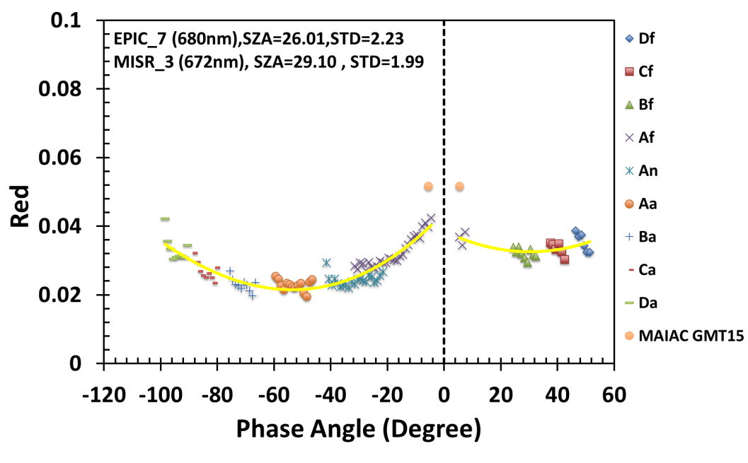
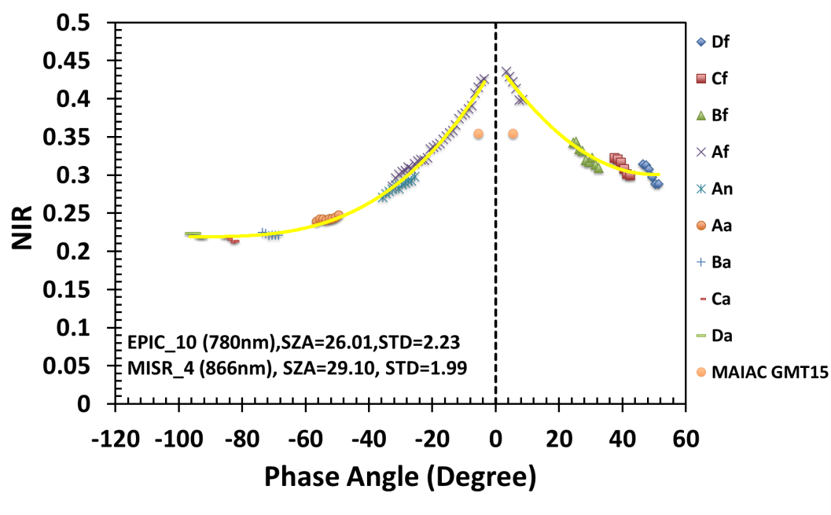
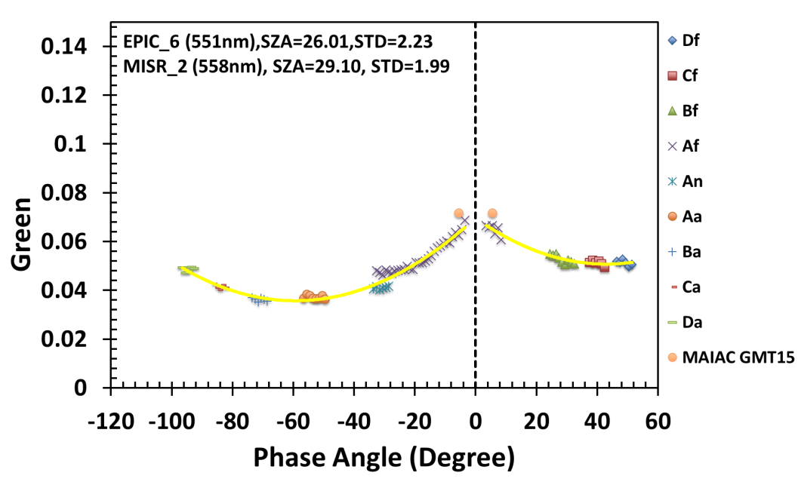
MATCHING DSCOVR MAIAC EPIC AND MISR BRF
DSCOVR_EPIC_L2_MAIAC: 2016-06-01 to 2016-08-27 (as of May 16-2017)
Sensor | RED spectral band, nm |  | NIR spectral band, nm |  | Green spectral band, nm
 | Center | Bandwidth | Center | Band width
MISR | 672 | 22 | 866 | 40 | 555 | 20
EPIC | 680 | 3 | 780 | 2 | 551 | 3

Slide 9
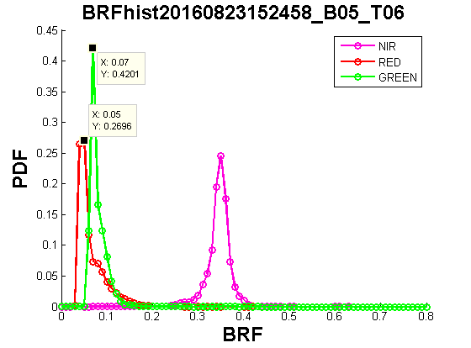
MATCHING DSCOVR MAIAC EPIC AND MISR BRF
DSCOVR_EPIC_L2_MAIAC: 2016-06-01 to 2016-08-27 (as of May 16-2017)

Slide 10
STATUS
VESDR algorithm has been developed and delivered to NCCS
  1.8 sec/image; ~2h to process 1Y data (DELL)
  10 km Biome Classification Map from MODIS MCD12Q1 product has been generated
  biome distribution within 10 km pixel
  A paper describing Algorithm Theoretical Basis has been published
needs to be done
Obtain MAIAC BRF, input to the VESDR algorithm
Finalize VESDR algorithm calibration
  ~ 3 months once MAIAC BRF available
Generation of the VESDR product

Slide 11
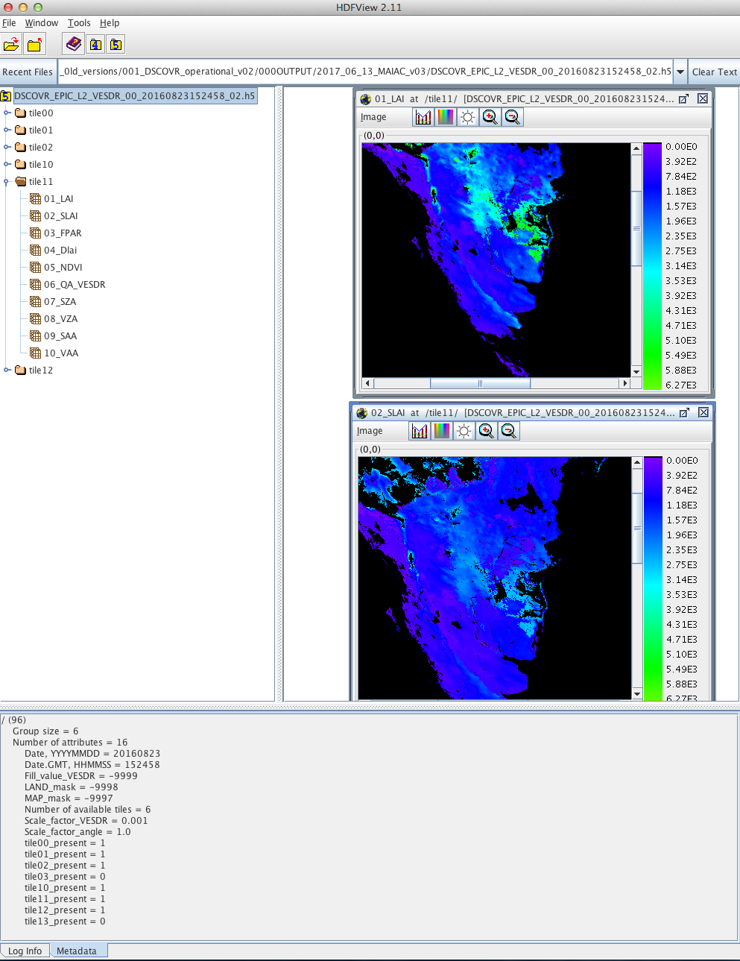
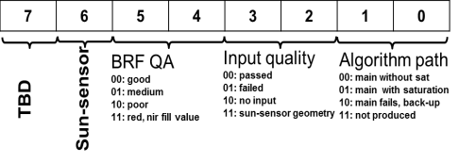
Deliverables
DSCOVR_EPIC_L2_VESDR_00_20160823152458_02.h5
  VESDR data record
00
01
02
10
11
12
LAI
Maturity Status
LAI, FPAR: Stage 1 validation status
NDVI: same as MAIAC BRF
SLAI: Provisional validation status
QA_VESDR
Stage 1 validation status
Product accuracy has been estimated using a small number of independent measurements obtained from selected locations and time periods and ground truth/field program effort
Provisional validation status
Obvious artifacts or blunders have been identified and either minimized or documented. General research community is encouraged to participate in the QA and validation. Parameter may be used in publications as long as provisional quality is indicated by the authors. The Data Quality Summary states estimated uncertainties.
Notes:
Provisional Status:
Incremental improvements are still occurring. Obvious artifacts or blunders observed in beta product have been identified and either minimized or documented.
General research community is encouraged to participate in the QA and validation, but need to be aware that product validation and QA are ongoing.
Parameter may be used in publications as long as provisional quality is indicated by the authors. Users are urged to contact science team representatives prior to use of the data in publications, and to recommend members of the instrument teams as reviewers.
The Data Quality Summary states estimated uncertainties.
May be replaced in the archive when an upgraded product becomes available, but should be reproducible upon demand.

Slide 12
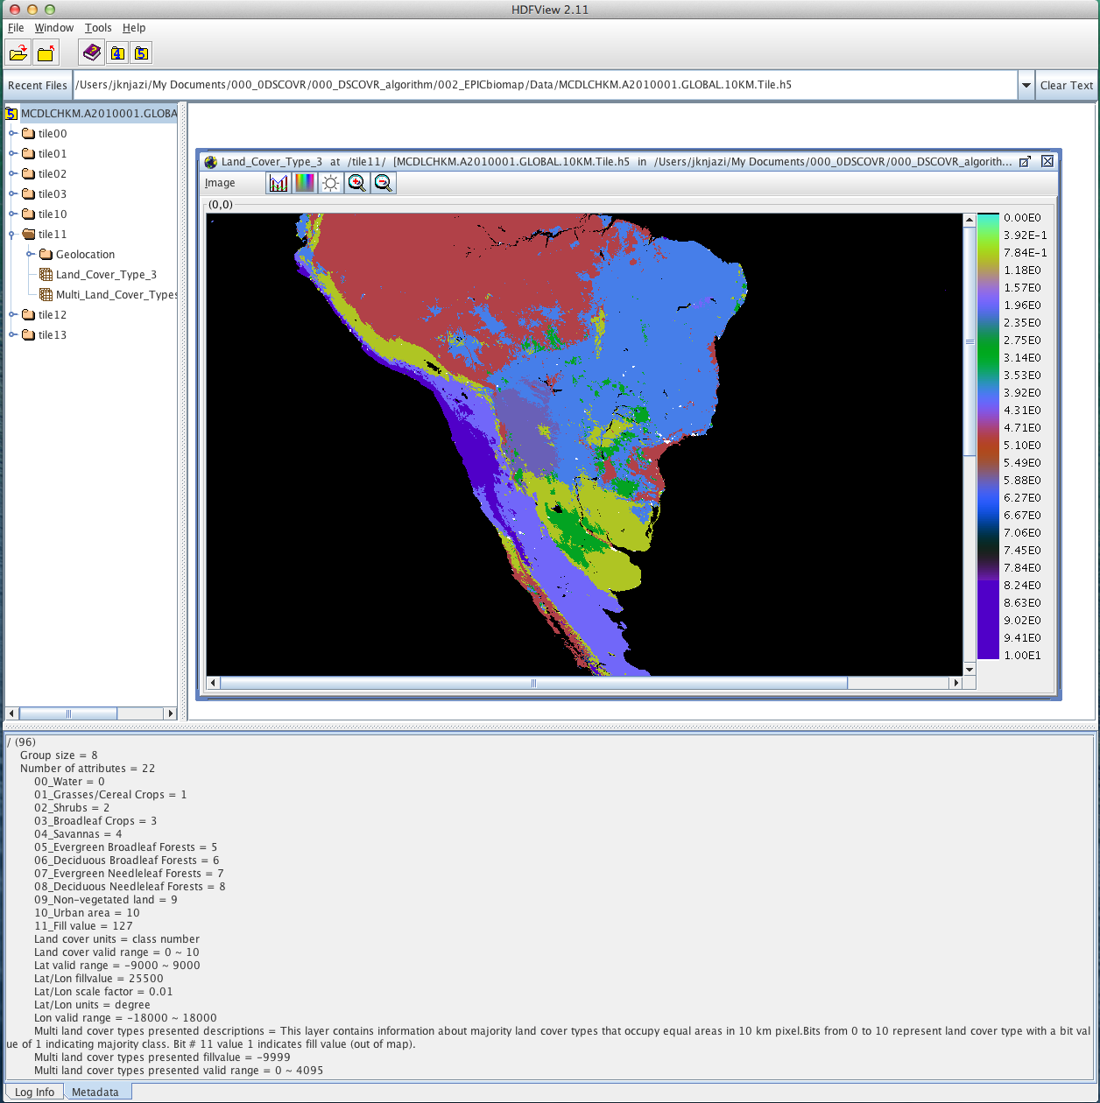
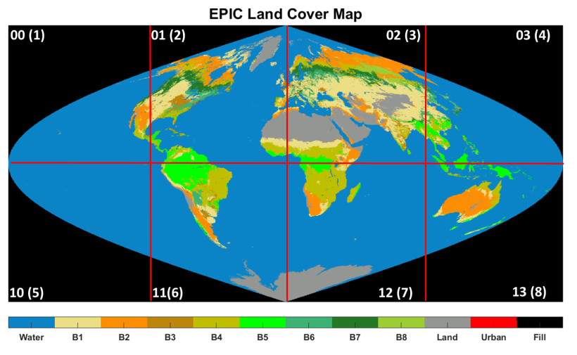
Deliverables
  10 km Biome Classification Map from (static)
MCDLCHKM.A2010001.GLOBAL.10KM.Tile.h5
Maturity Status: Stage 2 validation status

Slide 13
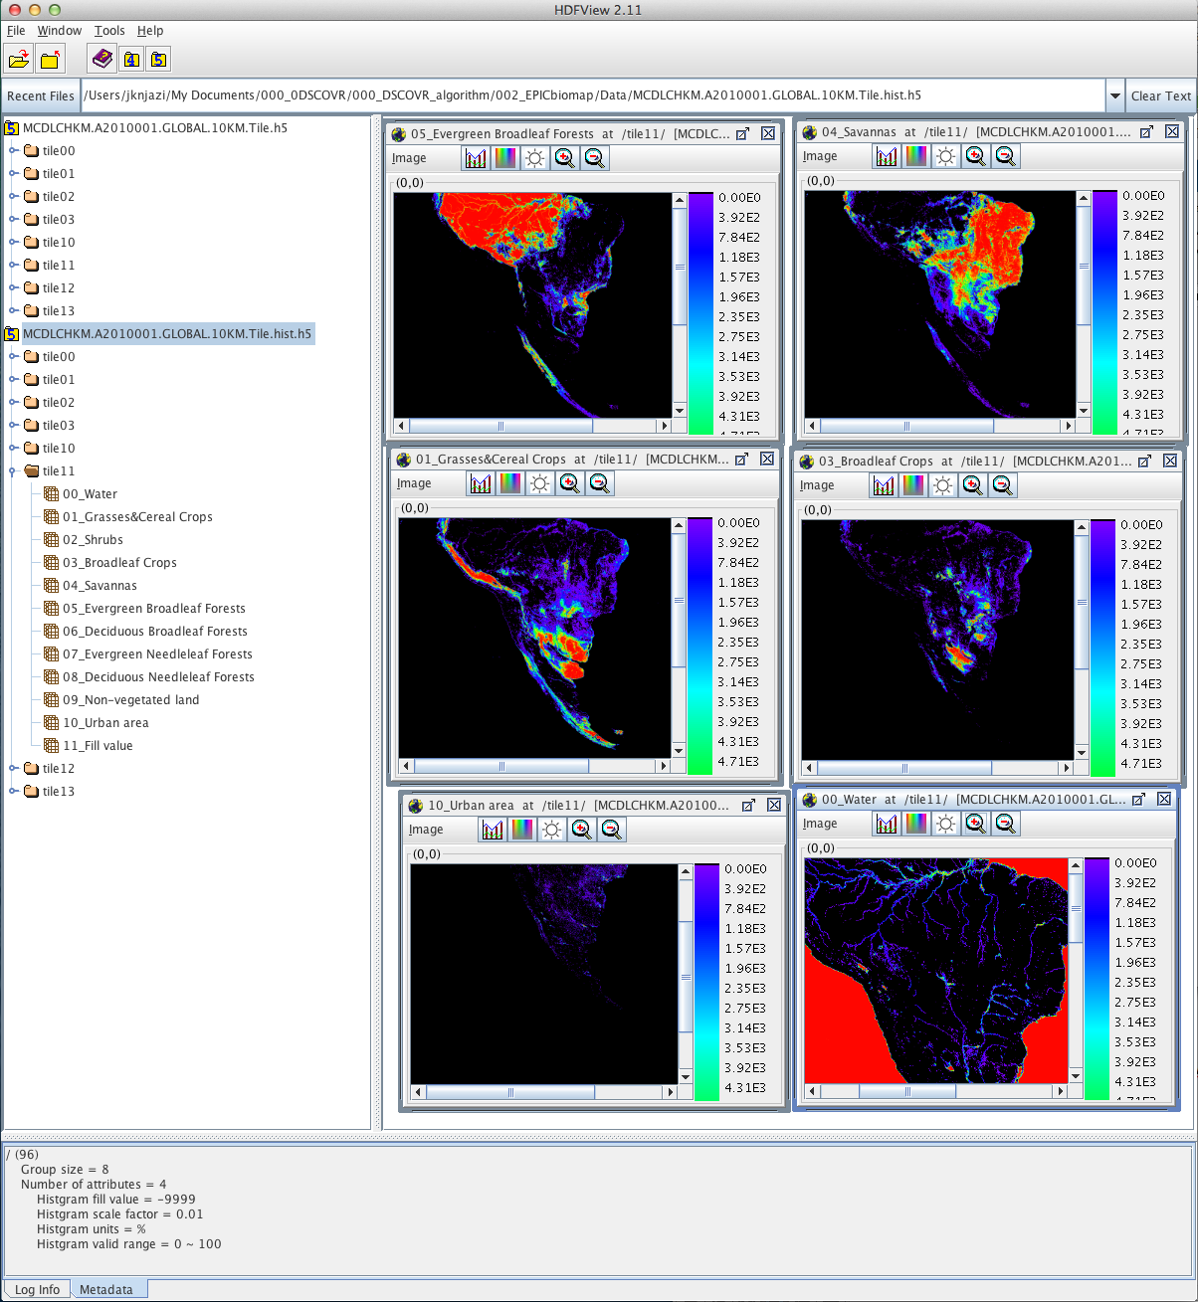
Deliverables
  biome distribution within 10 km pixel
MCDLCHKM.A2010001.GLOBAL.10KM.Tile.hist.h5
Validation Status: Stage 2 validation status

Slide 14
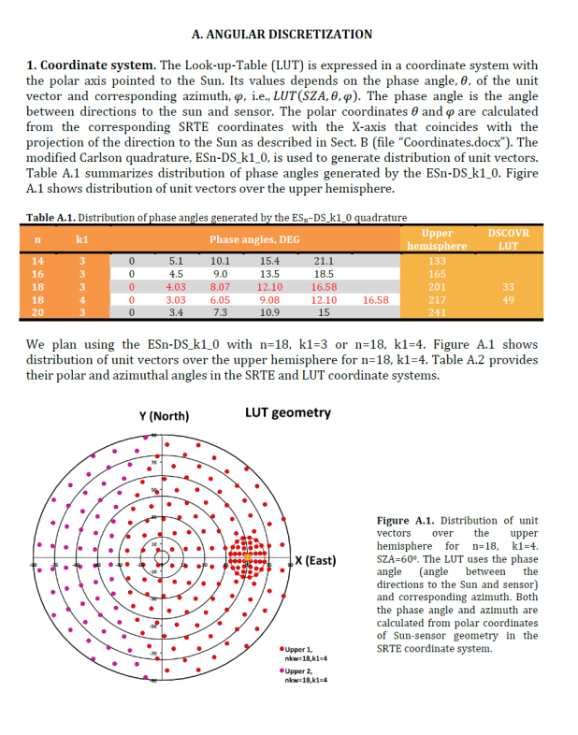
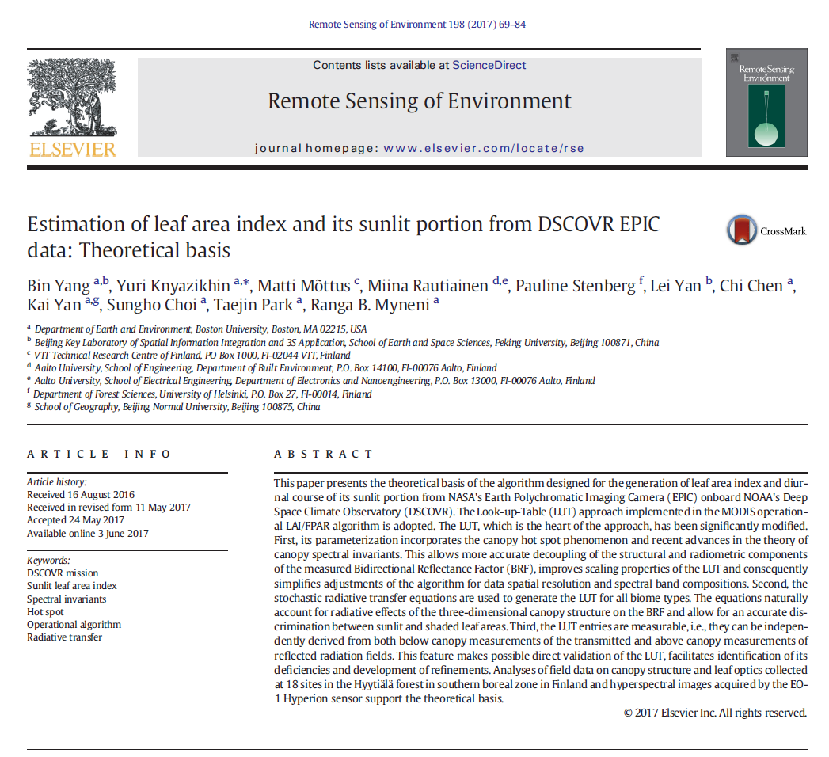
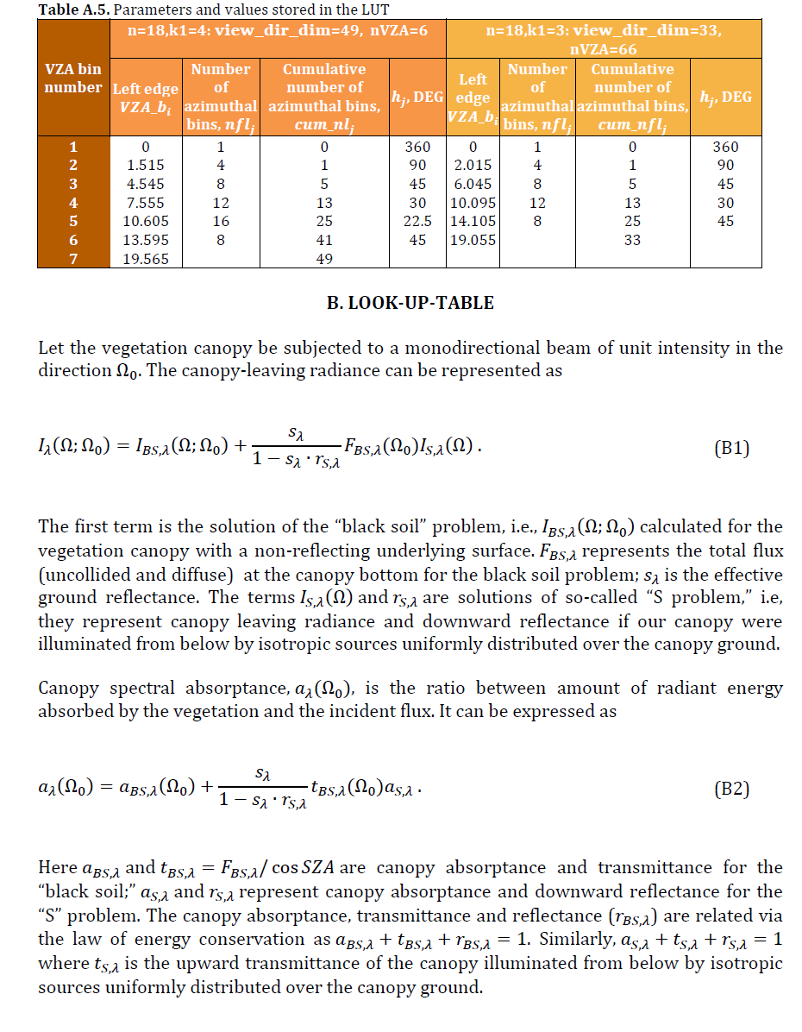
Deliverables
  ATBD and User Guide

Slide 15
SUMMARY
VESDR algorithm has been developed and delivered to NCCS
  1.8 sec/image; ~2h to process 1Y data (DELL)
  VESDR calibration technique has been developed
  10 km Biome Classification Map from MODIS MCD12Q1 product has been generated
  biome distribution within 10 km pixel
  A paper describing Algorithm Theoretical Basis has been published
needs to be done
Obtain MAIAC BRF, input to the VESDR algorithm
Finalize VESDR algorithm calibration
  ~ 3 months once MAIAC BRF available
Generation of the VESDR product

