Slide 1

Improvement and Evaluation of Total O₃ and Volcanic SO₂ from DSCOVR EPIC
Kai Yang - UMCP
DSCOVR Science Team Meeting, GSFC Oct. 3 – 4, 2017
Acknowledgement: This work is supported by NASA.

Slide 2
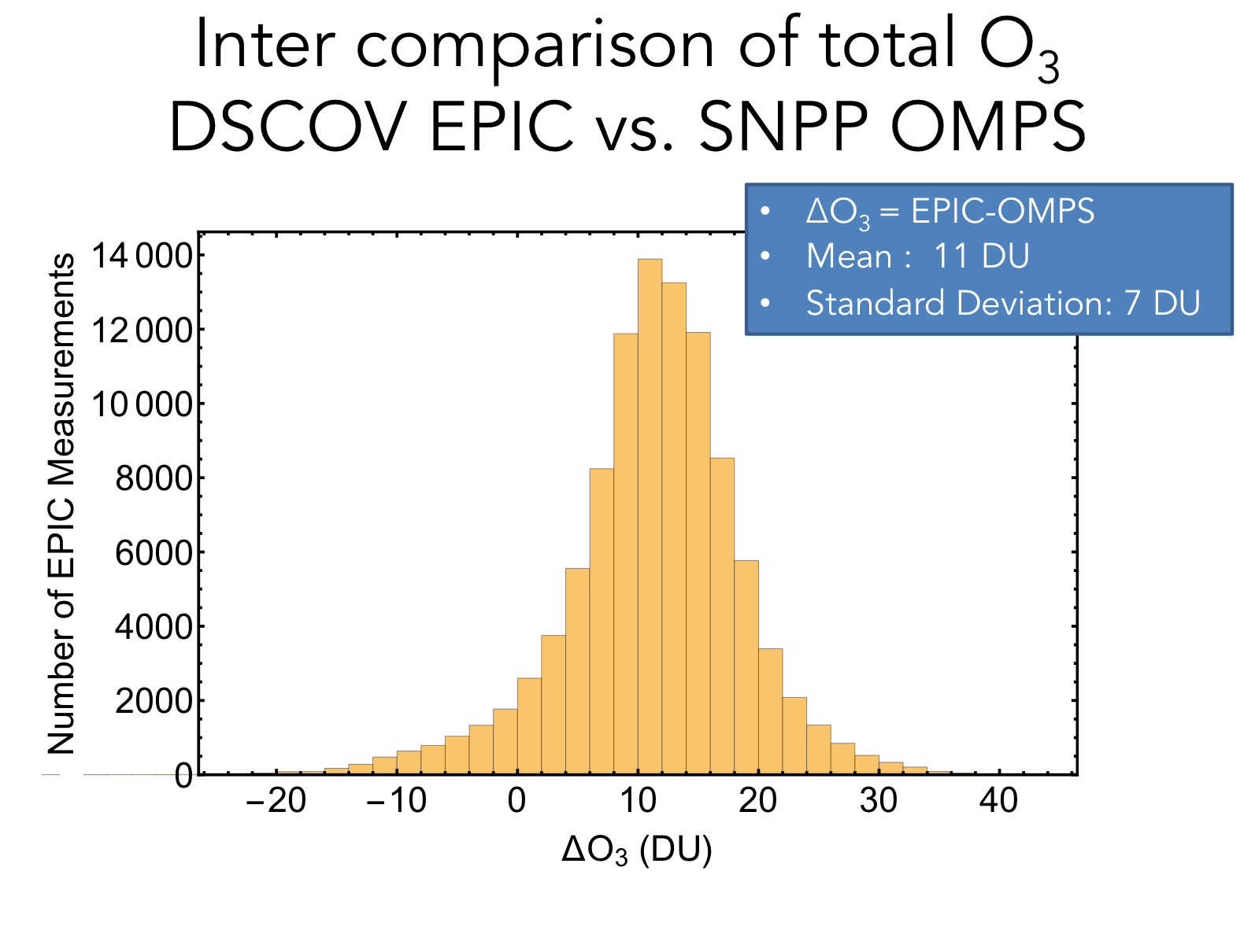
Evaluation of EPIC O₃
Presented at Last DSCOVR STM
Significant O₃ biases between EPIC and OMPS
total Ozone: ~11 DU or ~3 %

Slide 3
Improvements
Soft calibration to correct UV radiance biases
Seasonal-dependent column-classified O₃ climatology for more accurate O₃ profile specification
Look-Up Tables (LUTs) for fast and accurate radiative transfer modeling
Spatial Optimal Estimation (SOE) for effective band-to-band mismatch correction

Slide 4
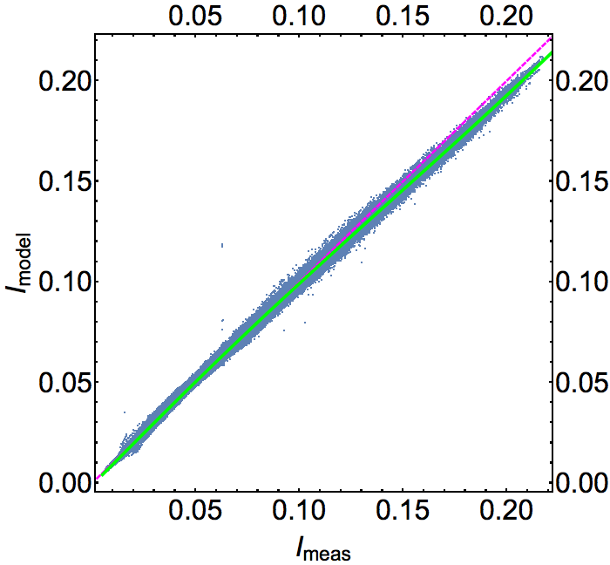
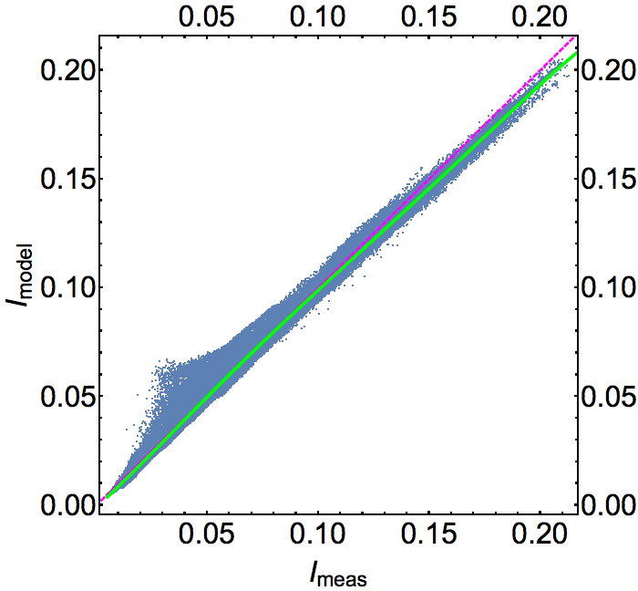
Soft Calibration: UV bands
EPIC Band 1
317 nm
01/09/2017
10/15/2015
I_{meas}: sun normalized radiance measured by EPIC

Slide 5
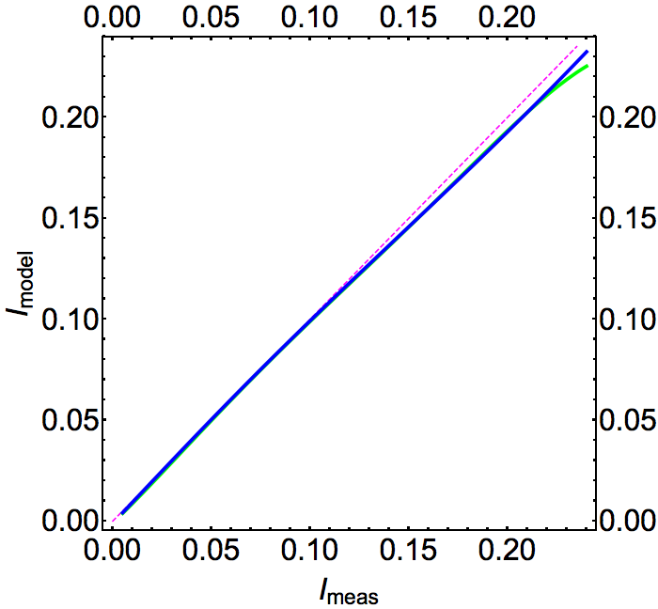
Soft Calibration: Time Dependence
01/09/2017
vs.
10/15/2015
No significant
Change over time

Slide 6
Column-Classified O₃ Climatology
By Month and Latitude Zones

Slide 7
Accounting for O₃ Profile Variations
Square root of the diagonal of the covariance matrix
Normalized covariance matrix: normalized by the product of the square root variance.
First two eigenvectors of the covariance matrix

Slide 8
Fast and Accurate Radiance Modeling with Look-Up Tables
Accuracy ~ 0.2 % for full range of angles and O₃
Processing speed-up by a factor of ~ 5.
LUT with layer Jacobian
LUT Radiances achieve an accuracy better than 0.2%
Use heritage TOMS-like LUT approach may have a few % error.

Slide 9
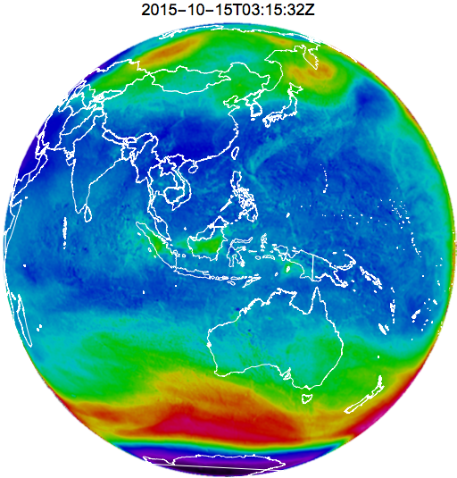
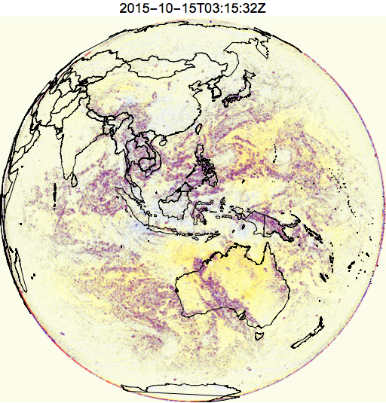
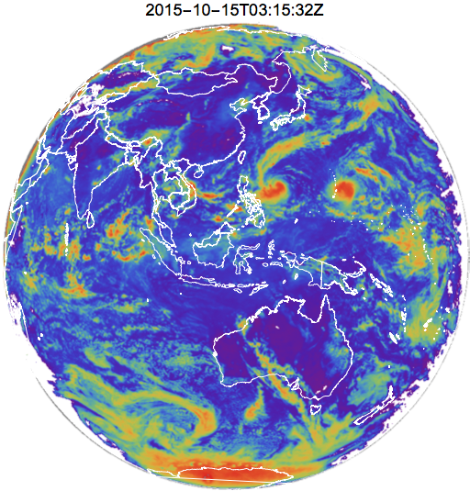
Spatial Optimal Estimation (SOE)
Simultaneous O₃ and reflectivity estimation to correct errors in O₃ and reflectivity due to timing differences among observations from different bands, i.e., band-to-band scene mismatch. SOE reduces the O₃ artificial noise level by ~ 5 DU.
O₃
Δ O₃
LER @ 340 nm
O₃ (DU) ΔO₃ (DU) LER @ 340 nm

Slide 10
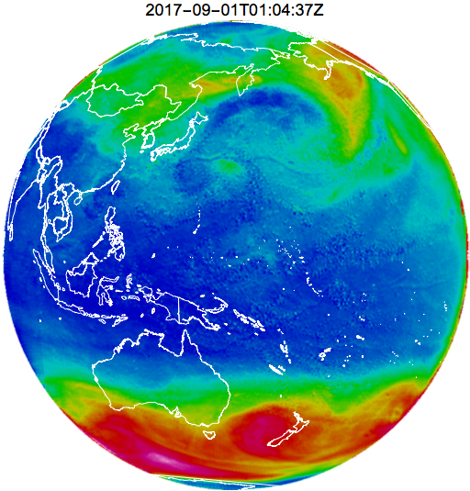
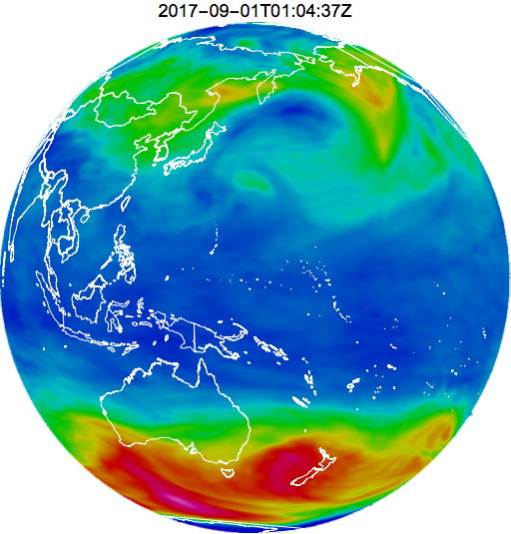
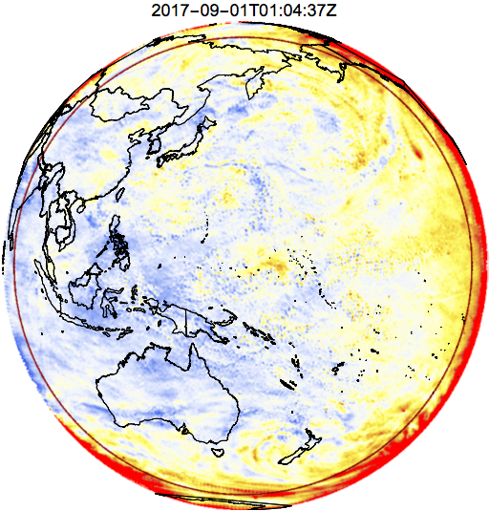
Inter-comparison of total O₃
EPIC vs. MERRA-2
2017-09-01T01:04:37Z
EPIC O₃
MERRA-2 O₃
Δ O₃
EPIC O₃ (DU) Merra-2 O₃ (DU) ΔO₃ (DU) = EPIC – MERRA2

Slide 11
Inter-comparison of total O₃
EPIC vs. MERRA-2
2017-09-01T01:04:37Z
VZA <= 69°
Mean O₃ : -1.7 DU
Std O₃ : 7.7 DU

Slide 12
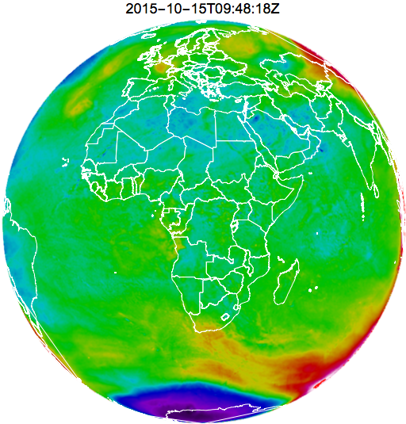
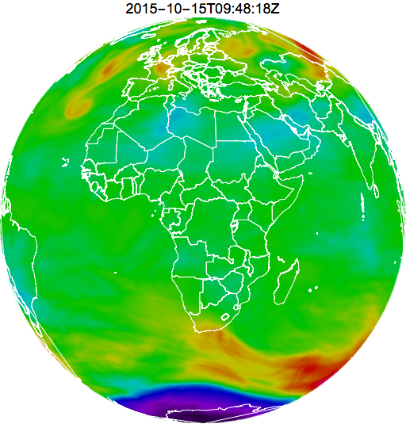
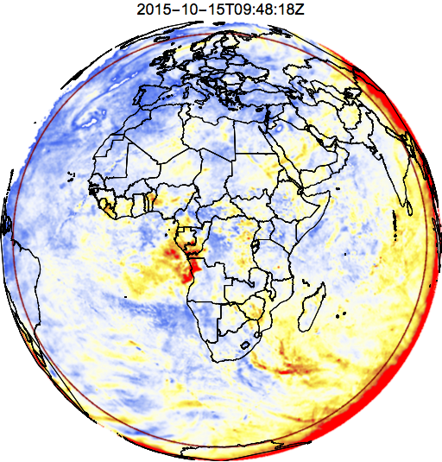
Inter-comparison of total O₃
EPIC vs. MERRA-2
2015-10-15T09:48:18Z
EPIC O₃
MERRA-2 O₃
Δ O₃
EPIC O₃ (DU) Merra-2 O₃ (DU) ΔO₃ (DU) = EPIC – MERRA2

Slide 13
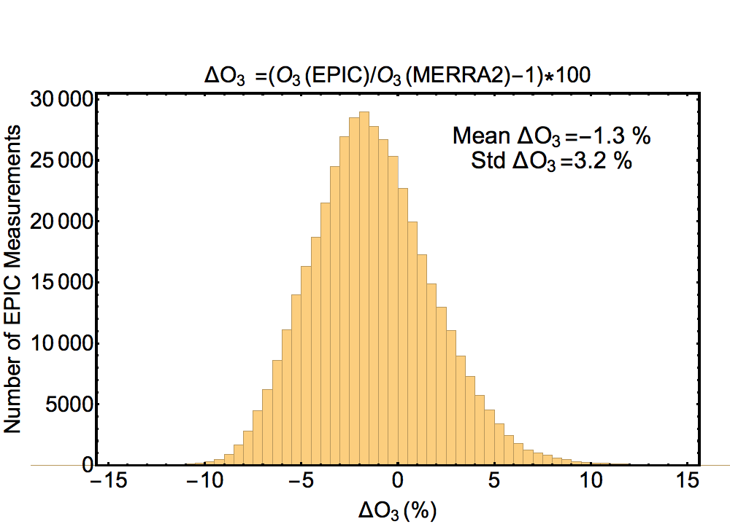
Inter-comparison of total O₃
EPIC vs. MERRA-2
2015-10-15T09:48:18Z
VZA <= 69°
Mean O₃ : -3.7 DU
Std O₃ : 9.0 DU

Slide 14
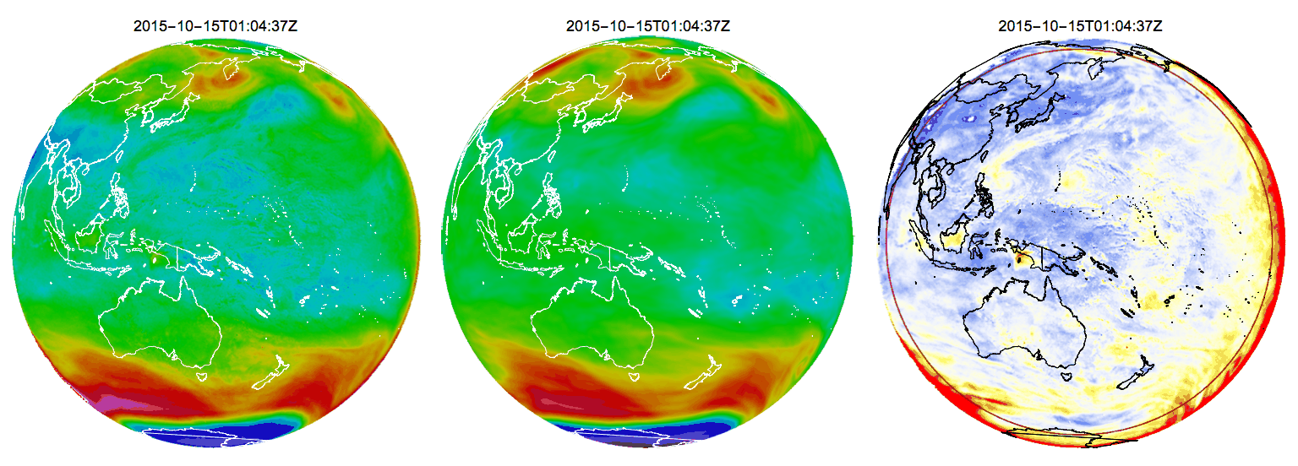

Total O₃ EPIC vs. MERRA-2
2015-10-15
EPIC O₃
MERRA-2 O₃
Δ O₃
EPIC O₃ (DU) Merra-2 O₃ (DU) ΔO₃ (DU) = EPIC – MERRA2

Slide 15
Ozone Summary
Good agreement between EPIC and MERRA-2 O₃: their difference is characterized by the daily mean: better than 4 DU or 1.4%, and the daily standard deviation: 9 DU or 3.3% for VZA<69°.
This agreement is achieved with one set of calibration coefficients that are applied to the full EPIC record without change over time.
Reducing the systematic differences may require detector specific calibration coefficients.
In addition, better agreement may be achieved with more accurate retrievals under cloud and or aerosol conditions.

Slide 16
Volcanic SO₂ : OMPS vs. EPIC
Etna Eruption 12/03/2015
SO₂ (DU)
11:04 UT
11:52 UT
OMPS
EPIC
SO₂ Height
SO₂ Mass
EPIC : 45 kt
OMPS: 55 kt
OMPS
OMPS

Slide 17
Product Status
Total O₃ accuracy is estimated to be better than 2% for SZA < 69° and SO₂ accuracy is estimated to be better than 25% for column amount > 10 DU.
Ozone product has sufficient quality and accuracy to be released.

