Slide 1
EPIC and the 2017 Solar Eclipse
The 21 August 2017 solar eclipse experiment was designed to test 3-D radiative transfer calculations against measurements made on the ground (Pandora Spectrometer Instrument) in Casper Wyoming and from space using EPIC.
This presentation will only discuss the EPIC portion of the experiment.
The bottom line is that EPIC detected an 11% reduction in global sunlight reflected back to space or reaching the ground for the wavelength range 387 – 780 nm.

Slide 2
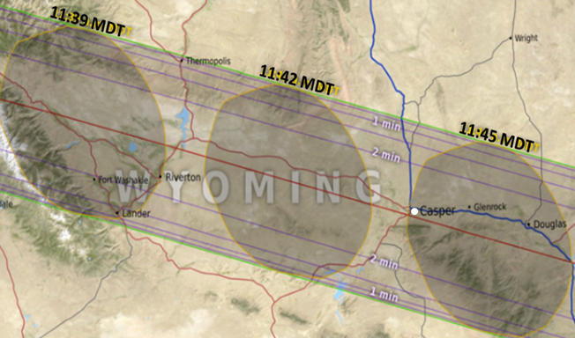
EPIC and the 2017 Solar Eclipse
The timing and shape of the Moon’s shadow over Casper, Wyoming showing the
relative location of Casper (white circle) at 11:45 MDT
(https://eclipse2017.nasa.gov/eclipse-maps).

Slide 3
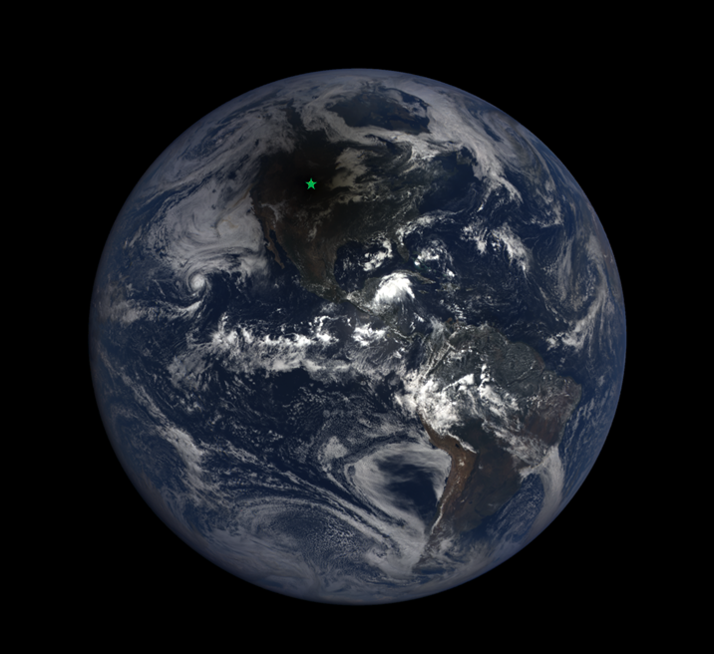
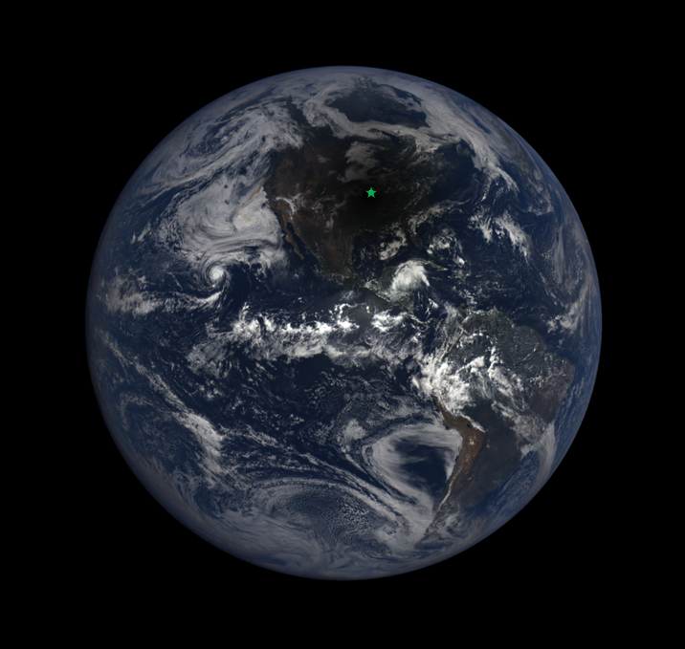
EPIC and the 2017 Solar Eclipse
Casper WY Columbia MO
We observed at two sites, Casper Wyoming and Columbia Missouri

Slide 4
EPIC and the 2017 Solar Eclipse
All of the wavelengths considered were obtained in a period of 2.7 minutes within 100 km of Casper or 1^{O} of Longitude
Table 1 Eclipse Maximum and EPIC Image Times |  | Measurement Duration 2.7 minutes | Longitude
Eclipse West Edge of WY | 2017-08-21 17:35:40 |  | -111^{O}02’
Wavelength (nm) | Date and Time | Location
551 | 2017-08-21 17:42:36 | West of Casper | -106^{O}22’
680 | 2017-08-21 17:43:30 | West of Casper
Casper Wyoming | 2017-08-21 17:43:51 | Casper WY | -106^{O}19’
780 | 2017-08-21 17:44:24 | Near Glenrock WY | -105^{O}52’
443 | 2017-08-21 17:44:50 | West of Douglas WY
388 | 2017-08-21 17:45:18 | West of Douglas WY | -105^{O}17’
Eclipse East Edge of WY | 2017-08-21 17:48:04 |  | -104^{O}03’

Slide 5
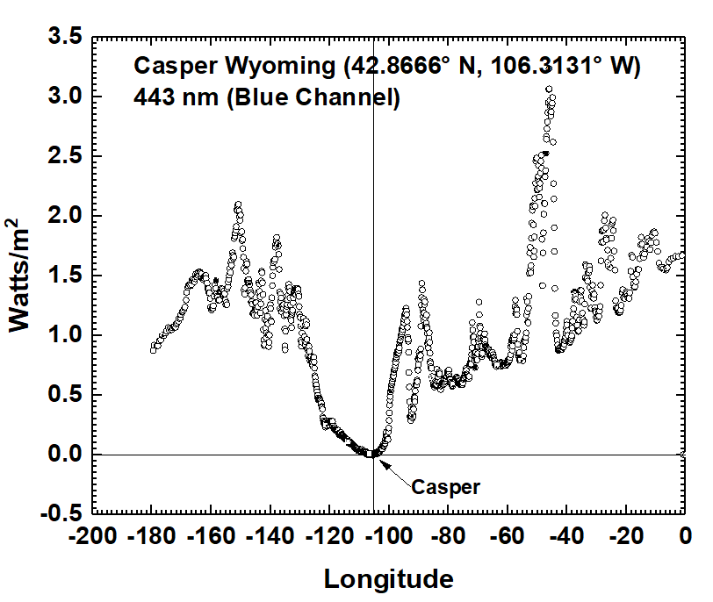
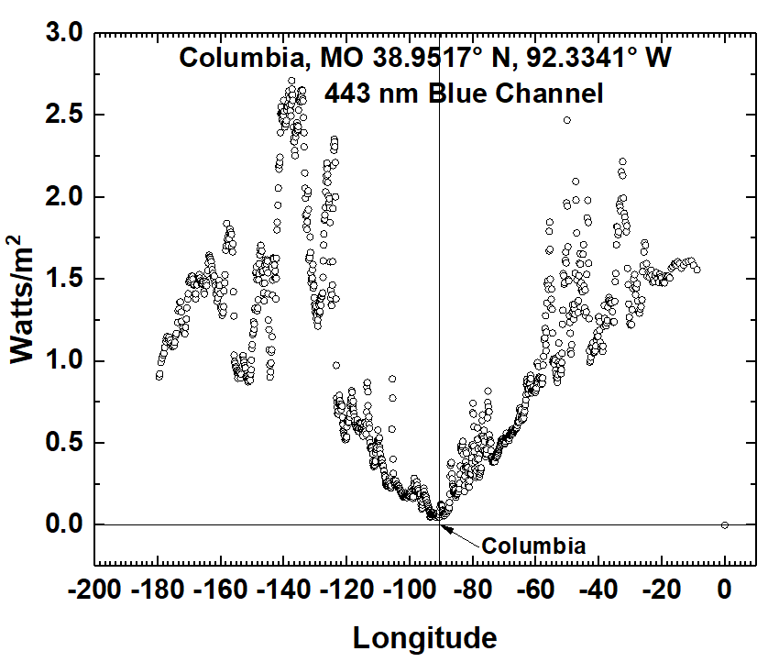
EPIC and the 2017 Solar Eclipse
Reflected Irradiance in longitudinal slice
The effect of an eclipse on the solar energy reflected back to space as a function of longitude (degrees). In Casper WY, the eclipse totality reached almost zero energy reflected back to space, while light clouds in Columbia MO diminished the effect. For 443±1.3 nm, reflected irradiance(W/m²) = 5.291x10⁻⁶ π 2.6 C/S.

Slide 6
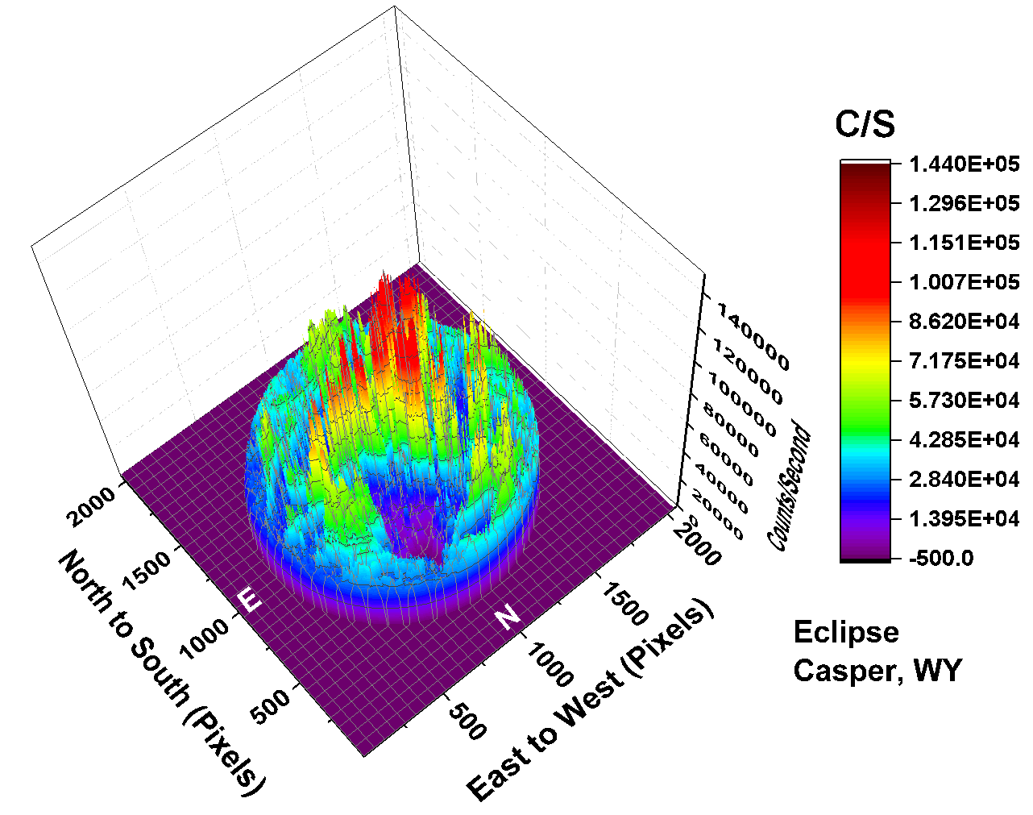
EPIC and the 2017 Solar Eclipse
443 nm
The counts/second C/S observed by EPIC for the 443 nm channel corresponding to the color image. In this image there are approximately 2.59x10⁶ illuminated pixels out of 2048² = 4.194304x10⁶ pixels (61.8%). Illuminated pixels form a circle of 1816 pixels in diameter

Slide 7
EPIC and the 2017 Solar Eclipse
Method
Integrate the global Counts/Second for the time of the eclipse totality
Integrate the previous and following days for the same geometry
Form the ratios of the totality scene to the non-eclipse scenes to calculate the average reduction caused by the eclipse for each wavelength

Slide 8
EPIC and the 2017 Solar Eclipse

Slide 9
Why did we do this experiment?
The next step is to take a 3-D radiative transfer calculation to attempt to reproduce the observations from EPIC and from the ground measurements by the Pandora Spectrometer Instrument.
The goal is to see if the 3-D radiative transfer calculation is an improvement over the 1-D methods matching calculations and measurements.
If so, the 3-D methods can be applied to clouds that affect the Earth’s energy balance

