Slide 1
EPIC UV Science Products
Jay Herman Liang Huang Richard McPeters
Ozone *
SO₂ Nickolay Krotkov
LER *
Aerosols Omar Torres
Erythemal Irradiance *
* amt-2017-155 Submitted on 15 May 2017 ”EPIC Synoptic Ozone, Cloud Reflectivity, and Erythemal Irradiance from Sunrise to Sunset for the Whole Earth as viewed by the DSCOVR spacecraft from Lagrange-1” Jay Herman, Liang Huang, Richard McPeters, Jerry Ziemke, Alexander Cede, and Karin Blank

Slide 3
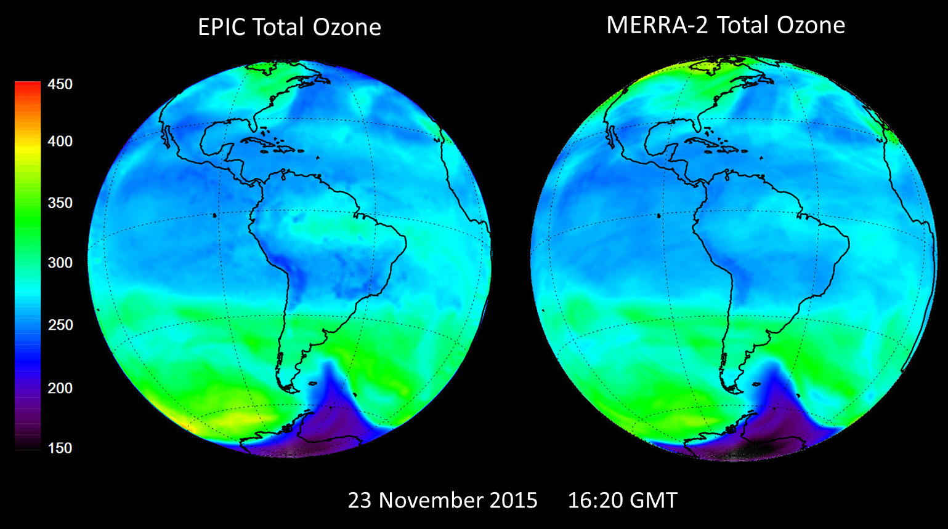
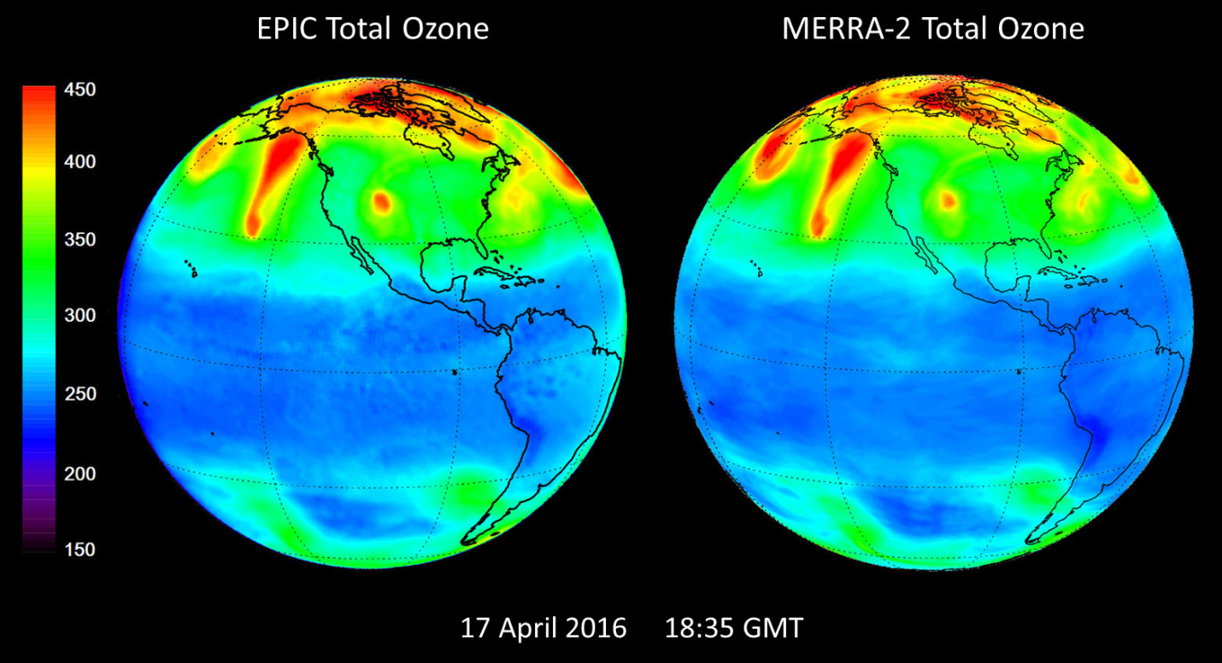

Slide 4
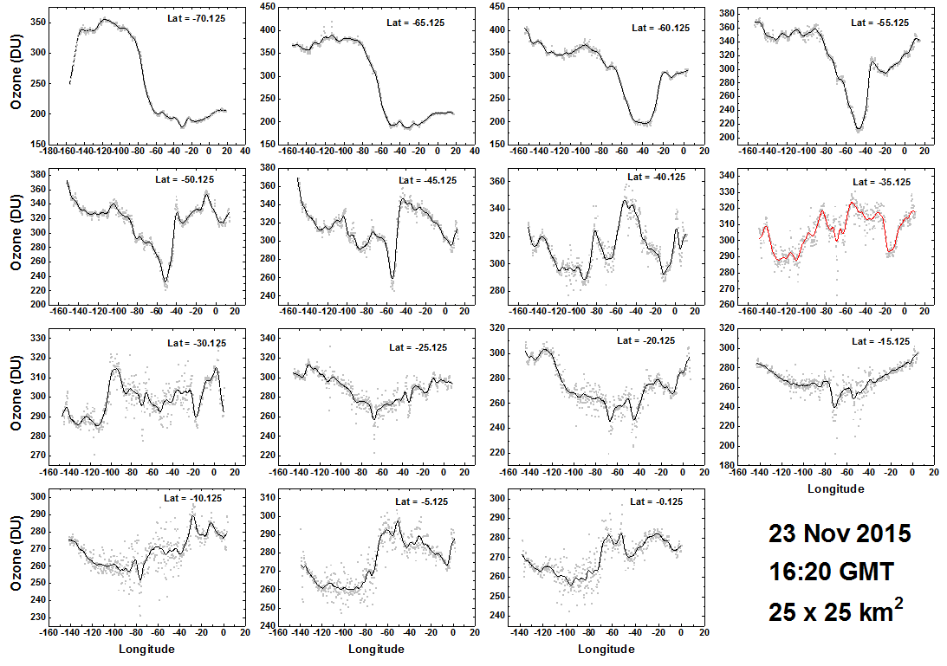
O₃ in Southern Hemisphere Latitude Bands

Slide 5
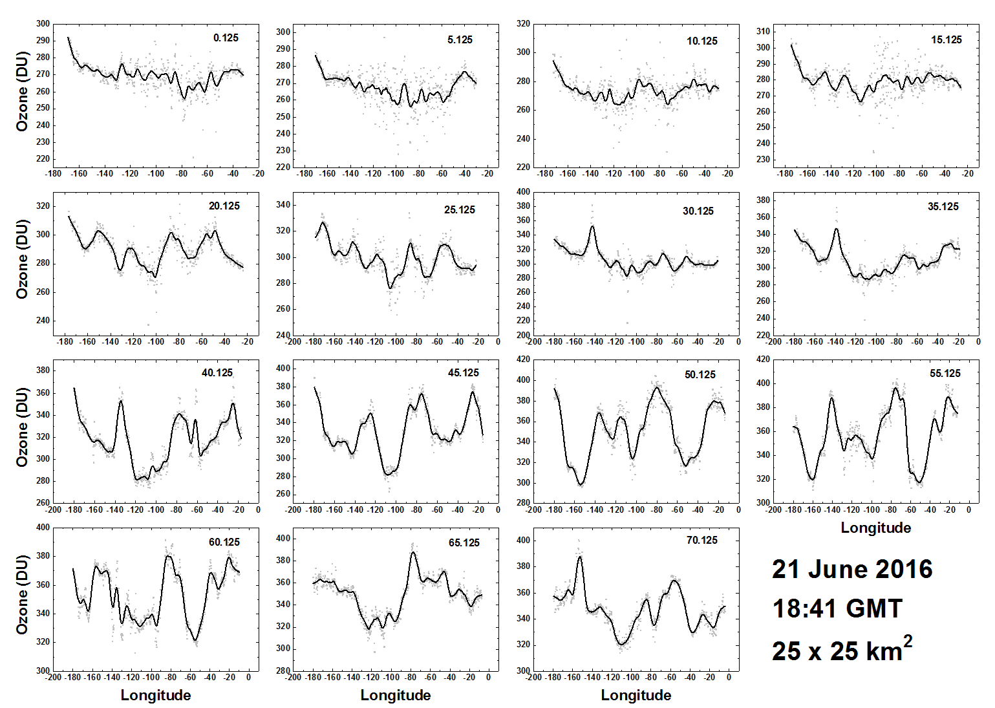
O₃ in Northern Hemisphere Latitude Bands

Slide 6
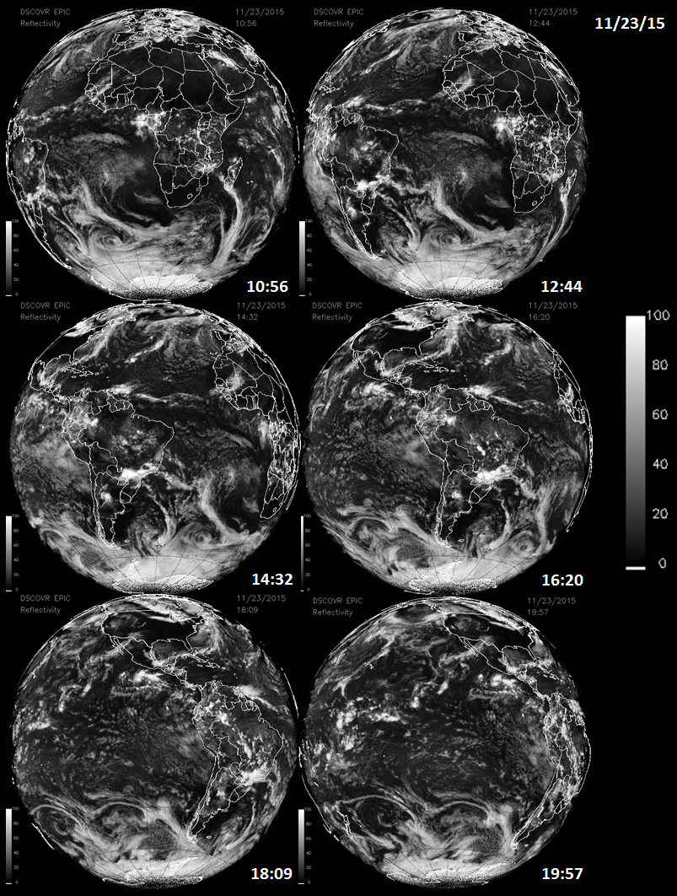
Reflectivity (340 nm LER)
11/23/2015
10:56 to 19:57 UT

Slide 8
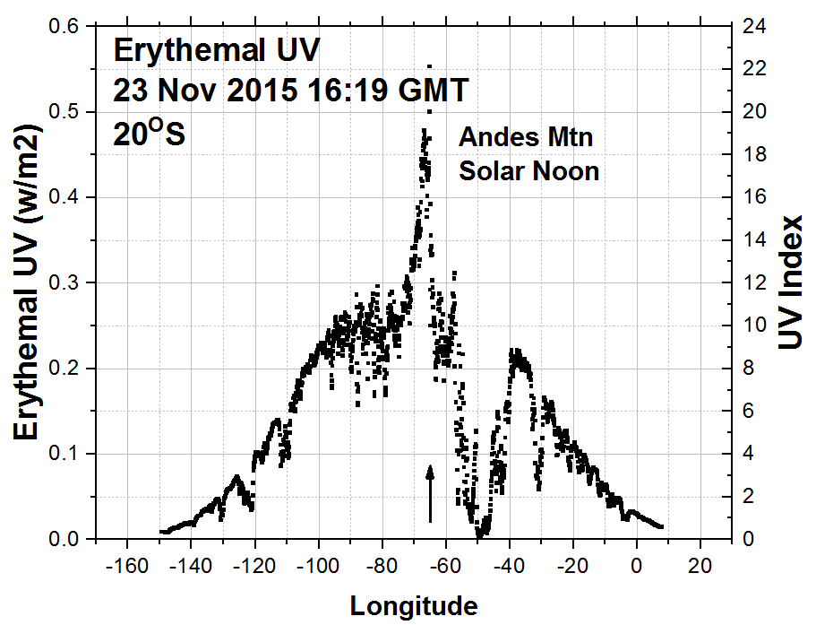
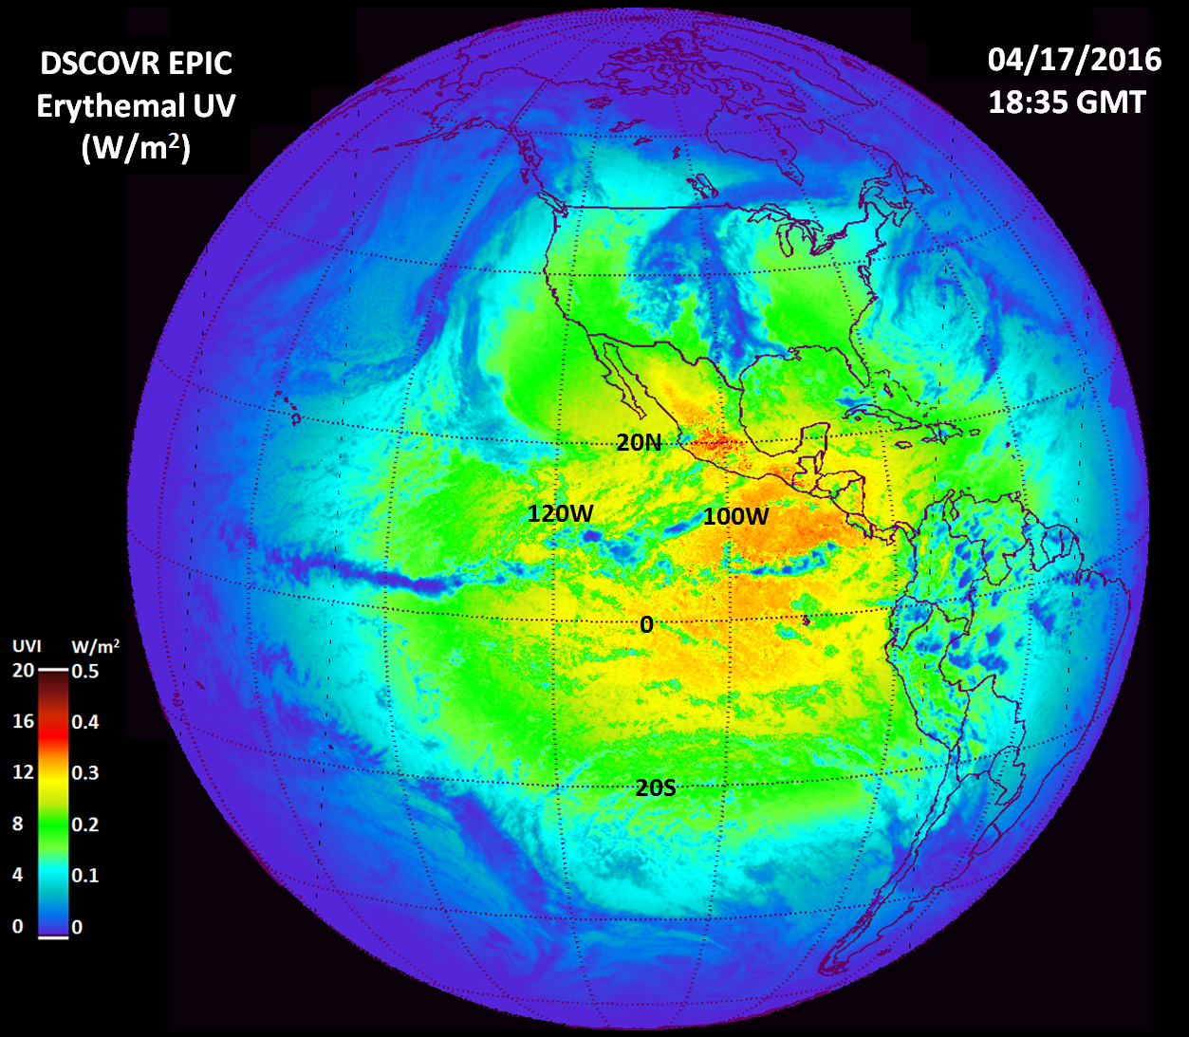
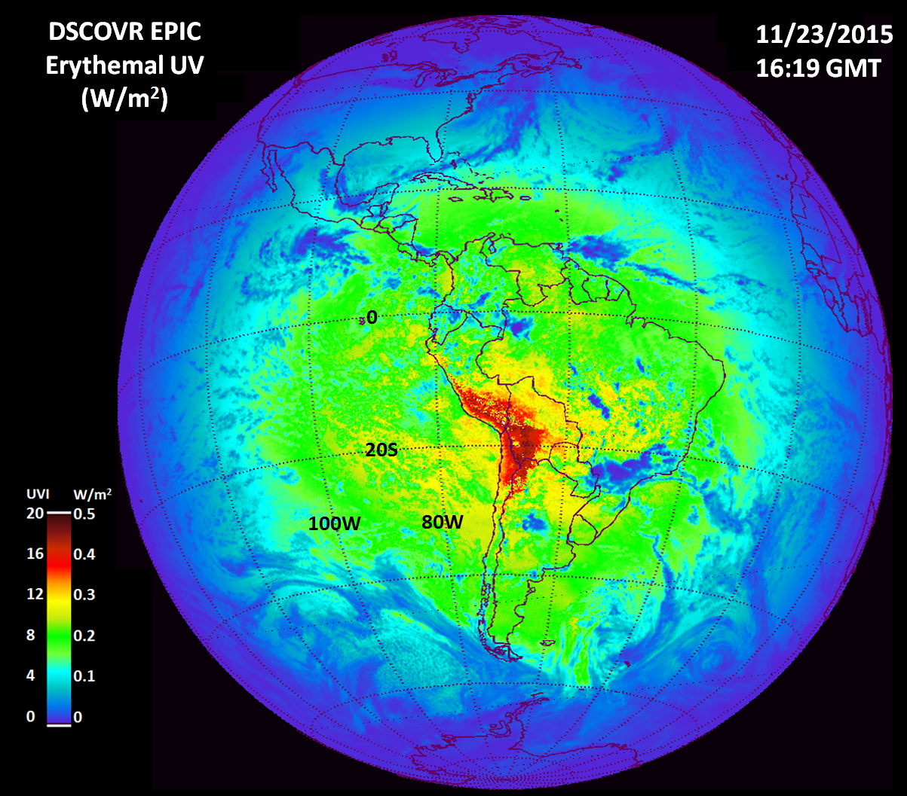
Erythemal Irradiance
(Watts/m²)

