Slide 4
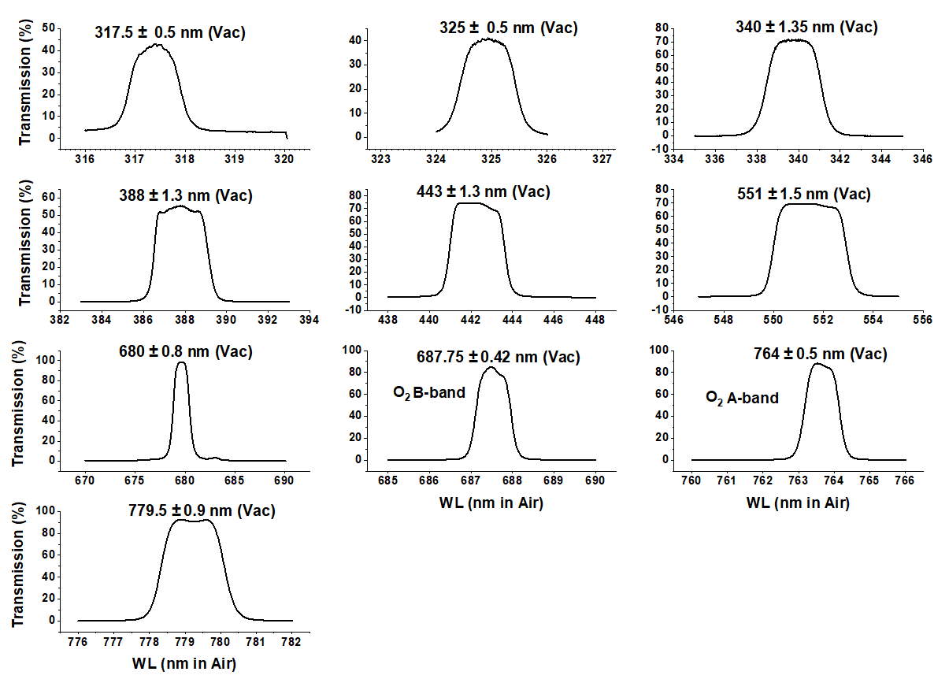
Outline of Calibration Method
T_{M} = :

Slide 5
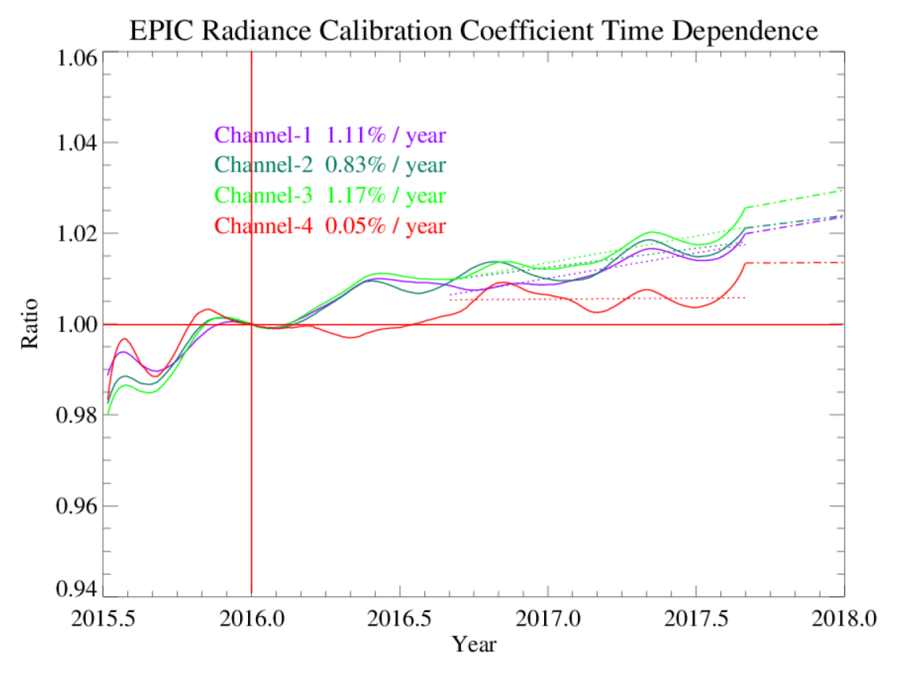
Outline of Calibration Method
Wavelength Radiance* Reflectance
Channel | Wavelength (nm) | A0 (V1) | K1=pi*A0/SF | A0 (V2) | Ratio (V2/V1) | SF(mW/m²/nm) | K2=pi*A0/SF
1 | 317.478 | 0.03172 | 1.22E-04 | 0.03125 | 0.9852 | 819.00 | 1.20E-04
2 | 325.035 | 0.02857 | 1.11E-04 | 0.02819 | 0.9868 | 807.70 | 1.10E-04
3 | 339.858 | 0.00626 | 1.98E-05 | 0.0062 | 0.9909 | 995.80 | 1.96E-05
4 | 387.923 | 0.00857 | 2.69E-05 | 0.00854 | 0.9957 | 1003.30 | 2.67E-05
5 | 442.397 | 0.00524 | 8.42E-06 | 0.00527 | 1.0057 | 1956.00 | 8.46E-06
*Radiance (mW/(m²nm sr)

Slide 6
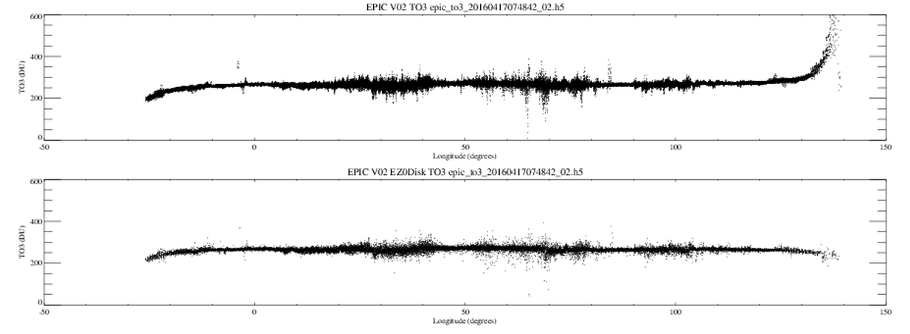
Possible Geolocation Validation for Version 3
A geolocation method devised by Huang is based on finding the edge of the earth by distinguishing the atmosphere from the solid earth based on the results from the OMPS limb sounder
This method is needed for the UV and 443 nm channels where Rayleigh scattering is important. Although less important, the method should also be used for the green and red channels.
An improved production method of geolocation is being developed for all channels that will be validated using Huang’s method
V2 - Current
V2 - Huang
Longitude

Slide 7
Ozone Correction from Huang’s Improved Limb Location
For small angles, the geolocation correction is minor, but becomes significant as the SZA and VZA become larger
-50 0 50 100 150
Longitude

Slide 8
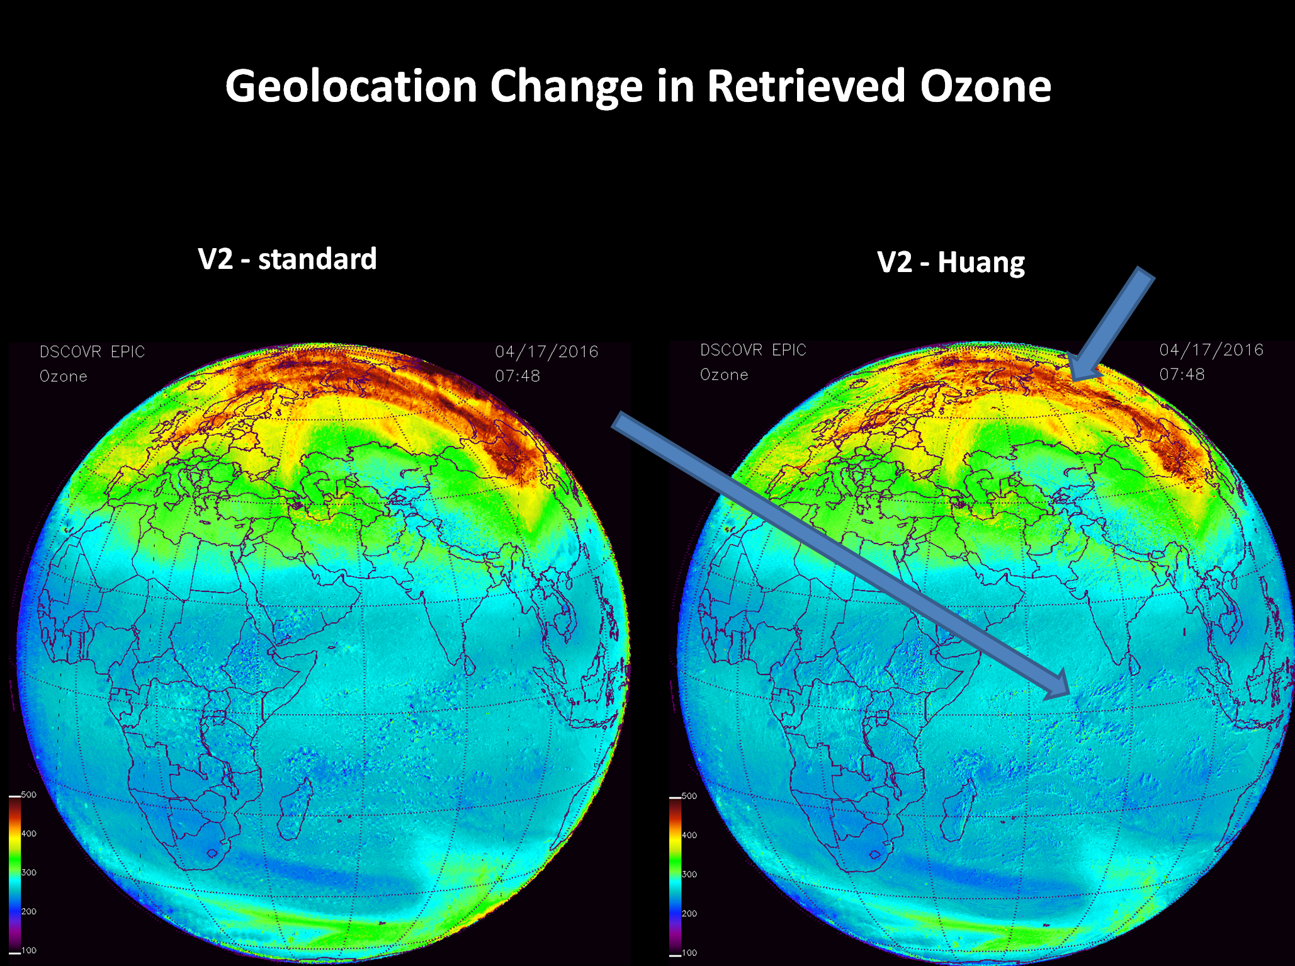

Slide 9
Summary
EPIC UV calculations are sufficient to calculate UV science products at a useful level of accuracy and precision
Improved geolocation methods will reduce errors arising from small remaining misalignment of the filter images
A modification of CCD flat-fielding is being investigated for further reduction of apparent noise in retrieval algorithms

