Slide 1

MAIAC:
Spectral Aerosol Absorption and Height from DSCOVR EPIC
Alexei Lyapustin, GSFC
Sujung Go (UMBC), M. Choi (UMBC)
Y. Wang (UMBC), S. Korkin (USRA)
DSCOVR STM
NASA GSFC, September 27-29, 2022

Slide 2
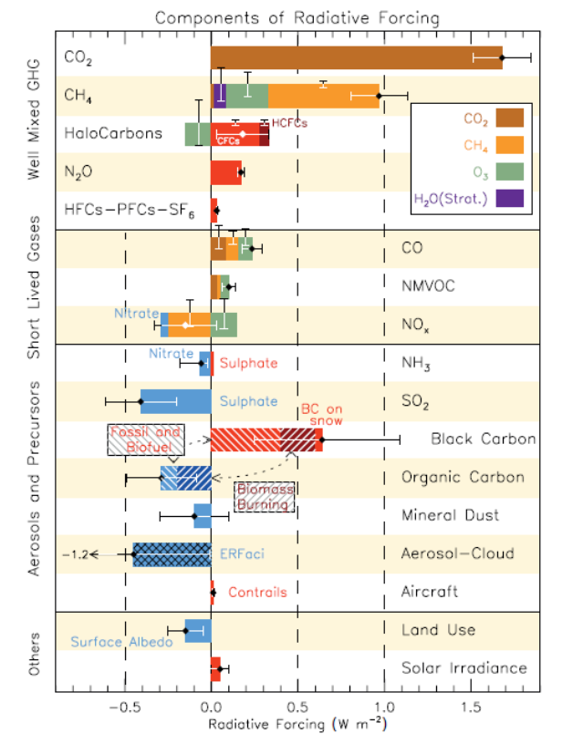
MAIAC v2 Overview
MAIAC v2 includes:
  i) standard processing (aerosol retrieval with climatological regional aerosol models and atmospheric correction),
  ii) advanced aerosol retrieval and speciation algorithm (land only)
Reported products (standard algorithm):
  CM, QA, AOD_{0.44}, spectral BRF, and BRDF model parameters over land;
  AOD-FMF, water leaving reflectance over ocean;
Reported products (3D algorithm based on UV-Vis):
  AOD, refIM(λ), SSA (for Hª=1km and 4km)
  Speciation information on main absorbers for smoke (Bc/BrC) and dust (Hematite/Goethite)
from IPCC AR5
1. Lyapustin A, Wang Y, Go S, Choi M, Korkin S, Huang D, Knyazikhin Y, Blank K and Marshak A (2021) Atmospheric Correction of DSCOVR EPIC: Version 2 MAIAC Algorithm. Front. Remote Sens. 2:748362. doi: 10.3389/frsen.2021.748362.
2. Lyapustin A., Go S., Korkin S., Wang Y., Torres O., Jethva H. and Marshak A. (2021) Retrievals of Aerosol Optical Depth and Spectral Absorption From DSCOVR EPIC. Front. Remote Sens. 2:645794. doi: 10.3389/frsen.2021.645794.
3. Go, S., Lyapustin, A., Schuster, G. L., Choi, M., Ginoux, P., Chin, M., Kalashnikova, O., Dubovik, O., Kim, J., Silva, A. D., Holben, B., and Reid, J. S.: Inferring iron oxides species content in atmospheric mineral dust from DSCOVR EPIC observations, Atmos. Chem. Phys. Discuss. https://doi.org/10.5194/acp-2021-599, in review, 2021.
4. Choi, M., A. Lyapustin, G. Schuster, S. Go, et al. Retrieval of BC and BrC smoke aerosol components from DSCOVR EPIC, Atmos. Chem. Phys. (to be submitted, 2022).

Slide 3
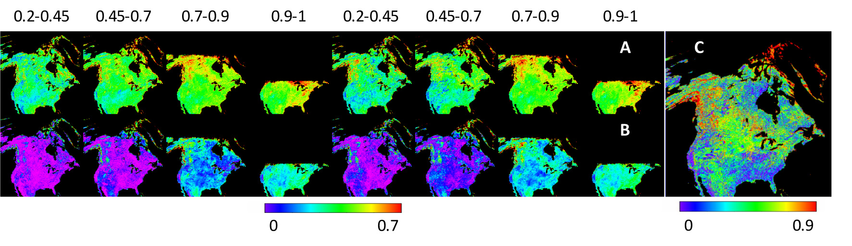

MAIAC EPIC AOD – refIM Algorithm (3D)
  Minimum Reflectance Method to characterize spectral SR ratio at 340, 388, 443 and 680nm in 4 SZA bins
  Absorbing dust aerosols detection using AI (340-388)
  Absorption model: k_{λ}= k₀ (λ/ λ₀)^{-b} where λ₀ = 680nm
  (in the limit of small particles, AAE~b+1, where Absorption Ångström Exponent AAE is defined for the AAOD).
  Real refIM and size distribution are fixed. The results are reported for Hª=1 and 4km for smoke and dust.
  AOD-k₀-b retrieval using Levenberg-Marquart optimal fit of 340, 388, 443 and 680nm:
  F² = $1/N\sum{({\frac{L_{λ}^{m}−L_{λ}^{t}}{L_{λ}^{m}})}^{2}}$=min{AOD₄₄₃, k₀, b}
  LUT-based retrievals on a 4x4 matrix of b={0.1, 1.5, 3, 4} and k₀ ={0.001, 0.006, 0.011, 0.016} - smoke
  {0.0006, 0.0014, 0.0022, 0.003} - dust.
Example for NA:
443/680
388/680
340/388

Slide 4
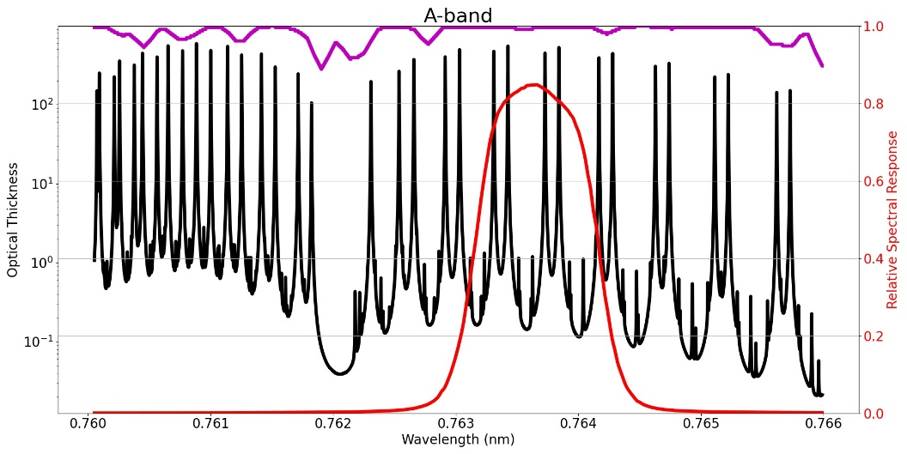
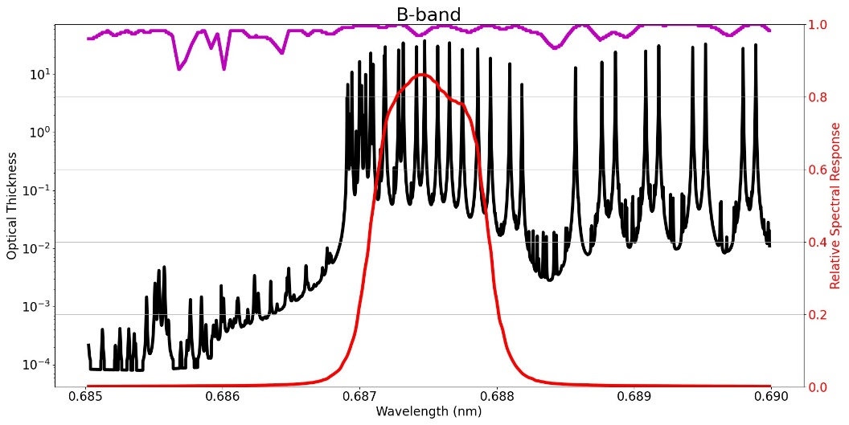
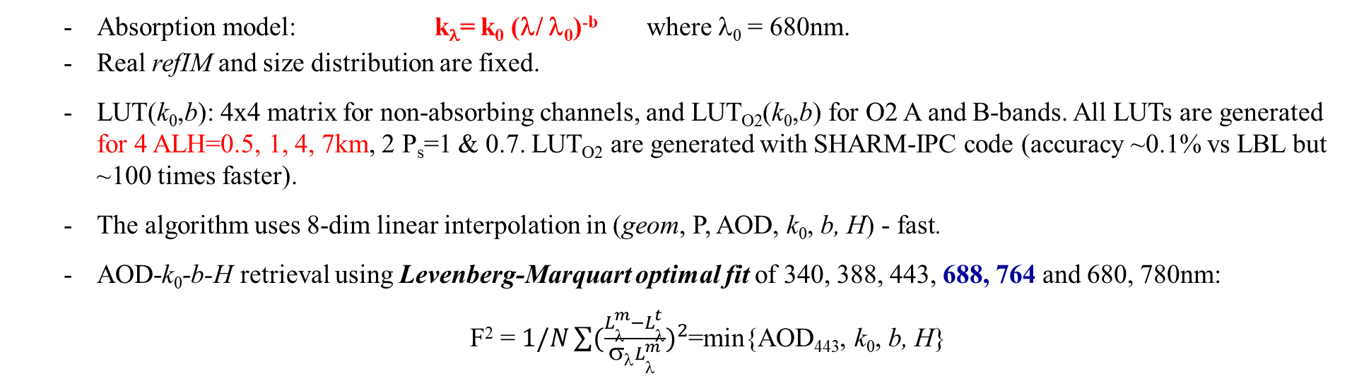
AOD – k₀ – SAE - ALH Algorithm (4D)
  Absorption model: k_{λ}= k₀ (λ/ λ₀)^{-b} where λ₀ = 680nm.
  Real refIM and size distribution are fixed.
  LUT(k₀,b): 4x4 matrix for non-absorbing channels, and LUT_{O2}(k₀,b) for O2 A and B-bands. All LUTs are generated for 4 ALH=0.5, 1, 4, 7km, 2 P_{s}=1 & 0.7. LUT_{O2} are generated with SHARM-IPC code (accuracy ~0.1% vs LBL but ~100 times faster).
  The algorithm uses 8-dim linear interpolation in (geom, P, AOD, k₀, b, H) - fast.
  AOD-k₀-b-H retrieval using Levenberg-Marquart optimal fit of 340, 388, 443, 688, 764 and 680, 780nm:
  F² = $1/N\sum{({\frac{L_{λ}^{m}−L_{λ}^{t}}{σλL_{λ}^{m}})}^{2}}$=min{AOD₄₄₃, k₀, b, H}
Lyapustin, A., 2003: Interpolation and Profile Correction (IPC) method for shortwave radiative transfer in spectral intervals of gaseous absorption. J. Atmos. Sci., 60, 865-871

Slide 5
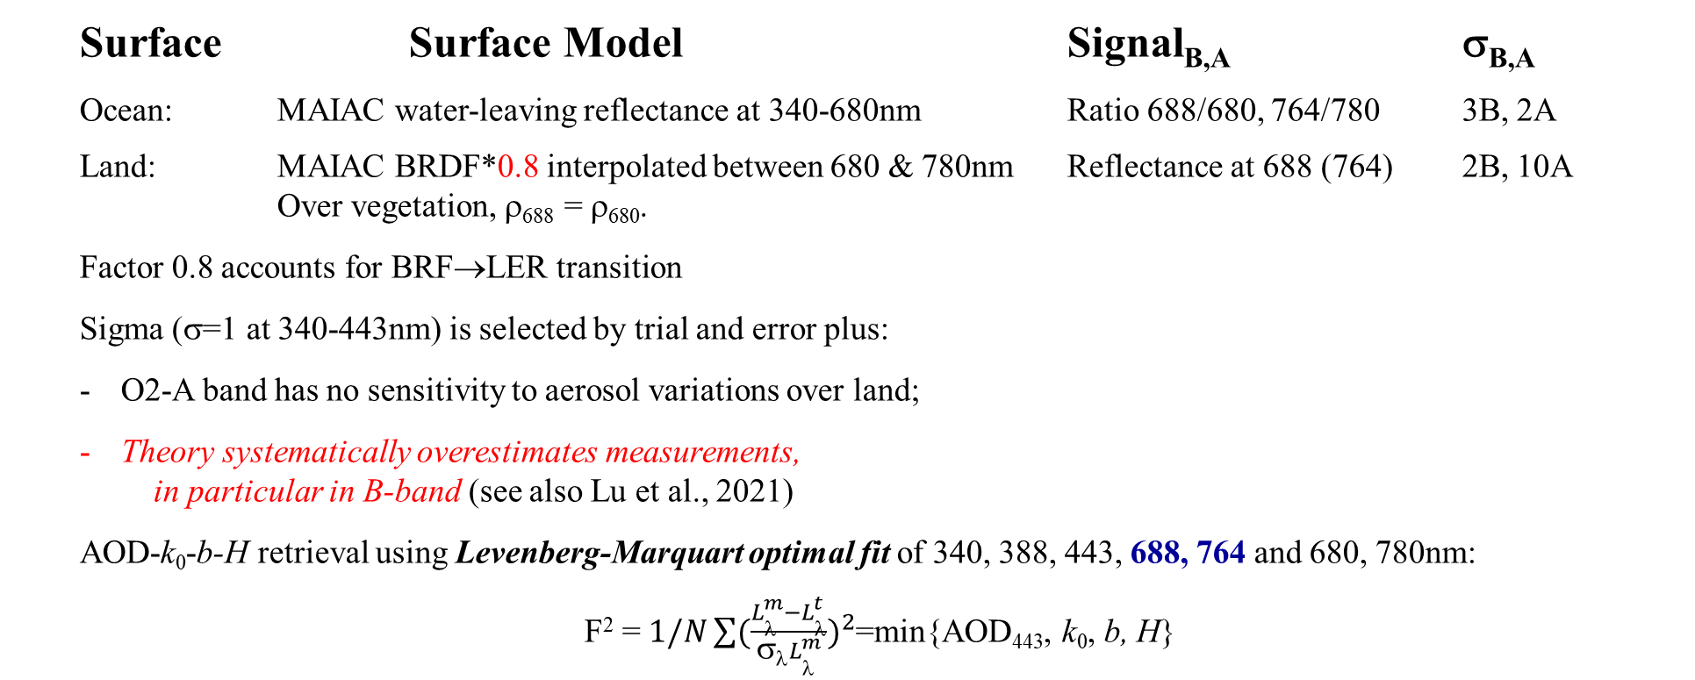
AOD – k₀ – SAE - ALH Algorithm
  Surface Surface Model Signal_{B,A} σ_{B,A}
  Ocean: MAIAC water-leaving reflectance at 340-680nm Ratio 688/680, 764/780 3B, 2A
  Land: MAIAC BRDF*0.8 interpolated between 680 & 780nm Reflectance at 688 (764) 2B, 10A
  Over vegetation, ρ₆₈₈ = ρ₆₈₀.
  Factor 0.8 accounts for BRF→LER transition
  Sigma (σ=1 at 340-443nm) is selected by trial and error plus:
  O2-A band has no sensitivity to aerosol variations over land;
  Theory systematically overestimates measurements,
  in particular in B-band (see also Lu et al., 2021)
  AOD-k₀-b-H retrieval using Levenberg-Marquart optimal fit of 340, 388, 443, 688, 764 and 680, 780nm:
  F² = $1/N\sum{({\frac{L_{λ}^{m}−L_{λ}^{t}}{σλL_{λ}^{m}})}^{2}}$=min{AOD₄₄₃, k₀, b, H}
From: Z.Lu et al., FRSen, 2021
Lu Z, Wang J, Xu X, Chen X, Kondragunta S, Torres O, Wilcox EM and Zeng J (2021) Hourly Mapping of the Layer Height of Thick Smoke Plumes Over the Western U.S. in 2020 Severe Fire Season. Front. Remote Sens. 2:766628. doi: 10.3389/frsen.2021.766628
Xu, X., Wang, J., Wang, Y., Zeng, J., Torres, O., Yang, Y., et al. (2017). Passive Remote Sensing of Altitude and Optical Depth of Dust Plumes Using the Oxygen A and B Bands: First Results from EPIC/DSCOVR at Lagrange-1 point. Geophys. Res. Lett. 44 (14), 7544–7554. doi:10.1002/2017gl073939
Xu, X., Wang, J., Wang, Y., Zeng, J., Torres, O., Reid, J. S., et al. (2019). Detecting Layer Height of Smoke Aerosols over Vegetated Land and Water Surfaces via Oxygen Absorption Bands: Hourly Results from EPIC/DSCOVR in Deep Space. Atmos. Meas. Tech. 12 (6), 3269–3288. doi:10.5194/amt-12-3269-2019

Slide 6
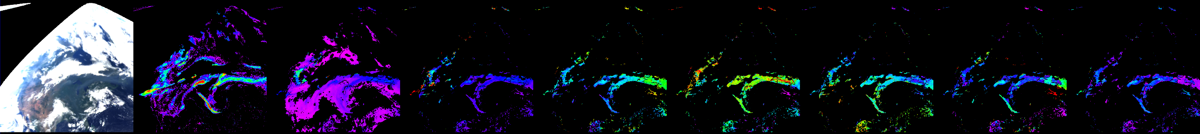
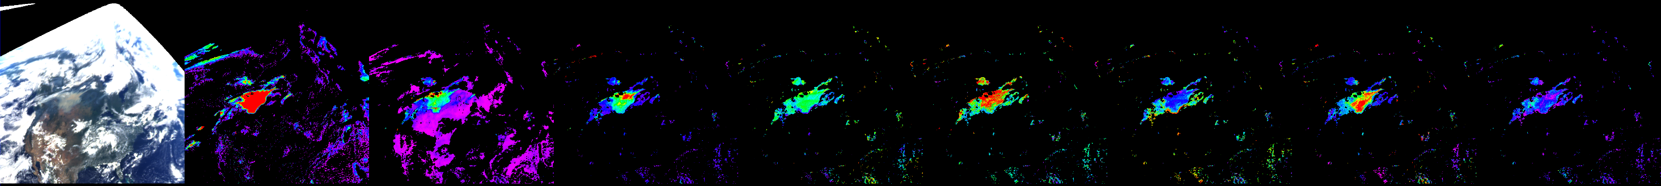
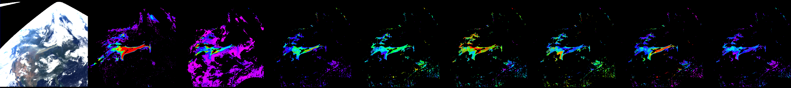
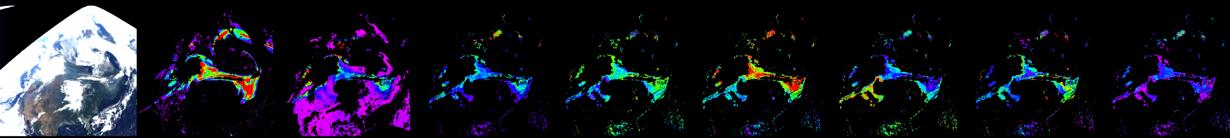
Example: US Fires in August 2018
TOA AI AOD_{Bkgr} AOD_{4D} SSA₄₄₃ SAE k₀ ALH (km) F_{min}
Aug. 13
Aug. 15
Aug. 16
Aug. 24
2 6
0 6
0.85 1
0 4
0. 0.016
0 7
0 10%

Slide 7
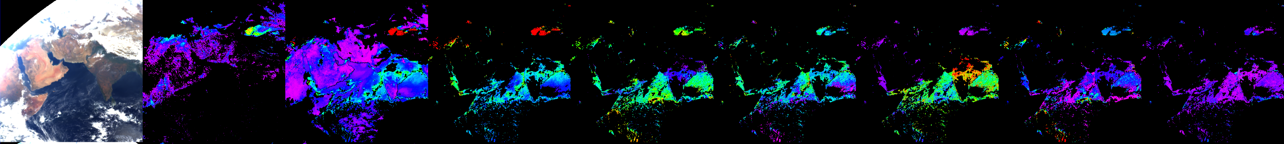
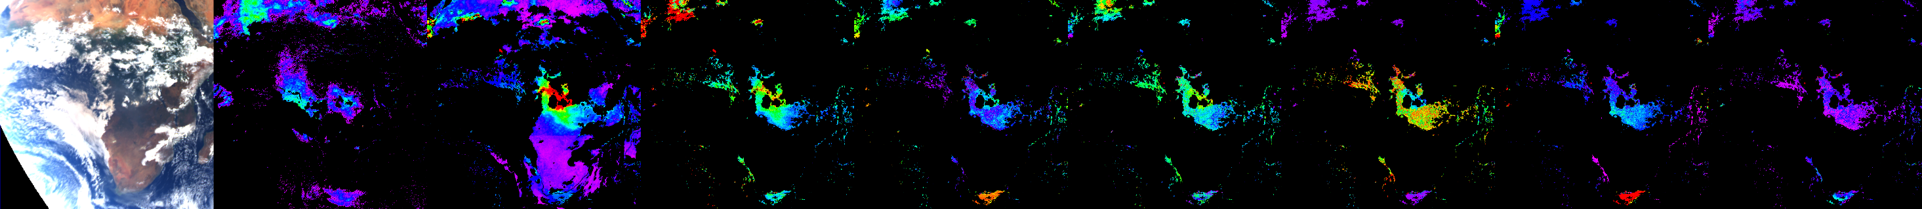
Contrasting Regional Aerosol Properties
TOA AI AOD_{Bkgr} AOD_{4D} SSA₄₄₃ SAE k₀ ALH (km) F_{min}
Mar. 4, 2018
Aug. 9, 2020
Aug. 24, 2018
2 6
0 6
0.85 1
0 4
0. 0.016
0 7
0 10%
USA: Forest wildfires: moderate abs., SSA~0.9-0.94, high SAE (BrC), low-moderate k₀ (BC), ALH can be very high.
India, South Africa biomass burning: bush- and grasslands, agriculture crop residue etc. (low energy fast burning):
high absorption, SSA~0.85-0.88, low-moderate SAE (BrC), high k₀ (BC), ALH is low (<1-1.5km).

Slide 8
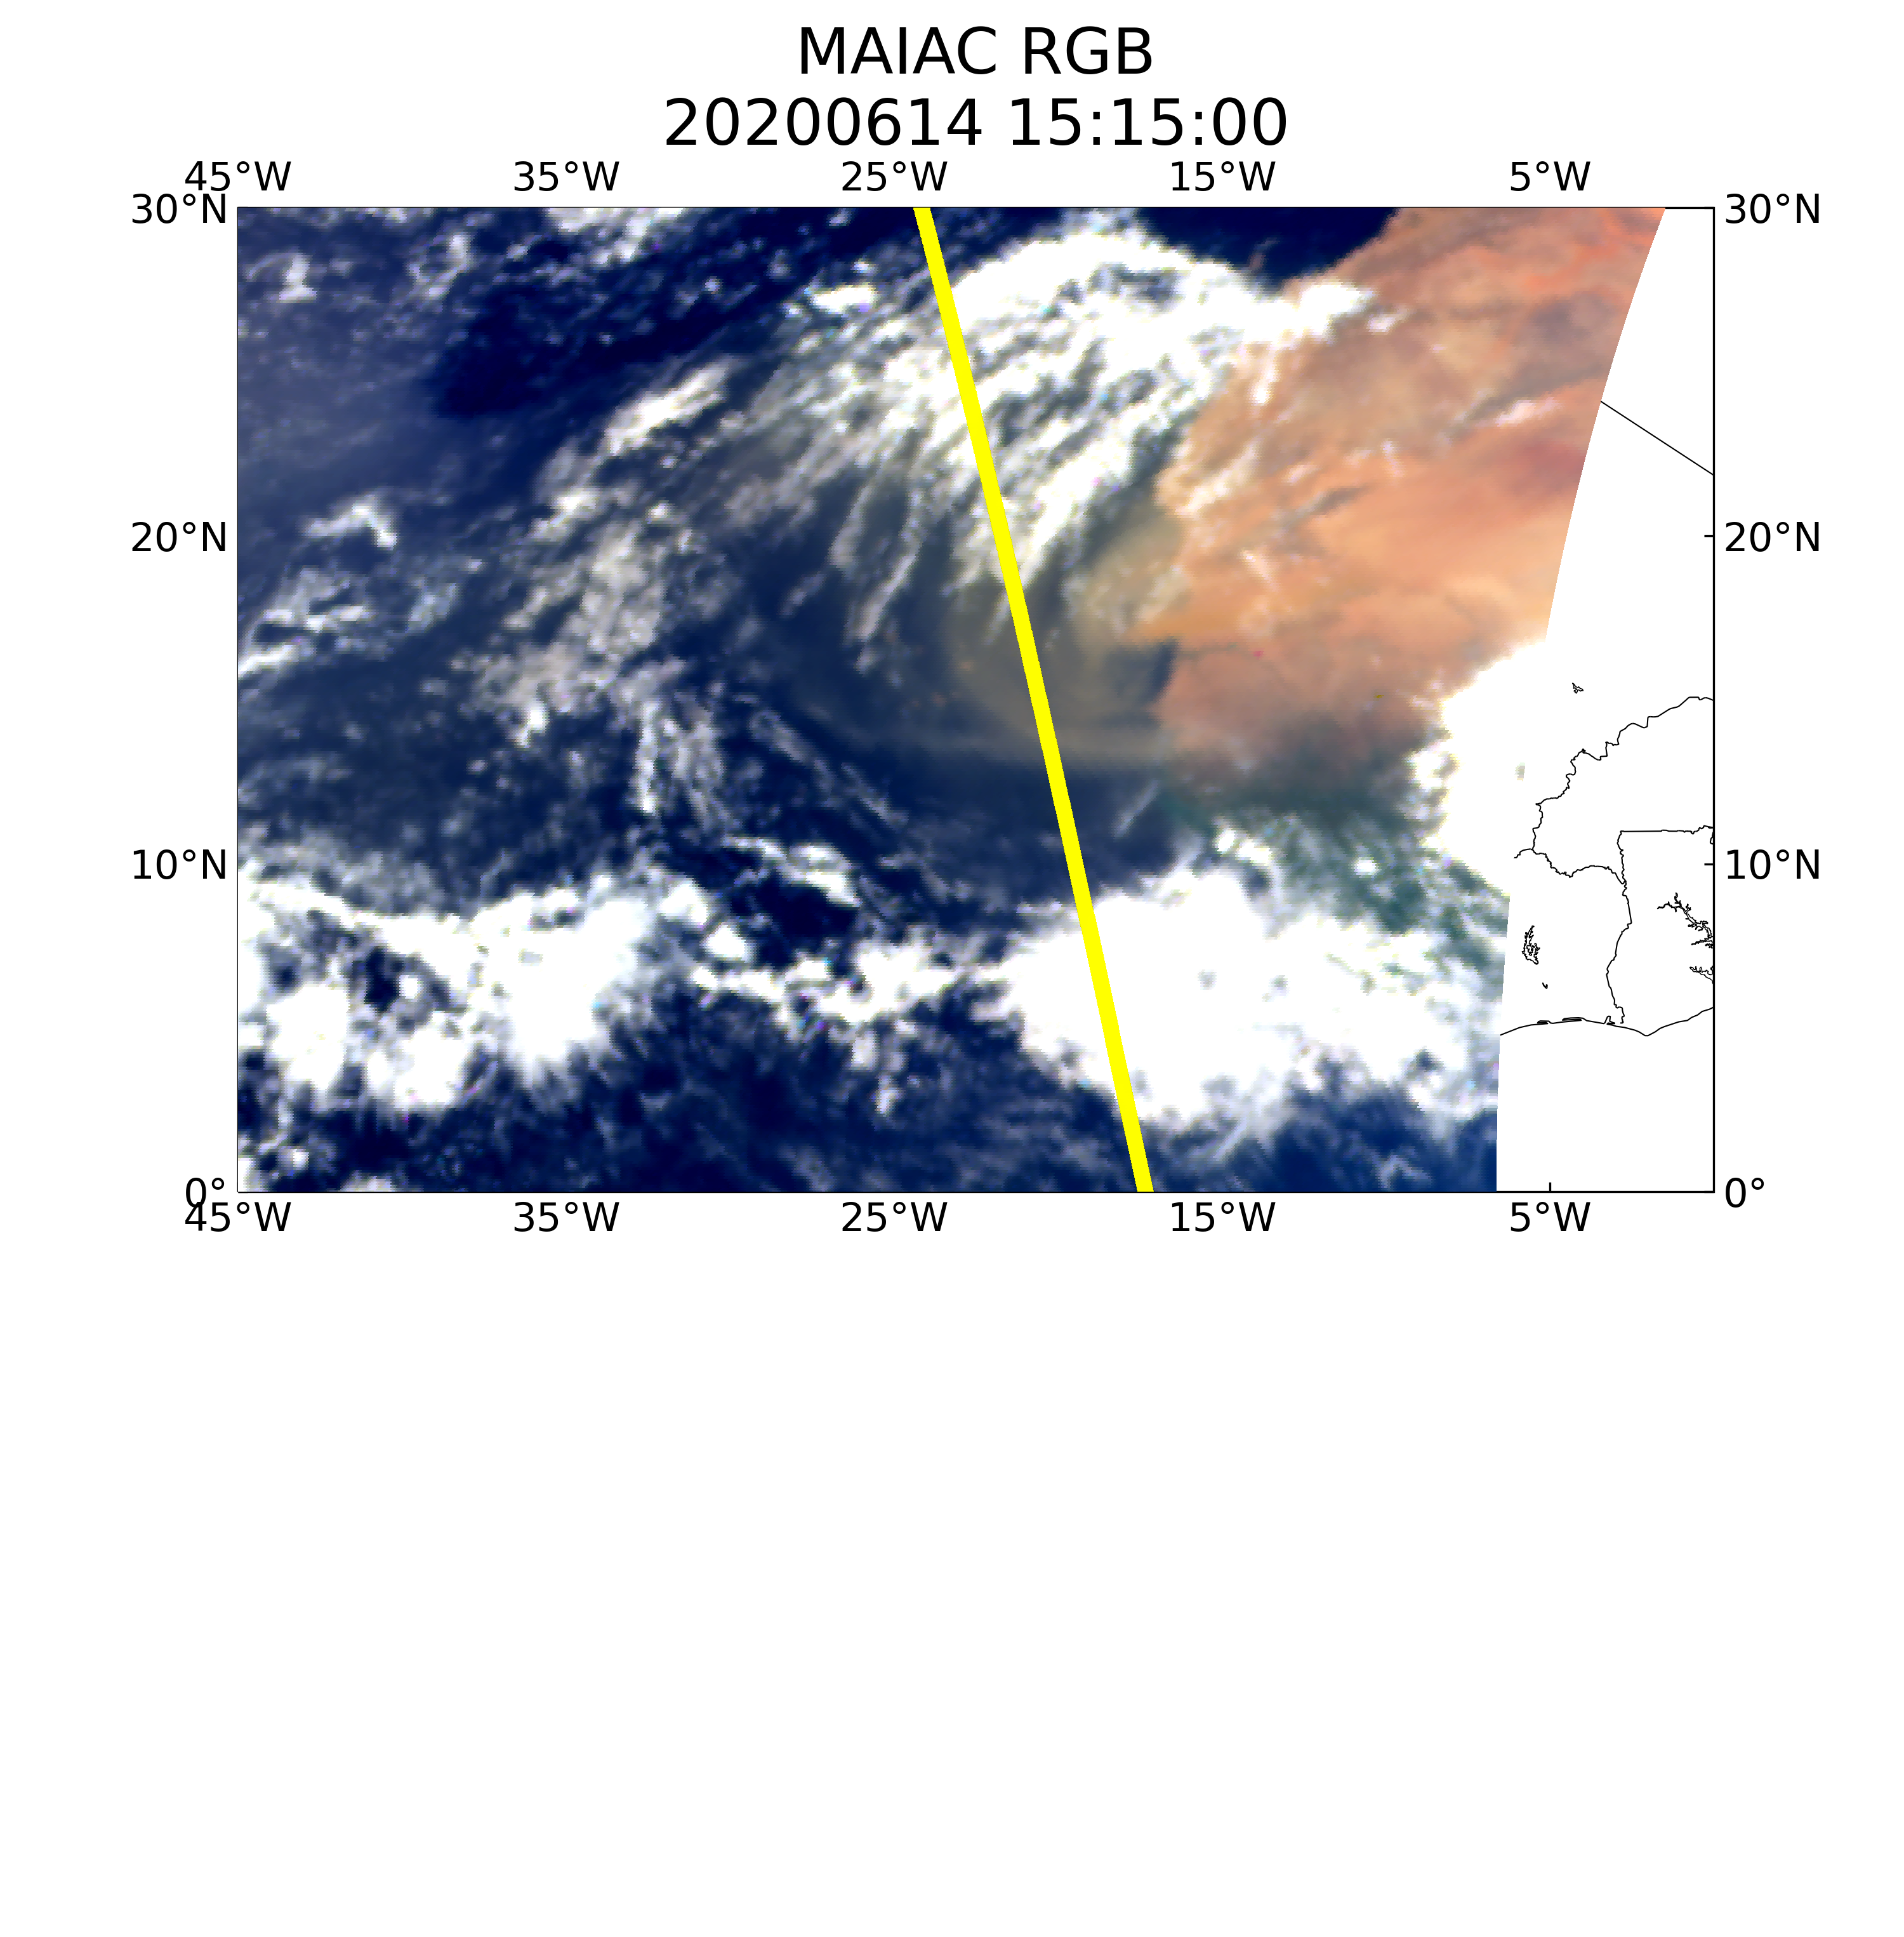
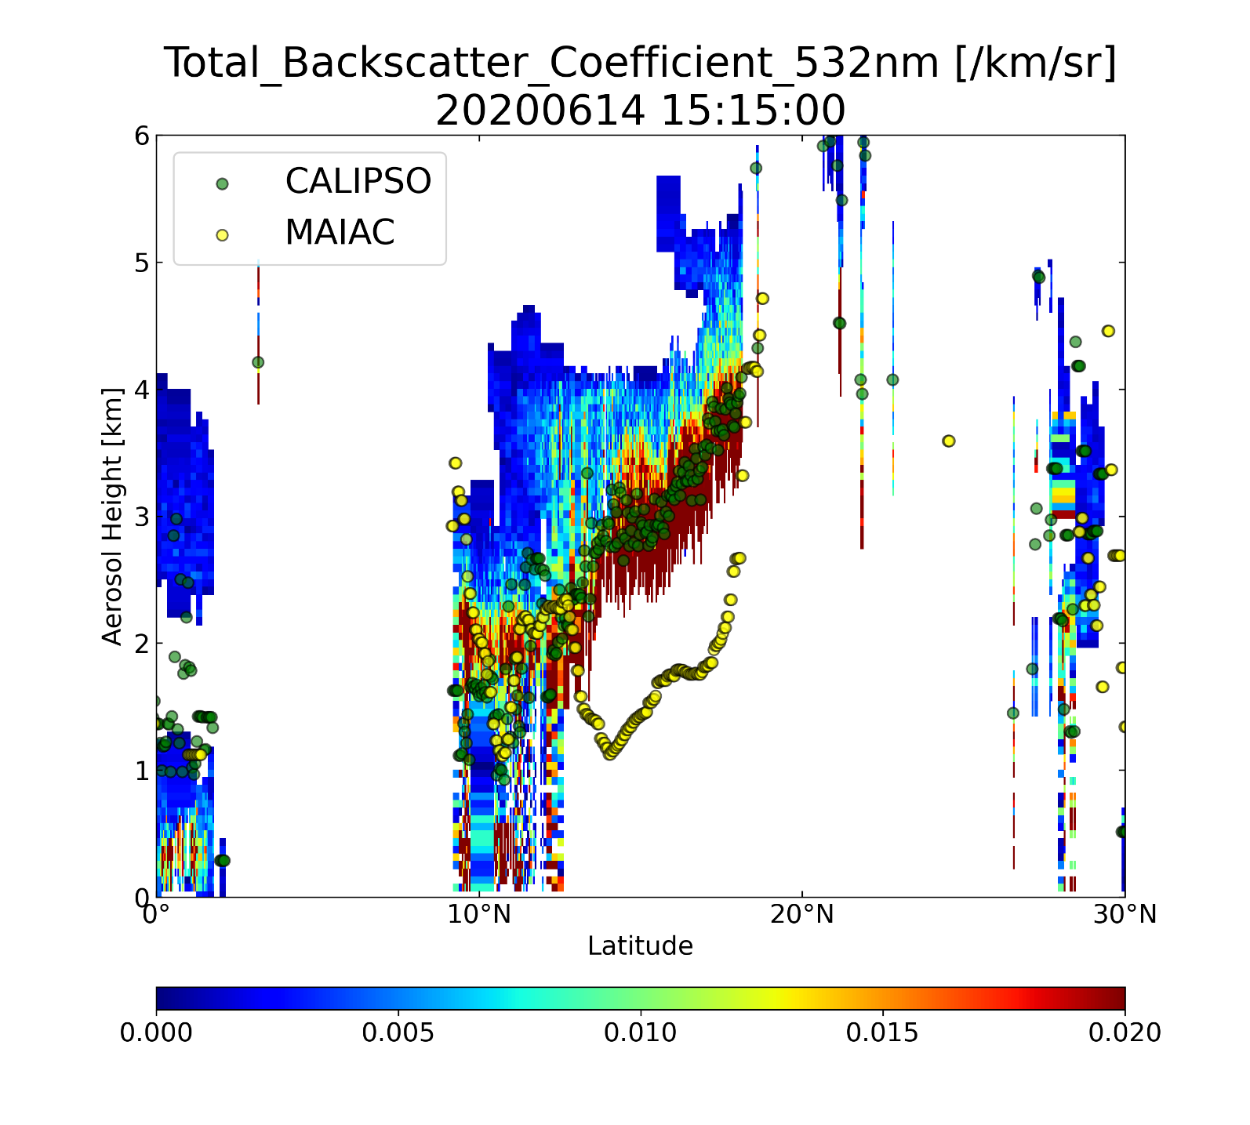
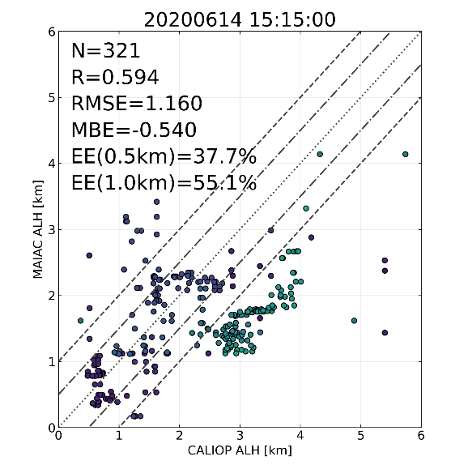
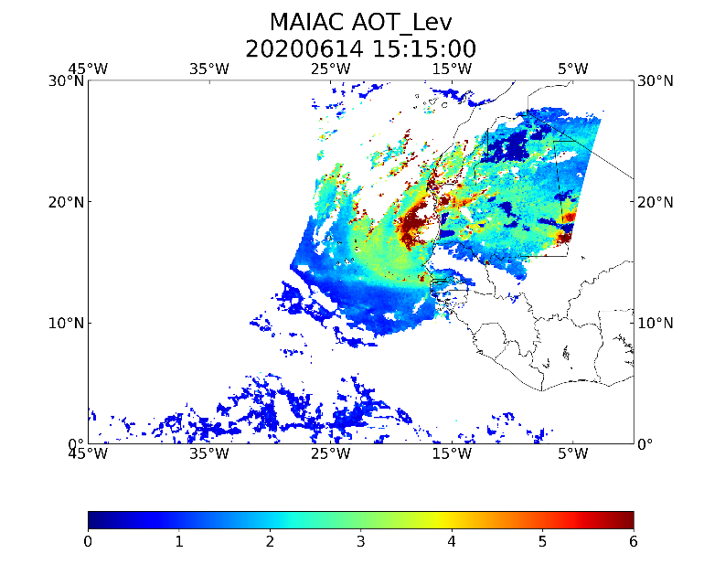
CALIOP ALH Evaluation

Slide 9
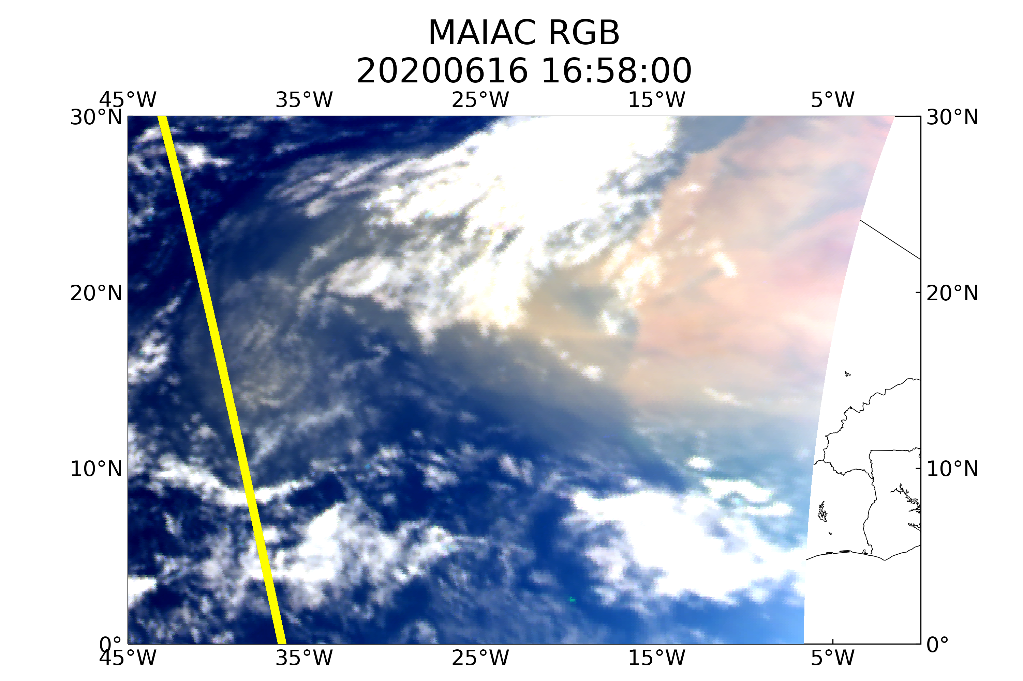
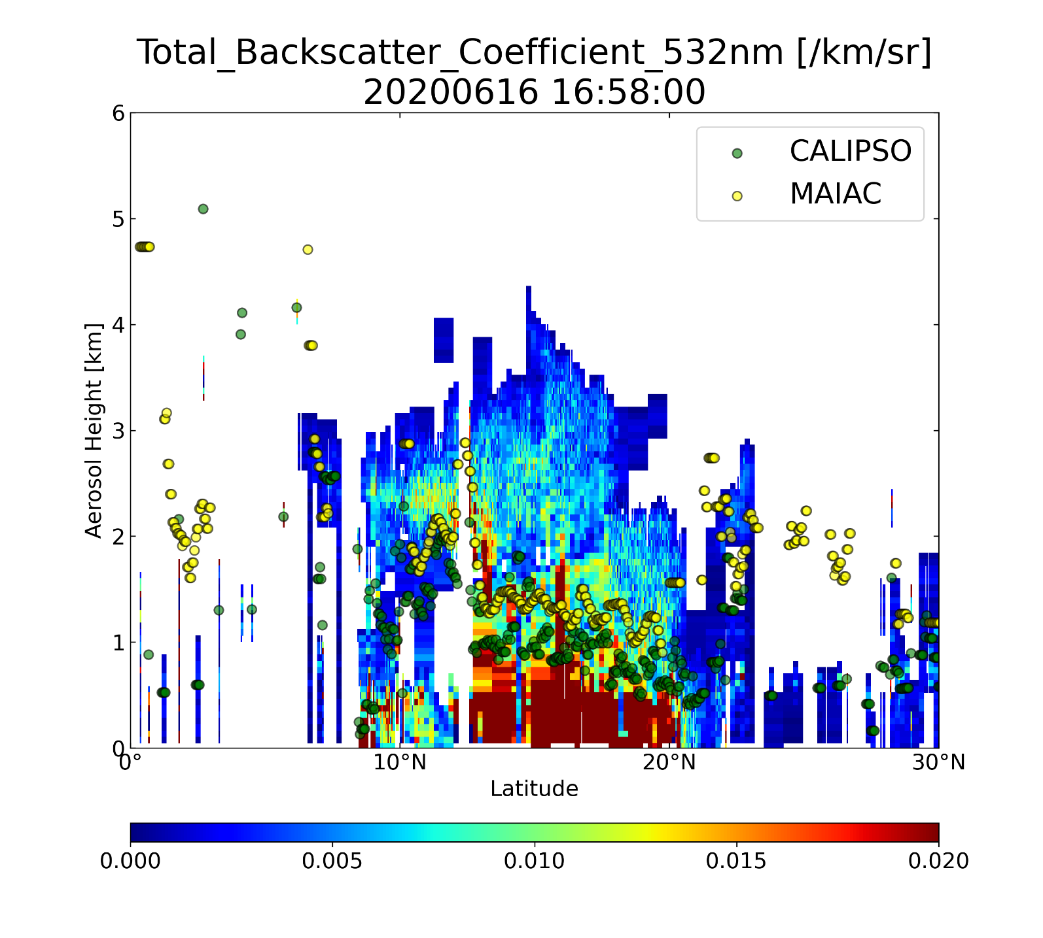
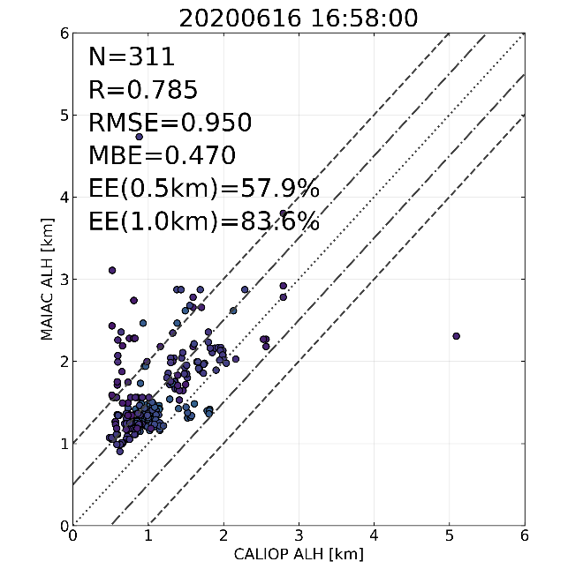
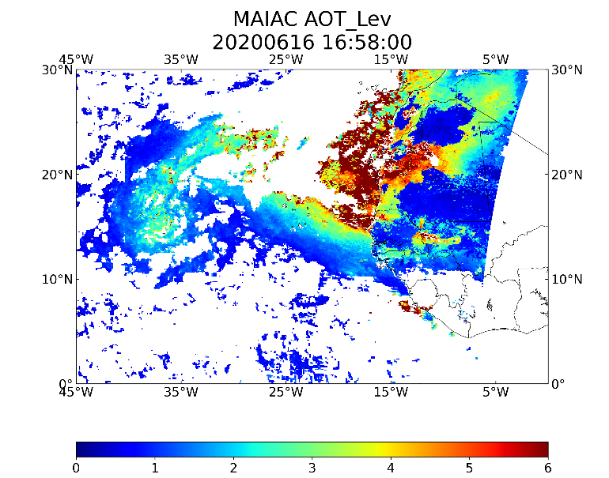
CALIOP ALH Evaluation

Slide 10
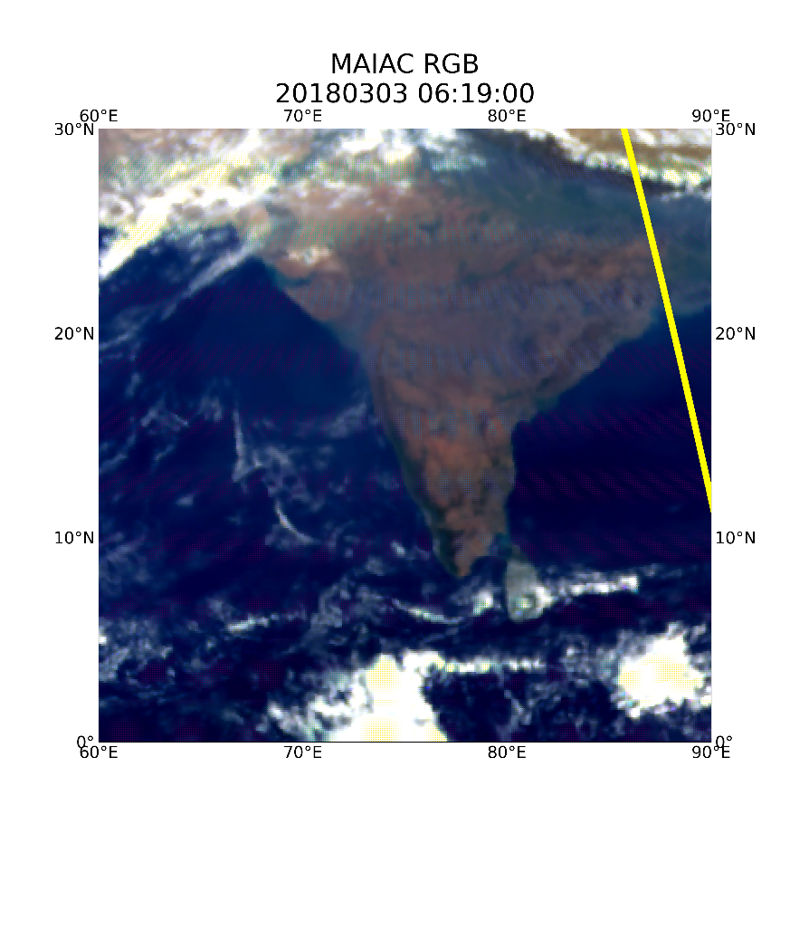
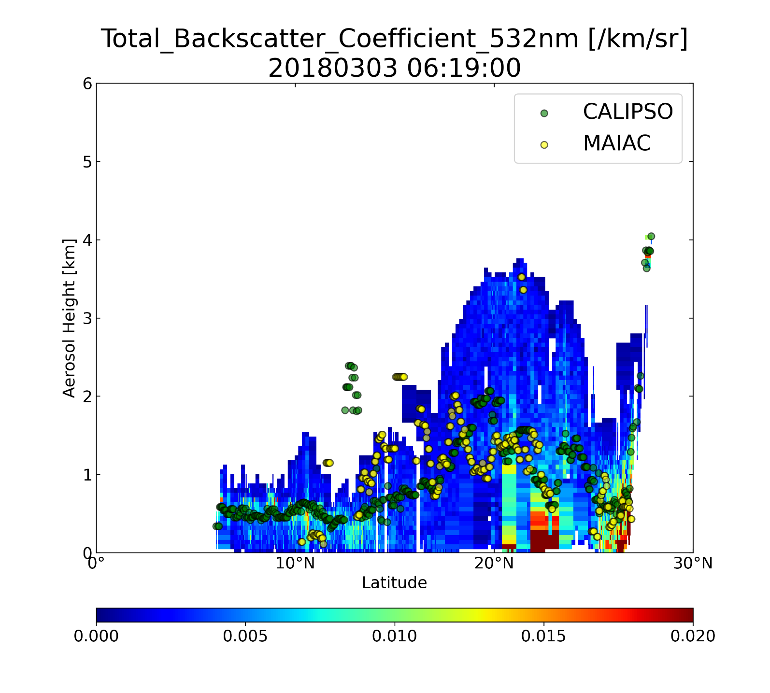
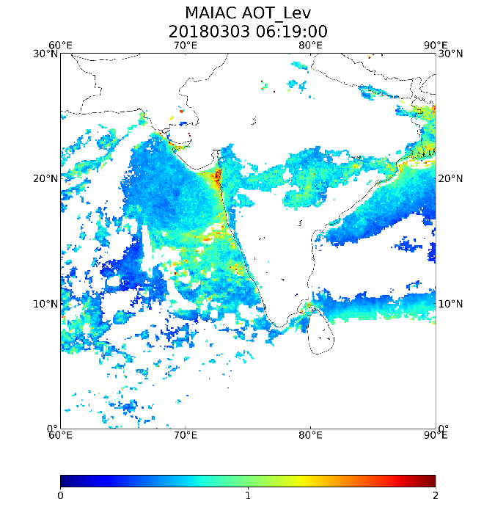
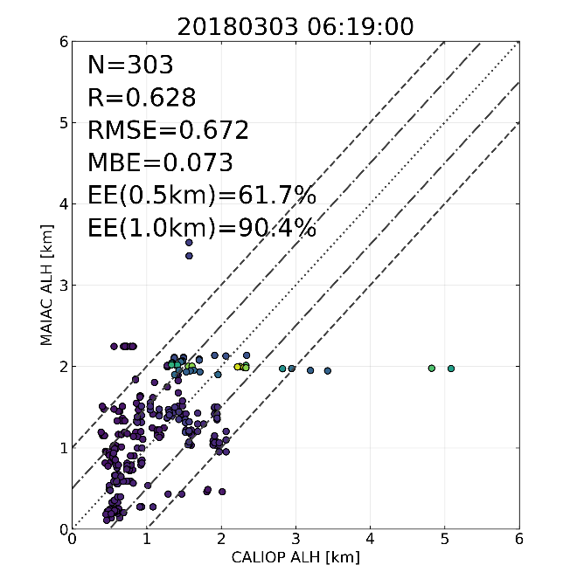
CALIOP ALH Evaluation

Slide 11
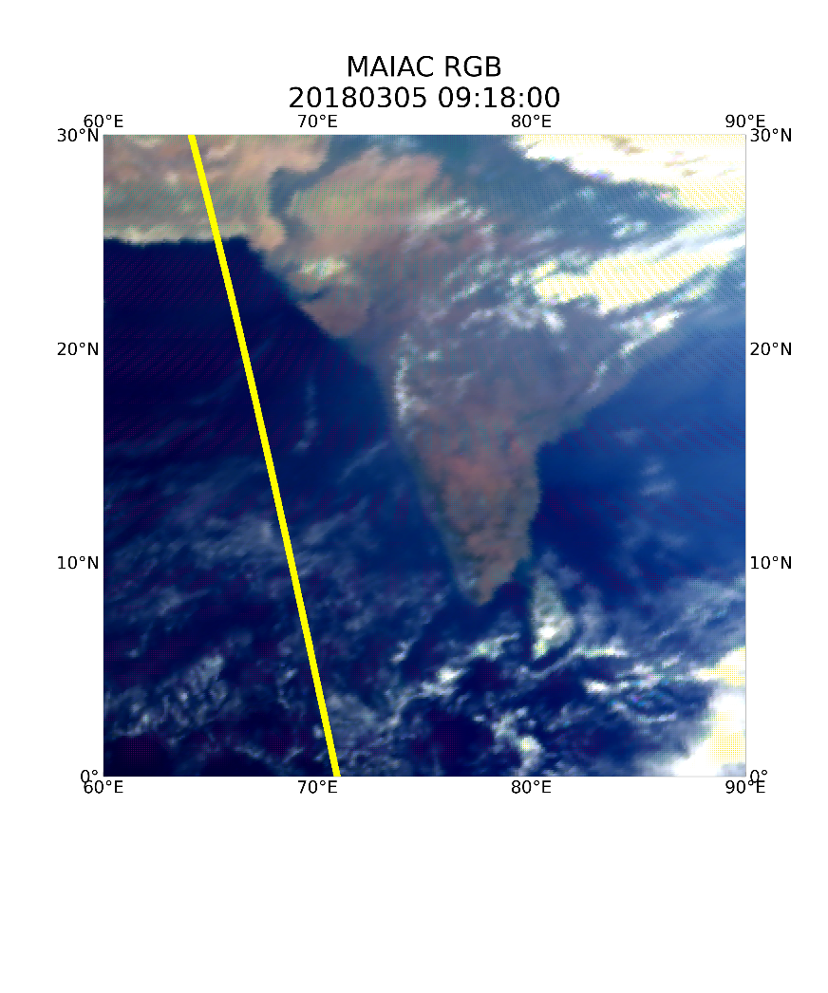
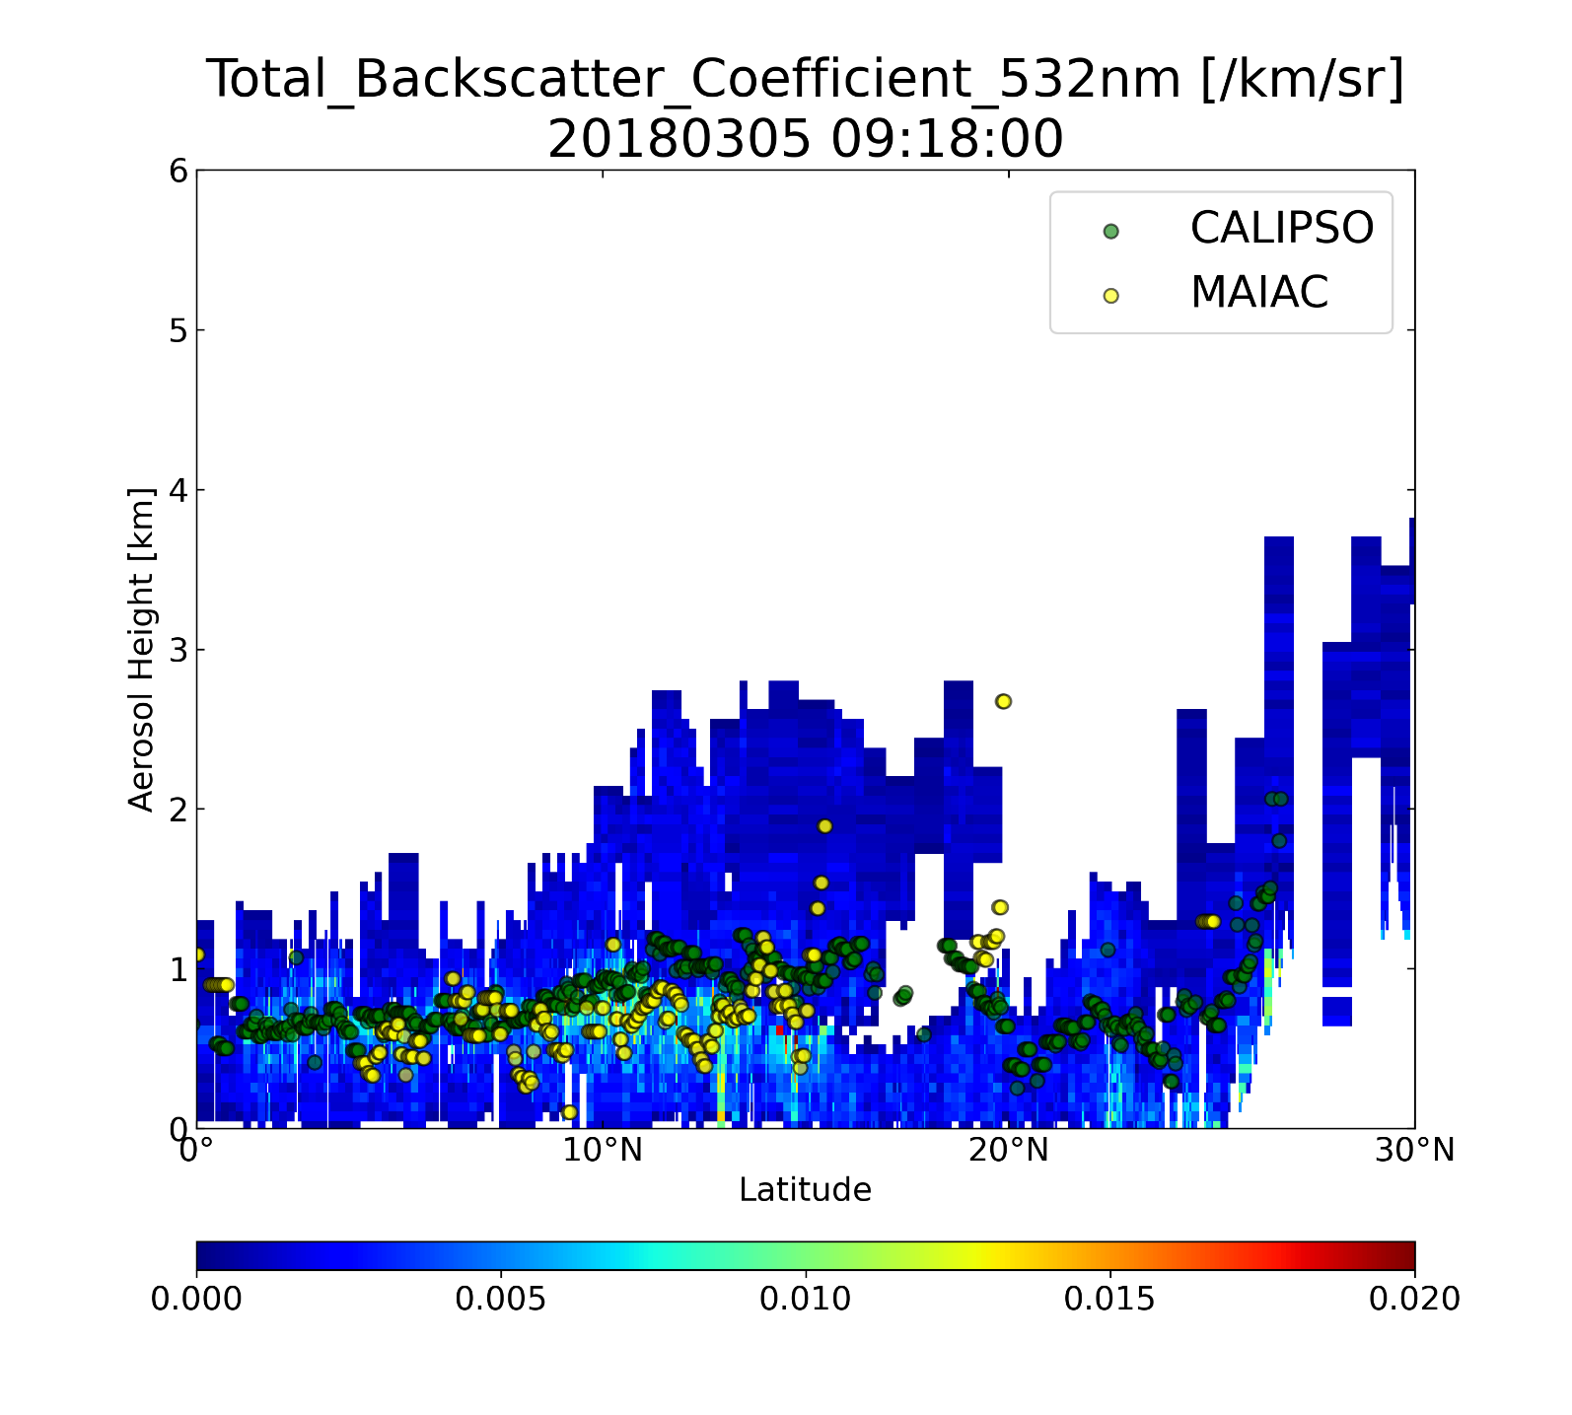
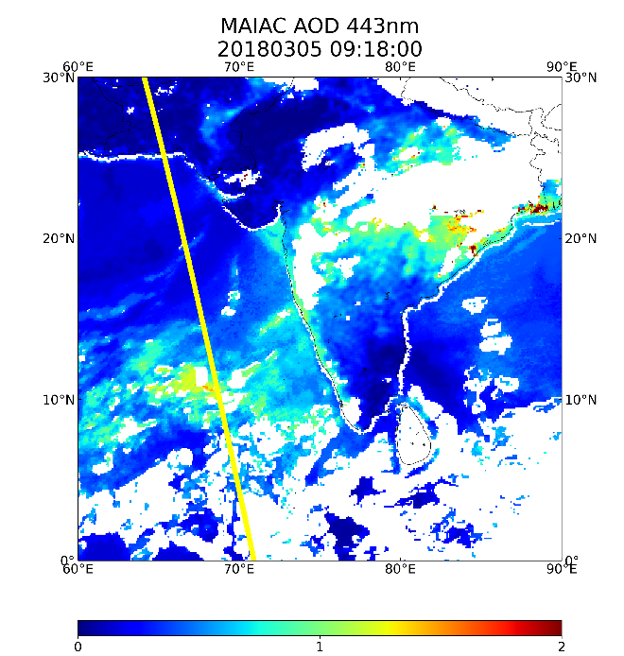
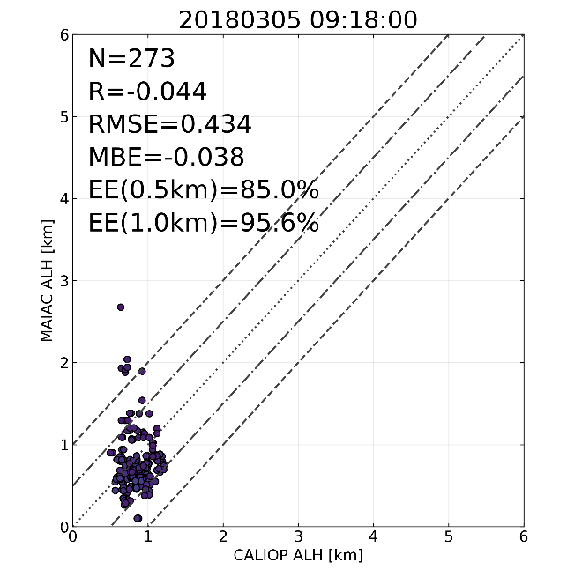
CALIOP ALH Evaluation

Slide 12
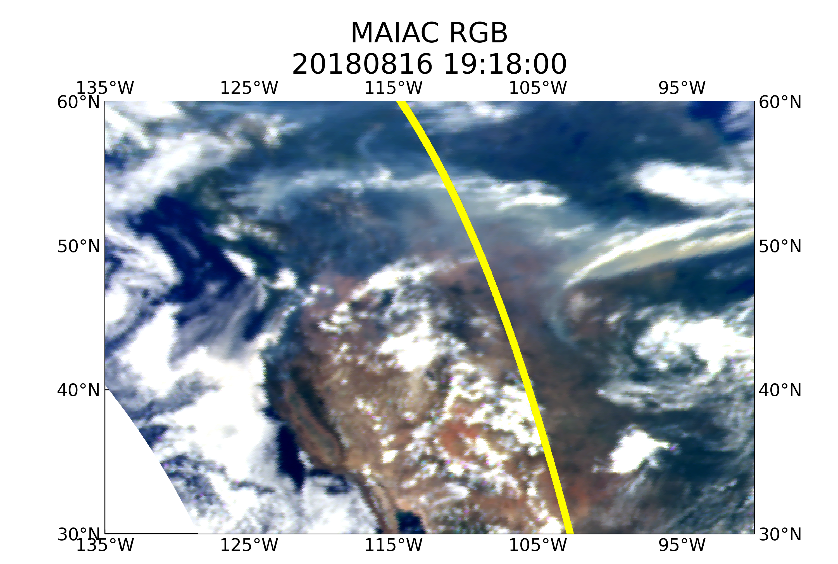
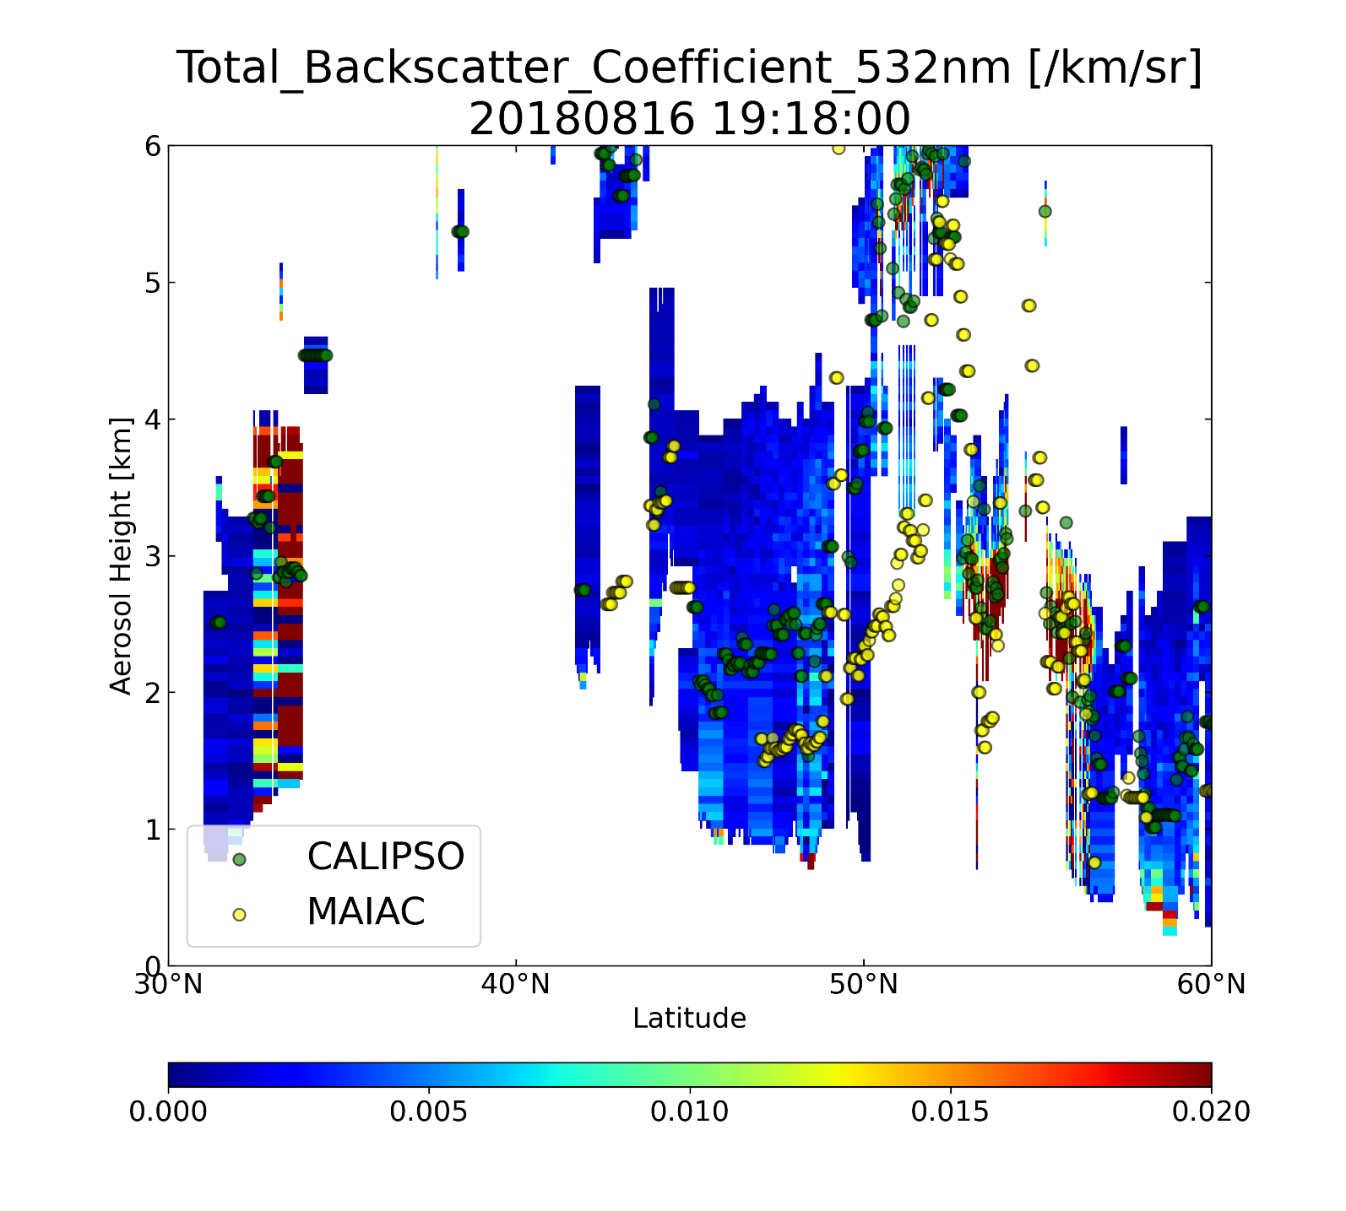
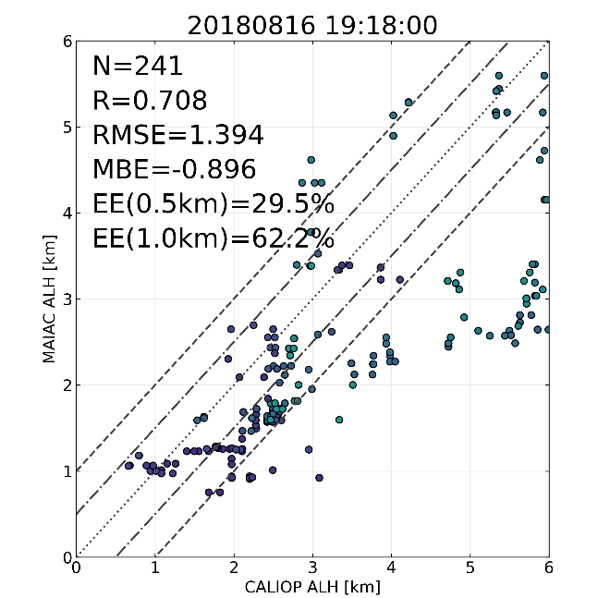
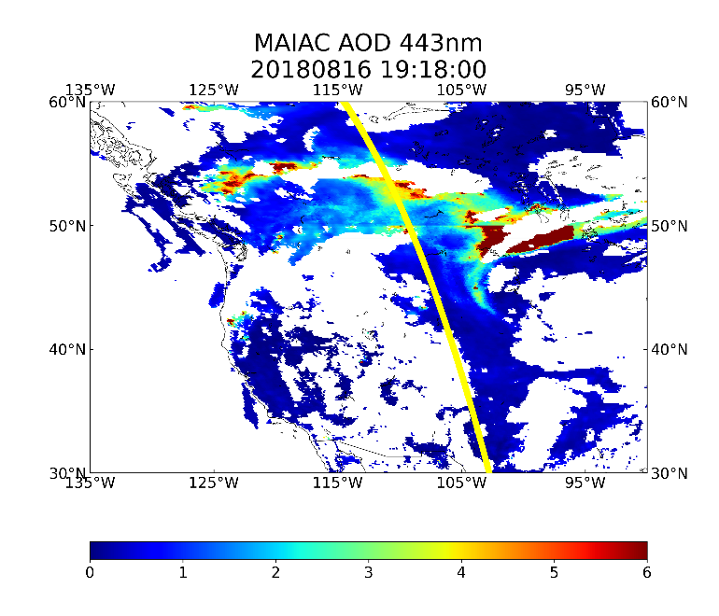
CALIOP ALH Evaluation

Slide 13

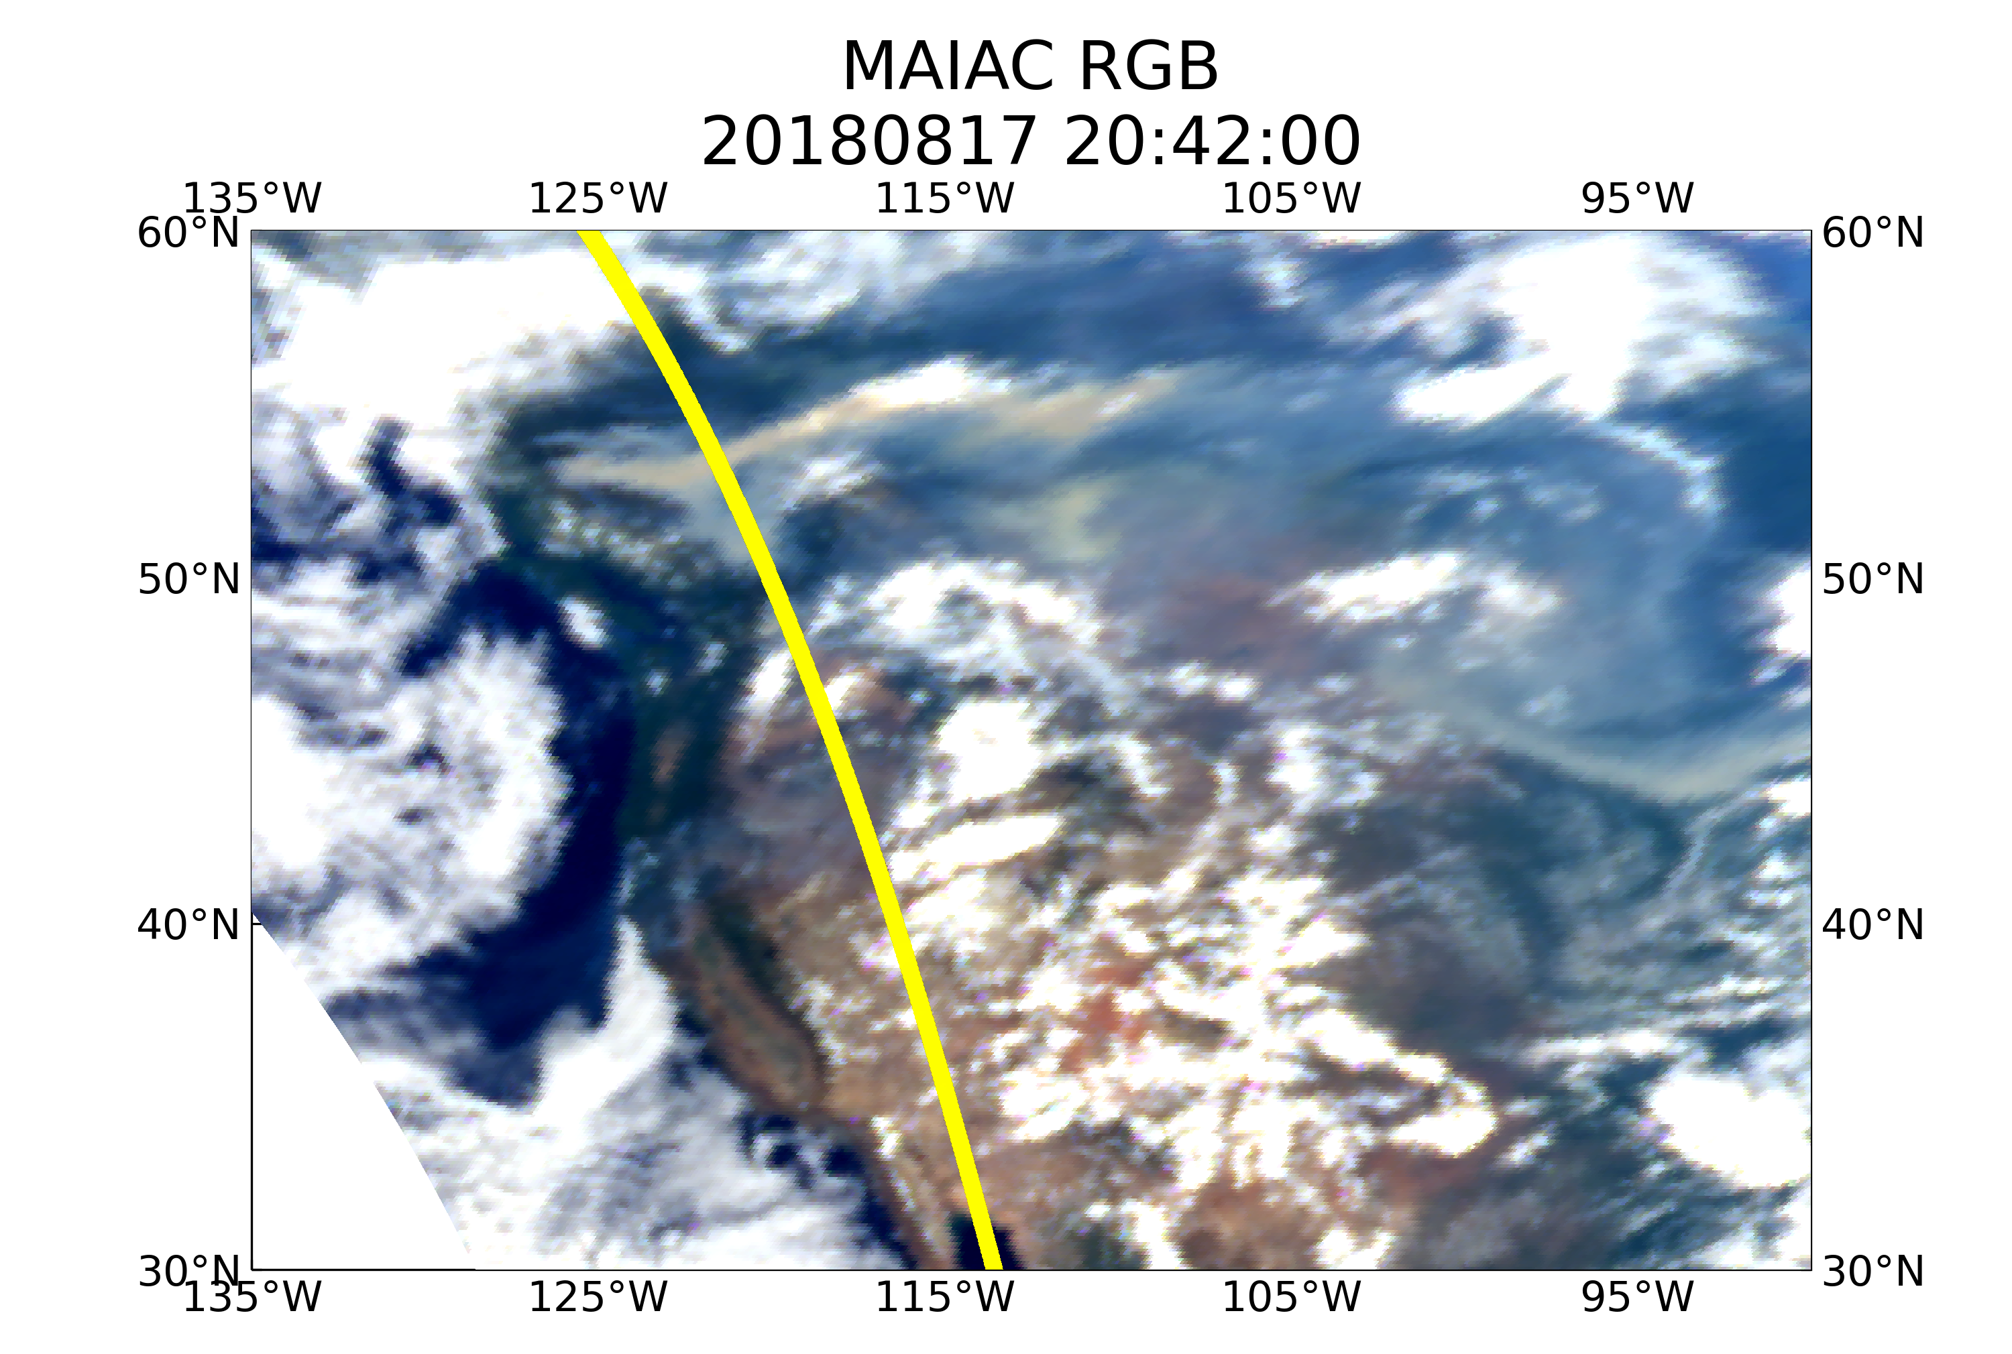
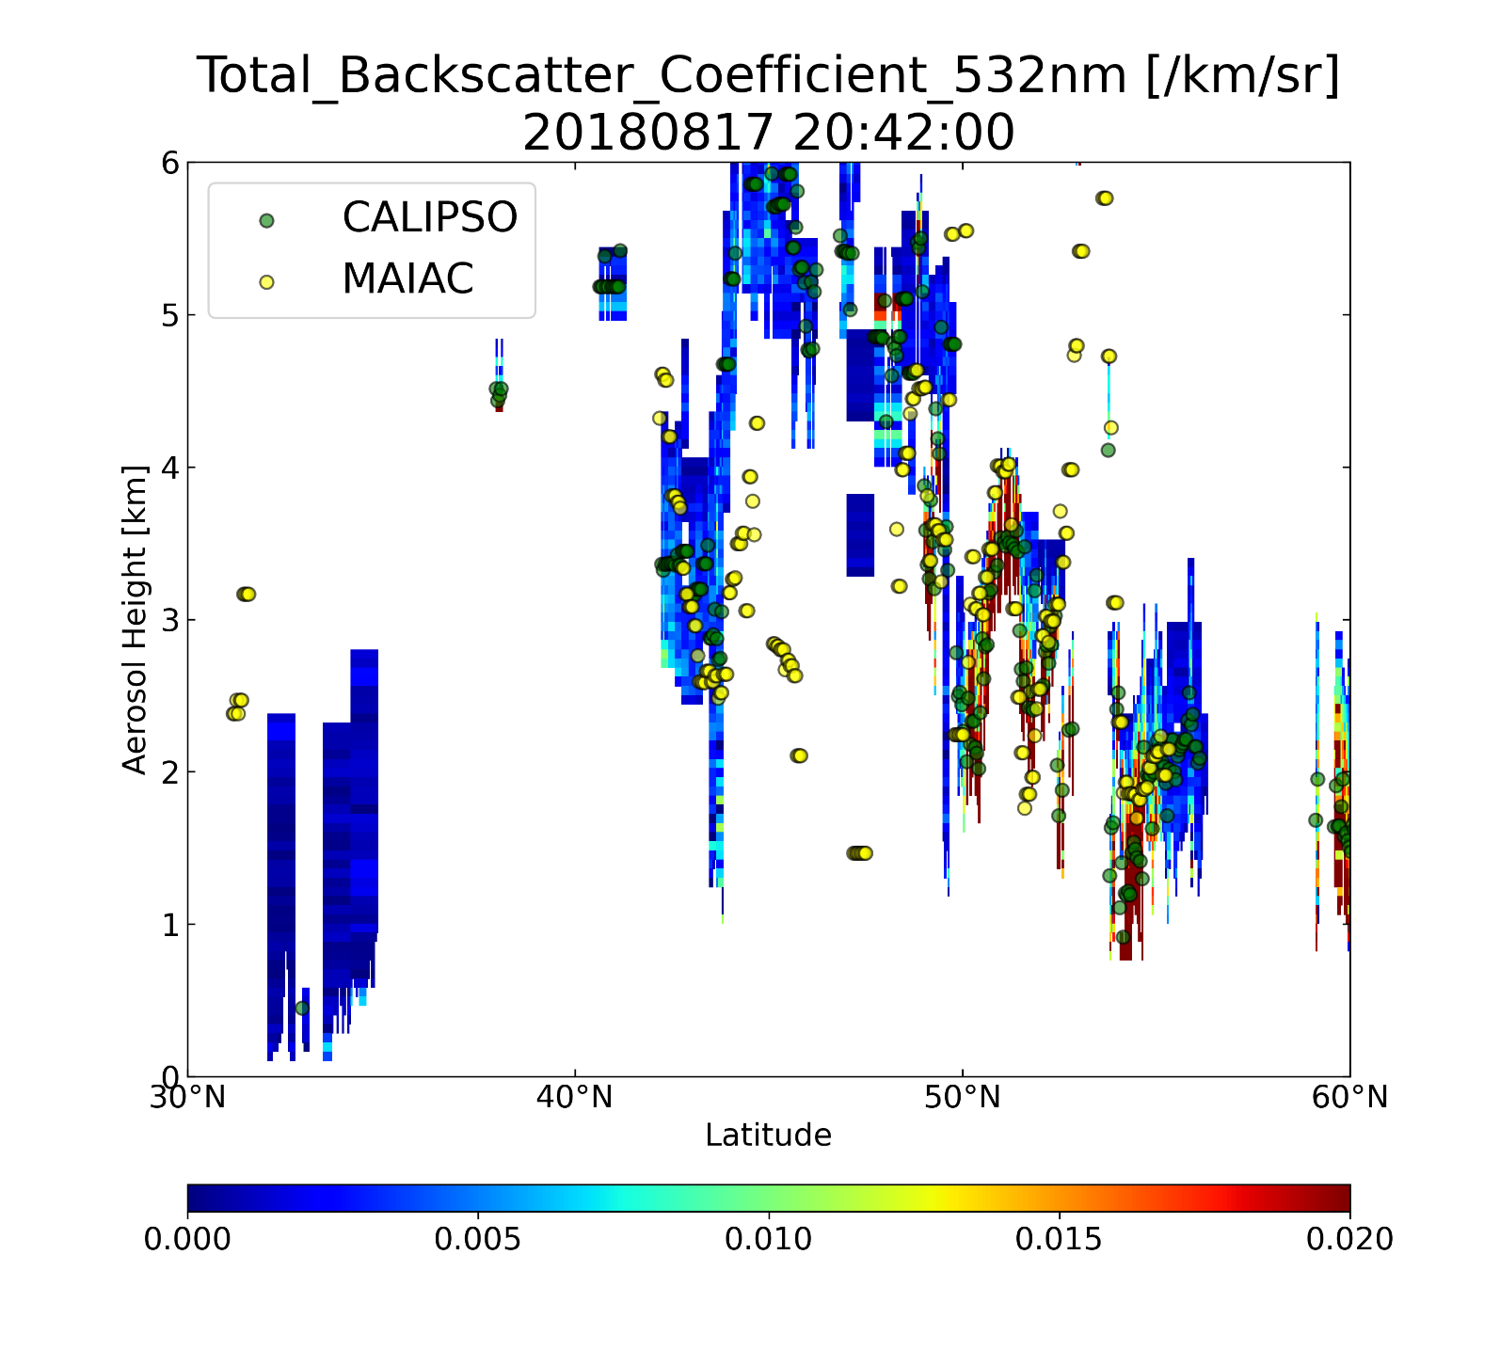
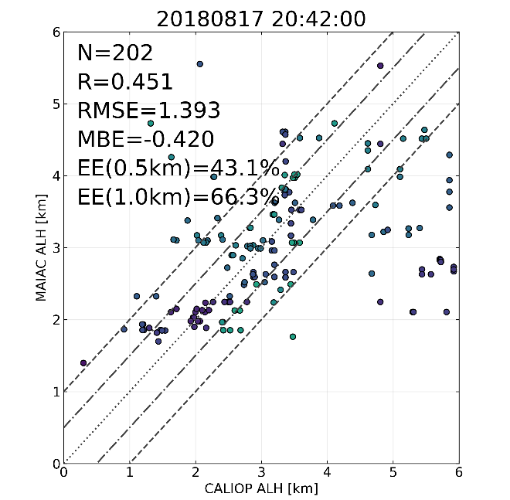
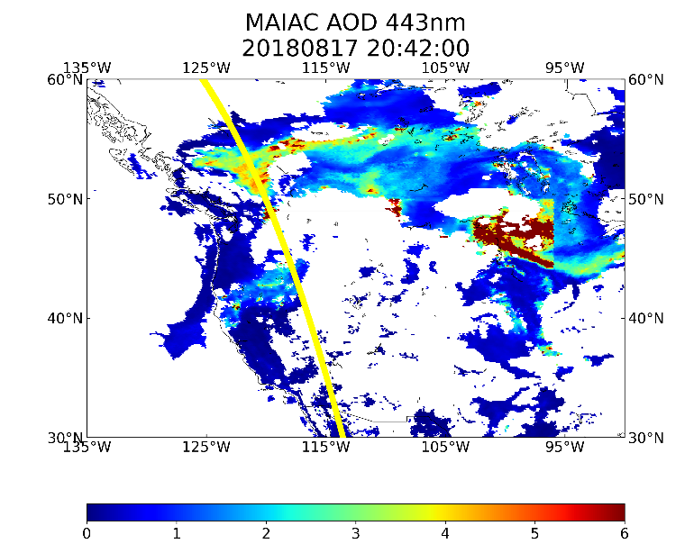
CALIOP ALH Evaluation

Slide 14
Conclusions
  New 4D joint retrieval of AOD, spectral absorption and aerosol layer height over land and ocean;
  4D algorithm shows improved AOD-SSA for smoke (vs 3D for MAIAC v2);
  Operational version 3 of MAIAC will be available in November-December timeframe;
  V3 will feature more reported parameters (ALH + speciation) than v2 but less output;
  A systematic validation of AOD and spectral SSA coming soon;
  Validation of ALH is ongoing: initial assessment shows ~0.5km low bias
  Need a closer look at O2 A,B bands calibration (Moon; EPIC vs TropOMI)

