Slide 1
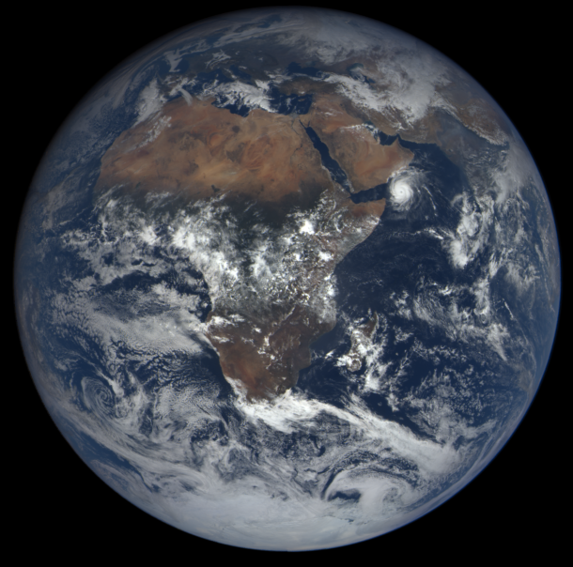
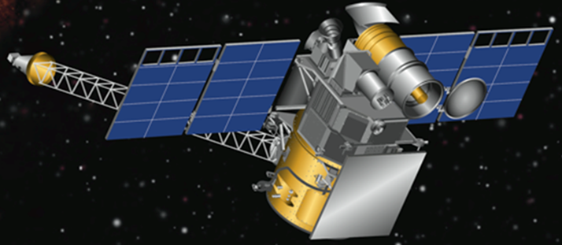
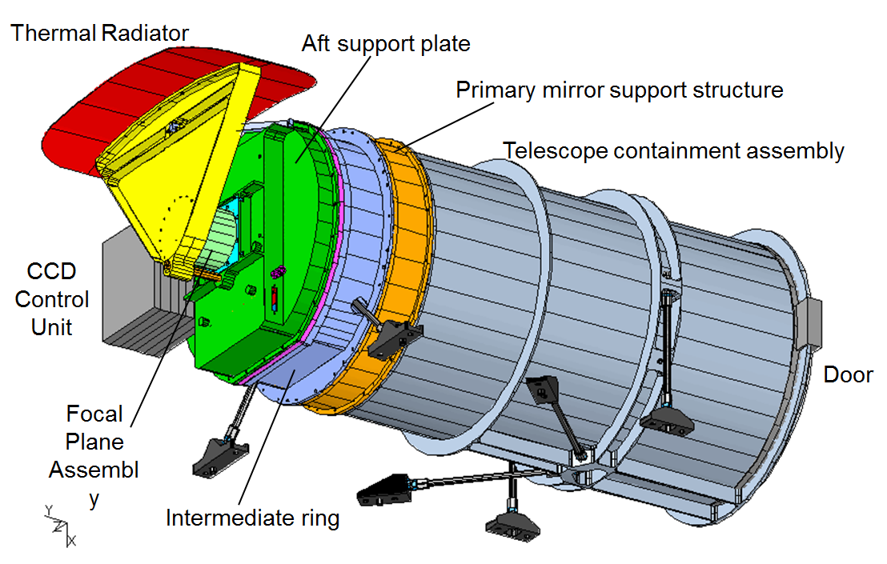
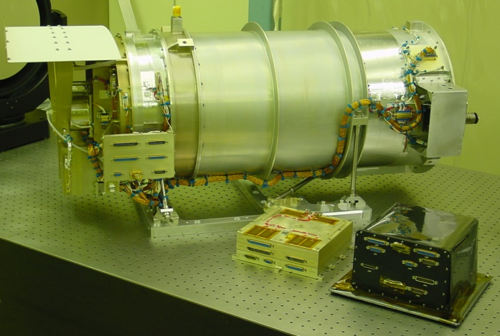
DSCOVR/EPIC Images and Science: A New Earth View
Dr. Jay Herman
EPIC Instrument Scientist
Dr. Adam Szabo
Project Scientist
Dr. Alexander Marshak
Deputy Project Scientist
5 Months
Launch February 11, 2015 -------------> L-1 Orbit June 2015

Slide 2
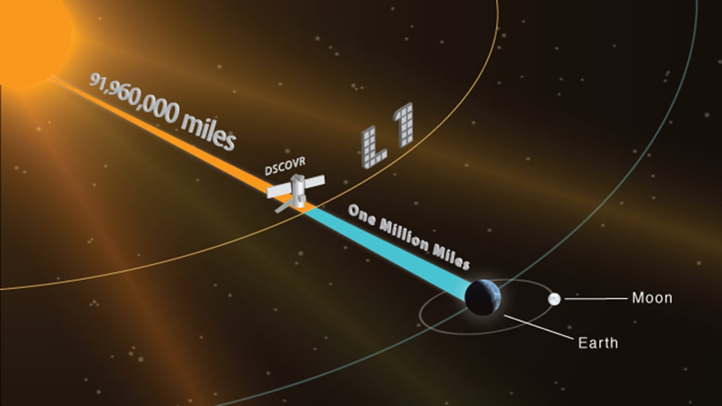
DSCOVR at Lagrange-1

Slide 3
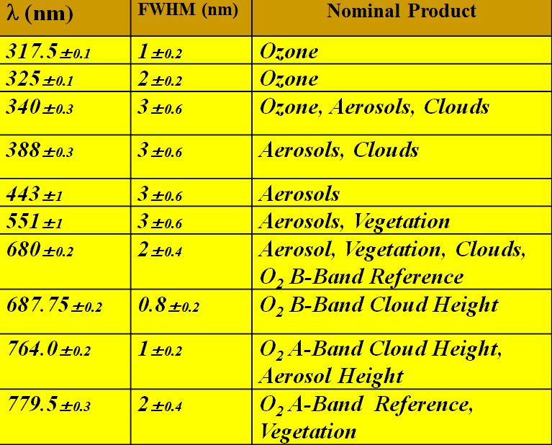
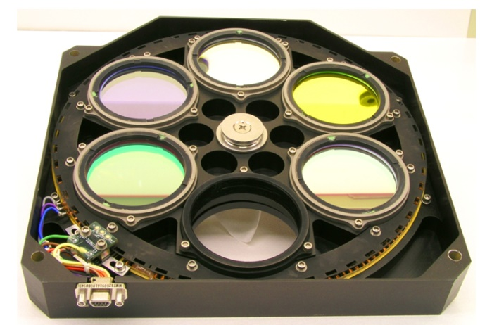
EPIC 30 cm Telescope & Camera
Double Filter Wheel

Slide 4
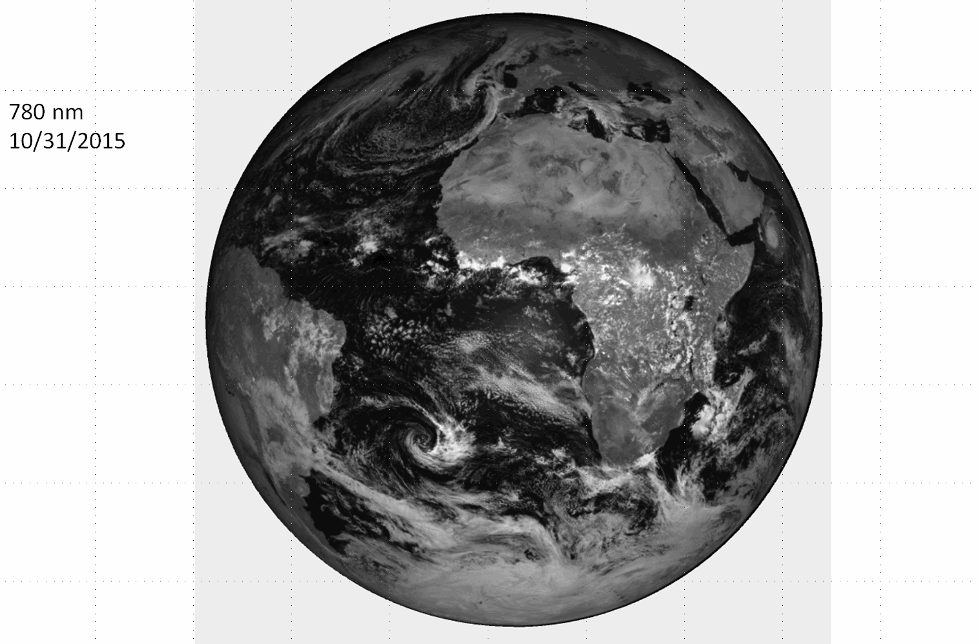

Slide 5
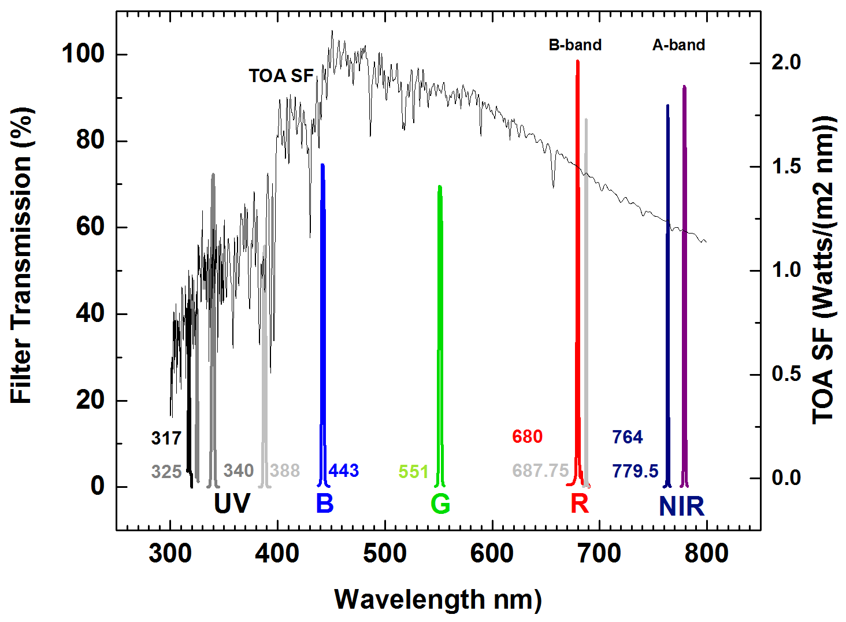
Solar Spectrum and Filter Wavelengths
Double Filter Wheel
Exposures were manually adjusted to fill the CCD to approximately 80% for each wavelength

Slide 6
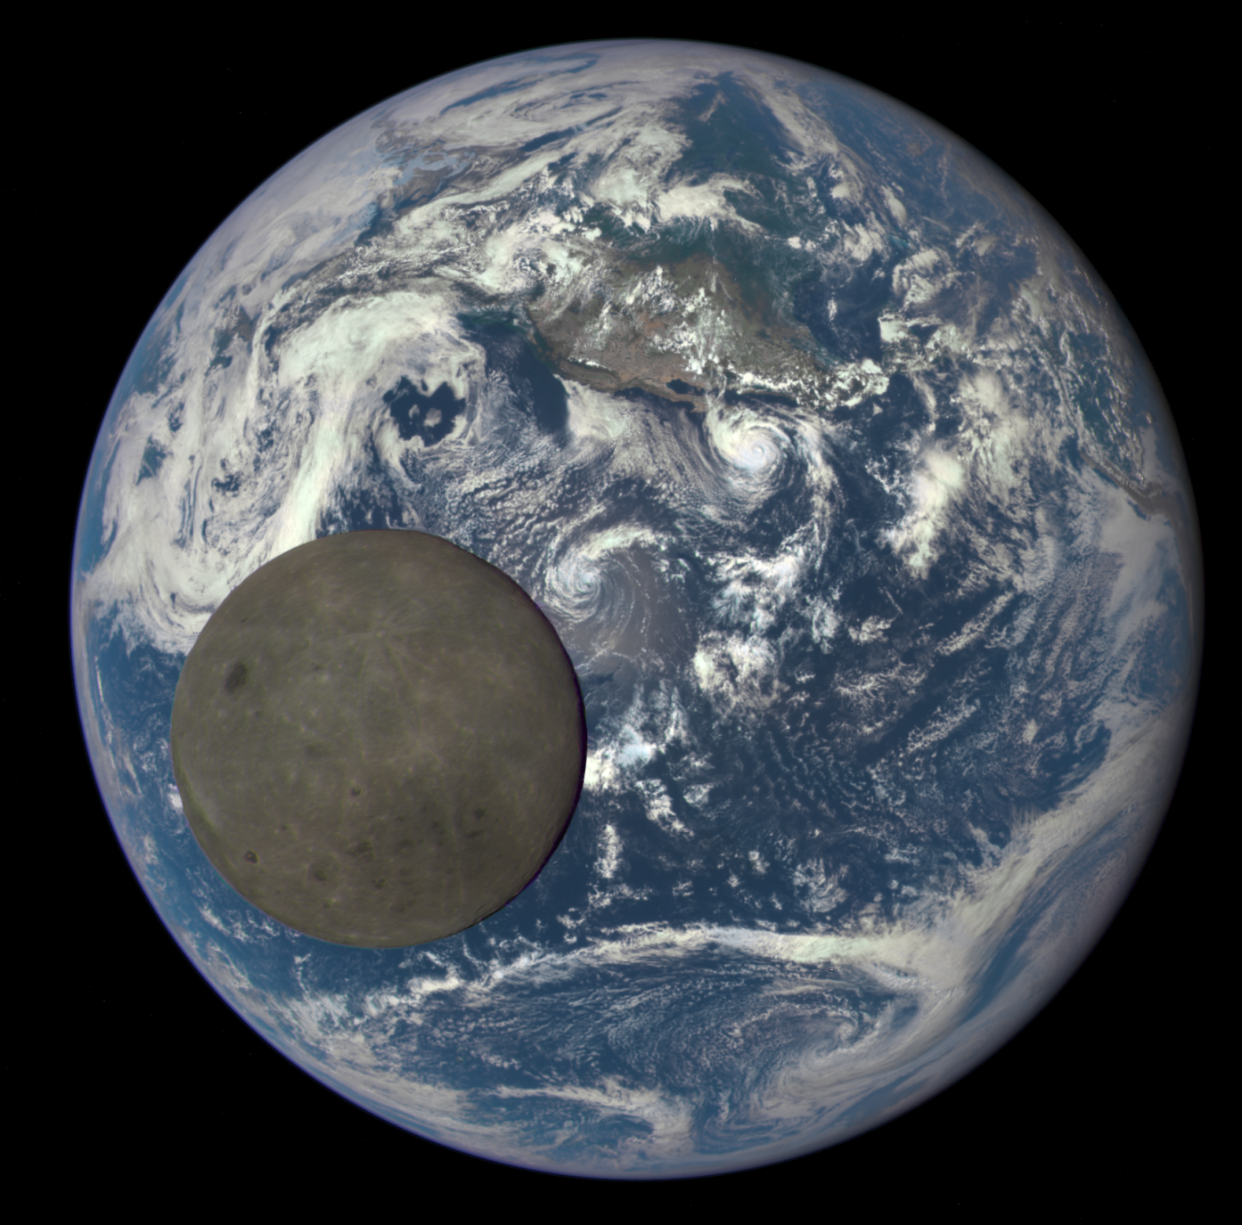
EPIC Field of View vs Angular Size of the Earth
CCD
FOV
0.62^{O}
0.45^{O}
to
0.53^{O}
Earth Size

Slide 7
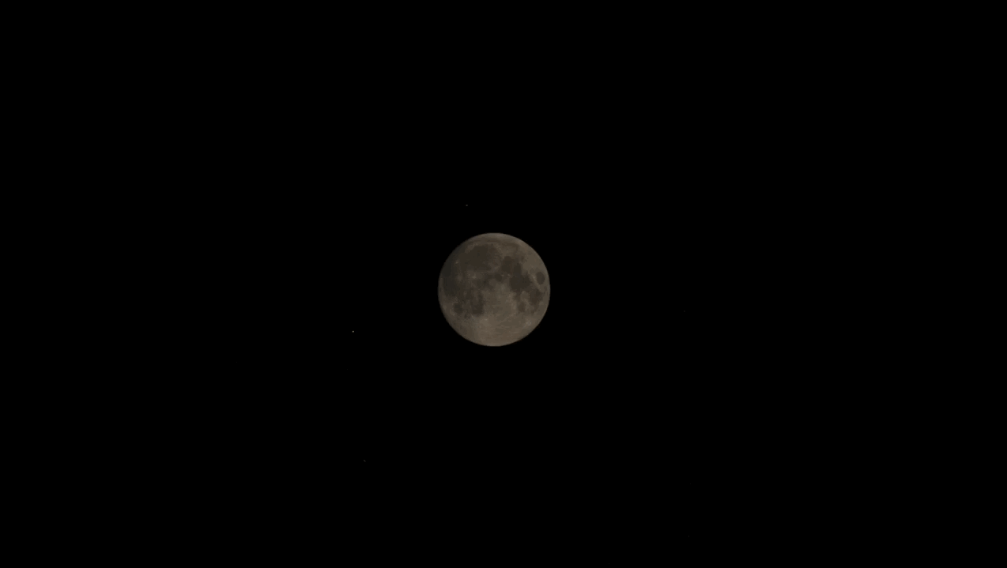
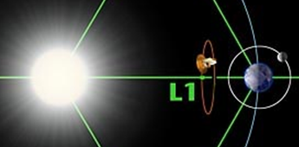
The Moon Passes Behind the Earth as viewed from DSCOVR’s Lagrange-1 orbit four hours before the lunar eclipse seen from Earth September 27, 2015
DSCOVR/EPIC’s View of Earth Transit in Front of the Moon
Transit at 11:00 GMT
Or 07:00 EDT

Slide 8
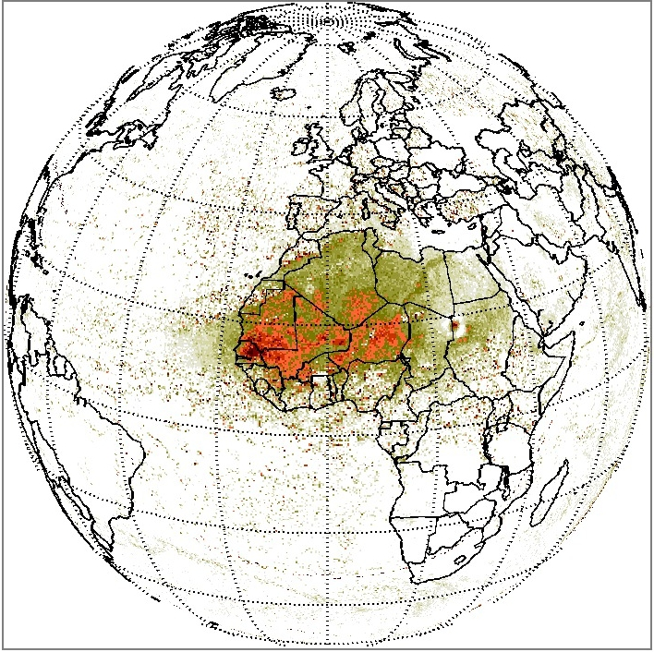
Aerosol Index (Saharan Dust) Measured in the UV (340 and 388 nm) Channels
Sunrise
Sunset
Sample EPIC UV Science Data

Slide 9
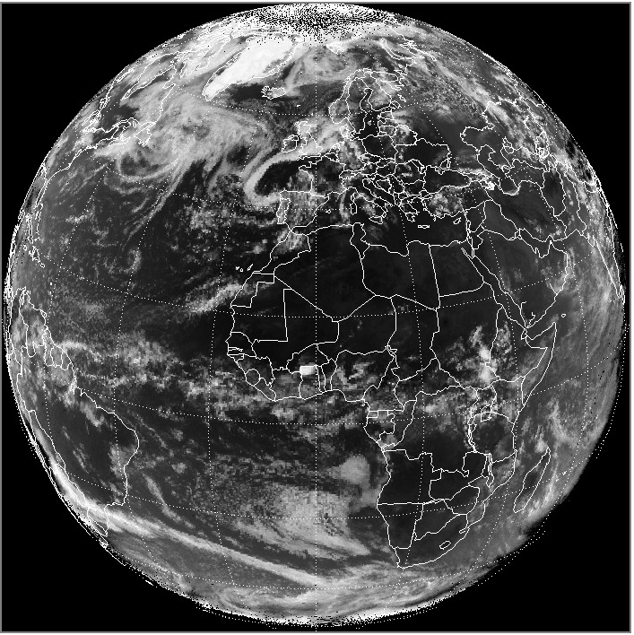
Earth Reflectivity using the 388 nm channel
Bright White = 94% Black = 4%
Sunrise
Sunset
Sample EPIC UV Science Data

Slide 10
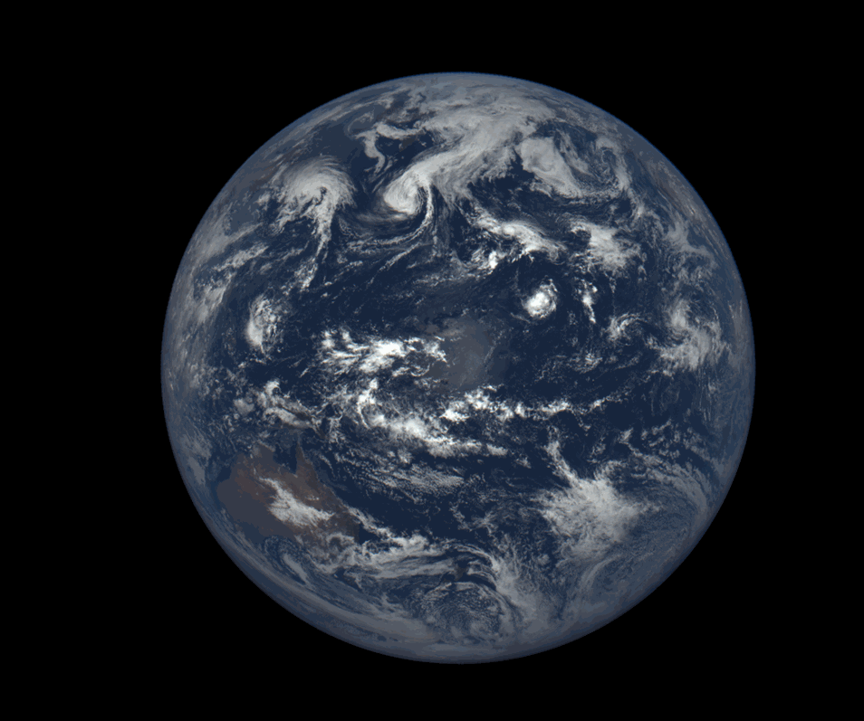
24 Hours - August 26, 2015

