Slide 1
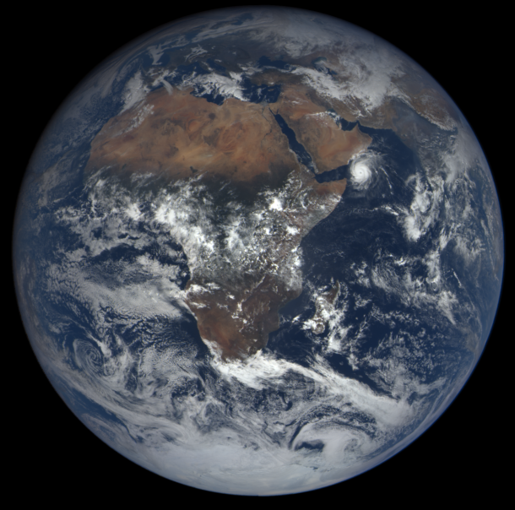
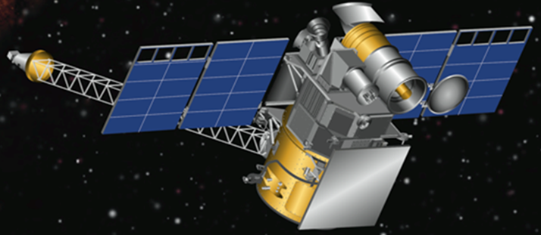
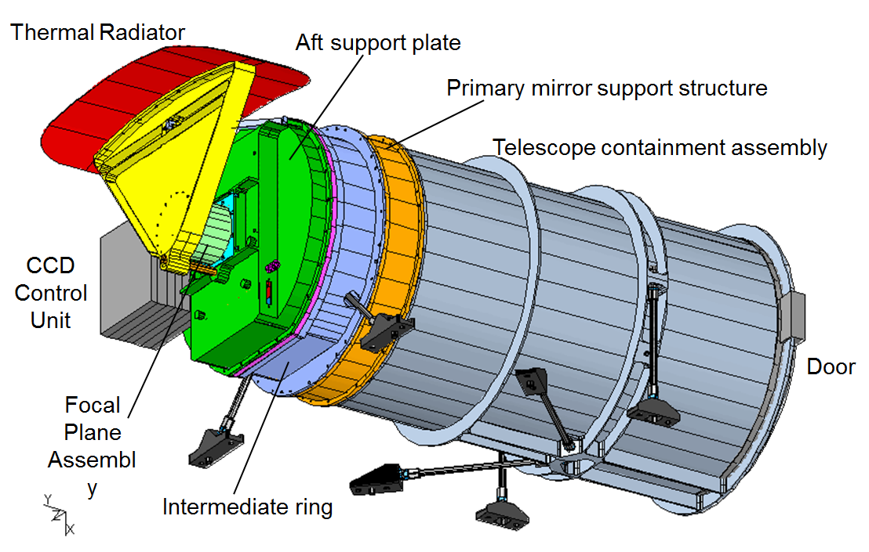
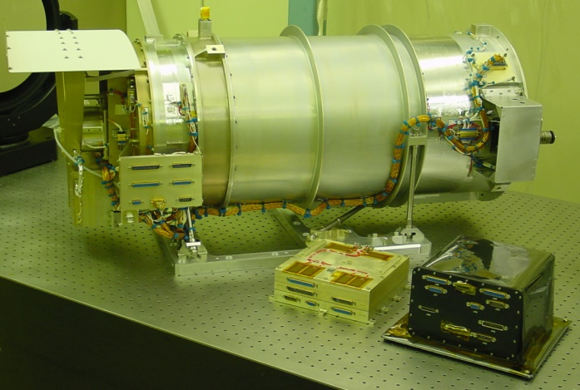
DSCOVR/EPIC Images and Science: A New Earth View
Dr. Jay Herman
EPIC Instrument Scientist
Dr. Adam Szabo
Project Scientist
Dr. Alexander Marshak
Deputy Project Scientist
5 Months
Launch February 11, 2015 -------------> L-1 Orbit June 2015

Slide 2
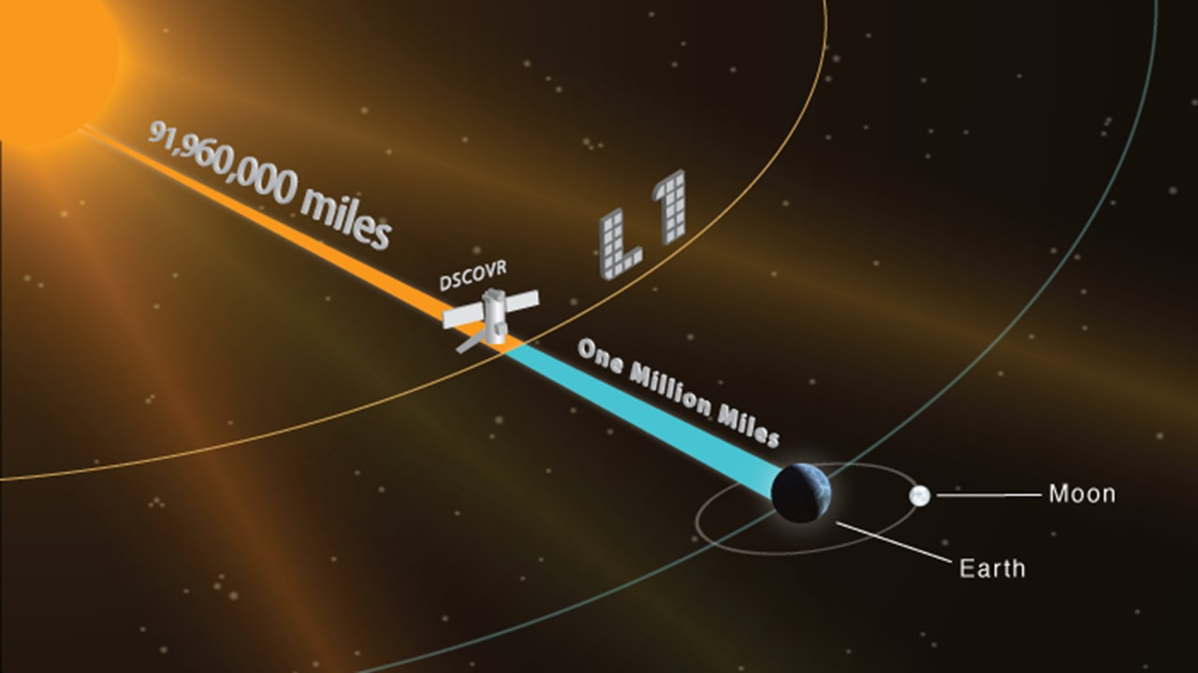
DSCOVR at Lagrange-1

Slide 3
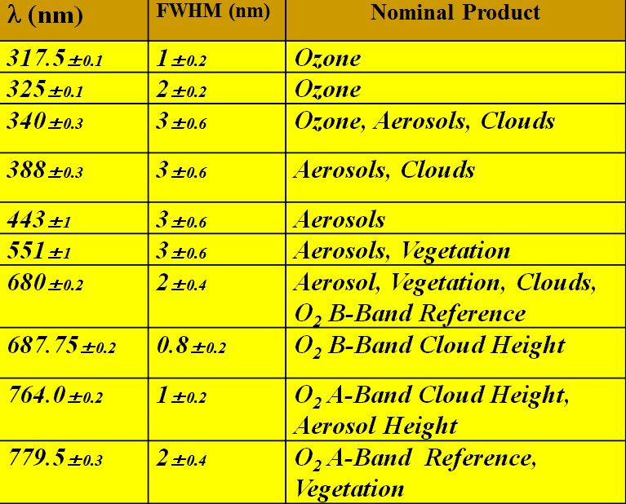
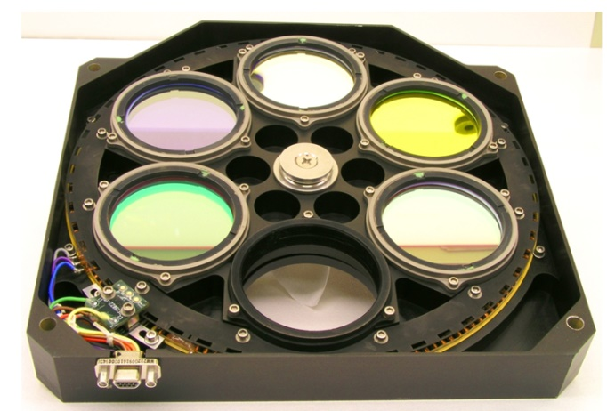
EPIC Wavelengths and Science Products
Double Filter Wheel

Slide 4
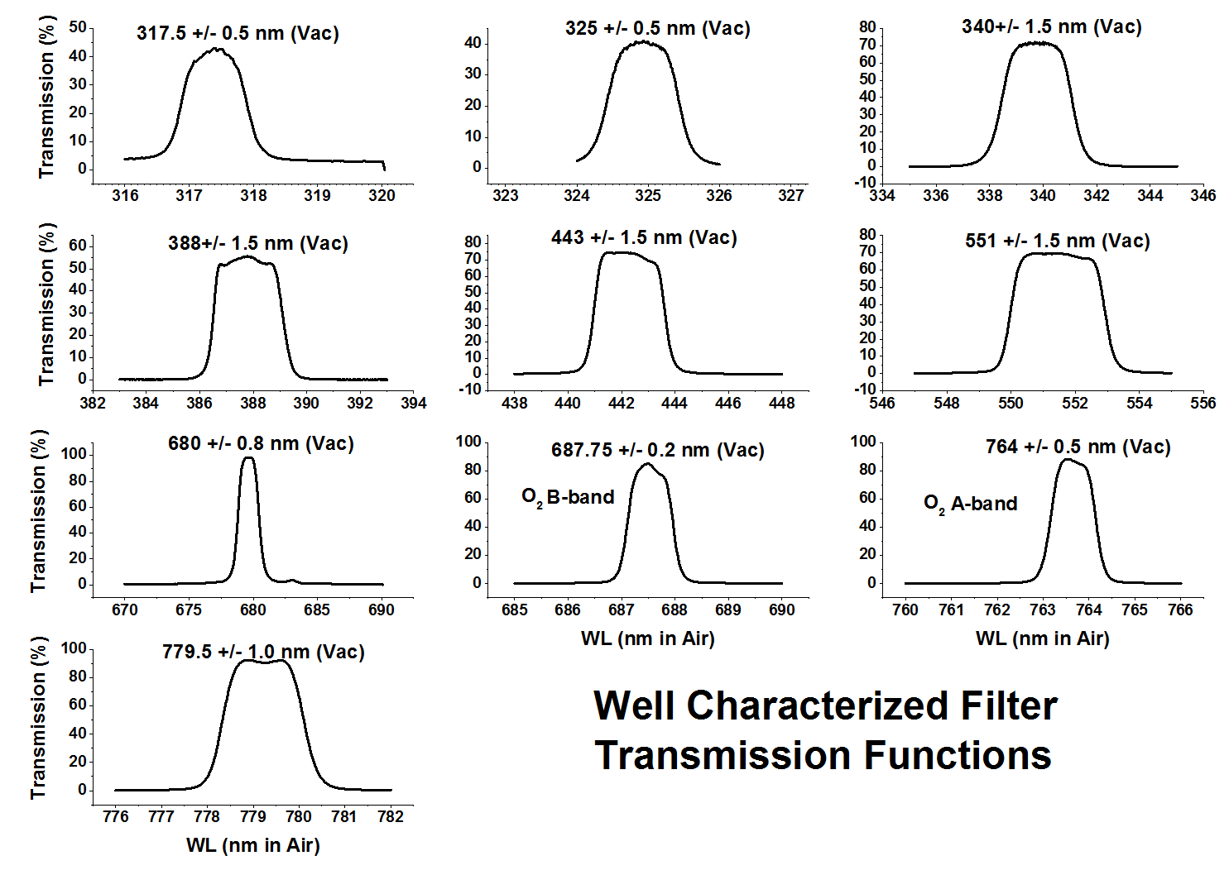

Slide 5
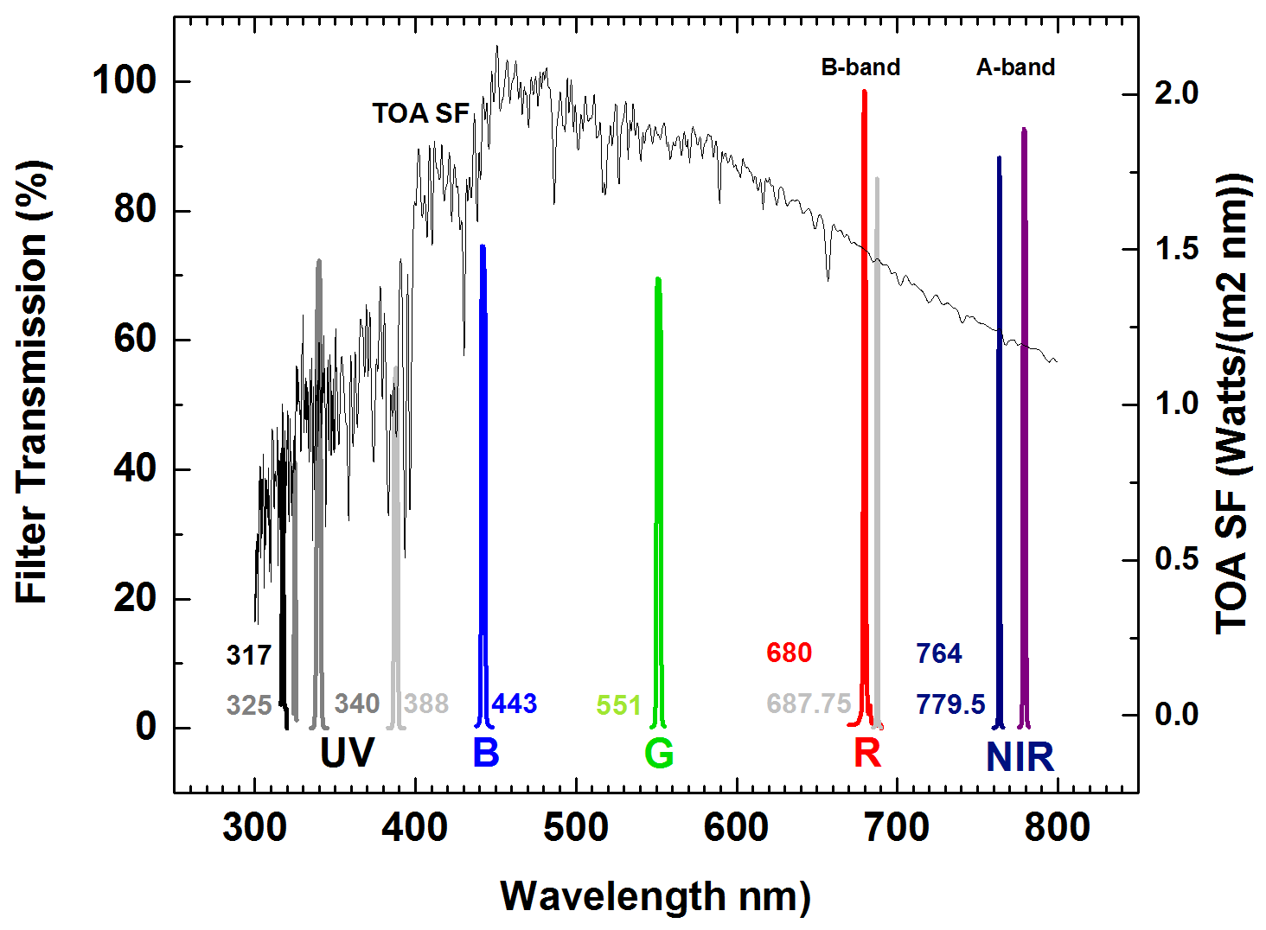
Solar Spectrum and Filter Wavelengths
Double Filter Wheel
Exposures were manually adjusted to fill the CCD to approximately 80% for each wavelength

Slide 6
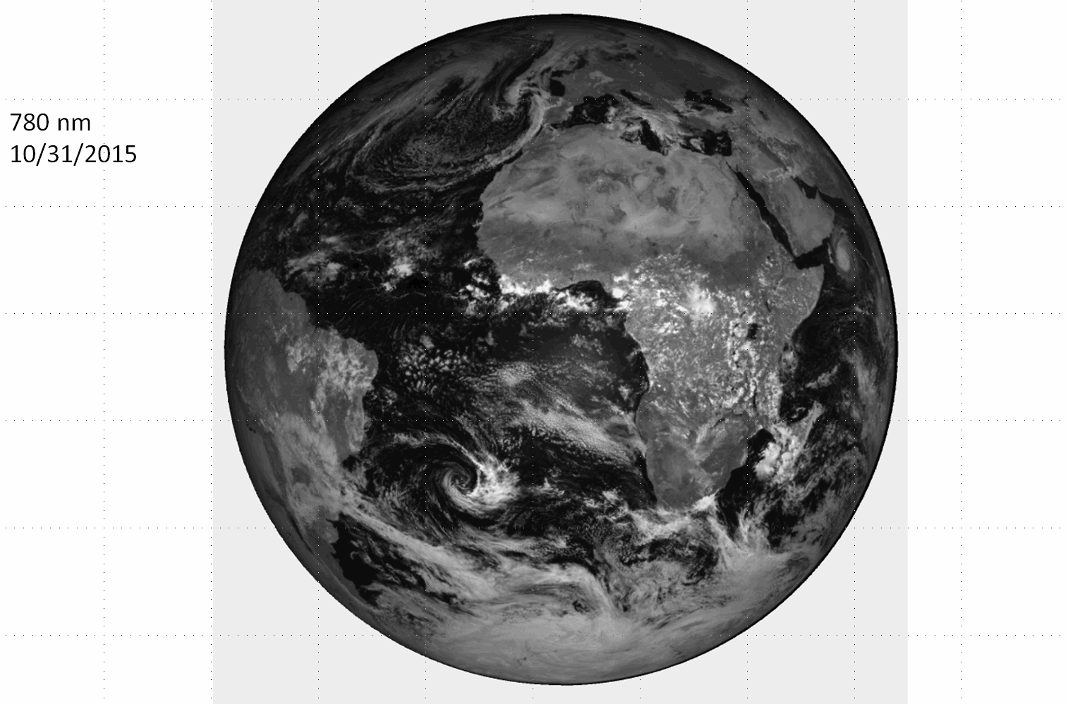

Slide 7
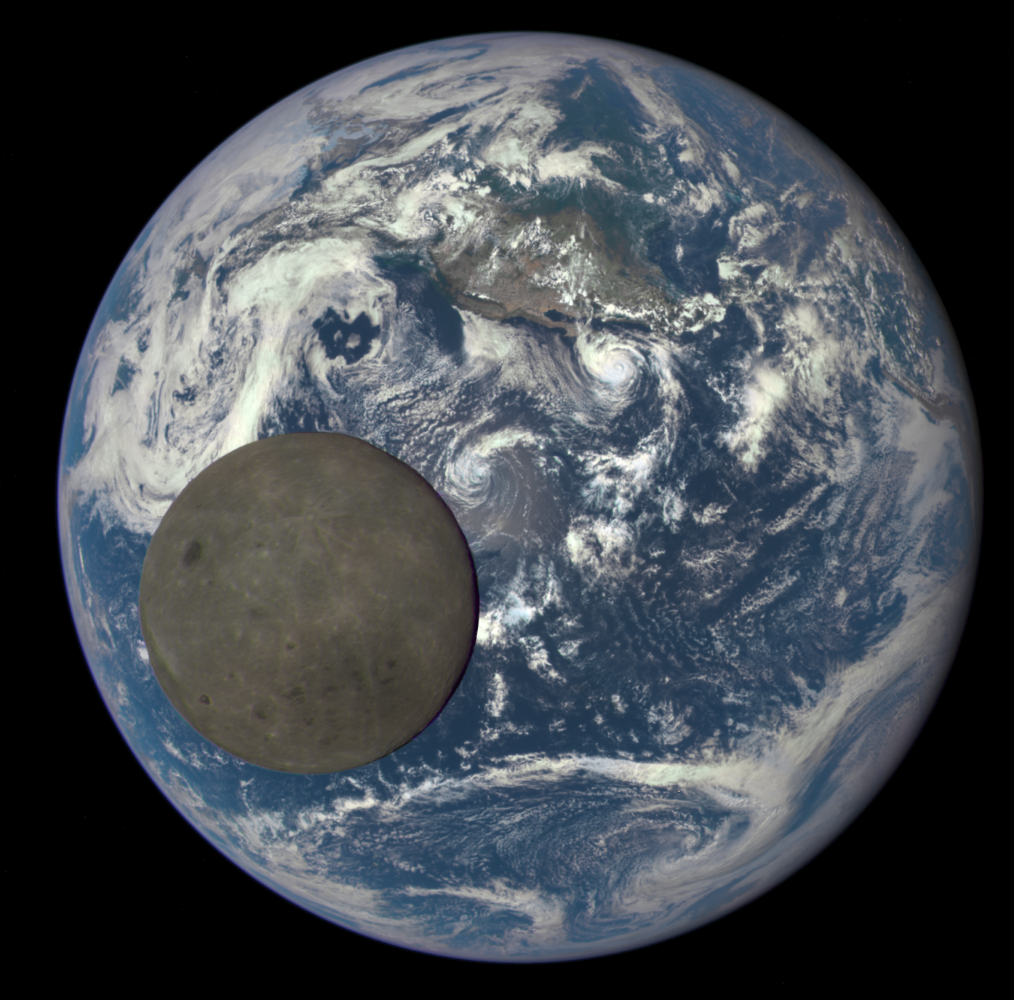
Angular Size of the Earth vs EPIC Field of View
July 16, 2015
CCD
FOV
0.62^{O}
0.45^{O}
to
0.53^{O}
Earth Size

Slide 8
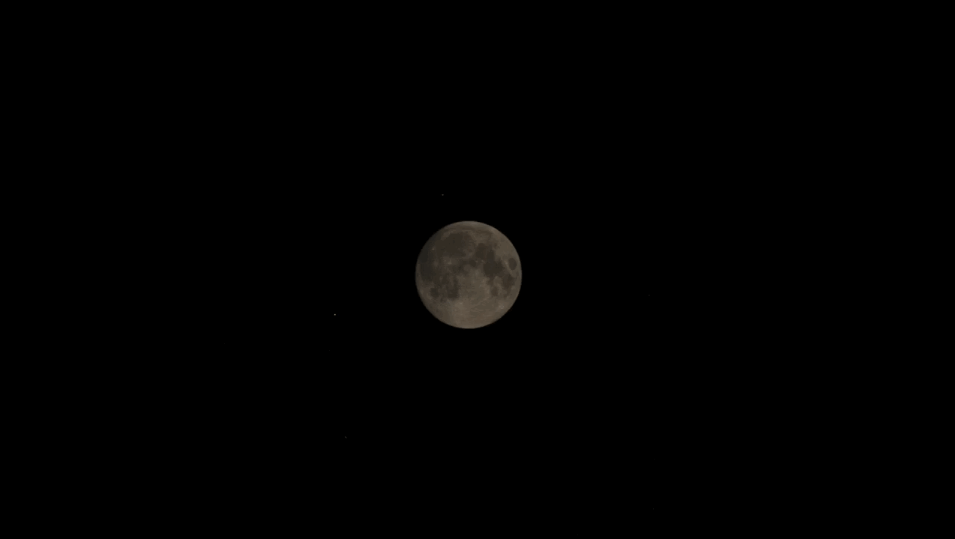
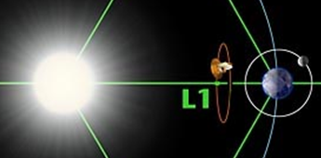
The Moon Passes Behind the Earth viewed from DSCOVR’s Lagrange-1 orbit four hours before the lunar eclipse seen from Earth September 27, 2015
DSCOVR/EPIC’s View of Earth Transit in Front of the Moon
Transit at 11:00 GMT
Or 07:00 EDT

Slide 9
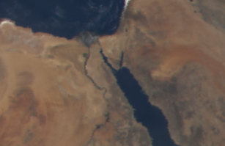
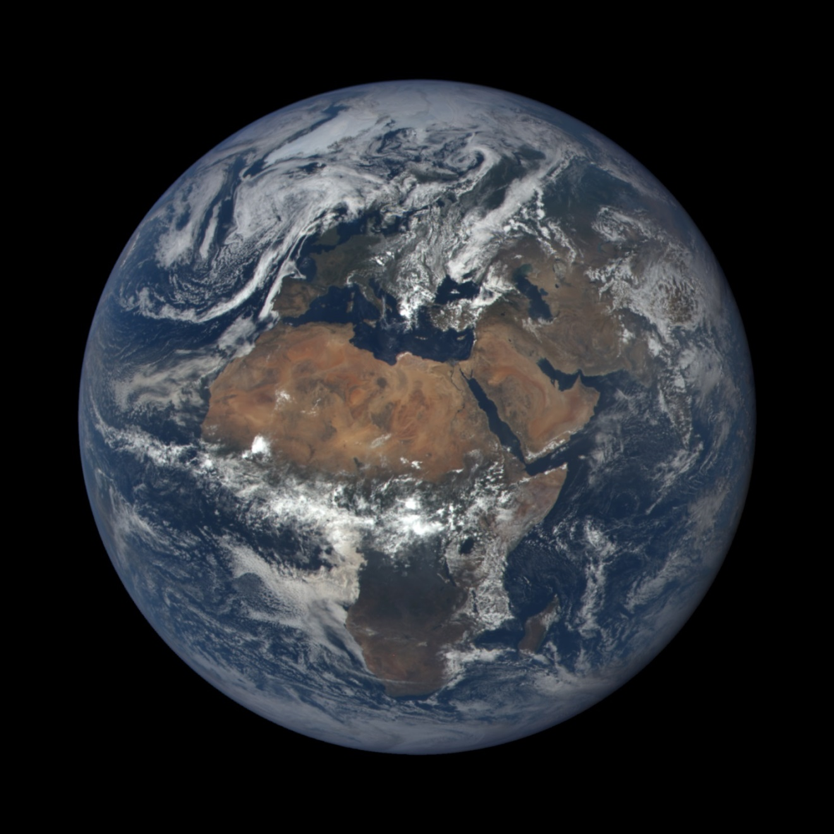
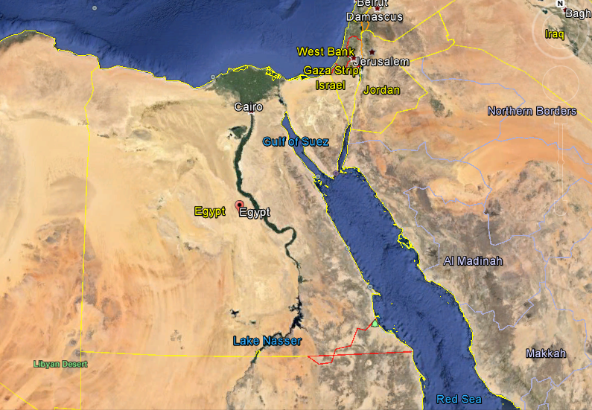
30 June 2015
EPIC
Pixel Projection = 1 arc second = 8 km
Near the Sub-Satellite Point
Google
Earth

Slide 10
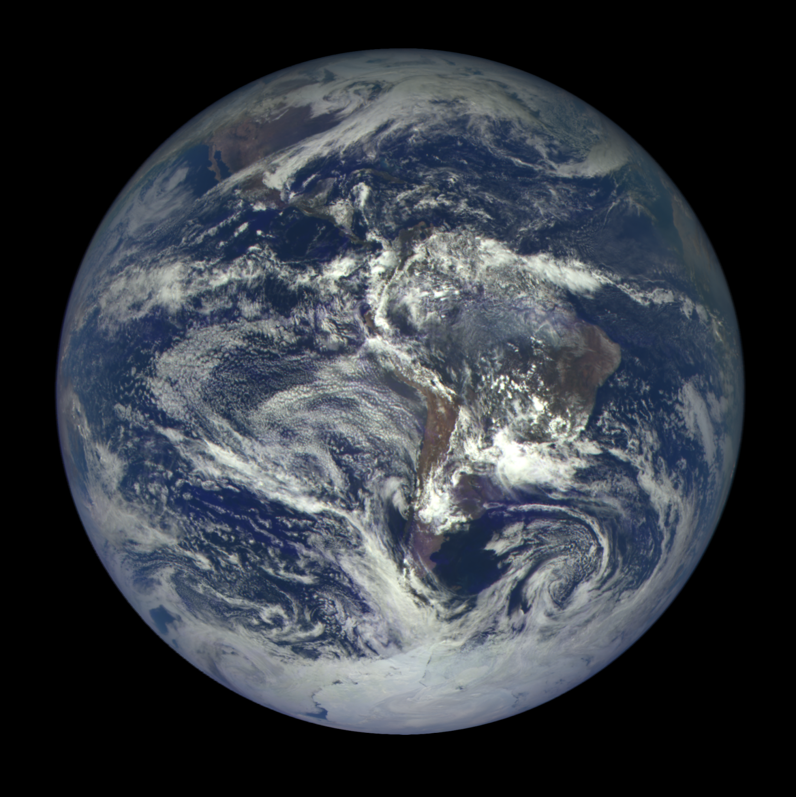
02 December 2015
Clouds over Ice/Snow are Barely Visible

Slide 11
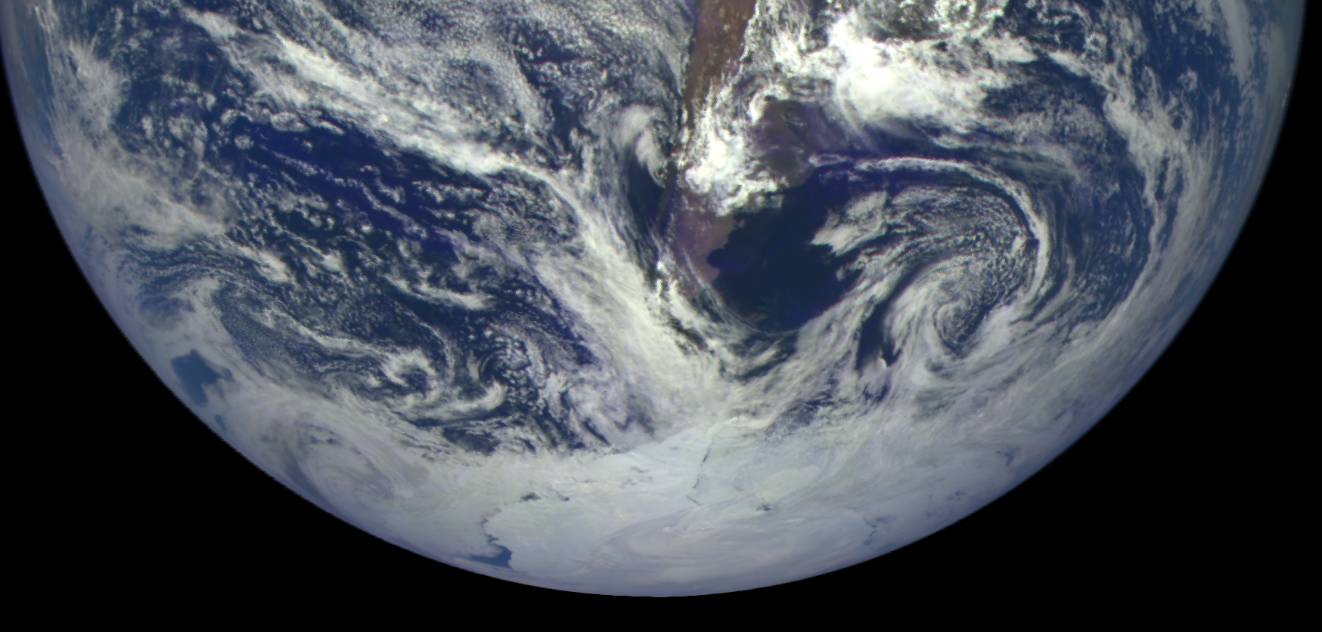
View of Antarctica on 02 December 2015
South America and Palmer Peninsula

Slide 12
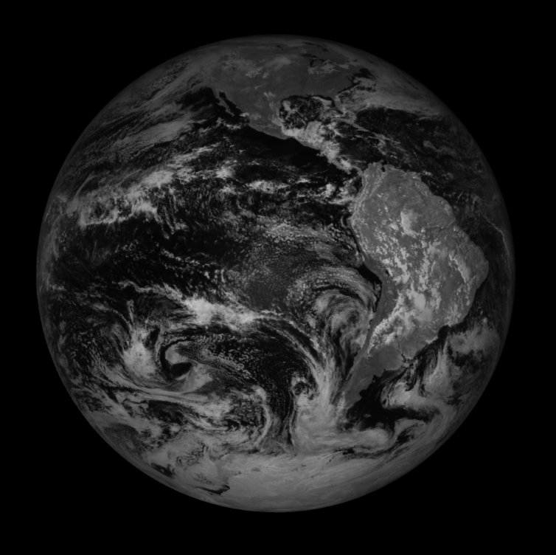
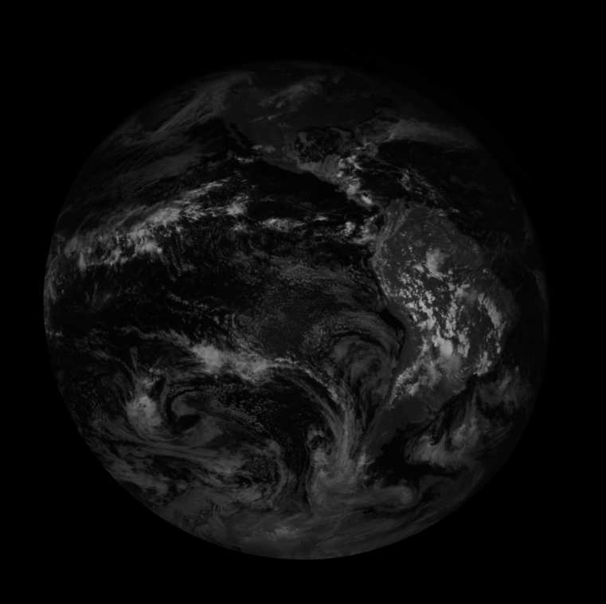
780 nm
764 nm
Clouds Over
Antarctica
05 Dec 2015
O₂ A-Band
O₂ A-Band
764 nm

Slide 13
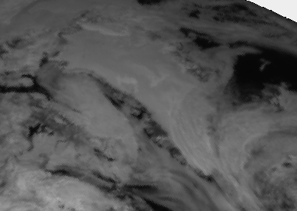
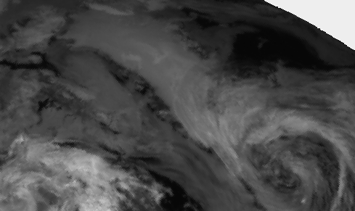
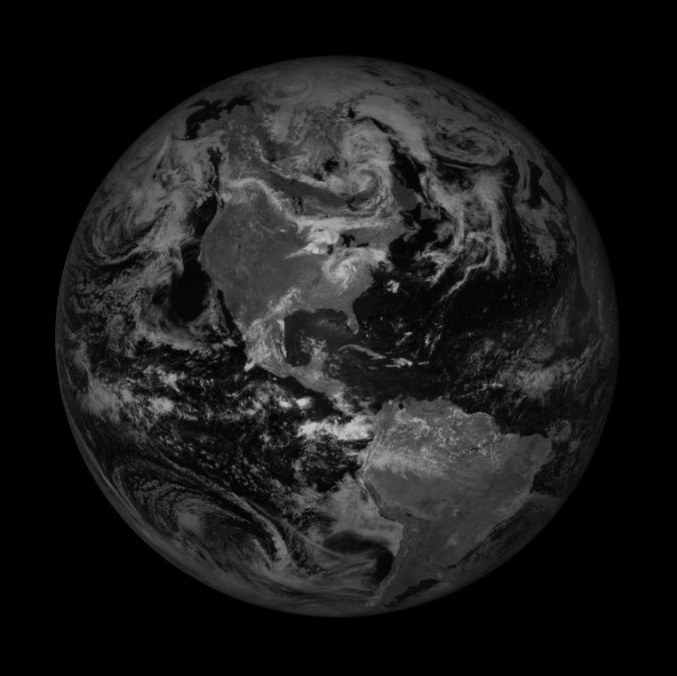
780 nm
764 nm
O₂ A-Band
Clouds Over
Greenland
20 June 2015
780 nm

Slide 14
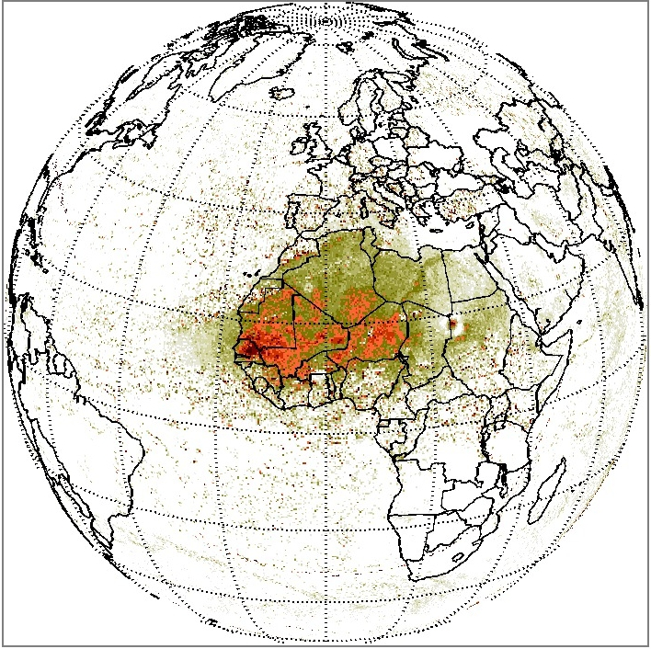
Aerosol Index (Saharan Dust) Measured in the UV (340 and 388 nm) Channels
Sunrise
Sunset
Sample EPIC UV Science Data

Slide 15
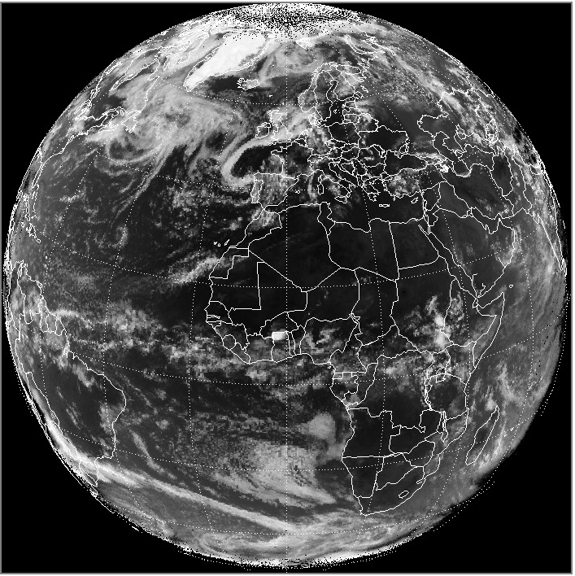
Earth Reflectivity using the 388 nm channel
Bright White = 94% Black = 4%
Sunrise
Sunset
Sample EPIC UV Science Data

Slide 16
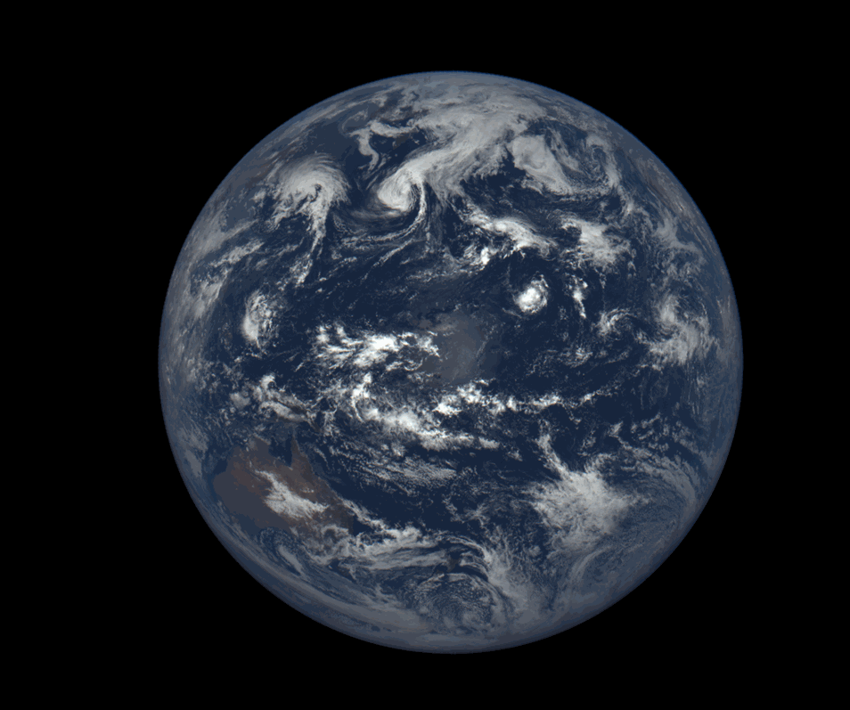
24 Hours - August 26, 2015

Slide 17
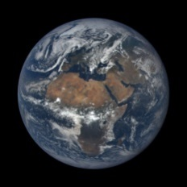
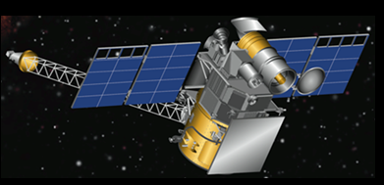
Looking at Earth from L-1 provides a unique viewpoint that has strong advantages compared to geostationary or low earth orbiting satellites.
Always simultaneously viewing from sunrise to sunset and pole to pole – almost 180 degrees in latitude and longitude. Geostationary satellites are limited to 120 degrees and LEO satellites only see a fixed local time.
The cloud height measurements (O₂ A- and B-bands) for the entire Earth every day are unique and will give the first measure of diurnal variation of cloud amount, height, and reflectivity. Since high convective clouds reflect more light UV, Visible, and NIR) back to space than low clouds, knowing the daily and seasonal variation of high and low clouds will provide a useful input to the Earth’s energy balance calculations.
Epic is unique for tracking aerosols (smoke, dust, and volcanic ash) as they flow across land and oceans for the entire day.

