Slide 1
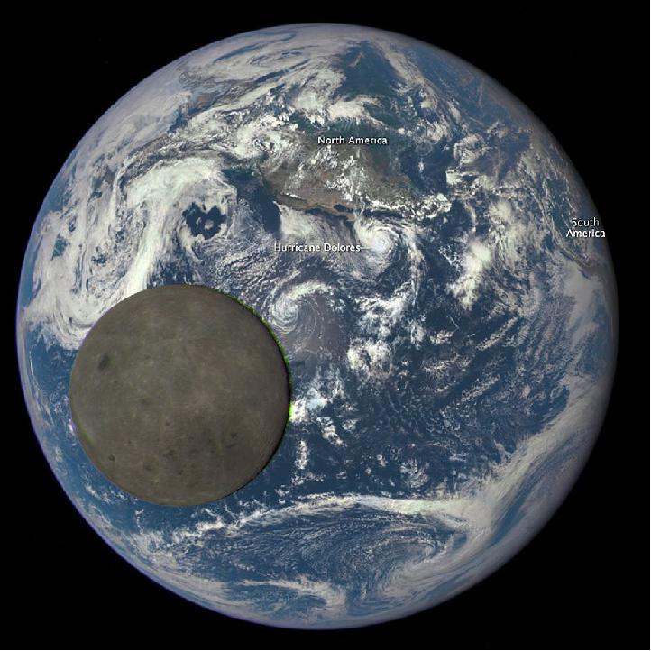
HISE 2016, Leipzig, Germany, 2016-11-14
The Earth Polychromatic Imaging Camera
on the Deep Space Climate Observatory
Alexander Cede ^{1,2,3}, Matt Kowalewski ^{1,3},
Sasha Marshak ¹ & Jay Herman ¹
1 NASA/Goddard Space Flight Center, USA
2 LuftBlick Earth Observation Technologies, Austria
3 SciGlob Instrument & Services, USA
http://epic.gsfc.nasa.gov/

Slide 2
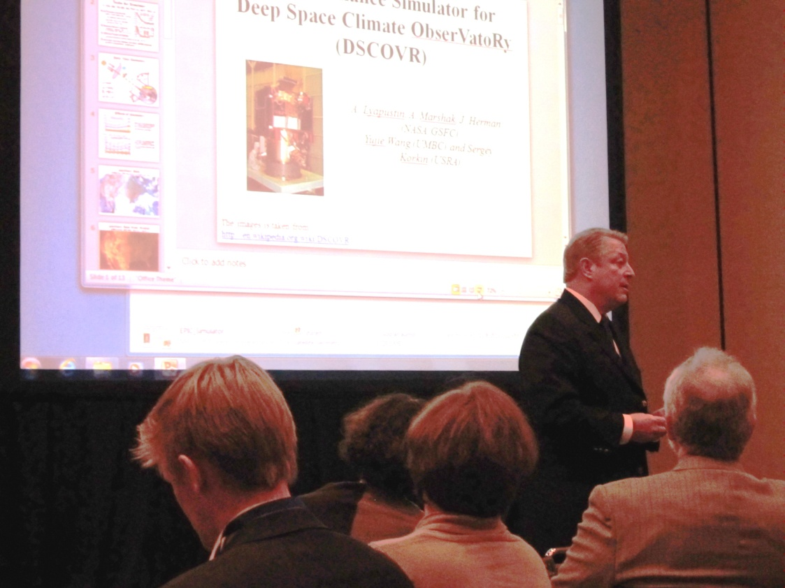
Are we taking pictures of our entire Earth from space?
1998 Triana mission initiated; involvement of Al Gore; launch planned for 2001
2001 Mission postponed
2003 Mission renamed to Deep Space Climate ObserVatoRy (DSCOVR); still space weather systems (solar wind) and two Earth viewing instruments (NISTAR and EPIC)
2006 Mission terminated; satellite in storage
2009 Refurbishment of DSCOVR initiated decision to change the filters in EPIC
2011 Finished refurbishment and initial laboratory calibration of EPIC; electronics refurbished at GSFC
2012 DSCOVR mission is secured
2013 Sensors mounted on satellite
2014 Vacuum chamber tests at GSFC; satellite shipped from GSFC, Maryland, to KSC, Florida
2015 Launch on 11 Feb from KSC
Al Gore promoting DSCOVR at AGU Fall meeting 2011, San Francisco

Slide 3
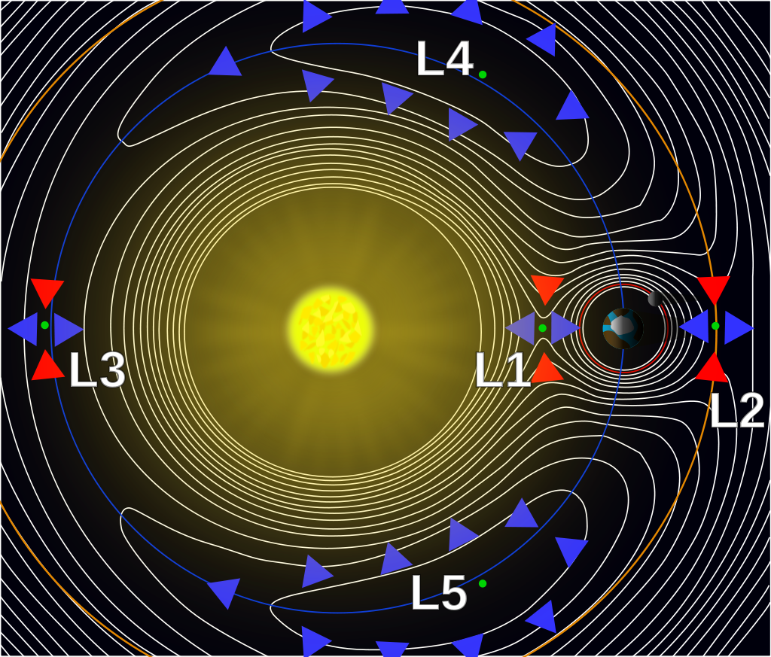
Lagrange 1, the ‘ultimate’
Earth observation point
This is not a LEO or a GEO!
Lagrange 1 is
1.5e6 km away from Earth in the direction of the Sun

Slide 4
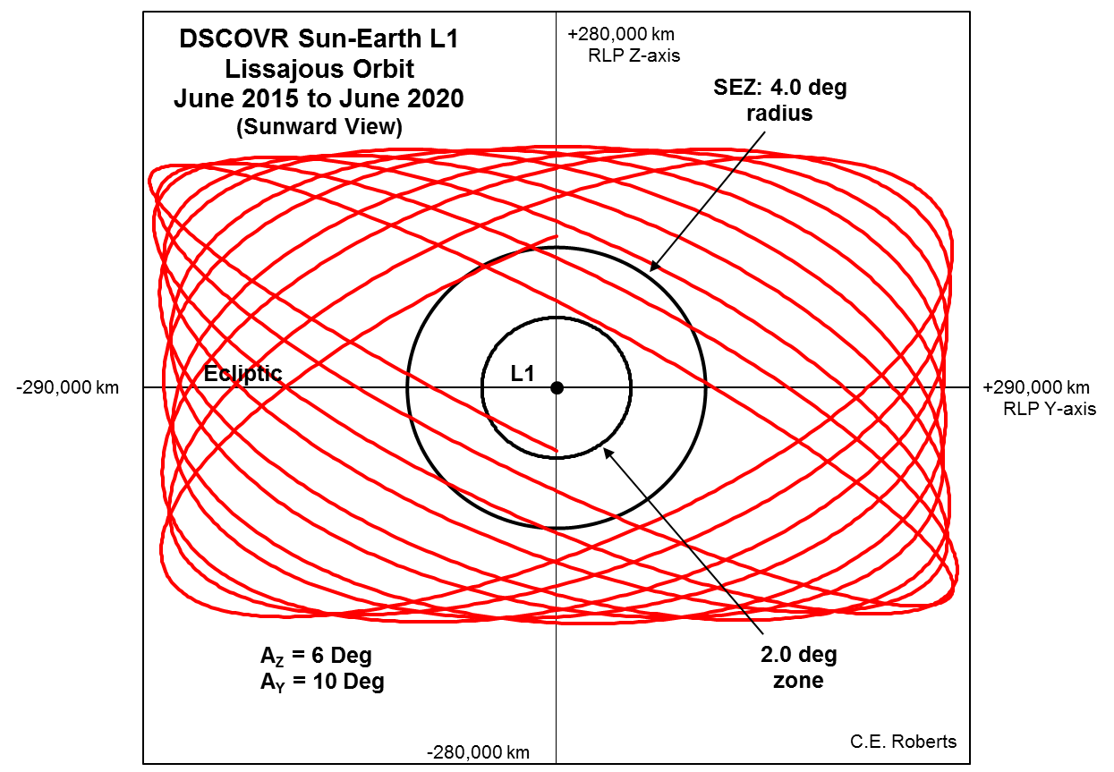
Lissajous Orbit
The angle Sun-Earth-DSCOVR can be as much as 15°!

Slide 5
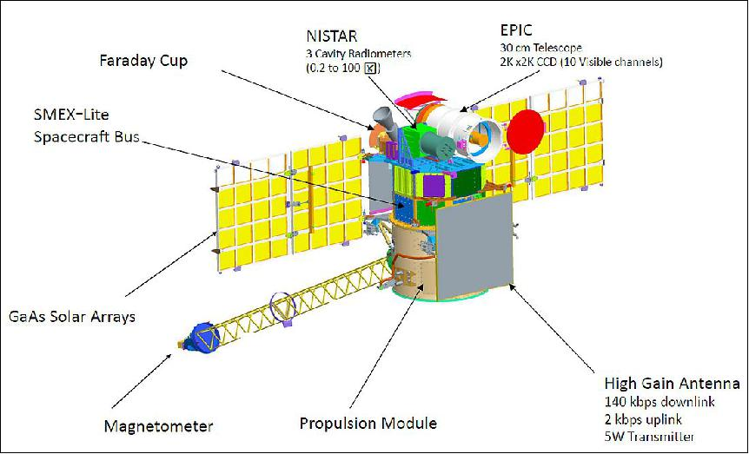
DSCOVR
Deep Space Climate Observatory

Slide 6
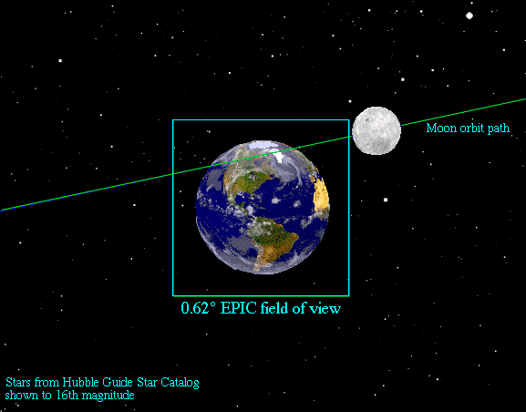
Field of view of EPIC and NISTAR
NISTAR: FOV 1º
FOR 7º

Slide 7
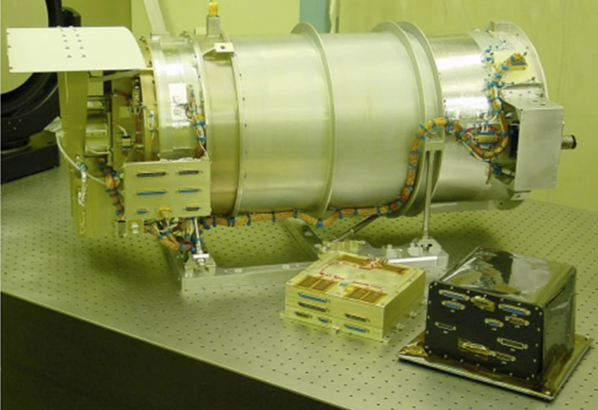
EPIC
Earth Polychromatic Imaging Camera
2048 x 2048 pixel CCD stabilized -20°, 12bit AD converter (i.e. 0 to 4095 counts)
Exposure times from 40ms to 1s
SNR from 50:1 for dark scenes (clearsky) in visible channels to 300:1 for bright scenes (cloudy)
One full set of 10 images approx. every 75 min!
CCD
2048 x 2048 pixels
7.8km from
pixel to pixel
FOV ~14km

Slide 8
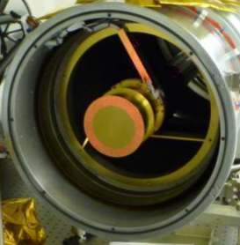
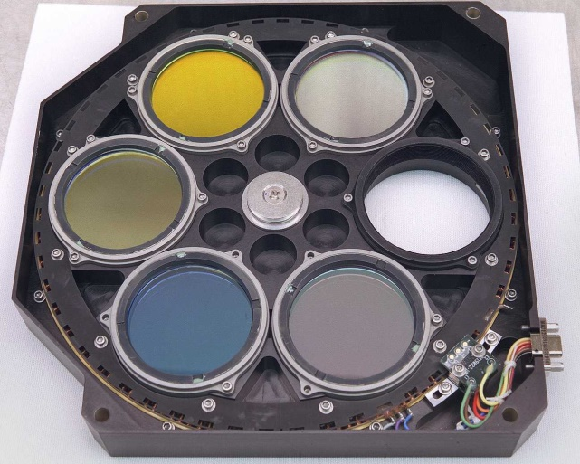
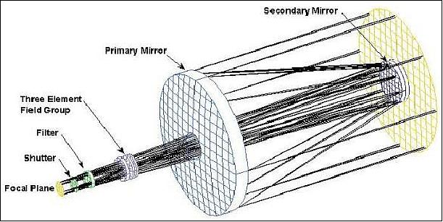
EPIC optical path
2 filterwheels with 6 positions each (open hole plus 5 spectral filters) → 10 channels
Cassegrain telescope

Slide 9
Channels
Ozone and SO2: total column
Aerosol properties: aerosol index, aerosol optical thickness, aerosol height
Cloud & surface properties: cloud fraction, cloud height, surface albedo
Vegetation properties: vegetation index and Leaf Area Index (LAI)
RGB: colored image of the Earth’s sunlit face
Center [nm] | FWHM [nm] | Primary purpose
317 | 1 | Ozone + SO2
325 | 1 | Ozone + SO2
340 | 3 | Ozone + SO2, Aerosols, Reflectivity
388 | 3 | Aerosols, Reflectivity
443 | 3 | Aerosols, Reflectivity, Vegetation, RGB
552 | 3 | Aerosols, Reflectivity, Vegetation, RGB
680 | 2 | Aerosols, Reflectivity, Vegetation, LAI, O₂B-Band Reference, RGB
688 | 0.8 | O₂B-Band Cloud Height
764 | 1 | O₂A-Band Cloud Height, Aerosol Height
779 | 2 | Aerosols, Reflectivity, Vegetation, LAI, O₂A-Band Reference

Slide 10
Data correction steps
Several correction steps are applied to the raw data
The biggest challenges are “Flat fielding” and “Stray light”
Processing step | Average impact | Affected pixels impact
Dark correction | Moderate | Extreme
Enhanced pixel detection | Small | Large
Read wave correction | Small | Small
Latency correction | Moderate | Significant
Non-linearity correction | Small | Small
Temperature correction | Small | Small
Conversion to count rates | Small | Small
Flat fielding | Significant | Large
Stray light correction | Significant | Large
Conversion to radiances | Significant | Significant
Small: ε<0.4%
Moderate: 0.4%<ε<2%
Significant: 2%<ε<10%
Large: 10%<ε<50%
Extreme: ε>50%

Slide 11
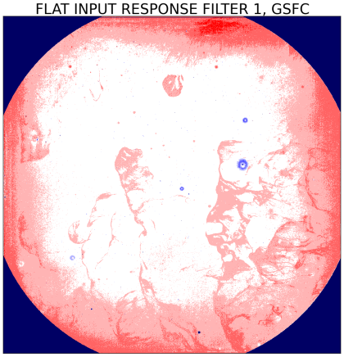
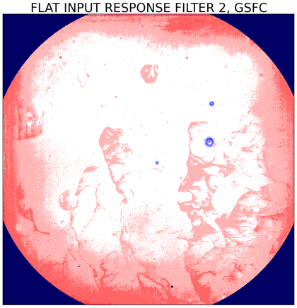
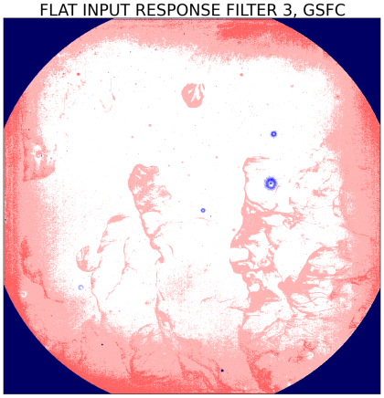
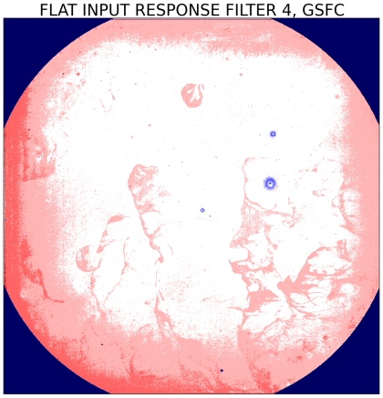
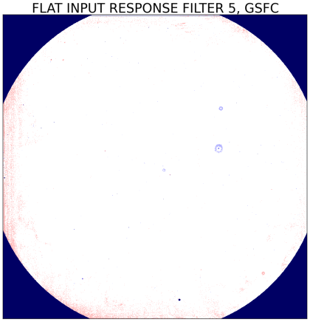
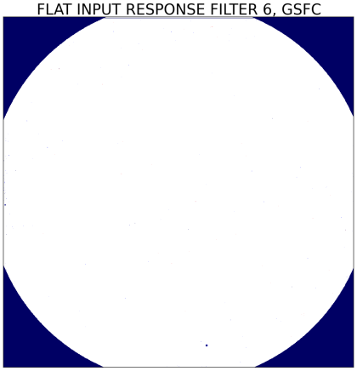
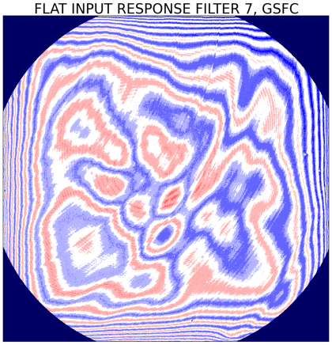
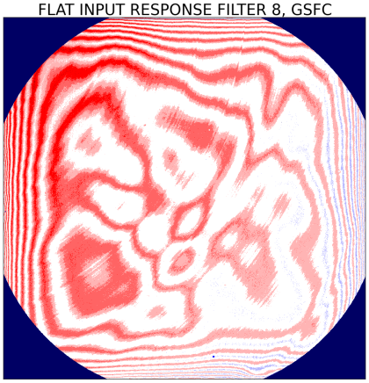
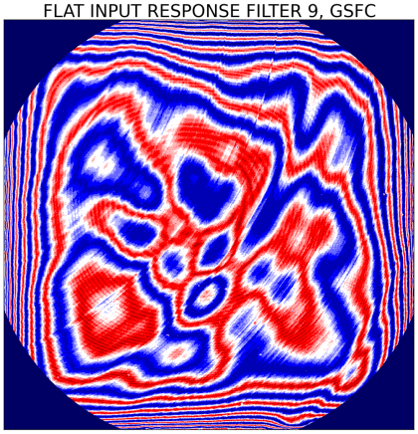
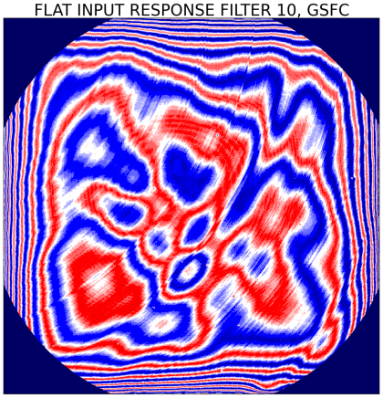
Flat field
“Flat input does not produce flat signal”
Flat field response is combination of different physical effect: etaloning, surface inhomogeneity and PRNU (pixel response non uniformity)
EPIC’s “non-flatness” is significant!
EPIC flat field was determined based on pre-launch calibration and modified in Nov 2016 based on an analysis of the first 1.5 years of data

Slide 12
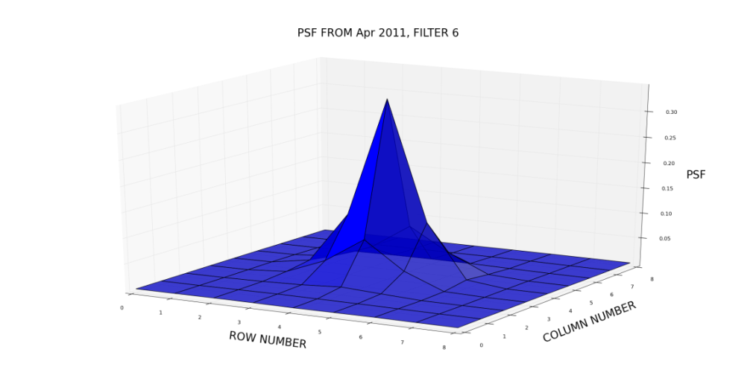
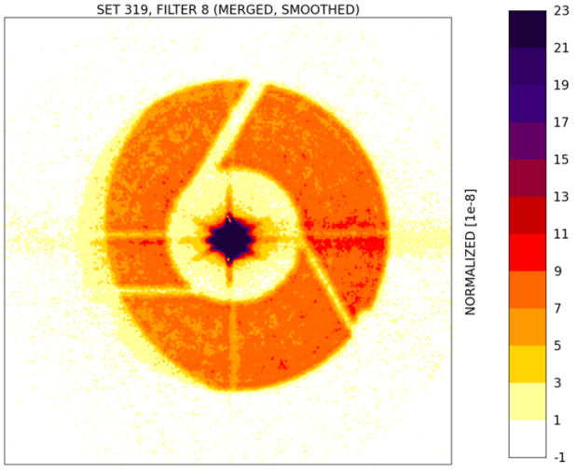
Stray light effect
“Not all the light ends up where we want it to end up.”
We want the light from a point source to end up in the corresponding pixel and the neighbor pixels, however a very significant portion of the light spreads over the entire CCD (stray light).This is described by the point spread function (PSF).
Lab-measurements were taken with different “targets” .
The sub-pixel target gives us the core of the PSF but the stray light disappears in the noise. A circular target with radius of 17 pixels shows the stray light.
We noticed that there is a stray light level of 10-20%!
5μm-target (sub-pixel)
300μm-target (r=17pixels)

Slide 13
Point spread function
The PSF is dominated by
Diffraction, main responsible for near field stray light, blue region in panels
Ghosting, created by reflections between the CCD surface and the filter surfaces, main responsible for far field stray light, orange region in panels
Stray light is different for each channel

Slide 14
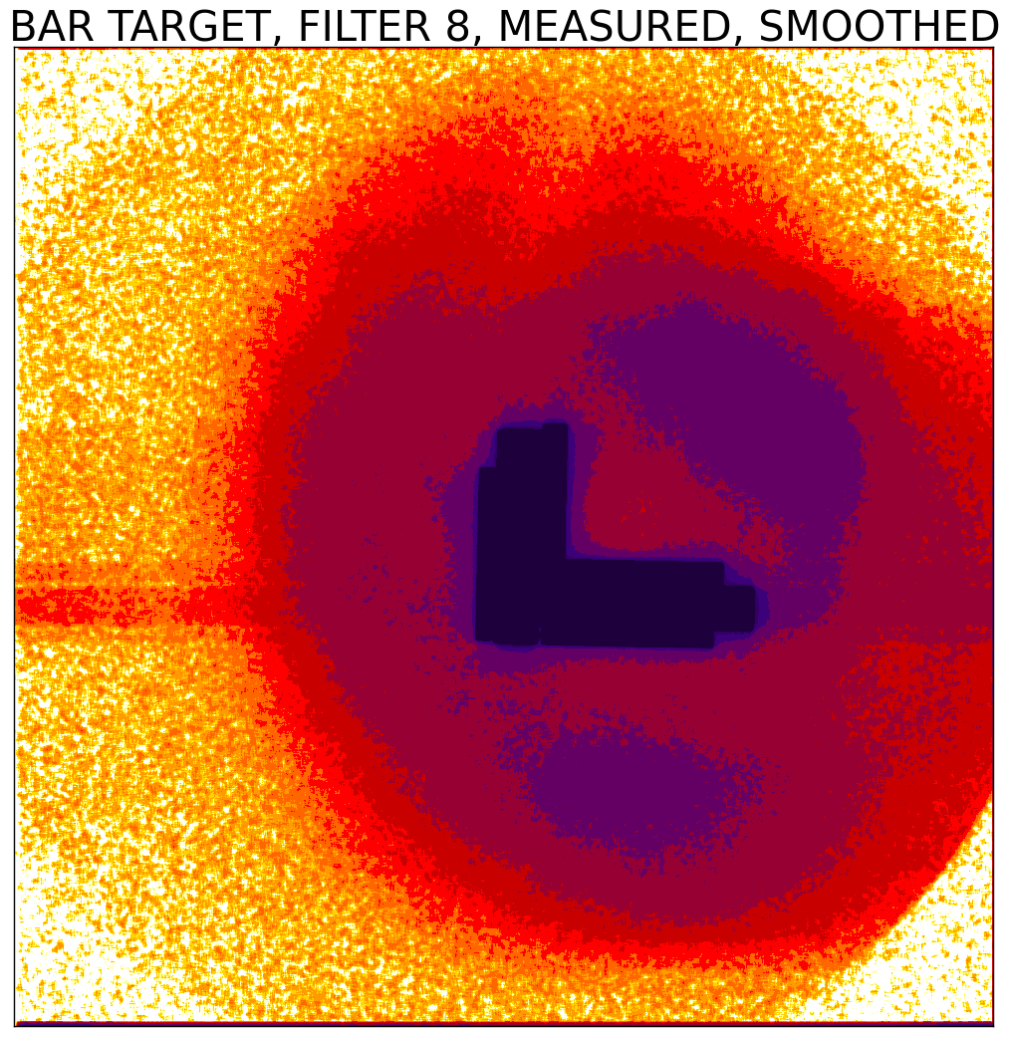
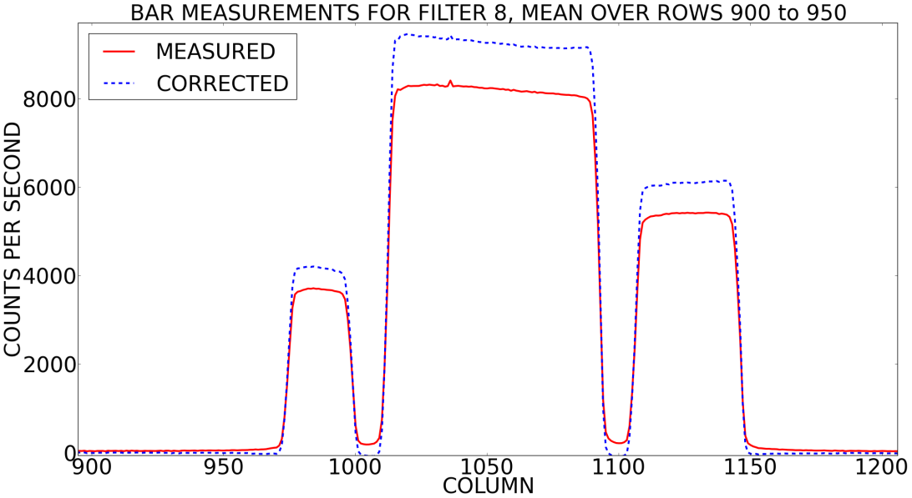
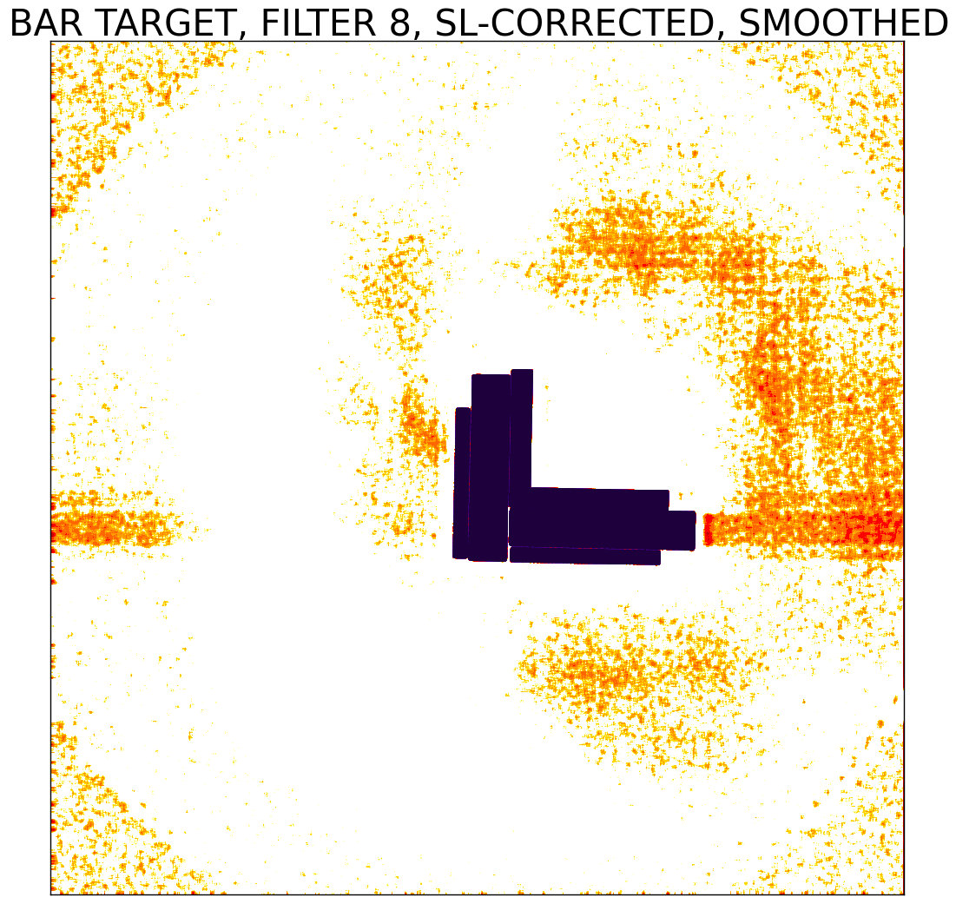
Pre-launch stray light tests
Illumination of EPIC in the laboratory with different “targets” of smaller and larger sizes and different patterns
Here e.g. a “bar target” with different horizontal and vertical cuts
Before stray light correction
After stray light correction

Slide 15
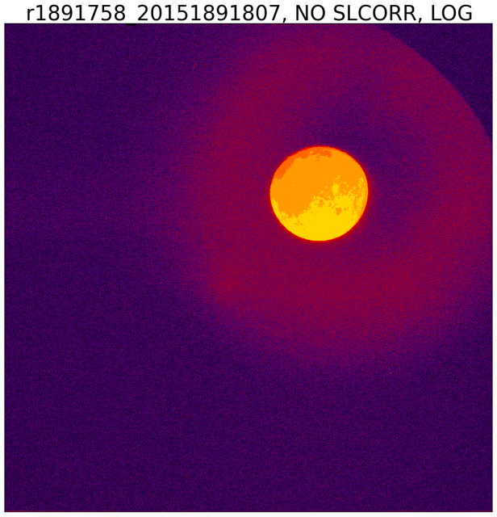
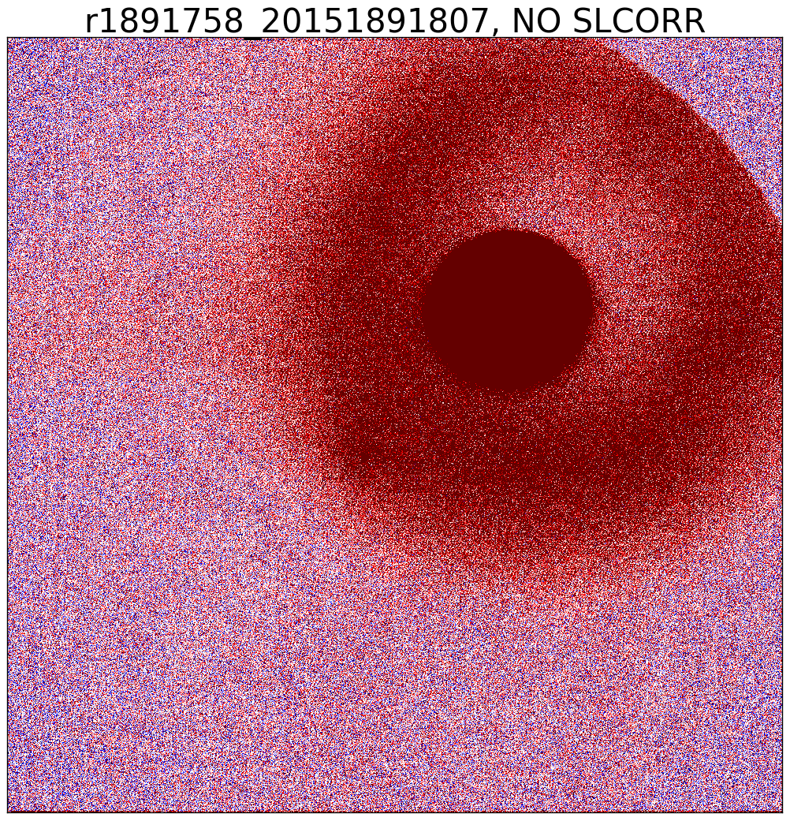
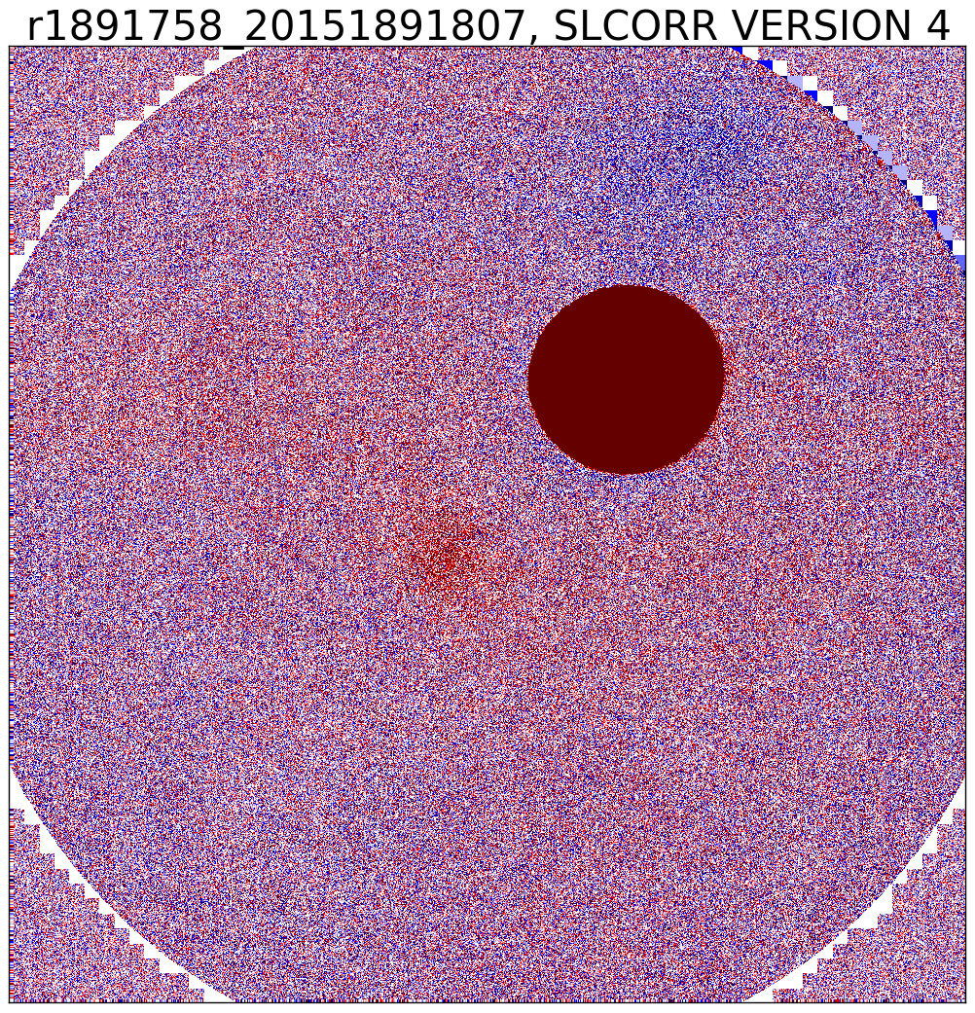
On orbit stray light tests using moon
The ghost image in the PSF results in a “halo” around the moon.
Before stray light correction
After stray light correction

Slide 16
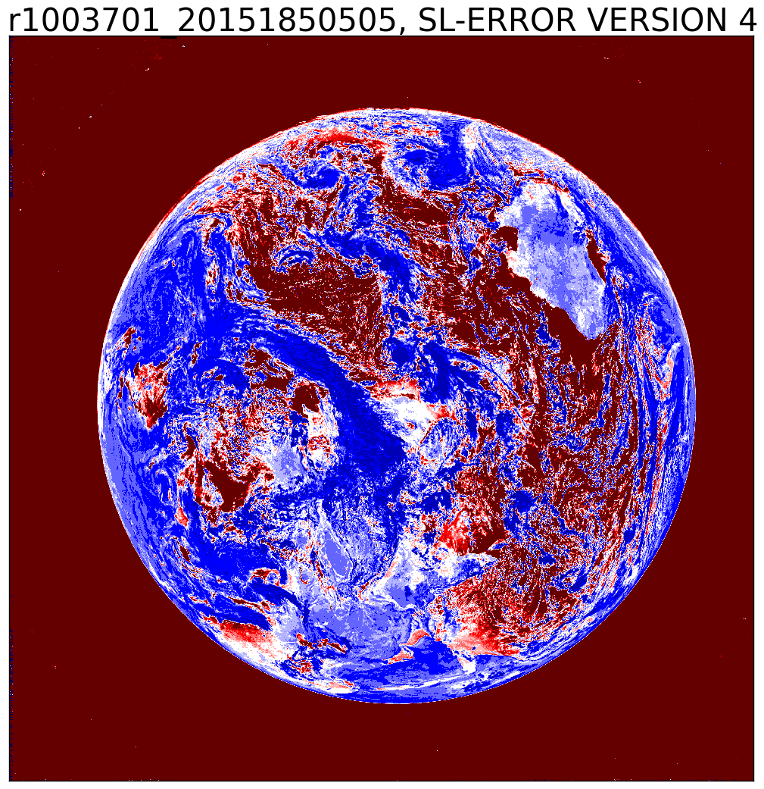
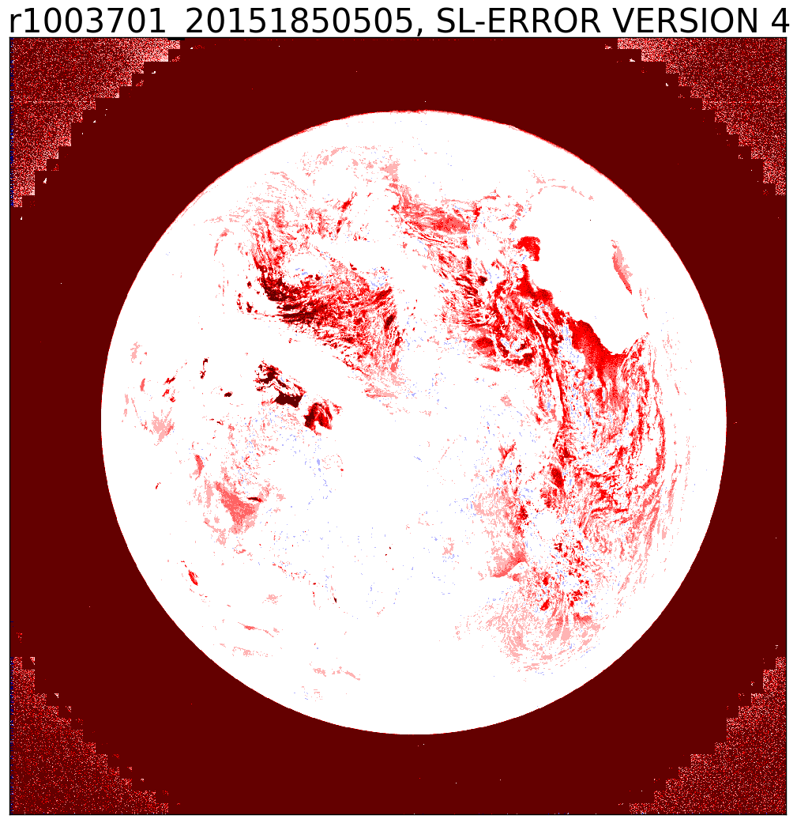
Stray light error
The stray light effect is stronger for the visible filters than for the UV filters, mostly because the dynamic range in the visible is stronger.
The stray light correction is a large computational effort, therefore the EPIC data processing is done Goddard’s super computer system.
Panels show stray light error at 680nm channel.
Stray light enhances the clear scenes (marked red) and reduces the cloudy scenes (marked in blue).

Slide 17
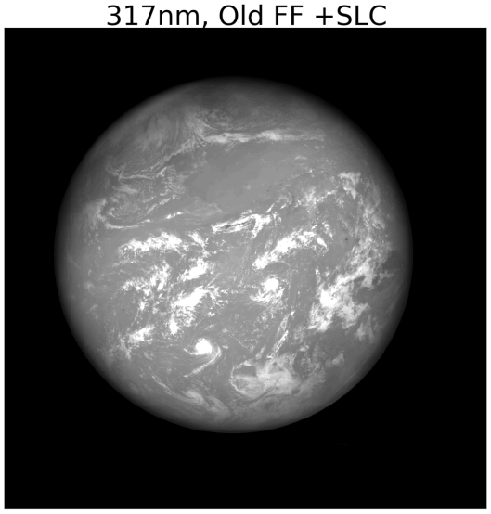
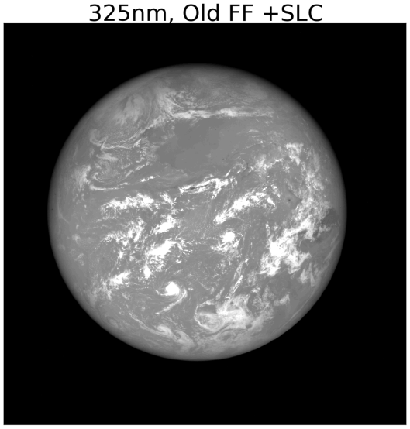
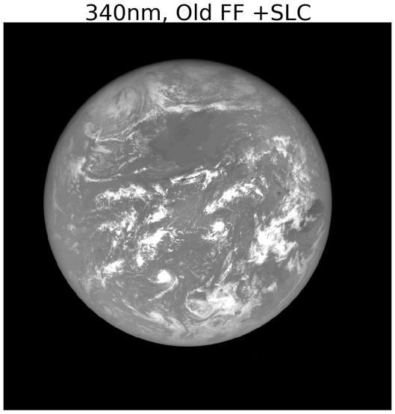
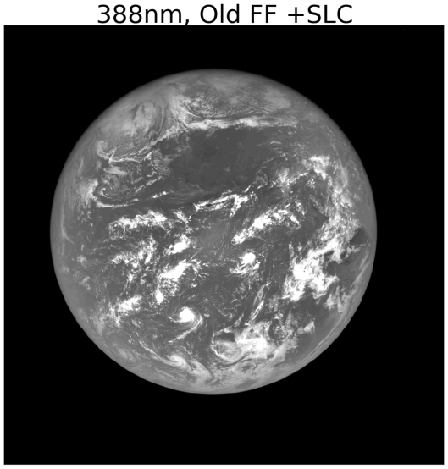
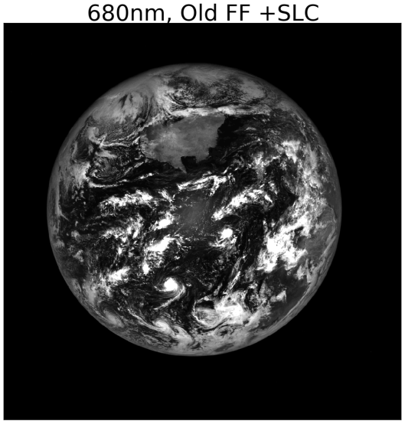
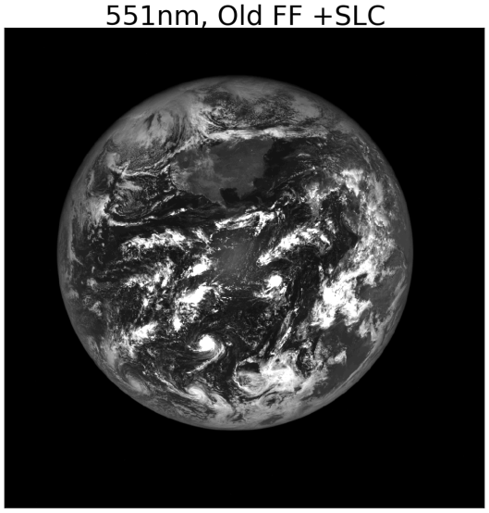
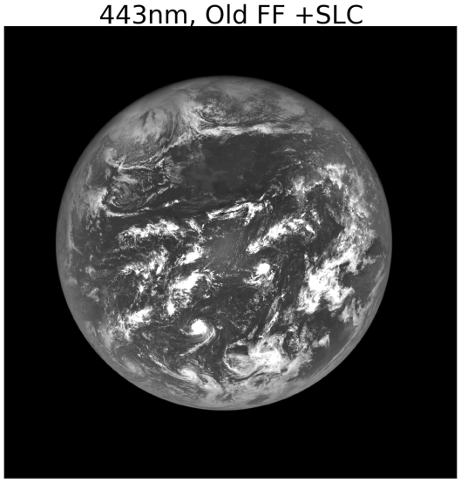
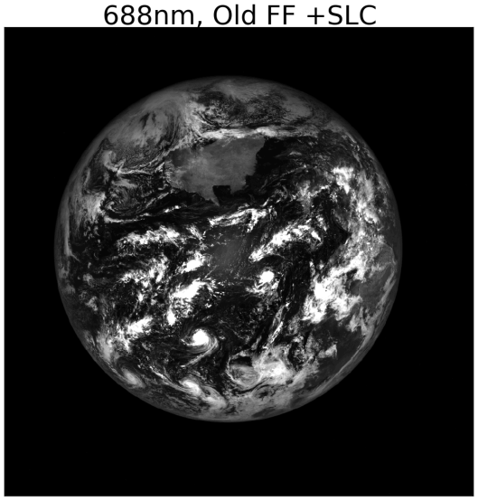
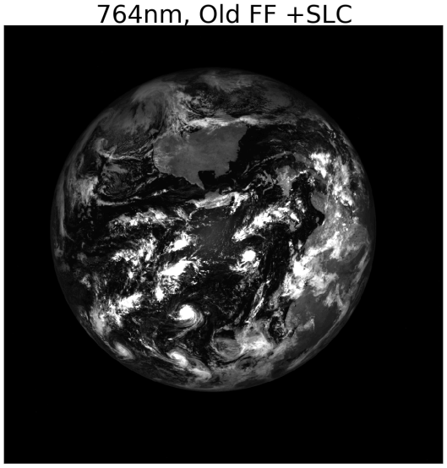
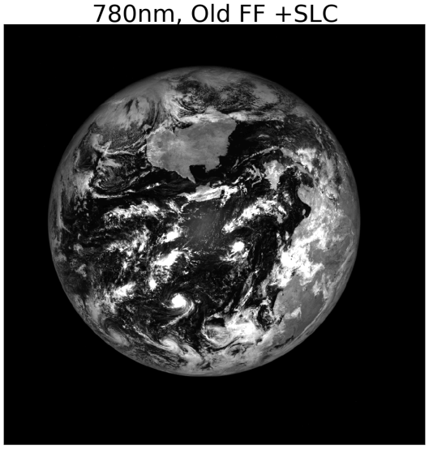
Ozone + SO2
Ozone + SO2
Ozone + SO2
Aerosols
The Earth
in 10
channels
RED
GREEN
BLUE
EPIC images from 5 Sept 2015
O₂B-Band
O₂A-Band
Cloud reference

Slide 18
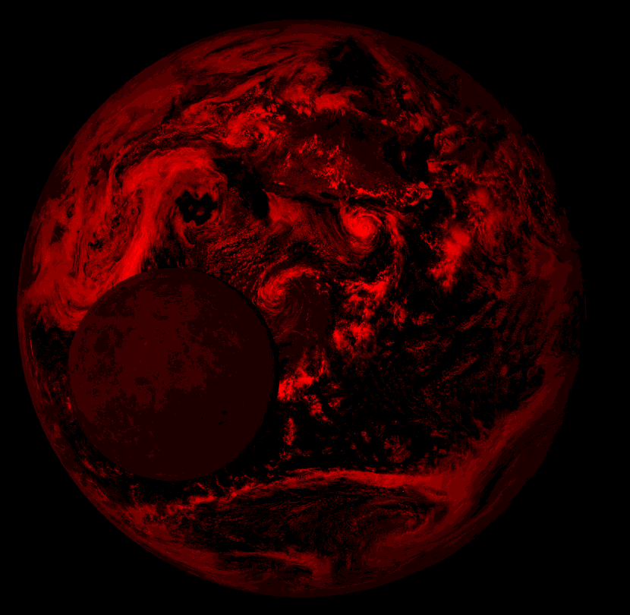
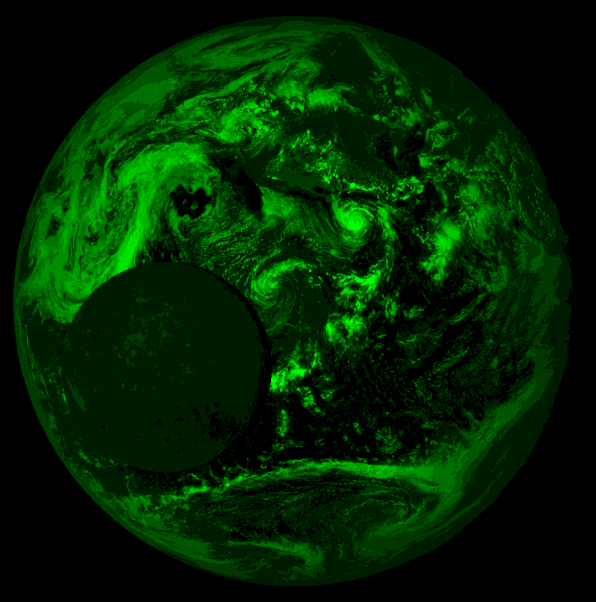
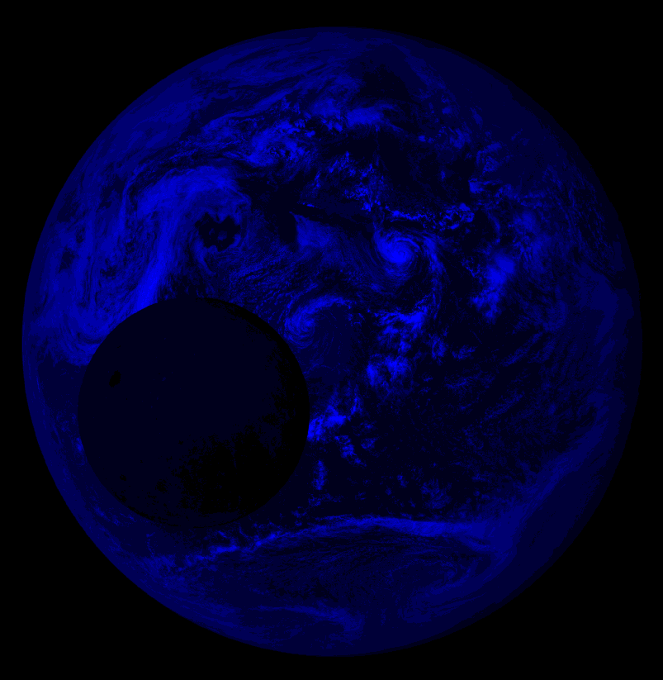
RGB images
RGB is combination of 680nm, 551nm & 443nm
About 1min time between green and blue filter
Telemetry pointing information accuracy is ~2arcsec (~16km) → sophisticated Geolocation algorithm needed to combine the filters

Slide 19
First published EPIC image

Slide 20
RGB Movie
Images 15min apart taken on 16-July-2015 (new moon)

Slide 21
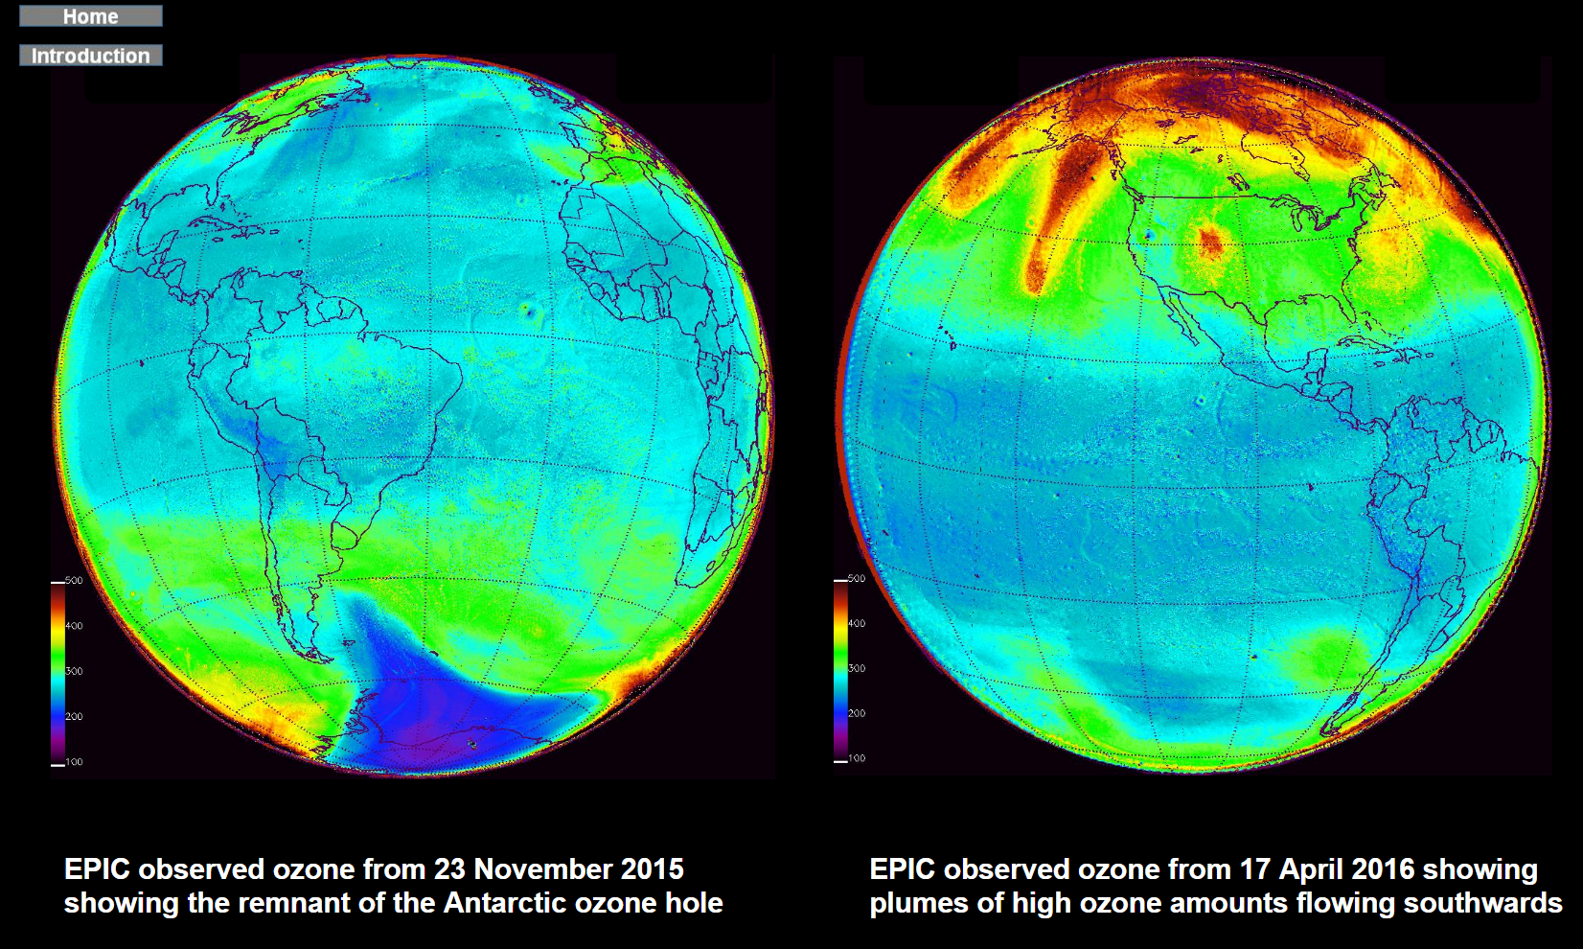
Total ozone column

Slide 22
Volcanic SO2 columns

Slide 23
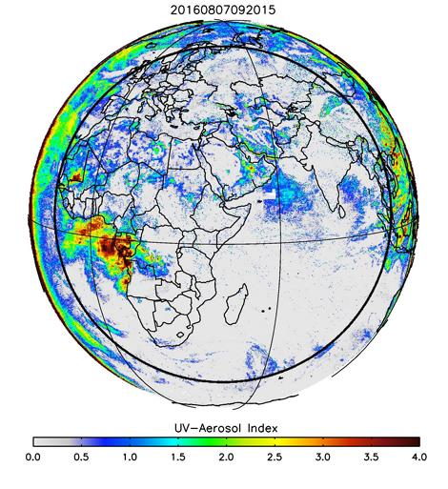
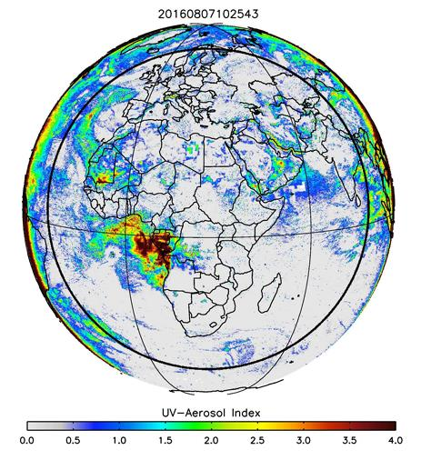
Aerosols

Slide 24
Vegetation index & Leaf area index

Slide 25
Cloud height

