Slide 1
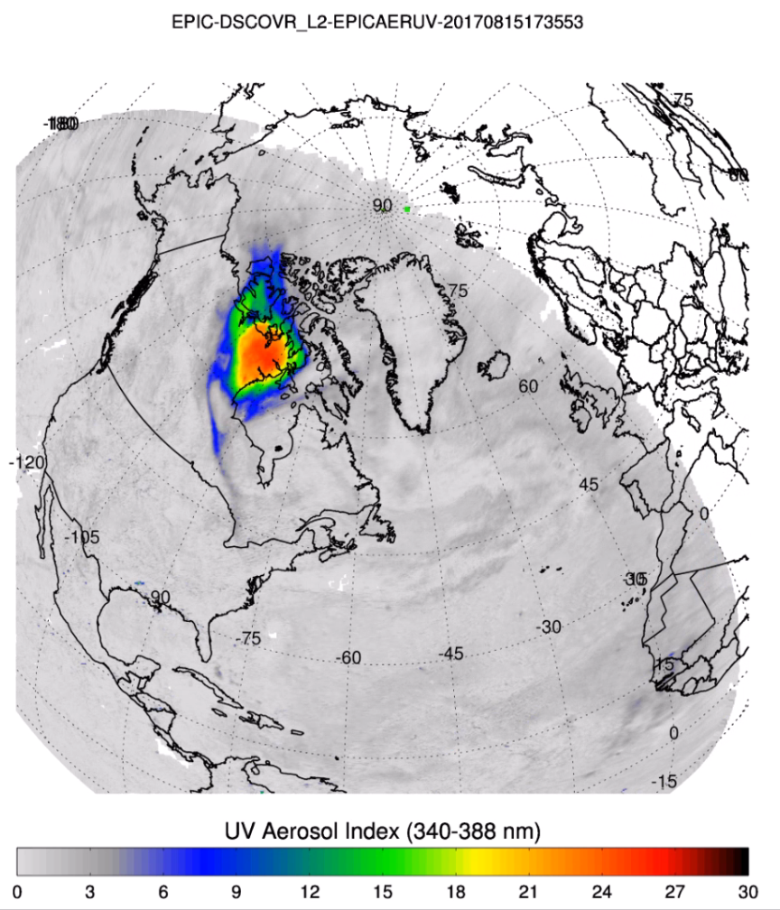
Smoke Aerosol from Canadian Boreal Fire
Extraordinarily high values of Aerosol Index (absorption)
For smoke penetrating into the stratosphere

