Slide 1
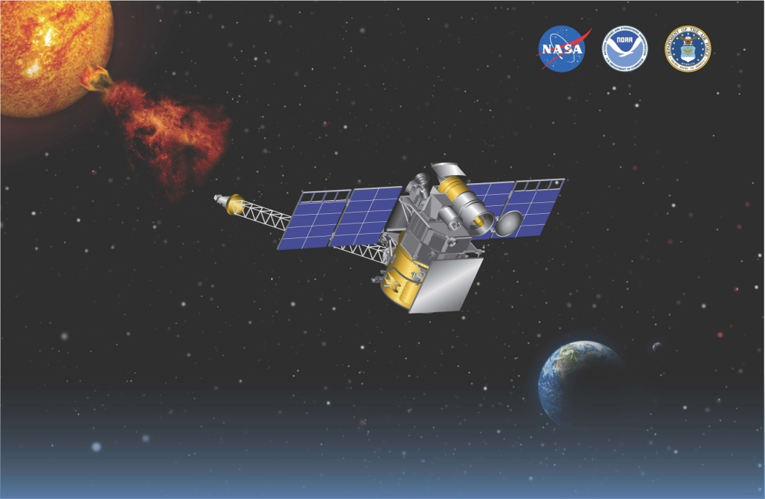
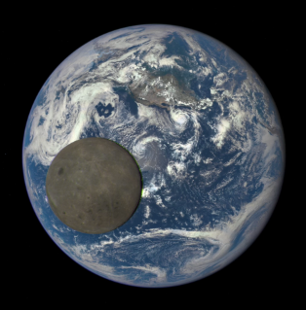
Mission Overview
Mission Description: DSCOVR is a reimbursable project funded by the National Oceanic and Atmospheric Administration (NOAA) with a Launch vehicle being contributed by the United States Air Force (USAF). DSCOVR provides space weather measurements of the solar wind magnetic field, and the solar wind plasma ion velocity and density. These measurements provide warnings of space weather events with 15-60 minute lead times. DSCOVR also provides measurements of Earth radiances and imagery in the visible, NIR, and UV spectrum.
Organizations: NASA GSFC, NOAA, Air Force
Mission Overview: 3-axis stabilized spacecraft, in Lissajous orbit around the Earth-Sun L1 point, 1.5 million km from Earth.
Dry Mass: 425 kg
Wet Mass: 570 kg
Power: 500W EOL
Instruments:
Plasma – Magnetometer (PlasMag)
  Magnetometer
  Faraday Cup
  Electron Spectrometer
Earth Polychromatic Imaging Camera (EPIC)
NIST Advanced Radiometer (NISTAR)
Mission Data:
Launch Vehicle: Falcon 9 - USAF Provided
Launch Date: Feb 11, 2015
Orbit: L1 Lissajous
Mission Class: Category 2, Risk Class D

Slide 2
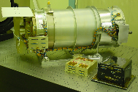
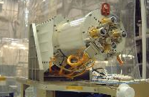
DSCOVR Earth Science
Earth Polychromatic Imaging Camera (EPIC) Objectives
Image the sunlit disk of Earth to form true-color RGB pictures of the planet with a spatial resolution of 35 km or better at the near the image center with 4 hour cadence. We achieve 10 km
Image Earth in ten spectral bands that are sufficient to determine ozone, aerosol, scene reflectivity, cloud cover and height, and vegetation indices. We achieved all of these
EPIC Status
  RGB images posted daily at http://epic.gsfc.nasa.gov
  Level 1 A, B data posted at Langley ASDC
  (https://eosweb.larc.nasa.gov/ )
  In-flight calibrations completed
  Dark field corrections completed
  Stray light correction analysis completed
  Absolute calibrations established and continuously
  updated
  Level 2 data products generated and published at ASDC
  Instrument performs nominally
Right: 30 cm Cassegrain Telescope
EPIC measures radiances from
the sunlit face of the Earth on a
2048 x 2048 pixel CCD in 10
narrowband channels (UV, Visible,
NIR) 317.5 to 799 nm.
NIST Advanced Radiometer (NISTAR) Objectives
NISTAR will provide measurements that could be used to determine the Earth reflected irradiance in the wavelength range of 0.2-100 microns with an accuracy of 1.5% or better. We are still working on this problem
NISTAR Status
In-flight calibrations complete
Absolute calibration analysis continuing
Level 1 A, B data published at Langley ASDC
  Instrument performed nominally
Right: NISTAR measures the absolute “irradiance” integrated over the entire sunlit face of the Earth in 4 broadband channels.

Slide 3
DSCOVR Level-1 Requirements
DSCOVR will utilize the EPIC instrument to image Earth in ten spectral
bands that can be used to determine:
  Ozone
  Sulfur Dioxide
  Aerosol
  Cloud
  Vegetation
  RGB pictures of the planet with a spatial resolution of 35 km or better
  at central meridian (updated at KDP-E).
The time cadence of these spectral band images from EPIC will be provided
on a best effort basis given existing ground system and network capabilities,
and will typically be no faster than 10 spectral bands every 4 hours.
DSCOVR will utilize the NISTAR instrument to provide measurements that
could be used to determine the Earth reflected irradiance in the wavelength
range of 0.2 – 100 microns with an accuracy of 1.5% or better.

Slide 4
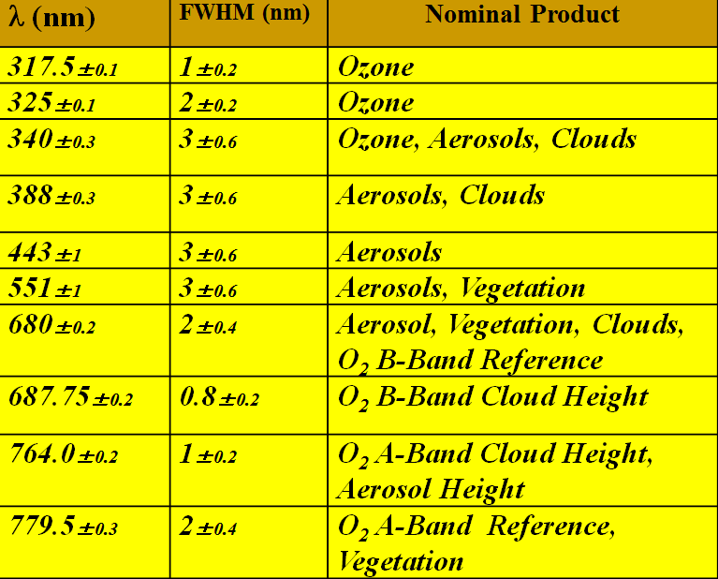
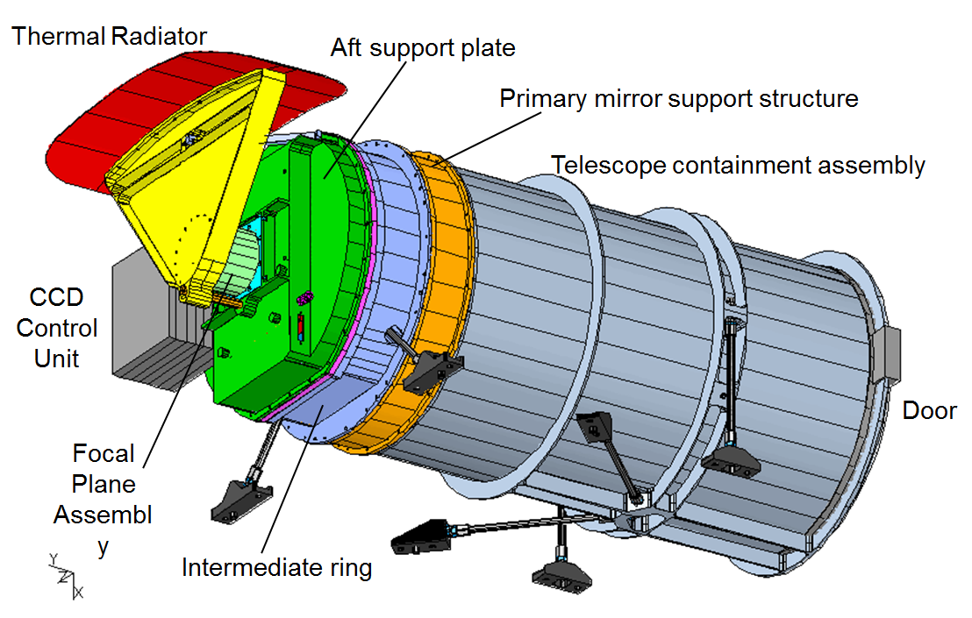

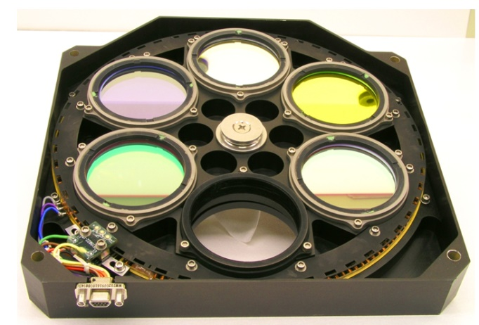
EPIC Wavelengths and Science Products
Double Filter Wheel

Slide 5
EPIC Level-1a Processing Steps
Processing step | Average impact | Affected pixels impact
Dark correction | Moderate | Extreme
Enhanced pixel detection | Small | Large
Read wave correction | Small | Small
Latency correction | Moderate | Significant
Non-linearity correction | Small | Small
Temperature correction | Small | Small
Conversion to count rates | Small | Small
Flat fielding | Significant | Large
Stray light correction | Significant | Large
Conversion to radiances | Significant | Significant
The highest impact corrections summarized on next slides.

Slide 6
Dark Corrections
Dark current rates are inherent detector pixel level signals produced by thermal electrons during the integration time of the observation.
Pre-launch dark rate map based on a CCD temperature of -40°C, but in-flight temperature approximately
-20°C.
??????
Currently used constant dark rate map updated based on the images taken routinely in-flight. Significantly reduces error in dark correction. <1% effect for dark scenes.
Slope and oscillations will be corrected for summer 2018 reprocessing. Largely
due to temperature variations not fully characterized during pre-launch testing.
Will reduce the associated error to <0.5%.

Slide 7
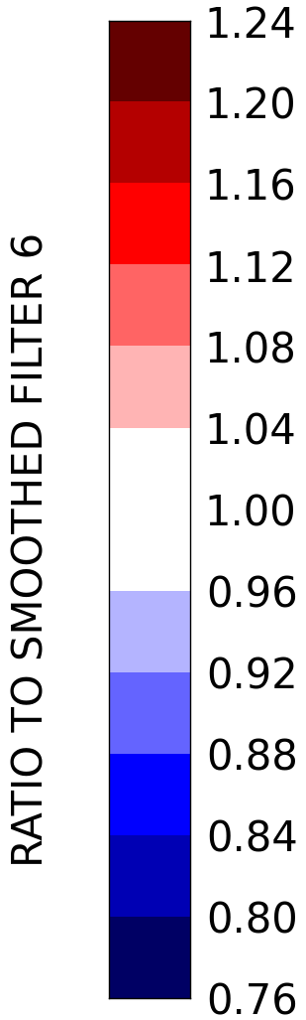
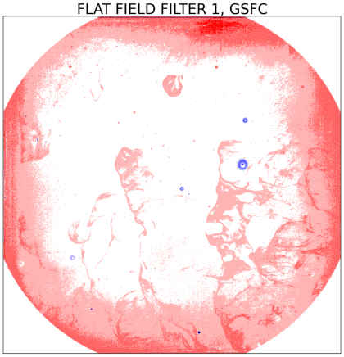
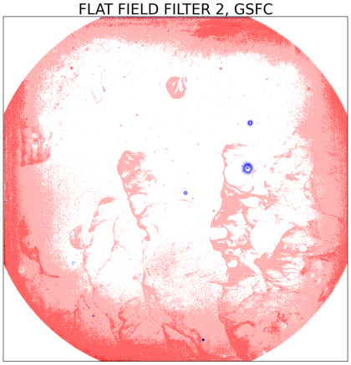
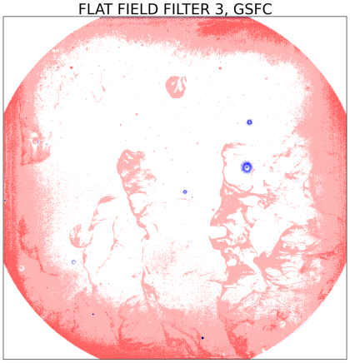
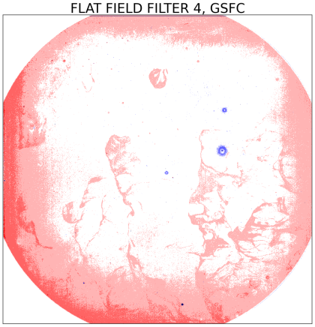
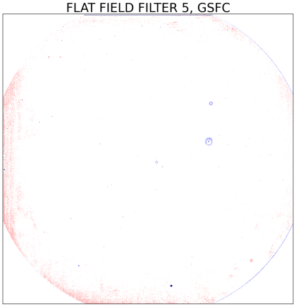
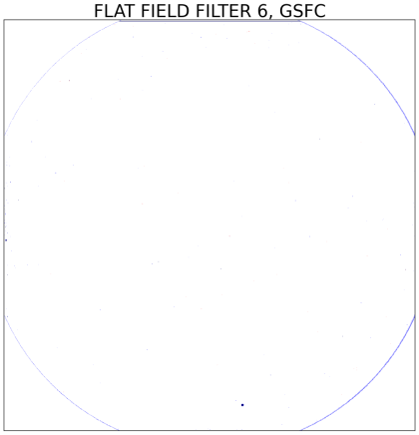
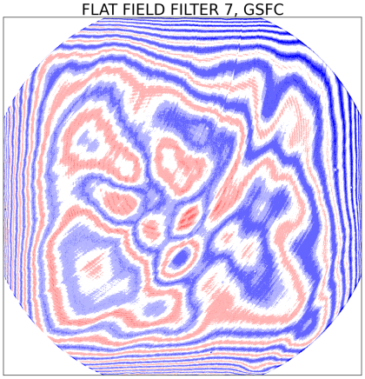
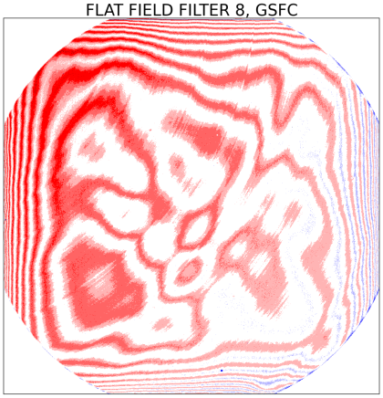
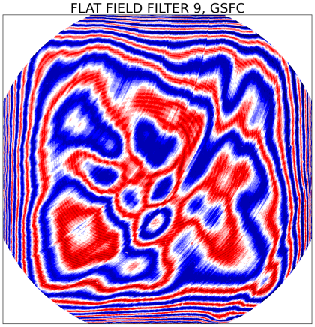
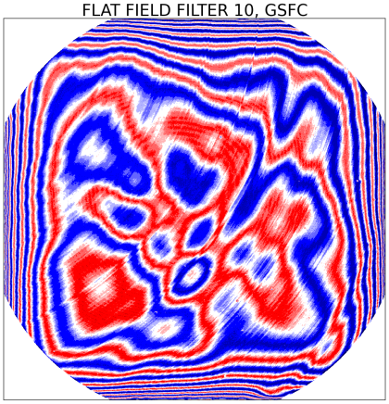
Flat Fielding
EPIC flat field corrections are required due to 3 physical sources:
  Etaloning, filters 7 to 10 (>600nm) only
  Detector inhomogeneity, effect increases towards lower wavelengths
  Pixel response non uniformity, same effect for all filters
Pre-launch calibrations used for initial correction and updated based on in-flight observations.
Images below show pre-launch correction levels.

Slide 8
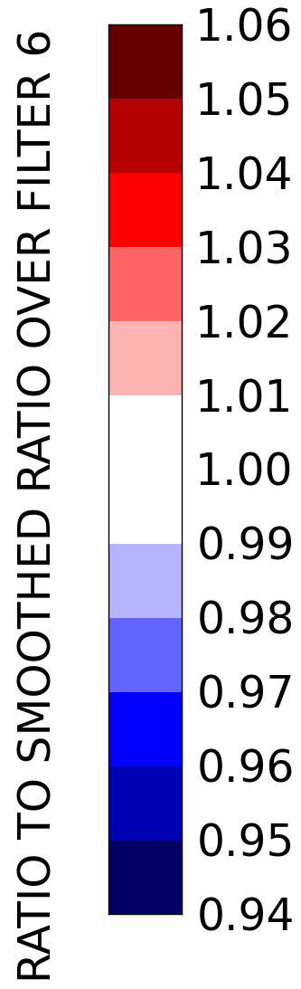
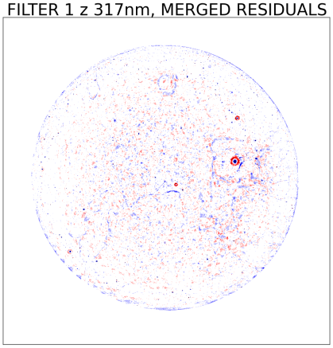
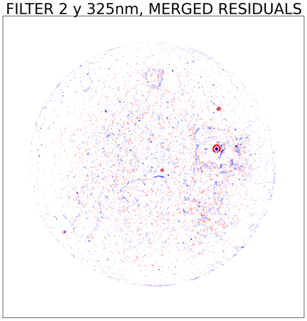
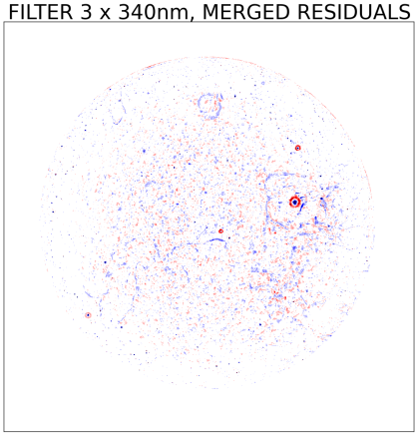
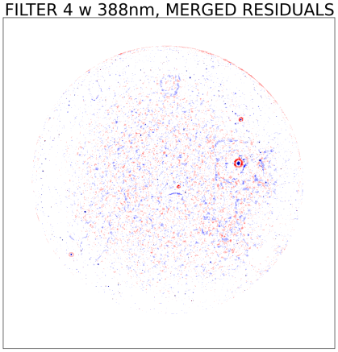
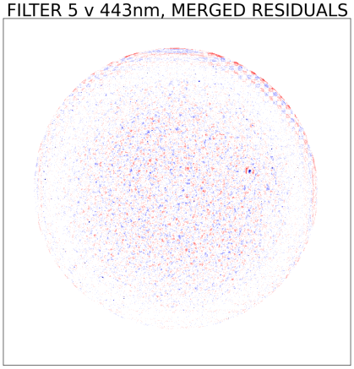
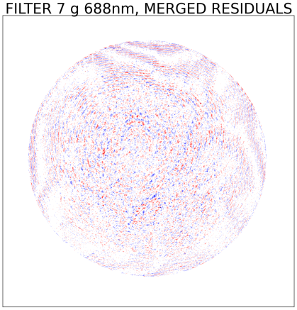
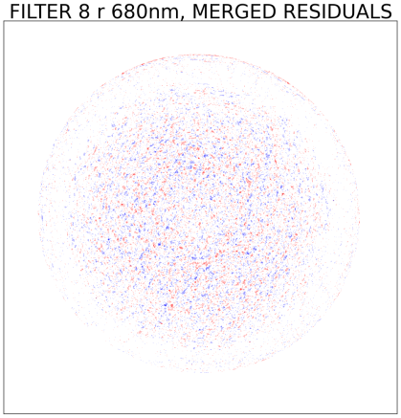
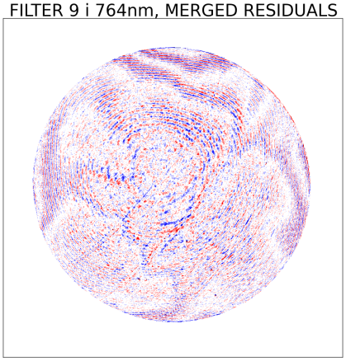
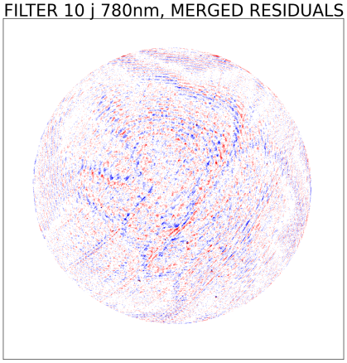
Flat Fielding In-flight Updates
In-flight observations used to validate and improve flat fielding correction.
Implemented technique similar to MODIS where Earth observations averaged together to obtain a smooth image, taking advantage of atmospheric and surface features averaging out over the detector.
Any remaining features in these averaged maps would be attributed to:
  residual flat field errors,
  systematic features in the images, which always occur at the same place on the CCD.
Images below show residual differences between pre-launch and in-flight flat field correction.

Slide 9
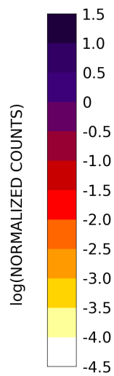
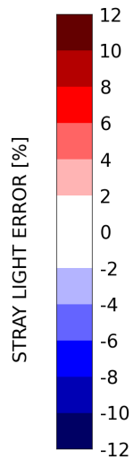
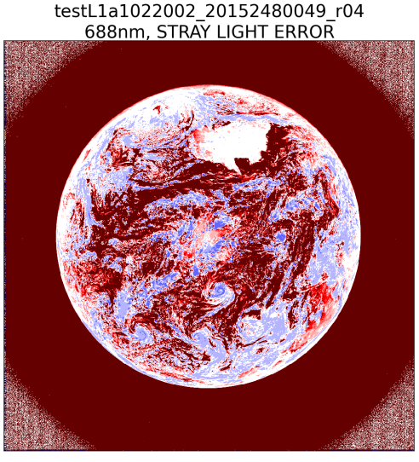
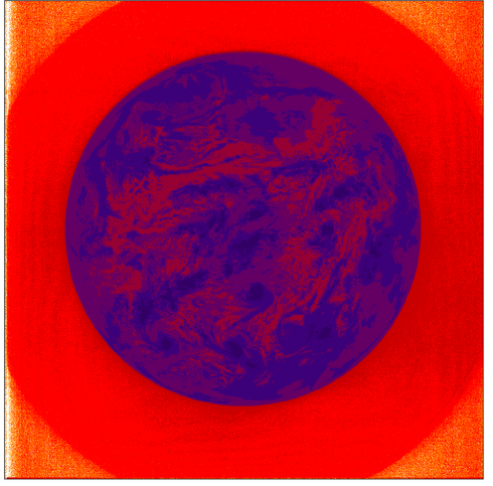
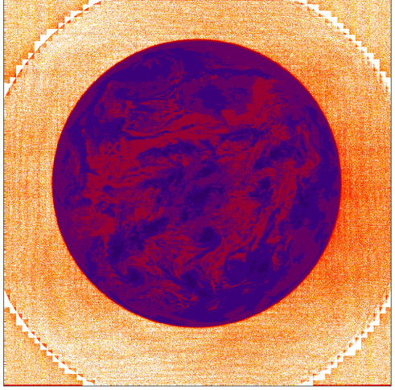
Stray Light Correction
Stray light is generated by in-field and out-of-field objects whose light is scattered within the EPIC optical system into un-wanted field angles. In essence, light from one part of the scene is corrupting measured signal from another part.
For visible filters the stray light error is large due to the larger dynamic range (50:1) in the data and larger amount of stray light induced by EPIC.
The “stray light error” shown here is based on the assumption that the data after the stray light correction are the “truth”.
Most affected by stray light are dark scenes (low albedo, clear sky), which have overestimated signal if no stray light correction is applied.
No correction, SL=1.94%
With correction, SL=0.09%
688nm

Slide 10
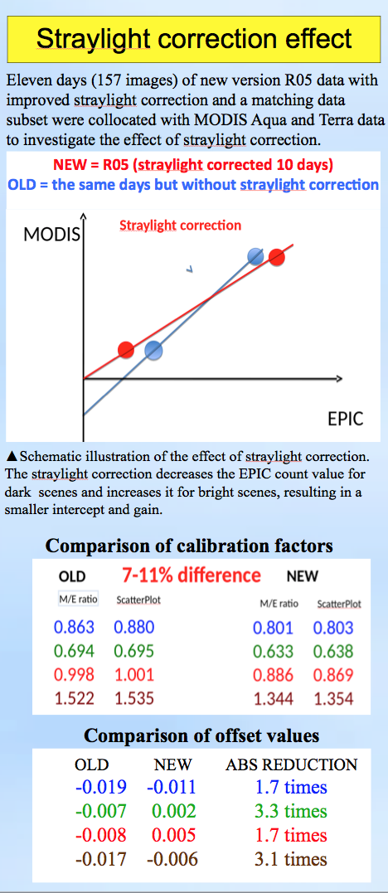
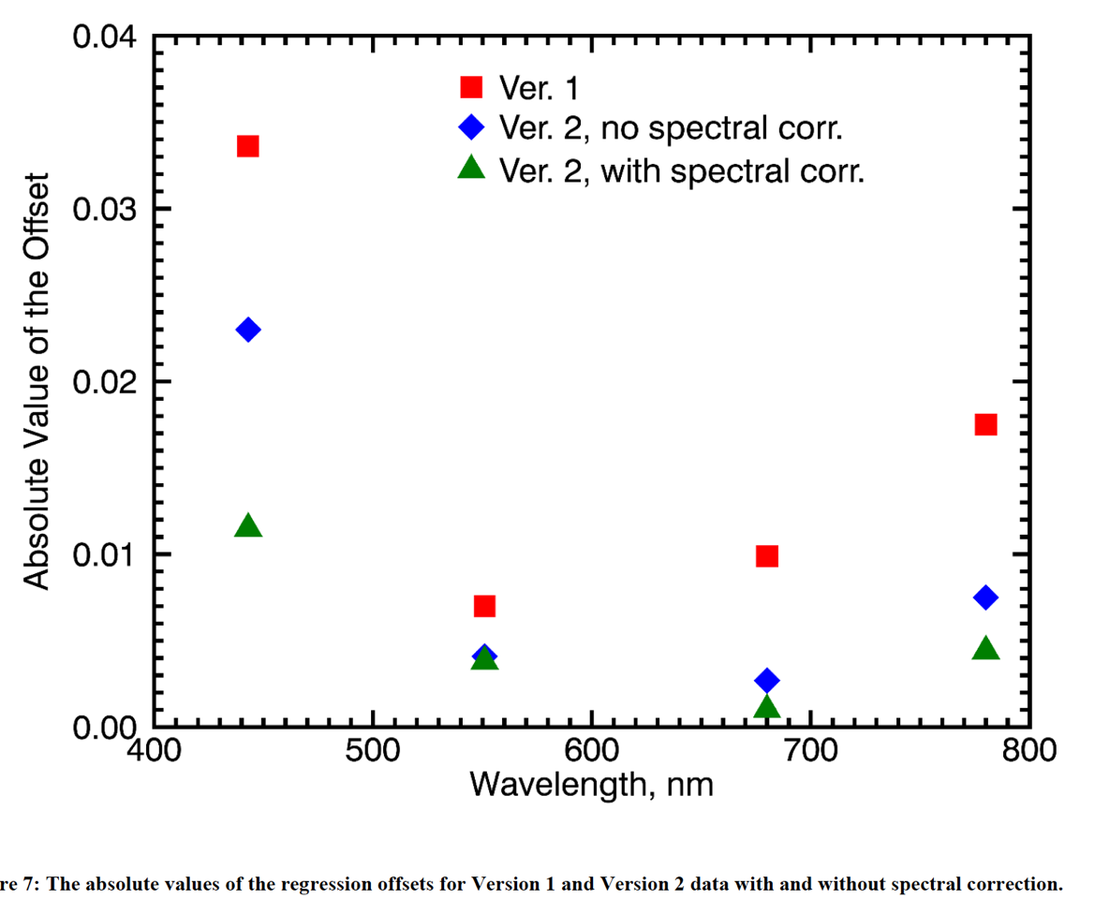
Stray Light Correction (Cont.)
The quality of corrections was checked against MODIS measurements (whether EPIC data, multiplied with a single calibration value, agree with MODIS data (>400 nm) or OMPS (< 400 nm) for both clear sky and cloudy data).
For visible light filters (443, 551, 688, and 780 nm), where comparison with MODIS was possible, the stray light correction is a demonstrated improvement.
Radiance
Counts

Slide 11
Level 1a,b: EPIC Geolocation
Analytical Correction
  Astronomical
  Optical Model
  Atmospheric Correction
Empirical Correction
  Attitude Accuracy Improvement
  Optical Calibration
Result
  Latitude, Longitude, sun & spacecraft values
  Accurate within +/- 0.5 pixel

Slide 12
EPIC Level 2 Data Products
Data Product | Start | End | % Complete
Ozone | 2015 6/17 | 2018 6/18 | 92%
Sulfur Dioxide | 2015 12/3 | 2018 7/4 | Event Based
UV Aerosol | 2015 6/27 | 2018 7/11 | 98%
Cloud | 2015 8/18 | 2018 6/5 | 96%
Visible Aerosol, Atmospheric Correction, Surface Reflectance | 2015 6/13 | 2018 5/15 | 100%
Vegetation | 2015 7/11 | 2018 5/15 | 100%
O3SO2AI K. Yang | 2015 6/12 | 2018 7/12 | 100%
All EPIC Level 2 data is publicly available through Langley ASDC and EarthDATA.

Slide 13
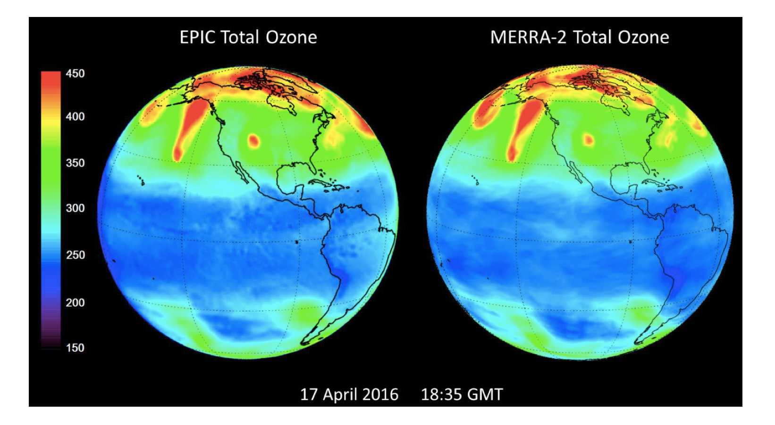
Req. 1a: Total Ozone - EPIC vs. MERRA-2
Spectral Bands Used (nm)
Courtesy of J. Herman
317.5
325
340
388
443
551
680
687.75
764
779.5
Comparison of EPIC total column ozone with the MERRA-2 assimilation ozone model for April 17, 2016.

Slide 14
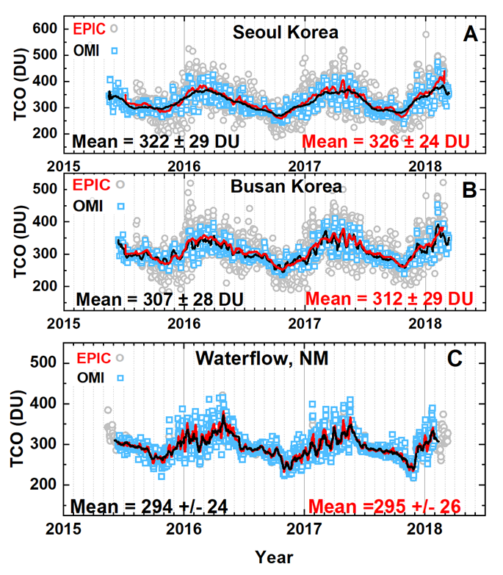
Req. 1a: Comparison of EPIC Total Column Ozone (TCO) with OMI TCO
Spectral Bands Used (nm)
317.5
325
340
388
443
551
680
687.75
764
779.5
Solid lines = 10 day Average
Grey = All EPIC data
Blue = All OMI Data
Location | EPIC Mean | OMI Mean | % Diff.
Seoul | 326 | 322 | 1.2
Busan | 312 | 307 | 1.6
Waterflow | 295 | 294 | 0.3
Units: DU = 2.69 x 10¹⁶ molecules/cm²
Courtesy of J. Herman

Slide 15
Req. 1b: Volcanic Sulfur Dioxide Comparison: EPIC vs. SNPP-OMPS
Spectral Bands Used (nm)
317.5
325
340
388
443
551
680
687.75
764
779.5
SO₂ Mass=42 kt
SO₂ Mass=45 kt
SO₂ Mass=41 kt
10:04 UTC
EPIC
10:05 UTC
OMPS
11:52 UTC
EPIC
SO₂ (DU)
This quantitative comparisons demonstrate a very good agreement of total SO₂ mass measured by DSCOVR EPIC and SNPP OMPS. These maps also illustrate the advantages of EPIC: higher spatial resolution and more frequent observations, allowing improved monitoring of volcanic eruptions.
Courtesy of K. Yang

Slide 16
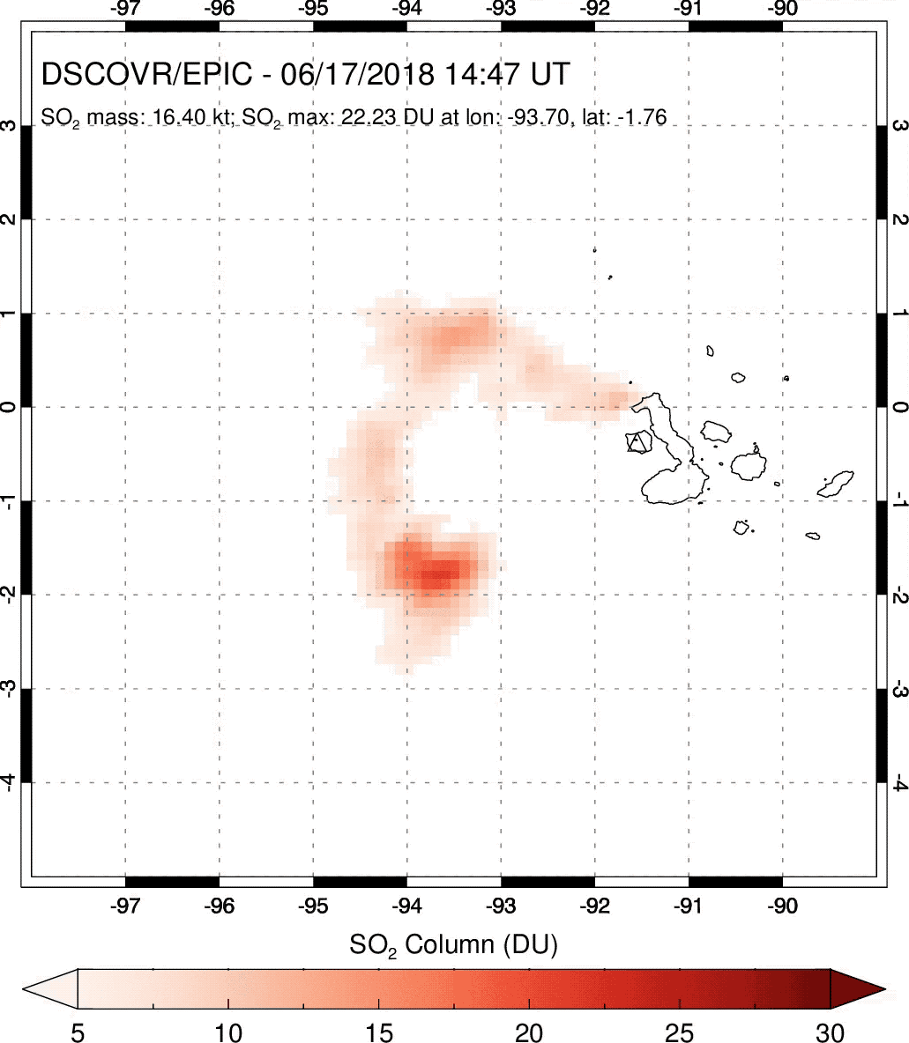
EPIC Hourly SO2
maps on June 17, 2018
from the June 16
volcanic eruption on
Fernandina Island in
the Galapagos (triangle).
Fast dispersion of
volcanic plume with
prevailing tropospheric
winds.

Slide 17
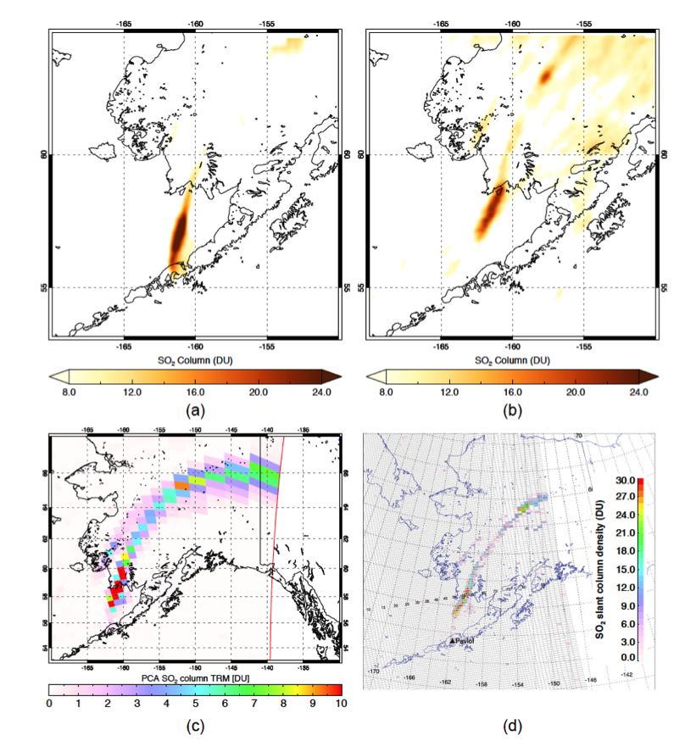
Req. 1b: Aerosols - Volcanic Sulfur Dioxide Comparison:
EPIC vs. NPP/OMPS and AQUA/AIRS
Spectral Bands Used (nm)
EPIC: 21:54 UTC March 28. 2016
EPIC: 00:08 UTC March 29. 2016
317.5
325
340
388
443
551
680
687.75
764
779.5
EPIC SO₂ retrievals (a and b) for the high-latitude eruption of Pavlof (Alaska) in March 2016 under challenging viewing conditions.
Comparisons with the low-Earth orbiting Suomi NPP-hyperspectral Ozone Mapping & Profiler Suite (OMPS) SO₂ data (c) and the atmospheric infrared sounder (AIRS) on NASA Aqua satellite shows that EPIC clearly detects the proximal volcanic plume where SO₂ columns were highest (>10 Dobson Units: 1DU = 2.69x10¹⁶ molecules SO₂ cm⁻²), along with some of the distal plume.
The total SO₂ mass of 33 kilotons (kT) measured by AIRS compares favorably with the EPIC retrievals, which detected ~25 kT of SO₂.
AQUA/AIRS
NPP/OMPS
Courtesy of N. Krotkov

Slide 18
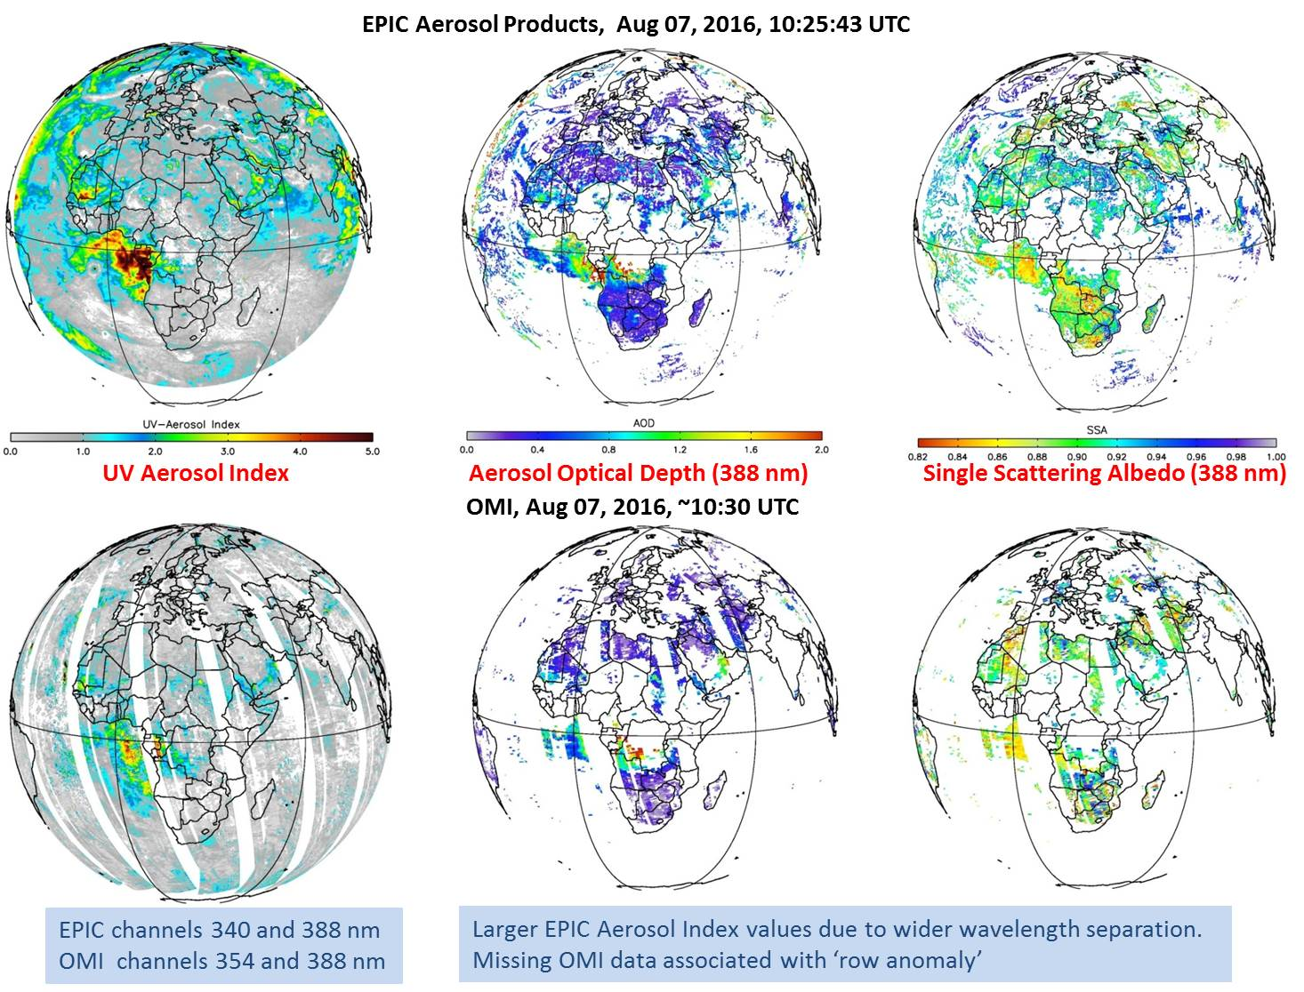
Req. 1c: UV Aerosols - Comparison of EPIC to OMI
Spectral Bands Used (nm)
317.5
325
340
388
443
551
680
687.75
764
779.5
EPIC
OMI
Courtesy of O. Torres

Slide 19
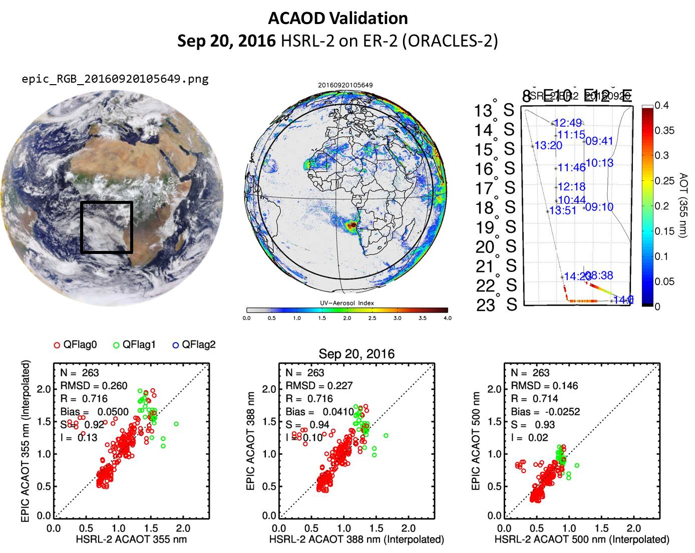
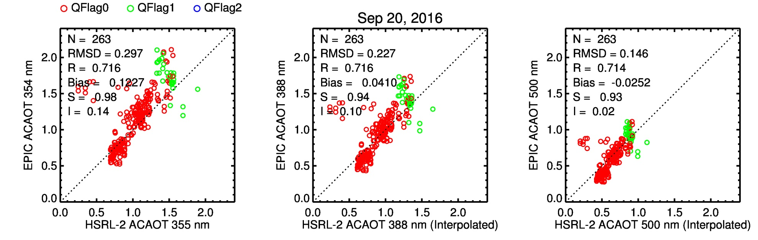
Req. 1c: Aerosols - EPIC Above-Cloud-Aerosol Optical Depth (ACAOD)
Comparison with ORACLES-2 Lidar Observations
Spectral Bands Used (nm)
Courtesy of O. Torres
317.5
325
340
388
443
551
680
687.75
764
779.5

Slide 20
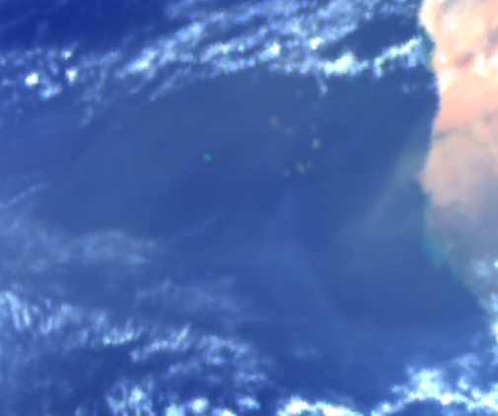
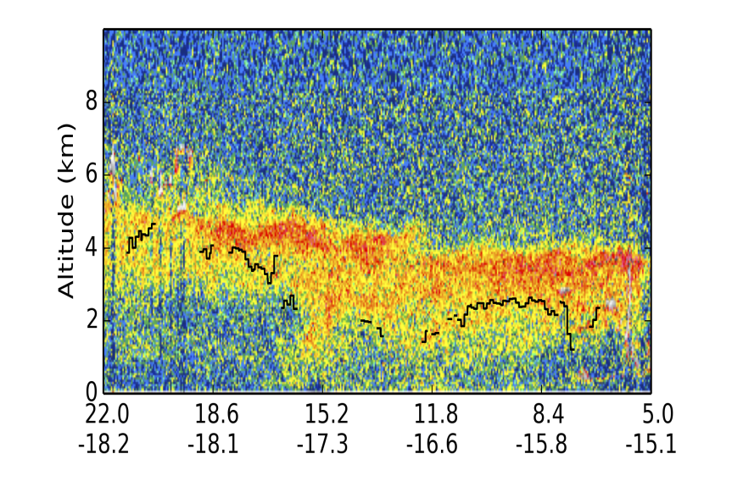
Req. 1c: Aerosols - Retrieving aerosol layer height from EPIC O₂ A and B bands
Comparison with CALIOP Observations
Spectral Bands Used (nm)
Courtesy of Y. Yang
317.5
325
340
388
443
551
680
687.75
764
779.5
A case study: EPIC at 2016-04-17 14:59 UTC
RGB
AOD
H, km
CALIPSO
track
sun glint
removed
CALIPSO 2016-04-17 14:18 UTC
EPIC retrieved H
clouds
EPIC retrieved H
Notes:
Retrieval results of AOD and aerosol height from EPIC O2-A and B bands
Validate with collocated CALIPSO measurements of backscatter and extinction coefficients.
Not an actual product, yet. We know that this is Saharan dust

Slide 21
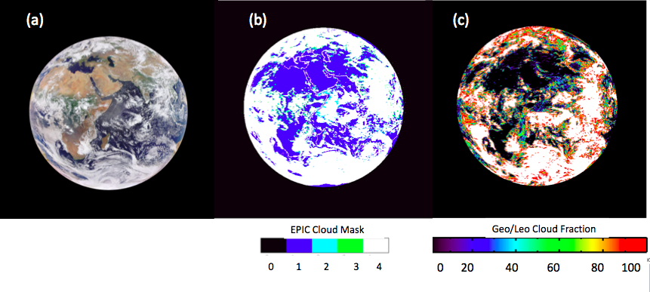
Req. 1d: Cloud Cover - Cloud Mask
Spectral Bands Used (nm)
317.5
325
340
388
443
551
680
687.75
764
779.5
EPIC cloud mask validation example (a) EPIC RGB image taken on Aug. 18, 2016 at 08 GMT, (b) EPIC cloud mask and (c) cloud fraction of each EPIC pixel calculated from collocated Geo/Leo satellite products by NASA LRC. Comparison show that EPIC cloud mask performs well. It generally classifies a pixel as cloudy when the pixel has a cloud fraction above 0.3.
Courtesy of Y. Yang

Slide 22
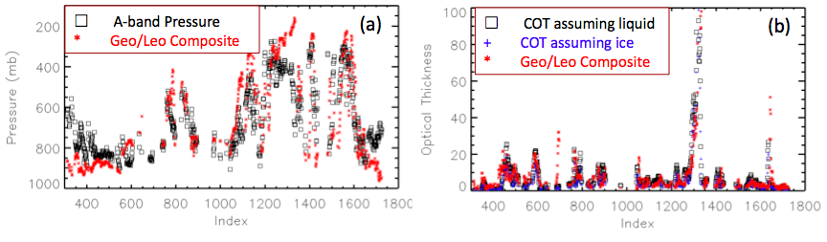
Req. 1d: Cloud Height and Cloud Optical Depth
Spectral Bands Used (nm)
317.5
325
340
388
443
551
680
687.75
764
779.5
EPIC cloud effective pressure and cloud optical thickness (COT) performance example. Comparison are done along a line in the middle of the image (a) comparison between EPIC A-band cloud pressure and the Geo/Leo composite; and (b) comparison between EPIC COT assuming liquid/ice with the Geo/Leo composites.
Results show that the EPIC average A-band pressure is 658 mb, while the Geo/Leo composite has a value 645mb. The average COT for EPIC assuming liquid and ice phases are 8.9 and 7.4, while the Geo/Leo composite has a value of 9.5. These results are consistent with the theoretical expectations
Courtesy of Y. Yang

Slide 23
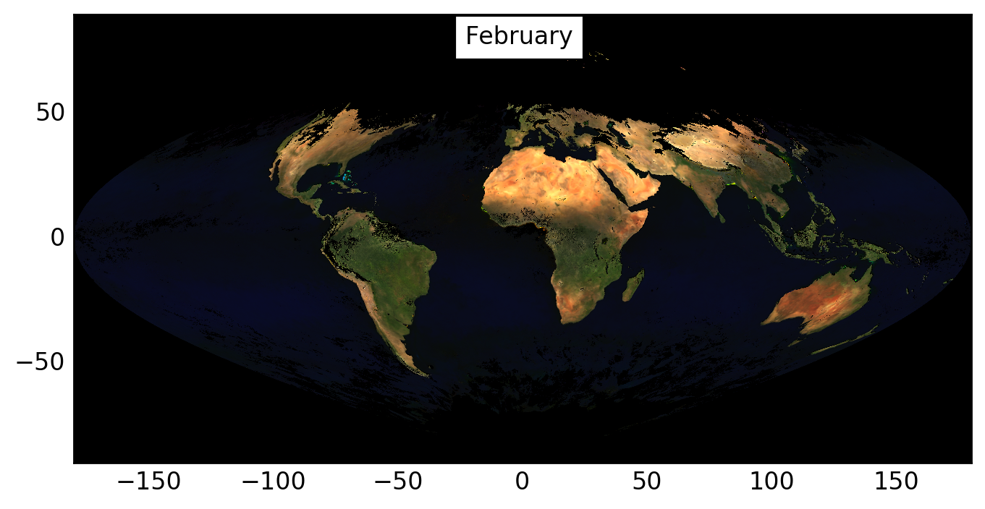
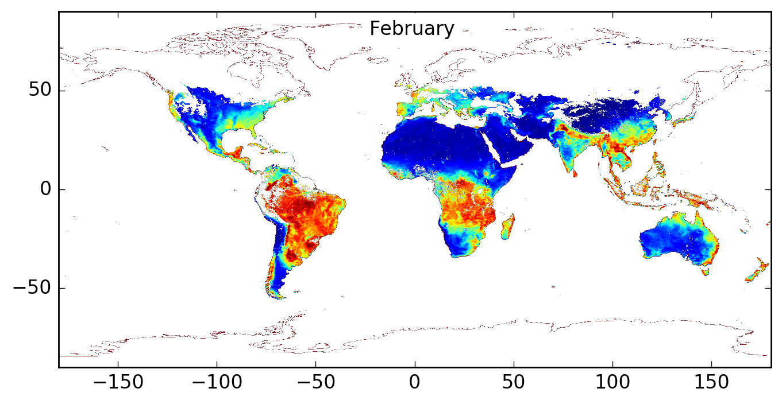
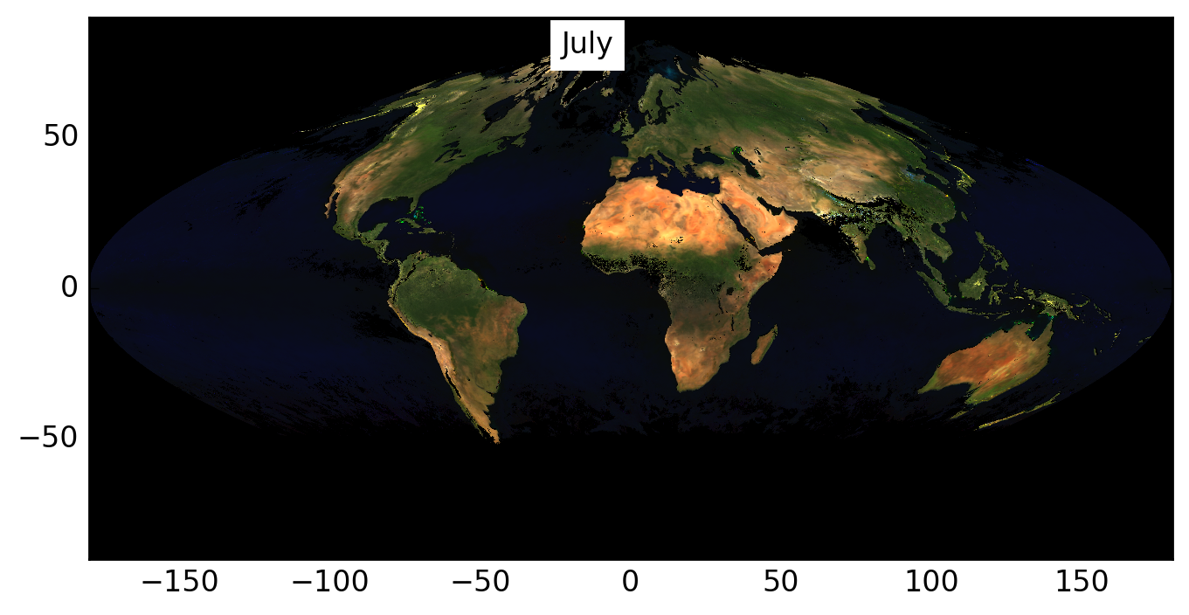
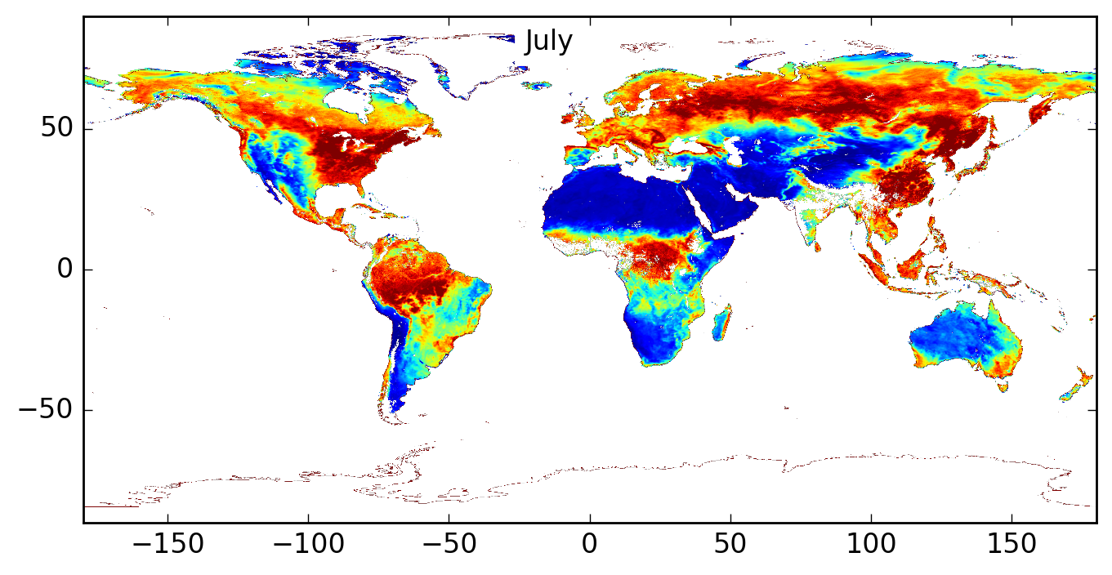
Req. 1e: Vegetation Index and Atmospheric Correction
Spectral Bands Used (nm)
Spectral bands used:
443, 551, 680, 780 nm
317.5
325
340
388
443
551
680
687.75
764
779.5
Monthly Composites of
RGB Surface BRF
NDVI
Courtesy of A. Lyapustin

Slide 24

Req. 1e: Sunlit Leaf Area Index
max: 4.9 10⁵
SLOPE, DEG
First product to show sunlit leaf area index of illuminated leaves
Notes:
First product to show sunlit leaf area index of illuminated leaves

Slide 25
Req. 1e: Vegetation and BRF – EPIC vs. MISR
20160823152458
Spectral Bands Used (nm)
317.5
325
340
388
443
551
680
687.75
764
779.5
Sensor | Green spectral band, nm
 | Center | Band width
MISR | 555 | 20
EPIC | 551 | 3
Mean MISR and EPIC BRFs over an area of 563kmx985km in Amazonian rainforests, which represents structurally homogeneous area.
Courtesy of Y. Knyazikhin
Notes:
Date: 2016-08-23, 15:24:58GMT. Shown are mean MISR and EPIC BRFs over an area of 563kmx985km in Amazonian rainforests, which represents structurally homogeneous area.

Slide 26







Req. 1e: Leaf Area Index – Comparison with C6 MODIS (Aug 2016)
R²=0.31
R²=0.51
R²=0.74
R²=0.71
EPIC Land Cover Map
Spectral Bands Used (nm)
R²=0.66
R²=0.63
317.5
325
340
388
443
551
680
687.75
764
779.5
Courtesy of Y. Knyazikhin
Notes:
Spectra bands used to derived the VESDR product: 551nm, 680nm and 780nm.
EPIC Land Cover Map was derived from MODIS 8-biome 500 m Land cover type 3 product (MCDLCHKM). This static map is input for VESDR algorithm, which will be released to users. Global vegetation is stratified into eight canopy architectural types, or biomes. The eight biomes are
B1: grasses and cereal crops,
B2: shrubs,
B3: broadleaf crops,
B4: savannas,
B5: evergreen broadleaf forests,
B6: deciduous broadleaf forests,
B7: evergreen needle leaf forests,
B8: deciduous needle leaf forests.
------------------------------------------------------
Shown are histograms of EPIC LAI and C6 MODIS LAI products for different biome types.
B6: A low R2 for is due to biome mixture at 10 km EPIC pixel: MODIS LAI product is at 500m resolution. Biome mixture within 500m pixel is low and thus MODIS gives accurate LAI for B6. In the case of EPIC, biome mixture within 10 km is high at low LAIs. Thus EPIC histogram includes both B6 and other biomes at low LAIs. Distribution of biome types within each 10 km pixels is also a product of the VESDR and will be available to users.
B5: same as for B6.
B3: may indicate a bias of 0.25 LAI units.
B1: I believe that EPIC provides a more accurate LAI histogram.

Slide 27


New Product: UV 388 nm Reflectivity (Clouds + Snow or Ice)
Reflectivity 0 < R < 1
Brighter Clouds are usually at higher altitude
In the UV, the land and ocean have a reflectivity of 0.04 or less, so the reflectivity is mostly clouds and snow/ice.
The ground is not visible.
Notice Greenland in upper right
Allows investigation of diurnal variation.
08/23/2017 17:54:36

Slide 28


New: UV Erythemal Irradiance (Watts/m² and UV Index)
Erythemal Irradiance from sunrise (West) to sunset (East)
Calculated from measured ozone amounts and cloud reflectivity
UV index = 40* I(Watts/m²)
A UV index of 10 is quite dangerous for sunburn and cancer
Note the high values in the Andes mountains UV index 16 to 20

Slide 29




Glint from oriented ice crystals
20160317094607
20151028094609
20160317094609
zoom
20151028094609
zoom
Many DSCOVR/EPIC images contain bright flashes of light over both ocean and land. It was demonstrated that the flashes over land are specular reflections off tiny ice platelets floating in the air nearly horizontally. Such deep space detection of tropospheric ice can be used to constrain the likelihood of oriented crystals and their contribution to Earth albedo.
Source: Marshak et al., 2017. Terrestrial glint seen from deep space: oriented ice crystals detected from the Lagrangian point. Geoph. Res. Lett., 44, doi:10.1002/2017GL073248.

Slide 30

Two EPIC NDVIs from March 22, 2016
If the EPIC O2 B-band (688 nm) is used instead of the red band, the effect of atmosphere (the diffuse radiation) on surface reflectance will be reduced and the residual uncertainties in atmospheric correction can be better tolerated. This is due to two factors:
vegetated surface is yet sufficiently dark at 688 nm and
the O2 absorbing atmosphere substantially reduces multiple scattering.
Source: Marshak, A. and Y. Knyazikhin, 2017: The spectral invariant approximation within canopy radiative transfer to support the use of the EPIC/DSCOVR oxygen B-band for monitoring vegetation. J. Quant. Spectrosc. Radiat. Trans., 191, 7-12, doi:10.1016/j.jqsrt.2017.01.015.

Slide 31



Requirement 1g: 35 km resolution at
central meridian
EPIC
Pixel Projection = 1 arc second = 8 km
Near the Sub-Satellite Point
Features 10 km resolvable due to
the combination of RGB images.
30 June 2015
Google
Earth

Slide 32

Req. 2: Time Cadence of EPIC RGB Images
2015
2016
2017
2018
Goal: 6 per day
Ops plan:
13 during winter
22 during summer
Performance:
2016: 90.0%
2017: 92.4%
2018: 92.2%
Total number of images:
15,406 out of 17,006
Total # lost due to
spacecraft safe-hold:
347 or 2% loss
Number of EPIC RGB images per day
Days from June 12, 2015
Spacecraft Safe-Hold Events

Slide 33

https://epic.gsfc.nasa.gov

Slide 34



DSCOVR: NISTAR
Full-disk measurement of absolute out-going irradiance
Three Electrical Substitution
Radiometers in different bands
Cavity absorbers and electrical substitution utilized for excellent long-term stability
One Silicon Photodiode Channel
Band | Wavelength
Total | 0.2 µm to 100 µm
SW Solar Reflected | 0.2 µm to 4 µm
NIR Solar Reflected | 0.7 µm to 100 µm
Photodiode | 0.2 µm to 1.1 µm

Slide 35

DSCOVR: NISTAR – Uncertainty Budget
$$Earth Irradiance=−\frac{𝒟\left\{Earth View\right\}− 𝒟\left\{Space View\right\}}{R }$$
$$𝒟\left\{ \right\}≡Signal Demodulation Operation$$
$$R ≡Responsivity (Calibration Constant)$$
Filter Channel | Instrument Noise (Precision) |  |  | Responsivity (Calibration) |  | NISTAR Total Uncertainty⁵
 | Space View¹ | Earth View² | Total Noise | Laboratory Calibration³ | Stability on Orbit⁴
 |  | 4 Hr Daily | 4 Hr Daily |  |  | 4 Hr Daily
Total | 1.0 % | 0.7 % 0.3 % | 1.2 % 1.0 % | <0.2 % | 0.3 % | 1.3 % 1.1 %
SW | 1.3 % | 1.0 % 0.4 % | 1.7 % 1.4 % | 1 % | 0.3 % | 2.0 % 1.7 %
NIR | 3.5 % | 4.2 % 1.7 % | 5.5 % 3.9 % | 1 % | 0.3 % | 5.6 % 4.0 %
All uncertainties are calculated at k = 1
Normalized to the Earth signal. 2-hour dark space view performed monthly. 3 consecutive dark space views are averaged for the SW and NIR channels; no averaging for the Total channel.
Based on the 4-hour and daily averages of the Earth view signal.
Uncertainty components are from both the ESR receiver and the filter transmission. For the two filtered channels, SW and NIR, the uncertainty of the filter transmission dominates.
From on-orbit inter-comparison between receivers and filters collected while viewing the earth.
Total uncertainties of 4-hour and daily include both the measurement precision and calibration.

Slide 36

DSCOVR: NISTAR Photodiode for 2.5 years
NISTAR PD Channel over 2.5 years
Earth distance effects removed
DISCOVR orbit effects viewing angle which does not align with seasons
Observed shortwave reflectance shows significant annual variations (5 % to 8%).

Slide 37

DSCOVR: NISTAR PD - SW - EPIC Comparison
NISTAR PD/SW Compared to EPIC
Data averaged over a weekly time period
EPIC spectral radiance is weighted sum of 10 bands to match the PD response
Long-term variations agree well in spite different spectral response of NISTAR SW and PD

Slide 38

DSCOVR: NISTAR-CERES SW Comparison
NISTAR SW & PD Versus CERES SW SYN1deg
Stable short-term correlations
NISTAR SW and PD both show larger (≈20%) daily variations than CERES Synoptic Model
NISTAR SW shifted down by 12 % for comparison

Slide 39

DSCOVR: NISTAR-CERES SW Comparison
NISTAR and CERES SW Comparison (weekly average)
Anisotropy factor removes most scene angular dependence
Resultant NISTAR SW flux is higher than CERES SW flux by 12 %

Slide 40
DSCOVR: NISTAR Conclusions
NISTAR Ground Calibration and “Native Scale” agreed to < 1 %
No Degradation On-Orbit
  Cavity Responsivities < 1 %.
  Filter transmittance stable to < 0.3 % and within 1 % of expected value
CERES Synoptic Model using LaRC anisotropy predictions disagree with SW and LW by ≈10 %
Both teams continue to work the disagreement.
NISTAR is a very “clean” measurement, but inter-comparisons with other instruments are highly model dependent.

Slide 41
Summary
EPIC Level 1, 2 data products exceeded the mission level 1
requirements.
EPIC RGB image resolution and cadence exceeded level 1
requirements.
NISTAR A-band (full bandwidth) data product reached
the required 1.5% precision requirement.
Comparison of NISTAR and CERES short and long wavelength
products is on-going and presents some puzzles.

